Slide 1
The power supply system of the NICA Collider
V.Karpinskii at all.

Slide 2
The power supply system of the Collider
Main parameters of the structural superconducting magnets
The inductance of the dipole magnets, Lm | мН | 36
The inductance of the quadrupole focusing magnets, Lf | мН | 4,6
The inductance of the quadrupole defocusing magnets, Ld | мН | 4,6
The current of the dipole magnet with a field of 1.8 T, Im | кА | 10,4
Current stability, ∆Im/ Im, ppm |  | 20
The current of quadrupole focusing magnet with gradient field, If | кА | 10,4
Voltage at the rate of change of the magnetic field 0.1 T/s, U | V | 26
Characteristic | Collider
 | Dipole | Lens
Number of magnets in the ring | 80 | 86 (+12*)
Maximum magnetic induction, T (field gradient), T/m | 1,8 - | - 23
Minimum magnetic induction, T (field gradient), T/m | 0,57 - | - 7,2
Effective magnetic length, m | 1,94 | 0,46
Ramp rate ^{dB}/_{dt}, T/s ^{dG}/_{dt}, T/(m·s) | ≤ 0,5 | -
Field error ∆ B/ B (∆ G/ G ) at R= 30 mm | ≤ 2⋅10⁻⁴
Beam pipe aperture (horizontal/vertical), mm/mm | 120/70 | 120/70
Pole radius, mm | - | 47,5
Bending angle, deg | 4,5 | -
Yoke width, m | 0,304 | 0,258
Yoke height, m | 0,554 | 0,548
Distance between the beams, m | 0,32
Overall weight , kg | 1000 | 300
Current at maximum field (field gradient), kA | 10,4
Number of turns in the winding | 10 | 8
Inductance , µH | 450 | 94
Vacuum shell outer diameter , mm | 812
Helium pressure drop in the cooling channel, kPa | ≤ 27
Maximal temperature of helium in the winding, K | 4,65
V.Karpinskii
November 2021
Notes:
Параметры структурных магнитов коллайдера приведены на слайде. Для системы питания основопологающие следующие данные – смотри таблицу.
Скорость
The parameters of the structural magnets of the Collider are shown on the slide. For the power system, the following basic data – see the table. Speed

Slide 3
The power supply system of the Collider
Power system requirements
The cycle of the magnetic field / current
Requirements for the system of energy evacuation from the SС-magnets of the Collider
energy output constant - 160ms,
the potential of the magnetic elements relatively to the "earth" - not more than 500V,
3) reliability.
V.Karpinskii
November 2021
Notes:
Цикл магнитного поля/ тока состоит из участков :
завода тока в магниты без особых требований к точности,
инжекции банчей,
доускорения,
проведения эксперимента,
замедления банчей,
Повторной инжекции с повторением процесса.
Требования по выводу энергии исходят из отсутствия разрушающего перегрева при переходе СП проводника в нормальное состояние. Данные параметры по выводу энергии позволят нагреться СП до температуры 170 гр.К
Есть требования к установке по уровню напряжения менее 500В Для удовлетворения этого необходимо разбить магниты на группы
требование надежности работы системы эвакуации.
The magnetic field/ current cycle consists of phases: factory current into magnets with no special accuracy requirements, injection of bunches, acceleration, conducting experiments, slowing Banca ,Repeat injection with repetition of the process.
The withdrawal requirements of power come from the lack of destructive overheating at the transition SP Explorer back to normal. These parameters for the energy output will allow to heat the joint venture to a temperature of 170 K.
There are installation requirements for a voltage level of less than 500V To meet this need to break the magnets into groups.
The requirement of reliability of the evacuation system.
Fault авария

Slide 4
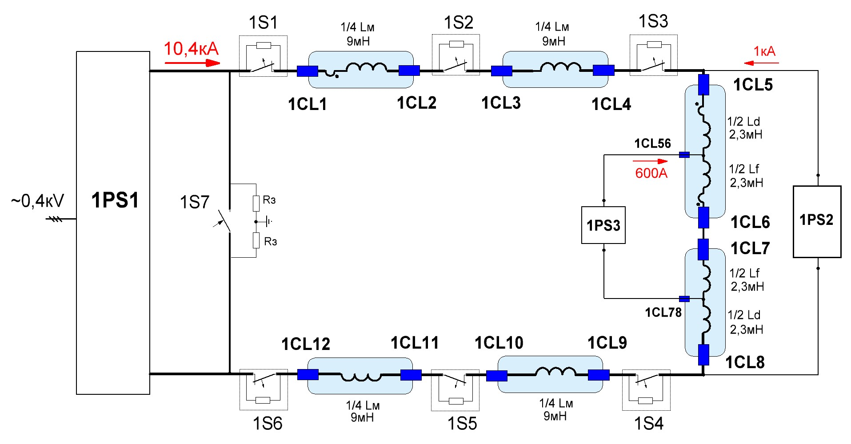
The power supply system of the Collider
Schematic diagram
V.Karpinskii
November 2021
Notes:
Исходя из вышеперечисленных требований разработана принципиальная схема
СП Магниты разбиты на 6 групп. 4 группы дипольных магнитов и 2 квадруполных. Индуктивности групп диполей и квадруполей примерно одинаковы.
Между группами включены 6 энергии эвакуации ключей. Количество групп и ключей определяется требованием не превышения 500В.
Основной мощный источник тока PS1 питает все соединенные последовательно группы магнитов. Два дополнительных источника тока PS2 и PS3 питают группы фокусирующих и дефокусирующих линз.
Based on the above requirements, a schematic diagram is developed. SС Magnets are divided into 6 groups. 4 groups of dipole magnets and 2 quadrupole magnets. Inductance groups of dipoles and quadrupoles are approximately the same.
Between groups included 6 energy evacuation keys. The number of groups and keys is determined by the requirement not to exceed 500V.
The main powerful current source PS1 feeds all series-connected groups of magnets. Two additional PS2 and PS3 current sources supply the focusing and defocusing lens groups

Slide 5
The power supply system of the Collider
Main parameters of power supplies
 | PS1 | PS2 | PS3
Supply voltage | 3ф ~50Hz 380В +/-10% TN-S
Maximum power, | 600 кW | 45 кW | 25 кW
Average power, not more than | 250 кW | 20 кW | 10 кW
Source voltage | +/-50 V_{DC} | +/-40 V_{DC} | +/-30 V_{DC}
Output current | 11000 А_{DC} | 1000 А_{DC} | 600 А_{DC}
The inductance of the load | 45 мH | 9,2 мH | 4,6 мH
ΔI/I at di/dt not equal to zero, ppm | 200 | 500 | 500
The minimum duration of rise/fall field | 18 s
ΔI/I at di/dt=0, ppm | 20 | 200 | 200
The maximum length of a table field with a di/dt=0 | 24 h
Operating mode: statics, speaker dI/dt | yes 0…+/- 600 А/s | yes 0…+/- 60 А/s | yes 0…+/- 20 А/s
V.Karpinskii
November 2021
Notes:
Надо дать принципиальную схему источника, рабочие частоты и т.д.
Относительная точность relative precision
requirements

Slide 6
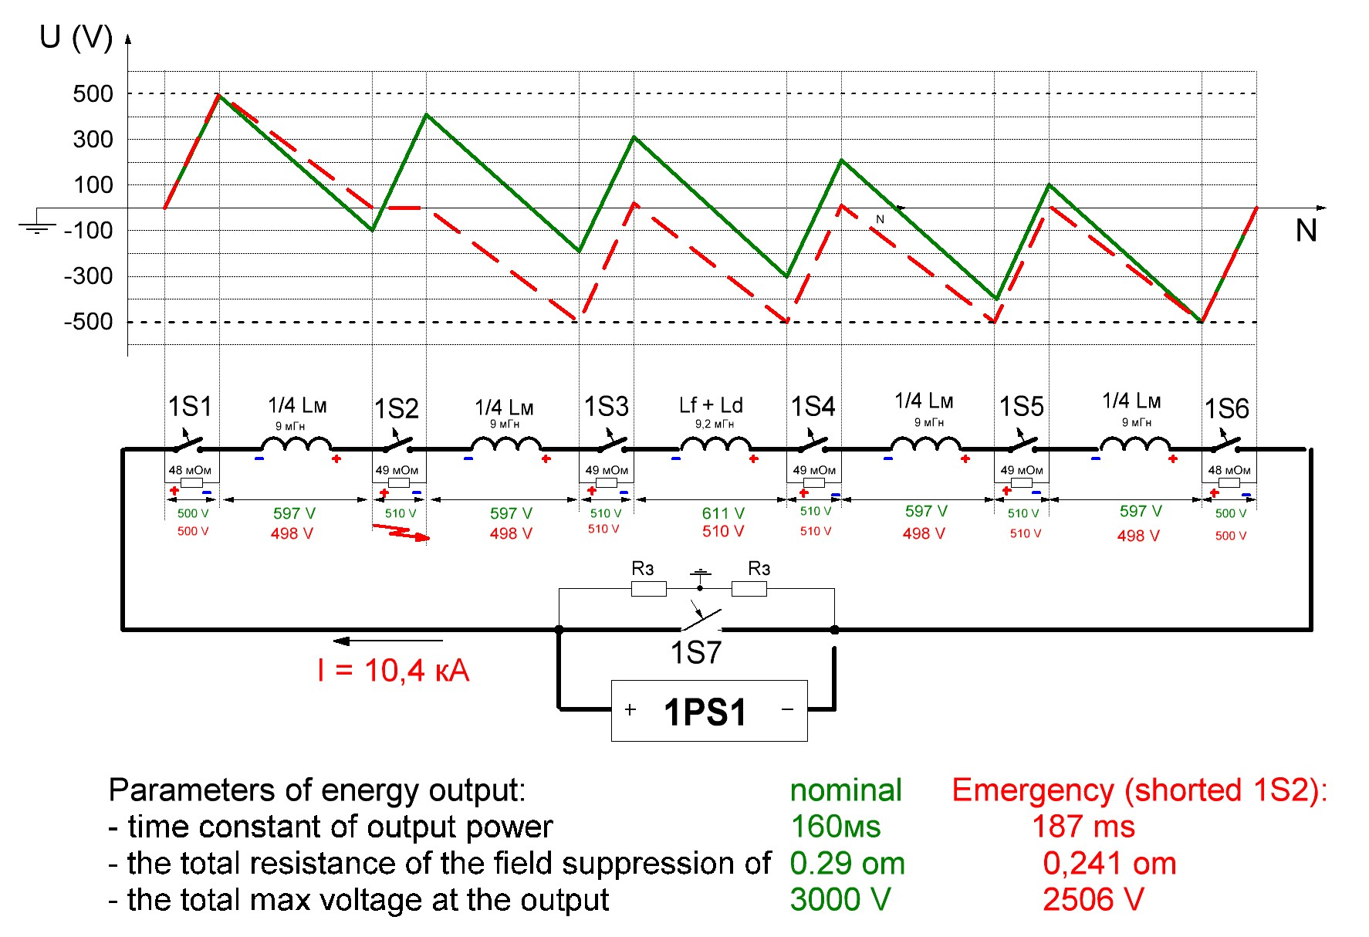
The power supply system of the Collider
System energy evacuation from the SC-magnets
V.Karpinskii
November 2021
Notes:
Диаграмма распределения потенциала по элементам системы питания при аварийном выводе энергии при токе 10,4кА.
В штатном режиме эвакуации энергии при 6 ключах – зеленая линия - последовательно с магнитами вводится резистор 0,29 Ом. Постоянная времени 160мс.
В случае выхода из строя одного из ключей – красная линия – постоянная времени увеличится до 187 мс, нагрев проводника до около 200К.
Diagram of potential distribution on the elements of the power supply system in case of emergency output of energy at a current of 10.4 kA.
In the normal mode of energy evacuation at 6 keys – green line - in series with the magnets introduced resistor 0.29 Ohms. Time constant 160ms.
In case of failure of one of the keys – the red line – the time constant will increase to 187 MS, heating the conductor to about 200K.

Slide 7
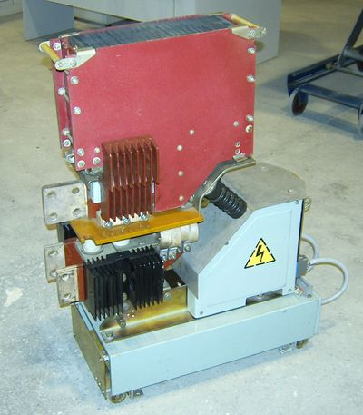
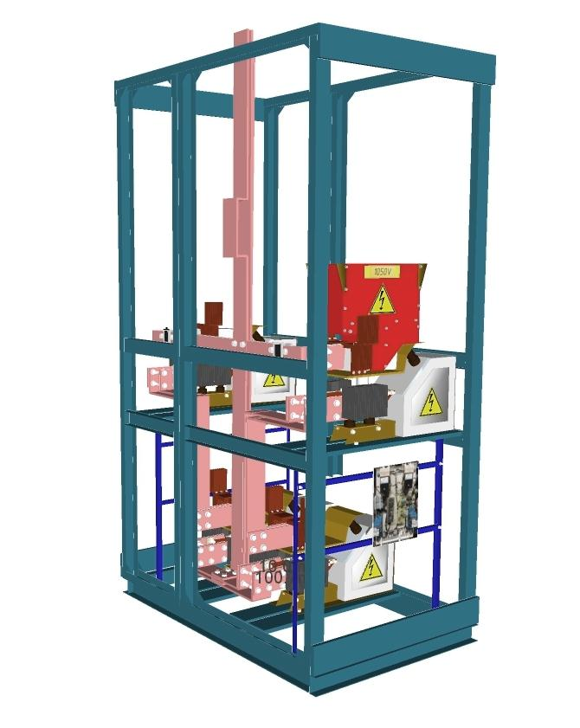
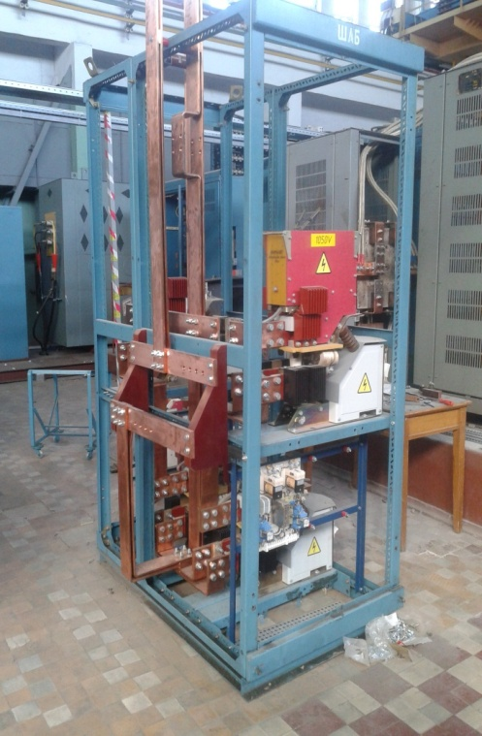
The power supply system of the Collider
Energy evacuation Switch
Main parameters : 1) Static mode
2) Minimal energy loss
3) Operational reliability.
General view ВАБ49
Prototype energy evacuation switch
Switch automatic high-speed ВАБ49-6300:
rated current - 6300A
rated voltage - 1050V
the off - time of 8ms
The model
The prototype
V.Karpinskii
November 2021
Notes:
Надо нарисовать принципиальную схему.
Конструкция ключа.
В основе лежит быстродействующий выключатель ВАБ 49 на ток 6,3кА, 1050В.
Этот аппарат апробирован в ЦЕРНе. У нас создан макет ключа, проводятся испытания.
Для повышения надежности разрабатывается система управления, где все ключи автономны.
The design of the key.It is based on a high-speed switch PSA 49 at a current of 6.3 kA, 1050.
This device has been tested at CERN. We have created a model of the key, tests are being conducted.
To improve reliability, a control system is developed, where all keys are Autonomous.

Slide 8
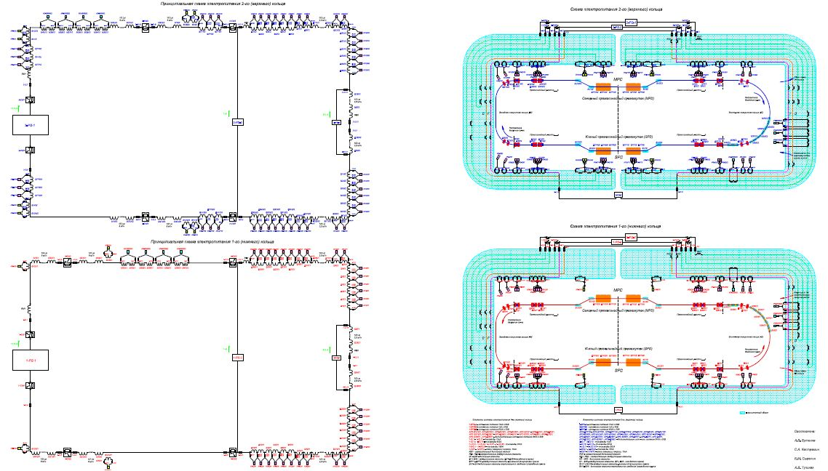
The power supply system of the Collider
General electrical diagram red and blue rings
V.Karpinskii
November 2021
Notes:
Line section
Difficult – сложный
Connected подключать

Slide 9
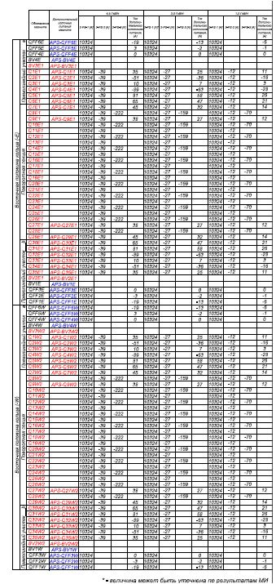
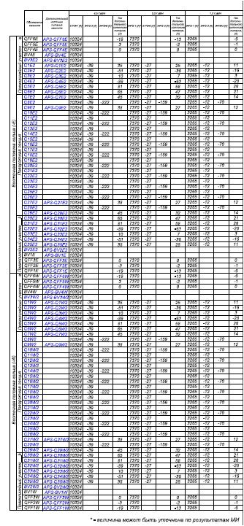
The power supply system of the Collider
Supply currents of all magnets red and blue rings
In addition to the main power sources, it is necessary to have sources of imbalance (10V x 300A) :
for the ring "blue" – 44 pcs.,
for the ring "red" – 44 pcs.
Total 88 pieces.
It is necessary to make the management and control system additional sources
special power supplies for beam reduction/ breeding magnets BV1,2
12 units
Voltage - 15V,
Current - 500A,
Stability - 20ppm
V.Karpinskii
November 2021
Notes:
Line section
Difficult – сложный
Connected подключать

Slide 10
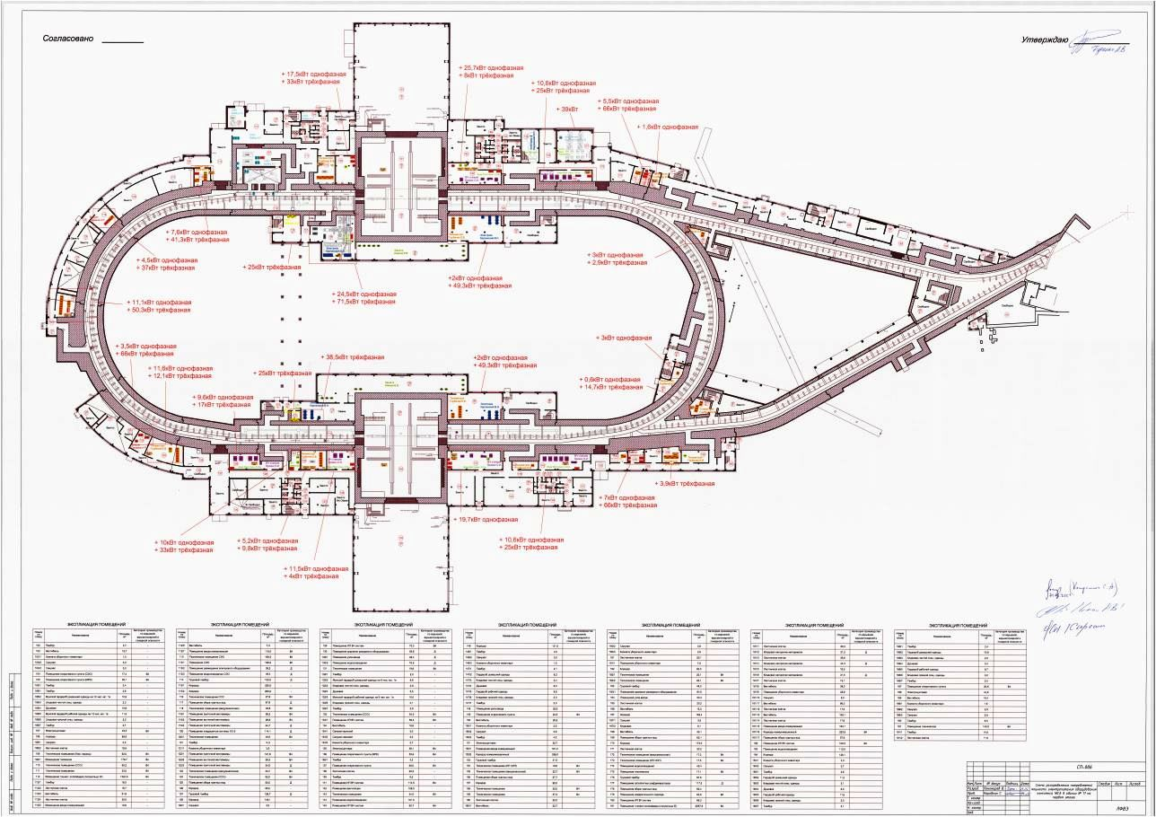
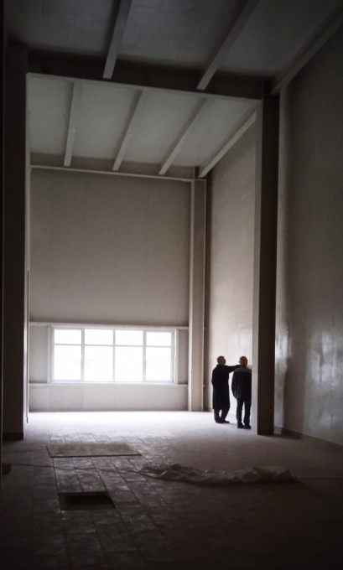
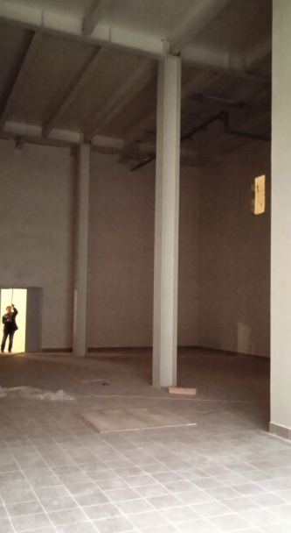
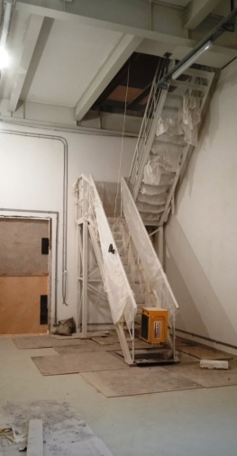
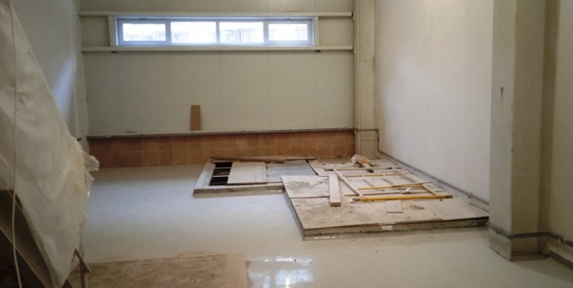
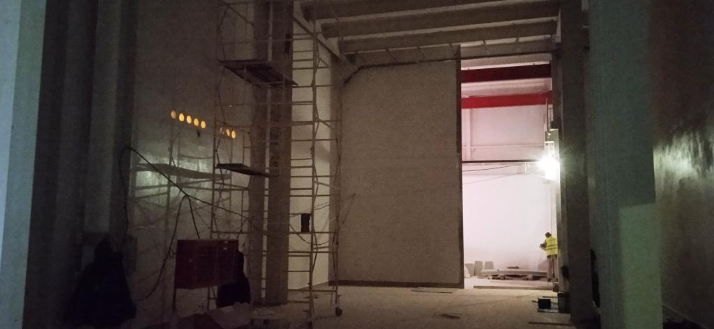
The power supply system of the Collider
Placement of power system equipment
Room 109/1
Room 240
power cable lines 10kA
V.Karpinskii
November 2021

Slide 11
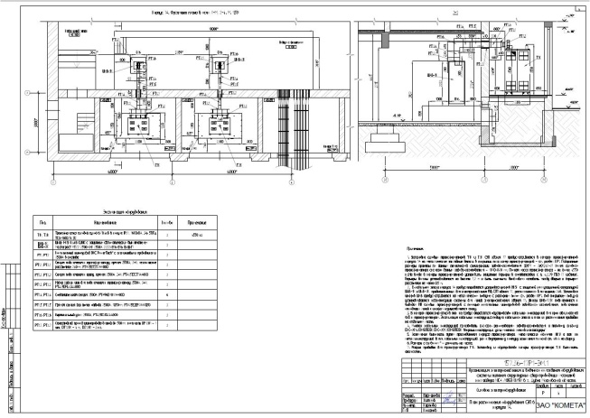
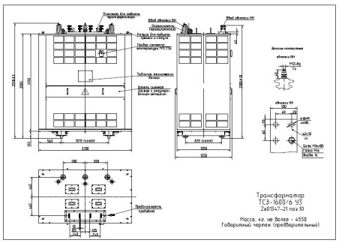
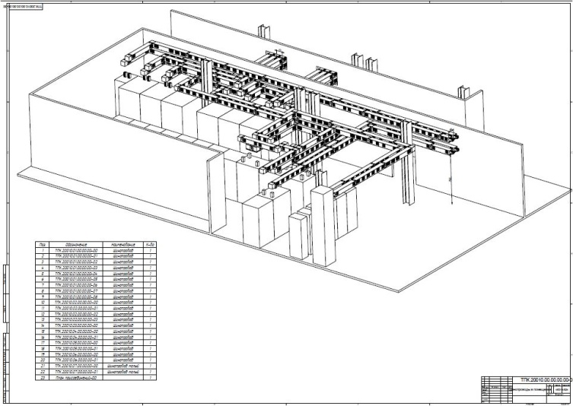
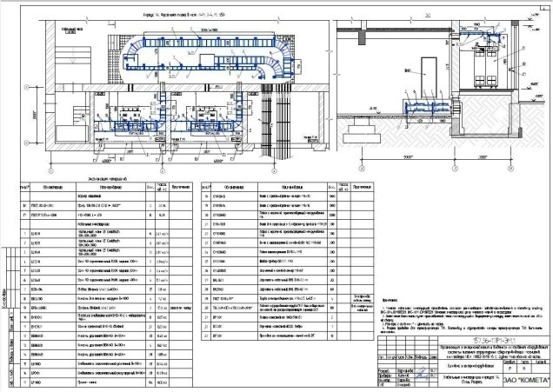
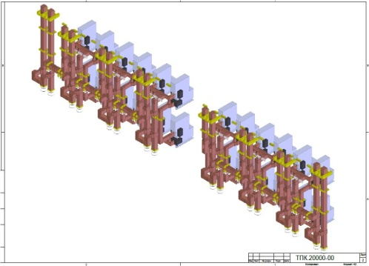
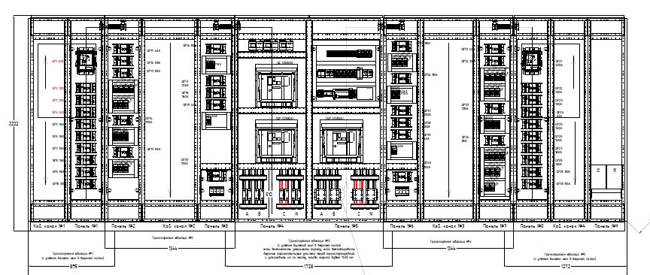
The power supply system of the Collider
Design of the collider power system
Energy supply from the bld. 1 A
Project of power connections
Transformer 1.6MW, 6/0.4kV
General view of the 400 V network switchboard
V.Karpinskii
November 2021

Slide 12
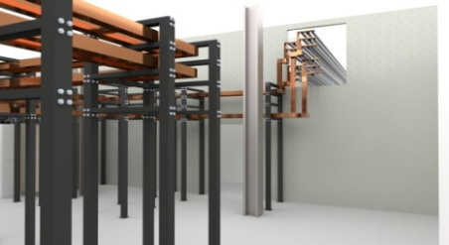
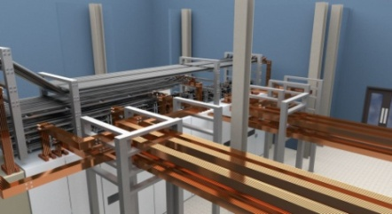
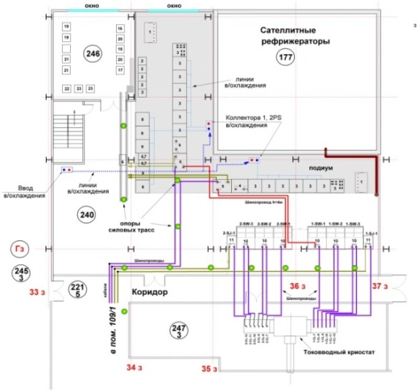
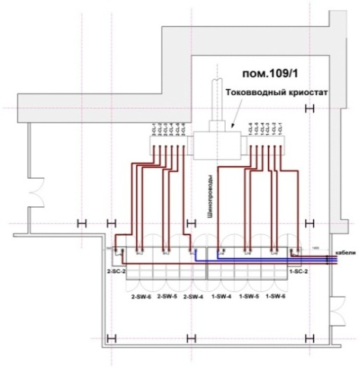
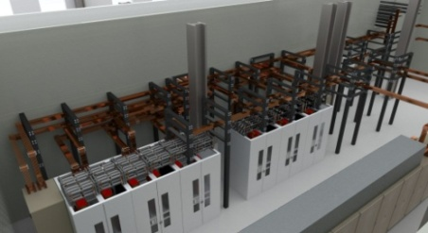
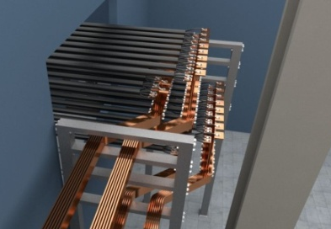
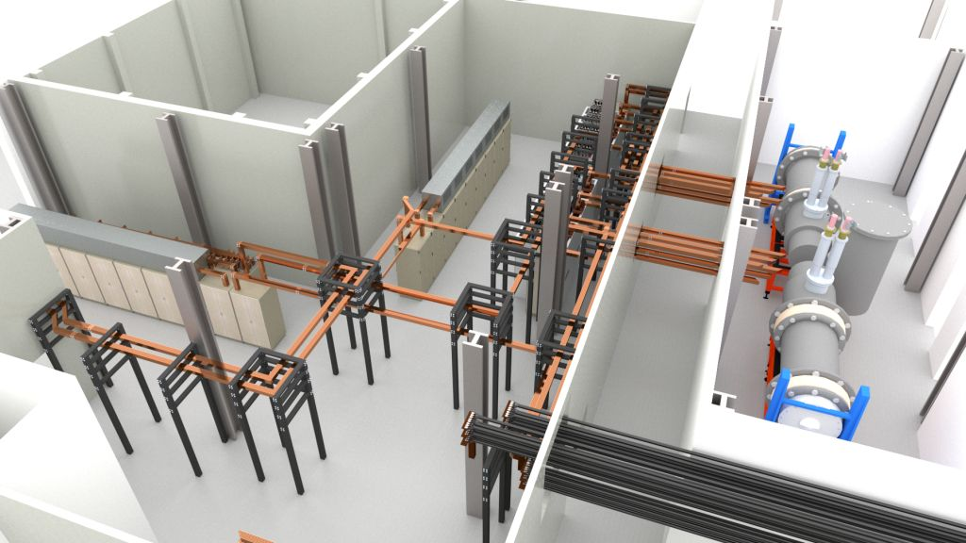
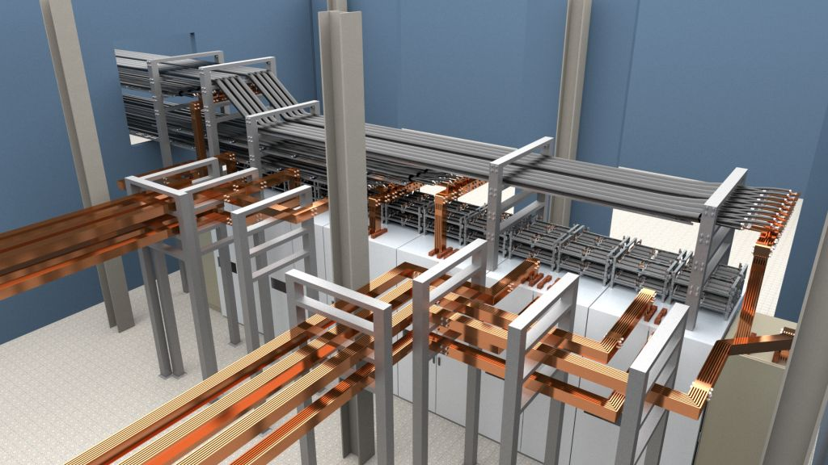
The power supply system of the Collider
Equipment placement plan. Development of a 3d model of the equipment layout
Room 109/1
Room 240
V.Karpinskii
12
November 2021
Notes:
Коллайдер состоит из 2 полу колец.
Каждое полу кольцо имеет свои токовводы. Между полу кольцами прокладываются теплые кабели. Все источники питания и половина ключей распологаются в одном помещении. Вотрая часть ключей в другом около токовводных криостатов.
Схема имеет возможность переключения на тест.
The Collider consists of 2 half rings. Each half ring has its own current leads cryostat. Warm cables are build between the build rings. All power supplies and half of the EES are located in the same room. Other part of keys in the other near the cryostats.The scheme has the ability to switch to the test.

Slide 13
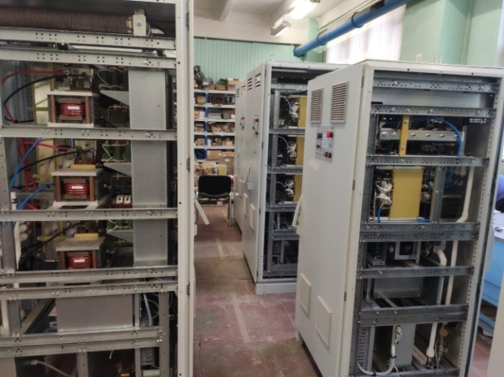
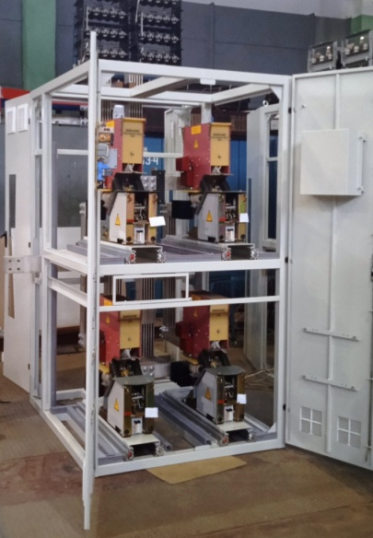
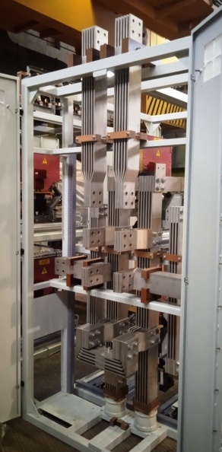
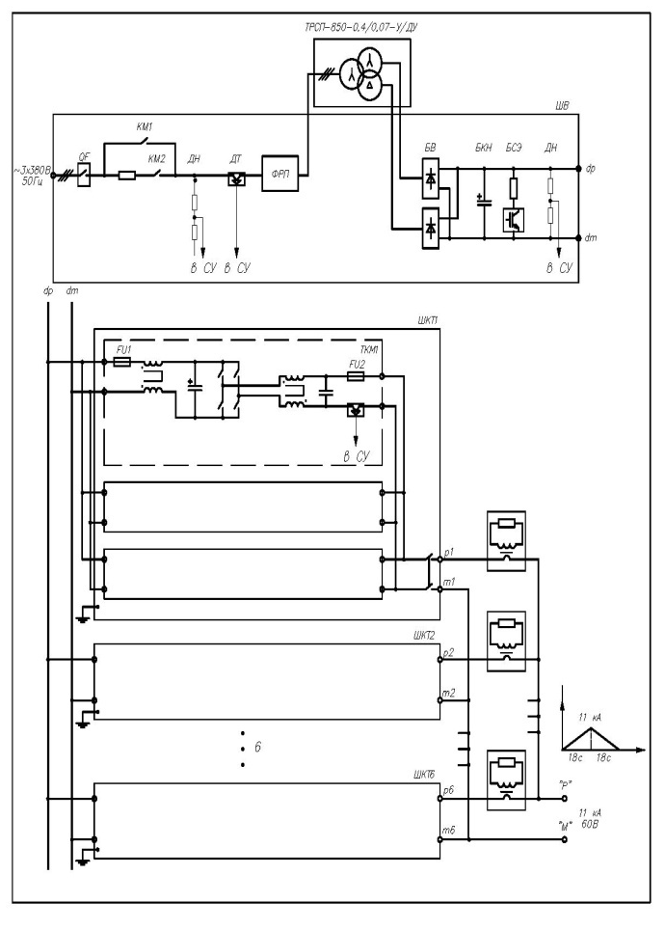
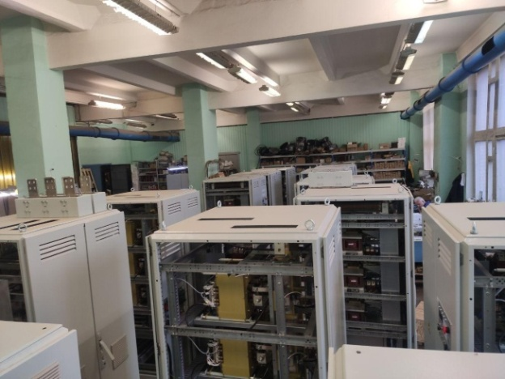
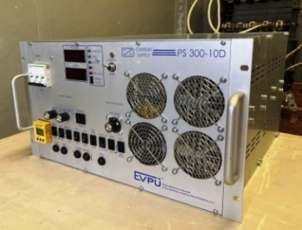
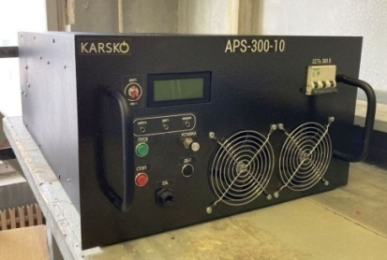
The power supply system of the Collider
Status of the main equipment
Main power supply
Energy evacuation Switch
production
Sources of imbalance (10V х 300А)
Made by LM Inverter
testing is underway
(the manufacturer of the series is not selected)
V.Karpinskii
November 2021

Slide 14
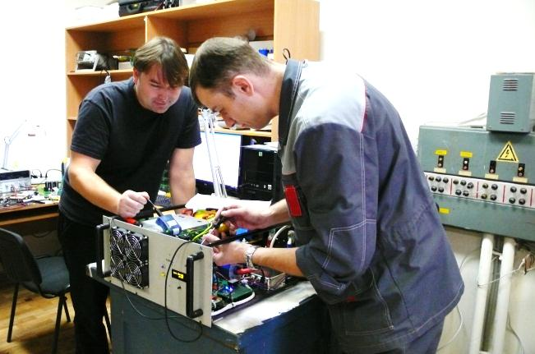
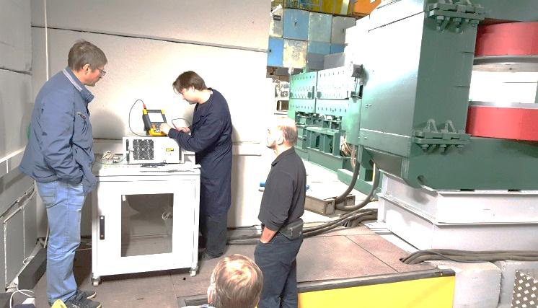
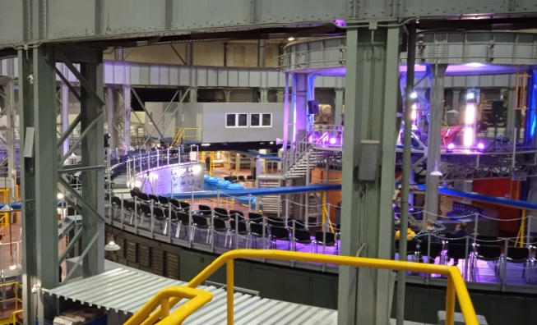
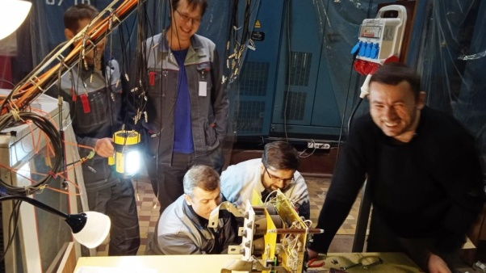
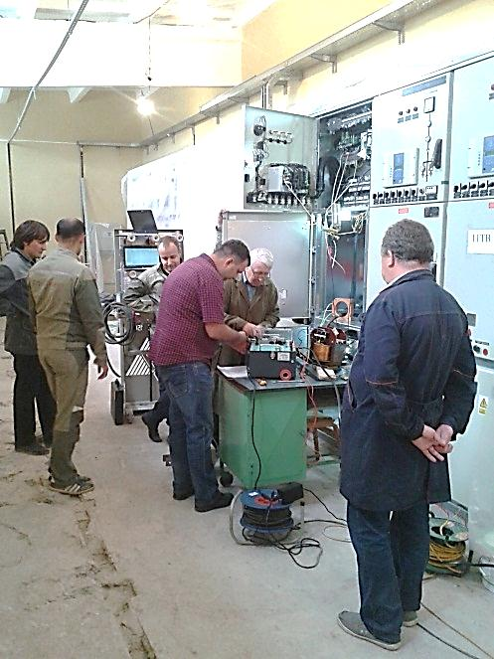
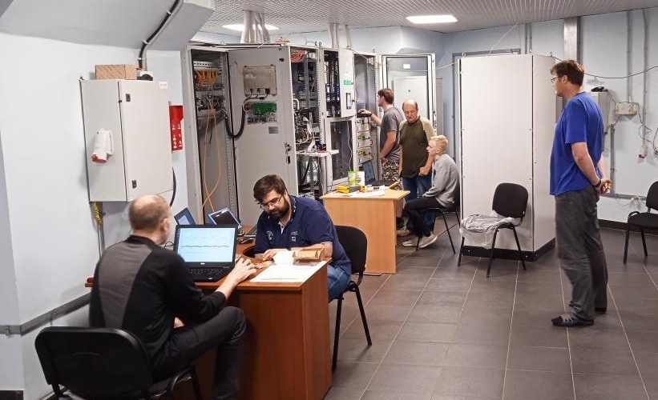
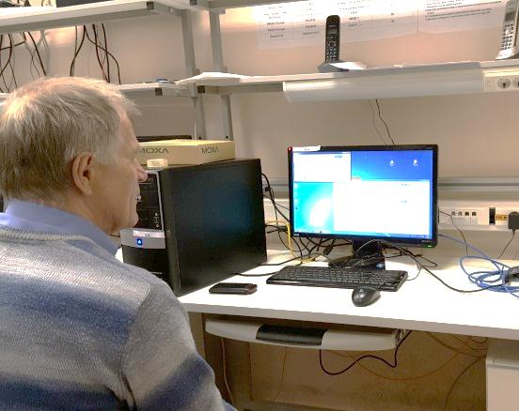
Thank you for your attention!

Slide 15
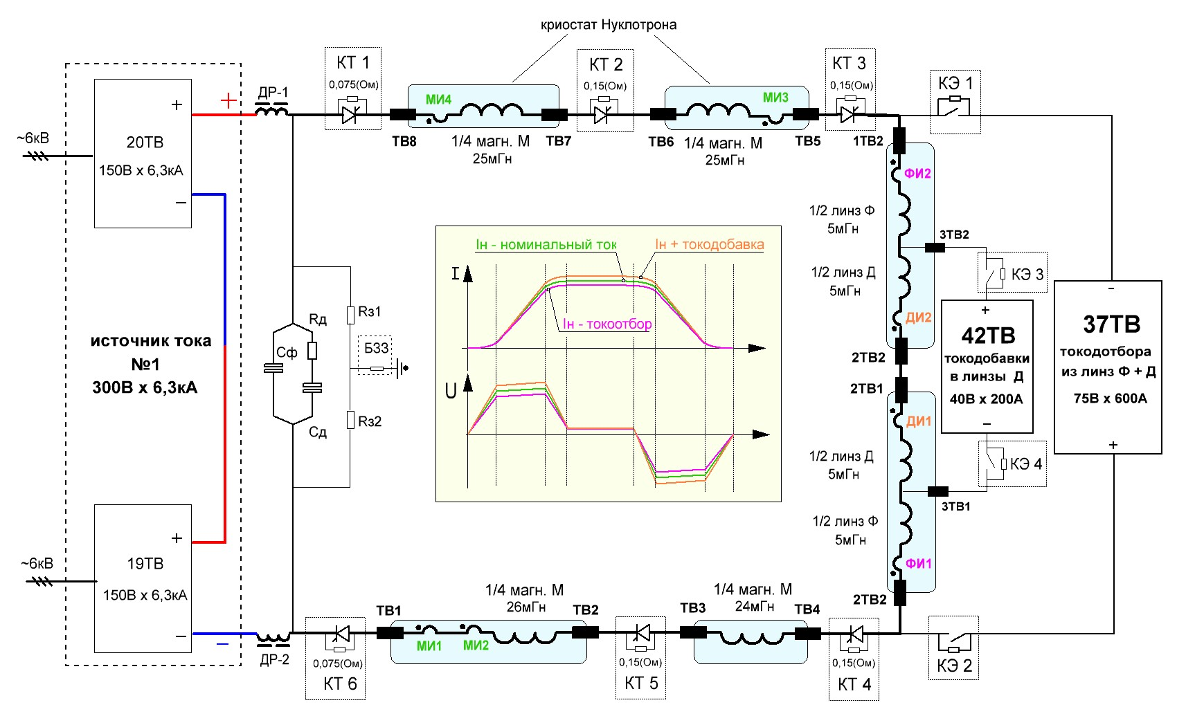
Nuclotron power supply System
Schematic diagram of the Nuclotron power supply system

Slide 16
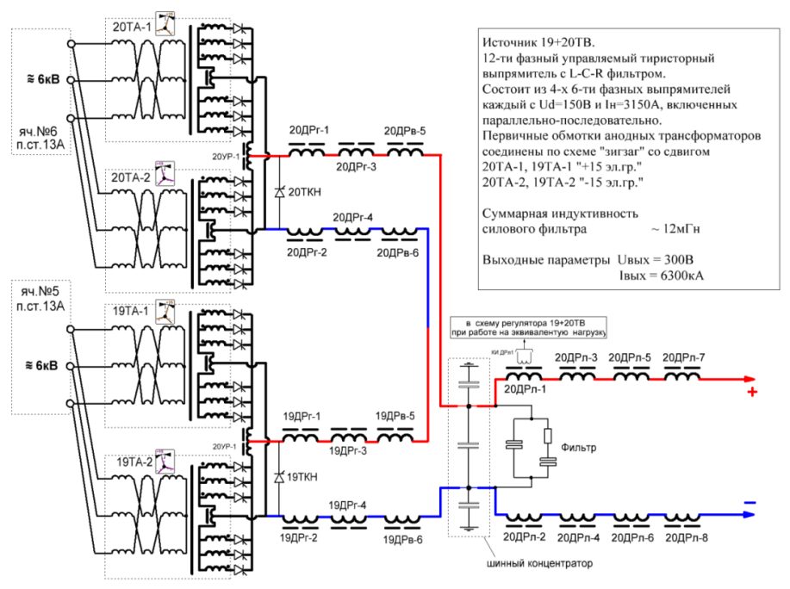
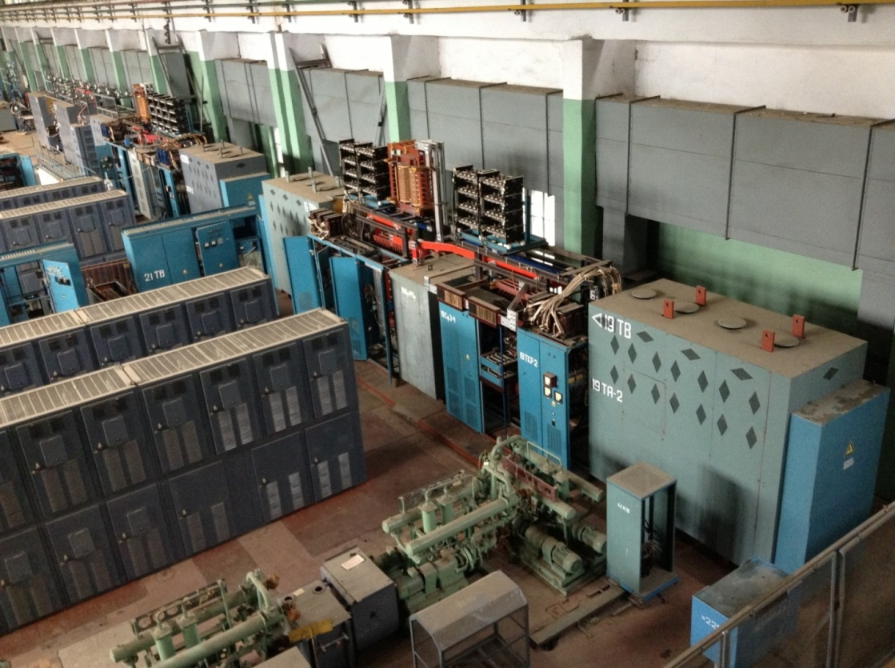
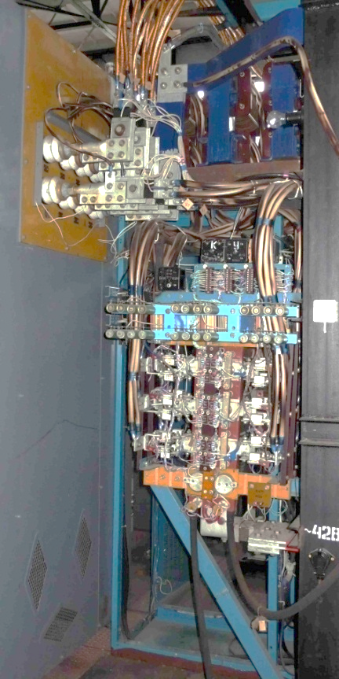
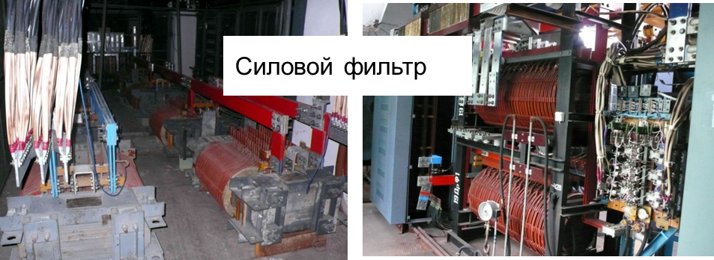
Nuclotron power supply System
Block diagram of the source 19TV 20TV
Notes:
Сделать анимацию

Slide 17
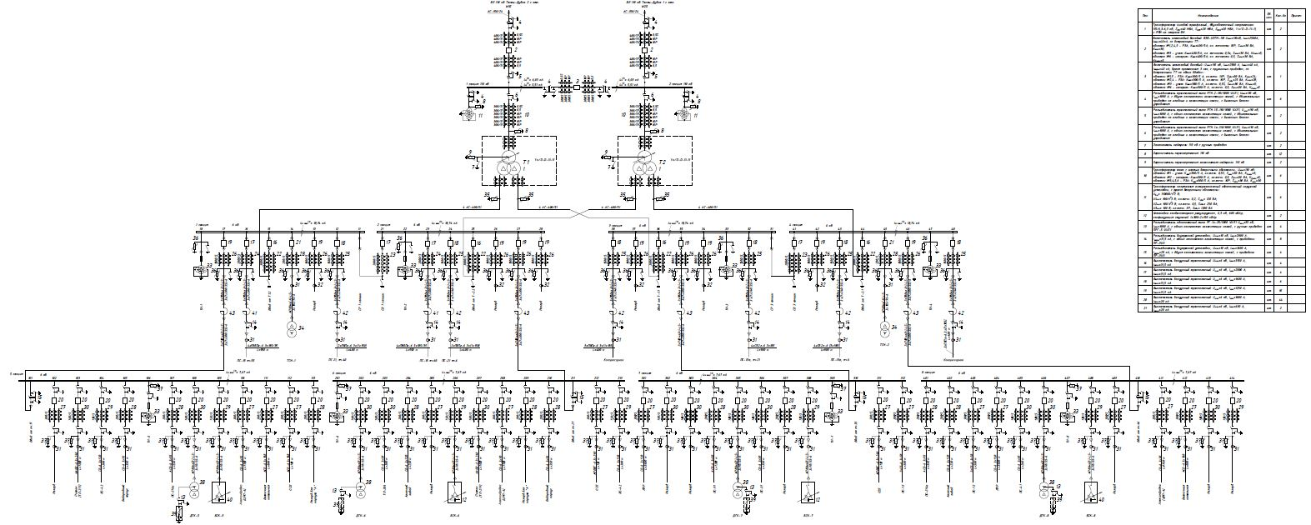
Nuclotron power supply System
Power consumption of the network is 6 kV
power supply scheme ГПП1
(main step-down substation)
SG13,
20TV
SG13,
19TV
Notes:
Анимация = общие слова о системе измерения – общая картинка цикла

Slide 18
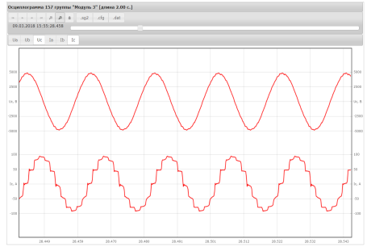
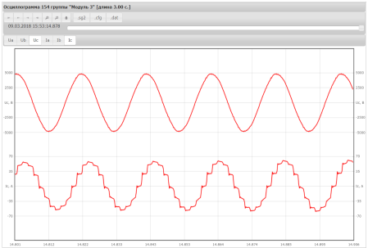
Nuclotron power supply System
Power consumption of the network is 6 kV
аmplitude Iac ~ 100A
supply 19TV, nets 6kV
cos (73.8) = 0.28
voltage waveform
current waveform
4.1мс
Current rise
Current plateau
Reduce current
2.8мс
6.7мс
аmplitude Iac ~ 80A
I = 4.4 kА
аmplitude Iac ~ 80A
cos (50.4) = 0.63
cos (120.6) = -0.51
current cycle of the Nuclotron
Speak=2.1MVA, Ppeak ~ 1MW, Pavr ~ 60kW
Notes:
Анимация = общие слова о системе измерения – общая картинка цикла

Slide 19
Booster power system
Block diagram of the current source
Schematic diagram of the current source ПИТ11-260
Production «НПП ЛМ Инвертор», Moscow, Russia
Notes:
Сделать надписи к картинкам,
Анимация – увеличивающееся картинки 1. схема принц-монтажная потом уменьшающаяся
2 принц схе ПИт11 на весь экран

Slide 20
Booster power system
Technological modes
2 session sept. 2021
1 session dec. 2020
current ПИТ11, ПИТ06, ПИТ03
cycle
energy evacuation
emergency cycle
Project cycle 9,7kA ПИТ11
Power consumption
switchboard ПИТ11, nets 0.69kV
сurrent
voltage
Ptot = 88kW
Qtot = 84kVA
Stot = 121kVA
20
Notes:
анимация

Slide 21
Development of Booster and Nuclotron power supply systems
General accelerator NICA power supply system
Сurrent cycles of the NICA
The main parameters of the magnetic cycles of the Booster and the Nuclotron
Booster
Parameters | Booster | Nuclotron
Total inductance of superconducting magnets, L [мH] | 31 | 120
Maximum current (field),[А] ([Т]) | 10 (1,8) | 6,0 (2,0)
Voltage of current sources,[V] | 260 | 450
Accumulated for each half-cycle (current rises) energy,[МJ] | 1,6 | 2,16
Peak power of the current source, [МW] | 2,2 | 2,7
Nuclotron
antiphase operation
booster and the Nuclotronin the collider injection chain

Slide 22
Development of Booster and Nuclotron power supply systems
Scheme Booster
Scheme Nuclotron
W booster
1,6МJ
W nuclotron
2,2МJ
existing PS
storage energy
New power supply:
- current – 6kA
voltage – 450V
ΔI – 50ppm
Superconducting magnetic energy storage – SMES
- solenoid made of high temperature superconducting cable,
energy 3-5 MJ,
temperature 28 K,
liquid neon cooling,
- operating current up to 10 kA,
- 3x inductively coupled windings.
Сapacitor bank
capacitor capacity 60F
voltage 400V
energy 4.8MJ
AC/DC
~690V

