Slide 1

Superconducting magnets of the Collider of the NICA complex
Nikiforov D.
on behalf of the team
NICA MAC2021

Slide 2

Outline
Creation of factory for the production SC magnets
SC magnets
Cryogenic tests results of SC magnets
Conclusions

Slide 3
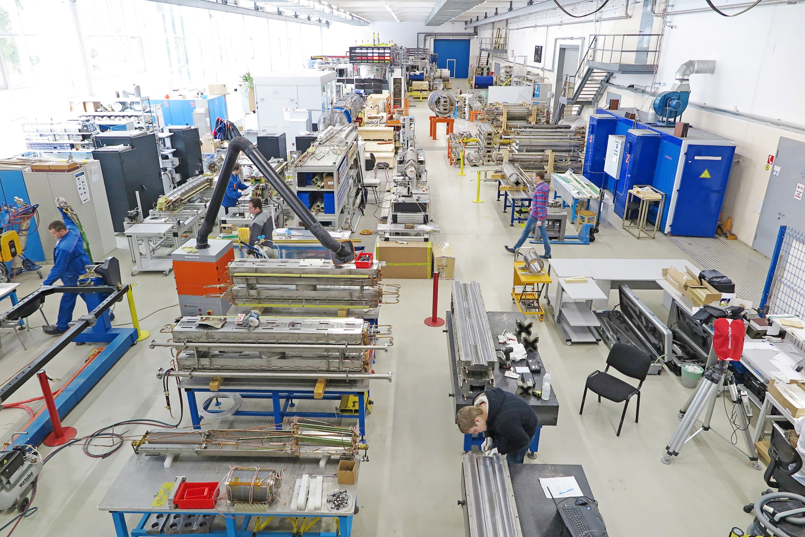
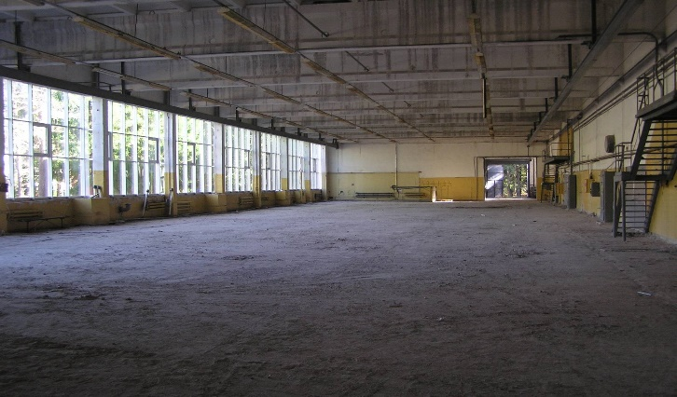
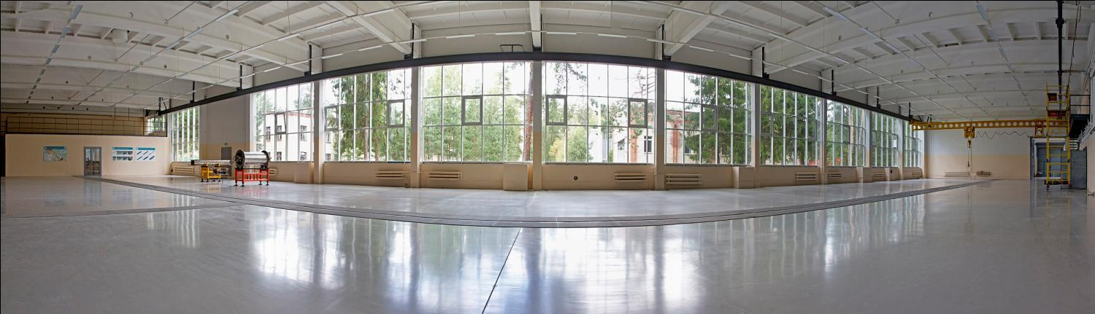
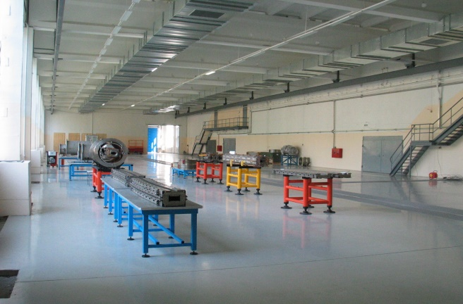
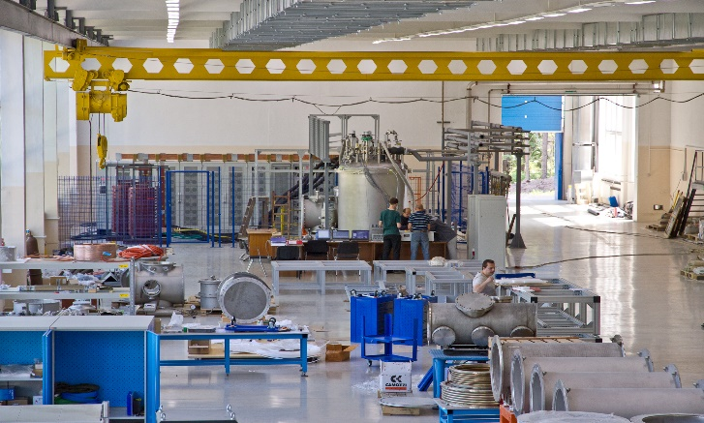
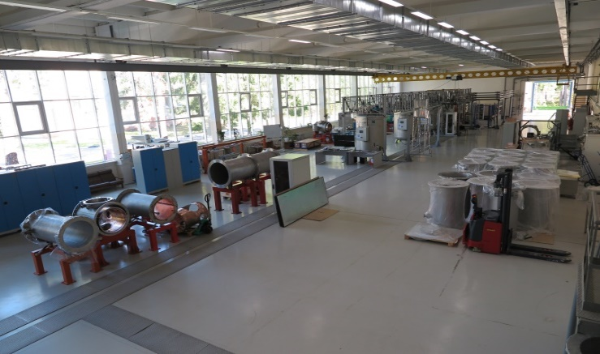
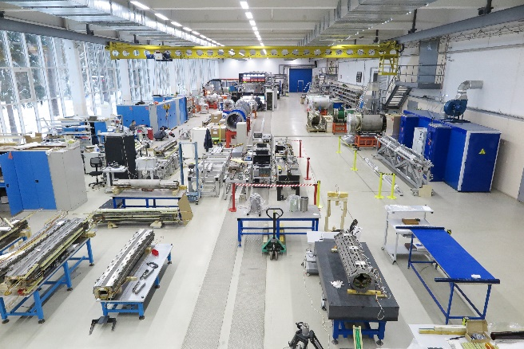
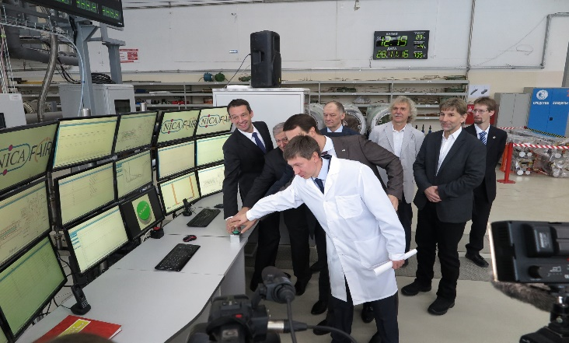
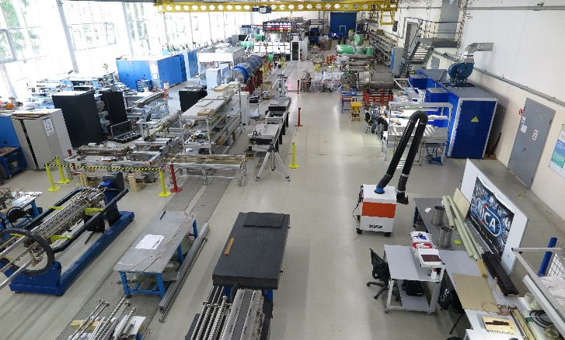
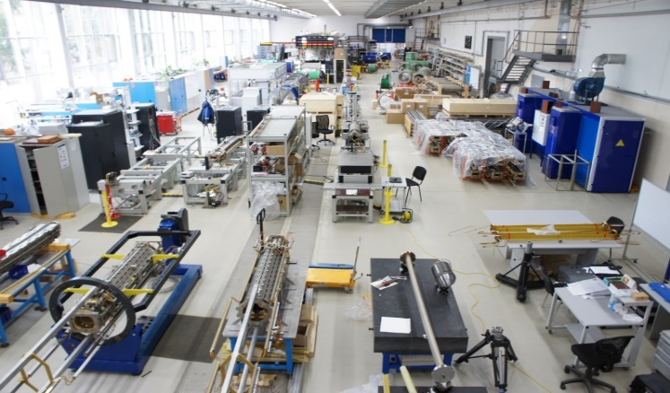
Stages of development a high-technology line for assembling and testing of SC magnet of NICA and FAIR projects
2011
2012
2013
2014
2015
2016
2016
2017
2018
3
2021

Slide 4
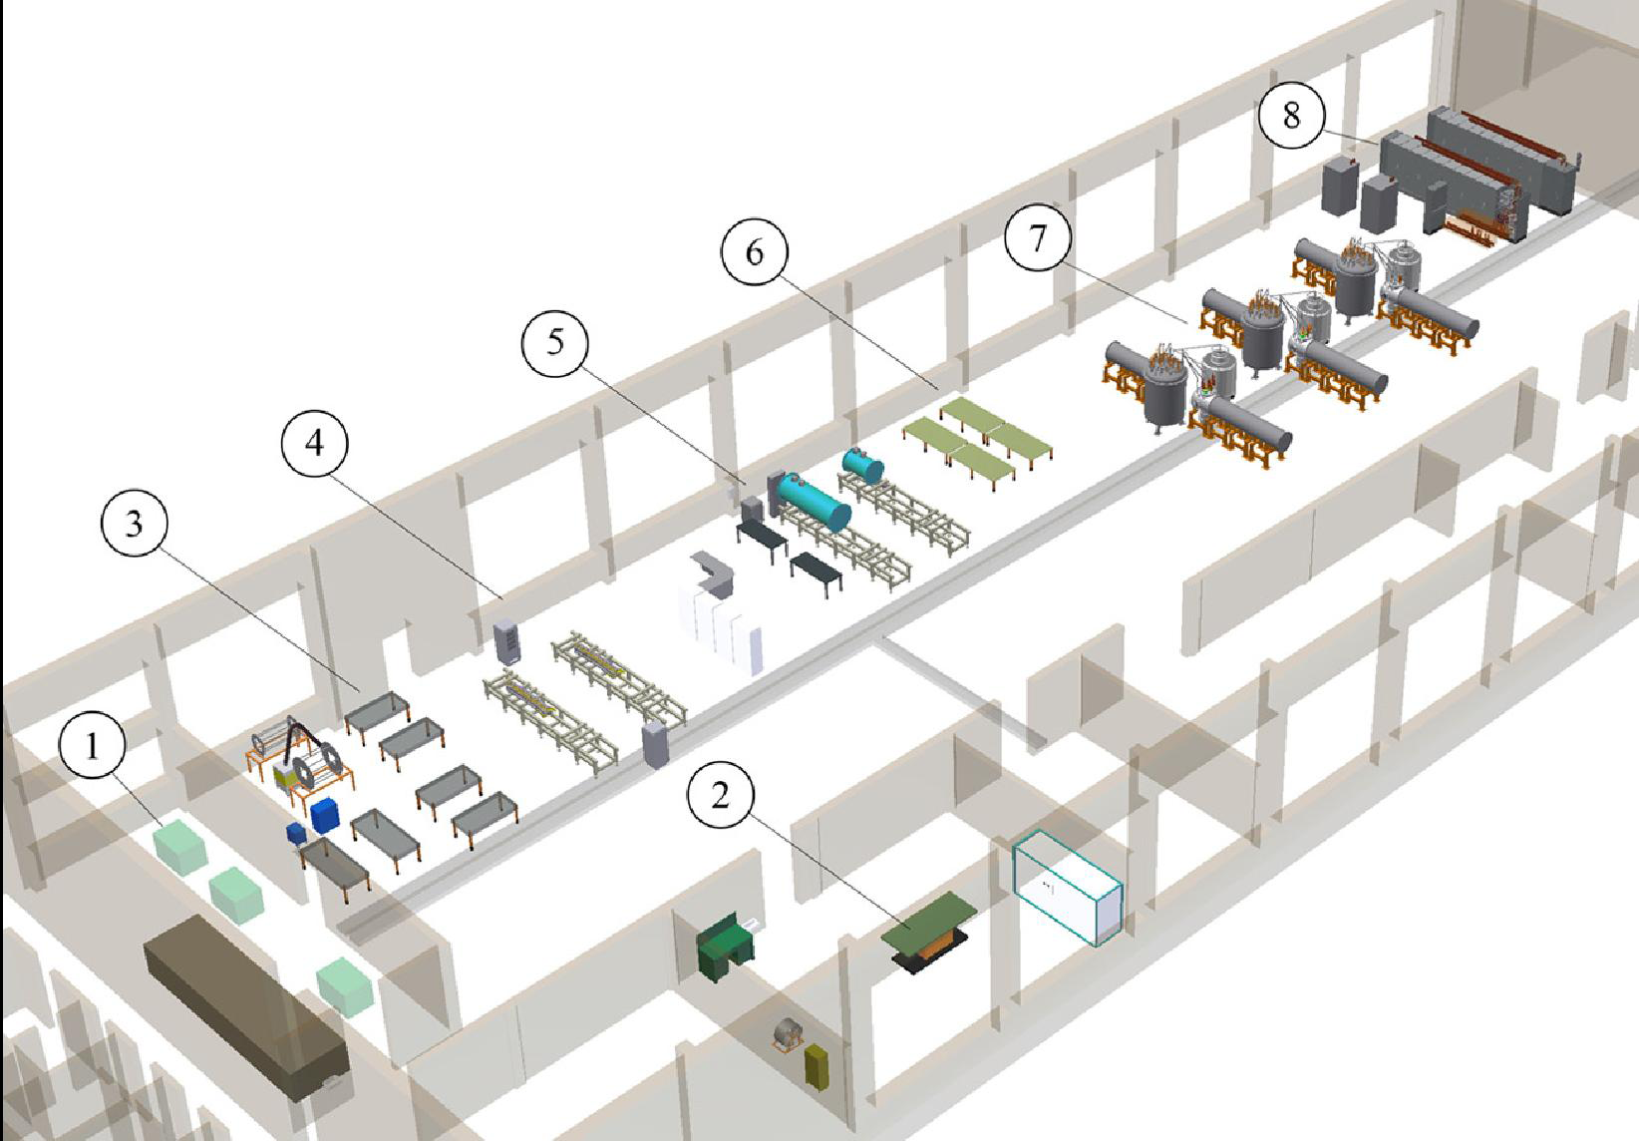
Test facility
1 – Section of manufacture SC cable
2 – Section of manufacture SC coils
3 – Section of assembling SC magnets
4 – Section of “warm” magnetic tests
5 – Section of vacuum tests
6 – Section of assembling SC magnets in cryostates
7 – Section of cryogenic tests
8 – Section of power supply

Slide 5
SC magnets
Booster synchrotron | Dipole magnet | 41+4
 | Quadrupole magnet | 50+4
 | Dipole correction magnet | 24
 | Multipole correction magnet | 8
 | Total: | 131 (131)
Collider | Dipole magnet | 81+5
 | Quadrupole lens (arch) | 46+4
 | Quadrupole lens (doublet) | 24+3
 | Dipole magnet BV | 8
 | Quadrupole final focus lens (LFF) | 12
 | Correction magnet | 132
 | Total: | 315 (176)
 | Total for NICA: | 446 (307)
Synchrotron SIS100 | Quadrupole magnet | 166
 | Sextupole magnet | 42
 | Steerer | 83
 | Multipole correction magnet | 12
 | Total for SIS100: | 303 (66)
 | Total: | 749 (373)
-magnets were produced
-magnets are produced
-magnets are in the design phase

Slide 6
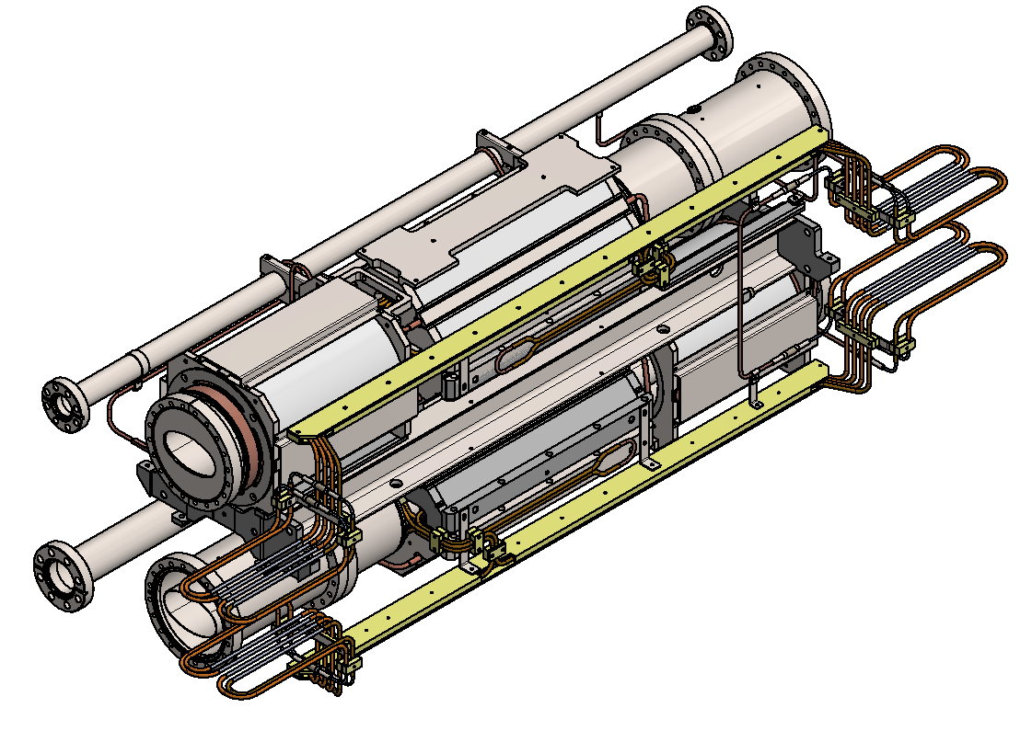
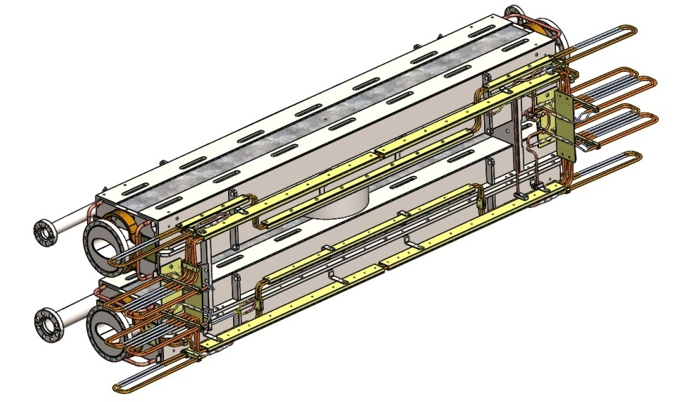
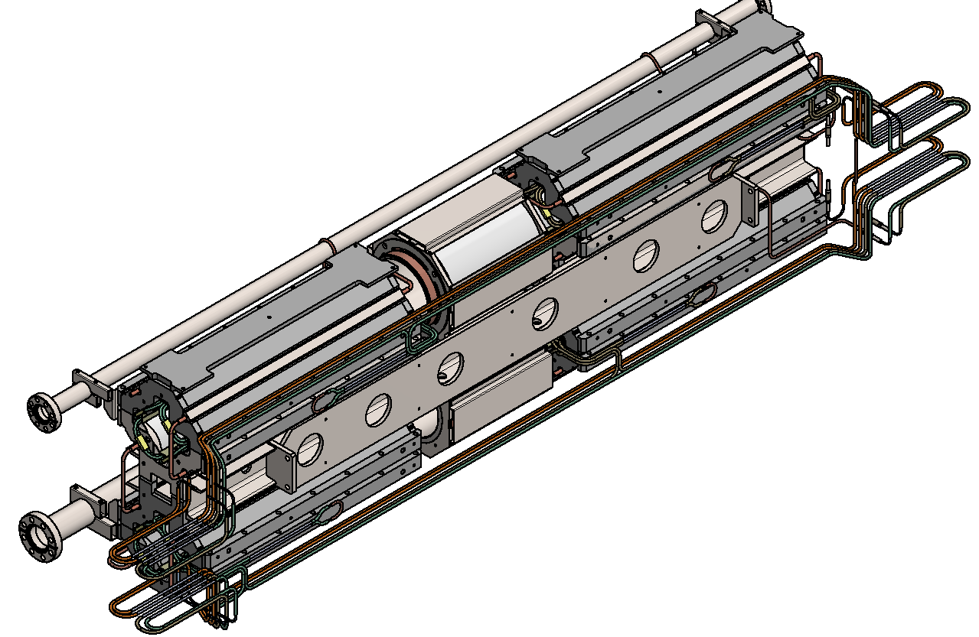
Three types of SC twin regular magnets of NICA collider
Dipole magnets
Quadrupole magnets (arch)
with multipole correctors
Quadrupole magnets (doublet) with multipole correctors

Slide 7
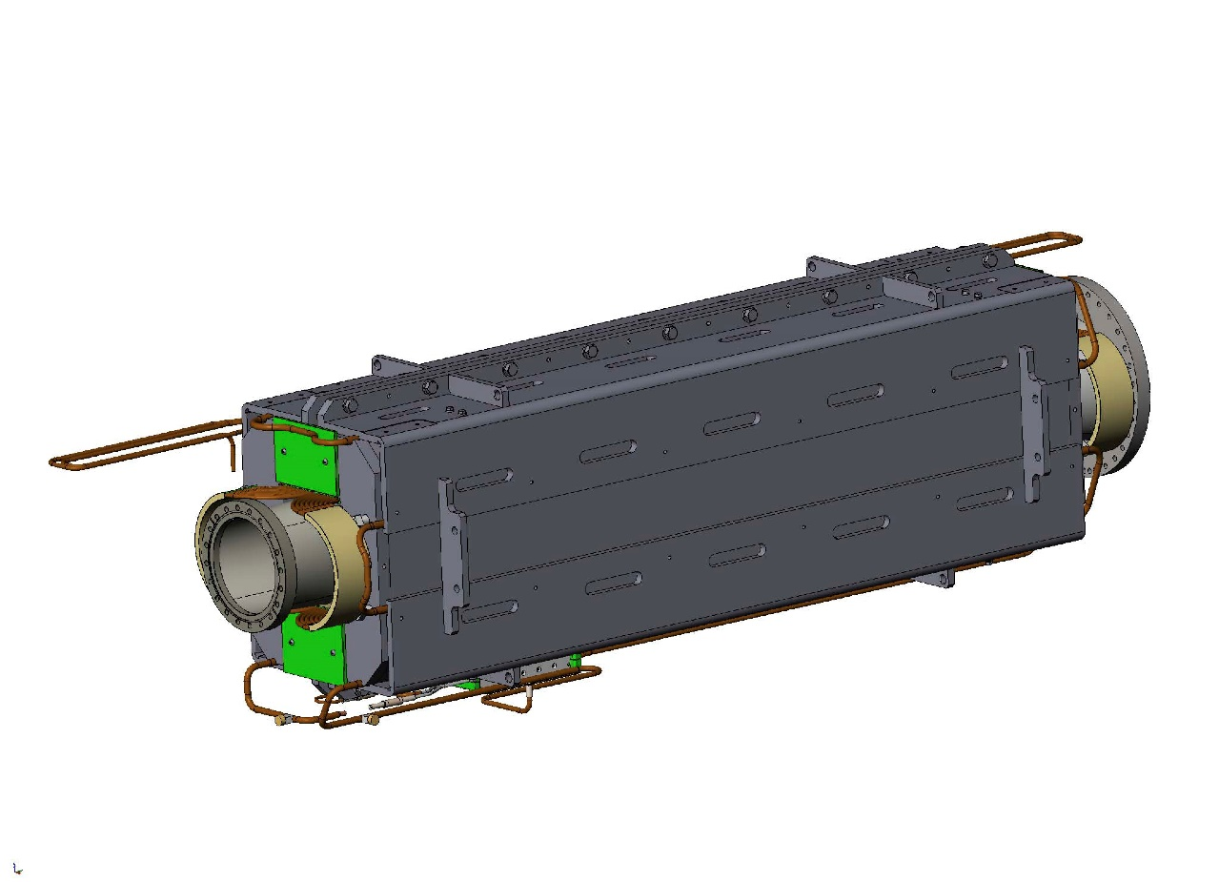
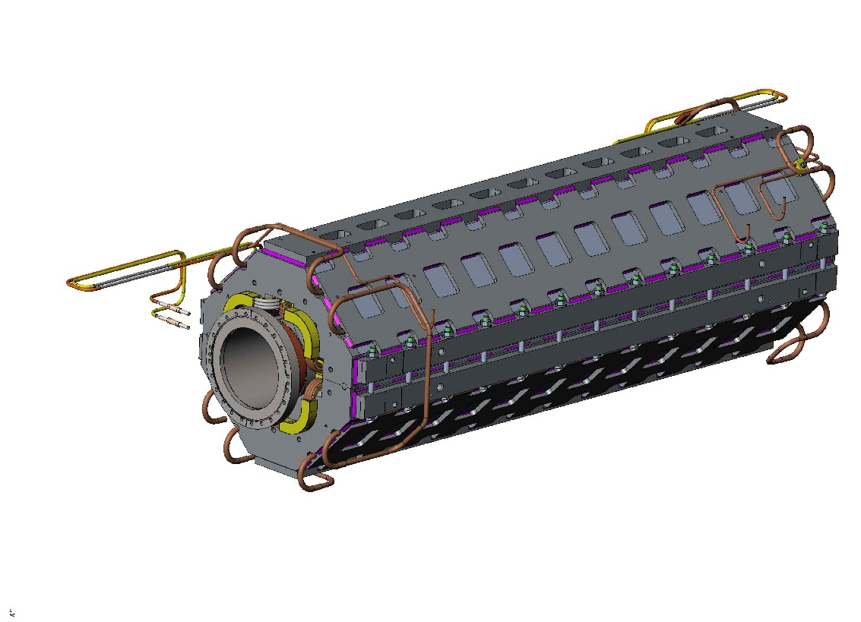
Two types of SC non regular magnets of NICA collider
Quadrupole magnets LFF
Dipole magnet BV
7

Slide 8
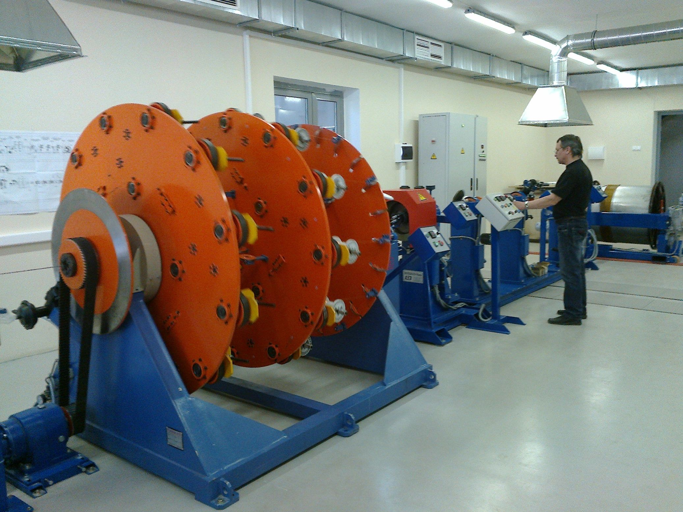
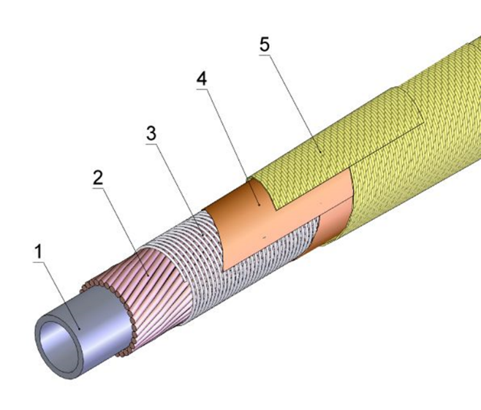
Section of manufacture SC cable
SC cable: 1 – CuNi tube 4х0,5 mm, 2 – SC strand (NbTi), 3 – NiCr wire, 4 – сapton tape, 5 – fiberglass tape.
Produced SC cable – 25 km.
Machine for production SC cable

Slide 9
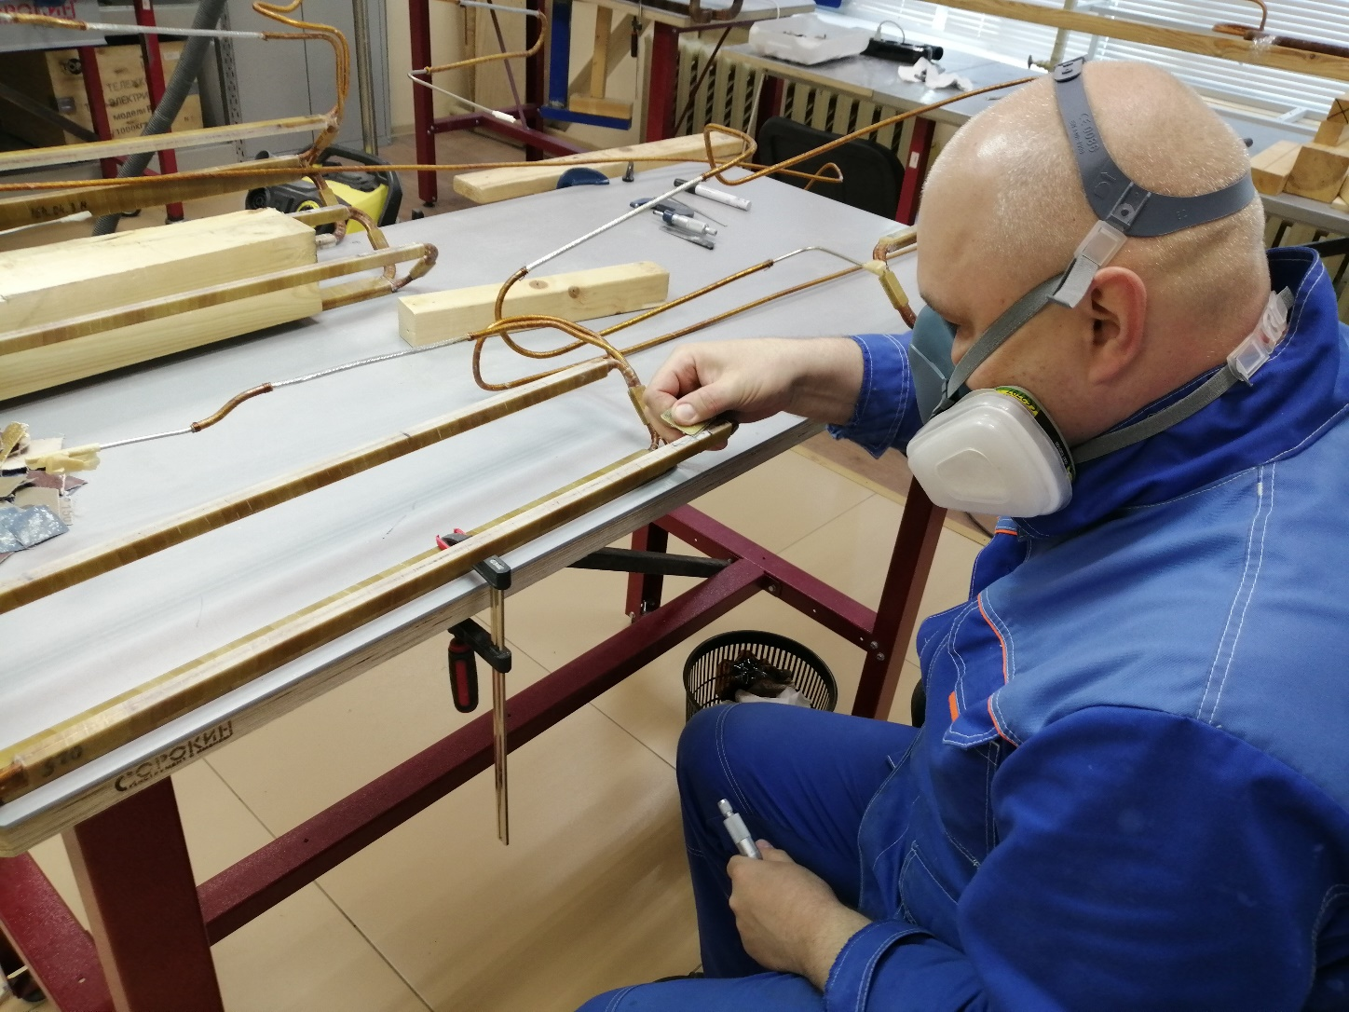
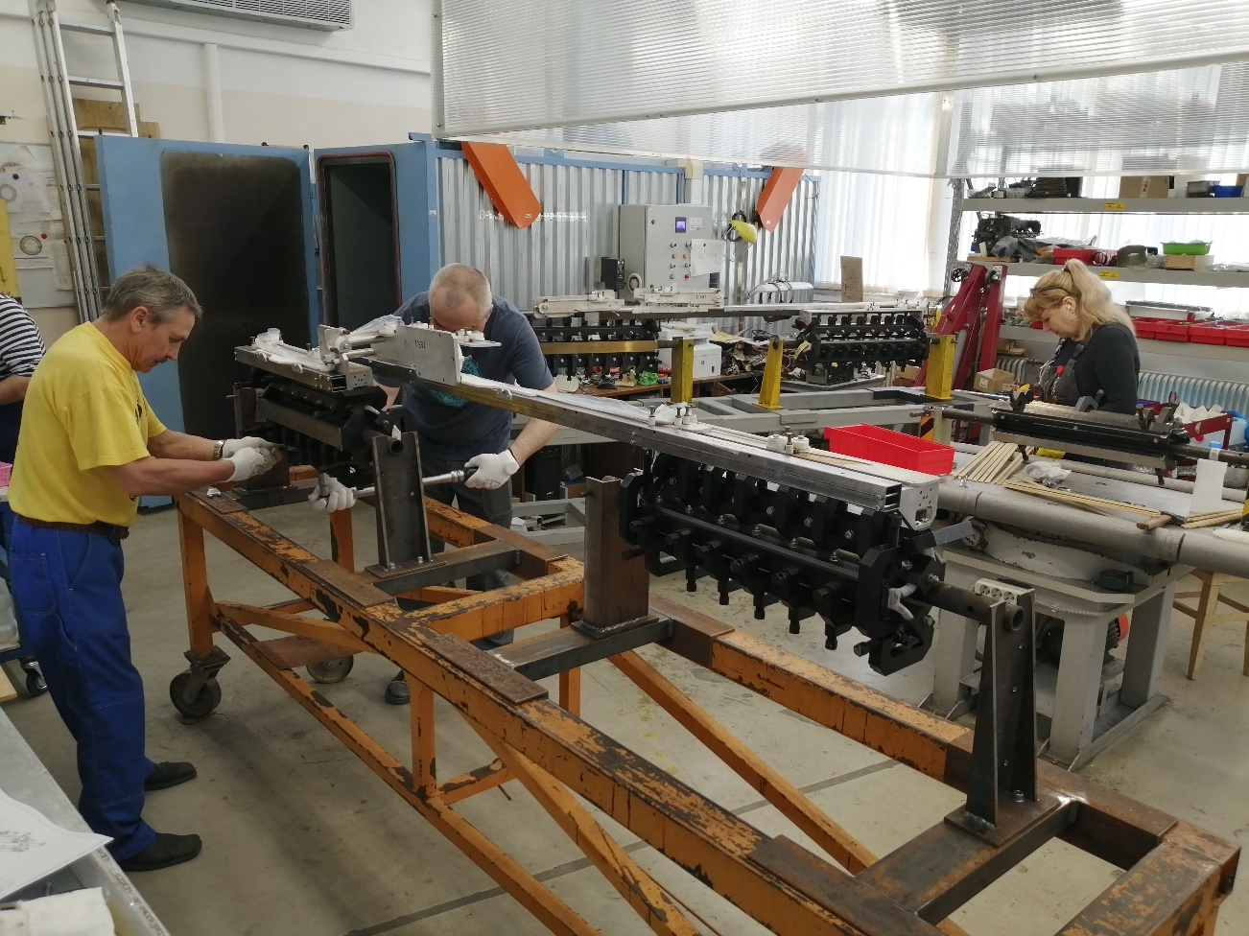
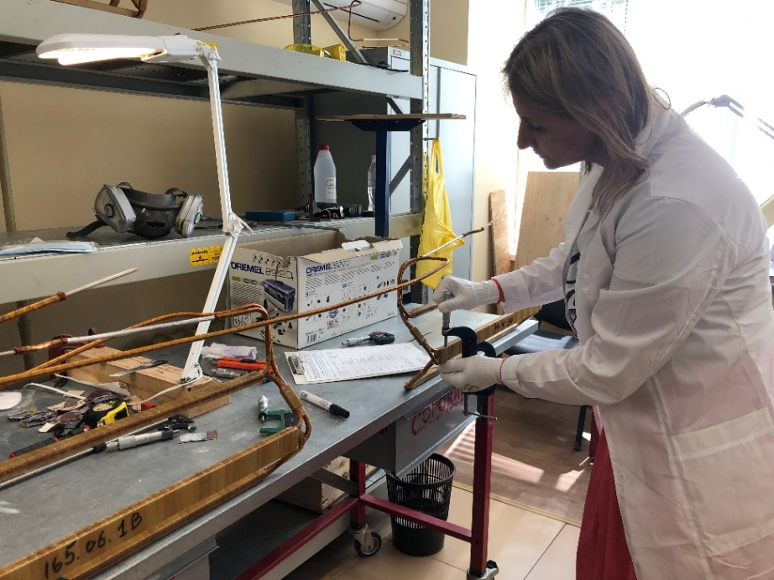
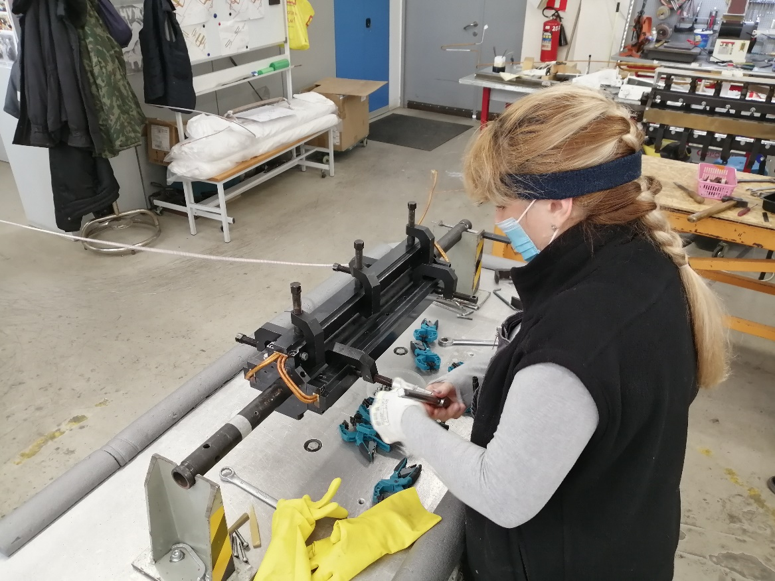
Section of manufacture SC coils
Produced SC coils – 422.

Slide 10
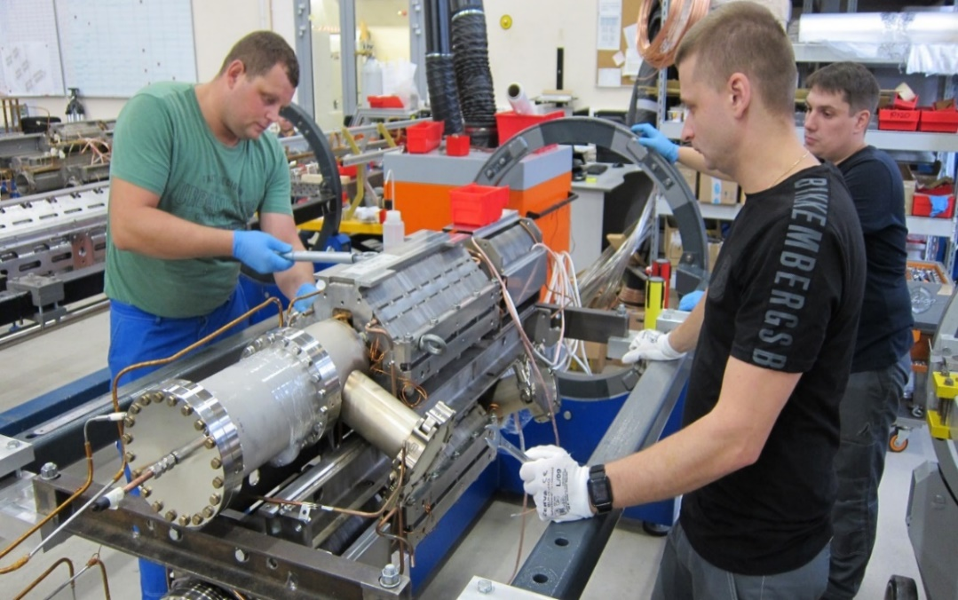
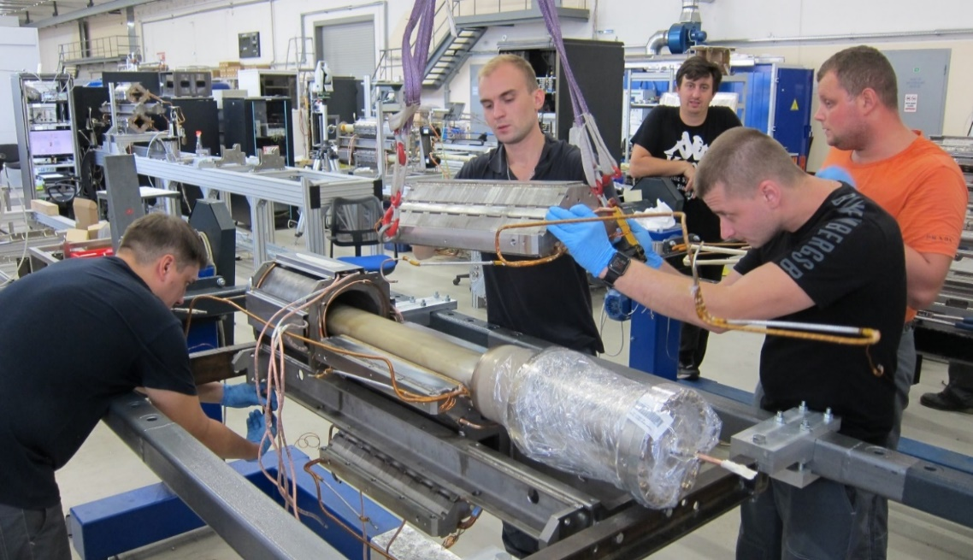
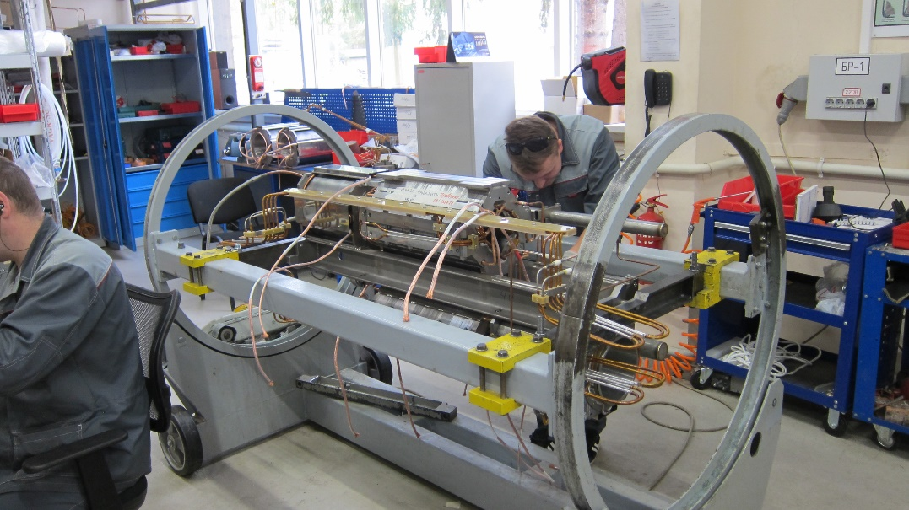
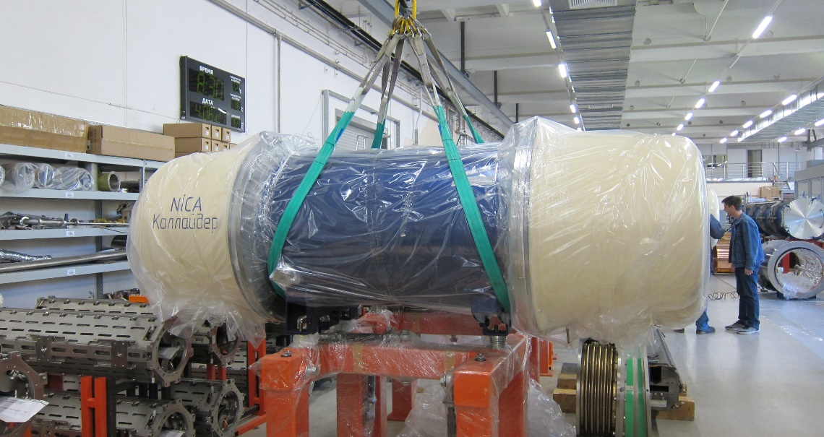
Section of assembling SC magnets
10

Slide 11
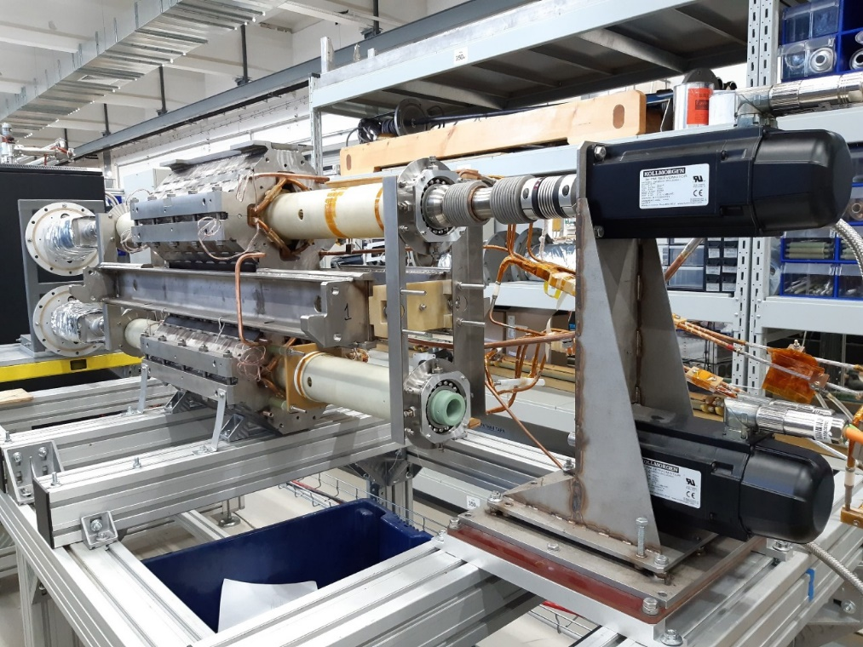
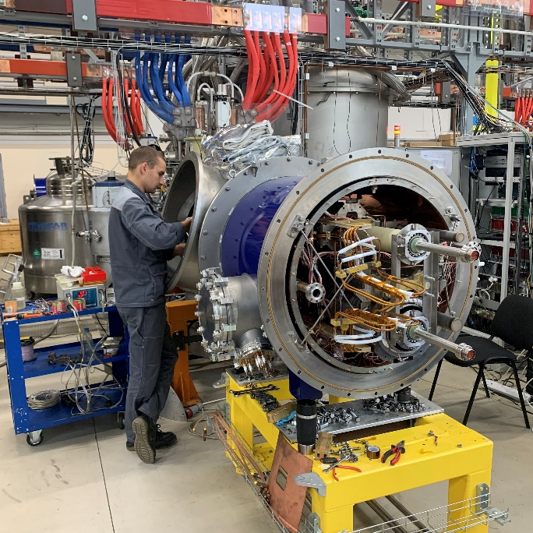
Magnetic measurement
Warm magnetic measurement
Op. current 100 А; 297 K
(rotating coil method)
Cold magnetic measurement
Op. current up to 10500 A; 4,5 K
(rotating coil method)
11

Slide 12
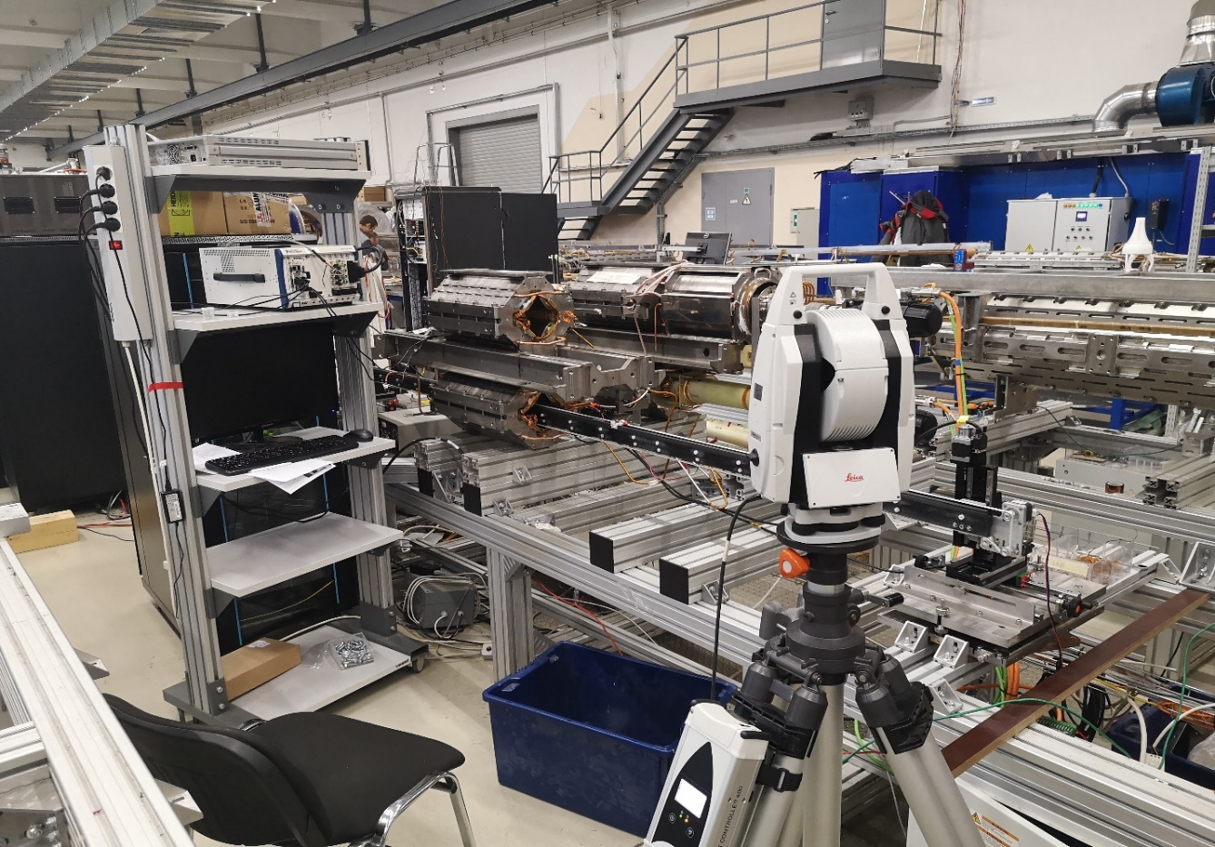
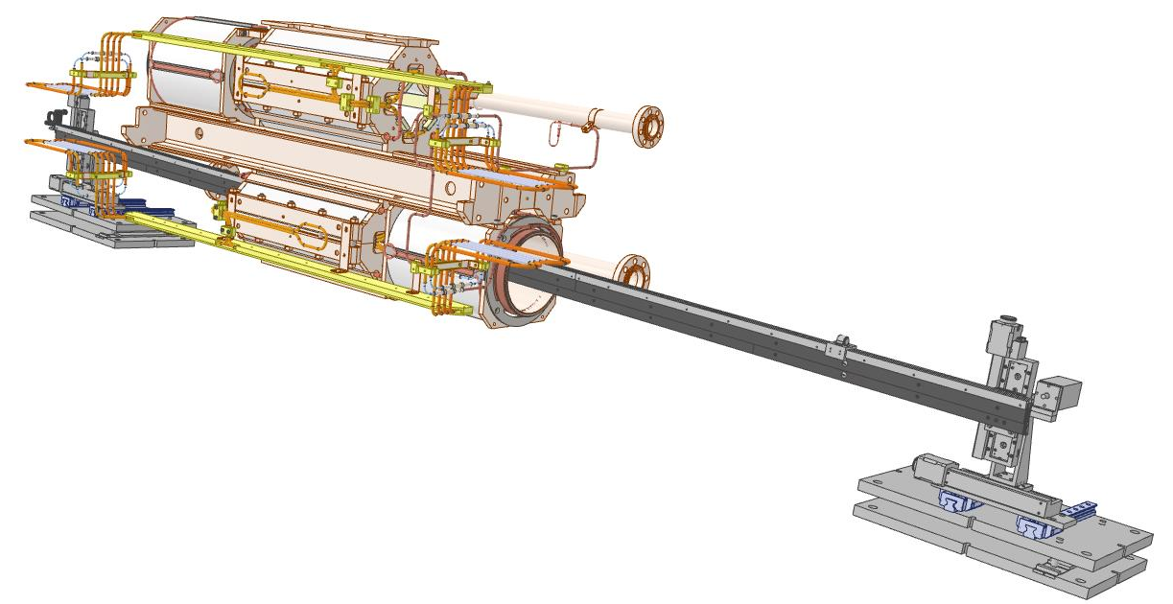
Hall probe measurement system
12

Slide 13
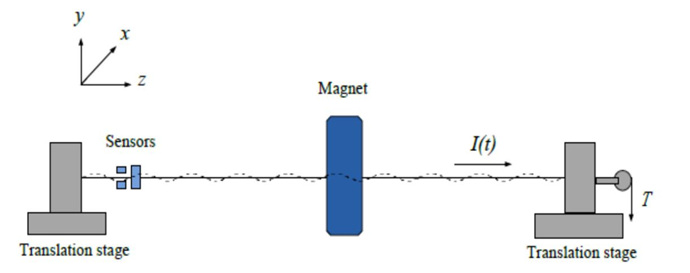
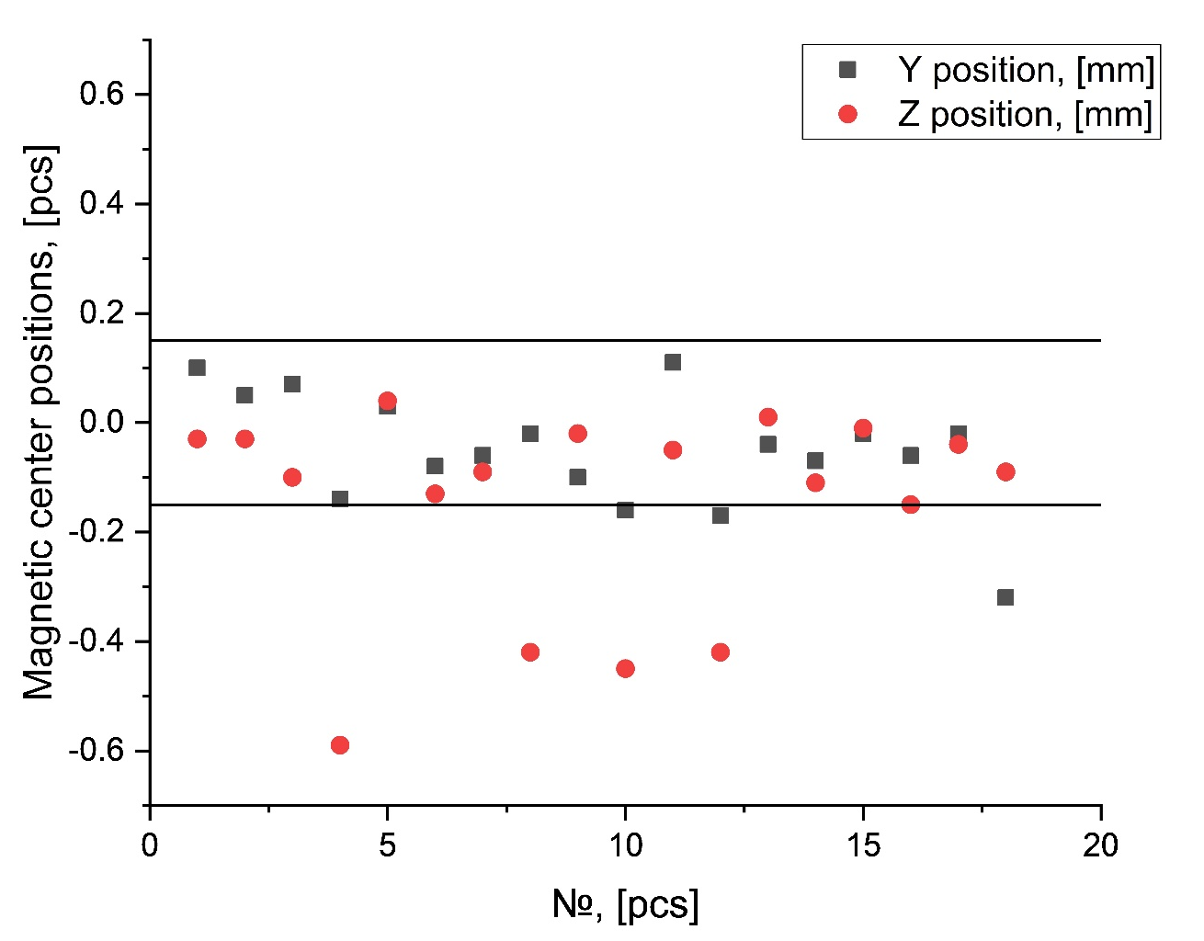
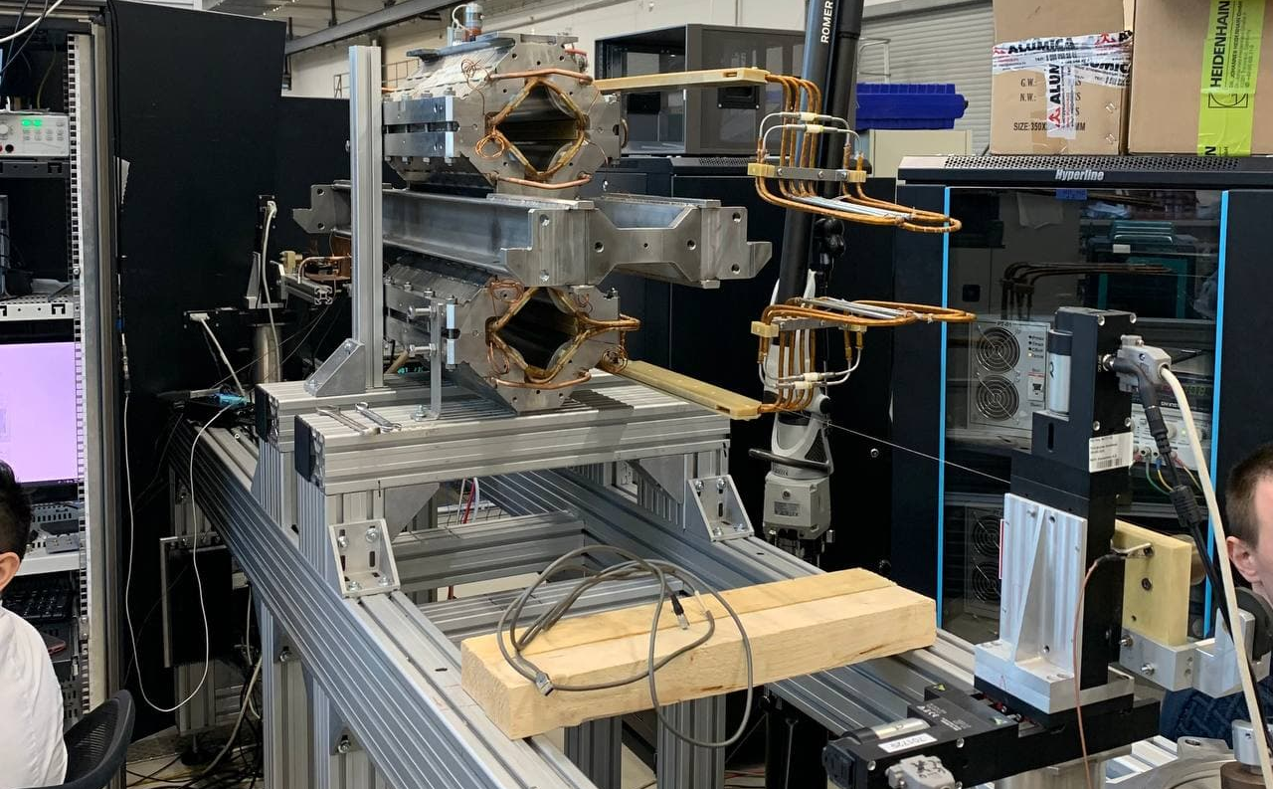
New vibrating wire measurement system
13

Slide 14
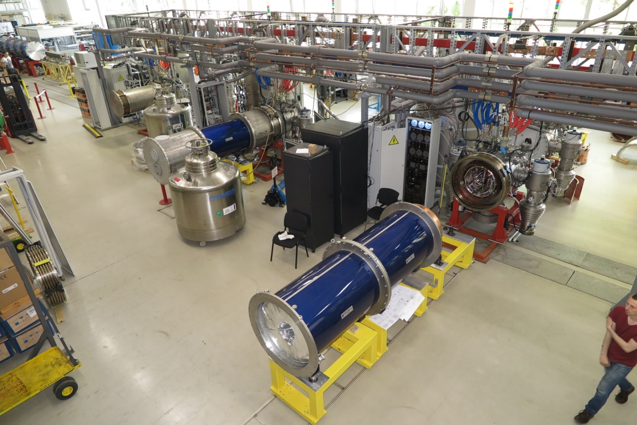
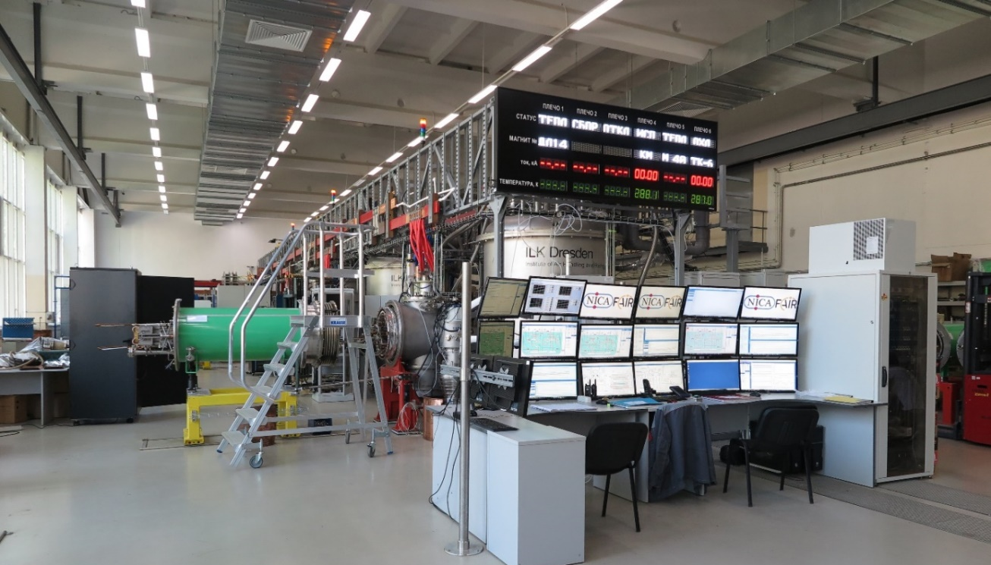
Cryogenic system of test section
Cryogenic test bench consists:
Three helium satellite refrigerators,
Six test stand,
Twelve HTSC current leads,
Maximum productivity 12 SC magnets per month.
Was tested – more 400 cryogenic test of SC magnets.
14

Slide 15
SC dipole magnet for collider
The number of SC magnets successfully passed the test - 86.
The total number of cryogenic tests - 113.
Parameter | Dipole magnets
Cooling channel diameter, mm | 3
Number of SC strands (diameter 0,90 mm) | 16
Superconductor | Nb – Ti
Length of SC cable, m | 120
Operation current (1.8T, 4.65K), kA | 10.44
Critical current (2.5T, 4.7K), kA | 19.2
Effective magnetic length, m | 1.924
Overall weight, kg | 1800
Number of SC magnets for collider. | 81
Cooling time, h | 65
15

Slide 16
SC magnets of collider
16

Slide 17
17

Slide 18
18

Slide 19
I=const=10.44 kA
Q=1.73 W
19

Slide 20
SC Quadrupole magnets (arch) for collider
The number of SC magnets successfully passed the test - 20.
The total number of cryogenic tests - 31.
Parameter | Dipole magnets
Cooling channel diameter, mm | 3
Number of SC strands (diameter 0,90 mm) | 16
Superconductor | Nb – Ti
Length of SC cable, m | 46
Operation current (1.8T, 4.65K), kA | 10.44
Critical current (2.5T, 4.7K), kA | 19.2
Effective magnetic length, m | 0.476
Overall weight, kg | 520
Number of SC magnets for collider. | 46
Cooling time, h | 45
20

Slide 21
21

Slide 22
I=const=10.44 kA
Q=1.09 W
22

Slide 23
Conclusions
 |  | total | prod. %
Dipole magnet | Coil | 81 | 100
 | Yoke | 81 | 100
 | Thermal shield | 81 | 100
 | Cryostat | 81 | 100
 | Cryogenic test | 113 | 100
 | Module | 81 | 100
Quadrupole magnet (arch) | Coil | 46 | 100
 | Yoke | 46 | 100
 | Thermal shield | 46 | 100
 | Cryostat | 46 | 100
 | Cryogenic test | 60 | 50
 | Module | 46 | 13
 |  | total | prod. %
Dipole magnet (BV) | Coil | 8 | 0
 | Yoke | 8 | 50
 | Thermal shield | 0 | 0
 | Cryostat | 0 | 0
 | Cryogenic test | 0 | 0
 | Module | 8 | 0
Quadrupole magnet (doublet) | Coil | 24 | 100
 | Yoke | 24 | 100
 | Thermal shield | 24 | 0
 | Cryostat | 24 | 100
 | Cryogenic test | 35 | 0
 | Module | 24 | 0
 |  | total | prod. %
Correction magnet | Coil | 132 | 90
 | Yoke | 132 | 100
 | Cooling cylinder | 132 | 61
 | Magnet | 132 | 61
 | Cryogenic test | 95 | 31
 | Module | 70 | 6
Quadrupole magnet (LFF) | Coil | 12 | 0
 | Yoke | 12 | 16
 | Thermal shield | 12 | 0
 | Cryostat | 12 | 0
 | Cryogenic test | 15 | 0
 | Module | 12 | 0
Collider

Slide 24
Conclusions
All (86) of the dipole magnets for the NICA collider were successfully passed cryogenic test and installed in the cryostat.
20 Quadrupole magnets (arch) were successfully passed cryogenic test and 9 of them installed in the cryostat.
In 2021, the number of cryogenic tests SC magnets doubled (from 72 to 120).
All (46) quadrupole magnets (arch) will be ready for ring mounting in early 2022
All magnets of the NICA complex will be ready by mid-2022
24

Slide 25
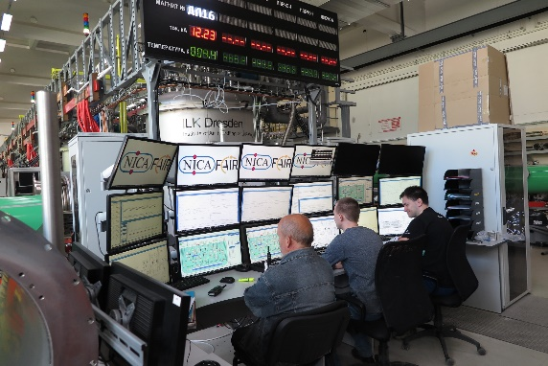

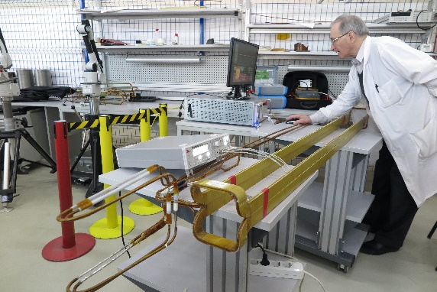
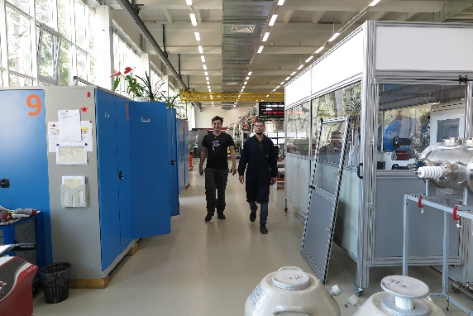
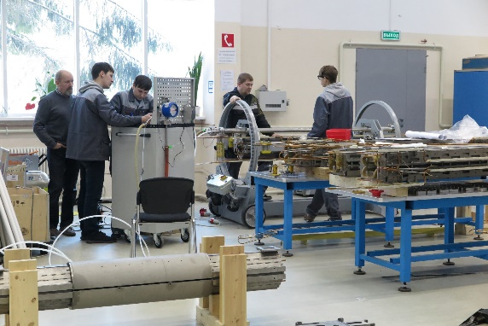
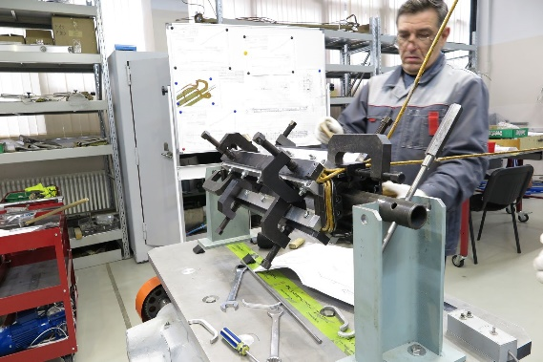
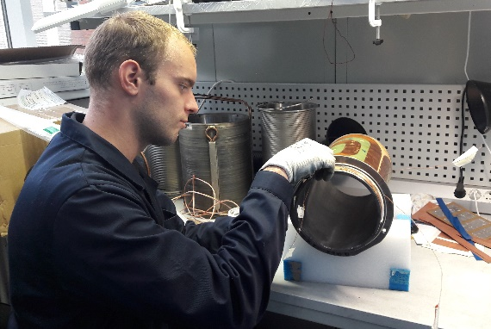
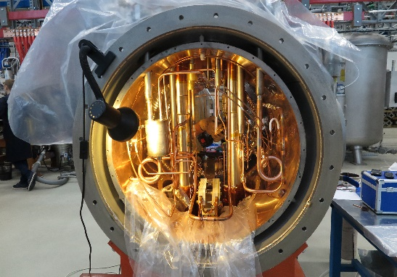
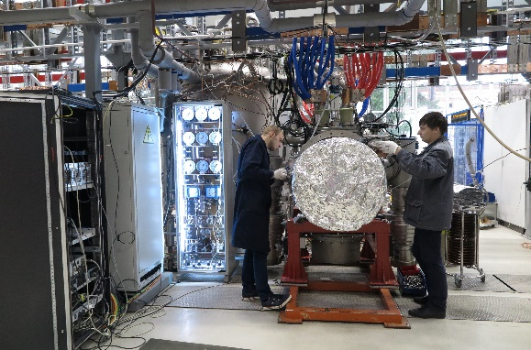
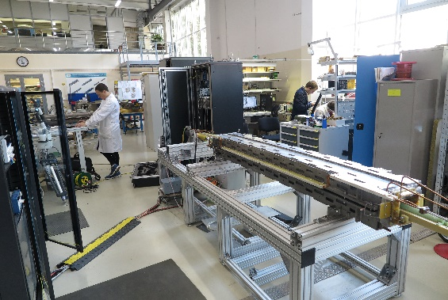
Thank you for attention!
25

