Slide 1
Beam diagnostics at the NICA accelerator complex
Evgeny Gorbachev on behalf of team VBLHEP, JINR

Slide 2
Content
Beam position measurements at Booster:
Overview
Experience in first Booster runs: results, problems and solutions.
Tune measurements at Booster.
Beam position measurements at Collider:
Overview.
Diagonal-cut type pick-ups: proposed matching circuit and electronics.
Strip-line monitors: prototype measurements at the test bench

Slide 3
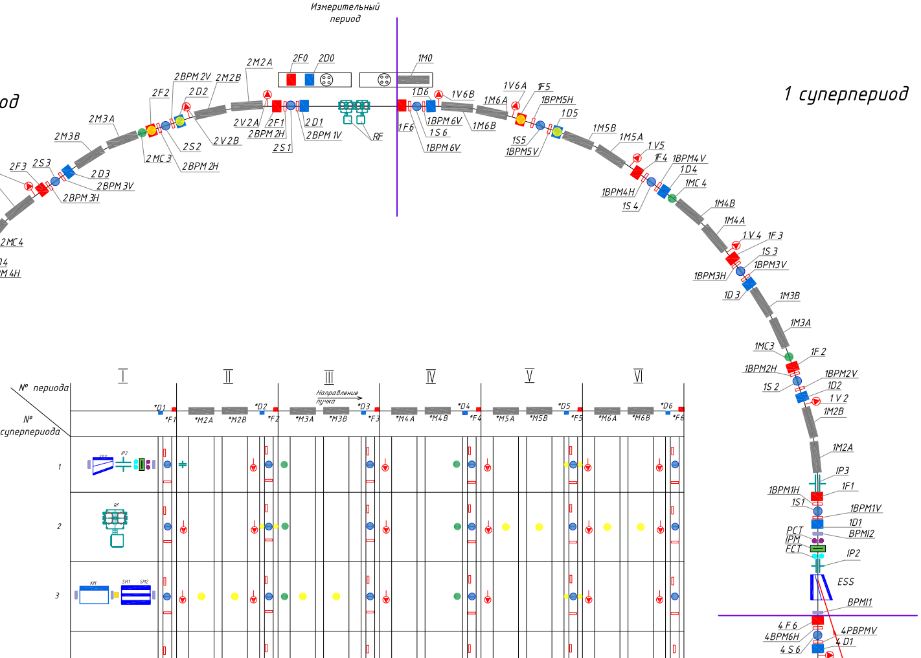
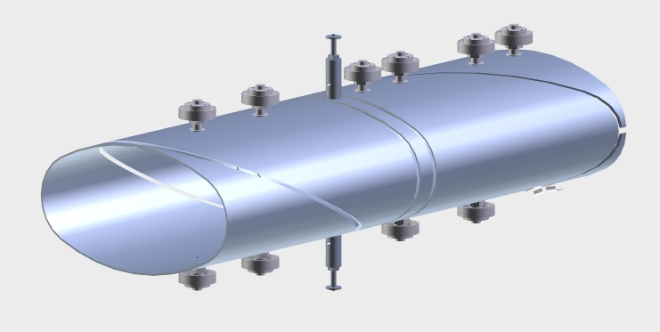
Beam position measurements at Booster
6 electrostatic elliptical PUs with diagonal cut per quadrant
2 pair of plates – horizontal and vertical
Plates are loaded on high impedance
Preamps at shortest possible distance
Custom coaxial cable inside the booster to reduce parasitic capacity to ground

Slide 4
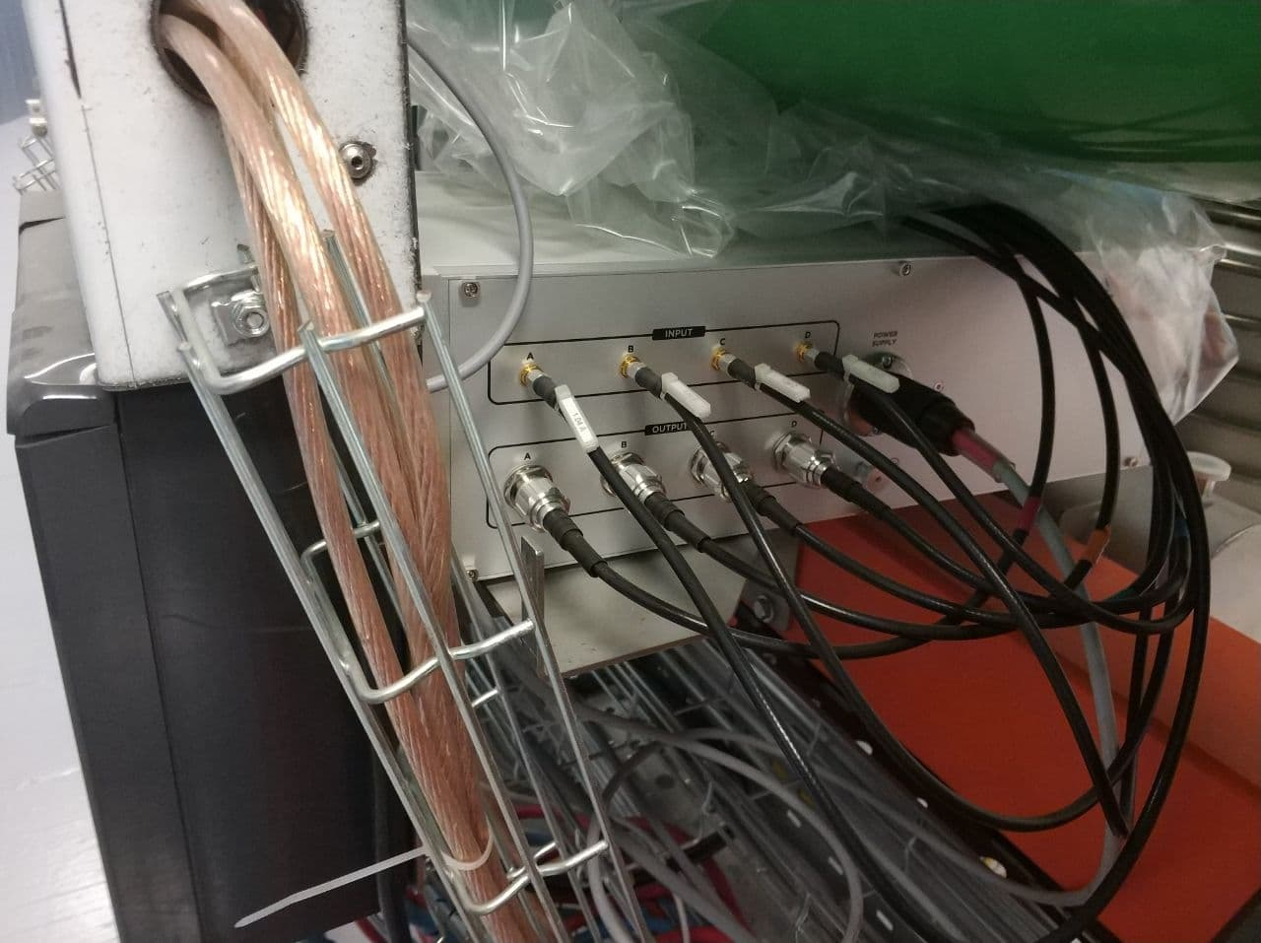
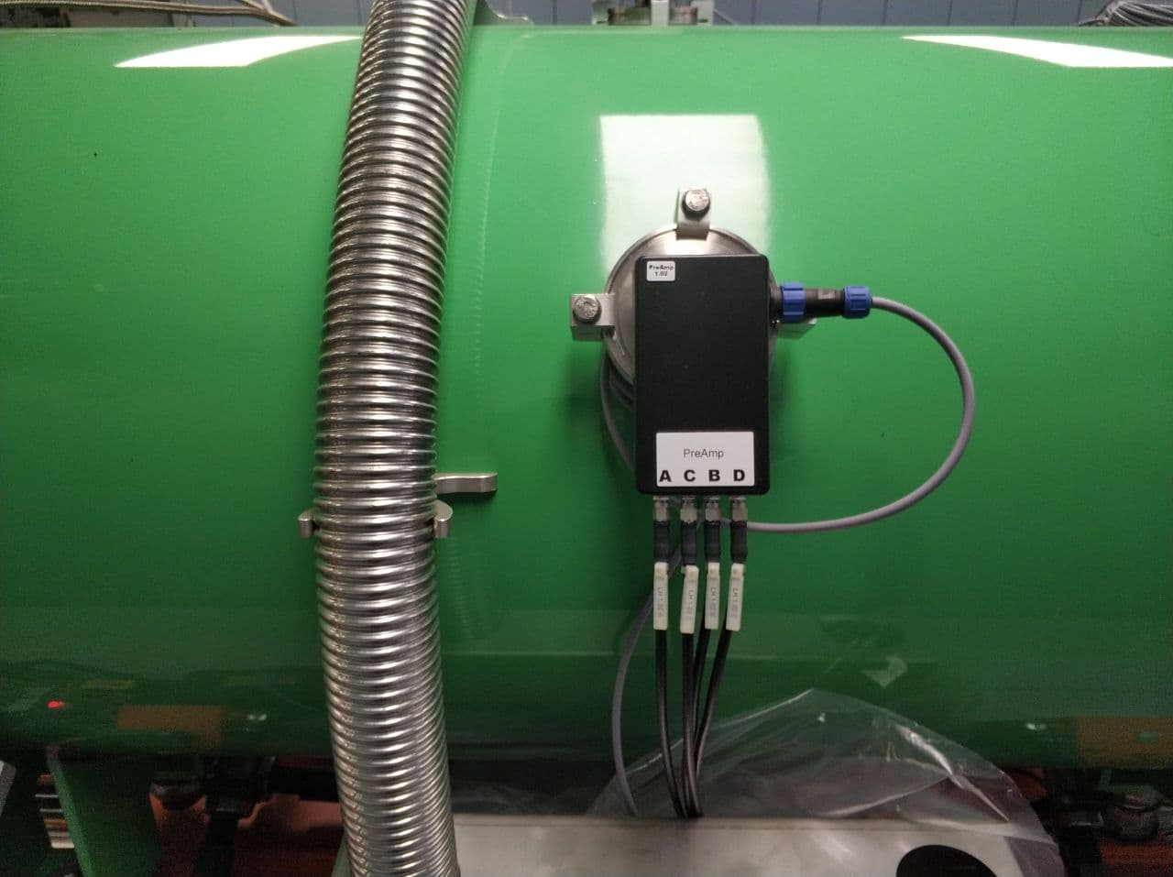
BPM amplifiers
Preamplifier on the BPM connector (G=0dB)
Amplifier110 (Instrumentation Technologies, Slovenia) – variable gain wideband amplifier (G=-50 – +60 dB),controlled via SPI interface (UTP cable) from Libera BPM module.

Slide 5
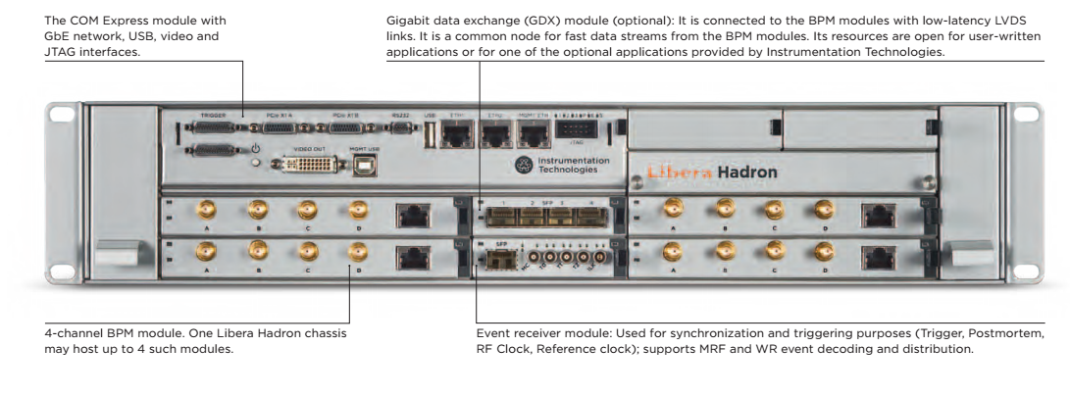
BPM read out electronics – Libera Hadron
Libera Hadron
(Instrumentation Technologies,
Slovenia)
Specifications:
4 BPM modules (4 plates )
16 bit 250MS/s ADC
Xilinx Virtex 6 FPGA
4GB memory per BPM
Performance:
Position RMS: 6 um
Temperature drift: 2um/C
Output data on demand and streams:
Raw ADC (A,B,C,D) – 268MS (>1s of data @250MHz)
calculated beam position (X,Y) – 67MS (67s of data @1MHz bunch rep rate)
Charge(SUM)
FFT
Slow (10S/s) and fast (10kS/s) data streams
Decimation and averaging is available for each data on demand.
External synchronization (TTL or MRF/WR):
Machine clock (TTL 10 MHz)
Start/stop trigger T2
RF clock T0
Postmortem trigger T1

Slide 6
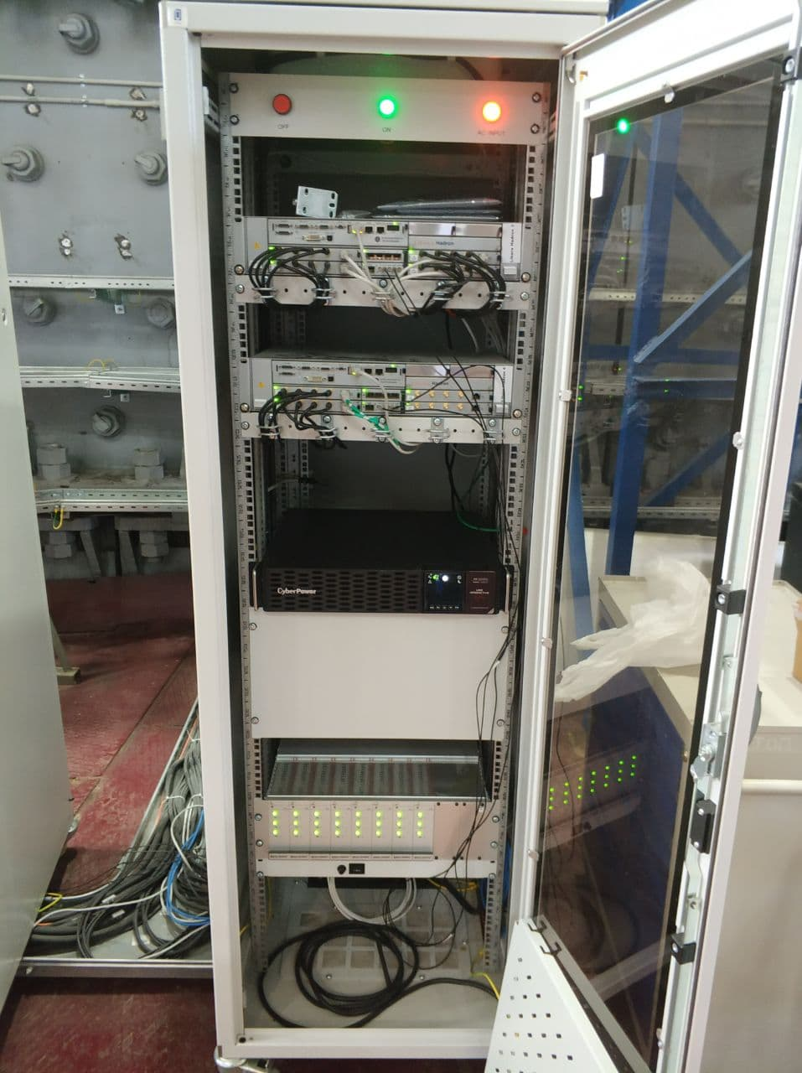
Booster BPM system hardware
24 H+V electrostatic pick-ups.
24 preamplifiers at the pickup connector to match PU impedance.
24 Amplifier110 – additional amplifiers near pickups with regulated gain up to 60dB in 10 dB steps.
19” rack with 2 Libera Hadron devices per quadrant.
4 racks with 8 Libera Hadron devices (32 channels) per ring.
4x2m + 4x38m RG223 double shielded coaxial cables per pick-up. The lengths of coax cables are equal for all pickups.
About 4km of RG223 cable in total.

Slide 7
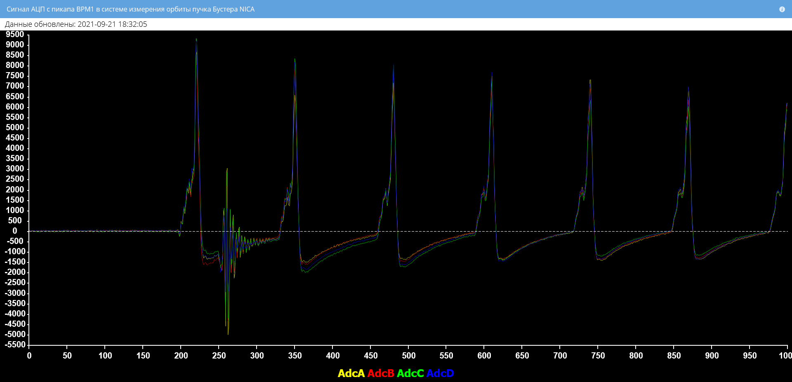
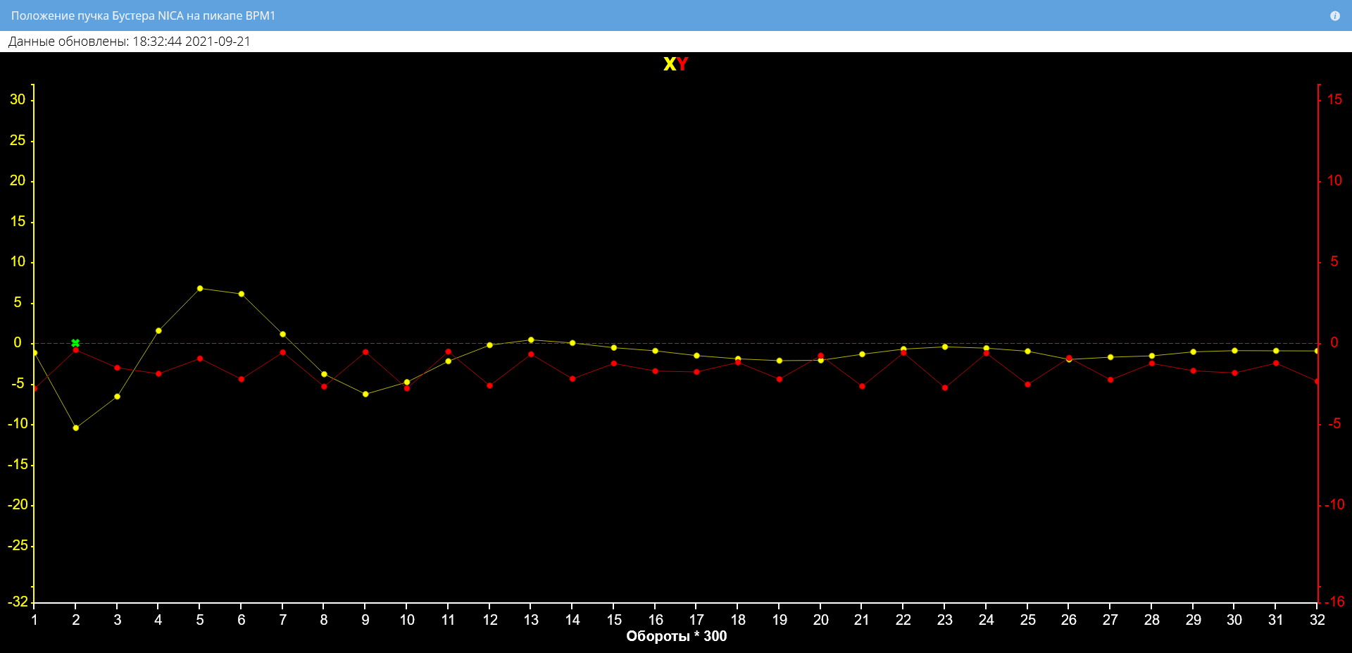
Beam position measurements at Booster
BPM1 raw ADC data from 4 PU plates at injection, Fe14+
Noise from inflector plates kick
BPM1 position measurements
Underload/overload status of the position calculated from noise

Slide 8
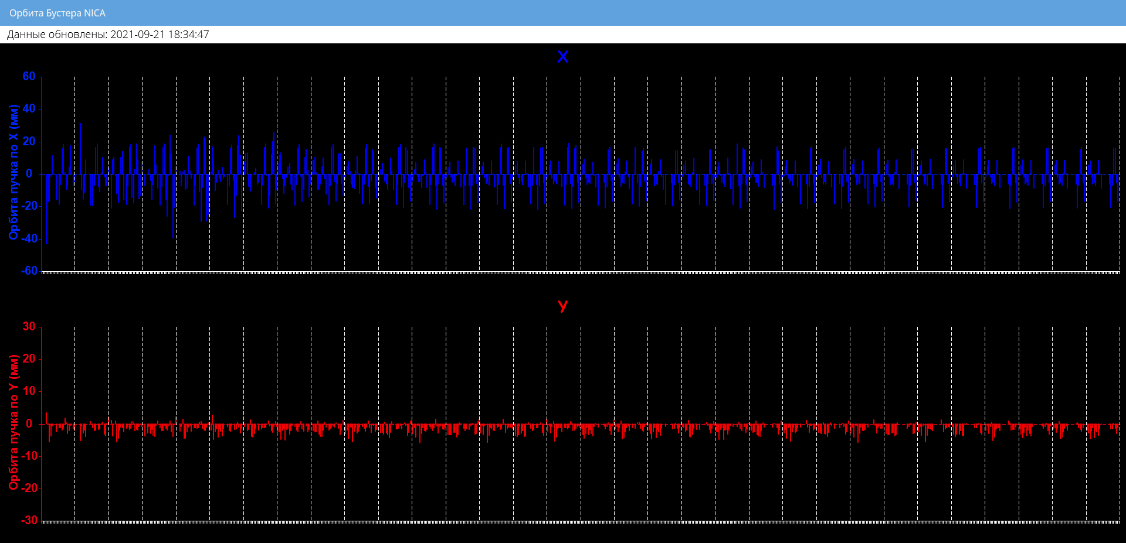
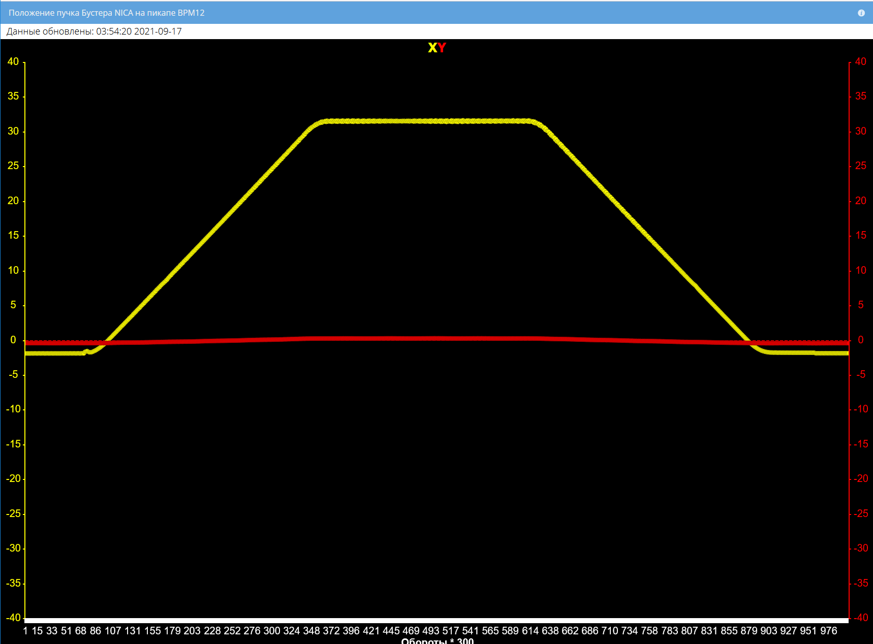
Beam position measurements at Booster
32 turns after injection Fe14+ from all 24 BPMs
Decimated beam position data (300 turns per point, 300k turns total) represents orbit bump at extraction point. Fe14+, 200 MeV

Slide 9
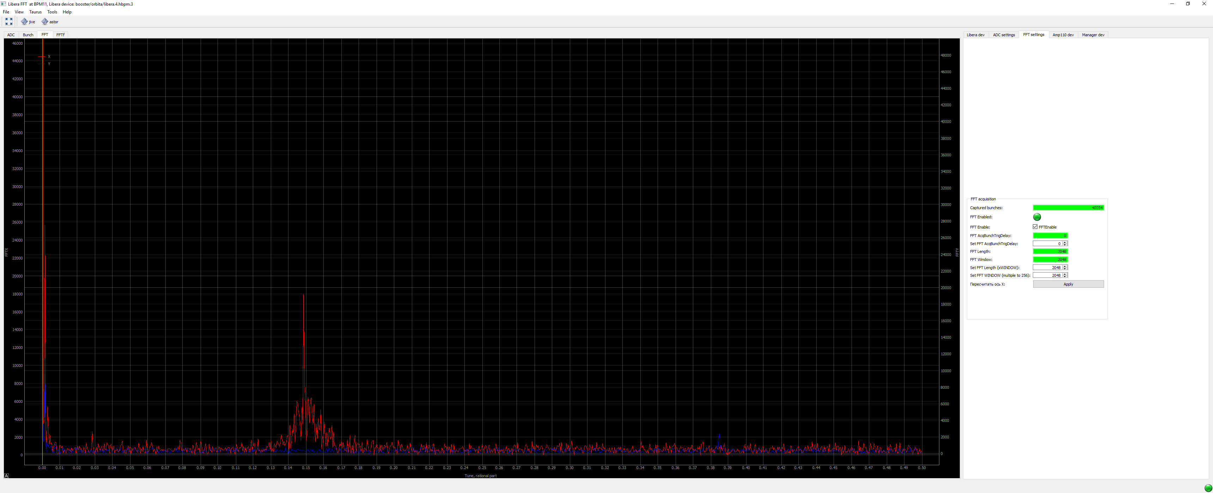
Beam position measurements at Booster
Fast Fourier Transform of the beam position data:
Allows measurements of tune
512-4096 bunches window size
Can pick n-th bunch for the processing – useful for harmonics number >1
Decimation and averaging to reduce the amount of data

Slide 10
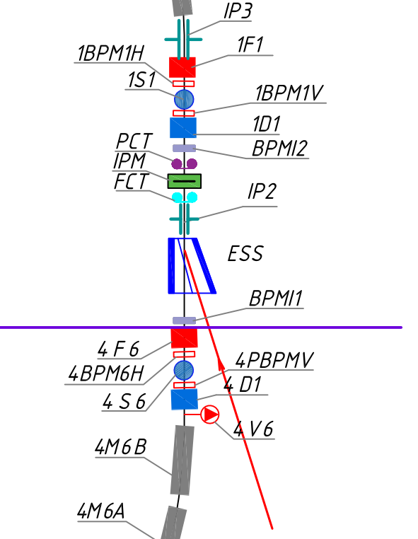
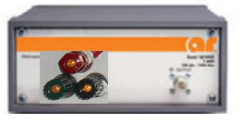
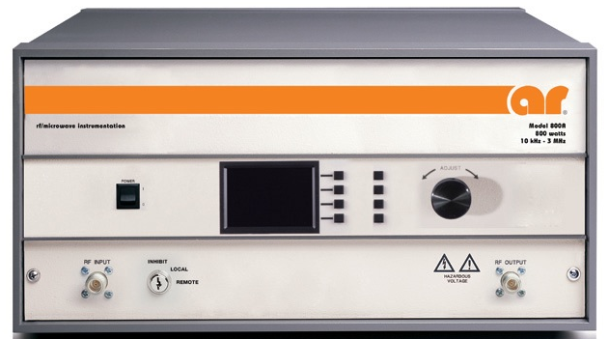
Tune measurement hardware at Booster
RF Amplifier AR800A3A:
800 W @ 50 ohm, 10kHz-3MHz BW
1:6 Impedance transformers,
±1200V on IP2
NI PXIe-7975 FPGA module with custom 14 bit 100MHz DAC adapter

Slide 11
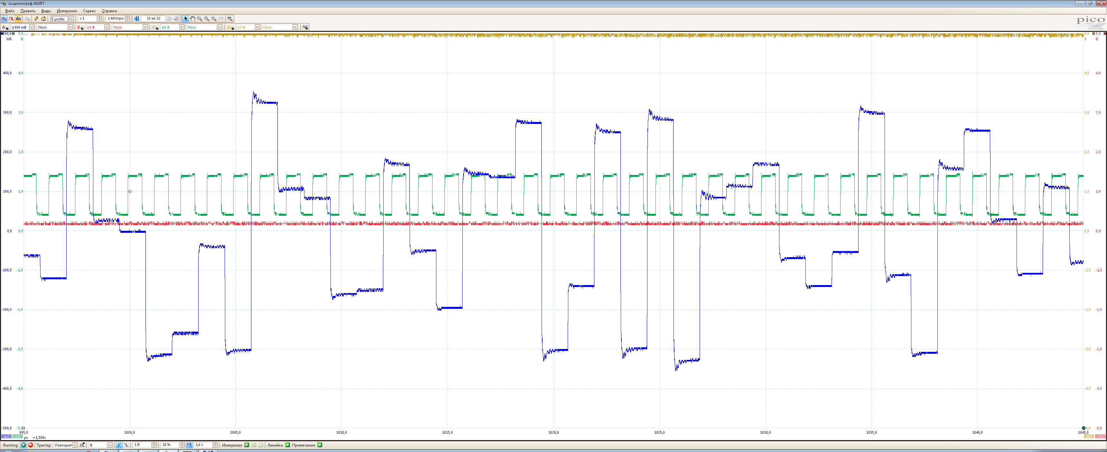
Beam excitation
Modes of beam excitation:
Noise
Coherent noise
Chirp
Coherent chirp
Coherent noise beam excitation signal (blue), RF (green).

Slide 12
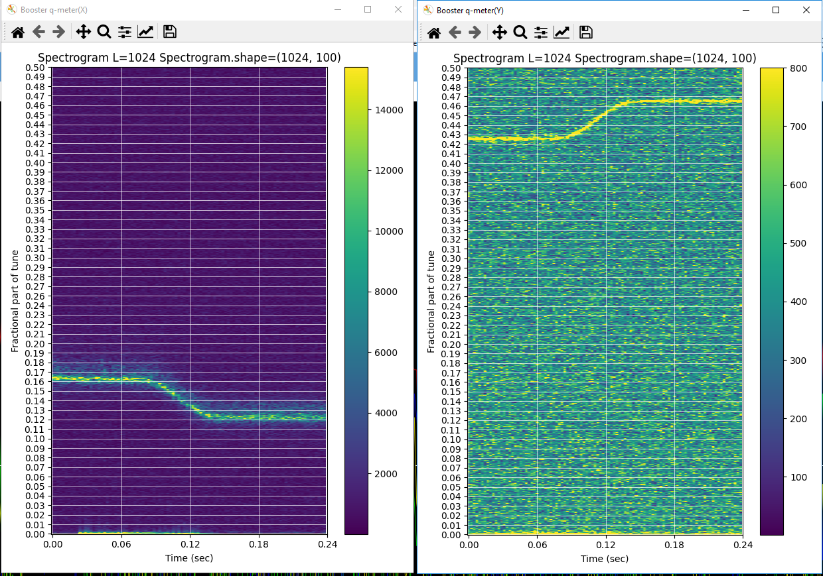
Tune measurements at Booster
He1+ E=200 MeV, B= 6078,4 Gs, h=1
There are 3 main power supplies:
Current in B magnets: I₀
Current in F lenses: I_{F}=I₀-I₁
Current in D lenses: I_{D}=I₀-I₁+I₂
where
I₁=k1*I₀ – current subtracted from F and D;
I₂=k2*I₀ – current added to D lenses.
Gradually changing k1=0.032,k2=0.06 to k1=0.025, k2=0.06

Slide 13
Tune measurements at Booster
k2=0.06 (I2=194.4A), Не1+, 200 MeV/u, 6078,4 Gs
k1=0.032(I1=103.68), Не1+, 200 MeV/u, 6078,4 Gs
k₁ | I₁ | q_{x} | q_{y}
0.05 | 162.02 | 0.725 | 0.325
0.045 | 145.82 | 0.765 | 0.355
0.040 | 129.60 | 0.79 | 0.38
0.032 | 103.68 | 0.835 | 0.425
0.025 | 81.0 | 0.875 | 0.465
0.02 | 64.8 | 0.905 | 0.495
k₂ | I₂ | q_{x} | q_{y}
0.065 | 210.59 | 0.82 | 0.475
0.06 | 194.4 | 0.835 | 0.425
0.055 | 178.2 | 0.855 | 0.38
0.050 | 162.0 | 0.87 | 0.33
0.045 | 145.8 | 0.90 | 0.28
0.04 | 129.59 | 0.92 | 0.23
0.035 | 113.39 | 0.93 | ----
0.03 | 97.22 | 0.955 | 0.14
0.025 | 81.00 | 0.96 | 0.08
Scanned the region:
Qx=4.725÷4.96
Qy=5.08÷5.475

Slide 14
Problems discovered during first runs.
TANGO server crashes in certain conditions.
Performance issues with TANGO events.
Unstable Libera devices startup with DHCP.
ADC buffer corruption in certain work regimes.
RF frequency is limited by 10.4MHz (we need 13MHz for collider).
High jitter of synchronized ADC mode (tBBB) (going to use for SLM acquisition).
Narrow-band algorithm is limited by 10.4MHz.
Most of the problems has been solved with help of Instrumentation Technologies engineers.

Slide 15
Beam position measurements at Collider
Diagonal-cut BPM near F lenses (X) | 24 + 24
Diagonal-cut BPM near D lenses (Y) | 22 + 22
Pick-up in straight sections (X/Z) | 20 + 20
Strip Line Monitors (X/Y) | 4
The accepted tolerance for mechanical alignment of BPM in the module is 0.1mm.
X and Y arc BPMs have to be combined together to be used in Libera Hadron BPM module.
Cable lengths have to be adjusted to take into account beam flight time between pickups.
Total number of 2-channel preamplifiers | 92
Total number of 4-channel preamplifiers | 40
Total number of Amplifier110 devices | 96
Total number of Libera Hadron devices | 24
Total number of racks (1 to 4 devices in rack) | 12
Rooms | 110, 116, 120/1, 124, 133, 152/1, 143, 154, 181/9, 181/2,173, 181/15
Estimated RG223 cable length | 16 km

Slide 16
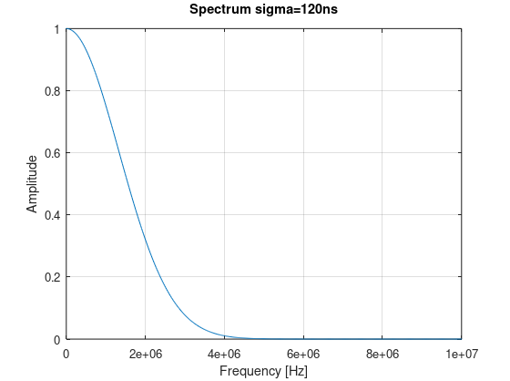
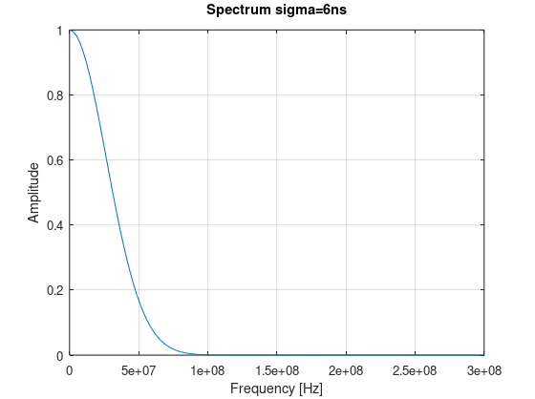
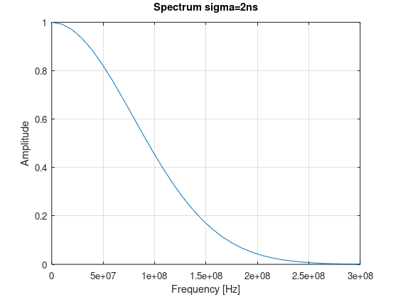
Beam position measurements at collider
Different modes of collider operation:
Accumulation at RF1, f=0.522-0.587,σ_{t}=120ns
Acceleration at RF2, f=11.484 - 12.914, h=22, σ_{t}=6ns
Collisions at RF3, f=34.452 - 38.742, h=66, σ_{t}=2ns
Commissioning with low intensity.
σ_{f}=1.3MHz
σ_{f}=26MHz
σ_{f}=80MHz

Slide 17
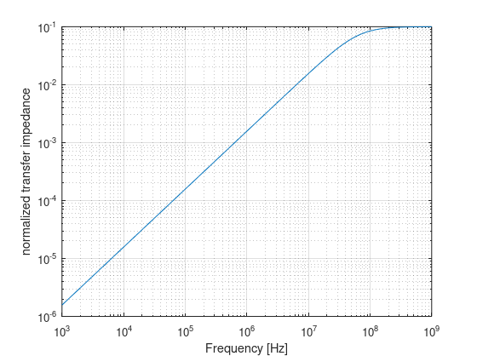
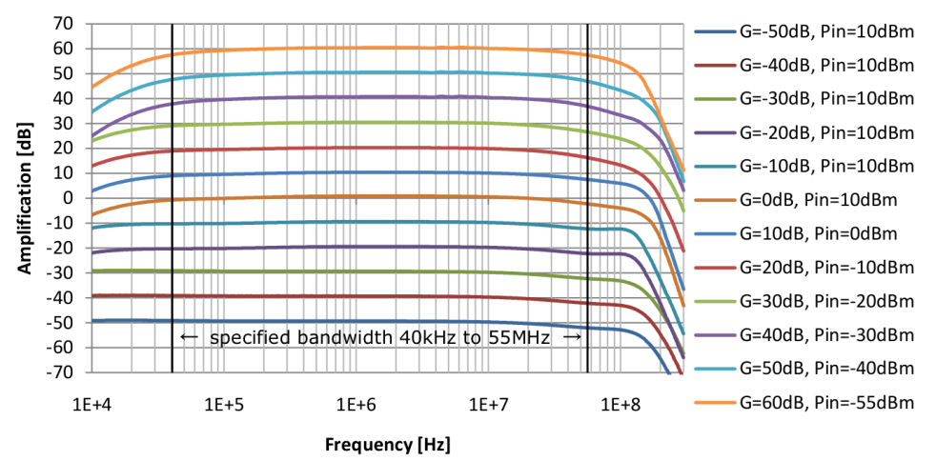
Beam position measurements at collider
A preamplifier has been developed which can be switched remotely to use either high impedance mode to use during accumulation or 50 Ohm with integrator to use during acceleration and collision regimes. The signal path is switched by wideband analog switches ADG919, which are controlled by ethernet remote control board installed in nearby Amplifier110.
Prototype of the preamplifier is in production now.
Spare space for remote ethernet control board
Transfer impedance of BPM
loaded by 50 Ohm
Amplifier110 gain

Slide 18
Estimation of Libera Hadron accuracy for collider
The worst case for beam position measurements is colliding mode with shortest bunches at maximum bunch repetition rate. The accuracy of Libera Hadron and Amplifier110 was estimated at the tests bench with gaussian pulse by measuring beam position in 3 different regimes.
 | Position X | N=1 | N=22 | N=220
σ=120ns,f=0.6MHz | Mean, um | -90.2 | -89.5 | -91.0
 | Std, um | 24.6 | 5.8 | 1.9
σ=6ns,f=13MHz | Mean, um | 77.0 | 77.2 | 77.6
 | Std, um | 91.2 | 17.2 | 5.5
σ=2ns,f=13MHz | Mean, um | 220.1 | 223.2 | 222.5
 | Std, um | 139.2 | 31.4 | 9.5
Amplifier 110 gain need to be switched after mode change.
Switching time is <20us in specifications.

Slide 19
Estimation of Libera Hadron accuracy for collider
Same measurements with active internal Amplifier110 low pass filters show better results.
 | Position X | N=1 | N=22 | N=220
σ=120ns,f=0.6MHz | Mean, um | -90.8 | -91.1 | -94.4
 | Std, um | 24.9 | 5.8 | 1.8
σ=6ns,f=13MHz | Mean, um | -128.2 | -127.3 | -125.1
 | Std, um | 70.4 | 16.4 | 5.2
σ=2ns,f=13MHz | Mean, um | 24.0 | 22.6 | 24.2
 | Std, um | 87.4 | 18.2 | 6

Slide 20
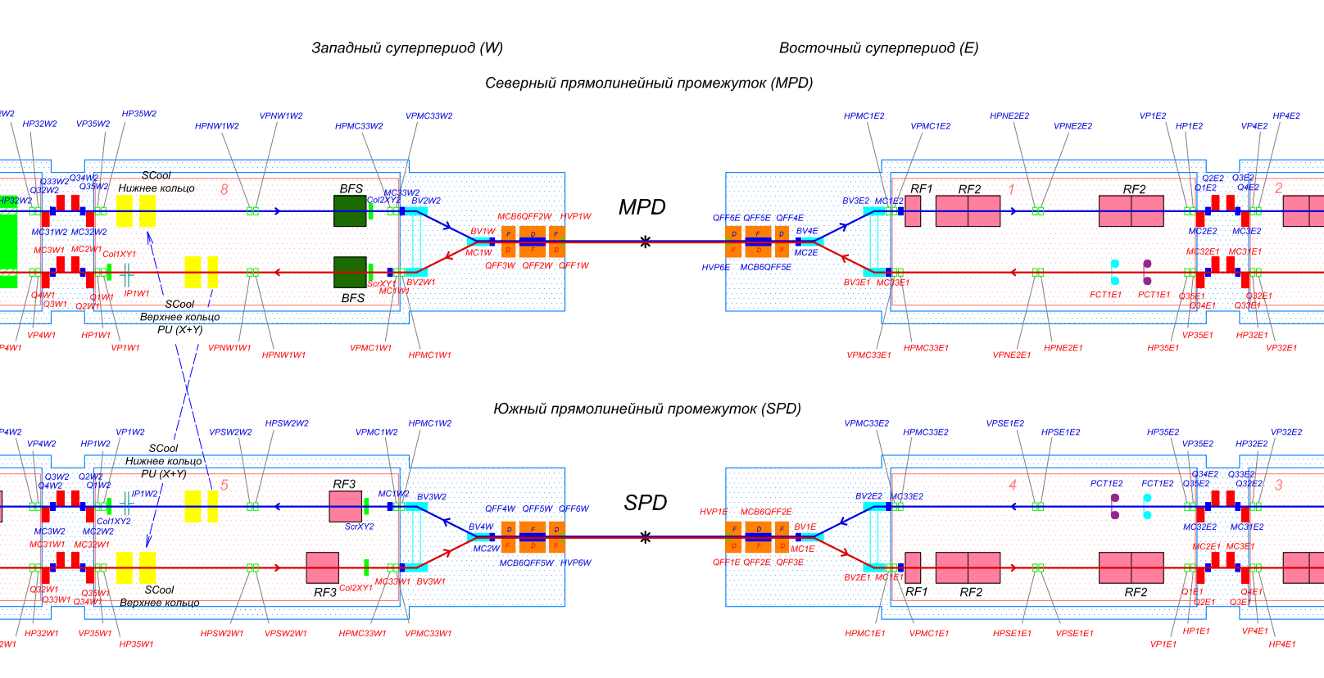
Strip-Line monitors at collider
4 SLM monitors on both sides of IPs.
Can detect position of both beams simultaneously.
The bunch length should be shorter than the SLM strip length to prevent signal overlapping.

Slide 21
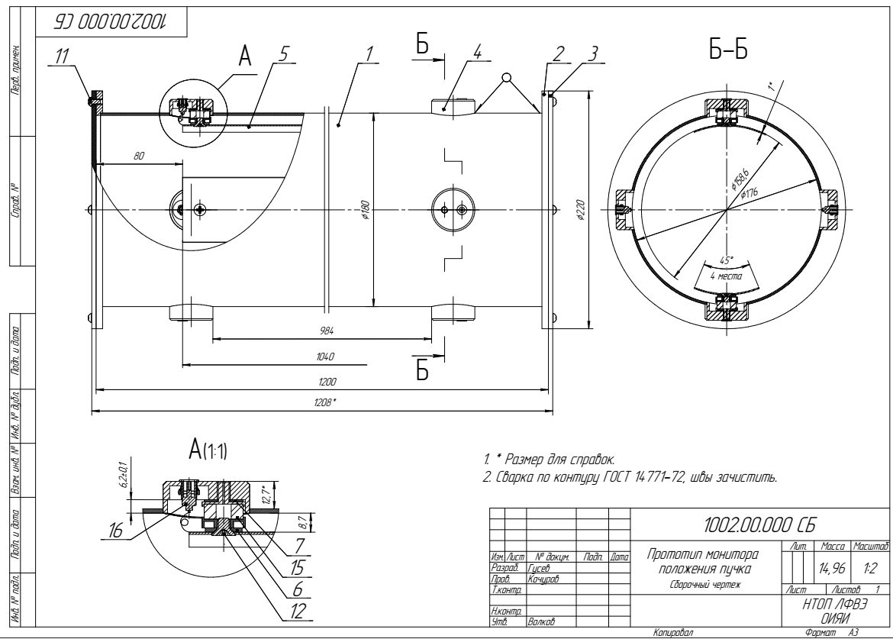
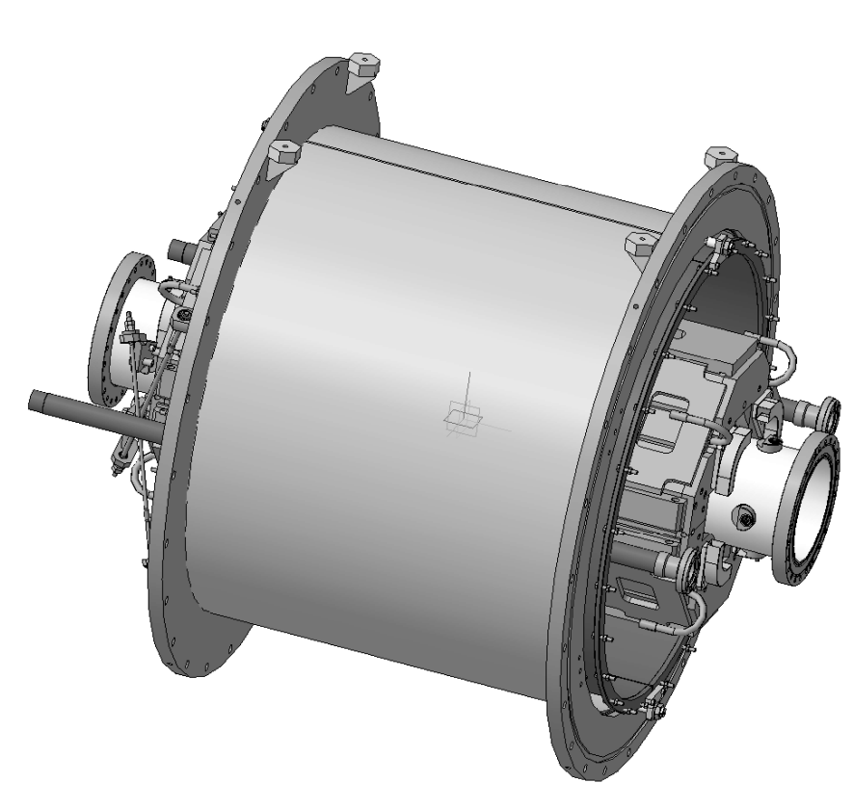
SLM prototype
SLM are situated in final focus lenses.
Aperture of plates D=158mm, length L=1040mm.
4 RF ports on each side to get beams position signals.

Slide 22
SLM test bench
SLM prototype with conducting bar
network analyzer;
signal generator(s);
oscilloscope;
Libera Hadron;
Amplifier110 with power supply.

Slide 23
SLM plates impedance adjusting
Adjust gap between plates and vacuum chamber to achieve 50 Ohm impedance.
Minimize reflection by measuring S11 and S22 using network analyzer.
Achieved 50±10 Ohm up to 250MHz.
Plate1
Plate2
Plate3
Plate4

Slide 24
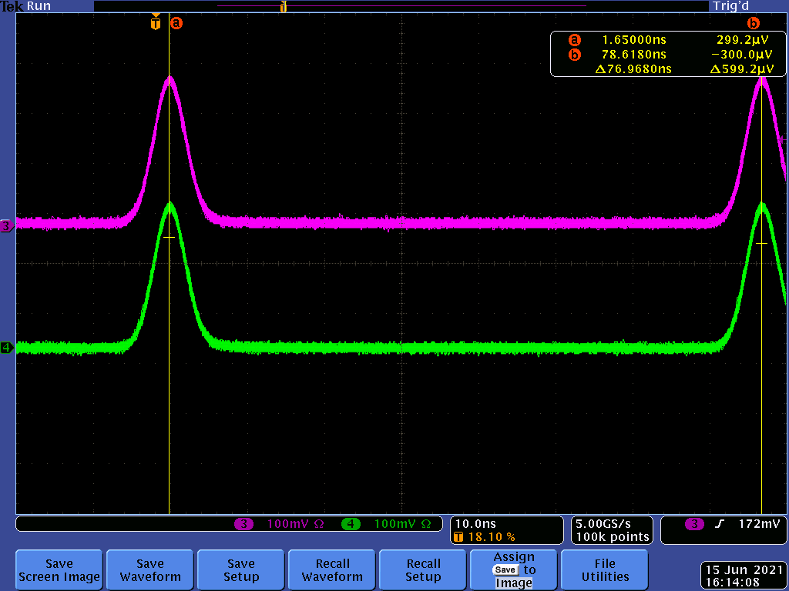
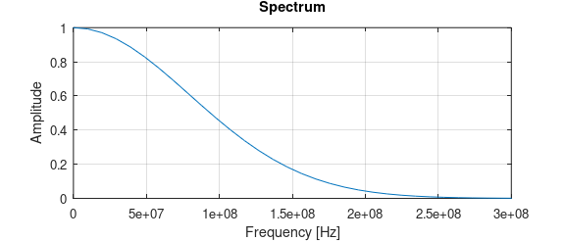
SLM prototype measurements with movable bar(s)
Impedance of coaxial line produced SLM and bar at the center is 213 Ohms.
Bar is loaded by resistor matched to SLM impedance, plates are loaded by 50 Ohms.
Test signal is similar to bunch at collisions:
Gaussian pulse amp=0.3V, σ=2ns, full width at half maximum FWHM=4.7ns, repetition frequency f=13MHz.
Power spectrum of the signal is < 250MHz.
50
Vp
66
50
50
213

Slide 25
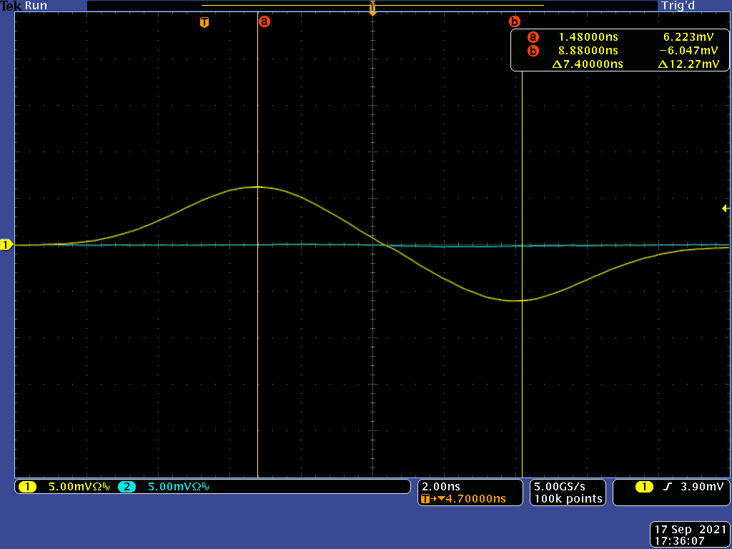
SLM prototype measurements
Signal on upstream (yellow) and downstream (blue) ports of SLM.
Peaks on downstream port signal are separated by time T=2L/c.
No signal on downstream port in case of ideal matching.

Slide 26
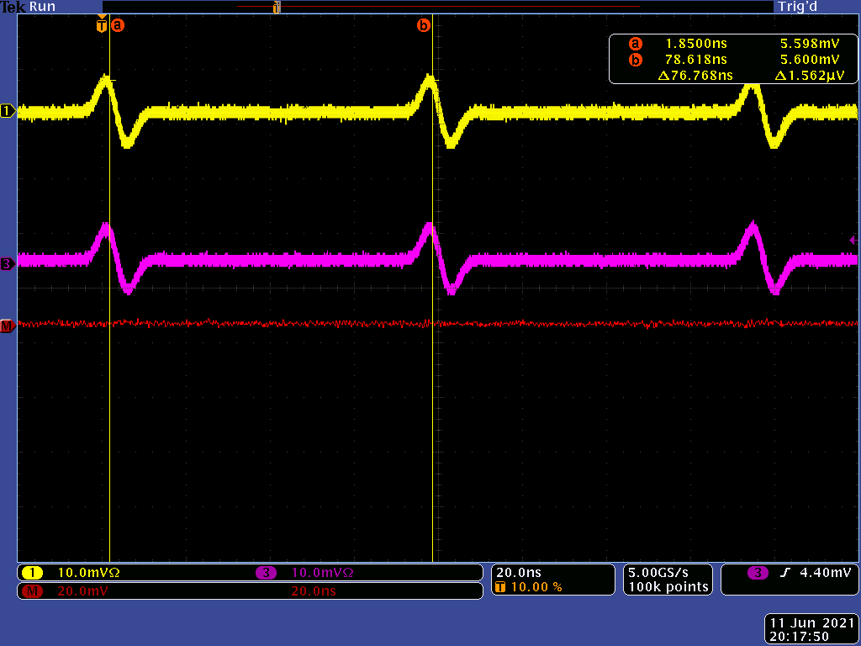
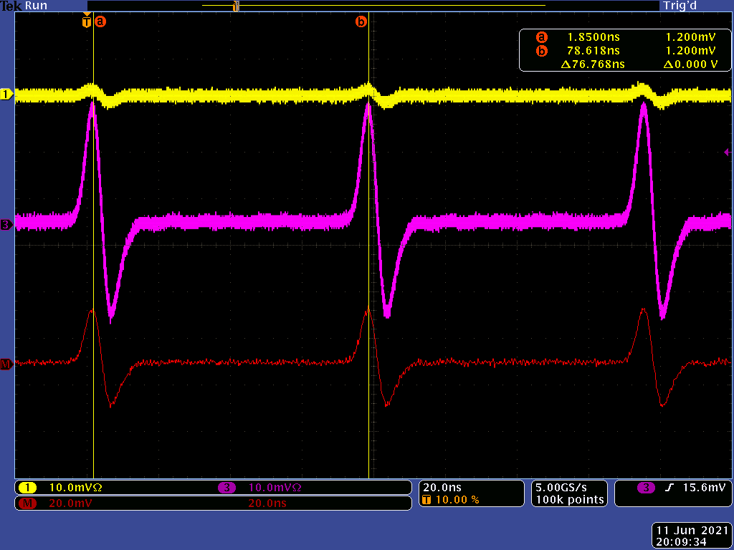
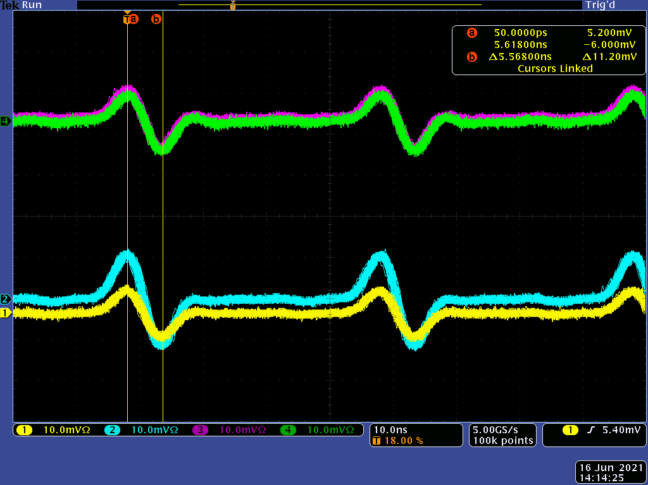
SLM prototype measurements
Bar is centered.
Bar is shifted to the edge of SLM aperture
Colliding beams simulation: 2 bars are fed from opposite sides.

Slide 27
SLM signals read out by Libera Hadron
Raw ADC data, no filter
Bar is shifted vertically by 10mm.
Sampling frequency is 250MHz => 4ns between points.
Averaging can be used to improve accuracy.
 | Position Y | N=1 | N=22 | N=220
σ=2ns,f=13MHz | Mean, um | 10001.6 | 9992.5 | 9988.9
 | Std, um | 248 | 36 | 11
Raw ADC data, LP filter

Slide 28
SLM prototype measurements conclusions
SLM plates have to be more rigid to reduce the sag.
Connection between plates and output connectors have to be redesigned.
Libera hadron (with averaging) can be used for colliding beam position measurements.
2 Libera Hadron devices needs for SLM read-out.
Additional variable gain wide-band amplifier instead of Amplifier110 may be useful to improve accuracy.

Slide 29
Thank you for you attention!

