Slide 1
NICA facility construction
Milestones, plan, critical path

Slide 2
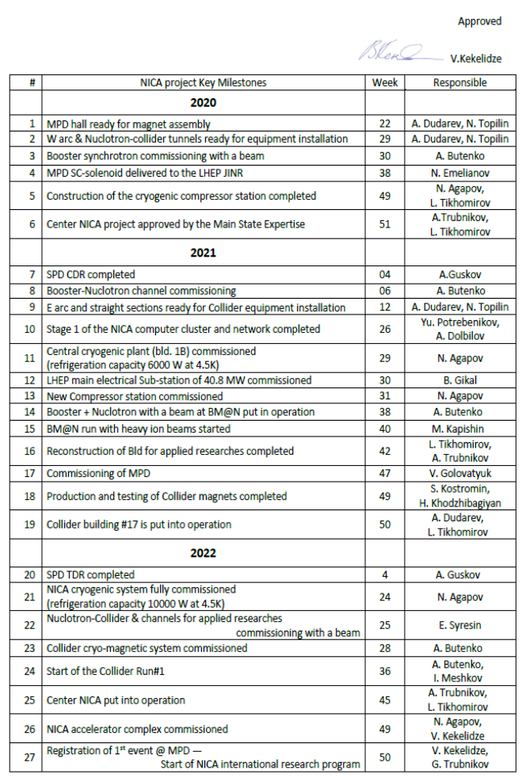
Key milestones
…main points
2020
Booster commissioning
construction cryogenic compressor station W49
2021
Booster – Nuclotron channel commissioning W06
LHEP electrical substation commissioning W49
BM@N run W40
MPD commissioning W47
2022
NICA cryogenic system fully commissioned W24
Start of Collider Run#1 W36

Slide 3
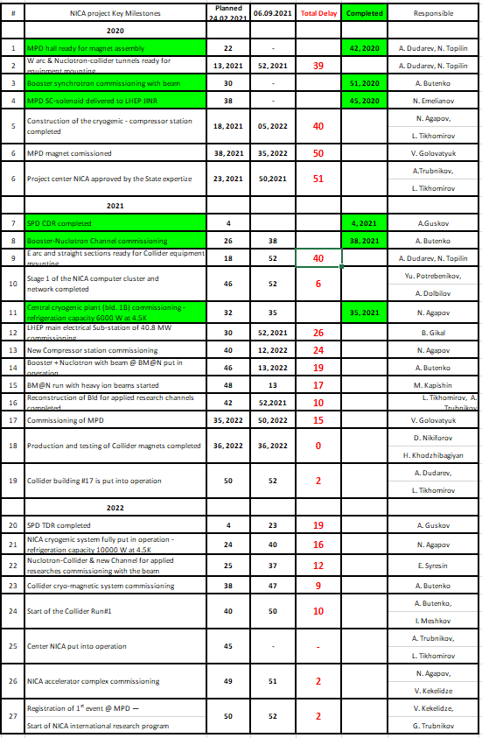
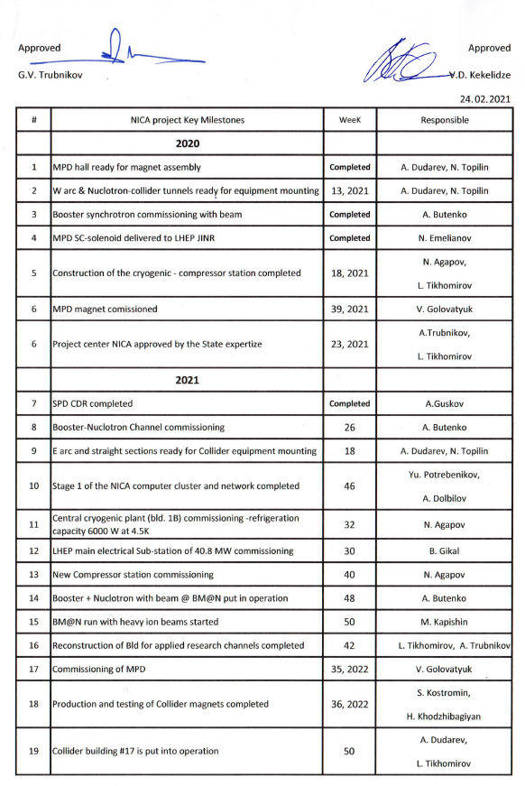
Key milestones list
6 milestones from 27 completed,

Slide 4
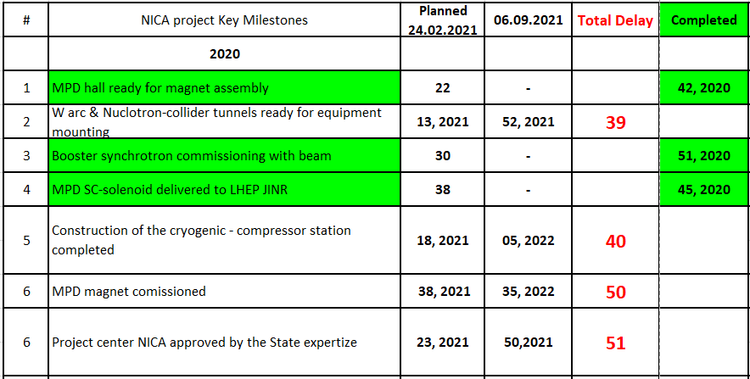
2020
!

Slide 5
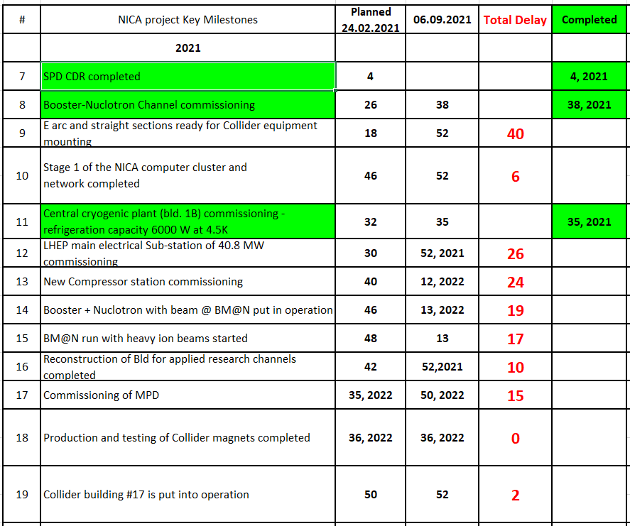
2021

Slide 6
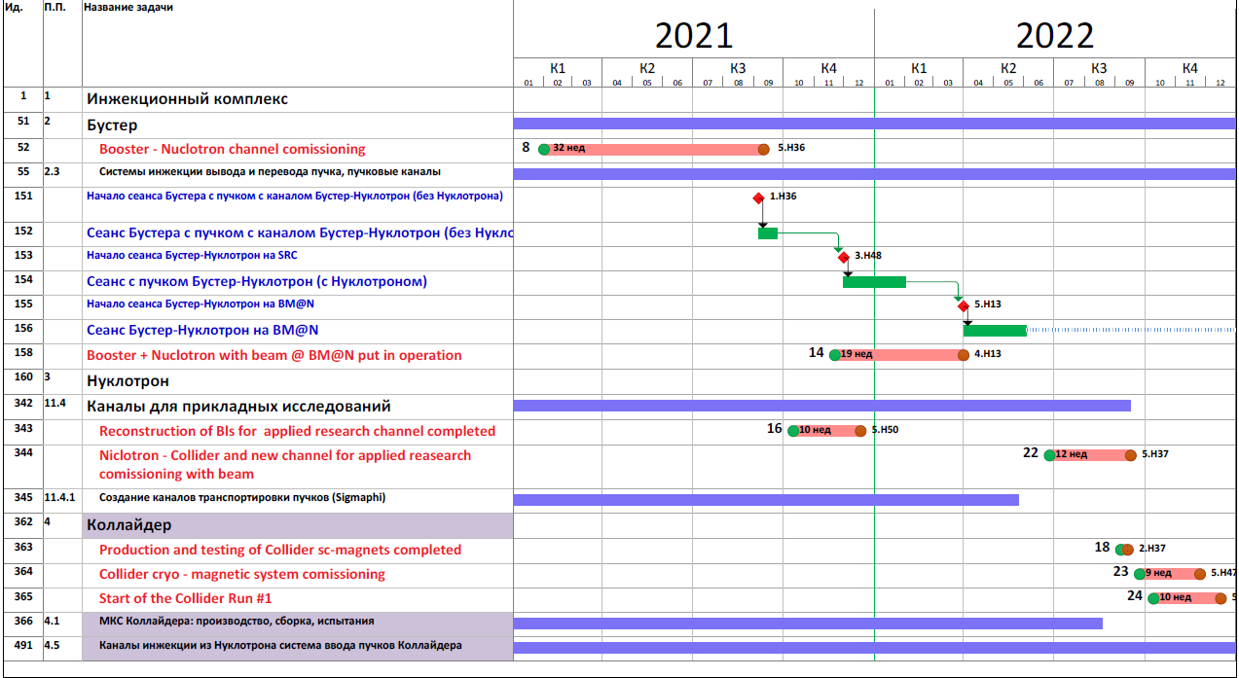

Slide 7
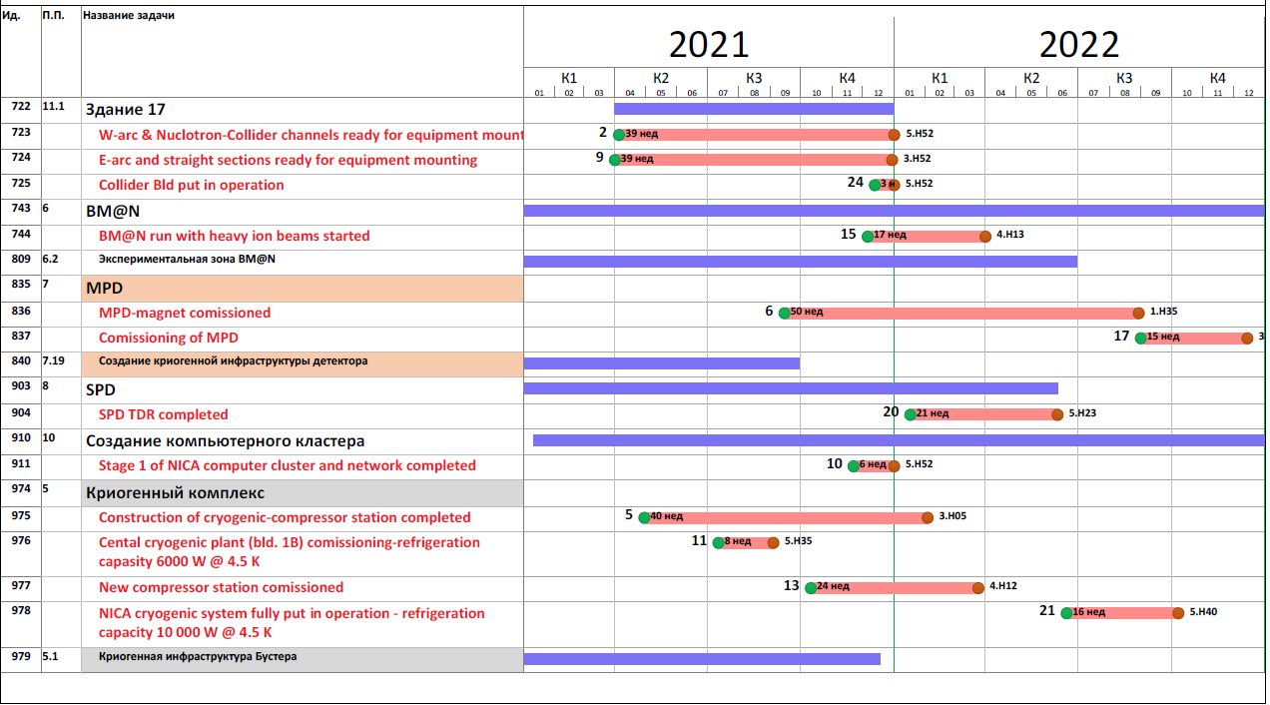

Slide 8
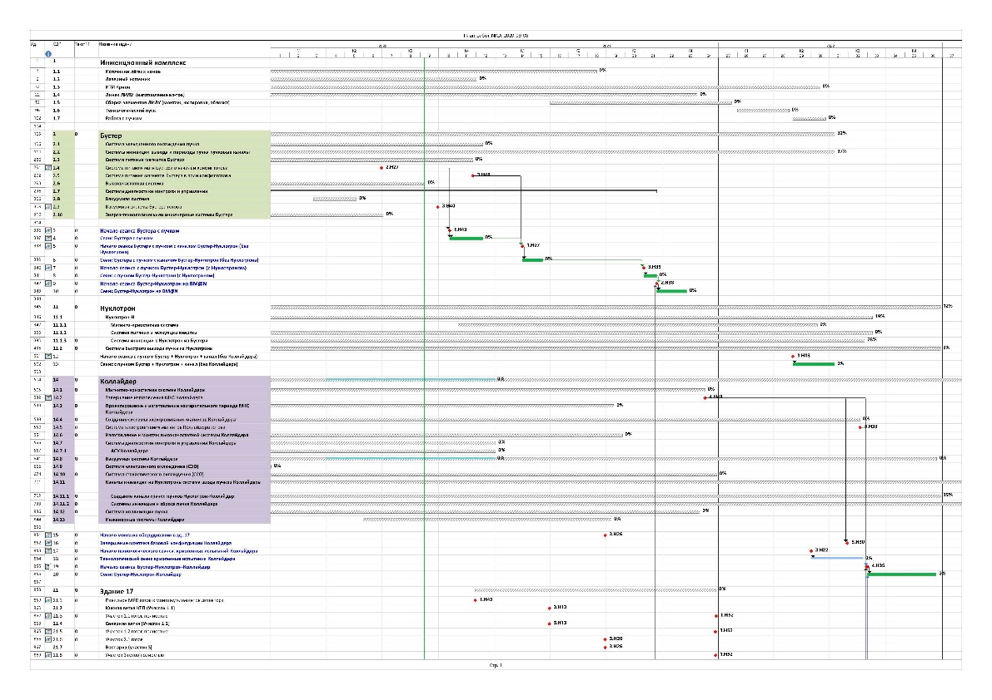
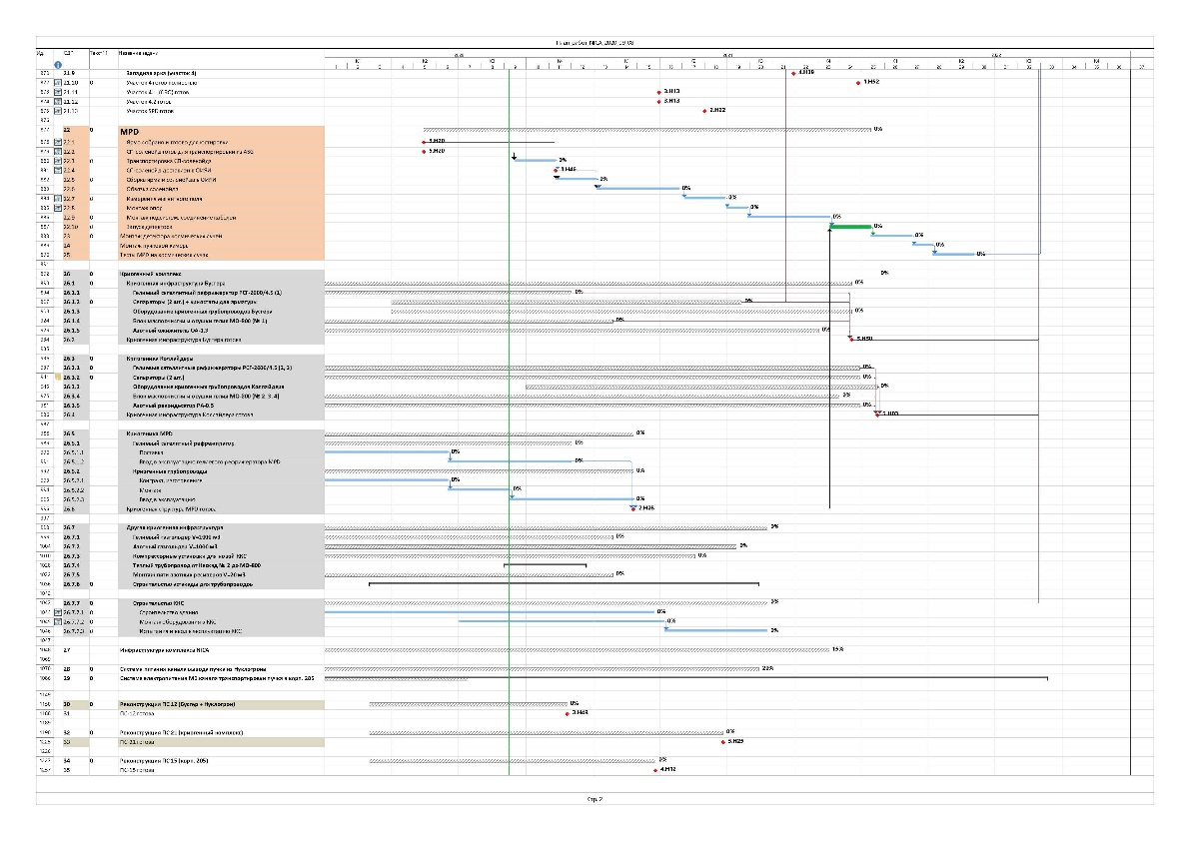
Project plan – overall level
Injection chain
List of works:
Booster
Injection chain – 103 items
Booster – 230 items
Runs schedule – 7 items
Nuclotron – 157 items
Collider – 345 items
Runs schedule – 6 items
Collider building – 17 items
MPD – 21 items
Cryogenic infrastructure – 128 items
Power infrastructure – 209 items
Runs schedule
Nuclotron
Collider
Collider building
MPD
Total: 1223 items
Cryogenic
infrastructure
Power infrastructure
@2020_09_11

Slide 9
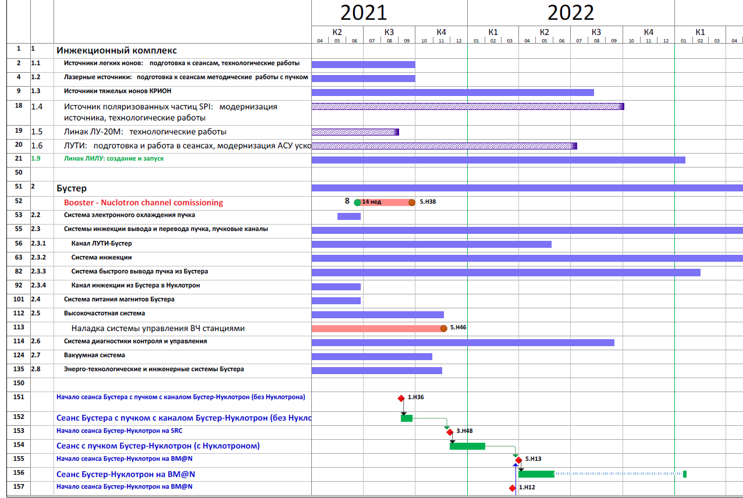
Project plan – overall level
Ion sources, Linacs
Heavy ion source
Booster
Inj /Extr in full config
Beam diagnostics
2021, 2022 Booster + Nuclotron runs

Slide 10
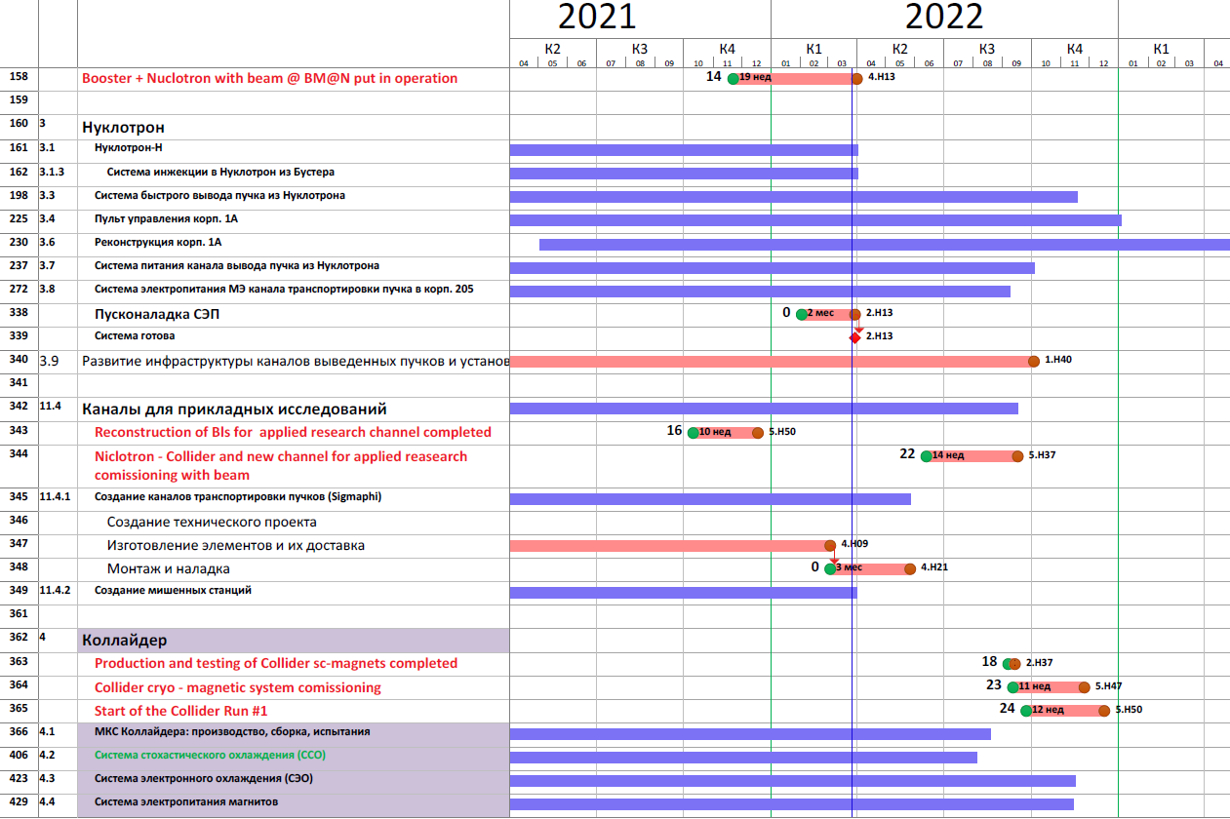
Project plan – overall level
Nuclotron
Inj from Booster system
Fast extraction system
Channels for applied research
Collider
SC-magnets testing

Slide 11
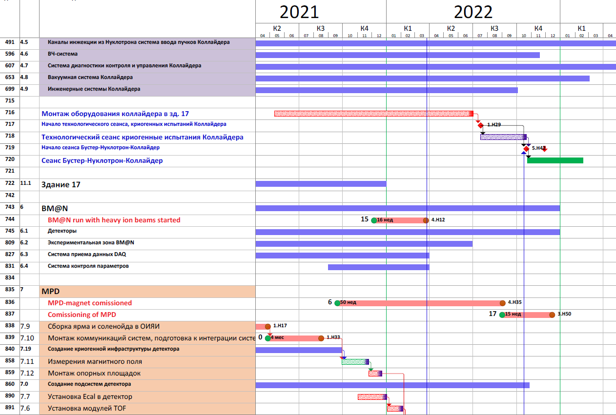
Project plan – overall level
Magnet modules – assembly & tests
Reference super period construction, production, assembly
Collider magnets electrical power supply system
RF-system
Beam diagnostics, control system
Vacuum system
Electron cooling system
Stochastic cooling system
Injection & beam dump system
Collimation system
Other collider engineering system
Collider assembling
Injection system,
Collider infrastructure - critical
Collider Run 1

Slide 12
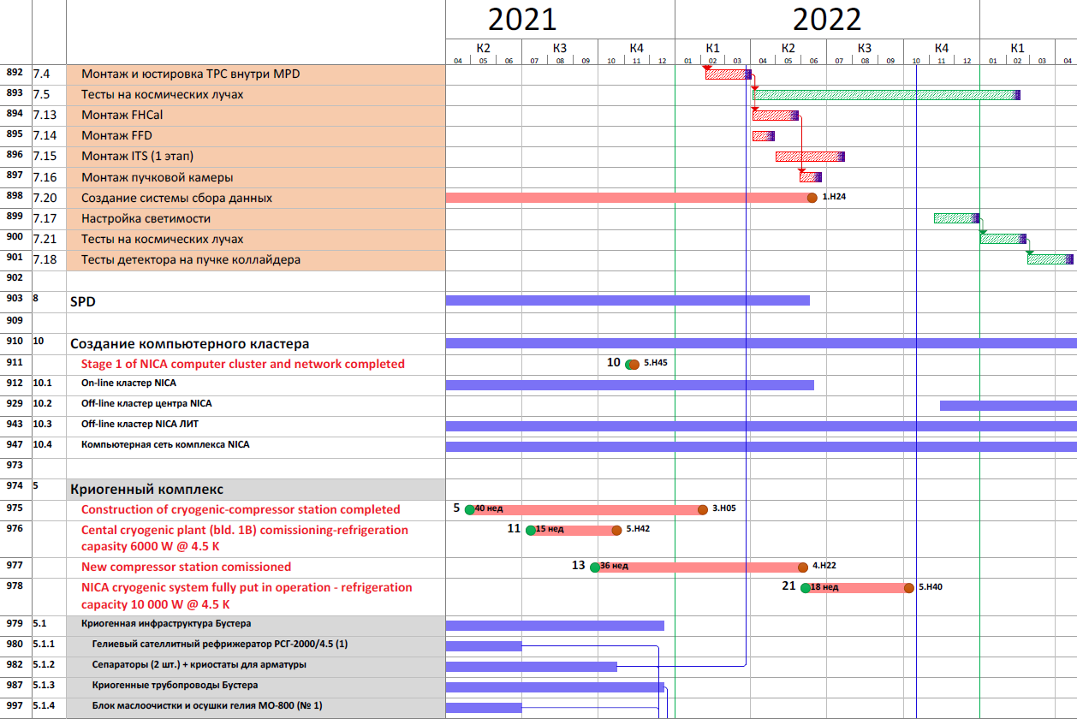
Project plan – overall level
Cryogenic infractructure

Slide 14
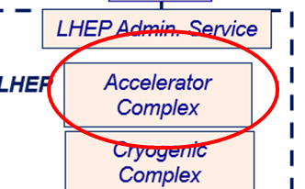
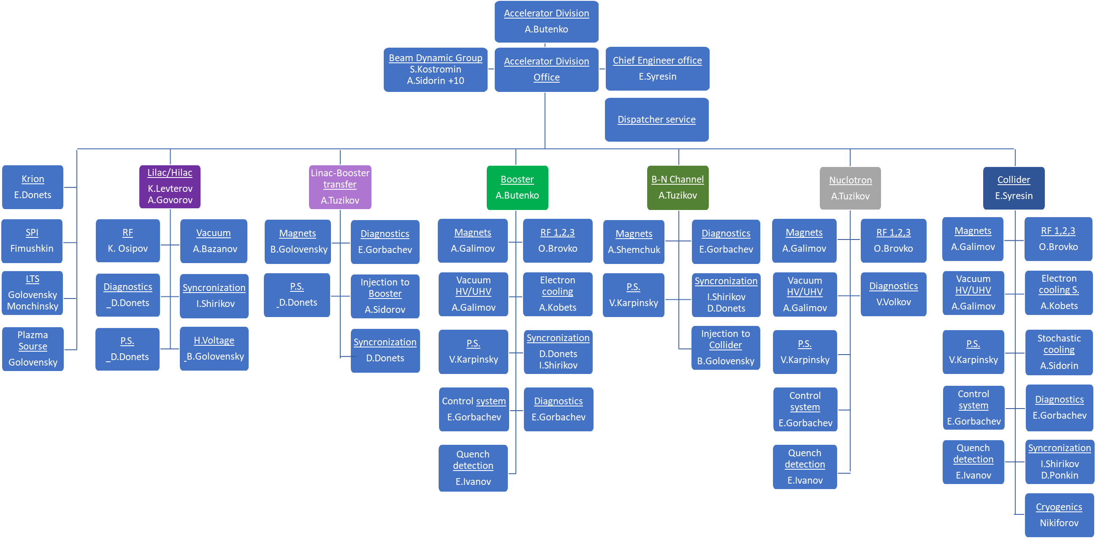
409 people for the moment

Slide 15
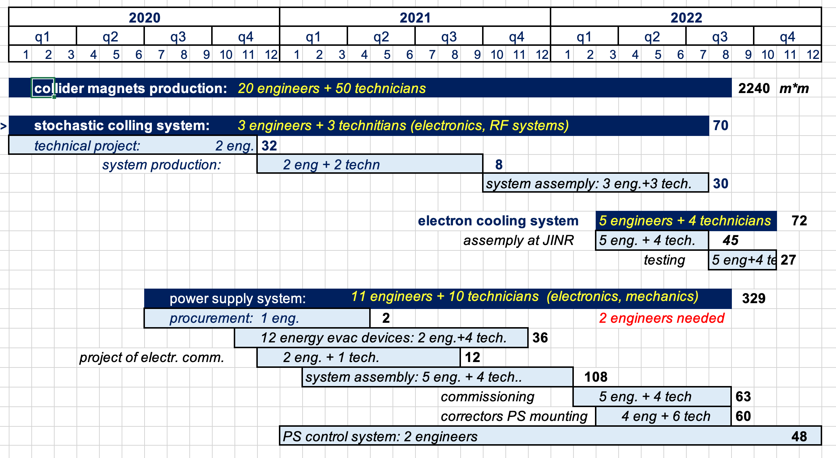
Project plan loading by HR
Manpower for construction of Collider systems in man-months
in total: 5 500 man-months
106 persons involved

Slide 16
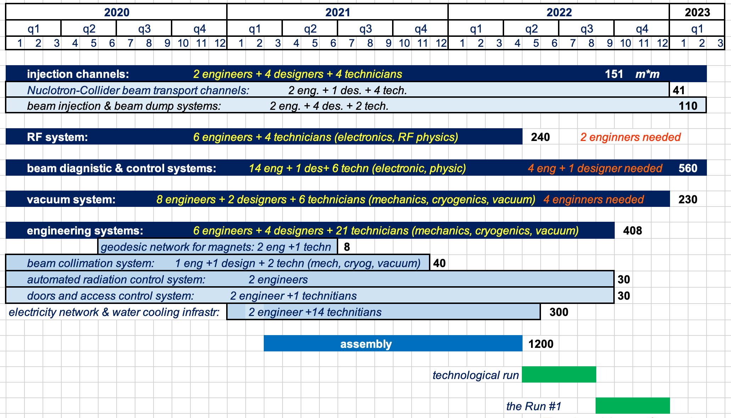
Project plan loading by HR
Manpower for construction of Collider systems in man-months
188 persons involved

Slide 17
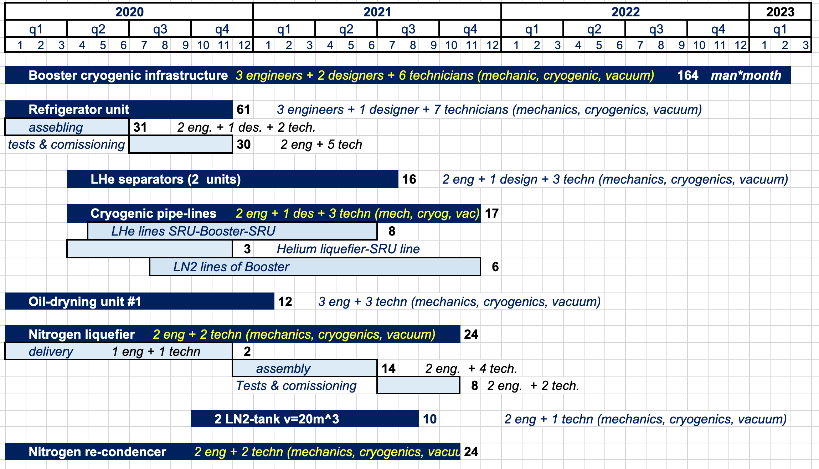
Project plan loading by HR
Manpower for cryogenic infrastructure construction in person-month
in total: 500 man-months
40 persons involved

Slide 18
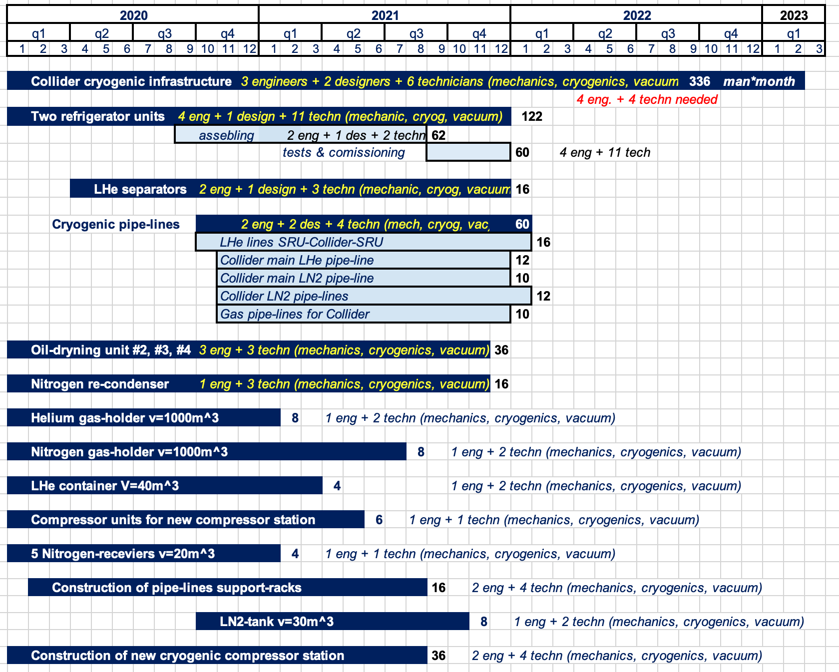
Project plan loading by HR
68 persons involved

Slide 19
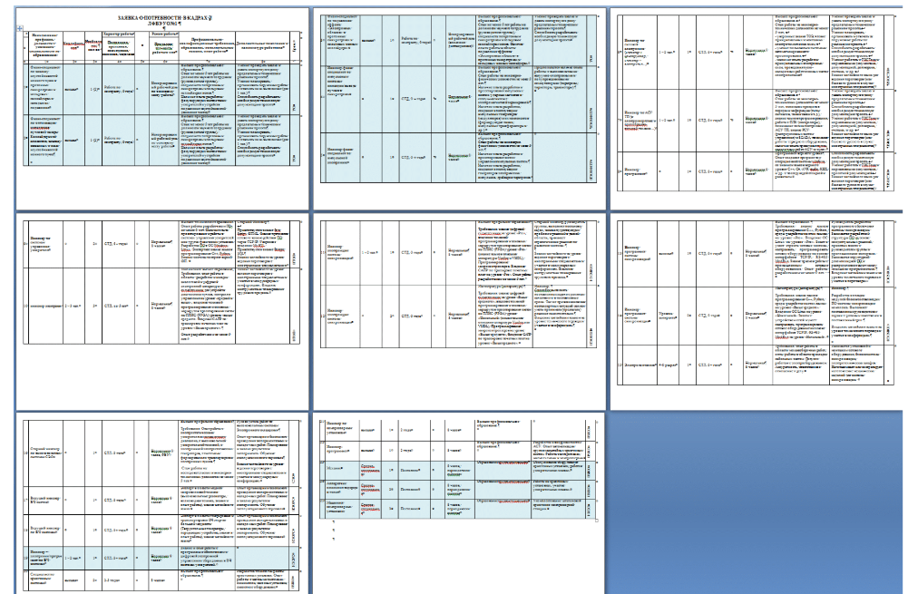
Project plan loading by HR
lack of resource in the project
List of needed personnel compiled
35(÷ 50) people needed in to accelerator division

