Slide 1
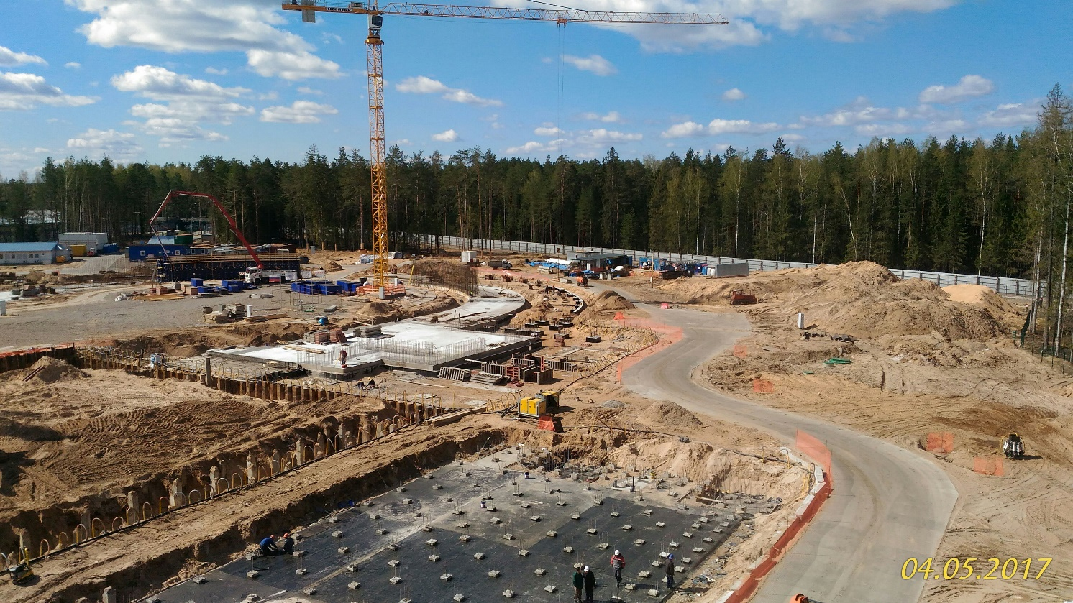
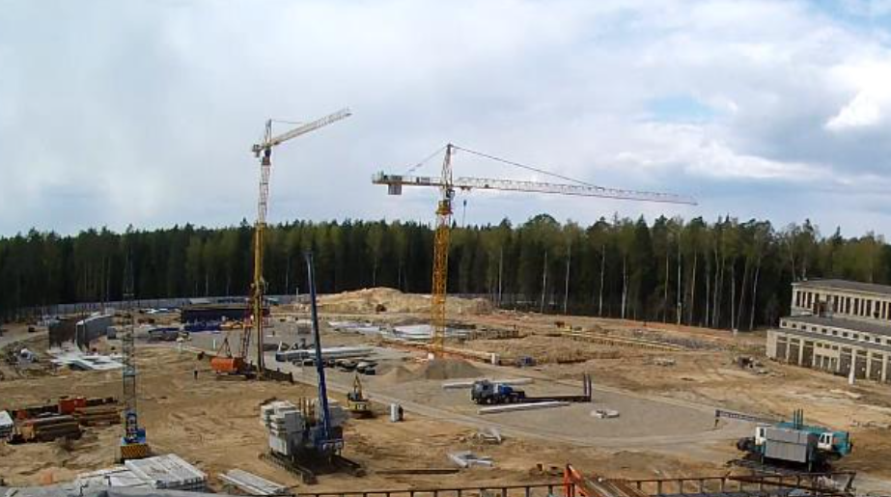


Report on the infrastructure developments, including the Nuclotron
N.N.Agapov

Slide 2

PRESENTATION OUTLINE
Main directions of the NICA infrastructure developments:
Construction of buildings
Line for assembling and cryogenic testing of SC-magnets
Water cooling systems on the base of open cooling towers
Cryogenics - liquid helium and liquid nitrogen plants
Modernization of electricity systems
Modernization of heating facilities
Reconstruction of the water pipelines, electric power networks and thermal grids

Slide 3
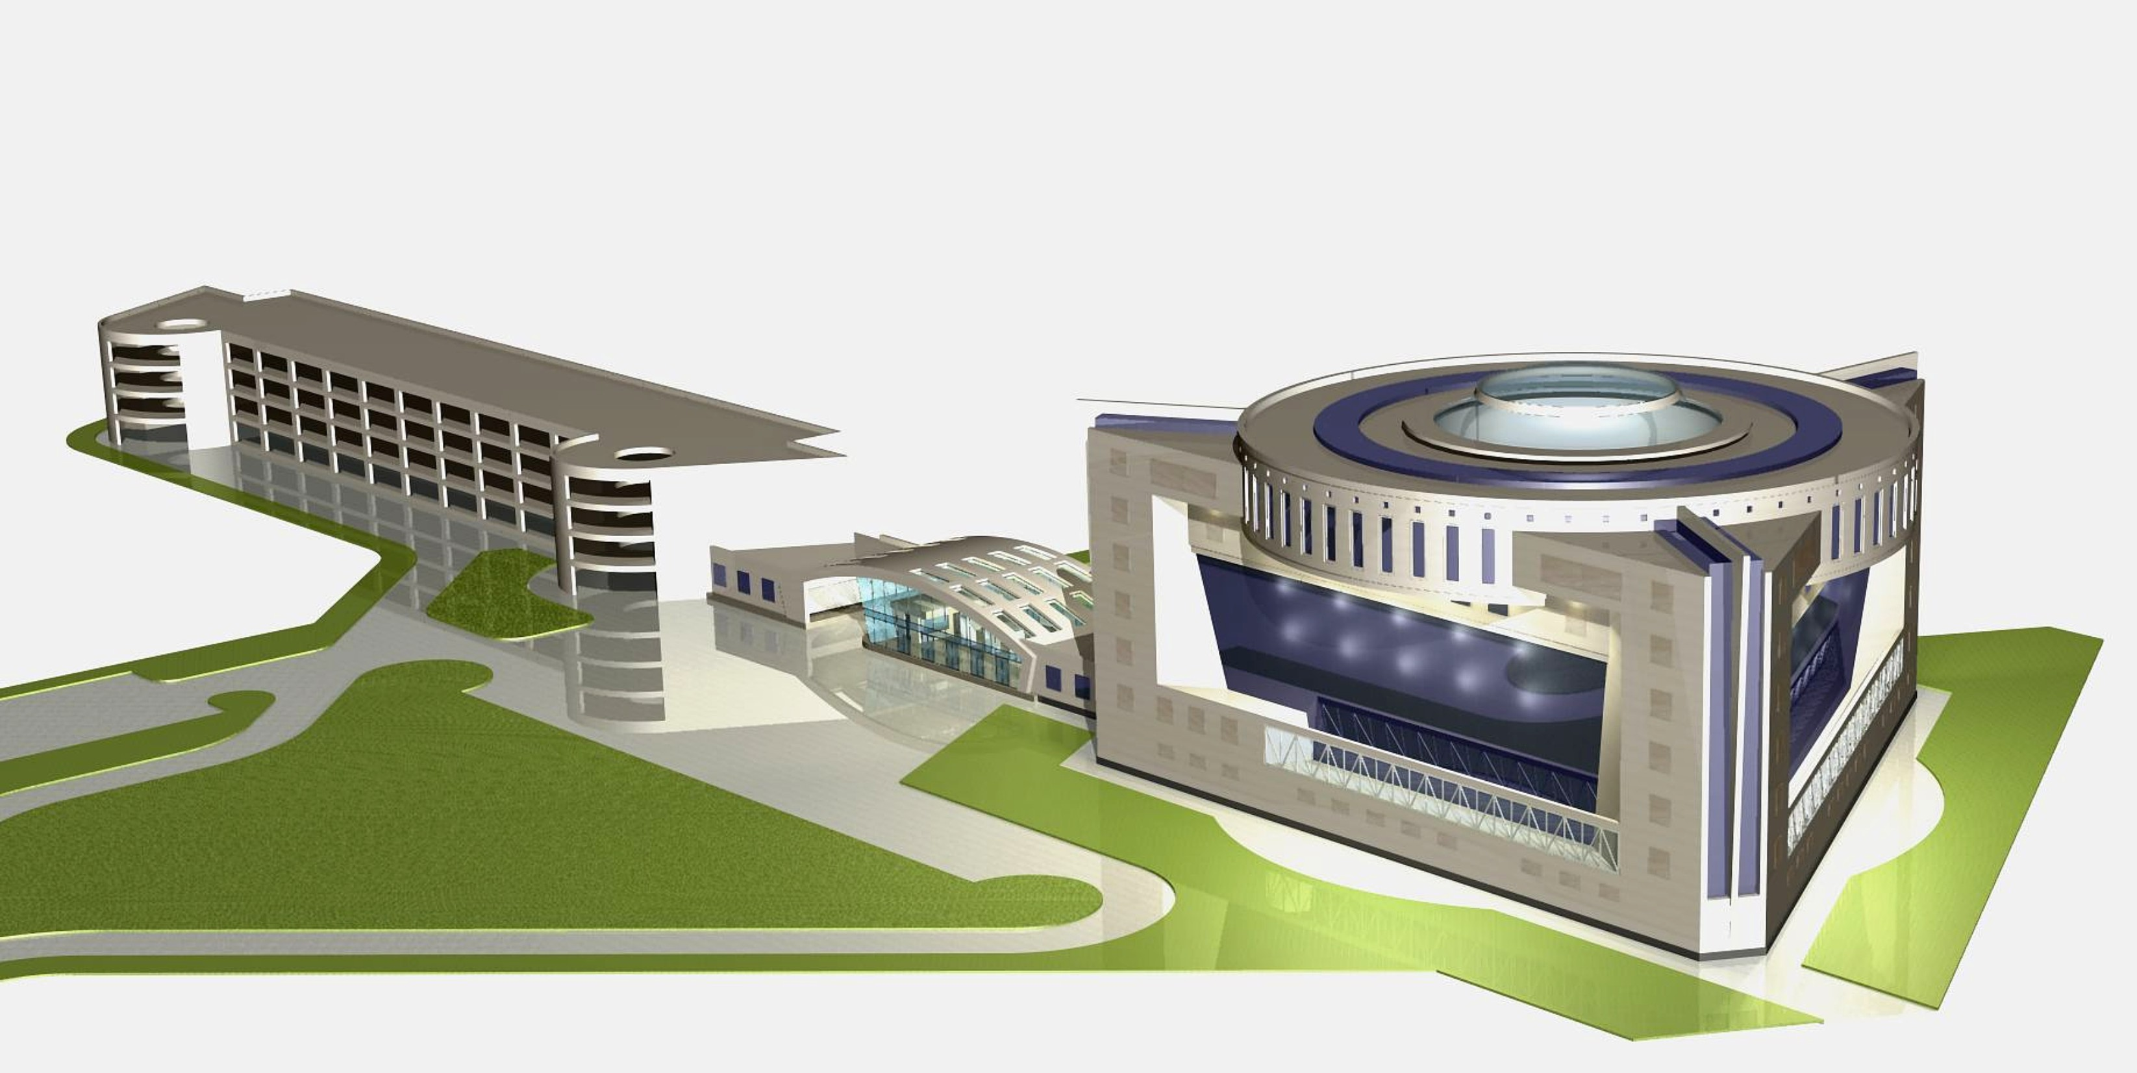
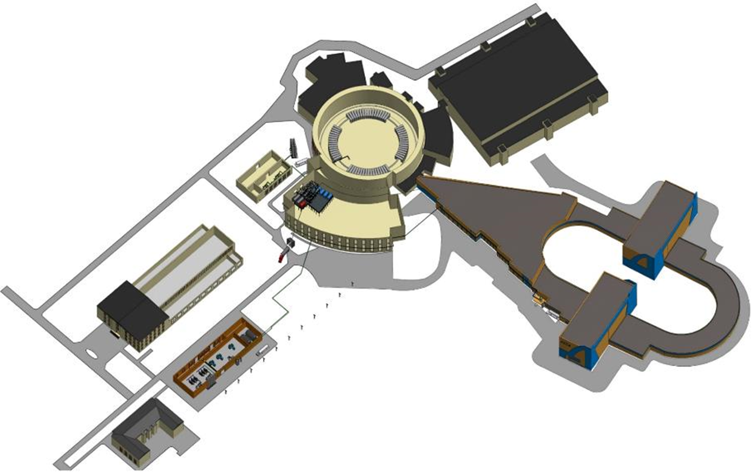

New buildings of the NICA complex
Collider building
NICA innovation center
New compressor hall building

Slide 4
Report on the construction of the collider building
December 2016:
- total number of organizations - 9
(general contractor of "Strabag" and 8 sub-contractors)
- total number of engineers and workers – 96
March – April 2016:
- total number of organizations - 8
("Strabag" and 7 sub-contractors)
- total number of engineers and workers - 154
Reinforced concrete works
Excavation and road construction
Piled work
March April

Slide 5
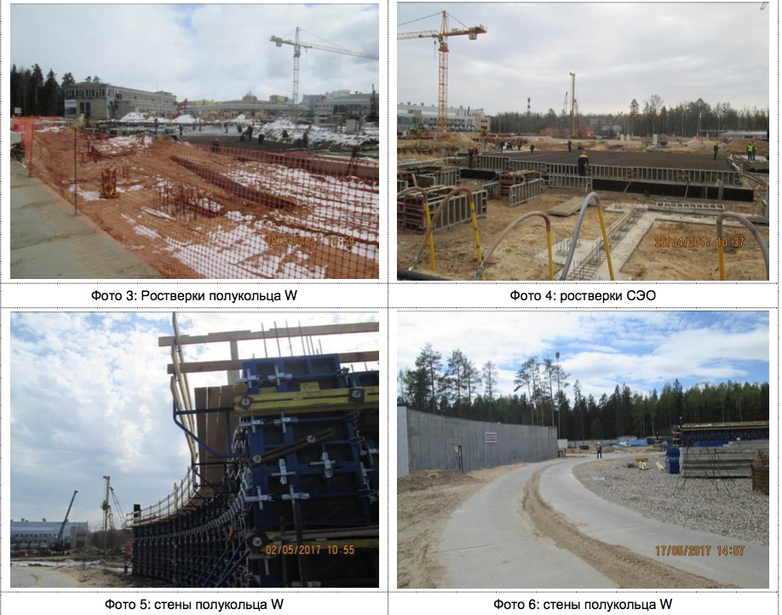
Reinforced concrete works

Slide 6
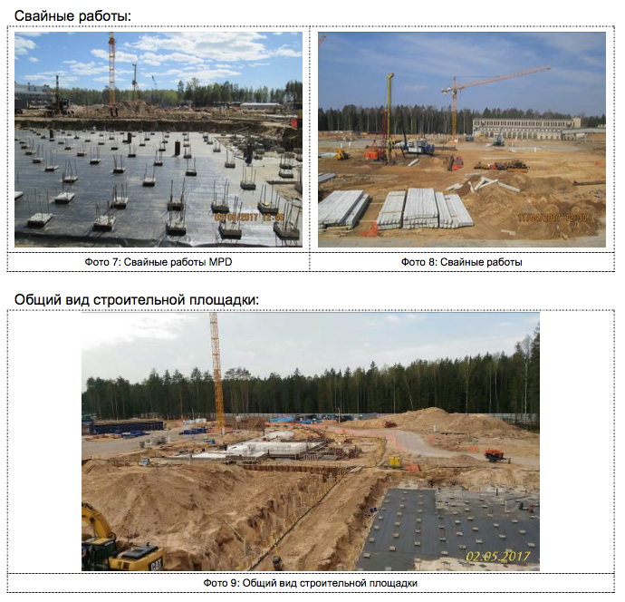
Piled work
Status 11.05.2017
Amount, PCs
 | planned | actual
W | 1409 | 1409
MPD | 841 | 823
E | 1029 | 489
SPD | 841 | 787
Add. | 847 | 4
Total | 4967 | 3512
% 100 70

Slide 7
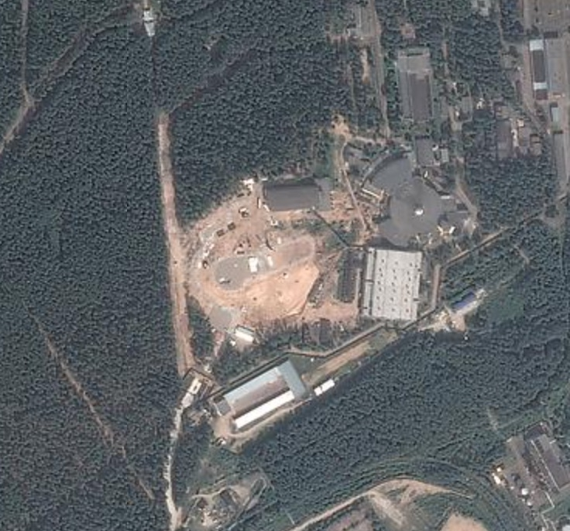
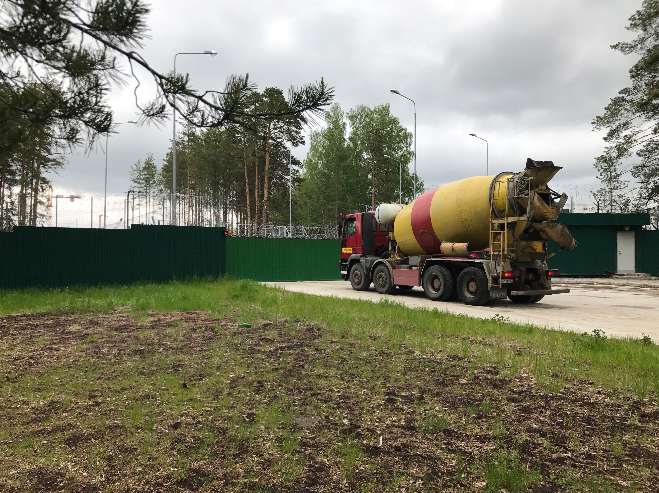
The second entrance checkpoint to the Lab now in operation с
New checkpoint

Slide 8

Existing compressor building 4,4 MW
New compressor building
9,6 MW

Slide 9
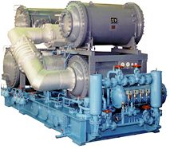
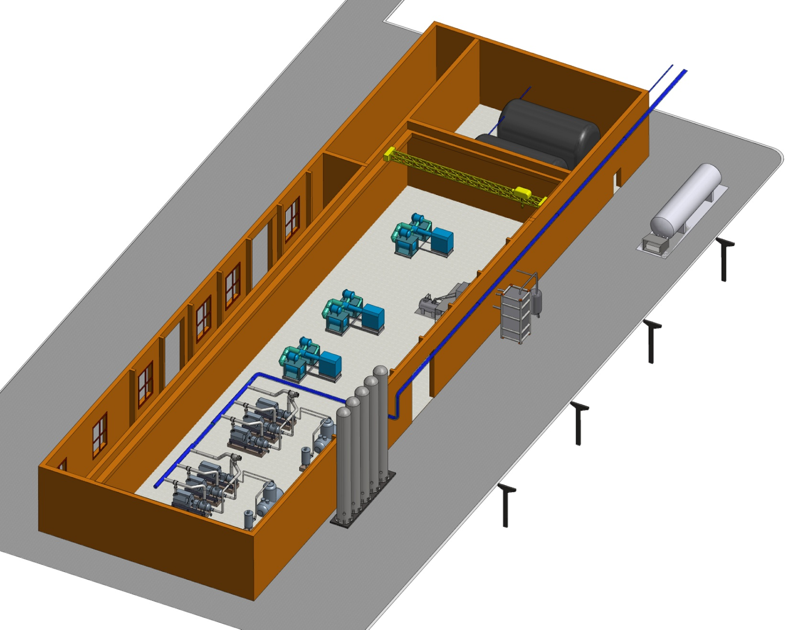
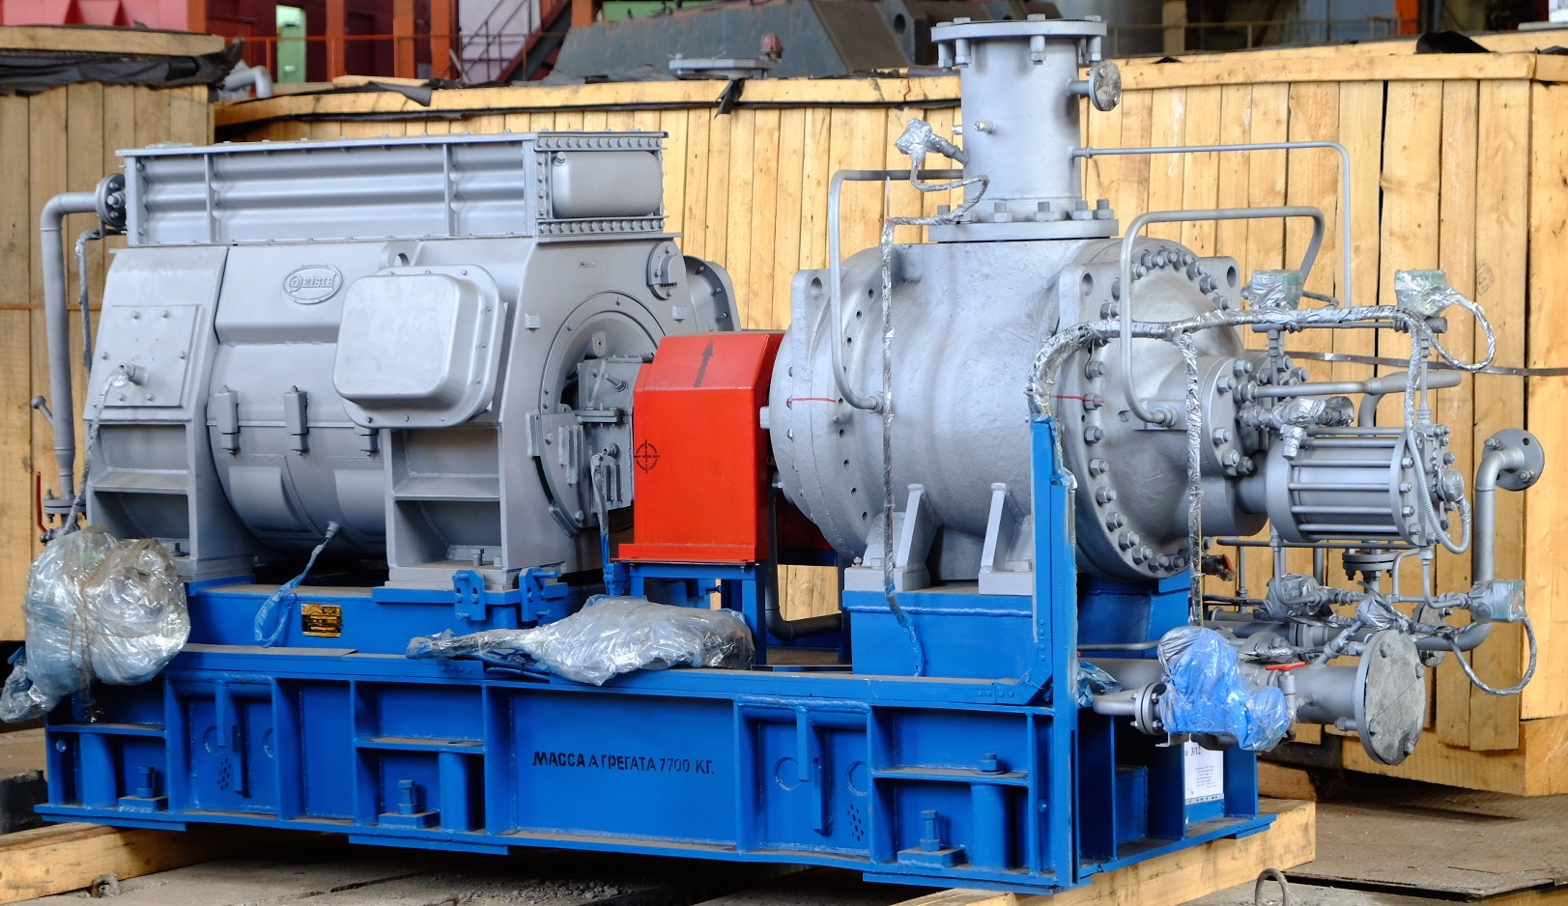
Nitrogen turbo compressors “Aerocom2-179/18” 2 units in operation, 1 in reserve
Capacity of compressor, Nm³/h | 10740
Inlet pressure, MPa | 0.102
Inlet temperature, °C | 30
Outlet pressure, MPa | 1.8
Outlet temperature, °C | 40
Temperature of cooling water, °C | 20
Installed power of electric motor, kW | 1800
200 m3 nitrogen gas bags
Helium screw compressors “Kaskad-110/30”
30 m3 LN2 reservoir with pumps
Capacity (Nm³/h) | 6600
Outlet pressure (MPa) | 3.0
Total power of electric motors (kW) | 1600
Voltage (V) | 6000
Number of compression stages | 2
Speed (rpm) | 2970
Flow rate of cooling water, m³/h | 78
1300 kg/h nitrogen liquefier
Nitrogen receivers

Slide 10
NICA innovation center

Slide 11
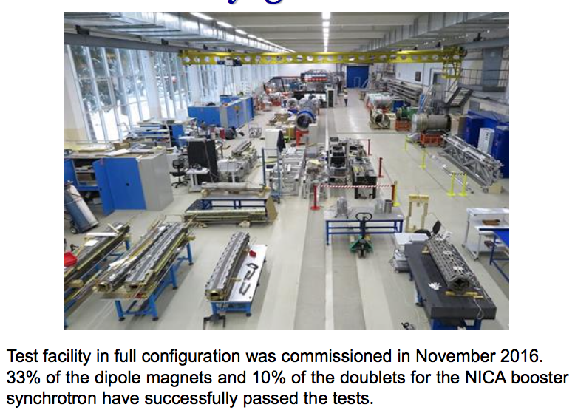
Line for assembling and cryogenic testing of SC-magnets
Main production areas:
Incoming inspection zone
SC cable production hall
SC coils production hall
Area for assembling the magnets
Area for the magnetic measurements under the room temperature
Leakage test area
Area for mounting the SC-magnets inside cryostats
Cryogenic tests bench

Slide 12
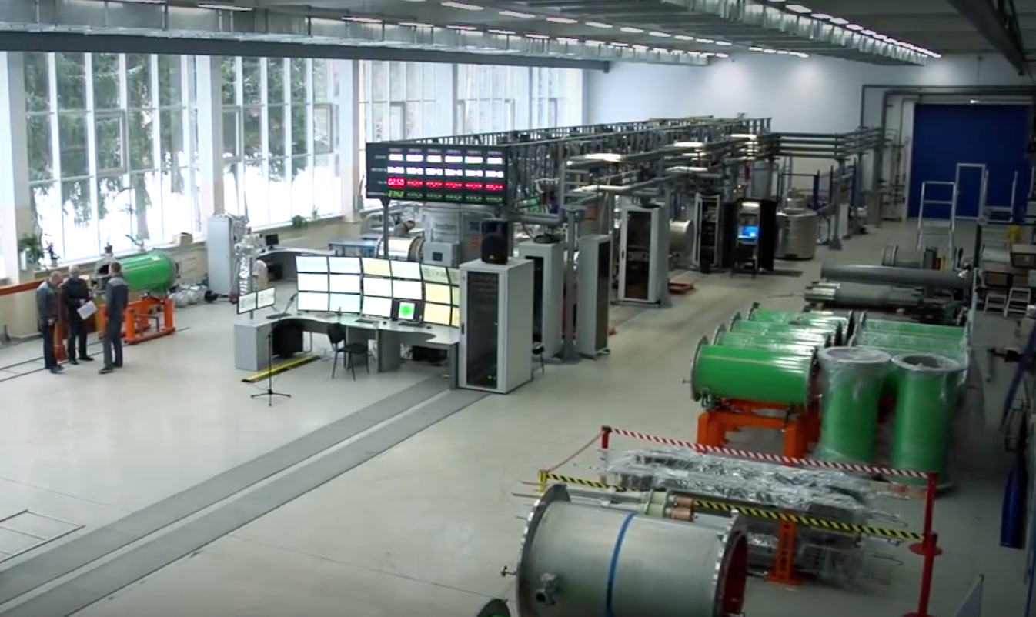
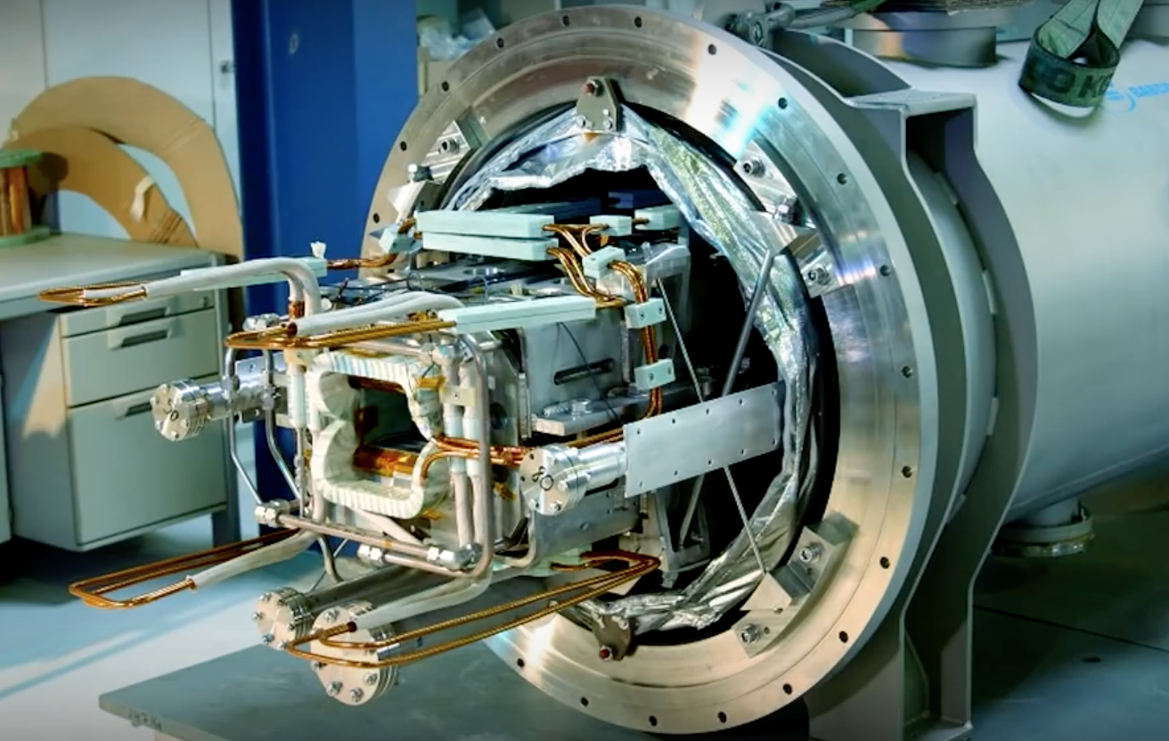
Production plans
40 dipole magnets for NICA Booster
48 quadrupole magnets with multipole correctors for NICA Booster
80 dipole magnets for NICA Collider
86 quadrupole magnets with multipole correctors for NICA Collider
175 quadrupole magnets with multipole correctors for SIS100 synchrotron (FAIR project)
Total 429

Slide 13
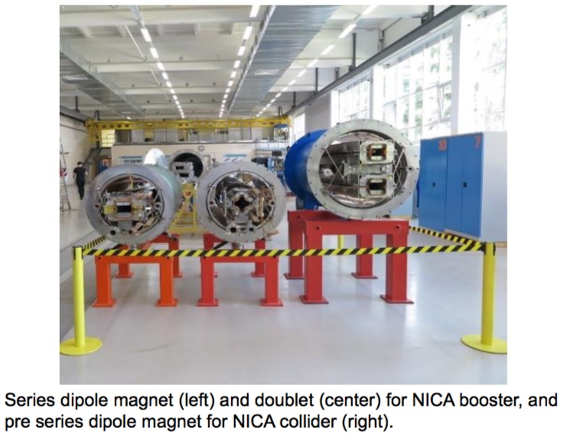
Line for assembling and cryogenic testing of SC-magnets

Slide 14
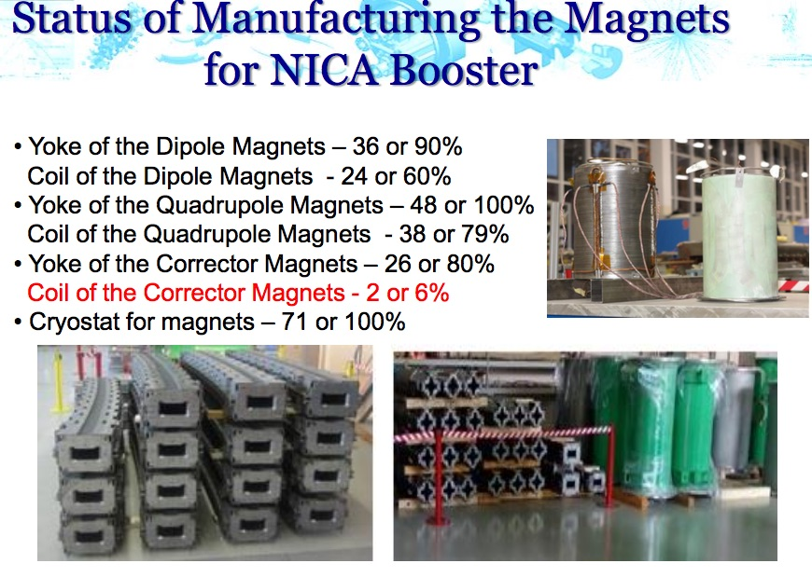
 | PCs | %%
Yoke of dipole magnets | 36 | 90
quadruple magnets | 48 | 100
corrector magnets | 26 | 80
Coil of dipole magnets | 24 | 60
quadruple magnets | 38 | 79
corrector magnets | 2 | 6
Cryostats | 71 | 100

Slide 15
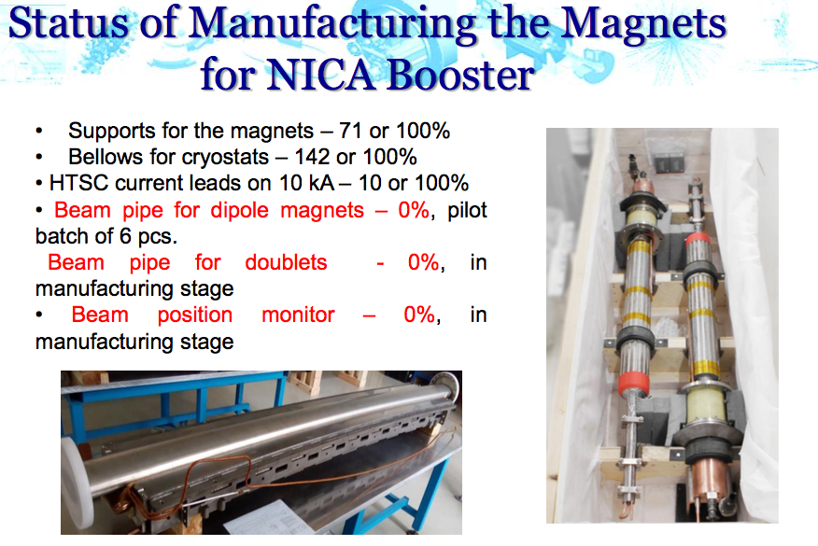
 | PCs | %%
Supports for the magnets | 71 | 100
Bellows for cryostats | 48 | 100
HTSC current leads (10 kA) | 10 | 100
Beam pipes for dipoles (pilot units of 6 PCs) | 0 | 0
Beam pipes quadruples (in manufacturing stage) | 0 | 0
Beam position monitor (in manufacturing stage) | 0 | 0

Slide 16
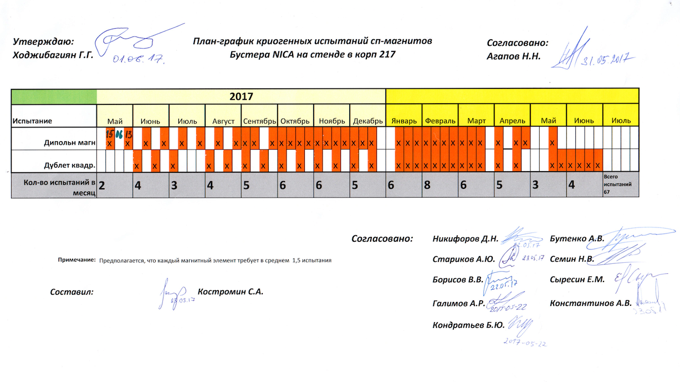
Schedule cryogenic test of superconducting magnets of the booster

Slide 17
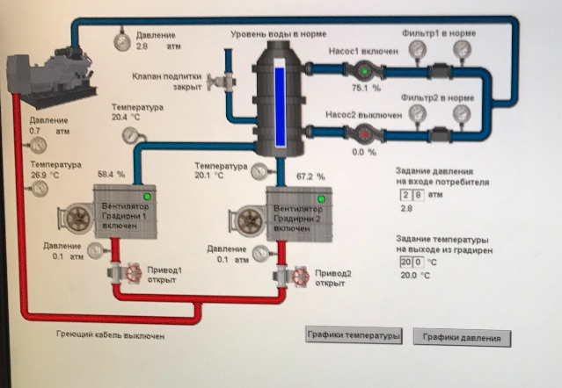
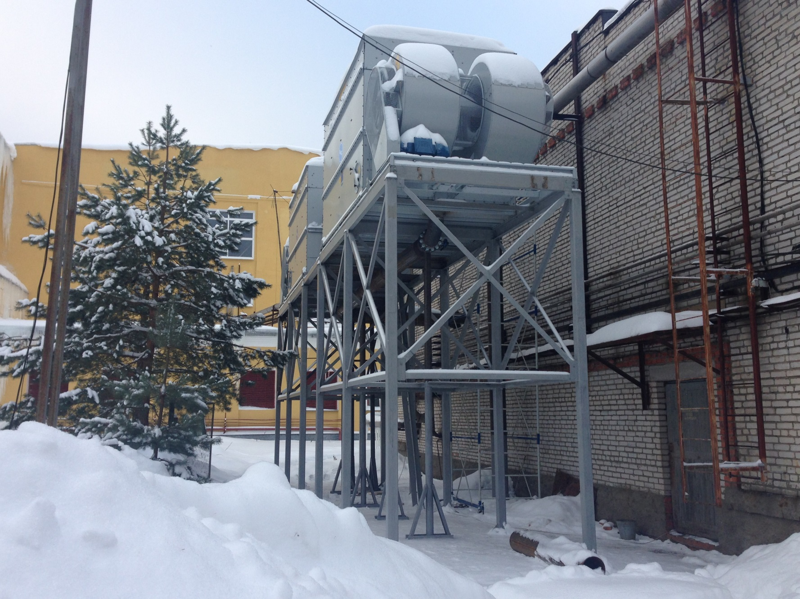
Water chilling systems on the base of cooling towers
Commissioning of the circulating water supply system for the Nuclotron compressor hall is finished, and it operates automatically.

Slide 18
Main results and plans for magnet production
Booster
Serial production of the magnets has been started
One third of the dipoles successfully has passed cryogenic tests
Ending of the “cold” tests is planned for middle of 2018
Collider
Cryogenic test of the pre-production dipole magnet is starting now
Pilot units of six cryostats for dipole magnets have been manufactured
Manufacturing of 350 bellows for cryostats is scheduled for 2017
300 km of SC wire for collider magnets will be delivered very soon to the Lab
380 tons of electrical steel for the magnet yokes have been ordered
Serial production of the magnets will be started on the second half of 2017
SIS100
Two SIS100 FoS units have been assembled and prepared for cryogenic tests
Serial production of SIS100 magnets will be started in November 2017

Slide 19
Cryogenics of the NICA accelerator complex
Nuclotron
Booster
Green-delivered
White-finishing 2017
Blue-designed
Red-design is continuing
500 kg/h nitrogen re-condenser RA-0.5 of the Nuclotron and booster
draining and oil-purification units MO-800
two satellite refrigerators
of the collider
1000 l/h helium liquefier OG-1000
satellite refrigerator
of the booster
2x6600 Nm³/h helium screw compressors
40 m³ liquid helium tank
1300 kg/h nitrogen liquefier OA-1.3
Collider
3x10740 Nm³/h nitrogen turbo compressors
500 kg/h nitrogen re-condenser RA-0.5 of the collider

Slide 20
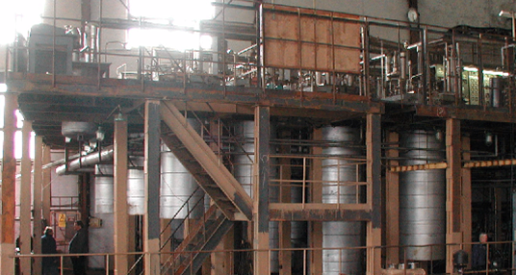
Existing liquid helium plant

Slide 21
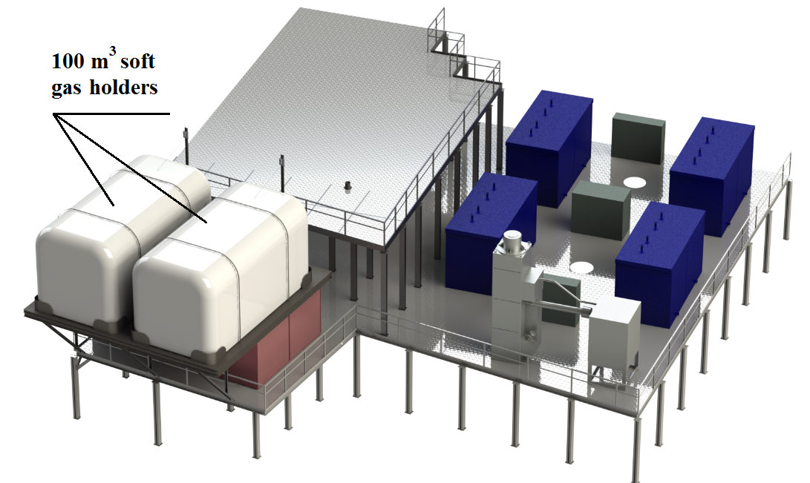
New equipment on the central cryogenic station
Existing liquid helium plant
100 m3 gas holders
100 m3 gas holders
100 m3 gas holders
100 m3 gas holders
Draining and oil purification units
100 m3 gas holders
100 m3 gas holders
Liquid nitrogen
re-condenser

Slide 22
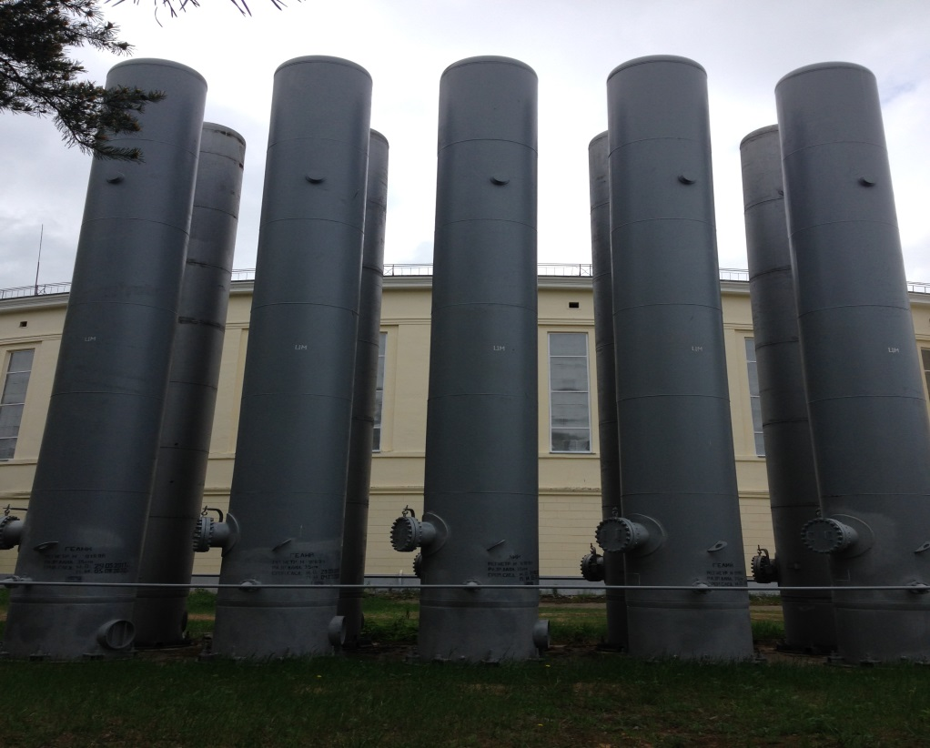
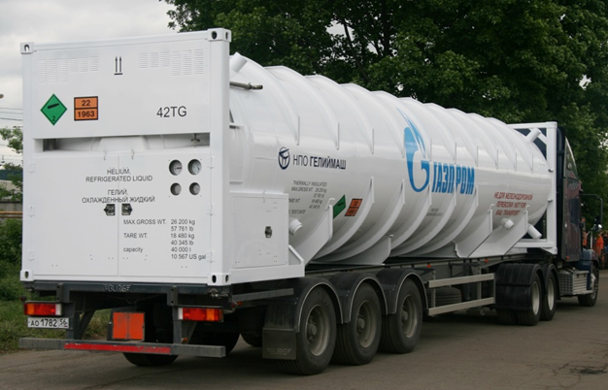
Storage System of Helium
20 m³ compressed-gas reservoirs
40 m³ liquid helium reservoir
Purchase of the 40 m³ liquid helium reservoir will solve several problems at once:
to increase capacity of the existing equipment for storage of helium by more than 4 times;
to provide a cost-effective delivery of helium from the manufacturer by own transport;
to have an additional source of cold for smoothing of the emergency situations arising at the accelerator complex.

Slide 23
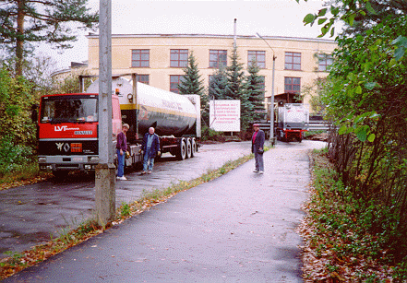
Large scale production of liquid helium
40 m3 containers of liquid helium before sending it to "Air Products" and "BOC” (1993).
The annual rate of supply of liquid helium in 1993-94 was increased to 1 million liters

Slide 24
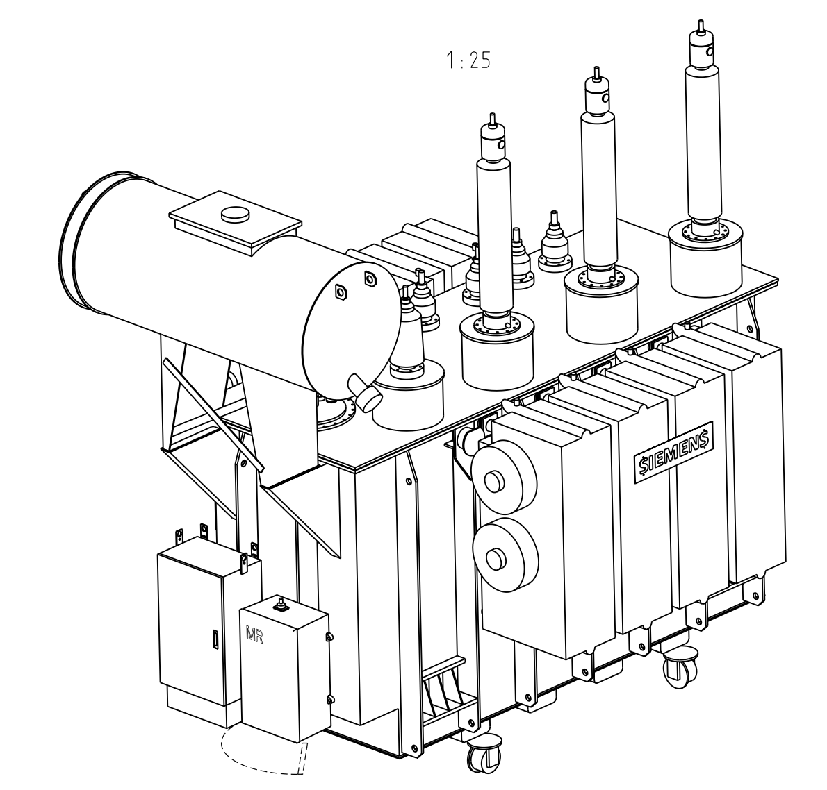
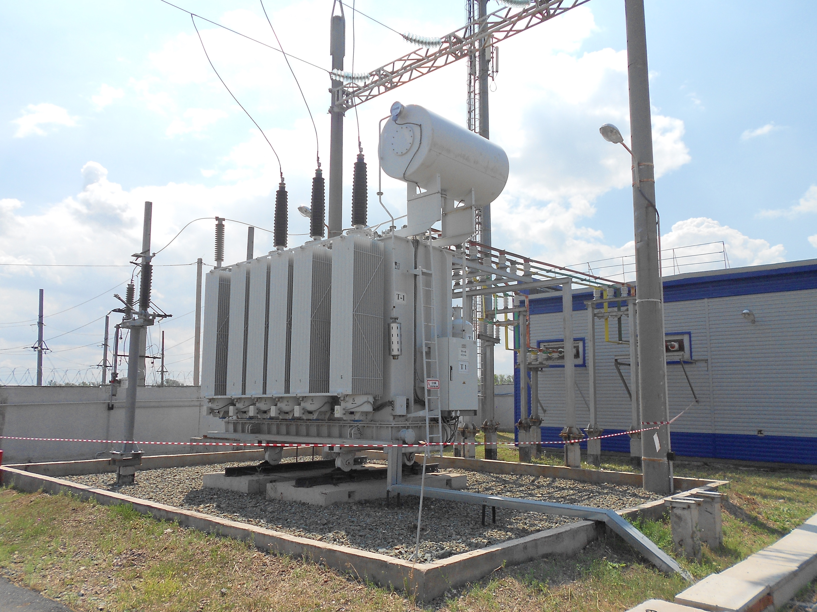
JSC "Siemens Transformers" (Voronezh, Russia)
Rated power 40 MVA
Maximum rated voltage 126 kV
Total mass with oil 52 t
Mass of oil 11 t
Shipping weight 45 t
Dimensions 5.5x3.5x5.0 m

Slide 25
Power distribution of the transformer station
 | Users | Power, MW
1 | Booster | 1.6
2 | Collider | 9.0
3 | New compressor hall | 9.6
4 | Computer cluster | 1.0
5 | Nuclotron | 1.4
6 | Channels of the bld. 205 | 1.6
7 | Facility for assembling and cryogenic tests of the SP magnets bld. 217 | 1.1
8 | Lab’s infrastructure | 4.4
9 | Eastern thermal station | 0.8
10 | Centre of innovative developments | 1.8
11 | Dubna city users | 8.5
 | TOTAL | 40.8

Slide 26
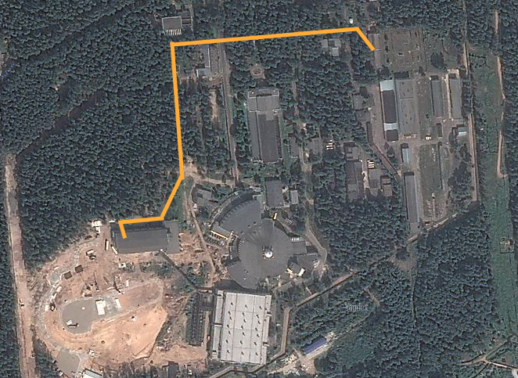
Construction of two parallel 6 kV cable lines from the Main power transformer station (110/6 kV) to Substation 13 is fully completed.
Main power transformer station (110/6 kV)
Much of the equipment at the main power transformer station (110/6 kV) and substation 13 has been reconstructed.
Now comes the commissioning.
Along with the future reconstruction of the substation 15, this will ensure future reliable supply of electricity for Collider, MPD and SPD.
Substation 13
6 kV cable lines
Substation 15

Slide 27
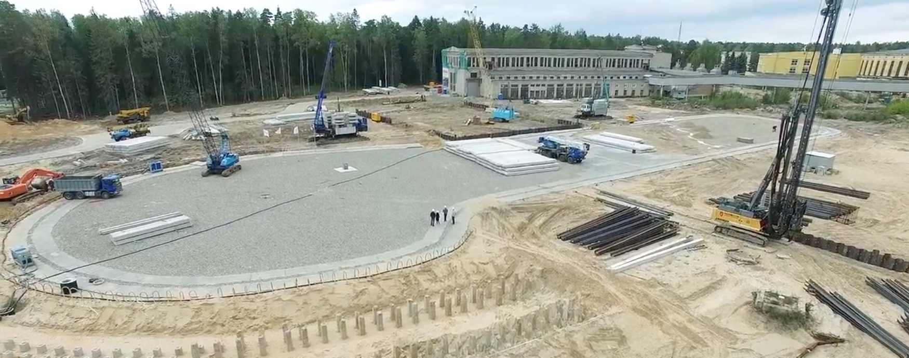
Thank you for your attention!

