Slide 1
Progress towards the realization
of the MPD project
Within the JINR theme 02-0-1065-2007/2019
Vadim Kolesnikov
(VBLHEP)
On behalf of the MPD team
Programme Advisory Committee for Particle Physics
47th Meeting
June 26, 2017

Slide 2
Outline
Introduction
Progress in MPD project realization:
Status of the MPD TDRs
Preparation for mass-production
Progress in MPD simulation: MPD-NICA interface
Conclusions

Slide 3
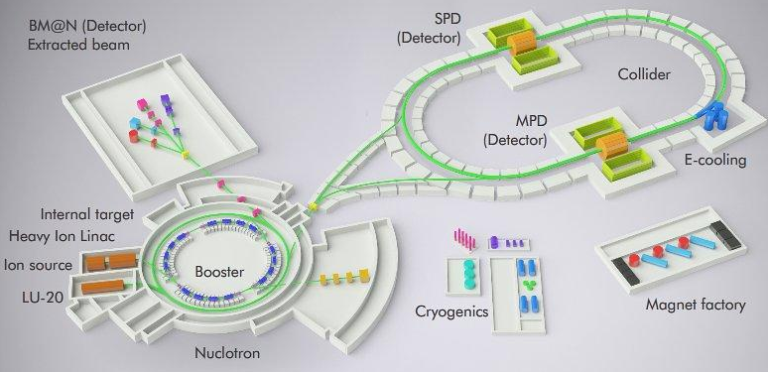
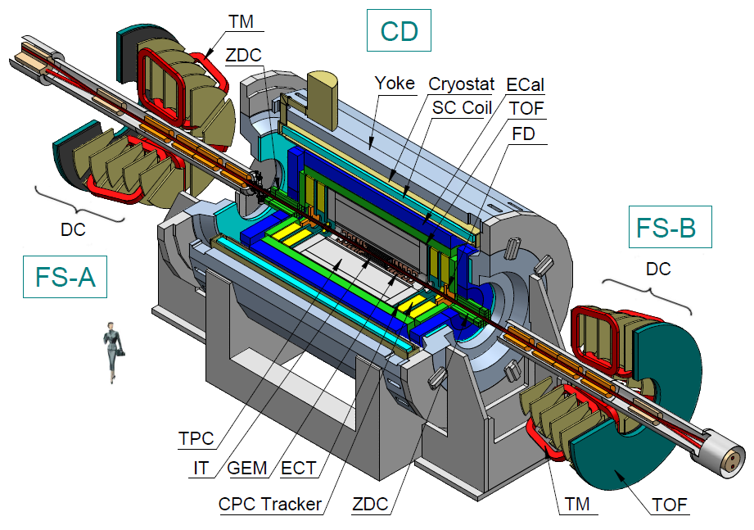
NICA Complex
Beams – p,d(h)..¹⁹⁷Au⁷⁹⁺
Collision energy (collider) – 4-11 GeV
(fixed target) - 1-6A GeV
Luminosity: 10²⁷ cm⁻²s⁻¹(Au), 10³² (p)
Experiments:
2 Interaction points – MPD and SPD
Fixed target experiment BM@N
MPD
The general contractor STRABAG

Slide 4
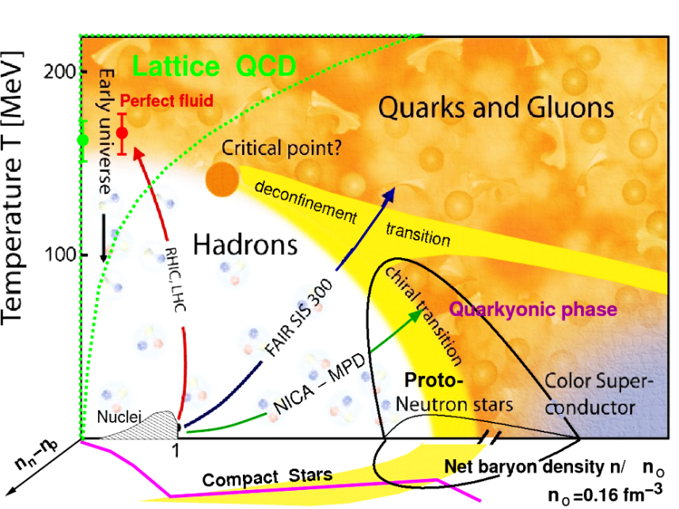
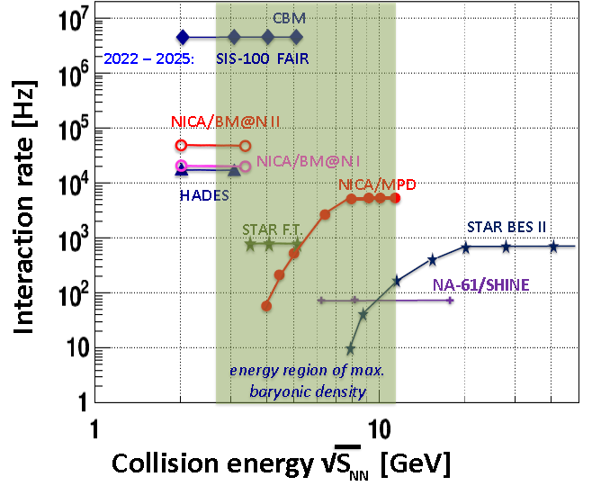
NICA-MPD heavy-ion program
Eur. Phys. J. A, 52 8 (2016) - NICA White Paper
RHIC-BES
Bulk properties, EOS
- particle yields & spectra, ratios, femtoscopy, flow
In-Medium modification of hadron properties
- onset of low-mass dilepton enhancement
Deconfinement (chiral) phase transition at high ρ_{B}
- enhanced strangeness production
- Chiral Magnetic (Votical) effect, Λ polarization
QCD Critical Point
- event-by-event fluctuations & correlations
Y-N interactions in dense nuclear matter
- hypernuclei
NICA
BM&N
QCD matter at NICA :
Highest net baryon density = 4-11A GeV
Energy range brackets onset of deconfinement
Complementary to the RHIC/BES, FAIR,
and CERN experimental programs

Slide 5
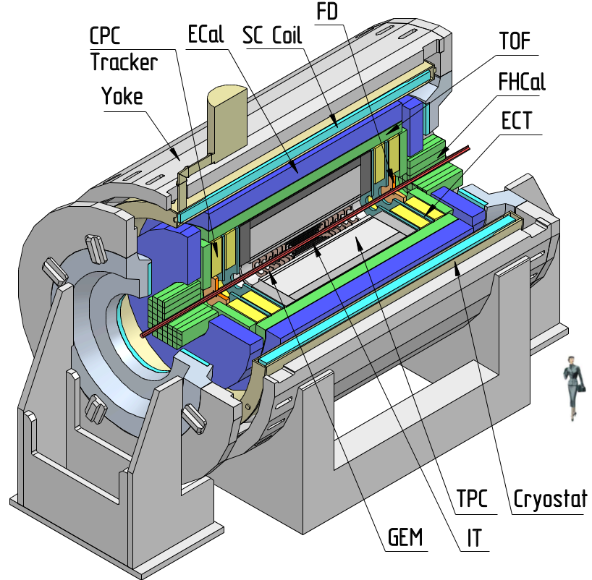
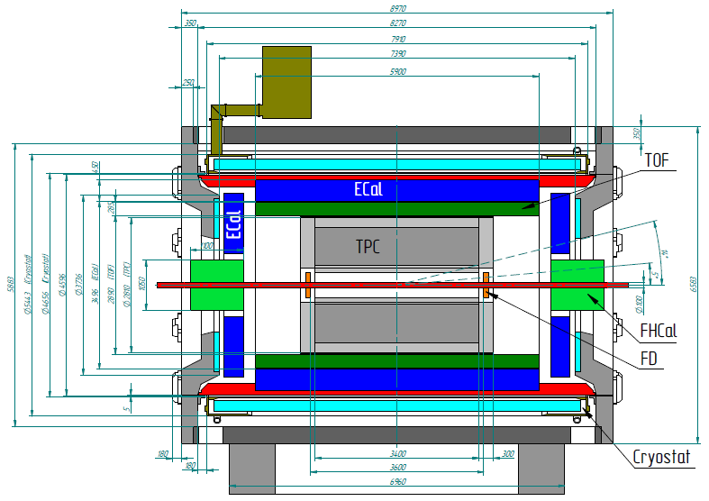
MultiPurpose Detector for A+A collisions @ NICA
Uniform acceptance, 2π in azimuth
3D tracking (TPC, ECT)
High resolution vertexing (IT)
Powerful PID (TPC, TOF, ECAL)
- π/K up to 1.5 GeV/c,
- K/p up to 3 GeV/c,
- γ, e : 0.1<p<3 GeV/c
Precise event characterization (FHCAL)
Fast timing and triggering (FFD)
Low material budget
High event rate (up to ~ 7 kHz)
Stage’1 setup
  I stage (barrel) – 2020
    upgraded (IT + endcaps) – 2023

Slide 6
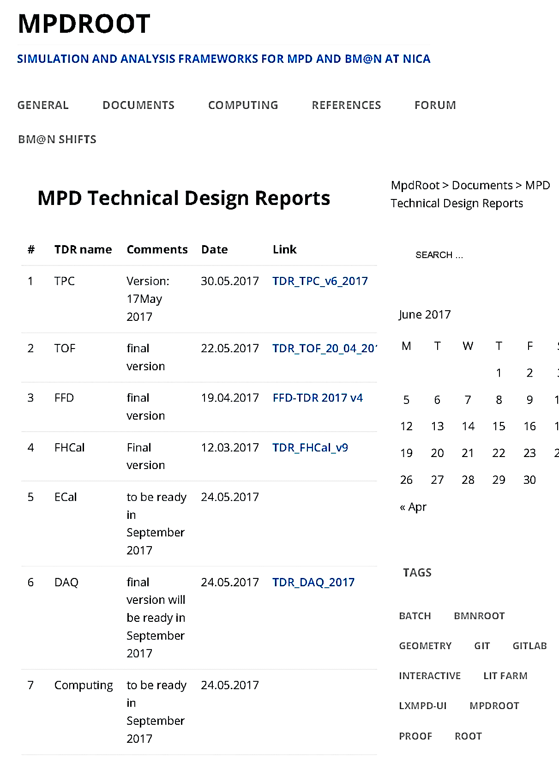
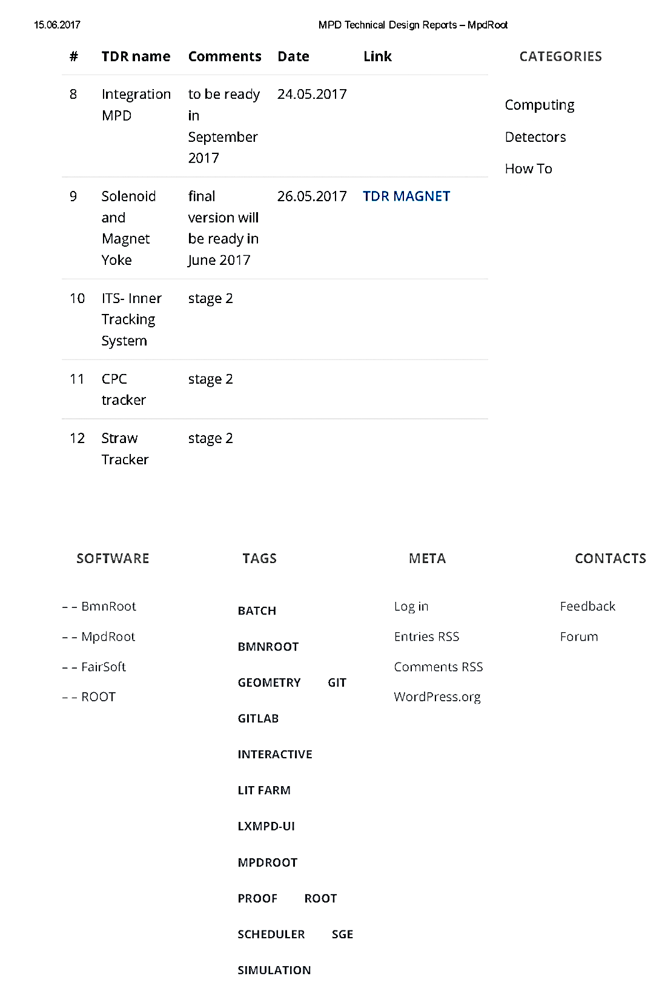
http://mpd.jinr.ru/doc/mpd-tdr/

Slide 7
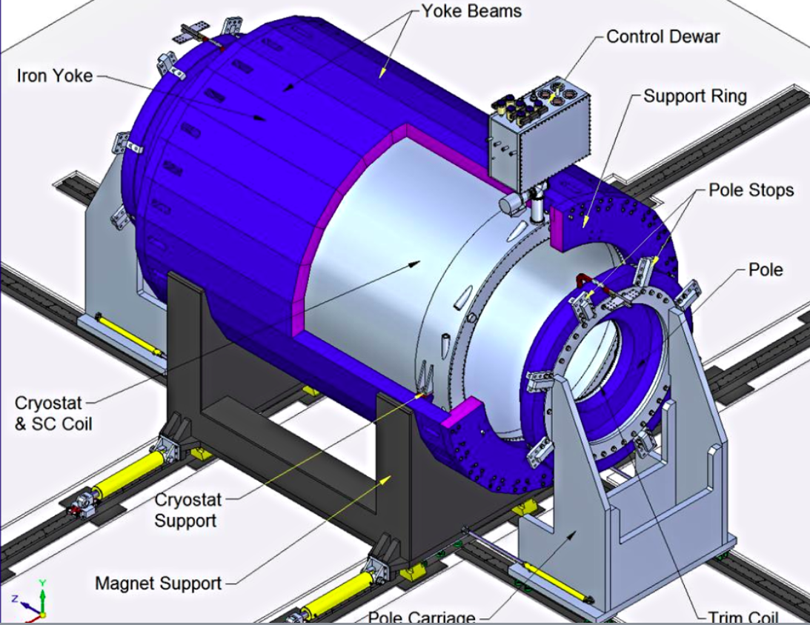
MPD superconducting solenoid
B₀=0.5 T
weight ~ 900 t
inhomogeneity of the
magnetic field ~ 3.10⁻⁴
Progress in 2017
Working documentation & TDR preparation
Solenoid and yoke manufacturing:
- SC cable – ordered, under manufacturing
- Copper conductor for the trim coils – delivered
to the supplier’s site
- Aluminum support cylinder blanks for SC coil - ready
- Winding machines for SC solenoid and
for trim coils – in operation
- Cryogenic helium refrigerator – designed and ordered
- Magnet yoke - ~80% ready, control assembling in 2017
MPD Solenoid production stages
Manufacturing Jan. 2016-Aug. 2018
Final Solenoid tests by AGS Jun. 2018
Packaging and Transportation Apr. 2018-Oct. 2018
Assembly at JINR, tests Oct. 2018-Apr. 2019
ASG superconductors (Genova, Italy): General responsibility

Slide 8
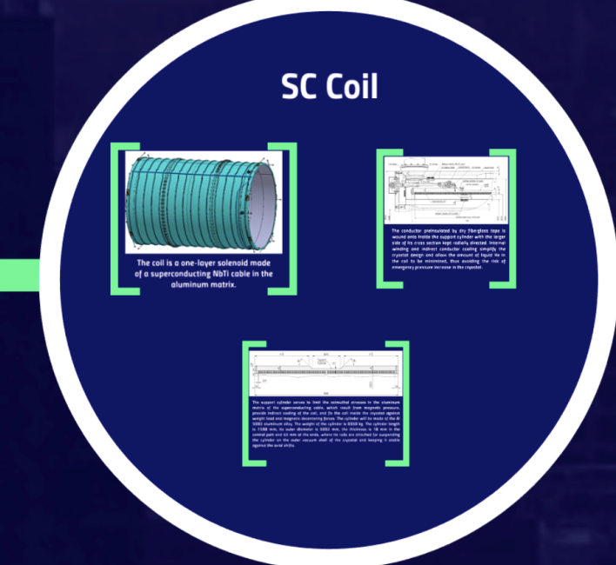
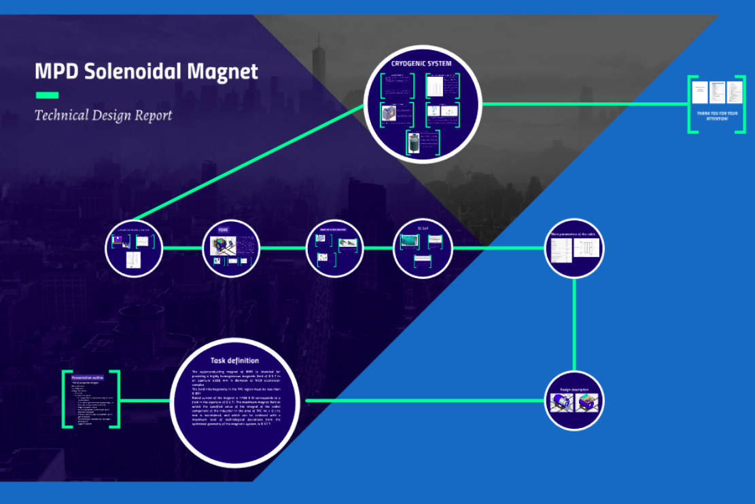
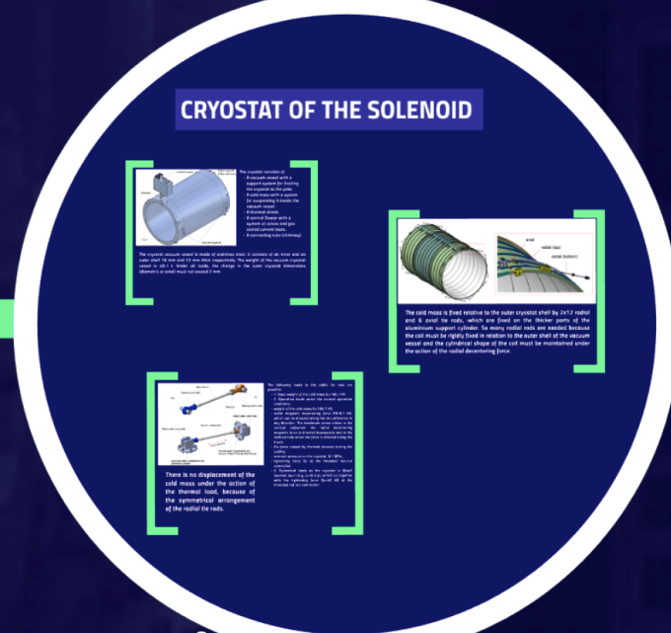
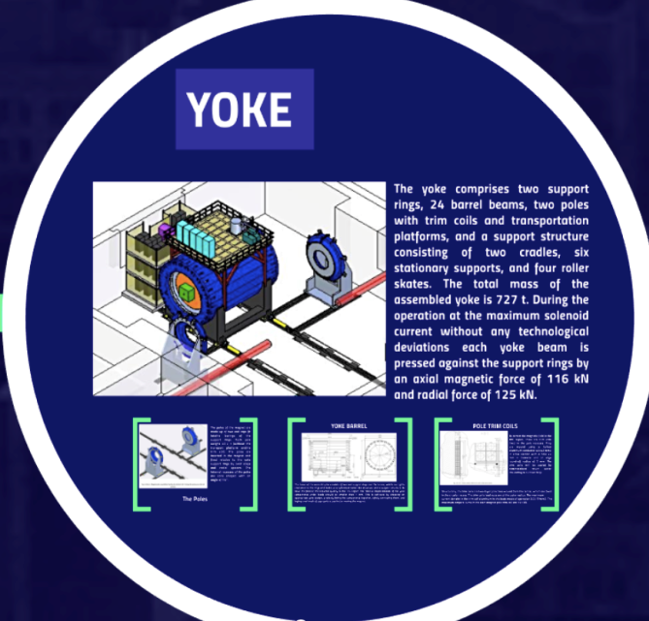
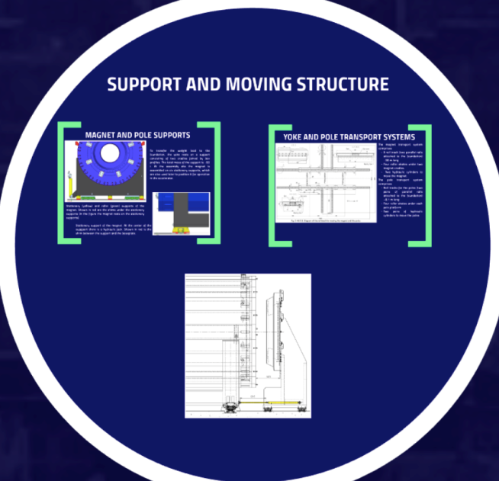

MPD Magnet : TDR
http://mpd.jinr.ru/doc/mpd-tdr

Slide 9
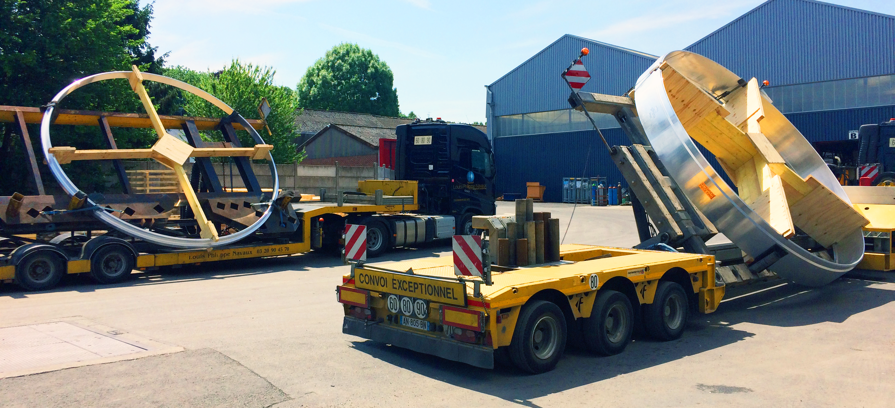
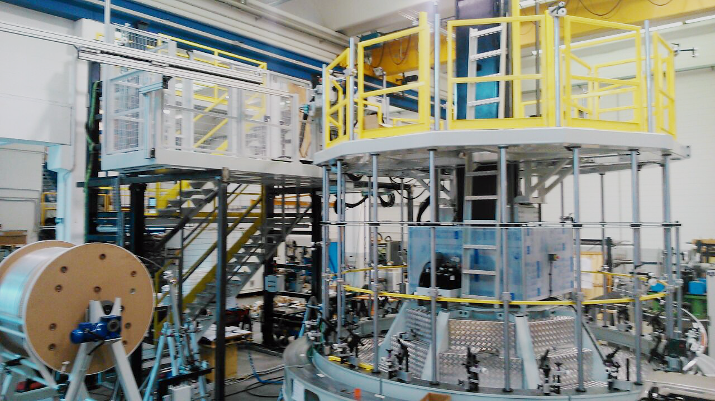
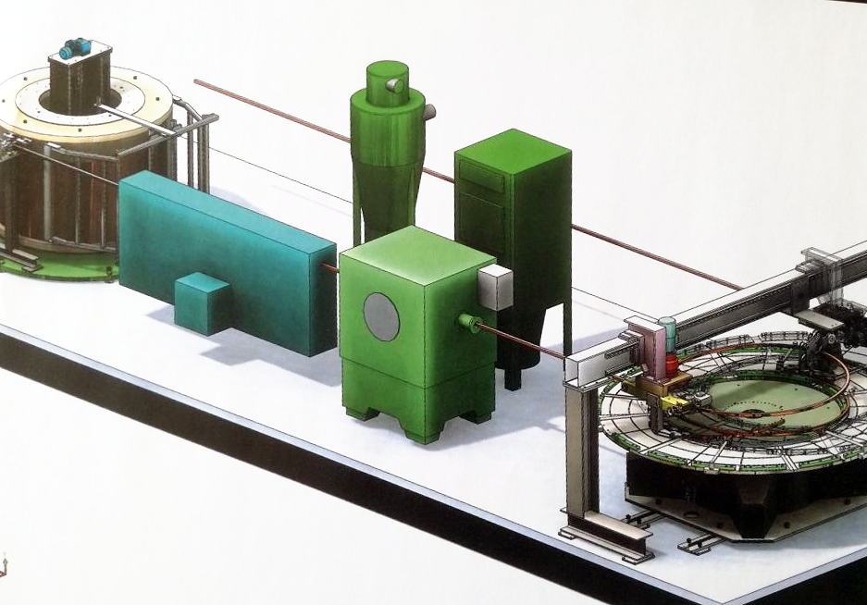
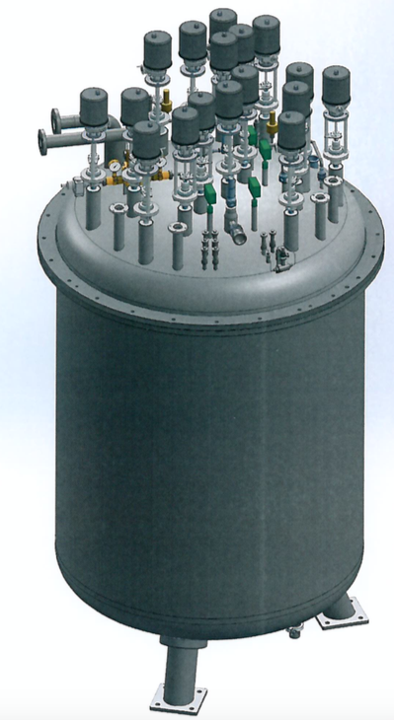
MPD Solenoid: progress in 2017
Aluminum support cylinder blanks
for SC coil during transportation
Winding machine for SC solenoid
MPD helium refrigerator

Slide 10
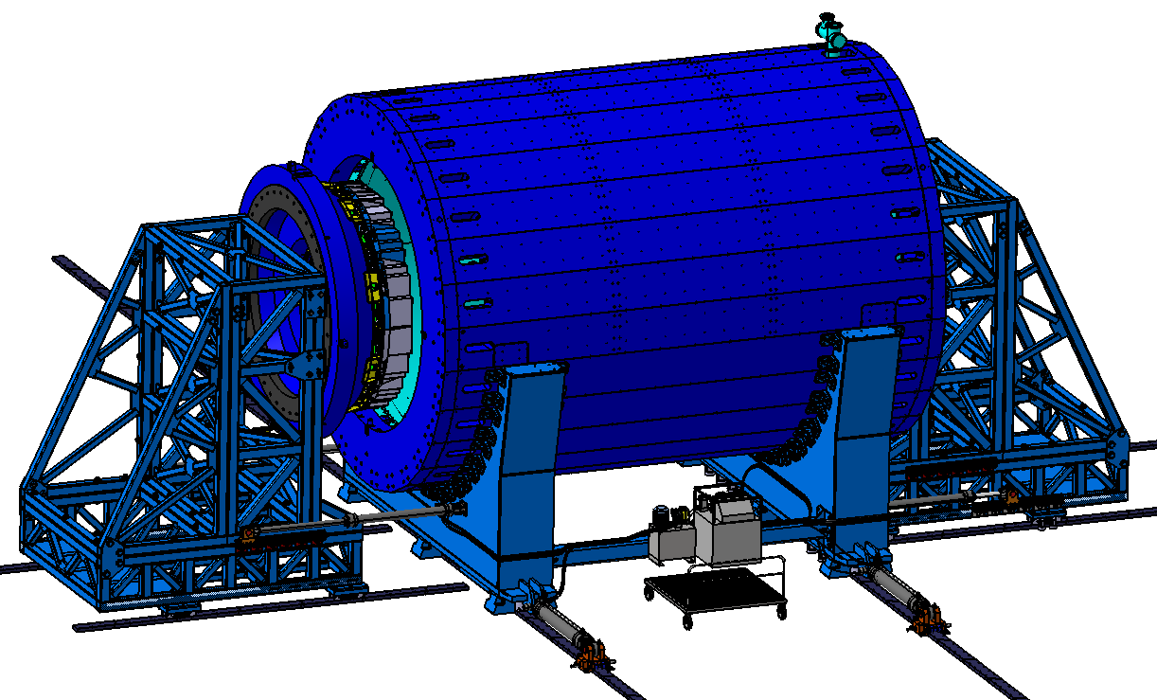
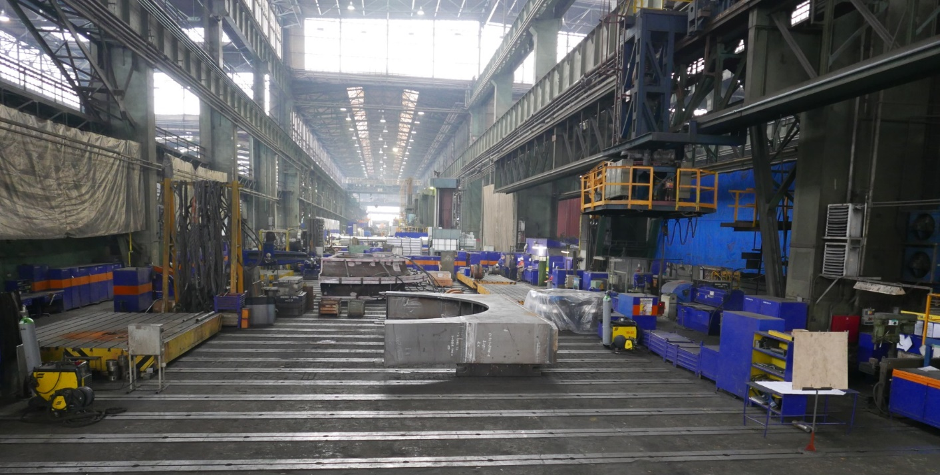
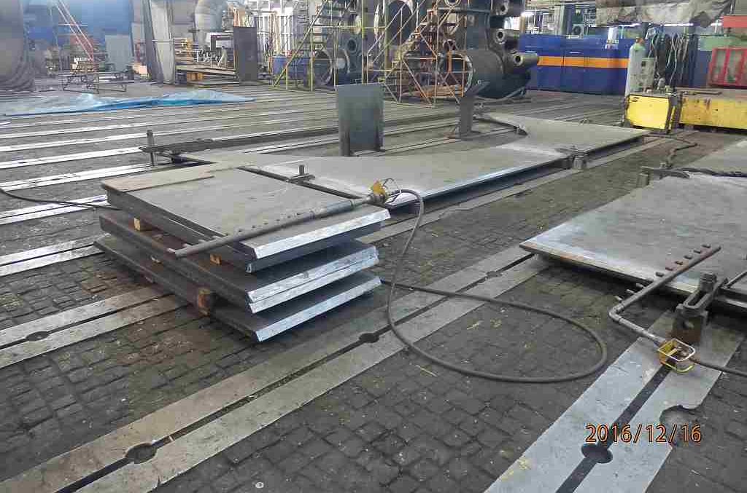
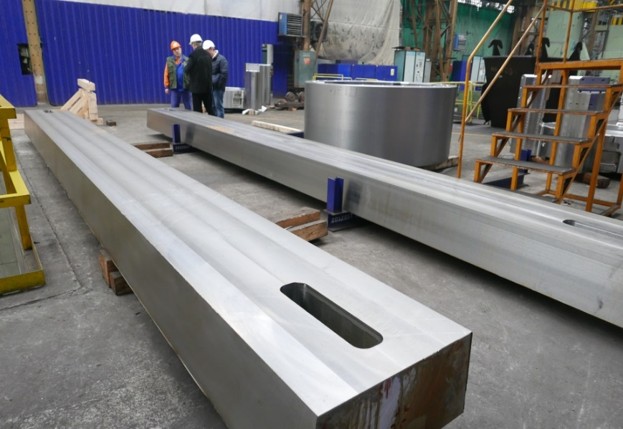
MPD Magnet Yoke (L=8970 mm, Ø6625 mm)
28 plates (16 t each) – 80% ready
2 support rings (42.5 t each) - ready
2 poles+trasport support (44 t each) – in progress
Lodgment (Yoke support): 70 t, ordinary steel St.3 (Fe 360) – 80% ready
MPD transport system - project is ready, preparations for the tender ongoing
80/20 tons cranes (MPD & SPD) – contract signed, delivery Nov’17- Feb’18
Control Assembling in VHМ (Vitkovice, Czech Republic) from Sept.-Oct. 2017
Place to control assembling of MPD barrel
(September – October 2017)
Plates
Notes:
The Company in Vitkovice has prepared the place for Control assembling of Magnet Yoke

Slide 11
MPD TPC : status 2017
TPC TDR – ready (rev.05)
TPC assembly hall – ready
Tooling for TPC assembly - delivered
Pad planes - ongoing
ROC chambers: 1 pc - tested, 20 pc – ready for assembly
TPC FrontEnd – under tests
FEC32S board (rev.01) – May 30 2017
FEC64S (8 pc) – July 30 2017
Service (gas, cooling & laser) – in progress
Integration, Mockuping – progressing

Slide 12
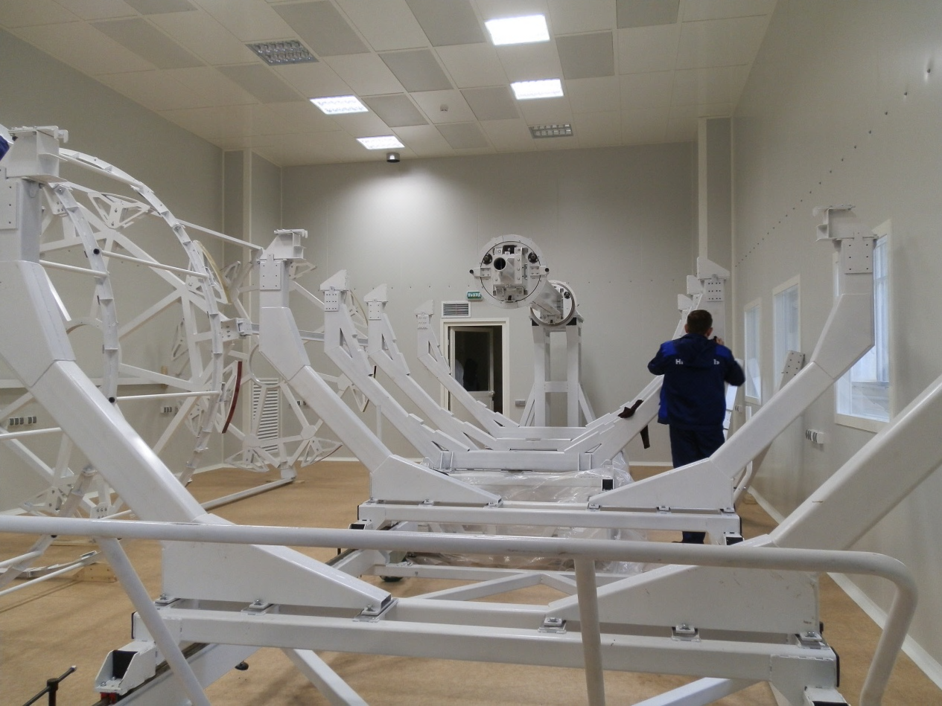
MPD TPC : progress in 2017
Clean room (S=84 m² ISO-6)
Service wheel of the TPC flange
TPC assembling tools
Mock up (tasks):
check cables connection to FE cards
FE card + cooling screen installation
manipulation/replacing of FE card
chamber and FE grounding
LVDB board installation/replacement
tubing, services, etc..
Manipulator for ROC chamber
installation (Briansk)

Slide 13
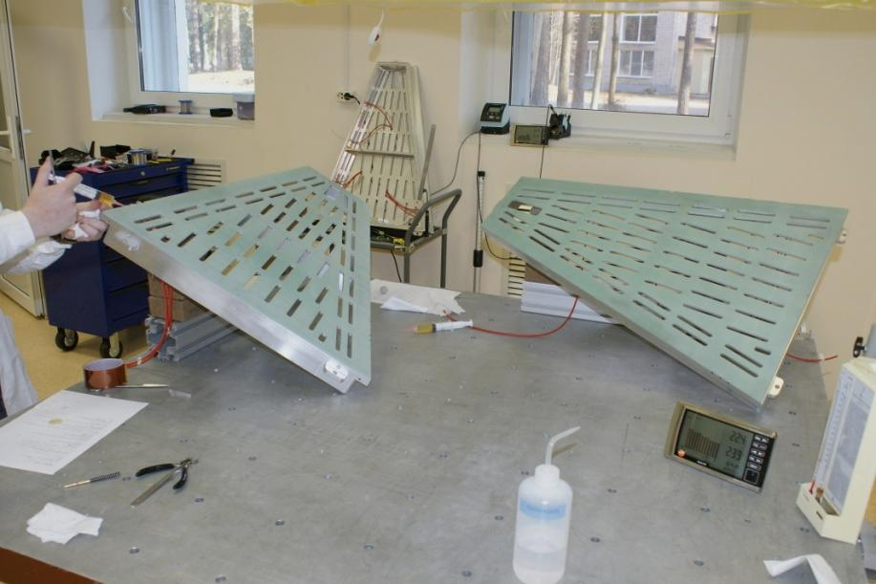
MPD TPC : ROC production
Surface final machining
ROC chamber flatness < 30 μm
Storage of 15pc serial frames

Slide 14
TPC service systems: laser calibration
For more detail, see the TPC TDR
New position of channel for laser beam
Semi transparency mirrors & prisms
Laser “planes” – 4+4
Points per plane - 4
Beams per point – 7
Laser “tracks”, N - 224
Full set of micro-mirror bundles - assembled
2 lasers (special option) - ordering in progress

Slide 15
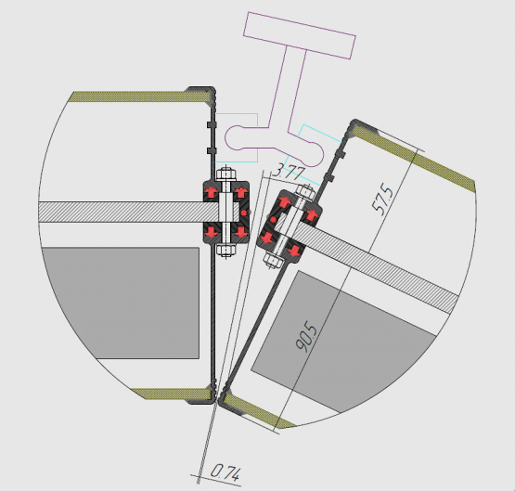
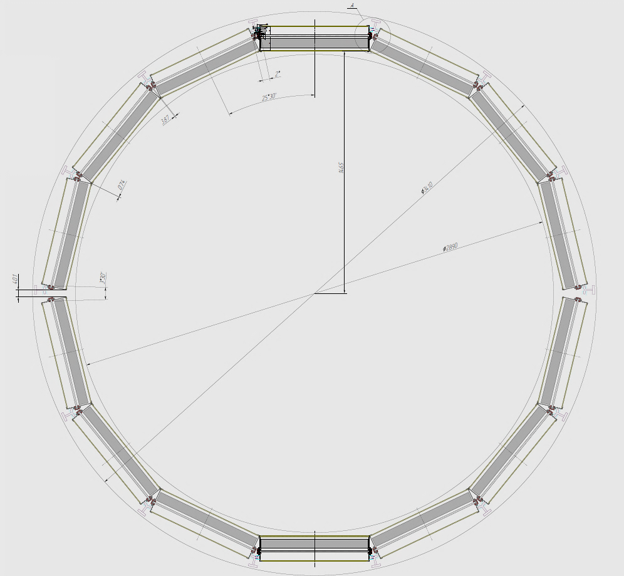
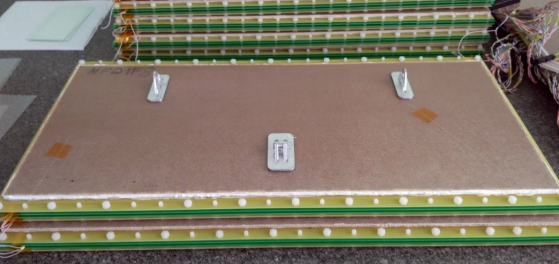
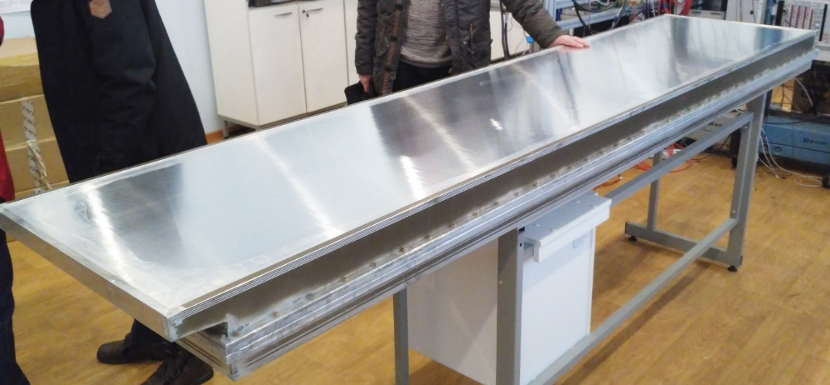
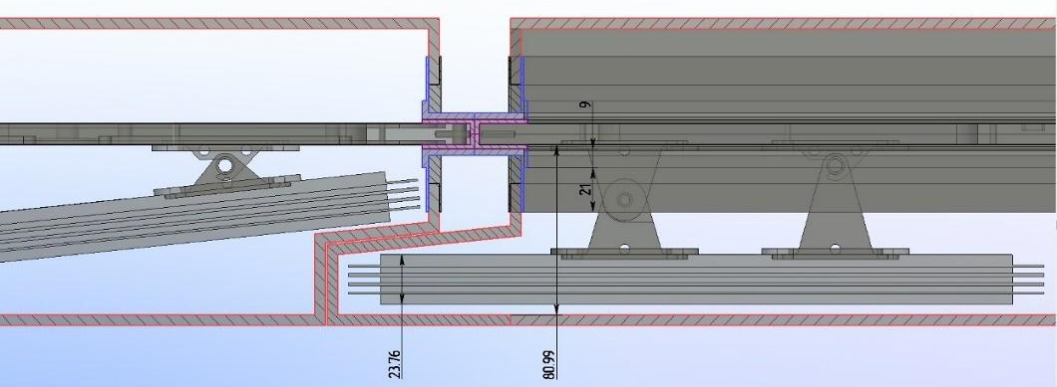
MPD TOF: progress in 2017
A
TOF TDR: close to the final version (under evaluation)
Final design of the TOF barrel
TOF integration issue and service systems
Preparation to mass-production
A
MRPC fixing inside the gas box
Aluminum gas & FEE box
NC PHEP BSU “Artmash” (Minsk, Belarus)
Notes:
It was decided to manufacture a box made of aluminum. The walls of the box welded of aluminum profile of special shape, which is manufactured by extrusion.
The central panel and the cover are made of aluminum honeycomb panels. All the elements are pulled together by pins and nuts. This design lighter and more convenient than the previous one.
Clic
First prototype of this design was made small for one detector. We tested it with detector last Nuclotron Run. Results was very good. Next step is the full scale box.
Clic
Now we are testing it and, most likely, it will be the final design, because it satisfies most of the requirements.

Slide 16
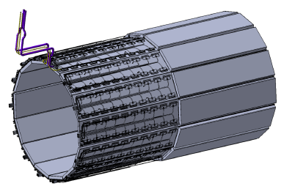
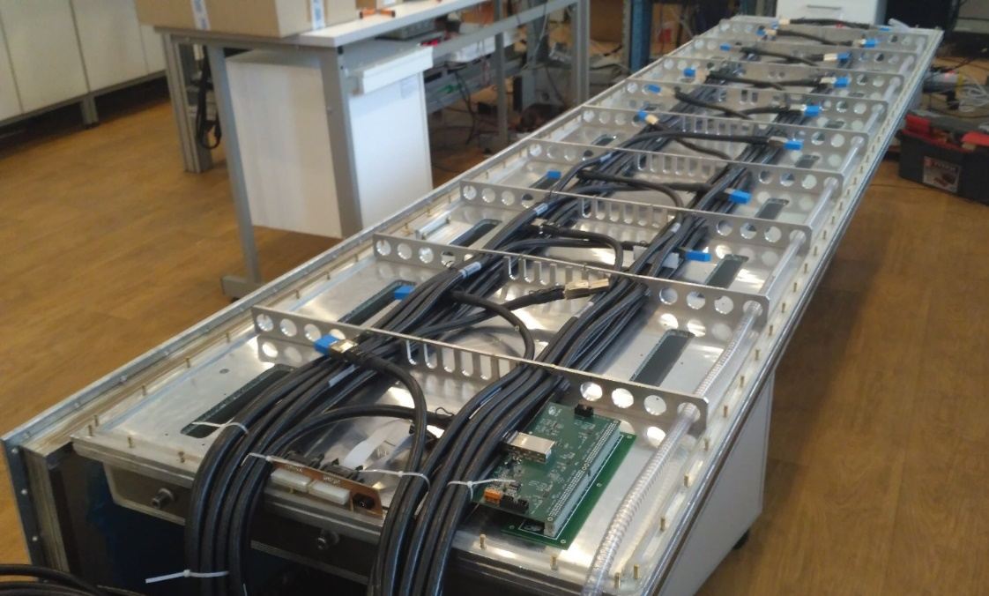
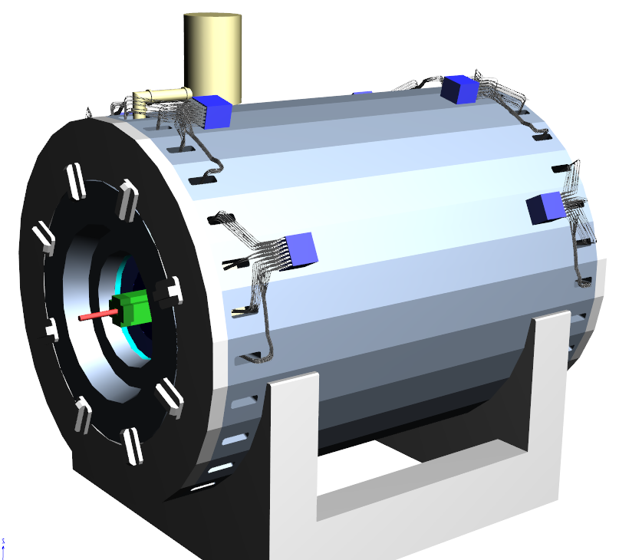
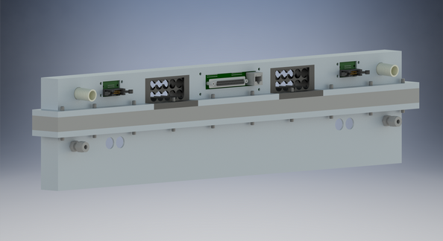
MPD TOF Integration: Cabling and pipelines
VMEx64 crate
A TOF module: HV and Molex cables,
NINO preampl., distribution boards, etc.
Air cooling
Trigger out
Signal cables
LV distribution
Slow control
Total cabling:
14 VME crates
196 TDC72VHL => 14 per crate
560 cables Molex CXP => 40 per crate
Cable lengths: 4 - 8 m
About 70 cm² in each technical
hole for cables and tubes.
Low heat dissipation
inside the barrel! ~10 W/m²
Gas connectors
HV connectors
Notes:
A very important part of creating the TOF system is the correct cabling.
This is single module with all communications that should be placed inside it.
The readout electronics must be as close as possible to the detector for achieving best time resolution.
But each crate radiates heat up to 300 W. Therefore we decided to fix them directly on the yoke.
Cables taking the signals from the FEE, LV cables, gas tubes and slow control buses will be routed through the center of the module to its outer ends.
Then they will come out from the external sides of the sector and pass through special holes in the yoke.
The space about 70 cm² (<1% of total size) is enough in each hole in the yoke for all TOF system cables, tubes.

Slide 17
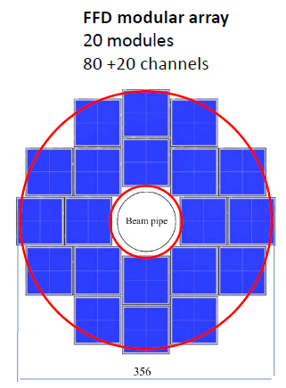
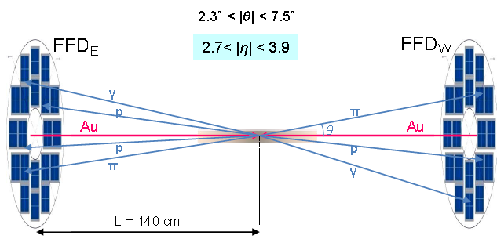
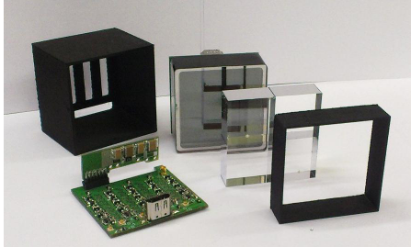
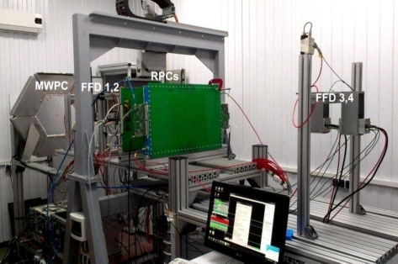
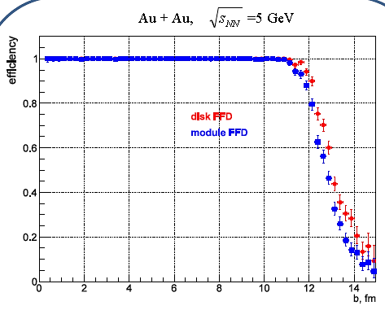
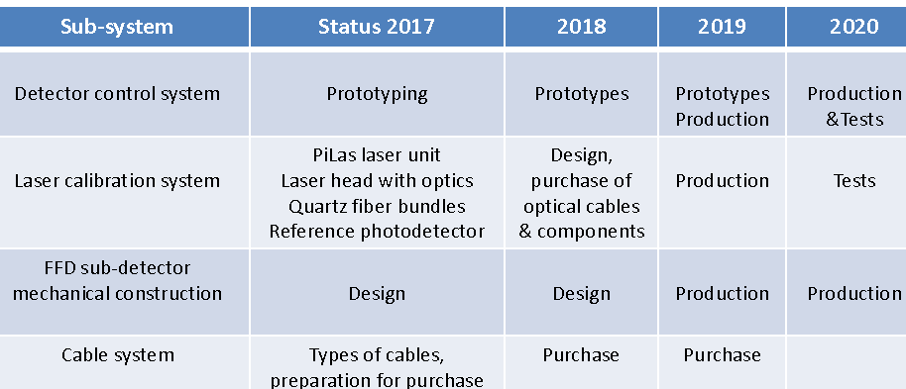
MPD FFD : progress in 2017
TDR FFD ready, got green light from MPD DAC
Additional MC study (efficiency, background, pp/pA/ AA)
Beam tests at MPD and BM&N (FEE, magnetic field, etc.)
Purchasing and mass-production

Slide 18
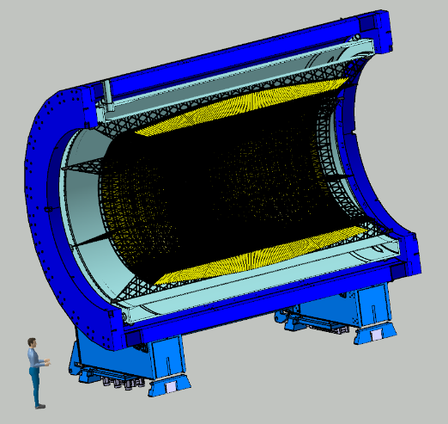
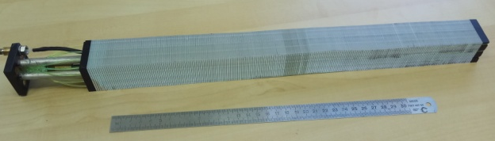
MPD ECAL: new (improved) design
Estimated cost of assembling and test of 43000 Ecal modules (Ttsinghua University, Beijing part) ~9M$.
Prototype of one module
Barrel ECAL ~ 43000 ECAL modules
Projective (new) geometry
Plane (current) geometry
Projective geometry provides higher efficiency and better resolution
No dependence on polar angle (pseudorapidity)

Slide 19
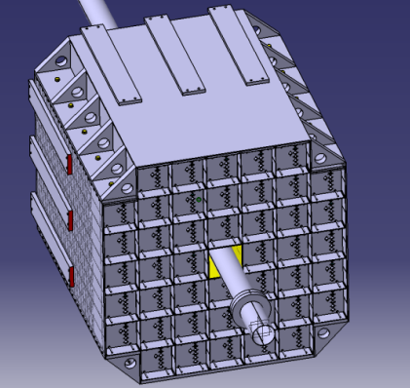

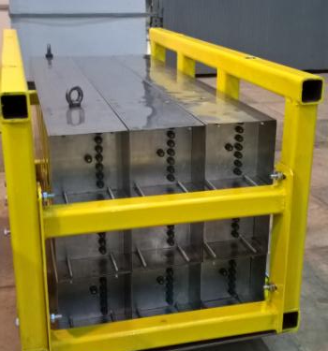
MPD FHCAL (INR, Troitsk) : progress in 2017
FHCAL calorimeter for centrality
& event plane determination
First nine modules (supermodule) are assembled and tested
All the components for the whole FHCAL (lead plates, scintillators,
WLS fibers and structure elements) are delivered
30 FHCAL modules will be assembled and tested this year
Several Front-End Electronics (FEE) boards are produced and tested
TDR status : ready
Results of realistic
simulation included
Preparation to mass-production
FEE board includes 7 photodiodes
MPPCs S12572-010C/P with power
supplies, differential amplifiers and
calibrated LED-source.
FHCAL supermodule

Slide 20
MPD FHCAL : test with cosmic rays
Full electronic readout chain was tested
The light yield in single section (MIP~5 MeV) is ~40-50 ph.e.
The electronic noise is below 10 ph.e. (1 MeV)
Beam tests at the Nuclotron under preparation
ADC64s2 board is used
for the data acquisition
ADC spectra from six longitudinal sections in a FHCAL module
Horizontal muons passed through all 7 sections
Inclined muons passed through 3 neighbor sections

Slide 21
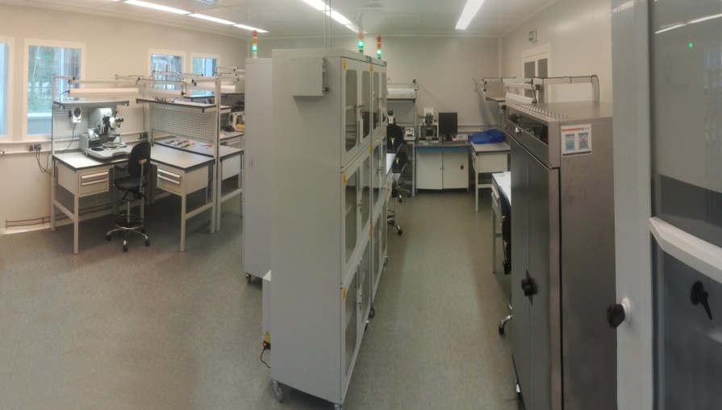
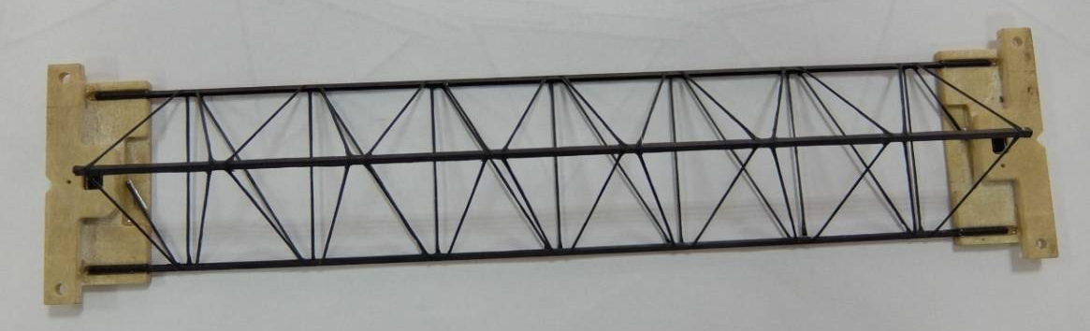
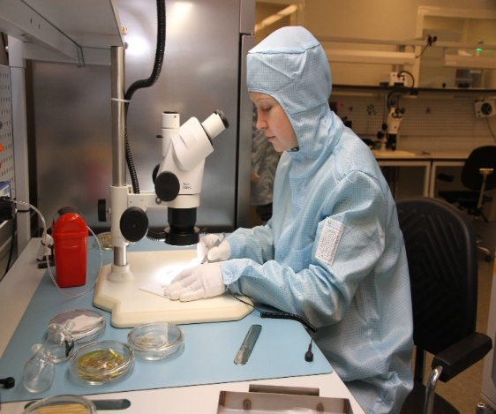
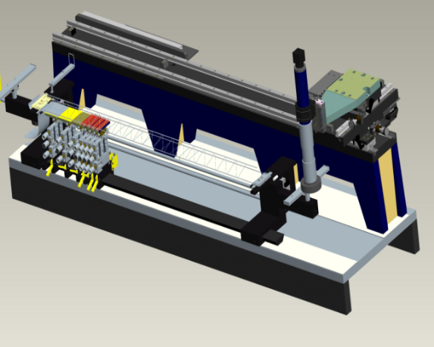
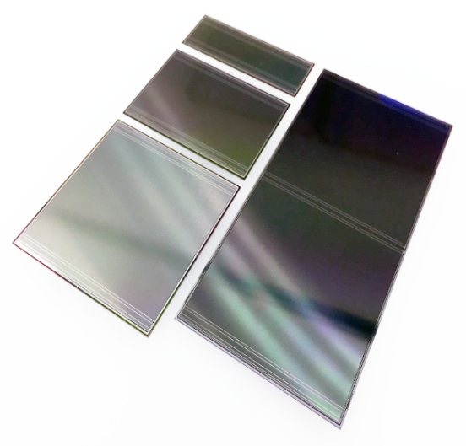
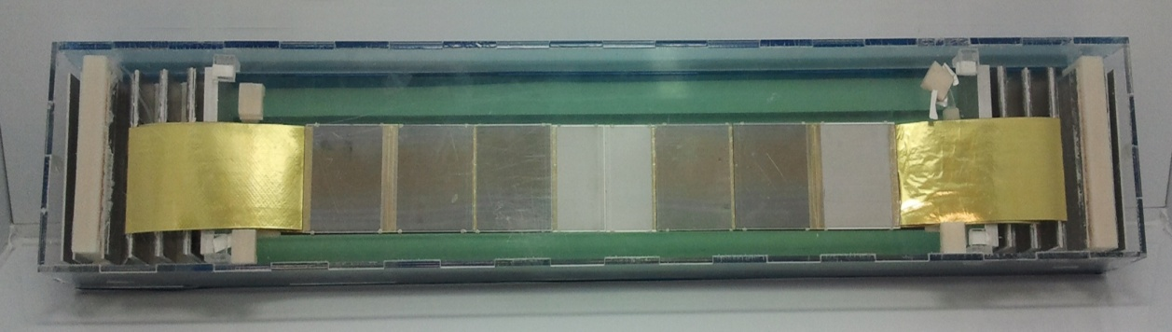
MPD ITS: progress in 2017
Site for module assembling
Ladder frames construction
QA testing of sensors
Mockuping
Ladder assembly device
Site for module assembly: the main room (90m² ) is class 7 ISO (less than 10⁴ p/ft³ < 0.5 mkm)
4 technicians are currently involved
in module assembling
Quality assurance of the sensors: sophisticated optical
and electrical methods established
400 sensors are already ordered and arrived at JINR
Mockup of the ladder
Si sensors
FEB box

Slide 22
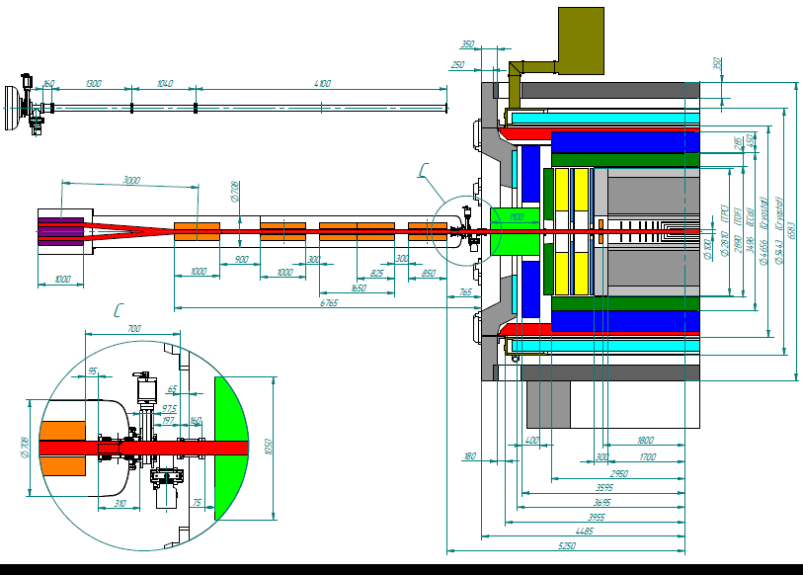

NICA-MPD Interface: MPD with the beam optic elements
Rest gas content: H₂ -90%+ CO - 5%+ CH₄ -5%
Positions of flux measurement
Pos.1 Pos.2
The number of interactions/cm^{2*} s
Collimator
Inner Layer of TPC R=38 cm
Beam from one side - 22 banches per 1,5*10⁻⁶ sec
Realistic beam MPD simulation for several parameters of the beam beta-function (longitudinal spread):
study of MPD TPC and IT efficiency for primary tracks and secondaries
Asymmetry of energy deposit in the FHCAL arms as a function of Z, centrality selection
The background from the Beam-Gas interactions inside the MPD detector
Background from beam particles hitting the collimators and the beam pipe
Concept of the assembling zone, dose estimates, etc..

Slide 23


MPD positions in the experimental zone
Beam pipe
FFD and FHCal for Luminosity tuning
Final focus lenses
Position 1 - Working position, Detector on the beam
Position 2 - Endcaps roll away zone
Position 3 – Detector Assembling area
The MPD FFD and FHCal systems for NICA Collider luminosity tuning

Slide 24
45th meeting, PAC for Particle Physics: RECOMMENDATIONS
“The PAC emphasizes again the need to attract young professionals
and additional external groups for the realization of the MPD project.”
Mexican group at MPD-NICA
Participant Institutions: BUAP, CINVESTAV (Fisica), UAS, UNISON, UNAM (II, FC & ICN)
Main goals of Mexican group at MPD-NICA
Theory: QCD phase diagram at finite T and μB, CEP signatures, chiral symmetry restoration mechanism
Experiment: inclusion of a detector that allows to MPD increase its pseudo-rapidity acceptance,
plus optimization of event plane resolution, multiplicity reference estimator, trigger system
and beam monitoring
MEXnICA group:
Maria Elena Tejeda Yeomans
Isabel Dominguez Jiménez
Wolfgang Bietenholz
José Alejando Ayala Mercado
Roger Hernández Pinto
Luis Manuel Montaño Zetina
Luis Valenzuela
Heber Zepeda
Rodolfo Palomino
E. Moreno
Victor Manuel Velazquez Aguilar
Lauro Santiago Cruz
Sergio Solis
Pedro Gonzalez Zamora
Mario Rodríguez Cahuantzi
In addition:
Contribution to MPD with computing resources in Puebla (BUAP) and Mexico City (ICN-UNAM)
ICN-UNAM: 300 nodes, 200 Tb of storage, 10 Gb (under demand)
LNS-BUAP: 268 nodes (under demand),1000 Tb of storage (under demand), 1.43 Tflops peak

Slide 25
Mexican group at MPD-NICA: first results
Proposal: Beam Monitor Detector (BMD) system will consists of two parts located at 2 meters away from the MPD center, Each half is composed by an array of 80 cells made of plastic scintillator arranged in 5 rings.
MC simulations of BMD performance:
Event plane reconstruction
Timing performance
Centrality determination
Trigger efficiencies
Luminosity control
Background rejection
1.7 < |η| < 4.4
* this summer two students
from Mexico will visit JINR to work on some of this tasks.
<cos (2*[ψ_{FIT} - ψ_{MC}])>
а resolution of the EP
BMD could contribute to the event plane resolution
(up to 80% for centralities between 15% and 35%)

Slide 26
Summary
Substantial progress in MPD project realization, mass-production
of MPD elements is getting closer (TPC, TOF, FFD, FHCAL)
TDR ready for Stage’1 MPD elements, evaluation by DAC ongoing
Magnet fabrication progressing well, 80% of the yoke ready,
control assembling in October 2017
MPD-NICA interface simulation has started
MPD Collaboration is growing: new groups
from Mexoco and Poland joined
Thank you for your attention!

Slide 27
Spares

Slide 28
NICA schedule
 | 2015 |  |  |  | 2016 |  |  |  | 2017 |  |  |  | 2018 |  |  |  | 2019 |  |  |  | 2020 |  |  |  | 2021 |  |  |  | 2022 |  |  |  | 2023
Injection complex
Lu-20 upgrade
HI Source
HI Linac
Nuclotron
general development
extracted channels
Booster
Collider
startup configuration
design configuration
BM@N
I stage
II stage
MPD
solenoid
TPC, TOF, Ecal (barrel)
upgraded end-caps
Civil engineering
MPD Hall
SPD Hall
collider tunnel
HEBT Nuclotron-collider
Cryogenic
for Booster
for Collider
running time

Slide 29

TPC FEE status
SAMPA option (FEC32S) – design in progress
ALTRO+PASA option (FEC64S) - design completed
Pilot system (512 ch) – under test
Controller design - design completed
Controller manufacture – December 2017
First Level Processor concept (for cosmic test)– under design
r/o of 8 boards
SAMPA-based option status&plans:
Design & Components soldering – done
Tests SAMPA naked FEC32S (rev.2) – finished
Tests of the next SAMPA revision (rev.3) – Sept.-Oct. 2017
Altro-based option (FEC-64S) status&plans:
readout up to 8 boards (based on kit) - July’17
test electronics with ROC chamber - December‘17
controller (for 62 boards) manufacture - December’17
Slow control integrated
to low voltage distribution
board (LVDB)
INP BSU (Minsk)
Prototype-02 (14 ch)

