Slide 1
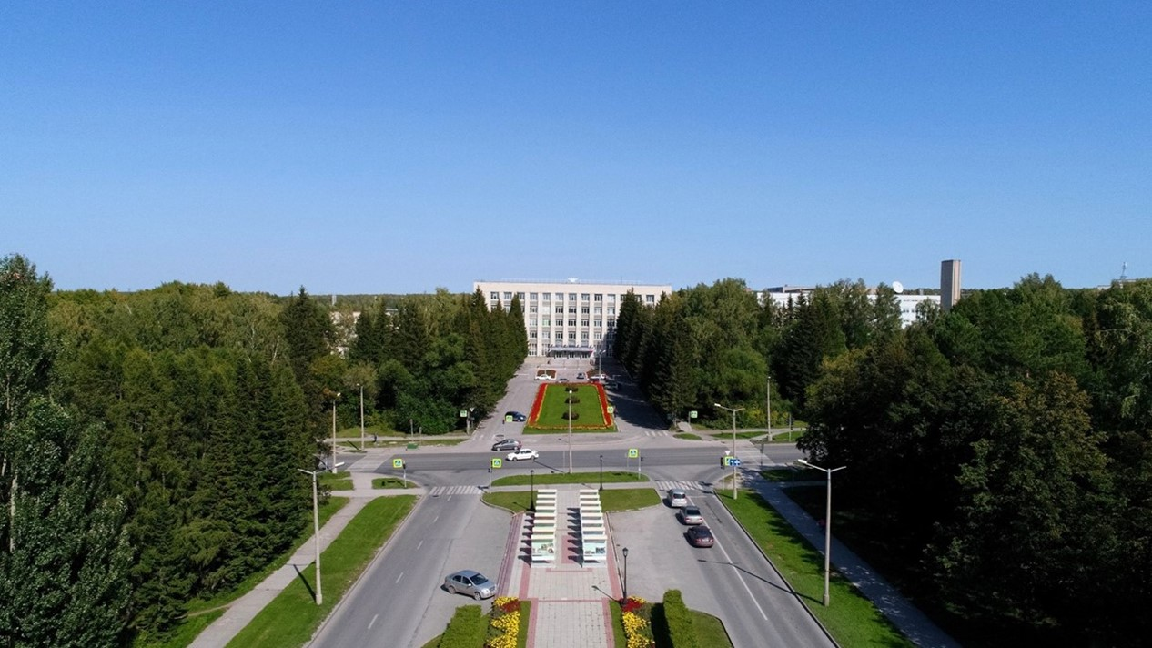
SPD solenoid
E.Pyata, S.Pivovarov, M.Kholopov, M.Azimbaev BINP, Novosibirsk

Slide 2
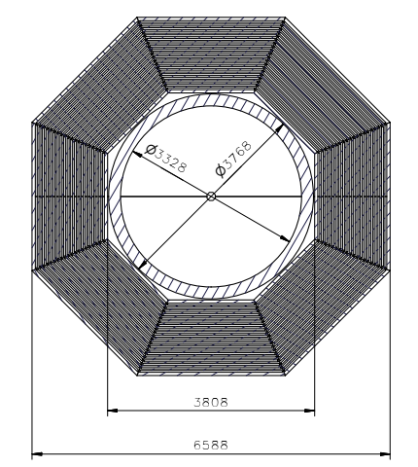
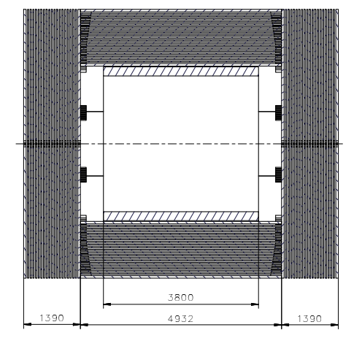
SPD yoke and solenoid
The cryostat of the magnet with the coils, cold mass and thermal shields is located inside the yoke.
The overall dimensions are driven by the space planned for the detectors of SPD and the ma field parameters. Outside diameter of the cryostat is 3768 mm and a gap between the yoke and the cryostat about 20 mm. Radially a free diameter of 3228 mm is left for the SPD detectors. The length of the magnet is 3800mm and the magnet should be installed symmetrically inside the yoke

Slide 3
SPD solenoid
Cryostat: OD –3668 mm; ID – 3228 mm;
Length - 3800 mm; Thickness – 220 mm;
Coils (3 pc.): Horizontal winding PANDA conductor – 2 layers; Turns = 552.
Weight: - cryostat about 9500 kg
- thermos shields – 850 kg
- coils about 3800 kg
Total: ~15 ton

Slide 4
SPD solenoid
Cryostat: OD –3668 mm; ID – 3228 mm;
Length - 3800 mm; Thickness – 220 mm;
Coils (3 pc.): Vertical winding PANDA conductor – 2 layers; Turns = 750.
Weight: - cryostat about 9500 kg
- thermos shields – 850 kg
- coils about 4200 kg
Total: ~15 ton

Slide 5
SPD solenoid
Cryostat: OD –3668 mm; ID – 3228 mm;
Length - 3800 mm; Thickness – 220 mm;
Coils (3 pc.): Vertical winding PANDA conductor – 2 layers; Turns = 750.
Weight: - cryostat about 9500 kg
- thermos shields – 850 kg
- coils about 4200 kg
Total: ~15 ton

Slide 6
SPD solenoid
SPD Magnet (Deformation, р=0,1MPa)
SPD Magnet (Stress, р=0,1MPa)
SPD Magnet (Deformation, р=0,05 MPa)
SPD Magnet (Stress, р=0,05 MPa)

Slide 7
SPD solenoid
BINP suggest to use a superconducting NbTi/Cu wire based Rutherford cable co-extruded with a high purity aluminum-stabilizing matrix. This type of conductor was used for production larger detectors such as CELLO, CDF, TOPAZ, VENUS, ALEPH, DELPHI, CLEO, SDC, BELLE, ATLAS CS, ATLAS ECTs, ATLAS BT, CMS, Mu2e solenoids and PANDA.
The SPD solenoid is designed to operate at a current of 6,3 kA for vertical position of the conductor, i.e. about 32% of its critical current at 4.5 K and 2,0 T peak magnetic field.
The conductor is The insulated conductor dimensions at 4.5 K are 10.90 mm in width and 7.90 mm in height. The Rutherford cable is composed of 8 strands with a diameter of 1.40 mm and a Cu/SC ratio of 1.0. The critical current density of the superconductor at 4.2 K and 5 T shall be larger than 2800 A/mm2 to ensure a temperature margin for quench well above 2.0 K. The same type of the conductor is produced in Russia and used for the PANDA solenoid, FAIR, Darmstadt.
At the case a horizontal position of the conductor a current is about of 8,3 kA and we need to use a Rutherford cable with 12 wires and the conductor dimensions should be at 4.5 K are 17,7 mm in width and 7.90 mm in height.

Slide 8
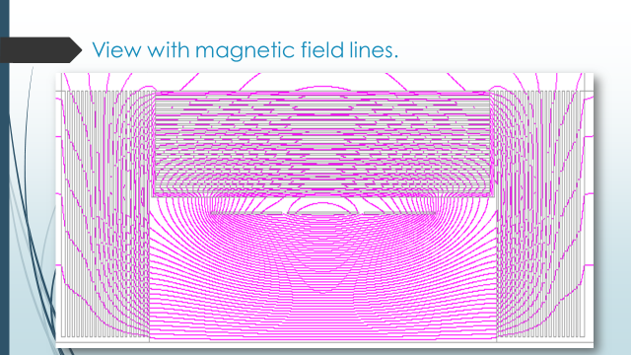
SPD solenoid Magnetic Analysis
Maximal field in the coil is 2.0 T

Slide 9
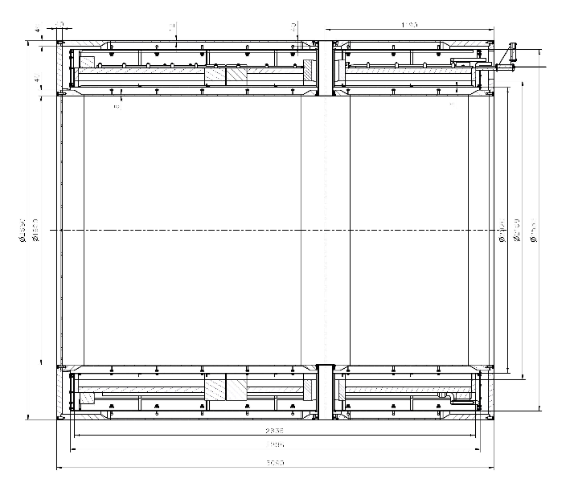
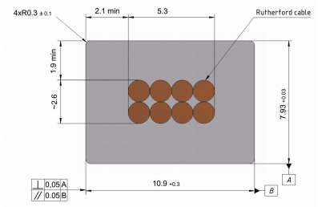
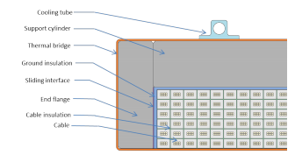
PANDA conductor
Rutherford cable, 8 strands, extruded in Al matrix
Thickness (after cold work) at 300 K | mm | 7.93 | ± 0.03
Width (after cold work) at 300 K | mm | 10.95 | ± 0.03
Critical current (at 4.2 K, 5 T) | A | > 14690
Critical current (at 4.5 K, 3 T) | A | > 16750
Overall Al/Cu/sc ratio |  | 10.5/1.0/1.0
Aluminum RRR (at 4.2 K, 0 T) |  | > 1000
Al 0.2% yield strength at 300 K | MPa | > 30
Longitudinal section of the cryostat with cold mass.
Conductor mechanical and electrical parameters.
Cold mass cross-section.
Cross-section of the conductor.

Slide 10
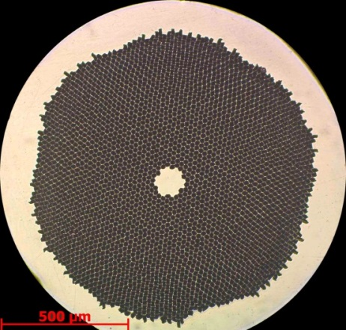
Conductor.
Production strands
Producer: “A.A. Bochvar High-technology Research Institute of Inorganic Materials” (JSC "VNIINM").
Protocol measurements 01-400/423 from 29.09.2021/18.10.2021
Superconductive NbTi strand PANDA solenoid
Parameter | Unit | Certified |  | 1-C2-1P-1-21/1 > 1400 m | 1-C2-1P-1-21/2-1-1-2 > 200 m
 |  | Value | Tolerance
Diameter filament | µm | < 20 | -
Diameter strand | mm | 1.400 | ± 0.005
Cu/SC ratio | - | .50/.50 | ± 0.05 | /0.5187 | /0.5132
Surface coating | - | none | - | none | none
NbTi J_{c} (at 4.2 K, 5 T) | A/mm² | > 2800 | -
Critical current (at 4.2 K, 5 T) | A | > 2160 | - | 2220 | 2175
n-value (at 4.2 K, 5 T) | - | > 30 | - | 71* | 70*
Conductor RRR | - | > 100 | - | 196 | 191
Twist direction | - | left | - | left | left
Twist pitch | mm | 25 | ± 5 | 22 | 21
Strand cross section
*Magnetic field value is 6 T
Table 1 NbTi/Cu strand mechanical and electrical specifications.

Slide 11
Conductor.
Production strands
Batch number / strand piece number | Diameter, mm (1,400 ± 0,005 mm) | Cu/SC ratio NbTi, % | Twist pitch |  | RRR
 |  |  | begin | end
1-C2-1P-1-21/1 | 1,4 | 0,5187 | 22 | 22 | 196
1-C2-1P-1-21/2-1-1-1 | 1,4 | 0,5140 | 21 | 22 | 207
1-C2-1P-1-21/2-1-1-2 | 1,4 | 0,5132 | 21 | 21 | 191
1-C2-1P-1-21/2-1-2 | 1,4 | 0,5126 | 22 | 22 | 205
1-C2-1P-1-21/2-2 | 1,4 | 0,5122 | 22 | 24 | 205
Table 2 Technical parameters
Batch number / strand piece number | Field, T | I_{c}, A (4,2 К; 0,1 mkV/sm) | n-value
1-C2-1P-1-21/1 | 8 | 789 | 35
 | 7 | 1253 | 52
 | 6 | 1746 | 71
 | 5 | 2220 (calc.) | -
1-C2-1P-1-21/2-1-1-1 | 8 | 750 | 35
 | 7 | 1208 | 53
 | 6 | 1694 | 71
 | 5 | 2175 (calc.) | -
1-C2-1P-1-21/2-2 | 8 | 750 | 36
 | 7 | 1200 | 50
 | 6 | - | -
 | 5 | 2165 (calc.) | -
Batch number / strand piece number | Sample | Measurement | Mechanical properties
 |  |  | Ultimate resistance, MPa | Yield strength, MPa
1-C2-1P-1-21/1 | 1n | 1 | 903 | 838
 |  | 2 | 897 | 836
 |  | 3 | 909 | 845
Table 3 Mechanical properties
Table 4 Critical current (at 4.2 K) and n-value (at 4.2 K) vs magnetic field.

Slide 12
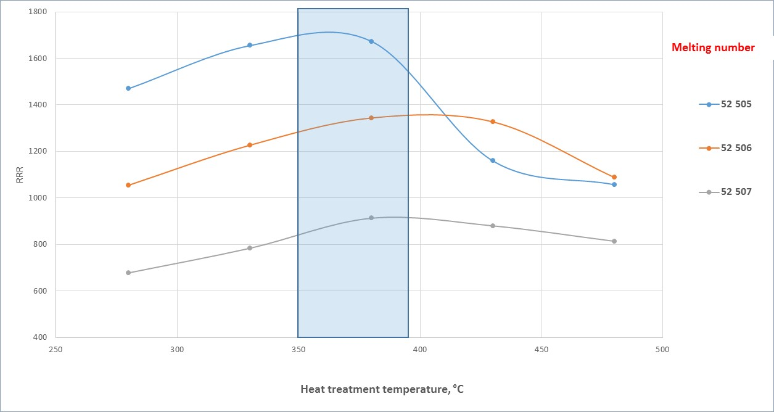
Conductor.
Status of the PANDA conductor development/ procurement
BINP/ VNIINM Bochvar/ VNIIKP/ Saransk cable optic (SarKO)
Worked range of high purity Aluminum is 350 – 380 °C

Slide 13
SPD heat loads
Table 1. Estimated heat loads of the SPD solenoid
T = 4,5 К | Heat loads
 | Worked condition | Without m.f. | With m.f.
Cryostat
Radiation | 7.8 | 7.8 | 7.8
Supports | 5* | 5* | 5*
Eddy current loss in casing | - | - | 11.50**
Eddy current loss in conductor | - | - | 0.09**
Current leads, 6.5kA B=1.25T | 15 | 9 | 9
Distribution box**
Radiation | 0.45 | 0.45 | 0.45
Supports of the LHe vessel | 0.26 | 0.26 | 0.26
Cold control valves | 1.05 | 1.05 | 1.05
Safety relief valves | 3,22 | 3,22 | 3,22
Vacuum barrier | 0.35 | 0.35 | 0.35
Transfer line**
Radiation | 0.06 | 0.06 | 0.06
Supports | 0.20 | 0.20 | 0.20
Total | 33,39 | 27,39 | 44,98
* Data of ATLAS central solenoid ** Data of PANDA solenoid

Slide 14
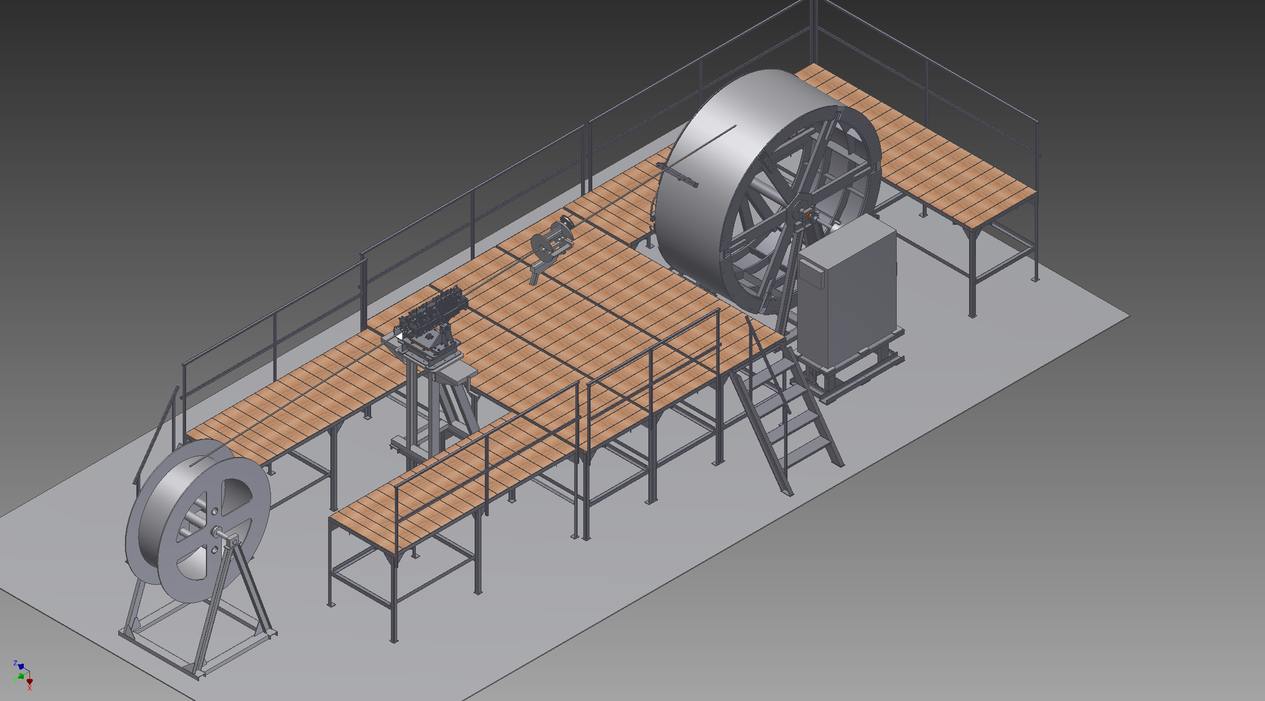
Drawing of the Devices for winding coil (scheme).
Production 10/2021

Slide 15
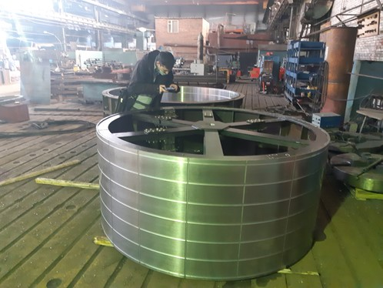
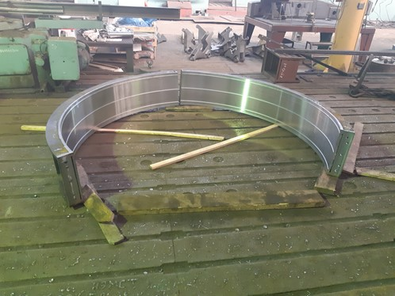
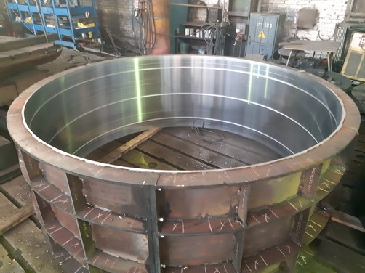
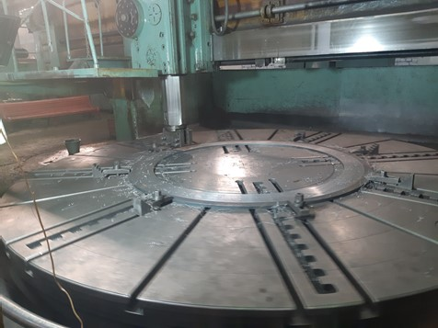
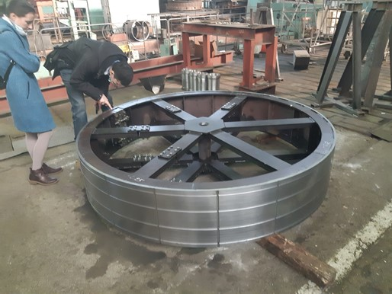
Photos of the tolling production

Slide 16
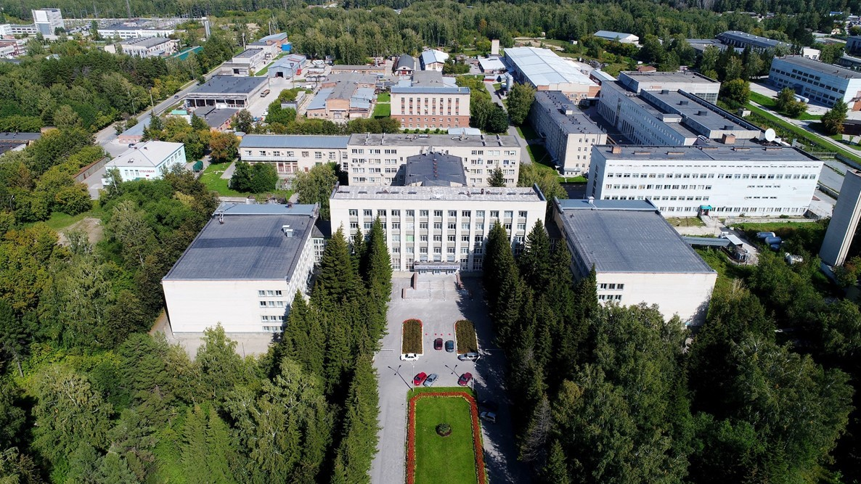
Thank you for your attention

