Slide 1
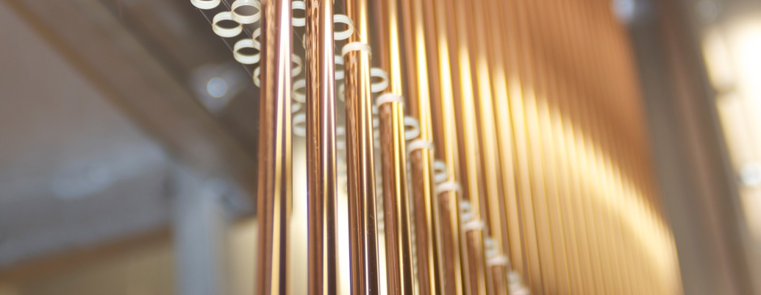
Straw tracker
14/12/2021
Notes:
First of all I wish to thank for the invitation and the good reception the Conference organizer. I want to told about straw tracker in the different experiment.
Good afternoon. Before you begin a report on straw Tracker SPD will talk a bit about the principles of using Straw Tracker.

Slide 2
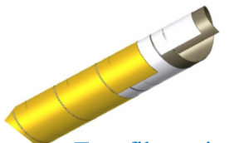
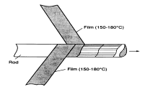
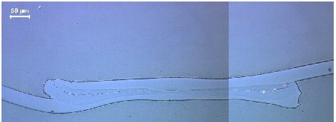
Two design of the straw-tube production
Straw winding. Two films revolve and stick together among themselves.
straw diameter from 2 mm to 18 mm
Ultrasonic welding of straws
straw diameter from 5 mm to 20 mm
both of these technologies are well developed at JINR
Notes:
The most popular two ways to manufacture straw. Wilding and ultrasonic welding. Two films revolve and stick together among themselves. This method has several drawbaks. One of which is elongation straw and falling tension. The advantage is a large overpressure limit. It is possible manufacture small radius straw-2mm. Some detector prepared in the straw group in LHEP may be used in the NA64.
Another method are ultrasonic welding and produced about 15km straw tubes in the NA62.

Slide 3
The straw tracker are using of in the different experiments.
Straw winding
Straw welding
ATLAS
LHCb
PANDA(overpressure)
CBM
COMPASS
Mu2e(vacuum)
NA64
SVD-2
GLUEX
COZY-TOF
..
NA62(vacuum)
COMET(vacuum)
SHiP(vacuum)
DUNE(overpressure)
SVD-2
..
Notes:
The straw tracker are using of in the different experiments. I want to talk some words about experiments we where are participant.

Slide 4
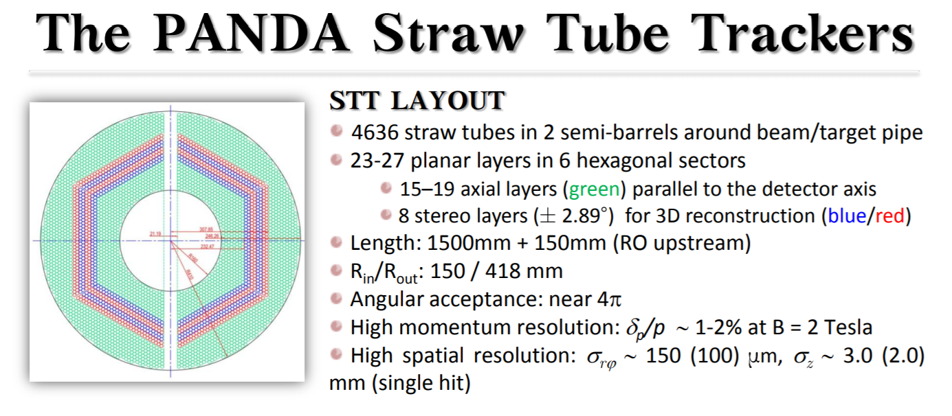
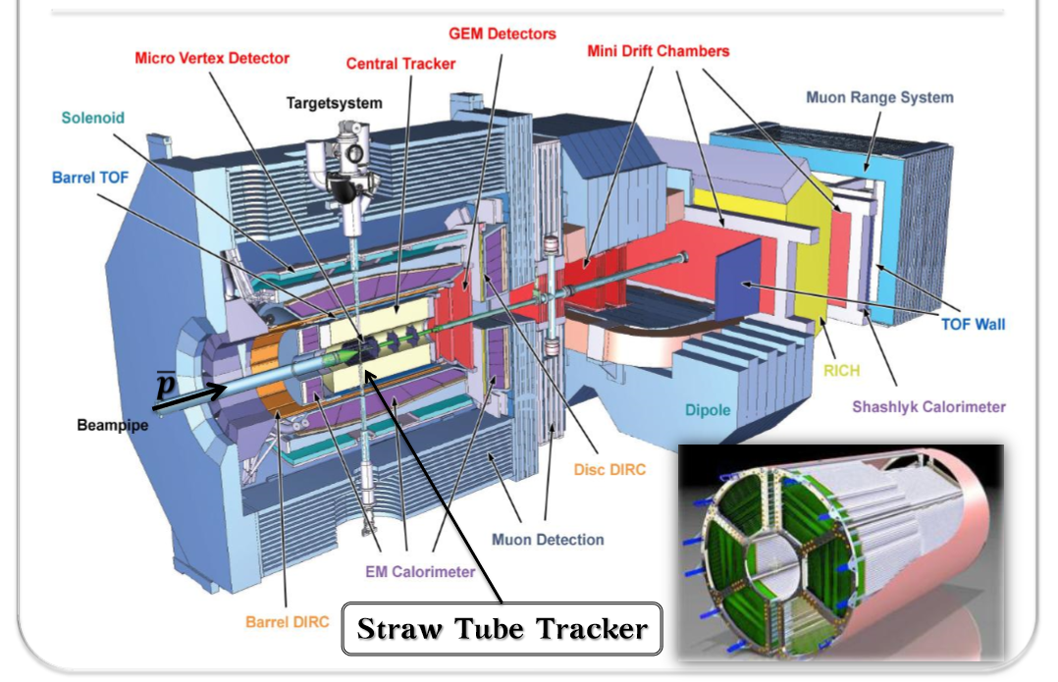
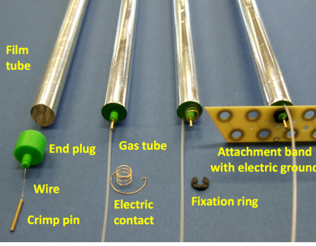
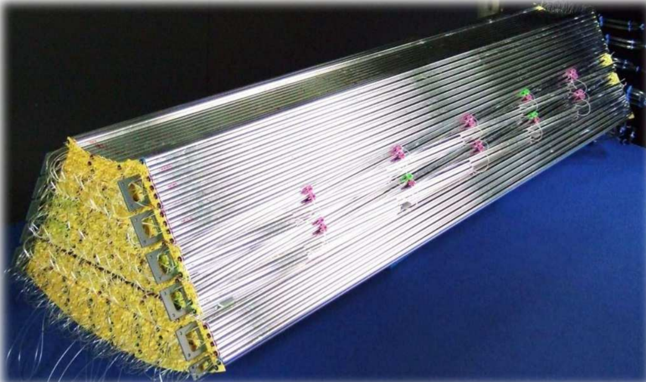
PANDA

Slide 5
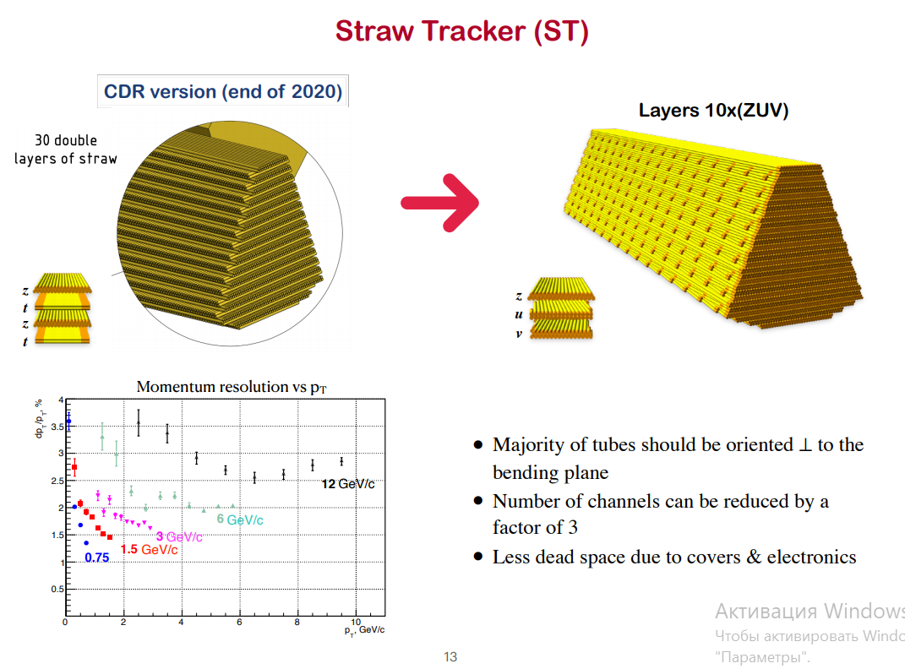

Slide 6
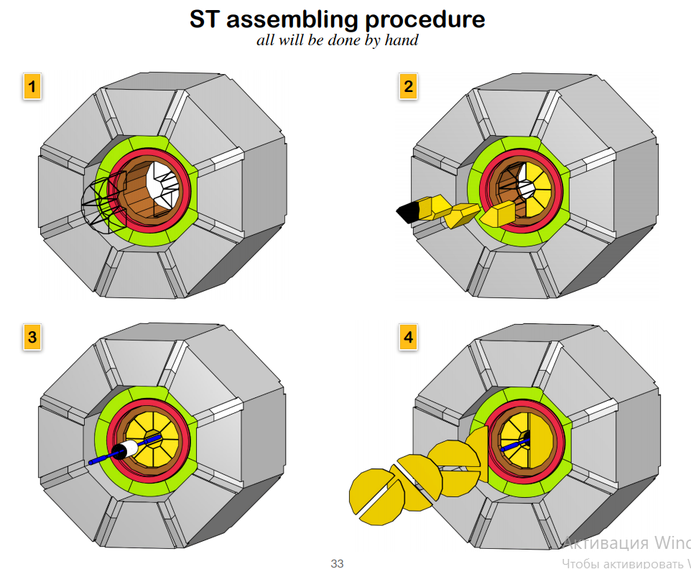

Slide 7
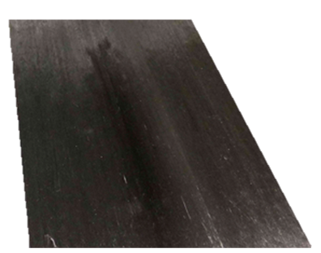
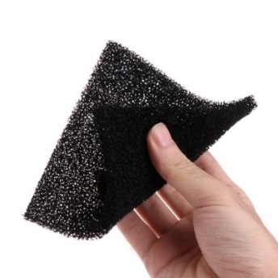
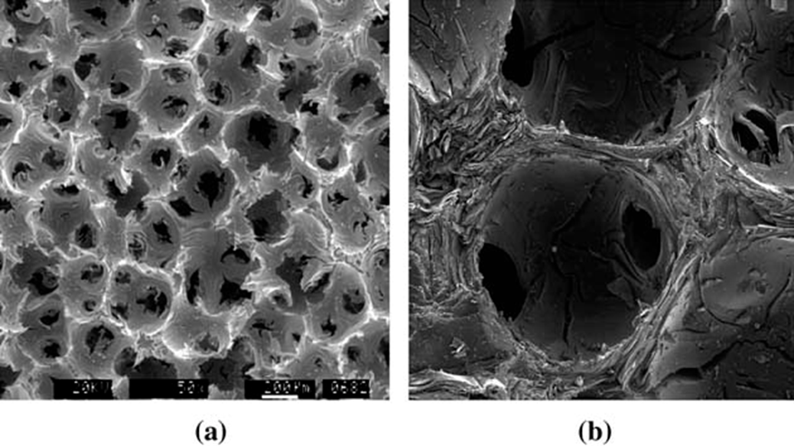

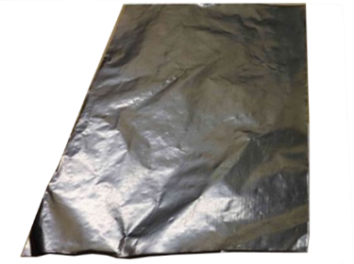




TRACKER MECHNICS
Consolidated use of Carbon as structural…
Requirements:
  support the tracker in position, with minimum mass, low X/X0
  provide cooling and thermal stability
  provide high dimensional and dynamic stability
Boundary conditions:
  high radiation levels
  Inelastic deformation
  temperature and humidity variations
5-11 µm
Carbon Unidirectional Prepreg: Ready to mold or cure material in sheet form which contains fiber all aligned in one direction. Filament diameter=11 µm
~ 45 µm
Carbon Fibre Reinforced Plastics
… and thermal management materials
 | Filaments [K=1000] | E1 [GPa] | X_{t} /X_{c} [MPa] | E2 [GPa] | Y_{t} [MPa] | K [W/mK] | CTE [10⁻⁶K⁻¹]
K13D2U [0] fibre | 2K | 935 | 3688 |  |  | 800 | -1,1
K13D2U [0] prepreg | 2K | 563 | 1800/340 | 6 | 25 | ~450 | -1,2 / 61
80 (g/m²) FAW
Carbon foam: high thermal performance, properties are porosity dependent
 | Density [g/cm3] | K In plane [W/mK] | K Out of plane [W/mK]
POCO HTC | 0.9 | 70-245 | 245
Thermal Pyrolytic Graphite: Thermal management material with very high thermal conductivity and flexibility
… and more
Aluminium Graphite Composites, Thermal phase change material
 | Thick. [µm] | Density [g/cm3] | K In plane [W/mK] | K Out of plane [W/mK]
Amec FGS_003 | 30 | 1.6 | 1500 | 15
TPG @ Tile | 250 | 2.25 | 1500-1700 | 6-10
 | Density [g/cm3] | K In plane [W/mK] | K Out of plane [W/mK]
ALG2208 | 2.2 | 220 | 140
 | Thick. [µm] | Trans. T [°C] | K [W/mK]
Tpcm 580 | 76-400 | 50 | 3.8

Slide 8
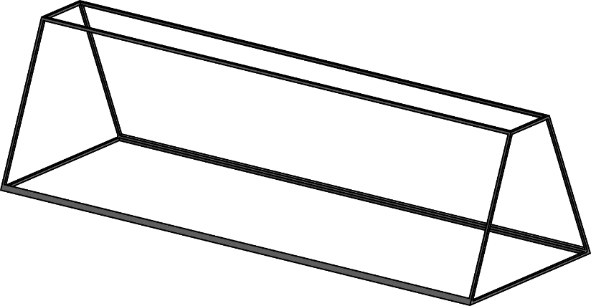
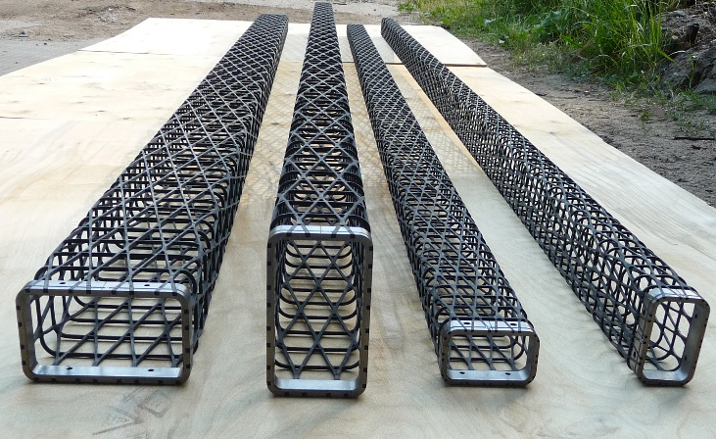
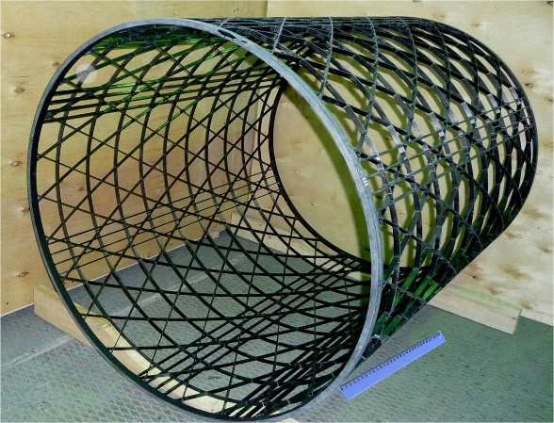
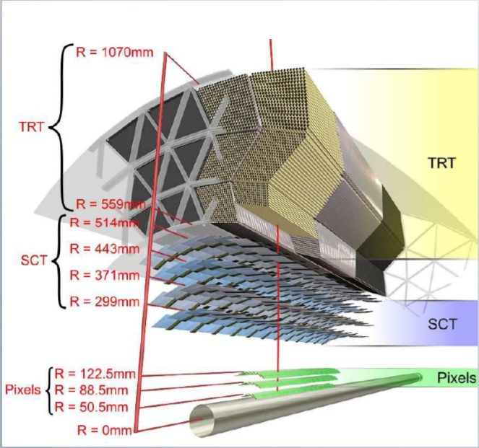
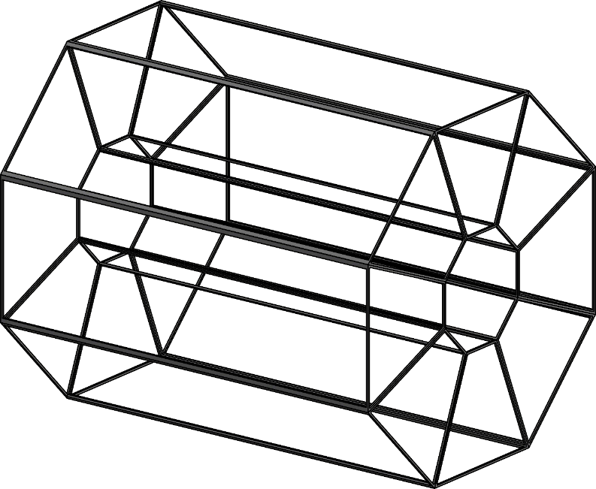
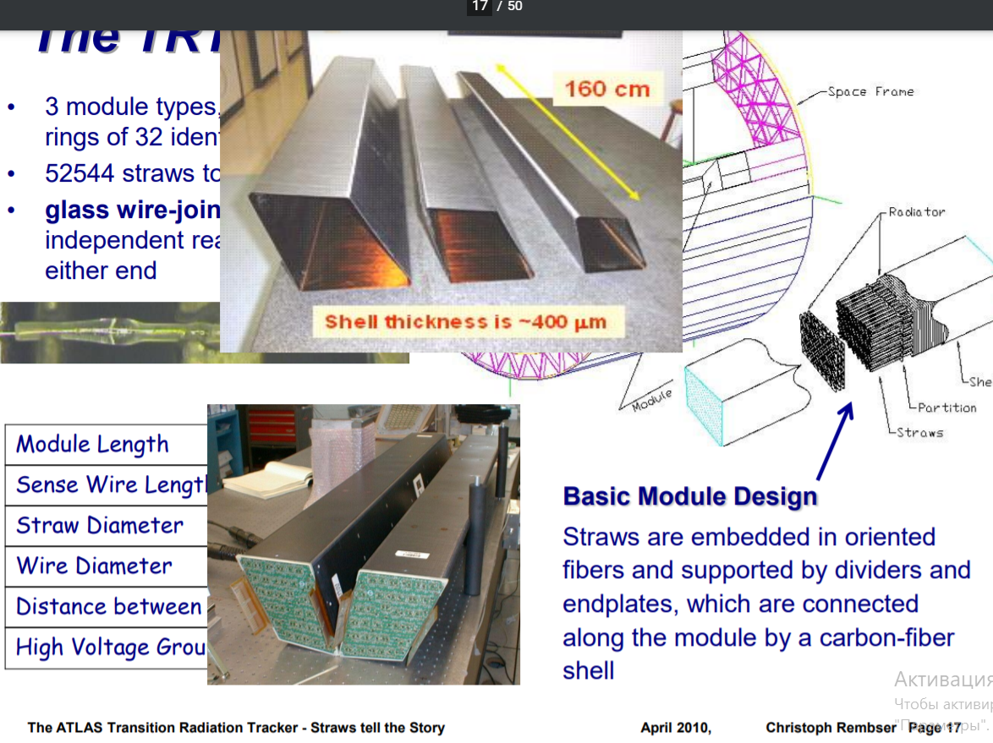
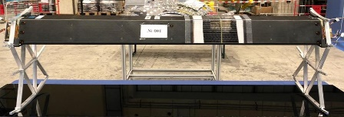
TRACKER MECHNICS

Slide 9
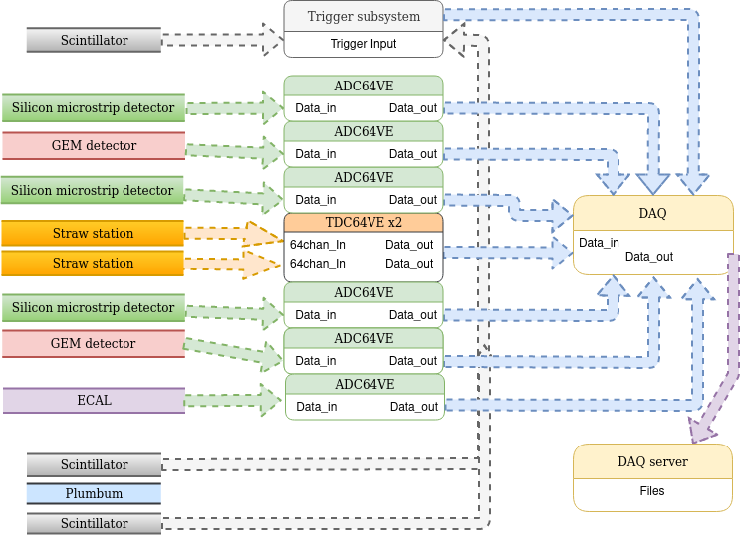
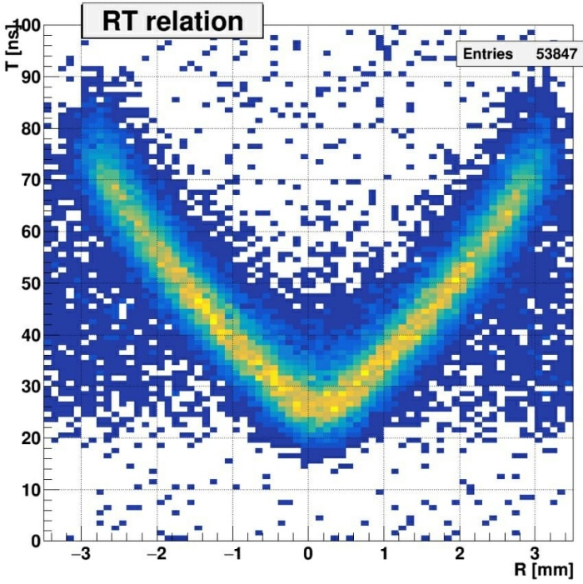
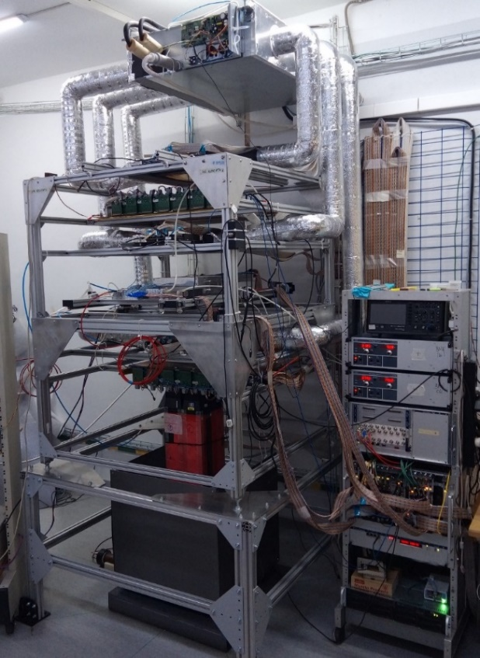
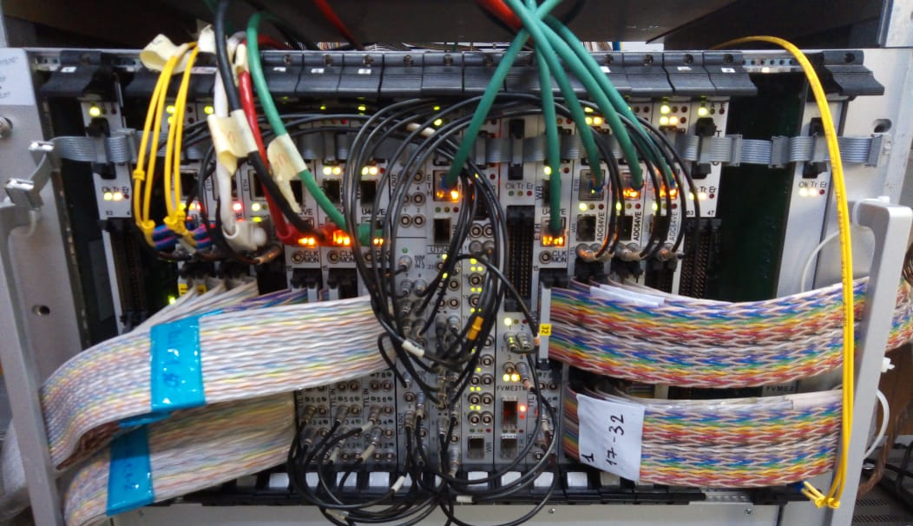
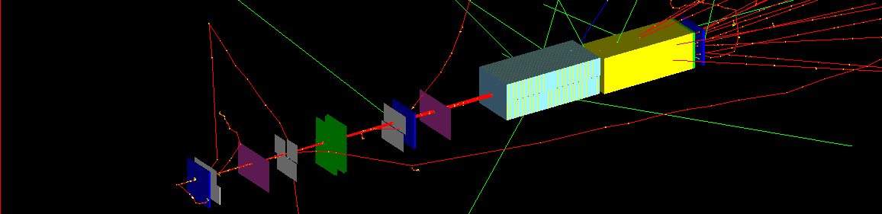
MiniSPD testing facility
DAQ BM&N and MPD
Straw+Vertex+Colorimeter
Spatial resolution 180mkm
Notes:
let me tell you about the work that has been done over the past 2 years. in this report I would like to tell you about the miniSPD installation that is currently functioning.
several teams participate in this work
on this slide you will see a more detailed arrangement of elements on the stand. From top to bottom you can see the location of the detectors. As a result, we have the following detectors today: three scintillation counters, three sicilicon detectors, two straw chambers, two GEM detectors, electromagnetic calorimeter and lead filter,DAQ and slow control systemperform tests with existing electronics and cameras on the electron beam DLNP
development and production of a prototype of a tracker barrel part
conducting work on the use of VMM3a electronics for the straw tracker prototype
perform tests with existing electronics and cameras on the test zone NICA SPD
work on the development of the slow control system at the miniSPD facility
training of personnel to work on the basic installation in the future
the main coordinator of technical and engineering work is Evgeny Martovitsky
the main coordinator of data analisis and software is Saha Gribovski

Slide 10

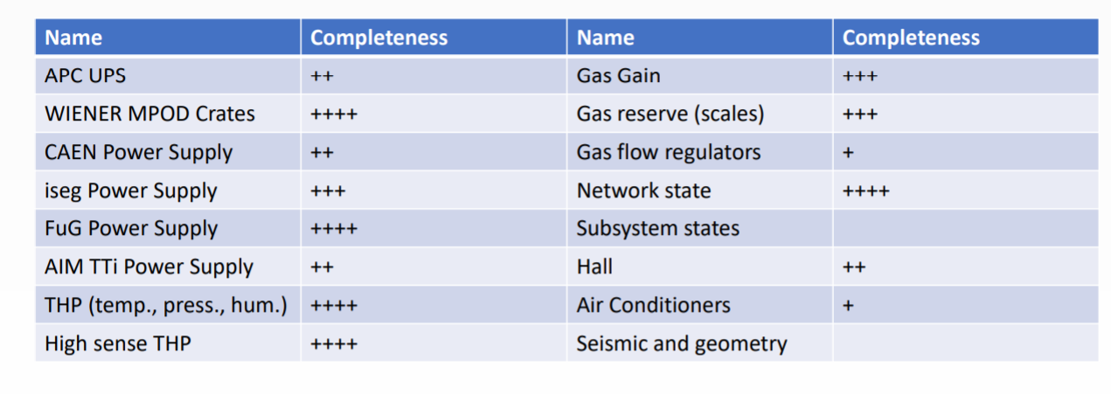
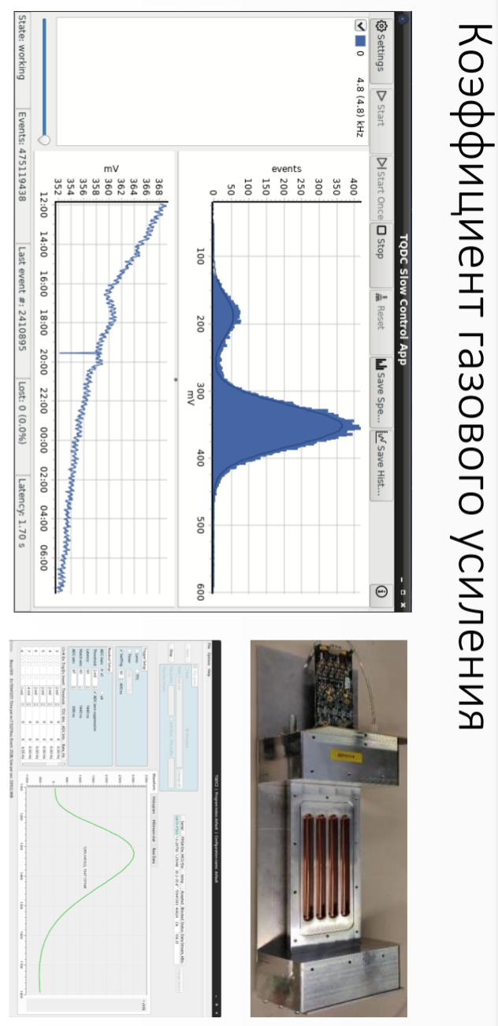
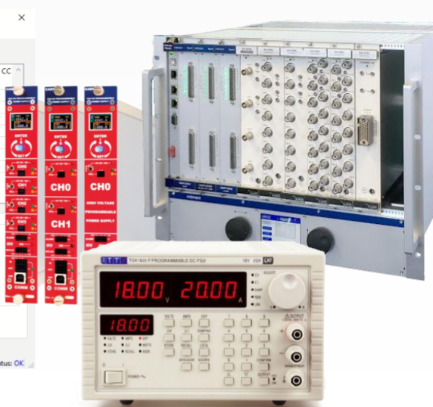
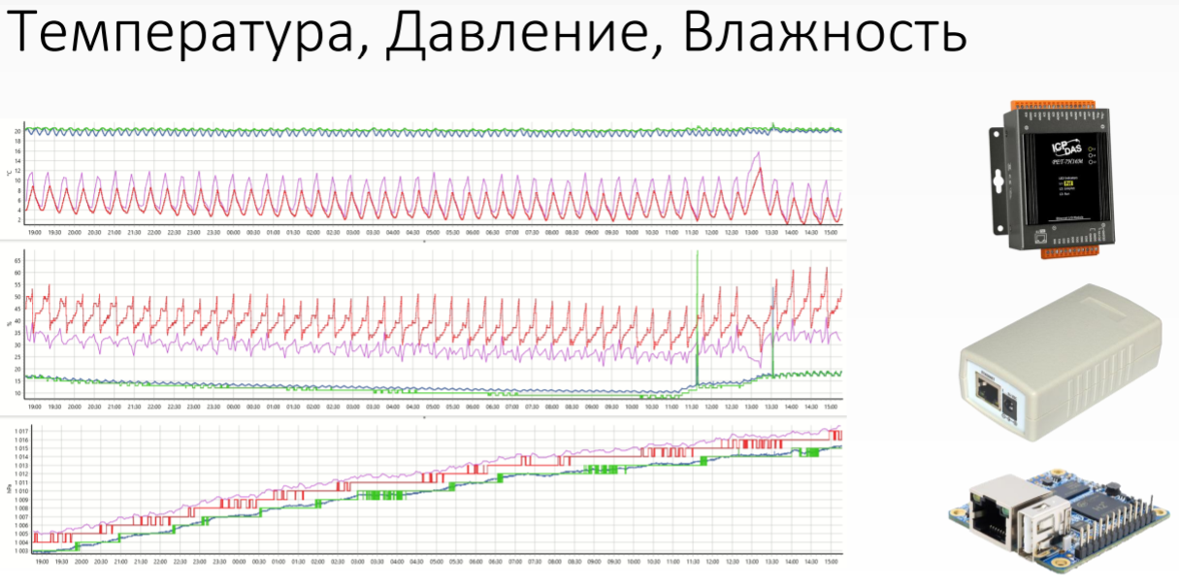
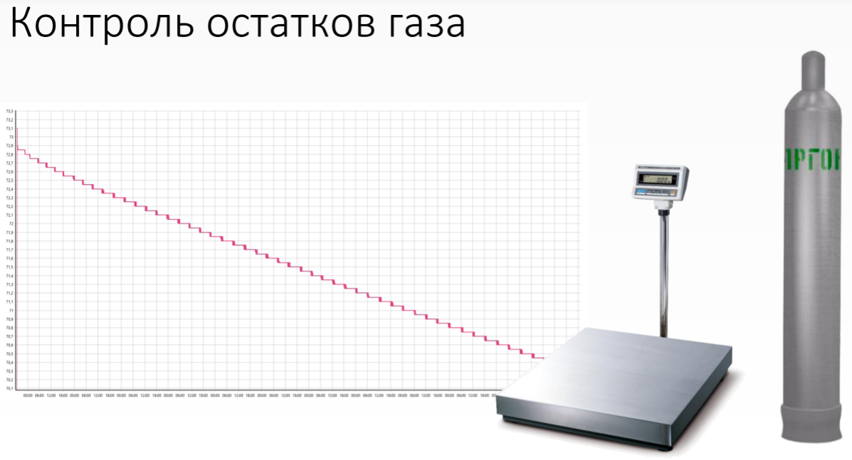
DCS

Slide 11
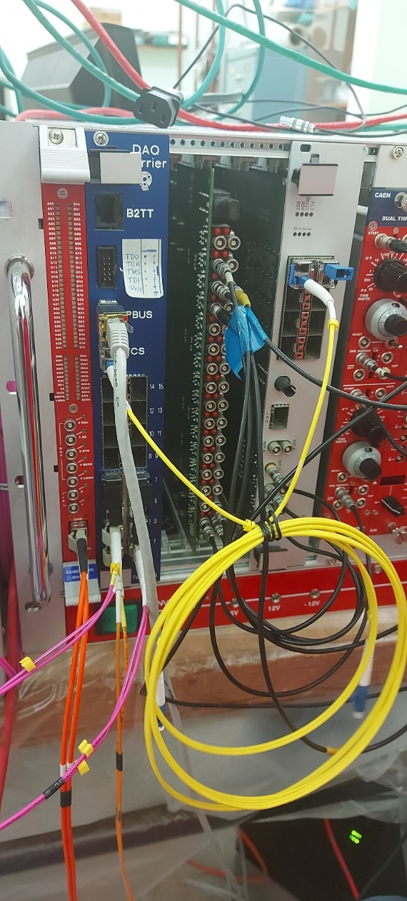
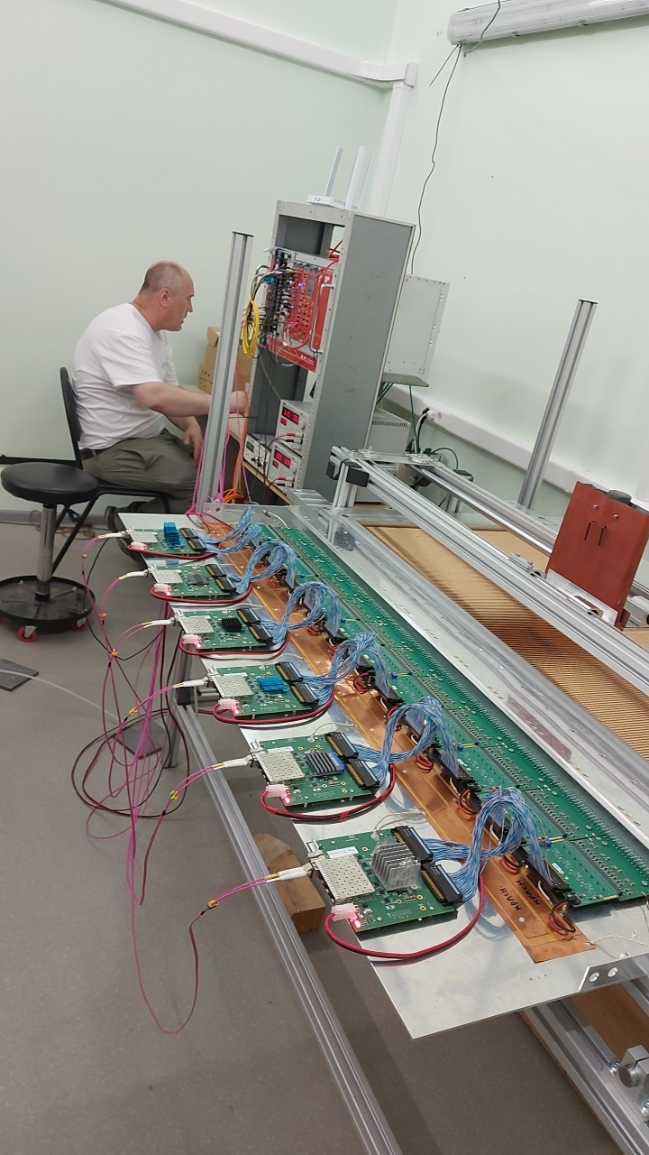
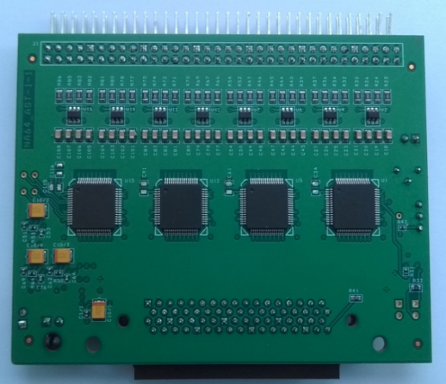
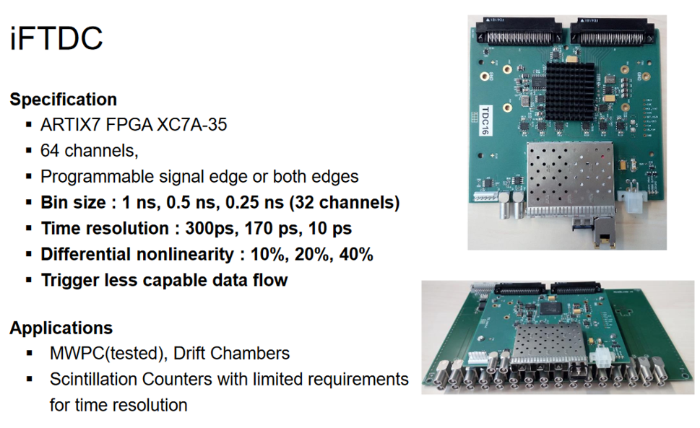
DAQ protoSPD
FFE Electronics are based AST-1-1 from Belorus
Straw+RS
Notes:
let me tell you about the work that has been done over the past 2 years. in this report I would like to tell you about the miniSPD installation that is currently functioning.
several teams participate in this work
on this slide you will see a more detailed arrangement of elements on the stand. From top to bottom you can see the location of the detectors. As a result, we have the following detectors today: three scintillation counters, three sicilicon detectors, two straw chambers, two GEM detectors, electromagnetic calorimeter and lead filter,DAQ and slow control systemperform tests with existing electronics and cameras on the electron beam DLNP
development and production of a prototype of a tracker barrel part
conducting work on the use of VMM3a electronics for the straw tracker prototype
perform tests with existing electronics and cameras on the test zone NICA SPD
work on the development of the slow control system at the miniSPD facility
training of personnel to work on the basic installation in the future
the main coordinator of technical and engineering work is Evgeny Martovitsky
the main coordinator of data analisis and software is Saha Gribovski

Slide 12
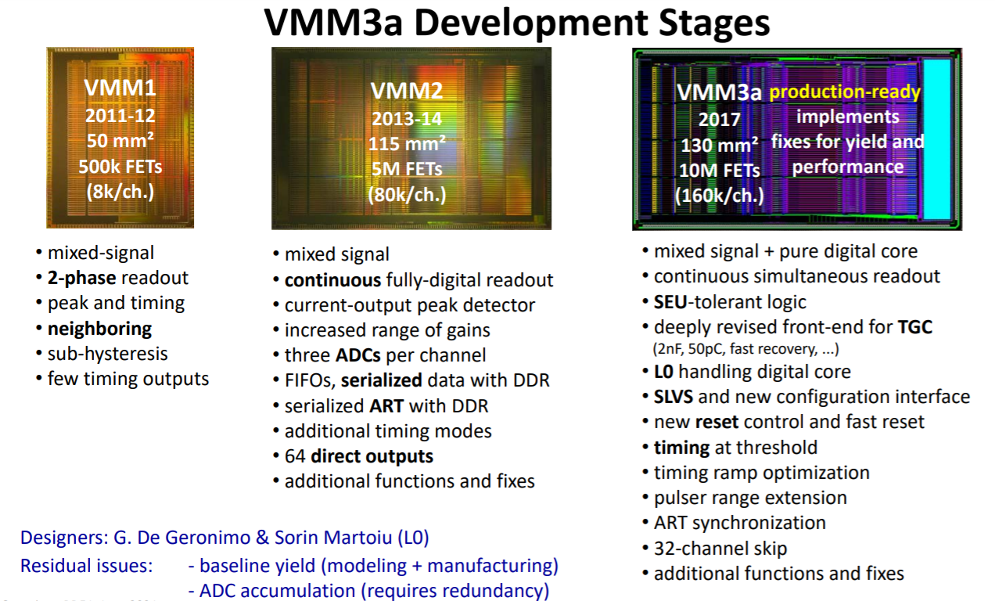

Slide 13
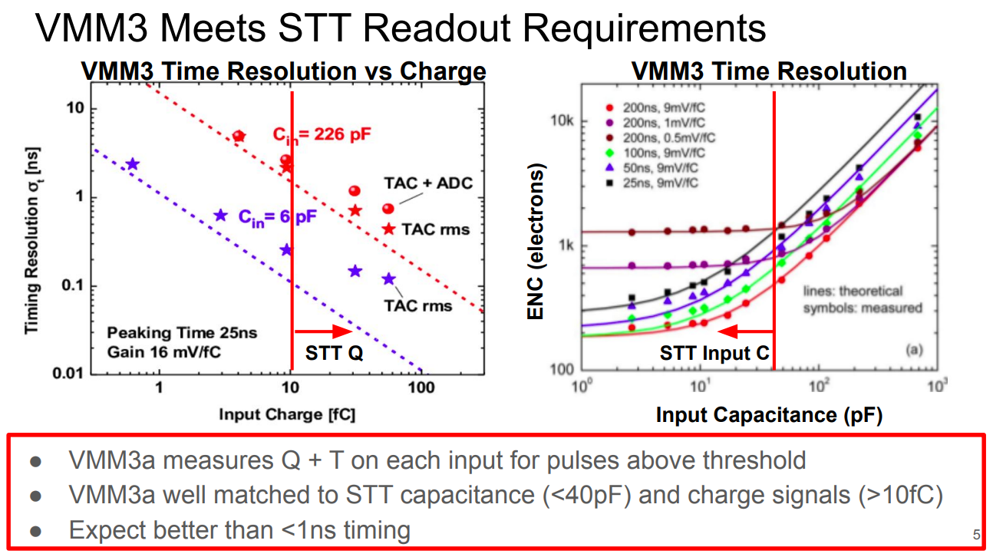

Slide 14
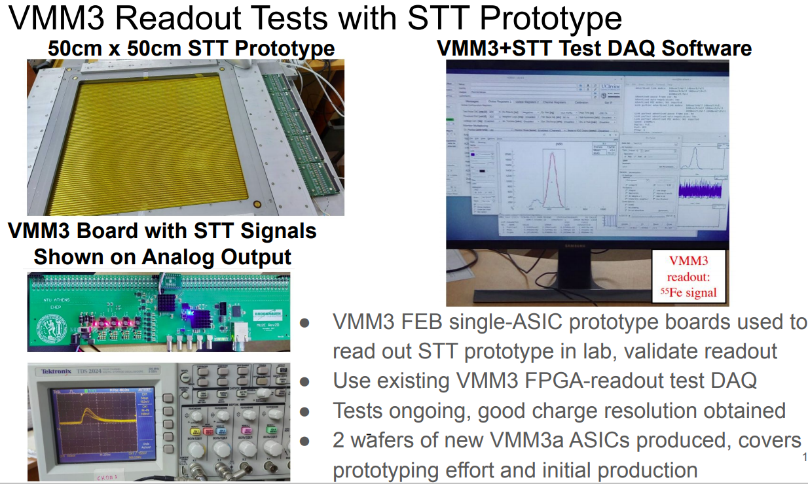

Slide 15
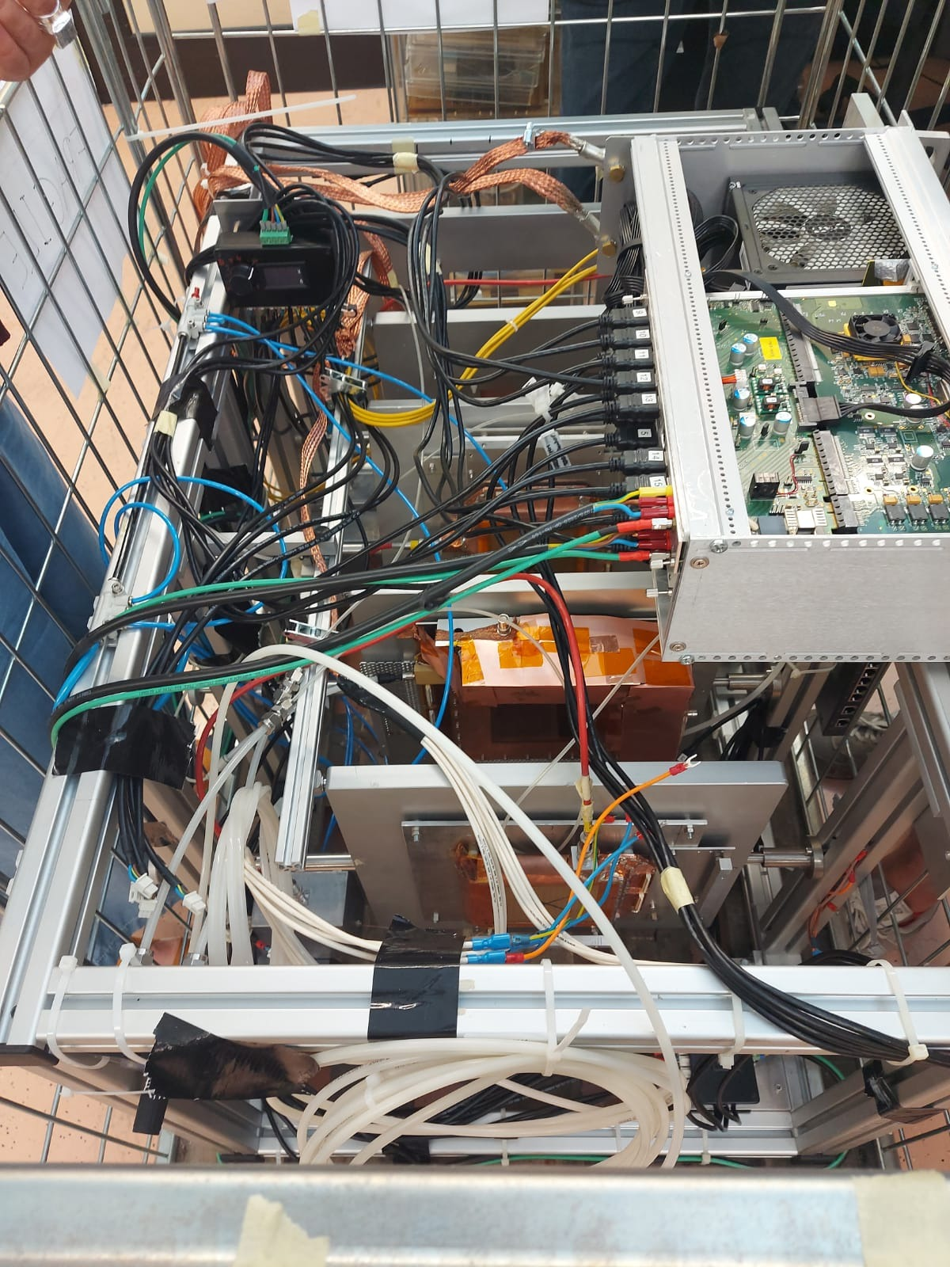
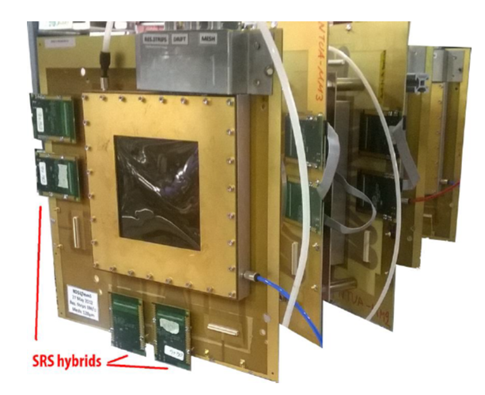
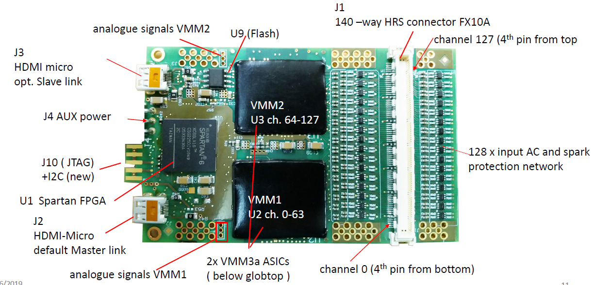
RD51 setup
GEM telescope with SRS readout

Slide 16
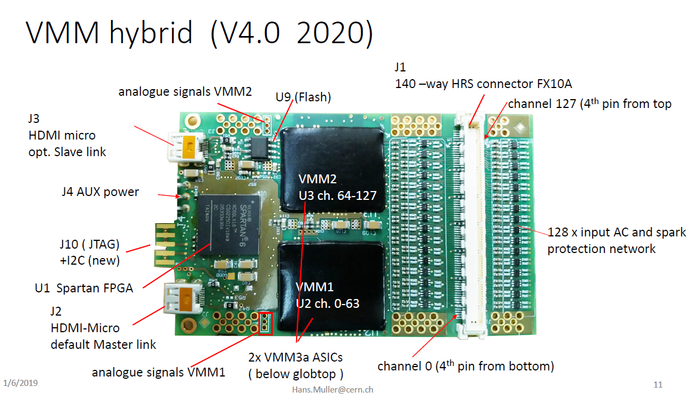

Slide 17
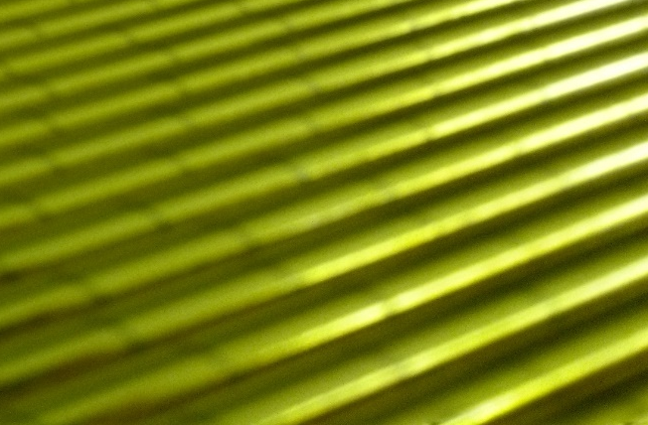
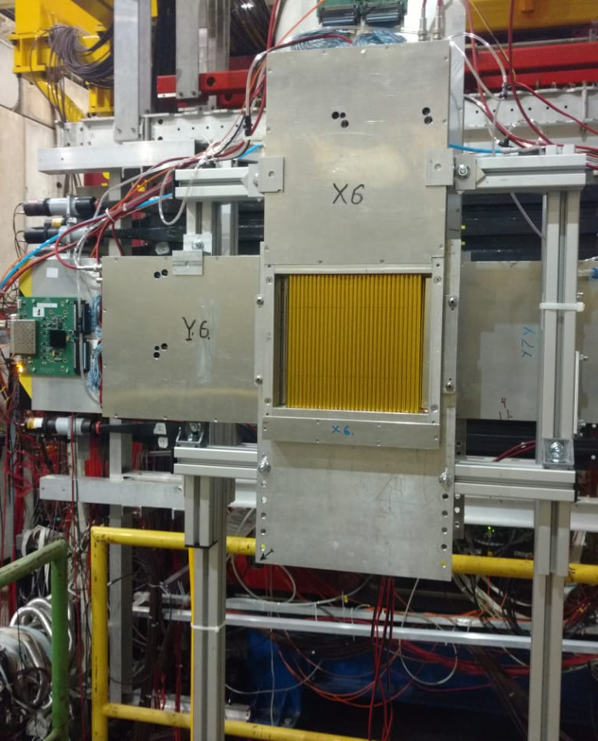
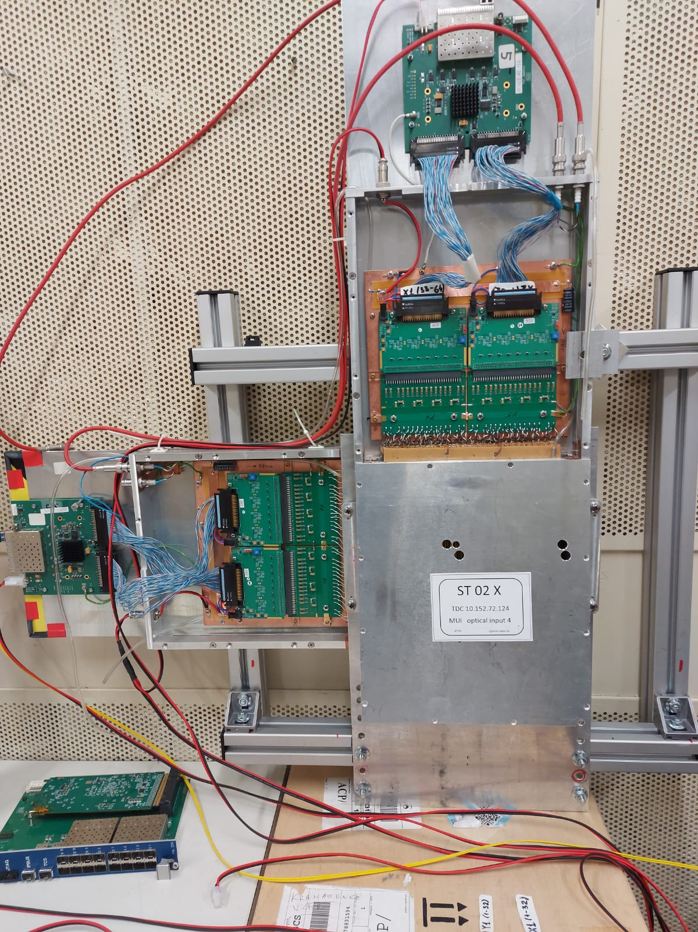
Straw tracker NA64
64chan TDC
2x32chan Preamp
200x200mm
D-6mm
4layer-XXYY

Slide 18

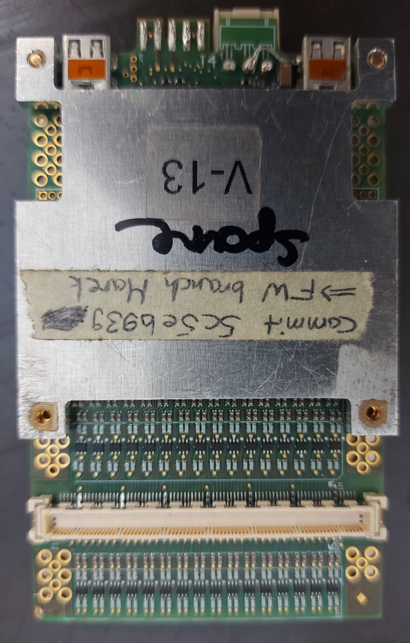
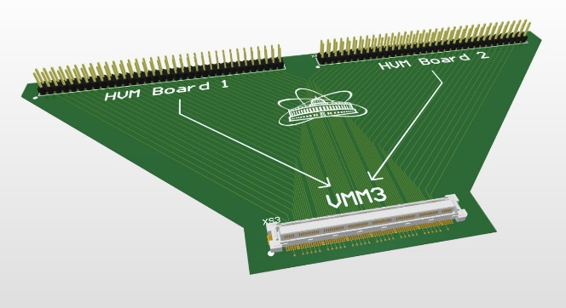
it is planned to start the experiment at the end of October
connection board between VMM3 and Straws Tracker

Slide 19
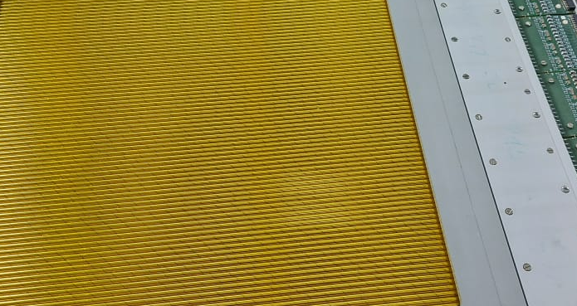
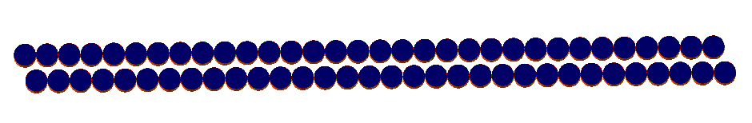
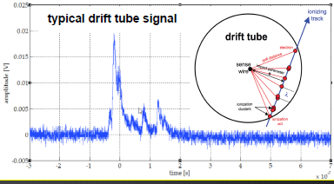
STRAW chamber 200x200mm
4 layer - XXYY
Diameter straw-6mm
Diameter anod-30mkm
Gas Ar:CO2/70:30
Drift time – 60nsec
6mm

Slide 20


Slide 21


Slide 22


Slide 23



Oct/Nov RD51 test beam H4 SPS CERN
RD51, GDD, UNIANDES, GSI, HIP, JINR(Dubna),PNPI(Gatchina)
Setup Description
Electronics:
1 Crate
2 FECs + 2 DVMMs + 2 PMX Boxes
1 CTF Card
16 Hybrids (1 disconnected from HDMI)
Detectors:
3 GEMs, 10cm x 10xcm
2 scintillator trigger NIM signals
1 XY Straw detector

Slide 24

VMM3a

