Slide 1
MRPC of SPD-TOF
Yi Wang
Tsinghua University

Slide 2
Outline
Multigap Resistive Plate Chamber (MRPC)
MRPC: at the R&D frontier: high rate + high time resolution
MRPC for SPD-TOF
Conclusions

Slide 3
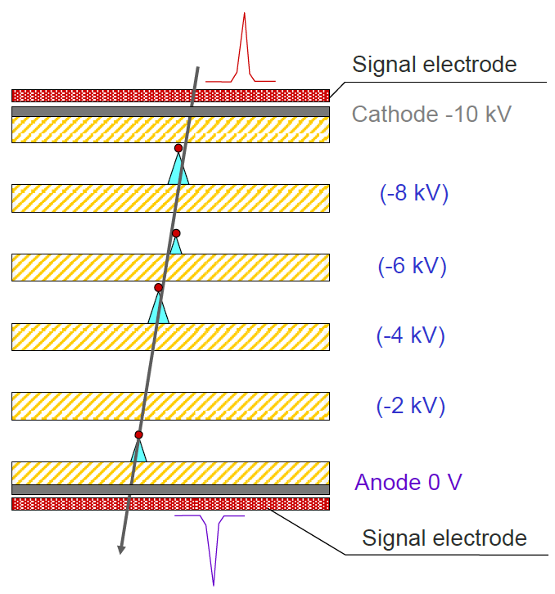
Multigap Resistive Plate Chamber
First proposed by E. C. Zeballos
MRPC has been broadly adopted to construct the Time of Flight (TOF) systems in HEP experiments.
In construction
Proposed
 | ALICE | STAR | FOPI | BESIII | CBM | SoLID
Active area per detector (cm) | 120 x 13 | 22 x 8.4 | 90 x 4.6 | 0.5x(9.2+14.8)x32.8 | 33 x 27.6 | --
Total active area (m²) | 141 | 50 | 5 | 1.33 | 120 | 10
Pad size (cm) | 3.7 x 2.5 | 6.3 x 3.1 | 90 x 0.3 | (9.1~14.1) x 2.4 | 27 x 1.0 | (16~28) x 2.5
Gap×thickness(mm) | 10 x 0.25 | 6 x 0.22 | 6 x 0.3 | 12 x 0.22 | 10 x 0.25 | 10 x 0.25
Gas mixtures (C₂H₂F₄/ C₄H₁₀/SF₆) | 90/5/5 | 95/5/0 | 85/5/10 | 90/5/5 | 90/5/5 | 90/5/5
Operating field (kV/cm) | 96 | 107 | 110 | 109 | 110 | 106
Efficiency | 99.9% | 95-97% | 97±3% | 99% | 97% | 98%
Time resolution(ps) | 40 | 60 | 73±5 | 60 | 60 | 20 ps
Max rate (Hz/cm²) | 50 | 10 | 50 | 50 | 30k | 20k
The multigap structure brings:
Narrow gap thus high time precision
Necessary gap thickness for good efficiency
The next generation MRPC applications mark the higher counting rate and time precision.

Slide 4
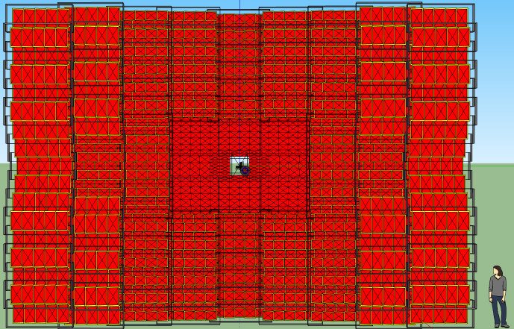

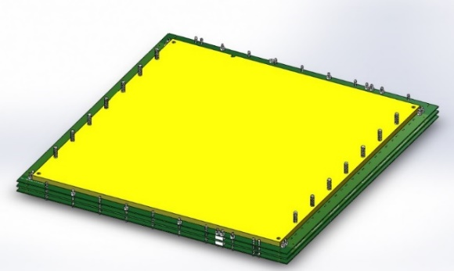

Expanding the MRPC rate capability
One must control the voltage drop (efficiency loss) when incident flux goes up.
MRPC2 with low-resistive glass will be applied in CBM-TOF wall, and has been operating at FAIR-Phase 0 programs like STAR-eTOF and mCBM
Decrease the resistivity of the electrodes
Rate capability verified through beam test: 93%, 80ps@70kHz/cm²
With the low-resistive glass developed in Tsinghua, resistivity has decreased by 2 orders of magnitude.
(common float glass: 10¹² Ωcm, low-resistive: 10¹⁰ Ωcm)

Slide 5
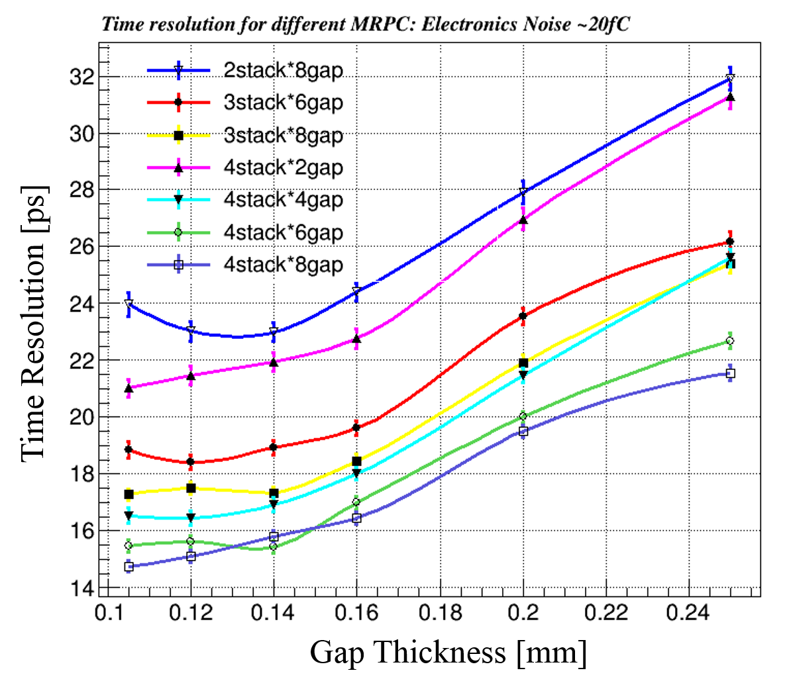
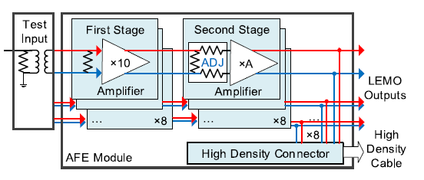
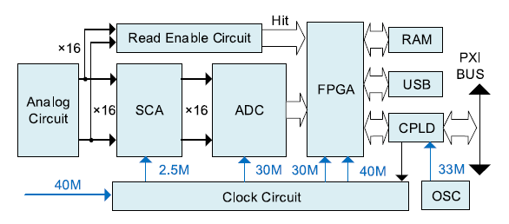
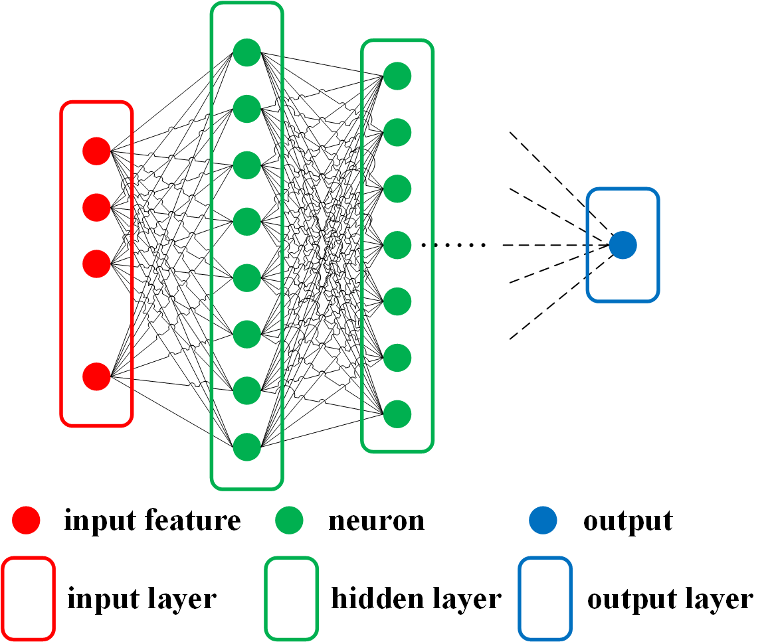
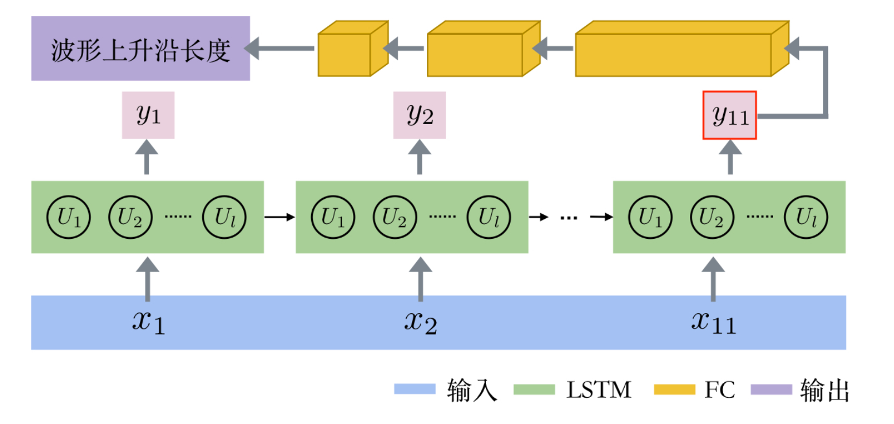




Towards a time precision < 20 ps
Time over Threshold (ToT) method
– Leading and trailing time
Simulation indicates proper ways to design the gap thickness and arrange the stacks
Waveform sampling technology
Nucl. Instrum. Meth. A 925 (2019) 53.
Fast-End Electronics:
Bandwidth: 1.4 GHz
Gain: 26-40 dB
Noise (NSD): < 1.5 nV/√Hz
Waveform Digitization:
Sampling freq.: 5 GS/s
Noise ampl.: 0.5 mV
$$σ_{t}$$
$$⨁$$
$$σ_{t}$$
$$< 5 ps$$
Waveform provides detailed information of avalanche that allows more calibration methods.
Narrower gap thickness required
Besides the ‘intrinsic’ time resolution of the detector, it is also crucial to develop an advanced readout technique.
An LSTM model for signal leading edge recognition and time calibration
An MLP neural network for position calibration

Slide 6
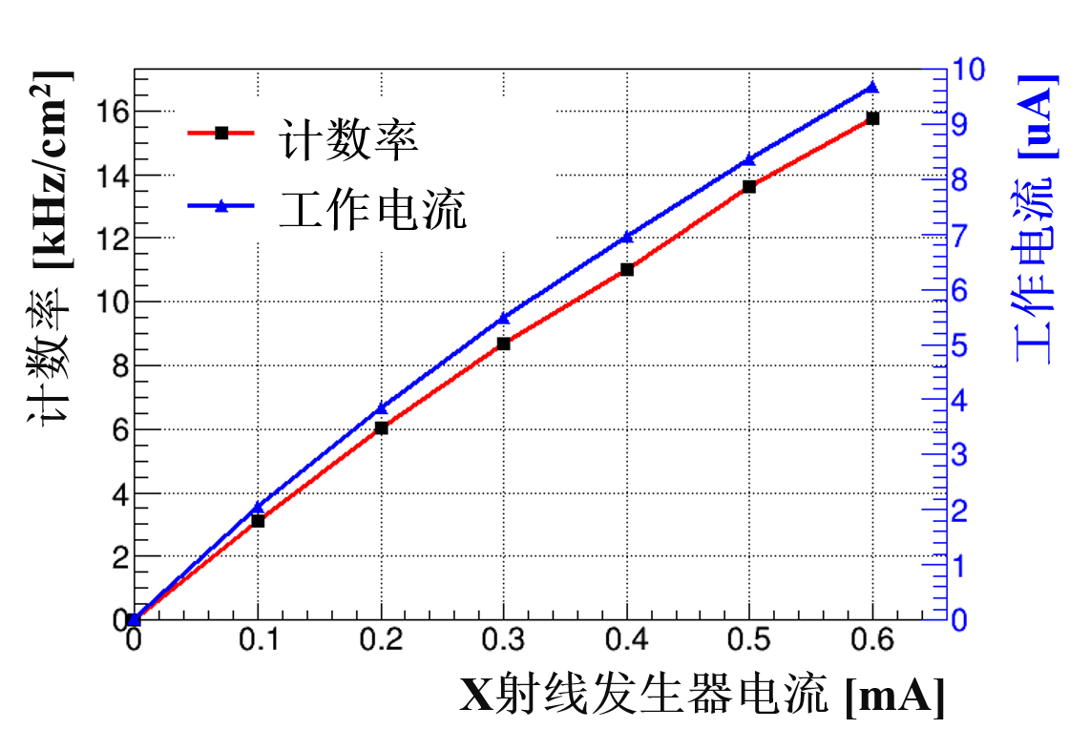
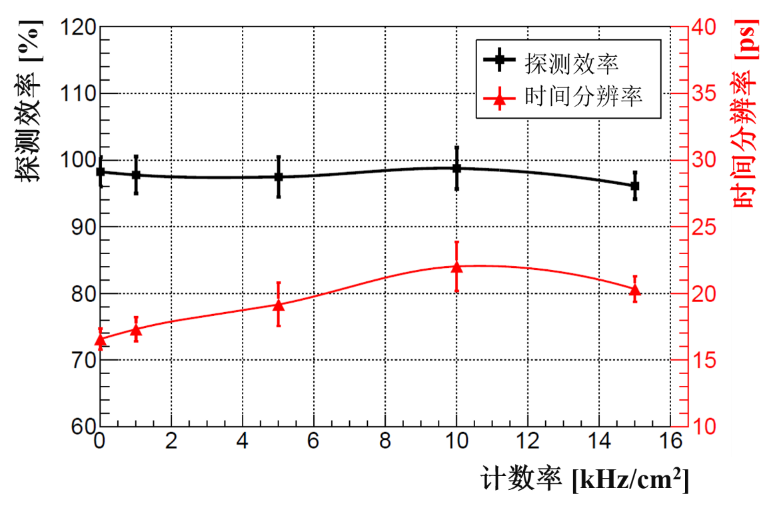
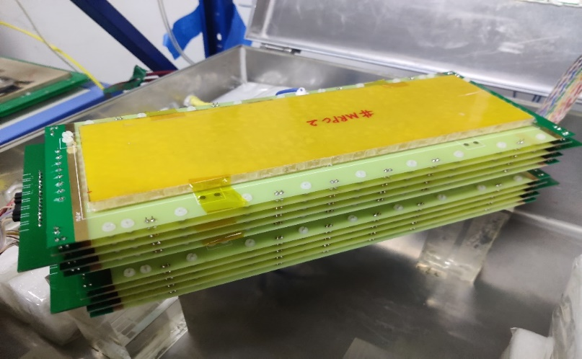
The high-rate high-resolution prototype
Two prototypes has been assembled and tested.
Counting rate
Current
Parameter | Value
Gap thickness (mm) | 0.128
N of gaps | 4 x 8
glass | Low-resistive
Glass thickness(mm) | 0.4
Strip interval (cm) | 0.5 width + 0.2 gap
The high rate test is carried out by discriminating cosmic event in X-ray irradiation.
Operating current
Counting rate
S0
Current of X-ray source
X ray source
Efficiency
Time resolution
Efficiency
Time resolution
Top MRPC
Bot MRPC
~ 20 ps achieved at high rate!
S1
Counting rate

Slide 7
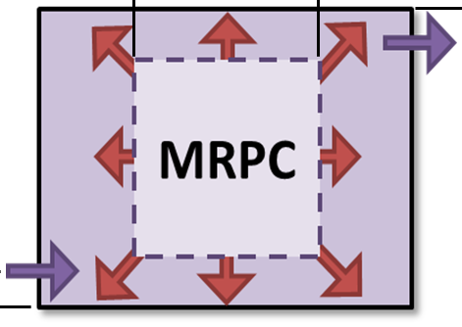
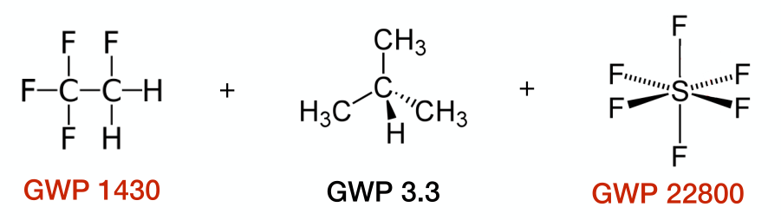
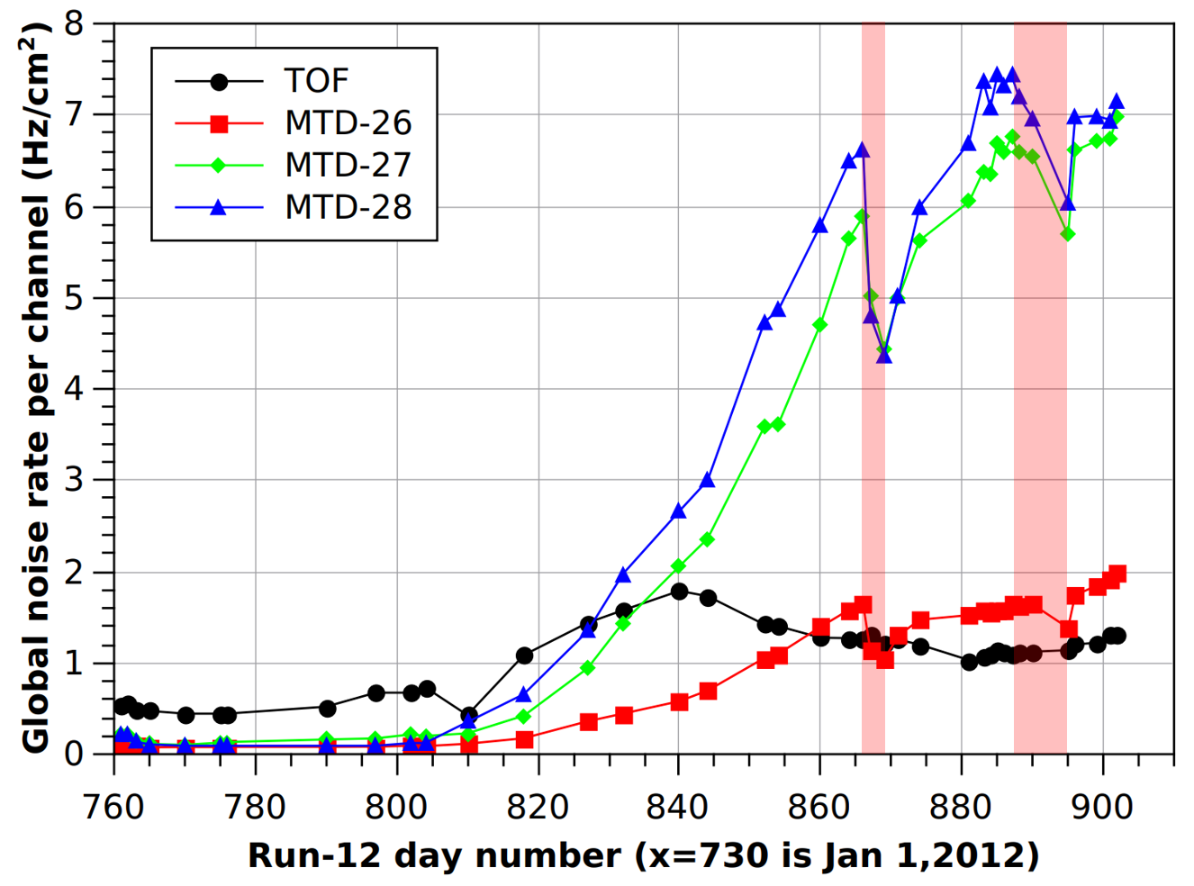
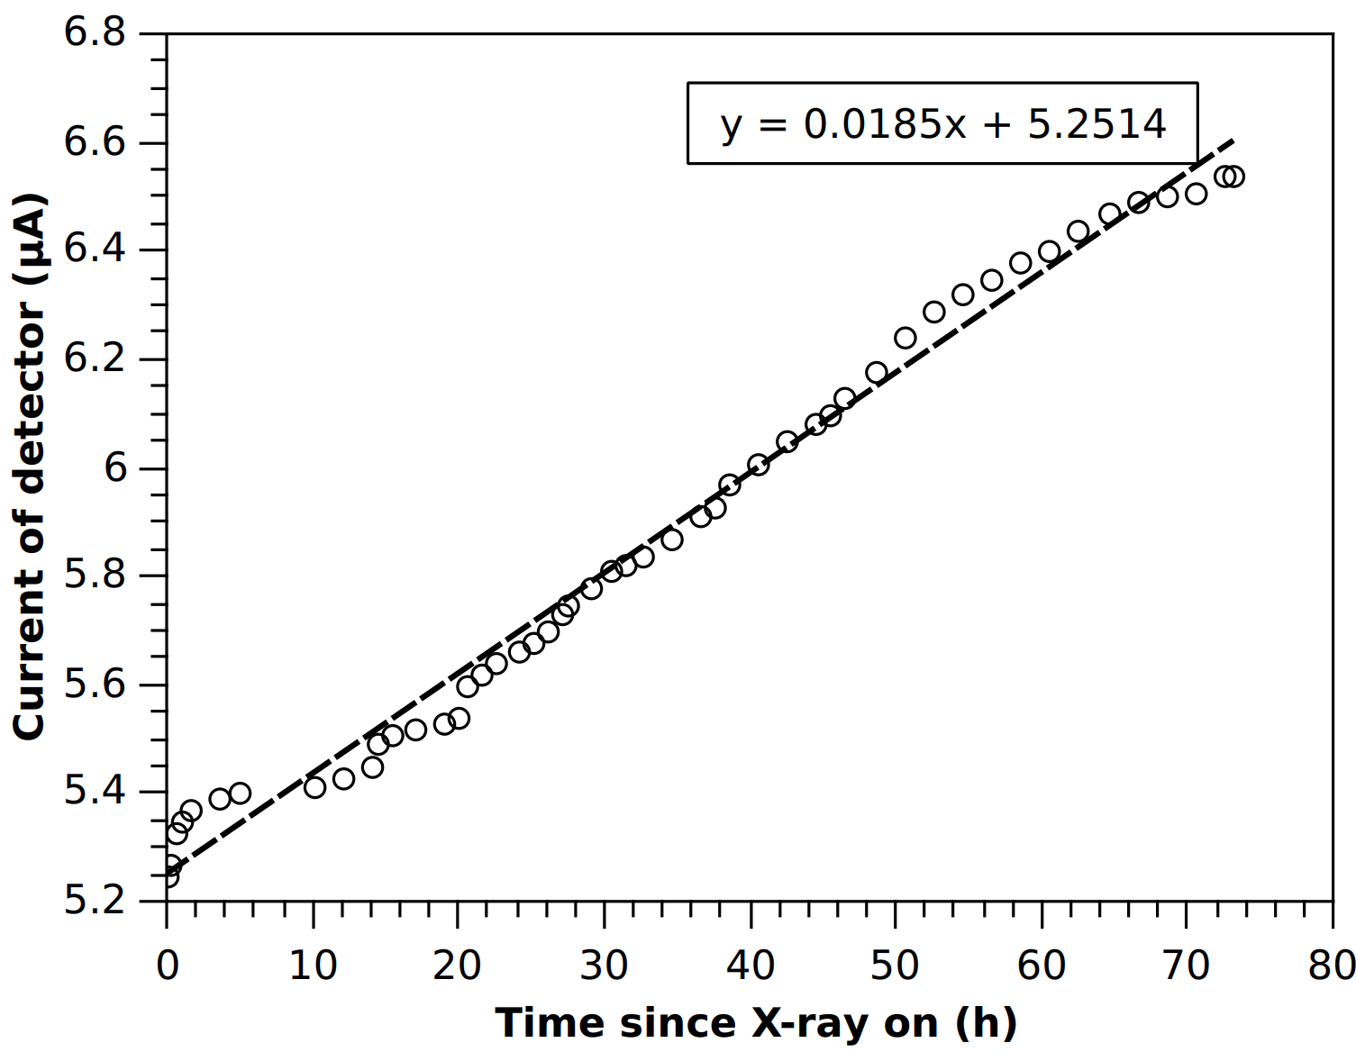
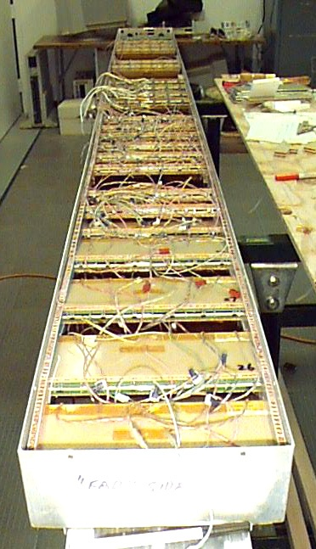
Gas-related challenges of MRPC
Regulations against greenhouse gases causes uncertainty:
availability, cost, eco-impact, …
Gas pollution effect in high rate conditions
Narrow gap of MRPC and large gas volume ---
ionization products exchanged slowly by diffusion
…observed in HEP experiments and lab tests.
Application with large area:
gas flow, cost, leakage, …
Constant rate condition of 1kHz/cm²
Pollution caused noise and current rise
Motivation: A wise design of the gas volume shall promote the gas exchange and decrease the gas consume.
STAR-TOF (left) and CBM-TOF (right) detectors in gas boxes forming a module

Slide 8
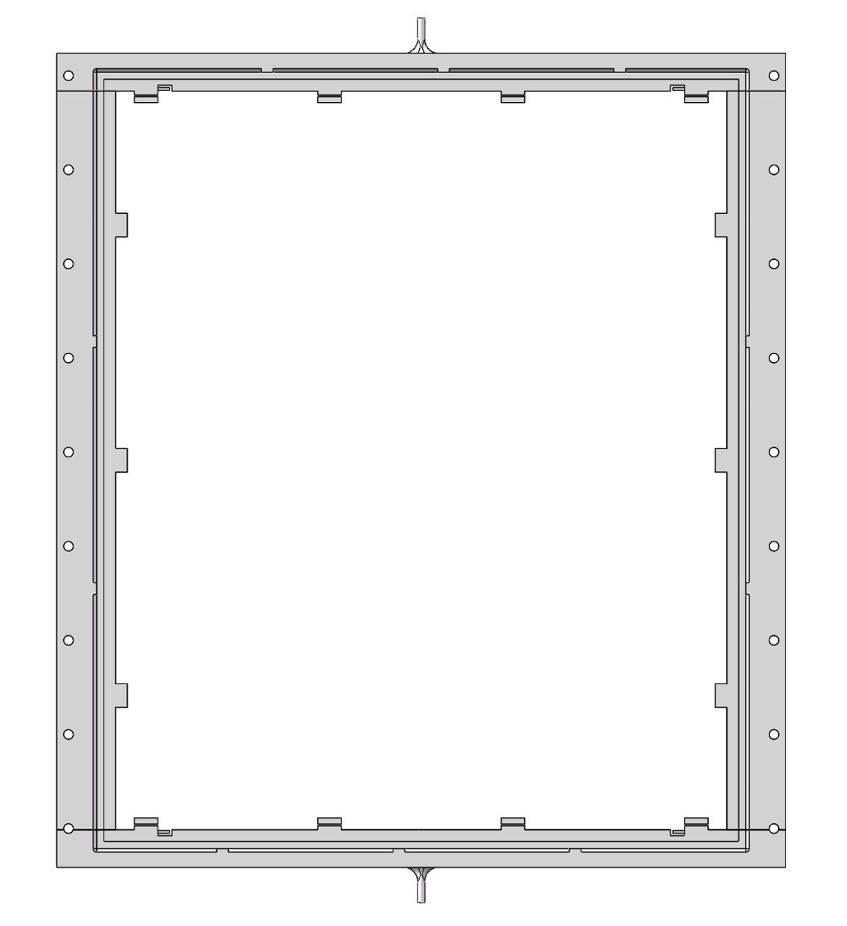
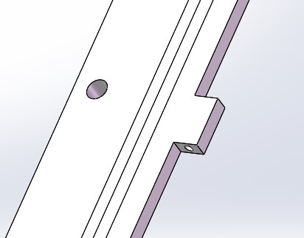
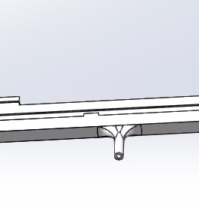
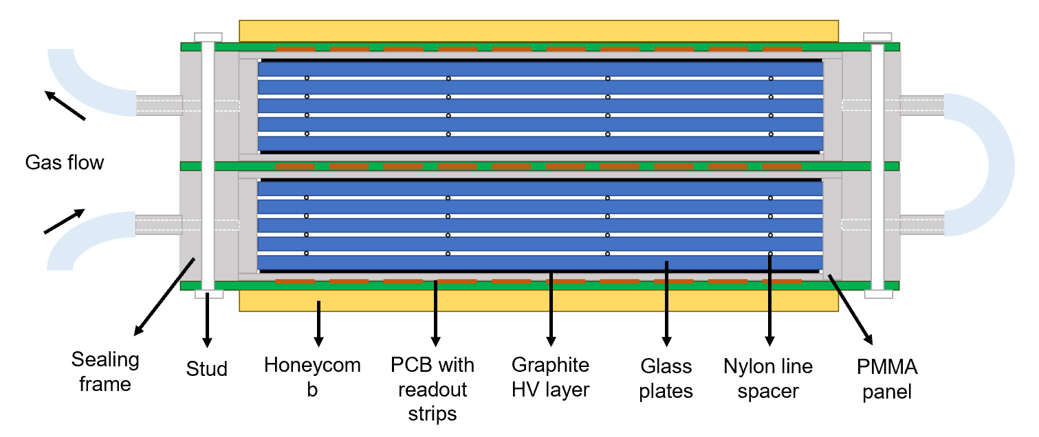
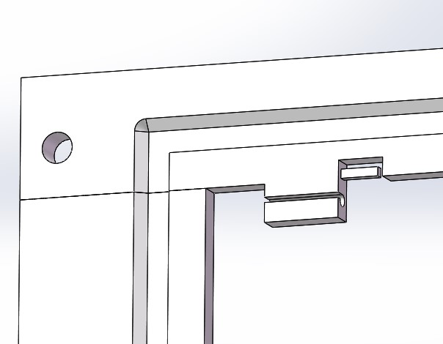
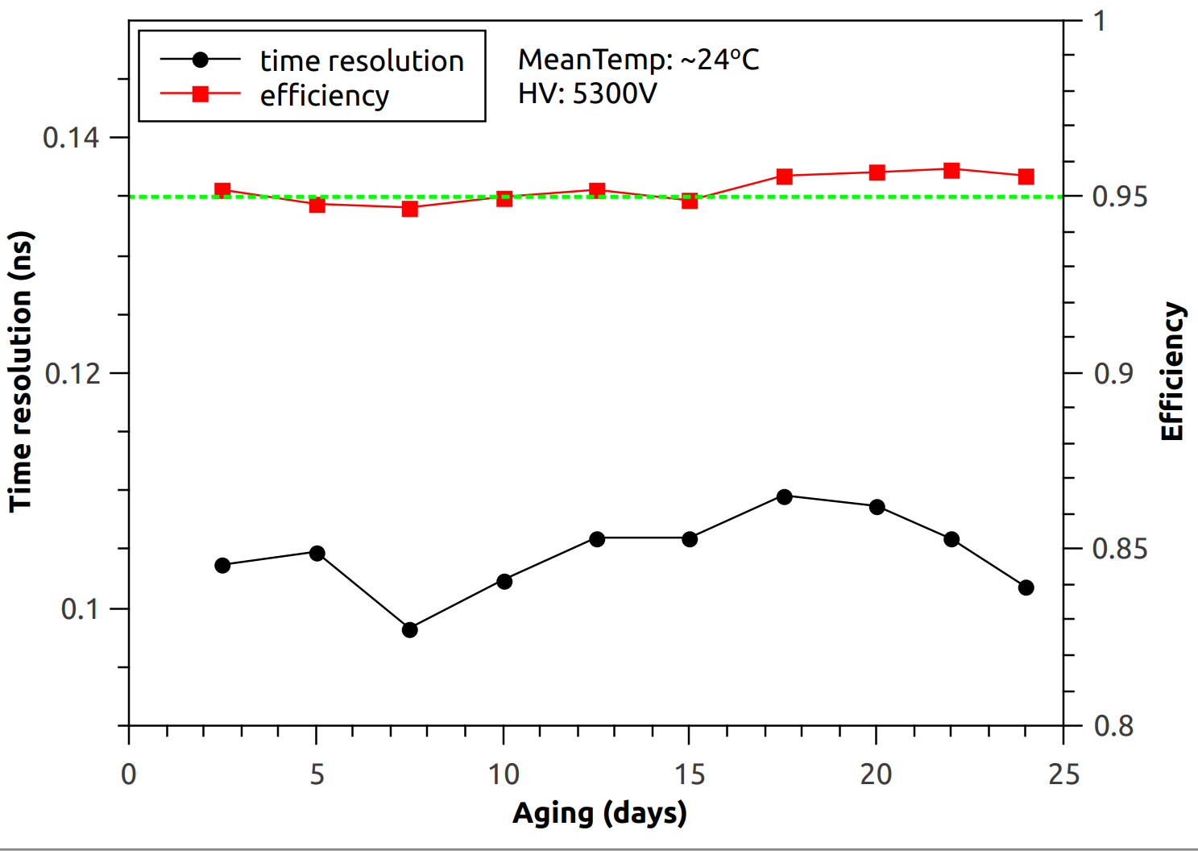
Sealed MRPC
Gas tube
Inlet/outlet
Fishline hook
3D printed sealing frame with Good strength, insulation and radiation persistency
With the lateral side mostly enclosed, the counter itself becomes a gas box. The sealed design brings the features of:
1. Gas saving: 20 sccm/m² gas flow with common practice
With cosmic ray test of a counter, 1 mL/min flow is examined with stable operation for the tested 24 days!

Slide 9
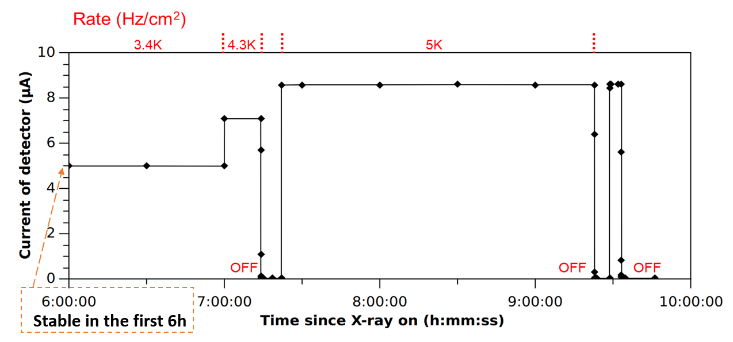
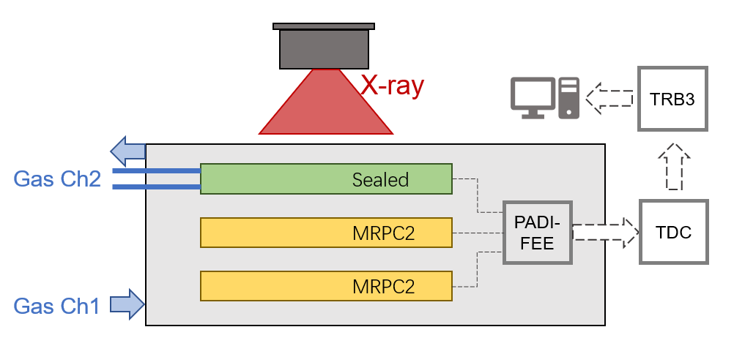
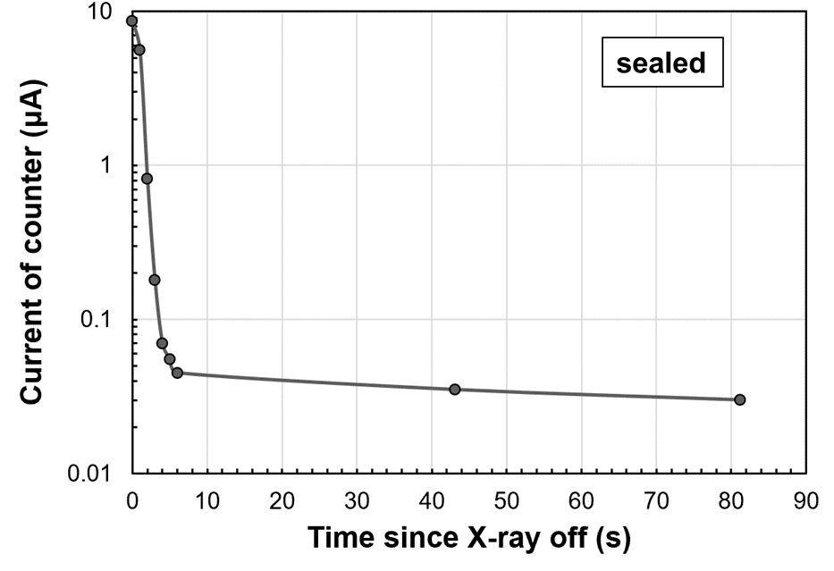
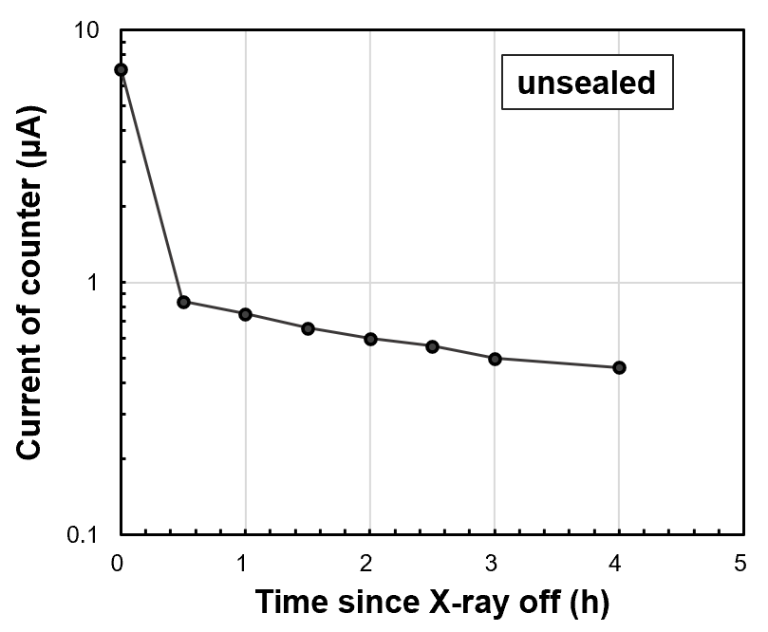
Sealed MRPC
2. Promoted gas exchange
Decrease the wait time of gas purging:
Reach the working HV in 2h since flowing the gas
Excellent current behavior under high rate irradiation:
Stable current with constant rate condition.
Fast decay of dark current since when X-ray is off

Slide 10
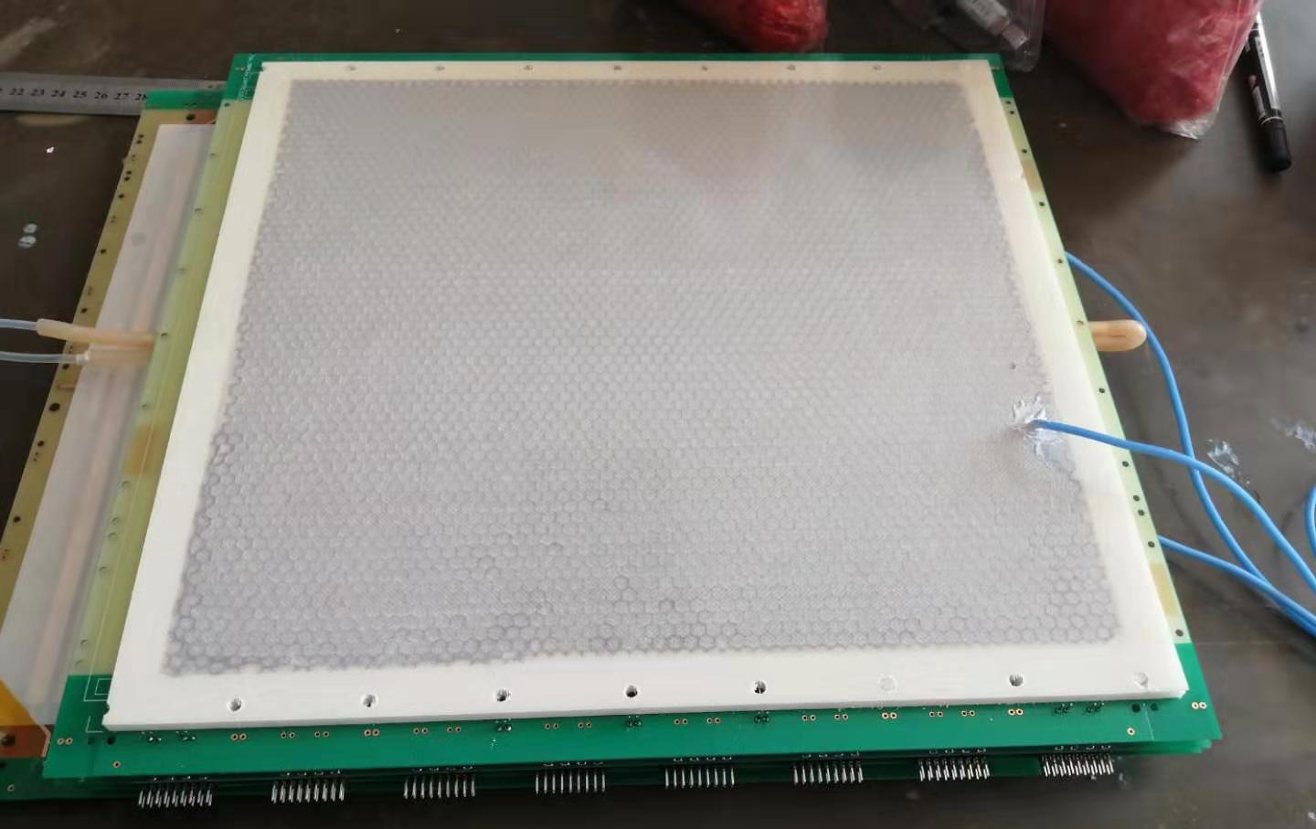
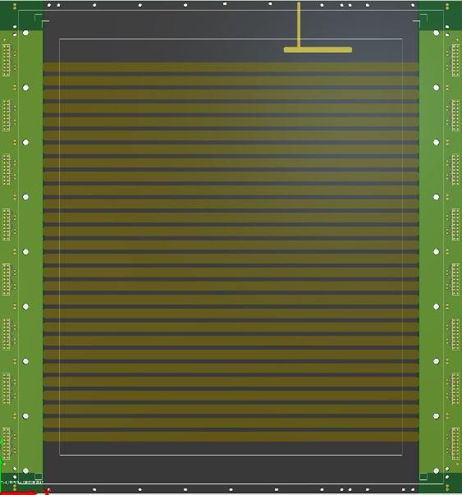
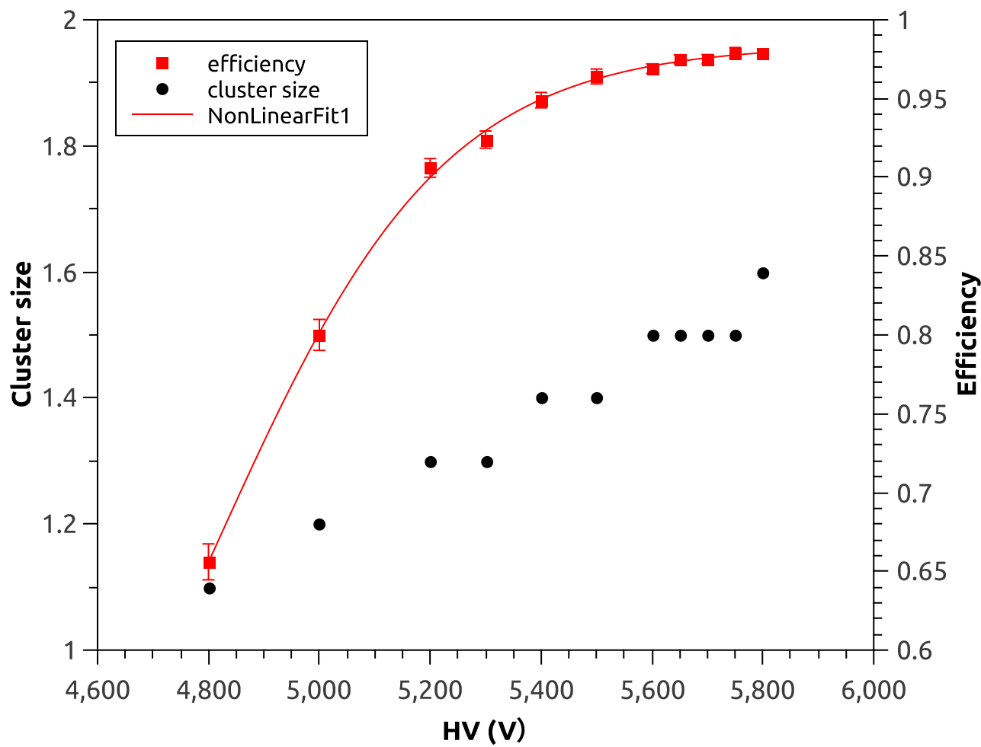
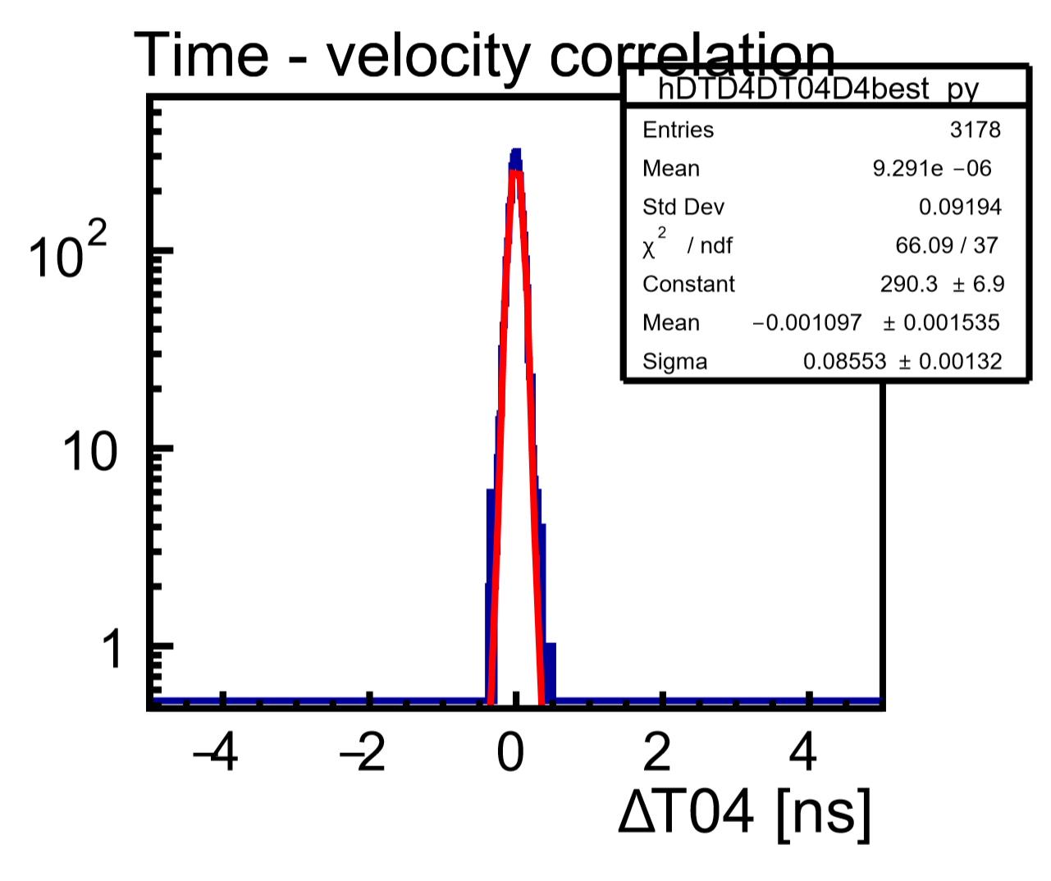
The real prototype for CEE-eTOF
Structure of sealed MRPC prototype
2 stack * 5 gas gap * 0.25mm
Float glass plates of 0.7mm width
32 channels, differential signal
2-end readout
Strip length 27cm, 7mm width+3mm gap
Sealed design, total gas volume ~170ml
Frame edge

Slide 11
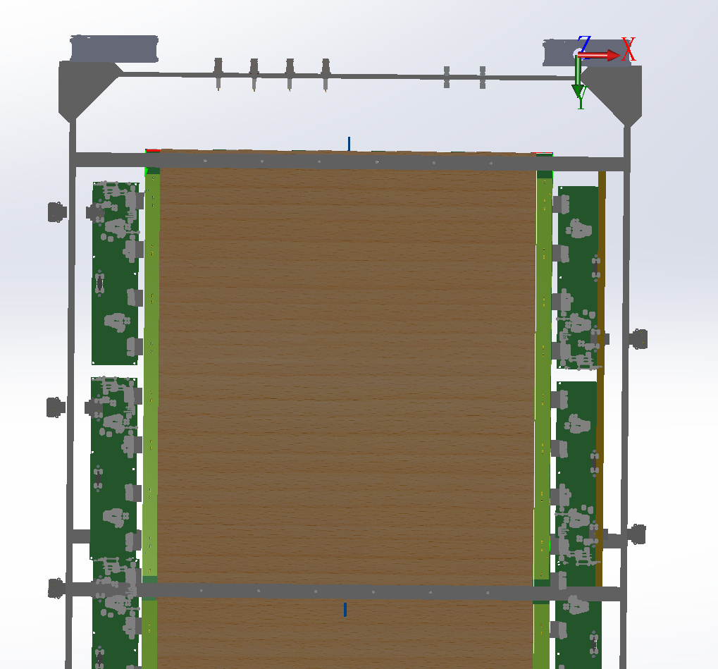
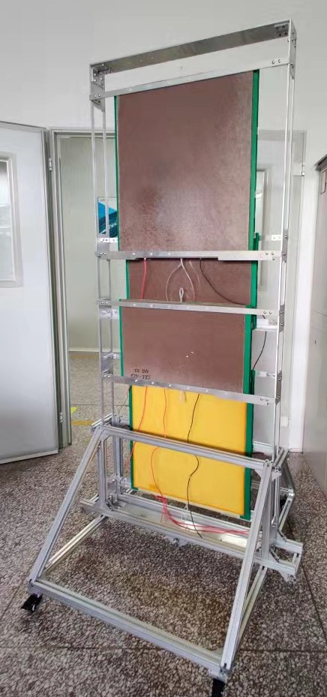
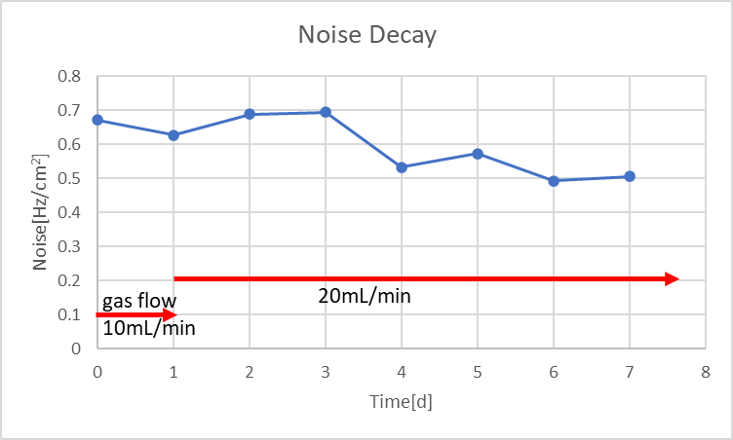
The super module with 4 MRPC
Noise level <0.5 Hz/cm²
Become better after long time training
Four MRPCs, total detection area ∼ 1m²
Working gas: Freon, 20sccm
HV: ±6.5kV
Total dark current: 70nA

Slide 12
Layout of SPD
Requirement for TOF system
PID : e few GeV at distance of 108cm
Time resolution: 70ps
Particle rate: 100Hz/cm²
Total area: 27m²

Slide 13
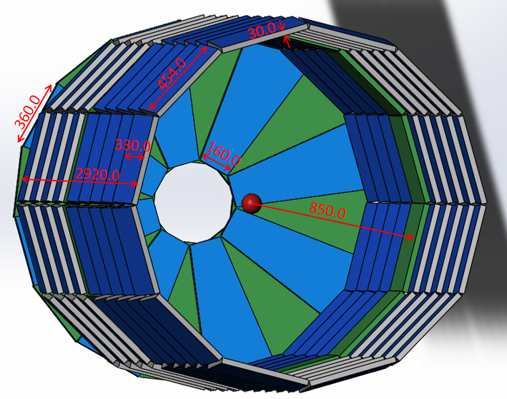
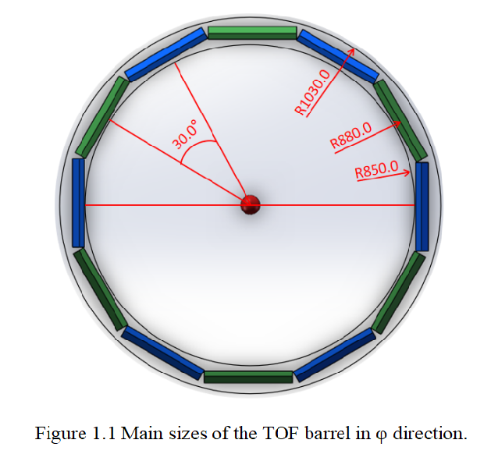
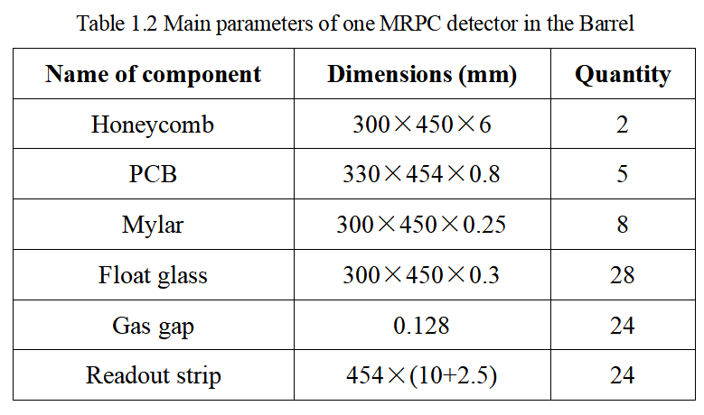
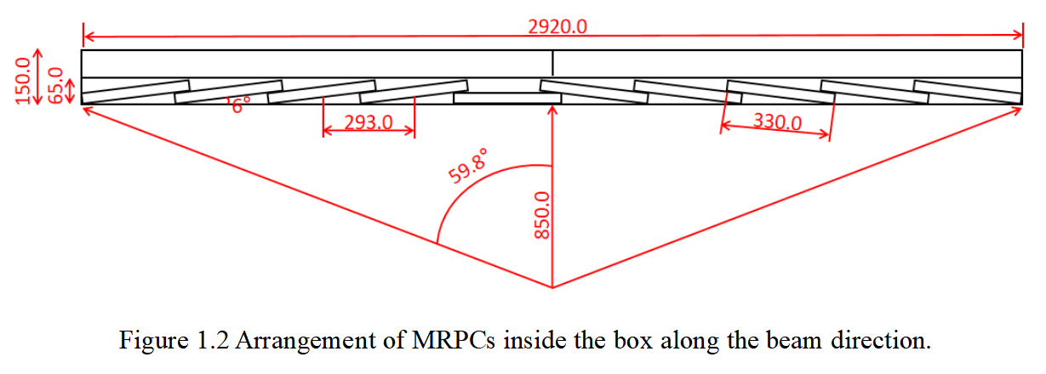
Structure of barrel TOF
12 module for
one circle
Each module consists of
10 sealed MRPC

Slide 14
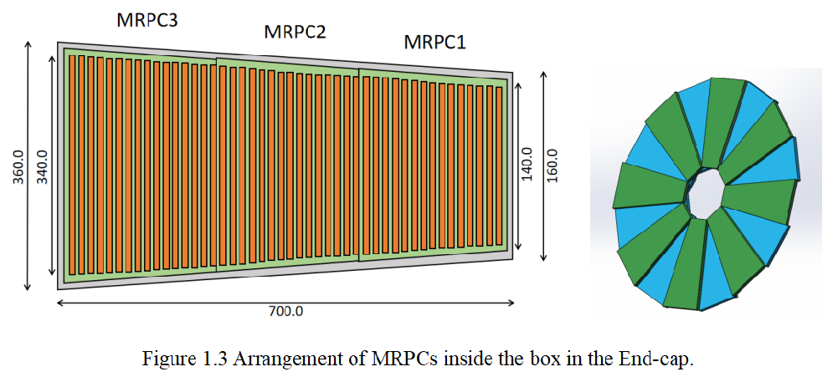
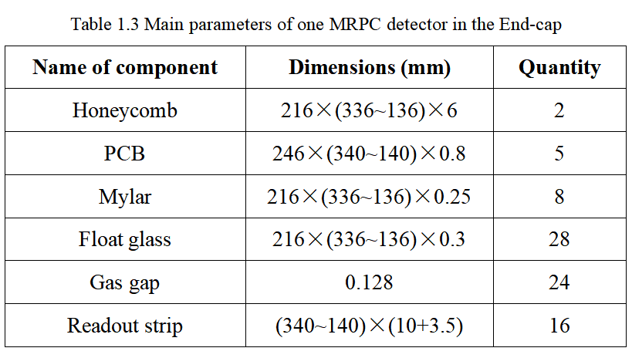
Structure of end-cap TOF
eTOF consists of 16 modules and each module consists of 3 sealed MRPC.

Slide 15
Fast amplifier+Pulse shape digitizer
Fast FEE by USTC
Time digitizer
    SCA (DRS4)：1024 sampling capacitor
    Max sampling rate：5.12 GHz
    Noise：0.5 mV
    Time jitter：3 ps
    Gain：26 dB~40 dB
    Band width：1.4 GHz
    Time jitter：4 ps
Nucl. Instrum. Meth. A 925 (2019) 53.

Slide 16
Ninos + FPGA-TDC
Ninos Asic specifications
Time precision is about 10ps !

Slide 17
Summary
Future HEP experiments calls for MRPCs with high rate capability and excellent time resolution.
Low-resistive electrodes help expand the rate capability.
Narrow gap width and advanced readout chain help improve the timing performance.
Prototype has been examined its 96% efficiency and 20 ps resolution at 20 kHz/cm² rate condition.
MRPC faces gas related challenges which motivates an enhanced gas exchange.
Sealed MRPC with low gas volume can be used in SPD-TOF.
Thank you !

