Slide 2
DIRAC as a service unified access to heterogeneous distributed resources
V. Korenkov¹, N. Kutovskiy¹, V. Mitsyn¹, I. Pelevanyuk¹, D. Podgayny¹, V. Trofimov¹, A. Tsaregorodtsev ³
¹Laboratory of Information Technologies, JINR
³CPPM, Aix-Marseille University, CNRS/IN2P3, Marseille, France
13 December 2021

Slide 3
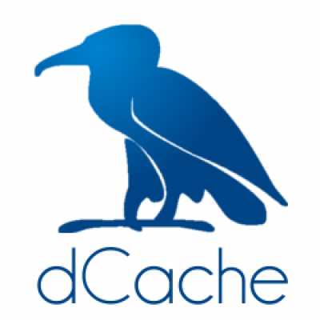
Variety of computing resources
EOS
dCache
Storage
Disk, Tape
Protocol
local, root
GridFTP, root
local
local
Auth Storage
Kerb. , x509
x509
ceph key
HybriLIT
Auth Jobs
Kerb. x509
x509
SSO
HybriLIT
Job Submit.
Slurm Grid
Grid
OpenNebula
Slurm
Component
Tier-2/CICC
Tier-1
Cloud
Govorun/HybriLIT
* This is a simplified schema to demonstrate complexity and variability of protocols and accesses approaches

Slide 4
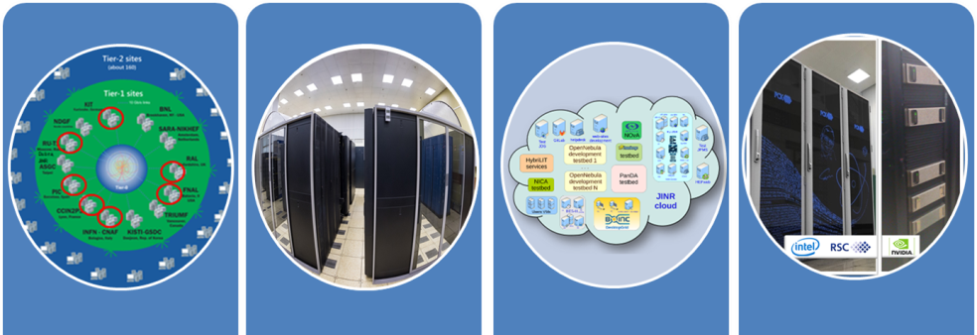
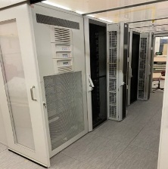
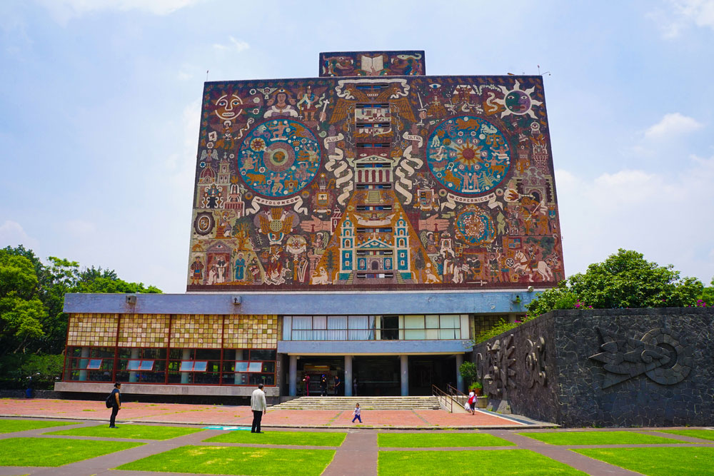
What was done
EOS
Tier-1
CICC/Tier-2
Clouds
Govorun
NICA Cluster
UNAM
Running
Running
Running
Running
Running
Running
The computing resources of the JINR Multifunctional Information and Computing Complex, clouds in JINR Member-States, cluster from Mexico University were combined using the DIRAC Interware.

Slide 5
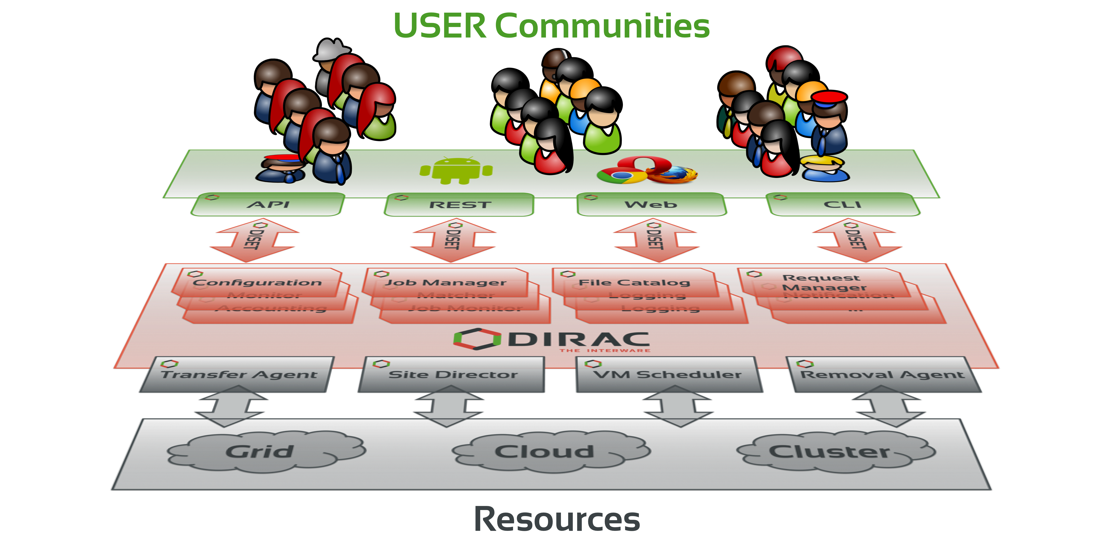
What is DIRAC?
DIRAC is a framework that provides all the necessary components to build ad-hoc grid infrastructures interconnecting computing resources of different types, allowing interoperability and simplifying interfaces. This allows to speak about the DIRAC interware.
Web
CLI
API
REST

Slide 6
Why DIRAC?
1. Single system for all aspects of computing
User Interface
API
Central configuration
Workload management
Data management
Integration tools
File Catalog
Workflow management
Metadata management
Accounting
Management

Slide 7
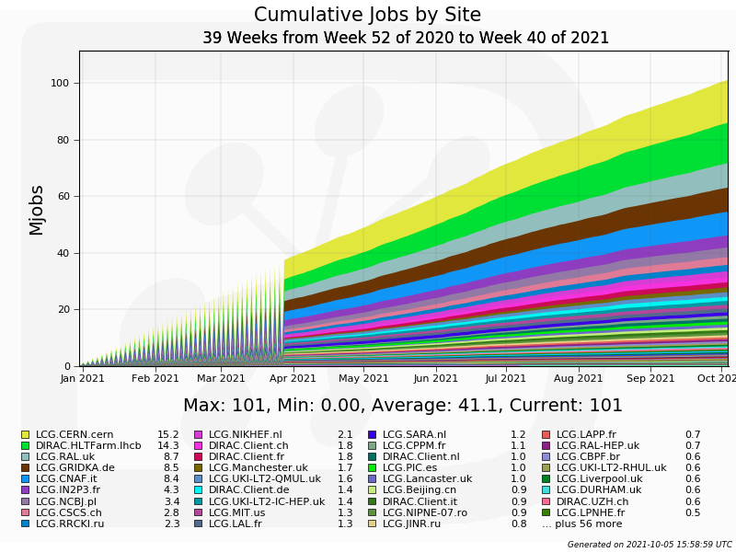
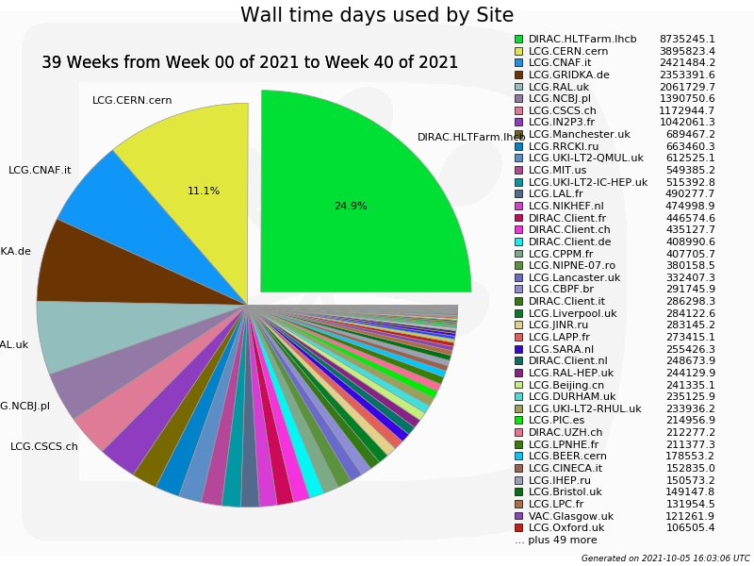
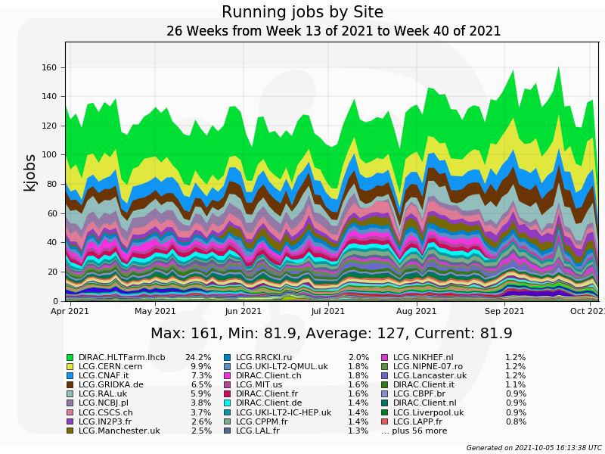
Why DIRAC?
2. Good performance

Slide 8
Why DIRAC?
3. Active users and developers community

Slide 9
History of DIRAC at JINR
2013 – Development of monitoring system for BES-III installation. First tries to setup and configure DIRAC infrastructure.
2017 – DIRAC Interware installed; basic configuration done. Used for educational purposes. dCache storage integrated, Tier2 integrated.
2018 – HybriLIT integrated. JINR cloud integrated using OCCI protocol. Tests of full cycle of Monte-Carlo for BM@N were performed.
2019 – Clouds of JINR Member-States integrated by module developed in JINR. MPD starts using DIRAC for massive Monte-Carlo production. Tier1, Govorun and EOS integrated in DIRAC.
2020 – Folding@Home jobs submitted to clouds via DIRAC. Baikal-GVD jobs submitted to JINR and PRUE clouds.

Slide 10
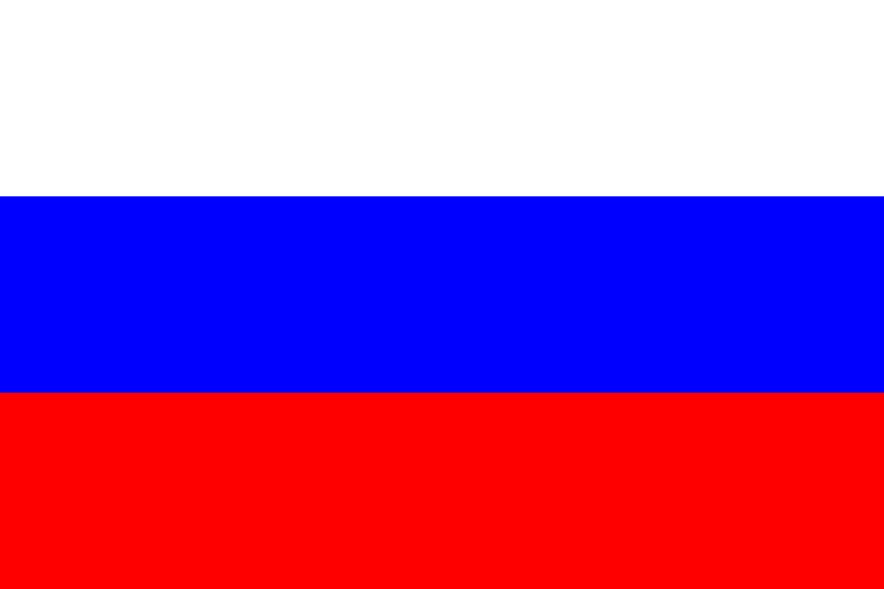
Computing Resources
MPD collaboration
JINR
Tier-1
920 slots
CICC/Tier-2
1000 slots
Cloud
80 slots
Govorun
184-870 slots
NICA Cluster
250 slots
UNAM
100 slots
Clouds
IPANAS
16 slots
INP
132 slots
SU
48 slots
INRNE
20 slots
INP
50 slots
REA Plehanova
132 slots
NOSU
84 slots
STI-SCI
98 slots
Total amount of cores exceeds 3000

Slide 11
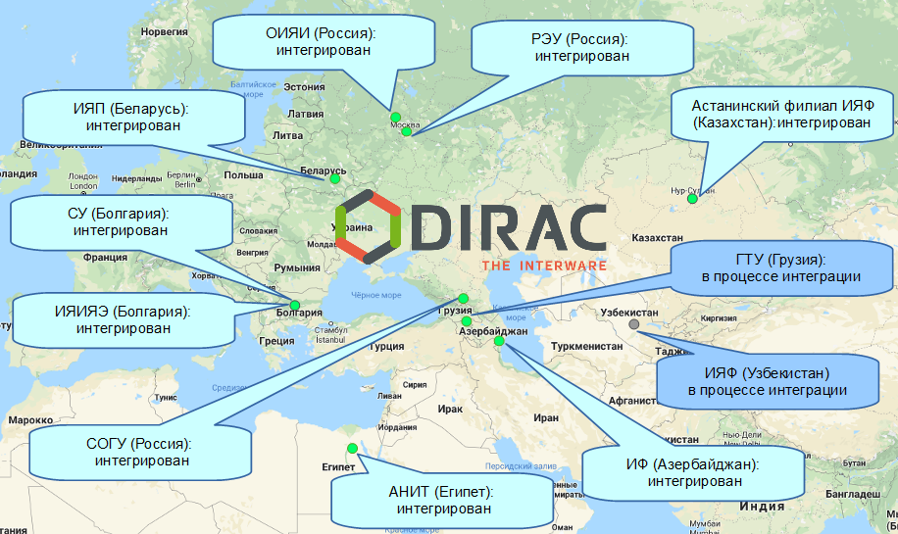
Cloud integration

Slide 12
Steps
1. DIRAC setup, configuration, development and tuning
2. Integration of computing and storage resources
3. Elaboration of approaches for effective use of resources

Slide 13
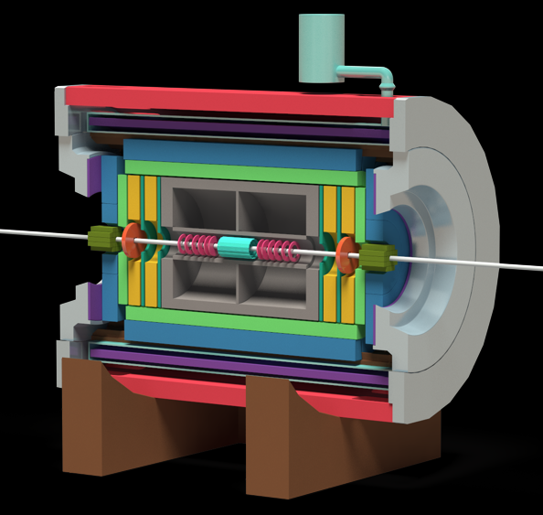
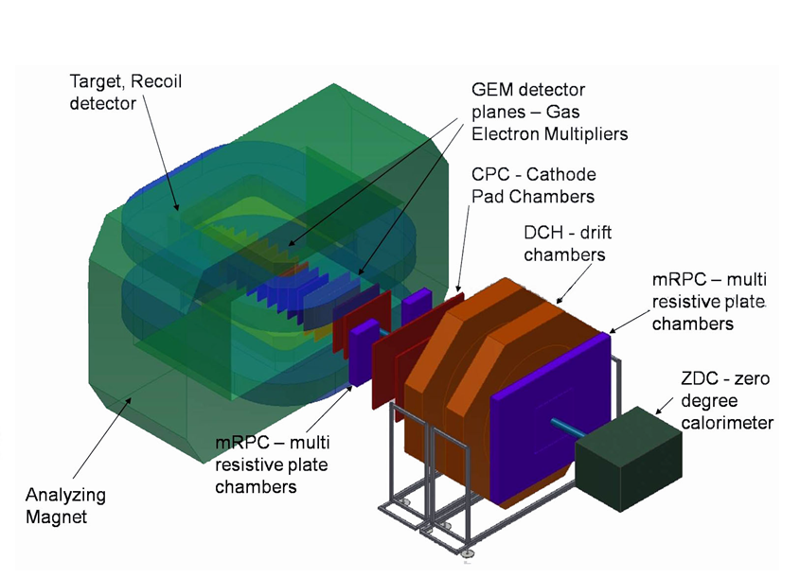
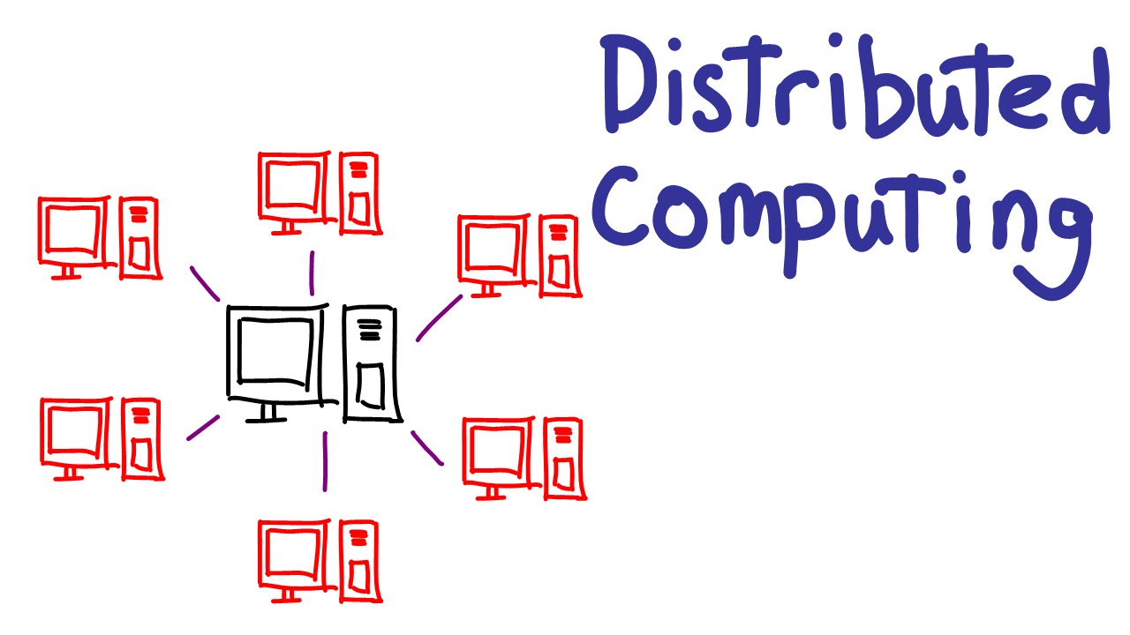
What do we use DIRAC for?
MPD@NICA
Baikal-GVD
BM@N
Monte-Carlo – Real
Analysis – Maybe
Monte-Carlo – Real
Monte-Carlo – Real
Reconstruction – Tests
Folding@HOME
Teaching

Slide 14
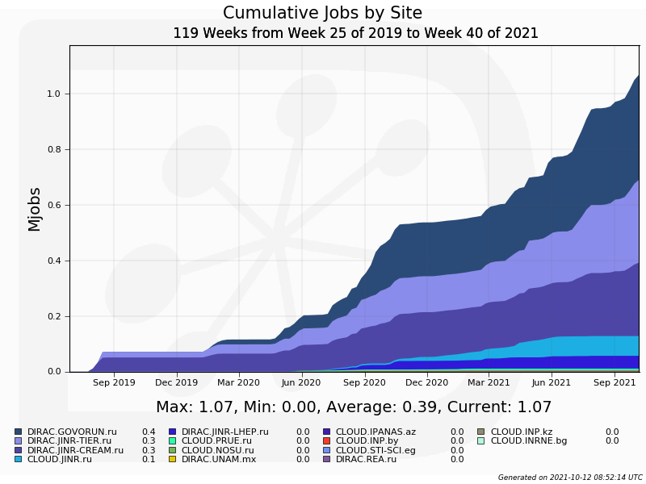
Statistics: jobs done
1 Million jobs

Slide 15
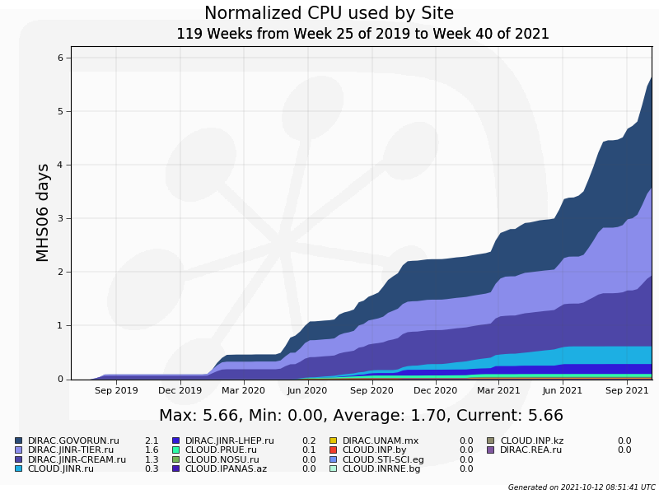
Statistics: normalized time
870 years
of computation on one core

Slide 16
Contribution: normalized time

Slide 17
Ratio: between experiments

Slide 18
Individual CPU core performance study
Centralized job management gives possibility for centralized and unified performance study of different computing resources.
Before running user jobs DIRAC Pilots execute benchmark for CPU core they are running on.
Benchmark is DiracBenchmark2012 or DB12. It evaluate just CPU core performance. Disk I/O, RAM speed, Network, CPU caches and other highly important aspects of performance are neglected by DB12.

Slide 19
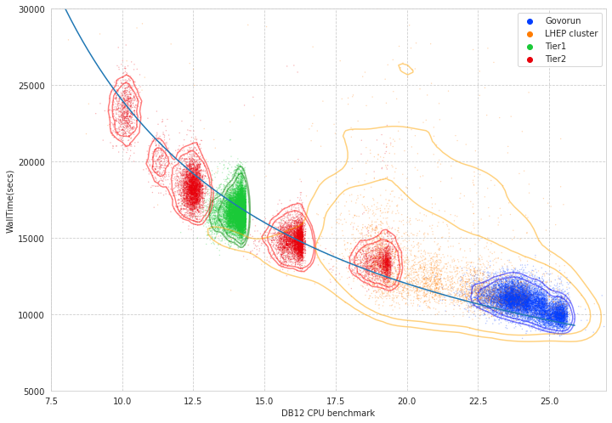
New: performance analysis

Slide 20
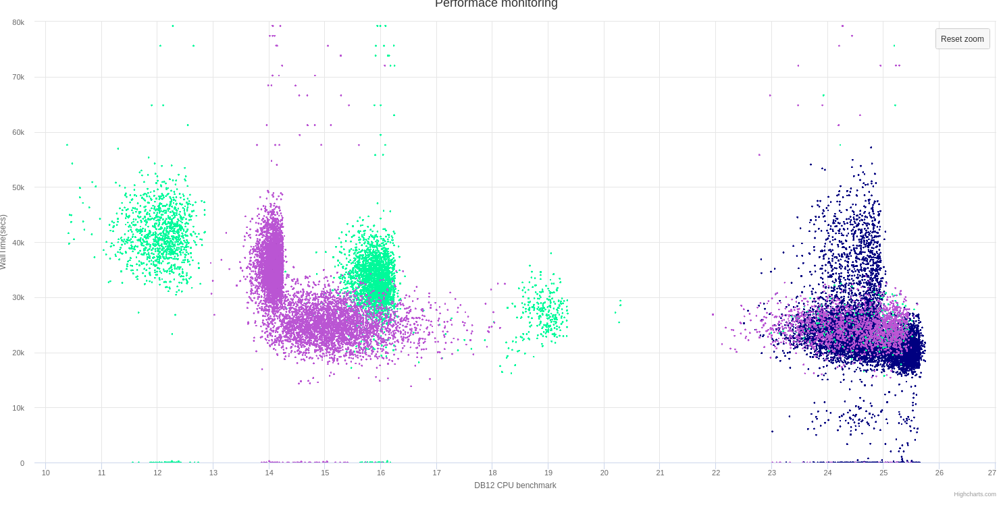
Discoveries
Wrong AMD processors estimation
Occasional speed loss on high ram Govorun nodes
Walltime
DB12 benchmark

Slide 21
MPD Monte-Carlo launchpad

Slide 22
Conclusion
All major computing resources were successfully integrated in DIRAC.
JINR Cloud and Member-State clouds were united.
MPD, Baikal-GVD, BM@N and Folding@Home used DIRAC.
>1M jobs successfully done, 5,66 millions HEPSPEC2006 days consumed (830 years of wall time).
Developed new approach to performance estimation of distributed heterogeneous computing resources.
All this could not be possible without cooperation between users, resource administrators, and DIRAC developers

Slide 23
Detailed articles 1
Korenkov, V., I. Pelevanyuk, P. Zrelov, and A. Tsaregorodtsev. 2016. "Accessing Distributed Computing Resources by Scientific Communities using DIRAC Services." CEUR workshop proceedings. Vol. 1752. p. 110-115.
Gergel, V., V. Korenkov, I. Pelevanyuk, M. Sapunov, A. Tsaregorodtsev, and P. Zrelov. 2017. Hybrid Distributed Computing Service Based on the DIRAC Interware. Communications in Computer and Information Science. Vol. 706. doi:10.1007/978-3-319-57135-5_8
Balashov, N. A., N. A. Kutovskiy, A. N. Makhalkin, Y. Mazhitova, I. S. Pelevanyuk, and R. N. Semenov. 2021. "Distributed Information and Computing Infrastructure of JINR Member States' Organizations.". AIP Conference Proceedings 2377, 040001 (2021); https://doi.org/10.1063/5.0063809
Balashov, N. A., R. I. Kuchumov, N. A. Kutovskiy, I. S. Pelevanyuk, V. N. Petrunin, and A. Yu Tsaregorodtsev. 2019. "Cloud Integration within the Dirac Interware.". CEUR workshop proceedings. Vol. 2507. p. 256-260.
Korenkov, V., I. Pelevanyuk, and A. Tsaregorodtsev. 2019. "Dirac System as a Mediator between Hybrid Resources and Data Intensive Domains.". CEUR workshop proceedings. Vol. 2523. p. 73-84.

Slide 24
Korenkov, V., I. Pelevanyuk, and A. Tsaregorodtsev. 2020. Integration of the JINR Hybrid Computing Resources with the DIRAC Interware for Data Intensive Applications. Communications in Computer and Information Science. Vol. 1223 CCIS. doi:10.1007/978-3-030-51913-1_3
Belyakov, D. V., A. G. Dolbilov, A. N. Moshkin, I. S. Pelevanyuk, D. V. Podgainy, O. V. Rogachevsky, O. I. Streltsova, and M. I. Zuev. 2019. "Using the "Govorun" Supercomputer for the NICA Megaproject.". CEUR workshop proceedings. Vol. 2507. p. 316-320.
Kutovskiy, N., V. Mitsyn, A. Moshkin, I. Pelevanyuk, D. Podgayny, O. Rogachevsky, B. Shchinov, V. Trofimov, and A. Tsaregorodtsev. 2021. "Integration of Distributed Heterogeneous Computing Resources for the MPD Experiment with DIRAC Interware." Physics of Particles and Nuclei 52 (4): 835-841. doi:10.1134/S1063779621040419
Kutovskiy, N. A., I. S. Pelevanyuk, and D.N. Zaborov. 2021. "Using distributed clouds for scientific computing". Accepted for publication in CEUR
Pelevanyuk, I. 2021. "Performance Evaluation of Computing Resources with DIRAC Interware.". AIP Conference Proceedings 2377, 040006 (2021); https://doi.org/10.1063/5.0064778
Moshkin, A. A., I. S. Pelevanyuk, and O. V. Rogachevskiy. 2021. "Design and development of application software for the MPD distributed computing infrastructure". Accepted for publication in CEUR.

