Slide 1
Monte Carlo Simulations of PP Interactions
A. Galoyan and V. Uzhinsky, 12.2021
Short history of MC generators
MC generators in work
Details of generators
Conclusion
1

Slide 2
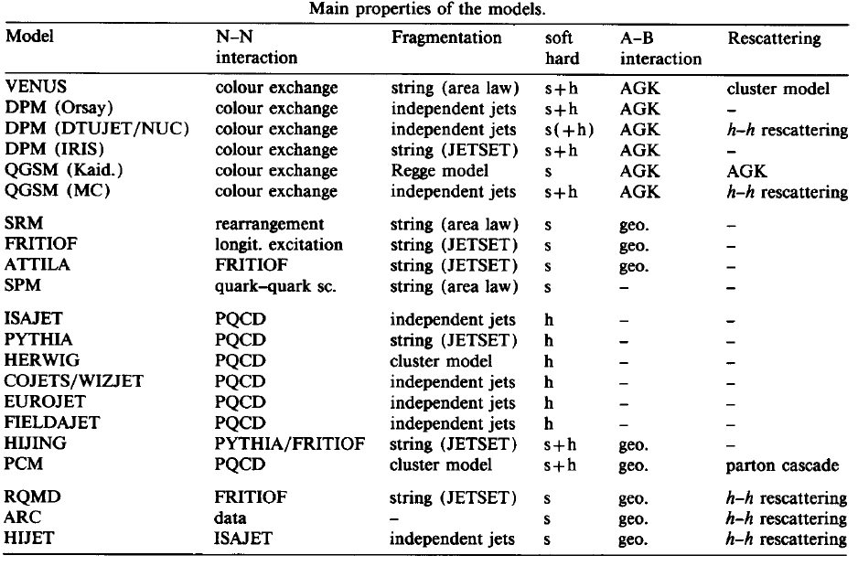
K. Werner: PHYSICS REPORTS 232, 87 (1993)
Strings, Pomerons and the VENUS model of hadronic interactions
at ultrarelativistic energies
EPOS
FLUKA
LA QGSM
GEANT4 …
PYTHIA
HIJING
UrQMD
At that time there was a struggle for soft and hard interactions!
2

Slide 3
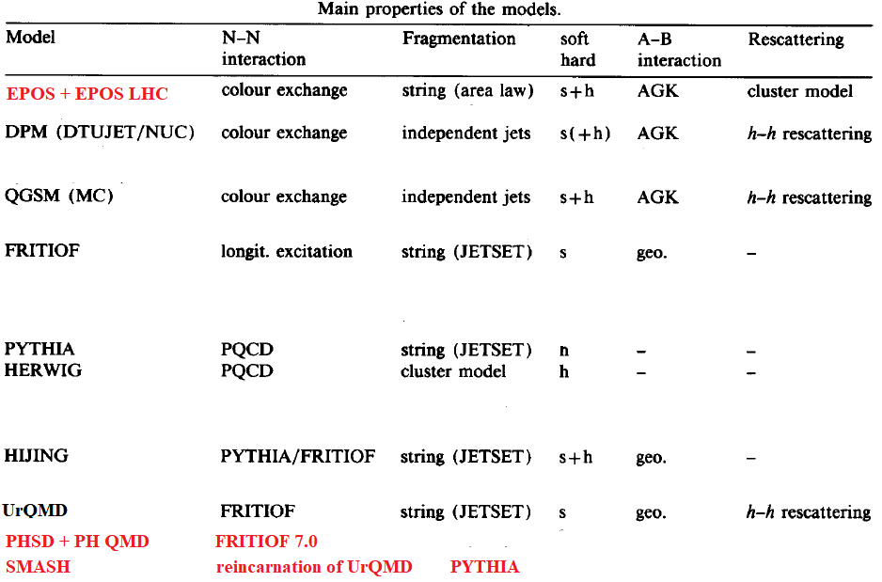
K. Werner et al. : PHYSICS REPORTS 350, 93 (2001)
PARTON-BASED GRIBOV+REGGE THEORY (EPOS)
EPOS
FLUKA
LA QGSM
DCM
GEANT4 …
PYTHIA
HIJING
AMPT
UrQMD
Today there is only slow evolution of MC models!
Main struggle is for neutrino interactions.
3

Slide 4
PHSD + PYTHIA 8.2
(V. Kireyeu et al.Eur. Phys. J. A (2020) 56:223)
Below sqrtS_nn ~ 10 GeV there is a large deviation between the models!
4

Slide 5
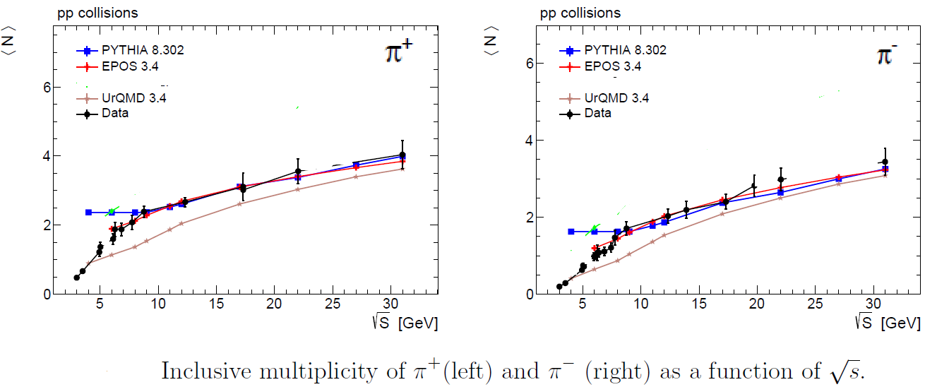
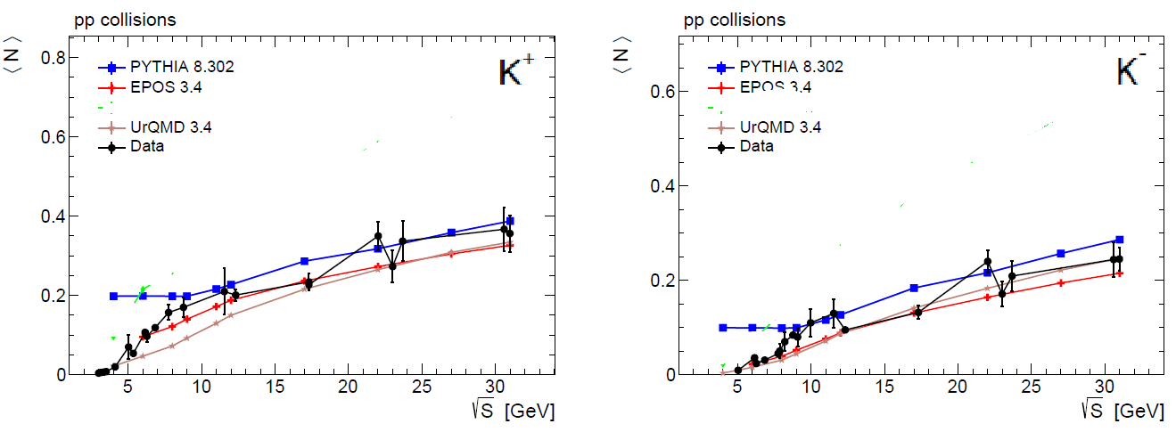
Performance of Monte Carlo models of pp collisions at NICA energies
Maxim Azarkin1, Martin Kirakosayn1 P.N. Lebedev Physics Institute, 2103.07222
EPOS works well at Ecms > 5 GeV!
5

Slide 6
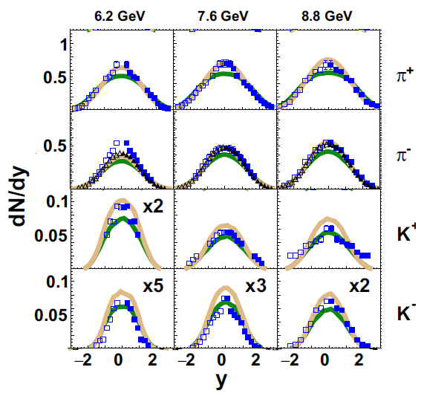
PHSD + PYTHIA 8.2 (V. Kireyeu et al. Eur. Phys. J. A (2020) 56:223)
Green lines
PHSD
Grey lines
Pythia 8
Pythia 8
Pi+, Pi- OK
K+, K- too
many!
PHSD
Pi+, Pi- less!
K+, K- OK
Rapidity distributions of particles. Data – NA61/SHINE
6

Slide 7
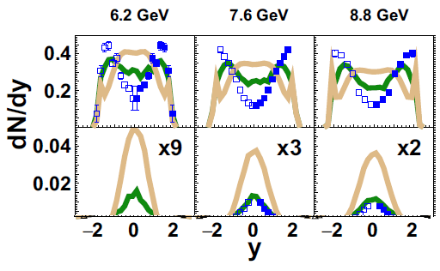
PHSD + PYTHIA 8.2 (V. Kireyeu et al. Eur. Phys. J. A (2020) 56:223)
P
Anti
P
Rapidity distributions of particles. Data – NA61/SHINE
Green lines
PHSD
Grey lines
Pythia 8
Pythia 8
All bad!
PHSD P bad!
Only anti P - OK
7

Slide 8
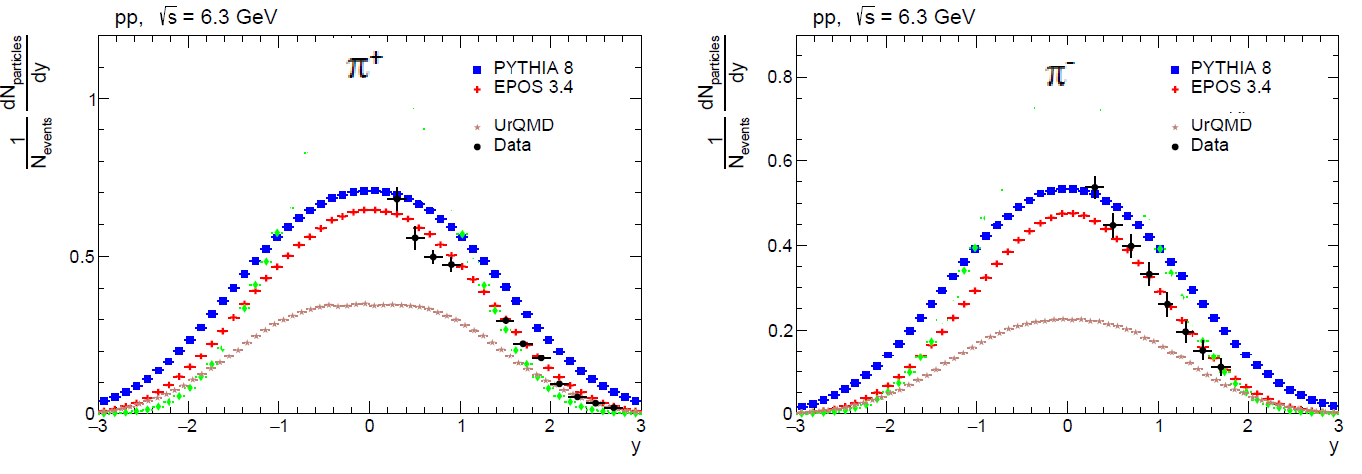
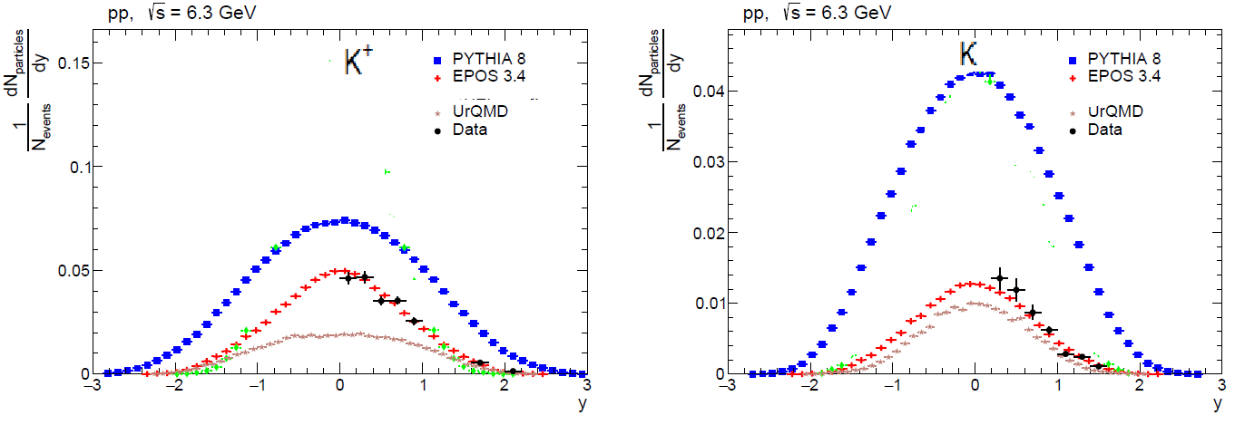
Performance of Monte Carlo models of pp collisions at NICA energies
Maxim Azarkin1, Martin Kirakosayn1 P.N. Lebedev Physics Institute, 2103.07222
EPOS works well at Ecms > 5 GeV! Pythia …?
8

Slide 9
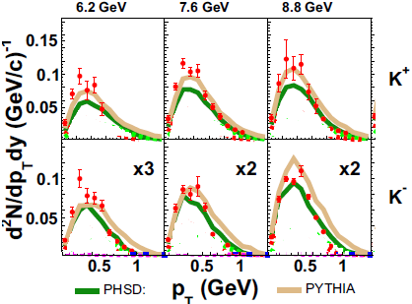
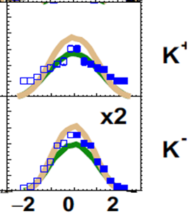
PHSD + PYTHIA 8.2 (V. Kireyeu et al. Eur. Phys. J. A (2020) 56:223)
Pythia 8
K+, K- too
many! ???
PHSD
K+, K- OK ???
Transverse momentum spectra of K+, K- − from p + p collisions in the central midrapidity interval 0 < y < 0.2
9

Slide 10
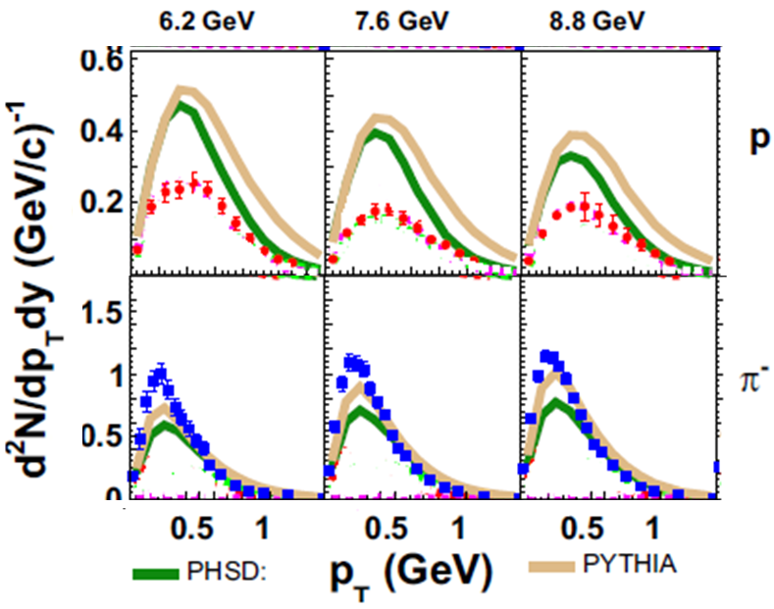
PHSD + PYTHIA 8.2 (V. Kireyeu et al. Eur. Phys. J. A (2020) 56:223)
Pythia 8
All bad!
PHSD
P bad!
Pythia 8
Pi- OK
PHSD
Pi- less! ???
Transverse momentum spectra of protons and Pi- from p + p collisions in the central midrapidity interval 0 < y < 0.2
10

Slide 11
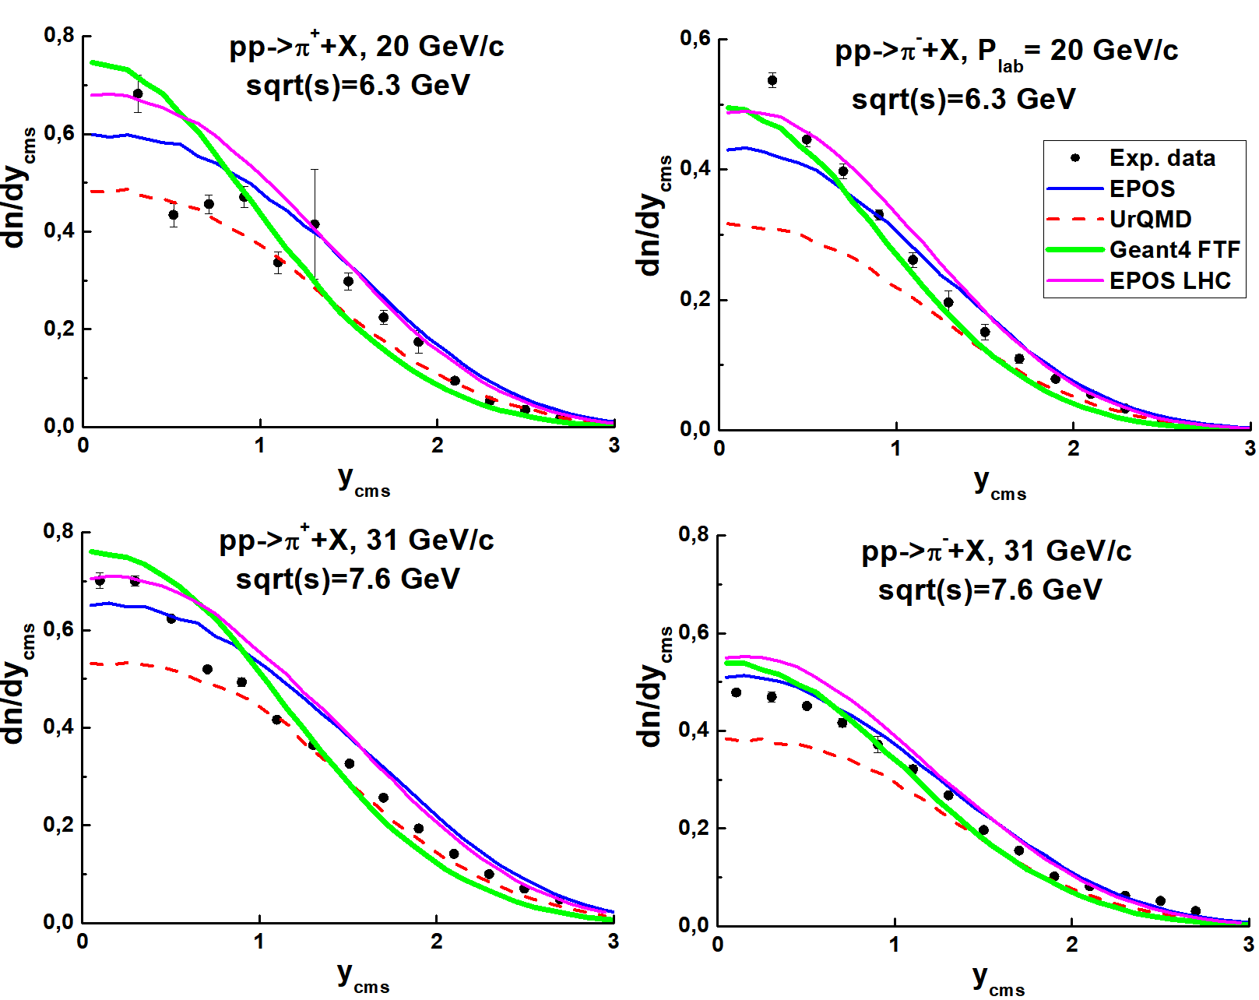
EPOS 1.99, Geant4/FTF, UrQMD, EPOS-LHC
UrQMD under-
estimates
meson
production
EPOS, FTF
It is complicated
to say,
what model
is better!
Experimental data for Pi+ scatters too strongly!
11

Slide 12
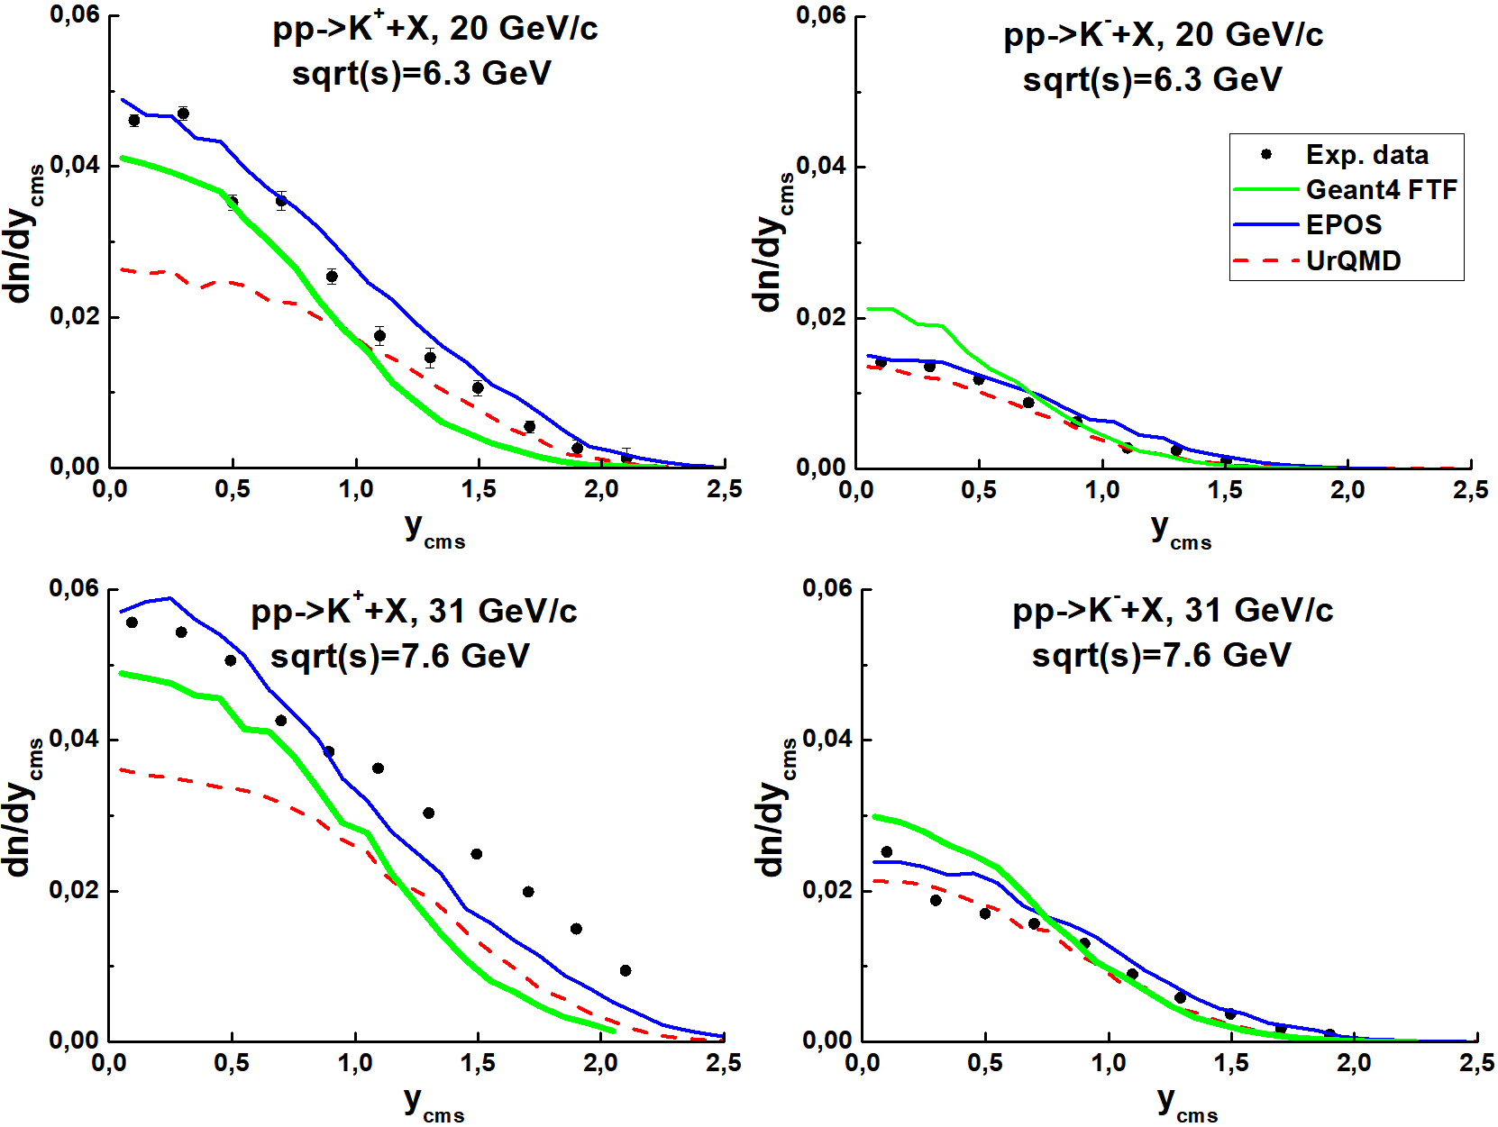
EPOS 1.99, Geant4/FTF, UrQMD
UrQMD under-
estimates
K+ meson
production
EPOS, FTF
It is complicated
to say,
what model
is better!
12

Slide 13
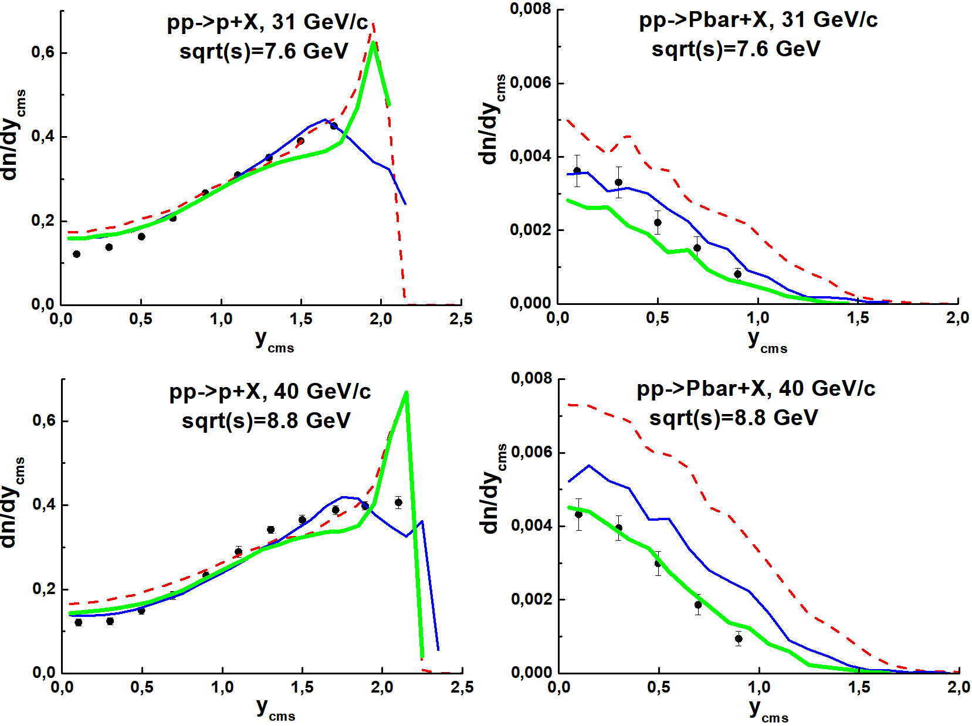
EPOS 1.99, Geant4/FTF, UrQMD
UrQMD over-
estimates
anti-proton
production
EPOS
No
diffraction
in
the model!
13

Slide 14
SUMMARY
Pythia 8 OK at Ecmc >= 8 GeV
It would be well to tune
for K+, K- and anti-proton
EPOS 1.99 & EPOS-LHC OK at Ecmc >= 5 GeV
It would be well to include
quark exchange processes
Geant4 FTF OK at Ecmc >= 3 GeV
It would be well to improve
spectra of K+ and K-
Below Ecmc 3 GeV
UrQMD → SMASH (C++ re-incarnation of UrQMD)
14

Slide 15
J Mohs, S Ryu1and H Elfner : J. Phys. G47 (2020) 065101 (SMASH)
Particle production via strings and baryon stopping within a hadronic transport approach
15

Slide 16
J Mohs, S Ryu1and H Elfner : J. Phys. G47 (2020) 065101 (SMASH)
Particle production via strings and baryon stopping within a hadronic transport approach
16

Slide 17
Application of SMASH at low energies
Thèse de doctorat de l'Université Paris-Saclay, Préparée à l’Université de Paris-Sud, à l’Institut de Physique Nucléaire d’Orsay, 18 September 2019
Models: OPER, GiBUU, UrQMD, SMASH + PLUTO
17

Slide 18
Application of SMASH at low energies
Study of baryonic resonances in the channel pp→ppπ+π− at 3.5 GeV beam energy with the HADES detector, Amal Belounnas
Models: OPER, GiBUU, UrQMD, SMASH + PLUTO
18

Slide 19
Application of SMASH at low energies
Study of baryonic resonances in the channel pp→ppπ+π− at 3.5 GeV beam energy with the HADES detector, Amal Belounnas
Models: OPER, GiBUU, UrQMD, SMASH + PLUTO
19

Slide 20
Application of SMASH at low energies
Lambda and Ks0​ Production in Pion-Nucleus Reactions at 1.7 GeV/c, Steffen Maurus, HADES
Models: OPER, GiBUU, UrQMD, SMASH + PLUTO
Comparison of absolute normalised
transport codes GiBUU (solid curve),
UrQMD (dashed curve) and SMASH
(dotted curve) to the experimental
cross-section in carbon.
20

Slide 21
Application of SMASH at low energies
Lambda and Ks0​ Production in Pion-Nucleus Reactions at 1.7 GeV/c, Steffen Maurus, HADES
Models: OPER, GiBUU, UrQMD, SMASH + PLUTO
Comparison of the Pt distribution
of absolute normalised transport
codes GiBUU (solid curve),
UrQMD (dashed curve) and
SMASH (dotted curve) to the
experimental cross-section in
tungsten for different rapidity bins. Experimental errors are indicated in black for the statistical, filled boxes for the systematic and
open boxes for the normalisation
error. In the upper panels the
comparison of the transport
models to the experimental data
is shown, while the lower panel
Indicates the difference in percents.
21

Slide 22
What will be for p+d and d+d interactions?
Eur. Phys. J. C81 (2021) 73, published on line 22 Jan. 2021, ArXiv: 5 Oct. 2020
The NA61/SHINE Collaboration
The results were compared with predictions of the models:
Epos 1.99, Urqmd 3.4, Ampt 1.26, Phsd 4.0 and Smash 1.6.
None of the models reproduces all features of the presented results.
22

Slide 23
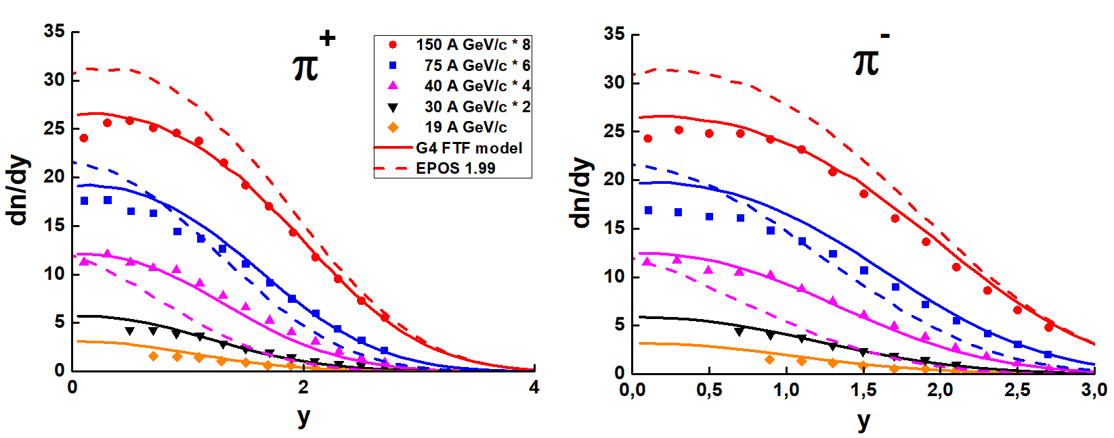
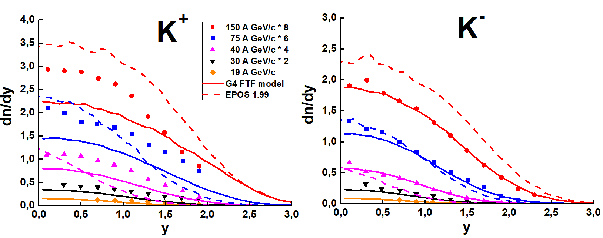
NA61/SHINE data on Be-7 + Be-9, 20 % centrality
EPOS 1.99 – Horror, horror! FTF – OK nearly.
23

Slide 24
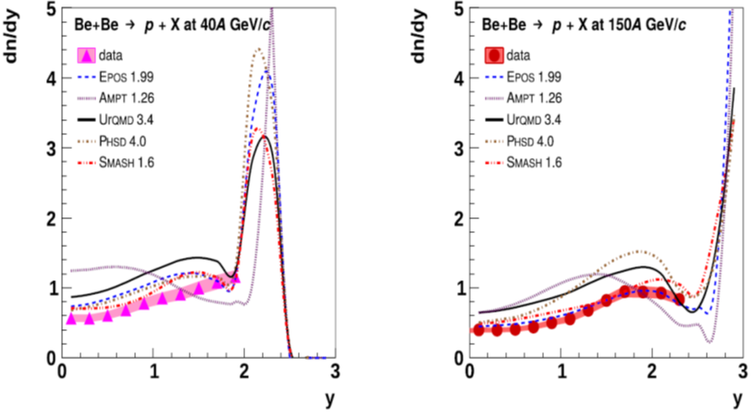
NA61/SHINE data on Be-7 + Be-9, 20 % centrality.
24

Slide 25
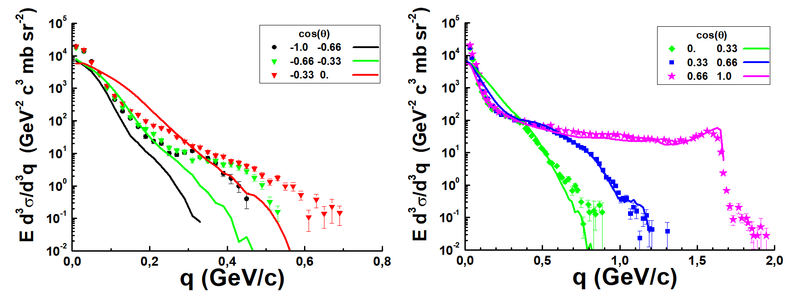
FTF model: D+p interactions
1 – 0º
0.66 -- 49º
0.33 – 71º
0 -- 90º
-0.33 – 109º
-0.66 – 131º
-1 -- 180º
Z. Phys. A 357, 107 (1997)
25

Slide 26
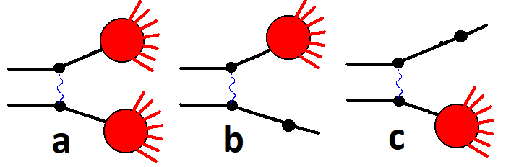
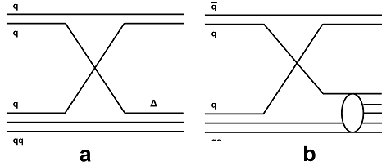
FTF model : basic assumptions
B.Andersson et al. Nucl. Phys. B281 289 (1987)
B.Nilsson-Almquist, E.Stenlund, Comp. Phys. Comm. 43 387 (1987).
Fig. 1: Processes of string's creations considered in the FTF model.
Fig. 2 Additional quark exchange processes in the FTF model.
String mass distribution
26

Slide 27
FTF model: string fragmentation details
For mesons
For baryons,
a’la Kaidalov
27

Slide 28
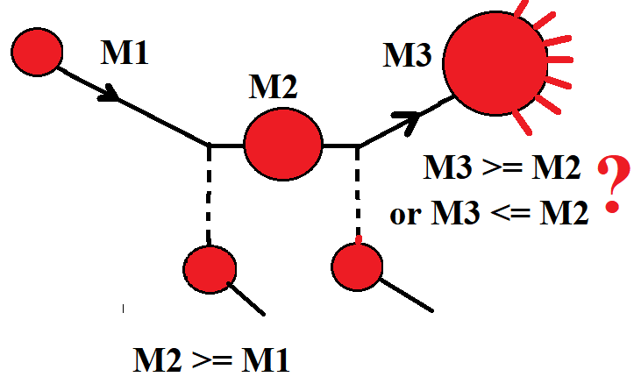

hA and AA interactions?
28

Slide 29
VENUS -> EPOS -> EPOS-LHC
K. Werner: PHYSICS REPORTS 232, 87 (1993)
Strings, Pomerons and the VENUS model of hadronic interactions at ultrarelativistic energies
String fragmentation a’la Artru-Mennessier
Average transverse momentum.
The area law parameter
The string cutoff mass
The splitting function h (x). In case of a string with a nucleon remnant at one end, we first split off a leading particle, before fragmenting the remaining q~çistring.
The strange quark and diquark probability
Ps=0.14, Pdiq = 0.12
29

Slide 30
VENUS -> EPOS -> EPOS-LHC
K. Werner: PHYSICS REPORTS 232, 87 (1993)
Strings, Pomerons and the VENUS model of hadronic interactions at ultrarelativistic energies
Cross sections: the Gribov—Regge theory (GRT) of multiple Pomeron exchange
AGK
Finite energy
corrections?
We discuss multistrings, being a unique feature of VENUS .
+minijets and jets
30

Slide 31
VENUS -> EPOS -> EPOS-LHC
K. Werner: PHYSICS REPORTS 232, 87 (1993)
Strings, Pomerons and the VENUS model of hadronic interactions at ultrarelativistic energies
The fundamental difference between sea and valence quark distributions
is their small x behaviour as
Soft contribution
Hard contribution
Semi-hard contribution
Diffractive scattering
31

Slide 32
T. Pierog et al.: PHYSICAL REVIEW C 92, 034906 (2015)
EPOS LHC: Test of collective hadronization with data
measured at the CERN Large Hadron Collider
Core – Corona
model
We discuss the effect of the collective hadronization in p-p scattering. A different parametrization of flow has been introduced in the case of a small volume with high density of thermalized matter (core) reached in p-p compared to large volume produ-ced in heavy ion collisions. Both parametrizations depend only on the geometry and the amount of secondary particles entering in the core and not on the beam mass or energy.
We construct a droplet of matter that is not uniform (for example the baryonic
density may vary along the longitudinal direction), whereas conventional hadronization models assume some (uniform) object.
32

Slide 33
T. Pierog et al.: PHYSICAL REVIEW C 92, 034906 (2015)
EPOS LHC: Test of collective hadronization with data
measured at the CERN Large Hadron Collider
Many strings in pp interactions can overlap since the distance
between partons is very small.
Dstring ~ 0.7 – 0.8 fm
It is assumed that the clusters hadronize at some given energy density, having acquired at that moment a collective radial flow, with a linear radial rapidity profile from inside to outside.
In addition, an azimuthal asymmetry was introduced.
Our hadronization of the core part is certainly motivated by the remarkable success of statistical hadronization models [6] and blast-wave fits [7,8].
n, n_alfa, gamma _s ???
33

Slide 34
Conclusion
1. Geant4 FTF works well for pions and baryons at energies in NN CMS below and upper 12 GeV!
There is a problem with strange particles!
2. Main problem of the models – bad description of
PP interactions!
SUMMARY
Geant4 FTF OK at Ecmc >= 3 GeV
Pythia 8 OK at Ecmc >= 8 GeV It would be well to tune for K+, K- and anti-proton
EPOS 1.99 & EPOS-LHC OK at Ecmc >= 5 GeV It would be well to include quark
exchange processes
Below Ecmc 3 GeV
UrQMD → SMASH (C++ re-incarnation of UrQMD) can be used.
34

