Slide 1
Vacuum system of the LINAC-200 accelerator.
Joint Institute For Nuclear Research
D.Shokin

Slide 2
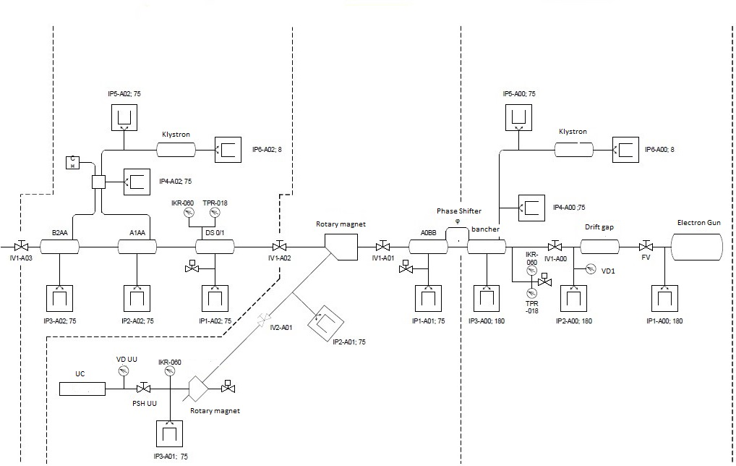
Diagram of the vacuum system of the LINAC-200 accelerator
The linear accelerator LINAC-200 at JINR is constructed to provide electron test beams with energy up to 200 MeV to carry out particle detector R&D, to perform studies of advanced methods of beam diagnostics, and to work as an irradiation facility for applied research. While the accelerator largely reuses refurbished parts of the MEA accelerator from NIKHEF, the accelerator vacuum system is renovated. In this report, the design and status of new vacuum system will be presented.
Station A02
Station A01
Station A00

Slide 3
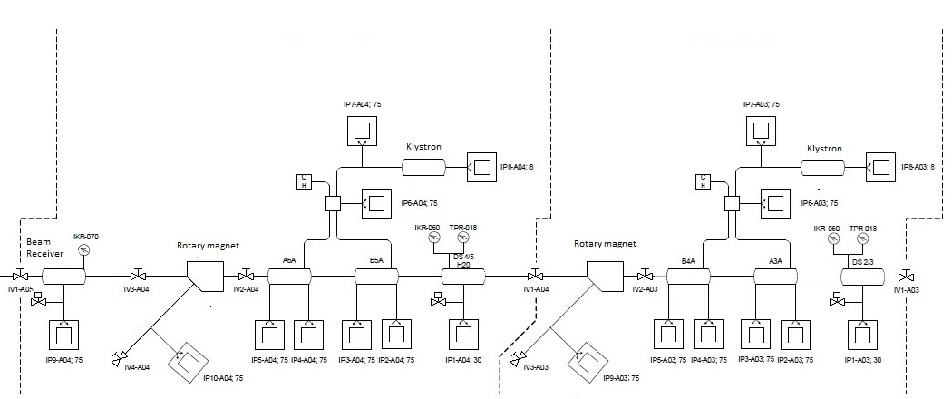
Station A04
Station A03
The operating level of the vacuum in various parts of the accelerator must be considered the level of Р≤5⋅10⁻⁸ torr.

Slide 4
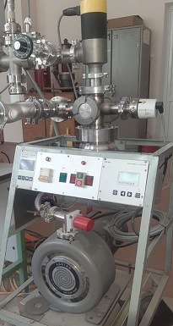
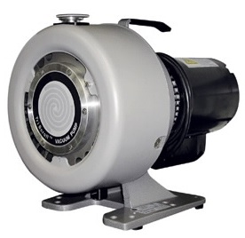
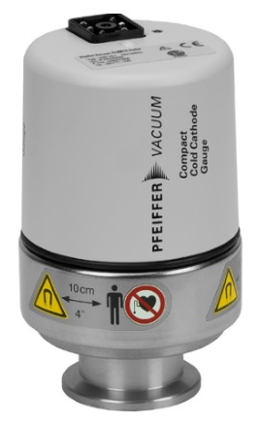
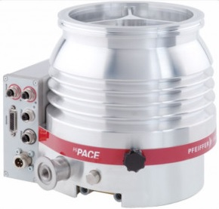
Obtaining a vacuum
The first stage: | Pumping of the LINAC-200 accelerator chamber (or individualsections) "from the atmosphere" using a mobile vacuum station: - Pre-vacuum pumping of the chamber to pressure Р ~ 5⋅10⁻² torr.
 | - Turbopump pumping to pressureР ~ 5⋅10⁻⁷ torr.
The second stage: | Switching on and further constant pumping of the accelerator chamber, ion magnetic discharge pumps up to pressureР ≤ 5⋅10⁻⁸ torr.
The mobile vacuum post consists of the following elements:
Turbomolecular pump
Forevacuum spiral pump;
Vacuometer;
Electric shutter (valve).
Mobile vacuum post
Turbomolecular pump
HiPace 300
Forevacuum spiral pump
Triscroll 300
Vacuometer Pfeiffer Vacuum
ActiveLine IKR 270

Slide 5
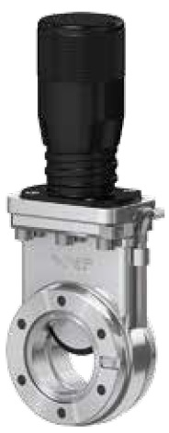
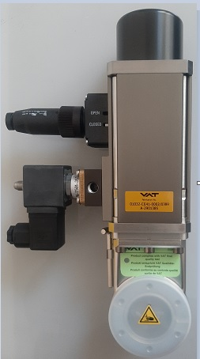
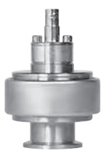
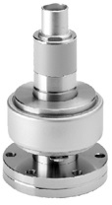
Vacuum measuring instruments
Selection of vacuum fittings
General requirements for vacuum measurement sensors:
High reliability of operation;
High radiation resistance;
Insensitivity to vacuum degradation (up to the atmosphere);
Providing vacuum measurement within Р=10⁻³÷5⋅10⁻⁹ torr
(for high-vacuum sensors).
General requirements.
1) High throughput, allowing maximum use of pumping characteristics of pumps;
2) The speed of operation of emergency automatic gate valves to protect the operating high-vacuum equipment in cases of deterioration of the vacuum or other emergency situations;
3) Possibility of remote control via the automated control system;
4) Relatively light weight.
Separation gate valves of stations and valves for connecting a vacuum mobile postmanual gate valves VAT Series 01 Mini UHV gate valve
Separation gates of stations - electropneumatic drives VAT Series 01 Mini UHV gate valve.
LINAC-200 gun gate - electropneumatic fast gate VAT Fast Closing Valve Series 75 (Part No: 75232-CE44-0006/0184)
TPR018
Measuring range
10³ ÷8⋅10⁻⁴ torr
IKR060
Measuring range
7,5⋅10⁻³ ÷1,5⋅10⁻⁹ torr
IKR070
Measuring range
5×10⁻³ - 1×10⁻¹¹ torr

Slide 6
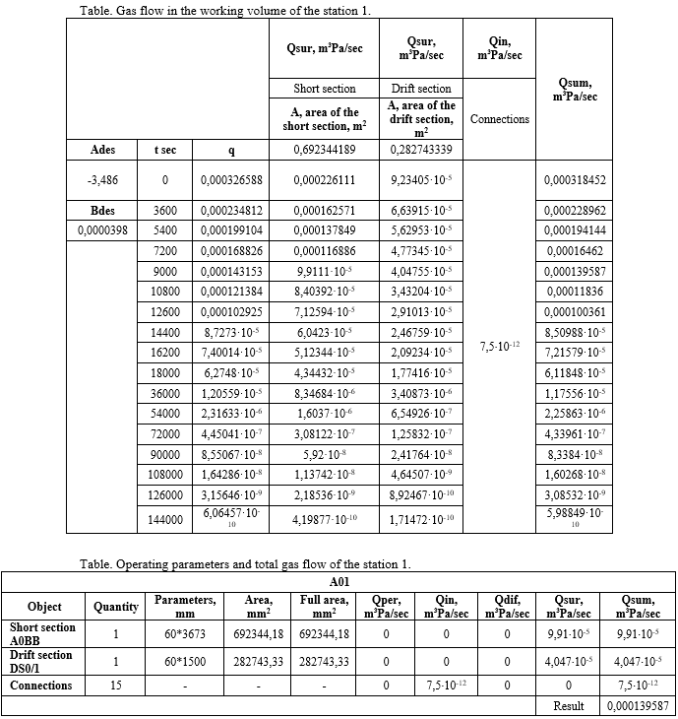
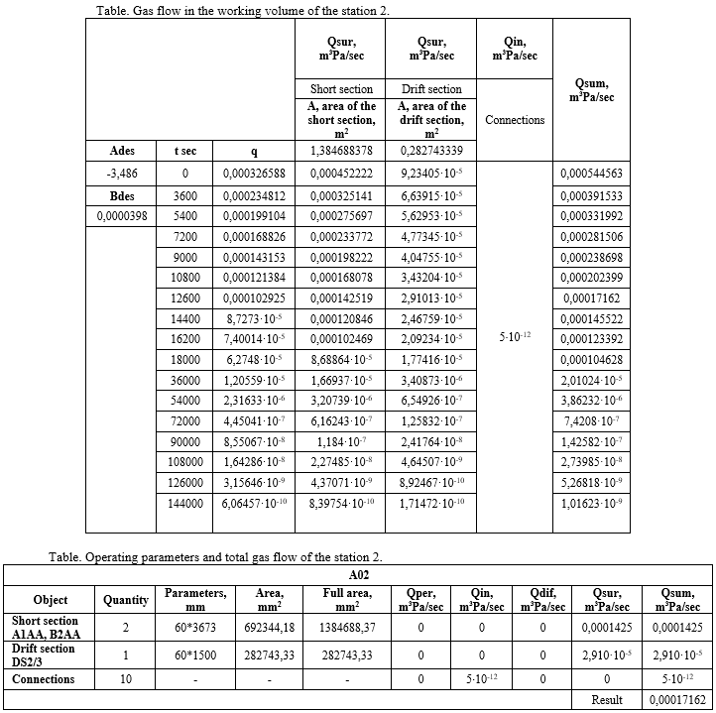
Design calculation of the vacuum system
As a result of the work carried out, the vacuum system of the LINAC-200 linear accelerator was upgraded, which now allows to obtain a vacuum in the chamber Р≤5⋅10⁻⁸ torr

