Slide 1


Ion guide system for GALS setup
K.A. Avvakumov, S.G. Zemlyanoy
Flerov Laboratory of Nuclear Reactions
GALS group
55th meeting of the PAC for Nuclear Physics
27 January 2022

Slide 2
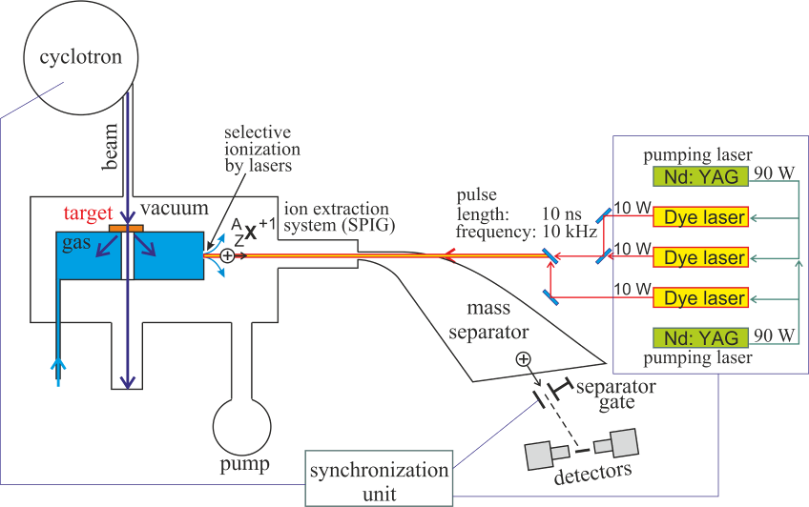
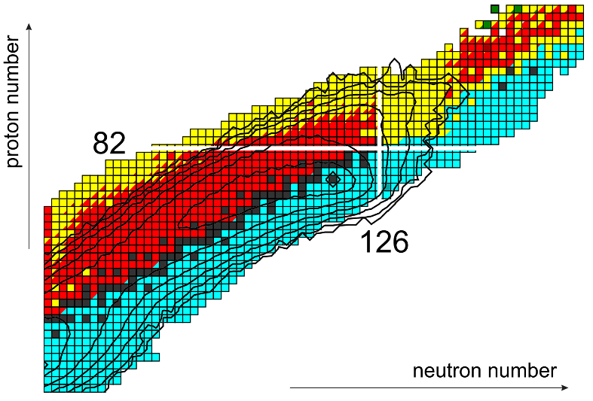
GALS setup
Gas Cell Based Laser Ionization & Separation Setup
Landscape of the cross sections for the production of isotopes around N = 126 in collisions of ¹⁹⁸Pt with ¹³⁶Xe at E_{c.m.} = 643 MeV.
Contour lines are drawn over an order of magnitude of the cross section down to 100 nb
Karpov, A.V., Saiko, V.V. Phys. Rev. C. 96, 024618 (2017)

Slide 3
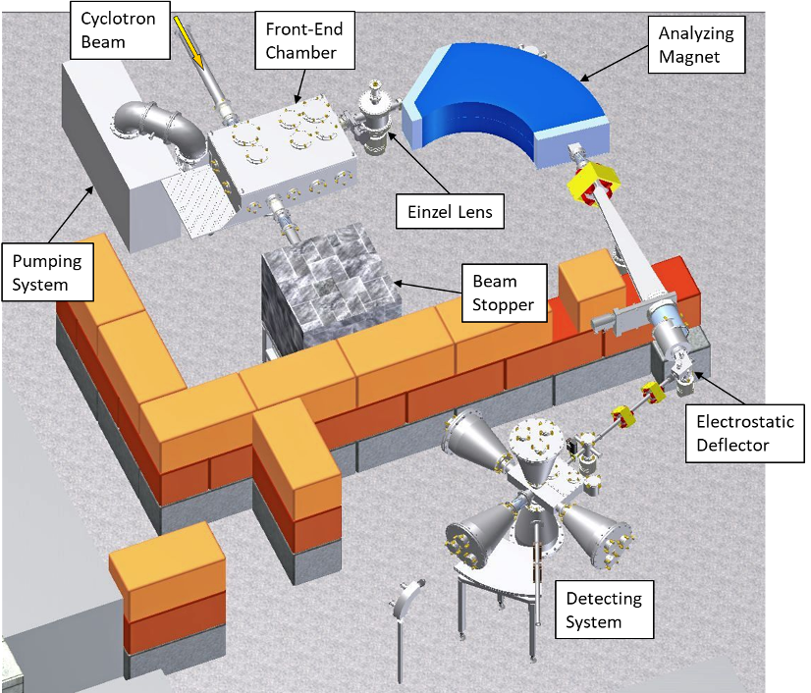
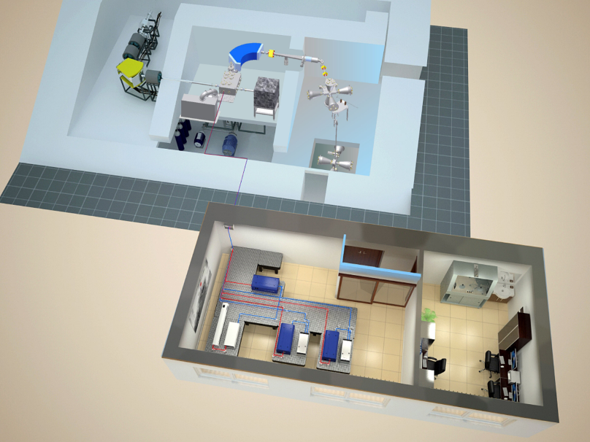
GALS setup
Gas Cell Based Laser Ionization & Separation Setup

Slide 4
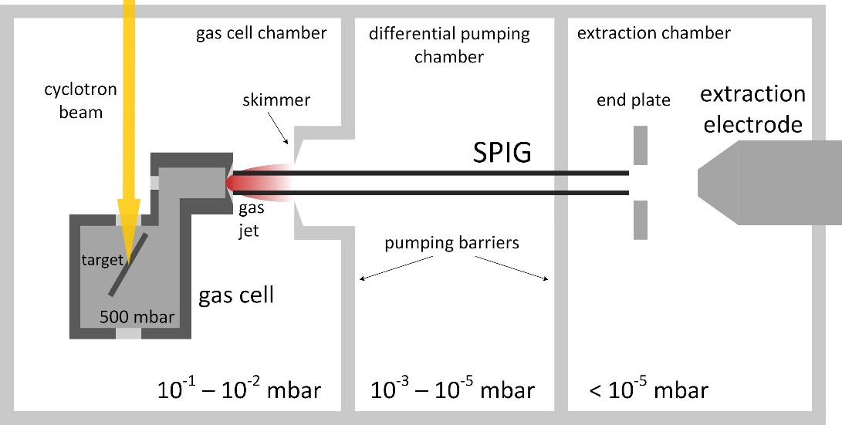
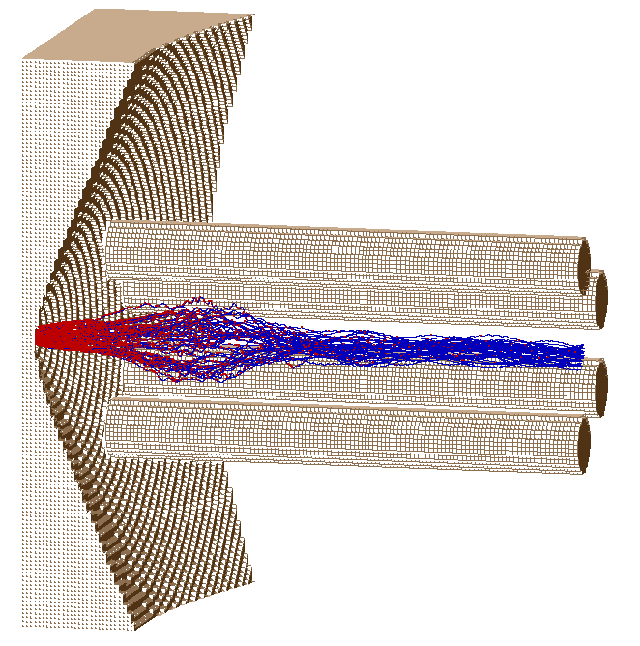
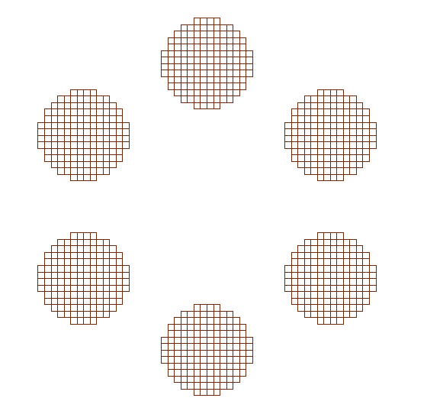
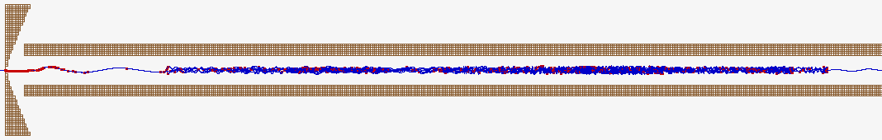
SIMION simulations of ion guide system: SPIG
SextuPole Ion Guide
The length of the SPIG ≈ 630 mm
U_{rf (peak-to-peak)} up to 500 V
Frequency = 4.7 MHz
Parameters at the end of SPIG:
Mean time of flight ≈ 3000 μs
Mean longitudinal kinetic energy ≈ 0.2 eV
Efficiency ≈ 95 %
Advantage: a single 6-rod structure ion guide through the whole front end vacuum chamber
Disadvantage: high risk that the ions get stuck inside long SPIG due to kinetic energy losses

Slide 5
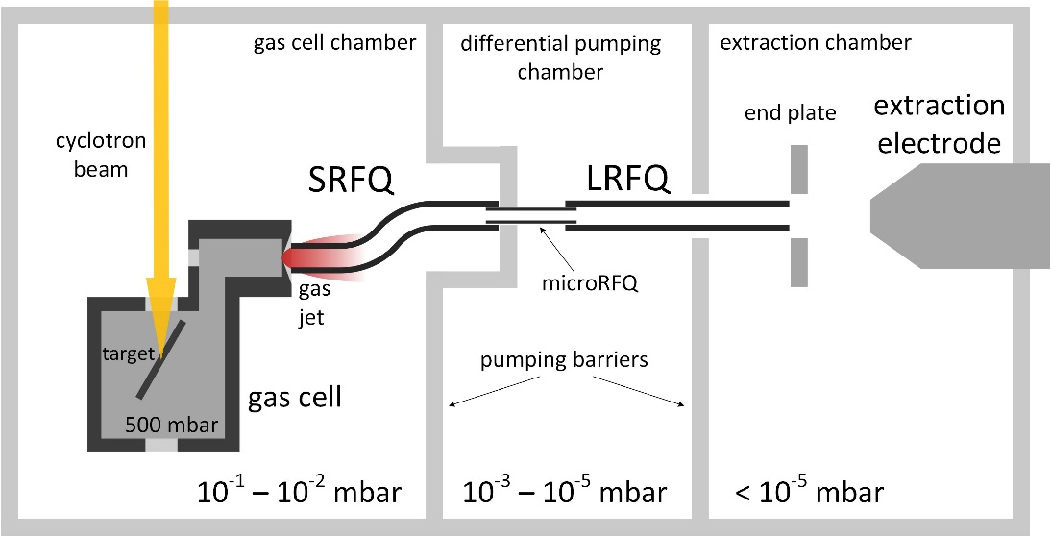
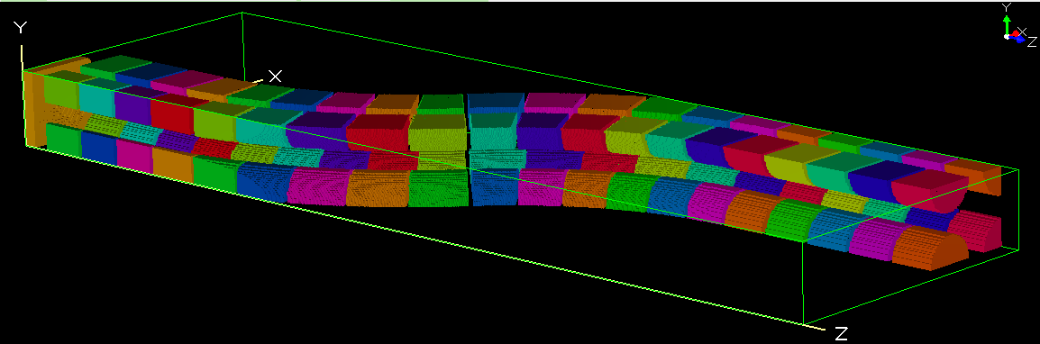
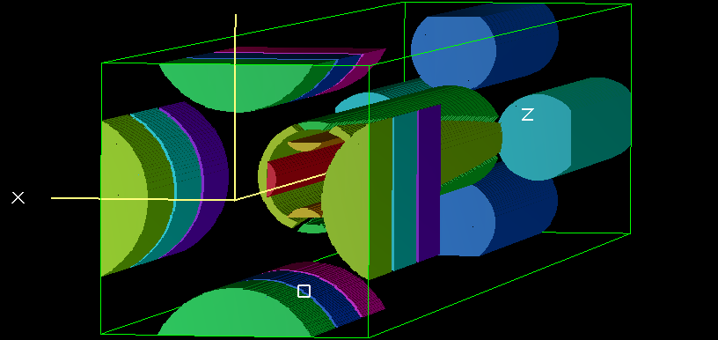
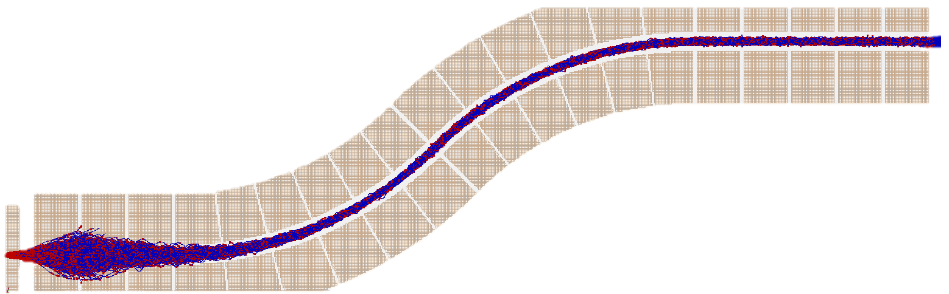
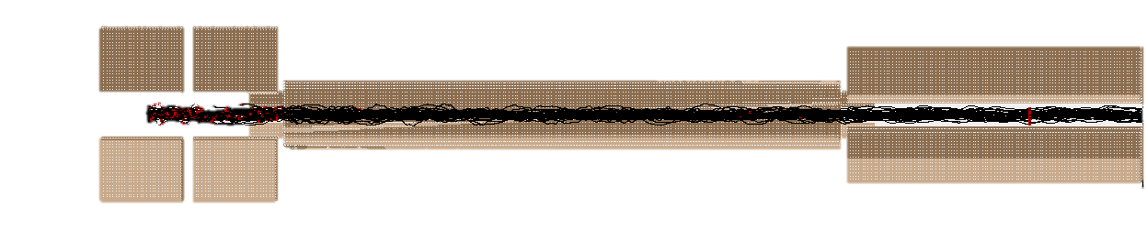
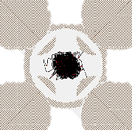
SIMION simulations of ion guide system: SRFQ
S-shaped RadioFrequency Quadrupole + microRFQ + Linear RFQ
Parameters at the end of LRFQ:
Mean time of flight ≈ 484,8 μs
Mean longitudinal kinetic energy ≈ 12 eV
Efficiency ≈ 95-98 %
Advantage: much better TOF and efficiency
Disadvantage: much more complicated system
S-shaped RFQ
microRFQ

Slide 6
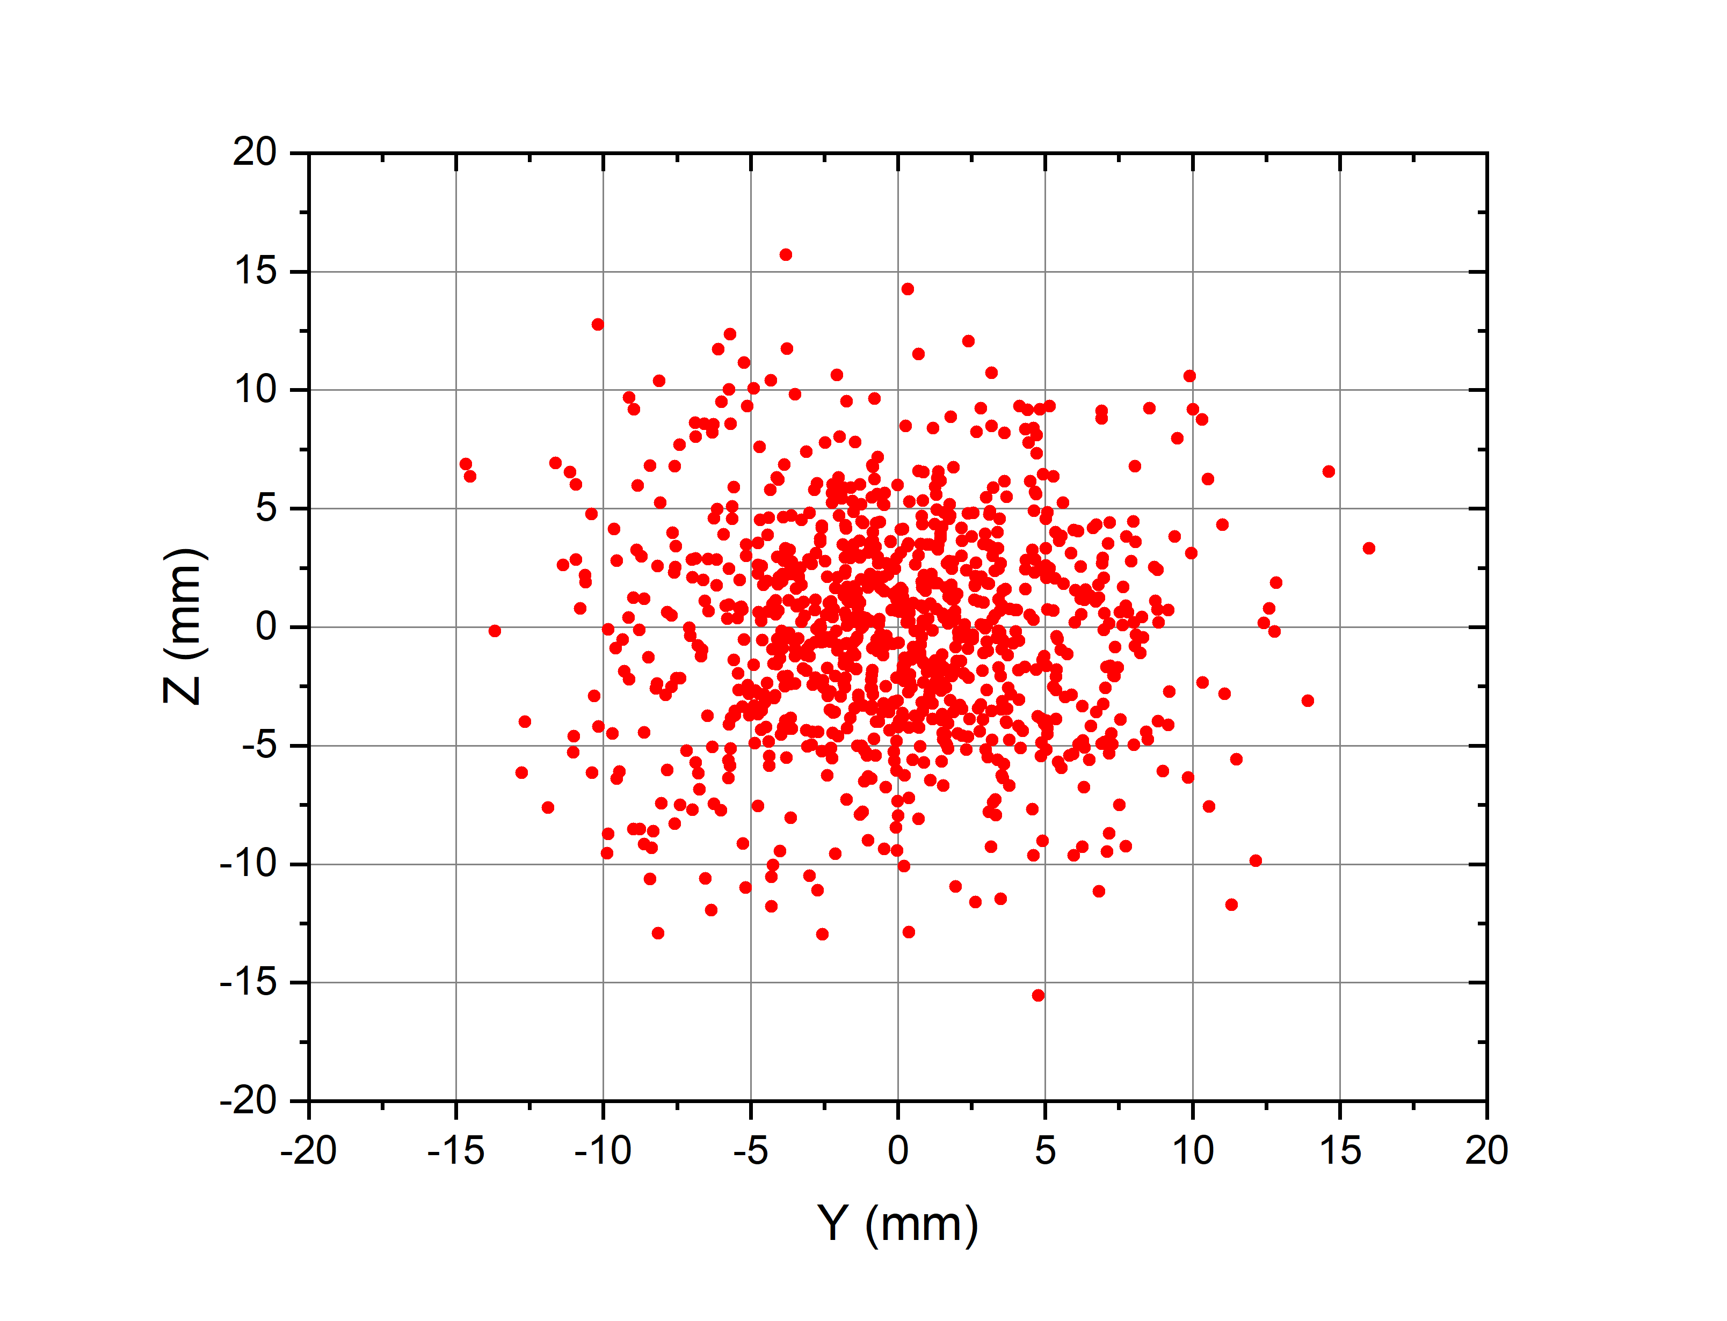
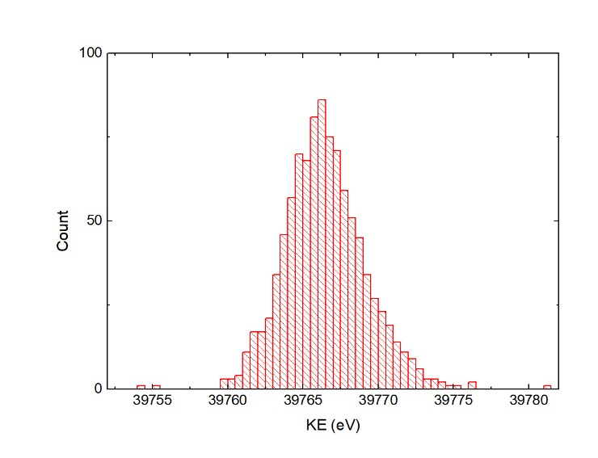
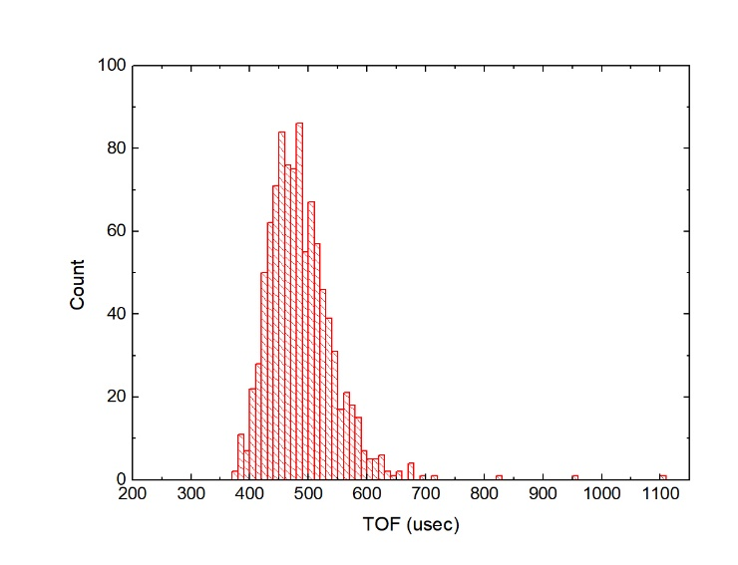
Output Ions Parameters
 | SPIG | SRFQ + mRFQ + LRFQ
Before the End Plate
Mean longitudinal kinetic K_{E} | 0.2 eV | 12 eV
Mean time of flight | 3138.5 μs | 484.8 μs
Efficiency | 98.8 % | 99.4 %
At analyzing magnet entry
Mean longitudinal kinetic energy K_{E} | 39783.7 eV | 39766.4 eV
Standard deviation of kinetic energy σ_{KE} | 183.8 eV | 2.7 eV
Mean time of flight t | 3154.1 μs | 487.2 µs
Standard deviation of time of flight σ_{t} | 3409.5 μs | 58.6 µs
Horizontal emittance component | 1 π ∙ mm ∙ mrad | 6.3 π ∙ mm ∙ mrad
Vertical emittance component | 1 π ∙ mm ∙ mrad | 6.4 π ∙ mm ∙ mrad
Efficiency | 97 % | 97 %
Beam profile at analyzing magnet entry
Kinetic energy and time of flight distributions of the resulting ion beam at analyzing magnet entry

Slide 7
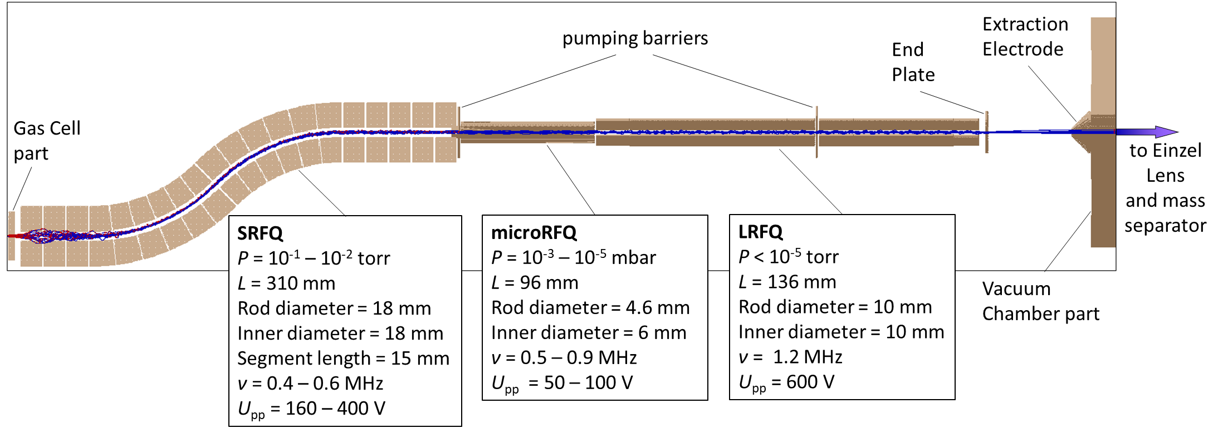
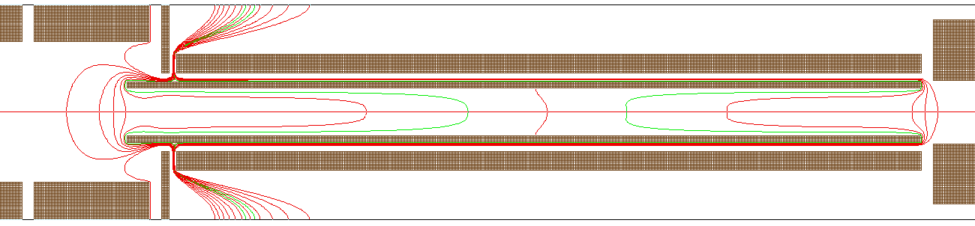
Final Ion Guide design
Simulations of the system were performed in SIMION software package using the hard sphere collision model and the additional code describing the gas jet. Initial ion parameters were the same as in the previous SPIG simulations (mass = 204 amu, charge = +1, speeds corresponding to thermal energy at 300 K).

Slide 8
Final Ion Guide design
The SRFQ, microRFQ and LRFQ parts of the GALS ion guide system.

Slide 9
Conclusion
Two general options for GALS ion guide system were simulated and compared
The chosen SRFQ ion guide system was optimized for effective ion guiding through the apertures between the differential pumping volumes
The ion guide was produced and delivered to the laboratory. Distributed power supply systems for the electrodes were developed and now are being installed and tested with electrical and radio frequency power systems.

Slide 10
Thank you for your attention!

