Slide 1
Programme Advisory Committee for Nuclear Physics
55th meeting
27 January 2022
Marek Lewitowicz

Slide 2
Programme Advisory Committee for Nuclear Physics, 54th. meeting, 23 June 2021
1. Opening of the meeting M. Lewitowicz
2. Implementation of the recommendations of the previous PAC meeting M. Lewitowicz
3. Information on the Resolution of the 129th session of the JINR Scientific Council (February 2021) and on the decisions S. Dmitriev
of the JINR Committee of Plenipotentiaries (March 2021)
4. Reports on the expiring themes:
"SHE at FLNR: research and development" (report on the theme 03-5-1130-2017/2021) Yu. Oganessian
“Development of the FLNR accelerator complex and experimental setups (DRIBs-III)” – 03-0-1129-2017/2021 G. Gulbekian
5. Development programme of the FLNR for 2022–2023. Proposal for the extension of themes S. Sidorchuk
03-5-1130-2017/2021 and 03-0-1129-2017/2021
6. Proposal for opening project “Investigation of Prompt Fission Neutron Emission in Fission (“ЕNGRIN”) Sh. Zeynalov
7. Status of the project: “MONUMENT” M. Shirchenko
8. Proposal for extending the project “E&T&RM” A. Baldin
Closed session:
9. Meeting of the PAC members with the JINR Directorate
10. Proposals for the agenda of the next PAC meeting
11. Preparation of the PAC recommendations
12. Presentation of the PAC recommendations to members of the Directorates of JINR and Laboratories
13. Closing of the meeting

Slide 3
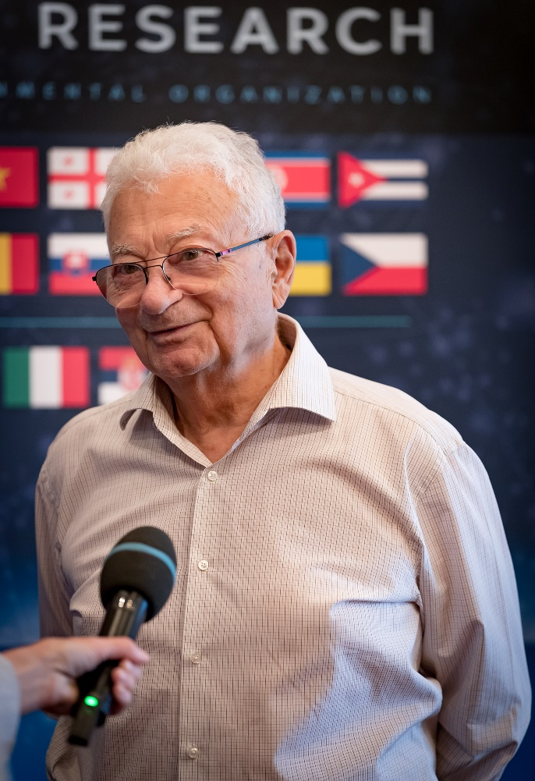
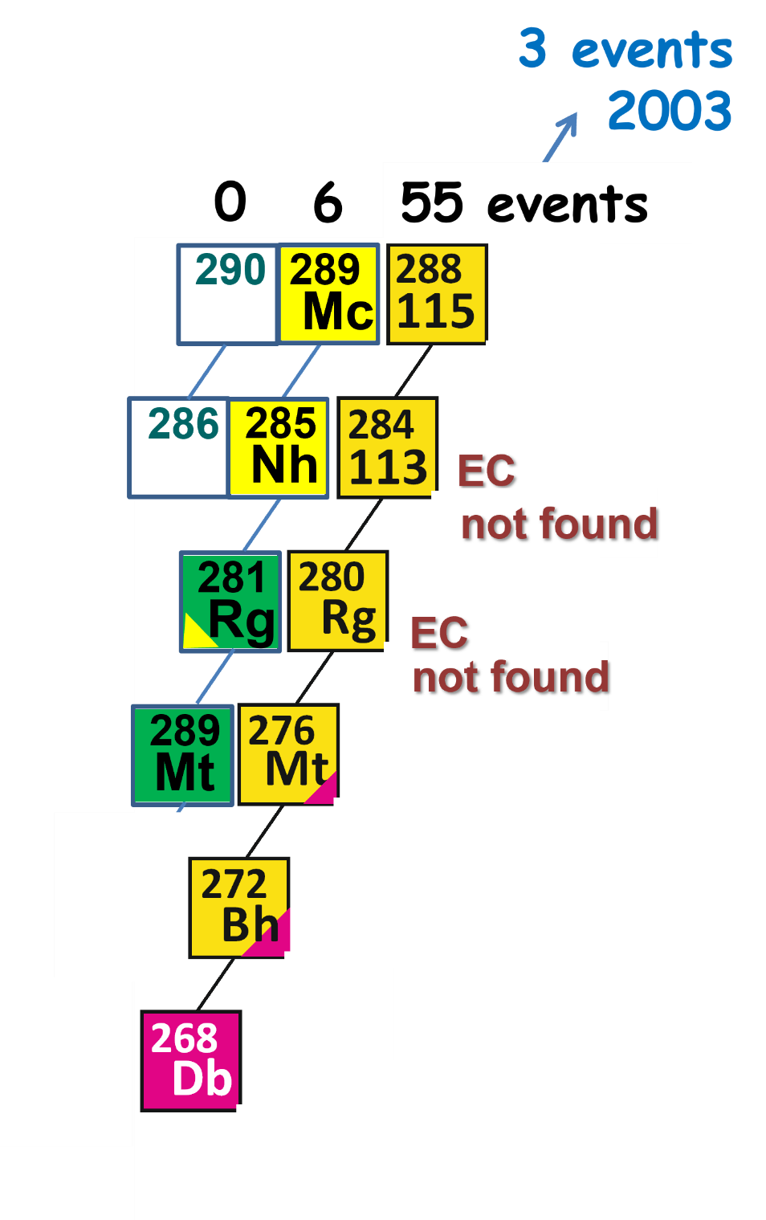
SHE at FLNR: research and development
The PAC heard the report on “SHE at FLNR: research and development” presented by Yuri Oganessian.
The report gave an overview on the work performed during the last four years.
First experiment (Nov.2020 – Jan.2021)
Production of the isotope ²⁸⁸Mc (Z=115) in reaction ²⁴³Am+ ⁴⁸Ca
²⁴³Am – target 18 mg
⁴⁸Са – beam intensity 1.25 pµA
Beam time 40 days

Slide 4
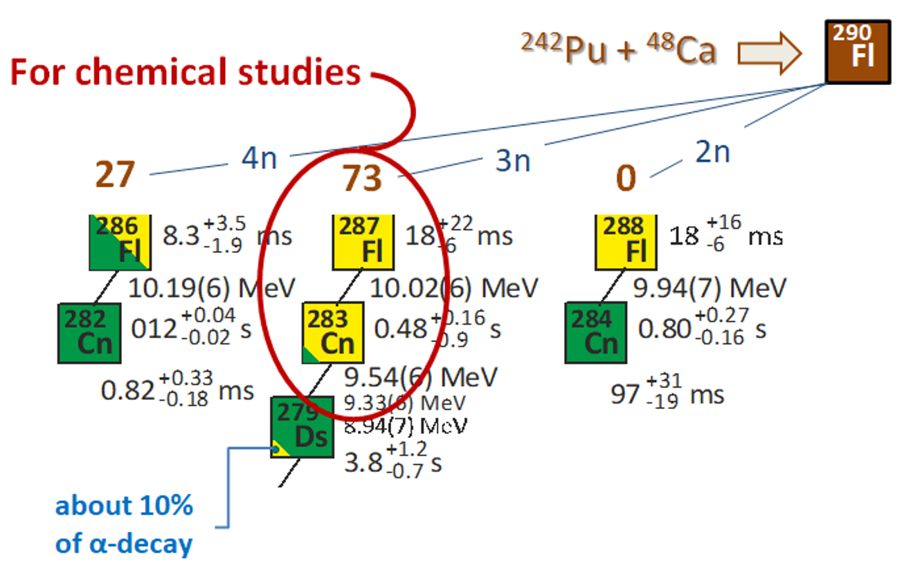
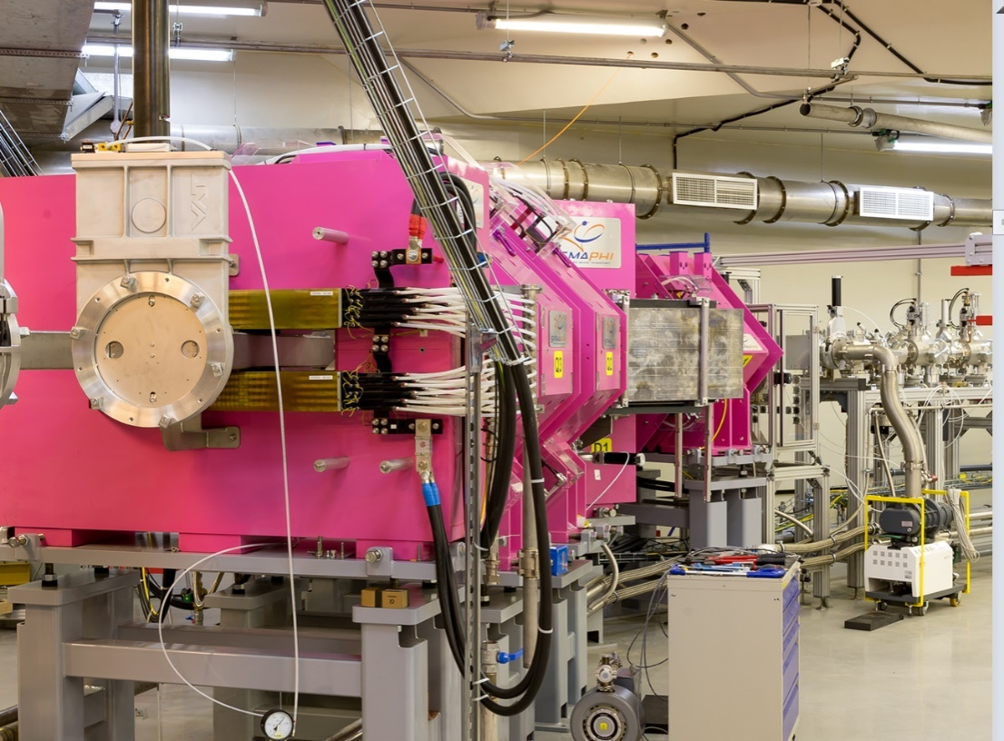
Second experiment (May - June 2021): Production of the isotope ²⁸⁷Fl (Z=114)
in reaction ²⁴²Pu + ⁴⁸Ca
²⁴²Pu – target 40 mg
⁴⁸Са – beam intensity 1.5 -3.0 pµA
Beam time 39 days
Ninety-nine ^{286, 287}Fl decay chains (in comparison to twenty-five chains for all previous years) have been registered.
DGFRS-III separator
The study of the chemical behaviour of the new elements and related relativistic effects is another goal of the experiments at FLNR.
For this purpose, a new gas-filled separator, DGFRS-III, is already mounted in the experimental hall at DC-280.

Slide 5
Recommendation:
The PAC took note of the report on "SHE at FLNR: research and development".
The PAC fully supports the presented scientific programme on the synthesis and studies of heavy and super-heavy nuclei and wishes the FLNR team every success in the ongoing and planned outstanding experiments.
NB: Today the information about new data on experiments at the SHE Factory will be presented by N. Kovrizhnykh

Slide 6
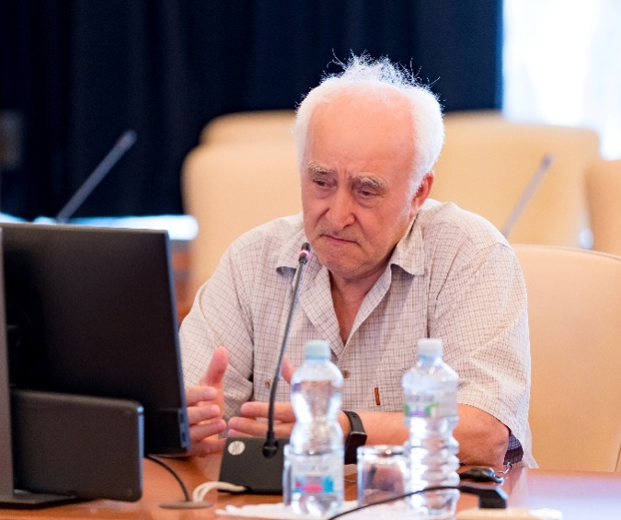
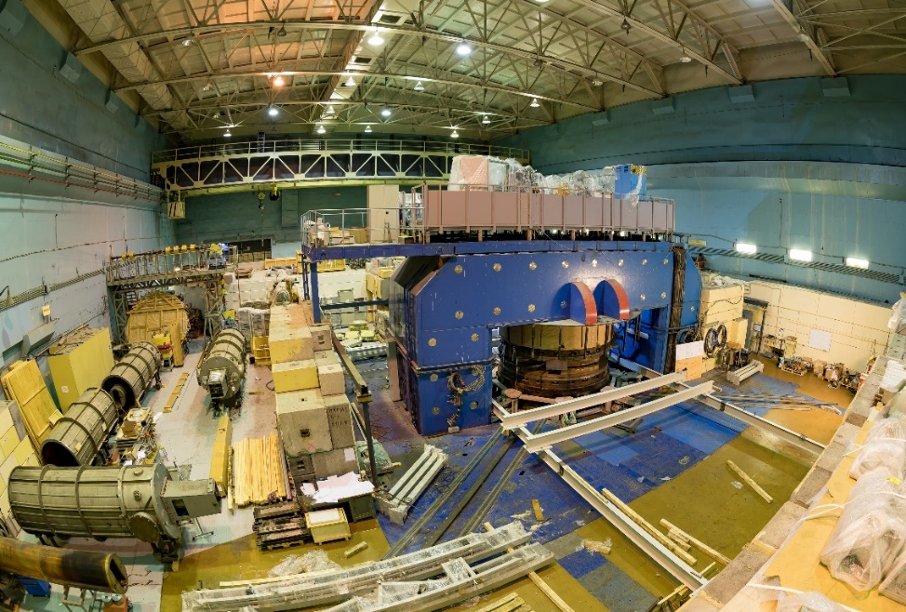
Development of the FLNR accelerator complex and experimental setups (DRIBs-III)
The PAC heard a report on the implementation of the theme for 2017–2021 presented by Georgy Gulbekyan.
A major part of experimental efforts at U-400 was devoted to research with ⁴⁸Ca (DGFRS and SHELS) and ⁵⁰Ti beams (SHELS) and applied work (Roscosmos).
Modernization of cyclotron U-400M
upgrade was started in July 2020
its commissioning being scheduled for the middle of 2022.
The modernization aims first and foremost at enhancing the reliability and stability of the accelerator and at increasing the intensity and energy of heavy-ion beams.
Before the upgrade was initiated, the U-400M cyclotron had ensured the implementation of the programme of experimental investigations with ¹¹B, ¹⁵N, ³²S (ACCULINNA-1 and ACCULINNA-2 separators), ¹⁸O, ²²Ne (COMBAS setup), and ⁴⁰Ar, ⁴⁸Ca beams (MASHA mass spectrometer).

Slide 7
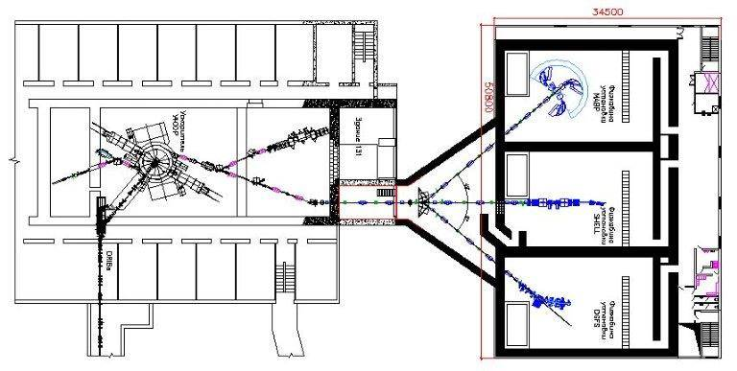
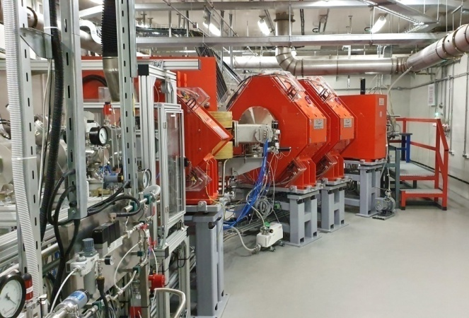
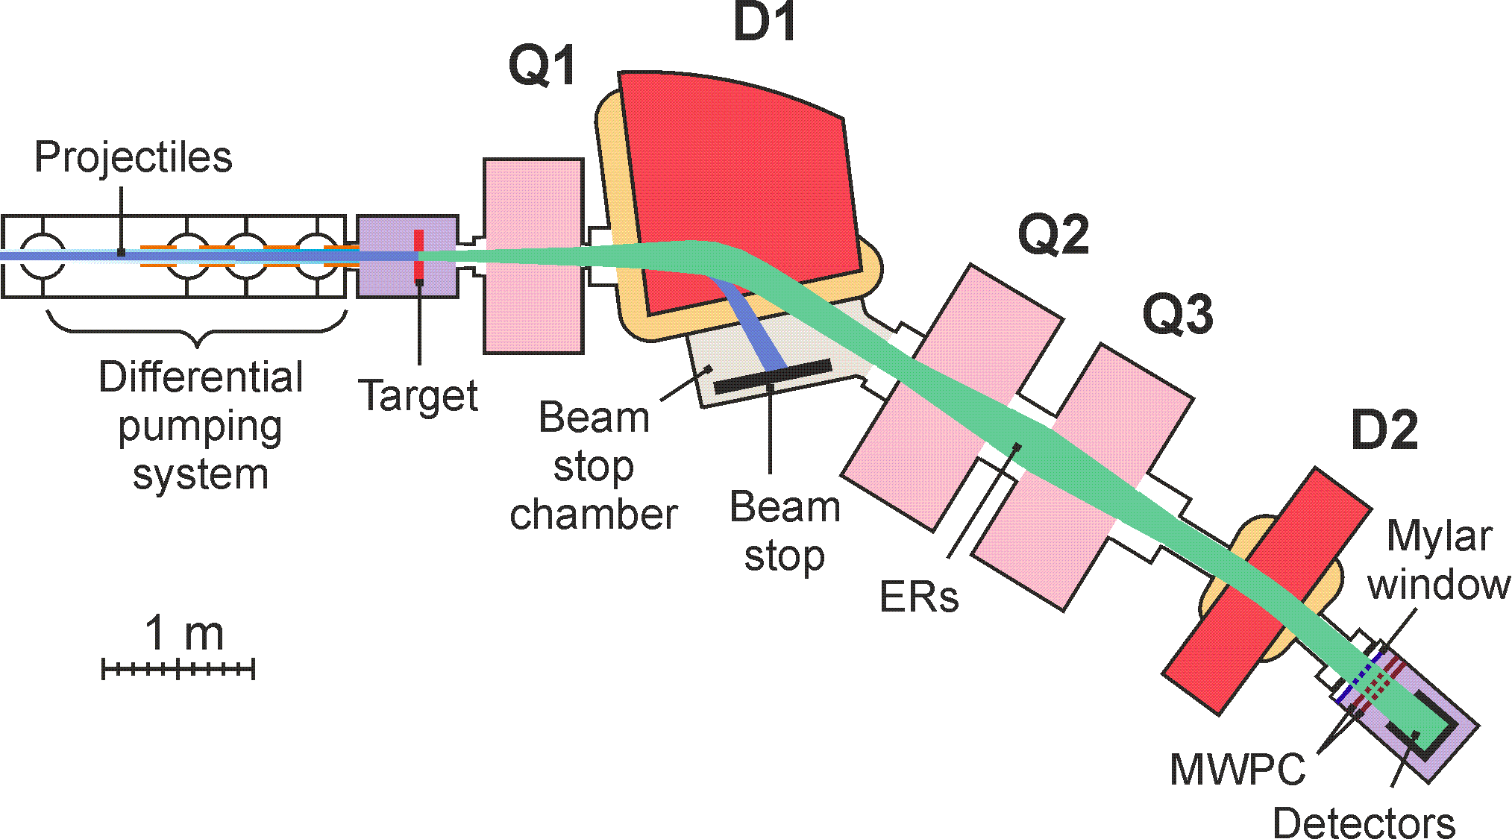
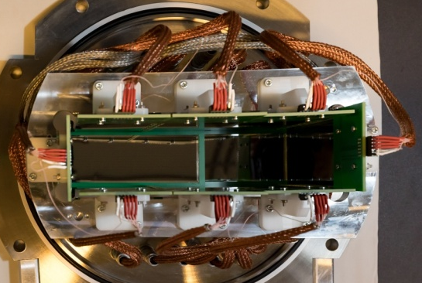
Development of the FLNR accelerator complex and experimental setups (DRIBs-III)
Reconstruction of the U-400 accelerator (→ U-400R) and the construction of the new experimental hall
The scheduled period for the construction of the new experimental hall is 2.5 years (2022–2024)
Dubna gas-filled recoil separator DGFRS-2
was commissioned;
the new expanded system of detectors was manufactured and tested;
the system is located in the focal plane of DGFRS-II allowing for an increase in reaction product collection by factor 1.5;
this is of paramount importance to the long-run experiments for SHE synthesis.

Slide 8
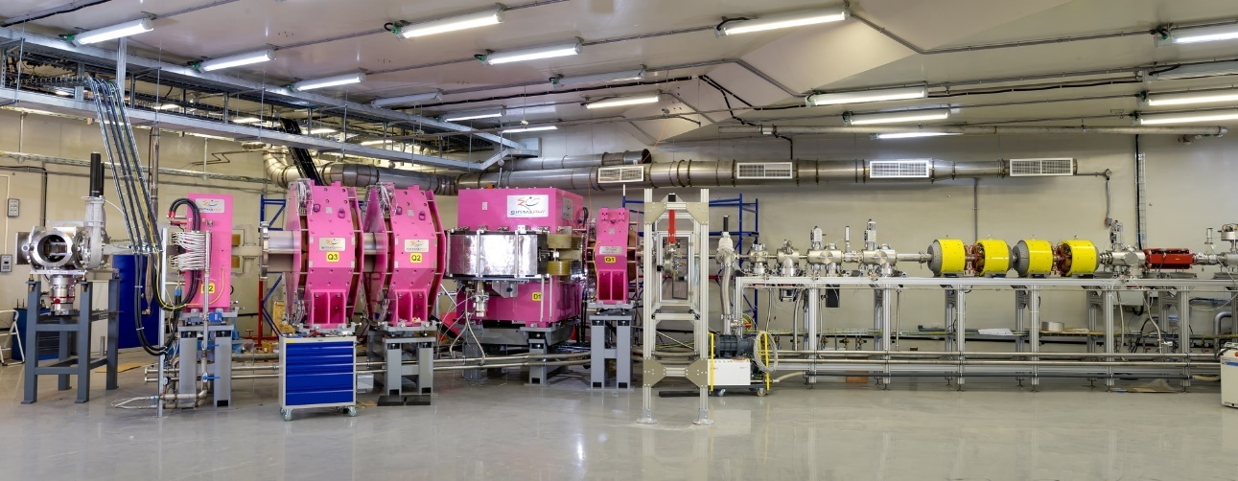
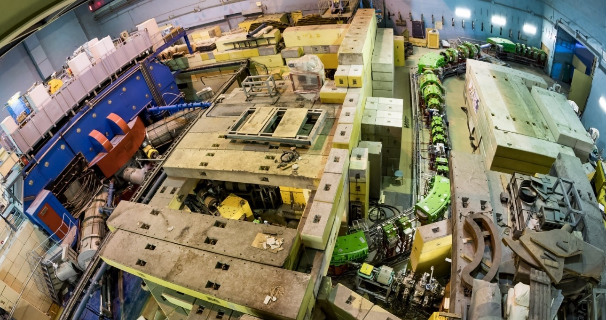
Development of the FLNR accelerator complex and experimental setups (DRIBs-III)
Dubna gas-filled recoil separator DGFRS-3
the commissioning of DGFRS-III begun in autumn 2021;
the construction of the ion gas catcher is continued;
the development of a multiple-reflection time-of-flight mass spectrometer for precision measurements of SHE mass has begun.
ACCULINNA-2 separator
was developed and commissioned within the theme;
series of methodological works to prepare experiments with ⁶Не, ⁸Не, ⁹Li, ¹⁰Ве, ²⁷S, etc. beams were undertaken in 2017–2021;
to prepare the new experiments aimed at studying light neutron-rich nuclei and scheduled for the end of 2023;
a project for creation of a tritium target is under implementation.
Recommendation:
The PAC took note of the report on the theme “Development of the FLNR accelerator complex and experimental setups (DRIBs-III)” for 2017–2021

Slide 9
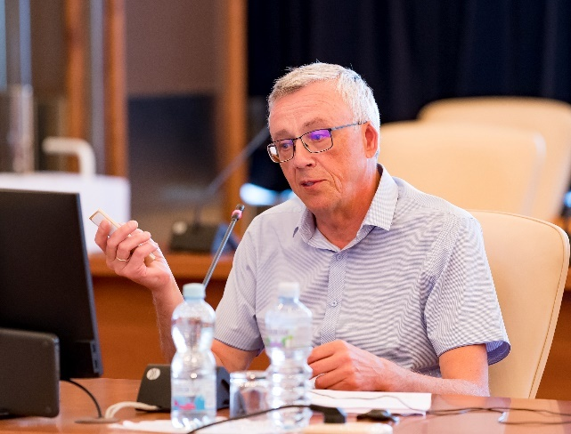
Extension of the themes “Development of the FLNR accelerator complex and experimental setups (DRIBs-III)” and “Synthesis and properties of superheavy elements, the structure of nuclei at the limits of nucleon stability”
The PAC heard a proposal for prolongation of the themes for 2022–2023 presented by Sergey Sidorchuk.
The plans for 2022–2023 are:
to continue increasing intensities and acceleration efficiency of heavy ions (primarily ⁴⁸Сa, ⁵⁰Ti, and ⁵⁴Cr);
to complete the upgrade and to launch the U-400M accelerator;
to work out a methodology for producing uranium beams at U-400;
to commence the construction of the new U-400R experiment building;
to continue the construction and development of the physics setups including commissioning DGFRS-III separator, completing the development of the ion gas catcher, designing and starting production of the multiple-reflection time-of-flight mass spectrometer and the cryogenic gas target complex of ACCULINNA-2 separator;

Slide 10
Extension of the themes “Synthesis and properties of superheavy elements, the structure of nuclei at the limits of nucleon stability”
the experiments for the synthesis of isotopes of elements 114 (Fl) and 115 (Mc) in reactions of ⁴⁸Ca ions beam with ²⁴²Pu and ²⁴³Am targets will be continued at SHE Factory. The aim of the experiments is to thoroughly study decay properties of Lr to Mc isotopes;
a series of experiments aimed at measuring production cross sections for SHE isotopes in reactions of actinides with ⁵⁰Ti and ⁵⁴Cr will be conducted allowing researchers to determine the prospects of synthesizing new elements 119 and 120 and to launch the first dedicated experiments;
the experiments on α-, β-, and γ-spectroscopy of the isotopes of transfermium elements will be continued using SHELS and DGFRS-III separators and GABRIELA and SFiNX detecting systems;
the first experiments on the spectroscopy of moscovium nuclei are planned;
the experiments for studying properties of SHE 112 and 114 will be conducted using DGFRS-III;
after launching the U-400M cyclotron in 2022, an evaluation of experimental capabilities will be carried on to improve the efficiency of experiments aimed at investigating the ⁷H structure using ACCULINNA-2.

Slide 11
Extension of the themes “Development of the FLNR accelerator complex and experimental setups (DRIBs-III)” and “Synthesis and properties of superheavy elements, the structure of nuclei at the limits of nucleon stability”
PAC Recommendation:
The PAC recommends that the themes “Development of the FLNR accelerator complex and experimental setups (DRIBS-III)” and “Synthesis and properties of superheavy elements, the structure of nuclei at the limits of nucleon stability” be extended to 2022–2023 with the highest priority.
SC recommendation:
The SC noted that the start of experiments at the SHE Factory at FLNR was an important event for JINR.
The SC noted that the commissioning of the SHE Factory, the upgrade of the U-400M cyclotron, as well as the creation of new generation experimental setups for operation at the FLNR accelerators scale up JINR's capacities for carrying out fundamental nuclear physics and applied research to the highest level in wide collaboration with scientific centers of the JINR Member States and other countries interested in conducting research in Dubna.
The SC particularly highlighted the results of the first experiments at the SHE Factory in production of Fl and Mc isotopes in fusion reactions ⁴⁸Ca + ²⁴²Pu,²⁴³Am, respectively, and supports the programme for a detailed study of radioactive properties of isotopes from Lr to Mc in 2022–2023.
The SC a supported the continuation of the experiments with α-, β- and γ spectroscopy of isotopes of transfermium elements using the SHELS and DGFRS-II separators, which are to obtain data about their nuclear levels.
The SC endorsed the PAC's recommendations for extending the themes “Synthesis and properties of superheavy elements, the structure of nuclei at the limits of nucleon stability” and “Development of the FLNR accelerator complex and experimental setups (DRIBs-III)” for 2022–2023 with first priority.

Slide 12
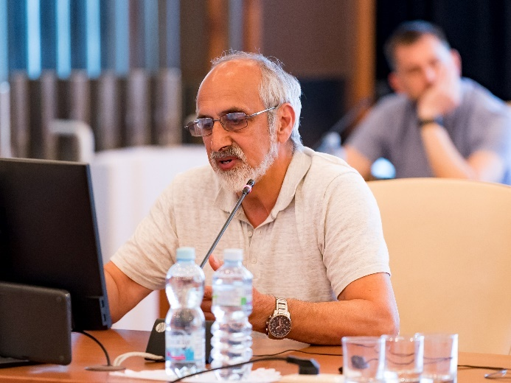
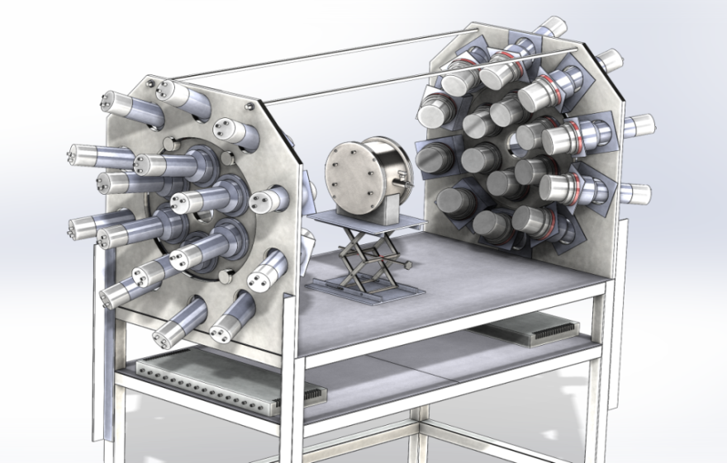
Project ENGRIN
The PAC heard a proposal to open a new project “Investigation of prompt fission neutron emission in fission” (project ENGRIN) presented by Shakir Zeynalov.
The experiments suggested by the authors of ENGRIN project and to be carried out with the use of resonance neutrons will study the correlation between the multiplicity and angular distributions for the prompt fission neutrons and the fragment energy and mass spectra.
A new setup for investigations of correlation between variations of TKE and PFN emission was developed in Dubna. Setup consists of 32 scintillators as neutron detectors and position sensitive double gridded ionization chamber.
Recommendation:
The PAC recommends opening this project for a year starting 2022 with its subsequent extension in case the work on its implementation is successful and the theme financing is approved. The PAC proposes the authors to reconsider the processes of the scattering of fission neutrons in the materials of ionization chamber and neutron detectors, which might lead to a false identification of the neutron emission angles and energy.
The PAC ranked the project in category "B".

Slide 13
SC recommendation
The SC endorsed the PAC's recommendation for launching “Investigation of prompt fission neutron emission in fission” (project ENGRIN) in 2022 as B-ranked project for one-year period and considering its possible further extension

Slide 14
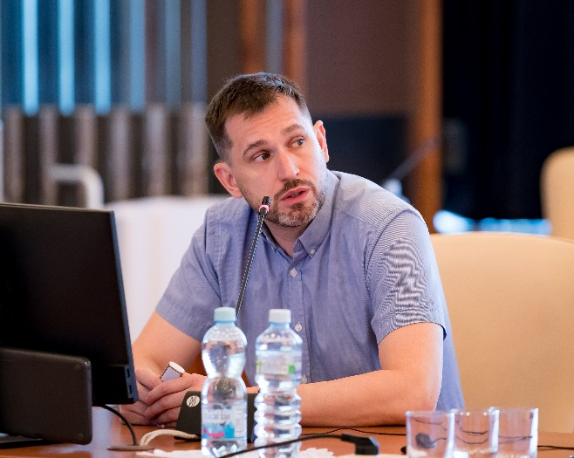
Project MONUMENT
In order to rank the project “Measurement of ordinary muon capture for testing nuclear matrix elements of 2β decays” the PAC heard a report presented by Mark Shirchenko.
52nd meeting PAC Recommendation.
The measurements of muon capture will be carried out at the meson factory of the Paul Scherrer Institute (PSI) in Switzerland. This application was reviewed and approved by the PSI User committee; the beam time was officially granted in 2020 for a preliminary study of ¹³⁶Ba with a further experimental programme for at least three years.
The participants of the MONUMENT project have required expertise and experience in the field of high-precision nuclear spectroscopy and its implementation for studying not only rare processes but also muon capture.
The PAC recommends opening the project MONUMENT for 2021–2023 with first priority and providing the project with full requested funding.
Recommendation:
The PAC recognizes the potential of project MONUMENT and recommends that this project be continued as previously recommended until the end of 2023.
The PAC ranked the project in category “A".

Slide 15
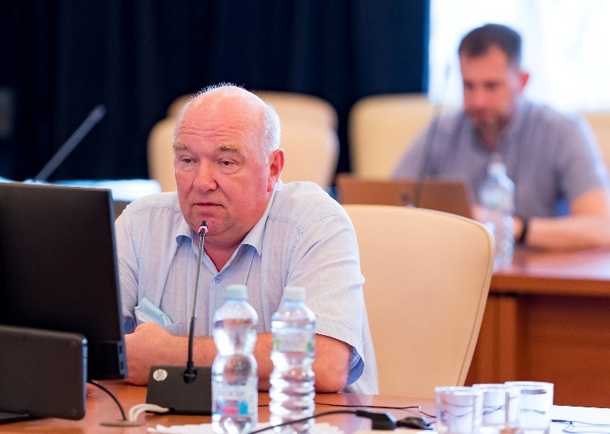
Project E&T&RM
The PAC heard a report on the project “Study of deep subcritical electronuclear systems and possibilities of their application for energy production, transmutation of radioactive waste and research in the field of radiation material science (E&T&RM)” presented by Anton Baldin.
The proposed project presents a workplan for two years and a detailed estimate of the required funds and employed workforce.
The presentation also included a short reference to two new branches of the project:
SINET (Station for Investigation of Nuclear Energy Technologies) and Development;
Construction of the Prototype of a Complex for Radiotherapy and Applied Research with Heavy-Ion Beams at the Nuclotron-M.
Recommendation:
The PAC recommends extending project E&T&RM until the end of 2023.
Furthermore, the PAC considers the two additional branches of extreme interest considering the future availability of high energy beams at the NICA complex. However, a plan concerning the two new branches is missing and it is not clear if they both are thought as part of the same E&T&RM project. Given the wide potential extension of the two new branches,
the PAC recommends dividing the project in three branches, and for each it is advisable to present at the next PAC meetings the current status and, if possible, a detailed plan including budget, man-power and institution involvement.
The PAC ranks the project E&T&RM in category “B”.

Slide 16
SC recommendation
The SC endorsed the PAC's recommendation for extending the B-ranked project “Study of deep subcritical electronuclear systems and possibilities of their application for energy production, transmutation of radioactive waste and research in the field of radiation material science (E&T&RM)” through the end of 2023.

Slide 17
THANK YOU FOR YOUR ATTENTION!

Slide 18
Synthesis of new elements at SHE Factory
⁵⁴Cr + ²⁴⁸Cm → 3n + ²⁹⁹120
A series of experiments were performed that aimed at studying mass-energy distributions of binary products formed in reactions with ^{52,54}Cr, ⁴⁸Ti, ⁸⁶Kr, and ⁶⁸Zn beams, leading to a composite system with Z = 114 and 120.
The experiments allow the evaluation of quasi-fission contribution to the capture cross section which is of great importance for the planned experiments for the synthesis of new superheavy elements with Z = 119 and 120.
⁵⁰Ti + ²⁴⁹Bk → 3n + ²⁹⁶119
Alpha decay of new nuclei leads
to the known decay chains.
known nuclei
Test reactions:
²³⁸U + ⁵⁴Cr → ²⁹²Lv*
²⁴²Pu + ⁵⁰Ti → ²⁹²Lv*
²⁴⁵Cm + ⁴⁸Ca→ ²⁹³Lv*
σ_{3n}= 4pb

