Slide 1
FairDb
Overview and Demonstration
Evgeny Lavrik,
Eberhard-Karls Universität Tübingen
for CBM Collaboration

Slide 2
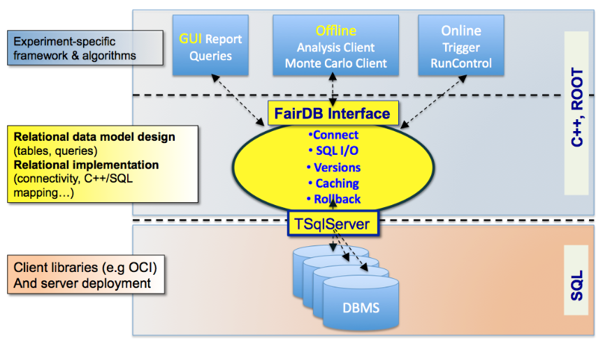
Architecture

Slide 3
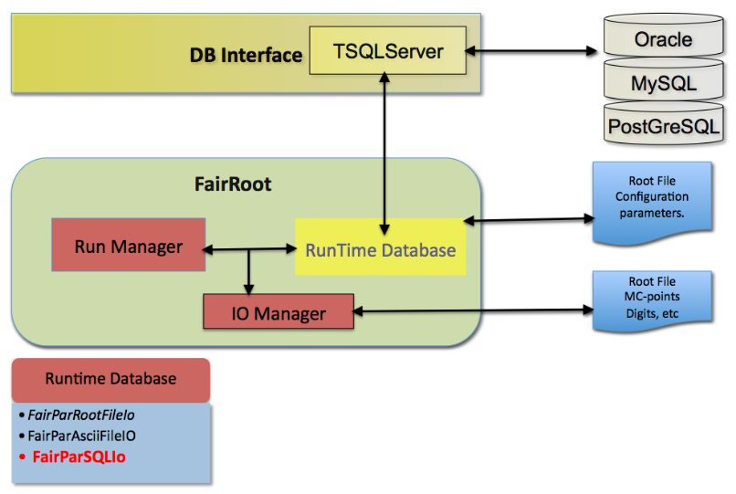
Architecture

Slide 4
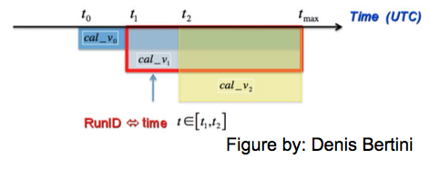
Insert only
Based on versioning:
Vaidity intervals
Well suited for:
Detector data
QA
FEE configs
Geometry
Allows storage of Arrays, ROOT Objects by serialization

Slide 5
Querying data
Define validity interval to retreive correct data
Single record: Get(), GetById(),
Multiple records by aggregation:
Use composite_id to group records
GetArray()

Slide 6
Defining data
Write a ROOT-Class inheriting from FairDbGenericParSet<>
Be sure to implement/override following methods:
Constructor/destructor
GetTableDefinition (returns sql code of a table to create)
Store() (data storage in correct order)
Fill() (data retreival)
clear (for object reuse)
Print() (always implement in a descriptive fashion)

Slide 7
Optical QA Database
Reports formed during analysis to be stored in Database
Centralised data storage for CBM – FairDB
1 full inspection is 12.2 GB per 6x6 sensor (n and p sides)
Up to 40 TB of images needs to be stored -> tape storage gStore from GSI
Database interfaces are currently being developed

Slide 9
Electrical QA scheme

Slide 10
Demonstration

