Slide 1
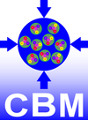

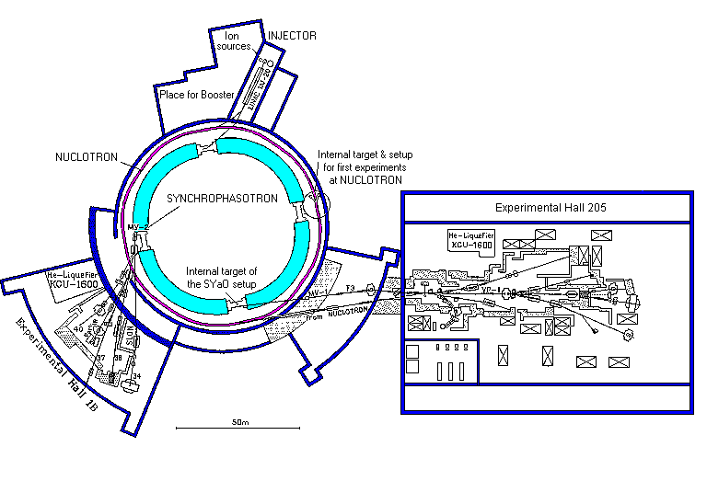
In-beam tests at Nuclotron in Feb 2017
Plans for Oct-Nov 2017
Dementev Dmitrii
JINR LHEP
22 May 2017

Slide 2
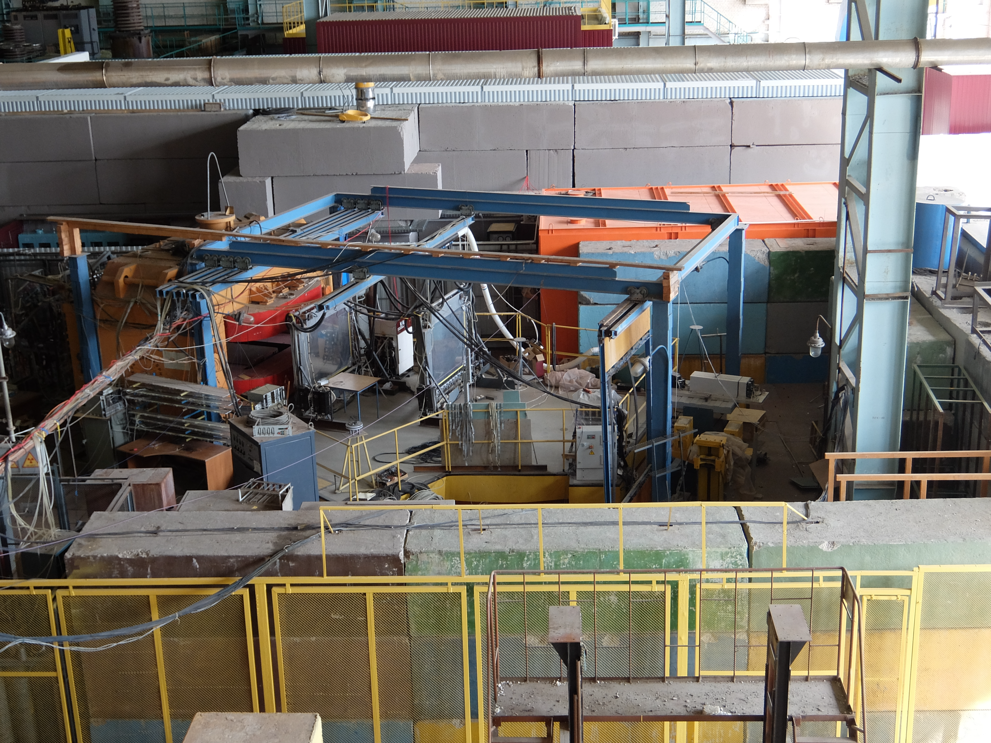
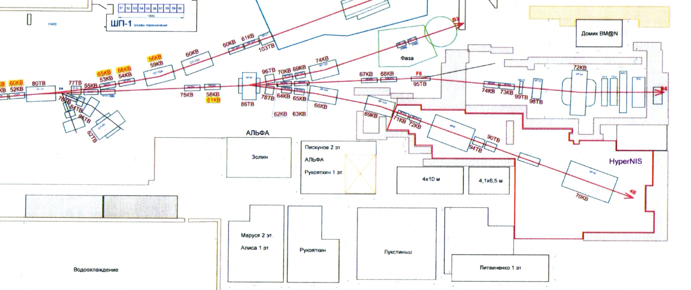
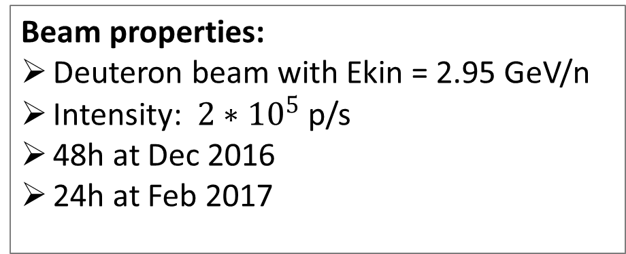
Test zone
Beam properties:
Deuteron beam with Ekin = 2.95 GeV/n
Intensity: $2∗{10}^{5}$ p/s
48h at Dec 2016
24h at Feb 2017
BM@N
MPD
Hyp NIS
STS
Control room
10 m

Slide 3
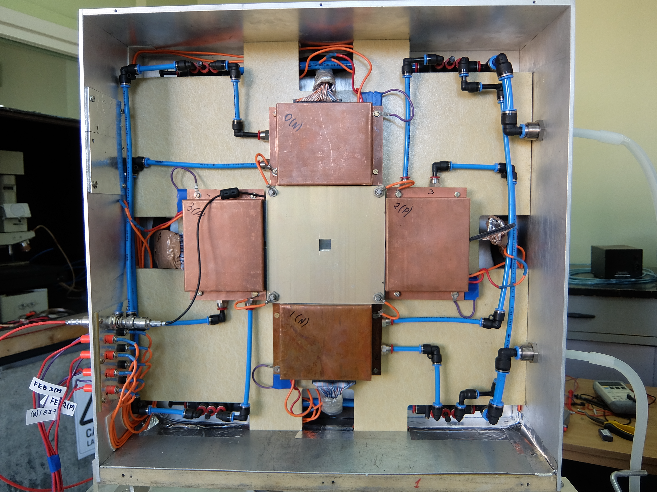
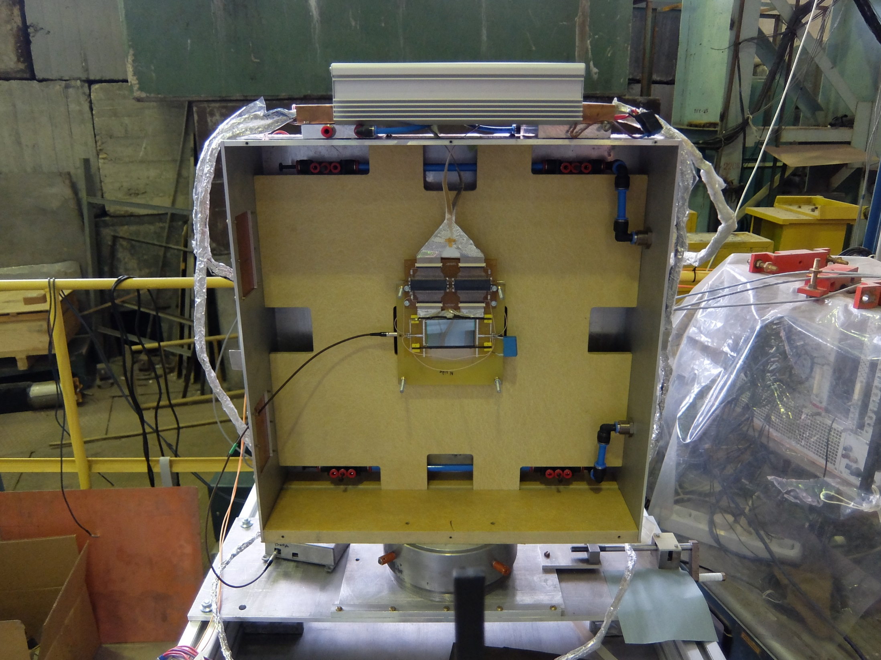
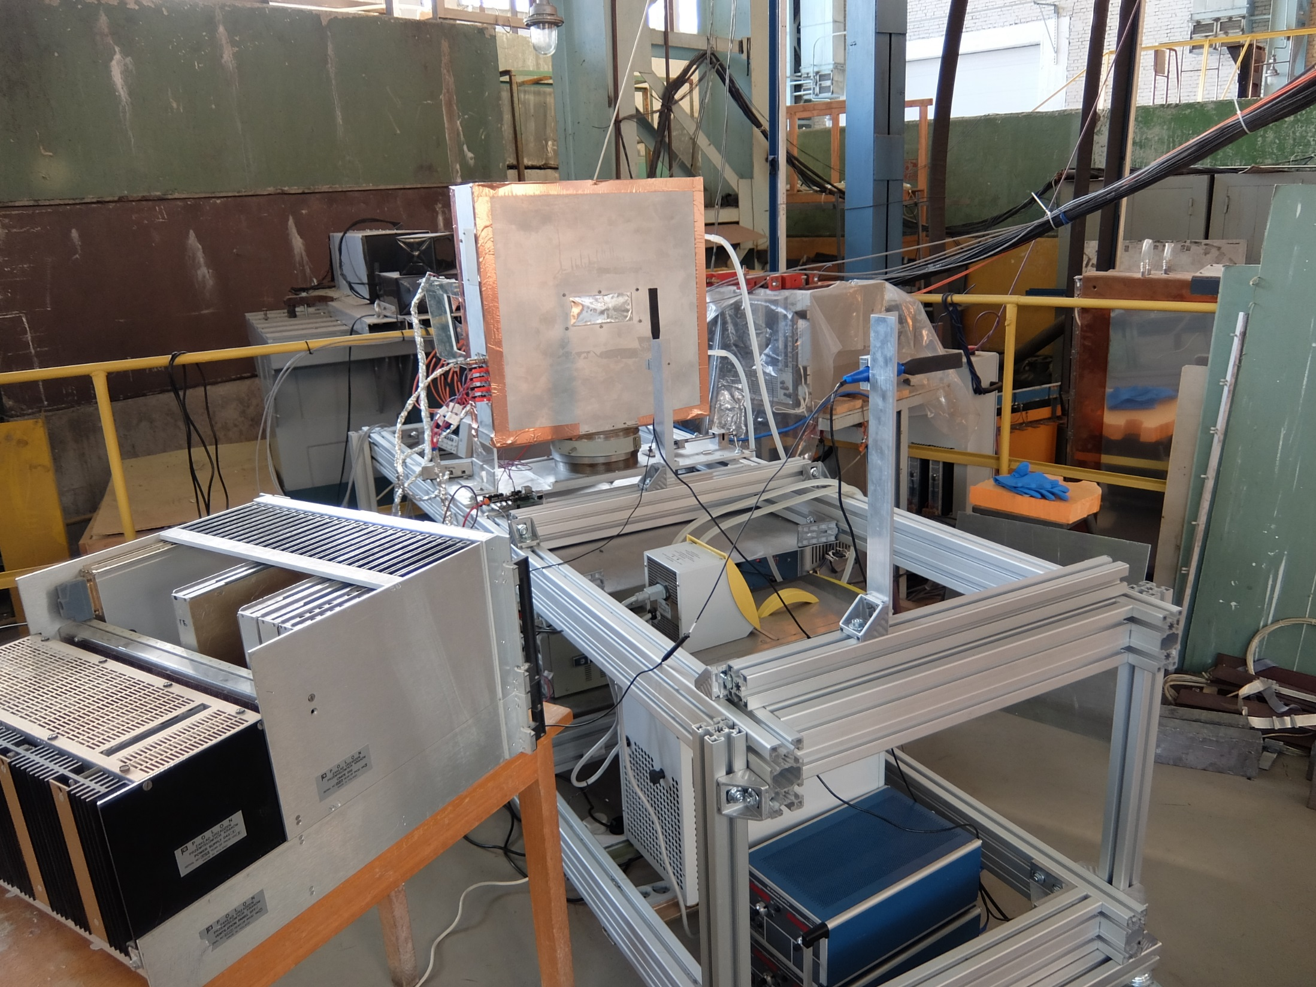
Test setup
One STS test station
Trigger system based on two scintillators counters
3 FEBs with nXYTER v.2.0 ASIC
SysCore v.2 based readout
Online Analysis based on DABC & Go4
Test station with “baby” sensor
Test station with CBM06C4-DM
beam
Two types of demonstrators were tested:
With “baby” sensor Hamamatsu
With CBM06C4-DM by CiS
Scintillator 2
Scintillator 1

Slide 4
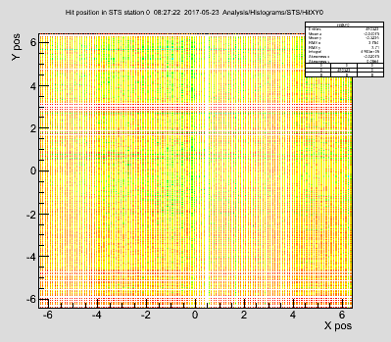
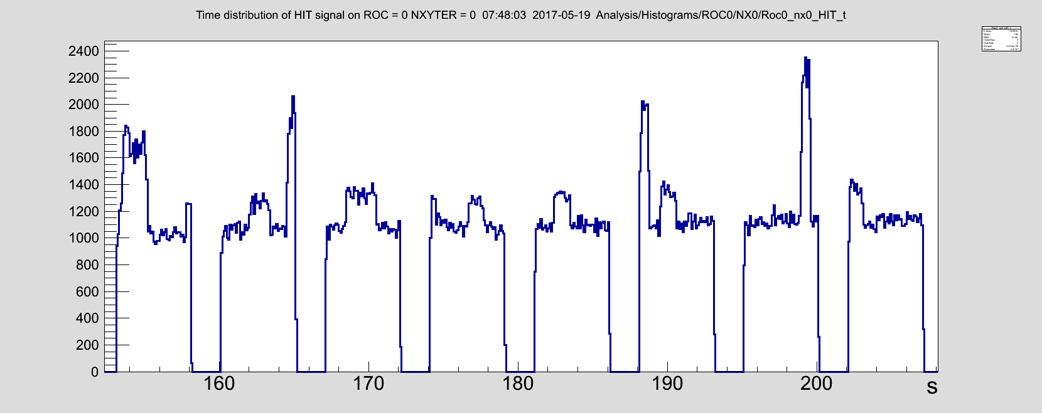
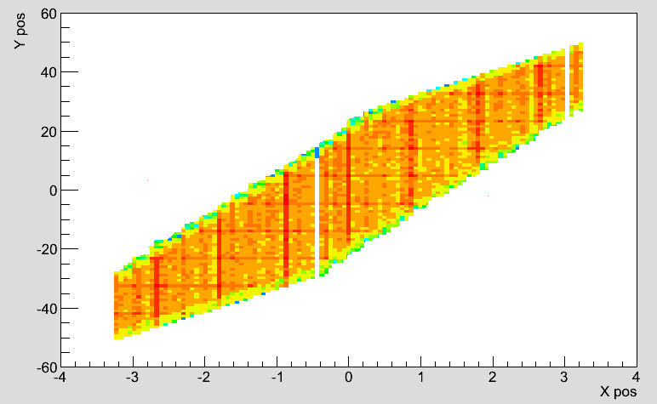
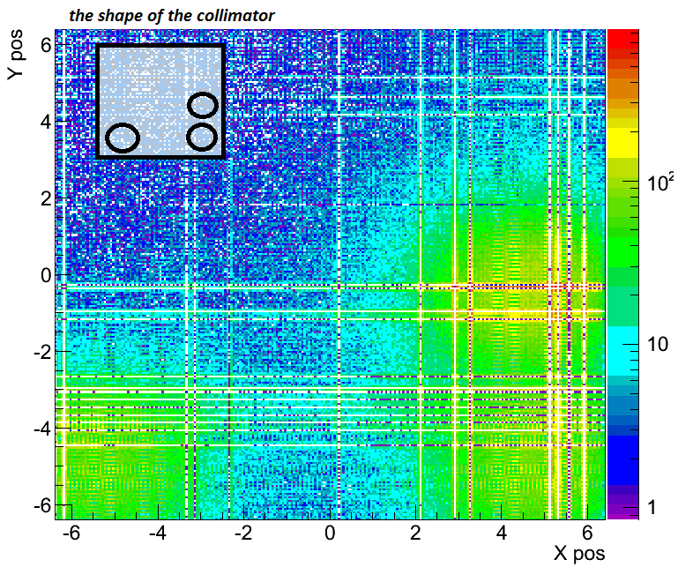

Beam structure
5 s
XY beam structure: baby sensor
Test of the mapping
with ${Sr}^{90}$ source
Time structure of the beam:
One spill is approx. 5s
Slow extraction at Nuclotron
Beam had ~15cm diameter at the sensor location
Since the sensitive area of the sensor is much smaller
It is seen as homogeneous
XY beam structure: CBM06C4-DM

Slide 5
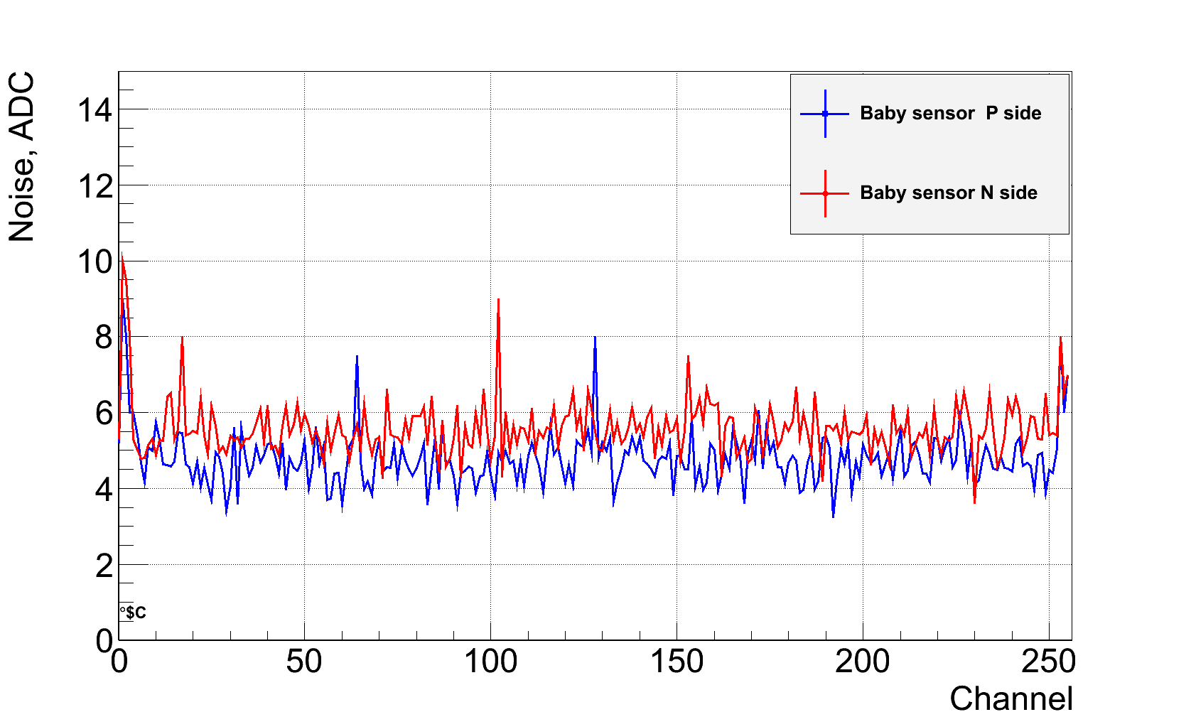
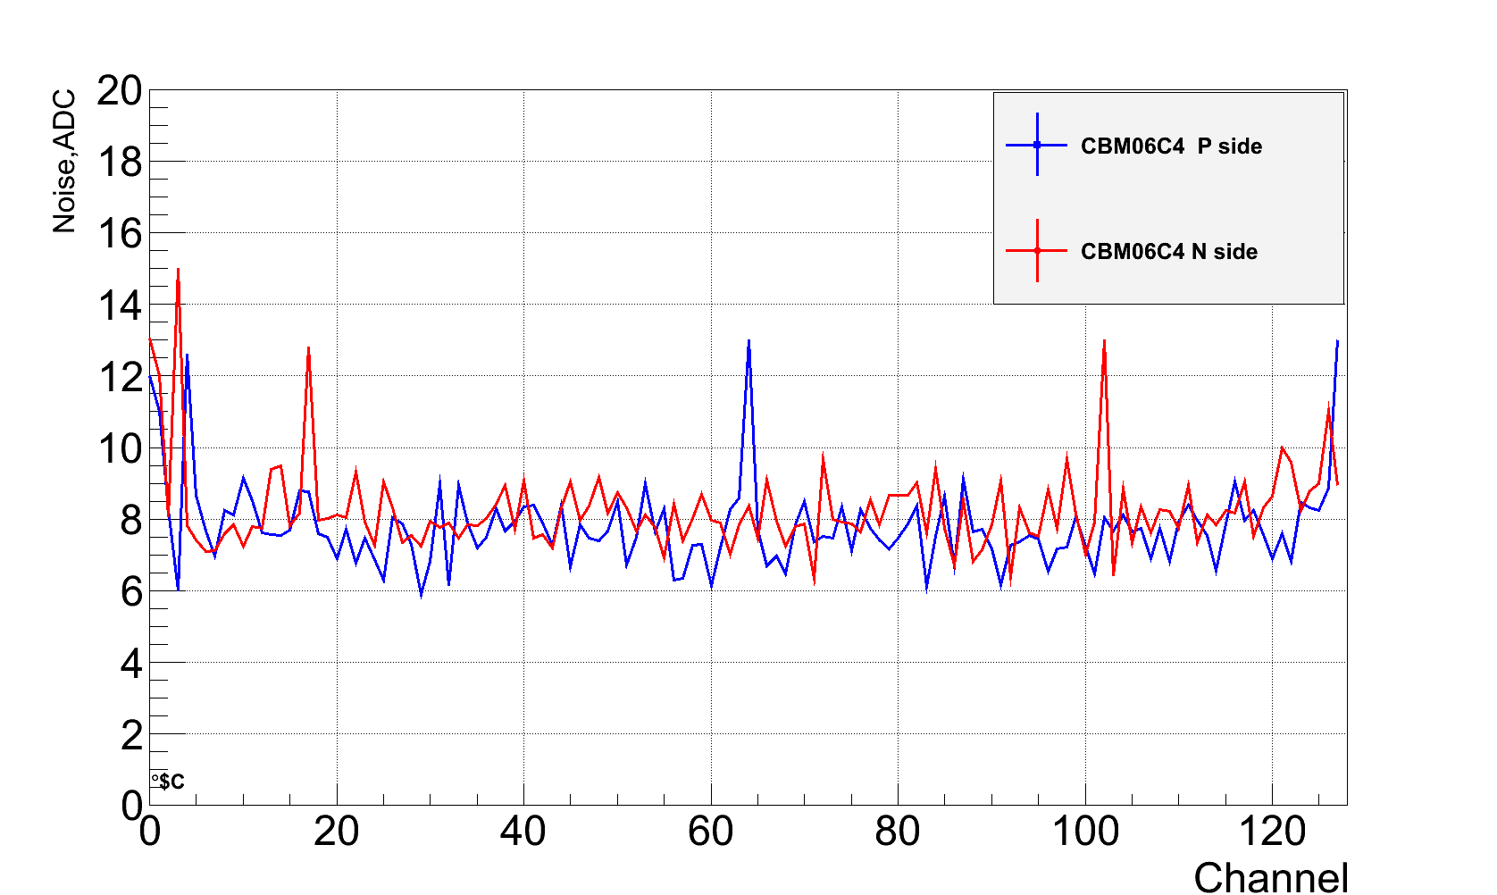
Noise
Noise per channel distribution on Baby sensor
Noise per channel distribution on CBM06C4 sensor
N side, av. noise | 5.5 ± 0.2 ADC
P side, av. noise | 4.7 ± 0.2 ADC
N side, av. noise | 7.7 ± 0.53 ADC
P side, av. noise | 8.1 ± 0.41 ADC
S/N for N side 23.4
S/N for P side 24.5
S/N for N side 17.1
S/N for P side 16.8

Slide 6
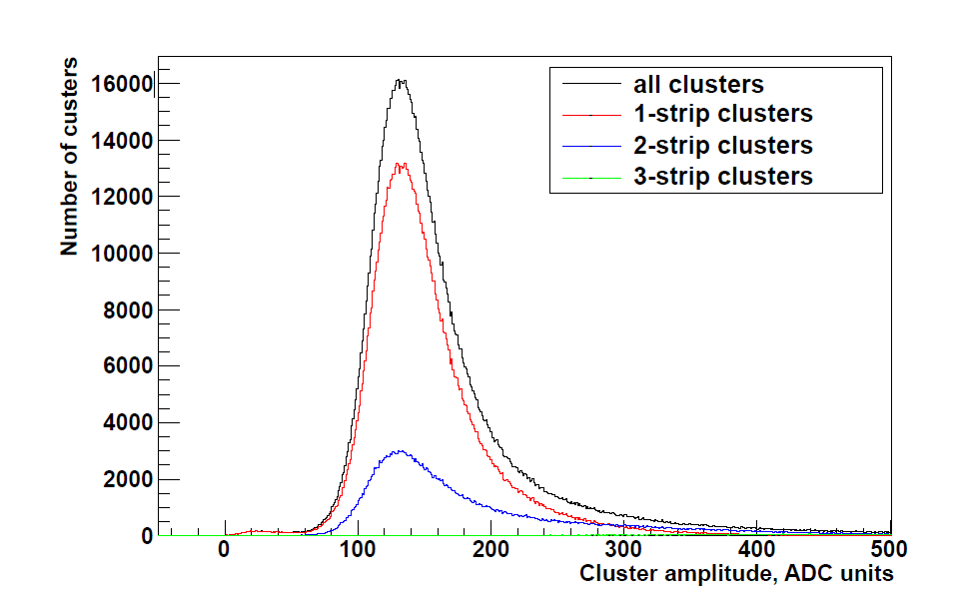
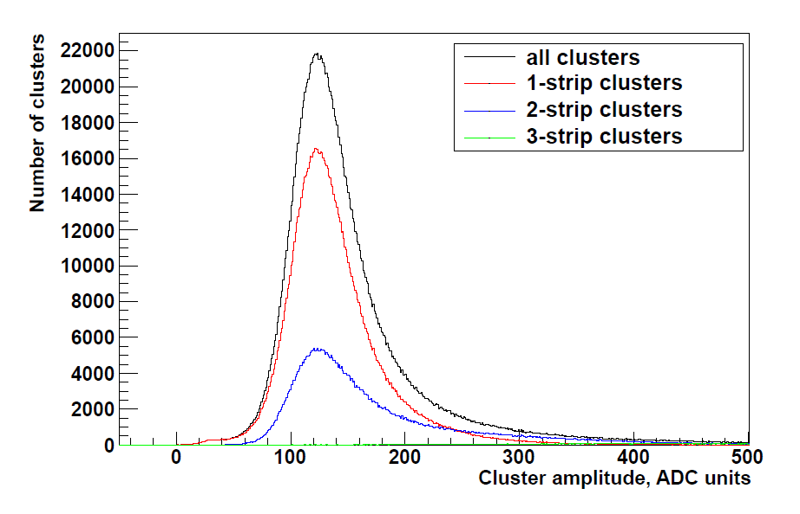
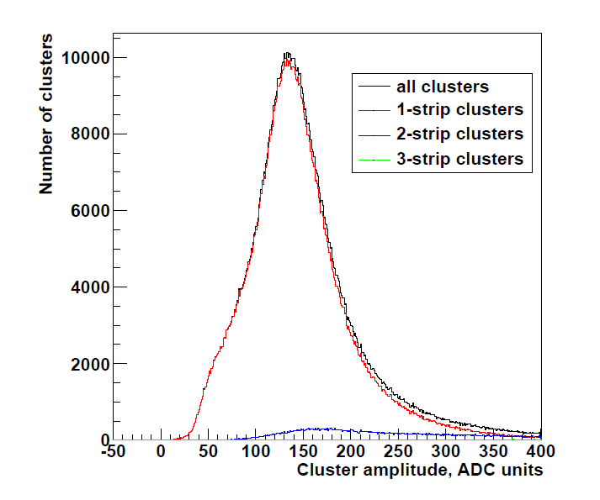
Clusters amplitude measured with d beam
Clusters amplitudes on the P side of baby sensor
Clusters amplitudes on the N side of baby sensor
Clusters amplitudes on the P side of CBM06C4-DM
sensor
Areas with no masked and noisy channels was selected.
Coincidence with trigger was applied
Deficiency of 2-strip clusters for the CBM06C4-DM is due to high value of comp. threshold (reg 18 val 42 )

Slide 7
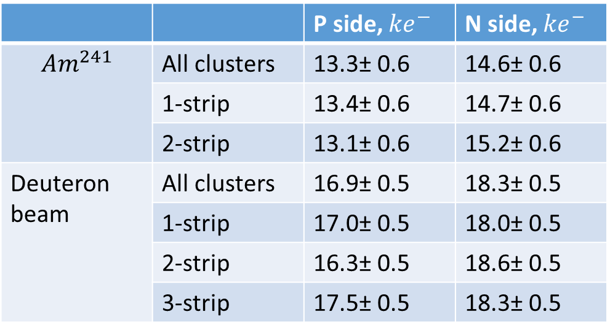
Cluster amplitudes
 |  | P side, ${ke}^{−}$ | N side, ${ke}^{−}$
$${Am}^{241}$$ | All clusters | 13.3± 0.6 | 14.6± 0.6
 | 1-strip | 13.4± 0.6 | 14.7± 0.6
 | 2-strip | 13.1± 0.6 | 15.2± 0.6
Deuteron beam | All clusters | 16.9± 0.5 | 18.3± 0.5
 | 1-strip | 17.0± 0.5 | 18.0± 0.5
 | 2-strip | 16.3± 0.5 | 18.6± 0.5
 | 3-strip | 17.5± 0.5 | 18.3± 0.5
Cluster amplitudes for baby sensor

Slide 8
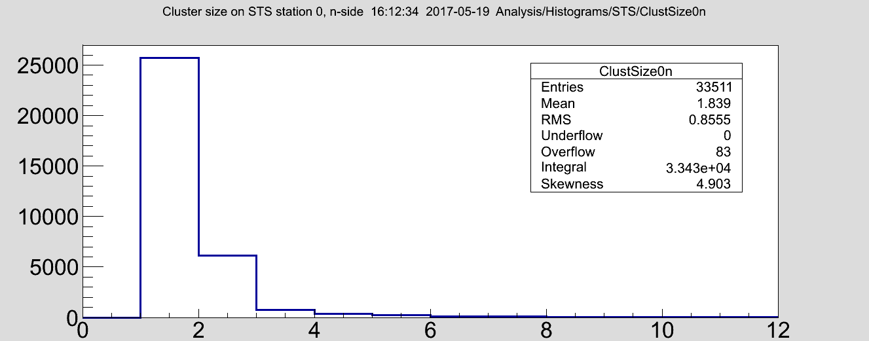
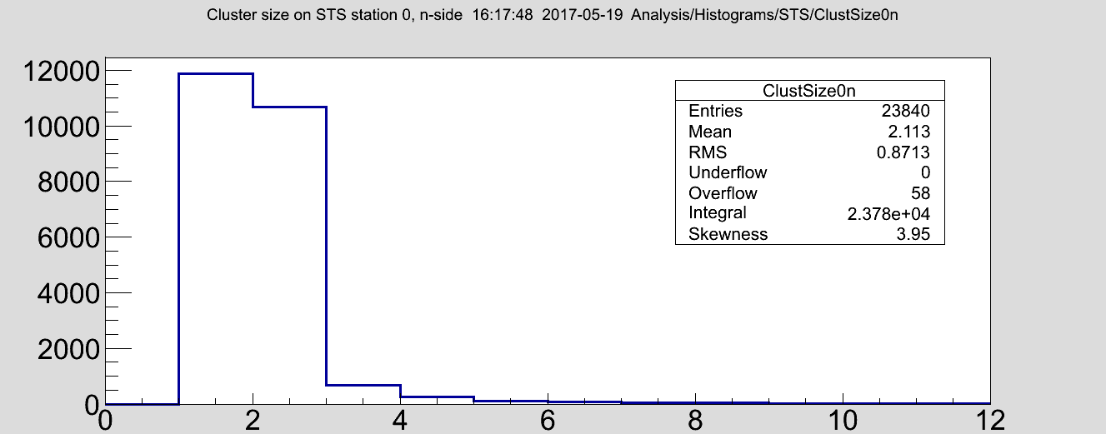
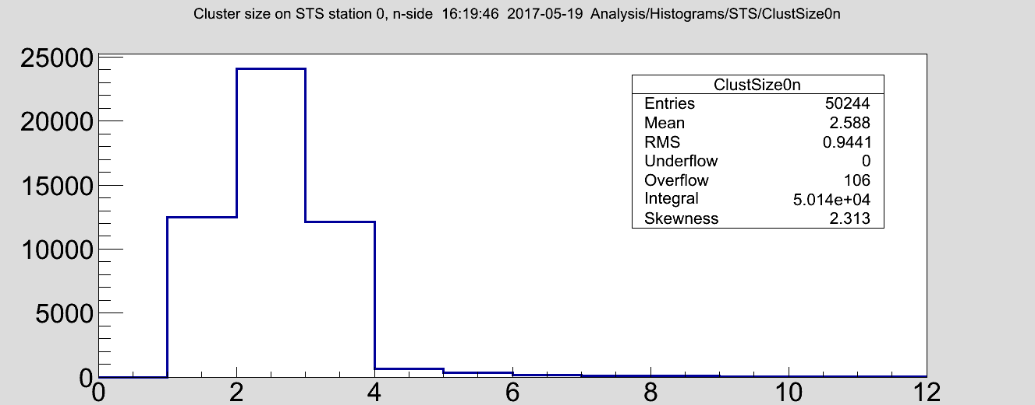
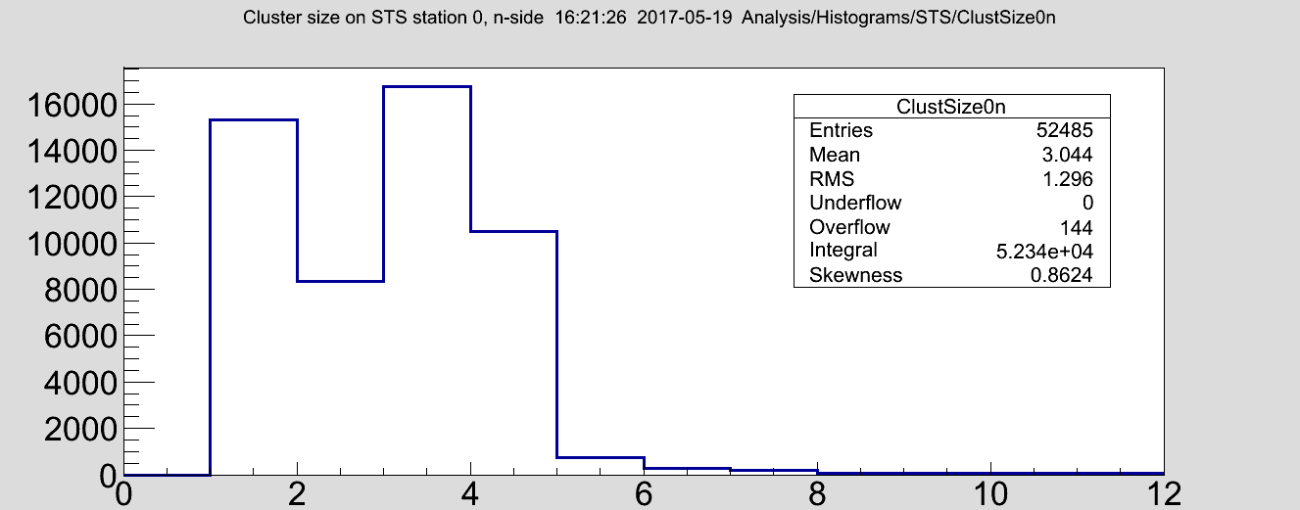
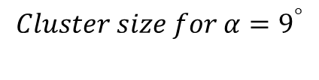
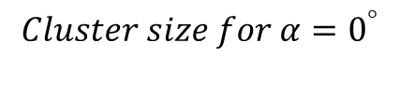
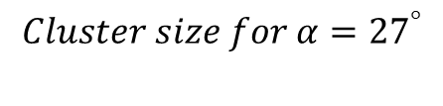
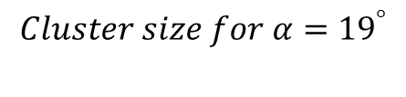
Cluster size dependence on the angle
α
sensor
beam
$$Cluster size for α=0^{°}$$
$$Cluster size for α=9^{°}$$
$$Cluster size for α={19}^{°}$$
$$Cluster size for α={27}^{°}$$

Slide 9
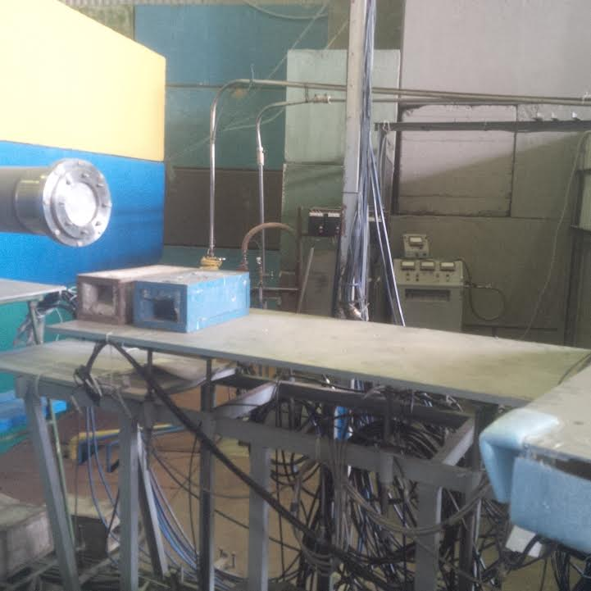
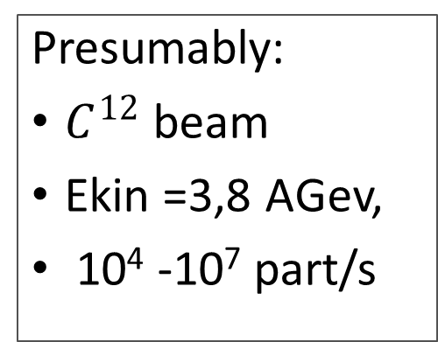
Plan for Oct-Nov
Presumably:
$C^{12}$ beam
Ekin =3,8 AGev,
10⁴ -10⁷ part/s
STS 1
beam pipe
STS 2
STS 3
Setup:
2 stations with baby sensors
1 station with CBM06C4-DM sensor
Front-end boards with STSXYTER
AFCK based readout with IP-bus
Stand alone analysis
NIS GIBS

Slide 10
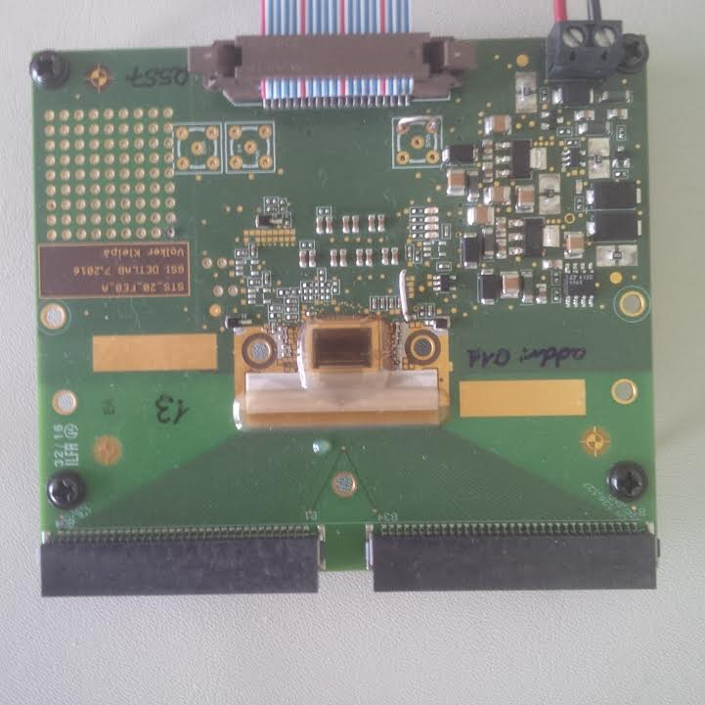
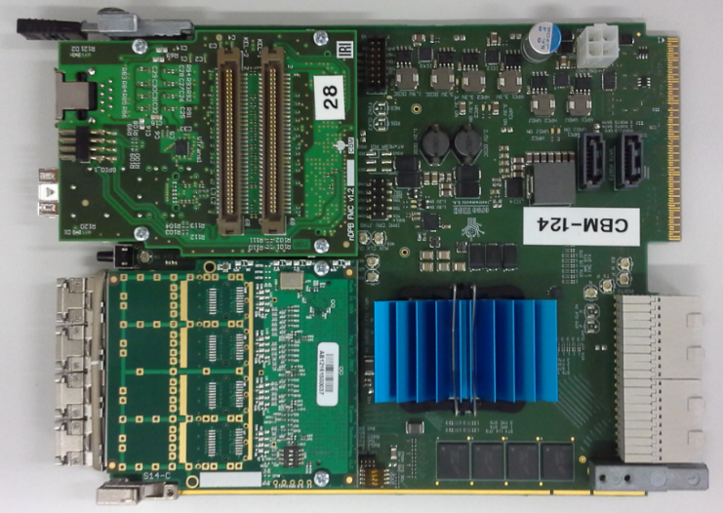
Readout chain for the Oct. beamtime
Twisted pair
Media converter
IP-bus
Eth connection
to the switch
List of hardware:
Needed in the lab
12 STSXYTER FEBs 3
7 AFCK boards 9
6 gDPB FMC 3
7 tDPB FMC 0
2 STSXYTER FEBs
AFCK board with mezzanine cards:
1 gDPB FMC
1 tDPB FMC

Slide 11
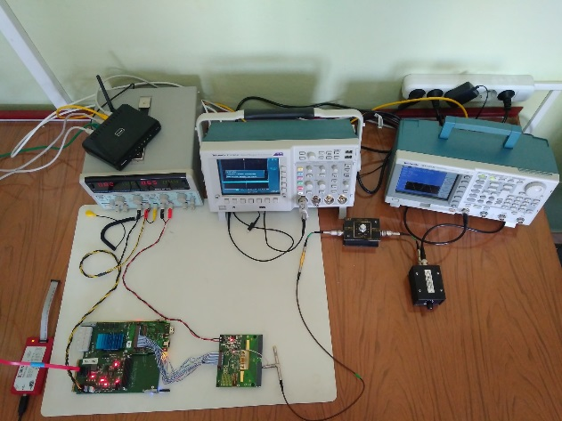
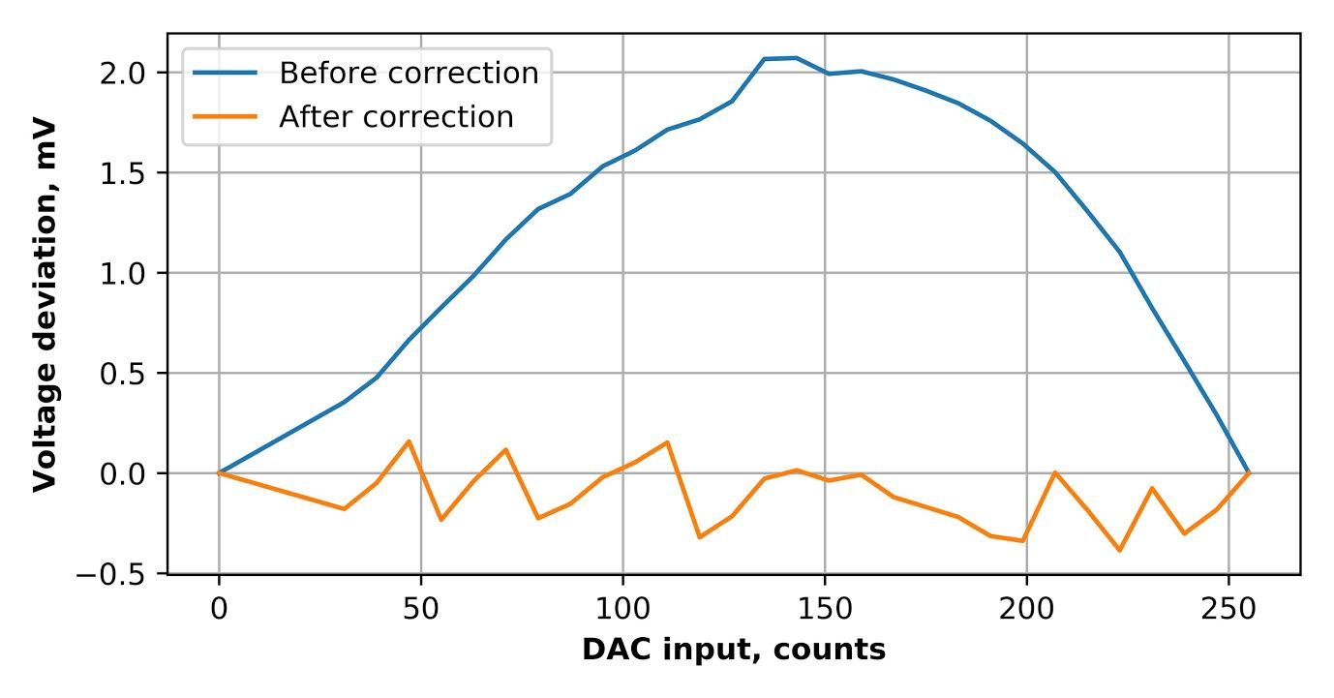
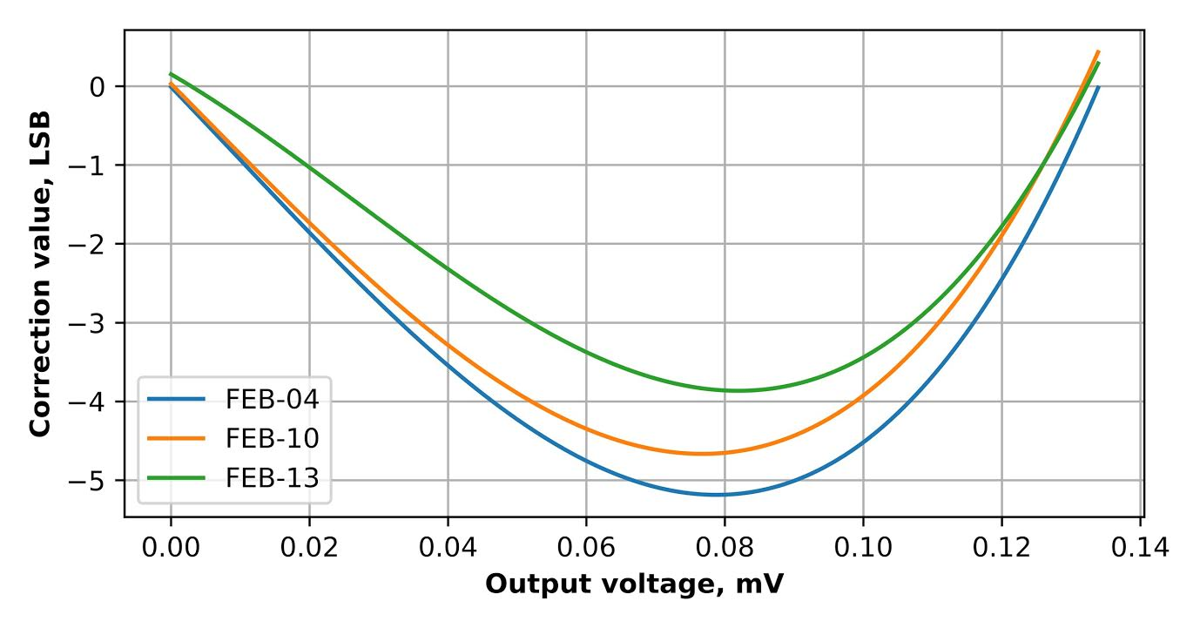
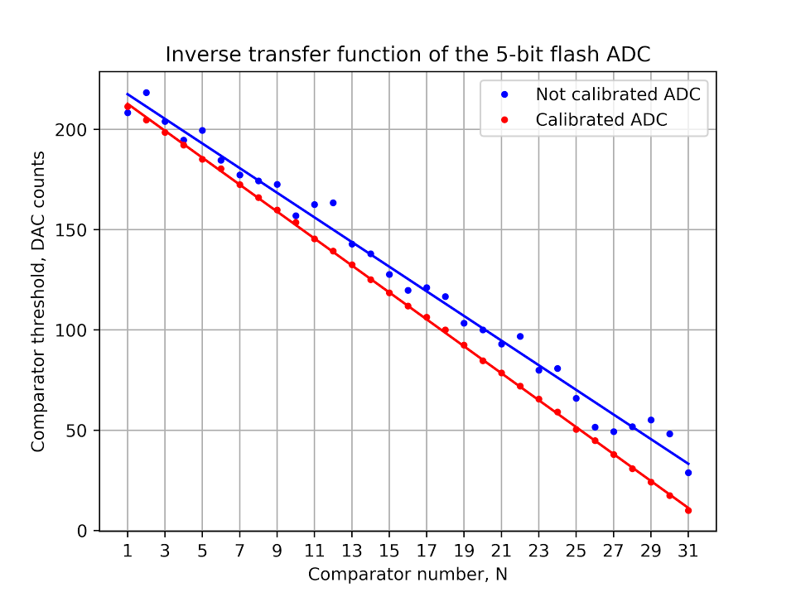
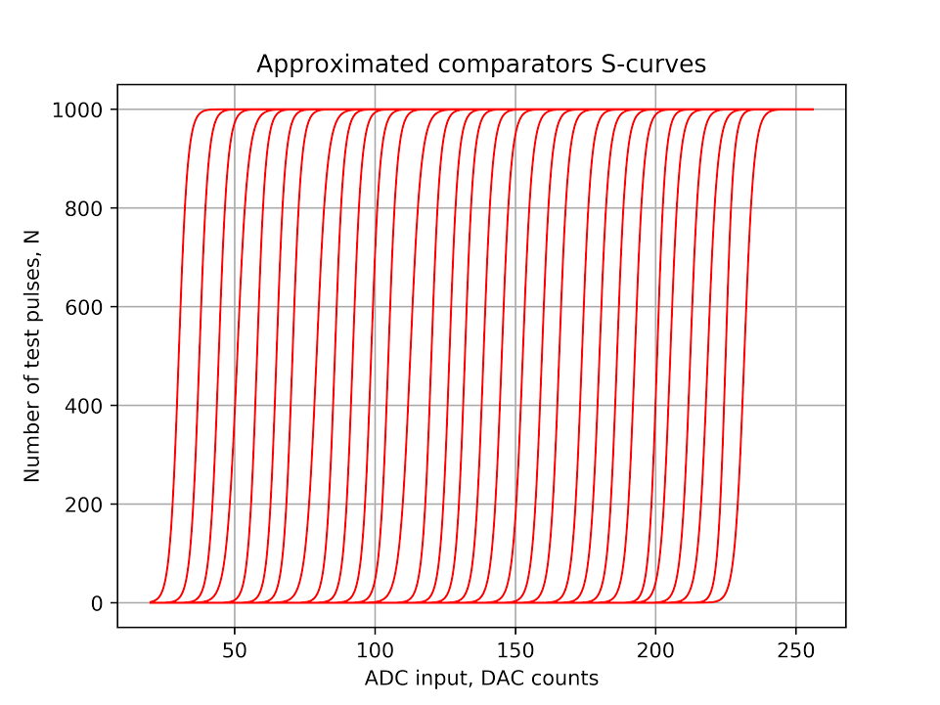
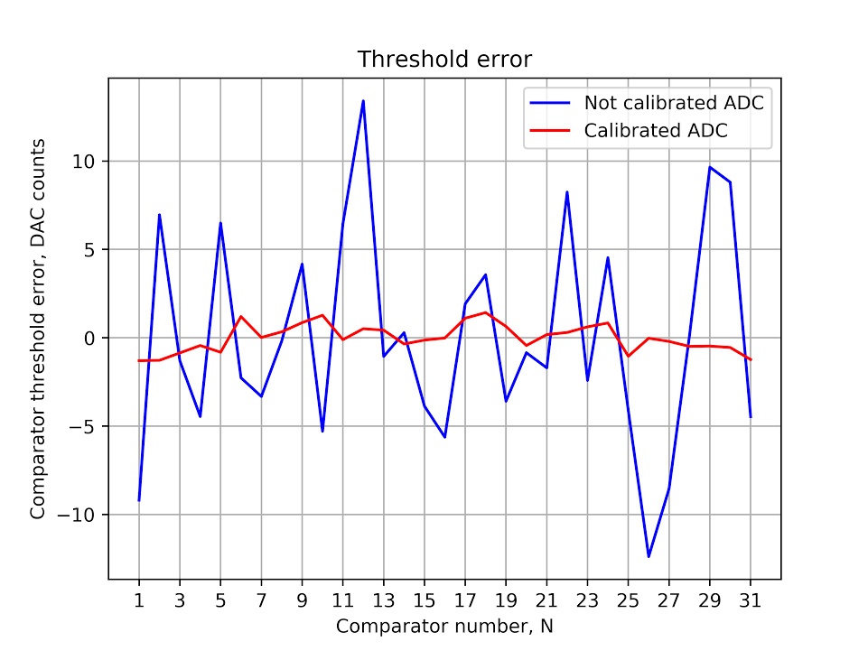
Characterization of STSXYTER ASIC
Test bench
Calibration and correction of non-linear effect of the internal test pulse generator
Correction of ADC, calibration of Slow channel
V. Sidorenko, M. Shitenkov

Slide 12
Conclusion
Beam quality at first beam time at Nuclotron was low due to big distance between the beam pipe and the test setup. Should be much better for the next beam time
We ask GSI to provide the following components for the test setup:
9 STSXYTER FEBs
6 gDPB FMCs
7 tDPB FMCs

Slide 13
Thank you for your attention!

Slide 14
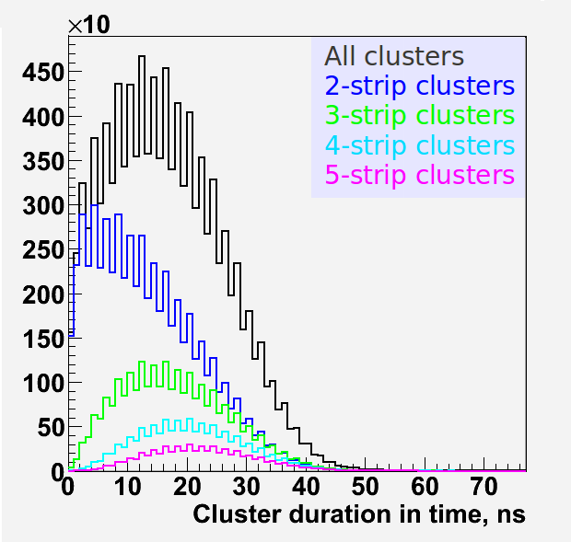
Cluster building
Typical time duration of the cluster was studied with Am241 source. Vbias = 90 V.
Clusters were build for the neighbor fired strips with a maximum time of 100 ns between hits.
According to the results maximum time of 50 ns was taken for cluster analysis

Slide 15
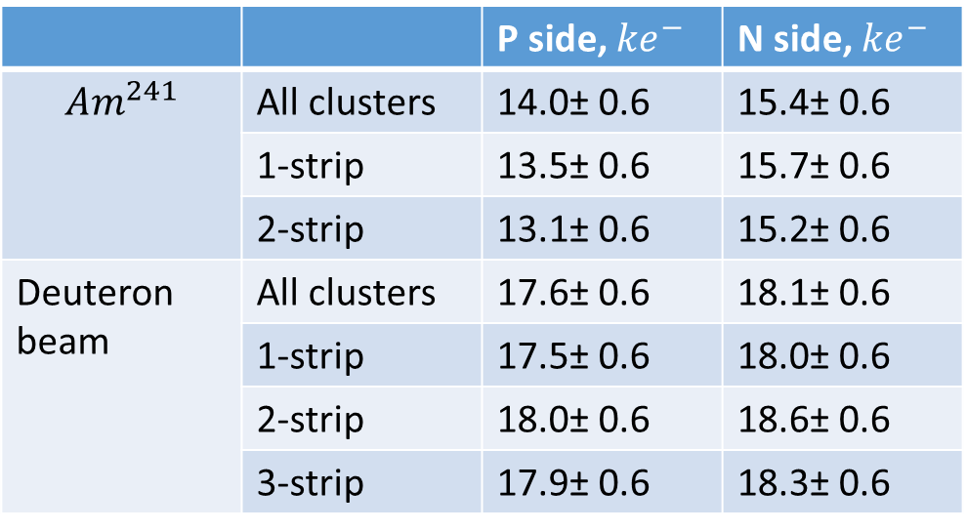
 |  | P side, ${ke}^{−}$ | N side, ${ke}^{−}$
$${Am}^{241}$$ | All clusters | 14.0± 0.6 | 15.4± 0.6
 | 1-strip | 13.5± 0.6 | 15.7± 0.6
 | 2-strip | 13.1± 0.6 | 15.2± 0.6
Deuteron beam | All clusters | 17.6± 0.6 | 18.1± 0.6
 | 1-strip | 17.5± 0.6 | 18.0± 0.6
 | 2-strip | 18.0± 0.6 | 18.6± 0.6
 | 3-strip | 17.9± 0.6 | 18.3± 0.6
Cluster amplitudes for CBM06C4-DM sensor

