Slide 1
Latest infrastructure development at VB LHEP
A. Sheremetev, LHEP JINR

Slide 2
Content of the talk
Development of infrastructure for assembly
Technological equipment LHEP for assembling a silicon tracking system
Our future plans

Slide 3
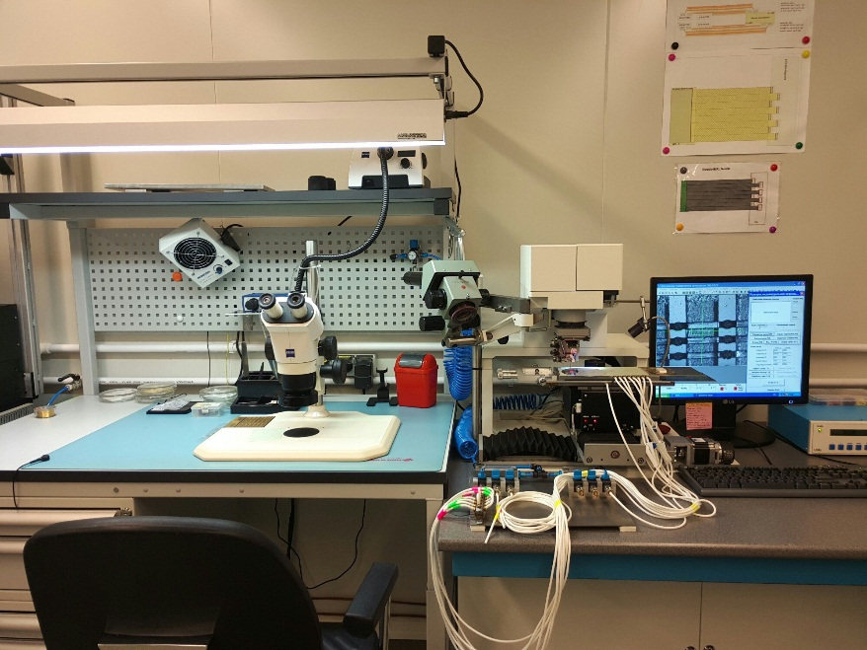
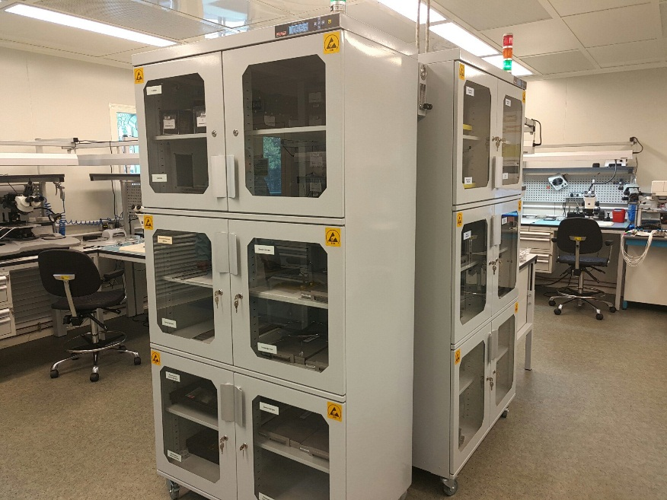
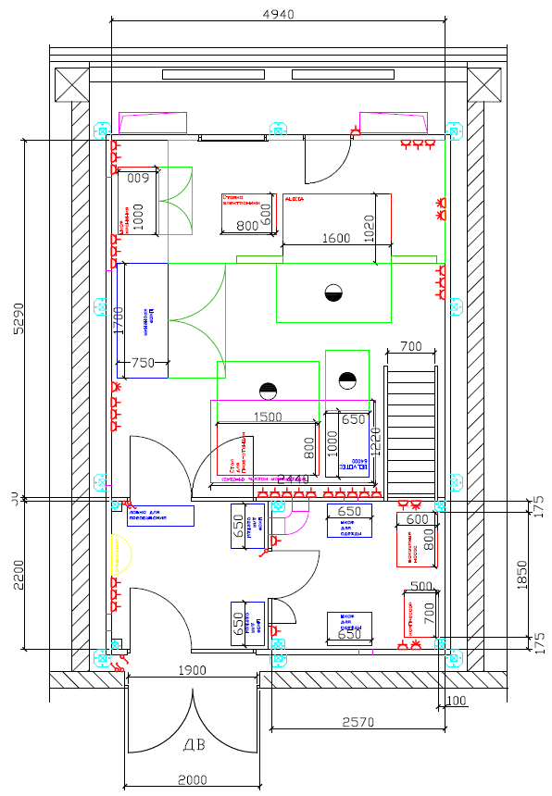
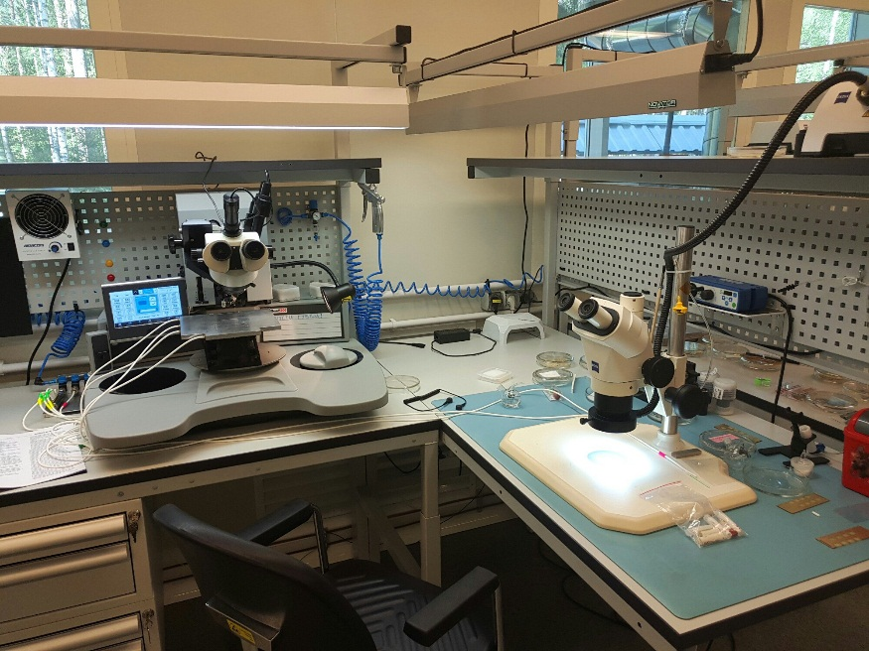
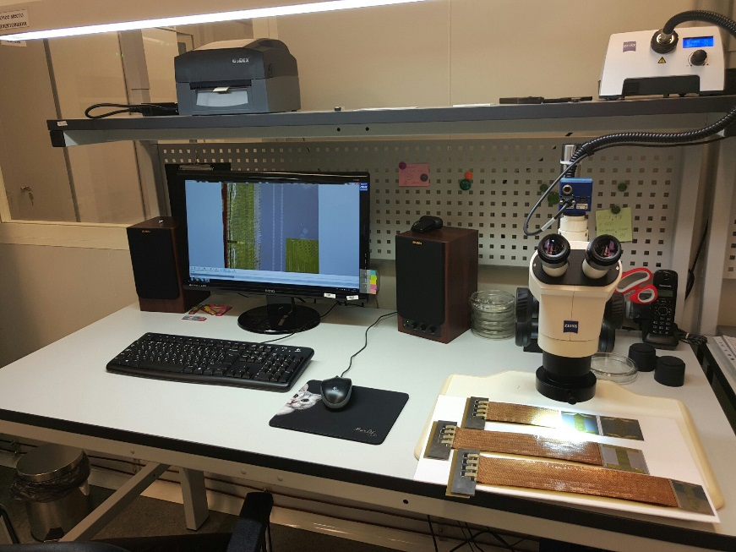
Infrastructure for the assembly

Slide 4
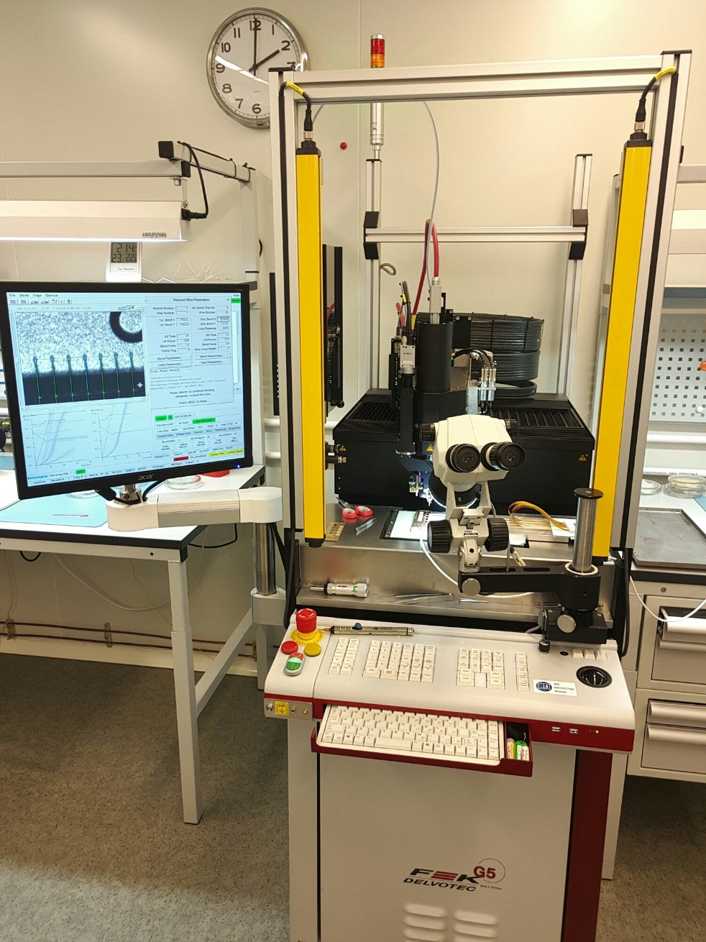
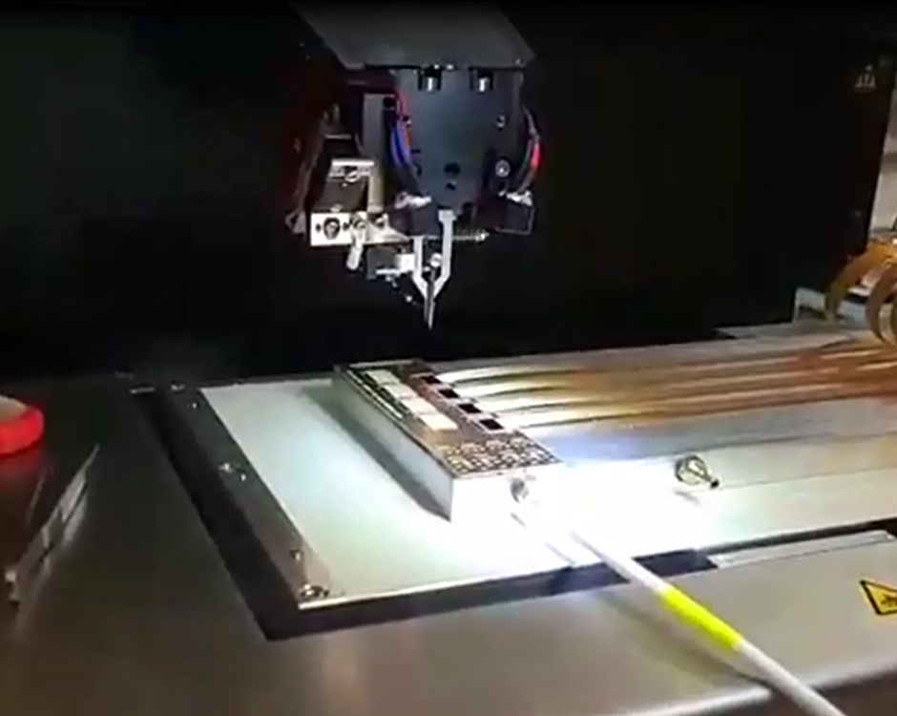
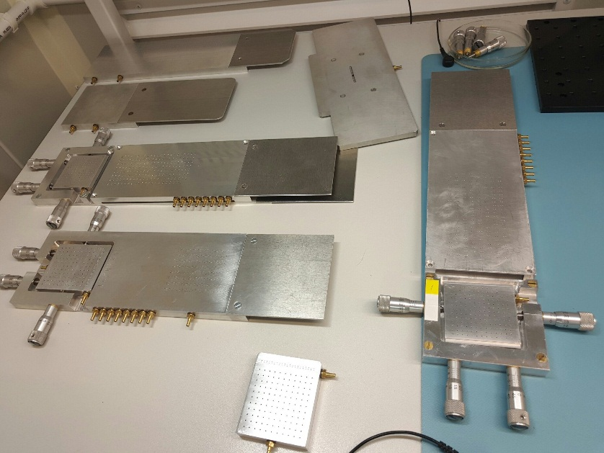
Technological equipment LHEP for assembling a silicon track system

Slide 5
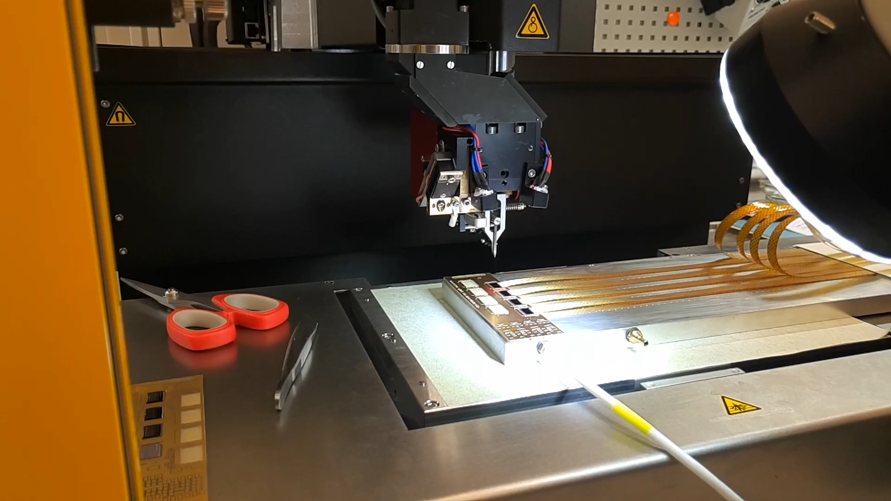
Technological equipment LHEP for assembling a silicon track system

Slide 6
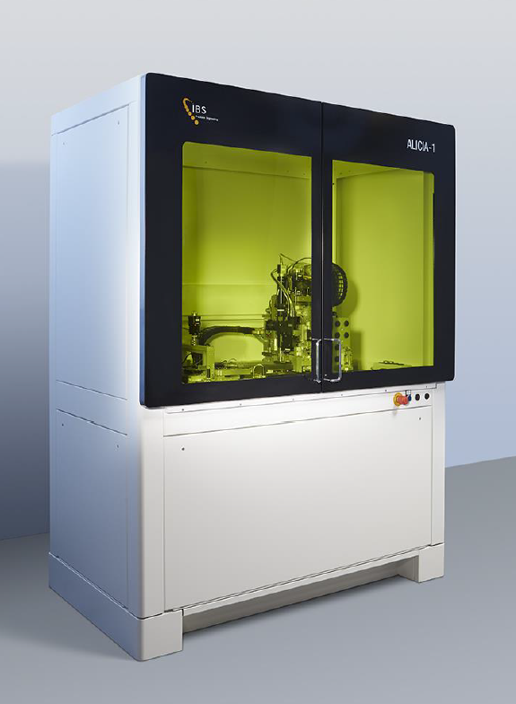
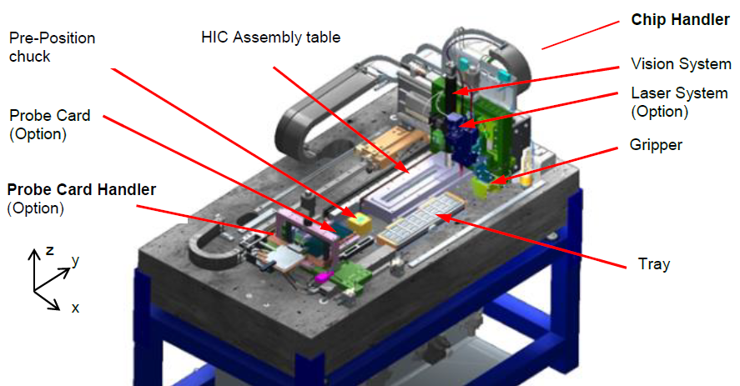
Technological equipment LHEP for assembling a silicon track system

Slide 7
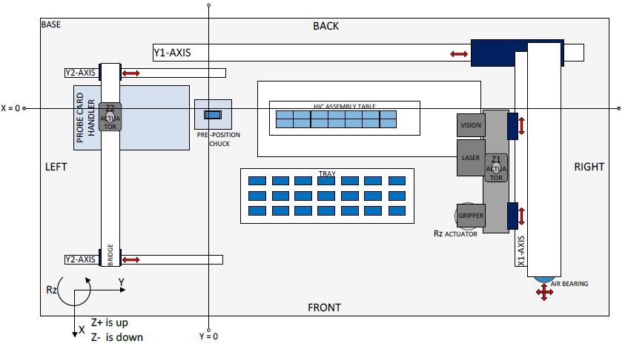
Technological equipment LHEP for assembling a silicon track system
Specification | Value
Chip positioning accuracy (XY) | ±5 μm (3σ)
Chip dimension measurements | ±5 μm (3σ)

Slide 8
Our future plans
To finish the building of clean room for tracker assembly
To buy all necessary equipment for clean room
Teach staff to work on high-tech equipment

