Slide 1
SBM/BM&N Mini-Work Meeting at JINR 22–23 May 2017
Module Assembly

Slide 2
What is going on at the VB LHEP module assembly lab?
At present we are assembling the mock-up modules.
Any of you knows the modules assembling sequence which initially was proposed by our Ukrainian colleagues.
The main assembly stages are:
analog cable with ASICs assembling
ASICs (equipped by cable) with sensor assembling
ASICs on to the FEBs mounting
mashed and shielding layers gluing
For some sensors of modules the interstrip or intersensor commutation have to be applied.

Slide 3
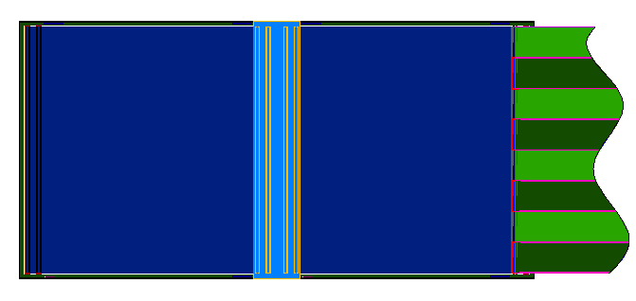
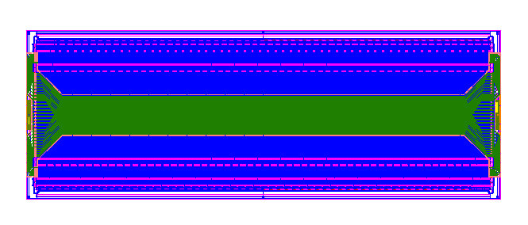
Interstrip and intersensor commutation (old design)
Intersrip cables are used for sensors with single metallization
Intersensor cables are used to connect two sensors 6x6 cm in one 6x12 cm

Slide 4
Tooling for module assembly
For above-listed procedures the set of tools was designed and produced:
jig for analog cable with ASIC assembly
jig for ASICs (equipped by cable) with 1-st side of sensor assembly
jig for ASICs (equipped by cable) with 2-nd side of sensor assembly
jig for ASICs on to the FEB mounting
Fist versions of them were not good, after were reworked, tested and decided as suitable for production.
jig for interstrip cable with sensor assembly
jigs for intersensor cables with sensors assembly (3 types)
They are not tested yet.

Slide 5
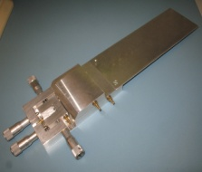
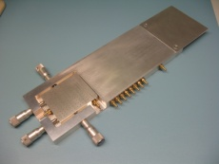
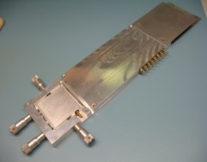
Tooling for module assembly
Procedure | Gig | Status
Analog cable with ASIC assembly |  | suitable for production
ASICs with 1-st side of sensor assembly |  | suitable for production
ASICs with 2-nd side of sensor assembly |  | suitable for production
ASICs on to the FEB mounting |  | suitable for production

Slide 6
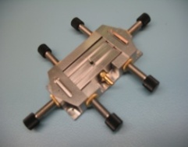
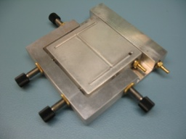
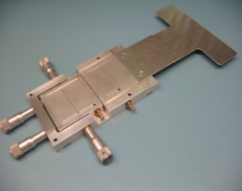
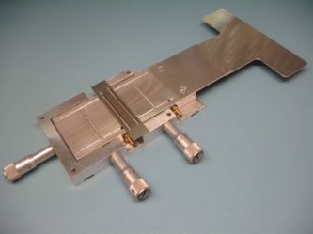
Tooling for module assembly
Procedure | Gig | Status
Jig for interstrip cable with sensor assembly |  | not tested yet
Jjgs for intersensor cables with sensors assembly |  | not tested yet

Slide 7
Last furniture
For carrying out of fool module assembly cycle we need to design and produce one more jig for assembly of ASICs (equipped by cable) with sensor 2-nd side.
This one will be intended for sensors with interstrip cable (on 1-st side).

Slide 8
Conclusion
Following our internal working schedule, we will announce the real module assembly readiness by December 2017 provided components to the Lab as well as QA test equipment shipped from Germany.

Slide 9
Thank you for your attention!

