Slide 1
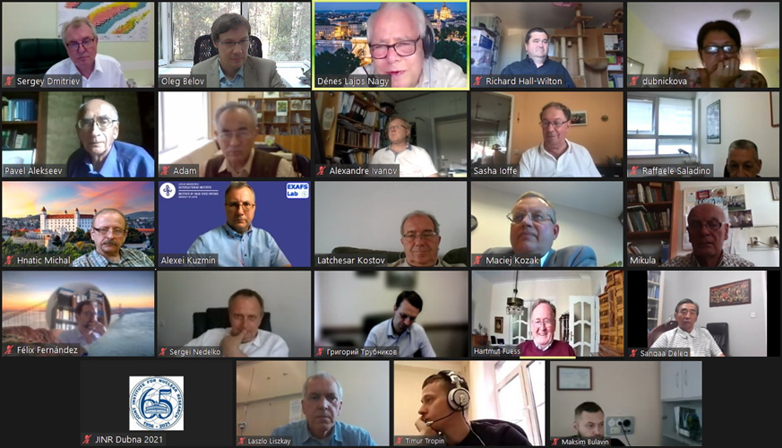
Programme Advisory Committee for Condensed Matter Physics
Follow-up after 54th meeting (28 June 2021, videoconference)
Dénes Lajos Nagy
55th Meeting of the Programme Advisory Committee for Condensed Matter Physics, 20-21 January 2022

Slide 2
Agenda of the 54th PAC meeting
Monday, 28 June 2021

Slide 3
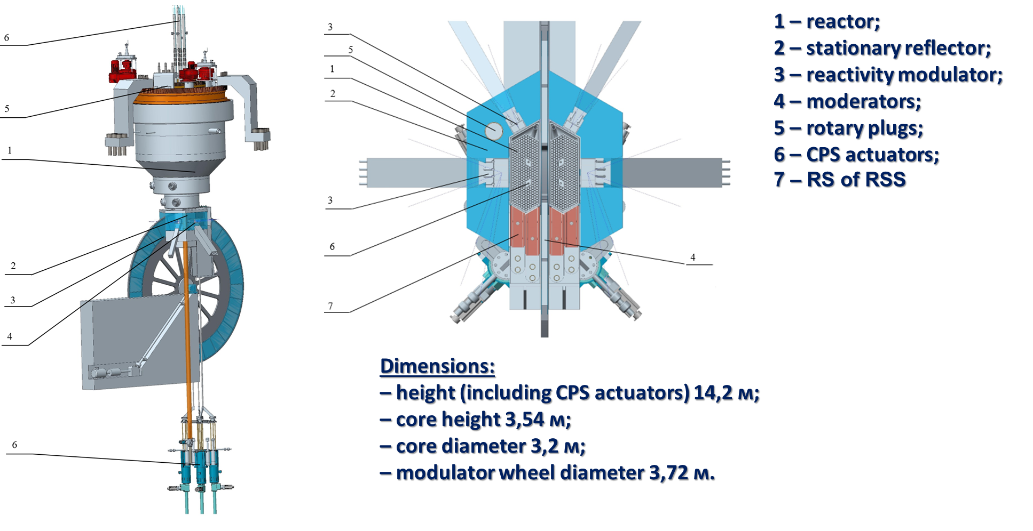
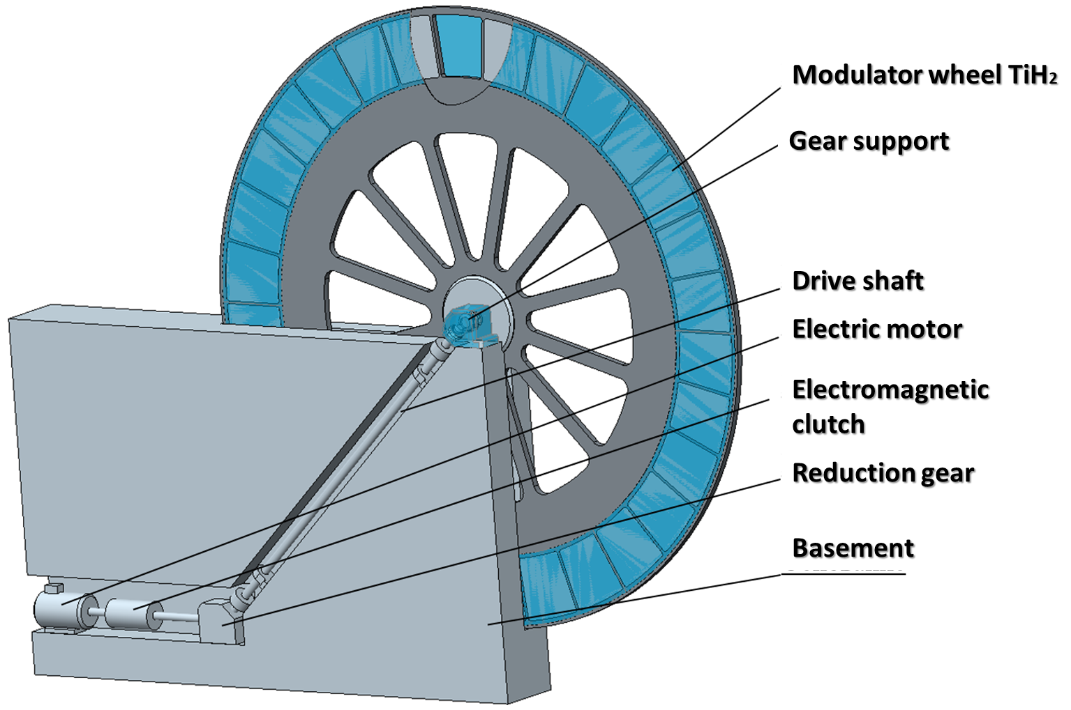
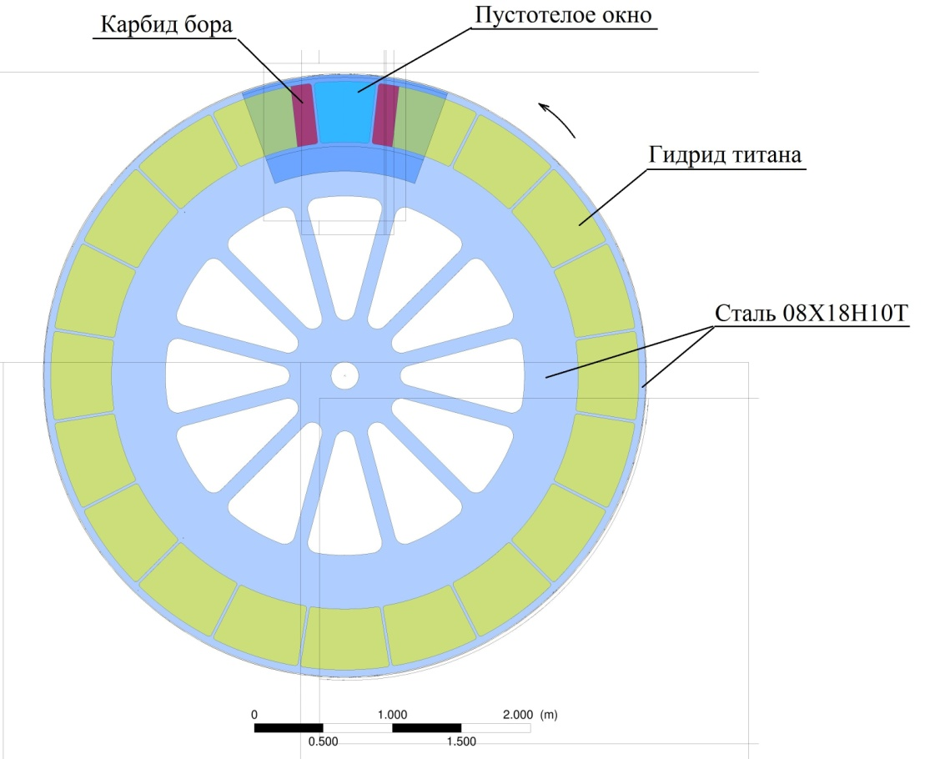
Development of the concept of the new neutron source at FLNP
Conceptual technical proposal of Neptune (by NIKIET) –
1st step of the roadmap
The PAC took note of the report on the status of the new Neptune neutron source of JINR and plans of activities on it presented by M. Bulavin.
Following the previous recommendations of the PAC, FLNP has updated the roadmap for the development of the new neutron source for approval by the JINR management and Rosatom State Atomic Energy Corporation.
The approval of the roadmap will enable R&D activities on the development of fuel elements with neptunium-nitride-based fuel and on the preparation of technical specifications for a conceptual design of the Neptune reactor.
Conceptual technical proposal of Neptune:
reactivity modulator

Slide 4
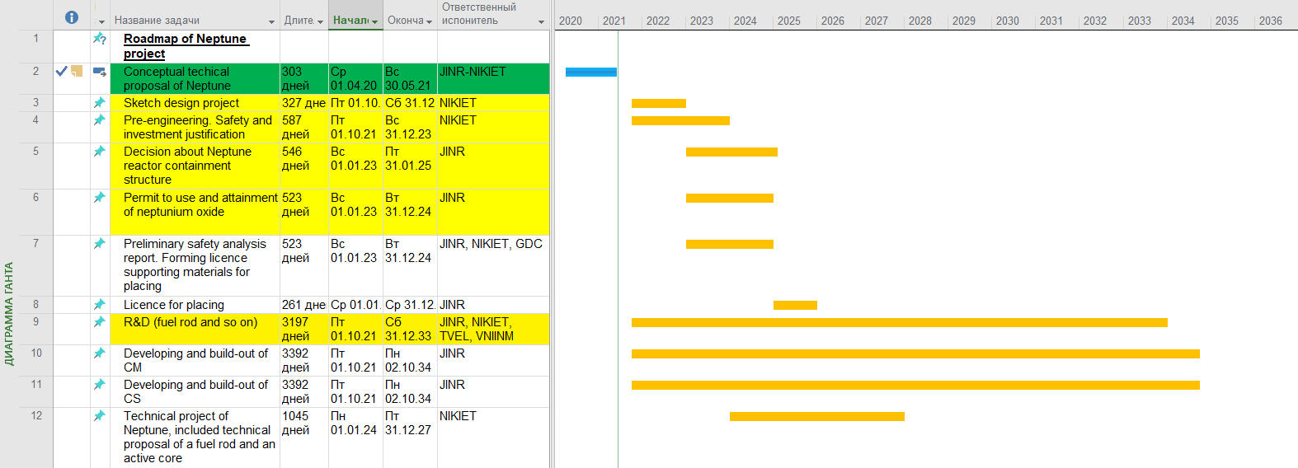
Project time schedule: short-range plans
1000 k$ (1 year)
2500 k$ (1,5 year) Science program of R&D of the IBR-3 main system construction is included in cost
3050+ k$ (2 years) IBR-3 building construction is included but, without SIJ
Summary 5 years – 11700 k$
without SIJ and TP
6150 k$ (5 years) included fuel rods irradiation and afterirradiation research
*NIKIET - N.A. Dollezhal Research and Development Institute of Power Engineering (Rosatom)
**VNIINM - A.A. Bochvar All-Russian Scientific Research Institute for Inorganic Materials (Rosatom)
*** TVEL – fuel company (Rosatom)
****GDC – general design construction

Slide 5
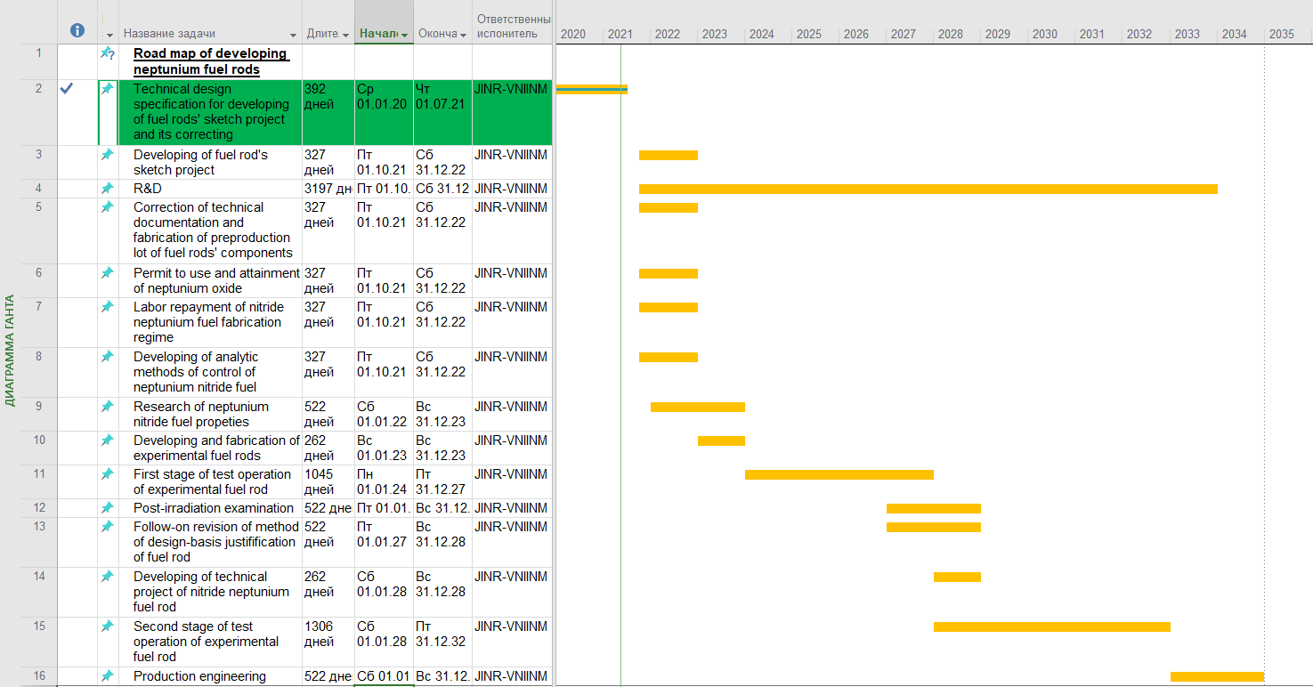
Roadmap of developing of neptunium fuel rods: short-range plans
4500 k$ (3 years R&D)
Technical design specification for a new multiyear JINR-VNIINM contract
(in process)
Multiyear JINR-VNIINM contract (2022-2026 years)
for a developing of fuel rods’ sketch project and R&D
1650 k$ (2 years)

Slide 6
Development of the new neutron source at FLNP
Recommendation by the PAC
The PAC recommended presenting a detailed report on the R&D activities on the development of fuel elements and on the preparation of the conceptual design of the “Neptune” reactor at the next PAC meeting. The PAC also expects to hear a report on the principal points of the design of cold moderators, primary neutron optics and shielding as an integral part of the neutron source.
Resolution of the JINR Scientific Council
The Scientific Council welcomed the on-going progress of the new neutron source of JINR – Neptune. In particular, the Scientific Council noted that, following the previous PAC recommendations, FLNP has updated the roadmap for the development of the new neutron source for approval of the JINR management and Rosatom State Atomiс Energy Corporation. The approval of the roadmap will enable R&D activities of developing fuel elements with neptunium-nitride-based fuel and of preparing technical specifications for a conceptual design of the Neptune reactor.
The Scientific Council agreed with the PAC that a detailed report on the R&D activities of developing fuel elements and preparing a conceptual design of the Neptune reactor should be presented at the next PAC meeting.
The Scientific Council also shared the expectation of the PAC to hear a report on principal points of the design of cold moderators, primary neutron optics and shielding as an integral part of the neutron source.

Slide 7
Report on the spectrometer complex of the IBR-2 facility
The PAC considered the report on the status of the YuMO small-angle neutron scattering diffractometer at beamline 4 of the IBR-2 reactor presented by O. Ivankov.
The PAC recognized the high demand for the diffractometer and the importance of the research results obtained with it and published in high-ranked journals.
The PAC noted with satisfaction that the installation of the new cold neutron source leads to a significant gain in the cold neutron flux at YuMO without a considerable decrease in thermal neutron flux.
The PAC noted new possibilities for user experiments resulting from the extension of the YuMO sample preparation lab and acquiring a new sample environment.
Recommendation by the PAC. The PAC supported further development of the small-angle neutron scattering method at present and future pulsed neutron sources of JINR. The PAC recommends continuing the work on upgrading the YuMO diffractometer and expects that a detailed upgrade programme will be presented at the next meeting.
Resolution of the JINR Scientific Council. Together with the PAC, the Scientific Council supported further development of the small-angle neutron scattering method at the pulsed neutron source of JINR. In particular, the Scientific Council recommended continuing the upgrade of the YuMO diffractometer and welcomed the PAC’s intention to consider its detailed upgrade programme at the next meeting.

Slide 8
Report on the expiring theme "Radiation Physics, Radiochemistry, and Nanotechnology Investigations Using Beams of Accelerated Heavy Ions" and proposal for its extension
The PAC took note of the report presented by P. Apel on the expiring theme "Radiation Physics, Radiochemistry, and Nanotechnology Investigations Using Beams of Accelerated Heavy Ions" and the proposal for its extension for the period 2022–2023. The PAC appreciated the wide range of the R&D studies that were realized and the high quality of the obtained results.
The proposal for the extension of the theme allows synchronizing the activity within the framework of the theme with the Seven-Year Plan for the Development of JINR, i.e. through 2023.
Justification: This additional two-year period is necessary to complete the modernization of the heavy-ion irradiation facilities that constitute the basis for all research directions within the theme. The suggested plan for 2022–2023 is a logical continuation of the research work performed in the previous 5-year period. The requested funding is justified. The researchers and technical personnel involved are well-qualified and have good experience to carry out the planned work.
Recommendation by the PAC. The PAC found the presented proposal well-formulated and recommended extending the theme "Radiation Physics, Radiochemistry, and Nanotechnology Investigations Using Beams of Accelerated Heavy Ions" for 2022–2023.
Resolution of the JINR Scientific Council. The Scientific Council agreed with the PAC’s recommendations for extending the theme "Radiation Physics, Radiochemistry, and Nanotechnology Investigations Using Beams of Accelerated Heavy Ions" for 2022–2023.

Slide 9
Prioritization of JINR projects
The PAC took note of the updated reports on the projects
"Construction of a complex of cryogenic moderators at the IBR-2 facility",
"New semiconductor detectors for fundamental and applied research“,
"Development of experimental techniques and applied research with slow monochromatic positron beams“,
“Research on the biological effects of heavy charged particles with different energies”,
“Research on cosmic matter on Earth and in nearby space; research on the biological and geochemical specifics of the early Earth”,
“RADIOGENE: Molecular genetics of radiation-induced changes at the gene, genome and transcriptome level in Drosophila melanogaster”,
“Study of the radioprotective properties of the Damage suppressor (Dsup) protein on a model organism Drosophila melanogaster and human cell culture HEK293”
and recommended assigning these projects category A.
The PAC expressed its detailed opinion on each of these projects as outlined in the Recommendations.
Resolution of the JINR Scientific Council. The Scientific Council thanked the PAC for continuing this activity at its regular 54th meeting held on 28 June 2021 and for completing the priority list of the JINR projects in Condensed Matter Physics following their detailed reviewing. The Scientific Council supported the ranking of the considered projects assigned in the PAC recommendations of 29 April and 28 June 2021.
The Scientific Council also welcomed the PAC’s suggestion to additionally discuss the approach for assigning reviewers to projects at the next meeting of the PAC.

Slide 10
Scientific reports
The PAC heard with interest the scientific reports
“Magnetic fluids and elastomers: structural studies for innovative applications”
presented by M. Balasoiu
and
“Investigating model lipid membranes complementarily by neutron and Raman scattering” presented by D. Soloviov and Y. Arynbek.
The PAC thanked the speakers for their excellent presentations.

Slide 11
Virtual presentations by young scientists
The PAC reviewed 12 virtual presentations made by young scientists in the field of condensed matter theory and information technology.
The virtual presentation “Effect of charged lipids on β-amyloid peptide interactions with a phospholipid membrane” made by D. Badreeva was selected the best presentation of the session.
The PAC noted two other high-quality virtual presentations:
“Distributed information and computing infrastructure of the JINR Member State organizations” by Ye. Mazhitova;
“Information system for analyzing behavioral and morphological changes in the central nervous system in the study of the effects of ionizing radiation and other factors” by I. Kolesnikоva.
Recommendation by the PAC. The PAC recommended the virtual presentation “Effect of charged lipids on β-amyloid peptide interactions with a phospholipid membrane” be reported at the session of the Scientific Council scheduled for September 2021.
Resolution of the JINR Scientific Council. The Scientific Council thanked the PAC for holding the young scientists’ poster session in videoconference format and suggested that the other PACs should have this practice.

Slide 12
Thank you for your attention!

