Slide 1


























Information on
the Resolution of the
130th session of the JINR Scientific
Council
(23-24 september 2021)
and on the decisions of the JINR
Committee of Plenipotentiaries
(22-23 november 2021)

Slide 2
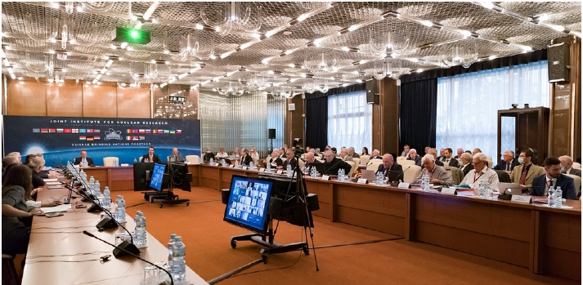
Information on the session of the JINR scientific council
23-24 september 2021
AGENDA
The 130th session of the JINR Scientific Council took place
on 23-24 September 2021.
Report by the JINR Director (G. Trubnikov)
Election of the co-chair of Scientific Council (G. Trubnikov)
Progress of implementation of the NICA project (R. Lednicky)
Four pillars of BLTP (D.Kazakov)
First steps in implementation of the JINR Long-term Development Strategic Plan (G. Trubnikov)
Presentation by the laureate of the Bruno Pontecorvo Prize (K.Niva)
PACs’ recommendations (I. Tserruya, M. Lewitowicz, D.L. Nagy)
Greetings statements by representatives of the diplomatic missions of Member States of JINR
Scientific report “Effect of charged lipids on β-amyloid peptide interactions with a phospholipid membran”
(D. Badreeva)
JINR annual prizes
Announcement of elections of the BLTP Director (G.Trubnikov)
It was co-chaired by JINR Director Grigory Trubnikov and by Professor Sergei Kilin (Deputy Chairman, Presidium of the National Academy of Sciences of Belarus)

Slide 3
the 130th session of JINR scientific council
RESOLUTION
The Scientific Council elected Sergei Kilin Co-Chair of the Scientific Council for the period of three years.
The Council appreciated the progress in the implementation of the Seven-Year Plan, especially as to the flagship projects.
The Council acknowledged the increased activity and outcomes of the international cooperation development.
The Council supported JINR’s development as an international intergovernmental research organization and the extension of its partnership.
The Scientific Council took note of the recommendations made by the PACs at their meetings in June 2021, as reported at this session by I.Tserruya, Chair of the PAC for Particle Physics, M.Lewitowicz, Chair of the PAC for Nuclear Physics, and D.L.Nagy, Chair of the PAC for Condensed Matter Physics. Following the recommendations, the projects were approved till the end of the current Seven-Year Plan (end of 2023), with the understanding that for those projects that will be included in the next Seven-Year Plan the approval will automatically be extended till the end of the requested period.
The Council has recognized that BLTP is on the top of the world scientific agenda in many areas. The cooperation of BLTP with other JINR research laboratories remains extremely important, within the flagship projects in particular.
The Scientific Council acknowledged the progress in creating the beam extraction and transport channel for heavy ions accelerated in the superconducting booster synchrotron to the Nuclotron, and appreciated the success in the infrastructure development and a good pace in the production of collider elements for NICA.
The Council has taken a positive note that, following the Long-Term Development Strategic Plan, JINR gets intensively acting for developing innovations: the Institute proceeded to create an International and Interlaboratory Innovation Centre and it has started NICA Applied Research and Innovation Committee.
The Scientific Council expects that a concept of the 7-year development strategic plan for 2024–2030 will be presented at the next session.
The 131st session of the Scientific Council is scheduled for 24–25 February 2022. The 132nd session of the Scientific Council is provisionally scheduled for 29–30 September 2022.

Slide 4
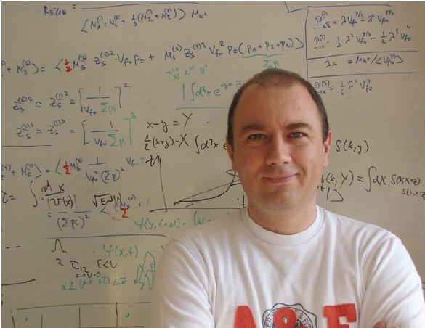
Information on the membership in the JINR scientific council
Plenipotentiary of the Government of Slovak Republic Prof. Dr. Fedor Šimkovic appointed Prof. Dr. Boris Tomášik ( Faculty of Natural Sciences, Matej Bel University, Banská Bystrica) as a member of the JINR Scientific Council, who substituted Prof. Michal Hnatic, starting November 1, 2021.

Slide 5
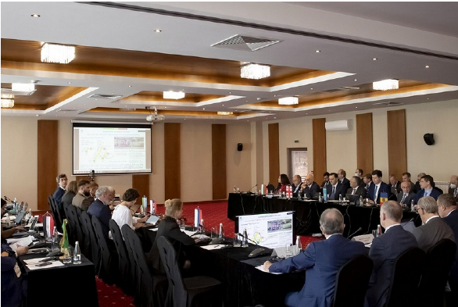
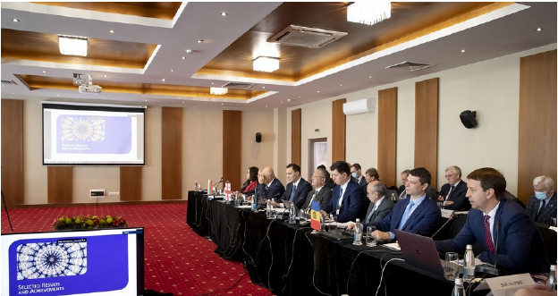
the session of the JINR committee of plenipotentiaries
22-23 November 2021, bulgaria, Bansko-sofia
AGENDA
Report by the JINR Director (G. Trubnikov)
The Arab Republic of Egypt joining JINR as its Member State
(G. Trubnikov)
JINR budget proposed for 2022; Member States provisional contributions for 2023, 2024, 2025 (N. Kalinin)
Project of the JINR innovation centre for nuclear research
(S. Dmitriev)
Regulations for the JINR associate membership (I. Štekl)
The JINR flag code (I. Štekl)
Sofia declaration on the value of international integration in science and technology (G. Trubnikov)
Bulgarian Academy of Sciences – traditions and horizons (J. Revalski)
The special meeting in Sofia dedicated to the celebration of the 65th anniversary of JINR and as part of the Year of Bulgaria in JINR with participation of the President of Bulgaria Rumen Radev
Chaired by Florin Dorian Buzatu (Romania)

Slide 6
the session of the JINR committee of plenipotentiaries
Resolutions
To take note of the information provided by the JINR Directorate on the Recommendations of the 130th session of the JINR Scientific Council. To note with appreciation the management actions and high pace of work taken by the Institute to achieve the objectives of the JINR Long-Term Development Strategic Plan up to 2030 and Beyond.
To positively note the successful work on the implementation of the NICA project: first of all, its next scheduled stage — the acceleration of the ion beam in the Booster as high as the projected capacity, the launch of the beam transportation channel from the Booster to Nuclotron, and the successful extraction of a Fe14+ ion beam from the Booster to Nuclotron via this channel. Taking into account the recommendations of the international MAC of the NICA Project, the decision of the international Cost and Schedule Review Committee of the NICA Project, as well as the decision of the Supervisory Board for the NICA Complex project on the need to extend the deadline for completing the project, to agree to reset the deadlinefor constructing the main facilities of the NICA Complex (its basic configuration) in order to start the research programme by the end of 2023.
To note the significant progress in the creation of the Baikal neutrino telescope for observing natural neutrino fluxes and also to encourage intensifying the work of analysing the data collected in 2018–2020.

Slide 7
the session of the JINR committee of plenipotentiaries
Resolutions
To note the significant advance of the SHE Factory experiments, including the experiments at DGFRS-II (Dubna Gas-Filled Recoil Separator-II), in which the target showed resistance to irradiation with high-intensity beams of up to 3 microamperes and more than 100 events of 286Fl and 287Fl isotope production were detected tripling the number of such events previously observed worldwide.
To take into account the information on the status of work for creating the new neutron source NEPTUN — the intense high-flux reactor (IBR-3) with neptunium nitride fuel. To decide in favour of getting to the next stage of work for developing reference design, conceptual design, feasibility assessment of the facility and scheduling resolution on its construction for 2023.
To note with satisfaction the active work of the Meshcheryakov Laboratory of Information Technologies for developing research in the field of quantum computing algorithms in the software environment containing a set of quantum simulators using Govorun supercomputer.
To uphold the intensive development of fundamental and applied research in life sciences and condensed matter physics by evolving the Interlaboratory Research Programme on the basis of the Laboratory of Radiation Biology and the interlaboratory international Innovation Centre for Nuclear Research that is in the process of being established by JINR.
To uphold the initiative of the JINR Directorate to assess the performance of the JINR Long-Term Development Strategic Plan up to 2030 and Beyond. The international working group is supposed to report on the implementation and adjustment of the scientific strategy for the JINR development up to 2030 and beyond at the next session of the Committee of Plenipotentiaries scheduled for March 2022.

Slide 8

the session of the JINR committee of plenipotentiaries
Resolutions
To endorse the Recommendations of the 129th and 130th sessions of the JINR Scientific Council, as well as the Topical Plan for JINR Research and International Cooperation for 2022.
To have the JINR Directorate submit the concept of the seven-year plan for the development of JINR for 2024-2030 at the session of the Committee of Plenipotentiaries scheduled for March 2022. The concept should accommodate optimization of the Topical Plan for JINR Research and International Cooperation, financing and staffing the research projects.
To work out a proposal for calculating the Member States’ contributions in dynamics providing implementation of the Seven-Year Plan for the Development of JINR for 2024–2030, taking into account the current world inflation statistics and forecasts.
To congratulate the Scientific Leader of the Flerov Laboratory of Nuclear Reactions, Yury Oganesyan, on being awarded the UNESCO-Russia International Prize named after D. Mendeleev for his achievements in fundamental sciences, to express the deepest appreciation for his contribution to world science and the development.

Slide 9
the session of the JINR committee of plenipotentiaries
Resolutions
To approve the amounts of the JINR Member States’ contributions for 2022.
To approve the JINR budget for 2022 in the total amount of US$ 274`304.1 thousand for income and expenditure.
To set the provisional amount of the JINR budget for income and expenditure as US$ 223.0 million for 2023, US$ 228.6 million for 2024, and US$ 234.6 million for 2025, as well as the provisional contributions of the JINR Member States for 2023, 2024 and 2025.
BREAKDOWN OF EXPENDITURE OF
THE JINR BUDGET FOR 2022 (DRAFT)
BY FIELDS OF RESEARCH
M$
Nuclear physics
(23.2%)
Particle physics and
Relativistic nuclear
physics
(49.5%)
45.7
97.7
Condensed matter physics,
Radiation and radiobiological
research (14.8%)
29.3
13.3
8.7
Networking, computing, computational physics (6.7%)
2,8
Educational programme
(1.4%)
Theoretical physics (4.4%)

Slide 10
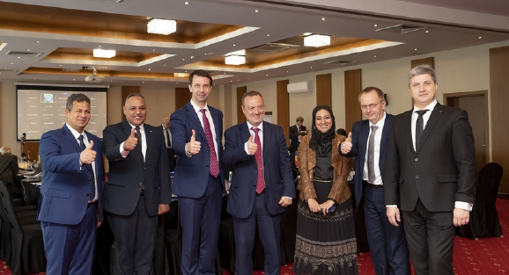
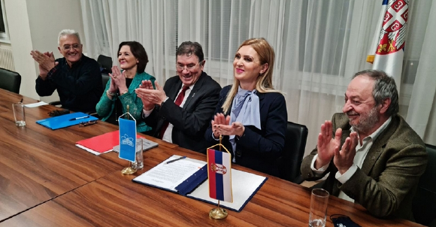
the session of the JINR committee of plenipotentiaries
Egypt became full-fledged JINR Member State.
Resolutions
In compliance with articles 7 and 17 of the JINR Charter, with reference to the Letter of application for JINR membership received from the Arab Republic of Egypt to participate in JINR as its full member presuming the applier’s consent with the JINR Charter and all that implies, based on consensus decision-making ADMITS the Arab Republic of Egypt in the JINR Member States.
Action plan of Republic of Serbia to enter JINR as its full member was signed
The Committee of Plenipotentiaries takes note of the information on the pre-accession actions undertaken by the Republic of Serbia to enter JINR as its full member and welcomes signing the respective action plan.

Slide 11
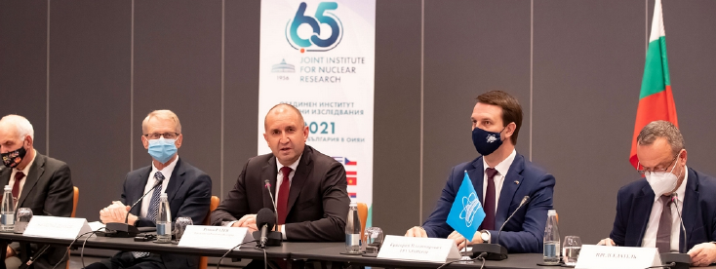
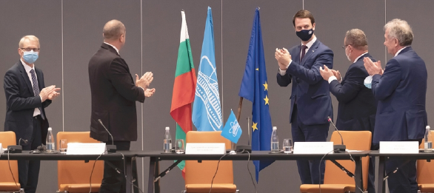
the session of the JINR committee of plenipotentiaries
Resolutions
To approve the Regulations for the JINR Associate
Membership. To extend the Regulations to cover the agreements on participation in the JINR programmes concluded by JINR with some states unless their terms are contrary to the Regulations.
To approve the JINR Flag Code. To release flagging in accordance with the JINR Flag Code.
The president of the Republic of Bulgaria Rumen Radev participated in the ceremonial meeting in Sofia was held within the framework of the CP session of JINR in Bulgaria dedicated to the celebration of the 65th anniversary of JINR and as part of the Year of Bulgaria in JINR. Heads of diplomatic missions of a number of JINR Member States in Bulgaria, leaders of the Bulgarian scientific community took part in the event.
CP accepted the “Sofia declaration on the value of international integration in science and technology” and resolved:
Following the Declaration and in accordance with the JINR Long-Term Development Strategic Plan up to 2030 and Beyond, to intensify the systematic work to attract new partners to JINR. To have the JINR Directorate explore new frontiers for further enlargement of the community of the Member States, Associate Members and partner countries.

Slide 12

THANK YOU!

