Slide 1
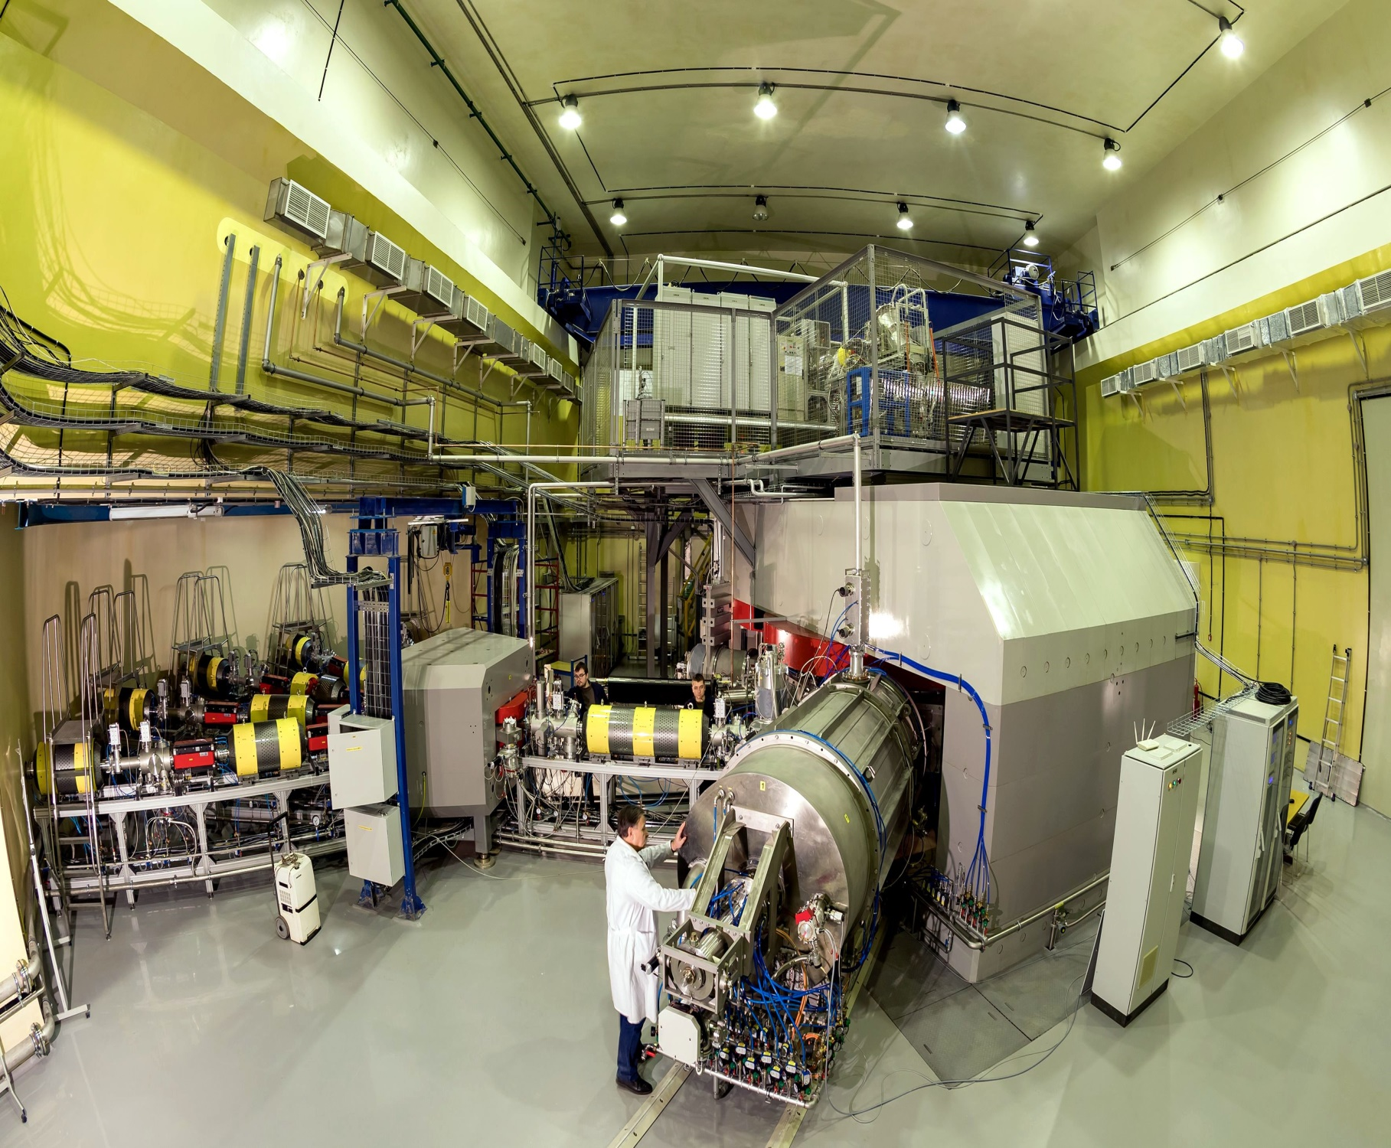
Results of obtaining ⁴⁸Ca, ⁴⁸Ti and ⁵²Cr ion beams at the
DC-280 cyclotron
Pugachev D.K., Bogomolov S.L., Mironov V.E., Efremov A.A., Loginov V.N., Lebedev A.N., Bondarchenko A.E., Kuzmenkov K.I.

Slide 2
Superheavy Elements (SHE) Factory – the Goals
Experiments at the extremely low (σ<100 fb) cross sections:
Synthesis of new SHE in reactions with ⁵⁰Ti, ⁵⁴Cr ...;
Synthesis of new isotopes of SHE;
Study of decay properties of SHE;
Experiments requiring high statistics:
Nuclear spectroscopy of SHE;
Study of chemical properties of SHE.
To carry out the scientific program, the DC-280 has to provide the following parameters of ion beams:
Ion energies (smooth variation) | 4 - 8 MeV/n
Ion masses | 10 - 238
Intensities (A~50) | >10 pµA
Efficiency of beam transfer from ion source to physical facility | >50%

Slide 3
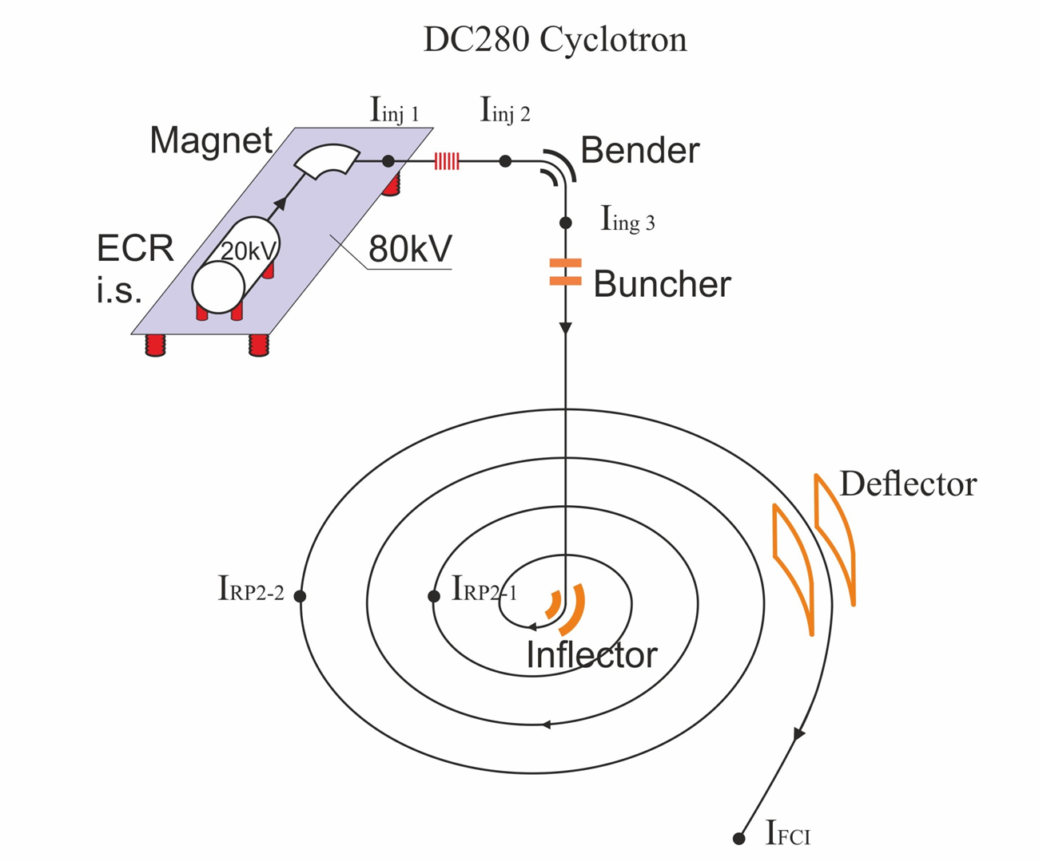
Main Parameters
Ion sources | Permanent magnet ECR DECRIS-PM - 14 GHz
Injection energy | Up to 80 keV/Z
A/Z range | 4÷7.5
Energy | 4÷8 MeV/n
Magnetic field level | 0.6÷1.3 T
K factor | 280
Magnet weight | 1000 t
Magnet power | 300 kW
Dee voltage | 2x130 kV
RF power consumption | 2x30 kW
Flat-top dee voltage | 2x14 kV
Deflector voltage | Up to 90 kV

Slide 4
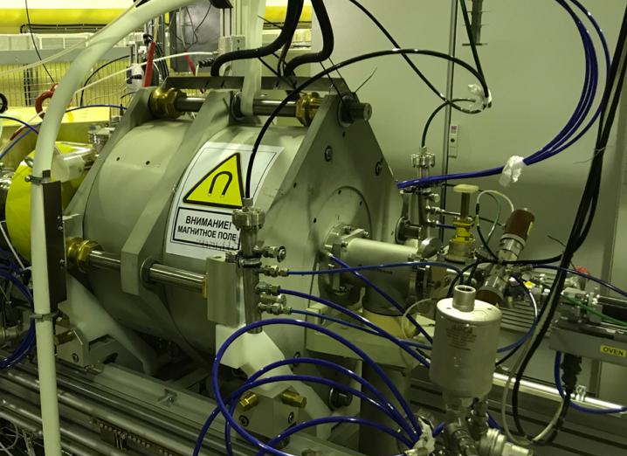
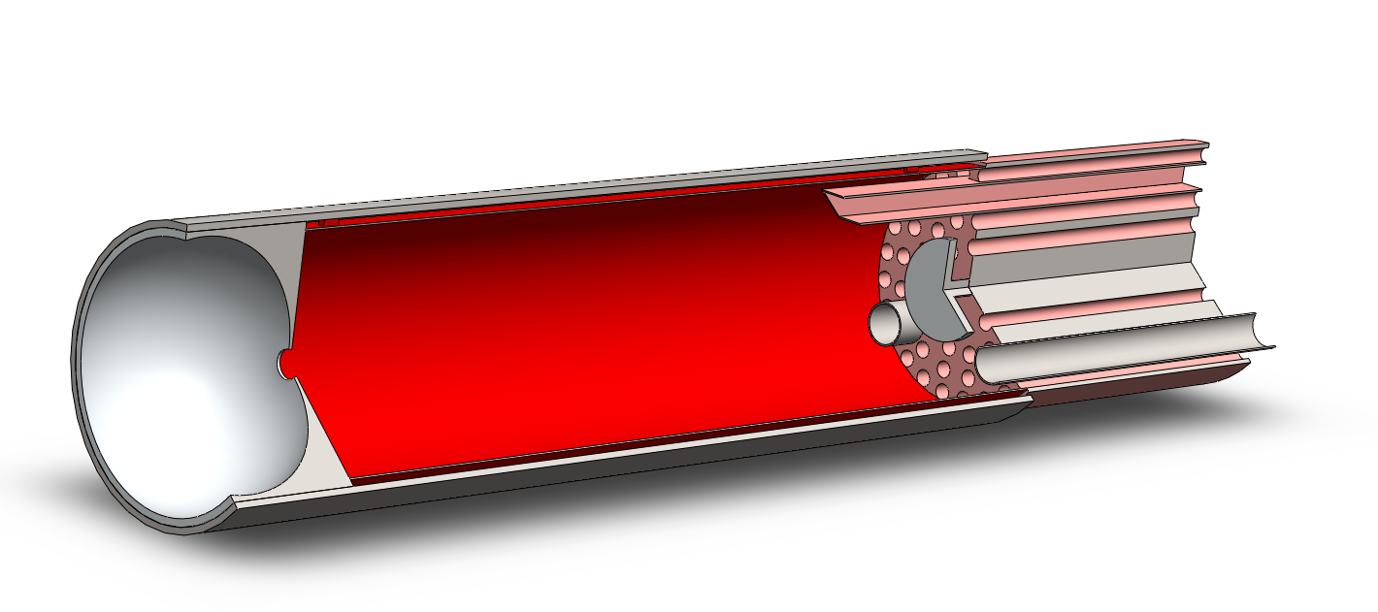
Ion source
Parameters of DECRIS-PM
UHF frequency | 14 GHz
Binj | ≥ 1.3 T
Bmin | 0.4 T
Bextr | 1.0 ÷1.1 T
Br | 1.05÷1.15 T
Plasma chamber internal diameter | 70 mm

Slide 5
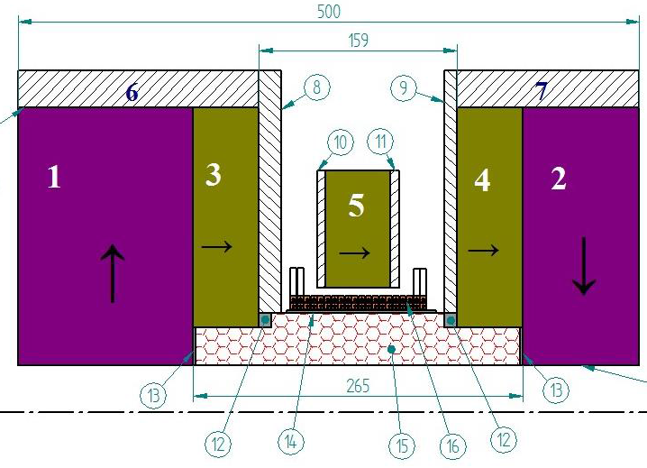
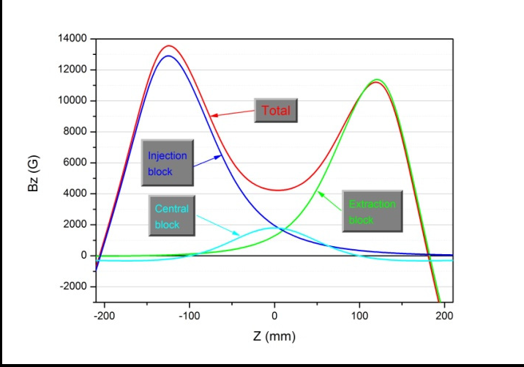
DECRIS-PM magnet system
Magnetic structure of DERIS-PM.
1÷5 – PM rings; 6, 7 – soft iron rings;
8÷11 – soft iron plates;
12÷14 - auxiliary elements;
15 – hexapole; 16 – coil.
Axial magnetic field distribution

Slide 6
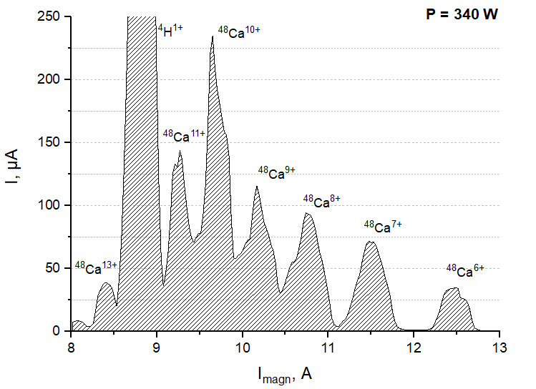
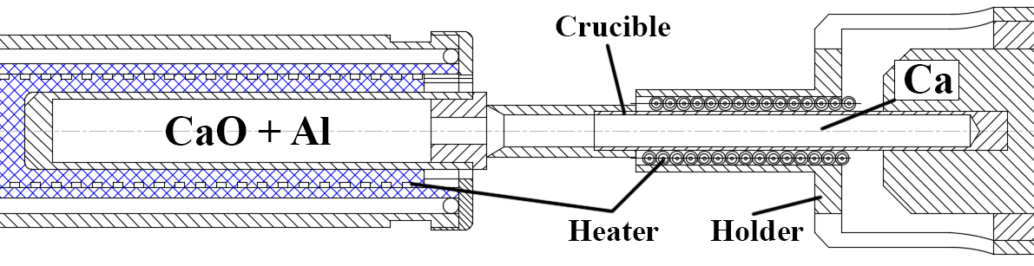
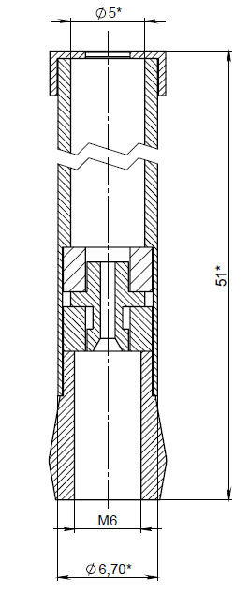
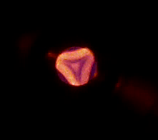
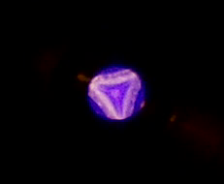
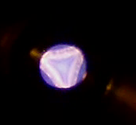
Production of ⁴⁸Ca beam
Reduction of calcium from
calcium oxide
Oven 2
500 °C
Oven 1
1300 °C
3 ⁴⁸CaO + 2 Al
3 ⁴⁸Ca + Al₂O₃
The ⁴⁸Ca ion spectrum, optimized for Ca¹⁰⁺
Helium
Helium + Ca
Helium + Ca +
UHF Power>300

Slide 7
Production of ⁴⁸Ca beam
Faraday Cup | Current, emkA | Efficiency of beam transfer
I_{inj1} | 240.5 | 100.00%
I_{inj2} | 229.5 | 95.43%
I_{inj3} | 190 | 79.00%
I_{RP2-1} | 130.2 | 54.14%
I_{RP2-2} | 105.8 | 43.99%
I_{FCI} | 71.106 | 29.57%
61 events of ₁₁₅Mc
94 events of ₁₁₄Fl
16 events of ₁₁₂Cn

Slide 8
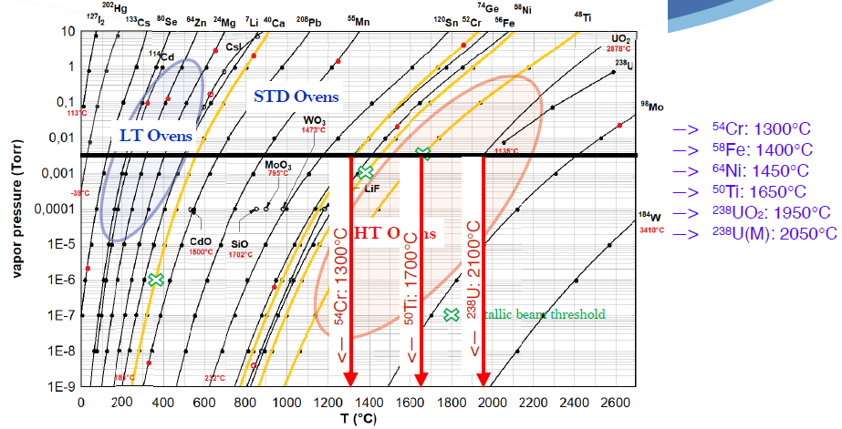
Production of ⁵⁰Ti and ⁵⁴Cr beams

Slide 9
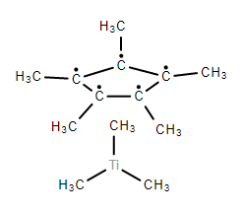
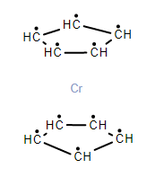
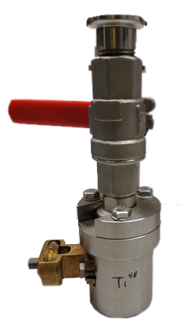
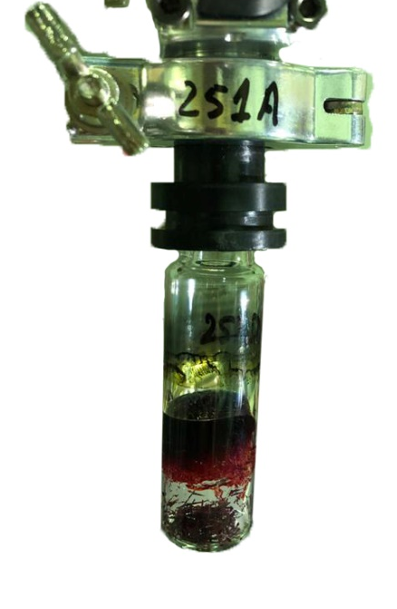
Production of ⁴⁸Ti and ⁵²Cr beams
(CH₃)₅C₅Ti(CH₃)₃
Compound Properties | (CH₃)₅C₅Ti(CH₃)₃ | C₁₀H₁₀Cr
Molar mass, g·mol⁻¹ | 228.291 | 182.186
Appearance | yellow crystals | dark red crystals
Density, g/cm³ | 1.081 | 1.43
Vapor Pressure, mmHg at 25°C | - | 418
Sensitive | Light, Air & Moisture Sensitive | Air & Moisture Sensitive
C₁₀H₁₀Cr

Slide 10
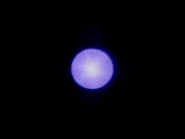
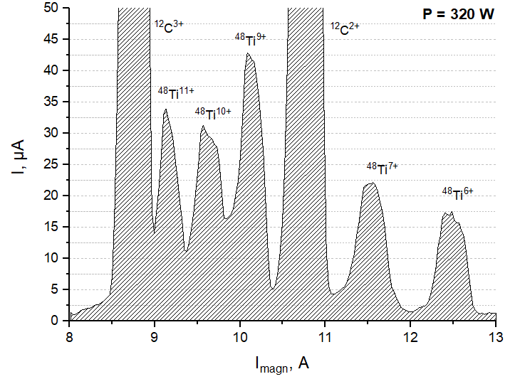
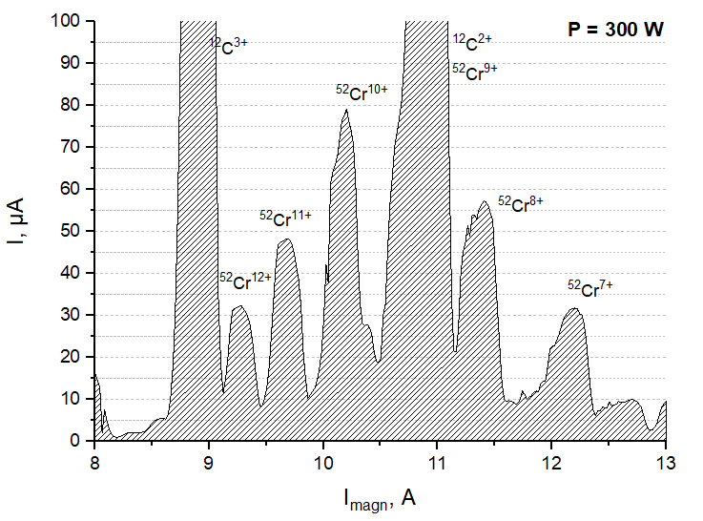
Production of ⁴⁸Ti and ⁵²Cr beams
⁴⁸Ti + UHF Power 350 W
The ⁴⁸Ti ion spectrum. optimized for Ti¹⁰⁺
The ⁵²Cr ion spectrum. optimized for Cr¹⁰⁺

Slide 11
Production of ⁴⁸Ti and ⁵²Cr beams
⁴⁸Ti⁷⁺
⁵²Cr¹⁰⁺
Faraday Cup | Current, emkA | Efficiency of beam transfer | Current, emkA | Efficiency of beam transfer
I_{inj1} | 22.746 | 100.00% | 70.498 | 100.00%
I_{inj2} | 20.346 | 89.45% | 58.372 | 82.80%
I_{inj3} | 15.849 | 69.68% | 51.841 | 73.54%
I_{RP2-1} | 11.556 | 50.80% | 34.72 | 49.25%
I_{RP2-2} | 9.949 | 43.74% | 30.925 | 43.87%
I_{FCI} | 7.27 | 31.96% | 25.5 | 36.17%

Slide 12
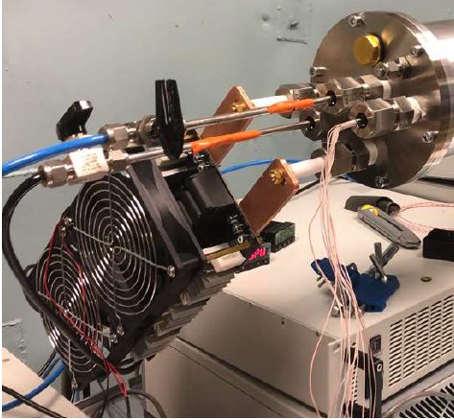
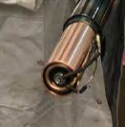
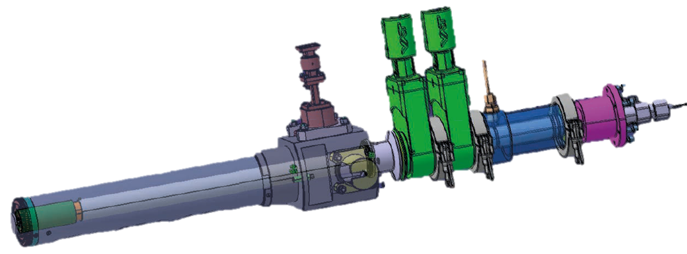
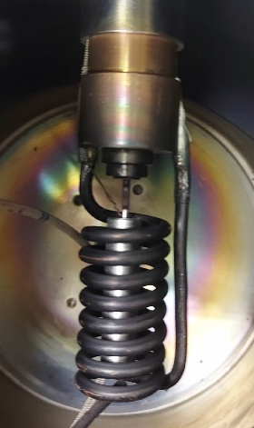
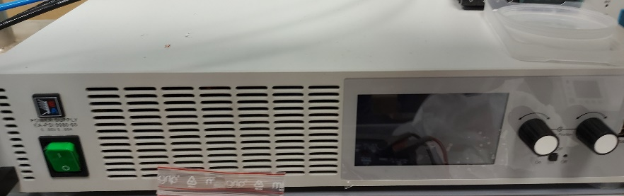
Inductive oven
Resonator
Pre-pumping volume
Inductor
Waveguide
Screen
water cooling of the inductor
Power supply:
EA-PSI 9080-60
0÷80 V, 0÷60 A, 0÷1500 W
IPHC Strasbourg / FLNR Dubna collaboration

Slide 13
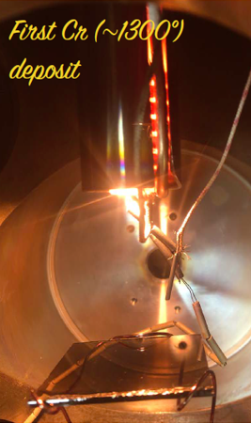
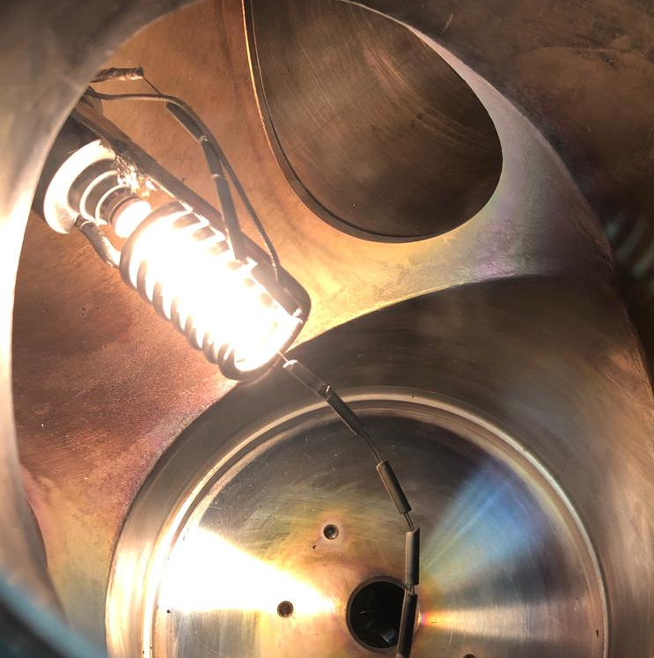
First results
The first test of the inductive oven gave a good result. We have reached the required temperature for evaporation of Ti (1700 degC) and Cr (1300 degC).
T_{max}=1860 degC in a crucible with room temperature on the outer surface of the plug.
IPHC Strasbourg / FLNR Dubna collaboration

Slide 14
Results and future plans
Calcium consumption was 1.2 mg/h for a high-intensity ion beam (14 pµA ⁴⁸Ca¹⁰⁺) and 0.3 mg/h for a low-intensity beam (4 pµA ⁴⁸Ca¹⁰⁺). Average consumption of calcium 0.67 mg/h. Total working time with a calcium beam for the last year around 3200 h.
Titanium and chromium beams were obtained on the DC-280 cyclotron. The issues of modernization of the design of some elements of the ion source, contributing to an increase in the intensity of the ion beam using the MIVOC method, are being solved.
The successful first test of the inductive oven in an isolated vacuum chamber allows us to start real tests with the ion source DECRIS-2M (Test-bench).

Slide 15
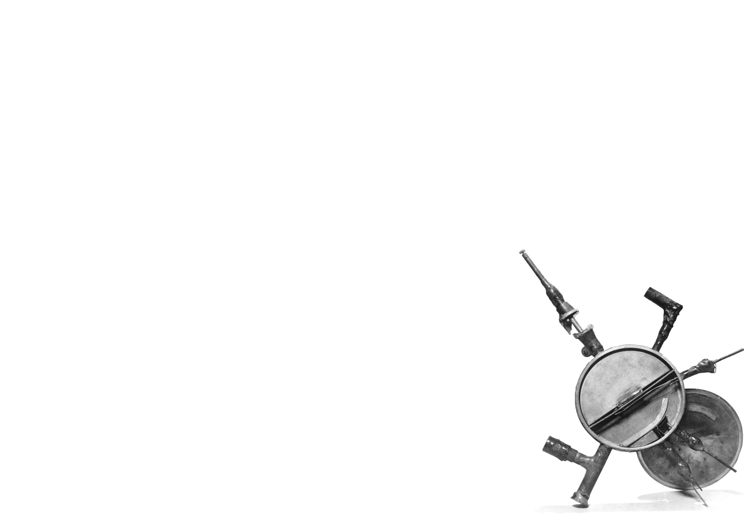
Thank you for your attention

