Slide 1
Determination of the elemental composition of archaeological ceramics, found on the territory of Kazakhstan, by nuclear-physical methods and statistical analysis of the results.
V.V. Lobachev, A.Yu. Dmitriev, R. S. Zhumataev, O.E. Chepurchenko, A.Zh. Zhomartova

Slide 2
Fragments of medieval vessels
Notes:
Research of the elemental composition of 17 ceramics pieces found on the Kazakhstan territory were done in cooperation with the Al-Farabi Kazakh National University. Neutron activation analysis(NAA) and X-ray fluorescence(XRF) analysis were used for experiment.

Slide 3
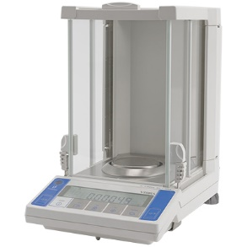
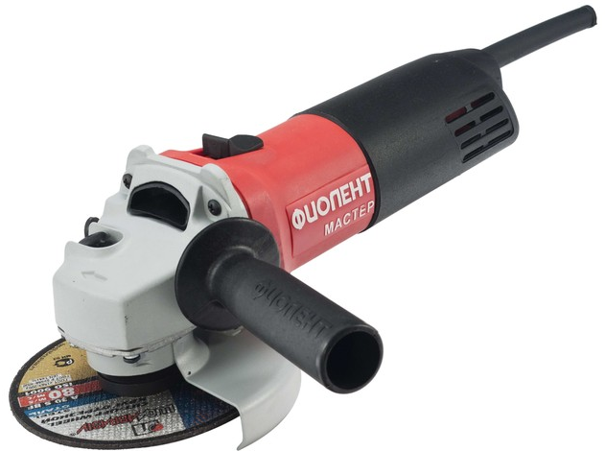
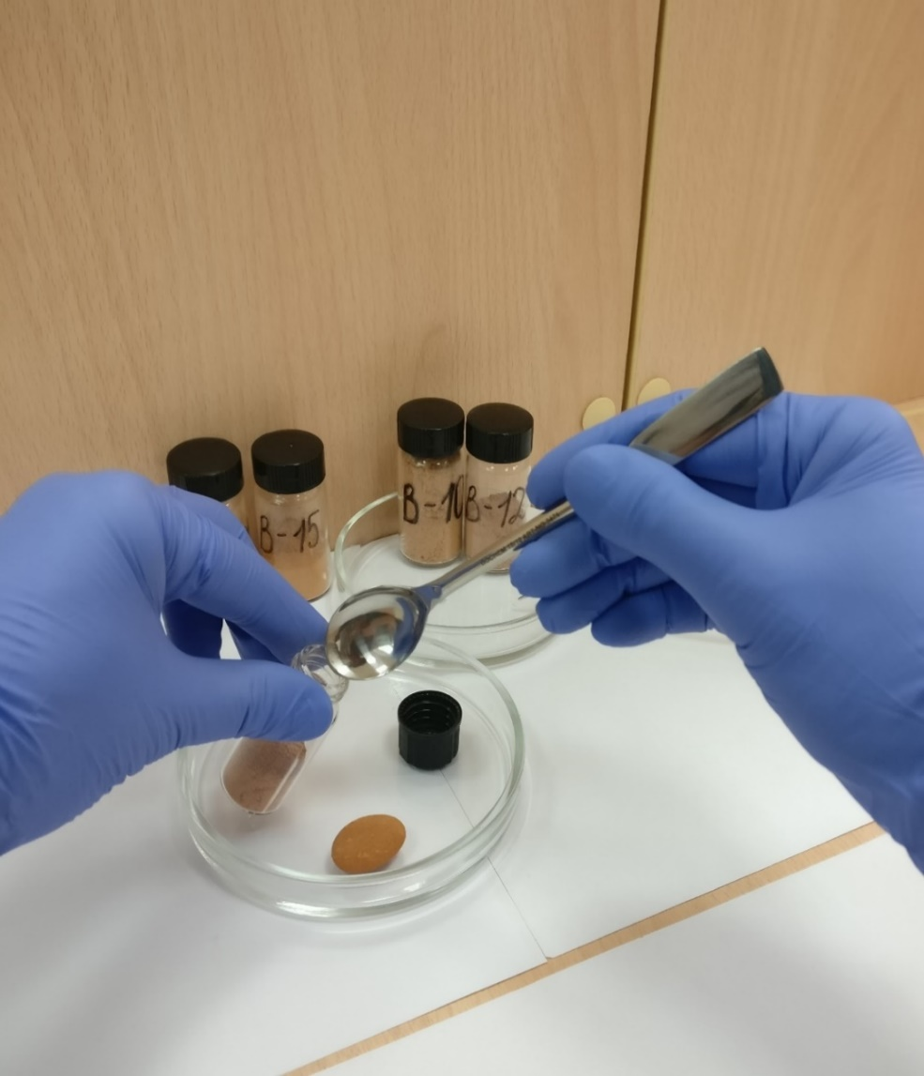
Preparation for neutron activation analysis
Figure 1. Vibra AF 225DRCE analytical balance
Figure. 2. Grinding machine
Figure. 3. Fritsch Pulverisette 6 planetary mill
Figure. 4. Labeled glass vials for temporary storage
Notes:
The weight of each sample was recorded using an analytical balance before to cleaning. The surface layer of each sample was removed using a grinding machine. Then the samples were washed with distilled water and wiped with cotton wool soaked in alcohol. The samples were ground using a planetary mill. Grinding time was 3 minutes, rotation speed reached 300 rpm. The resulting powder was placed in marked glass vials. This vials were placed in the drying cupboard at a temperature of 104 ° C to constant weight.

Slide 4
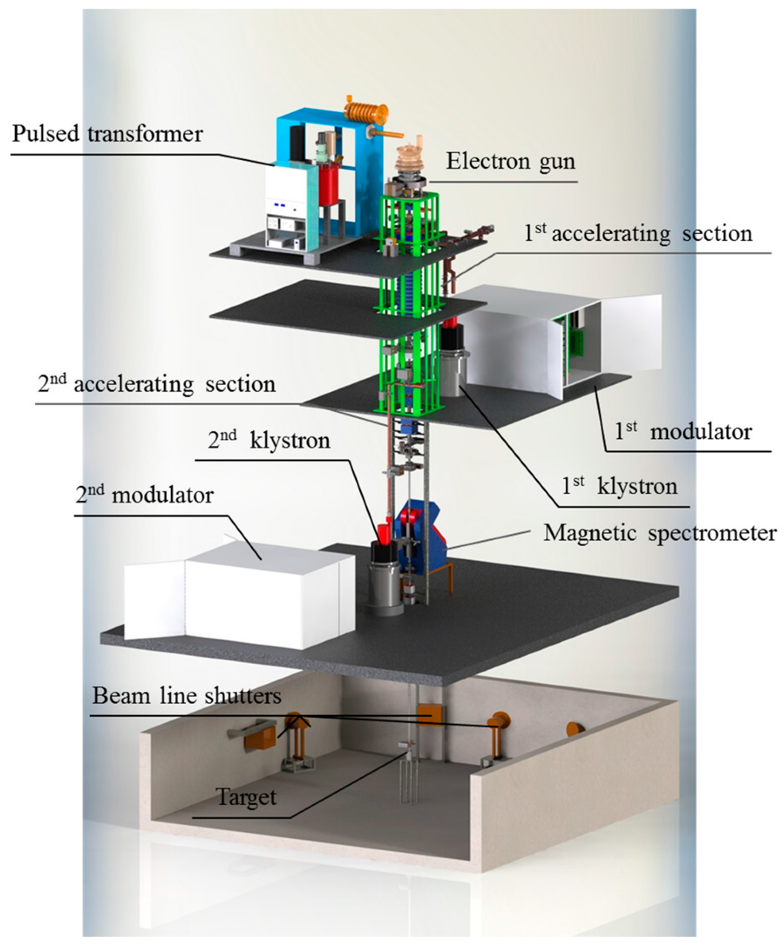
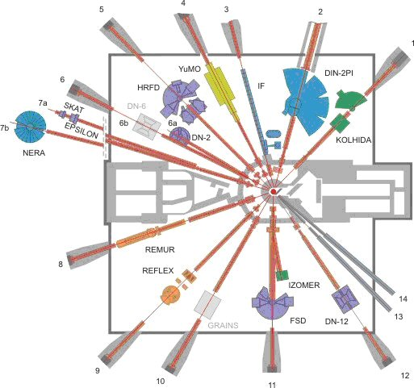
Irradiation facility
Figure. 5. IREN facility
Figure. 6. IBR-2, experimental facilities.
Notes:
For NAA, the samples were irradiated using the IREN facility and the IBR-2 reactor. Moreover, the IREN facility was used to get short-lived isotopes, and the IBR-2 reactor for medium and long-lived isotopes.

Slide 5
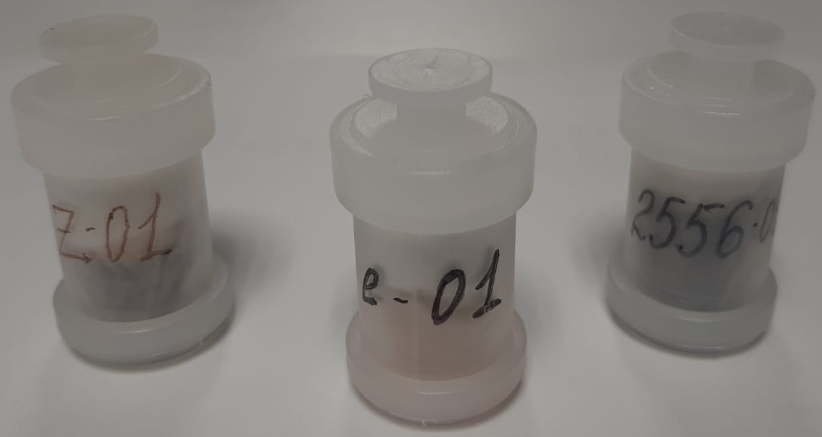
Samples for irradiation at IREN facility
Short-lived isotopes: Mg, Al, Si, V, Mg, Sr;
weight of each sample: 3 gram.
Figure. 7. Polyethylene container for irradiation at IREN
Notes:
A 3 gram aliquot was packed in a double polyethylene bag. Then all the bags were placed in polyethylene containers and fixed in a static position with cotton wool. The containers were closed with special lids.

Slide 6
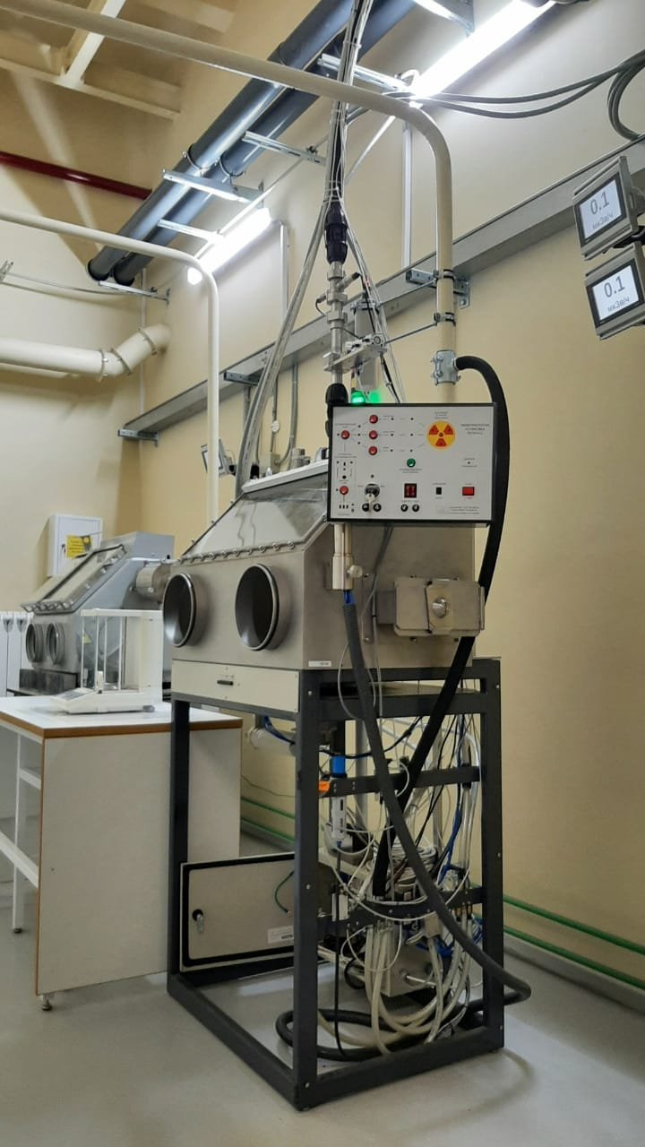
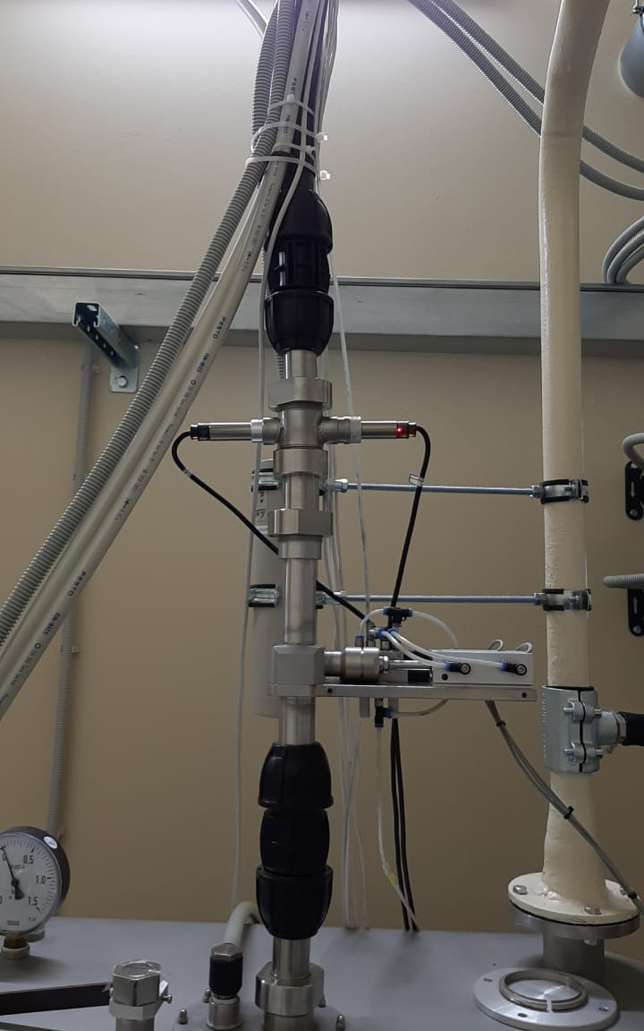
Pneumatic transport system REGATA2
Figure. 8. Box with loading and unloading station
Figure. 9. Pipeline to the target hall
Notes:
The Regata 2 pneumatic transport system was used to deliver containers with samples to the irradiation zone at the IREN facility. On the left side of this slide, you can see the box with the loading and unloading station and the control panel. Every samples is been delivered to the target hall through the pipeline.

Slide 7
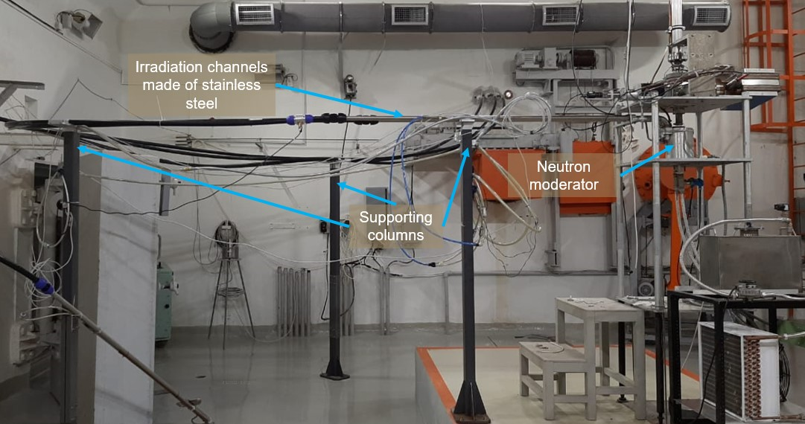
Irradiation process at the IREN facility
Irradiation one sample was 40 minutes;
flux of thermal and resonance neutrons was approximately 10 power 7 n / (cm2 s);
Figure. 10. Target hall of the IREN facility
Notes:
The duration irradiation time for each sample was 40 minutes. The flux of thermal and resonance neutrons was approximately 10 power of 7 n / (cm2 s). After the sample arrive at the neutron moderator, the system counts the time and returns the container to the box, where he is removed from the loading and unloading station for delivery to the detector.

Slide 8
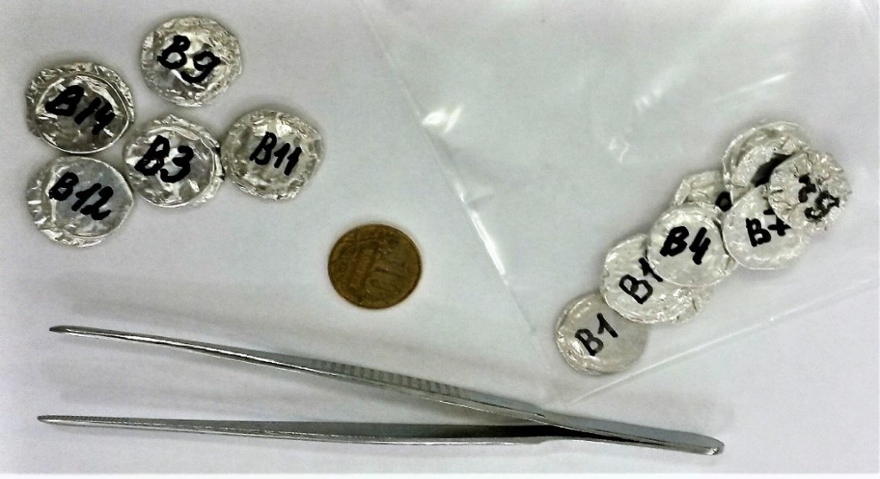
Samples for irradiation at the IBR-2 reactor
Medium-lived isotopes:
Na, K, Fe, Ni, Zn, As, Br, Rb, Sn,
Sb, Ba, La, Nd, Sm, Eu, Tb, Lu, U.
Long-lived isotopes:
Sc, Cr, Co, Sr, Cs, Ce, Yb, Hf, Ta, Th.
Figure. 11. Aluminum capsules with samples
Notes:
Sub sample weighing approximately 100 mg was taken for irradiation at the IBR-2 reactor. Aluminum capsules with samples and standards were packed with aluminum foil. Sample preparation was carried out in the laboratory using disposable protective equipment.

Slide 9
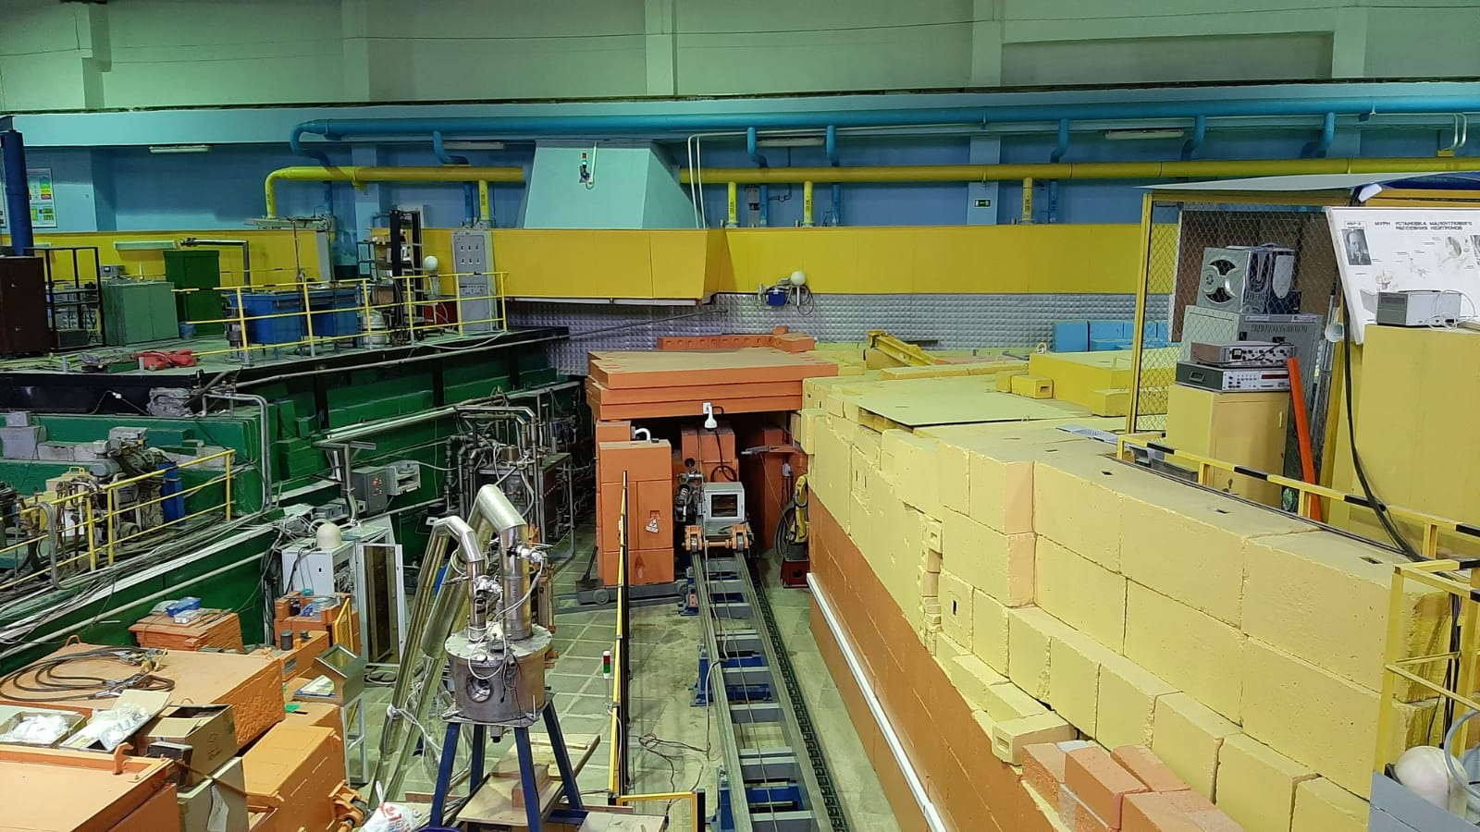
The irradiation facility on channel 3 of the IBR-2 reactor
Irradiation was carried out for 14 days;
flux of thermal and resonance neutrons was approximately 10 to the power of 11 n / (cm2 s);
reactor power was 1.55 kW.
Figure. 12. IBR-2, experimental hall
Notes:
The irradiation facility on beam 3 of the IBR-2 reactor at JINR FLNP was used to irradiate the samples. Irradiation was carried out for 14 days. The flux of thermal and resonance neutrons was approximately 10 power 11 n / (cm2 s). The reactor power was 1.55 kW. Five days after the end of irradiation samples and standards were packed in clean plastic containers and closed with lids.

Slide 10
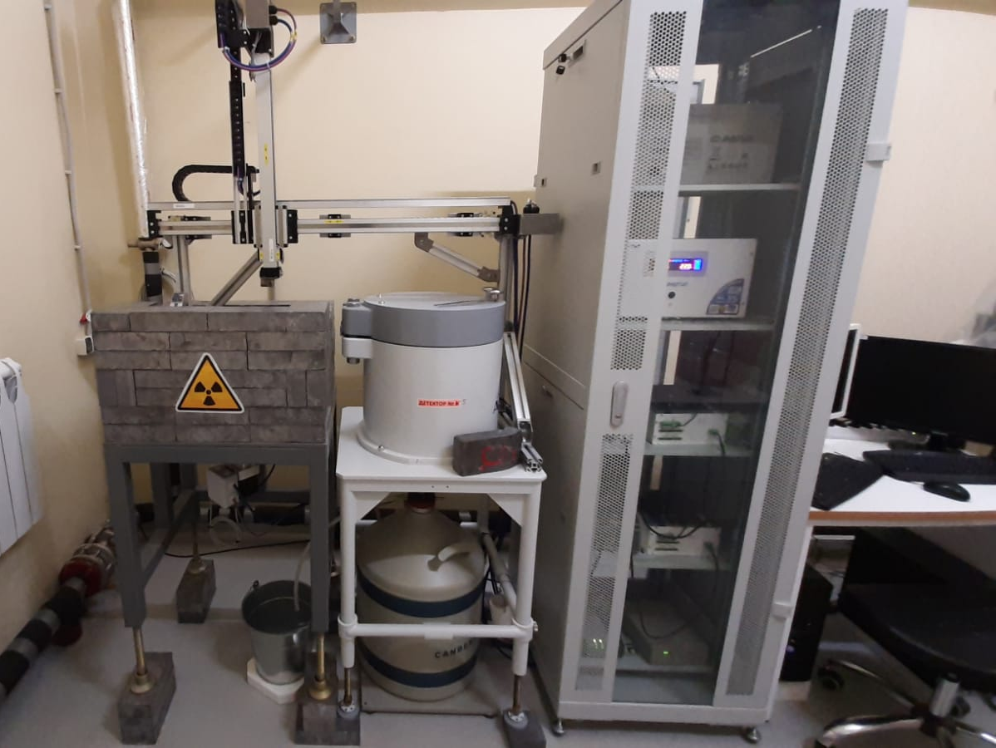
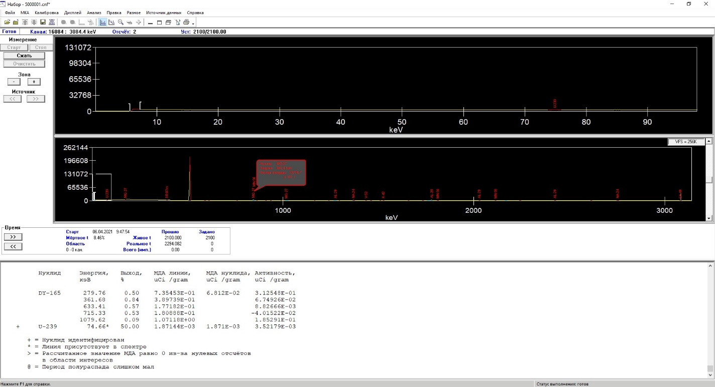
Acquisition system and spectra processing
Parameters of the Canberra GC10021 detector:
resolution of 2.1 keV for the 60Co gamma line;
energy of 1332 keV;
relative efficiency of 100%.
Figure. 13. Automatic spectra measurement system and detector Canberra GC10021
Figure. 14. spectra processing in GENIE-2000 program
Notes:
The measurements of activity spectra of the isotopes got from the two facilities were carried out using an automatic spectra measurement system. It was developed at FLNP JINR and includes a Canberra detector. This detector have the resolution of 2.1 keV for the Co60 gamma line with the energy of 1332 keV and a relative efficiency of 100%. The Concentration program developed at JINR FLNP was used to calculate the elements mass fractions.

Slide 11
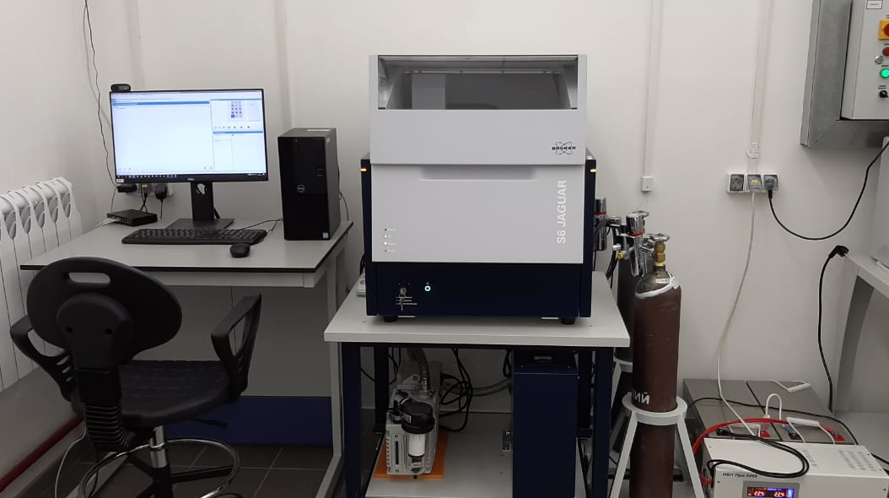
X-ray fluorescence analysis
Figure. 15. Wave dispersive spectrometer Bruker s6 Jaguar
Notes:
There are some elements that are difficult to identify using NAA. Therefore XRF is used. XRF was carried out using a Bruker S6 JAGUAR wave dispersive spectrometer. The SMART-QUANT WD standardless method of analysis was used for the measurements. This analysis provides quantitative results for the elements mass fraction from Fluorine to Uranium in the concentration up to 100%.

Slide 12
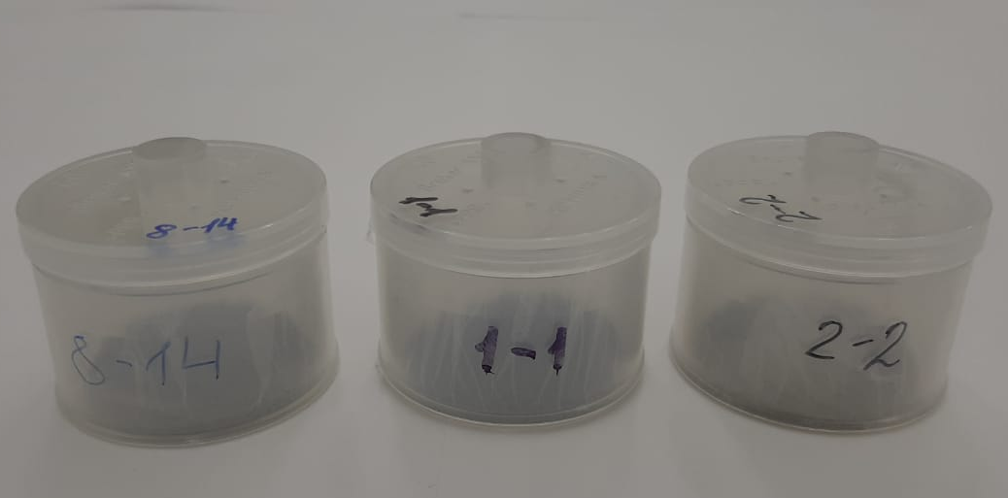
Preparation for XRF analysis
Figure. 16. Plastic cuvettes for XRF
Notes:
For measurements, we used powdered samples prepared in the same way as for the NAA method. Samples were weighed on the analytical balance and then placed in special polyethylene cuvettes for XRF. A 4 µm thick polypropylene film was used as the bottom of the cuvettes.

Slide 13
Quantitative data of ceramic samples
Samples | Na |  |  | Mg |  | Al |  | Si |  |  | P | K
 | NAA |  | XRF | NAA |  | NAA |  | NAA |  | XRF | XRF | NAA |  | XRF
 | mg/kg | % | mg/kg | mg/kg | % | mg/kg | % | mg/kg | % | mg/kg | XRF | mg/kg | % | mg/kg
No.7 mound 2020, Fragments of ceramics 1 | 34300 | 3.1 | 30900 | 39000 | 6.7 | 225000 | 6 | 271000 | 4.0 | 274000 | 473 | 24800 | 9.5 | 26500
No.7 mound 2020, Fragments of ceramics 2 | 39100 | 3.1 | 28400 | 30700 | 6.8 | 207000 | 6 | 281000 | 4.0 | 276000 | 1320 | 26800 | 8.8 | 24000
No.20 mound 2020, Fragments of ceramics 1 | 18100 | 3.1 | 13400 | 19800 | 6.8 | 102000 | 6.3 | 213000 | 4.1 | 266000 | 1500 | 23100 | 8.6 | 23200
No.20 Kurgan 2020, Fragments of ceramics 2 | 18800 | 3.1 | 13700 | 22500 | 6.9 | 118000 | 6 | 244000 | 4.0 | 258000 | 776 | 23400 | 8.6 | 22400
AAE, Fragments of ceramics 1 | 16200 | 3.1 | 11900 | 20200 | 6.8 | 142000 | 6.3 | 232000 | 4.1 | 269000 | 1010 | 25700 | 8.4 | 26100
AAE, Fragments of ceramics 2 | 18000 | 3.1 | 13600 | 18300 | 6.9 | 148000 | 6.4 | 264000 | 4.1 | 278000 | 1240 | 19800 | 8.8 | 19500
AAE, Fragments of ceramics 3 | 15900 | 3.1 | 10900 | 21700 | 7 | 216000 | 6.4 | 246000 | 4.3 | 267000 | 625 | 28600 | 8.8 | 26300
Excavation 2015-16, medieval site of ancient settlement Zhaipakulken | 16500 | 3.3 | 10900 | 21400 | 6.9 | 113000 | 6 | 361000 | 3.9 | 272000 | 1400 | 25300 | 4.2 | 24500
Excavations 2015-16, medieval site of ancient settlement Zhaipak | 18800 | 3.3 | 14700 | 16000 | 7 | 104000 | 6.3 | 331000 | 4.0 | 268000 | 2960 | 20500 | 4.4 | 20100
Excavation 2019, early Iron Age mounds 5 | 6350 | 3.1 | 4450 | 17200 | 6.9 | 80700 | 6.3 | 265000 | 4.0 | 261000 | 1520 | 18500 | 3.9 | 20000
Excavation 2019, early Iron Age mounds 6 | 24500 | 3.3 | 16600 | 23300 | 6.8 | 118000 | 6 | 315000 | 3.9 | 245000 | 1520 | 16300 | 5.8 | 15700
Excavation 2017 Bronze Age mounds | 6550 | 3.1 | 4990 | 22600 | 6.8 | 59600 | 6 | 241000 | 3.9 | 228000 | 1740 | 5400 | 4.5 | 5490
Sample 2, Excavation 2019, Bronze Age Monument | 19200 | 3.3 | 9320 | 23200 | 6.9 | 178000 | 6 | 424000 | 3.9 | 217000 | 1050 | 36000 | 4.1 | 30200
Sample 3, Excavation 2019, Bronze Age Monument | 13100 | 3.1 | 8500 | 16300 | 7 | 99600 | 6.3 | 318000 | 4.0 | 265000 | 573 | 28600 | 3.9 | 27400
Sample 1, Excavation 2019, Bronze Age Monument | 15700 | 3.3 | 8360 | 22600 | 7 | 128000 | 6 | 340000 | 3.9 | 221000 | 1350 | 25000 | 9.8 | 21800
Sample A, Excavation 2019, Bronze Age Monument | 11400 | 3.3 | - | 29500 | 7.1 | 327000 | 6 | 483000 | 3.9 | - | - | 14200 | 12 | -
Sample C, Excavation 2019, Bronze Age Monument | 19400 | 3.3 | 11690 | 24600 | 7 | 183000 | 6 | 439000 | 3.9 | 248000 | 303 | 24700 | 11 | 23200
Figure. 17. Fragment of the table containing the concentration of ceramic elements obtained using NAA and XRF
Notes:
The results of NAA and XRF present on this slide. The NAA and XRF are in line to each other, except for the elements Sodium and Silicon, in three samples. This fact requires additional analysis.

Slide 14
Cluster Analysis
Index number | Samples
1 | No.7 mound 2020, Fragments of ceramics 1
2 | No.7 mound 2020, Fragments of ceramics 2
3 | No.20 mound 2020, Fragments of ceramics 1
4 | No.20 Kurgan 2020, Fragments of ceramics 2
5 | AAE, Fragments of ceramics 1
6 | AAE, Fragments of ceramics 2
7 | AAE, Fragments of ceramics 3
8 | Excavation 2015-16, medieval site of ancient settlement Zhaipakulken
9 | Excavations 2015-16, medieval site of ancient settlement Zhaipak
10 | Excavation 2019, early Iron Age mounds 5
11 | Excavation 2019, early Iron Age mounds 6
12 | Excavation 2017 Bronze Age mounds
13 | Sample 2, Excavation 2019, Bronze Age Monument
14 | Sample 3, Excavation 2019, Bronze Age Monument
15 | Sample 1, Excavation 2019, Bronze Age Monument
16 | Sample A, Excavation 2019, Bronze Age Monument
17 | Sample C, Excavation 2019, Bronze Age Monument
Figure. 18. Dendrogram, built according to NAA and XRF analysis
Notes:
Сluster analysis was carried out using the R program language according to Ward's method based on the data from the table. If data were got using both methods, NAA results were selected. Based on Euclidean metric and average clustering, hierarchical cluster analysis revealed four groups, which can be described as follows: Sample numbers 1 and 2 cluster well together. This cluster fits well with the description of the samples. This is mainly due to the similar characteristics of the two samples. The second cluster contains sample numbers 9, 10, 11, and 12. Despite the fact that sample numbers 10 and 11 are from the Early Iron Age, they have clustered together in the same cluster but a little far apart. The third cluster contains 10 samples. However, it can be clearly seen that there are four subclusters. This can be interpreted as it was previously for the second group. The 4th group contains only one sample, which tends to form a separate cluster. In other cases, it could be considered an outlier.

Slide 15
Thank you for your attention!

