Slide 1
The fast and neat approach to calculate Total Phase Slip (TPS), implemented in CORD code, and its demonstrative run for SC200 & SC230 cyclotrons.
D. Popov, O. Karamyshev, V. Malinin, T. Karamysheva, I. Lyapin, S. Gurskiy, S. Shirkov
New Accelerators Department, DLNP, JINR AYSS-2021

Slide 2
Introduction
Current project and phase slip definition.

Slide 3
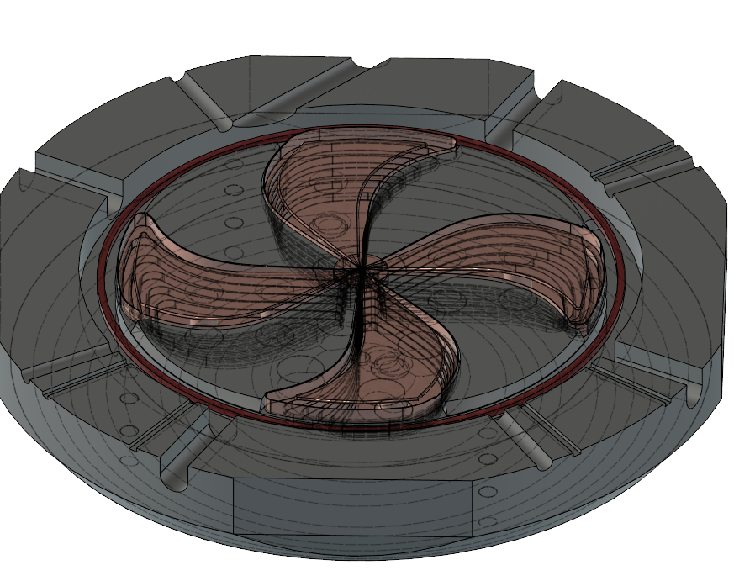
SC230^{[1]}
Cyclotron Project
Dees and Cavities
Accelerated Particles | Protons
Magnet Type | Compact, SC coil, warm yoke, B≈1.5 T
Number of Sectors | 4
Number of RF Cavities | 4
Ion Source | Internal, PIG
Final Energy | 230 MeV
Number of Turns | 600
Sectors
Yoke
Inside the SC230

Slide 4
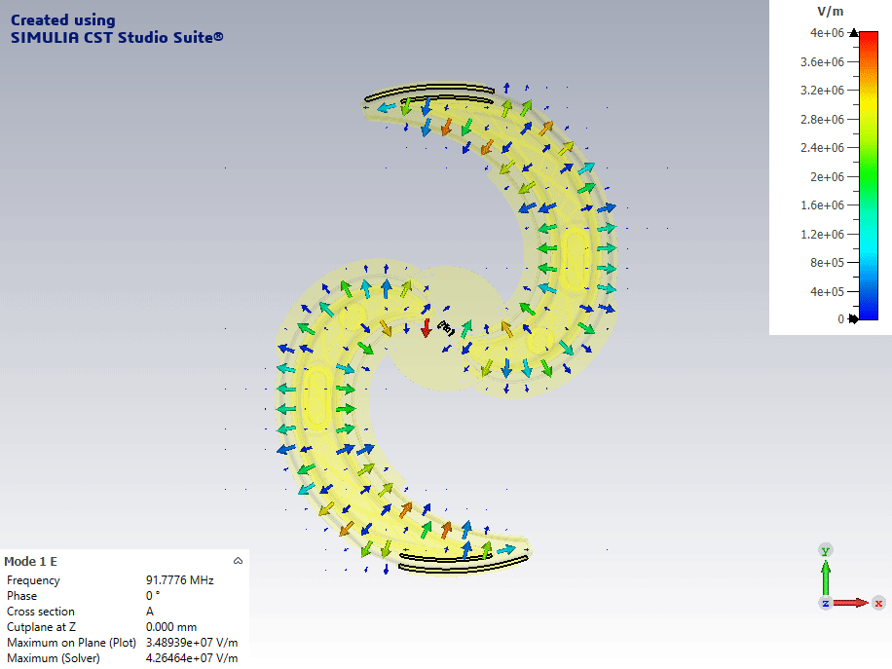
Total Phase Slip (TPS)…
…is a parameter of an accelerated particle in a current moment which shows (in degrees) how out of phase, of the RF acceleration system, the particle comes to current accelerating gap.
Total Phase Slip (TPS) of the beam is a net quantity in cyclotron physics which allows quickly estimate the quality of the acceleration.
Notes:
!!! isochronism of the field mainly, as well

Slide 5
TPS Calculation
The methods of calculation of the Total Phase Slip of the beam

Slide 6
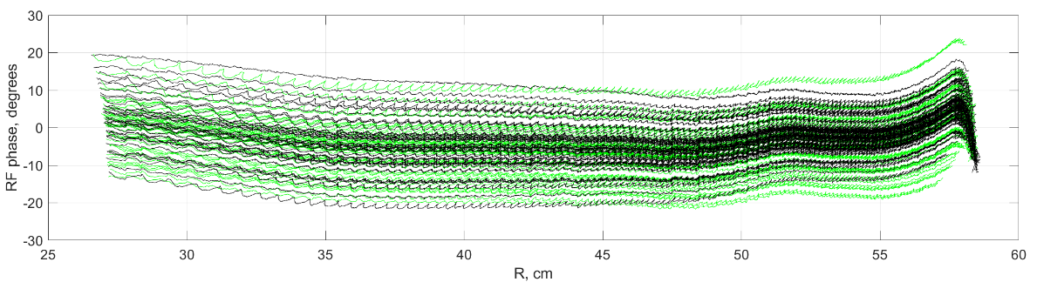
General TPS Calculation Methods
The BDS Method
The Integral Method ^{[2,3]}
  Evaluates IPS precisely for every particle simulated.
  Requires at least magnetic and electric field maps.
  Consumes a lot of time and computational power.
  Computes IPS analytically through one integral.
  Requires closed orbit computation based on magnetic field map.
  Estimates IPS roughly:
    Implies there is only one accelerating gap with constant voltage on it.

Slide 7
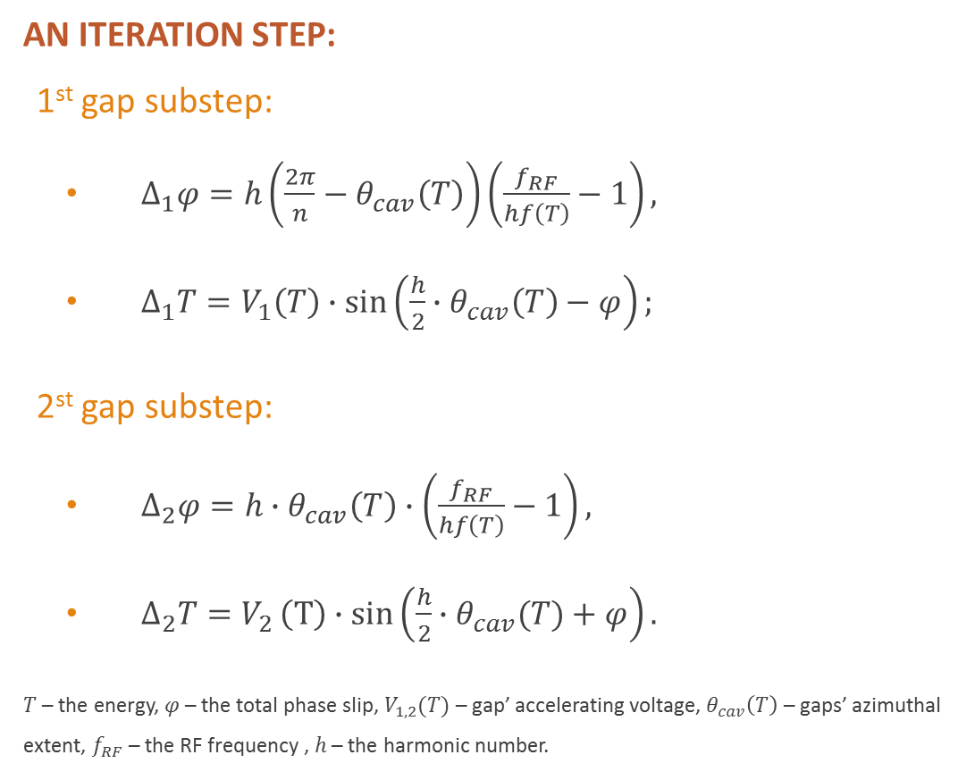
Our Method
– the Iteration Method…
AN ITERATION STEP:
1st gap substep:
  $∆_{1}φ=h\left(\frac{2π}{n}−θ_{cav}\left(T\right)\right)\left(\frac{f_{RF}}{hf\left(T\right)}−1\right),$
  $∆_{1}T=V_{1}\left(T\right)∙\sin\left(\frac{h}{2}∙θ_{cav}\left(T\right)−φ\right);$
2st gap substep:
  $∆_{2}φ=h∙θ_{cav}\left(T\right)∙\left(\frac{f_{RF}}{hf\left(T\right)}−1\right),$
  $∆_{2}T=V_{2}\left(T\right)∙sin\left(\frac{h}{2}∙θ_{cav}(T)+φ\right).$
$T$ – the energy, $φ$ – the total phase slip, $V_{1,2}(T)$ – gap’ accelerating voltage, $θ_{cav}\left(T\right)$ – gaps’ azimuthal extent, $f_{RF}$ – the RF frequency , $h$ – the harmonic number.
…is an iteration procedure aiming to estimate central particle TPS and energy alteration through the acceleration process. The procedure distinguishes 1st and 2nd accelerating gaps and their azimuthal extent.
Requires:
Electric and magnetic field maps.
Computations required:
Gaps’ position and voltage.
Closed orbits with respect to particle energy.

Slide 8
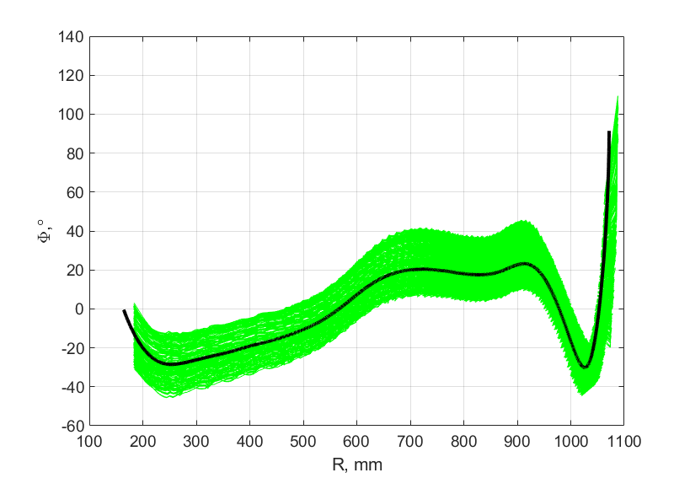
Advantages of the Iteration Method
Evaluates TPS with utmost precision.

Slide 9
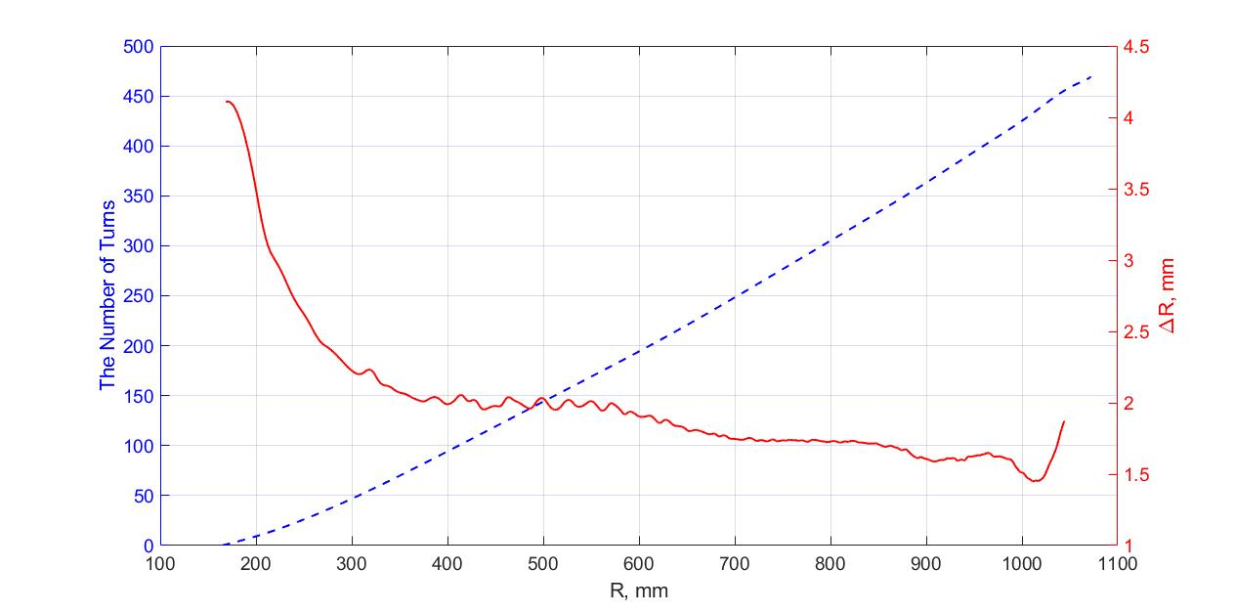
Advantages of the Iteration Method
Evaluates TPS with utmost precision.
Allows easy calculation of turn number and orbit separation distance versus the radius/energy.
Conducts all computations within seconds or less.
Can be evaluated on demand as and independent module.

Slide 10
Advantages of the Iteration Method
Evaluates TPS with utmost precision.
Allows easy calculation of turn number and orbit separation distance versus the radius/energy.
Conducts all computations within seconds or less.
Can be evaluated on demand as and independent module.
Evaluates TPS variation on every accelerating gap.

Slide 11
The CORD^{[4]}
(Closed ORbit Dynamics) – MATLAB code with modular structure
Notes:
A multitool for field map analysis, modification and analytic presentation.

Slide 12
The Reasons for Modular Structure
Field map:
  RF or magnet?
  Magnetic or electric?
  Simulated or measured?
  2D or 3D? 1 or 3 component?
  Coarse or robust?
  Cartesian or cylindrical?
  Uniform or concentrated?
Some action:
  Analyze?
  Prepare?
  Repair?
  Expand?
  Transform?
  Align?
  Add? Combine?
Beam dynamics:
  Harmonics and flutter?
  CYCLOPS? Baumgarten?
  Betatron tunes & resonances?
  Central particle?
  BDS 2D? 3D?
  Relativistic? Space-charge?
  Collisions? Influences?
  Tracking in packages? CST? COMSOL? 2D packages?
Results post processing:
  Individual for every task type.
  Algorithms?
  Plots?
  Decoration?
  Presentation?
Field and design corrections:
  (could be anything)
  Shimming?
  Tolerances?
  Sector design:
    Spirality?
    Gap?
    Partitioning?
  RF design?
  Extraction system design?
  Beam focusing?
  Resonance avoiding?
Commissioning and testing:
  How to align precisely the measured field and the simulated one?
  Probes’ error estimation?
  Defect determination using field maps?
And many many more question marks!
There is the variety of task which couldn’t be achieved simultaneously within the run of one solid program.
This is caused by mutually exclusive needs between different tasks: for some tasks one wants to be solved fast but with many runs of iterative parametric change, for some – the good accuracy is need, for another – the neat modeling, and there are task for which fluent cooperation between packages is paramount.

Slide 13
CORD Modules
 | Preforms initial quick analytics for the given field map.
 | Makes all kind of transformations with the given field map.
 | Calculates closed orbits, orbital frequency, betatrone tunes and resonances.
 | Calculates gaps’ position, voltage and azimuthal extent.
 | Performs simplified acceleration for the central particle.
 | Generates effective magnetic field map of the RF-system.
Analyze FM
Transform FM
CYCLOPS Gordon
Most regular tasks written in code.
Each module several number of parameters for better tuning.
Each module provides and illustrates some useful information in a presentative view.
Our new implementation^{[4]} of the CYCLOPS method^{[2]} modified by Baumgarten^{[5]}.
CYCLOPS Baumgarten
Find Accel. Gaps
TPS & Energy Gain
Effective Brf

Slide 14
                MATLAB
Bz
FM
RF Hz
FM
RF E
FM
Measurements
Analyze FM
CST
Transform FM
The Live Script
known as CORD
CYCLOPS Gordon
Find Accel. Gaps
COMSOL
CYCLOPS Baumgarten
TPS & Energy Gain
OPERA 3D and others
Effective Brf
Notes:
CST-MATLAB, LIVELINK

Slide 15
                MATLAB
Bz
FM
RF Hz
FM
RF E
FM
Measurements
Analyze FM
CST
Transform FM
The Live Script
known as CORD
CYCLOPS Gordon
Find Accel. Gaps
COMSOL
CYCLOPS Baumgarten
TPS & Energy Gain
OPERA 3D and others
Effective Brf

Slide 16
CORD
Live Script
Sequential structure.
Informative description of the physics engaged and parameters.
Instantaneous refreshment of the result plots.
Specified task oriented.

Slide 17
The Application
Practical runs for SC200 and SC230 cyclotrons

Slide 18
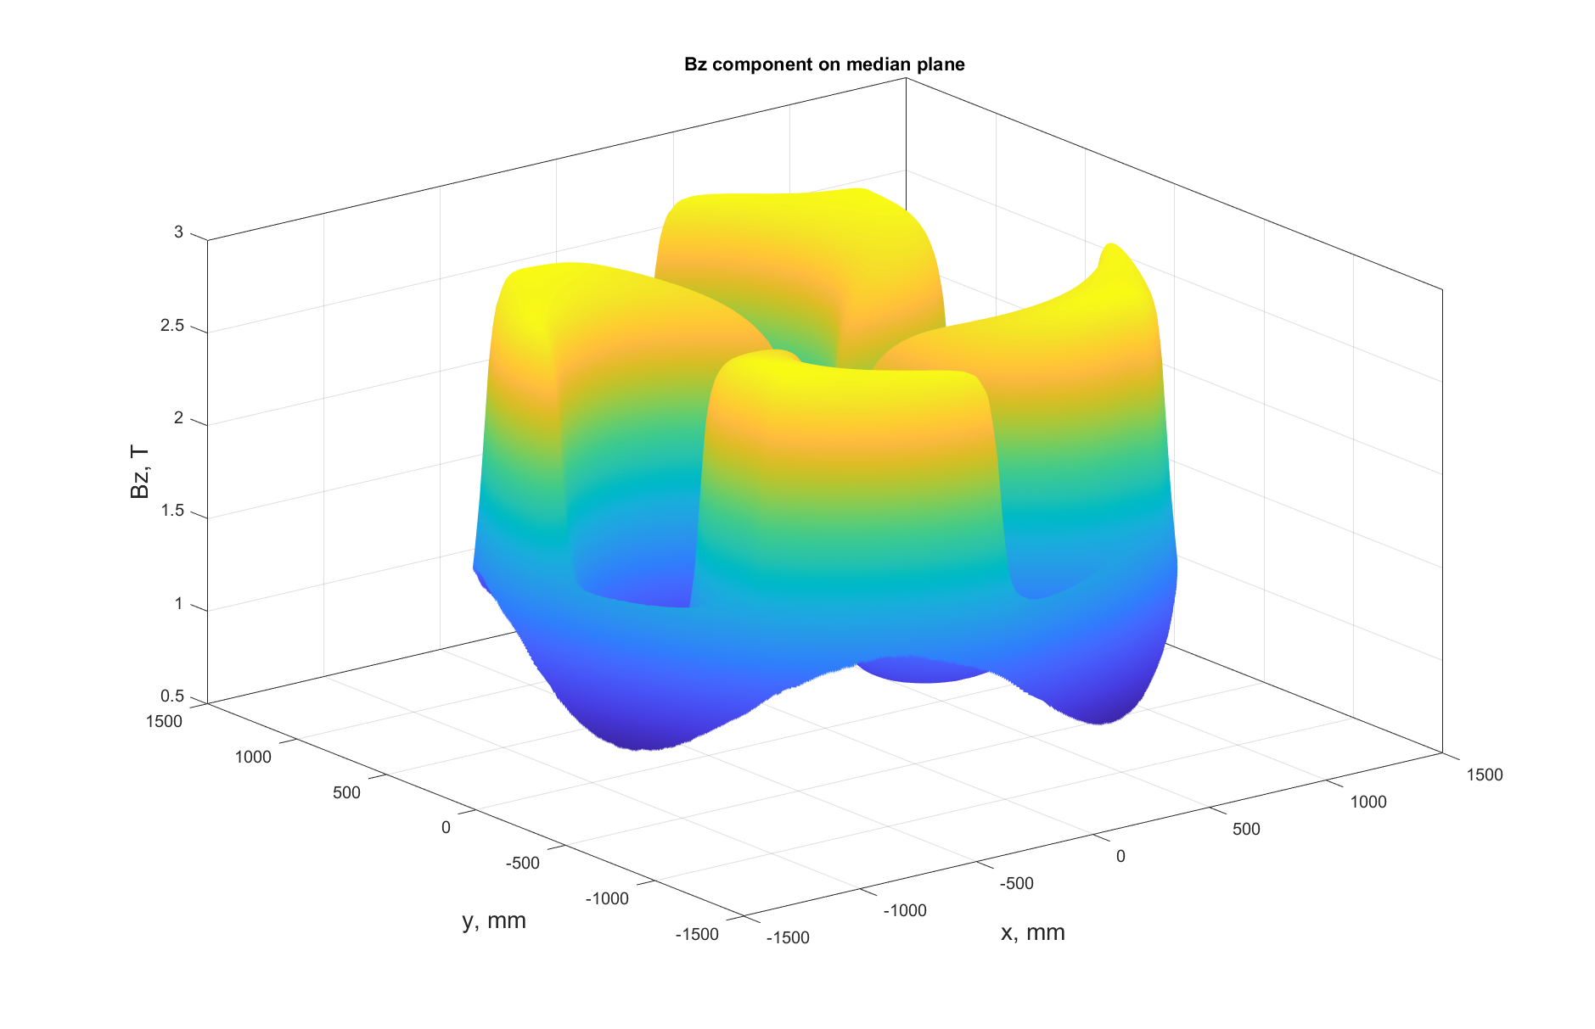
Regular Use for SC200 & SC230
The code was tested numerous times for these machines. Its fast versatile computations reduces duration of a variety of tasks, whether it be design, correction or analysis.

Slide 19
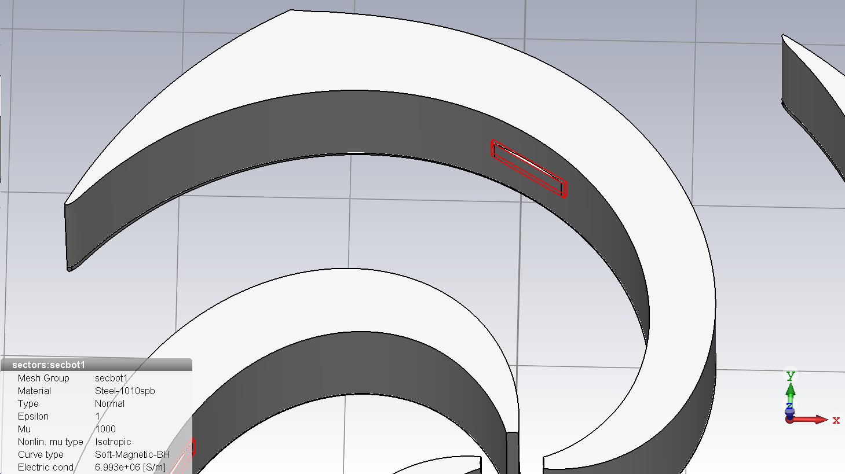
SC200^{[6]}
Correcting the RF System Magnetic Influence.
The compensational field calculation and improvement.
The phase slip variation.
The correction shim.

Slide 20
Final Words
Conclusion & References

Slide 21
Conclusion
  implemented our own method of TPS calculation with special benefits engaged in our other codes.
  created the modular structure called CORD which has already got several significant updates and is planned to develop much more.
  applied this code to our project with successful result.
We’ve:

Slide 22
References
[1] Karamyshev O. V. et al. Research and Development of the SC230 Superconducting Cyclotron for Proton Therapy //Physics of particles and nuclei letters. – 2021. – Т. 18. – №. 1. – С. 63-74.
[2] Gordon M. M. Computation of closed orbits and basic focusing properties for sector-focused cyclotrons and the design of" CYCLOPS" //Part. Accel. – 1984. – Т. 16. – С. 39-62.
[3] Kleeven W., Zaremba S. Cyclotrons: magnetic design and beam dynamics //arXiv preprint arXiv:1804.08961. – 2018.
[4] Karamyshev O. et al. Cord (Closed Orbit Dynamics): A New Field Map Evaluation Tool for Cyclotron Particle Dynamics //Physics of Particles and Nuclei Letters. – 2021. – Т. 18. – №. 4. – С. 481-487.
[5] Baumgarten C. Cyclotron closed orbits on a radial grid //Nuclear Instruments and Methods in Physics Research Section A: Accelerators, Spectrometers, Detectors and Associated Equipment. – 2011. – Т. 647. – №. 1. – С. 31-33.
[6] Karamysheva G. et al. Influence of the RF magnetic field on beam dynamics in SC200 cyclotron //Nuclear Instruments and Methods in Physics Research Section A: Accelerators, Spectrometers, Detectors and Associated Equipment. – 2019. – Т. 940. – С. 61-65.

Slide 23
Thank for Your Attention
¯\_(ツ)_/¯

