Slide 1
OMC4DBD analysis
forthweekly meeting
D.Z. Zinatulina
07.12.2021
Link: https://indico.jinr.ru/event/2691/

Slide 3
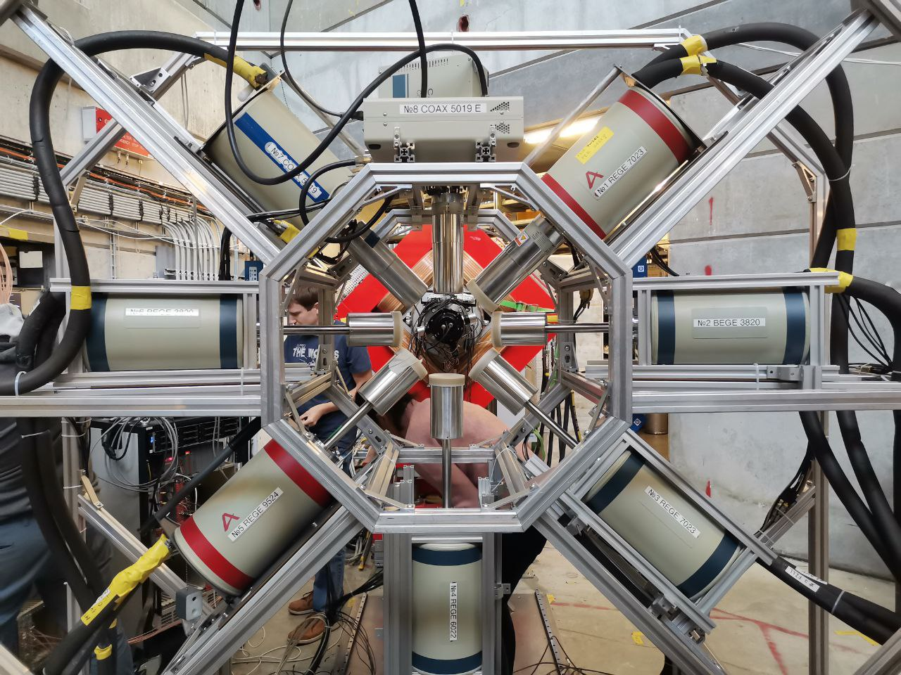
Progress report of 2021 campaign
Please note:
The latest corrections
should be done
till 22:00 25/12/2021
Overleaf link of the general Proposal:
https://ru.overleaf.com/project/5defe238bc758000019f5694
Overleaf link of the Progress report example:
https://ru.overleaf.com/2188139956tbmwgzrnmyjr
Daniya Zinatulina , 07.12.2021 3

Slide 4
Request for the next beam time 2022
Proposal of the time:
From 19th June to 16th July
or
From 4th September to 1st October
What will be measured:
Solid ¹⁰⁰Mo and ⁹⁶Mo enriched
3 weeks of measurements
+ 1 week for mounting
Daniya Zinatulina , 07.12.2021 4

