Slide 1


Global observables in 2021-some results and plans -1
Talk is based on slides of the PWG1 status report in October https://indico.jinr.ru/event/2528/
G. Feofilov
V.Fock Institute for Physics, Laboratory of Ultra-High Energy Physics, Saint-Petersburg State University
PWG1 MPD Collaboration meeting 16.12.2021
https://indico.jinr.ru/event/2709/
Notes:
1

Slide 2
Some critical issues
What was achieved by the PWG1 in the period April-December 2021?
What is expected to be new and could be better measured by the MPD in comparison with STAR@RHIC - from the point of view of Global Observables?
What is still not quite in line with the expectations of the PWG1?

Slide 3
Where are we today?
Some news from the Physics Council 08.12.2021
Beams at NICA collider are expected in the end of 2022 (no collisions)
Collisions – in the 3rQ of 2023
EPJA Paper - practically ready for submission
Talks at the conferences (QM 2022 and RHIC workshop)
New MPD Physics paper is being considered, some discussion on the content
and preparations are to be started in January 2022 – the role of PWGs is important!
--please, start thinking!

Slide 4
Where are we today?
Some news from the Physics Council 08.12.2021
Beams at NICA collider are expected in the end of 2022 (no collisions)
Collisions – in the 3rQ of 2023
EPJA Paper - practically ready for submission
Talks at the conferences (QM 2022 and RHIC workshop)
New MPD Physics paper is being considered, some discussion on the content
and preparations are to be started in January 2022 – the role of PWGs is important!
--please, start thinking!

Slide 5
Where are we today?
PWG1 meetings in 2021
18 November “Nuclear fragments deposited in FHCal. DCM-QGSM or DCM-SMM?”, Dr Genis Musulmanbekov
“Discussion concerning a way to establish a standartized procedure for basic QA”, Alexey Aparin
07 October “Draft of PWG1 Status report/Global observables in heavy-ion collisions at NICA”, G. Feofilov
09 Sept."Centrality determination in MPD at NICA"¶ 20m
by Pedro Antonio Nieto Marín "Centrality determination in MPD at NICA".
The talk is prepared for the conference AYSS-2021.
24 June, "Study of centrality classes based on number of charged particles for the Multi-Purpose Detector (MPD) at NICA complex"¶ 20m Authors: Pedro Antonio Nieto Marín, Universidad Autónoma de Sinaloa, México;
Alexey Aparin, Joint Institute for Nuclear Research
03 June The main topic is to dicsuss and to fix the near tasks for the MC production of a common set of data using the UrQMD, SMASH and DCM-QGSM-SMM event-generators for Bi+Bi collsions at sqrt(s_NN)=9.2 GeV. Speaker: Grigory Feofilov
20 May, Some PWG1 tasks for the MC production using the available event-generators for a new MPD Physics Performance paper¶ Speaker: Grigory Feofilov
15 April On difference between DCM and Glauber model. Speaker: Dr Genis Musulmanbekov (JINR, LIT)
Discussion on the PWG1 talk at the MPD Week 21-23 of April, Grigory Feofilov

Slide 6
Discussion of the MC production
Task 1: to start and compare with STAR@RHIC)

Slide 7
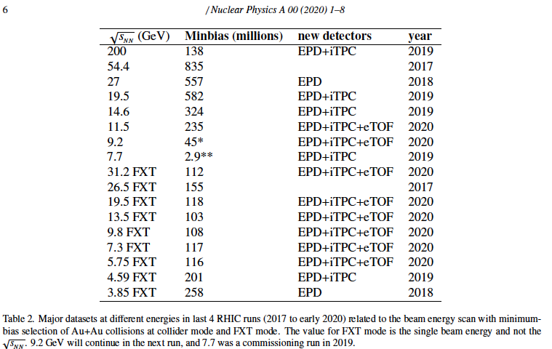
Where are we today?
STAR@RHIC data-sets [2]
[2] https://www.osti.gov/servlets/purl/1762771 --we have to check the data-sets available!

Slide 8
Question: with very reach harvest of STAR data at RHIC what is expected to be new and better by the MPD?
…

Slide 9
Question: with very reach harvest of STAR data at RHIC what is expected to be new and better by the MPD?
More precise selection of the centrality class in the MPD vs. STAR
  will provide more accurate determination of the number of binary collisions and of the RAA factor
Classes with narrow width of central collisions will eliminate considerably the trivial volume fluctuations and allow to get new results at the NICA energy:
  in fluctuations and correlation measurements,
  in elliptic flow measurements and flow fluctuations

Slide 10
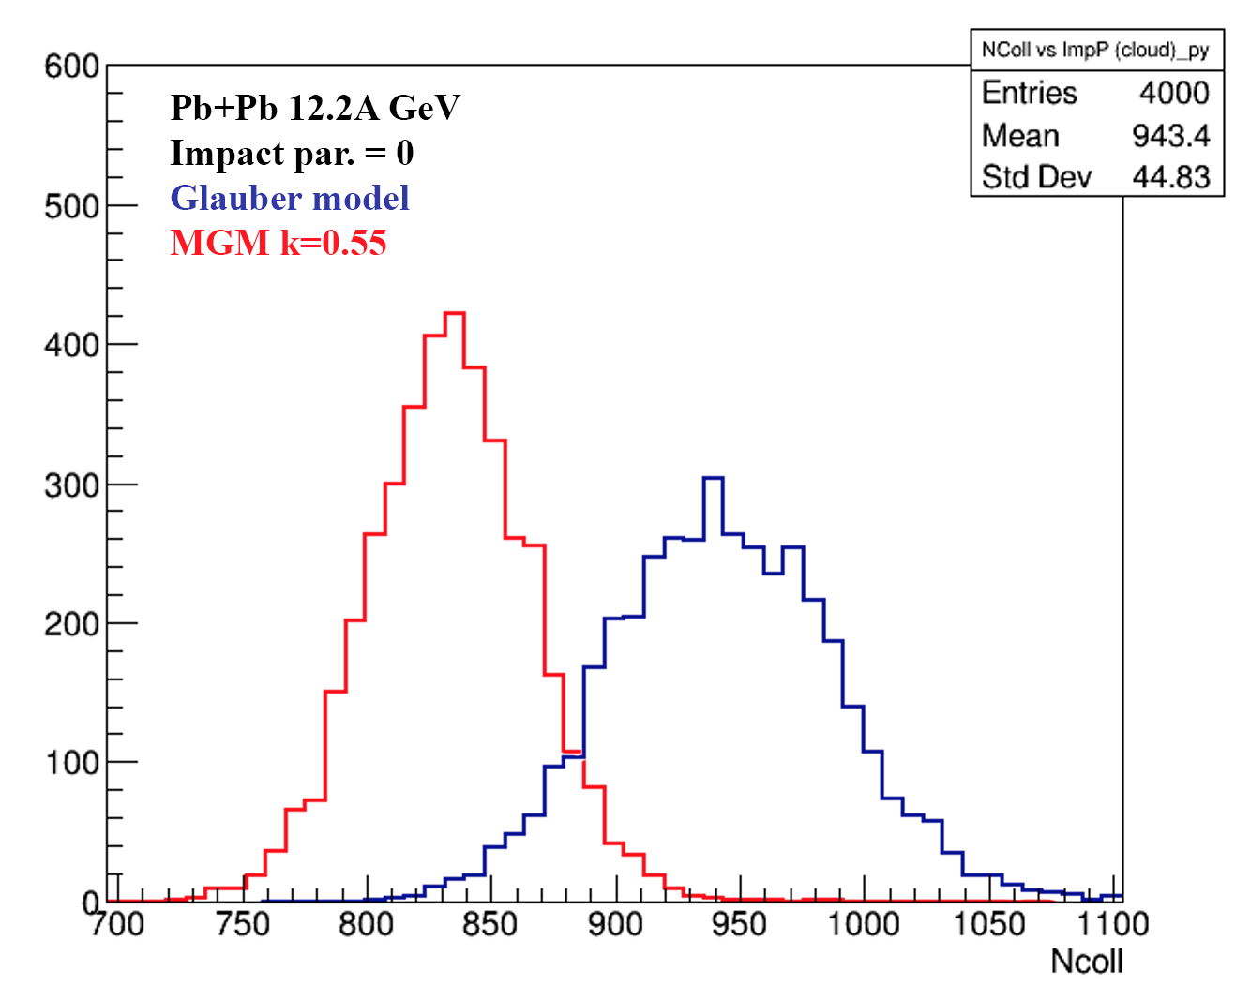
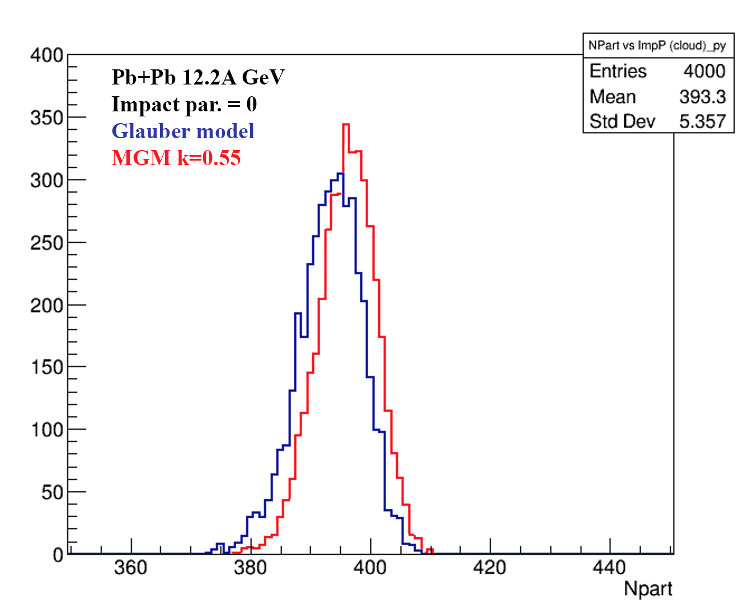

MGM and GM for Pb+Pb collisions:
N_{coll} and N_{part} mean values and fluctuations[1]
N_{coll}
N_{part}
Glauber model and MGM calculations of N_{coll} (left) and N_{part} (right) for Pb+Pb collisions at b=0
Account of energy-momentum conservation in multiparticle production process decreases considerably values of N_{coll}
It is one of the subject for further studies with available event-generators (SMASH, DCM-QGSM-SMM, …)
[1] G.Feofilov et al, RFBR report “ Investigation of initial states…” Physics of Elementary Particles and Atomic Nuclei, 52, № 4 ,2021, 584-590, DOI: 10.1134/S1063779621040043

Slide 11
Centrality of relativistic heavy ion collisions
^{In} ^{ALICE as an example}
PHYSICAL REVIEW C 88, 044909 (2013)
FIG. 10. (Color online) Distribution of the sum of amplitudes in the VZERO scintillators. The distribution is fitted with the NBD- Glauber fit (explained in the text), shown as a line. The centrality classes used in the analysis are indicated in the figure. The inset shows a zoom of the most peripheral region.
Results indicate that selection of a narrow centrality class in multiplicity does not assume real selection of very central events in terms of the impact parameter

Slide 12
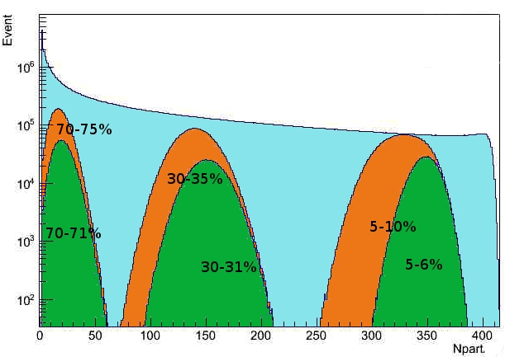
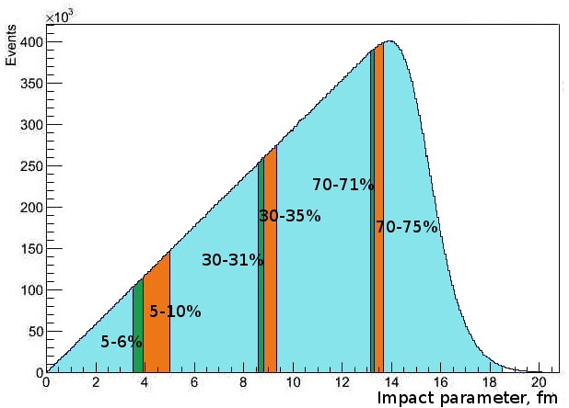
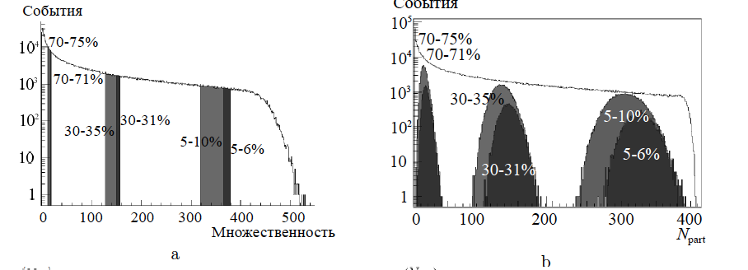
Impact parameter b, multiplicity and N_{part} in MC Glauber model
Percentile
MC Glauber, PbPb 2.76TeV
b
b
Some impact parameter centrality classes
Npart distribution in the different centrality classes
Centrality and multiparticle production in ultrarelativistic nuclear collisions
Drozhzhova T.A., Kovalenko V.N., Seryakov A.Y., Feofilov G.A.
Physics of Atomic Nuclei. 2016. Т. 79. № 5. С. 737-748.

Slide 13
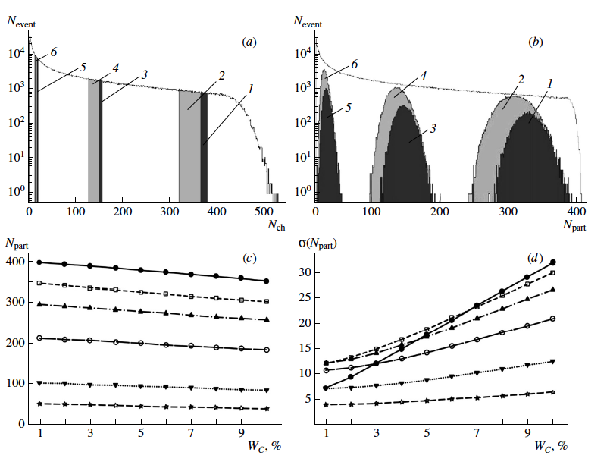
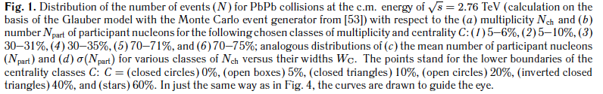
Centrality-wise optimization of the class width

Slide 14
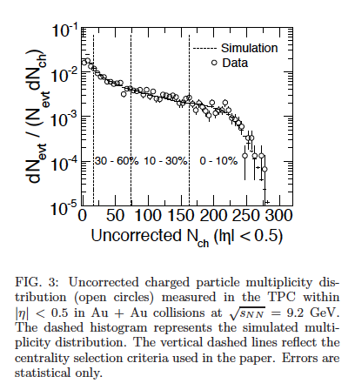

Multiplicity distribution at STAR@RHIC in Au+Au at √sNN= 9.2 GeV
PHYSICAL REVIEW C 81, 024911 (2010)
February 2010Physical Review C 81(2)
DOI:10.1103/PhysRevC.81.024911
SourcearXiv
https://www.researchgate.net/publication/235576464_Identified_particle_production_azimuthal_anisotropy_and_interferometry_measurements_in_AuAu_collisions_at_sNN92_GeV

Slide 15
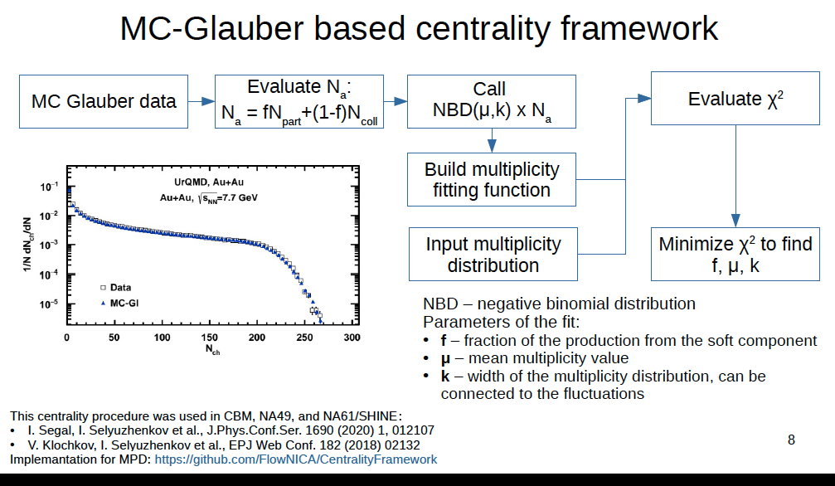
Slide from Petr Parfenov talk:

Slide 16
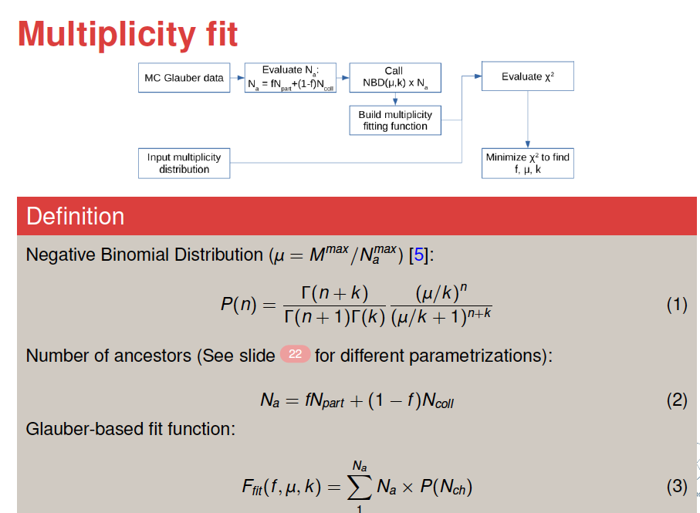
Slide from Pedro Nieto talk:

Slide 17
Parameters x and f, μ, k) in standard Glauber-based approach ?
The systematic behaviour of these parameters appears to be rather strange (e.g. for “f”)
It is one of the tasks to be studied before the experimental data analysis at NICA with any application of standard Glauber-based approach

Slide 18
Centrality classes selection to compare with STAR
What is needed:
MC simulations fo Bi+Bi collisions at 9.2 GeV for 0-10%, 0-30%, 30-60% and 0-60% and 10-30% multiplicity-based centrality classes
Central pseudorapidity intervals: |η|<0.5 and |η|<1.0
Statistics: ~ 100 mln min bias events -- ?
…something else?

Slide 19
Discussion of the MC production
Task 2:Selection of the pseudorapidity intervals and centrality classes for MPD analysis and MC simulations for the Physics Performance paper
---- Bi+Bi collisions at √s _{NN}=9.2GeV

Slide 20
Request 16: PWG1 -- DCM-SMM, min bias BiBi@9.2 GeV, 1 mln
For physics studies within PWG1 (centrality determination with
FHCal). Done.
dst:
/eos/nica/mpd/dirac/mpd.nica.jinr/vo/mpd/data/exp/dst-BiBi-09.2GeV-mp07-21-2kev/BiBi/09.2GeV-mb/DCMSMM/BiBi-09.2GeV-mp07-21-2kev
MiniDst
/eos/nica/mpd/dirac/mpd.nica.jinr/vo/mpd/data/MiniDST/dst-BiBi-09.2GeV-mp07-21-2kev/BiBi/09.2GeV-mb/DCMSMM/BiBi-09.2GeV-mp07-21-2kev
500 files, 2000 events per file
On NICA cluster
MiniDst:
/eos/nica/mpd/sim/data/MiniDst/dst-BiBi-09.2GeV-mp07-21-2kev/BiBi/09.2GeV-mb/DCMSMM/BiBi-09.2GeV-mp07-21-2kev
dst:
/eos/nica/mpd/sim/data/exp/dst-BiBi-09.2GeV-mp07-21-2kev/BiBi/09.2GeV-mb/DCMSMM/BiBi-09.2GeV-mp07-21-2kev
Shall we just mention that the analysis has started? Should we go into the details of the problems that we found? SO FAR, THERE IS NO FEEDBACK FROM THE ANALYSIS THAT WAS STARTED!
https://mpdforum.jinr.ru/t/request-16-pwg1-dcm-smm-min-bias-bibi-9-2-gev-1-mln/376

Slide 21
Request 14: PWG1 - UrQMD, 1M min. bias BiBi @ 9.2 GeV
This production will rely on GEANT4 to simulate the detector response and use UrQMD as an event generator and will be used for physics studies within PWG1 (centrality determination).
Done:
dst:
/eos/nica/mpd/sim/data/exp/dst-BiBi-09.2GeV-mp06-21-500ev/BiBi/09.2GeV-mb/UrQMD/BiBi-09.2GeV-mp06-21-500ev
minidst:
/eos/nica/mpd/dirac/mpd.nica.jinr/vo/mpd/data/MiniDST/dst-BiBi-09.2GeV-mp06-21-500ev/BiBi/09.2GeV-mb/UrQMD/BiBi-09.2GeV-mp06-21-500ev
Shall we mention that the analysis is in progress?
SO FAR, THERE IS NO FEEDBACK FROM THE ANALYSIS THAT WAS STARTED!
https://mpdforum.jinr.ru/t/request-14-pwg1-urqmd-1m-min-bias-bibi-9-2-gev/377/3

Slide 22
Two main approaches to determination of classes of centrality
Multiplicity in TPC as centrality class estimator
-- method was suggested by MEPHI/GSI team
Report by Petr Parfenov at the MPD Physics forum 15.04.2021r:
See https://indico.jinr.ru/event/2065/
https://github.com/FlowNICA/CentralityFramework
https://github.com/Dim23/GammaFit
Draft of analysis note:
https://github.com/FlowNICA/CentralityFramework/blob/master/Documentation/Centrality_AnalysisNote.pdf
Spectator nucleons with FHCal
– by the INR RAS team, see the PWG1 meetings Report by Vadim Volkov at the PWG1 meeting 01 April 2021
https://indico.jinr.ru/event/2066/
or RFBR conference:
https://indico.jinr.ru/event/1469/contributions/9905/attachments/8135/12126/ivashkin_RFBR_2020.pdf
Codes: https://github.com/qweek2/Centrality_NICA/tree/master
  .
Global observables in heavy-ion collisions at NICA.
PWG1 status report , MPD Collaboration meeting 21.04.2021—23.04.2021, JINR, Dubna

Slide 23
Two main approaches to determination of classes of centrality
Spectator nucleons with FHCal
– by the INR RAS team, see the PWG1 meetings Report by Vadim Volkov at the PWG1 meeting 01 April 2021
https://indico.jinr.ru/event/2066/
or RFBR conference:
https://indico.jinr.ru/event/1469/contributions/9905/attachments/8135/12126/ivashkin_RFBR_2020.pdf
Codes: https://github.com/qweek2/Centrality_NICA/tree/master
It is important to proceed with the results presented by Genis in the report
G. Musulmanbekov, V. Zhezher , “Nuclear fragments deposited in FHCal. DCM-QGSM or DCM-SMM?”,
“DCM-QGSM-SMM is more reliable than DCM-QGSM-GEM for description of spallation of excited Nuclear Remnants”
see https://indico.jinr.ru/event/2658/
  .
Global observables in heavy-ion collisions at NICA.
PWG1 status report , MPD Collaboration meeting 21.04.2021—23.04.2021, JINR, Dubna

Slide 24
DCM-QGSM-GEM vs DCM-QGSM-SMM
DCM-QGSM-GEM
Step 1
Intranuclear Cascade
Step 2
Coalescence
Step 3 Residual Nucleus (RN)
Preequlibrium emission
Step 4
Fermi-break-up if A_{res} < 13
Generalized evaporation (GEM)
Fission
DCM-QGSM-SMM
Step 1
Intranuclear Cascade
Step 2
Coalescence
Step 3 Residual Nucleus (RN)
None
Step 4 Residual Nucleus (RN)
Fermi break-up if A_{res} < 13
Statistical Multifragmentation (SMM)
Secondary Fragmentation and Evaporation of excited fragments
Fission

Slide 25
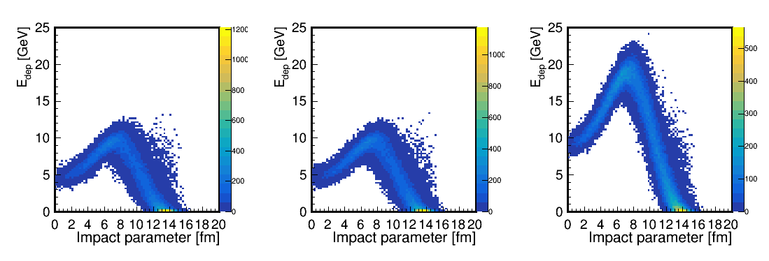
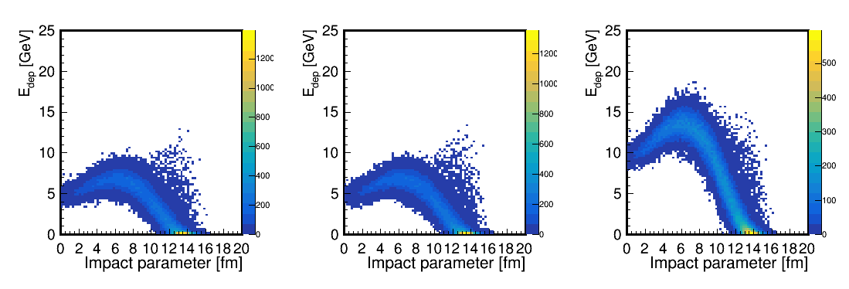
Conclusion
DCM-QGSM-GEM
DCM-QGSM-SMM
DCM-QGSM-SMM
is more reliable for estimation
E_{FHCal} and Centrality

Slide 26
Proposals for MC simulations for the Physics Performance paper
Statistics for Bi+Bi collisions at 9.2 GeV: ~ 100 mln min bias events -- ?
Central pseudorapidity intervals for TPC physics analysis: |η|<0.5 and |η|<1.0
Different pseudorapidity intervals should be considered for multiplicity classes selections In order to avoid trivial autocorrelations : TPC tracks in 0.5 <|η|<1.5
Other pseudorapidity intervals: e.g. FFDs, which are symmetrically placed to the MPD center along the beam line 2.5 ≤| η |≤ 3.2 (also mini-BeBe – ?) could be aslo considered for the multiplicity classes selection
Class-wise optimization of the class width: MC simulations fo Bi+Bi collisions at 9.2 GeV for 0-1%, 0-3%, 0-5%, 0-7%, 0-10%, 0-20% multiplicity based centrality classes (and similar optimization for the FHCal classes)
Z-position of the interaction vertex should be taken into account in the new MC simulations production. Studies of z-cuts are needed.

Slide 27
Some comments to Multiplicity-based methods used in the PWG1
Very detailed analysis +documentation in two approaches used
Important for comparison with RHIC data
… but we have to continue to investigate the problems:
Multiplicity-based method is being used currently at the midrapiidty |η |<0.5: therefore, auto-correlations might be possible in the analysis of fluctuations etc. Different pseudorapidity intervals should be selected
Three parameters (f, μ, k) in standard Glauber-based approach …
Constant class width for all centrality classes (should be optimized)
Systematic errors and effects of various cuts on multiplicity distribution….one of the items for studies
Glauber-based approach produces noticeble bias to the number of binary collisions Ncoll….it is the old problem – is also one of the items for further studies and checks with the MC event generators

Slide 28
Proposals for MC simulations
Statistics for Bi+Bi collisions at 9.2 GeV: ~ 100 mln min bias events -- ?
Central pseudorapidity intervals for TPC physics analysis: |η|<0.5 and |η|<1.0
Different pseudorapidity intervals should be considered for multiplicity classes selections In order to avoid trivial autocorrelations : TPC tracks in 0.5 <|η|<1.5
Other pseudorapidity intervals: e.g. FFDs, which are symmetrically placed to the MPD center along the beam line 2.5 ≤| η |≤ 3.2 (also mini-BeBe – ?) could be aslo considered for the multiplicity classes selection
Class-wise optimization of the class width: MC simulations fo Bi+Bi collisions at 9.2 GeV for 0-1%, 0-3%, 0-5%, 0-7%, 0-10%, 0-20% multiplicity based centrality classes (and similar optimization for the FHCal classes)
Z-position of the interaction vertex should be taken into account in the new MC simulations production. Studies of z-cuts are needed.

Slide 29
The next steps:
Distribution inside the PWG1 of tasks and subtasks of the MC simulations production – it is crucial to proceed further with understanding of individual interests
The main two approaches (multiplicity-based and FHCal energy) to the determination of the classes of centrality are valid and important for the further investigations.
Other approaches to centrality classes definition (selection of pseudorapidity intervals, account of asymmetry of the total spectator volume in AAMCC and fragmentation processes, effects of nucleon stopping, etc… ) should be also developed further
We have the following experts today – Petr Parfenov, Vadim Volkov, Pedro Nieto, Mike Medina and Ivonne Maldonado -- who may trigger via the PWG1 the requests on MC production at NICA clusters in line with results of our discussion
Tentative plans from the groups in PWG1 for 2022- the proposal is to discuss in January. Please, prepare your regions of interest.

Slide 30
Thank you for your attention!

Slide 31
Some critical issues to be presented in the given report
What is expected to be new and could be better measured by the MPD in comparison with STAR@RHIC - from the point of view of Global Observables?
What was achieved by the PWG1 in the period April-October 2021?
What is still not quite in line with the expectations of the PWG1?
Important issue: it is proposed to have contact persons/experts in each relevant field/topic of study& Names within PWG1

Slide 32
Summary-1
Two approaches, are being developed for determination of centrality classes in AA collisions: (i) traditional multiplicity-based, and (ii) novel approach, based on spectators spatial distributions in FHCal
Theoretical considerations aimed at physics description of fragmentation processes in AA collisions and for understanding of the collision dynamics, are also in progress. An additional observable for centrality classes is proposed: a ratio of (a sum of fragment charges}²/{total Spect.Energy}.
Selecting multiplicity classes, as a proxy to centrality in heavy-ion collisions, is needed at the first stage of MPD data analysis to compare with the already existing results obtsained at RHIC.
Codes for selecting events for classes for multiplicity are developed and accessible. Documentation is also provided (however, the working groups must interact closely with the PWG1)
Global observables in heavy-ion collisions at NICA.
PWG1 status report , MPD Collaboration meeting 21.04.2021—23.04.2021, JINR, Dubna

Slide 33
Summary-2
The choice of classes on the energy of spectators in the FHCAL calorimeter ---- the procedure is demonstrated based on the newly developed approach of accounting not only energy, but also the spatial distribution of energy of spectators hitting the calorimeter.
This new FHCAL technique provides an independent selection of classes of events (and it excludes also autocorrelations in the analysis of data on fluctuations and correlations of observables).
Some problems relevant to the centrality classes selection are revealed: -- The events with a rather wide set of impact parameters could be mixed into the class. The trivial volume fluctuations are to be minimized by centrality-wise optimization of the class width used. --The number of binary collisions obtained in a standard Glauber approach is usually model biased (e.g. Glauber). It should be taken into account in the MPD data physics analysis.
Global observables in heavy-ion collisions at NICA.
PWG1 status report , MPD Collaboration meeting 21.04.2021—23.04.2021, JINR, Dubna

Slide 34
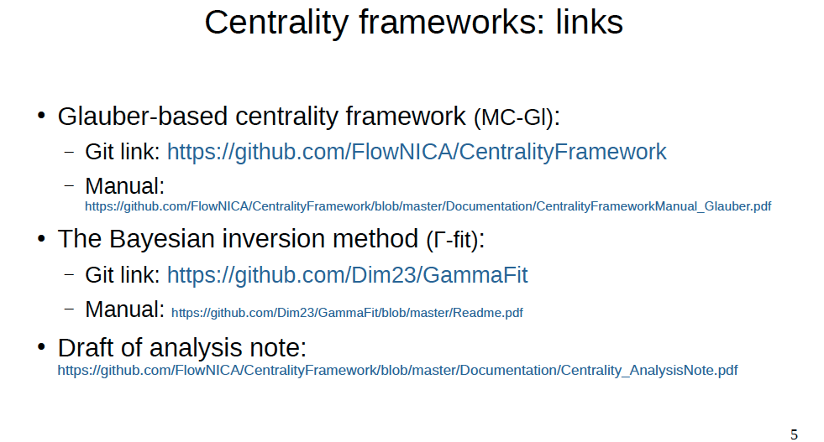

Slide 35
Discussion of the MC production
Task 1: to start and compare with STAR@RHIC)
Selection of the pseudorapidity intervals and centrality classes
STAR@RHIC: Au+Au collisions at √s _{NN}=9.2GeV, year 2008 , a short test run of ~3000 good events [1]
Energy dependence of particle ratios,π−/π+, p/p, K−/K+ and K/π, plotted as a function of √sNN. Results from 0–10% central Au+Au collisions at 9.2 GeV at midrapidity (|y|<0.5) are compared with those from AGS, SPS and RHIC.
Azimuthal anisotropy measurements
Pion interferometry measurements
[1] STAR Collaboration, Bulk Properties in Au+Au Collisions at √ s_{NN}= 9.2 GeV in STAR Experiment at RHIC, Nucl.Phys.A830:275c-278c,2009; arXiv:0907.1943v2

Slide 36
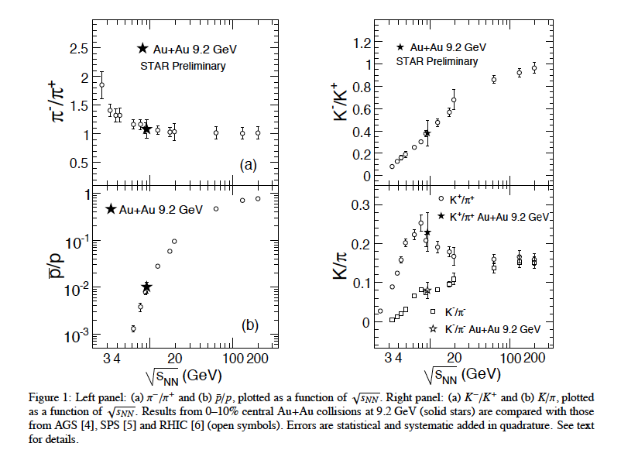
We have to start and compare with STAR@RHIC [1]
Energy dependence of particle ratios
[1] STAR Collaboration, Bulk Properties in Au+Au Collisions at √ s_{NN}= 9.2 GeV in STAR Experiment at RHIC, Nucl.Phys.A830:275c-278c,2009; arXiv:0907.1943v2
At midrapidity
(|y|<0.5)
Centrality
Class
0-10%

Slide 37
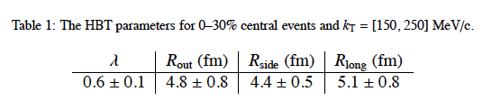
We have to start and compare with STAR@RHIC [1]
[1] STAR Collaboration, Bulk Properties in Au+Au Collisions at ‾‾‾√ sNN‾= 9.2 GeV in STAR Experiment at RHIC, Nucl.Phys.A830:275c-278c,2009; arXiv:0907.1943v2
Pion interferometry measurements
Centrality
class 0-30%

Slide 38
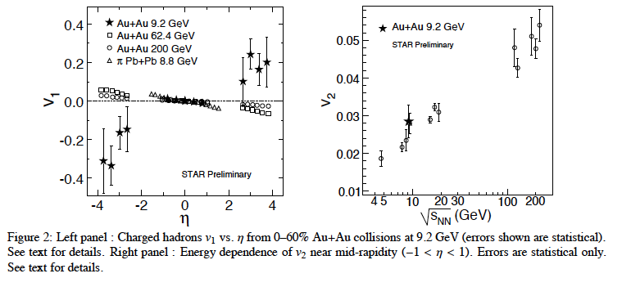
We have to start and compare with STAR@RHIC [1]
Azimuthal anisotropy measurements
[1] STAR Collaboration, Bulk Properties in Au+Au Collisions at √ s_{NN}= 9.2 GeV in STAR Experiment at RHIC, Nucl.Phys.A830:275c-278c,2009; arXiv:0907.1943v2
At midrapidity
(|η|<1.0)
Centrality
class 0-60%

Slide 39
Layout
1) Introduction. Where are we today?
2) Discussion of the MC production
Task 1. Compare to STAR Au+Au data at √s_{NN}=9.2 GeV:
Analysis of Bi+Bi (Au+Au?) MC data in the same pseudorapidity and centrality intervals of the multiplicity-based classes as in STAR-like procedure
Task 2: New MC simulations. What is needed:
Selection of the pseudorapidity intervals for the multiplicity-based classes of Bi+Bi data at √s_{NN}=9.2 GeV in order to minimize the autocorrelation effects in the data analysis
      Class-wize optimization of the centrality class-width
Account of influence of the wide distribution in Z position of the interaction vertex on (i) the selection of the multiplicity classes and (ii) a possible bias in the FHCal measurements
Event-generators that could be used and discussed in the MPD Physics paper: SMASH, URQMD, DCM-QGSM-SMM, AMPT, AAMCC…something else?
3) The next steps

Slide 40
Discussion of the MC production
Task 1: to start and compare with STAR@RHIC) → our comparison to [1] is not completed
Selection of the pseudorapidity intervals and centrality classes
STAR@RHIC: Au+Au collisions at √s _{NN}=9.2GeV, year 2008 , a short test run of ~3000 good events [1]
Energy dependence of particle ratios,π−/π+, p/p, K−/K+ and K/π, plotted as a function of √sNN. Results from 0–10% central Au+Au collisions at 9.2 GeV at midrapidity (|y|<0.5) are compared with those from AGS, SPS and RHIC.
Azimuthal anisotropy measurements
Pion interferometry measurements
[1] STAR Collaboration, Bulk Properties in Au+Au Collisions at √ s_{NN}= 9.2 GeV in STAR Experiment at RHIC, Nucl.Phys.A830:275c-278c,2009; arXiv:0907.1943v2

