Slide 1
Memberships of the PACs
G. Trubnikov
131st session of the Scientific Council

Slide 2
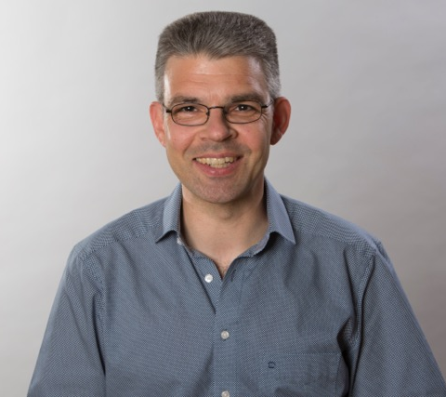
PROPOSALS OF THE JINR DIRECTORATE
To appoint Michael Block (GSI Centre for Heavy Ion Research, Darmstadt, Germany) as a new member of the PAC for Nuclear Physics for a term of three years.
To thank the outgoing member Sigurt Hofmann (GSI) for his dedicated work as member of the PAC for Nuclear Physics since 2005 and for his outstanding contribution to the cooperation with the Flerov Laboratory of Nuclear Reactions in the field of synthesis of superheavy elements.

Slide 3
The JINR Directorate asks the Scientific Council
to approve these proposals

