Slide 1
FLNP PROPOSAL TO JINR 7-YEAR PLAN 2024 - 2030
Nuclear and Particle Physics
Condensed Matter Phisics
Neutron Investigations
Directions of FLNP Activities
Fundamental physics
Optical Investigations
Neutron nuclear physics
Technical developments
Facilities
Detector technologies
Current facilities
Automation and control systems
NEPTUNE project
Cryogenic moderators
SOLCRYS project
Notes:
JINR has a long tradition in Condensed Matter and Neutron Physics research using neutrons from their on-site research reactors. These research are concentrated in FLNR.
The main activities of the Laboratory in the next 7 years will be focused on the following areas:
Neutron and optical investigations will be performed in order to study different phenomena in condensed matter physics;
To enable these investigations at world level the detector technologies, automation and control systems as well cryogenic moderators will be further developed;
A lot of efforts will be devoted to the safe and reliable operation of IBR 2, the completion of the feasibility study for building a new neutron impulse reactor and the construction of a new laboratory for structural research SOLCRYS at the modern synchrotron source of the Polish National Synchrotron Radiation Centre SOLARIS

Slide 2
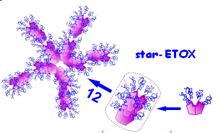
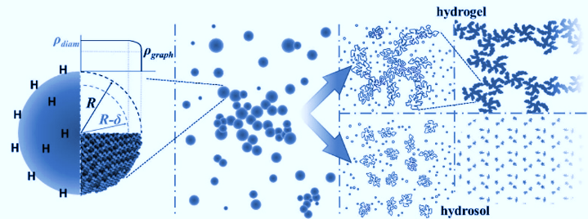
NEUTRON INVESTIGATIONS OF CONDENSED MATTER
Priority research directions in 2024-2030:
Condensed Matter Physics and Materials Science
Physics of Nanosystems and Nanoscale Phenomena
Physics of Complex Liquids and Polymers
Biophysics and Pharmacology
Applied Materials and Engineering Sciences
Notes:
Priority areas of interdisciplinary research conducted at FLNP within the framework of the 7-year plan for the period 2024-2030. to be: Condensed Matter Physics and Materials Science, Physics of nanosystems and nanoscale phenomena, Physics of complex liquids and polymers, Biophysics and pharmacology, Applied materials and engineering sciences.

Slide 3
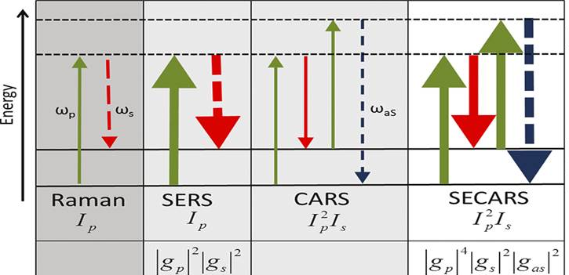
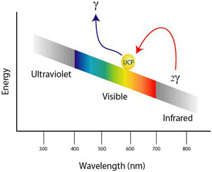
VIBRATIONAL SPECTROSCOPY and MICROSCOPY: RAMAN and FT-IR
Raman microspectroscopy, including its various enhanced options:
CARS: Coherent antiStokes Raman spectroscopy using picosecond lasers
SERS: Surface-enhanced Raman spectroscopy – a few molecules sensitivity
SECARS: Surface-enhanced CARS
Applications: life science, material science, nanobiotechnology, in-vivo diagnostics
PHOTO and UP-CONVERSION LUMINESCENCE – highly contrast bioimaging
Notes:
Along with neutron and synchrotron studies, optical spectroscopy, including vibrational (Raman and IR) spectroscopy, has its own specific niche in the study of the properties, structure, and diagnostics of condensed matter.
Over the past few years, such studies have been successfully carried out at the FLNP on the basis of the modern Raman spectrometer «СARS».
It should be noted that the activity in this division is aimed, among others, at the Life Science and is partially implemented (when it is appropriate) complementary with the neutron scattering methods.

Slide 4
Technical developments
DETECTOR TECHNOLOGIES FOR NEUTRON SCATTERING STATIONS
Development of advanced position-sensitive gas detectors with ³Не gas converter based on tubes with resistive anode.
Development of gas neutron counters, position-sensitive detectors with ¹⁰В₄С boron carbide converter.
Construction of a pilot site for the deposition of thin-film boron-containing coatings and, on the basis of it, laboratories for the production of detectors.
Implementation of novel advanced data acquisition electronics to ensure record parameters in terms of speed, spatial and temporal resolution.
AUTOMATION AND CONTROL SYSTEMS
Development and implementation of experimental equipment control automation systems based on programmable logic controllers (PLC)
Development and creation of individual elements of experimental stations
Calculation, simulation and design of novel neutron scattering stations for the future neutron source “NEPTUN”
Development of a software package for real-time data acquisition, processing and visualization
Development of network infrastructure for storage, processing and transmission of experimental data
Development of an industrial control and monitoring system for the cryogenic moderator complex of the IBR-2 reactor
Notes:
From the technical developments I like to mention only some accents in the DETECTOR TECHNOLOGIES FOR NEUTRON SCATTERING STATIONS:
Development of advanced position-sensitive gas detectors with ³Не gas converter based on tubes with resistive anode.
Development of gas neutron counters, position-sensitive detectors with ¹⁰В₄С boron carbide converter.
Construction of a pilot site for the deposition of thin-film boron-containing coatings and, on the basis of it, laboratories for the production of detectors.

Slide 5
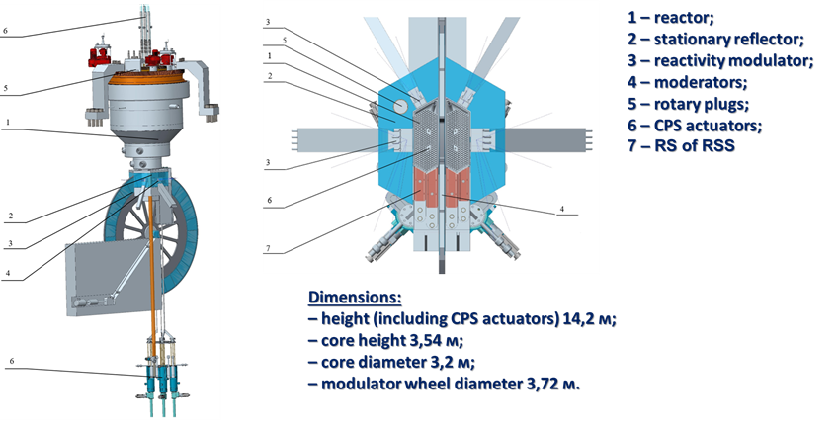
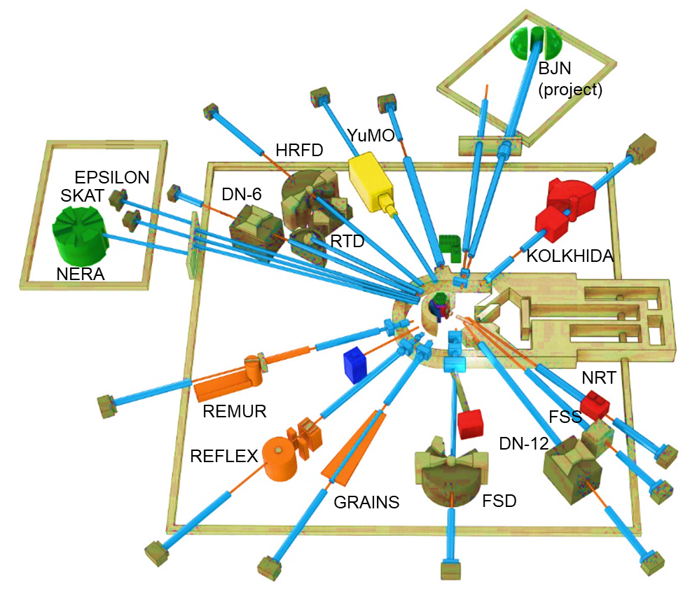
(10, 2011)
Number of powerful neutron sources
in the world is decreasing
(6, 2022,
Functional - 3)
NEPTUNE neutron source
Increasing worldwide demand for
structure analysis
(soft and biological systems, Crystal and magnetic structure)
(?, 2042)
Increasing worldwide demand for
long pulse neutron sources
ESS
2027
n + X ray
n versus X ray
JINR world priority in the creation of pulsed reactors
Expertise in the creation and operation of pulsed reactors
!
creation of a new
high-flux, pulsed, reactor based
neutron source
by 2040
Demand for maintaining international community of neutron users from JINR member states
Additional benefits:
New fuel technology
!
extension of IBR-2 resources until 2042
and simultaneous
modernization of the spectrometric fleet
Notes:
As reported by the ESFRI working group on neutron scattering, after 2030 only five sources will be available in Europe including three currently operating facilities: ISIS (Didcot, UK), SINQ (PSI, Villigen, Switzerland), FRM II (TU Munich, FRG), and two new sources (ESS (Lund, Sweden) and steady-state reactor PIK (PNPI NRC KI, Gatchina, Russia), both under construction with the start of operations planned for 2023-2024. The 2nd target station at the Spallation Neutron Source (STS SNS) of Oak Ridge National Laboratory (USA) is planned for the full-scale operation in 2037. Thus, the need for a next-generation high-flux neutron source is driven by a growing interest in neutron investigations against the background of a steadily decreasing number of neutron sources in the world.
The main efforts of the Frank laboratory will be devoted to the extension of the IBR-2 lifetime until 2042, modernization of the scattering instruments at IBR-2 and construction of the next generation pulsed source NEPTUNE.

Slide 6
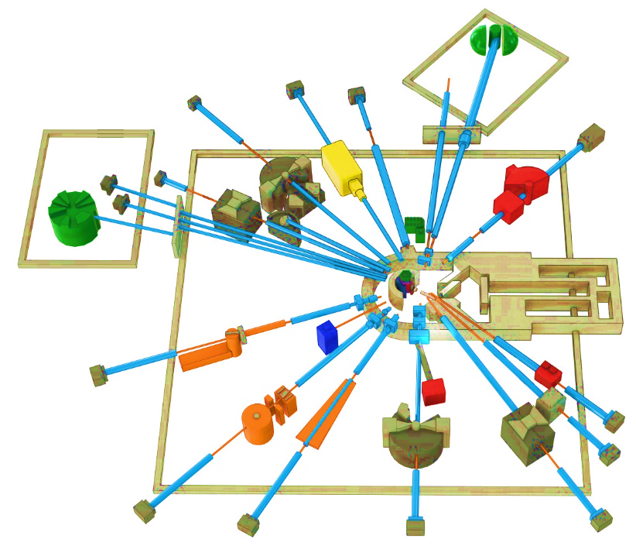
DEVELOPMENT OF THE IBR-2 SPECTROMETER COMPLEX
Development of the basic configuration elements of the inverse geometry inelastic neutron scattering spectrometer BJN at the IBR 2 reactor.
Completion of the development of basic configuration of the small angle neutron scattering and imaging spectrometer.
Modernization and reconstruction of spectrometers HRFD, YuMO, RTD, DN-6, DN-12, FSD, NERA, REMUR, REFLEX, SKAT, EPSILON, FSS, NRT, focused on improvement of technical parameters and extension of research capabilities.
Development of laboratory equipment for samples characterization and physical properties measurements.
Support and modernization of the complex of cryogenic moderators.
BJN
(project)
HRFD
YuMO
EPSILON
DN-6
SKAT
RTD
KOLKHIDA
NERA
NRT
REMUR
FSS
REFLEX
DN-12
GRAINS
FSD
Notes:
The priority tasks for the development of the complex of spectrometers of the IBR-2 reactor will be:
Development and creation of elements of the main configuration of a new inelastic neutron scattering spectrometer in inverse geometry BJN.
Completion of work on the development and creation of the basic configuration of the small-angle scattering and imaging spectrometer.
Modernization and reconstruction of existing installations HRFD, YuMO, RTD, DN-6, DN-12, FSD, NERA, REMUR, REFLEX, SKAT, EPSILON, FSS, NRT, aimed at improving technical parameters and expanding experimental capabilities.
Development of laboratory equipment for sample characterization and physical property measurements.
Support and modernization of the complex of cryogenic moderators

Slide 7
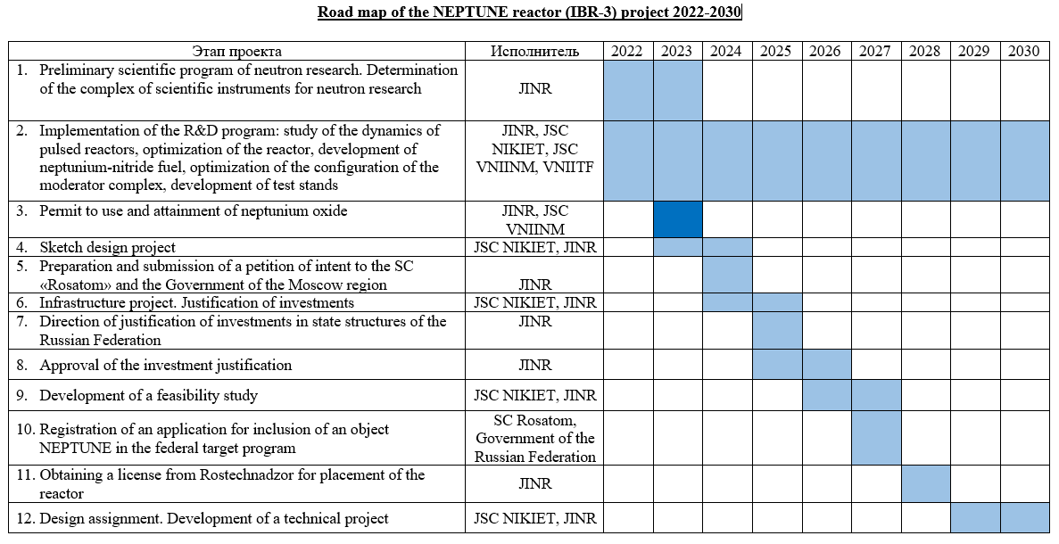
Notes:
On this slide are shown all stages of the roadmap of the project for the development of a new neutron source – the NEPTUNE reactor in 2022-2030 : 1) development of a preliminary scientific research program on nuclear and condensed matter physics at the NEPTUNE reactor and determination of the composition of the complex of scientific instruments for conducting research within the framework of the scientific program should be completed during this and next year; 3) a critical stage is- obtaining permission to use and purchase neptunium oxide; development of a feasibility study is another important step in this program; and the last stage is the design assignment and technical project.

Slide 8
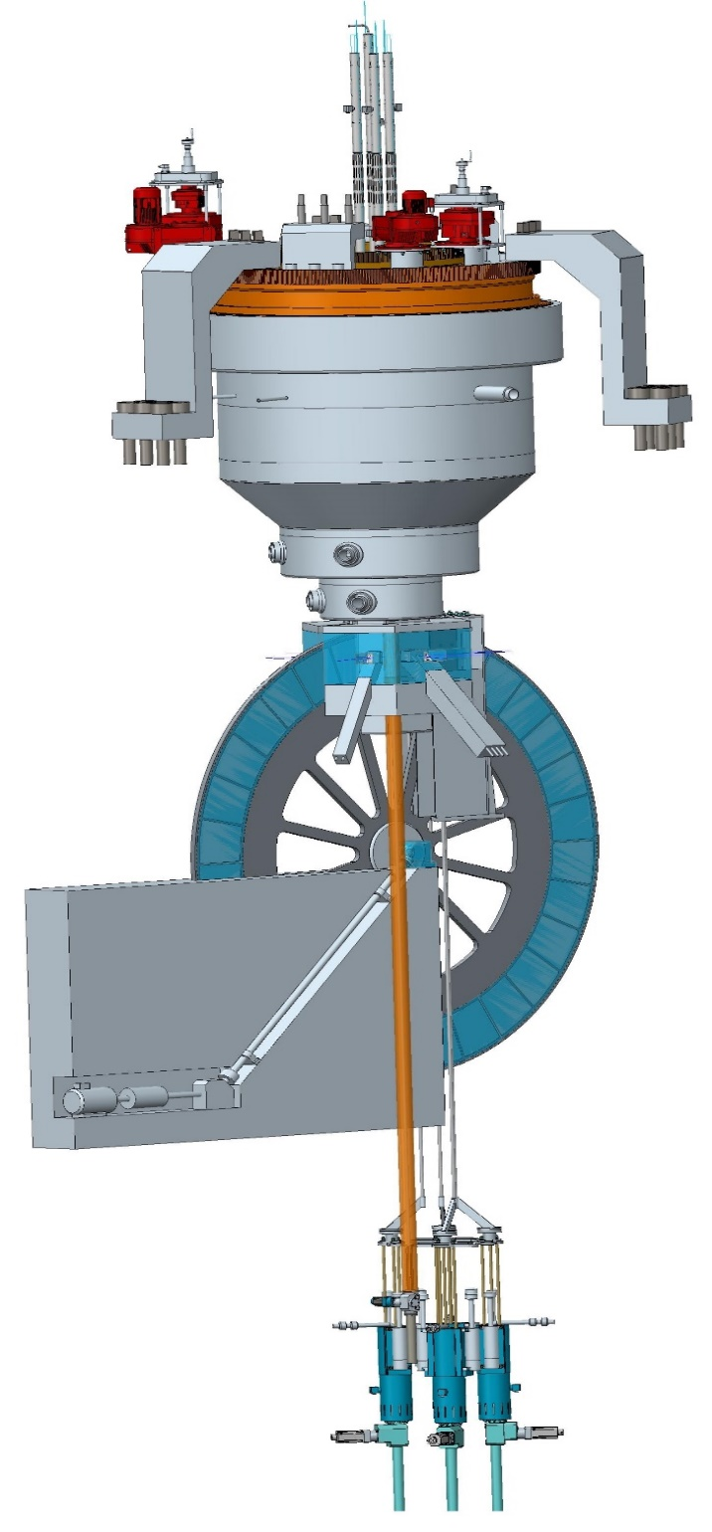
R&D of neptunium-nitride fuel of NEPTINE reactor (JSC VNIINM, 2022)
R & D for the development of fuel rods includes the following stages:
permit to use of nuclear materials, which is in federal ownership;
development of preliminary design specifications for neptunium nitride fuel;
development a complex of fuel characteristics’ measurement methods;
development a technology of fuel fabrication for experimental fuel rods;
carry out of fuel rods researches before reactor irradiation;
reactor irradiation of fuel rods (with dose of 77 dpa)
post-irradiation researches of fuel rods in hot cells
Notes:
A critical task for 2022-2030 is the development of fuel rods based on nitride-neptunium fuel for the NEPTUNE reactor. The diameter of the fuel rod is 17 mm, the thickness is 0.45 mm. R & D for the development of fuel rods includes the following stages: 1) permit to use of nuclear materials, which is in federal ownership; 2) development of preliminary design specifications for neptunium nitride fuel; 3) development a complex of fuel characteristics’ measurement methods; 4) development a technology of fuel fabrication for experimental fuel rods; 5) carry out of fuel rods researches before reactor irradiation; 6) reactor irradiation of fuel rods (with dose of 77 dpa); 7) post-irradiation researches of fuel rods in hot cells

Slide 9
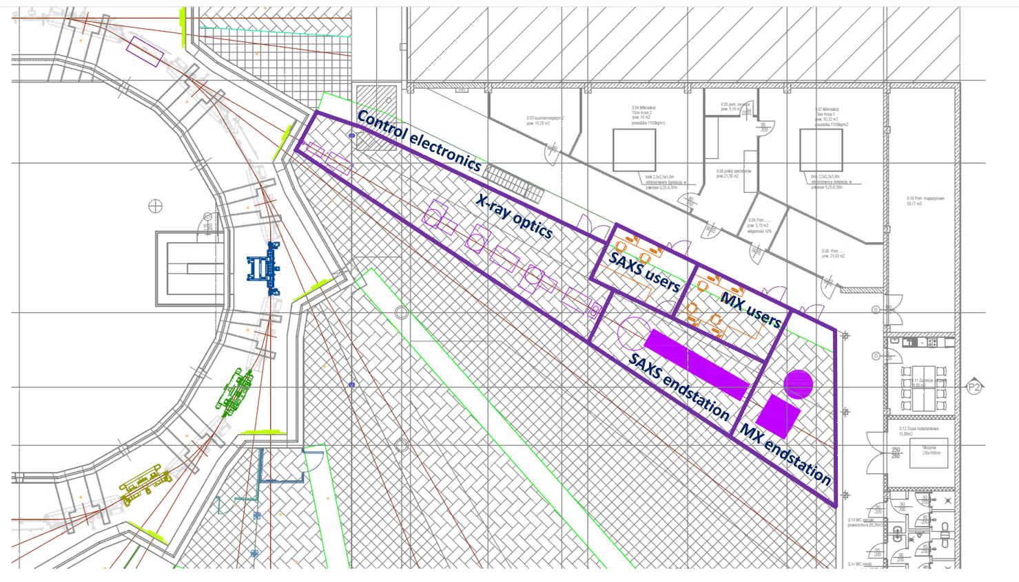
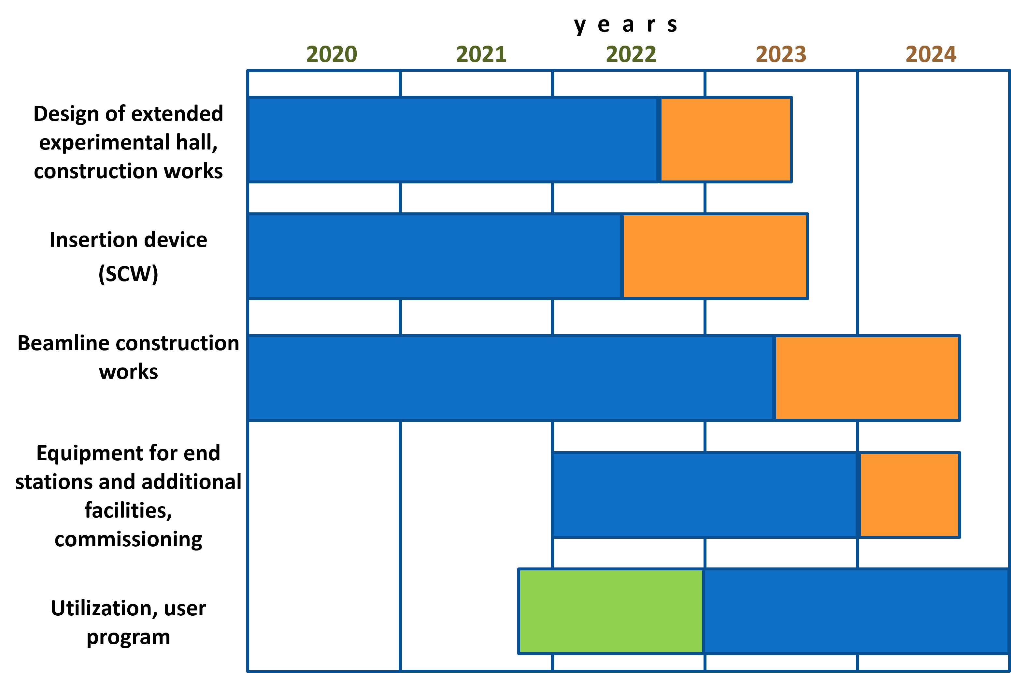
SOLCRYS – A JINR FACILITY FOR STRUCTURAL RESEARCH AT SYNCHROTRON SOLARIS
Beam-lines
MX – Macromolecular Crystallography
SAXS – Small Angle X-ray Scattering
PD – Powder Diffraction
Condensed Matter Research
Materials science
structure of crystalline materials, semiconductors and new electronic materials, alloys and nanocomposites, polymers and fibers
Chemistry
catalysis, porous materials
Pharmacy
drug polymorphism, drug carriers, gels, lotions, creams
Structural biology
proteins and nucleic acids, biomacromolecular solutions
Notes:
It is important to acknowledge the needs of additionally employed X-ray scattering techniques in the condensed matter research. Utilizing the approaches of neutron and X-ray scattering in a complementary way gives the scattering-based approaches a distinct advantage. A new laboratory for structural research SOLCRYS is under the construction at the modern synchrotron source of the Polish National Synchrotron Radiation Centre SOLARIS. The utilization and the user program is planed to begin at the end of 2024.
The three measuring stations proposed will allow accomplishing the goals as:
Macromolecular X-ray Crystallography – dedicated to the diffraction studies of single crystals, which should operate in the full power range using photons in the energy range 6-25 keV.
Small-Angle X-ray Scattering – equipped with high-end X-ray optics allowing small-angle X-ray scattering studies of solutions of biomacromolecules (BioSAXS) or nanoparticle suspensions. Studies at this station will include wide range of biological objects.
Powder Diffraction – equipped with powder diffractometer with high-quality line or surface detector. The whole system will allow the measurement of diffraction in a wide temperature range (60-1500K) and pressures.

