Slide 1
SPD track reconstruction using GraphNet neural network
Leonid Lubchenkov,
St.Petersburg Polytechnic University
2022

Slide 2
Performance for 2000 event dataset:
No fake hits | Up to 100 fake hits per event
Recall: 0.9578 Precision: 0.9877 Mean preprocessing time: 0.1774 s (5.64 ev/s) Mean evaluation time: 0.0188 s (53.15 ev/s) | Recall: 0.9138 Precision: 0.9053 Mean preprocessing time: 0.1774 s (5.60 ev/s) Mean evaluation time: 0.0188 s (53.71 ev/s)
CPU: Intel Pentium G4560 @ 3.50GHz
$$Recall= \frac{N_{rec true}}{N_{all}}$$
$$Precision= \frac{N_{rec true}}{N_{rec}}$$

Slide 3
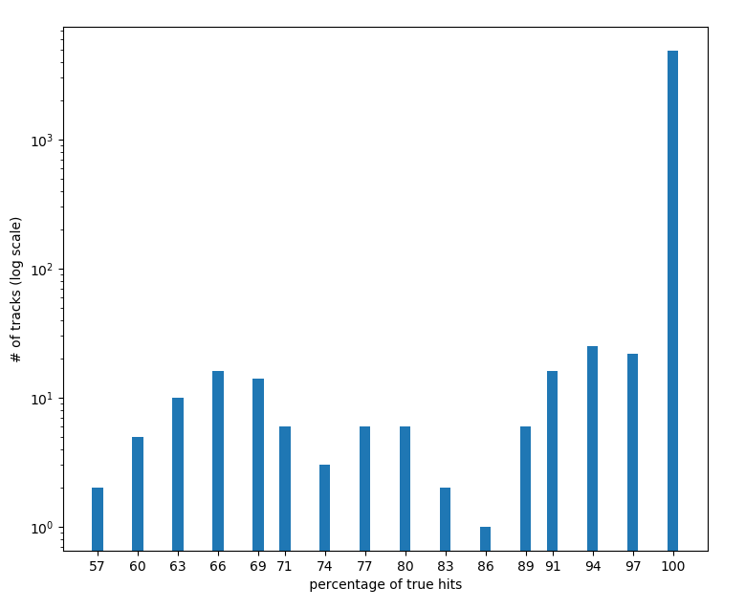
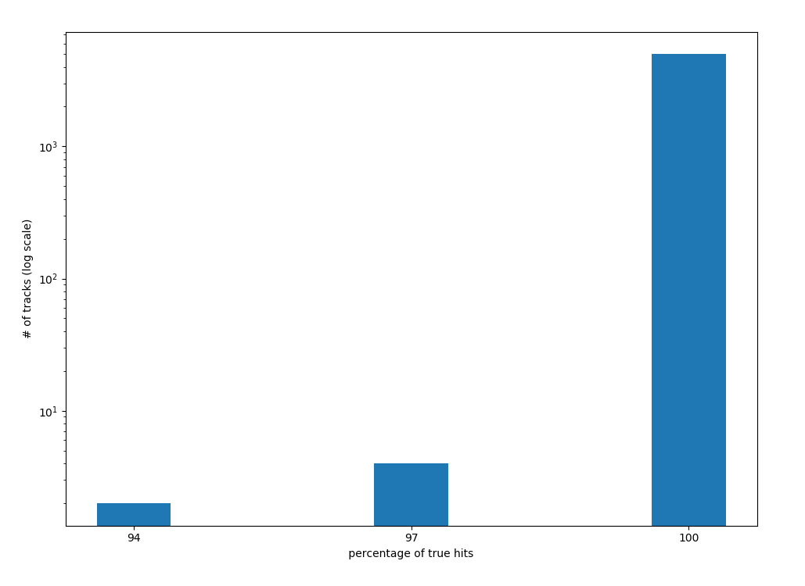
Track distribution by percentage of correctly determined hits

Slide 4
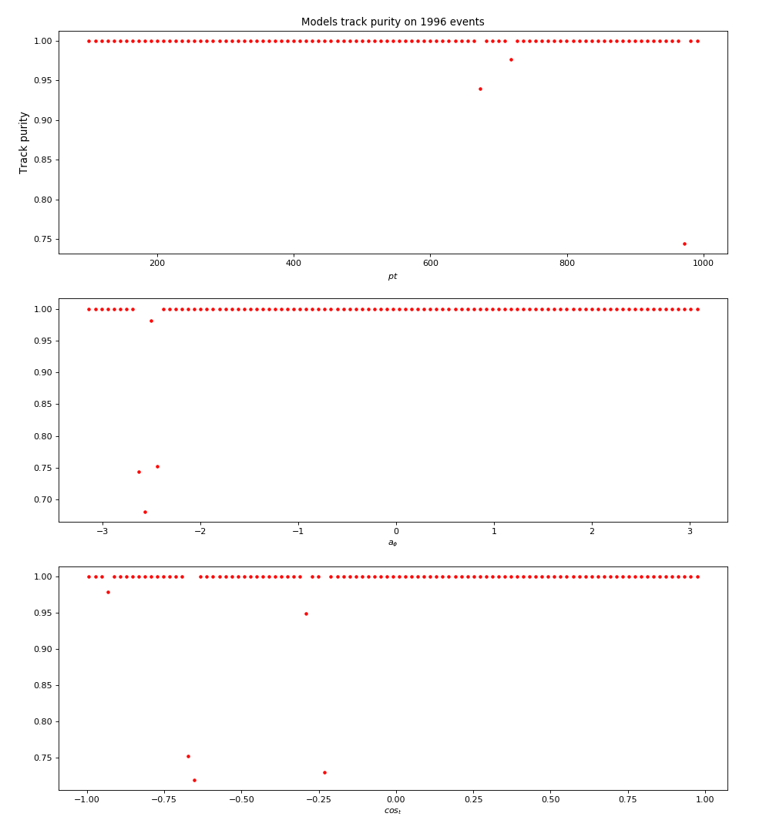
Precision as function of transverse momentum, azimuthal angle and cosine of polar angle respectively

Slide 5
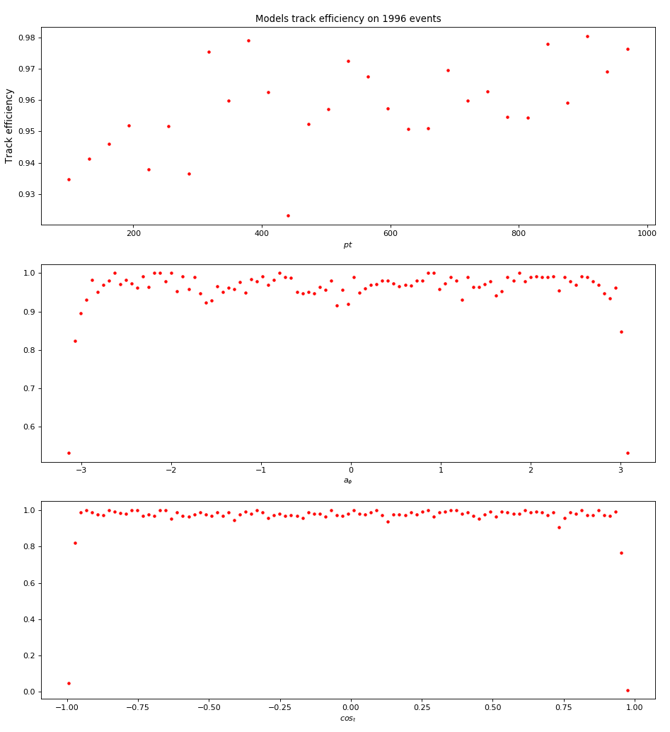
Recall as function of transverse momentum, azimuthal angle and cosine of polar angle respectively

Slide 6
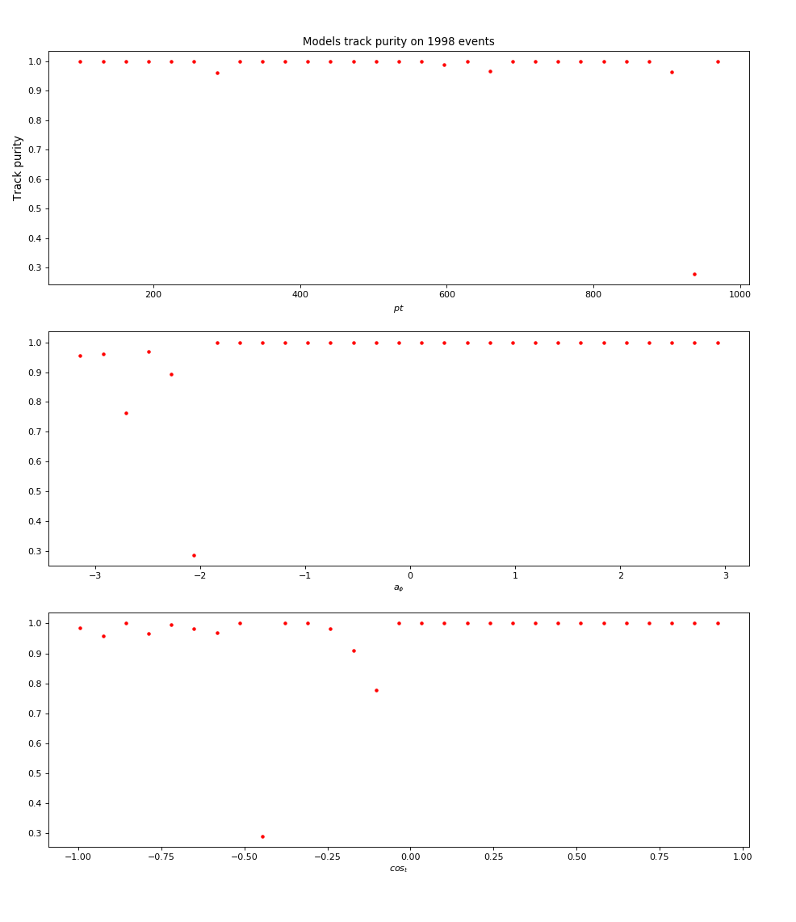
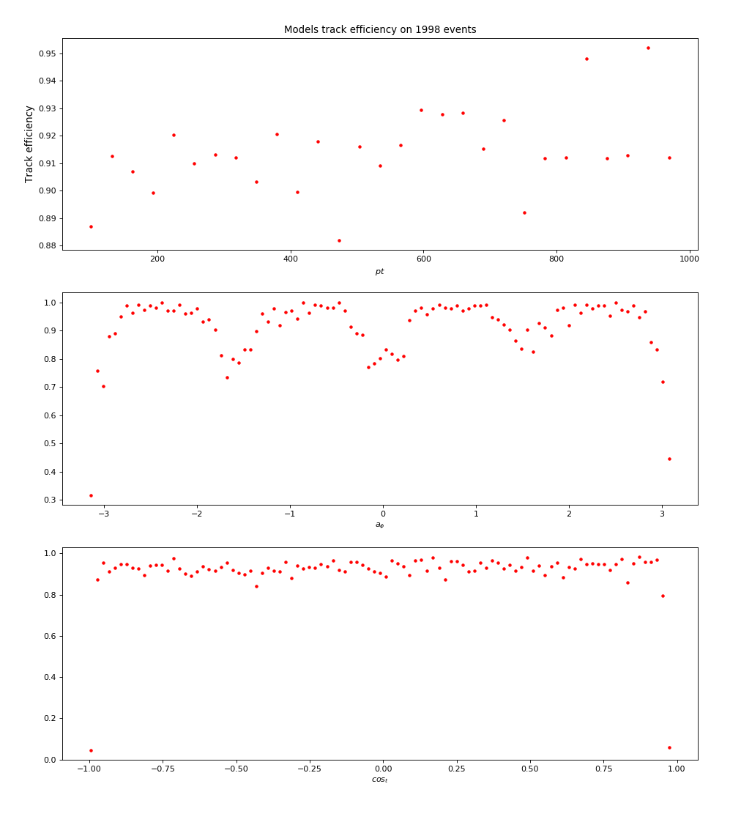

Slide 7
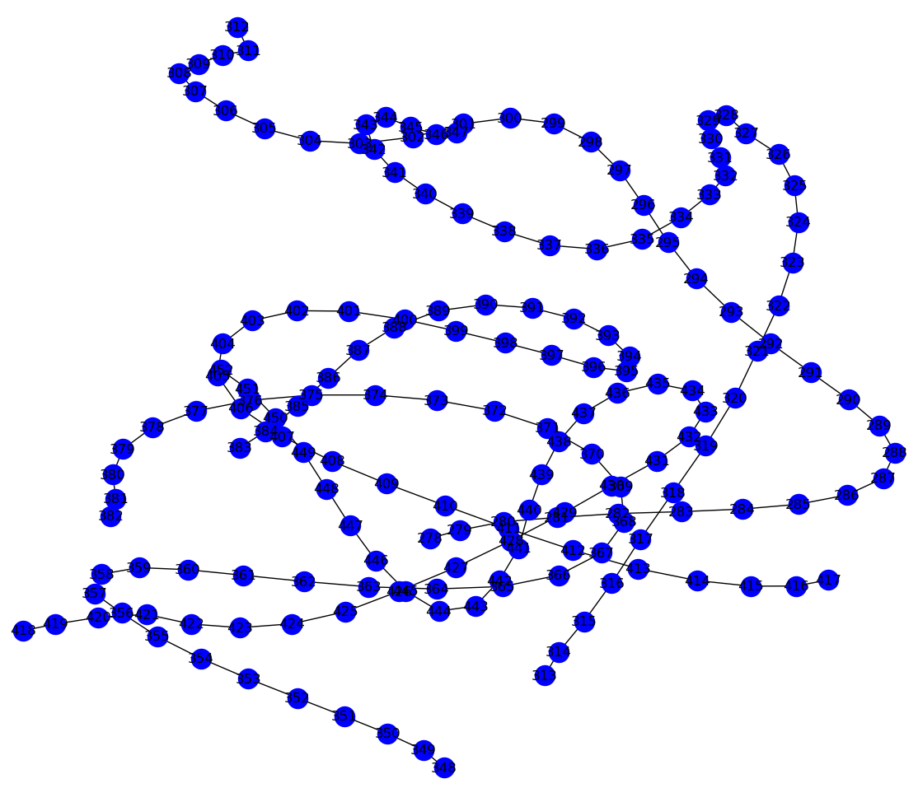
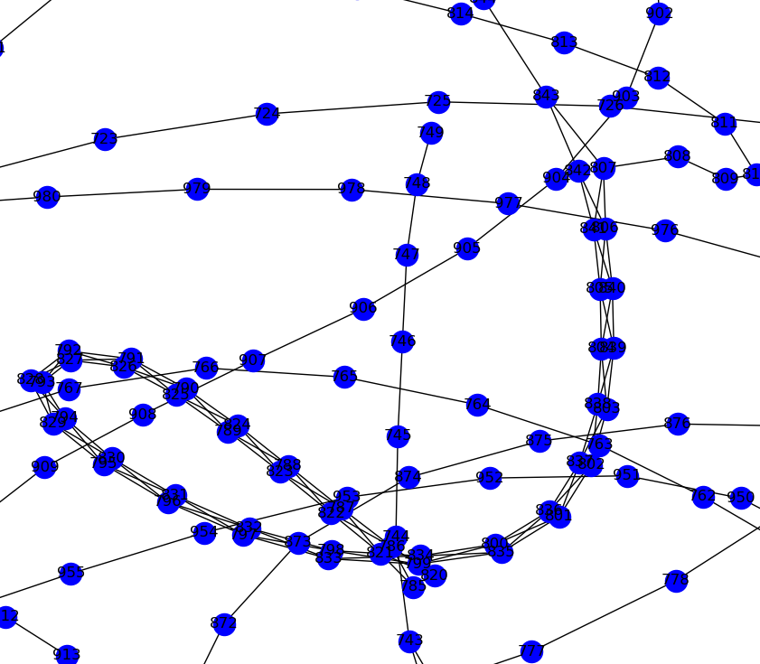
Influence of filtering by weight in preprocessing

