Slide 1
Monte Carlo simulation of the strip planes for the MiniSPD setup
Group 1

Slide 2
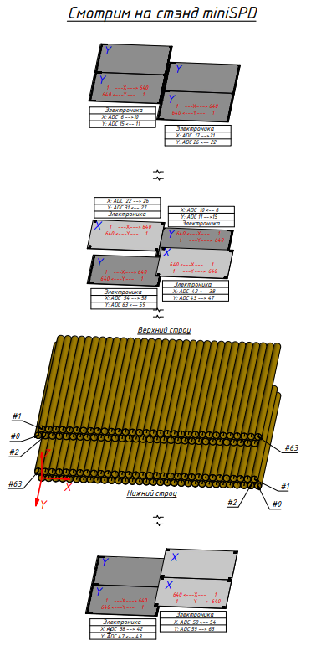
MiniSPD scheme
Z
X
Y

Slide 3
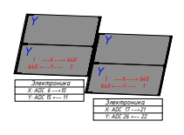
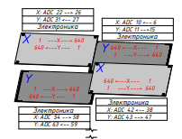
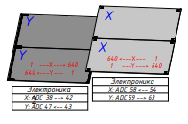
Two-sided Si-plates
1
TOP
2
Top module:
1st part - U/X (coordinates)
2nd part – U/X
Middle module:
3rd – X/U, 4th – Y/U
5th – U/X, 6th – X/U
Bottom module:
7th part - U/X
8th part – X/U
3
4
MIDDLE
5
6
7
8
BOTTOM

Slide 4
Geometry of Silicone plates
Thickness of every single Si-plate – 300 microns
Number of strips – 640
Strip’s size – 0,095 mm
Measured coordinates – X & U (2,5°)
Strip numeration:
Numeration of strips from left to right:
X1, X2, X4, X5, X7 and U1, U2, U3, U4, U5, U7
From right to left:
X3, X6, X8 and U6, U8.

Slide 5
Geometry of Silicone plates
 | X, mm | Y, mm | Z, mm | Size, mm
Sx1, Su1 | -28,55 | 0 | 35,0 | 63 x 126
Sx2, Su2 | 31,55 | 0 | 50,3 | 63 x 126
Sx3, Su3 | -32,55 | -27,55 | 387,8 | 63 x 63
Sx4, Su4 | 27,55 | -32.55 | 395,1 | 63 x 63
Sx5, Su5 | -27,55 | 32,55 | 395,1 | 63 x 63
Sx6, Su6 | 32,55 | 27,55 | 387,8 | 63 x 63
Sx7, Su7 | -28,55 | 0 | 893,5 | 63 x 126
Sx8, Su8 | 31,55 | 0 | 886,2 | 63 x 126
Table 1. Detector coordinates

Slide 6
Inclusion in basic packet of StripStepping.cc for simulation of triggering of strips
Add StripStepping.cc to SteppingAction.cc
In StripStepping for every module and part:
1. Connect the triggered strip number with X-coordinate, define U-coordinate for the same plane and the strip number on U-plate and its E_dep (energy deposition). The counter works.
2. Sorting of triggered strip number in increasing order for elimination of repeating numbers (X and U plates).
3. Border accounting. (Complicated programme)

Slide 7
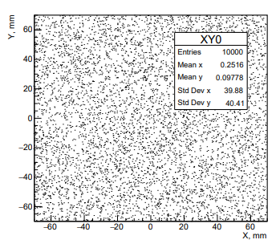
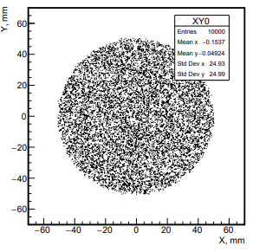
Direction and position of initial muons
Polar angle distribution by cosine
X(Y) – R(0, r) (uniform distribution)
-10° ≤ θ ≤ 10°, ρ (density) on θ -25° ≤ θ ≤ 25°
r = 100 mm r = 50 mm
Number of muons - 10000

Slide 8
-25° ≤ θ ≤ 25°

Slide 9
1
2
3
4
Nx 1-4, 50 deg

Slide 10
Nx 5-8, 50 deg

Slide 11
1
2
3
4
NU 1-4, 50 deg

Slide 12
NU 5-8, 50 deg

Slide 13
Ax 1-4, 50 deg

Slide 14
Ax 5-8, 50 deg

Slide 15
AU 1-4, 50 deg

Slide 16
AU 5-8, 50 deg

Slide 17
Edx 1-4, 50 deg

Slide 18
Edx 5-8, 50 deg

Slide 19
EdU 1-4, 50 deg

Slide 20
EdU 5-8, 50 deg

Slide 21
Scheme of MiniSPD
Geant4. Theta = 50 degrees

Slide 22
-10° ≤ θ ≤ 10°

Slide 23
Nx 1-4, 20 deg

Slide 24
Nx 5-8, 20 deg

Slide 25
Ax 1-4, 20 deg

Slide 26
Ax 5-8, 20 deg

Slide 27
Ex 1-4, 20 deg

Slide 28
Ex 5-8, 20 deg

Slide 29
Data processing of MiniSPD experimental results (Preliminary)

Slide 30
Nx 1-4

Slide 31
Nx 5-8

Slide 32
NU 1-4

Slide 33
NU 5-8

Slide 34
ADC_x 1-4

Slide 35
ADC_x 5-8

Slide 36
ADC_U 1-4

Slide 37
ADC_U 5-8

Slide 38
Estimation of low threshold of energy deposition in single strip with using of experimental data (preliminary)
mean ADC E_dep (MeV)
366,7 0,08
cut ~ 80 ?
With taking into account low energy deposition we choose E_cut ≈ 0,025 MeV

Slide 39
Ex 1-4, 20 deg.
Simulation with cutting (E_cut)

Slide 40
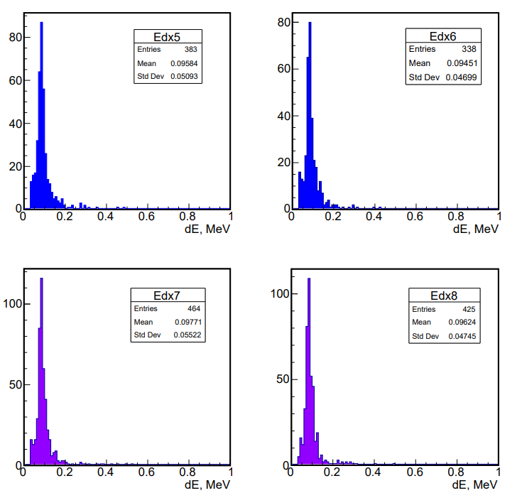
Ex 5-8, 20 deg
Simulation with cutting (E_cut)

Slide 41
Conclusions. It was carried out:
1.Simulation of work with taking into account Si-strip plates for x,U coordinates at MiniSPD setup.
2. Investigation of different polar (Theta = 20, 50 degrees) angles and regions of muon-emission ( r = 100 mm, r = 50 mm).
3.Distributions by: number of triggered strips (on clusters), numbers of triggered strips, energy depositions in one strip.
4. Analysis of processed data for comparison with simulation. Choice of E_cut.
5. We observe agreement between them (simulation and data).

