Slide 1
Introduction to Spack
Valeriy Onuchin
JINR/DNLP/SPD

Slide 2
Why & What is Spack?
My goal is to add SPD EDM to the key4hep
Spack is required to build the whole key4hep framework
Spack is required to develop a single package of key4hep
What is Spack?
Spack originated from LLNL and for the supercomputing community
Now an open-source community project, developed in Python
Designed to support multiple versions and configurations of a software on many different platforms and environments
NOT a replacement for a package-local build system.
pack does NOT place requirements on how each package is built
(but does know about many common build systems, e.g cmake, autotools, meson, etc… etc.)
NOT an OS-level package system
“root” permissions are NOT required
Второй уровень
Третий уровень
Четвертый уровень
Пятый уровень

Slide 3
What is Spack?
Spack is a multi-platform package manager that builds and installs multiple versions and configurations of software. It works on Linux, macOS, and many supercomputers. Spack is non-destructive: installing a new version of a package does not break existing installations, so many configurations of the same package can coexist.
Spack offers a simple “spec” syntax that allows users to specify versions and configuration options. Package files are written in pure Python, and specs allow package authors to write a single script for many different builds of the same package. With Spack, you can build your software all the ways you want to.
The packages are installed by Spack automatically using package recipes 📦 which are python files. The recipe lists the dependencies of the given package and describes its installation procedure. The advantage of Python here is that Spack offers a few base classes to ease the description of the builds, depending on the build system used (e.g. cmake, autotools, meson, etc…). Also an advantage of Spack is that a single package file usually describes the building of many versions of that package.
Spack specs: <package>@<version>%<compiler>+<variants>

Slide 4
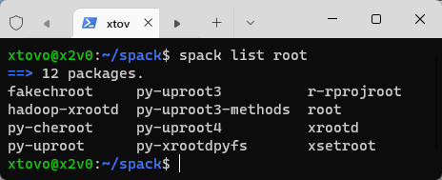
A Spack quick start
$ git clone https://github.com/spack/spack.git
$ source spack/share/spack/setup-env.sh
$ spack install emacs
$ spack load emacs
$ emacs --version
GNU Emacs 27.2
$ spack list
$ spack list | wc
6468 6468 69518

Slide 5
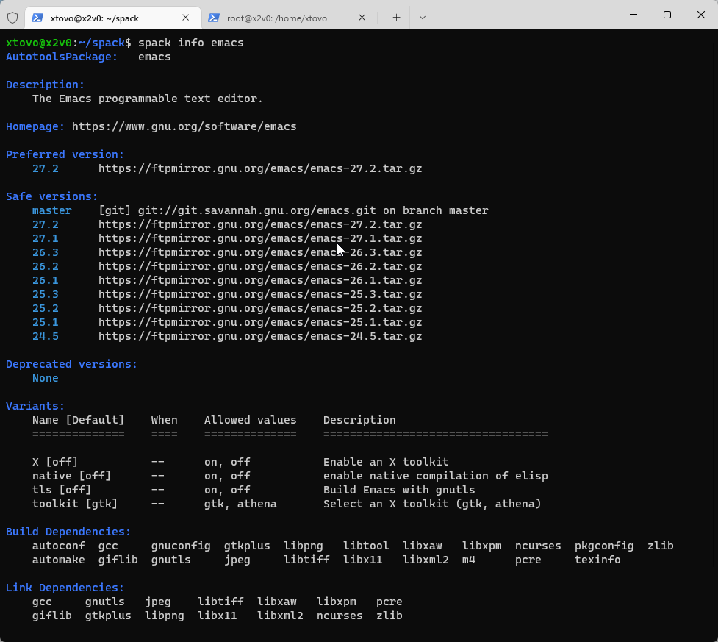
Basic Workflow. spack info
spack info <package>
Get a list of all possible building configuration available
Small description, Version available, list of dependencies and variants

Slide 6
Basic Workflow. spack spec
spack spec <package>@<version>%<compiler> + <variants>
To be done before any installation to check what is exactly going to be installed.
Show what would be installed given a spec
Prints the whole set of dependencies and how they will be installed
Can print conflicts

Slide 7
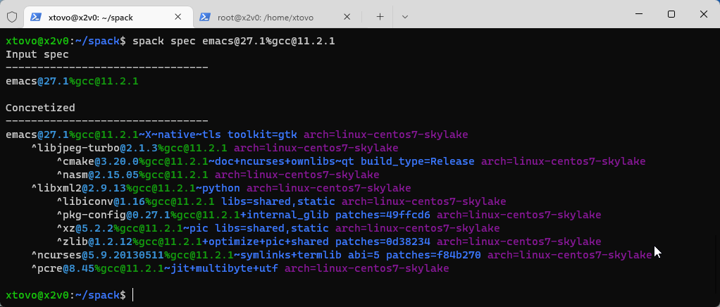
Basic Workflow. spack spec

Slide 8
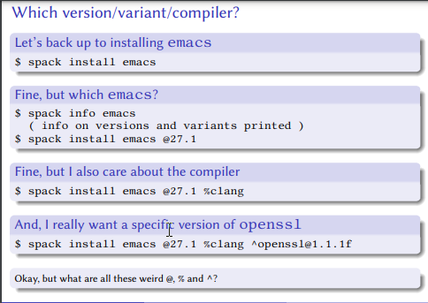
Basic Workflow. spack install
spack install <package>@<version>%<compiler> + <variants>

Slide 9
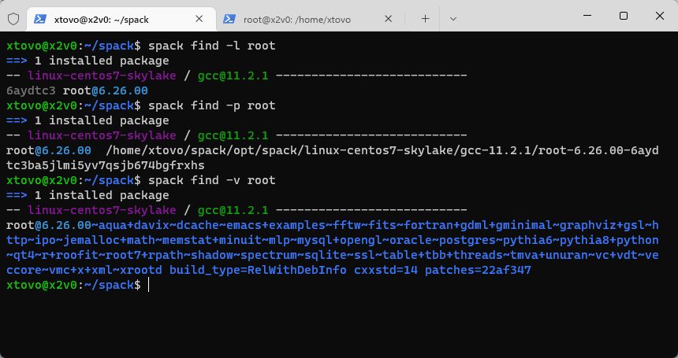
Basic Workflow. spack find
spack find -lpv <package>

Slide 10
References
Repos & Docs:
https://spack.io/
https://github.com/spack/
https://spack.readthedocs.io/
https://spack-tutorial.readthedocs.io/
Videos:
2021 ECP Annual Meeting: Using Spack to Accelerate Developer Workflows (6 hours)
Spack: A package manager for HPC
The Spack 2022 Roadmap
SPACK: A Package Manager for Supercomputers, Linux and MacOS

