Slide 1
The International Workshop on Nuclear and Particles Physics
Peculiarities of magnetic moment switching in the 𝜑₀ -junction
T. Belgibayev, Yu. M. Shukrinov, A. Plecenik, J. Pechousek and C. Burdik BLTP, JINR
Almaty, April 24-30, 2022

Slide 2
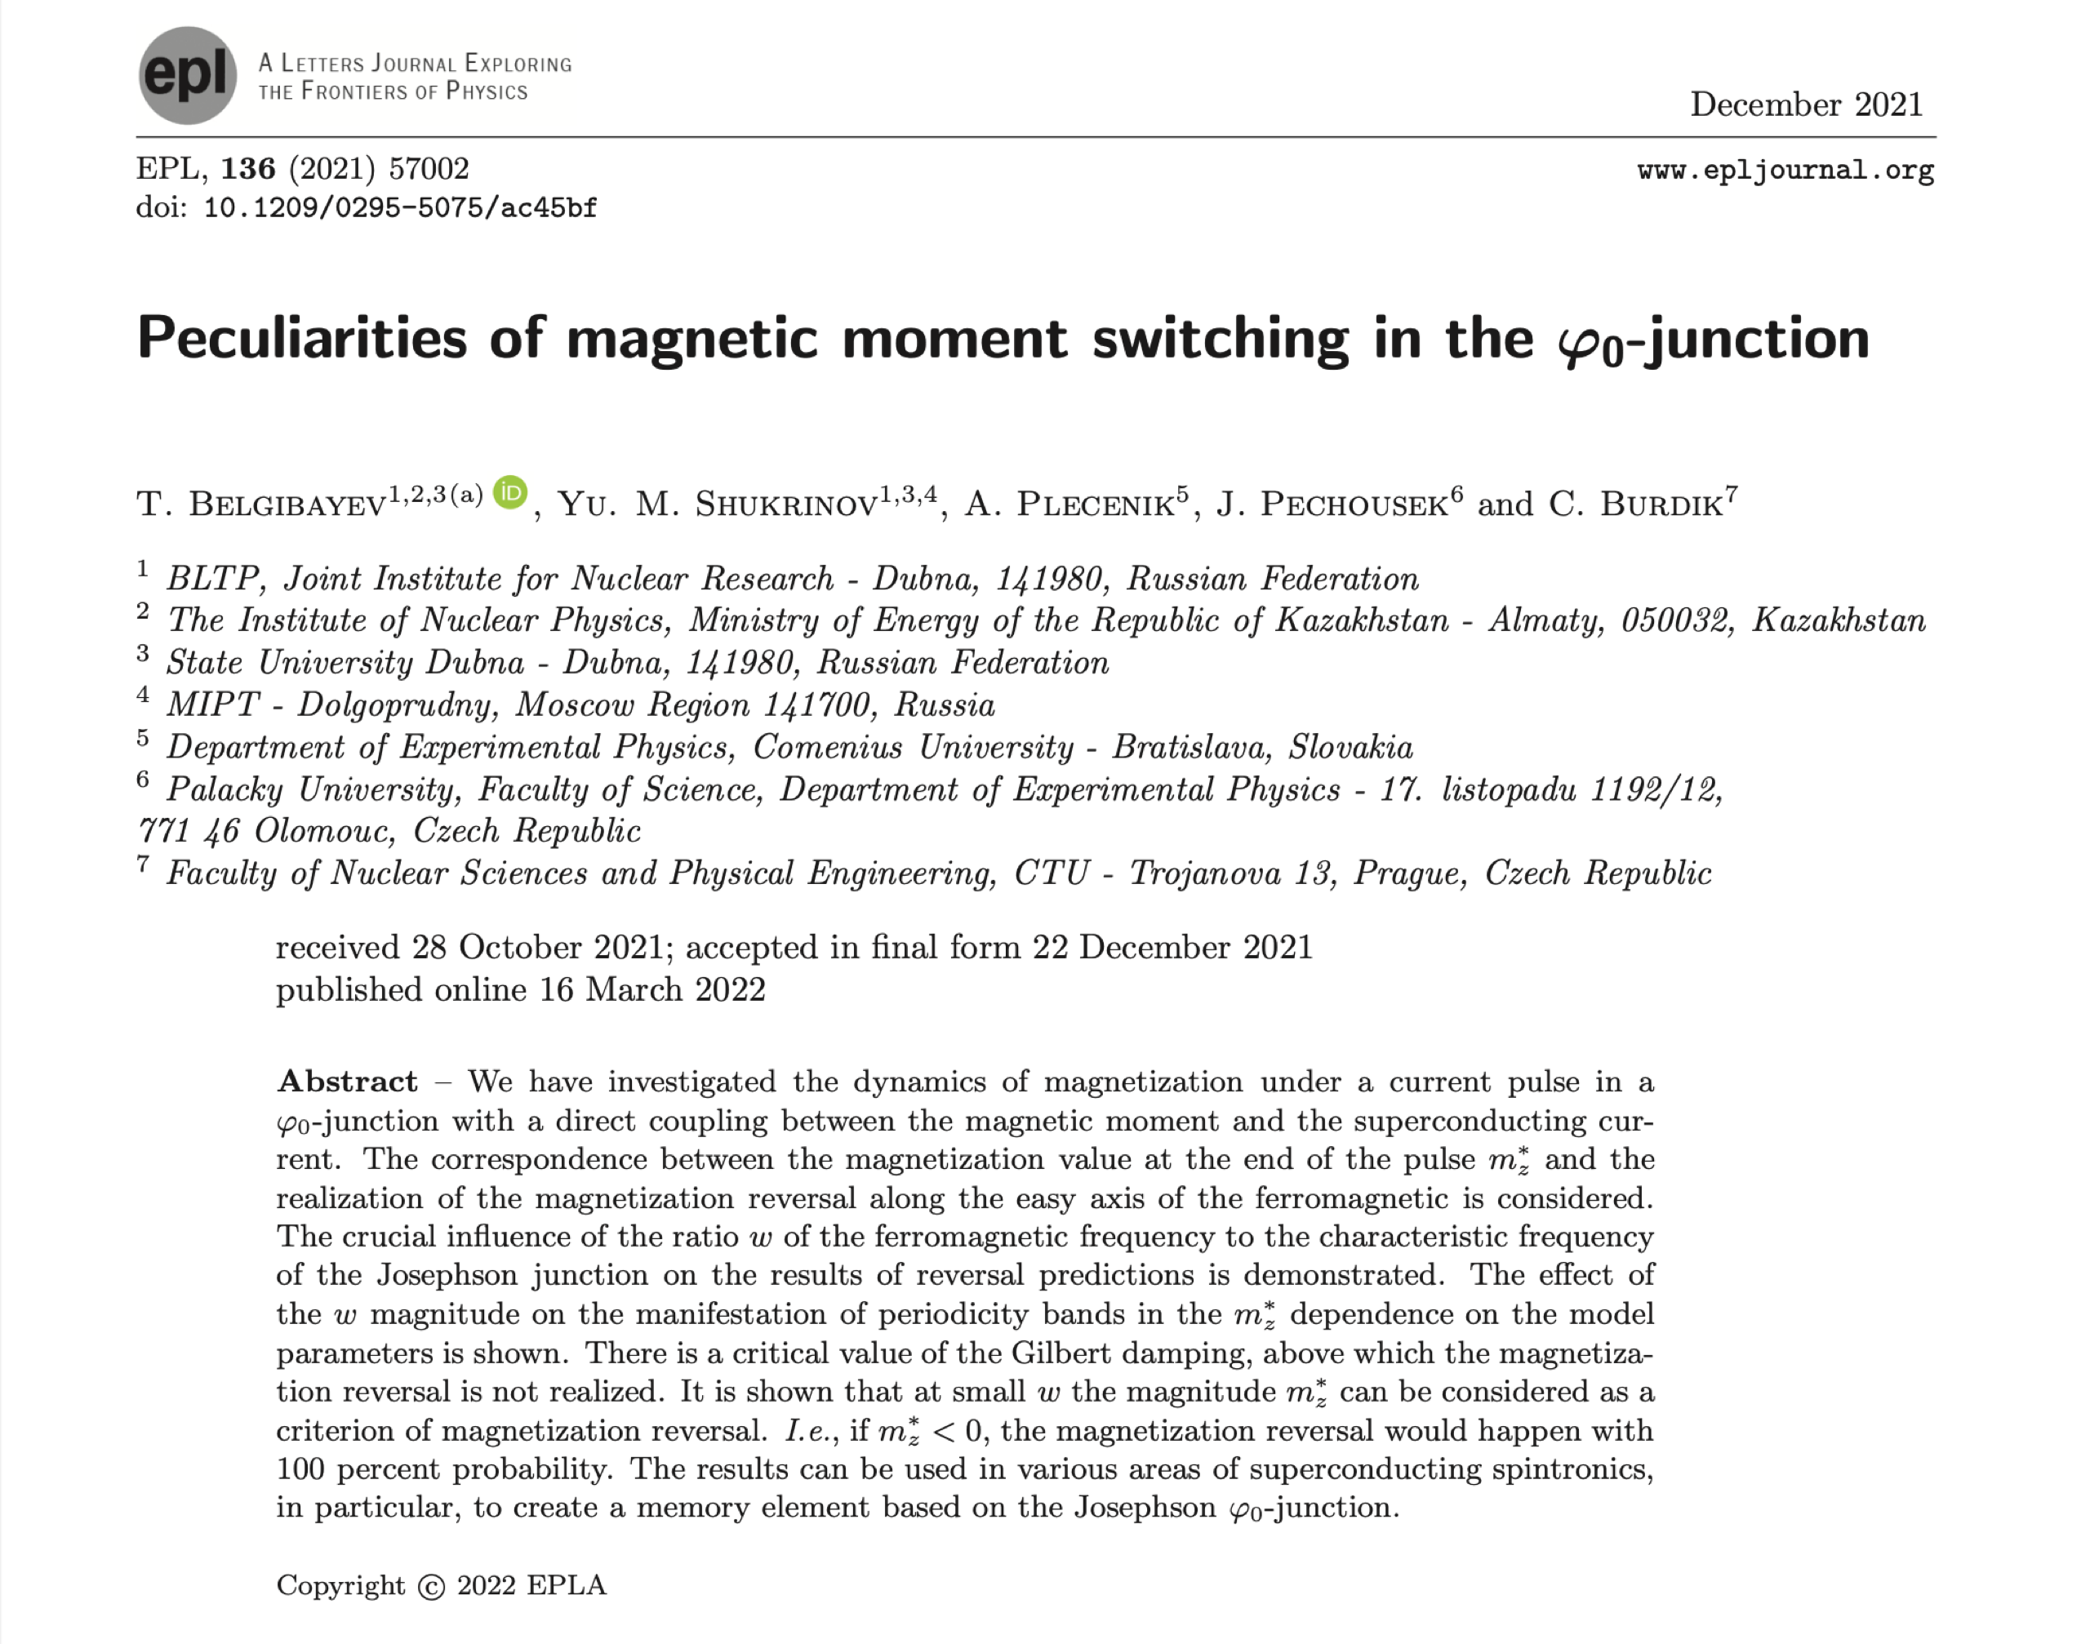
Outline
Introductory Notes on the Josephson Effect
𝜑₀ - junction
Dynamic Equations
Results
Conclusion

Slide 3
Introductory Notes on the Josephson Effect
The two basic Josephson equations originally derived for an S_{L}-I-S_{R} junction are [1]:
[1]. B.D. Josephson, Possible new effects in superconductive tunnelling. Phys. Lett. 7, 251–253 (1962)

Slide 4
We have the Josephson effect as long as the macroscopic wave functions of the two electrodes and
overlap in the barrier region

Slide 5
Different Types of Josephson Junctions
a Different junction configurations: window-type geometry for a sandwich junction with a insulating or b normal metal or semiconducting or ferromagnet barrier. c Coplanar variable- thickness bridge; the barrier is grown before the deposition of the superconductor, while in d the two superconducting electrodes, grown on an insulating substrate can be connected thorough a thin layer deposited on the top. The barrier can be a flake of graphene or of topological insulator (e) which in the suspended configuration can be deposited on the superconductor (f). In all these graphs we use blue for a superconductor, yellow for a metal or a semiconductor or a ferromagnet. Thin insulating barrier is in grey, while thick insulating layers are in green and they serve to completely isolate the electrodes. The width (W) and the length (L) are indicated for all types of junction schemes. While for junctions reported in a, b, L and W represent the cross section of the junction, in all other types of junctions L refers to the length of the barrier, while W has the same meaning for all types of junctions.

Slide 6
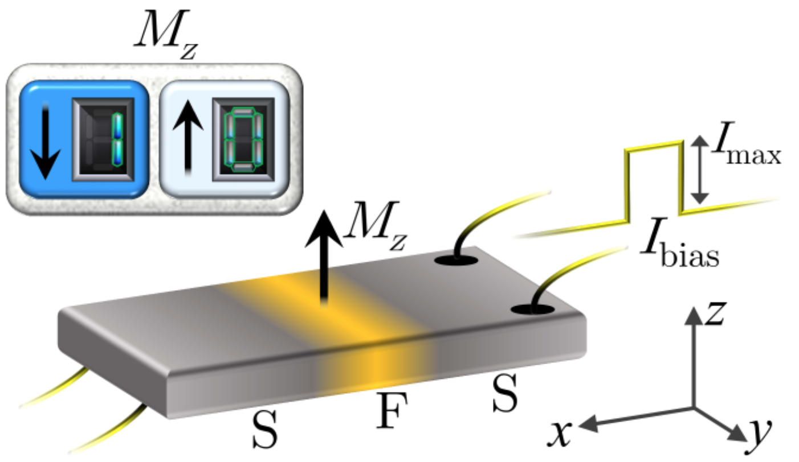
𝜑₀ - junction
where
Experimental implementation of the φ0-junction was recently demonstrated in a number of papers [2–5] through direct measurement of the current- phase ratio.
[2]. Strambini E., Iorio A., Durante O., et al., Nat. Nanotechnol., 15 (2020) 656.
[3]. Szombati D., Nadj-Perge S., Car D., Plissard S., Bakkers E. and Kouwenhoven L., Nat. Phys., 12 (2016) 568.
[4]. Assouline A., Feuillet-Palma C., Bergeal N., Zhang T., et al., Nat. Commun., 10 (2019) 1.
[5]. Mayer W., Dartiailh M. C., Yuan J., Wickramas- inghe K. S., et al. Nat. Commun., 11 (2020) 1.

Slide 7
Dynamic equations

Slide 8
Results

Slide 11
Fig. 5: (a) The m_{Z}* as a function of the damping parameter ⍺ at two values of the ratio w. The calculation parameters are shown in the figure. The red line corresponds to the case w = 0.01, and the blue w = 1; (b) The dependence of the critical value ⍺_{crit} as a function of w

Slide 12
Fig. 6: (a) Numerical results demonstrating the MR realization in the ⍺ - G plane at w=1. The stripe reflect the areas where magnetization reversal is realized. The calculation is performed for the G with the step △G = 0.5 and for ⍺ with the step △⍺ = 0.01. Other parameters are r=0.1, A_{S}/I_{C} = 0.16, 𝜆_{pulse} = 2; (b) The same at w=0.01.

Slide 13
Conclusion
These results help to understand fundamental spin-dependent phenomena and also contribute to the development of applications for computer technology. In particular, the control of the magnetic state using superconductivity can be used to develop ultrafast cryogenic memory [6].
The results of a detailed study of the magnitude of the magnetization at the end of the current pulse m_{Z}∗ indicate that, in a number of cases at chosen system’s parameters, there is a one-to-one correspondence between its value and the realization of magnetization reversal or its absence. We have demonstrated this correspondence clearly at w = 0.01, and showed that the magnetization reversal phenomenon at those parameters is realized with 100 percent of probability at m_{Z}∗ < 0.
We have shown the manifestation of periodicity bands in the dependencies of m_{Z}∗ on the ratio of the Josephson energy to the magnetic, spin-orbit coupling, which determine the presence of switching, the position of which does not depend on the parameter w.
[6]. Guarcello C. and Bergeret F. S., Phys. Rev. Appl., 13 (2020) 034012.

Slide 14
Thank you for attention!

