Slide 1



Dilution cryostats for experiments with the Frozen Spin polarized Target at particle accelerators.
Ivan Gorodnov - LDT DLNP
JINR AYSS-Alushta-2022
Alushta, Russia
6 June 2022
1

Slide 2
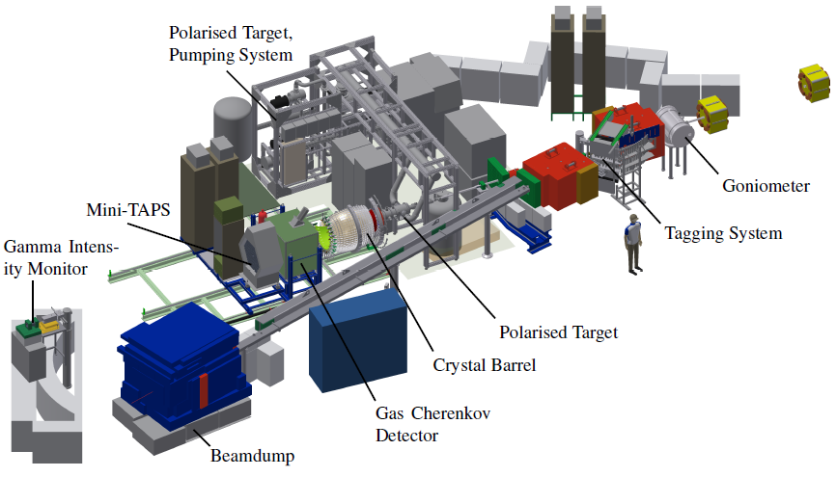
Experimental setup of the CBELSA/TAPS experiment
2

Slide 3
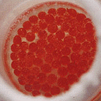
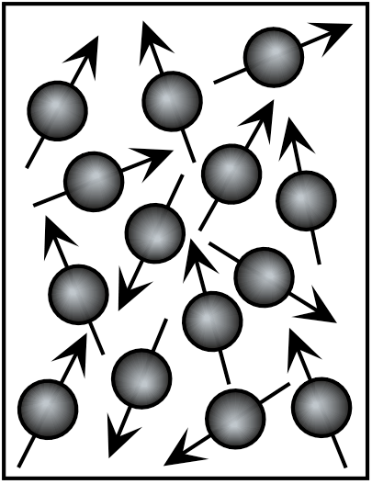
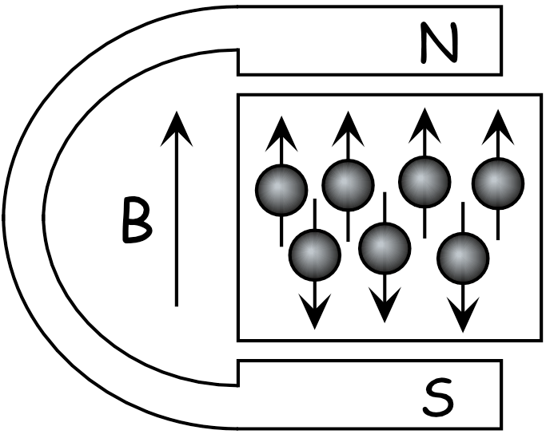
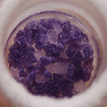
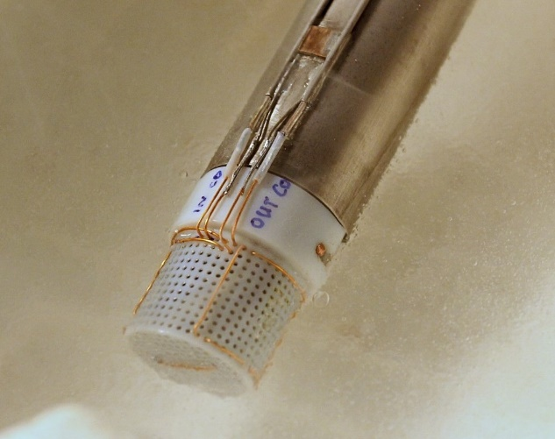
Polarized target
Polarisation = Orientation of Spins in a magnetic field
Tempo
+
CH₃
CH₃
CH₃
N
CH₃
O
Butanol
Ammonia
Ideally: All spins in field direction
P=±100%
Container with target material and 2 NMR coils
on Inner Insert
in liquid nitrogen
2cm
3

Slide 4

Polarizing the spins: Dynamic Nuclear Polarization
Sample is prepared with paramagnetic radicals (~10¹⁹ cm⁻³)
Radicals are polarized at low temperature and high field, tanh(m_{e}B/kT) > 99%
Nuclei remain unpolarized, < 1%
The goal of DNP is to transfer the radicals’ polarization to the nuclei
B
4

Slide 5
Polarizing the spins: Dynamic Nuclear Polarization
Microwaves near the radicals resonance frequency induce mutual electron/nuclear spin flips.
Freq. matching: ν = ν_{e} ± ν_{N}
The electron flips back quickly to its equilibrium orientation.
The nucleus does not.
B
5

Slide 6
Polarizing the spins: Dynamic Nuclear Polarization
Microwaves near the radicals resonance frequency induce mutual electron/nuclear spin flips.
Freq. matching: ν = ν_{e} ± ν_{N}
The electron flips back quickly to its equilibrium orientation.
The nucleus does not.
Eventually, the nuclei in the area of the radical become polarized.
Nuclear polarization spreads quickly throughout sample via spin diffusion
B
6

Slide 7

Freezing the spins
Once DNP is stopped, the polarization begins to decay towards its natural, thermal-equilibrium value
Decay is exponential, with T₁ (spin-lattice time constant or relaxation time) of a few days to a few months
Holding field is typically ~½ tesla (higher is better)
Temperature is typically < 50 mK (lower is better)
P(t) = P_{o}e^{-t/T1} + P_{TE}
Polarization
Time
7

Slide 8
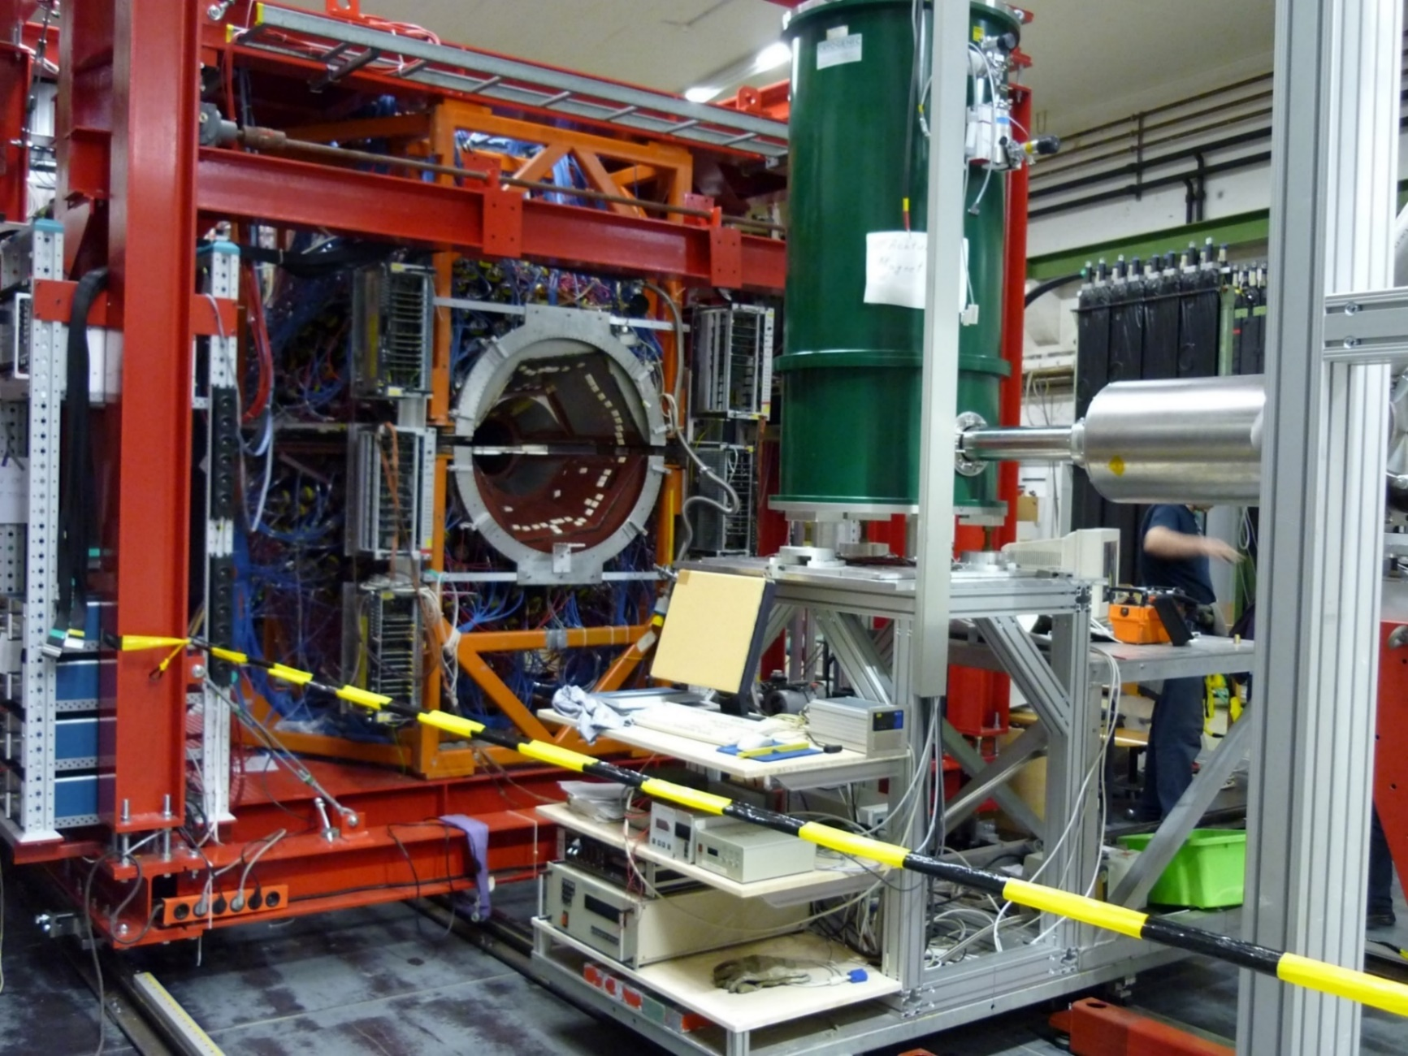

«Crystal Ball» detector and superconducting magnet on MAMI C (Mainz)
8

Slide 9
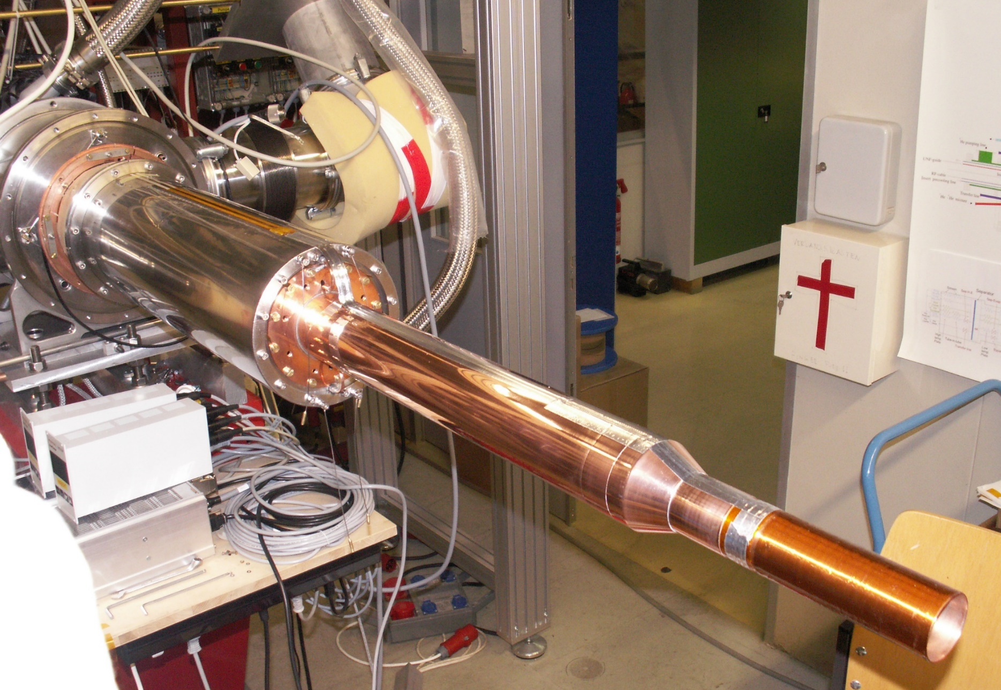
Holding coil on open Mainz dilution cryostat
9

Slide 10
«Crystal Ball» detector and superconducting magnet on MAMI C (Mainz)
10

Slide 11
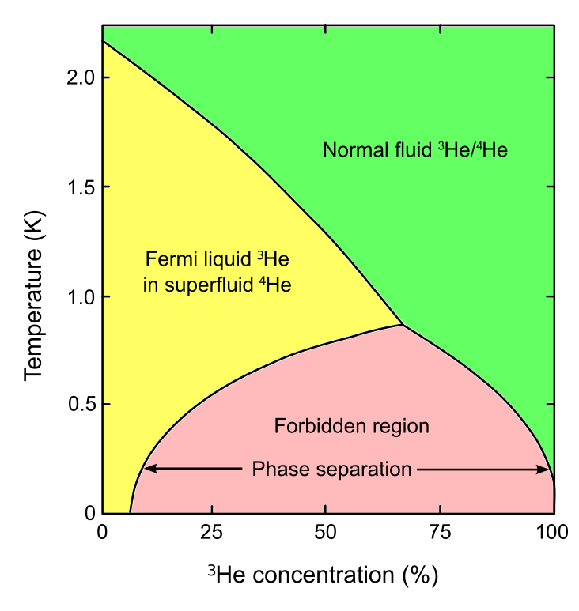
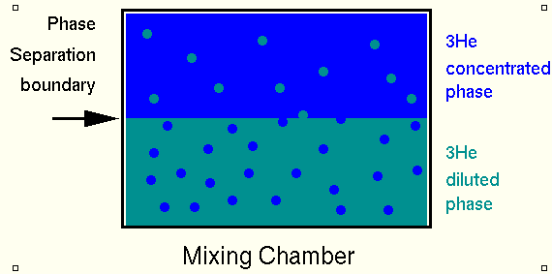

The dilution effect
Maximum cooling power:
Q$=84\dot{n_{3}}T_{mc}^{2}$
11

Slide 12
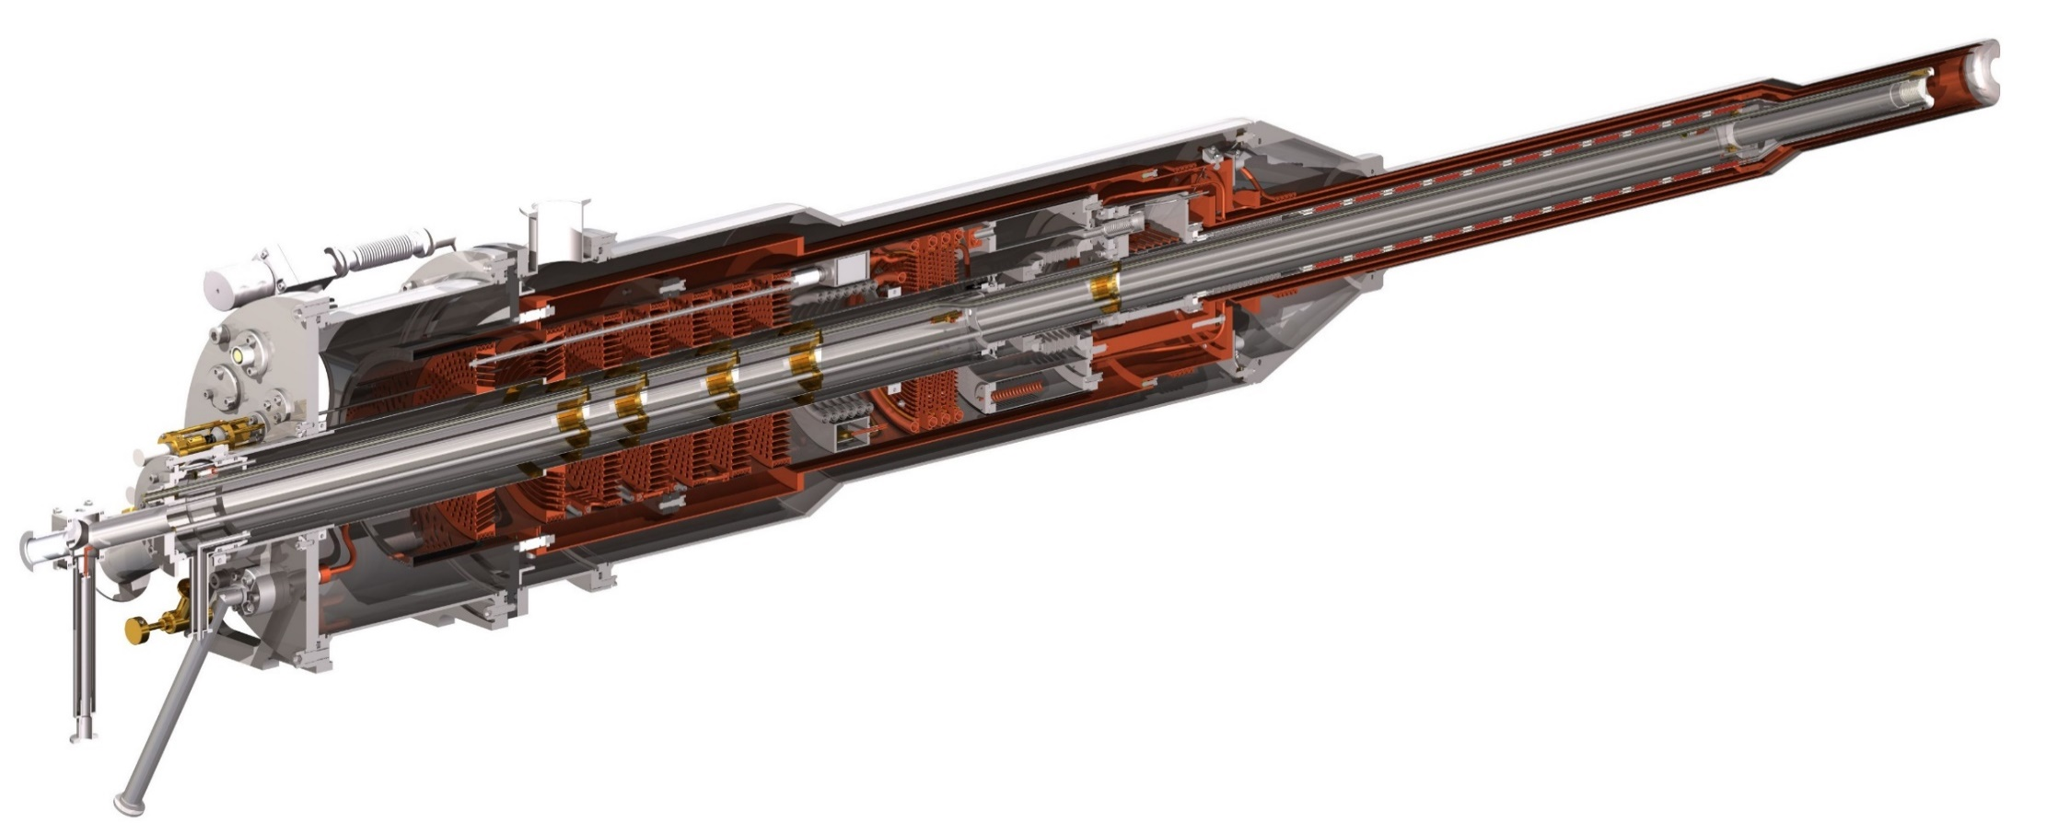
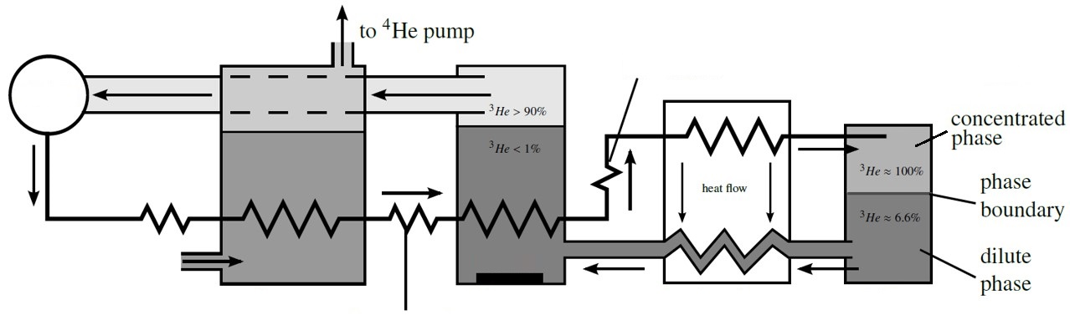

Principle of a dilution refrigerator
Dilution unit
Maximum
cooling power:
Evaporator
1K
Still 0.8K
Q$=84\dot{n_{3}}T_{mc}^{2}$
Flow
impendence
Mixing
chamber
Pumps
Super-Liquid
⁴He
Condenser2
Liquid ⁴He
Condenser1
Heater
Sintered heat exchangers
Flow impendence

Slide 13
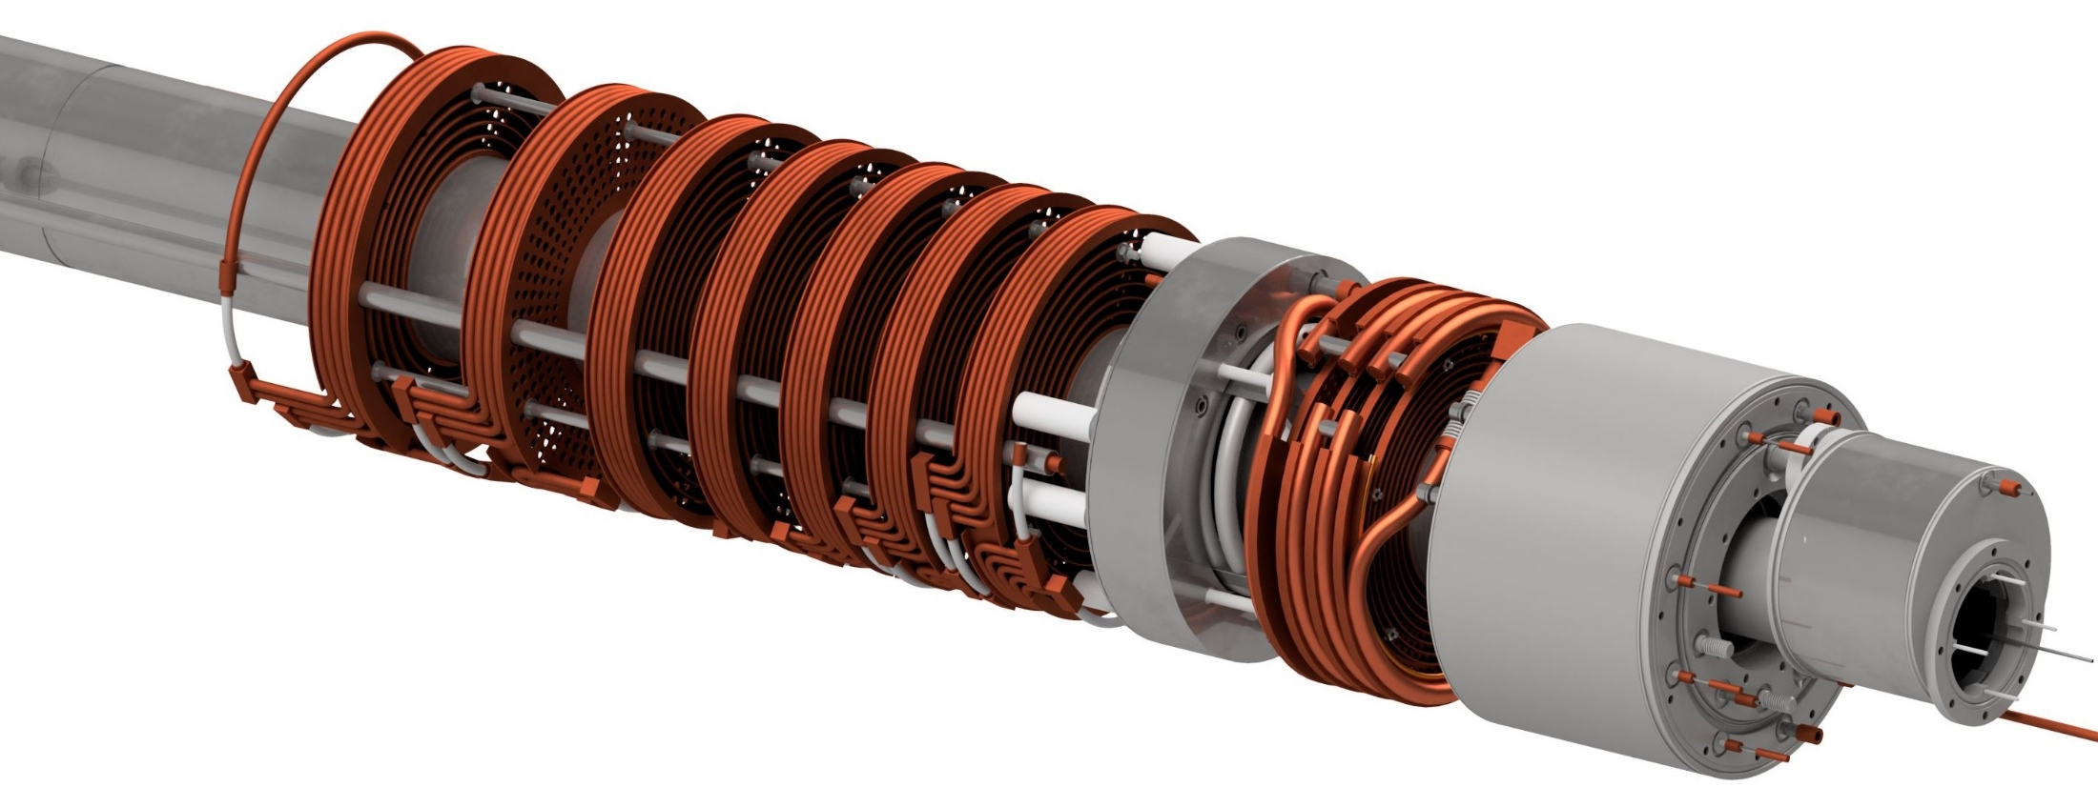
Precooling Stages
H.E.1
300K
Separator
4K
Evaporator
1K
CND1 inside
10K
H.E.2
4.5K
H.E.3 1.2K
Still 0.8K
CND2 inside
13

Slide 14
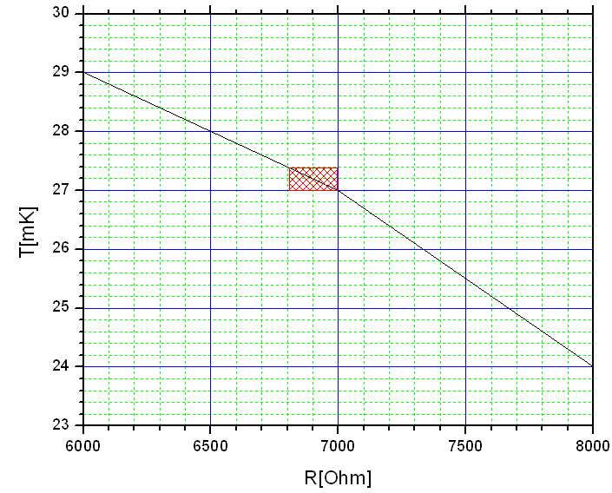
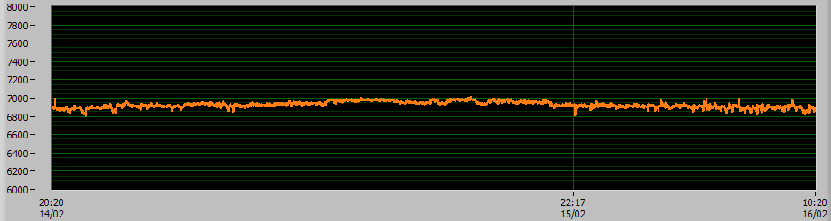
Temperature stability
Temperature stability:
ΔT ~ ± 0.2mKelvin (one day)
(typical one week measurement period).
T=24mK
T=27mK
T=29mK
Δt=40h
14

Slide 15
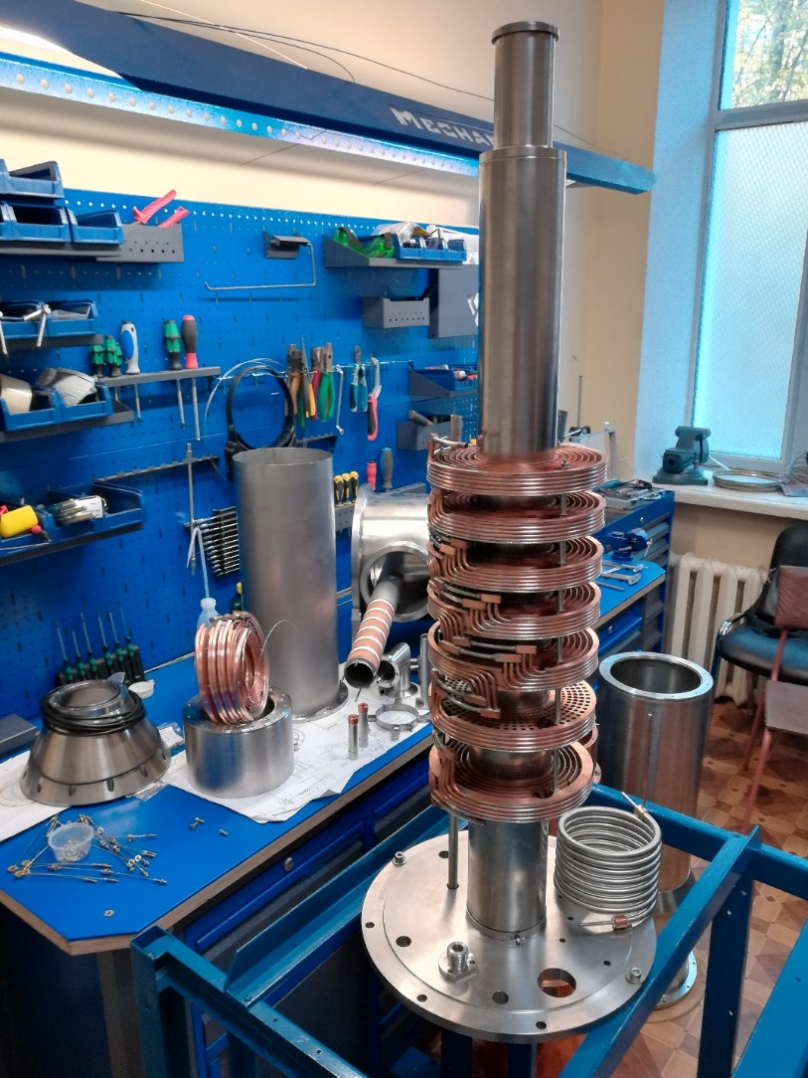
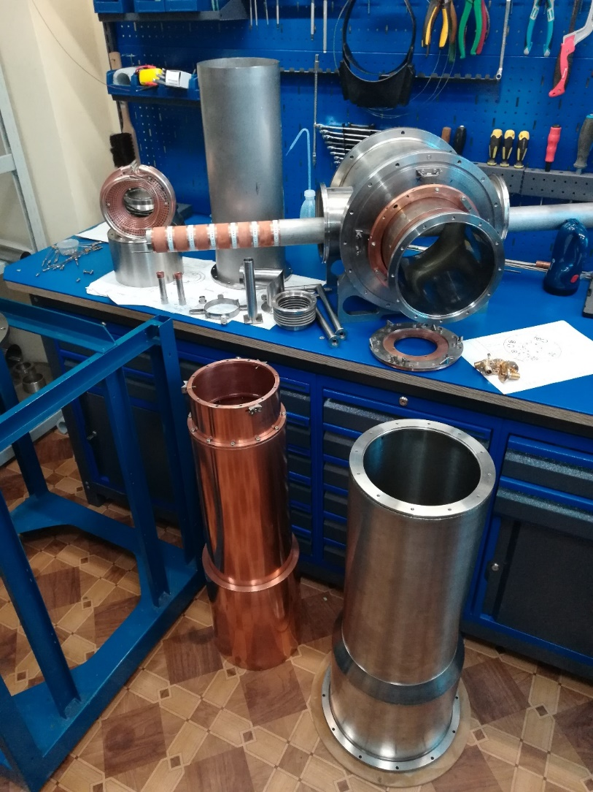
Technical realisation of Bonn dilution cryostat
15

Slide 16
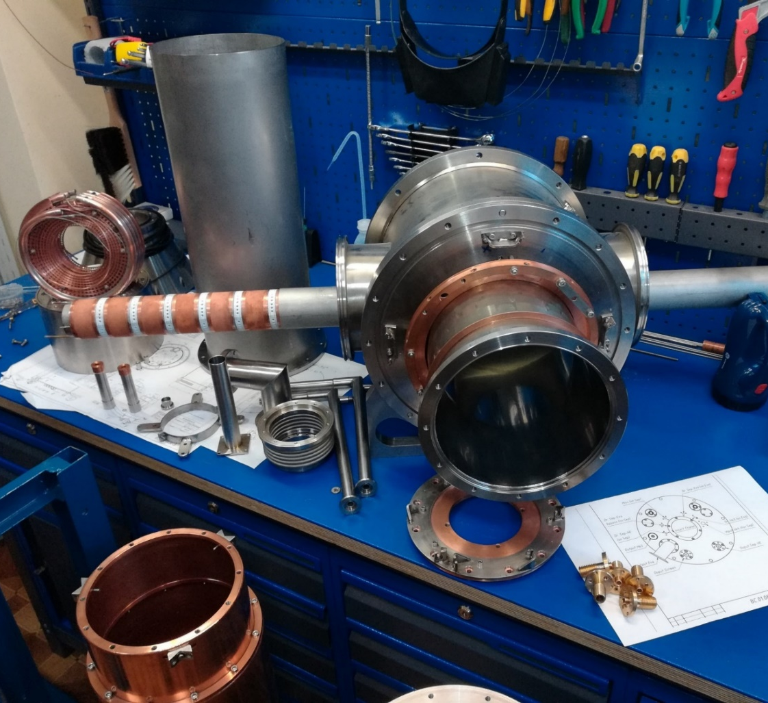
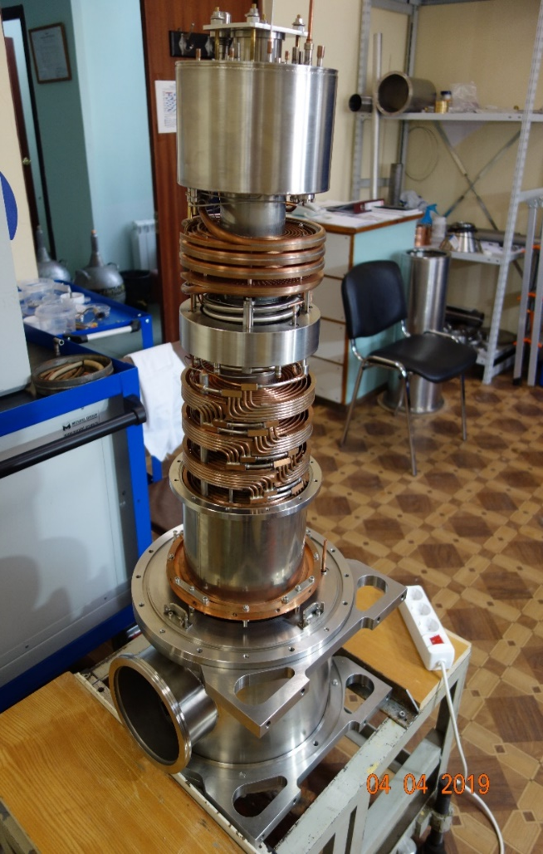
Technical realisation of Bonn dilution cryostat
16

Slide 17




Thank you
for your attention
The map of JINR’s frozen polarized target activities
Physikalisches Institut
Universität Bonn
PINP
GATCHINA
BONN
JINR Preprints 13-10253, 10-10257, Dubna 1976
Prib Techn. Exp. 2 (1978) 32
Contract 200/1548
Institut für Kernphisik
Johannes Gutenberg University
2460 km
645 km
Майнц, Германия
2435 km
DUBNA
A2 collaboration on MAMI
2007-2018
NIM A 372 (1996) 349
2000 km
260 km
P2 experiment at MESA (a new linear Mainz Energy-Recovery Superconducting Accelerator)
Hydro-Möller Polarimeter
https://www.mesa.uni-mainz.de
Charles University
IHEP
PRAGUE
PROTVINO
NIM A 345, (1994) 421-428
JINR Preprint 1-80-93, Dubna 1980
17

Slide 18
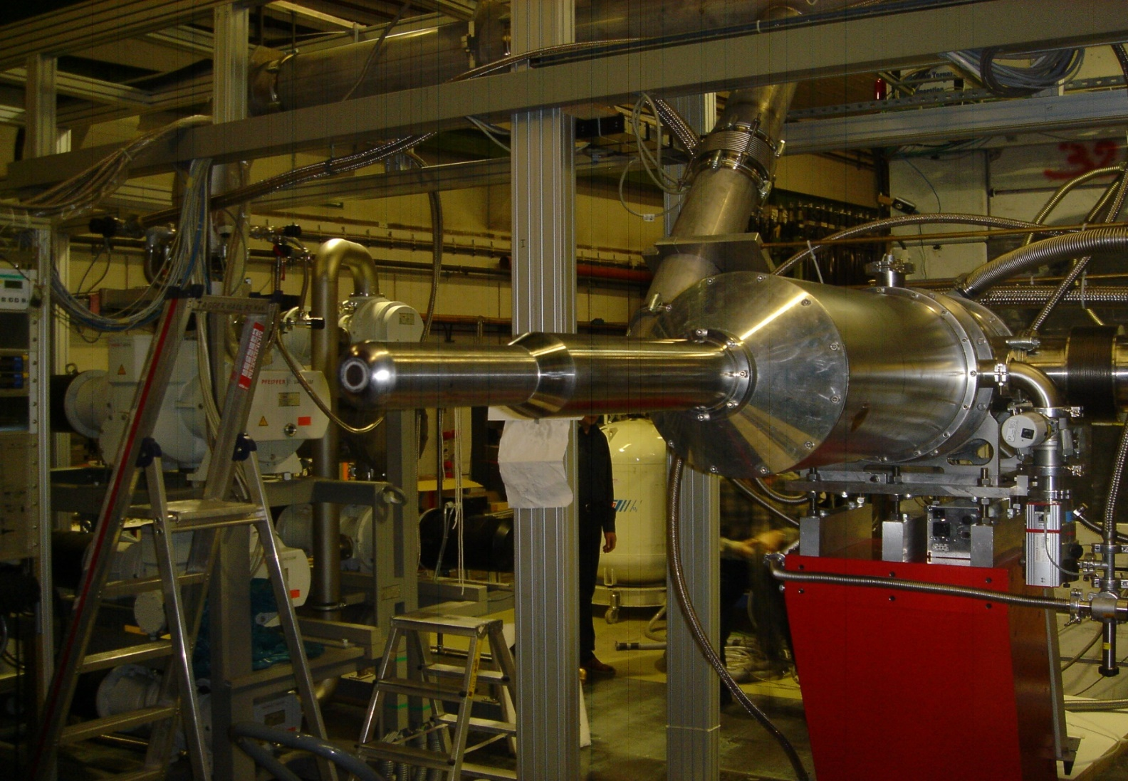
Frozen Spin polarized Target on MAMI C ( Mainz) - 2010
18
Notes:
1818

