Slide 1



Experimental setup for elemental analysis using prompt gamma rays at research reactor IBR-2
Constantin Hramco
costea.edinets@mail.ru
XI JINR Association of Young Scientists and Specialists Conference "Alushta-2022“,
June 5 – 12, 2022, Alushta, Russian Federation
JINR AYSS XI, June 05 – 12, 2022, Alushta, Russian Federation

Slide 2
Full list of authors
C. Hramco ^{1,2}, K. Turlybekuly ^{1,3,4}, E.V. Lychagin ¹, S.B. Borzakov ¹, N.A. Gundorin ¹, A.Yu. Muzychka ¹, G.V. Nehaev ¹, A.V. Strelkov ¹, E. Teymurov ^{1,5,6}
1. Frank Laboratory of Neutron Physics, Joint Institute for Nuclear Research, Joliot Currie 6, 141980 Dubna, Moscow region, Russia
2. Institute of Chemistry of Moldova (ICh,) Academiei str., 3; MD-2028 Chisinau, Republic of Moldova
3. L.N. Gumilyov Eurasian National University, Satpayev str, 2, 010000 Nur-Sultan, the Republic of Kazakhstan
4. The Institute of Nuclear Physics, Ministry of Energy of the Republic of Kazakhstan, Ibragimova str., 1,050032 Almaty, the Republic of Kazakhstan
5. National Nuclear Research Centre, Baku-Shamakhi highway, AZ1073, Qobu settlement, Azerbaijan
6. National Nuclear Research University MEPhI (Moscow Engineering Physics Institute), Kashirskoe highway, 31, 115409, Moscow, Russia
JINR AYSS XI, June 05 – 12, 2022, Alushta, Russian Federation

Slide 3
Motivation
The cycle of works for hydrogen content analysis in the samples of nano-diamond powders
- To build own neutron prompt-gamma setup for multi-elemental detection purposes
JINR AYSS XI, June 05 – 12, 2022, Alushta, Russian Federation

Slide 4
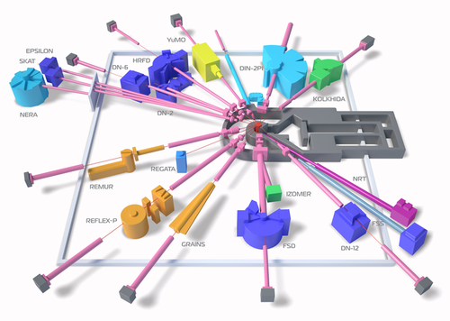
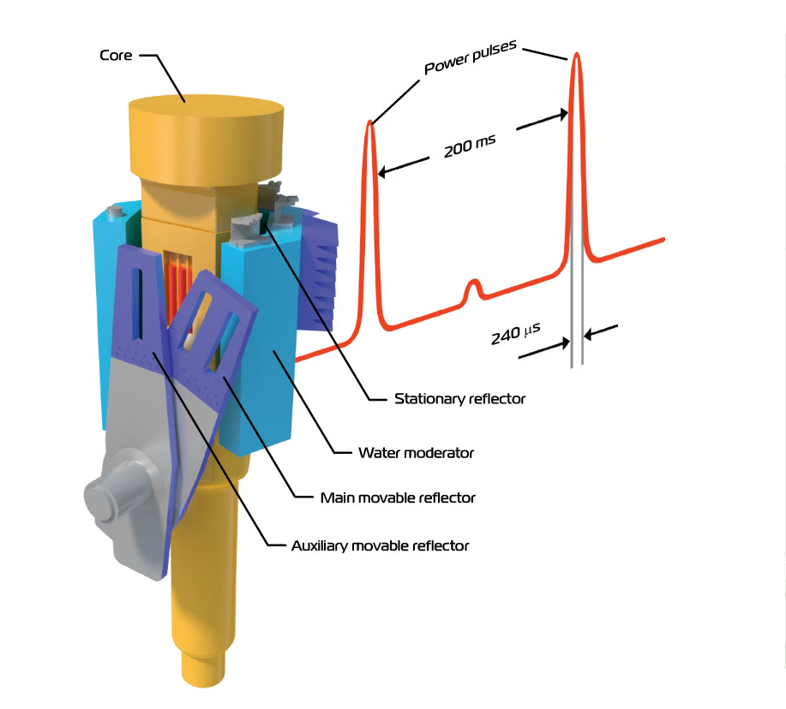
Neutron source
The neutron source is pulsed reactor IBR-2 operating at a power of ~1.6 MW. The pulse frequency is 5 Hz and the duration is about 300 µs. The mirror guide with the length of 15 m and the radius of curvature of 2000 m, starts at 3.5 m from the surface of the neutron moderator. This type of guide allows to separate the fast and thermal neutron beams and delivering to the sample a relatively clean thermal neutron beam. The cross-section of our neutron beam is ~ 2x10 cm² and neutron flux density at the guide’s output is ~ 5 ∙ 10⁵ n ∙ s⁻¹ cm⁻².
200
11b channel
“Isomer”
JINR AYSS XI, June 05 – 12, 2022, Alushta, Russian Federation

Slide 5
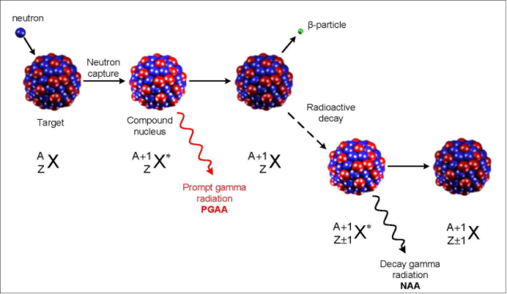
Scheme of interaction between neutron and nucleus
JINR AYSS XI, June 05 – 12, 2022, Alushta, Russian Federation

Slide 6
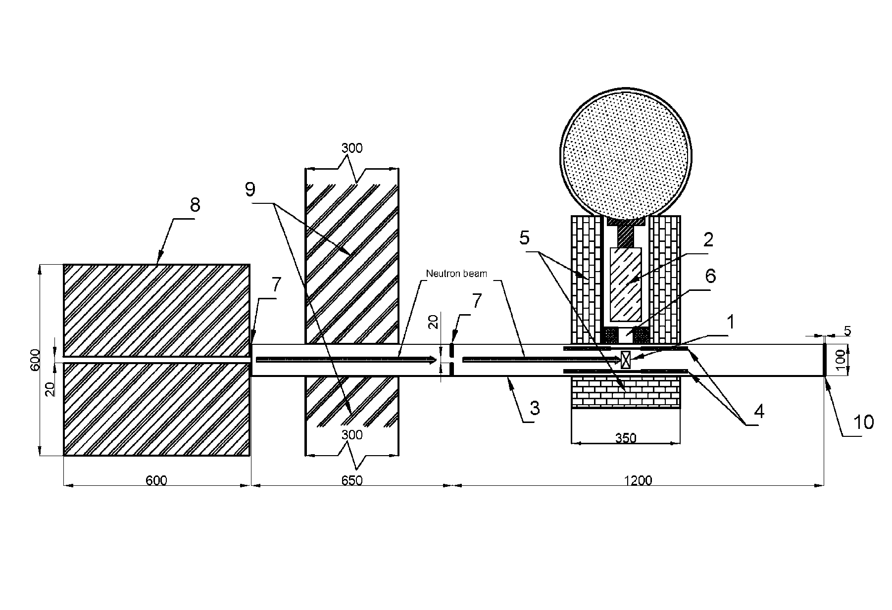
2D scheme of the setup
Neutrons
guide
1 – sample, 2 – HPGe radiation resistant detector, 3 – vacuum guide, 4 – LiF shielding, 5 – Cd covered lead shielding, 6 – Bi gamma collimator, 7 – boron rubber neutron collimator, 8 – boron polyethylene neutron collimator, 9 – Cd covered polyethylene shielding, 10 – boron rubber beam stop
JINR AYSS XI, June 05 – 12, 2022, Alushta, Russian Federation

Slide 7
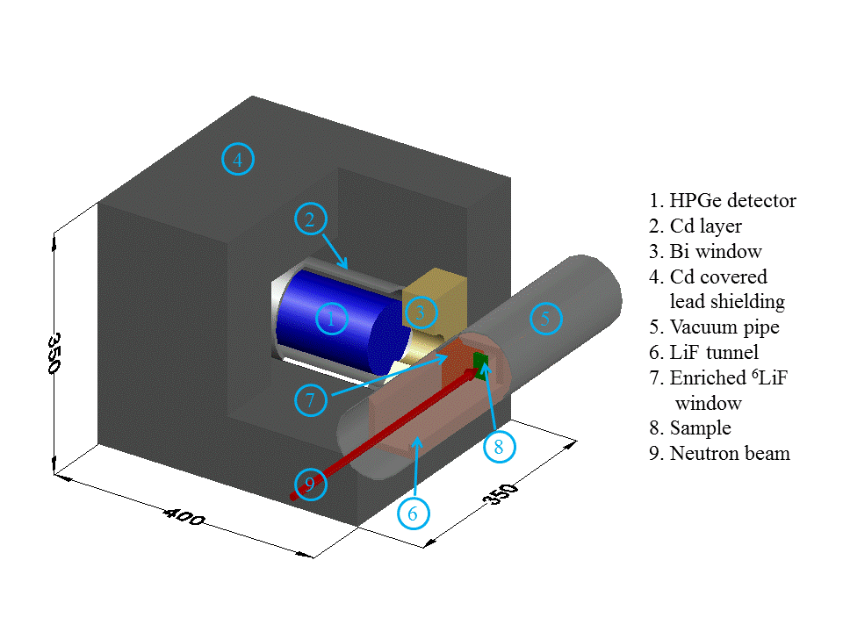
3D model of the detector’s environment
JINR AYSS XI, June 05 – 12, 2022, Alushta, Russian Federation

Slide 8
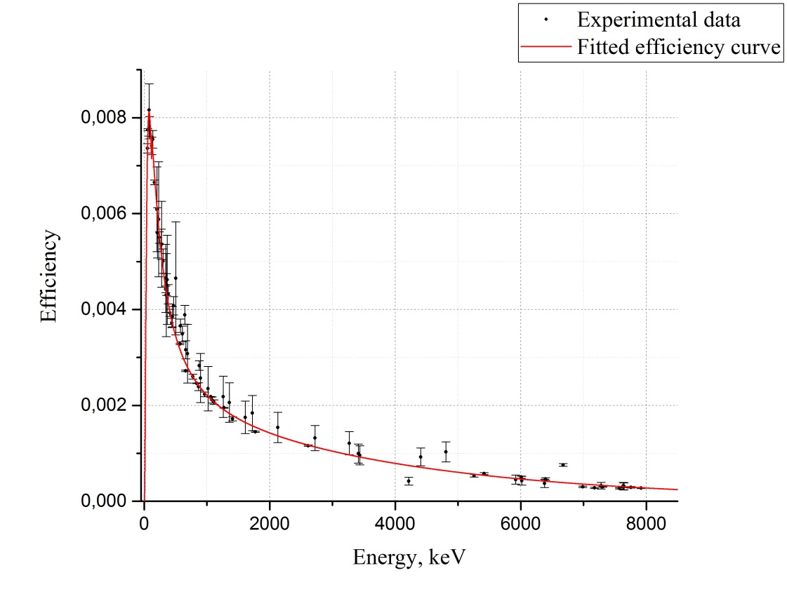
Few word about the HPGe detector
The HPGe radiation-resistant detector from Canberra with energy resolution 2.3 keV for the ⁶⁰Co 1332.5 keV and relative efficiency of 80% is placed 20 m long from the reactor core. The detector was set at a distance of 14 cm from the neutron beam axis.
JINR AYSS XI, June 05 – 12, 2022, Alushta, Russian Federation

Slide 9
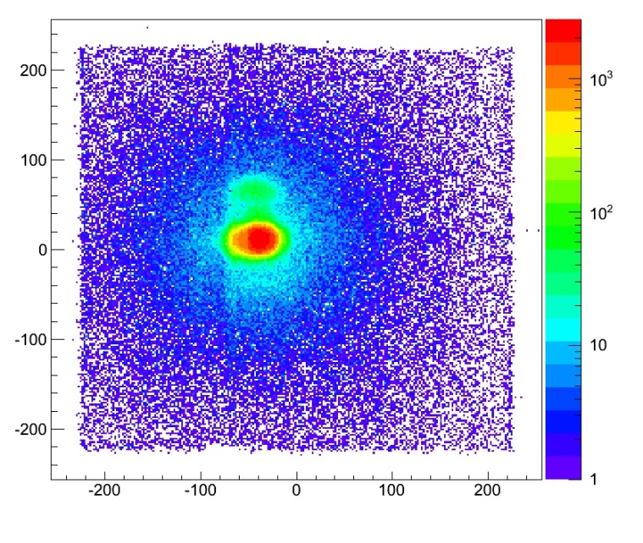
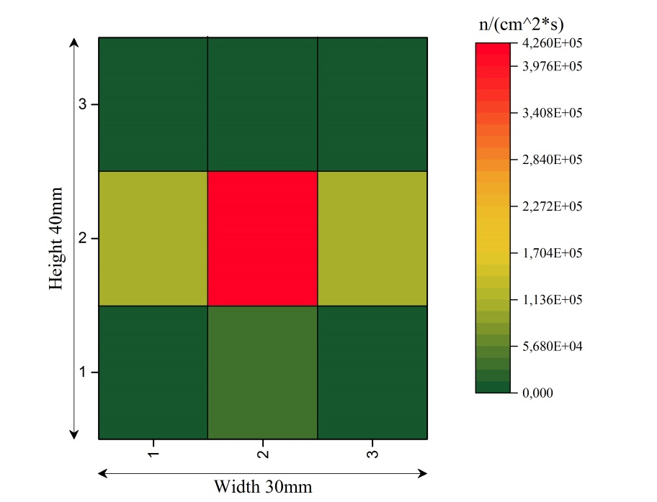
Neutron beam collimation
Channel number
Neutrons count
Channel number
Well beam collimation proved by 2 types of measurements:
– Position sensitive detector (left image)
– Activation analysis measurements (right image)
JINR AYSS XI, June 05 – 12, 2022, Alushta, Russian Federation

Slide 10
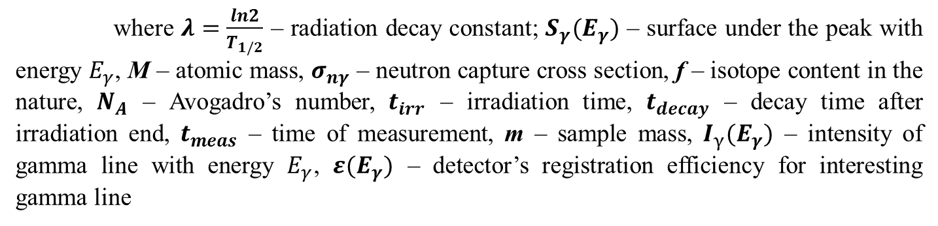
Used formula and materials for NAA flux calculations
$$Ф_{n}=\frac{S_{γ}(E_{γ})∙M{∙λ∙e}^{λ∙t_{decay}}}{N_{A}∙I_{γ}(E_{γ})∙ε(E_{γ})∙m∙f∙σ_{nγ}∙(1−e^{−λ{∙t}_{irr}})∙(1−e^{−λ∙t_{meas}})}$$
where $λ=\frac{ln2}{T_{1/2}}$ – radiation decay constant; $S_{γ}(E_{γ})$ – surface under the peak with energy $E_{γ}$, М – atomic mass, $σ_{nγ}$ – neutron capture cross section, f – isotope content in the nature, $N_{A}$ – Avogadro’s number, $t_{irr}$ – irradiation time, $t_{decay}$ – decay time after irradiation end, $t_{meas}$ – time of measurement, m – sample mass, $I_{γ}{(E}_{γ})$ – intensity of gamma line with energy $E_{γ}$, $ε(E_{γ})$ – detector’s registration efficiency for interesting gamma line
9 copper indicators with mass ~0,122 g each was used to determine the flux distribution in the sample’s position. The dimension of each indicator is 13х10 mm² and the thickness ~100 µm. Time of irradiations of the indicators was 4,5 h. The induced gamma activity was measured during 20 minutes for each monitor. Maximum detected flux value is 4·10⁵ n/cm²s.
JINR AYSS XI, June 05 – 12, 2022, Alushta, Russian Federation

Slide 11
Types of gamma backgrounds
– Natural – radioactive isotopes emissions coming from building materials components (⁴⁰K and decay products from uranium and thorium)
– Induced – the gamma emissions coming from neutron-nuclei interaction in the environment
JINR AYSS XI, June 05 – 12, 2022, Alushta, Russian Federation

Slide 12
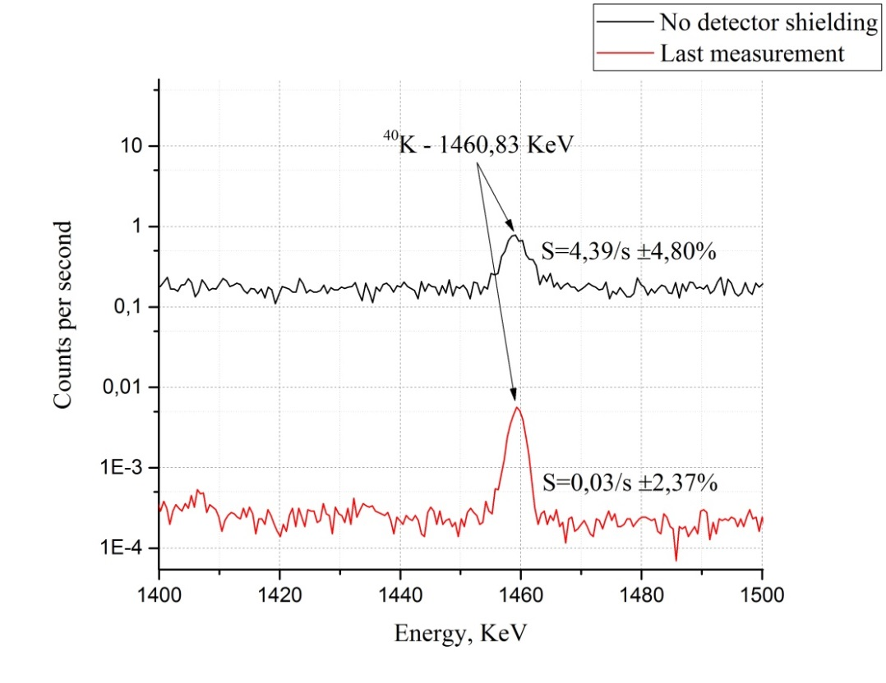
Background suppression
Natural background suppression more than 140 times
JINR AYSS XI, June 05 – 12, 2022, Alushta, Russian Federation

Slide 13
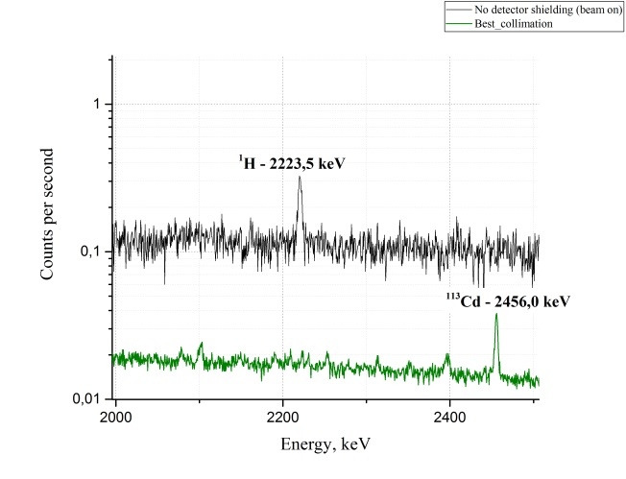
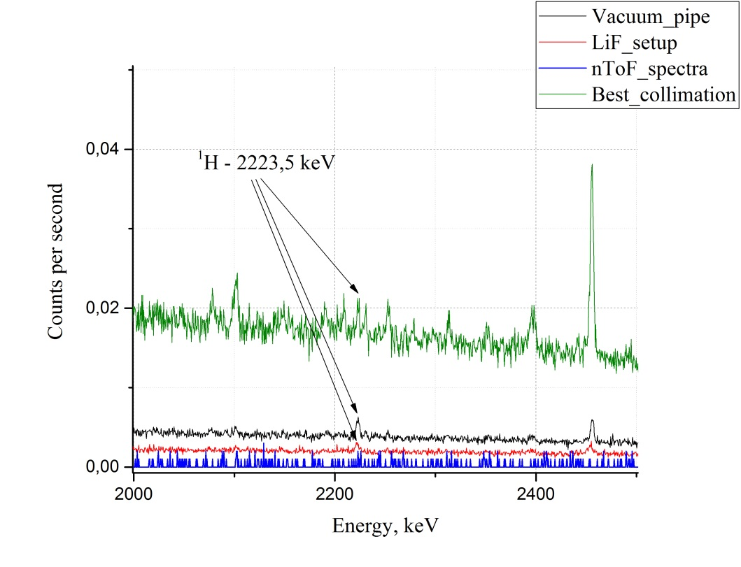
Background suppression
¹¹³Cd - 2456,0 keV
The reactor IBR-2 is working in pulse mode with a frequency 5Hz
Induced background suppression almost 60 times in comparison with the green spectra on the left picture and more than 800 times in comparison with the initial level of induced gamma background.
JINR AYSS XI, June 05 – 12, 2022, Alushta, Russian Federation

Slide 14
Modeling of the primary collimation setup
The calculations of the interaction of fast neutrons with collimation setup of borated polyethylene was done by using MCNP program and Monte Carlo method. Calculation contains the monoenergetic spectra of neutrons with the energies 1, 2, and 3 MeV.
E_{n}, MeV | P_ref (%) | P_abs (%) | P_sides | P_trs
1 | 24.23 | ~75.76 | 4.77E-06 | 3.40E-06
2 | 20.20 | ~79.78 | 1.34E-04 | 7.08E-06
3 | 17.53 | ~82.40 | 5.96E-04 | 3.13E-05
Where E_{n} – neutrons energy, P_{ref} – the probability of reflection from the incident side of the BPE setup, P_{trs} – the probability of the neutron transition, P_{sides} – the probability of the scattering and escape from sides of the setup, P_{abs} – the probability of the absorption inside the setup of the neutrons with energy E_{n}.
JINR AYSS XI, June 05 – 12, 2022, Alushta, Russian Federation

Slide 15
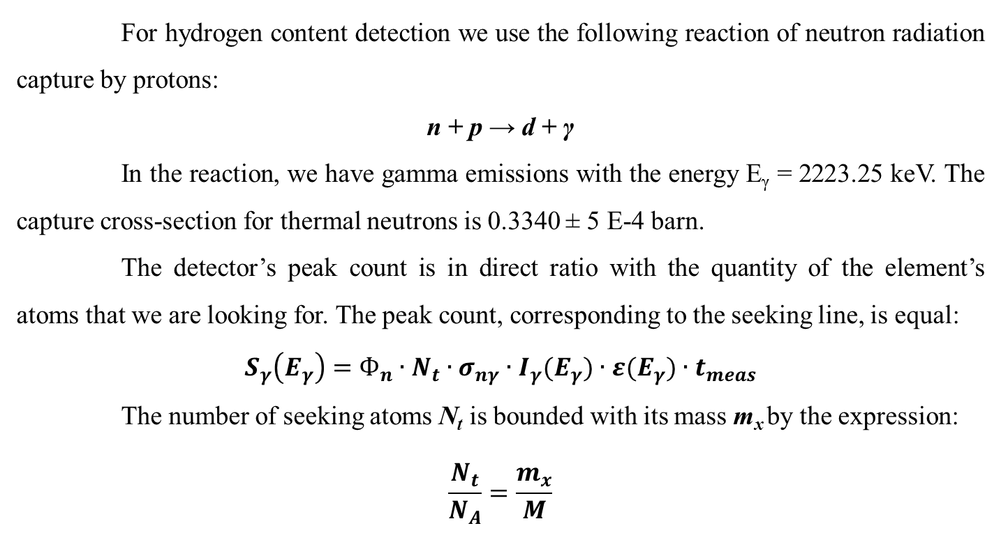
Setup’s sensitivity to ¹H detection
For hydrogen content detection we use the following reaction of neutron radiation capture by protons:
n + p → d + γ
In the reaction, we have gamma emissions with the energy E_{γ} = 2223.25 keV. The capture cross-section for thermal neutrons is 0.3340 ± 5 E-4 barn.
The detector’s peak count is in direct ratio with the quantity of the element’s atoms that we are looking for. The peak count, corresponding to the seeking line, is equal:
$$S_{γ}\left(E_{γ}\right)=Ф_{n}∙N_{t}∙σ_{nγ}∙I_{γ}(E_{γ})∙ε(E_{γ})∙t_{meas}$$
The number of seeking atoms N_{t} is bounded with its mass m_{x} by the expression:
$$\frac{N_{t}}{N_{A}}=\frac{m_{x}}{M}$$
JINR AYSS XI, June 05 – 12, 2022, Alushta, Russian Federation

Slide 16
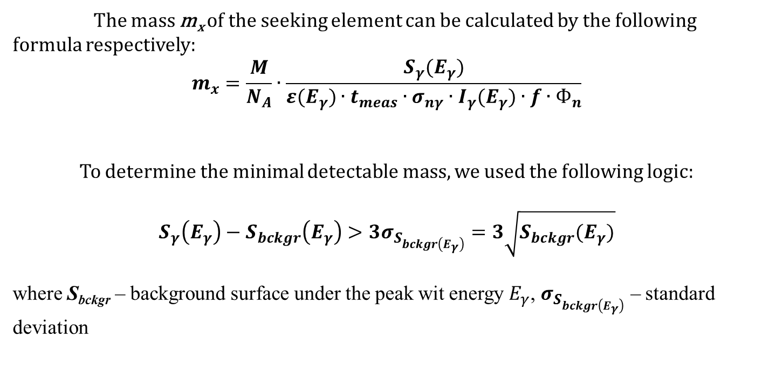
Setup’s sensitivity to ¹H detection
The mass m_{x} of the seeking element can be calculated by the following formula respectively:
$$m_{x}=\frac{M}{N_{A}}∙\frac{S_{γ}(E_{γ})}{ε(E_{γ})∙t_{meas}∙σ_{nγ}∙I_{γ}(E_{γ})∙f∙Ф_{n}}$$
To determine the minimal detectable mass, we used the following logic:
$$S_{γ}\left(E_{γ}\right)−S_{bckgr}\left(E_{γ}\right)>{3σ}_{S_{bckgr\left(E_{γ}\right)}}=3\sqrt{S_{bckgr}(E_{γ})}$$
where S_{bckgr} – background surface under the peak wit energy $E_{γ}$, $σ_{S_{bckgr\left(E_{γ}\right)}}$ – standard deviation
JINR AYSS XI, June 05 – 12, 2022, Alushta, Russian Federation

Slide 17
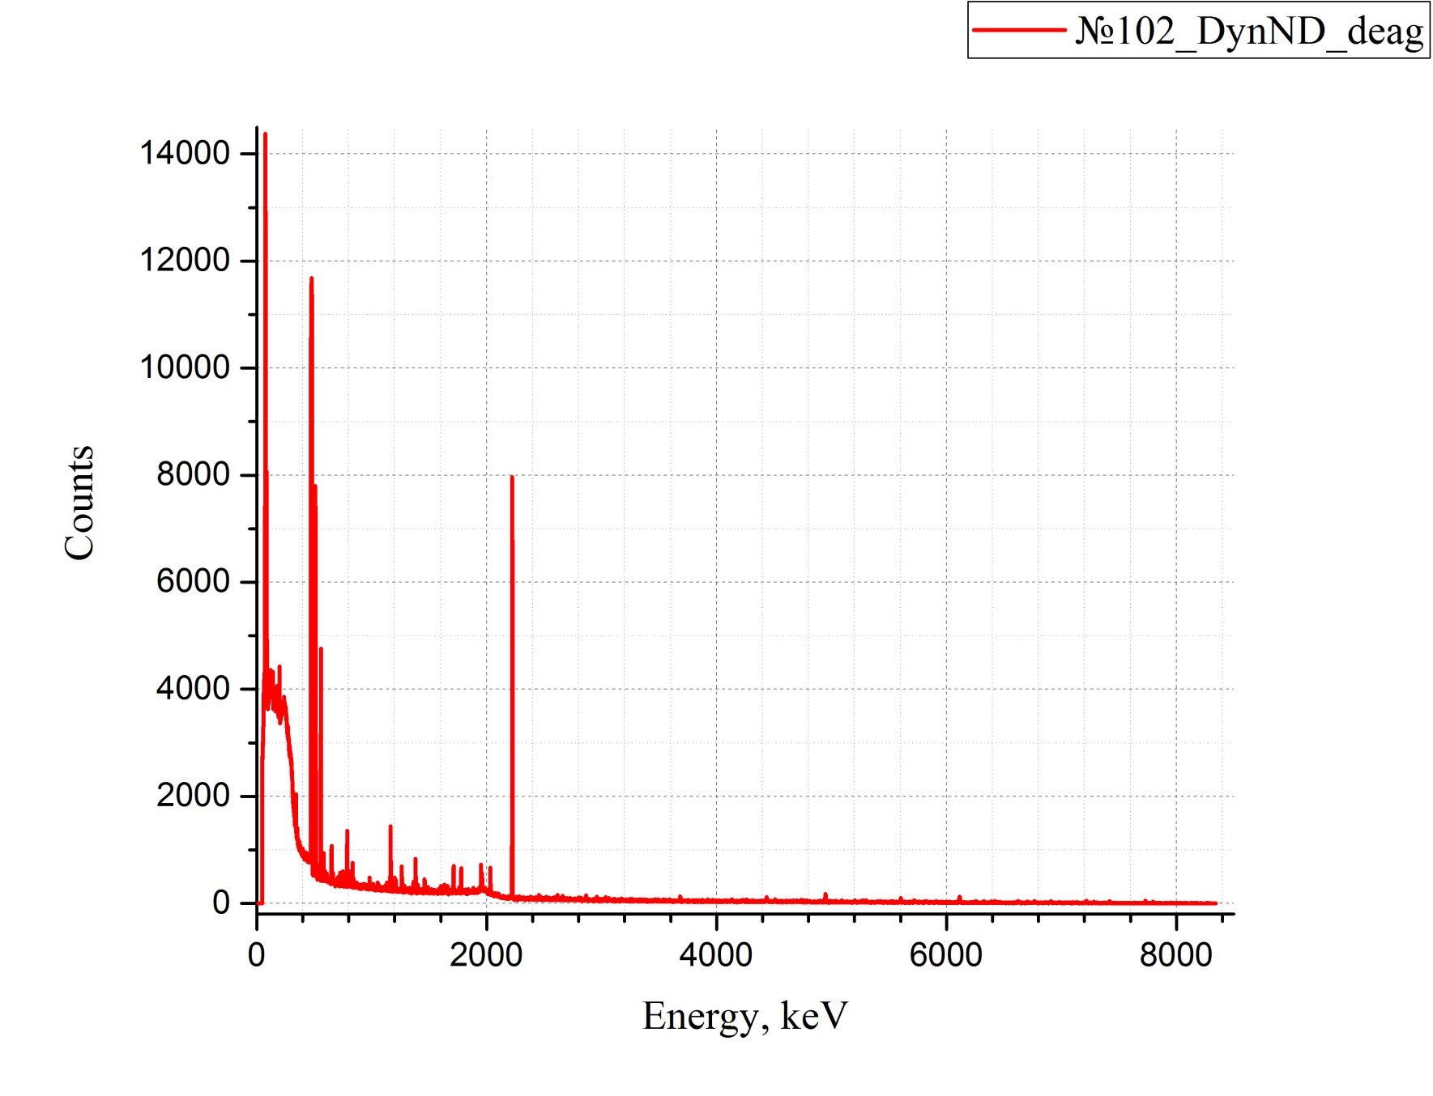
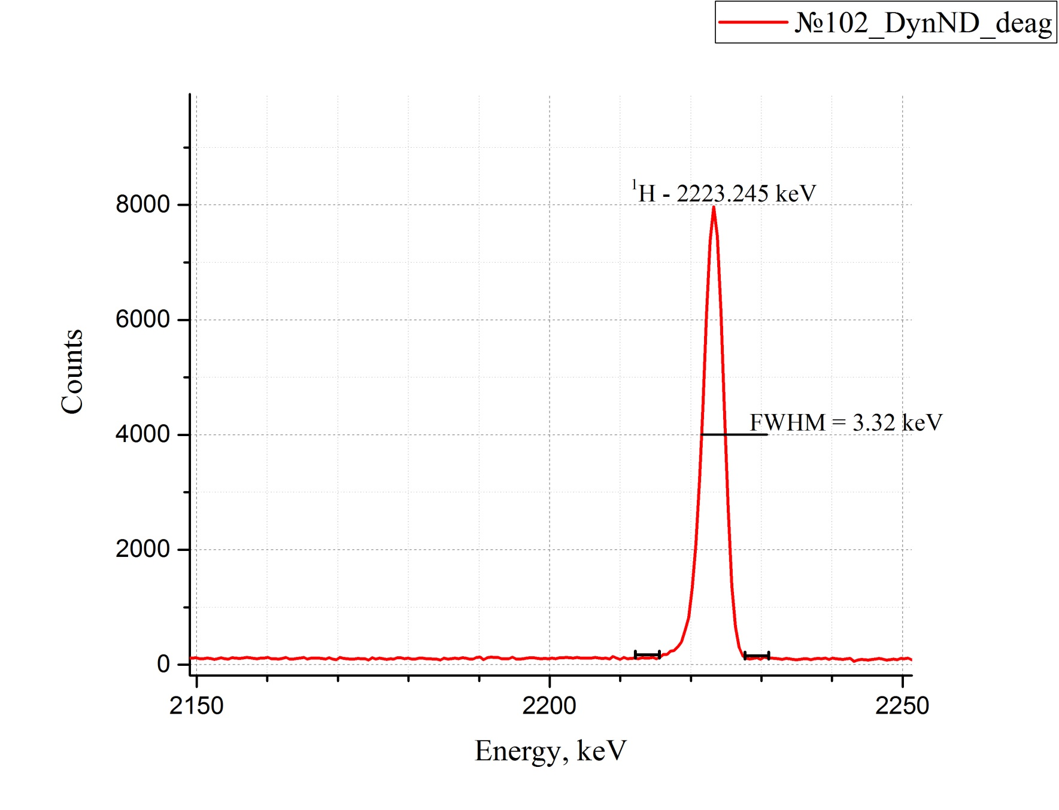
Setup’s sensitivity to ¹H detection
Package – 20 µm PTFE bag
m(sample) = 0.2 g
t_{meas} = 43 h
m(H) = 1.5 E-3 g
JINR AYSS XI, June 05 – 12, 2022, Alushta, Russian Federation

Slide 18
Setup’s sensitivity to ¹H detection
$$m_{x(min)}=\frac{M}{N_{A}}∙\frac{3\sqrt{S_{bckgr}(E_{γ})}}{ε(E_{γ})∙t_{meas}∙σ_{nγ}∙I_{γ}(E_{γ})∙f∙Ф_{n}}$$
M, g,mol | S_{bkgr}(E_{γ}) | N_{A}, 1/mol | ε(E_{γ}) | t_{meas}, sec | σ_{nγ}, barn | I_{γ}(E_{γ}) | f | Ф_{n}, n/cm²s
1 | 4773 | 0,6022 | 1.32E-3 | 154625.4 (43h) | 0.32 | 1 | 1 | 1.45E+6
m_{x(min)} = 3.6 E-6 g
JINR AYSS XI, June 05 – 12, 2022, Alushta, Russian Federation

Slide 19
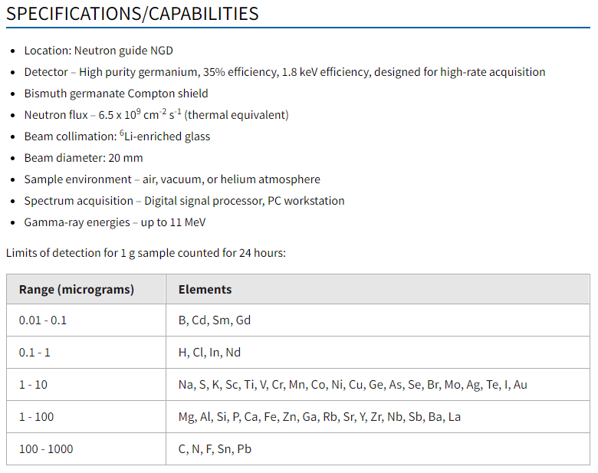
Comparison of the results
https://www.nist.gov/laboratories/tools-instruments/prompt-gamma-ray-activation-analysis-pgaa
“Matrix- and background-free detection limits for PGAA at NIST cold neutron beam, assuming a 24-hour measurement and u = 10% precision from counting statistics.”
Lindstrom, R.M., Révay, Z. Prompt gamma neutron activation analysis (PGAA): recent developments and applications // J. Radioanal. Nucl. Chem., 314, 843–858 (2017). https://doi.org/10.1007/s10967-017-5483-8
JINR AYSS XI, June 05 – 12, 2022, Alushta, Russian Federation

Slide 20
Future plans
To improve the detection limit there is planned to make a few modifications:
– installation of anti-Compton protection for the gamma detector,
– modifying the protection against scattered neutrons in the sample surrounding.
The above changes will allow us to further reduce the background gamma radiation, which will allow us to register a better signal-background ratio, consequently, will improve the minimum detectable level of the target nuclei of the sample.
JINR AYSS XI, June 05 – 12, 2022, Alushta, Russian Federation

Slide 21
Summary
1. Experimental setup for elemental analysis using prompt gamma rays at research reactor IBR-2, FLNP JINR has been successfully built.
2. Was done the simulations of fast neutron distribution in collimator assembly using the MCNP software, which helped in a better understanding of the sources of induced gamma background.
3. The signal-to-background ratio has been improved. The level of the substrate in the accumulated spectra has been successfully reduced by more than 140 times for natural gamma radiation and more than 800 times for neutron-induced activity.
4. The minimum level of hydrogen detection (3.6 µg) for this setup was determined by the example of the analysis of nano-diamond powder.
5. Opportunities for improvement and prospects of the installation of elemental analysis by instantaneous gamma quanta were indicated.
JINR AYSS XI, June 05 – 12, 2022, Alushta, Russian Federation

Slide 22
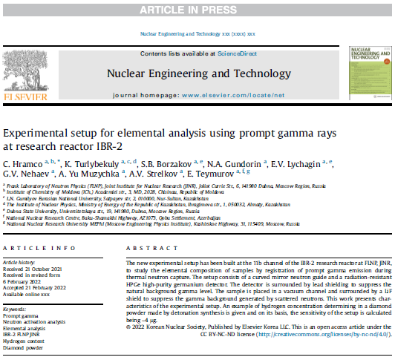
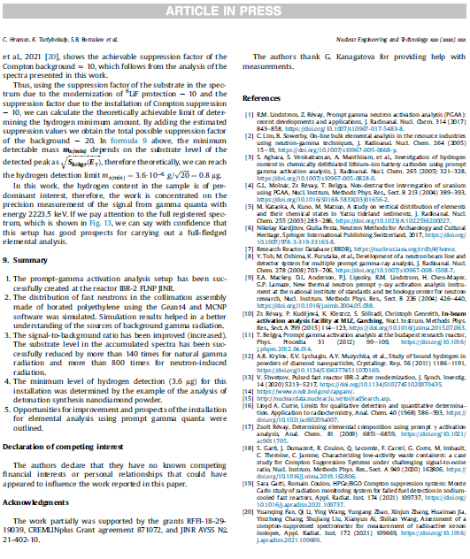
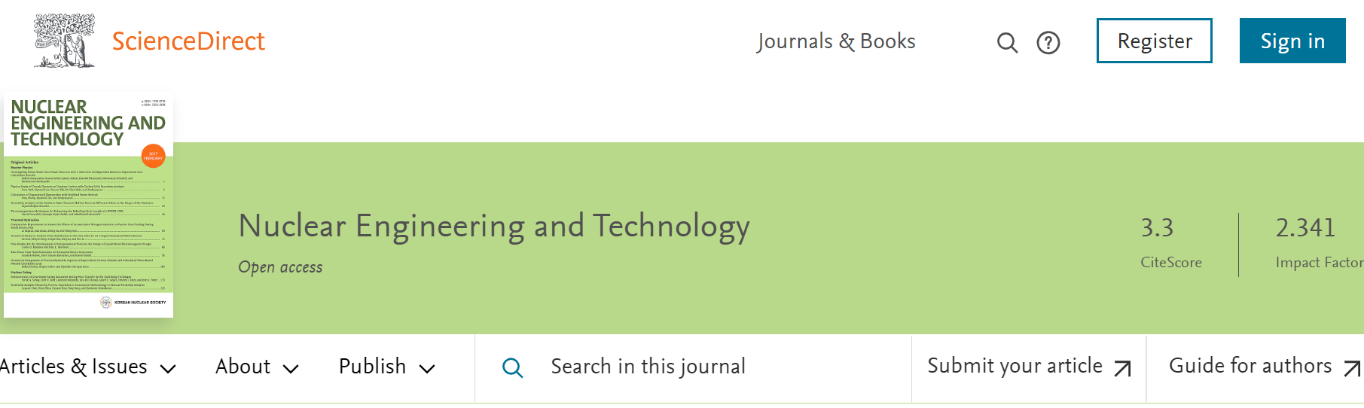
JINR AYSS XI, June 05 – 12, 2022, Alushta, Russian Federation

Slide 23
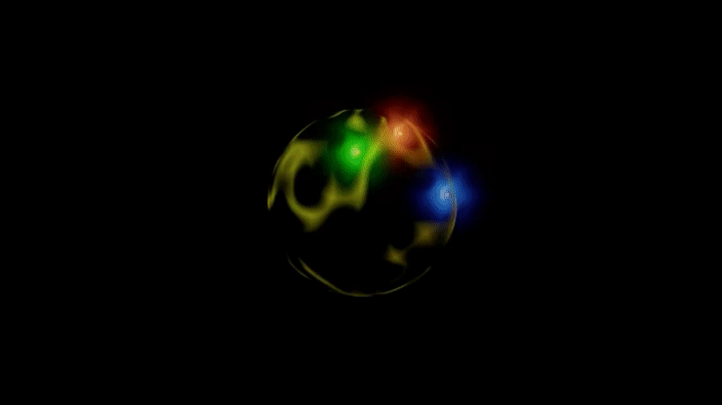
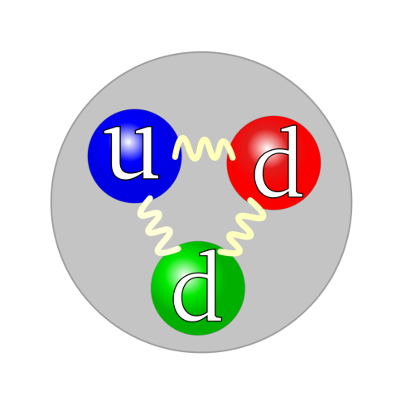
Thank you for
attention!
JINR AYSS XI, June 05 – 12, 2022, Alushta, Russian Federation

