Slide 1
Measurement of the detail of the transverse beam distribution by a non-destructive diagnostic method based on the ionization of residual gases
Аlushta – 2022
К. D. Timoshenko, Yu.G. Teterev, А.I. Krylov, S.V. Mitrofanov, А. Issatov
Speaker К. D. Timoshenko

Slide 2
Plan of the report
Motivation
Beam Diagnostics at the FLNR Accelerator Complex
Beam Profile Monitor
Conclusions

Slide 3
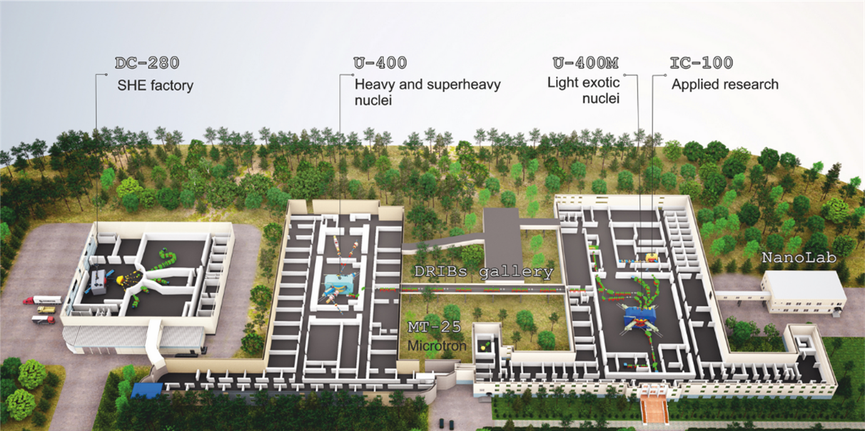
Motivation
The laboratory has four cyclotrons, which makes it possible to use beams of various ions in applied research in the energy range from 1 to 50 MeV/nucleon. The used beams can be of completely different transverse dimensions. Often, one of the requirements for these beams is a uniform distribution of the flux density in the working area.

Slide 5
Ion beam diagnostic methods :
Contact methods;
Non-destructive methods.

Slide 6
Contact methods
Faraday cup
Grid detectors, secondary radiation monitors, SEM
Phosphor screens

Slide 7
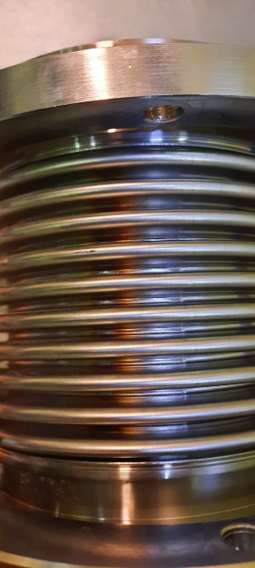
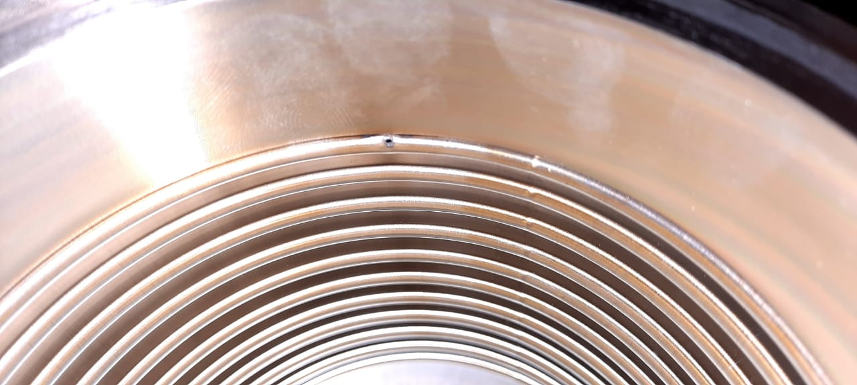
Disadvantages of contact methods
A serious problem for high-current accelerators is the high beam density, which can destroy equipment and bring magnets out of the superconducting condition.
Destructive effect on the beam. The loss of even a small fraction of an intense beam will lead to huge radiation and equipment destruction.
Hit of a high-intensity ion beam into the bellows at the DC-280 accelerator. Dubna

Slide 8
Requirements for non-destructive diagnostic methods
Sensitivity
Dynamic Range
Response time
Response to overexposure (saturation effects)
Physical size
Possibility of verification
Calibration technology

Slide 9
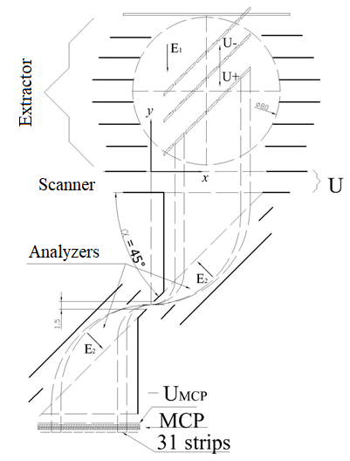
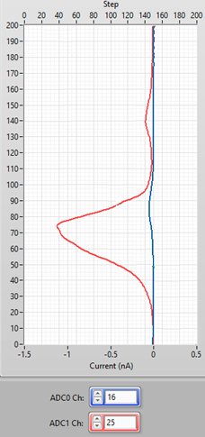
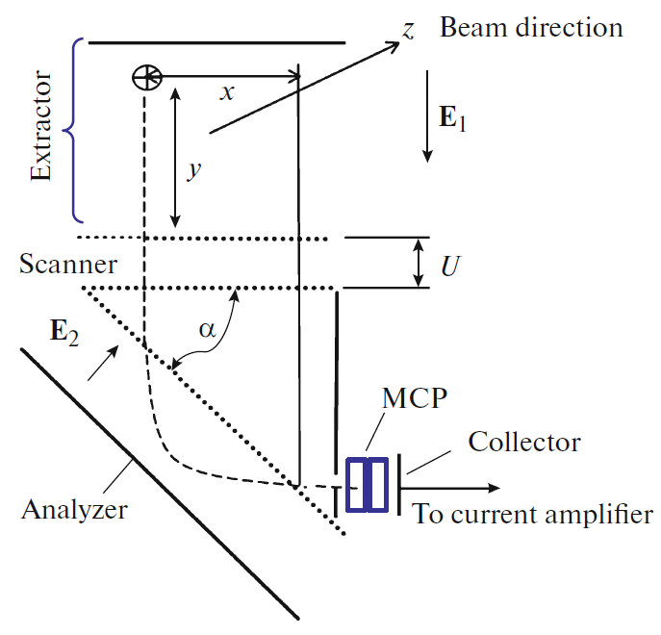
Upgraded two-dimensional Ionization Beam Profile Monitor
The monitor consists of :
extractor;
scanner;
2 electrostatic analyzers.
$$E_{1} y+U=E_{2}\frac{x}{\sqrt{2}}$$
Signal from strip 16 and 25
Two-dimensional Ionization Beam Profile Monitor
Upgraded two-dimensional Ionization Beam Profile Monitor

Slide 10
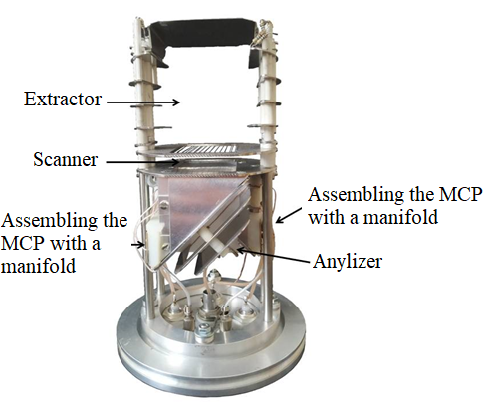
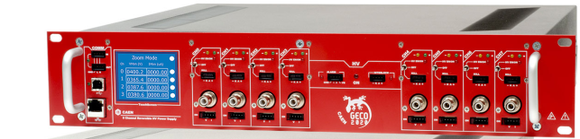
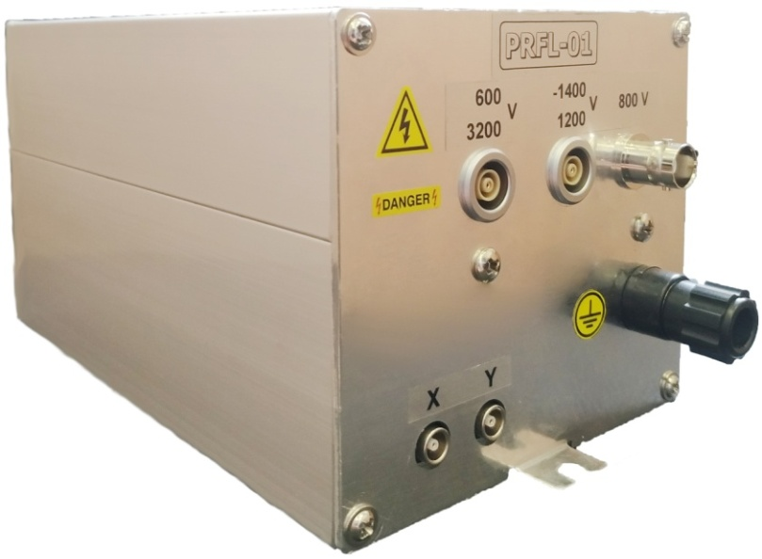
Two-dimensional Ionization Beam Profile Monitor
Screenshot of the program for working with the ion beam profile monitor

Slide 11
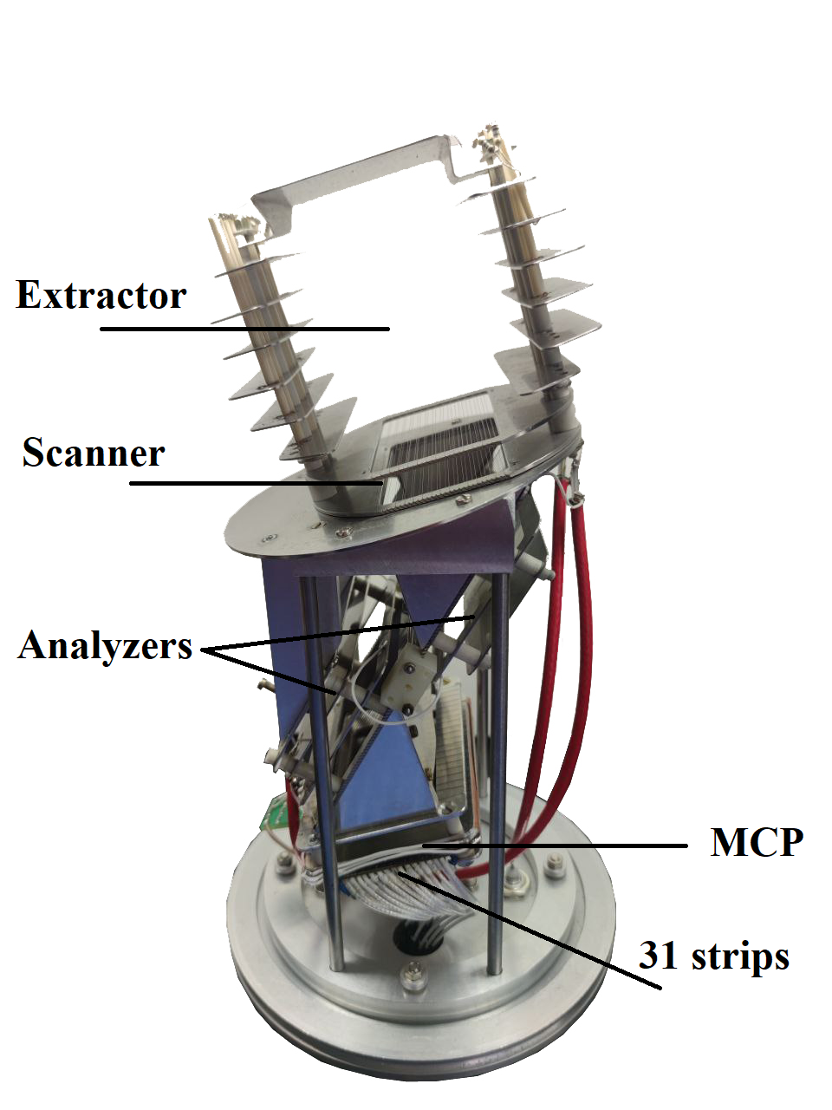
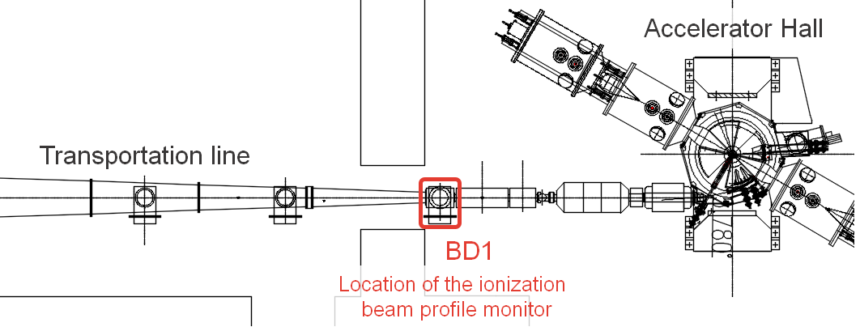
Location on the IC-100
Parameter | Meaning
Ion energy, MeV/nucle | 0,9-1,1
Range of accelerated ions | A / Z = 5,0-5,95
Working vacuum in the cyclotron, Torr | $${5∗10}^{−8}$$
Long-term stability of the extracted beam current, % | ± 10-15
Basic parameters of the IC-100 accelerator

Slide 12
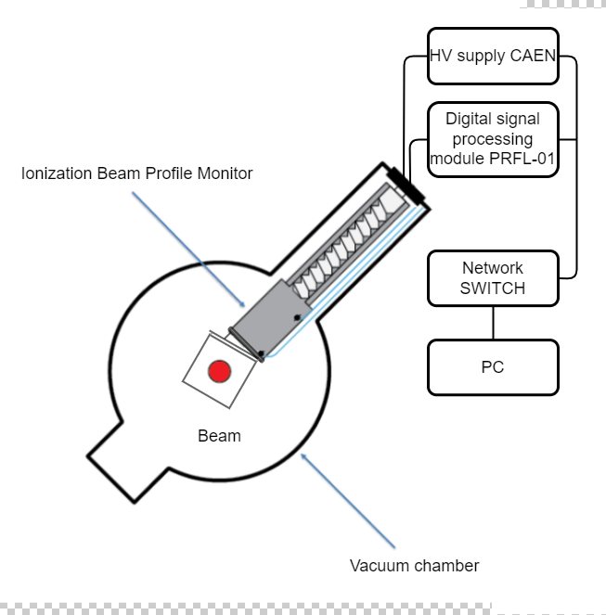
Electrical equipment for operation of the ionization beam profile monitor
The control and information processing system is designed to supply operating voltages, provide an algorithm for switching on, switching off and operating, taking measurements from an ionization profilometer. Displaying the received information in graphical form on a computer

Slide 13
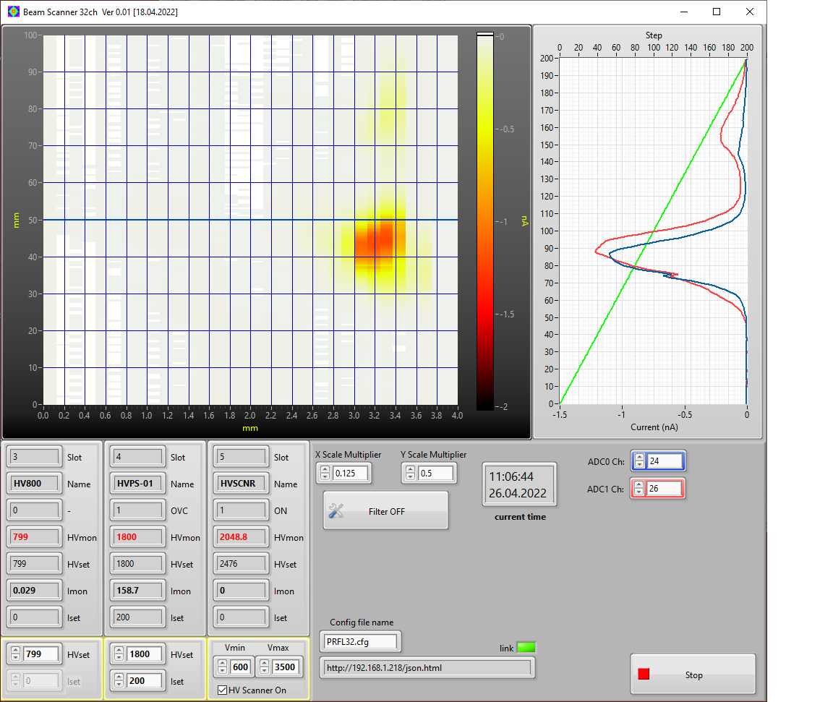
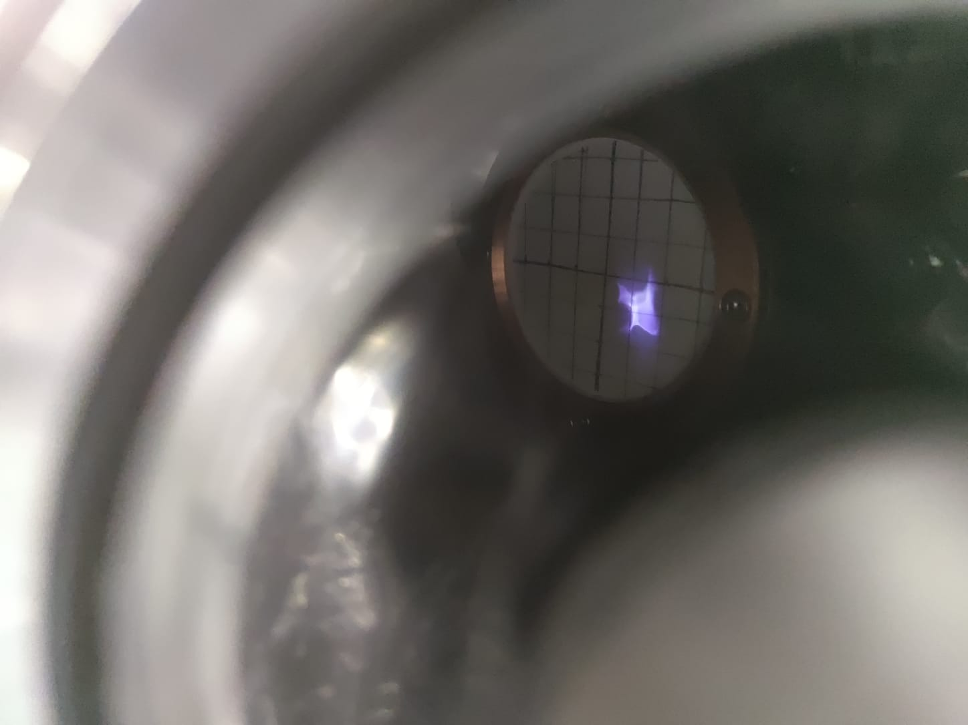
Beam Profile Monitor Test
Screenshot of the program for working with the ion beam profile monitor
Photo of the beam on the phosphor screen

Slide 14
Conclusions
The measurements were carried out at the IC-100 accelerator at the Laboratory of Nuclear Reactions of the Joint Institute for Nuclear Research. Based on the results obtained, it can be said that the graph, one of whose coordinates represents the strip number, the other the scanning voltage U, and the value of the current from the strip along the z axis, is a detailed graph of the two-dimensional beam transverse profile.
There is no need to use a second analyzer after the scanner, deployed at ${180}^{о}$ in relation to the first one. This fact makes it possible to double the length of the first analyzing capacitor in the beam direction, and hence the sensitivity.
At the stage of testing the beam profile monitor at the IС-100 accelerator, we saw an ion beam on the phosphor and in the profilometer program. It is necessary to finalize the software, the signal processing algorithm.
In the future, it is planned to install and conduct a series of experiments of such systems at the U-400 cyclotron and further at all basic FLNR facilities at JINR.

Slide 15
Measurement of the detail of the transverse beam distribution by a non-destructive diagnostic method based on the ionization of residual gases
Аlushta – 2022
К.D. Timoshenko
Email: timoshenkokd@jinr.ru

