Slide 1
Induction and repair of DNA double strand breaks in melanoma B16 cells in the presence of repair inhibitors under the action of X-rays in vitro
Dubna State University
Laboratory of Radiation Biology, JINR
Kuzmina E.A., Boreyko A.V., Chausov V.N., Erhan S.E., Ilyina E.V., Kozhina R.A., Shamina D.D., Tiounchik S.I, Zadneprianetc. M.G.
JINR Association of Young Scientists and Specialists Conference “Alushta-2022”

Slide 2
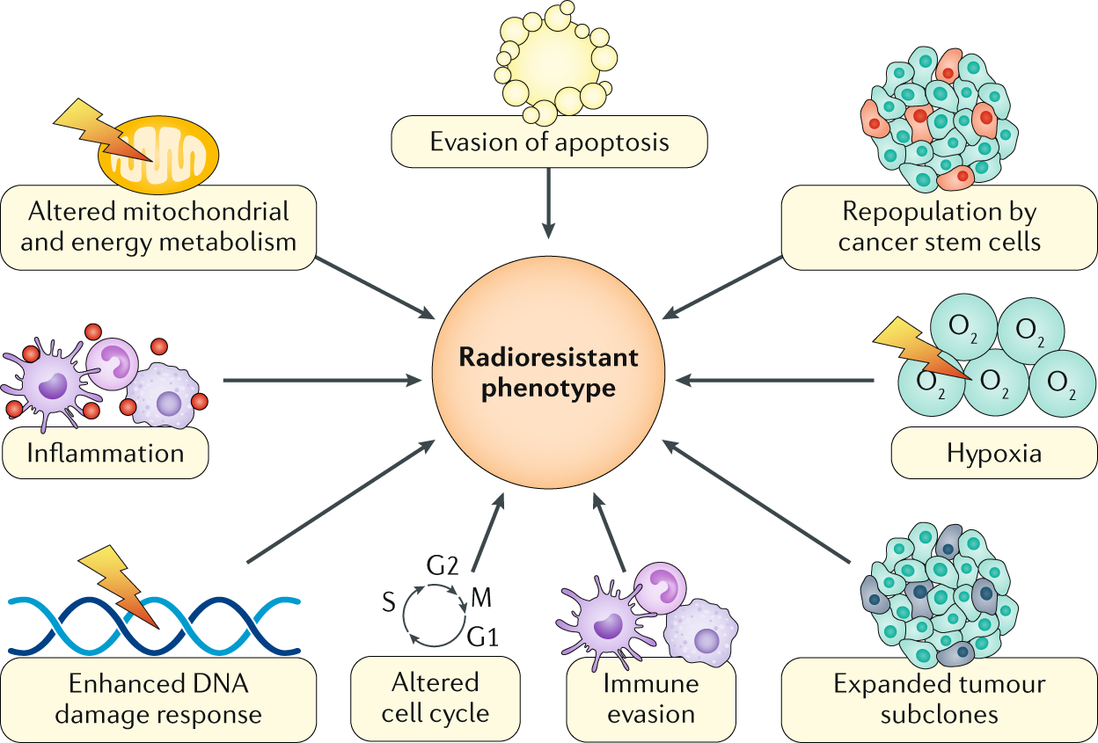
Relevance

Slide 3
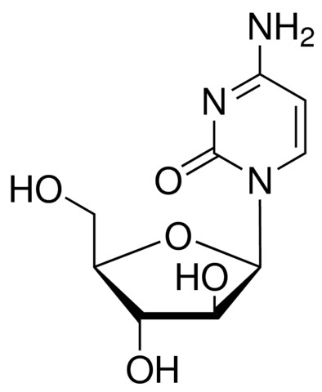
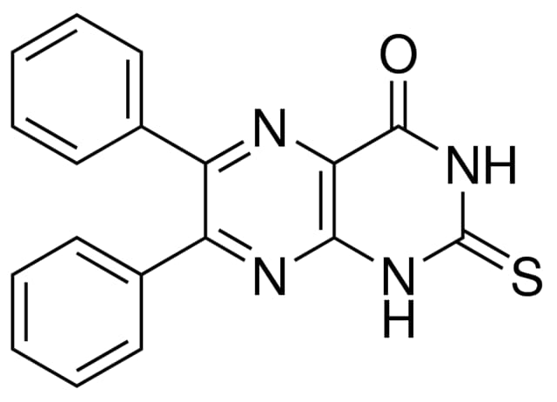
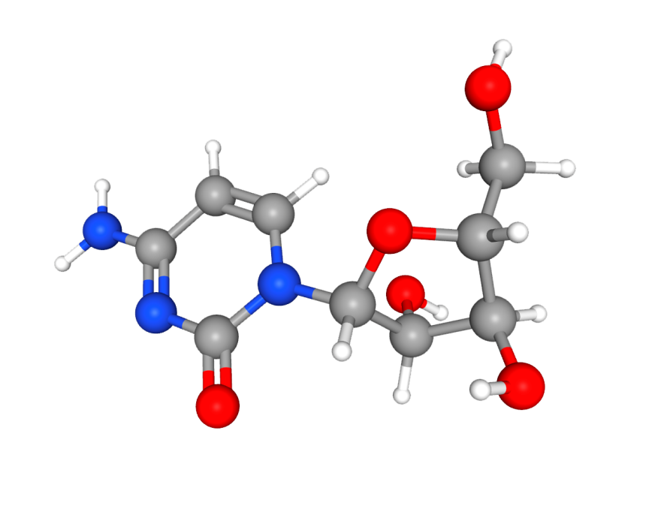
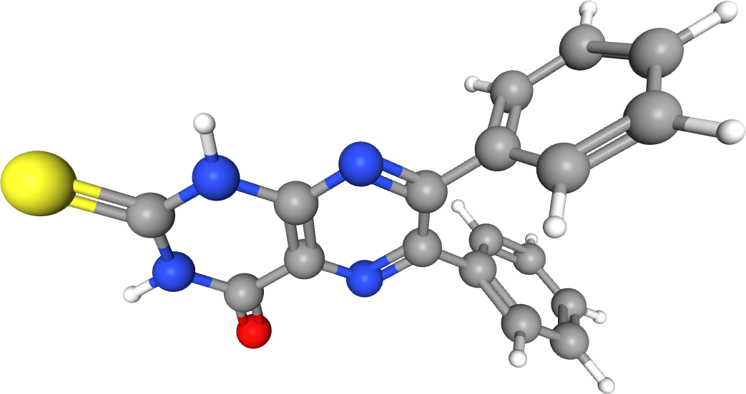
Repair inhibitors
1-β-D-arabinofuranosylcytosine (AraC)
SCR7 pyrazine
(SCR7)

Slide 4
Goals
Study of the modifying effect of repair inhibitors AraC and SCR7 on the formation of DNA double-strand breaks (DSB) in melanoma B16 cells after irradiation with X-rays in vitro.
Studying the repair kinetics of DNA DSB in melanoma B16 cells influence of radiomodifiers after irradiation with X-rays.
A comparative analysis of the yield and repair of DNA damage in the presence of repair inhibitors during irradiation with X-rays in melanoma B16 cells in vitro.

Slide 5
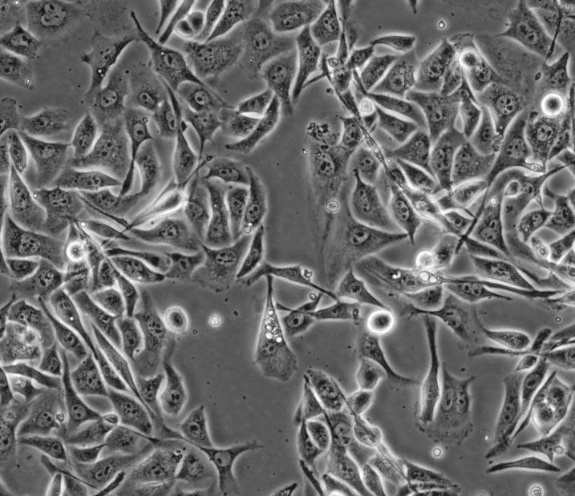
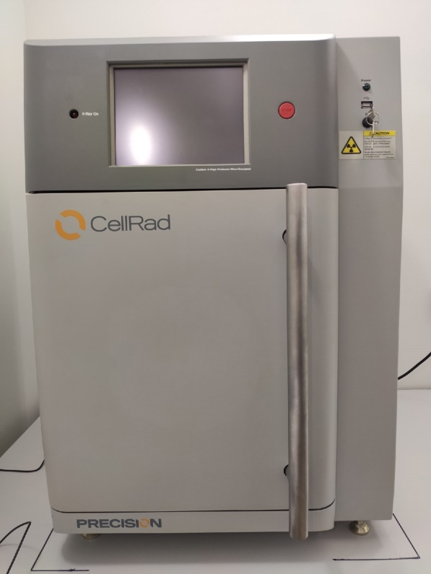
Objects of study
Melanoma cell culture: B16
Irradiation: X-rays
Dose: 1-5 Gy
Dose rate: 1.6 Gy/min
Compact Benchtop X-ray Irradiator “CellRad"
Laboratory of Radiation Biology, JINR

Slide 6
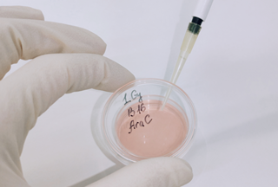
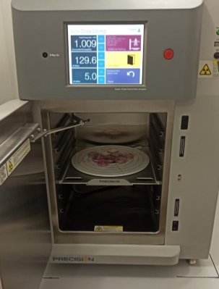
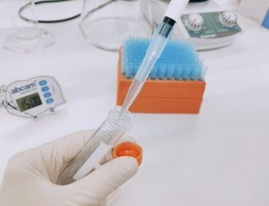
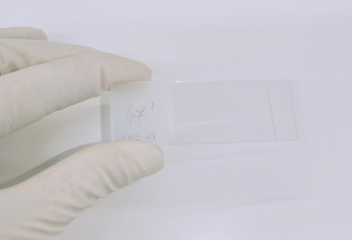
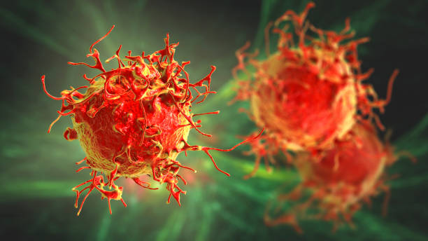
The scheme of the experiment
Introduction of repair inhibitors
Concentration of AraC and SCR7: 50 µM and 100 µM
Preparation of cell suspension
1 hour
Preparation of slides
Irradiation
The study of the formation of
DSB of DNA method of
DNA comet assay

Slide 7
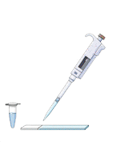
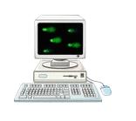
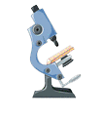
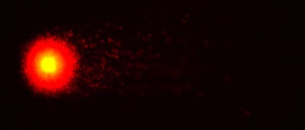
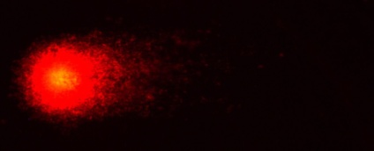
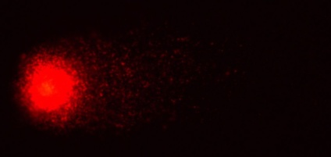
Comet assay
Staining and
visualization
Cell suspension with
low melting point agarose
Fixation
0 Gy
1 Gy
Neutralization
3 Gy
Lysis of the cell’s wall
5 Gy
Washing slides and electrophoresis

Slide 8
The induction of DNA DSB under the action of repair inhibitors in melanoma B16 cells after irradiation with X-rays
P$≤0,05$
Dose modifying factor
X-rays | AraC/control | 1,4
 | AraC+SRC7/control | 1,6
 | AraC+SRC7/AraC | 1,15

Slide 9
The kinetics of DNA DSB repair in melanoma B16 cells under the action of AraC and SCR7 after irradiation with X-rays
P$≤0,05$
Dose modifying factor (5 hours)
X-rays | AraC/control | 5,8
 | AraC+SRC7/control | 10,3
 | AraC+SRC7/AraC | 1,76

Slide 10
Conclusion
It was found that under the combined action of AraC/SCR7, the maximum amount of DNA DSB is formed, exceeding the amount of DNA DSB in the control level by 1.6 times, and 1.15 times under the influence of AraC.
It was shown that the repair kinetics is complex. In contrast with the control, the DNA DSB yield increases up to 6 hours post-irradiation, and then decreases.
Moreover, under the influence of the combined action of radiomodifiers the number of unrepaired lesions exceeds the control level by 10.3 times and by 1.76 times under the action of AraC alone.

Slide 11
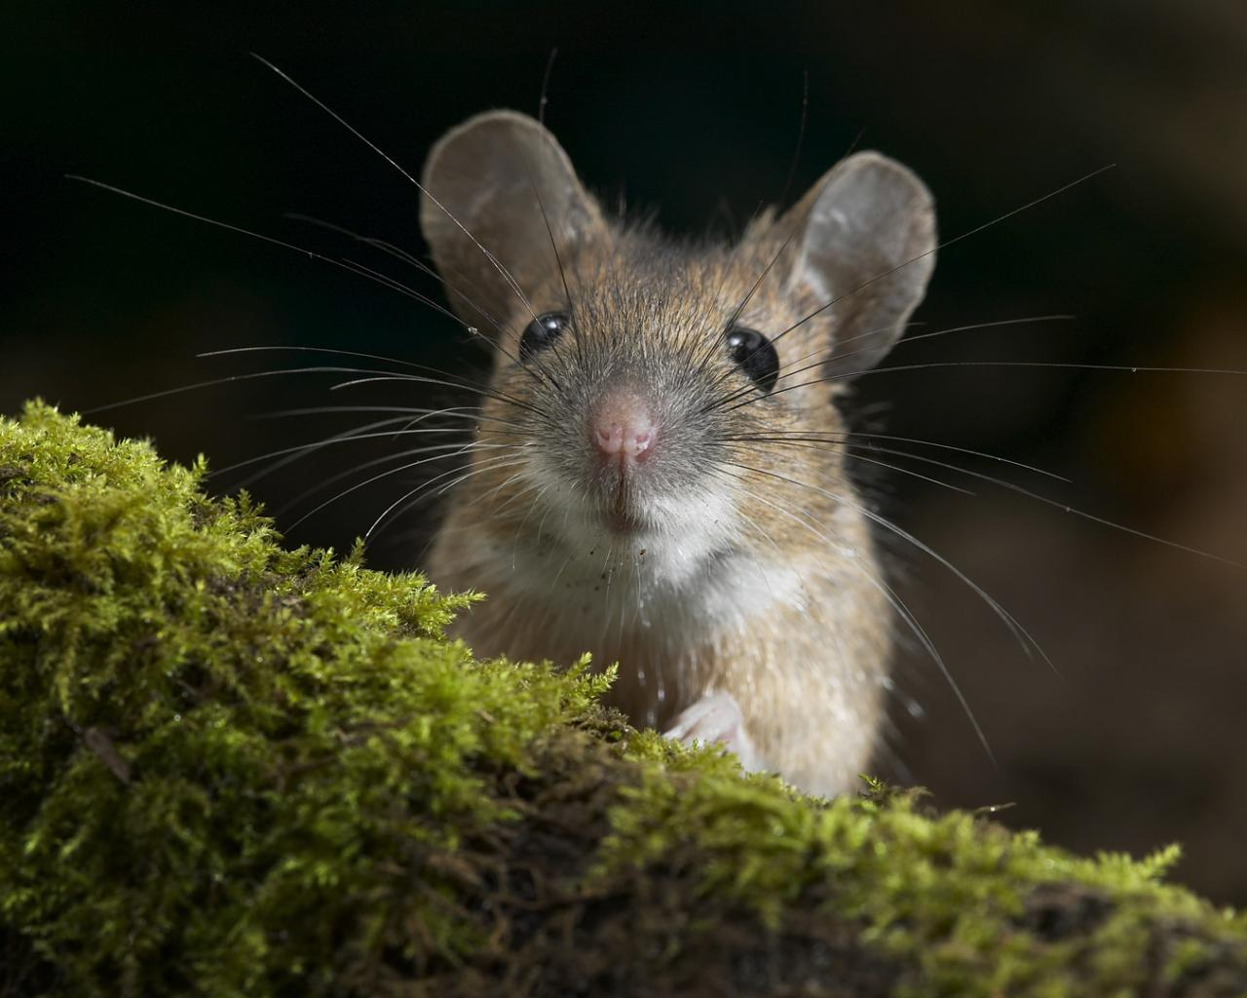
Thanks for the attention!

