Slide 1
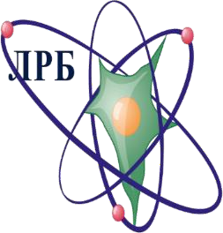
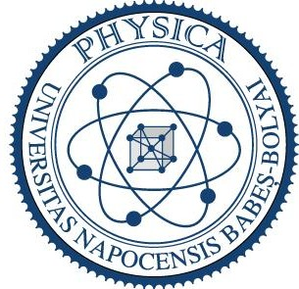
Effect of the combined use of proton radiation and AraC on morphological changes in the liver of rats
Yurii Severiukhin¹, Elena-Mădălina Ignat^{1,2} ,Maria Lalkovicova¹, Inna Kolesnikova¹ ,
Evginia Pronskikh¹ , Kristina Golikova¹, Dina Utina ¹
Joint Institute for Nuclear Research, Laboratory of Radiation Biology, Dubna, Russian Federation
2. “Babeș-Bolyai” University, Faculty of Physics, Department of Biomolecular Physics, Cluj Napoca, Romania
Contact address: severiukhin@jinr.ru

Slide 2
Purpose
Among ischemic heart disease and stroke, cancer is one of the leading causes of death worldwide. The most common treatment is represented by a combination of radiation therapy, chemotherapy, targeted therapy and surgery.
The idea of using cytostatic drugs to increase the efficiency of radiation therapy is of great interest. The aim of our study is to analyze the morphological changes determined by the combined use of AraC and proton irradiation in the liver of rats. We proposed a preclinical study and provided quantitative analysis results after the microscope investigation.

Slide 3
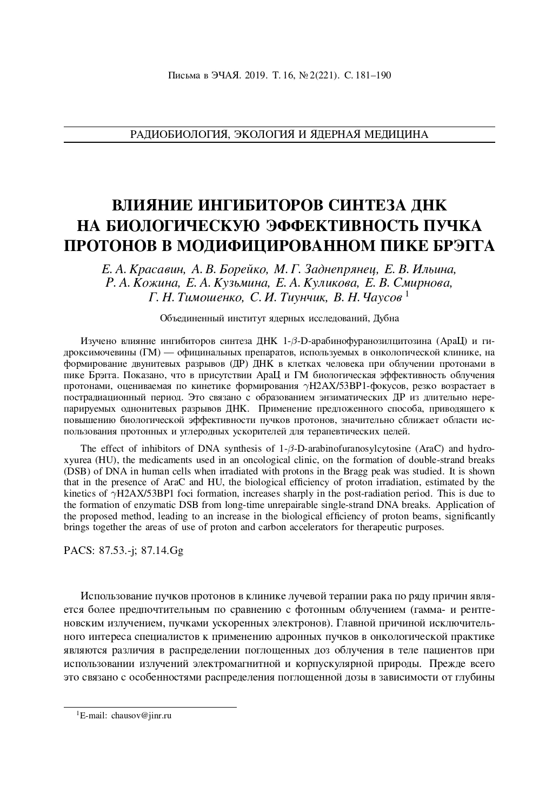
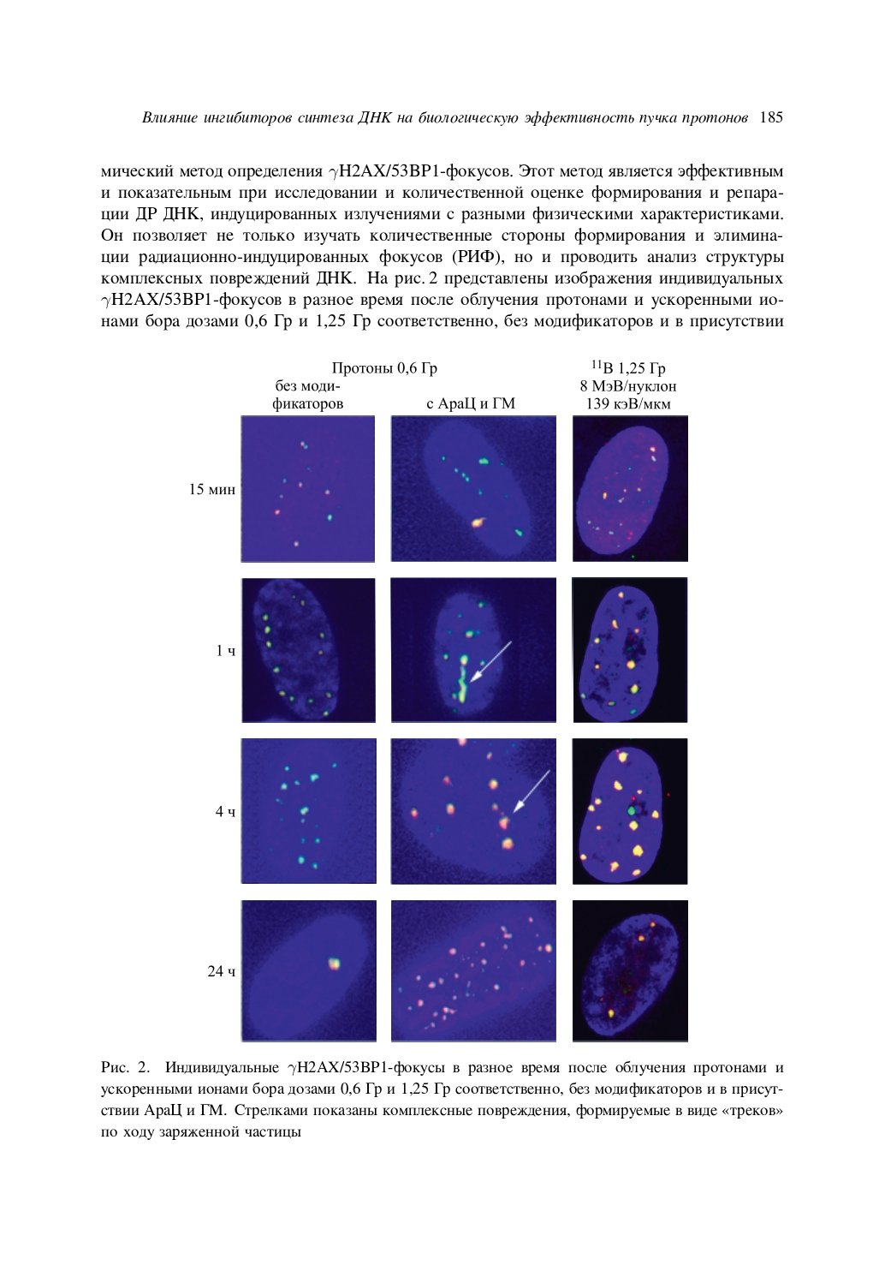
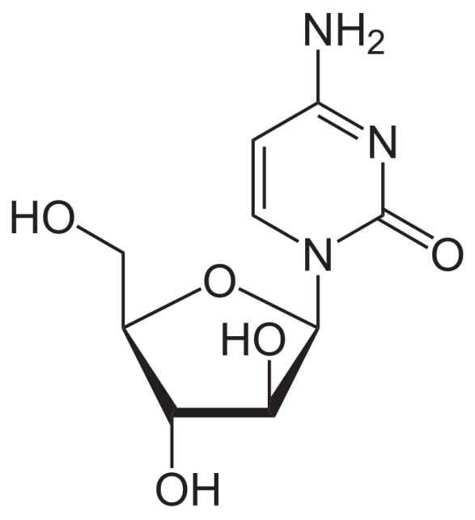
Research Background
4-amino-1-[(2R,3S,4R,5R)-3,4-dihydroxy-5- (hydroxymethyl)oxolan-2-yl] pyrimidin-2-one
Cytarabine (cytosine arabinoside, Ara-C)

Slide 4
Methods and materials
The experiments were carried out at the Laboratory of Radiation Biology from the Joint Institute for Nuclear Research.
Research topic "Research on the Biological Effect of Heavy Charged Particles with Different Energies", with the 04-9-1077-2009/2023 theme code from the JINR Topical Plan.
The maintenance and all procedures on animals were carried out in accordance with the “International Recommendations for Biomedical Research Using Animals” of the Council of International Medical Organizations (CIOMS), Geneva 1985.

Slide 5
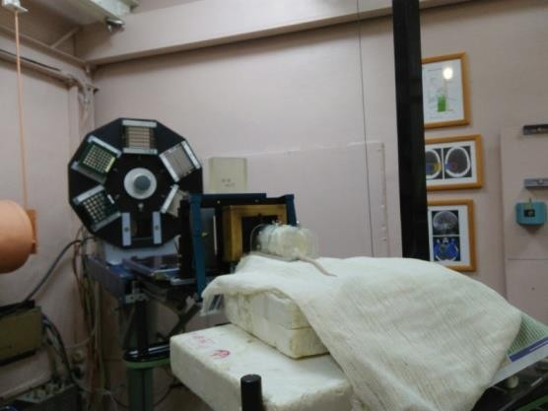
Methods and materials
16 male, Sprague Dawley rats;
Average weight of 160 grams, being 7 weeks old
12 received a 3Gy dose of protons with 170 MeV energy in the cranio- caudal direction at a 0.8 Gy/min dose rate
The AraC dose of 0.4 g/m^2 was administrated into the tail vein 1-1.5h before the irradiation procedure
Irradiation procedure at the Phasatron of DLNP JINR; experimental
equipment with fixing containers

Slide 6
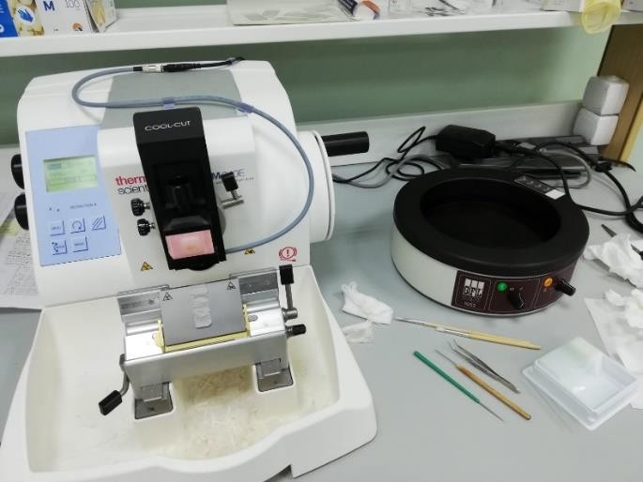
Methods and materials
The organs were harvested at 4, 24 and 48 hours after irradiation.
In order to preserve the organs in good conditions a dehydration protocol was followed.
The organs underwent a paraffinization
procedure and were placed into filling rings
Using Thermo ScientificTM HM 340E Electronic Microtome Cool-Cut 12 slides with 8 micrometers thickness were prepared for each paraffin embedded organ.
The slides were stained using Mayer Hematoxylin and Eosin method.
Electronic microtome and the additional equipment for
cutting slices (flotation bath, tweezers, brushes, glasses)

Slide 7
Methods and materials
Experimental groups
4h_3Gy group – 2 animals;
4h_3Gy+AraC – 2 animals;
TIMEPOINTS
24h control group – 2 animals;
24h_AraC– 2
animals;
24h_3Gy group
– 2 animals;
24h_3Gy+AraC group – 2 animals;
48h_3Gy group
– 2 animals;
48h_3Gy+AraC group – 2 animals;

Slide 8
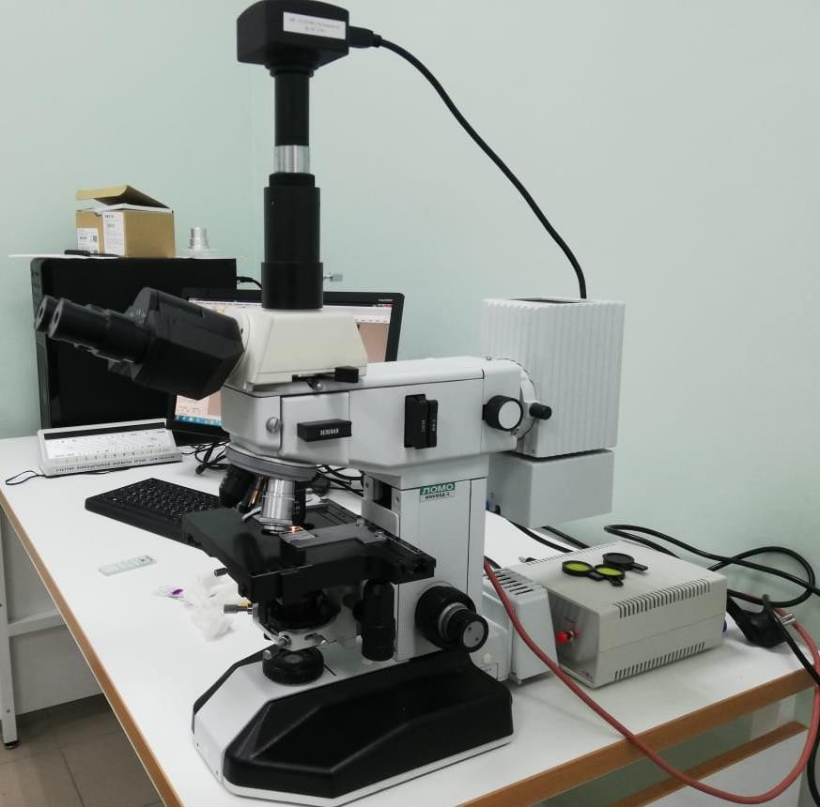
Methods and materials
The study of morphological changes was performed using a light microscope LOMOMikMed 2
For each tissue on every slide were acquired 10 pictures with the 40X magnification objective (NA 0.65)
ToupCamTM Industrial digital camera and ToupView processing application
Detection an morphological changes of the liver cells was performed using ImageJ (Cell Counter Plugin)
The LOMOMikMed 2 light microscope with the ToupCamTM

Slide 9
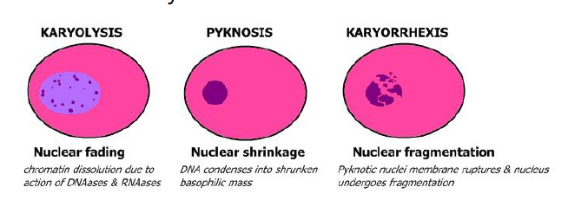
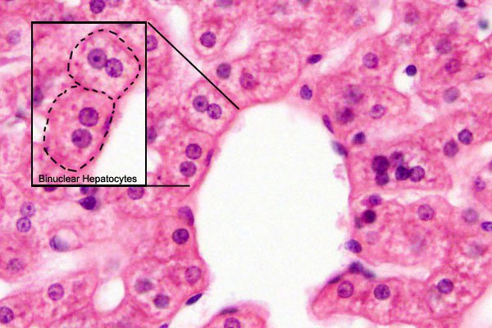
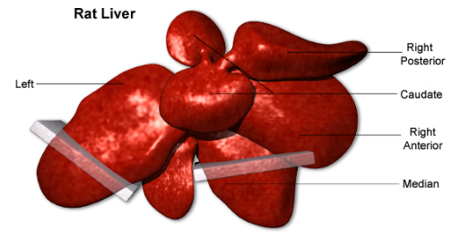
Methods and materials
https://embryology.med.unsw.edu.au/embryology/index.php?title=File%3ALiver_histology_004.jpg&mobileaction=toggle_view_mobile

Slide 10
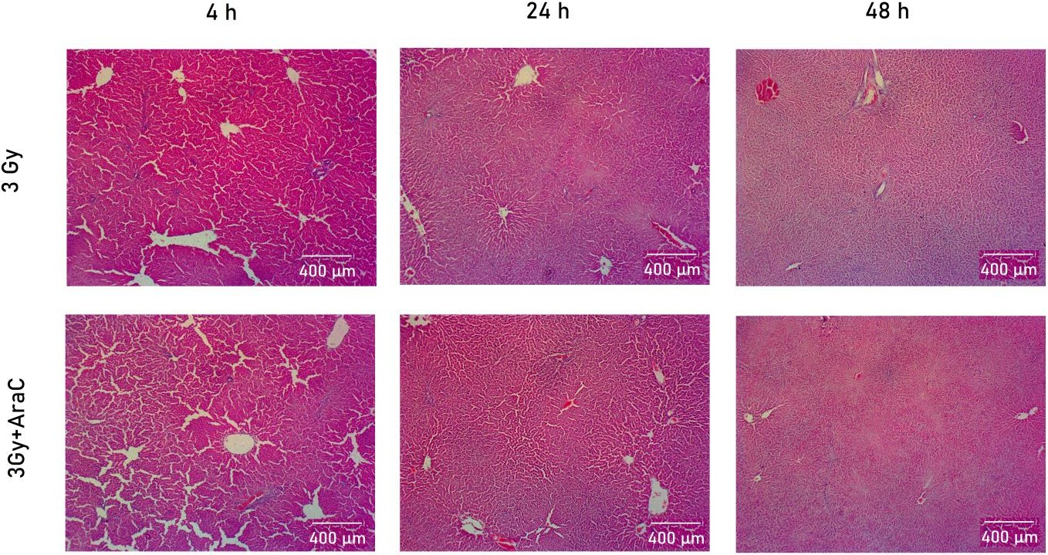
Results
Qualitative analysis
The liver parenchyma of irradiated rats showed a significant dilatation of the liver sinusoids in the periportal regions in the 4h_3Gy and 4h_3Gy+AraC groups
Images showing liver parenchyma

Slide 11
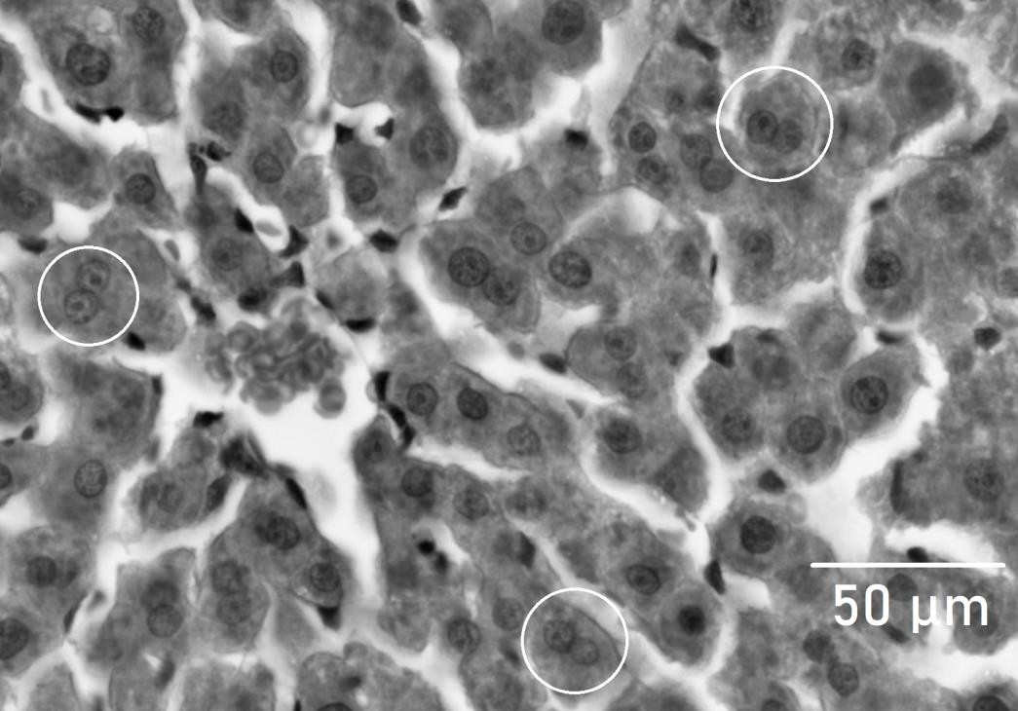
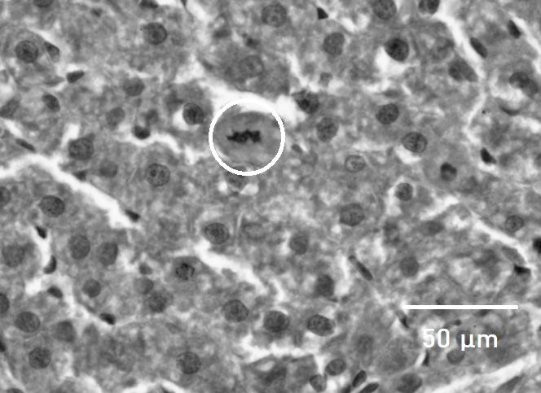
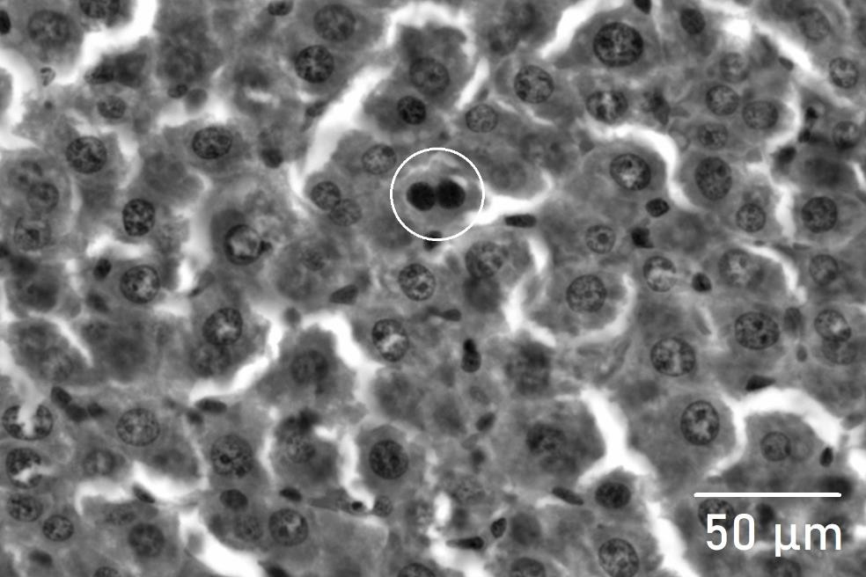
Results
Morphological changes
Binuclear hepatocytes – polyploidy;
Pyknosis – nuclear shrinkage;
Karyorrhexis – nuclear fragmentation;
Karyolisis – chromatin dissolution;
a)
Binuclear hepatocytes in rat liver 4h after irradiation
b)
Karyopyknosis in rat liver hepatocytes 24h after irradiation
c)
Karyorrhexis in rat liver hepatocytes 48h after irradiation

Slide 12
Results
Quantitative analysis
ImageJ software and the Cell Counter plugin for every type of cells
Group | Number of cells (%±SD)
 | Normal | Pyknosis (*) | Karyorrhexis | Karyolisis | Binuclear
4h_3Gy | 92,66±0,66 | 1,72±0,51 | 0,40±0,11 | 0,43±0,12 | 4,79±0,35
4h_3Gy+AraC | 93,66±0,60 | 1,65±0,40 | 0,55 ±0,13 | 0,73 ±0,17 | 3,41 ±0,42
24h | 93,09±0,70 | 1,69±0,68 | 0,27±0,17 | 0,41±0,12 | 4,53±0,80
24h_AraC | 90,04±0,99 | 6,63±1,13 | 0,30±0,10 | 0,53±0,13 | 2,50±0,30
24h_3Gy | 90,05±0,94 | 4,64±1,06 | 0,44±0,13 | 0,60±0,21 | 4,27±0,74
24h_3Gy+AraC | 90,04±0,60 | 5,48±0,90 | 0,27±0,17 | 1,00±0,37 | 3,22±0,47
48h_3Gy | 90,78±1,03 | 4,59±1,04 | 0,73±0,20 | 1,08±0,28 | 2,82±0,71
48h_3Gy+AraC | 83,37±2,31 | 11,69±2,16 | 0,51±0,11 | 1,41±0,39 | 3,02±0,45

Slide 13
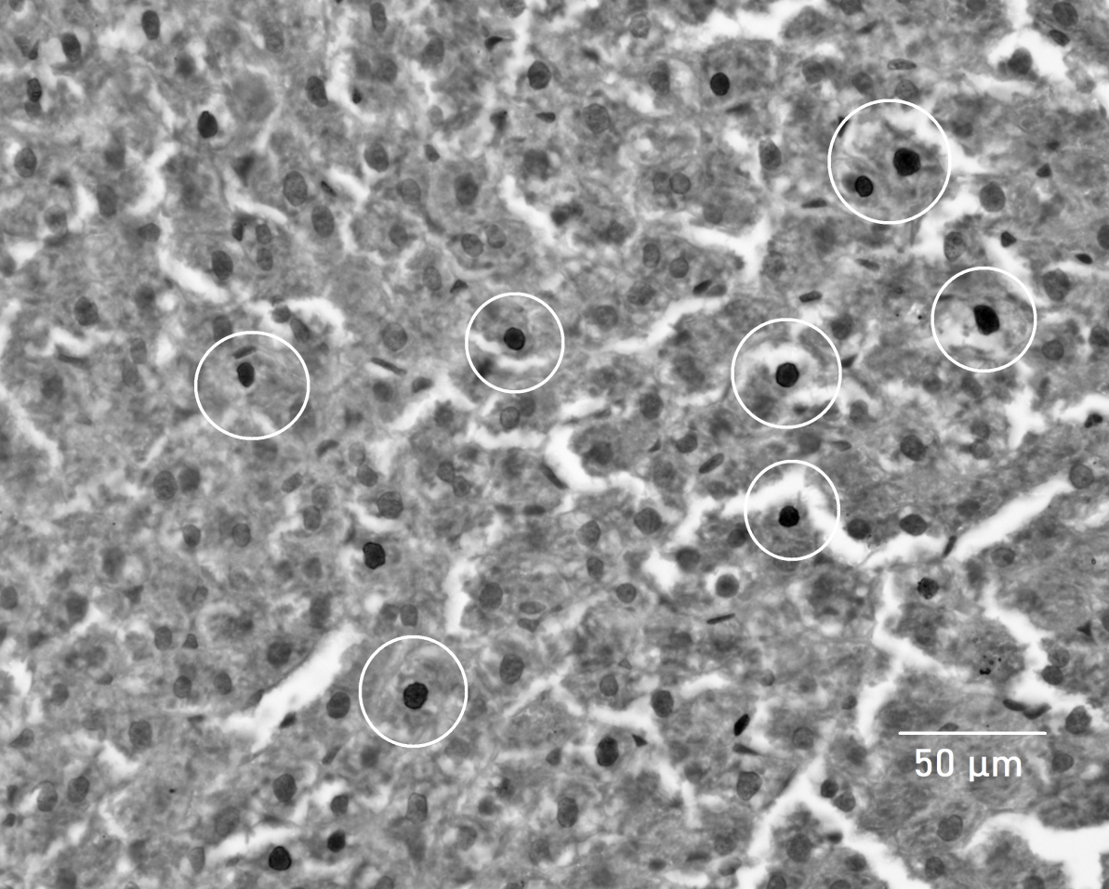
Results
Karyopyknosis in rat liver hepatocytes 48h after irradiation

Slide 14
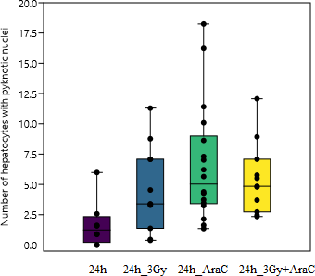
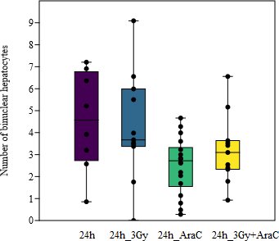
Results
Statistical analysis
PAST software was used to perform the Mann-Whitney Test and One-way ANOVA with the Mann-Whitney pairwise.
24h groups
Comparison between the number of hepatocytes with pyknotic nuclei in the 24h_groups; Statistical significance 24h and 24h_AraC (p=0.001); 24h and 24h_3Gy+AraC (p=0.005)
Comparison between the number of binuclear hepatocytes in the 24h_groups; Statistical significance between 24h and 24h_AraC (p=0.037); 24h_3Gy and 24h_AraC (p=0.026)

Slide 15
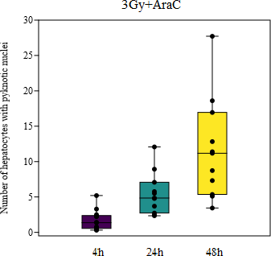
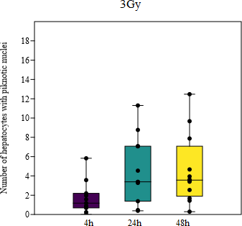
Results
Statistical analysis
Comparison between the number of cells in the 4h_3Gy+AraC, 24h_3Gy+AraC and 48h_3Gy+AraC
Comparison between the number of cells in the 4h_3Gy, 24h_3Gy and 48h_3Gy
Comparison between the number of hepatocytes with pyknotic nuclei in the 3Gy+AraC_groups; Statistical significance between 4h_3Gy+AraC and 24h_3Gy+AraC (p=0.0005); 4h_3Gy+AraC and 48h_3Gy+ AraC (p=0.00006); 24h_3Gy+AraC and 48h_3Gy+AraC (p=0.018)
Comparison between the number of hepatocytes with pyknotic nuclei in the 3Gy_groups; Statistical significance between 4h_3Gy and 24h_3Gy (p=0.049); 4h_3Gy and 48h_3Gy (p=0.017)

Slide 16
Conclusions and Further directions
At the first hours after irradiation a pronounced dilatation of sinusoidal capillaries was observed in the 4h_3Gy and in the 4h_3Gy+AraC groups.
At 24h groups an increase in the number of cells with pyknosis in the AraC treated groups was observed.
At 48h groups the long-term effect of the treatment was highlighted, showing the biggest amount of pyknotic hepatocytes in the 48h_AraC+3Gy group.
Our results pave the way to further research on the use of cytostatic drugs as a combination with radiation therapy.
A TUNEL assay is ongoing and the use of different immunohistochemical methods for the detection of apoptosis is planned.

Slide 17
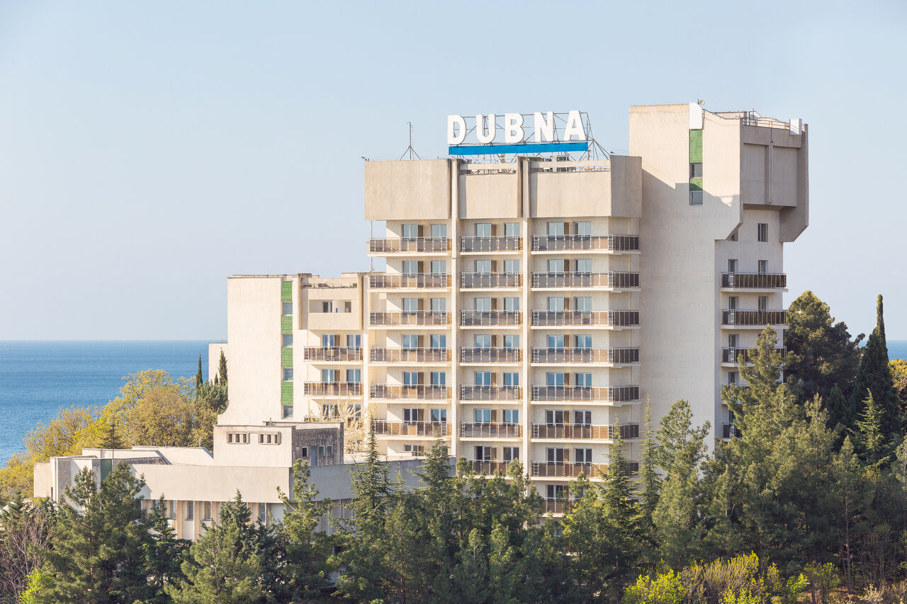
Thank you for attention!

