Slide 1
Production of π⁺ and K⁺ mesons in 3.2 AGeV argon-nucleus interactions at the Nuclotron
M.Kapishin, L.Kovachev, V.Plotnikov, Yu.Petukhov, I.Rufanov, M.Zavertyaev, A.Zinchenko
VBLHEP, JINR, Dubna, Russia
BM@N
collaboration meeting
14.09.2022

Slide 2
Outline
Run with argon beam (March 2018)
BM@N detector set-up
Data analysis (Ar+C, Ar+Al, Ar+Cu, Ar+Sn, Ar+Pb at 3.2A GeV)
Selection criteria
Reconstructed signal of π⁺/K⁺ (dN/dY & dN/p_{T} spectra)
Data ˗ MC agreement: multiplicity, momentum spectra
Decomposition of π⁺/K⁺ reconstruction efficiency
Trigger, luminosity and mean impact parameters
Cross section and yields of π⁺/K⁺
Reconstructed p_{T} spectra of π⁺/K⁺ and extracted inverse slope parameter
Systematic uncertainty and extrapolation factors
Summary and plans
14.09.2022
V.Plotnikov
2

Slide 3
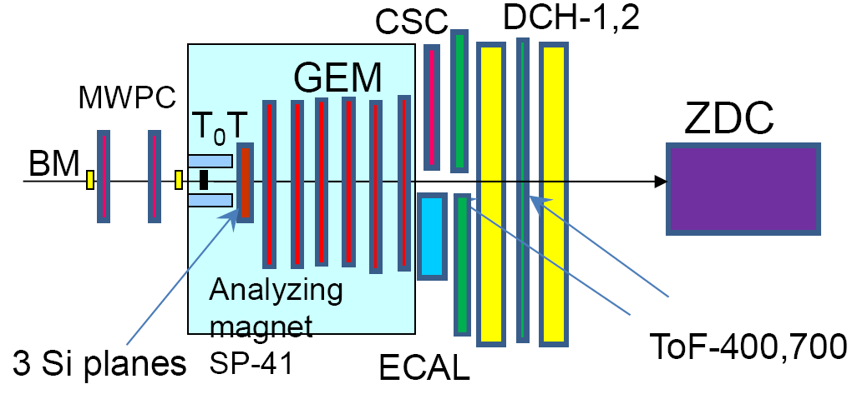
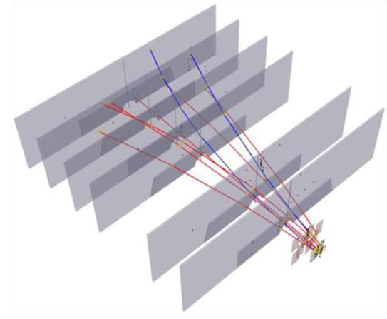
BM@N set-up in carbon run
Outline
Central tracker in argon run.
Schematic view of the beam counters, barrel detector, forward silicon detector and target.
14.09.2022
V.Plotnikov
3

Slide 4
Event selection criteria
Beam halo, pile-up suppression within the readout time window, number of signals in the start detector: BC1=1, number of signals in the beam counter: BC2=1, number of signals in the veto counter around the beam: Veto=0;
Trigger condition in the multiplicity and barrel detectors: number of signals FD≥n, n∈[2;4], BD≥m, m∈[2;4] and combinations of FD and BD triggers (run dependent).
Table 1. Number of triggered events, beam fluxes and integrated luminosities collected for the argon beam of 3.2A GeV (ToF-400 (ToF-700)).
Interactions (target thickness) | Number of triggers / 10⁶ | Integrated beam flux / 10⁷ | Integrated luminosity / 10³⁰ cm⁻²
Ar+C (2mm) | 11.7 (11.3) | 10.9 (8.7) | 2.06 (1.97)
Ar+Al (3.33mm) | 30.6 (29.2) | 15.4 (10.2) | 2.30 (2.05)
Ar+Cu (1.67mm) | 30.9 (28.7) | 15.9 (11.3) | 1.79 (1.60)
Ar+Sn (2.57mm) | 30.0 (25.9) | 15.1 (9.5) | 1.11 (0.91)
Ar+Pb (2.5mm) | 13.7 (13.7) | 7.0 (4.9) | 0.50 (0.40)
14.09.2022
V.Plotnikov
4

Slide 5
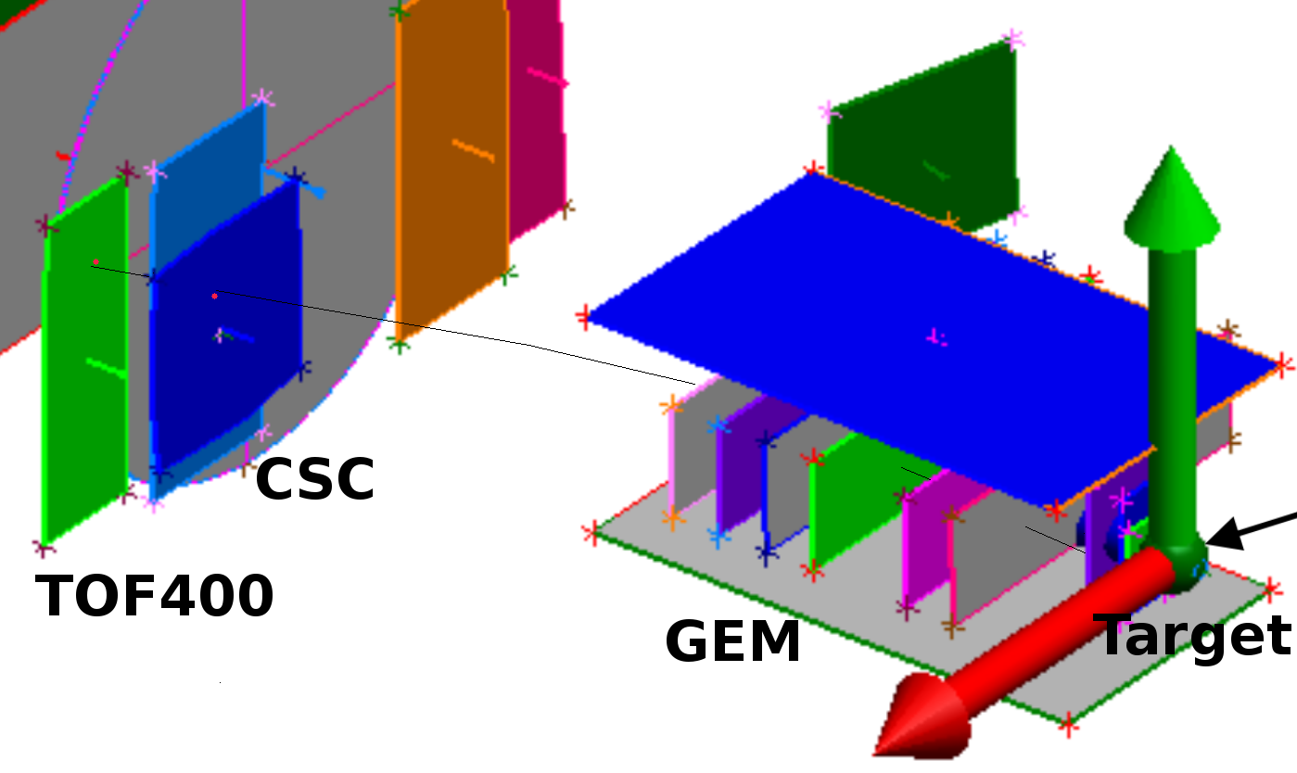
π⁺ and K⁺ selection criteria
Number of hits in 6 GEM per track > 3
Tracks from PV: -3.4 < Z_{PV} – Z₀ < 1.7 cm
Momentum range of tracks for ToF-400 (ToF-700): p < 0.5 (0.7) GeV/c
Distance from a track to PV in the X-Y plane: dca< 1 cm
χ²/ndf for tracks from the PV < 3.5²
Distance of extrapolated tracks to CSC (DCH) and ToF-400 (ToF-700): |resid_{X,Y}| < 2.5 σ of hit-track residual distribution
Abbreviation:
PV – primary vertex
Table2. Reconstructed signals of π⁺ and K⁺ for ToF-400 and ToF-700.
Particle, Detector | Target
 | C | Al | Cu | Sn | Pb
π⁺, ToF-400 | 4020±66 | 21130±152 | 28010±175 | 32060±186 | 22420±156
π⁺, ToF-700 | 1070±34 | 5640±80 | 8090±95 | 9450±104 | 6830±86
K⁺, ToF-400 | 45±10 | 278±25 | 538±31 | 729±36 | 570±32
K⁺, ToF-700 | 31±6 | 117±16 | 193±21 | 346±23 | 221±20
14.09.2022
V.Plotnikov
5

Slide 6
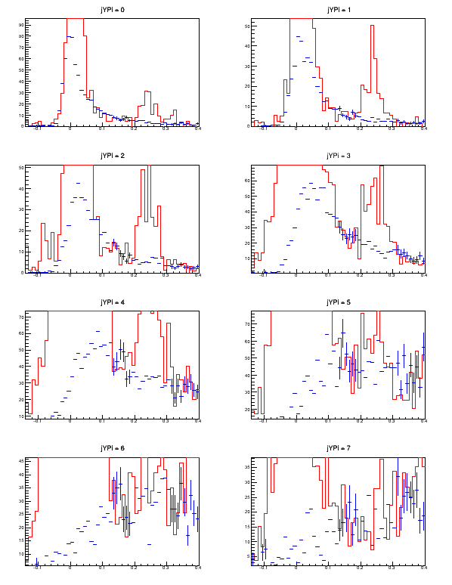
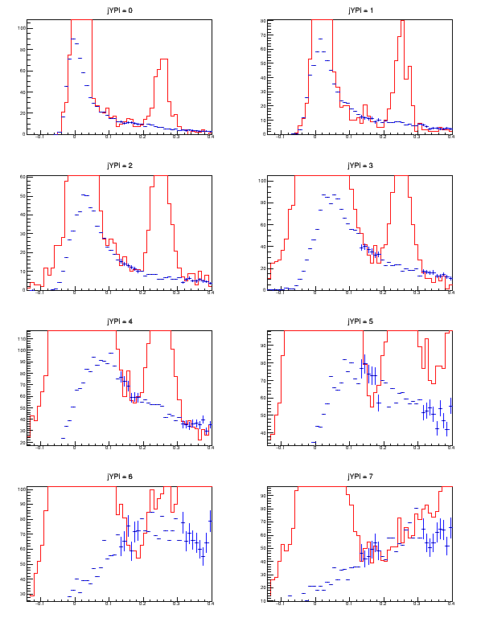
Signal of π⁺ in Ar+Sn interaction
Fig. 10e. Spectrum of mass squared in bins of y of π⁺ identified in ToF-400 in Ar+Sn interactions at 3.2 AGeV argon beam energy: left) experimental events, right) simulated events. Background (blue histogram) subtraction by mixed events.
14.09.2022
V.Plotnikov
6

Slide 7
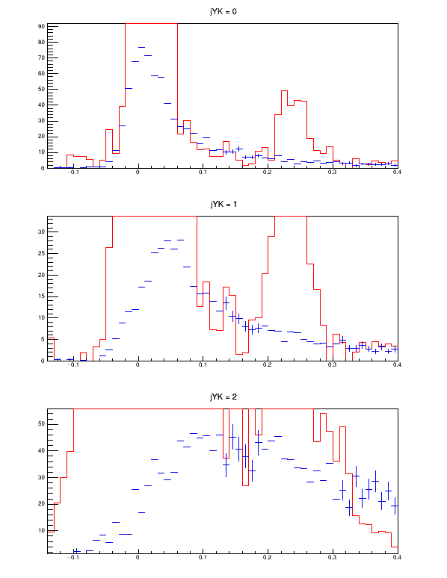
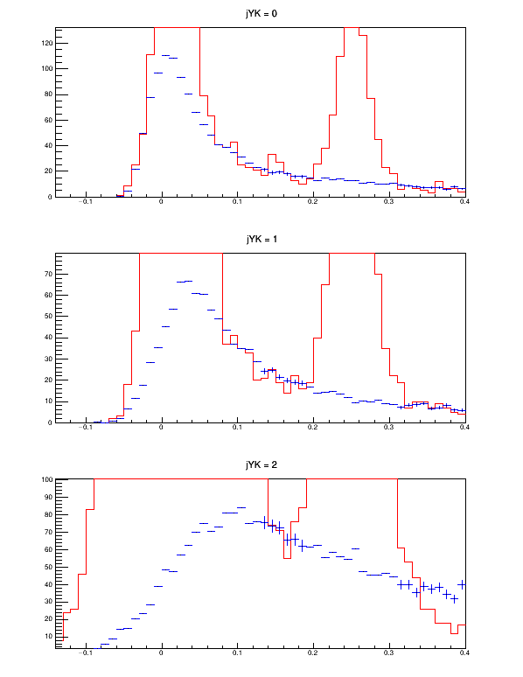
Signal of K⁺ in Ar+Sn interaction
Fig. 10f. Spectrum of mass squared in bins of y of K⁺ identified in ToF-400 in Ar+Sn interactions at 3.2 AGeV argon beam energy: left) experimental events, right) simulated events. Background (blue histogram) is taken from mixed events and normalized to the red signal histogram in the mass squared range below and above the K⁺ peak.
14.09.2022
V.Plotnikov
7

Slide 8
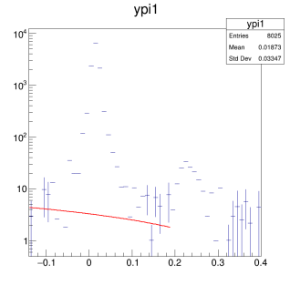
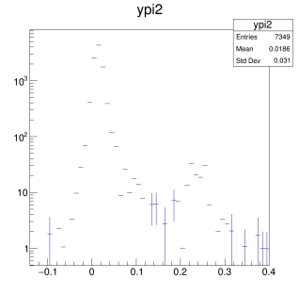
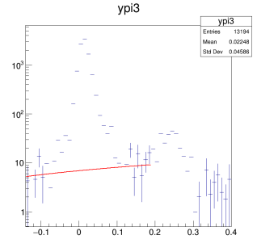
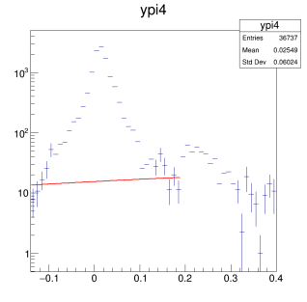
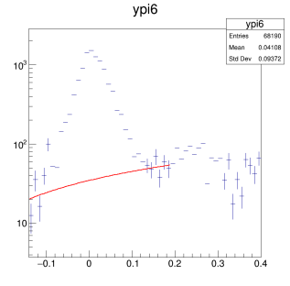
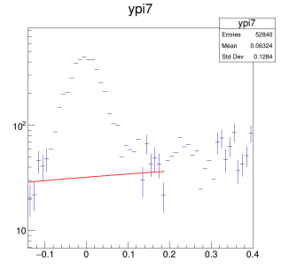
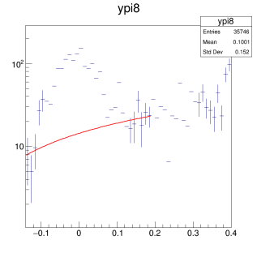
Signal of π⁺ in Ar+Cu interaction
Fig. 10c. Spectrum of mass squared in bins of y of π⁺ identified in ToF-400 in Ar+Cu interactions: background subtraction by the linear fit.
14.09.2022
V.Plotnikov
8

Slide 9
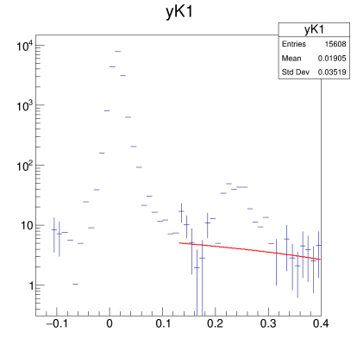
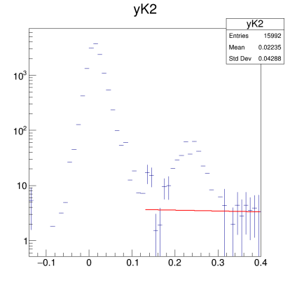
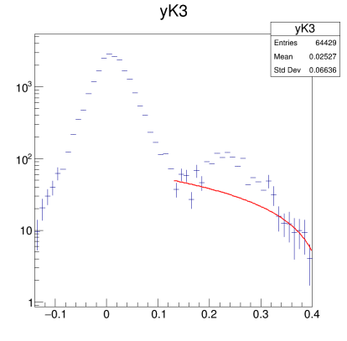
Signal of K⁺ in Ar+Cu interaction
Fig. 10d. Spectrum of mass squared in bins of y of K⁺ identified in ToF-400 in Ar+Cu interactions: background subtraction by the linear fit.
14.09.2022
V.Plotnikov
9

Slide 10
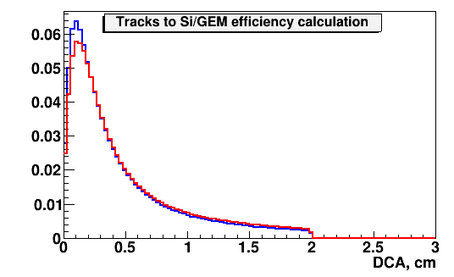
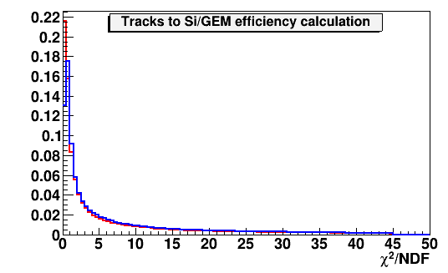
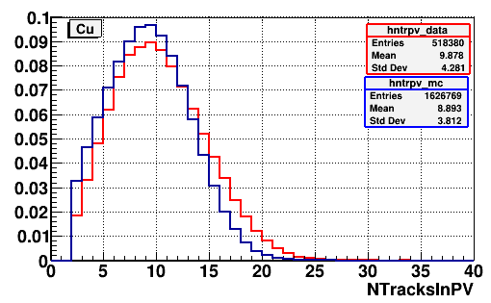
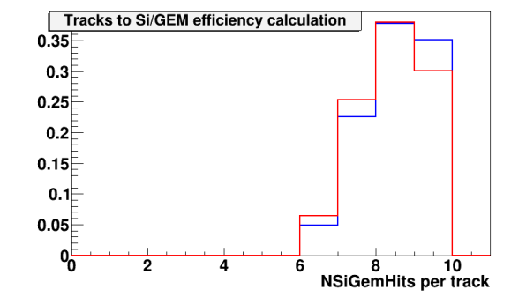
Comparison of experimental data and MC
Fig. 3a. Ar+A interactions at 3.2 AGeV argon beam energy: comparison of experimental distributions (red lines) and Monte Carlo GEANT distributions of events generated with the DCM-SMM model (blue lines): Distribution of the distance of the closest approach DCA between tracks and the vertex in the plane perpendicular to the beam direction; χ² of reconstructed tracks; number of tracks reconstructed in the primary vertex; number of hits per track reconstructed in 3 Si + 6 GEM detectors.
14.09.2022
V.Plotnikov
10

Slide 11
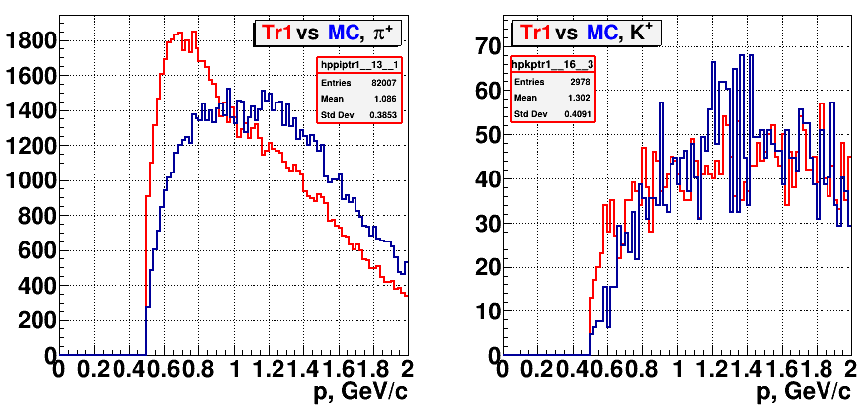
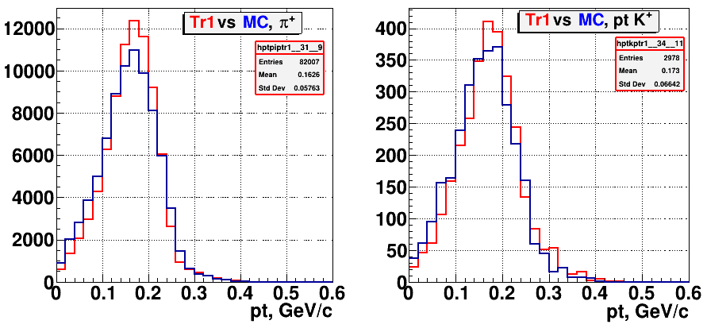
Comparison of experimental data and MC
Fig. 3b. Ar+A interactions at 3.2 AGeV argon beam energy: comparison of ToF-400 experimental data (red curves) and DCM-SMM + GEANT Monte Carlo simulation (blue curves): total momentum of identified π⁺ and K⁺ (upper plots); transverse momentum of π⁺ and K⁺ (lower plots).
14.09.2022
V.Plotnikov
11

Slide 12
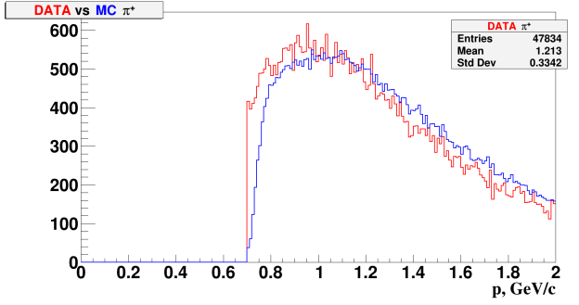
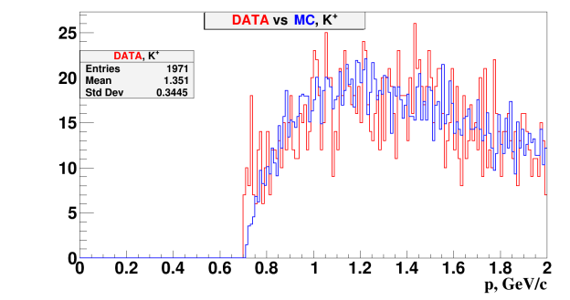
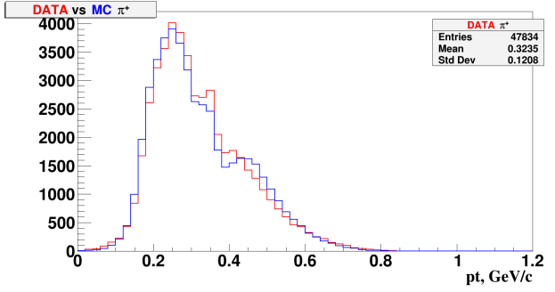
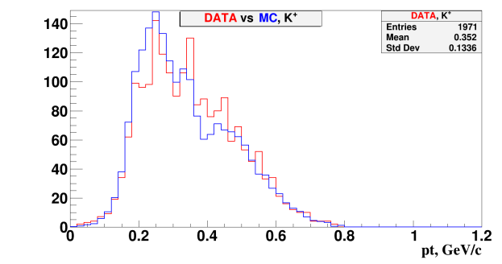
Comparison of experimental data and MC
Fig. 3c. Ar+A interactions at 3.2 AGeV argon beam energy: comparison of ToF-700 experimental data (red curves) and DCM-SMM + GEANT Monte Carlo simulation (blue curves): total momentum of identified π⁺ and K⁺ (upper plots); transverse momentum of π⁺ and K⁺ (lower plots).
14.09.2022
V.Plotnikov
12

Slide 13
Decomposition of efficiency
Table 4. Decomposition of π⁺/K⁺ reconstruction efficiency.
Reconstruction efficiency | ε_{rec} = ε_{acc} · ε_{cuts}
π⁺/K⁺ geometrical acceptance in detectors | ε_{acc} = N_{acc} (y,p_{T}) / N_{gen} (y,p_{T})
Efficiency of reconstruction of π⁺/ K⁺ within the detector geometrical acceptance after applying kinematic and spatial cuts | ε_{cuts} = N_{rec}(y,p_{T}) / N_{acc}(y,p_{T})
After the event simulation and reconstruction the successfully reconstructed π⁺/K⁺ were counted in the numerator N_{acc}. The detector acceptance was taken as N_{acc}/N_{gen}, where N_{gen} is the total number of generated MC events. The number of π⁺/K⁺ after applying kinematic and spatial cuts (N_{cuts}) gave the “selection cuts” efficiency with respect to the number of accepted ones from above.
14.09.2022
V.Plotnikov
13

Slide 14
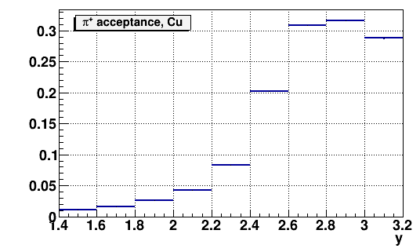
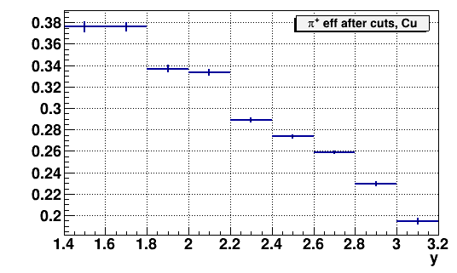
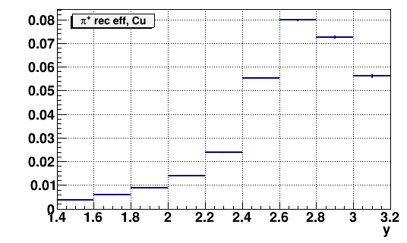
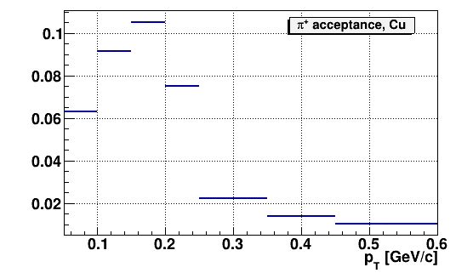
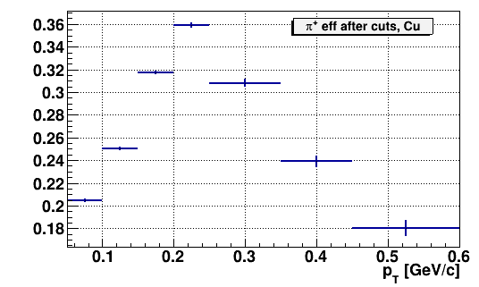
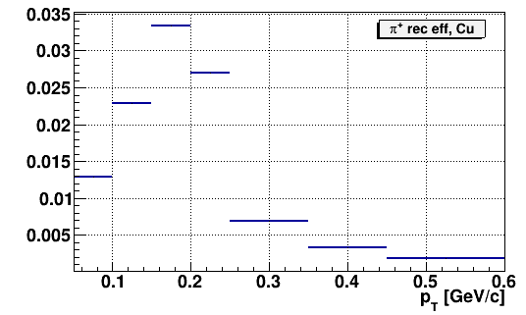
Efficiency in Ar+Cu interactions for π⁺
Fig.12a. π⁺ geometrical acceptance (left plots); efficiency of reconstruction of accepted π⁺
after applying kinematic and spatial cuts (middle plots) and full reconstruction efficiency (right plots) shown in bins of rapidity y lab in the laboratory system, transverse momentum p_{T}. Results are shown for Ar+Cu interactions at 3.2 AGeV argon beam energy.
14.09.2022
V.Plotnikov
14

Slide 15
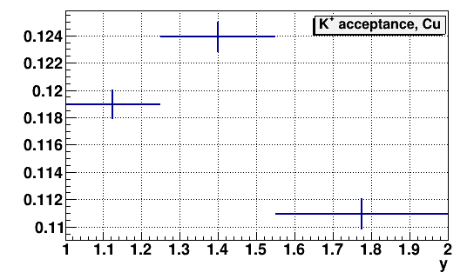
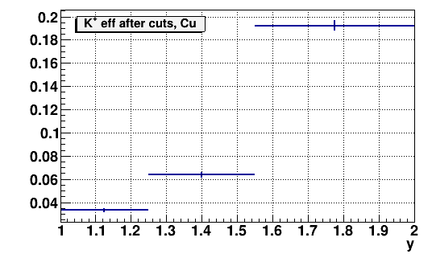
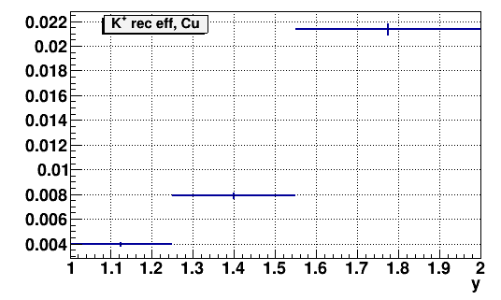
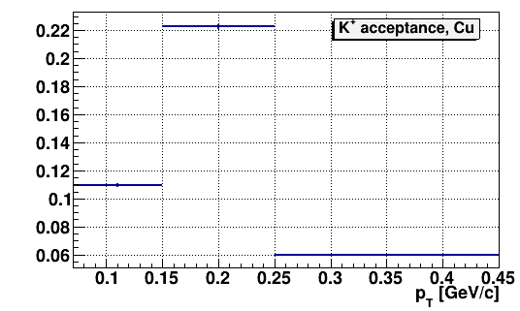
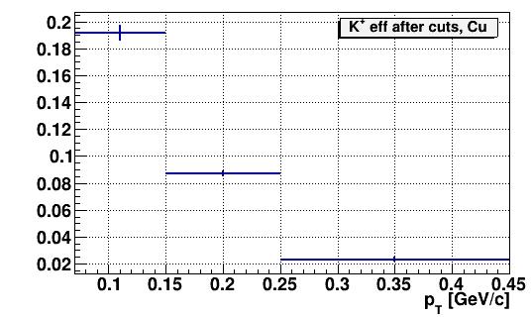
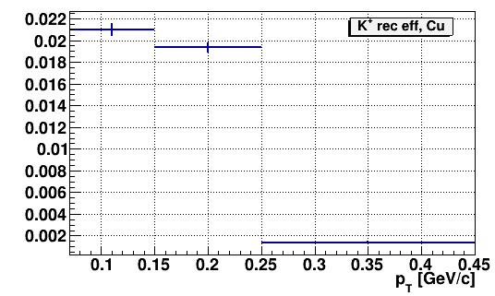
Efficiency in Ar+Cu interactions for K⁺
Fig.12b. K⁺ geometrical acceptance (left plots); efficiency of reconstruction of accepted K⁺
after applying kinematic and spatial cuts (middle plots) and full reconstruction efficiency (right plots) shown in bins of rapidity y lab in the laboratory system, transverse momentum p_{T}. Results are shown for Ar+Cu interactions at 3.2 AGeV argon beam energy.
14.09.2022
V.Plotnikov
15

Slide 16
Trigger efficiency for Barrel Detector
.
Table 5a. Mean BD trigger efficiency evaluated for events with reconstructed π⁺/K⁺ in
interactions of the argon beam with the whole set of C, Al, Cu, Sn, Pb targets.
Trigger / Target π⁺ mesons | C | Al | Cu | Sn | Pb
ε_{trig} (BD>=2) | 0.80±0.03 | 0.96±0.01 | 0.98±0.01 | 0.99±0.01 | 0.99±0.01
ε_{trig} (BD>=3) | 0.66±0.02 | 0.92±0.01 | 0.97±0.01 | 0.98±0.01 | 0.99±0.01
ε_{trig} (BD>=4) | 0.48±0.02 | 0.88±0.01 | 0.95±0.01 | 0.97±0.01 | 0.98±0.01
Trigger / Target K⁺ mesons | C | Al | Cu | Sn | Pb
ε_{trig} (BD>=2) | 0.67±0.15 | 0.97±0.02 | 0.98±0.01 | 0.99±0.01 | 0.99±0.01
ε_{trig} (BD>=3) | 0.67±0.15 | 0.96±0.02 | 0.97±0.01 | 0.99±0.01 | 0.99±0.01
ε_{trig} (BD>=4) | 0.67±0.15 | 0.94±0.02 | 0.95±0.02 | 0.99±0.01 | 0.98±0.01
14.09.2022
V.Plotnikov
16

Slide 17
Trigger efficiency for Forward Silicon
.
Table 5b. Mean FD trigger efficiency evaluated for events with reconstructed π⁺/K⁺ in
interactions of the argon beam with the whole set of C, Al, Cu, Sn, Pb targets.
Trigger / Target π⁺ mesons | C | Al | Cu | Sn | Pb
ε_{trig} (FD>=2) | 0.28±0.01 | 0.40±0.01 | 0.56±0.01 | 0.65±0.01 | 0.72±0.01
ε_{trig} (FD>=3) | 0.14±0.01 | 0.22±0.01 | 0.37±0.01 | 0.49±0.01 | 0.58±0.01
ε_{trig} (FD>=4) | 0.08±0.01 | 0.11±0.01 | 0.23±0.01 | 0.34±0.01 | 0.46±0.01
Trigger / Target K⁺ mesons | C | Al | Cu | Sn | Pb
ε_{trig} (FD>=2) | 0.30±0.06 | 0.40±0.03 | 0.64±0.03 | 0.74±0.03 | 0.82±0.03
ε_{trig} (FD>=3) | 0.17±0.04 | 0.23±0.02 | 0.45±0.03 | 0.61±0.03 | 0.73±0.03
ε_{trig} (FD>=4) | 0.08±0.03 | 0.12±0.02 | 0.35±0.03 | 0.44±0.03 | 0.58±0.03
14.09.2022
V.Plotnikov
17

Slide 18
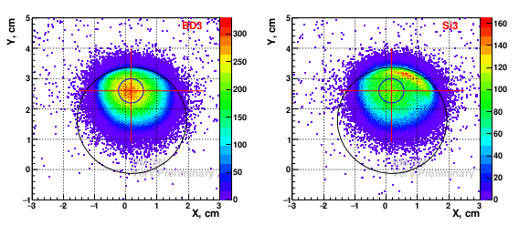
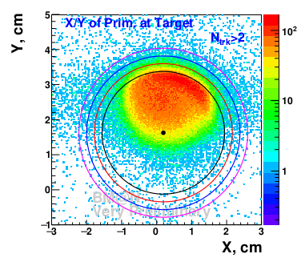
Luminosity
Fig.5 (lumi.pdf). Run-7, X-Y of the primary vertices for different trigger conditions. Left: BD ≥ 3, Right, Si ≥ 3.
Fig.6 (lumi.pdf). Run-7, X-Y of the primary vertices within 3−σlimits around the target.
13.5% of the beam is missed the target by the edge of the target due to shifted beam position.
The systematic uncertainty for this measurement do not exceed 2%.
The events collected with the Si-trigger near the upper edge of the target were recorded with higher efficiency relative the rest of the beam spot.
14.09.2022
V.Plotnikov
18

Slide 19
Impact parameters
.
Table 1*. Mean impact parameters of min. bias Ar+C, Ar+Al, Ar+Cu, Ar+Sn, Ar+Pb interactions with π⁺.
MC | b, fm (Ar+C) | b, fm (Ar+Al) | b, fm (Ar+Cu) | b, fm (Ar+Sn) | b, fm (Ar+Pb)
Events with gen. π⁺ | 4.18 | 4.79 | 5.59 | 6.29 | 7.04
Events with gen. π⁺ in the measured range of BM@N | 3.75 | 4.29 | 5.03 | 5.70 | 6.43
Events with rec. π⁺ | 3.51 | 3.91 | 4.61 | 5.29 | 6.13
Table 2*. Mean impact parameters of min. bias Ar+C, Ar+Al, Ar+Cu, Ar+Sn, Ar+Pb interactions with K⁺.
MC | b, fm (Ar+C) | b, fm (Ar+Al) | b, fm (Ar+Cu) | b, fm (Ar+Sn) | b, fm (Ar+Pb)
Events with gen. K⁺ | 3.24 | 3.50 | 3.98 | 4.50 | 5.12
Events with gen. K⁺ in the measured range of BM@N | 3.17 | 3.42 | 3.90 | 4.44 | 5.13
Events with rec. K⁺ | 3.25 | 3.55 | 4.13 | 4.72 | 5.46
14.09.2022
V.Plotnikov
19

Slide 20
Cross section and yields of π⁺/K⁺ mesons
The cross section σ_{π+} and yield Y_{π+} of π⁺ meson production in Ar+C, Ar+Al, Ar+Cu, Ar+Sn, Ar+Pb interactions are calculated in bins of y and p_{T} according to the formulae:
where L is the luminosity,
N_{rec}^{π+}– the number of reconstructed π⁺ mesons,
ε_{rec}– the combined efficiency of the π⁺ meson reconstruction,
ε_{trig}– the trigger efficiency,
σ_{inel}– the cross section for minimum bias inelastic Ar+A interactions.
The same formulas are used to calculate the K⁺ inclusive production cross section and yield in bins of y(p_{T}). The cross sections in (y, p_{T}) bins are calculated as weighted averaged of the results obtained with ToF-400 and ToF-700 data taking into account the statistical uncertainties (w ~ 1/ϭ²).
σ_{π+}(y,p_{T})=N_{rec}^{π+}(y,p_{T}) / (ε_{rec} (y,p_{T})·ε_{trig}·L); | Y_{π+} (y,p_{T}) = σ_{π+} (y,p_{T}) / σ_{inel}
Interaction | Ar+C | Ar+Al | Ar+Cu | Ar+Sn | Ar+Pb
Inelastic cross section, mb | 1470±50 | 1860±50 | 2480±50 | 3140±50 | 3970±50
The cross sections for inelastic Ar+Al, Ar+Cu, Ar+Sn, Ar+Pb interactions are taken from the predictions of the DCM-SMM model which are consistent with the results calculated by the formula: σ_{inel} = π R₀² (A_{P}^{1/3} + A_{T}^{1/3})², where R₀ = 1.2 fm is an effective nucleon radius, A_{P} and A_{T} are atomic numbers of the beam and target nucleus.
14.09.2022
V.Plotnikov
20

Slide 21
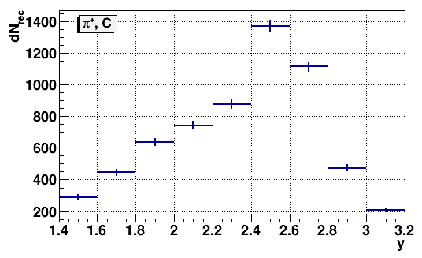
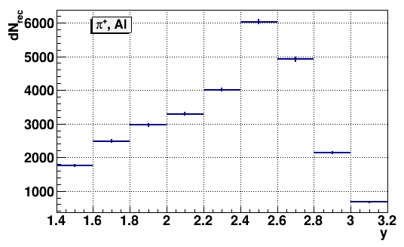
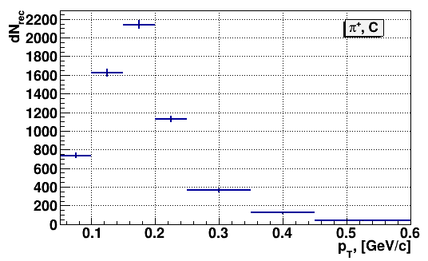
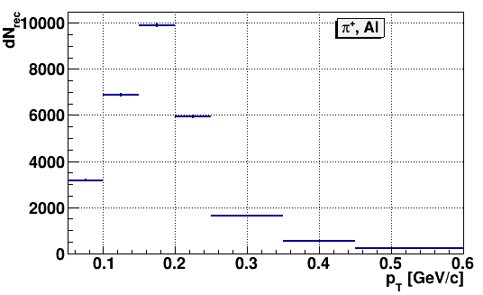
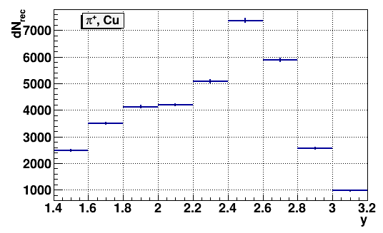
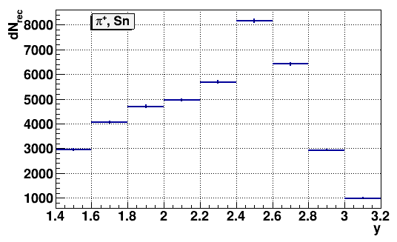
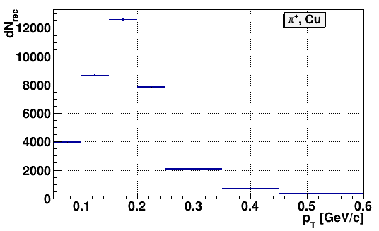
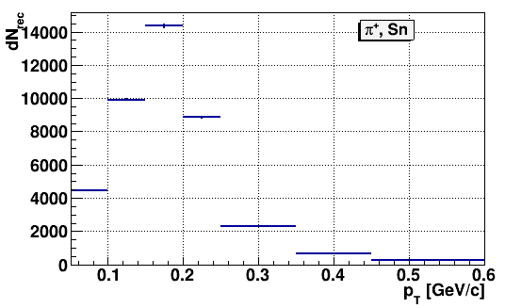
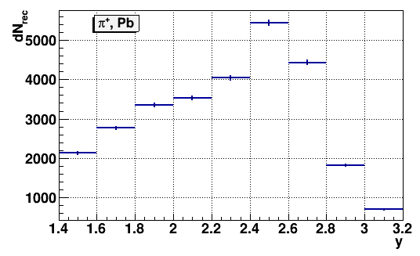
Number of reconstructed π⁺ mesons
Fig. 11a. Number of reconstructed π⁺ in ToF-400 in interactions of 3.2 AGeV argon beam with C, Al, Cu, Sn, Pb targets in bins of y (5 left plots) and in bins of p_{T} (5 right plots).
14.09.2022
V.Plotnikov
21

Slide 22
Number of reconstructed K⁺ mesons
Fig. 11b. Number of reconstructed K⁺ in ToF-400 in interactions of 3.2 AGeV argon beam with C, Al, Cu, Sn, Pb targets in bins of y (5 left plots) and in bins of p_{T} (5 right plots).
14.09.2022
V.Plotnikov
22

Slide 23
Reconstructed y spectra of π⁺ mesons
y_{CM}=1.08
Fig. 15a. Reconstructed rapidity y spectra of π⁺ measured in bins of p_{T} in minimum bias Ar+C, Ar+Al, Ar+Cu, Ar+Sn, Ar+Pb interactions at 3.2 AGeV argon beam energy (blue symbols). The error bars represent the statistical errors, the boxes show the systematic errors. Predictions of the DCM-SMM, UrQMD and PHSD models are shown as rose, green and magenta lines.
14.09.2022
V.Plotnikov
23

Slide 24
Reconstructed y spectra of K⁺ mesons
Fig. 15b. Reconstructed rapidity y spectra of K⁺ measured in bins of p_{T} in minimum bias Ar+Al, Ar+Cu, Ar+Sn, Ar+Pb interactions at 3.2 AGeV argon beam energy (blue symbols). Predictions of the DCM-SMM, UrQMD and PHSD models are shown as rose, green and magenta lines.
14.09.2022
V.Plotnikov
24

Slide 25
Reconstructed p_{T} spectra of π⁺ mesons
Fig. 16a. Reconstructed invariant transverse momentum p_{T} spectra of π⁺ measured in bins of rapidity in minimum bias Ar+C, Ar+Al, Ar+Cu, Ar+Sn, Ar+Pb interactions at 3.2 AGeV argon beam energy (symbols). Results of the fit are shown as curves.
1/p_{T}·d²N/dp_{T}dy=N·exp(-(m_{T}-m_{π+} )/T)
where m_{T}=√(m_{π+}²+p_{T}²) is the transverse mass, N – normalization (free parameter),
T – inverse slope (free parameter), dy corresponds to the measured y_{lab} range.
14.09.2022
V.Plotnikov
25

Slide 26
Reconstructed p_{T} spectra of K⁺ mesons
Fig. 16b. Reconstructed invariant transverse momentum p_{T} spectra of K⁺ in minimum bias Ar+Al, Ar+Cu, Ar+Sn, Ar+Pb interactions at 3.2 AGeV argon beam energy (symbols). The error bars represent the statistical errors, the boxes show the systematic errors. Results of the fit are shown as red curves.
14.09.2022
V.Plotnikov
26

Slide 27
Reconstructed p_{T} spectra of K⁺ mesons
Fig. 16c. Reconstructed invariant transverse momentum p_{T} spectra of K⁺ in the measured rapidity range in minimum bias Ar+C, Ar+Al, Ar+Cu, Ar+Sn, Ar+Pb interactions at 3.2 AGeV argon beam energy (symbols). Results of the fit are shown as red curves.
14.09.2022
V.Plotnikov
27

Slide 28
Inverse slope parameter T₀ of π⁺ mesons
Fig. 17a. The y dependences of the inverse slope parameter T0 of the π⁺ invariant p_{T} spectra in Ar+C, Ar+Al, Ar+Cu, Ar+Sn, Ar+Pb minimum bias interactions (blue symbols). The error bars represent the statistical errors, the boxes show the systematic errors. Predictions of the DCM-SMM, UrQMD and PHSD models are shown as rose, green and magenta lines.
14.09.2022
V.Plotnikov
28

Slide 29
Inverse slope parameter T₀ of π⁺ mesons
Fig. 17b. The y dependences of the inverse slope parameter T0 of the K⁺ invariant p_{T} spectra in Ar+Al, Ar+Cu, Ar+Sn, Ar+Pb minimum bias interactions (blue symbols). Predictions of the DCM-SMM, UrQMD and PHSD models are shown as rose, green and magenta lines.
14.09.2022
V.Plotnikov
29

Slide 30
Systematic uncertainties
The systematic uncertainty of the π⁺/K⁺ yields in every p_{T} and y bin is calculated as a quadratic sum
of uncertainties coming from the following sources:
• Sys1: Systematic uncertainty of the trigger efficiency evaluated as a function of the number of
tracks from the primary vertex and the primary vertex position.
• Sys2: Systematic uncertainties of the reconstruction efficiency due to the remaining difference
in the X/Y primary vertex distribution in the simulation relative to the experimental data.
• Sys3: Systematic uncertainties of the background subtraction under the π⁺ and K⁺ signals in the
mass squared spectra of identified particles.
Table 10. Total systematic uncertainty of the π⁺ and K⁺ yields measured argon-nucleus interactions.
Target Systematics | π⁺ |  |  |  |  | Target Systematics | K⁺
 | C, sys% | Al, sys% | Cu, sys% | Al, sys% | Al, sys% |  | C, sys% | Al, sys% | Cu, sys% | Sn, sys% | Pb, sys%
Sys1-Sys3 | 14 | 11 | 12 | 9 | 9 | Sys1-Sys3 | 28 | 26 | 14 | 12 | 16
Norm | 7.8 | 6.3 | 6.2 | 6.2 | 6.2 | Norm | 29 | 10 | 8.4 | 7.6 | 7.4
The π⁺/K⁺ yield normalization uncertainty calculated as a quadratic sum of uncertainties of the trigger efficiency, luminosity and inelastic nucleus-nucleus cross section. The normalization uncertainty is valid for the whole measured kinematical range.
14.09.2022
V.Plotnikov
30

Slide 31
The π⁺ yields (BM@N)
Table 12a. Extrapolation factors to the full kinematic range and π⁺ yields for 3.2 AGeV argon-nucleus data in the measured and full kinematical ranges. The first errors given are statistical, the second errors are systematic.
3.2 AGeV, π⁺ | C | Al | Cu | Sn | Pb
DCM-SMM extrap. factor | 3.43 | 3.86 | 4.51 | 4.98 | 5.64
Yield in 0.1<p_{T}<0.6 GeV/c, 1.5<y_{lab}<3.2 | 0.275±0.006 ±0.027 | 1.00±0.01 ±0.07 | 1.14±0.01 ±0.08 | 1.28±0.01 ±0.09 | 1.25±0.01 ±0.085
Yield in the full kin. range | 0.943±0.019 ±0.092 | 3.86±0.04 ±0.27 | 5.15±0.05 ±0.35 | 6.35±0.05 ±0.44 | 7.03±0.07 ±0.48
14.09.2022
V.Plotnikov
31

Slide 32
The K⁺ yields (BM@N)
Table 12b. Extrapolation factors to the full kinematic range, K⁺ yields and K⁺ to π⁺ yield ratios for 3.2 AGeV data in the measured and full kinematical ranges. The first errors given are statistical, the second errors are systematic. Also the inverse slope parameters T of the invariant p_{T} spectra are given.
3.2 AGeV, K⁺ | C | Al | Cu | Sn | Pb
DCM-SMM extrap. factor | 2.33 | 2.51 | 2.84 | 3.21 | 3.67
Yield in 0.1<p_{T}<0.5 GeV/c, 1.0<y_{lab}<2.0 | 0.0094±0.0018±0.0035 | 0.0390±0.0028±0.0061 | 0.0417±0.0021±0.0066 | 0.0560±0.0022±0.0075 | 0.0510±0.0022±0.0092
Yield in the full kin. range | 0.0219±0.0042±0.0081 | 0.0980±0.0070±0.015 | 0.1190±0.0060±0.019 | 0.180±0.007 ±0.024 | 0.188±0.008 ±0.034
K⁺/π⁺ ratio in the measured range | 0.0343±0.0066±0.0125 | 0.0390±0.0028±0.0055 | 0.0366±0.0019±0.0053 | 0.0439±0.0018±0.0051 | 0.0411±0.0018±0.0068
K⁺/π⁺ ratio in the full kin. range | 0.0233±0.0045±0.0085 | 0.0253±0.0018±0.0035 | 0.0230±0.0012±0.0033 | 0.0283±0.0012±0.033 | 0.0268±0.0012±0.0044
K+ inverse slope T, MeV measured range | 73±14±13 | 80±7±5 | 81±5±5 | 81±5±4 | 78±5±4
14.09.2022
V.Plotnikov
32

Slide 33
The π⁺ and K⁺ yields and inverse slopes
Table 13. Yields of K⁺, π⁺ production and effective inverse slopes of invariant m_{T} spectra measured in interactions of light and medium nucleus.
Interacting nucleus / Beam kinetic energy / Experiment | π⁺, K⁺ yields | K⁺ / π⁺ yield ratio, ·10⁻² | T_{eff} at y* = 0, MeV, K⁺ / π⁺
Ar+KCl, 1.76 AGeV, HADES | 3.9±0.1±0.1 (π⁻) (2.8±0.2)∙10⁻² (K⁺) |  | 82.4±0.1^{+9.1}_{−4.6} (π⁻) 89±1±2 (K⁺)
Ni+Ni, 1.93 AGeV, FOPI | 3.6∙10⁻² (K⁺, A_{part}= 46.5) 8.25∙10⁻²(K⁺, A_{part} = 75) | (7.59±0.49)∙10⁻³ (A_{part} = 46.5) | 110.9±1.0 (A_{part} = 75)
Ni+Ni, 1.93 AGeV, KaoS | 3∙10⁻² (K⁺) |  | 97±7 (non-central) (K⁺) 107±10 (central)(K⁺)
14.09.2022
V.Plotnikov
33

Slide 34
Summary
Production of π⁺ and K⁺ mesons in interactions of the 3.2A GeV kinetic energy argon beam with C, Al, Cu, Sn, Pb targets was studied with the BM@N detector at the Nuclotron.
The analysis procedure has been presented and described.
Results on π⁺ and K⁺ meson yields and inverse slope parameters have been obtained and compared with model predictions and data available.
Draft article released 21.08.2022. Waiting for comments. Deadline 30 September 23:59.
Request for publication.
Outline
Thank you for attention!
14.09.2022
V.Plotnikov
34

Slide 35
Backup
V.Plotnikov
34

Slide 36
Efficiency distributions in Si/GEMs
Si-2
GEM-3
y, cm
y, cm
x, cm
x, cm
Fig. 4. 2-dimentional efficiency distributions in Si and GEM stations measured with experimental tracks and implemented into Monte Carlo simulation
V.Plotnikov
34

Slide 37
Residual distributions of GEM hits
Fig. 5a. Residual distributions of hits in X projection with respect to reconstructed tracks in Si and GEM detectors: experimental data (red histograms), simulated tracks (blue histograms).
Fig. 5b. Residual distributions of hits in Y projection with respect to reconstructed tracks in Si and GEM detectors: experimental data (red histograms), simulated tracks (blue histograms).
V.Plotnikov
34

Slide 38
Mean values of residuals of CSC hits
Fig. 6a. ToF-400 data and simulation: Mean values of residuals of CSC hits in X projection with respect to reconstructed positive tracks in dependence on the particle momentum: left plot – experimental data, right plot – simulated tracks.
Fig. 6b. ToF-400 data and simulation: Mean values of residuals of CSC hits in Y projection with respect to reconstructed positive tracks in dependence on the particle momentum: left plot – experimental data, right plot – simulated tracks.
V.Plotnikov
34

Slide 39
Sigma of residuals of CSC hits
Fig. 6c. ToF-400 data and simulation: Sigma of residuals of CSC hits in X projection with respect to reconstructed positive tracks in dependence on the particle momentum: left plot – experimental data, right plot – simulated tracks.
Fig. 6d. ToF-400 data and simulation: Sigma of residuals of CSC hits in Y projection with respect to reconstructed positive tracks in dependence on the particle momentum: left plot experimental data, right plot – simulated tracks.
V.Plotnikov
34

Slide 40
Mean values of residuals of ToF-400 hits
Fig. 7a. Mean values of residuals of ToF-400 hits in the X projection with respect to
reconstructed positive tracks in dependence on the particle momentum: left plot – experimental data, right plot – simulated tracks.
Fig. 7b. Mean values of residuals of ToF-400 hits in the Y projection with respect to
reconstructed positive tracks in dependence on the particle momentum: left plot – experimental data, right plot – simulated tracks.
V.Plotnikov
34

Slide 41
Sigma of residuals of ToF-400 hits
Fig. 7c. Sigma of residuals of ToF-400 hits in the X projection with respect to reconstructed positive tracks in dependence on the particle momentum: left plot – experimental data, right plot – simulated tracks.
Fig. 7d. Sigma of residuals of ToF-400 hits in the Y projection with respect to reconstructed positive tracks in dependence on the particle momentum: left plot – experimental data, right plot – simulated tracks.
V.Plotnikov
34

Slide 42
Mean values of residuals of DCH hits
Fig. 8a. ToF-700 data and simulation: Mean values of residuals of DCH hits in X and Y
projections with respect to reconstructed positive tracks in dependence on the particle
momentum: upper plots experimental data, lower plots – simulated tracks.
V.Plotnikov
34

Slide 43
Sigma of residuals of DCH hits
Fig. 8b. ToF-700 data and simulation: Sigma of residuals of DCH hits in X and Y
projections with respect to reconstructed positive tracks in dependence on the particle
momentum: upper plots experimental data, lower plots – simulated tracks.
V.Plotnikov
34

Slide 44
Mean values of residuals of ToF-700 hits
Fig. 9a. Mean values of residuals of ToF-700 hits in the X and Y projections with respect to reconstructed positive tracks in dependence on the particle momentum: upper plots -
experimental data, lower plots - simulated tracks.
V.Plotnikov
34

Slide 45
Sigma of residuals of ToF-700 hits
Fig. 9b. Sigma of residuals of ToF-700 hits in the X and Y projections with respect to
reconstructed positive tracks in dependence on the particle momentum: upper plots -
experimental data, lower plots - simulated tracks.
V.Plotnikov
34

Slide 46
n_{π}/A_{part}
Fig. NNN. Pion multiplicity n_{π} per mean number of participating nucleon A_{part} as a function of the kinetic beam energy E_{beam}.
V.Plotnikov
<number>

