Slide 2
Design and development of application software for MPD distributed computing infrastructure
8th MPD Collaboration Meeting
Andrey Moshkin, Igor Pelevanyuk, Oleg Rogachevskiy
13 October 2021

Slide 3
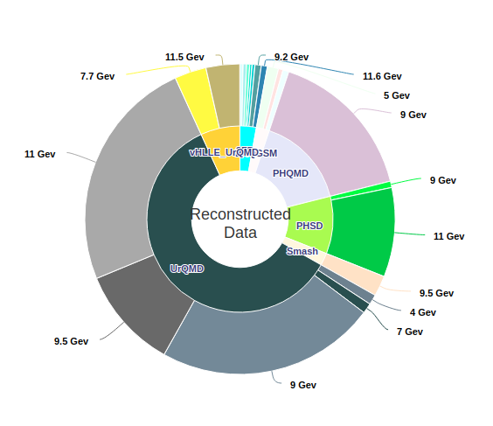
MPD MC generation
The MPD(Multi Purpose Detector) apparatus has been designed as a 4π spectrometer capable of detecting of charged hadrons, electrons and photons in heavy-ion collisions at high luminosity in the energy range of the NICA collider. To reach this goal, the detector will comprise a precise 3-D tracking system and a high-performance particle identification (PID) system based on the time-of-flight measurements and calorimetry.
Reconstructed Monte-Carlo events
MPD detector

Slide 4
MC generation math
In practice, to
generate 780M events
reconstruct 180M events
(size of reconstructed is around 1 MB)
You need to execute 700k jobs,
Each lasts for average 5-6 hours on one CPU core
(4-9 hours depending on the resource)
Notebook: ~120 years
Server(24cores): ~20 years
Cluster(10000 cores): ~ 18 days

Slide 5
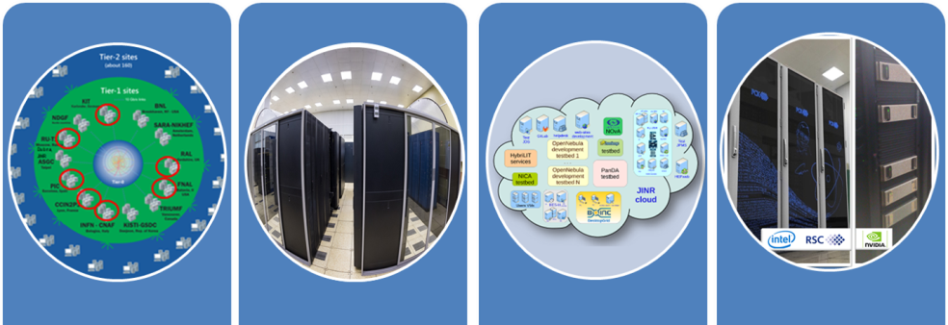
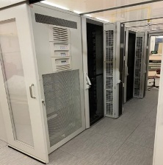
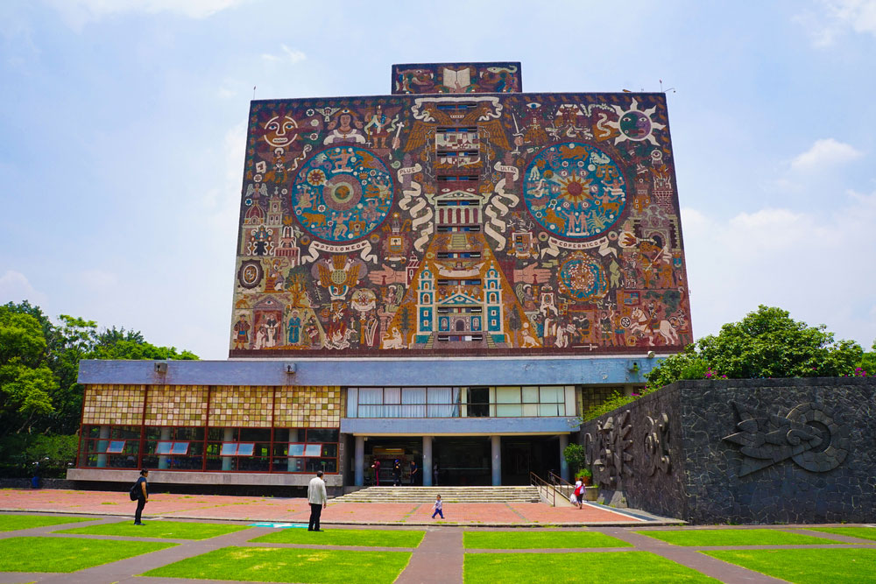
What was done in JINR
EOS
Tier-1
CICC/Tier-2
Clouds
Govorun
NICA Cluster
UNAM
Running
Running
Running
Running
Running
Running
The computing resources of the JINR Multifunctional Information and Computing Complex, clouds in JINR Member-States, cluster from Mexico University were combined using the DIRAC Interware.

Slide 6
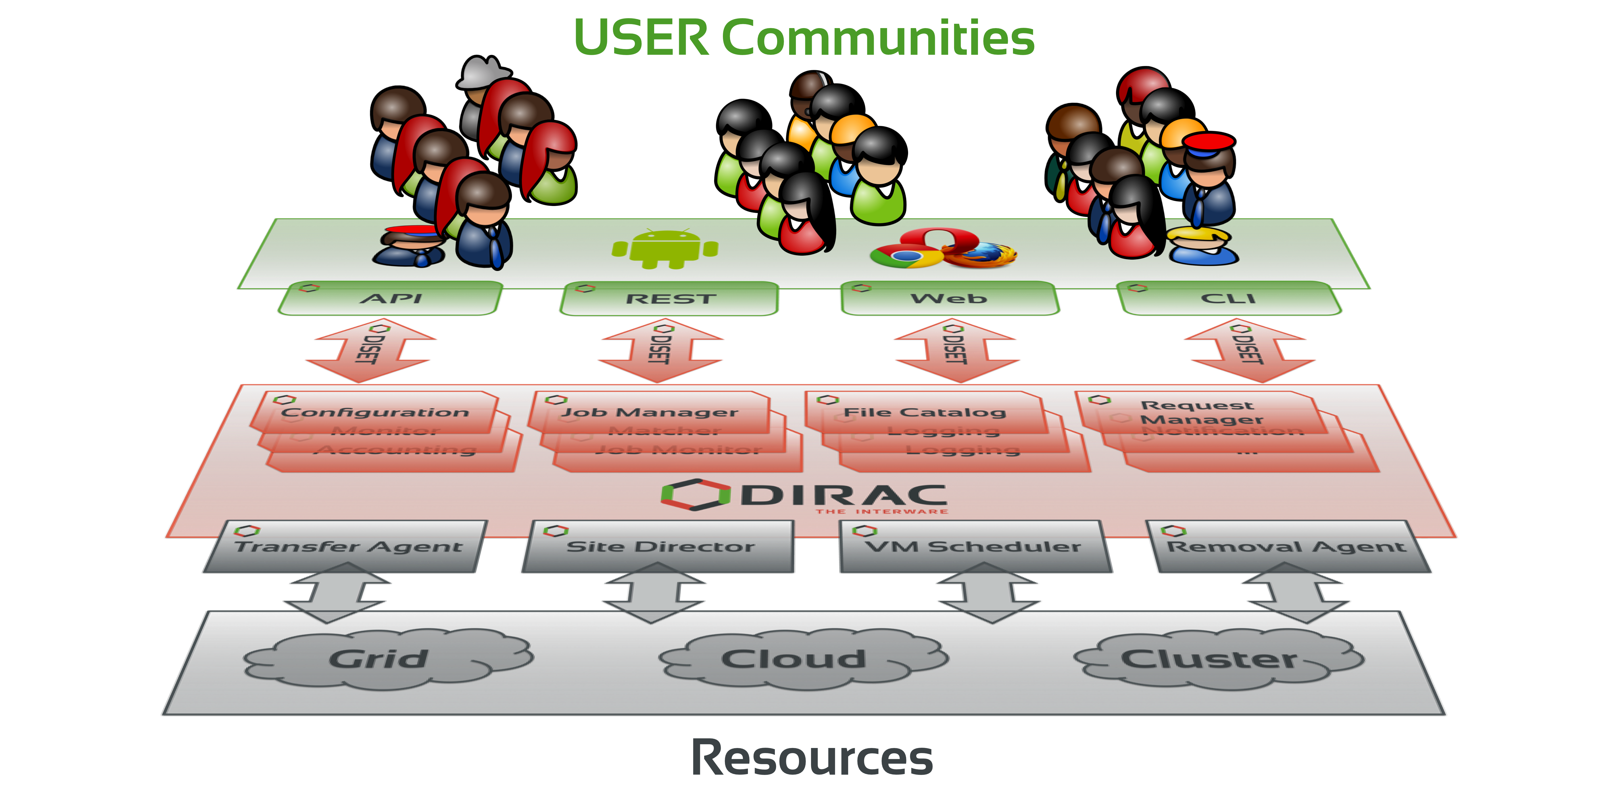
What is DIRAC?
DIRAC provides all the necessary components to build ad-hoc grid infrastructures interconnecting computing resources of different types, allowing interoperability and simplifying interfaces. This allows to speak about the DIRAC interware.
Web
CLI
API
REST

Slide 7
Amount of resources
Tier2 - 1000 cores
Tier1 - 920 cores
GOVORUN - 818 cores
NICA offline cluster - 250 cores
UNAM - 100 cores
Clouds - 70 cores

Slide 8
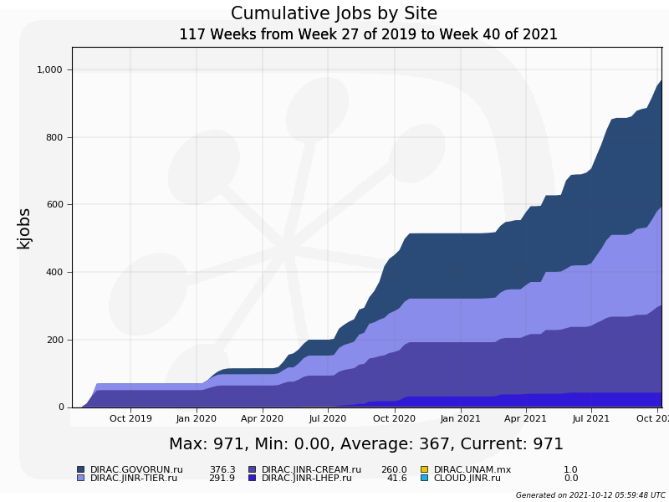
Amount of resources
7th MPD Meeting

Slide 9
Mass production storages
Main storage, integrated in Dirac File Catalog, size 1 PB
/eos/eos.jinr.ru/nica/mpd/dirac/mpd.nica.jinr/vo/mpd/data/
LHEP mirror, will be integrated in Dirac File Catalog, size 300 TB
/eos/nica/mpd/sim/data/
Data produced not from Mass production requests
/zfs/store6.hydra.local/mpddata/data/ , size 85 TB
/eos/hybrilit.jinr.ru/nica/ , size 100 TB
dCache(LIT type robot), tested
WebUI: http://mpdroot.jinr.ru -> SOFTWARE -> DataBases -> MPD DataBase

Slide 10
Standard job schema
1. Initial configuration
2. Input data download
3. Processing
4. Output data upload
5.Finalization
All this steps written in shell script. Shell script is complex, requires some knowledge of distributed infrastracture and should be written by specialist.

Slide 11
Challenges of writing jobs
1. DIRAC specifics. In order to write working job for DIRAC it is necessary to know the basics about DIRAC. How to submit job, how to access data inside job, how to match jobs and corresponding input data, how to write the result to the storage.
Dealing with failures
Matching of jobs and data
Job debug(remote)
Job design
Massive job submission
Data access

Slide 12
Challenges of writing jobs
2. Infrastructure limitations. DIRAC allow integration of heterogeneous diverse computing and storage resources. To use it efficiently it is crucial to know specifics of different resources.
Computing Resource 1
Computing Resource 2
Computing Resource 3
Week network connection
Access to fast local storage
Low amount of RAM per core
Requires manual cleaning if used
Have direct read access to data

Slide 13
Challenges of writing jobs
3. Experiment software. User need to know where to get software from. CVMFS should help to distribute software aroud computing resources. It is not always the case due to many reasons. Specialist should deploy software on some resources in advance manually. Jobs should be aware of all the pathes and necessary configuration.
Computing Resource 1
Computing Resource 2
Computing Resource 3
Local file system
CVMFS
Local file system
Module
add
User Job
User Job
User Job

Slide 14
Solution
In case if it is necessary to provide access to distributed resources to general user there are three major ways:
Perform extensive training for a user and gradually increase his access to different resources. Expensive in terms of time for both: DIRAC specialists and users. Very flexible after that. Requires users to keep up to date with changing and evolving infrastructure.
Place DIRAC specialist between resources and a user. Users explain the task to specialist and specialist design and submit jobs to resources. Less expensive in terms of time for users and DIRAC specialists. This approach has been successfully used by MPD and proved to be effective.
Develop dedicated DIRAC application to provide inteface defined in terms of user task (required software, type of job, energy, amount of events needed). Very convenient for end users. Requires efforts of DIRAC developers. Requires future support of developed app.

Slide 15
MPD Monte-Carlo launchpad

Slide 16
MPD Monte-Carlo launchpad
User
Launchpad
Grid
parameters
Job №1
parameters
Parameters
Job 1
run.mc
reco.mc
run.mc
reco.mc
run.mc
reco.mc
MC job script.sh
Hidden from user
...
Job №10000
MC job script.sh
Parameters
Job 10000
run.mc
reco.mc
MC job script.sh

Slide 17
Meta-data assign
MC job script.sh
1. Initial configuration
2. Input data download
3. Processing
4. Output data upload
4*. Metadata assign
5.Finalization
/mpd/model/DQGSM/v4_3/Au/Au/7GeV/2020-05-06/2k_001.root
type=model
date=
06.05.2020
beam=Au
generator=DQGSM
target=Au
events=2000
owner=amoshkin
group=PG3
version=4.3
energy=7

Slide 18
Conclusion
This work have been done recently and was tested by limited amount of MPD users. (That is probably the weekest point in this talk)
Development of dedicated grid applications for MPD within DIRAC is definitely possible.
It provides transparent access to heterogeneous distributed resources directly to end user.
All inteligence about infrastructure constrains and features placed inside application and hidden from user.
Standard applications for dedicated tasks (like Monte-Carlo) support consistency in data placement and meta-data assignation.

