Slide 1
Status of the MPD integration
Viacheslav Golovatyuk
(JINR)

Slide 2
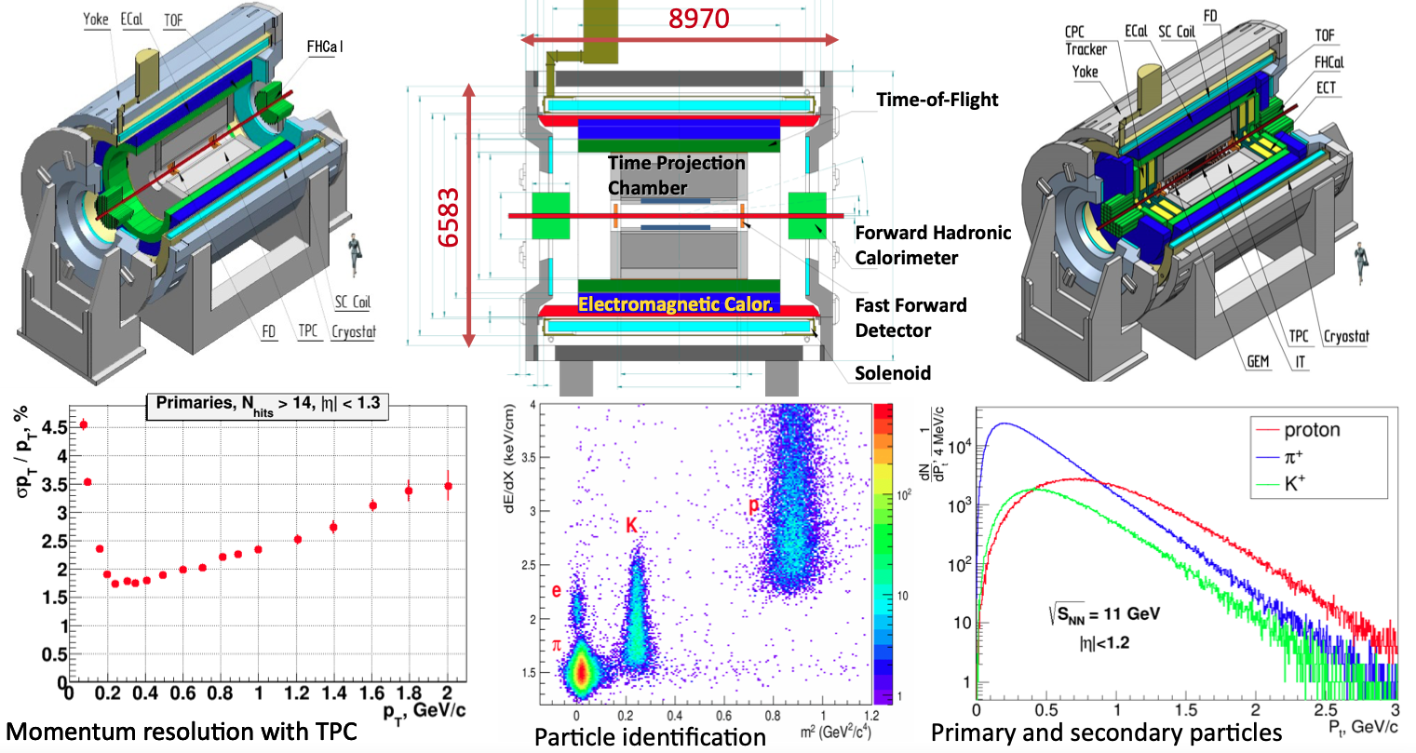
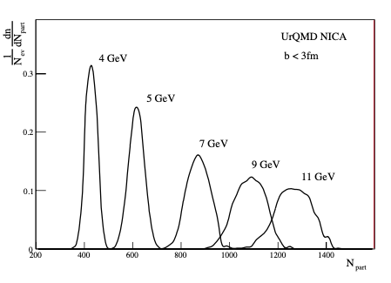
Charged multiplicity distributions in central Au + Au collisions (b < 3 fm) calculated by UrQMD.

Slide 3
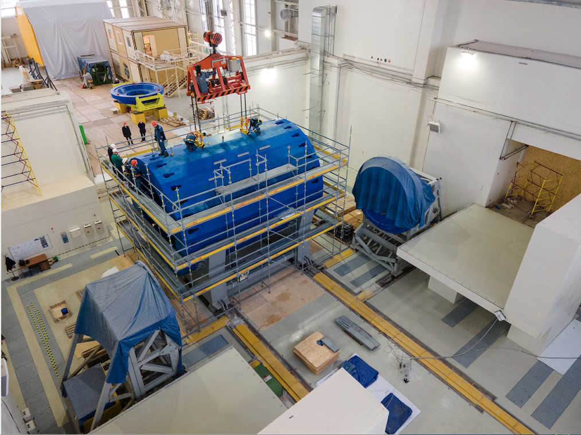
The MPD experimental Hall

Slide 4
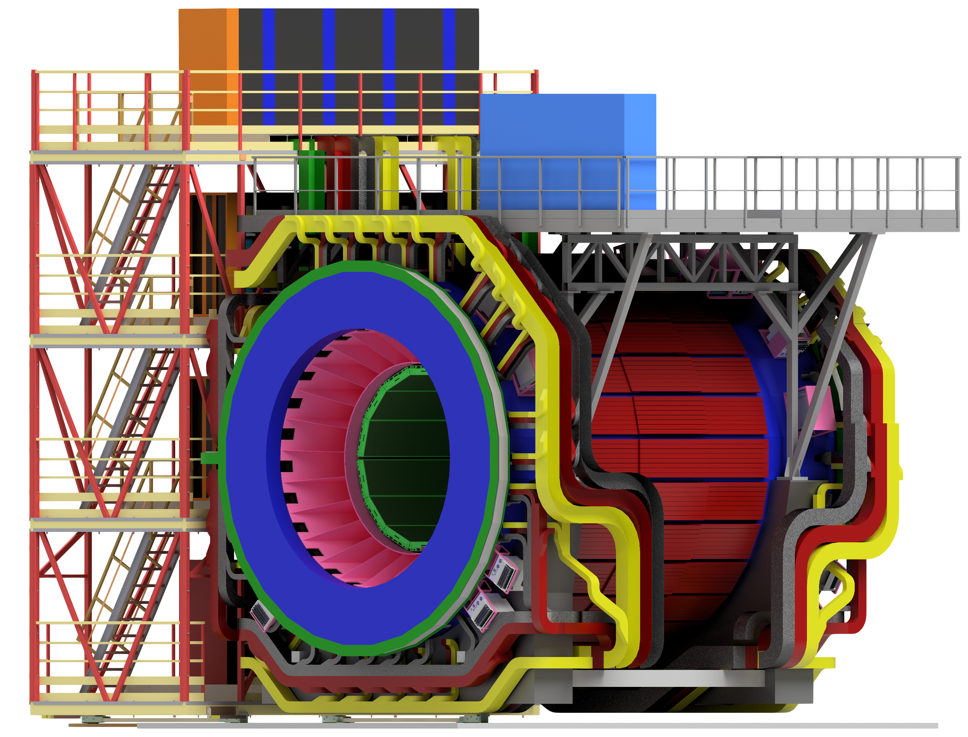
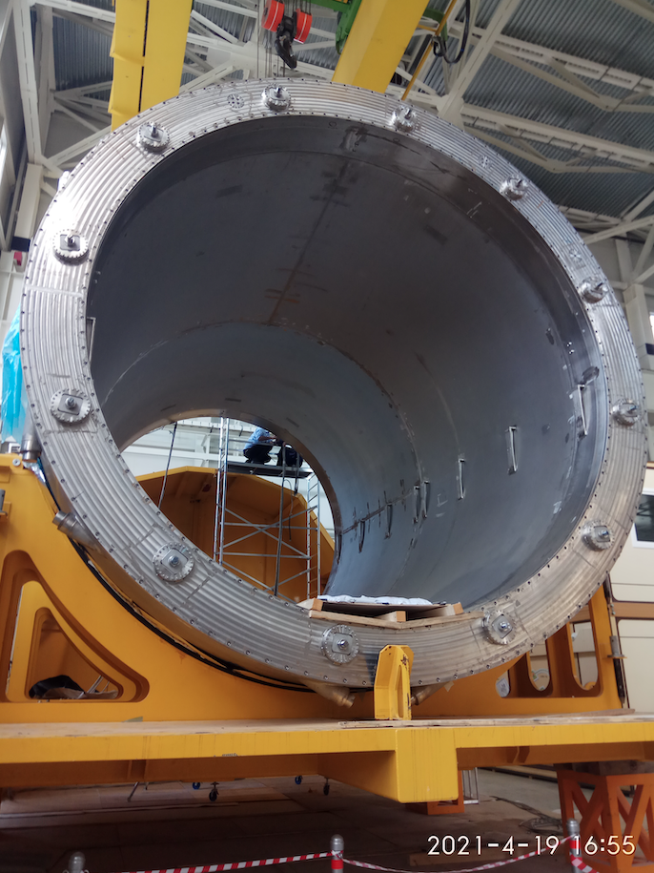
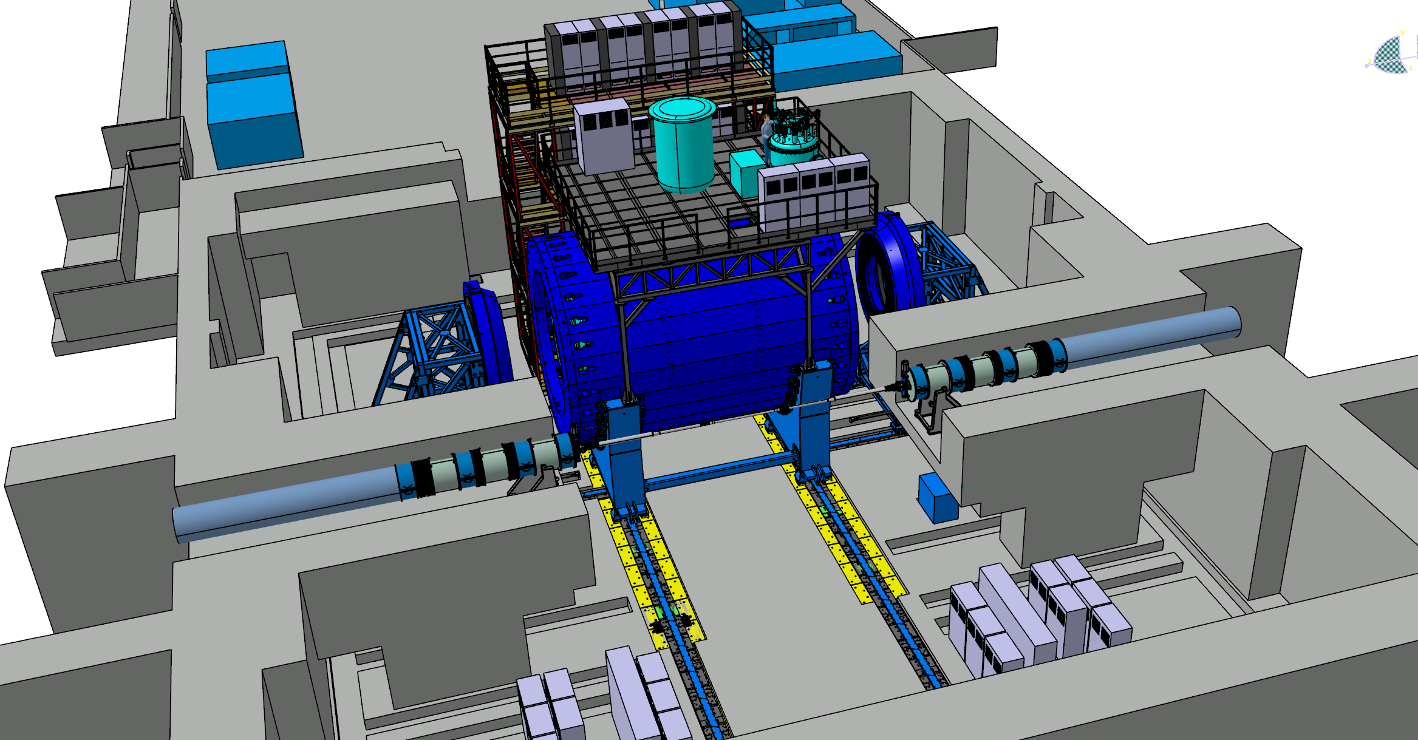
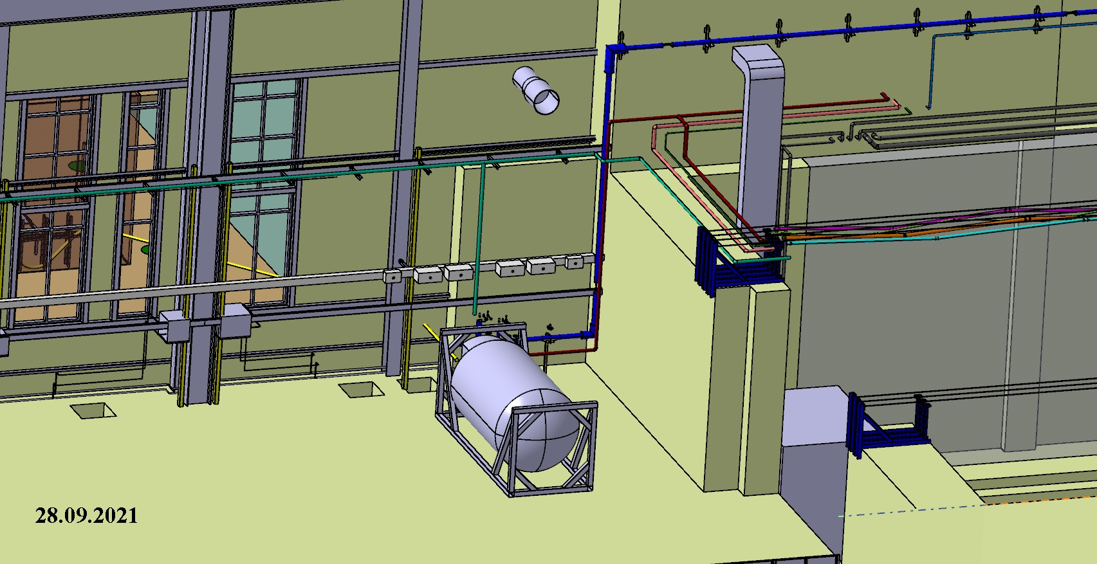
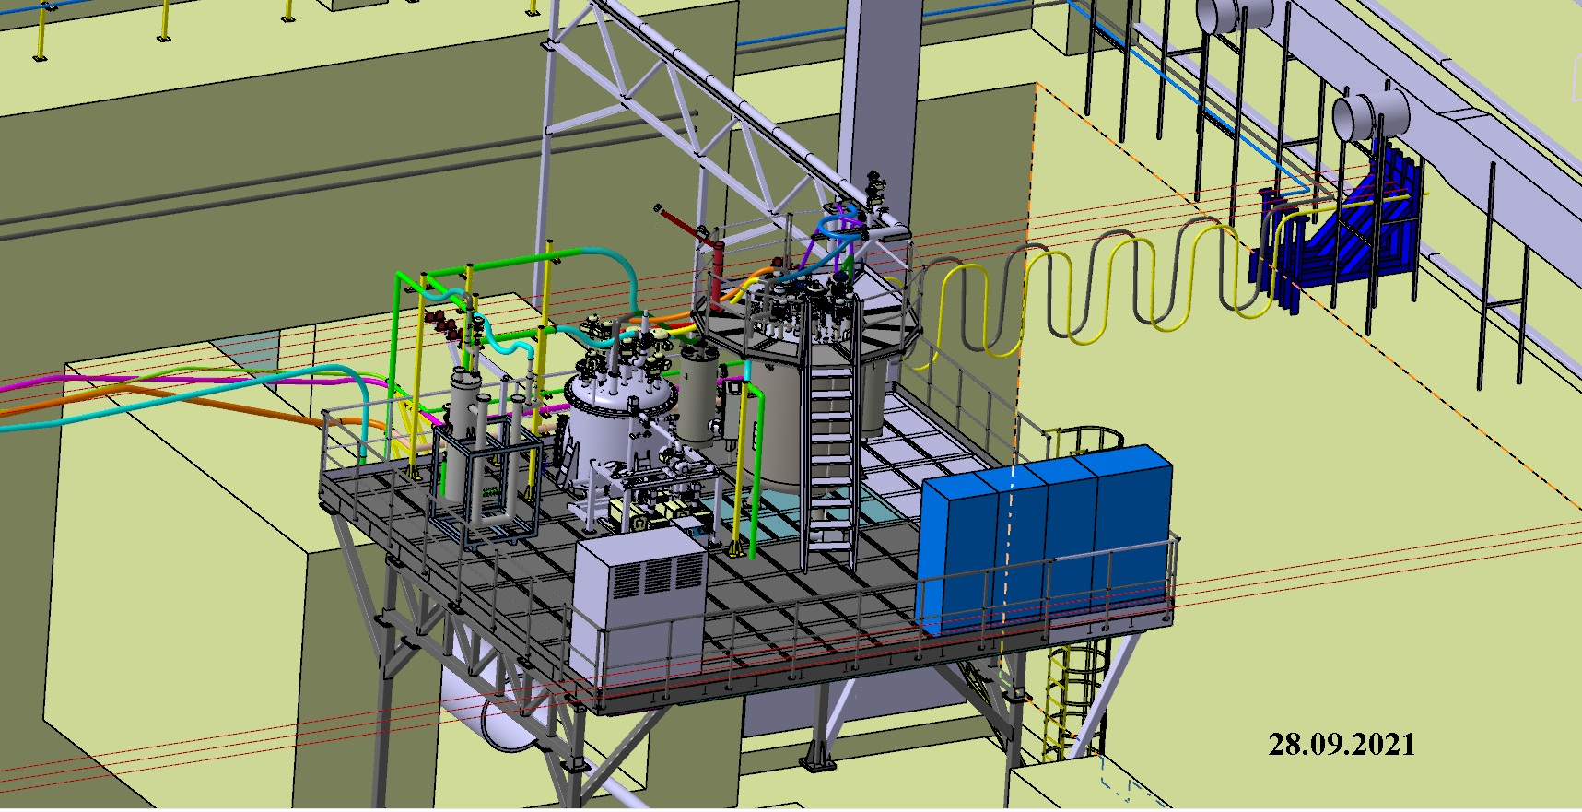
The MPD complex

Slide 5
 | List of the activities towards realization of our plan – Preparation the MPD for running on the collider beams
1 | Subsystems of MPD: TPC , TOF, Ecal, FHCal and FFD, DAQ, Trigger | On the stage of production and tests
2 | Beam pipe | Prototyping showed that all technological operation are developed. Two working pipes are on the stage of signing Contract
3 | Support Frame for detectors fixation inside MPD | In production, will be ready in December 2022
4 | Electronics Platform | Tech. documentation is ready, signing contract on production
5 | Cryogenics Infrastructure of the Solenoid. Gas&Liquid N₂ and He pipes, LHe, LN₂ tanks | LHe and LN2 pipes are ordered and partly produced Problem with delivering to JINR
6 | Cooling systems for the FE electronics TPC and Ecal and thermostability of TPC | Tender on design and production
7 | Equipment for detectors integration The lifting platform Equipment for Ecal installation Equipment for TOF installation Equipment TPC installation Platforms for FHCal fixation in the poles Equipment for beampipe installation | In production Technical documentation in preparation In production In production In production Technical documentation in preparation
8 | Four colling water lines for Solenoid power supplies, Correction coils, Platform Cooling system and Detector’s cooling system | Technical documentation is ready, in production by Strabach

Slide 6
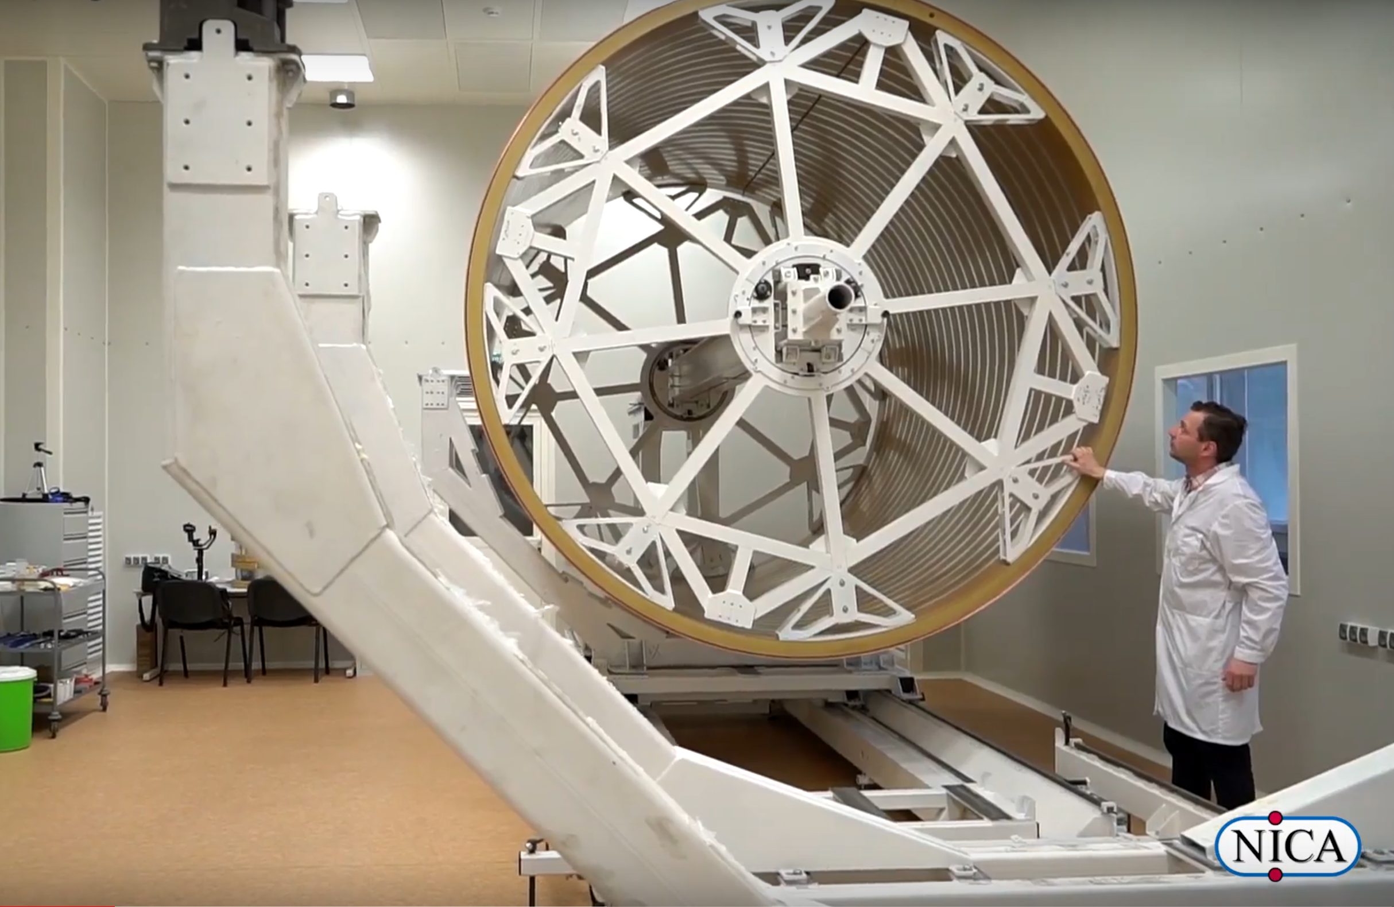
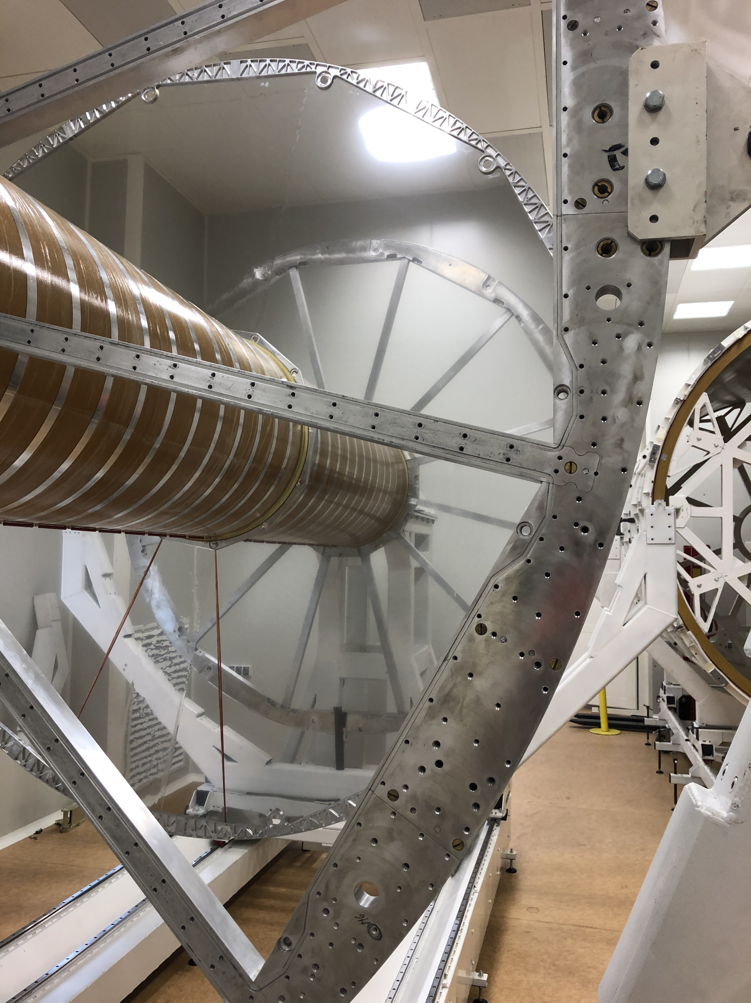
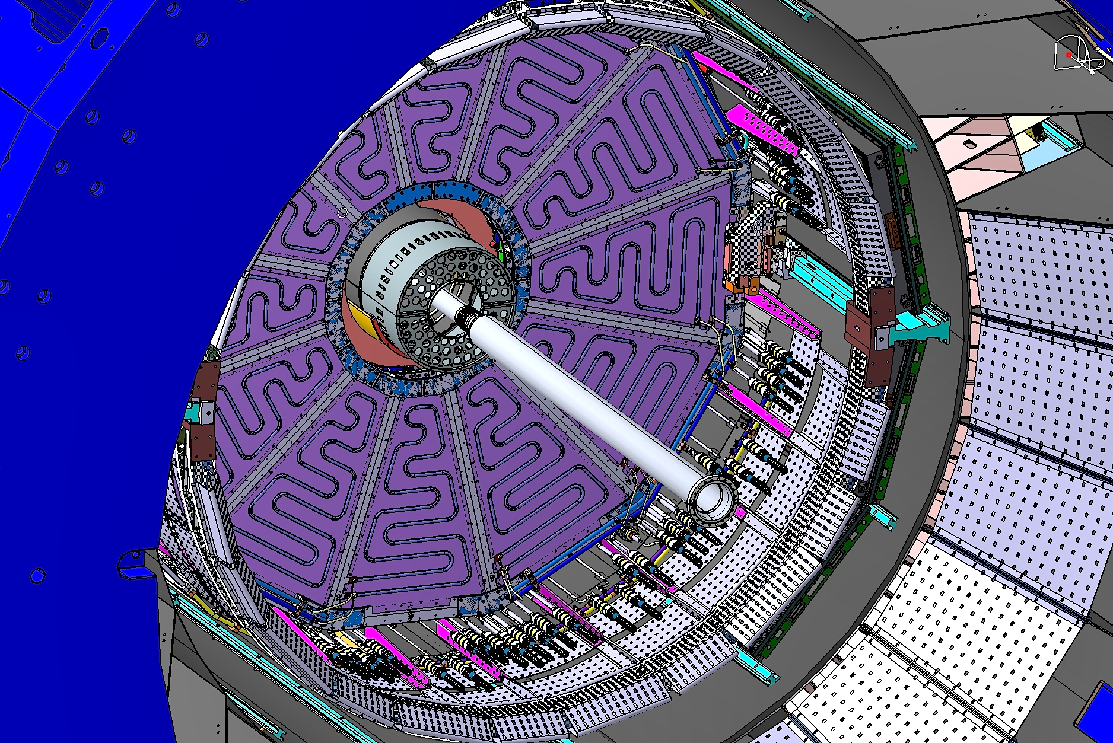
Status of the TPC
Sergey Movchan
= > DAQ and
HV+LV system:
tests in progress
=> Prototype №2 will be tested on next week
Vessel:
C3-C4 assembled
C1-C2 assembled
HV membrane - tested
(C1-C2) + flanges + HV membrane – assembly in progress
ROC chambers:
24 tested + 2 spare produced
Electronics:
477 pc ready (32%)
the rest (1011 pc) -- IIIq 2023
TPC+ECAL
cooling system:
NEW tender –>
October 2021
Cabling inside of the MPD

Slide 7
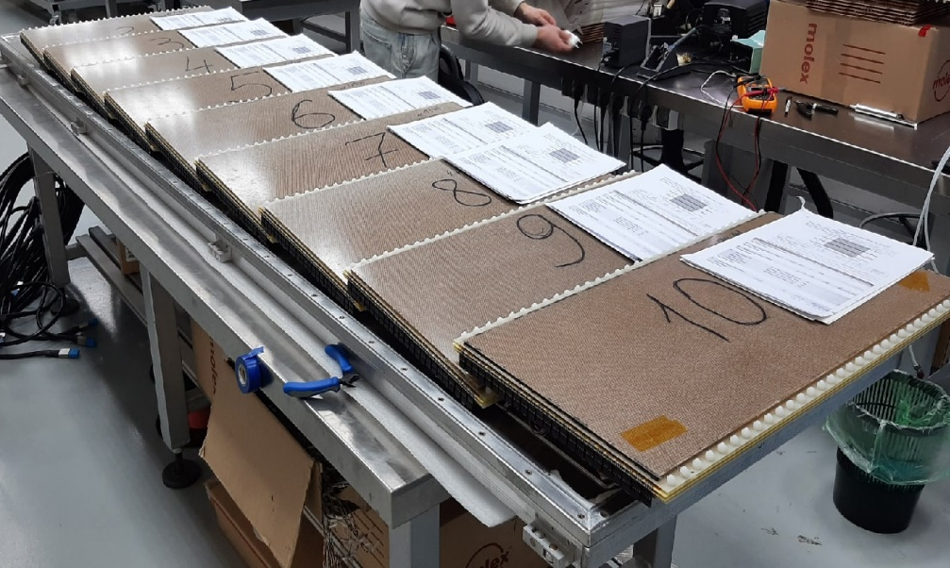
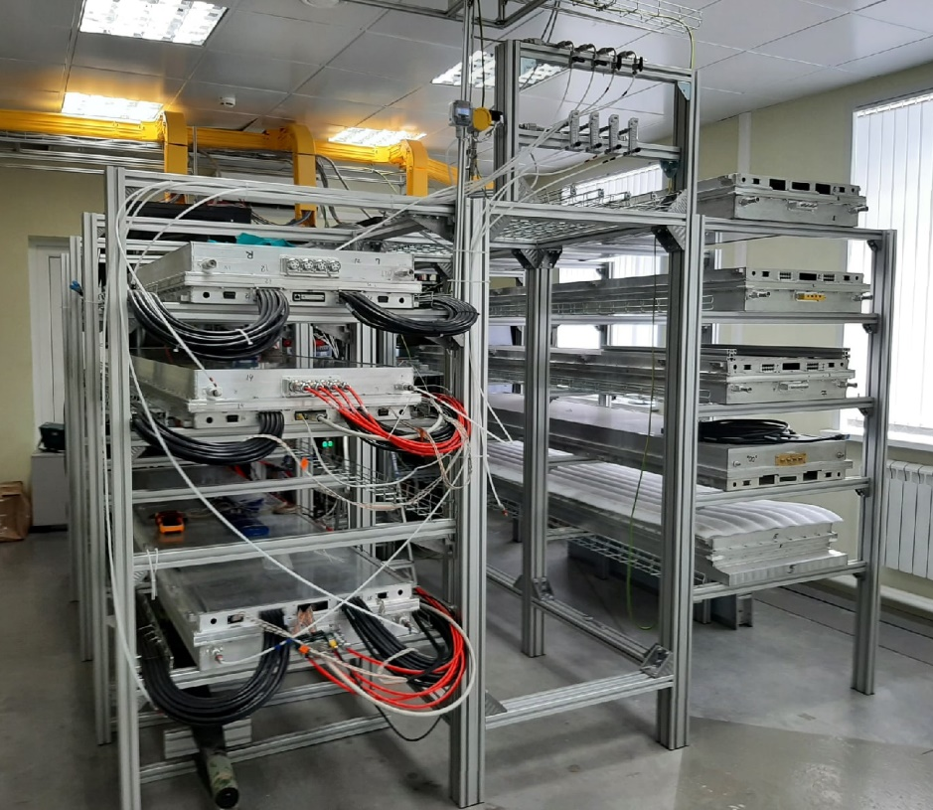
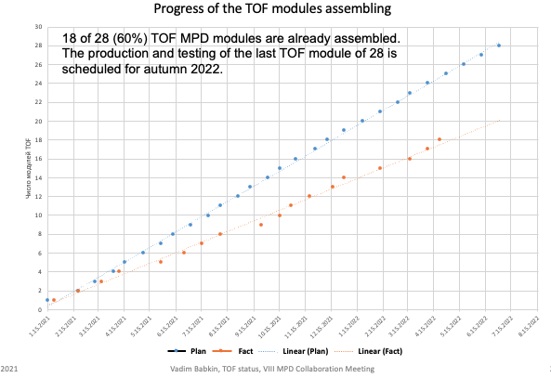
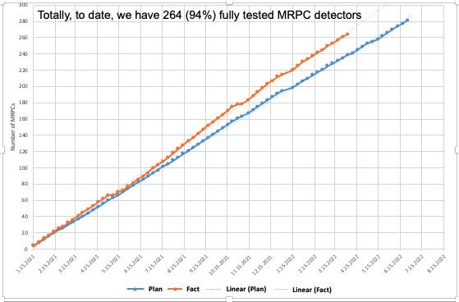
TOF status
The problems with dark current in a bunch of detector was solved!
The detectors with high current were reassembled.
Up to now, there are 264(94%) of 280 TOF detectors assembled.
also there 18 (60%) half sector modules out of 28 are assembled and tested
The problem is a tightness of the boxes
The team sees the ways to solve the problem and speed up the process of modules production.
TOF mass production report
Mass production reports on MRPC (left) and Half sector boxes (right)

Slide 8
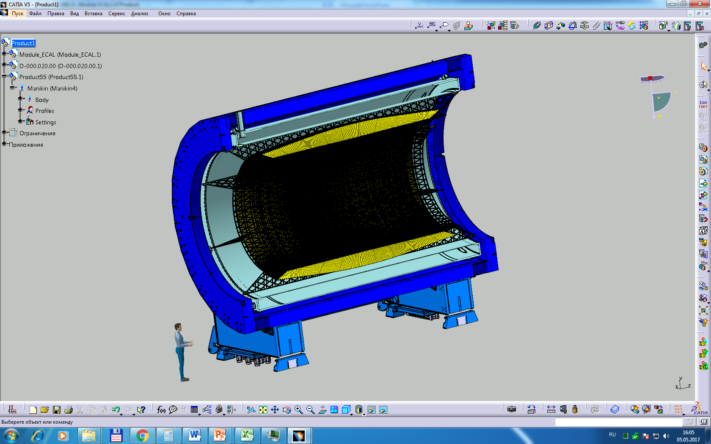
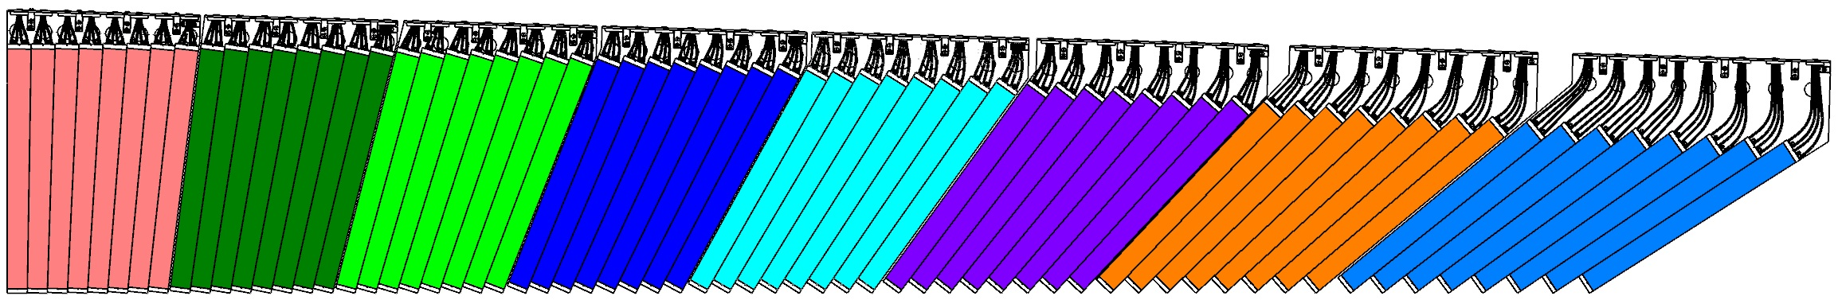
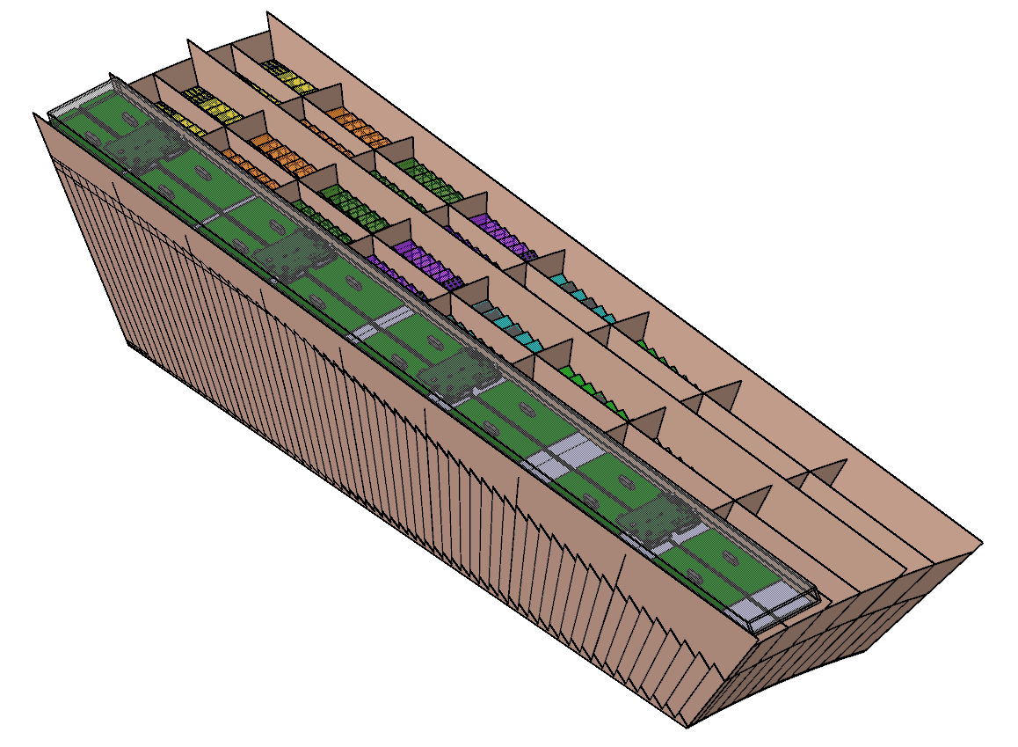
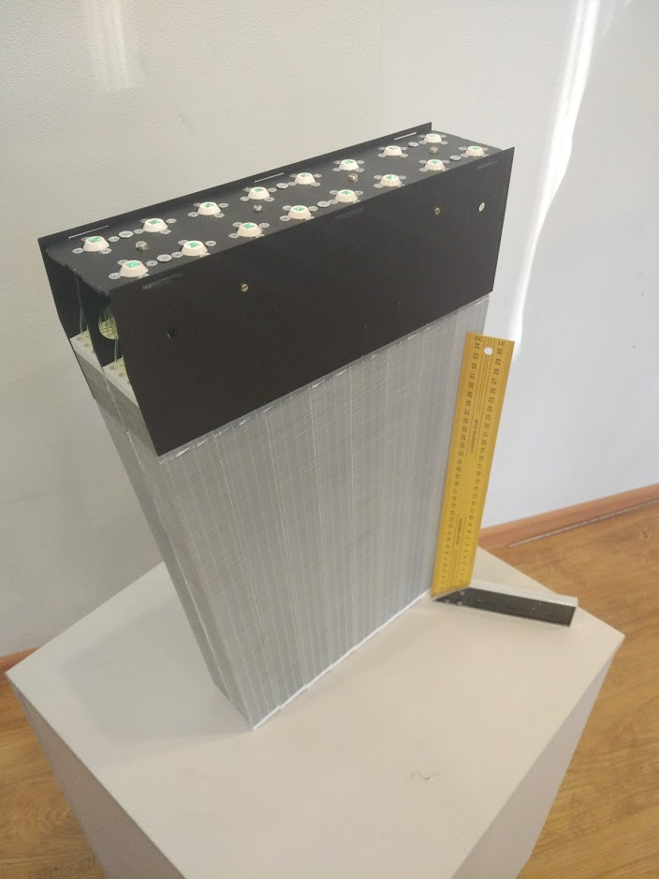
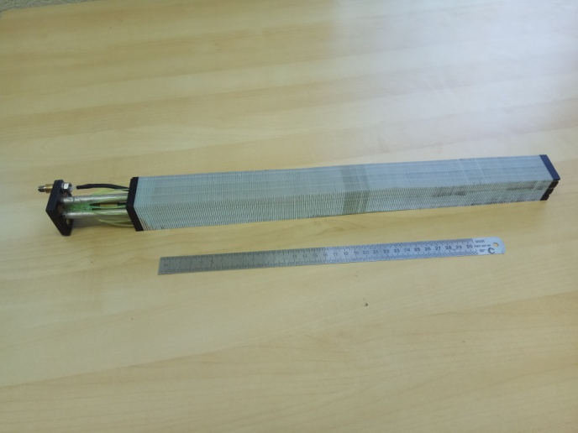
Electromagnetic Calorimeter (ECAL)
ECal – THU – Tsinghua University., Yi Wang
SDU –Shandong University
HU- Huzhou University Fuqing Wang
JINR – production in IHEP (Protvino) and Tenzor (Dubna)
ECal is organized into 25 sectors (50 half-sectors). Each half-sector contains 48 modules.
Barrel ECAL ~ 38400 ECAL towers
2400 modules
Container is made of Carbon composite
Total load of about 1.2 tons
We need Containers for sectors
A module (16 elements)
Photo of one element
JINR responsibility
800 modules (8 sectors)
CHINA responsibility
800 modules (8 sectors)
In total we planned to produce about 1600 modules which allow for assembly 16 full sectors (out of 25)
Now we see that production of these modules will be completed in QIV 2022.
Assembling of ECal sectors is not started yet,
no baskets!

Slide 9
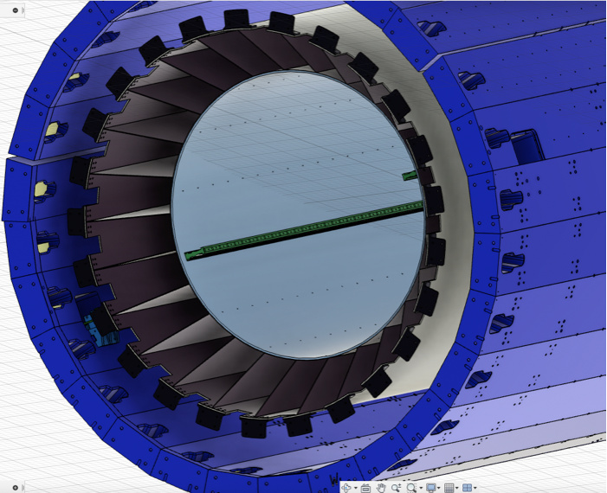
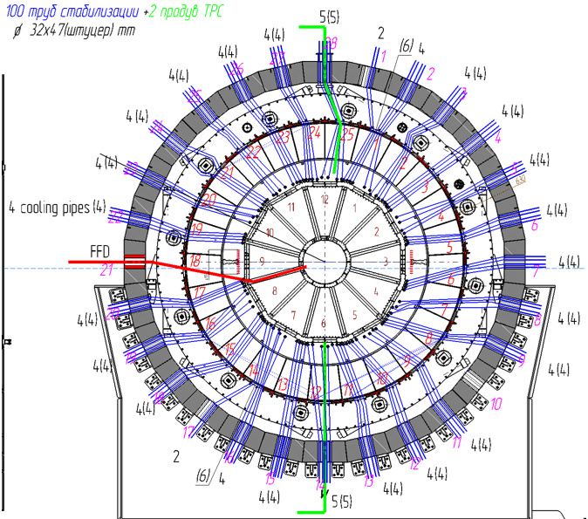
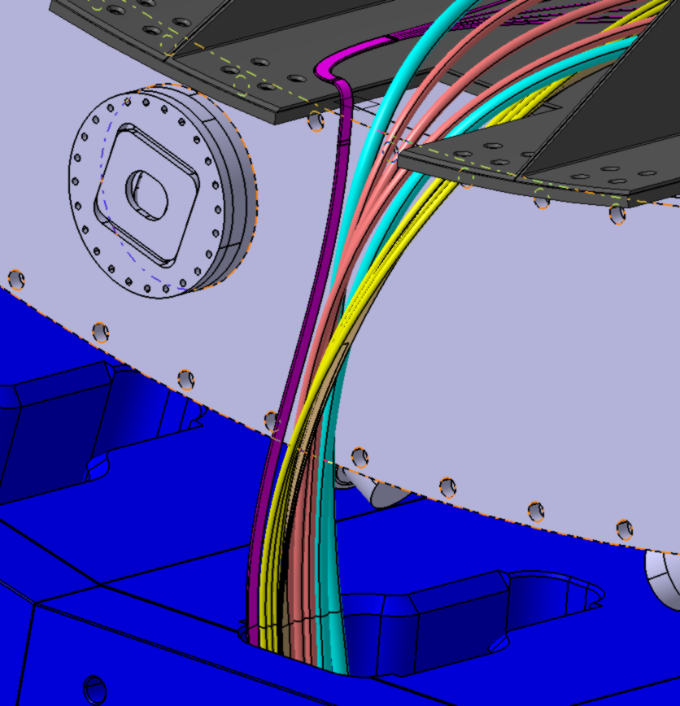
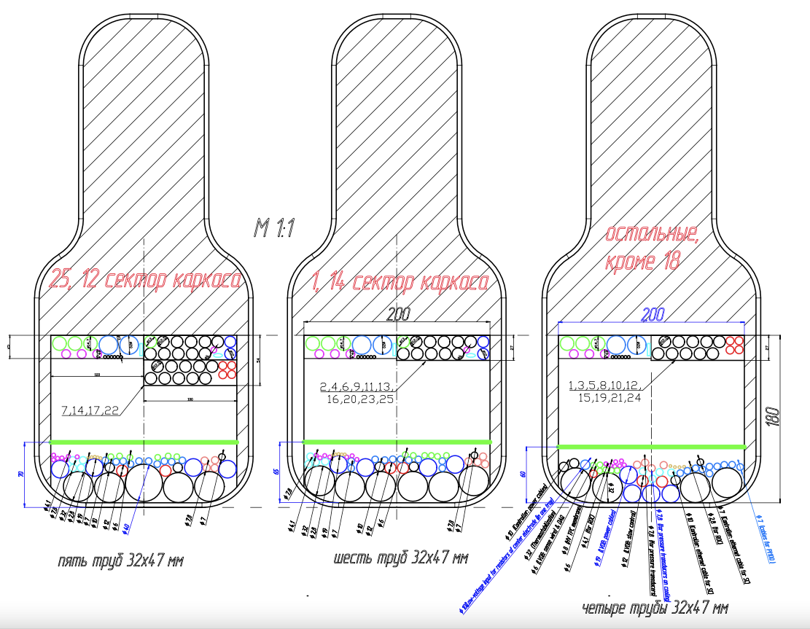
Cable routs to go inside of the barrel

Slide 10
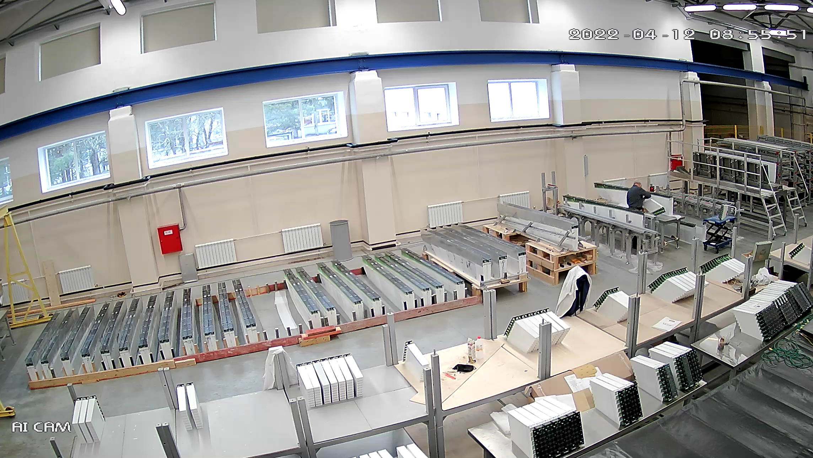
Mass production of half sectors for ECal
700 modules out of 800 modules
produced in Russia
800 modules should be delivered
before July from China
It is important for us to produce and install all sectors at the beginning.
Otherwise we need a big efforts reassemble all cables to install the rest of the sectors
We have a chance to complete production of 100% of Ecal barrel modules till the end of 2023, it means production of additional 800 modules. This goal is feasible in case of availability of all required materials.
For that we need additional founds. China team is ready to provide FE for this part of of sectors . JINR site is able to build this amount of modules till end of 2023. Money redistribution is required.
For completing the calorimeter up to 100% (additional 800 modules)
Materials -
Lead plates - 1 M$
Light guides -0.6 М$
Assembly of modules -1.5 М$
Total: about 3 M$.
Assembly of semi-sectors can be done on time
The production of 800 modules is difficult task to achieve in a short time.

Slide 11
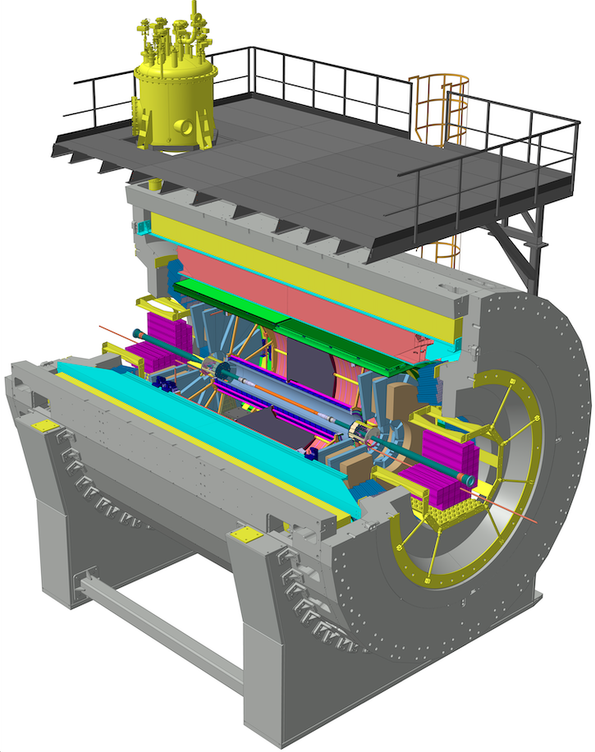
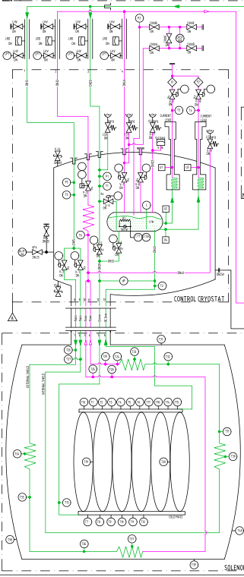
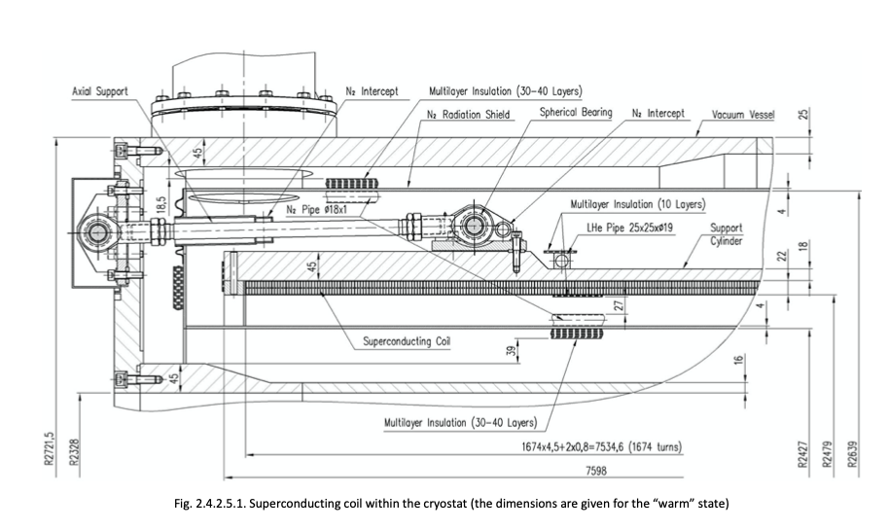
MPD Magnet
K.Mukhin
Solenoid consists of Vacuum vessel, Cold mass (Al cylinder with glued SC coil and cooling tubes with LHe) and Thermal screen - LN₂ cooling. Cold mass is suspended by 12 +12 radial supports and 6 axial- only from one side.

Slide 12
Activities to prepare Solenoid for the cooling
Work with Solenoid
- installation into Magnet Yoke
- alignment of Cold mass
- pressure test of Thermal shield and Cryostat cold mass
- replacement of flanges (transport to the working)
- vacuum test of Solenoid vessel, leak test of Cryostat
- connection temperature probes cables
- assembling Magnet Yoke
- alignment
- installation of Top platform
- chimney installation
2. Satellite Refrigerator Unit (SRU) - A new contract
with ILK
- Development of the new control system for the SRU
- Spare parts for the SRU
- Assembly of the SRU
- Cold test of the SRU at 4.5K
3. Cryogenics infrastructure
- construction of platform for LN₂ tanks and other
equipment
- pipes for LN₂ from tanks to the MPD hall
- liquid and gas pipes for N₂ and He inside of MPD
Hall
- pipes on the cryogenic platform
- LHe tank in the MPD Hall
- external lines for gas direct and return He and N₂
- Two LN tanks installation
4. Power Supplies and Control system preparation
- electricity in the MPD hall
- water for cooling system
- control system

Slide 13
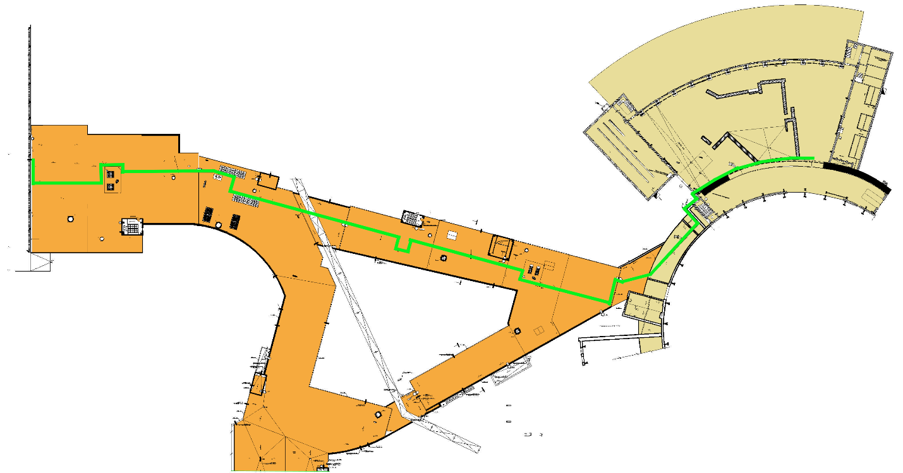
Cryogenics infrastructure
Place for LN₂ tanks and line to the MPD Hall
LN₂ and LHe lines inside of the MPD Hall , Gas lines (He, N2 and pressured air)

Slide 14
Prospect of contracts performance concluded by JINR with companies
Country | Company | Number of Contract | Subject | Сумма договора, EUR | Comments
Germany | Institut fuer Luft und Kaeltertechnik Gemeinnuetzige Gesellschaft mbH | 08626319/211082536-74 от 11/01/2022 | Contract with ILK for the assembly and commissioning of refrigerator | Agreement is signed | 1.Self-assembly, 2. Resumption of cooperation if possible. Remote consultation as agreed (to be discussed with ILK)
Germany | STOHR ARMATUREN GmbH & Co KG, Germany | 08626319/21644-73 б/д | Flexible pipeline No. 1; Flexible pipeline No. 2; Flexible pipeline No. 3 | 100% payment | Search for delivery options from Germany.
Italy | Costruz. Apparec. Elettron. Nucleari CAEN, Italy | 08626319/210825-74 от 07/10/2021 | Test equipment for TPC (LV) | 50% payment | OK! Shipment from CAEN scheduled for April 20, 2022
Poland | FRAKO TERM, Poland | 08626319/211092-73 от 08/02/2021 | Thermal Screen for liquid nitrogen | 100% payment | The firm plans to ship the screens by the end of April 2022.
England | A.S.Scientific Products Ltd, UK | 08626319/211259-73 от 19/04/2021 | Cryogenic pipeline 60m, supports made of low-carbon galvanized steel | Agreement signed | The supplier is ready to fulfill its obligations, subject to delivery from the UK on its own. Search for another producer.
England | A.S.Scientific Products Ltd, UK | 08626319/211040524-74 от 29/11/2021 | Heater housing with vacuum insulated helium heater with spare parts | Agreement signed | Search for delivery options from UK.
Czech Republic | CHART FEROX A.S. | 08626319/211053-73/CHART Q145680 от 14/04/2021 | Cryogenic stationary Liquid Nitrogen Tanks VT 21/18 | 30% payment | Search for delivery options

Slide 15
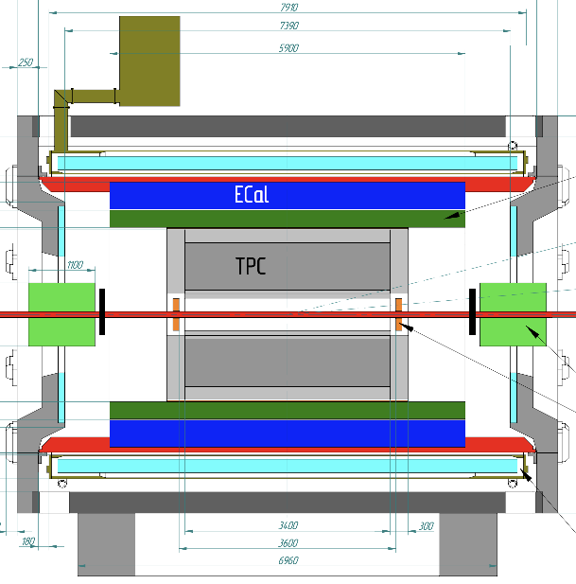
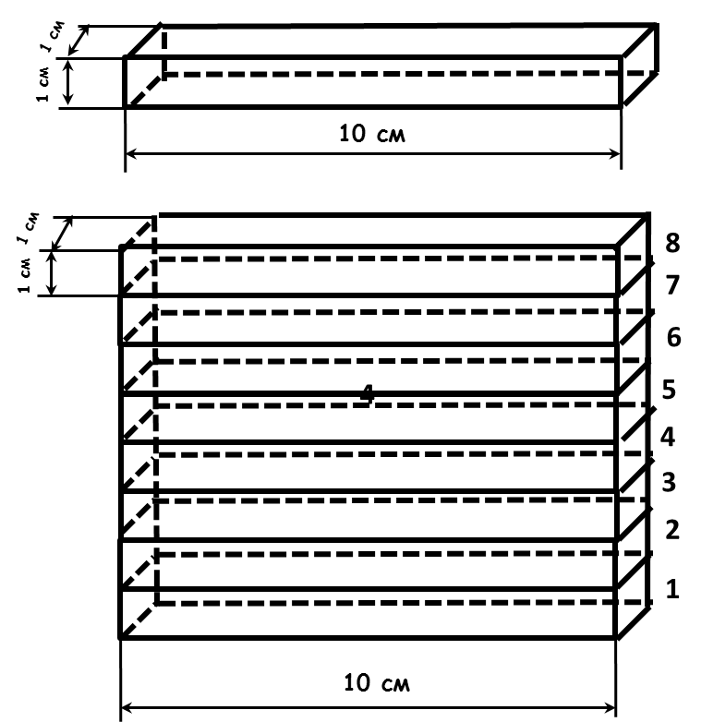
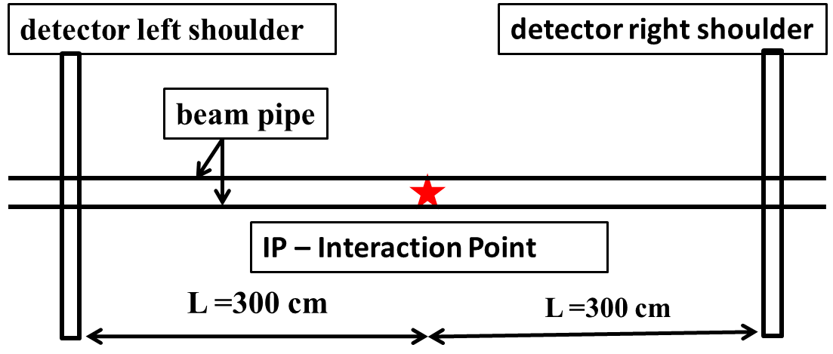
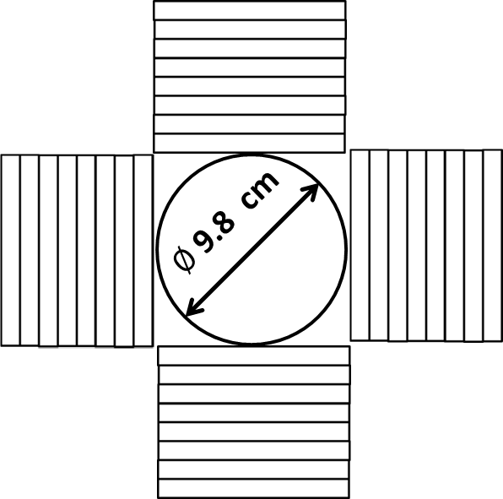
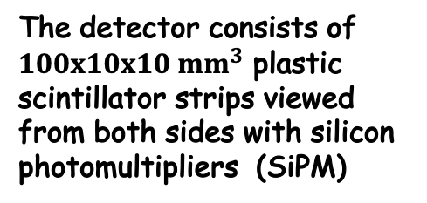
Control of luminosity at the interaction points in the collider NICA
A.Litvinenko ,JINR
on behalf of the working group
SiPM
SiPM
Detector circuit
The detector consists of $100x10x10 {mm}^{3}$ plastic
scintillator strips viewed from both sides with silicon photomultipliers (SiPM)
Detector circuit
one shoulder front view
Ion pipe made of Al - 1 mm thickness

Slide 16
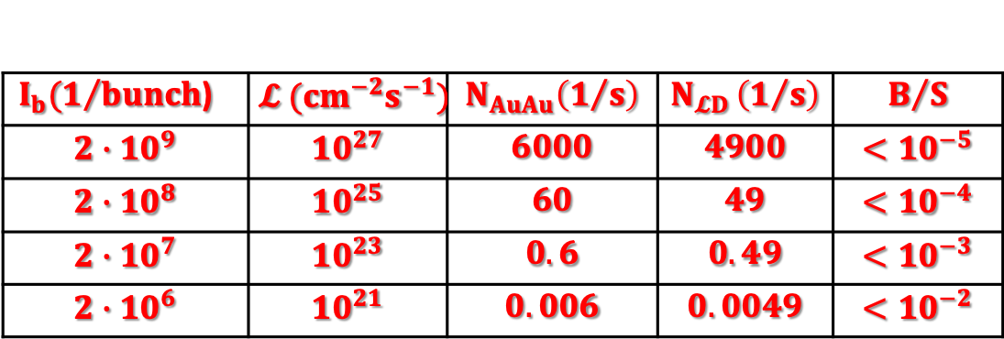
stage 0
$I_{b}(1/{bunch}$) | $$𝓛 ({cm}^{−2}s^{−1})$$ | $$N_{AuAu}\left(1/s\right)$$ | $$N_{𝓛D }\left(1/s\right)$$ | $$B/S$$
$$2∙{10}^{9}$$ | $${10}^{27}$$ | $$6000$$ | $$4900$$ | $$<{10}^{−5}$$
$$2∙{10}^{8}$$ | $${10}^{25}$$ | $$60$$ | $$49$$ | $$<{10}^{−4}$$
$$2∙{10}^{7}$$ | $${10}^{23}$$ | $$0.6$$ | $$0.49$$ | $$<{10}^{−3}$$
$$2∙{10}^{6}$$ | $${10}^{21}$$ | $$0.006$$ | $$0.0049$$ | $$<{10}^{−2}$$
Tasks which have to be solved by the detector
Assistance in controlling the transverse sizes of the bunches
Assistance in setting up transvers convergence of bunches
Assistance in setting up longitudinal convergence of bunches
Control of the distribution of vertices in the longitudinal direction.

Slide 17
Milestones of MPD assembling
in 2020-2023
Year 2020
1 July 15. - MPD Hall and pit are ready to store and unpack Yoke parts
2 August - The first 13 plates of Magnet Yoke are assembled for alignment checks
3. Sept 15-Oct 1. - Solenoid is ready for transportation from ASG (Italy)
4. November 10. - Solenoid arrived
5. Nov-Dec - Assembling of Magnet Yoke
Year 2021
6. July-Aug - Solenoid installation into Iron Yoke and alignment
7. Aug - Dec - Electrical, pressure and vacuum tests
Year 2022
8. April 30 - Cables for Solenoid probes signals are installed.
Ready for assembling of Iron Yoke
9. Apr 30 - June 15 - Assembling Iron yoke, Cryogenic platform and Cryostat. Vacuum test
10. June 16t - July 30 - Solenoid cooling down to Liquid Nitrogen temperature
11. September 30th - Cryogenic infrastructure ready
12. Oct 1st - Nov 20 - Cooling down to LHe temperature
13. Nov 20th – Dec 30. - Magnetic Field measurement
Year 2023
Jan 20 -Feb 15 - Support Frame installation
15. Feb 15th – April 10th - Installation of ECal half sectors
16. March-July - Electronics Platform assembling,
April-July - Cabling
18. April 1 – June 5th - Installation TOF modules
19. May15st – August 1st - TPC installation
20. June-July - - FHCal, Cosmic Ray test system
21. August - Switch on the MPD, Commissioning

Slide 18
Summary
All components of the 1st stage detector advanced in production.
All efforts of the MPD groups are put on the execution of the schedule plan with minimal delays

Slide 19
Thank you

