Slide 1
Status of MPD infrastructure as of September 2021 focused on cryogenics
V. Benda

Slide 2
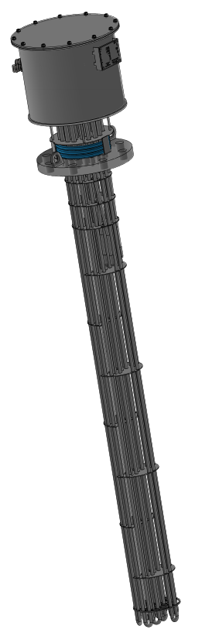
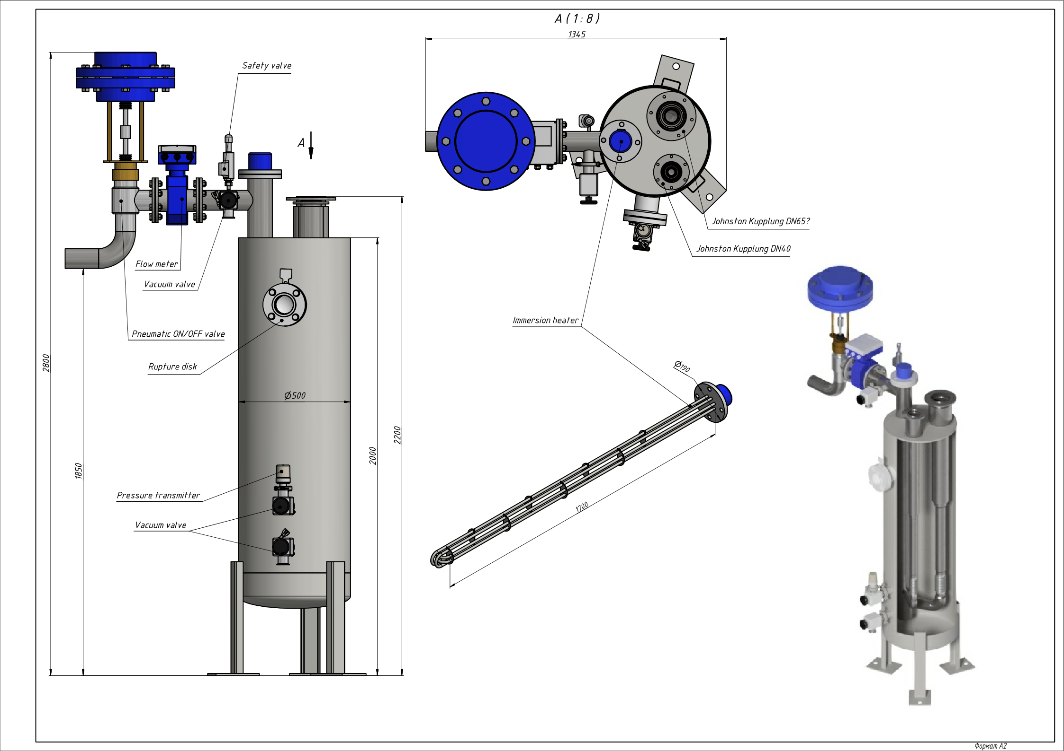
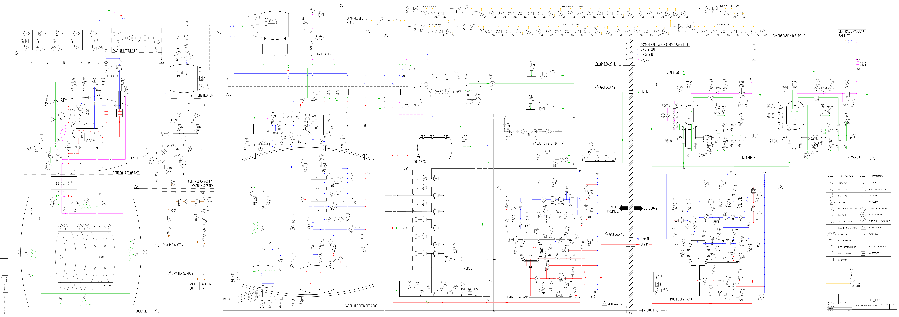



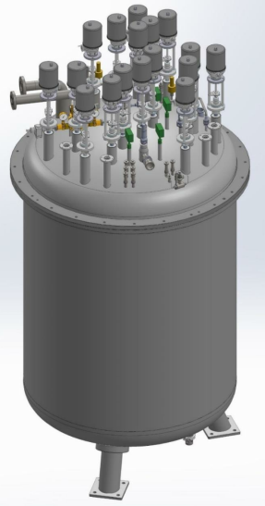

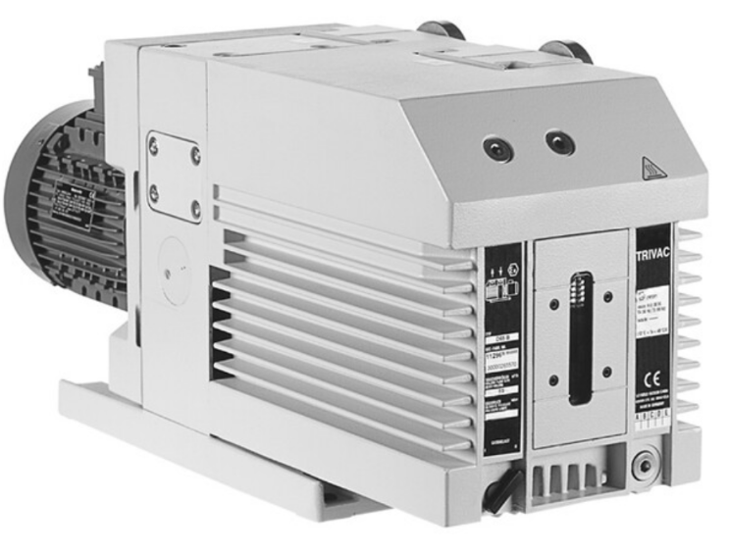
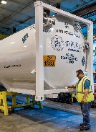
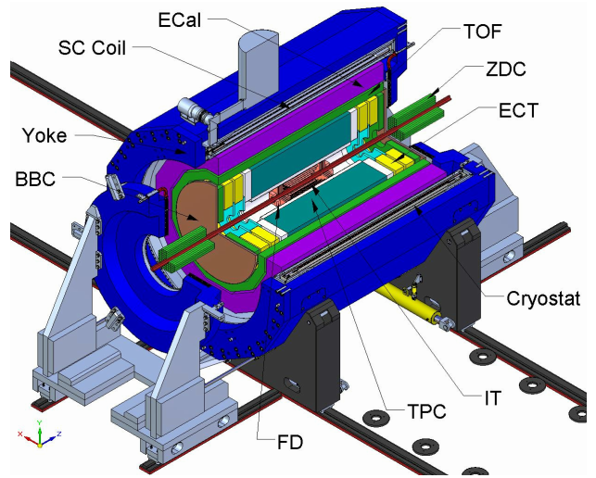
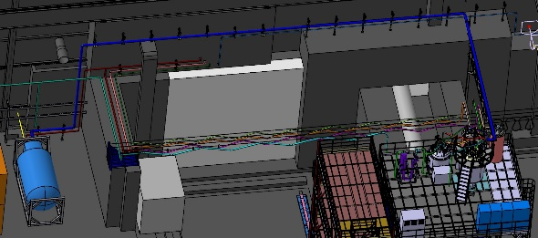
MPD P&I, Process and Instrumentation diagram is ready
GN₂ heater
Compressed air for valve actuators
GHe heater
MFS
Control cryostat
LN₂ tanks
LN₂ line
Refrigerator
Turbo-vacuum systems
Magnet
Purge pumps
LHe line
LHe tanks
Flexible & rigid cold and warm pipework

Slide 3
MPD – Infrastructure and their key components
Preliminary schedule focused to 80K magnet cool down. For final planning focused to magnet powering, see presentation of S. Golovatyuk
LN₂ tanks: Chart-Ferox (CZ). Tanks to be delivered November 2021
LHe line: A. S. Scientific Products (UK). Line to be installed in April 2022
GHe & GN₂ heater:
  Heating cartridges: Cetal (F) to be delivered December 2021
  Heater envelop: Tender started
MFS (CERN) ready for MPD magnet cool down November 2021
Temporary LN₂ lines for 80K magnet cool down: STOHR (D) - Production started, delivery date not available: ? end 2021 ? Critical for 80K magnet cool down
Vacuum equipment: Pfeiffer (D): Purge pumps, turbo pumping units are delivered. Leak detectors and valves are expected in November/December 2021
LHe tanks Gardner (USA) are ready, waiting for final documents to be available middle 2022
Lines warm & cold. Critical for the final infrastructure
  External: Routing design in process. Ready for ? end 2022 ?
  Internal: Routing design is done. Ready for ? end 2022 ?
LN₂ tank platform. February 2022
Satellite refrigerator and Control cryostat: ILK (D). Tender for collaboration is running in JINR SED system
  Supplementary contract for: Spare parts, assembly of the Satellite refrigerator including modification and testing, Control system on Siemens (April 2022) and Dummy design
Solenoid: ASG (I). Magnet preparation. Critical for 80K magnet cool down
  Leak test. Control cryostat to be connected & platform to be installed. Final test to be done.
  Magnet to be ready for 80K cool down ??? January/February 2022 ???
MPD Control system in process
  UNICOS or equivalent based on Siemens
  Draft of naming is ready for approval

Slide 4
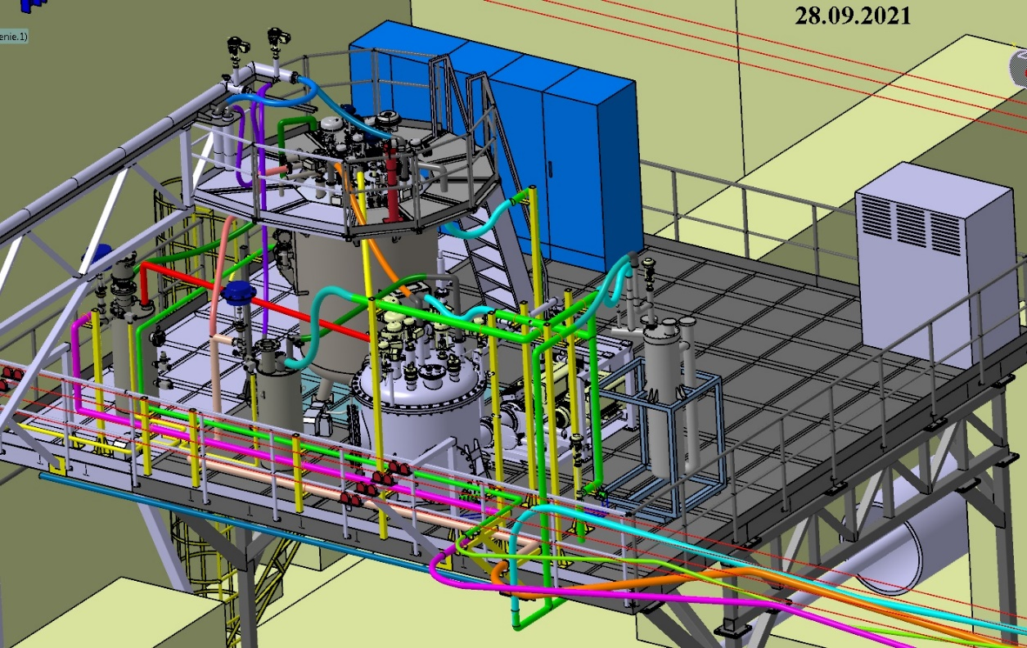

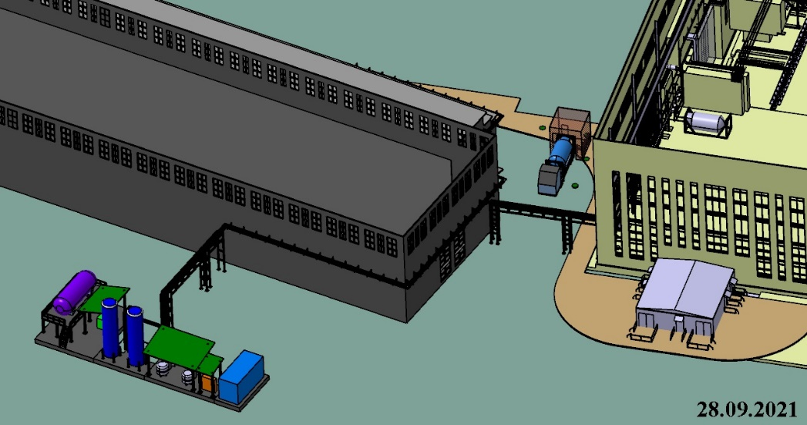
Layout
LHe supply
MPD infrastructure on the platform
LN₂ supply
LHe supply
MPD LN₂ tanks
LN₂ supply

Slide 5
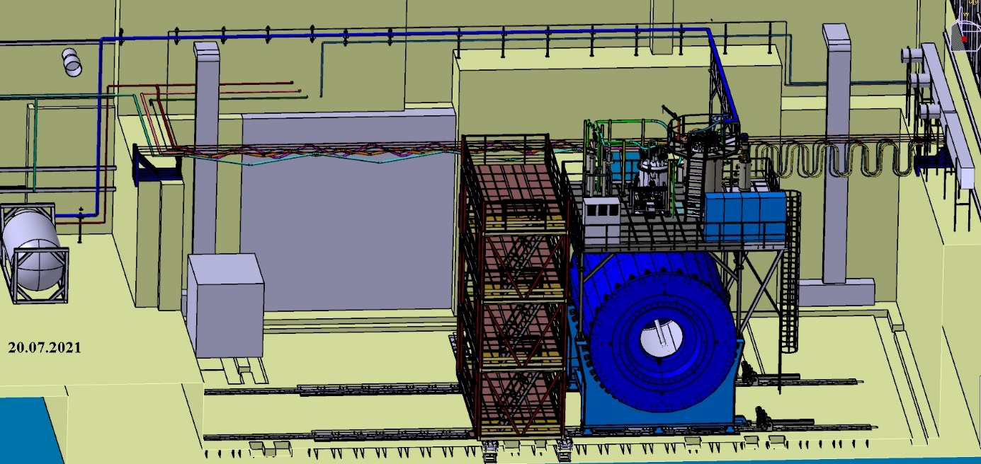
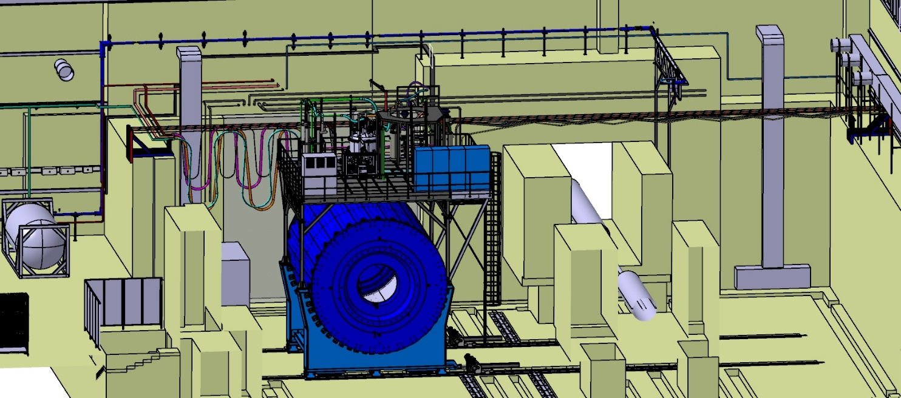
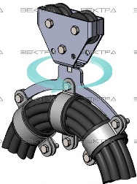
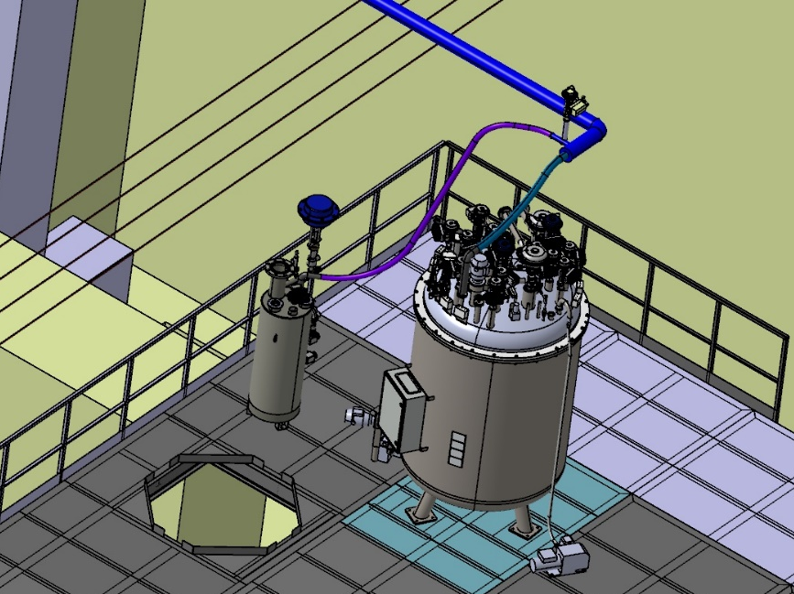
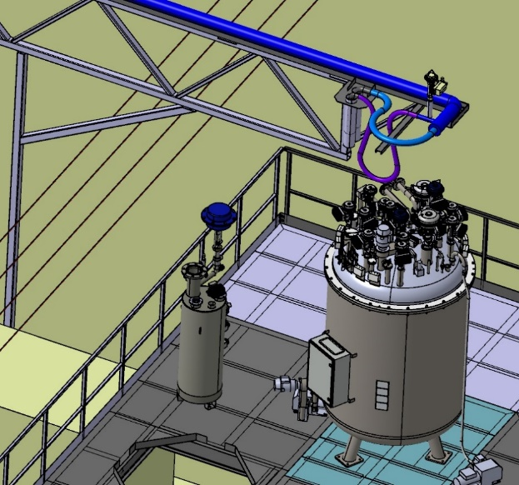
Strategy of LHe line connection allowing the magnet movement for 12m with maximum speed of 10 m/h. All other lines are flexible.
Beam position
Parking position
LHe line disconnected. Magnet ready to move.
LHe line connected

Slide 6
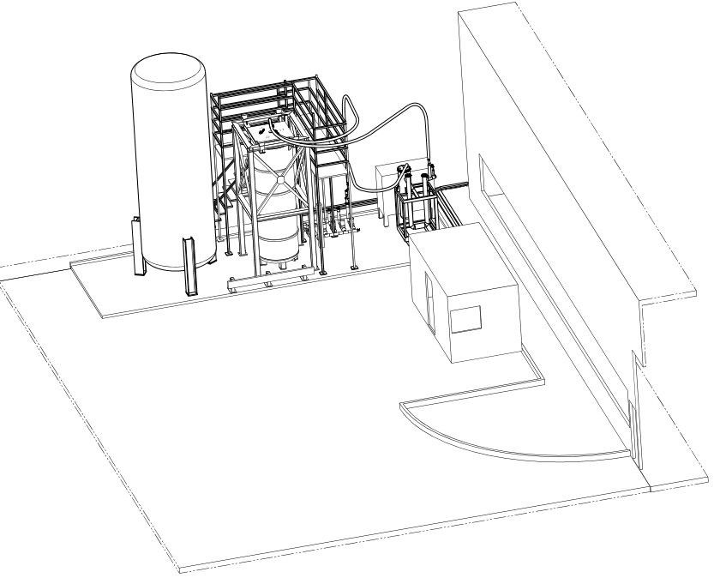
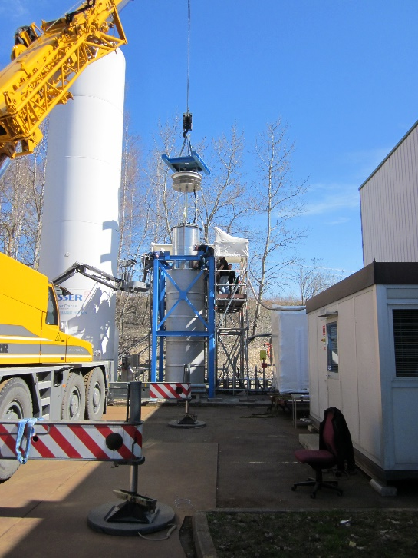
SC magnet cool-down to 80K by LN₂ at CERN
  To increase the speed of work on the MPD project, the magnet cooling to 80 K is under preparation
  At 80K, most of the possible problems will appear
    Cold leak and electrical short circuit between coil and ground
  In the event of the magnet malfunction, there will be more time for repair
  For this purpose, the MFS (Magnet Flushing Station), which was used at CERN for a similar task was brought and it is under preparation in Dubna
Slow magnet cool-down at CERN
LN₂ storage container
Test cryostat
MFS
PLC control system

Slide 7
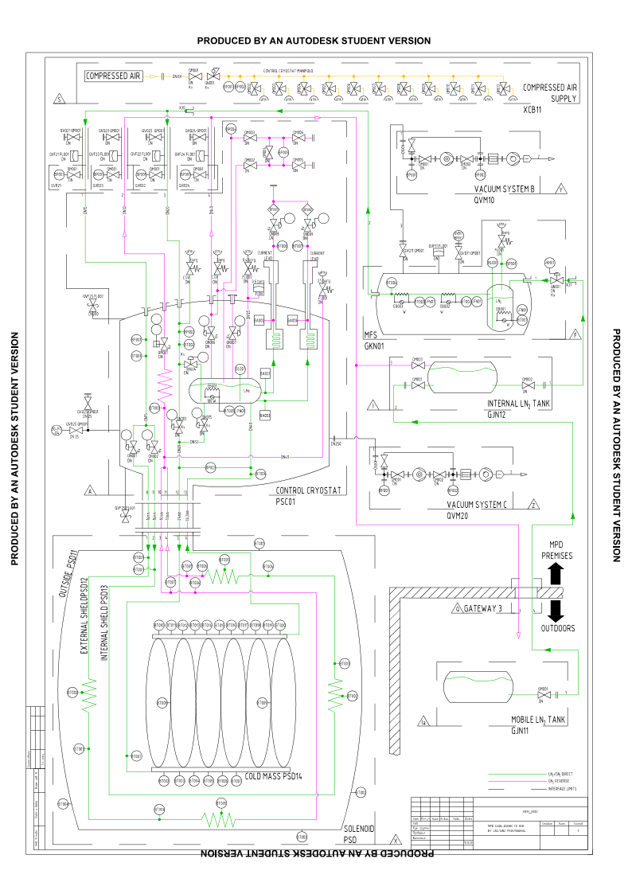
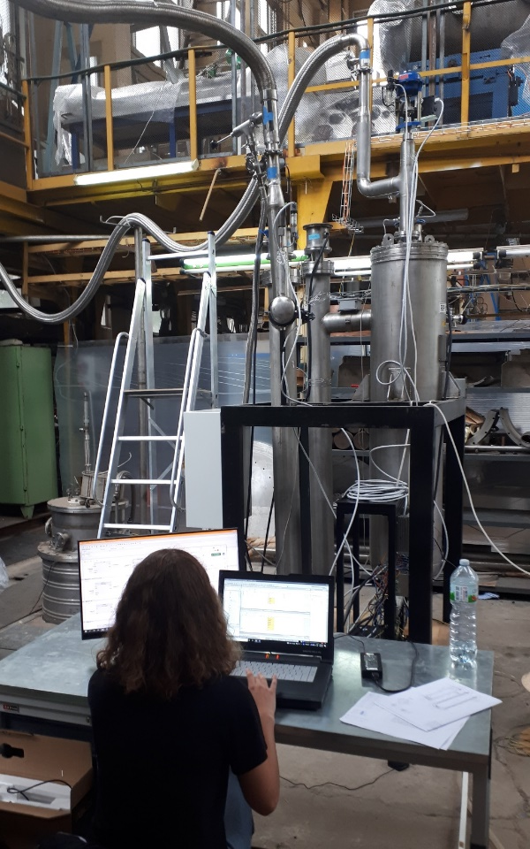
MFS preparation for MPD magnet cool-down to 80K in Dubna
MFS
Preparation and testing in b.203A

Slide 8
Thank you for your attention

Slide 9
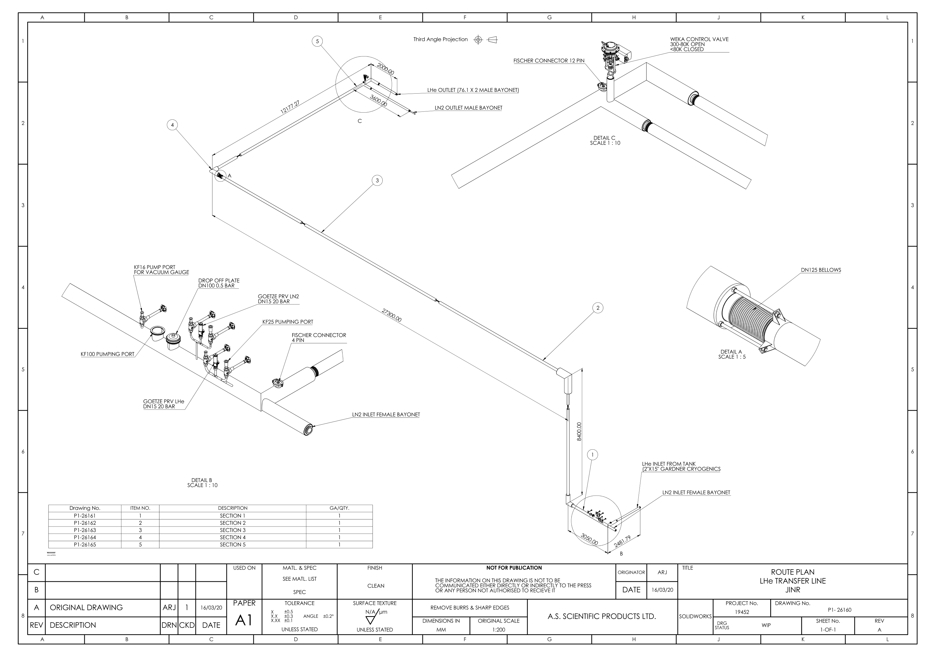
Preliminary design of LHe pipe shielded by LN₂

Slide 10
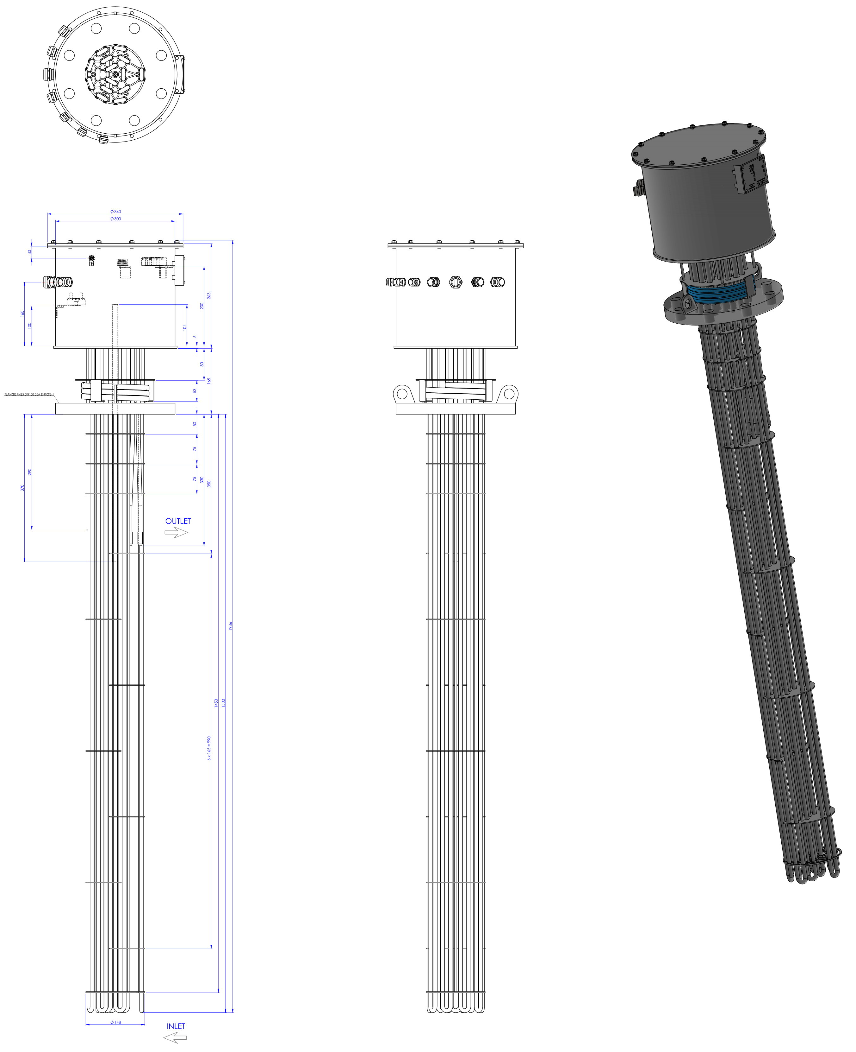
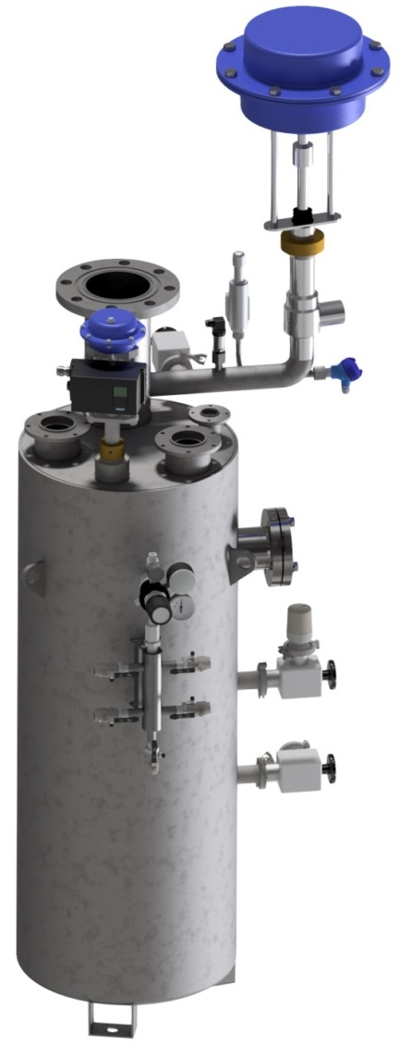
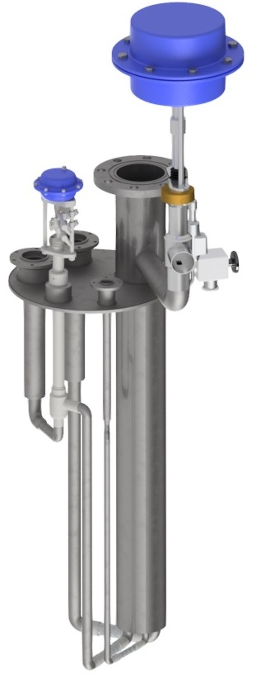
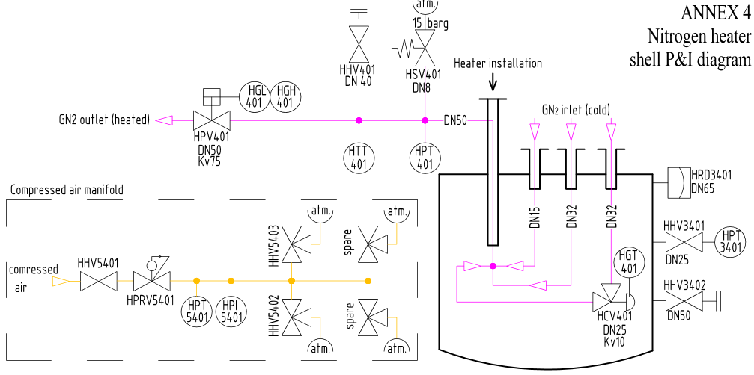
Gaseous heaters
Vacuum insulated heater shell
P&I diagram
Heating cartridge
Cetal

Slide 11
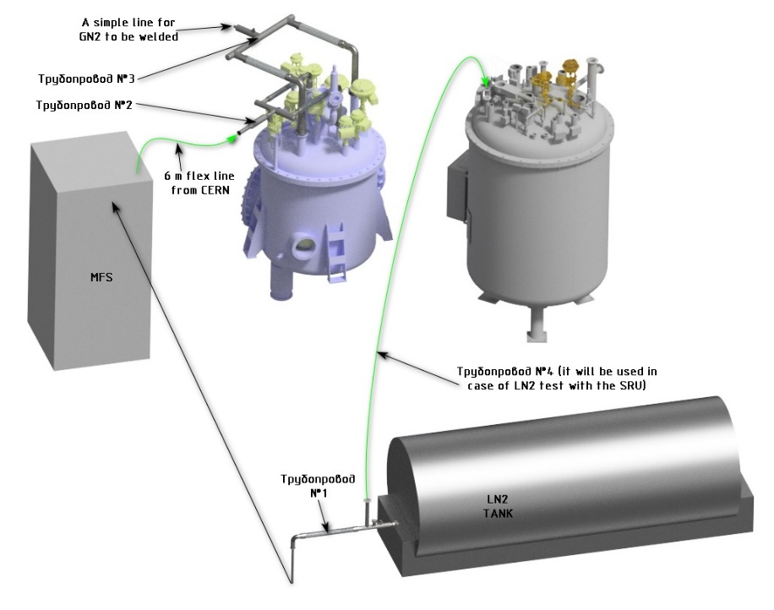
MPD magnet cool-down to 80K, required lines
Control cryostat
Flexible cryogenic lines
ordered at STOHR

Slide 12
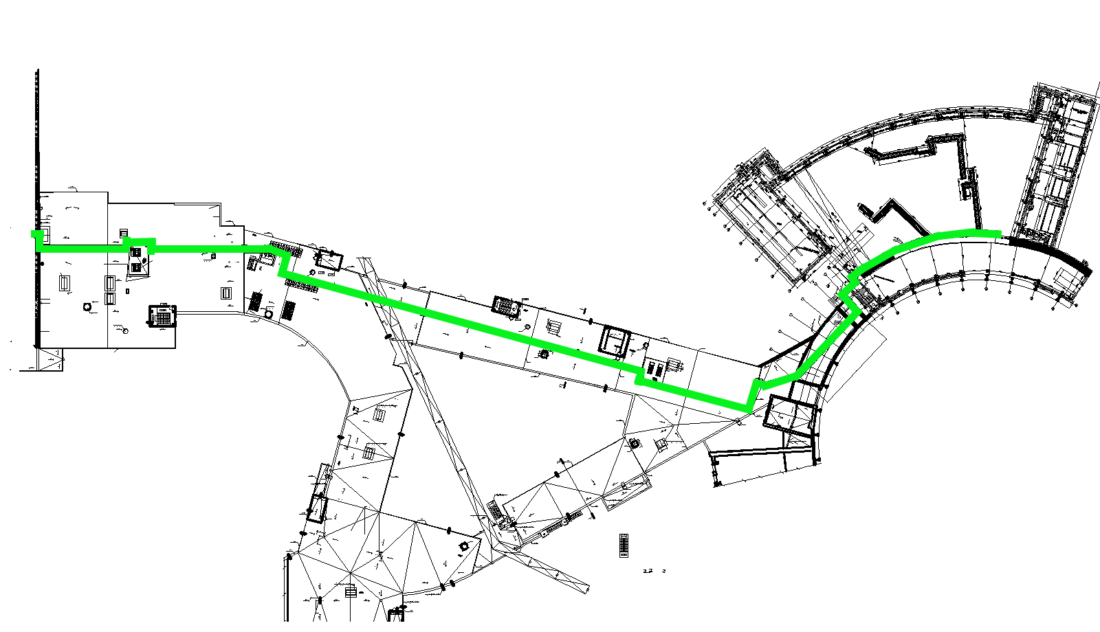
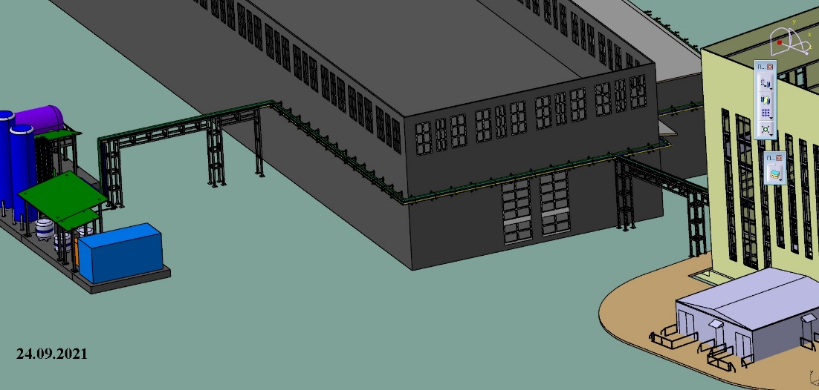
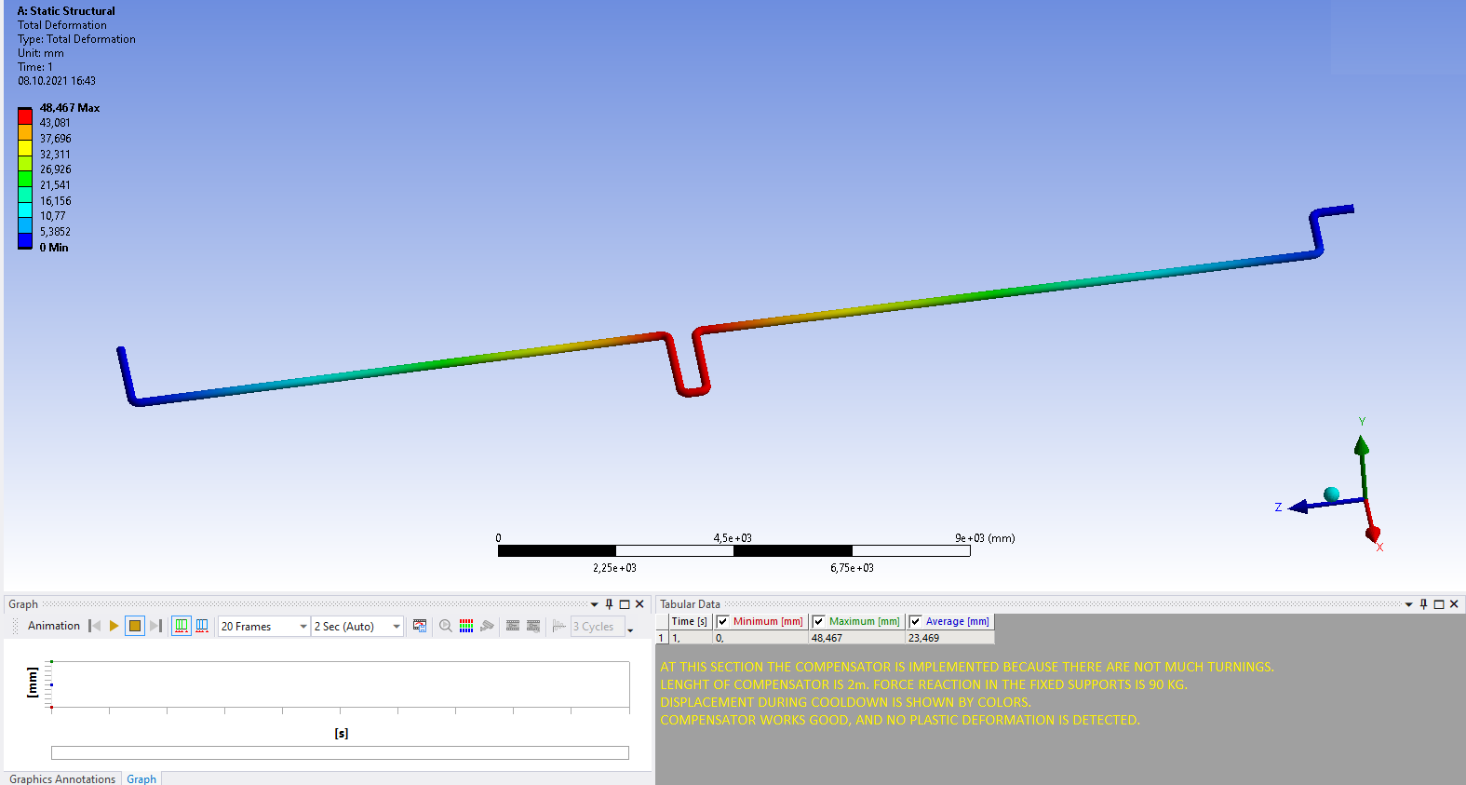
LN₂ pipe from LN₂ tanks to MPD
Warm pipes from MPD to Central Cryogenics
Four pipes are required, L=~300m
HP GHe
LP GHe
Compressed air
LP GN₂
Central cryogenic
MPD
Stress analysis due to temperature dilatation

Slide 13
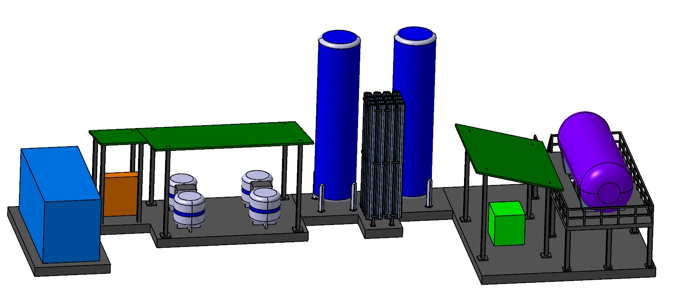
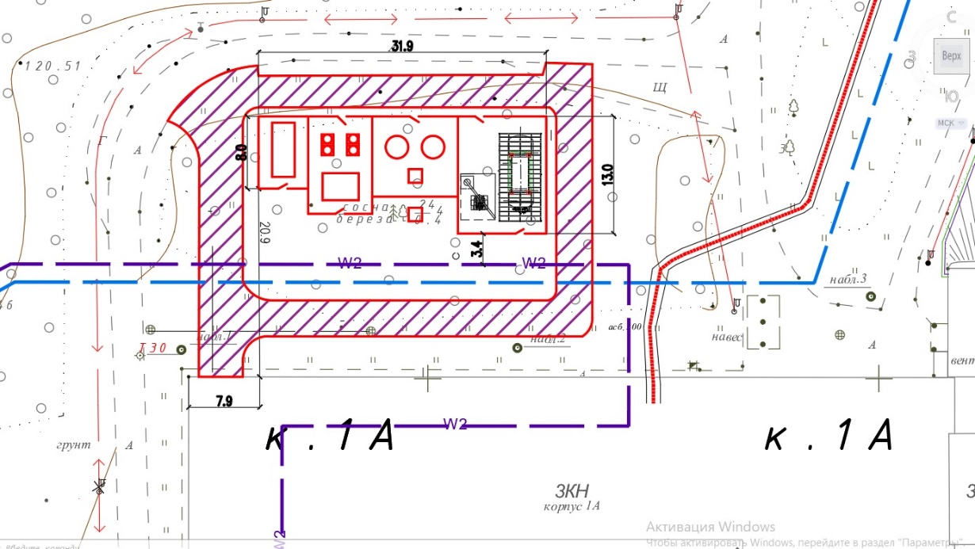
Platform for LN₂ tanks & others equipment including new road, protection, electricity etc.

Slide 14
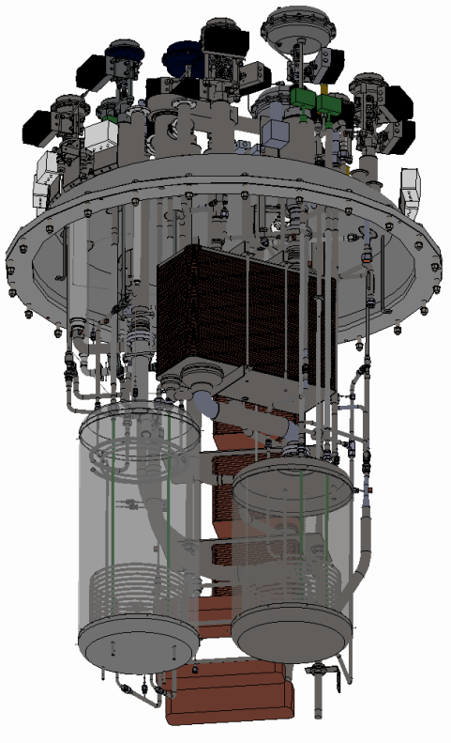
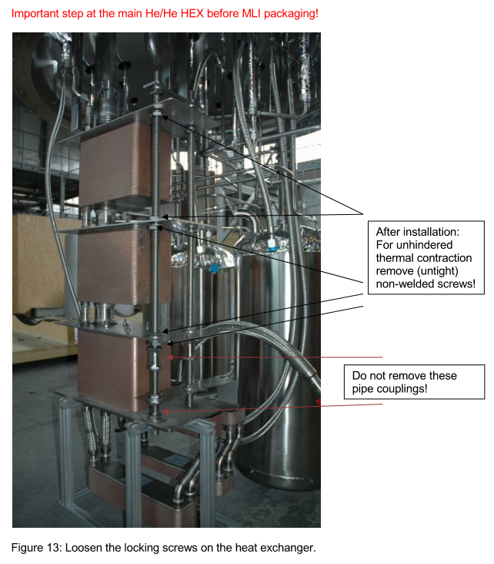
Satellite refrigerator to be assembled and tested for time being it is stored in 4 boxes
Pressure test
Leak test
Instrumentation test
PLC test
Cold test

Slide 15
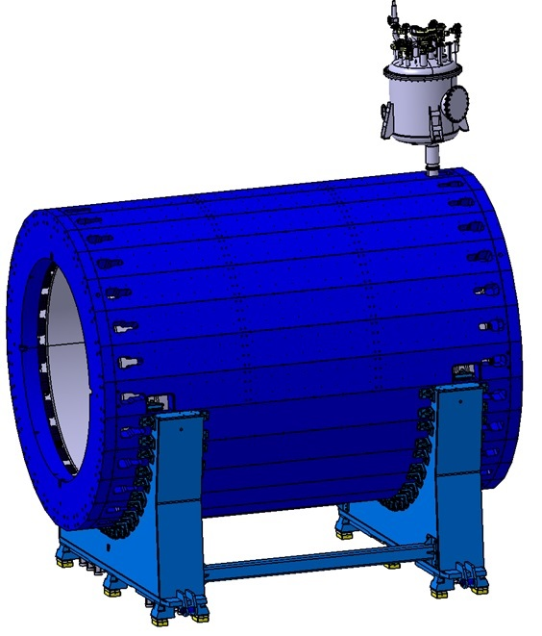
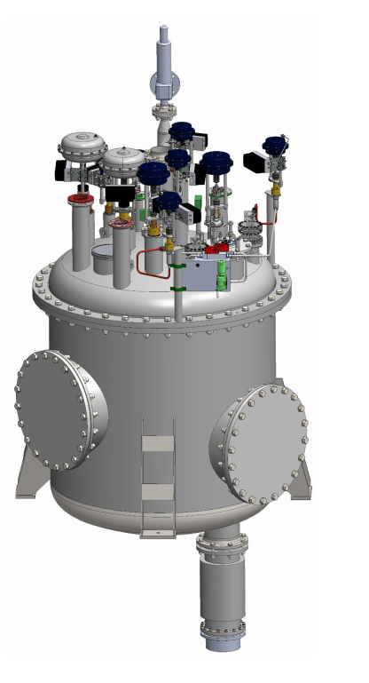
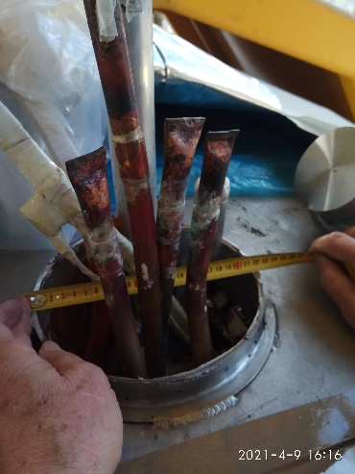
Control cryostat to be connected to the magnet by the chimney and tested together with magnet
Chimney
Pressure test
Leak test
Electrical test
Instrumentation test
PLC test
Chimney terminal to be adopted

Slide 16
Reference Designation System (RDS), with courtesy of F. Protoklitow
What is RDS
Example of the RDS code
=CRY1 GKN01 QN002 –KH01
Positioner 01 (KH – Processing of fluid and pneumatic signals)
of the control valve 002 (QN – Varying of flow of flowable substances in closed enclosures)
in the MFS 01 (GKN – Nitrogen vaporizing system)
belonging to the cryogenics system 1 (CRY – Cryogenics system)
Transparent identification of technical objects and documents
Classification according to purpose, task and composition
Representation of relations between objects
Based on international standards i.e., IEC 81346, IEC 61355
KH and QN are from IEC 81346-2 standard
GKN and CRY are NICA-specific implementations

Slide 17
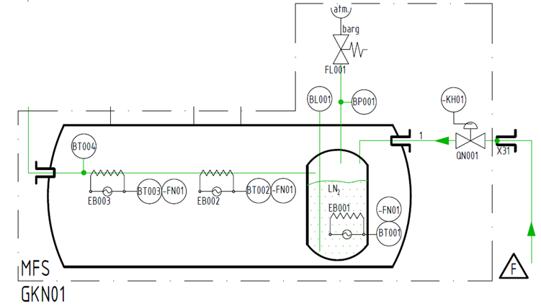
Example of the RDS implementation for 80K magnet cool-down
B - Converting an input variable (physical property, condition, or event) into a signal for further processing
BL - Level
BP – Pressure, vacuum
BT – Temperature
EB - Generation of heat by conversion of electrical energy
FL – Protection against hazardous pressure condition
FN - Protection against hazardous operating condition or damage
QN – Varying of flow of flowable substances in closed enclosures
KH – Processing of fluid and pneumatic signals

