Slide 1
Progress on the Magnet Yoke assembling October 2021
N.Topilin, E.Belyaeva, E.Gerasimov, O.Khilinova, A.Shunko
JINR, Dubna

Slide 2
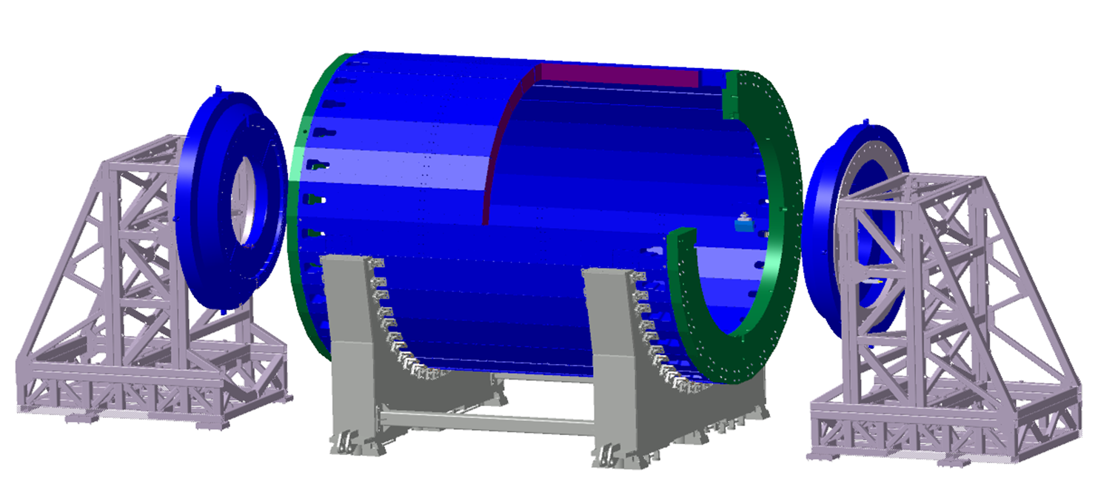
MPD Yoke (L=8970 mm, Ø6625 mm)
28 plates
16 t each
2 support rings
42.5 t each
2 poles
44 t each
Total weight: 621 t
Material:
Steel 10 (AISI 1010)
forging
Lodgement (Yoke support) – 70 tons, ordinary steel St.3 (Fe 360)
Pole transport supports 15 tons each without ballast

Slide 3
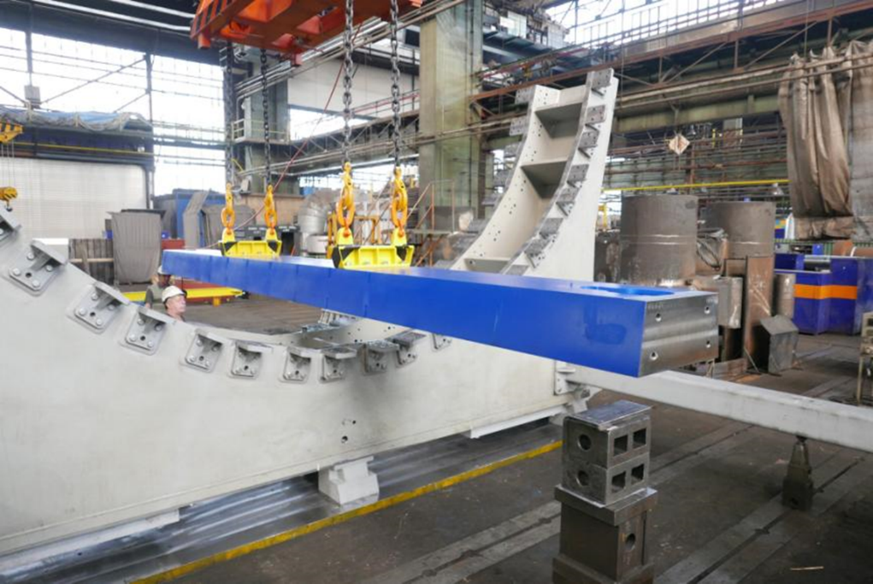
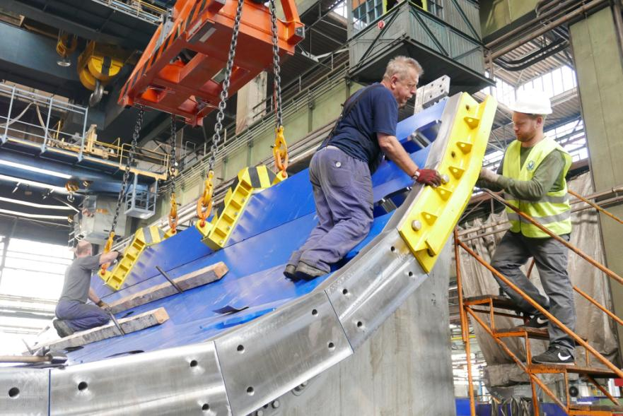
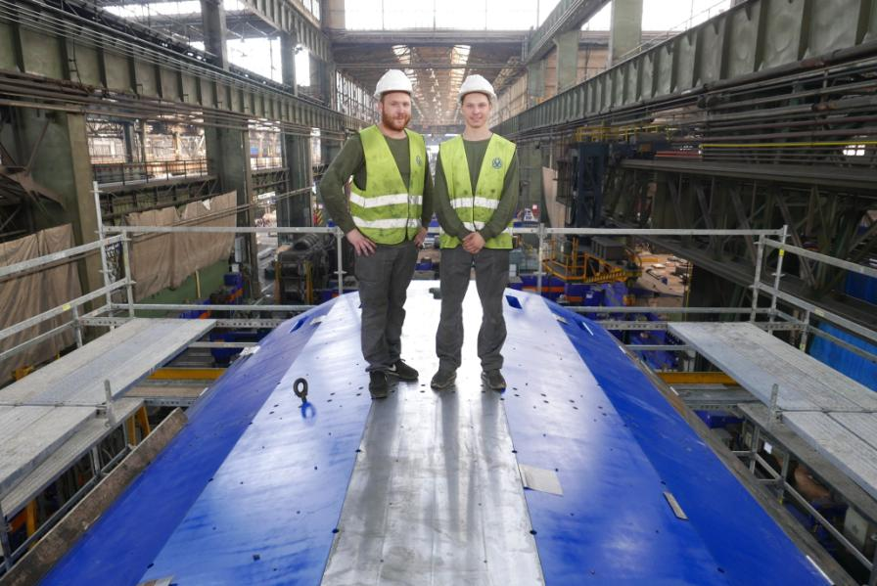
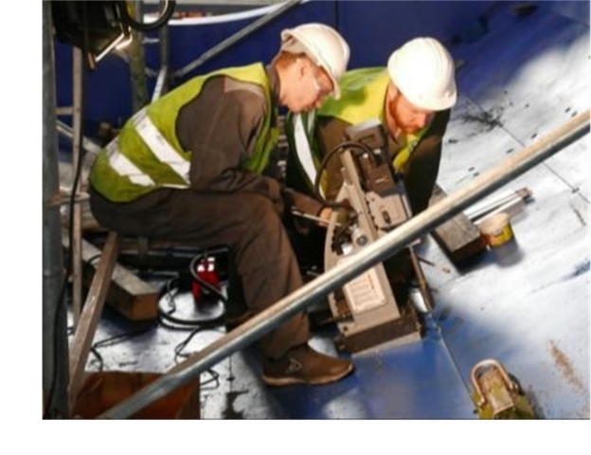
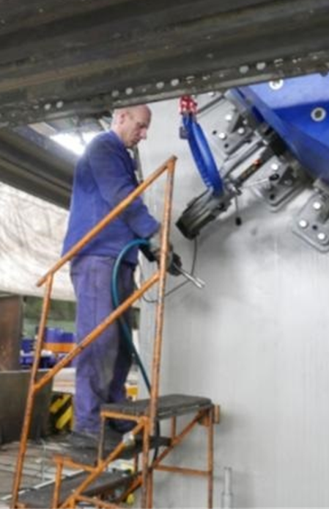
MPD yoke preassembly at VHM, June-August 2018

Slide 4
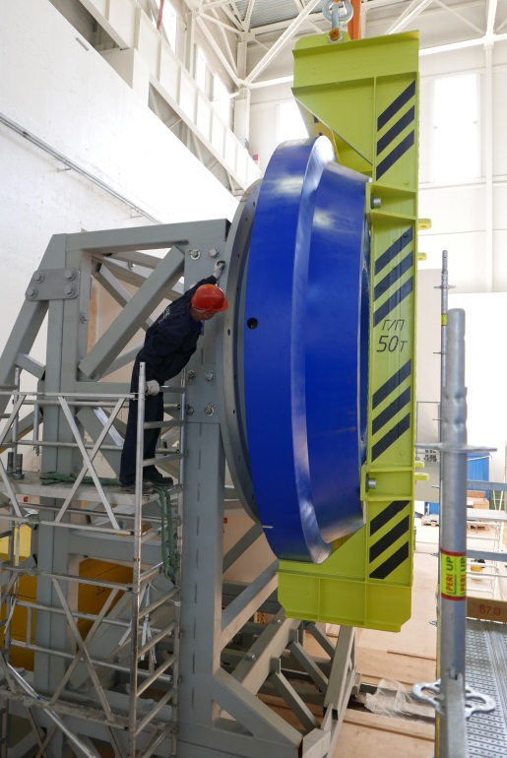
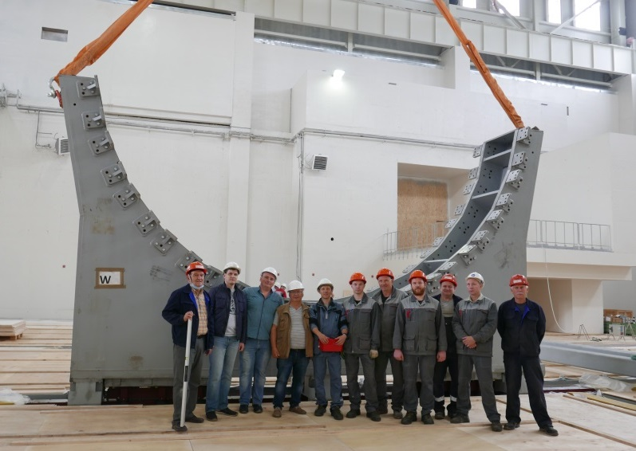
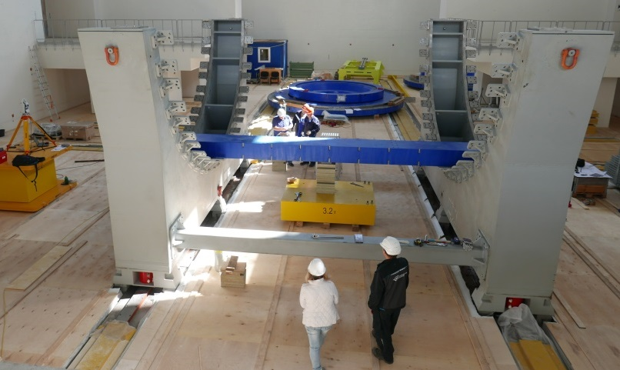
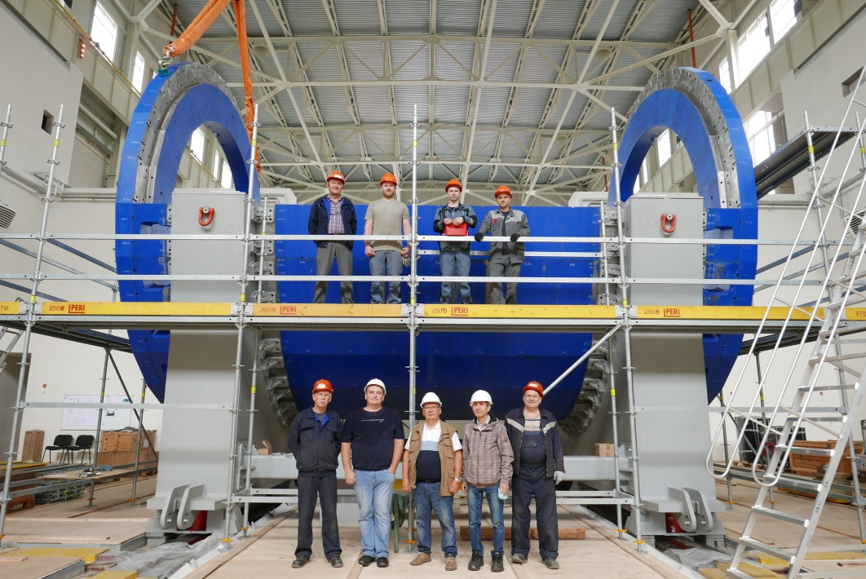
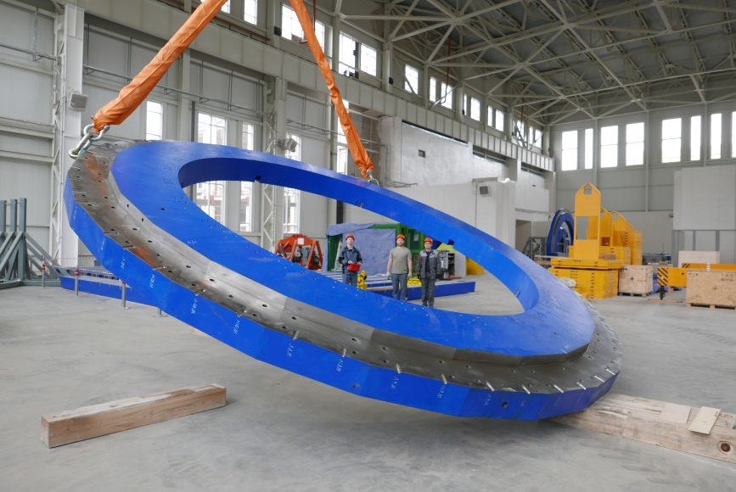
MPD pre assembly at JINR
(13 July – 12 August 2020)
Leading engineer N.Topilin VBLHEP
1-st stand
1-st plate: 8.5 m length, 16 tons
42 t Pole installation
JINR-Pelcom plant team
13 plates and 2 rings as 1 piece
370 tons in total
Support ring lifting, Ø 6.7 m, 44 tons
JINR-Pelcom plant team

Slide 5
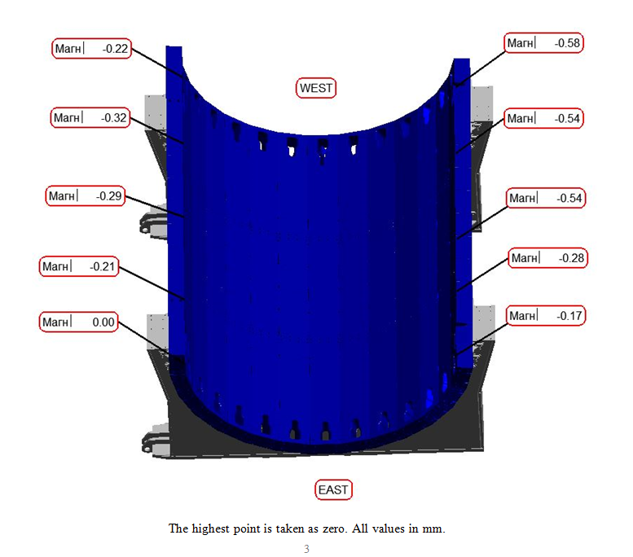
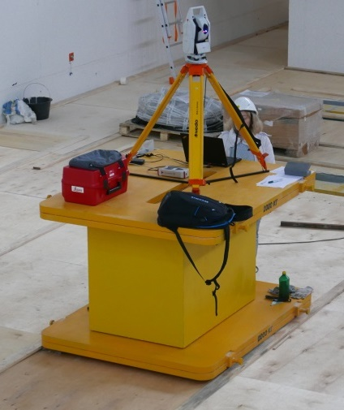
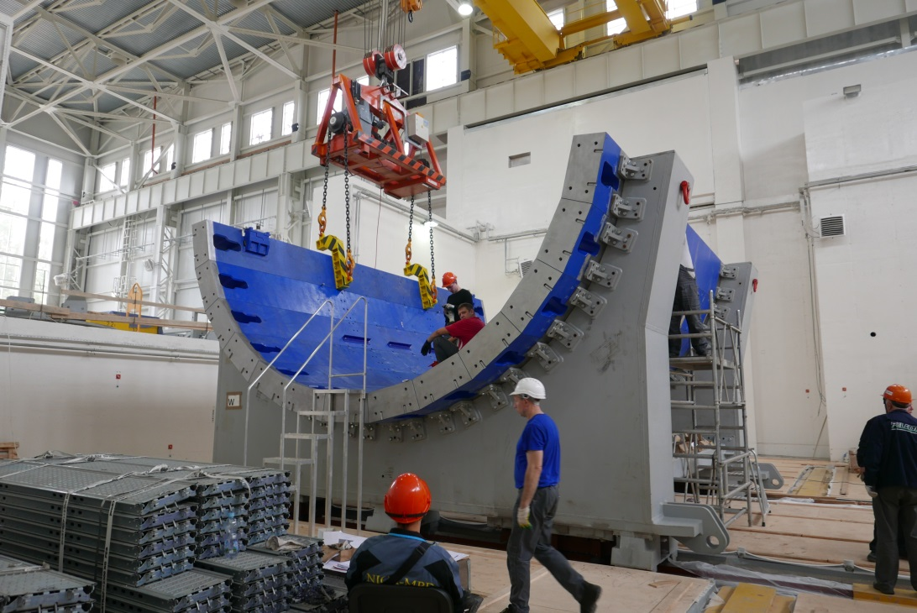
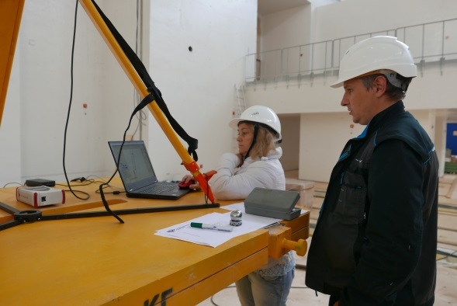
Measurements by “Industrial Measurements” LLC (ООО “Промышленные измерения”) , S.Peterburg
Rails planarity (top and side surfaces) – 0.4 mm on length 30 m
12 stands height deviations – 0.1 mm max
Stands shape deviation – 0.2 mm max
7 plates in assembly – nonplanarity 0.5 mm
13 plates in assembly - nonplanarity 0.58 mm max
13-th plate installation

Slide 6
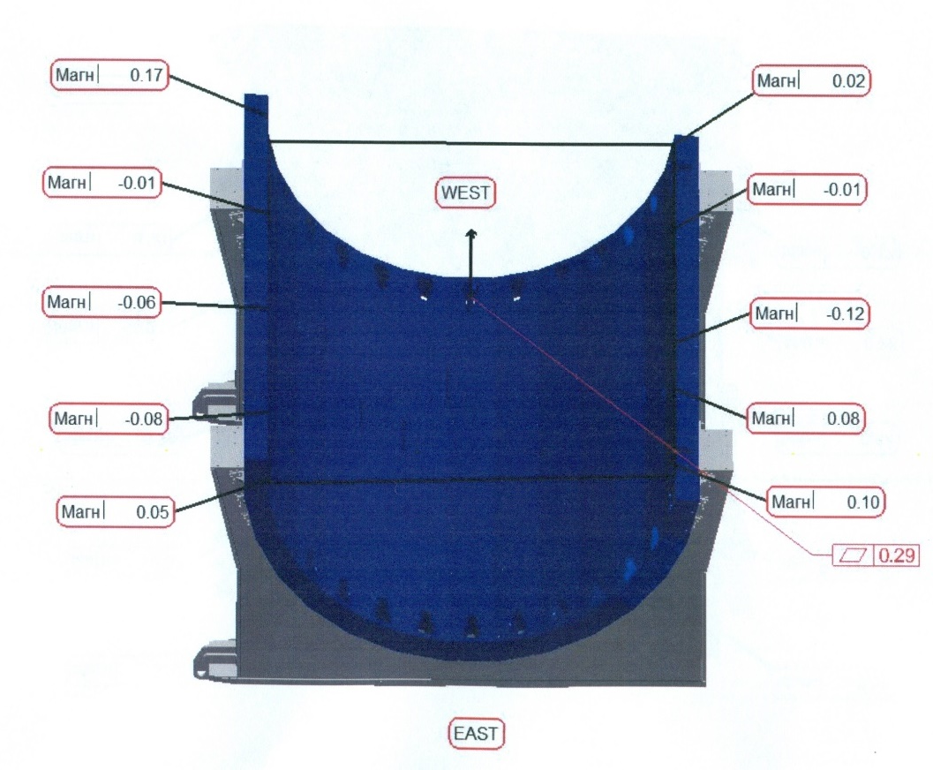
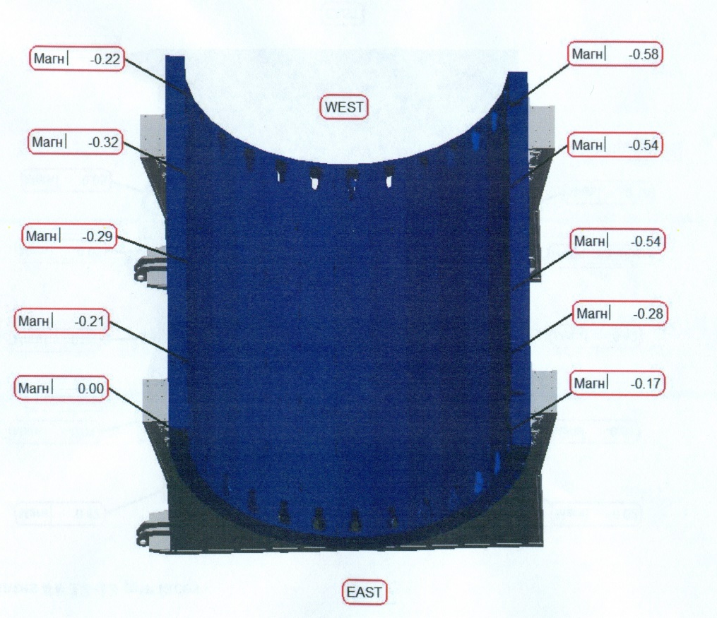
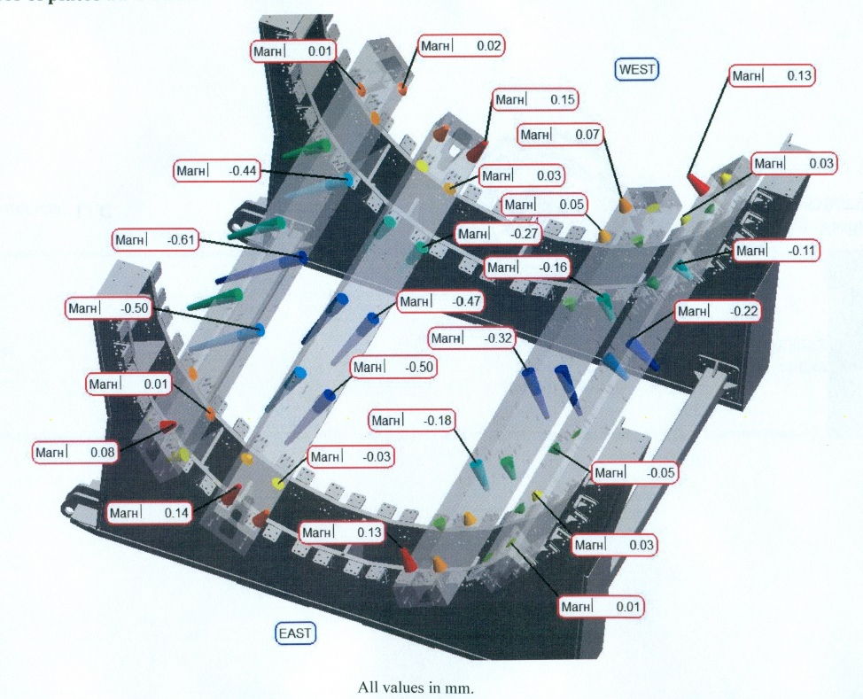
Geometry of 13 plates in the assembly
Nonflatness of plates
## 12-13 per faces
relative to the
horizontal plane
Nonflatness of plates
## 12-13 per faces
Nonflatness of plates
##4-5 and ##8-9

Slide 7
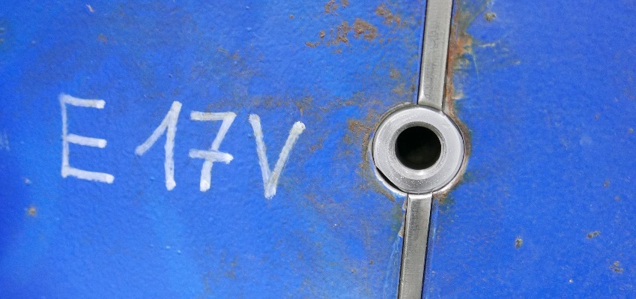
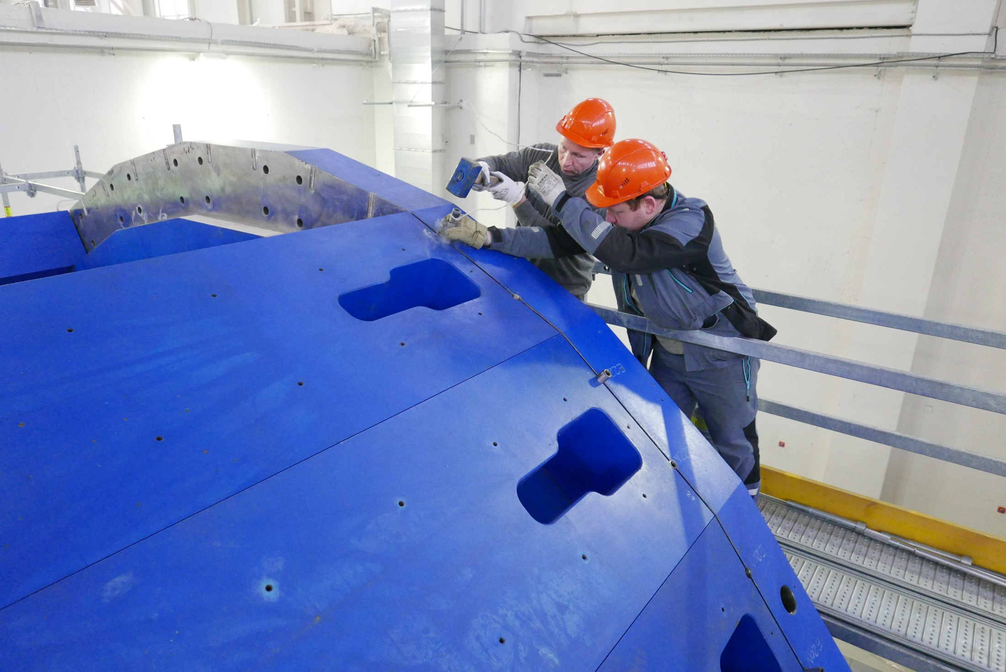
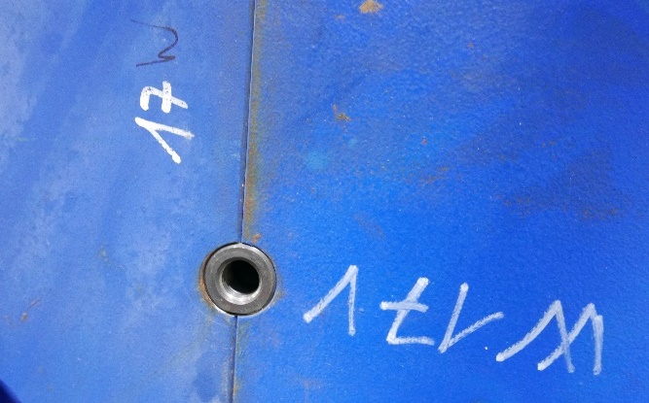
Capturing the position of the plate with micron accuracy
Поимка положения плиты с микронной точностью

Slide 8
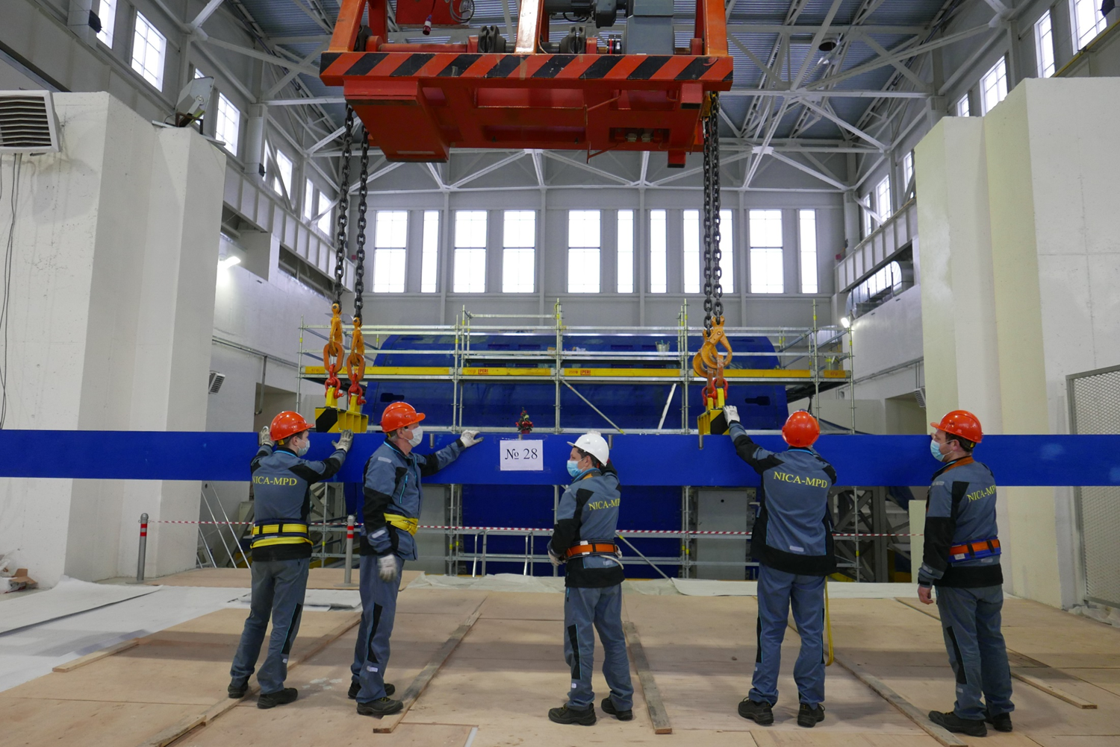
Installation top (last) plate #28

Slide 9
December 25, 2020

Slide 10
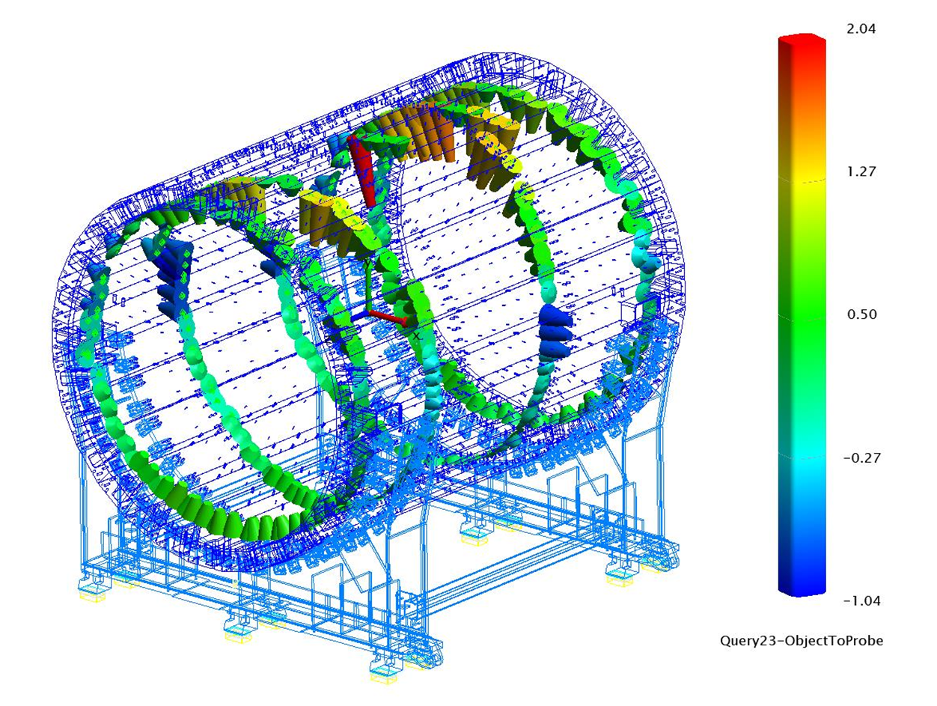
28 plates in assembly

Slide 11
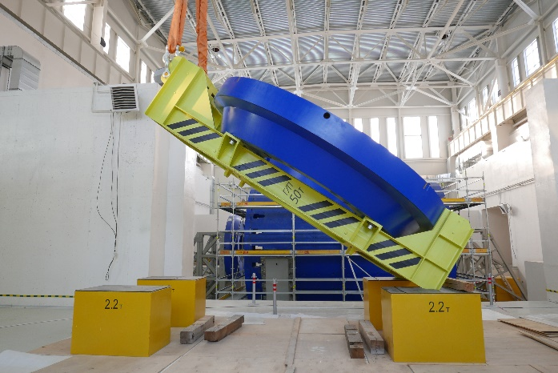
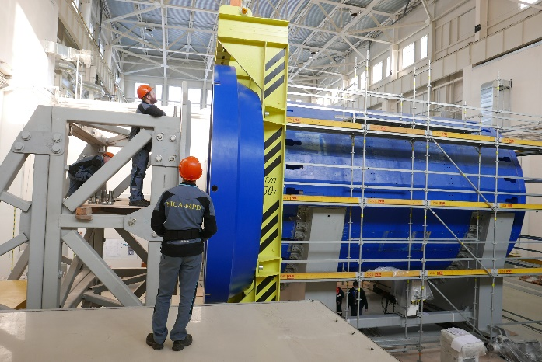
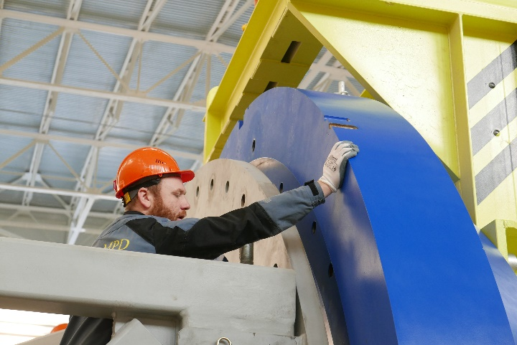
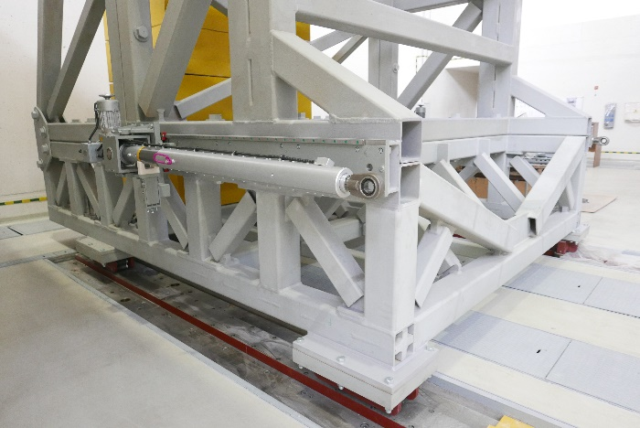
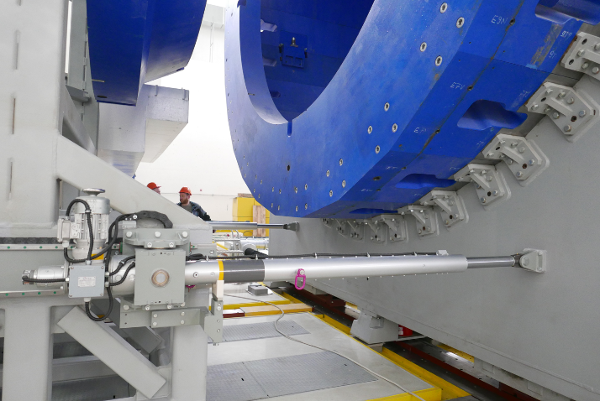
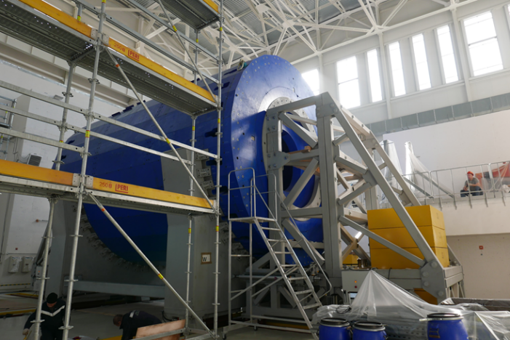
Poles installation technology
This operation was elaborated by DD of VBLHEP and performed only in JINR
The accuracy of the installation of the pole axis relative to the axis
of the support ring is 0.25 mm (provided technologically).

Slide 12
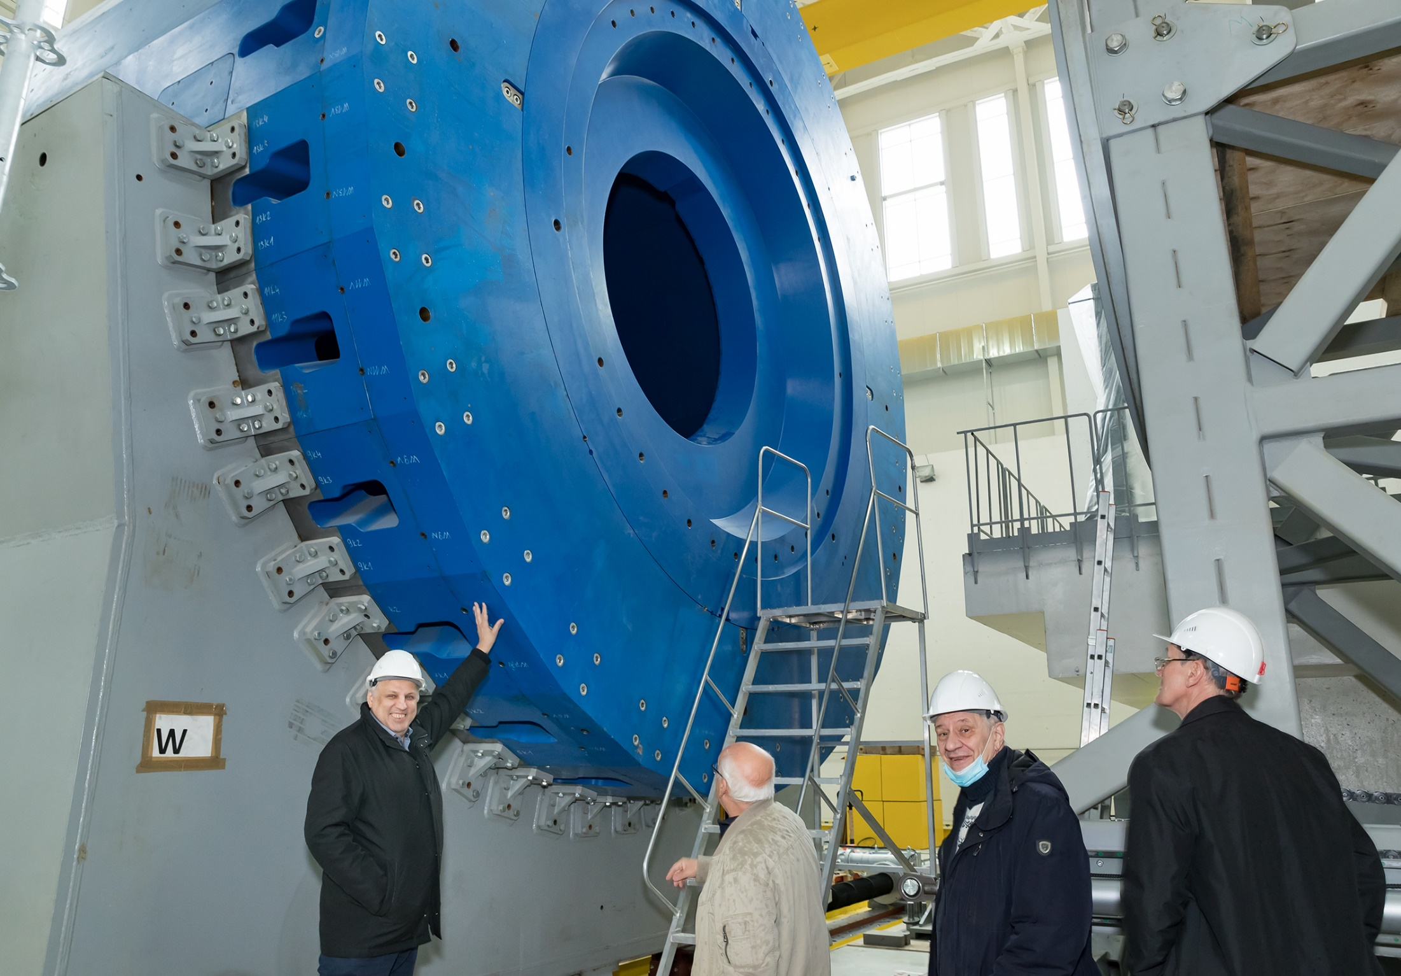

Slide 13
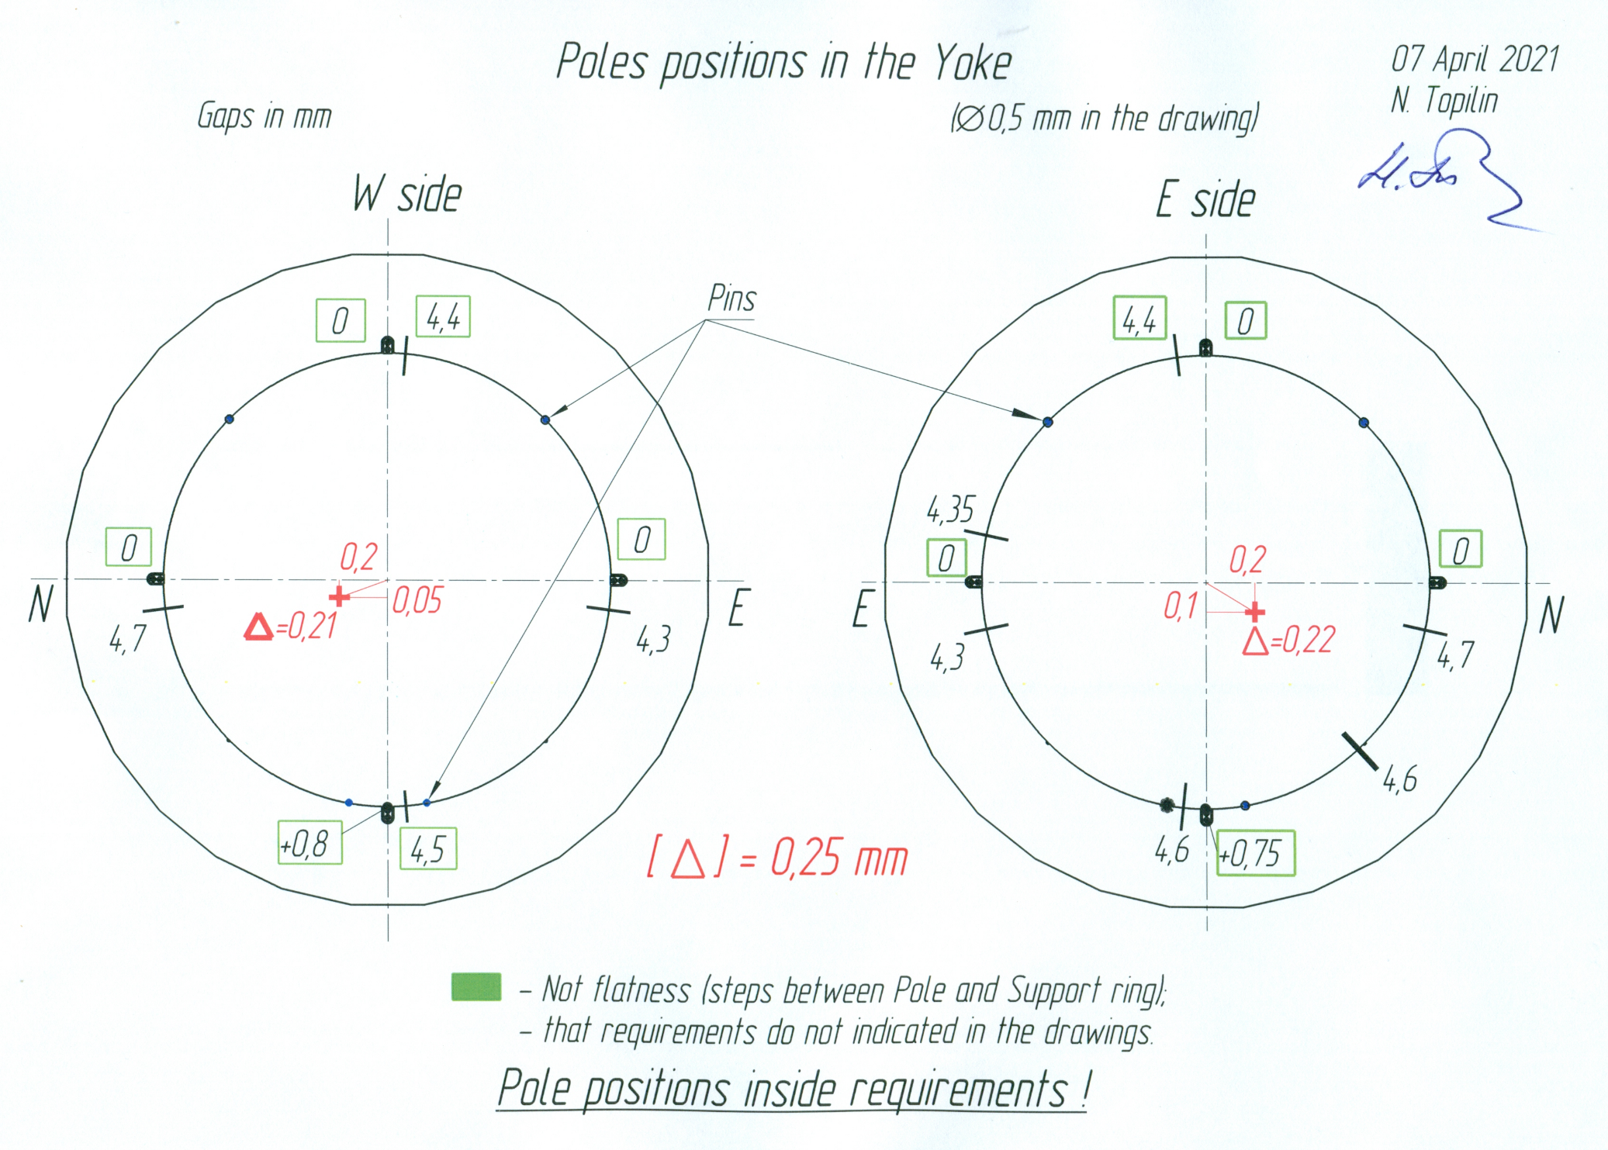

Slide 14
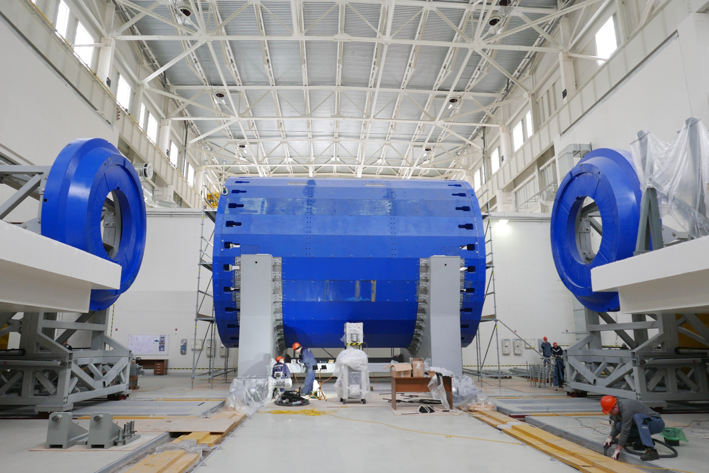
Movement system assembly and test

Slide 15
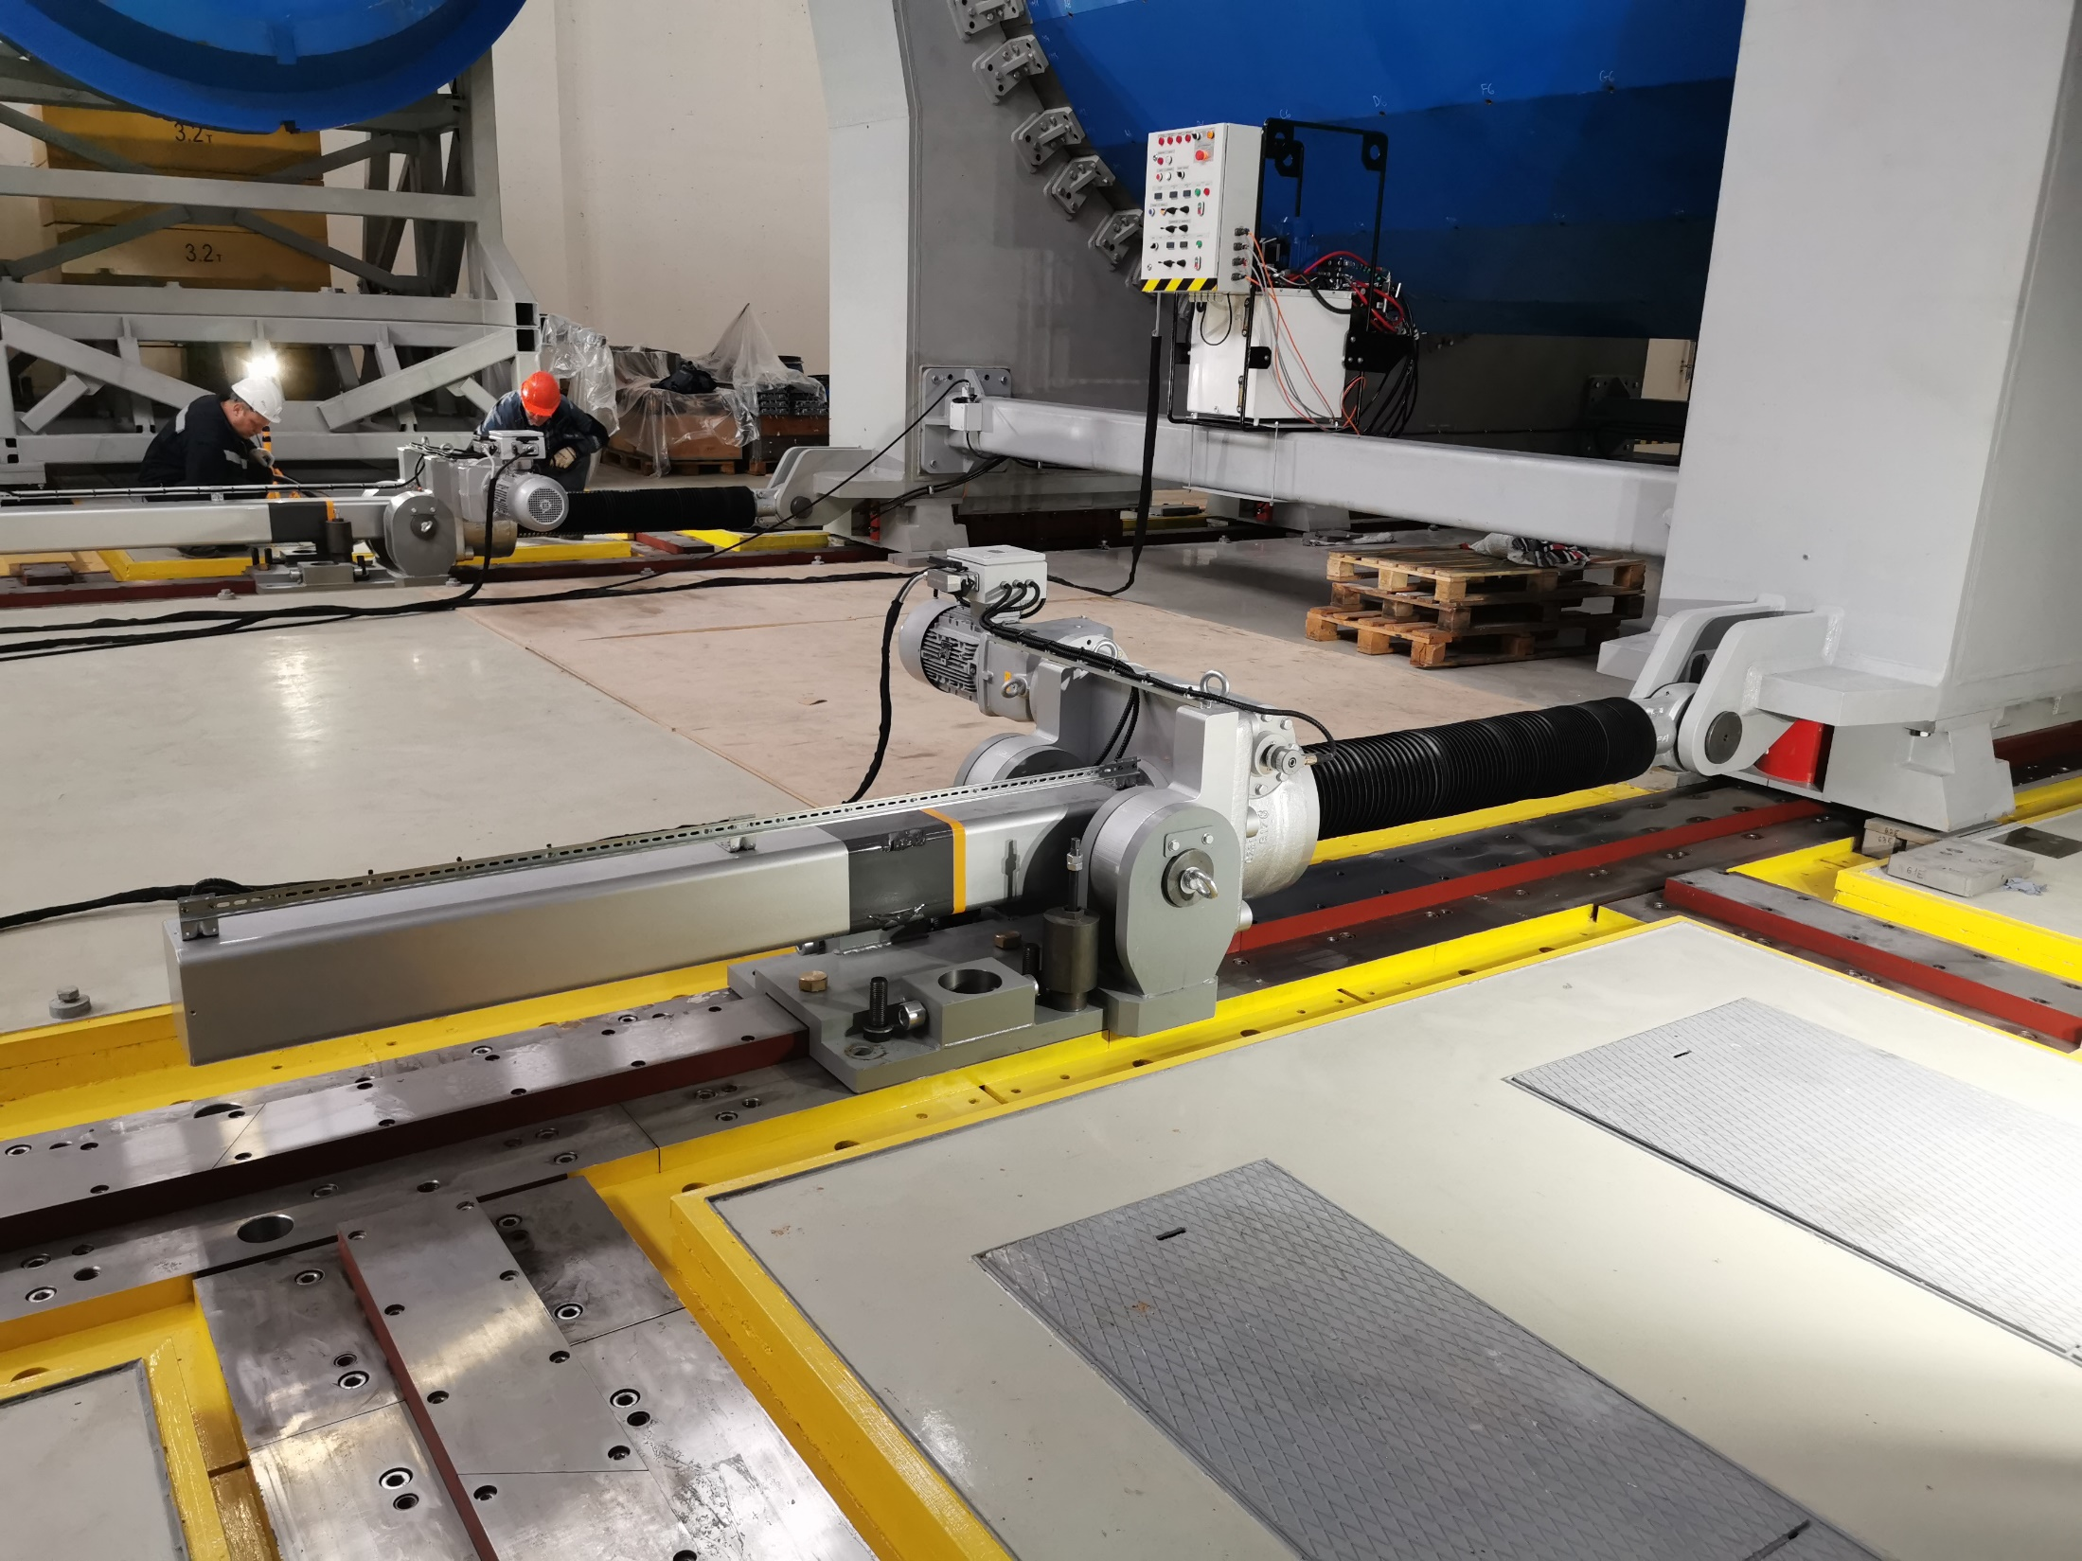
The movement system allows you to move an object weighing
up to 1000 tons with a positioning accuracy of 0.01 mm across
the beam and install it with an accuracy of 0.1 mm in height.
The speed of movement of all rods is from 0 to 3 mm/s.

Slide 16
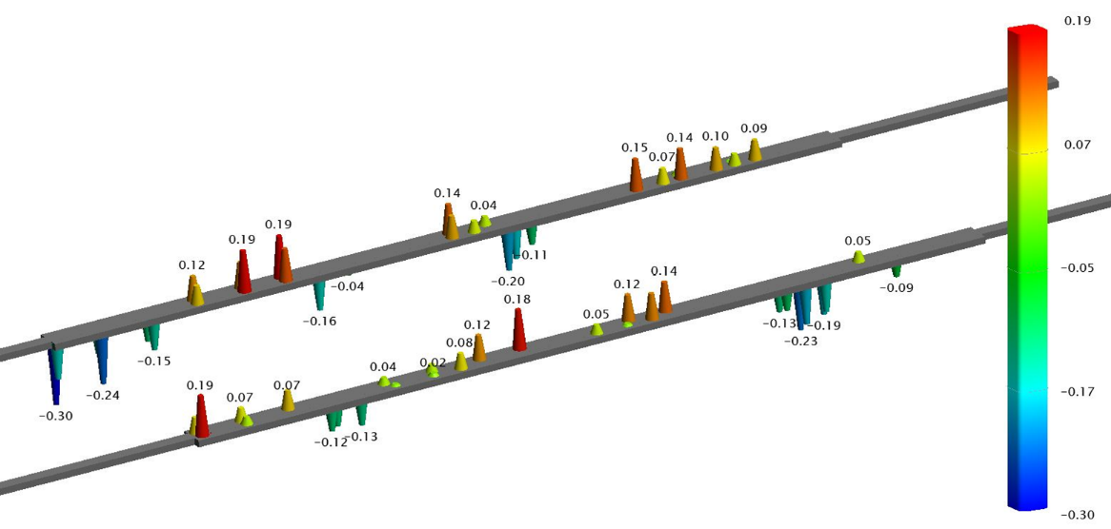
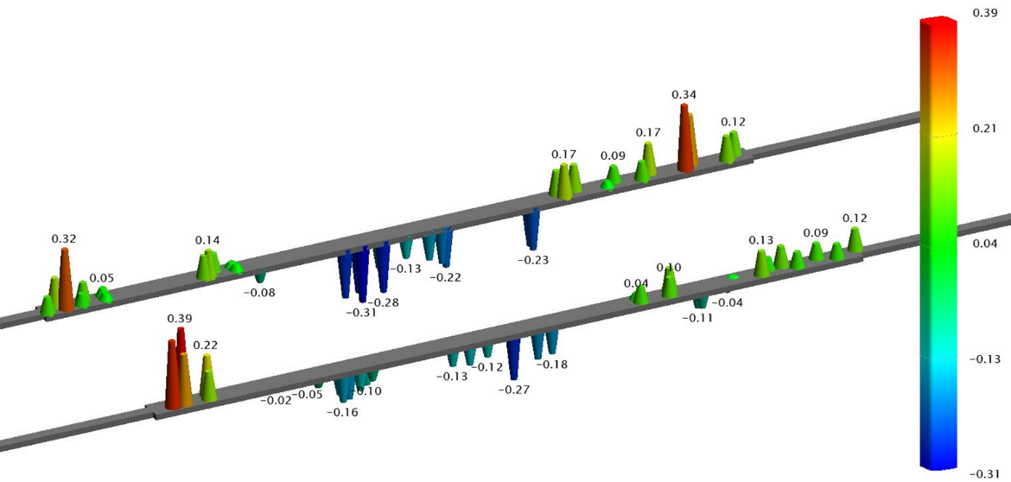
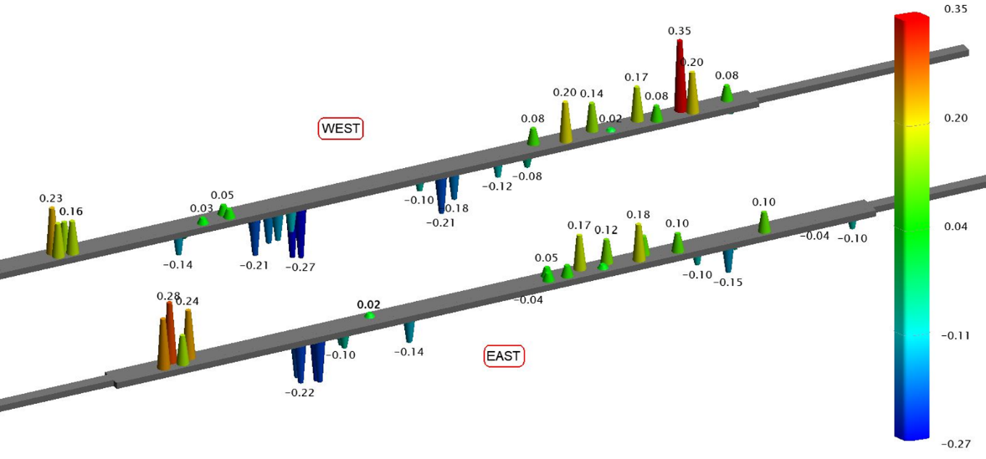
Rails shape during Yoke moving
1 - Assembly zone position
2 - Central position
(poles installation)
3 - Beam position

Slide 17
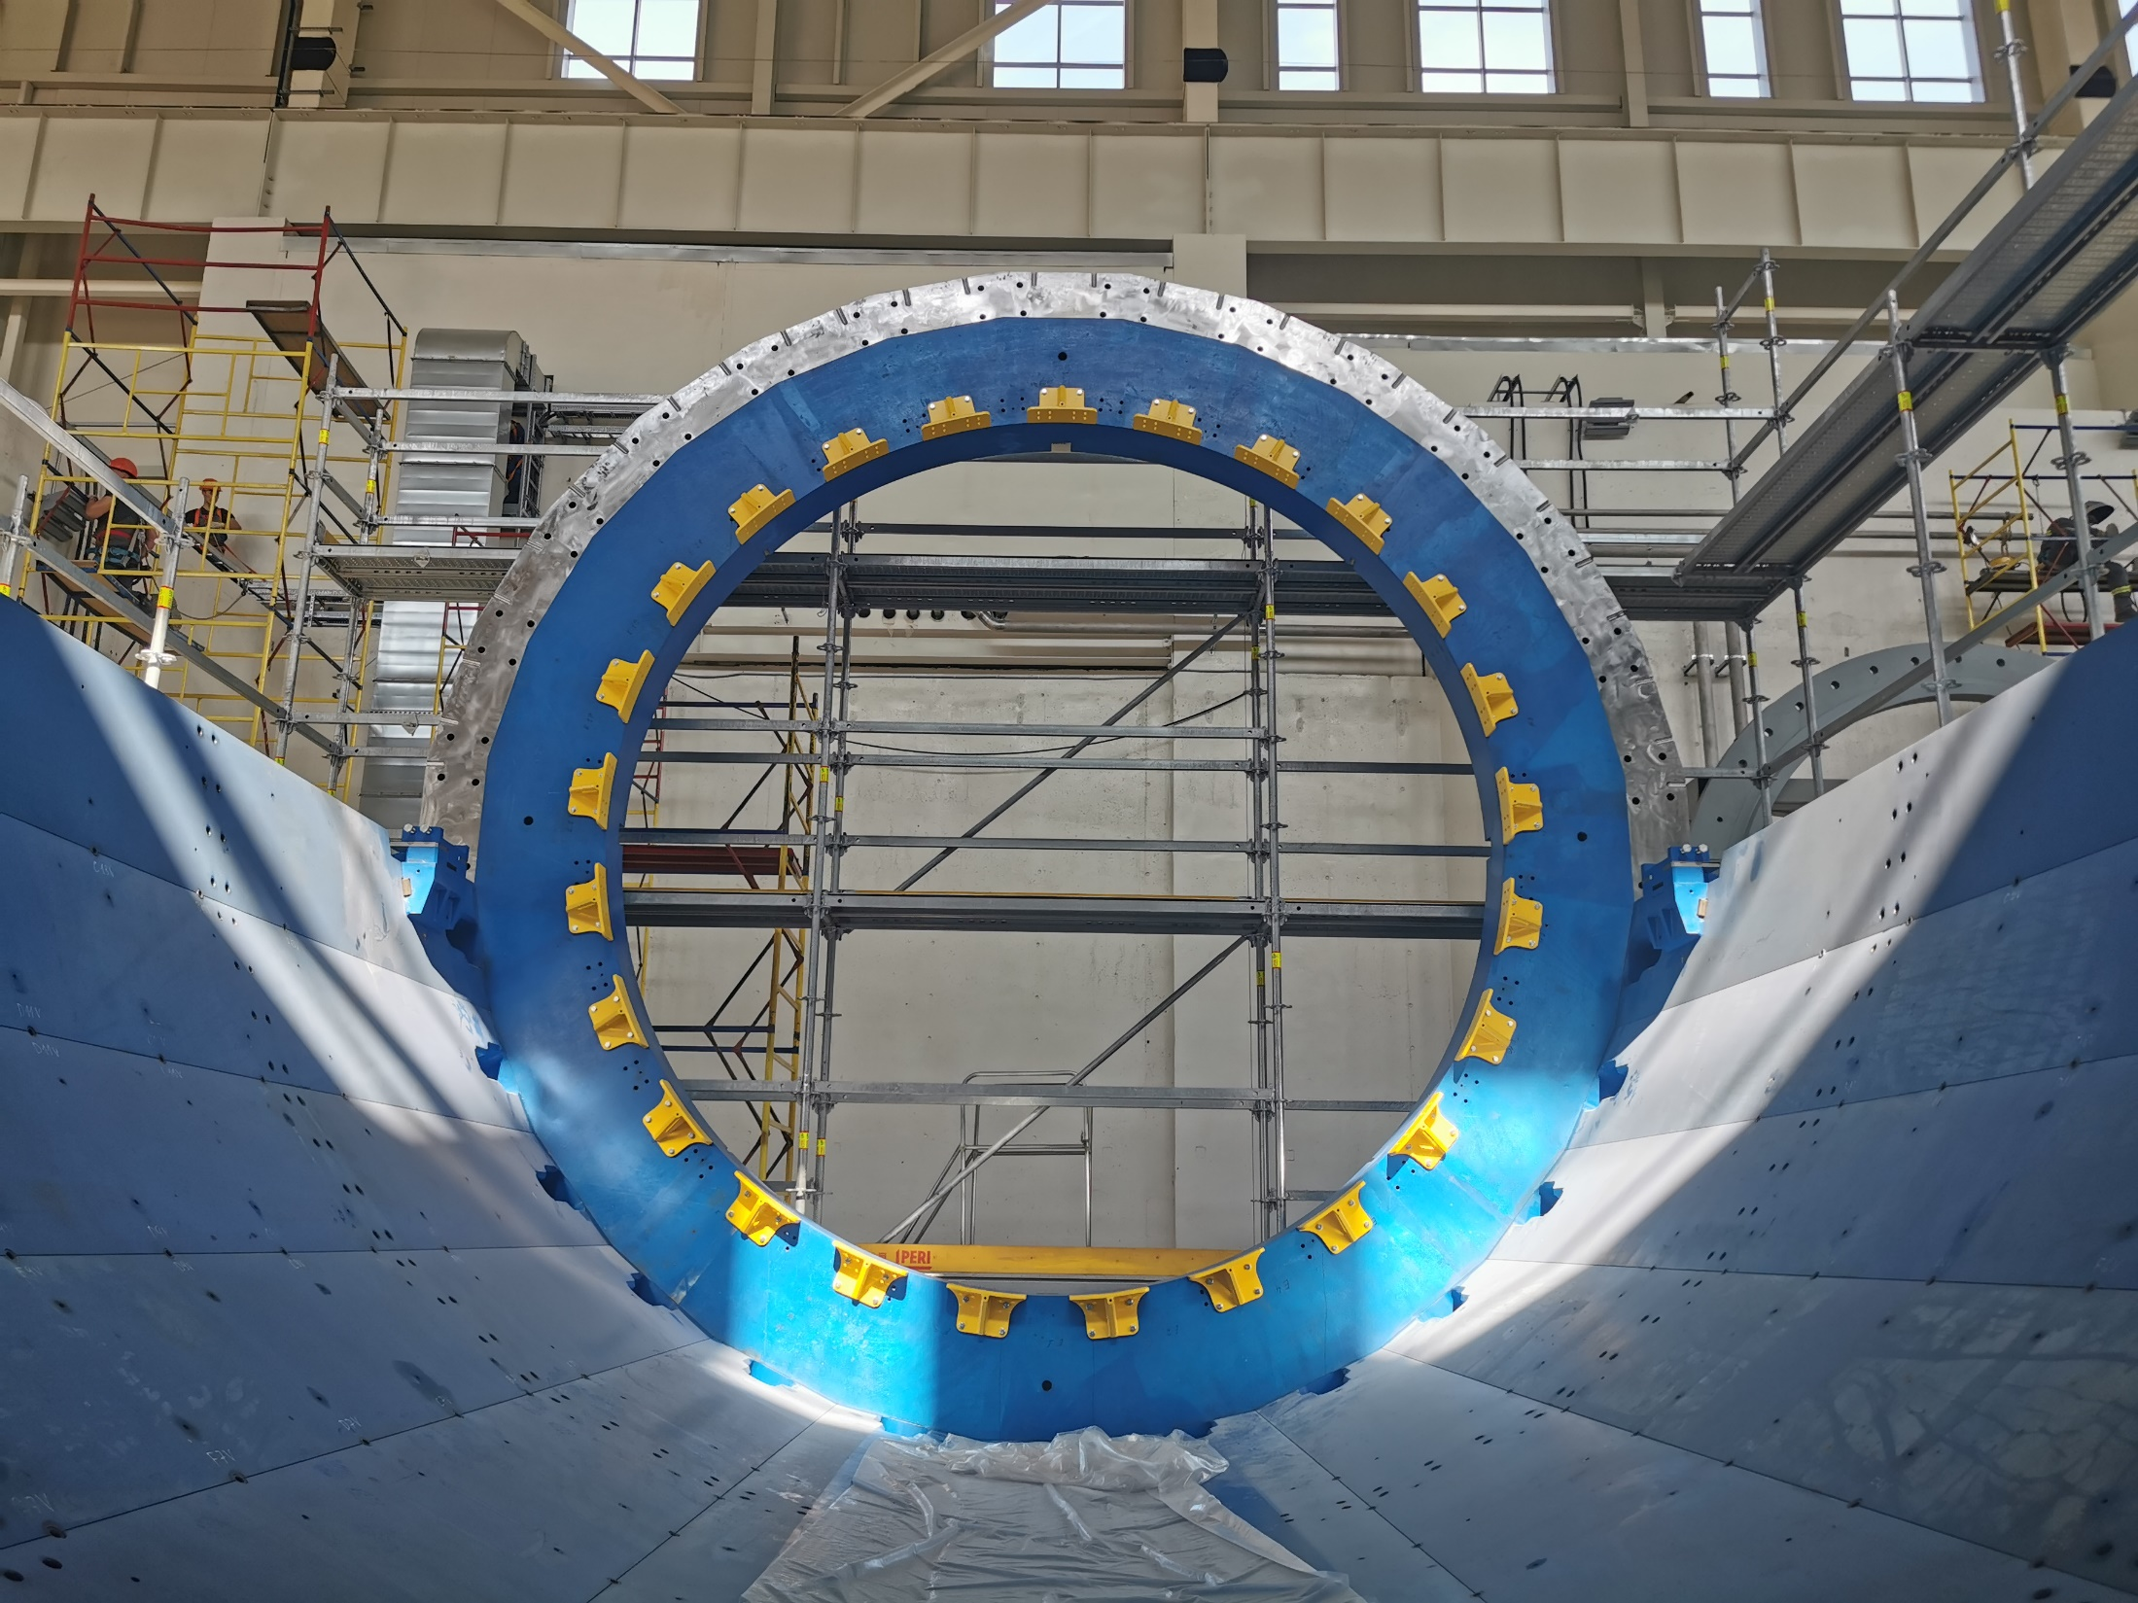
Power frame brackets

Slide 18
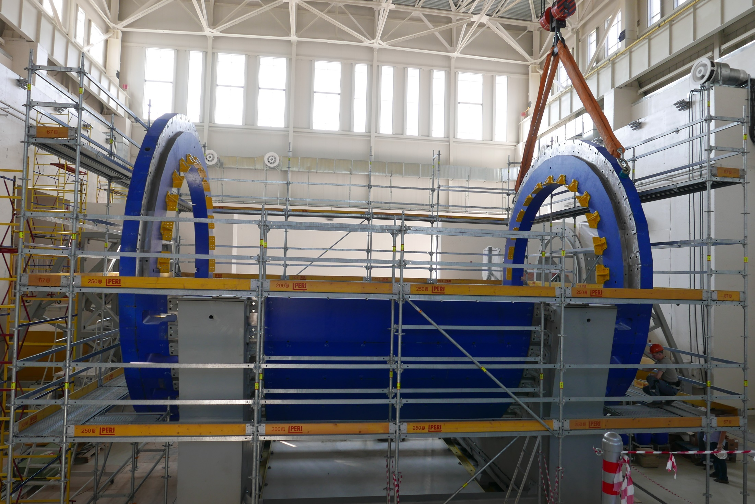
July 16, 2021

Slide 19
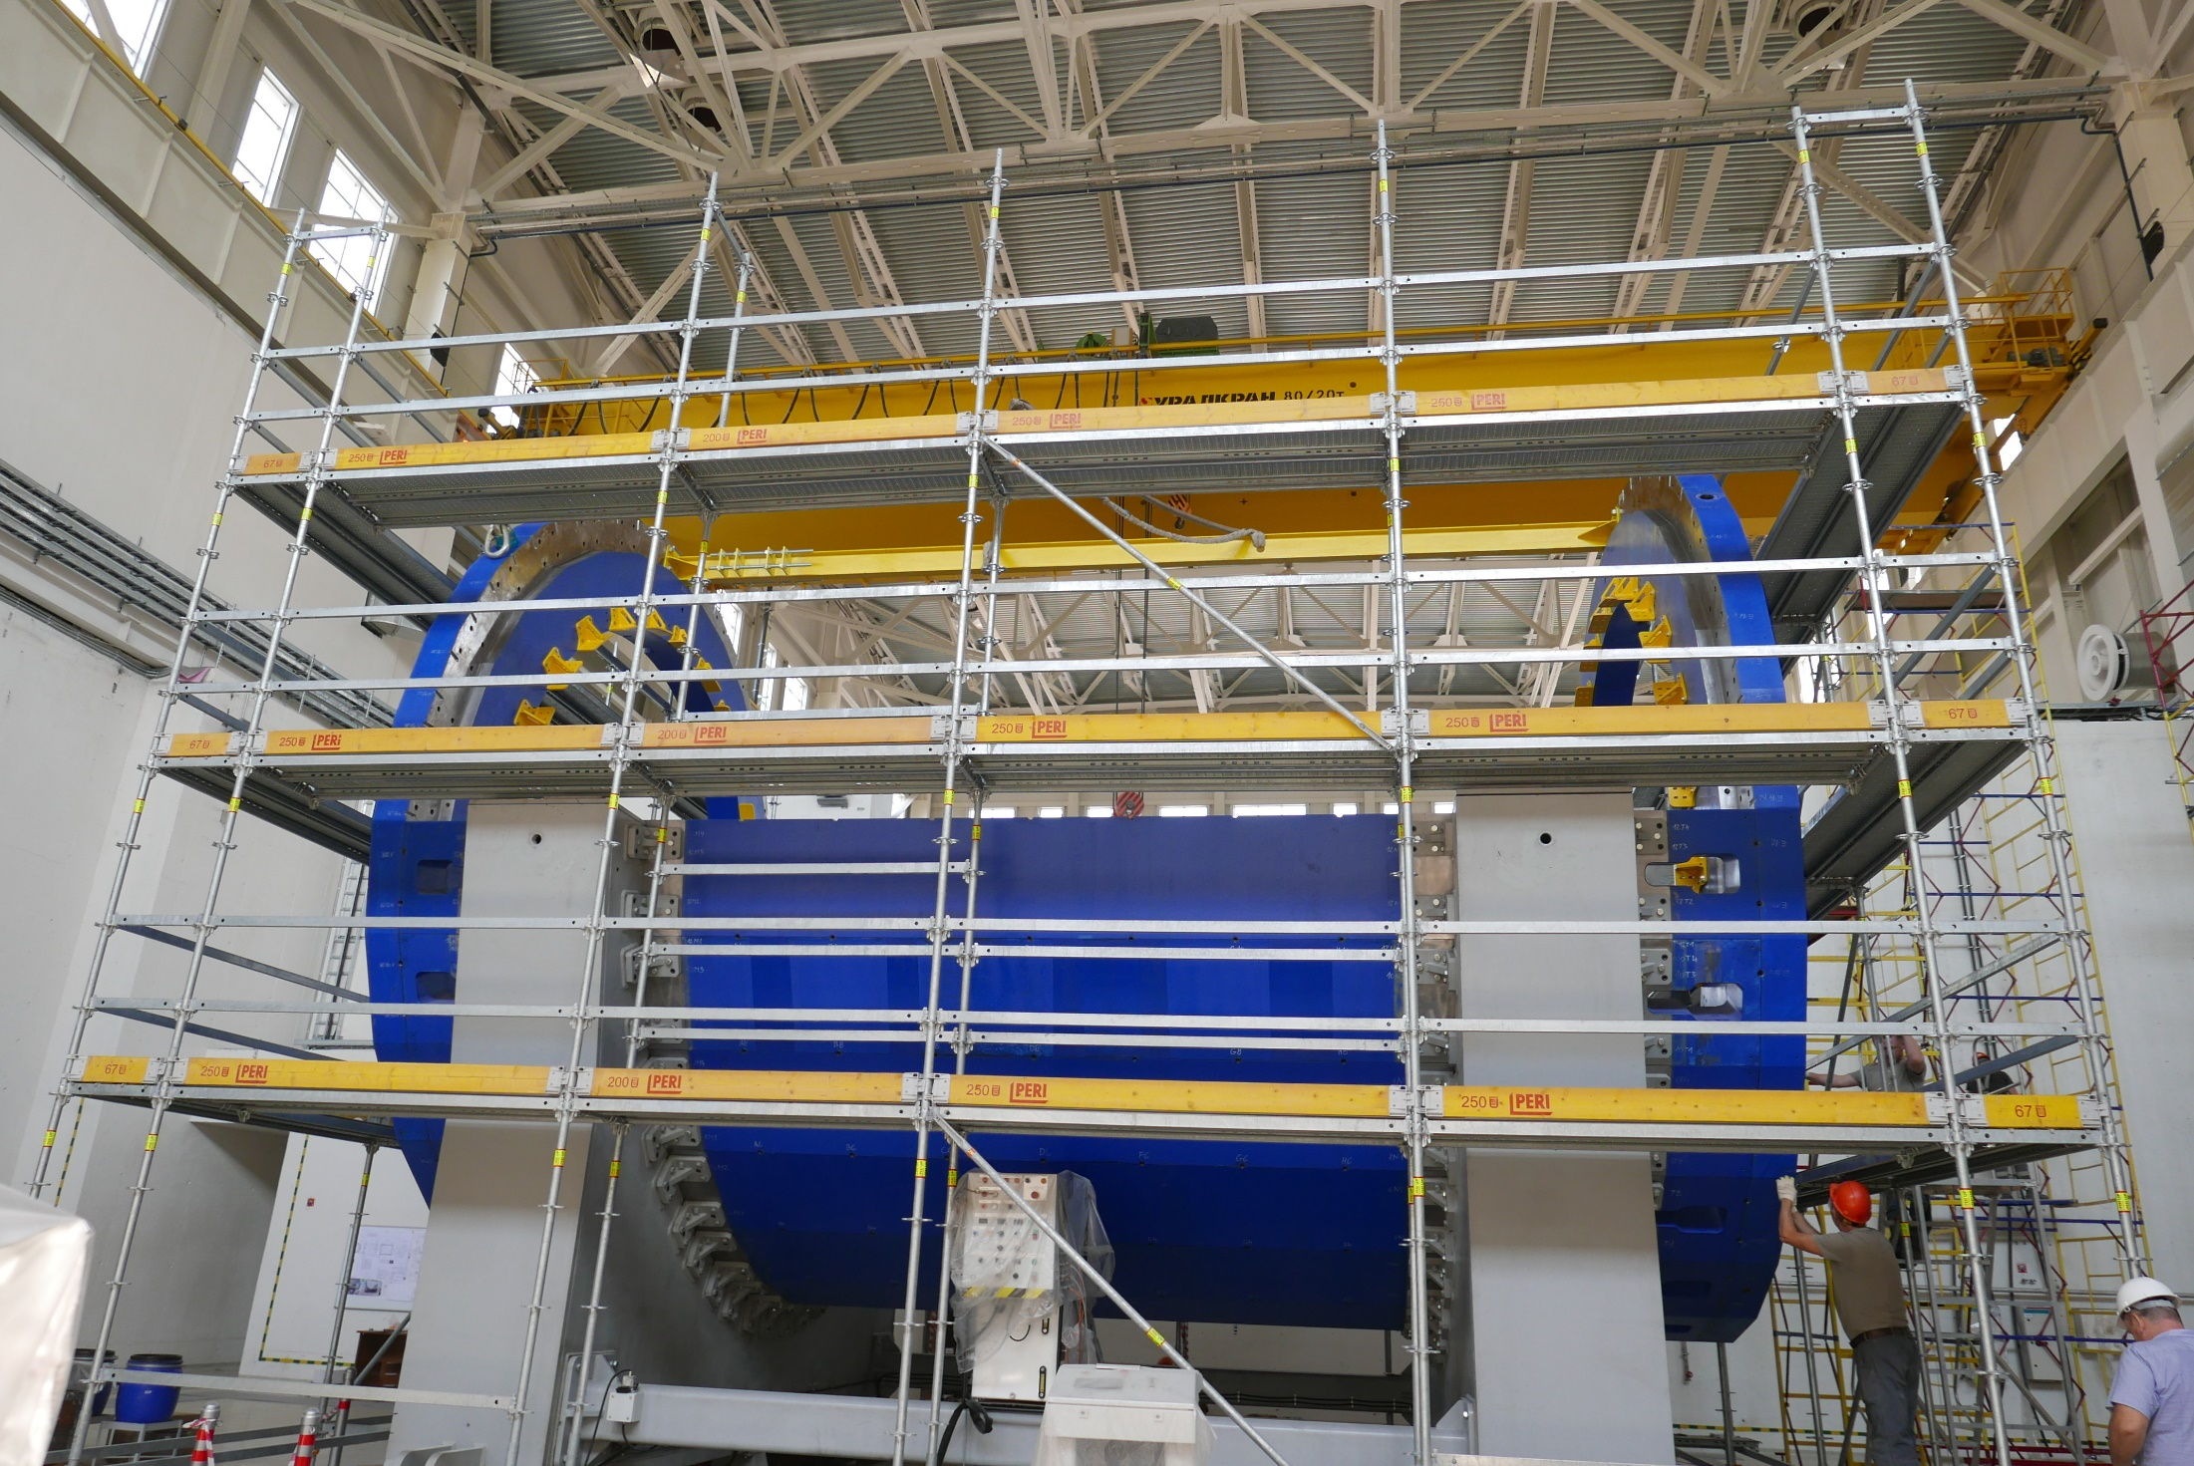
Technology beam 8470 mm length

Slide 20
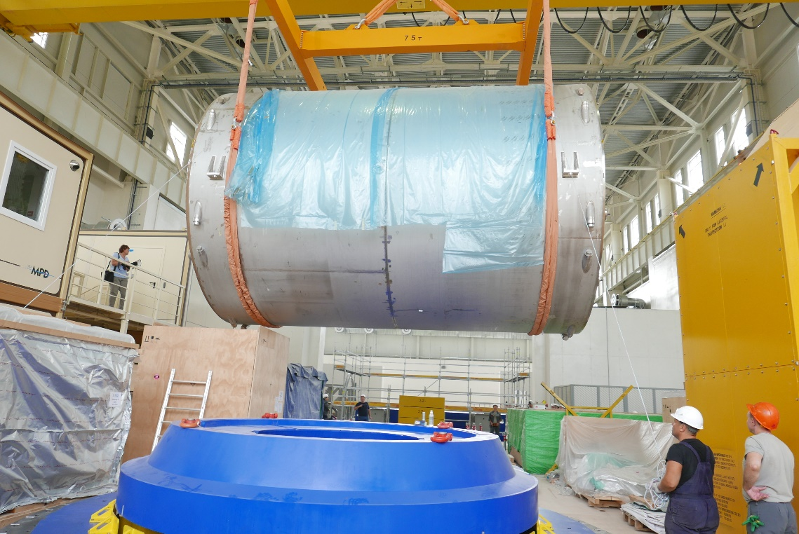
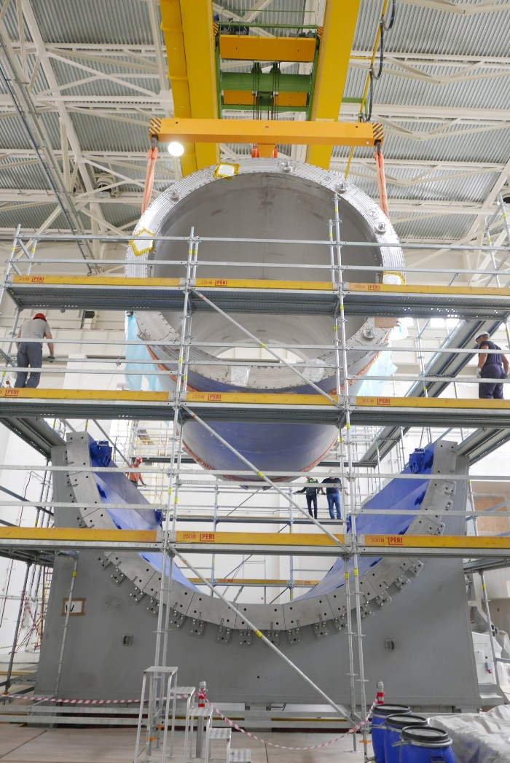
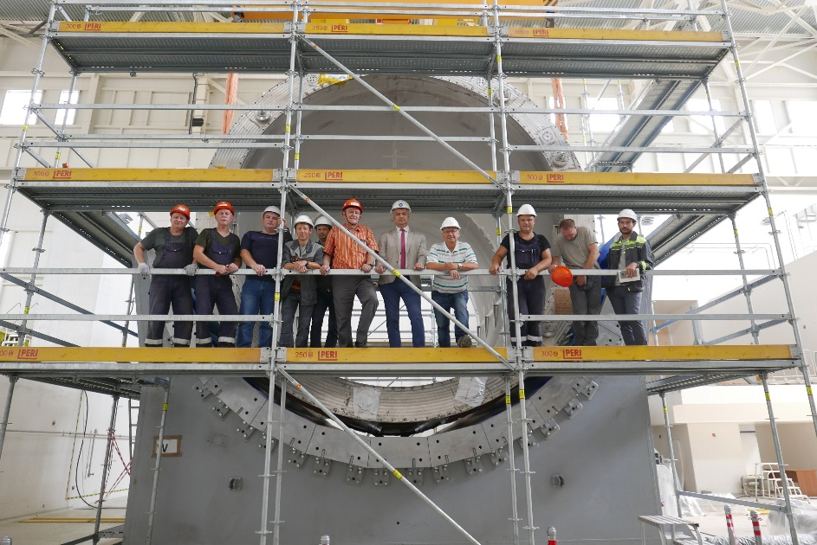
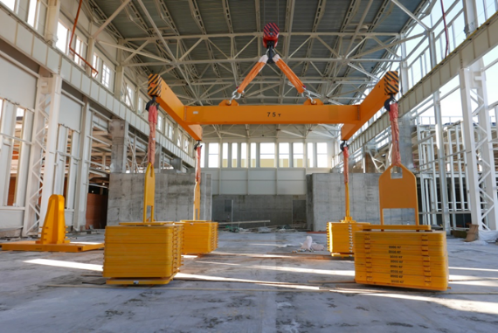
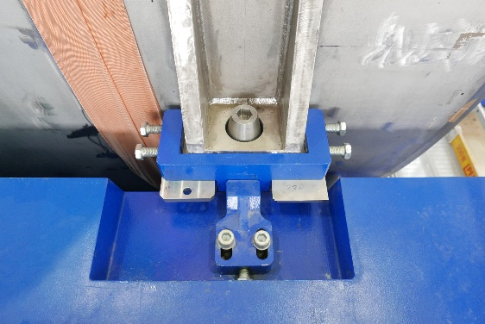
Magnet installation: July 30, 2021
August 2020
Traverse 75 t capacity and
80 t Crane test together

Slide 21
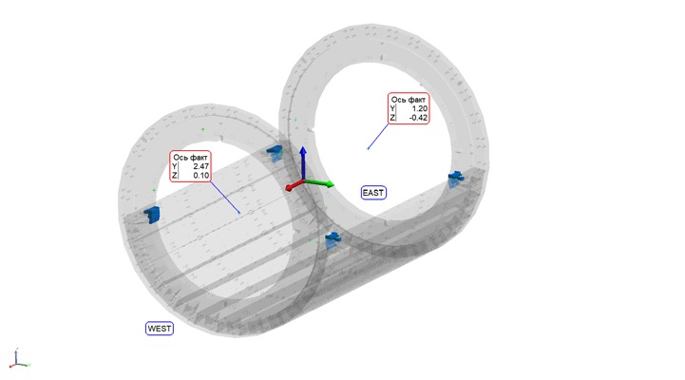
The position of the magnet axis relative to the axis of the Yoke

Slide 22
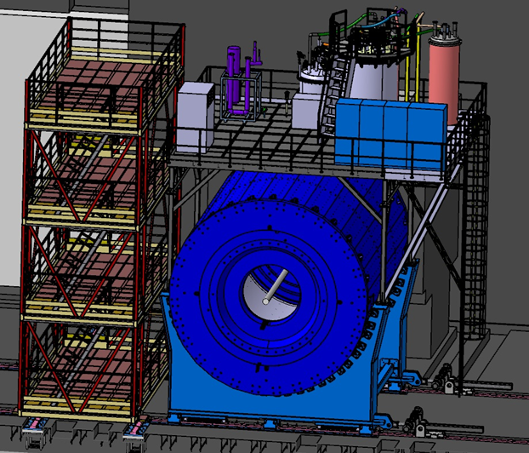
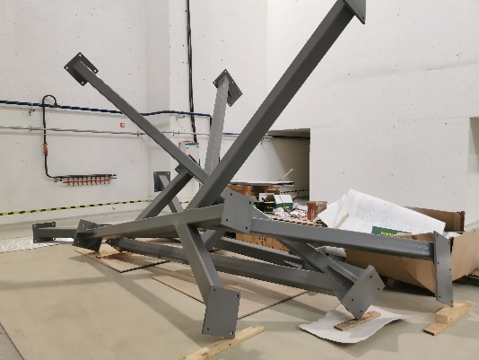
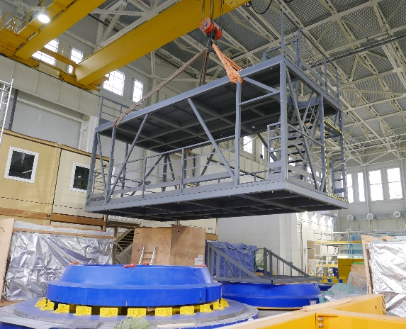
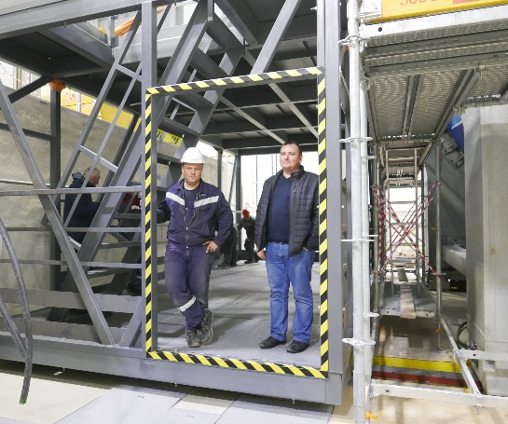
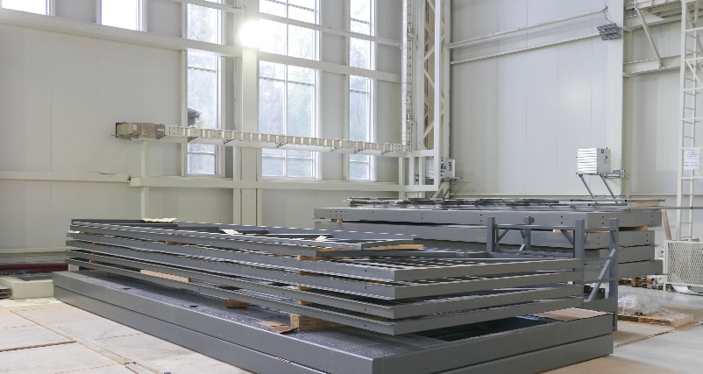
Related tasks
Evacuation of the ASG magnet transport container
Assembling and modification
the mobile platform

Slide 23
Pole transport support modification
by “Lider” Company, St-Peterburg
Modification reason: Cable space increasing
O-Ring, 3935 mm in diameter,
Overall thickness: 300 mm
Weight: 2.7 t , 2 ps
Installation: end of October 2021

Slide 24
Thanks for your attention !
Conclusion
Next steps:
Pole transport support modification
Yoke assembly finishing
Top platform assembly
Cryogenic equipment installation on the top platform
Worm coils installation in the poles
AOB for magnetic test preparation
All of these operations will be done as soon as it will be possible

