Slide 1

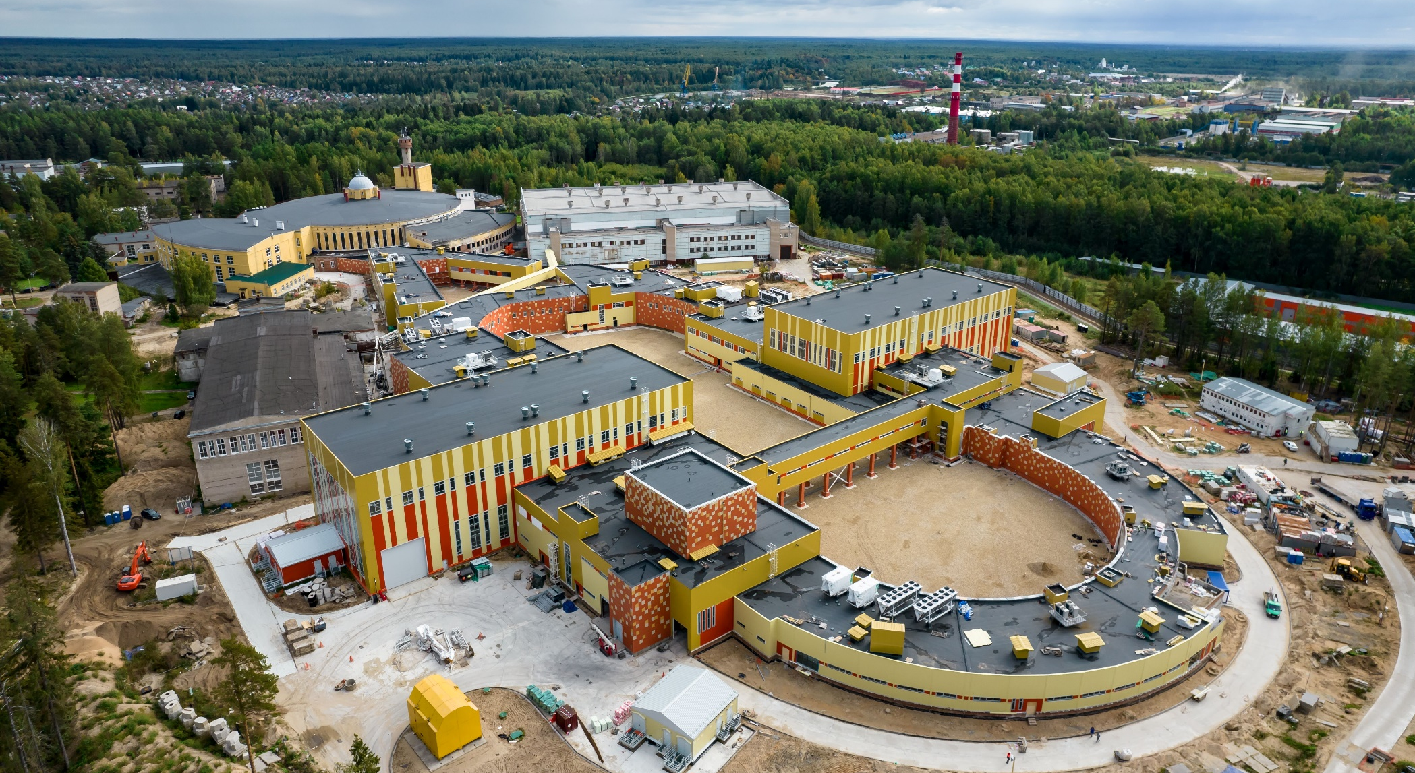


Status of the
NICA accelerator complex
A.Butenko on behalf of the team
Sarantsev V.P. workshop, 20 of September 2022, Crimea, Alushta

Slide 2

Introduction (complex NICA)
Two LINACs & ion sources
  LU-20/LILAc (light & pol. ions)
  HILAC (heavy ions)
The Booster ring (commissioning)
The Nuclotron ring
Collider systems status

Slide 3

NICA complex
Collider
Two linacs:
HILAC & LILAC
Nuclotron
Two Linear Injectors
& sources
Booster
Booster & beam line
Nuclotron ring
Collider ring

Slide 4
Structure of the Injection complex
Transfer to the collider rings
Slow extraction
& transfer to BM@N
Nuclotron
2×10⁹ Au⁷⁹⁺, 3.9 GeV/u
or
light ions, 5 GeV/u
LILAc
SPP
RFQ
LU-20
LIS
p↑, d↑, ions z/A>0.3, 5 MeV/u
Stripping Au³¹⁺=>Au⁷⁹⁺
Booster
HILAc
(2÷4)×10⁹ ions Au³¹⁺ 570 MeV/u
ESIS
RFQ
IH1
IH2
Au³¹⁺ 3.2 MeV/u

Slide 5
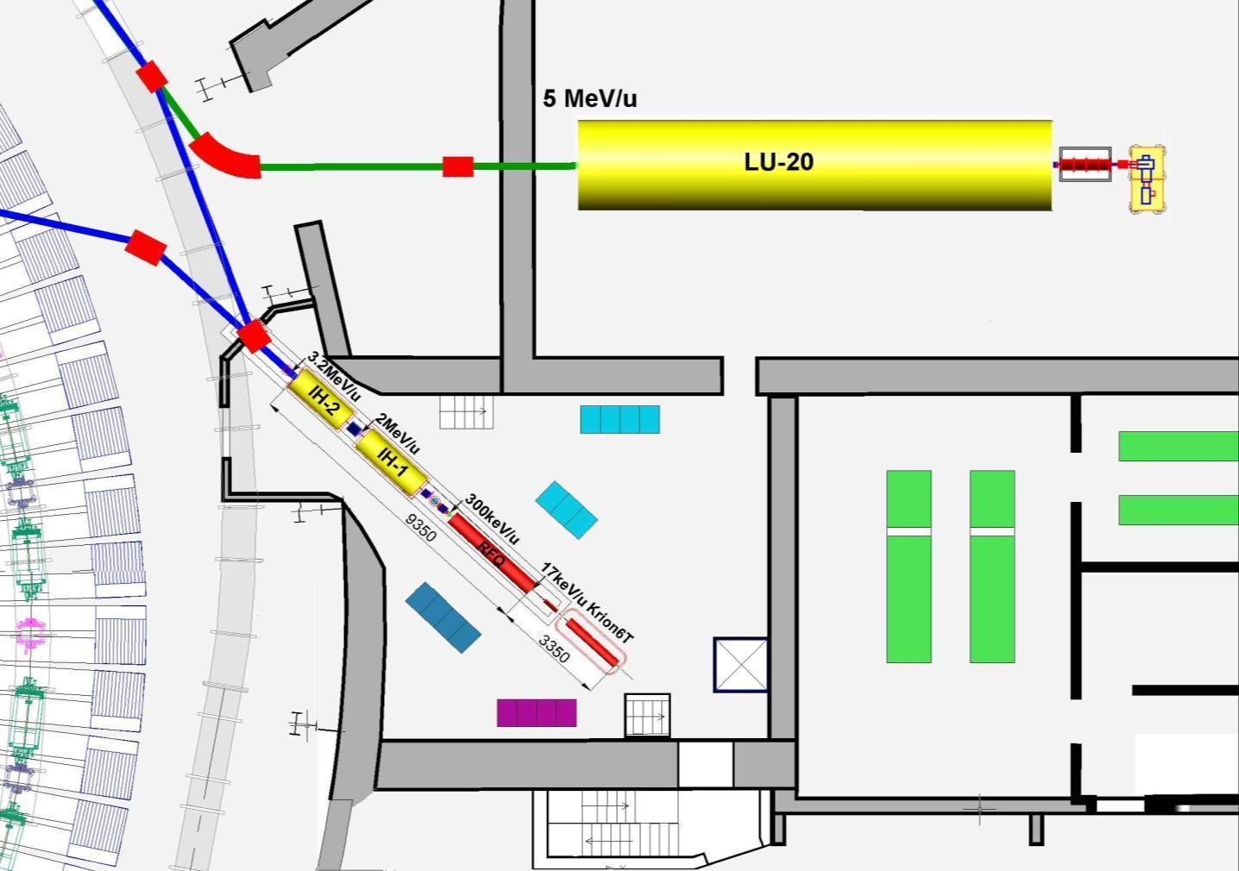
Layout of the linear Injectors
p↑, d↑, ions Z/A>0,3
Booster
Injection
channel
Ions Z/A>0,3
LIS
RFQ
SPI
p↑,d↑
10mA
LU-20 building
HILAc
HILAc building
^{Booster}
Nuclotron
RF amplifier for LU-20

Slide 6

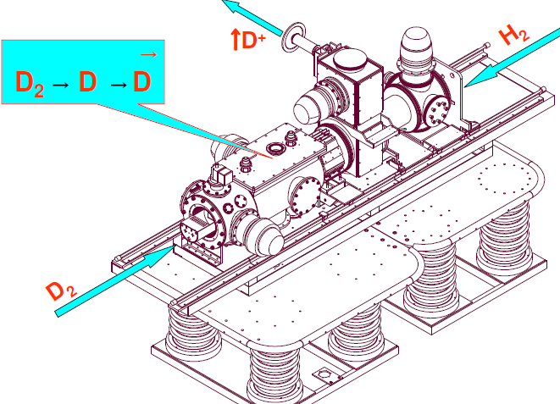
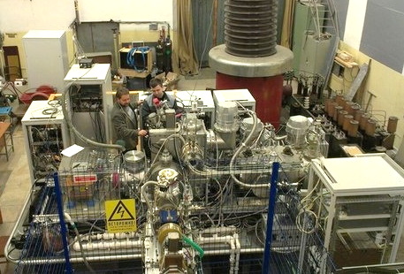
SPI, beams of polarized d & p
SPI “source of polarized ions” was transported, installed on the HV terminal and commissioned with the new fore-injector & LU-20
in spring 2016
The SPI-project was started more then 10 year ago.
Main purpose is to provide the intensity of the accelerated polarized beams (D+,H+) up to 10¹⁰ p/pulse
Commissioned in 2016
two Nuclotron beam RUNs
was provided
The SPI provided by polarized d & p Nuclotron complex during two beam RUNs in 2016-17.

Slide 7
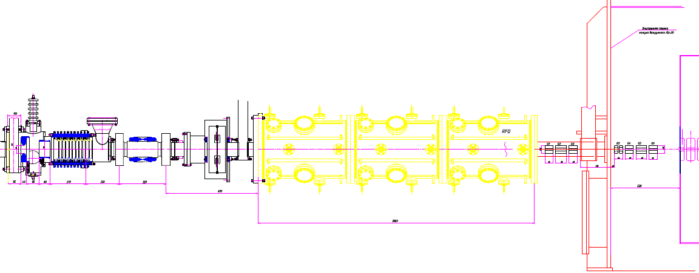
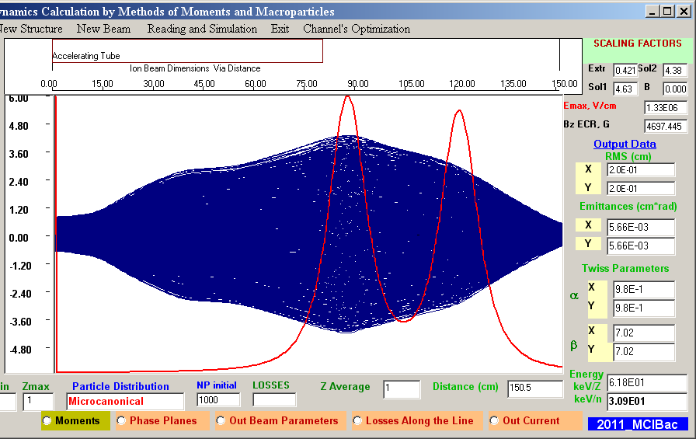
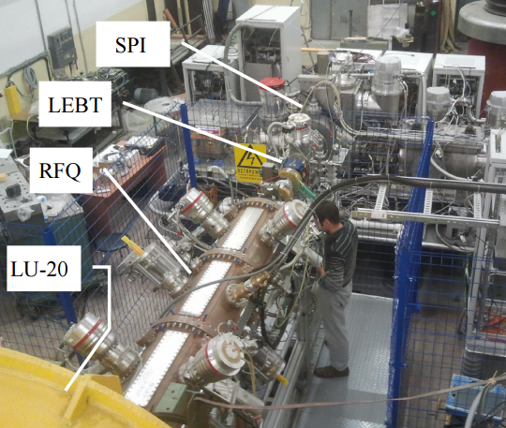
New fore-injector for LU-20
Designe has been started in 2012 In collaboration with ITEPH, MEPHI, Snezhinsk.
LEBT + Buncher
4 wane RFQ
(3 sections)
MEBT LU-20
QT + Bu +QT
Commissioned in 2016
4 Nuclotron beam RUNs
was provided
source

Slide 8
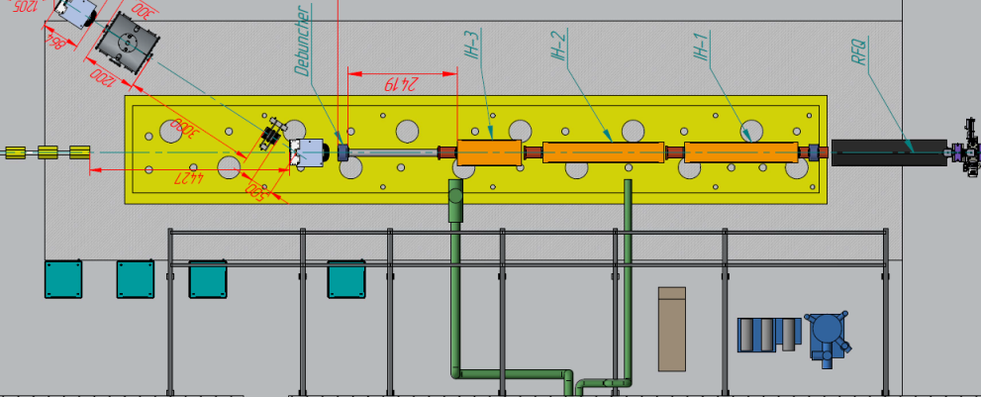
Layout of the linear Injectors
The new Light Ions Linac LILAC
p↑, d↑, ions Z/A>0,3
Booster
Injection
channel
Ions Z/A>0,3
LIS
RFQ
SPI
p↑,d↑
10mA
7 MeV/u for A/q<3, 13 MeV for protons
LU-20 hall
HILAc
HILAc building
^{Booster}
Nuclotron
RF amplifier for LU-20

Slide 9
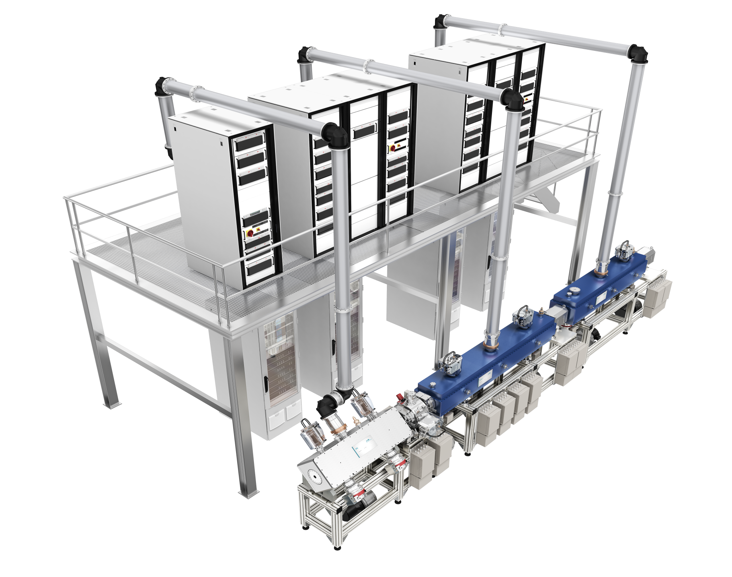
Layout of the linear Injectors
BEVATECH Germany
RF amplifiers
Tested at JINR
RFQ 4-rod
3Q of 2022
IH2 and MEBT
Mid of 2023
LLRF + PS
End of 2023
IH3 + debuncher
End of 2023
Under manufacturing

Slide 10
Layout of the linear Injectors
p↑, d↑, ions Z/A>0,3
Booster
Injection
channel
Ions Z/A>0,3
LIS
RFQ
SPI
p↑,d↑
10mA
LU-20 building
HILAc
HILAc building
^{Booster}
Nuclotron
RF amplifier for LU-20

Slide 11
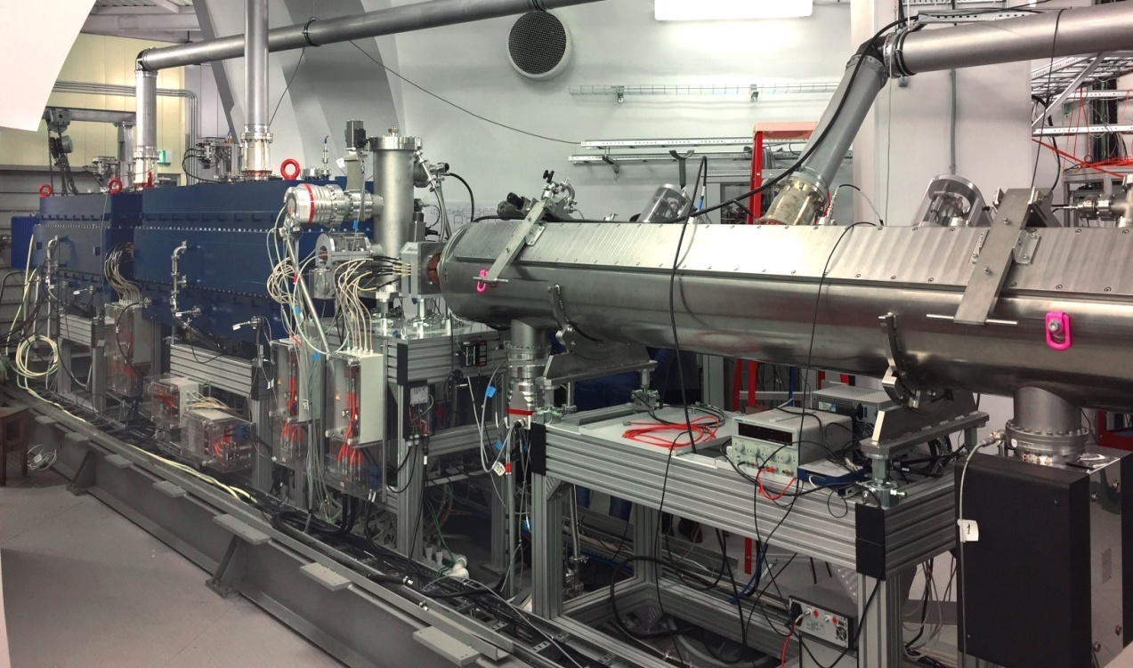
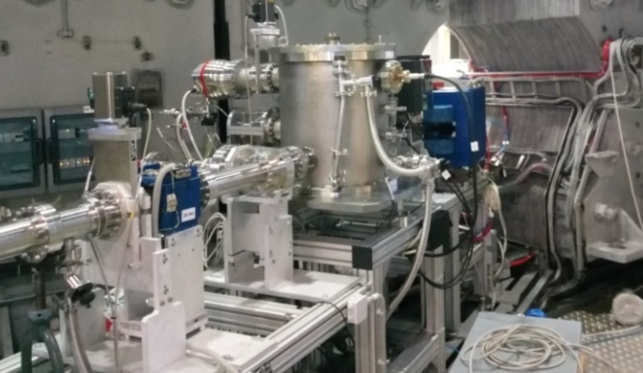
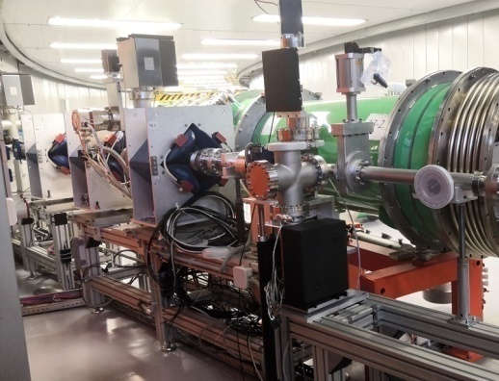
HILAC & Booster injection beam line
BEVATECH Germany
Stable and safe operation during Booster commissioning with He¹⁺ and Fe ¹⁴⁺ beams
Heavy Ion Linear Accelerator
Commissioned in 2018
A/q (Target Ion Au³¹⁺) | 6.25
Beam current | < 10 emA
Repetition rate | < 10 Hz
Output energy | 3.2 MeV/u
Transmission of 2mA Fe¹⁴⁺ ions beam is about 75% from RFQ to the exit of the HILAc, 3.2 MeV/u

Slide 12
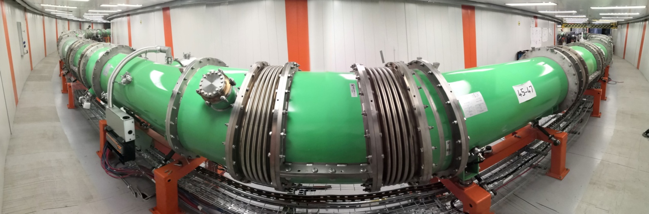
Introduction (complex NICA)
Two LINACs & ion sources
  LU-20/LILAc (light & pol. ions)
  HILAC (heavy ions)
The Booster ring (commissioning)
Beam transfer line
The Nuclotron ring

Slide 13
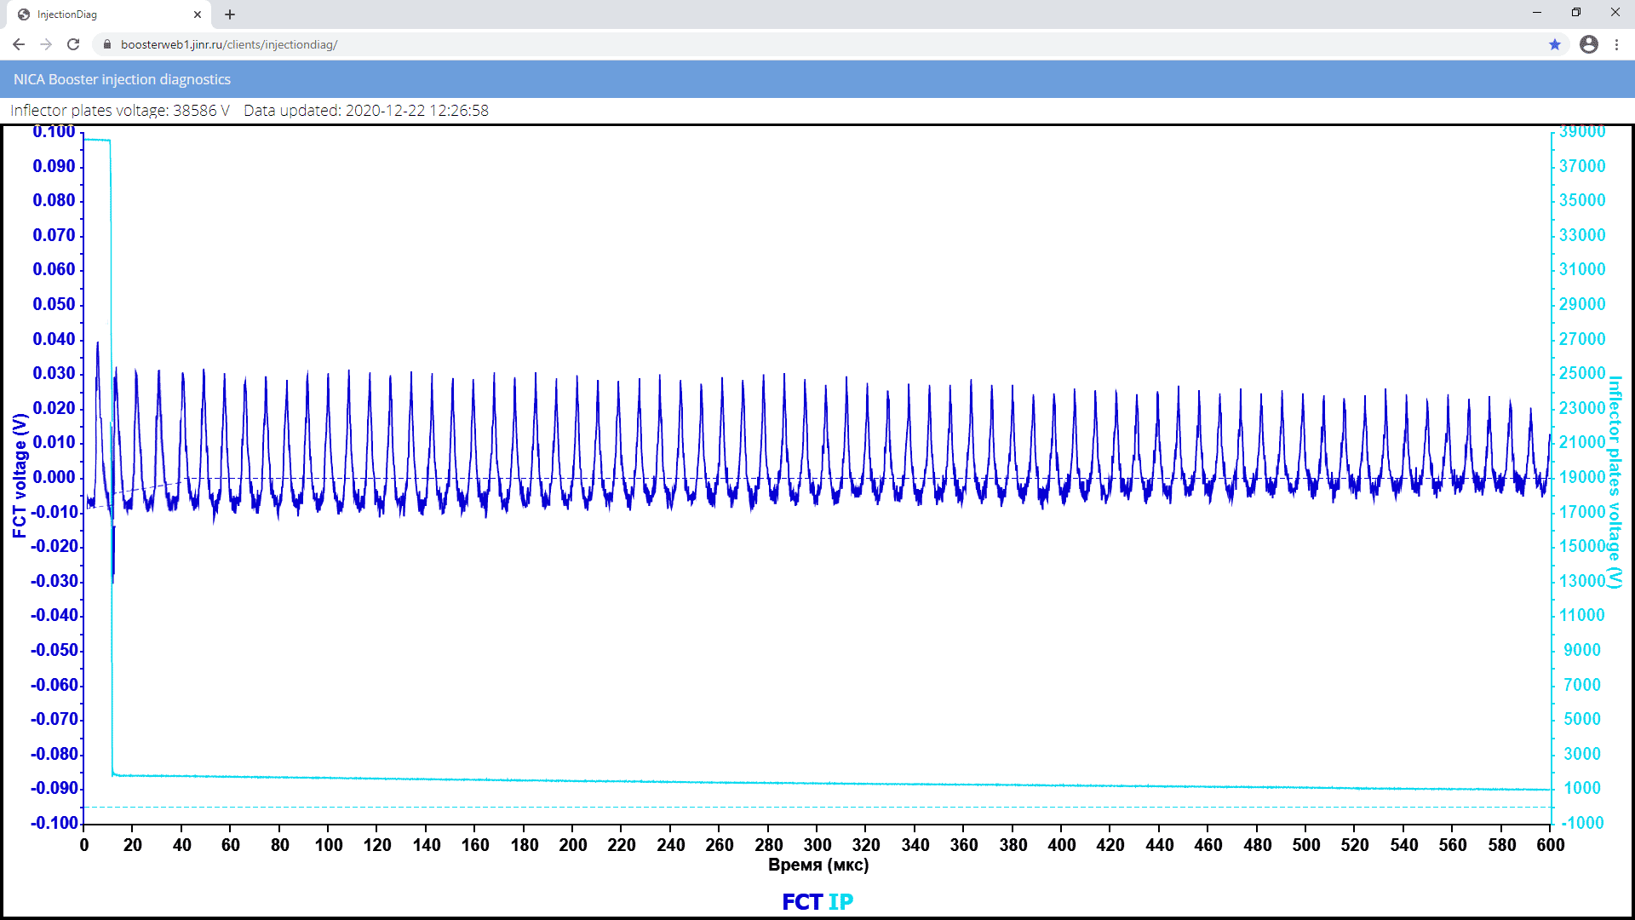
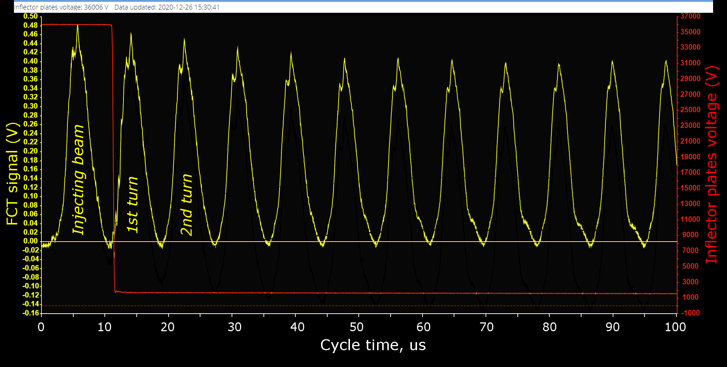
Beam injection & circulation
19.12.2020, 19:56 Moscow time. First beam in the ring.
Fast Current Transformer (FCT)
22.12.2020
Circulating beam
at the injection energy 3.2 MeV/u
600 ms circulation of He¹⁺
26.12.2020
Beam losses < 10%
just on the first 5 turns.

Slide 14
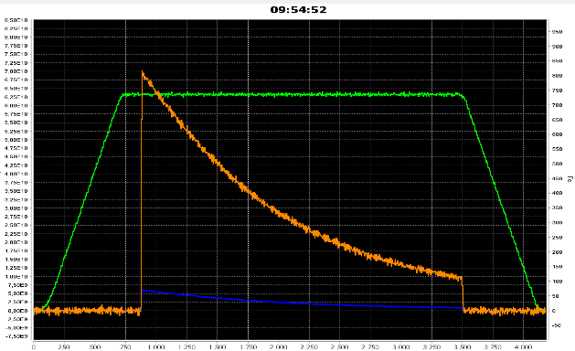
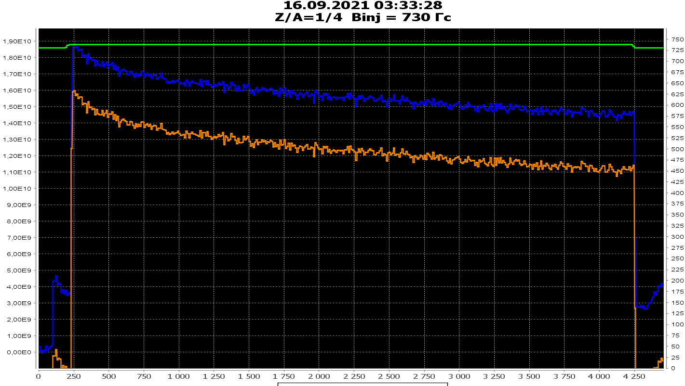
Beam current & vacuum conditions
16.09.2021: Measurements of integral vacuum conditions by intensity decrement of circulating He¹⁺
Parametric beam current transformer signal
RUN-1
PCT signal
Beam Intensity, ppc
Circulation of 3.2 MeV/u He¹⁺
~10 s beam lifetime
Beam intensity
Magnetic field, Gs
RUN-2
16 of September 2021
t, ms
0 500 1000 1500 2000 2500 3000 3500 4000
Life-time more then 10 s, equivalent pressure of residual gas
              is about 8÷9⋅10⁻⁹ Pa

Slide 15
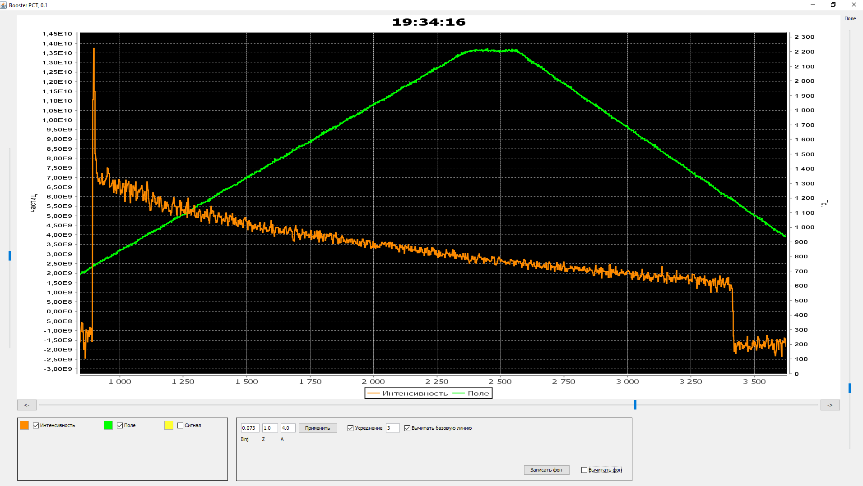
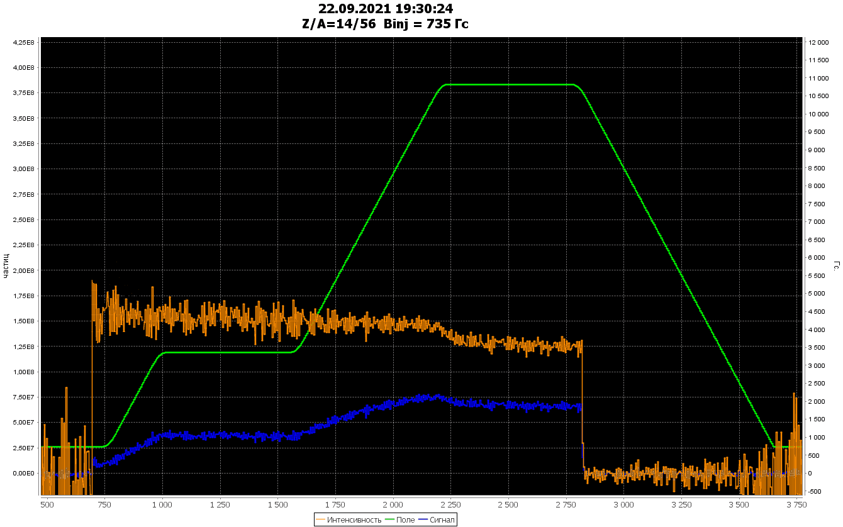
Beam acceleration
Parametric beam current transformer signal (DC mode)
Cycle-1 of commissioning
20 of December 2020 He¹⁺
Injection
Circulation
100 MeV/u
Magnetic field
Beam Intensity
PCT signal when beam injecting into rising field, capturing (~60%), accelerating & decelerating:
no transient losses on the MF table & after.
Acceleration
He¹⁺
Deceleration
Magnetic field
RF off
RUN-1
1000 1500 2000 2500 3000 3500
Cycle time, ms
Cycle 2 of commissioning
14-23 of September 2021 Fe¹⁴⁺
RUN-2
RF capturing 5 harm.
Acceleration
Re-capturing 1 harm.
Fe¹⁴⁺
Injection
Circulation
65 MeV/u
Acceleration
Circulation
578 MeV/u
Beam injection with adiabatic capturing 5 harmonic (>95%),
accelerating up to 65 MeV/u,
recapturing 1 harmonic (close to 100%)
acceleration up to 578 Mev/u
with project ramp dB/dt = 1.2 T/s
Magnetic field 1,2 T/s
500 1000 1500 2000 2500 3000 3500
Cycle time, ms

Slide 16
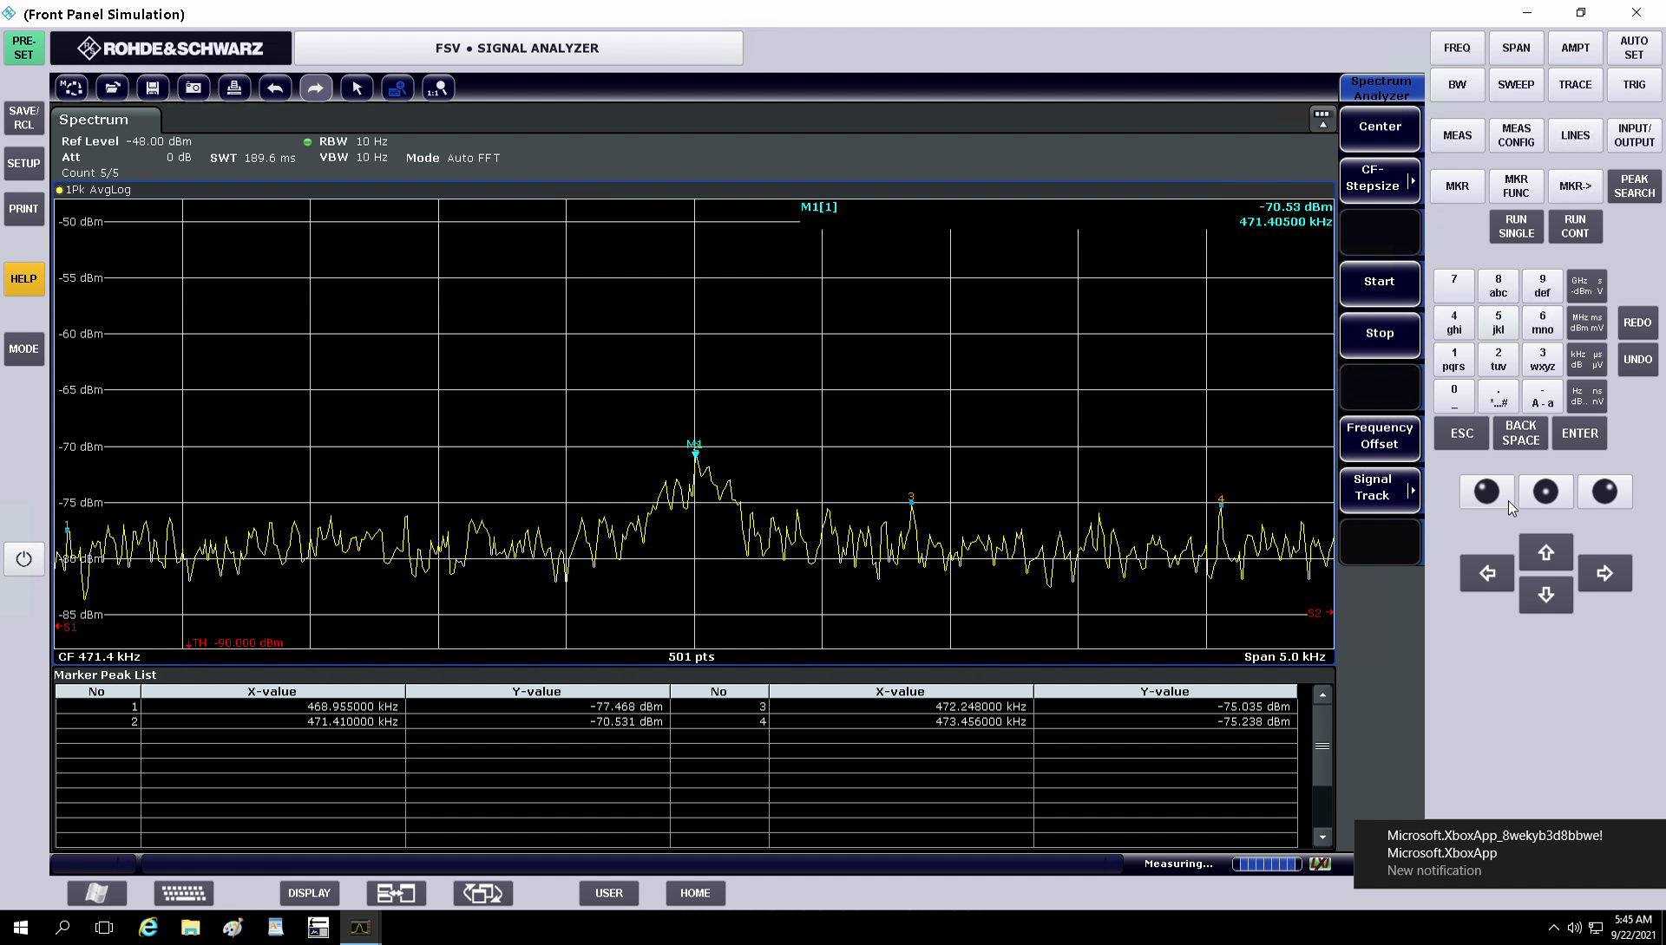
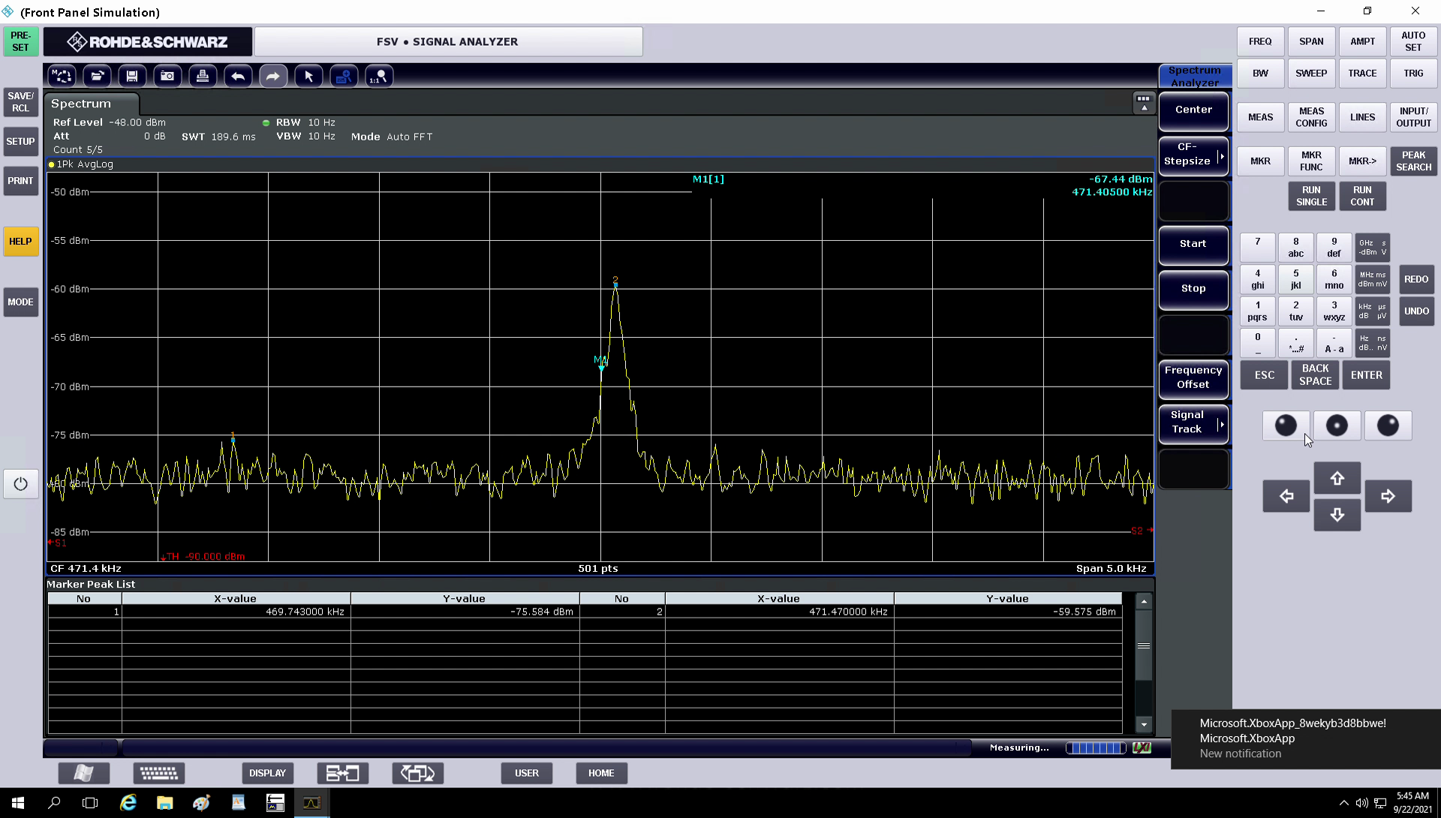

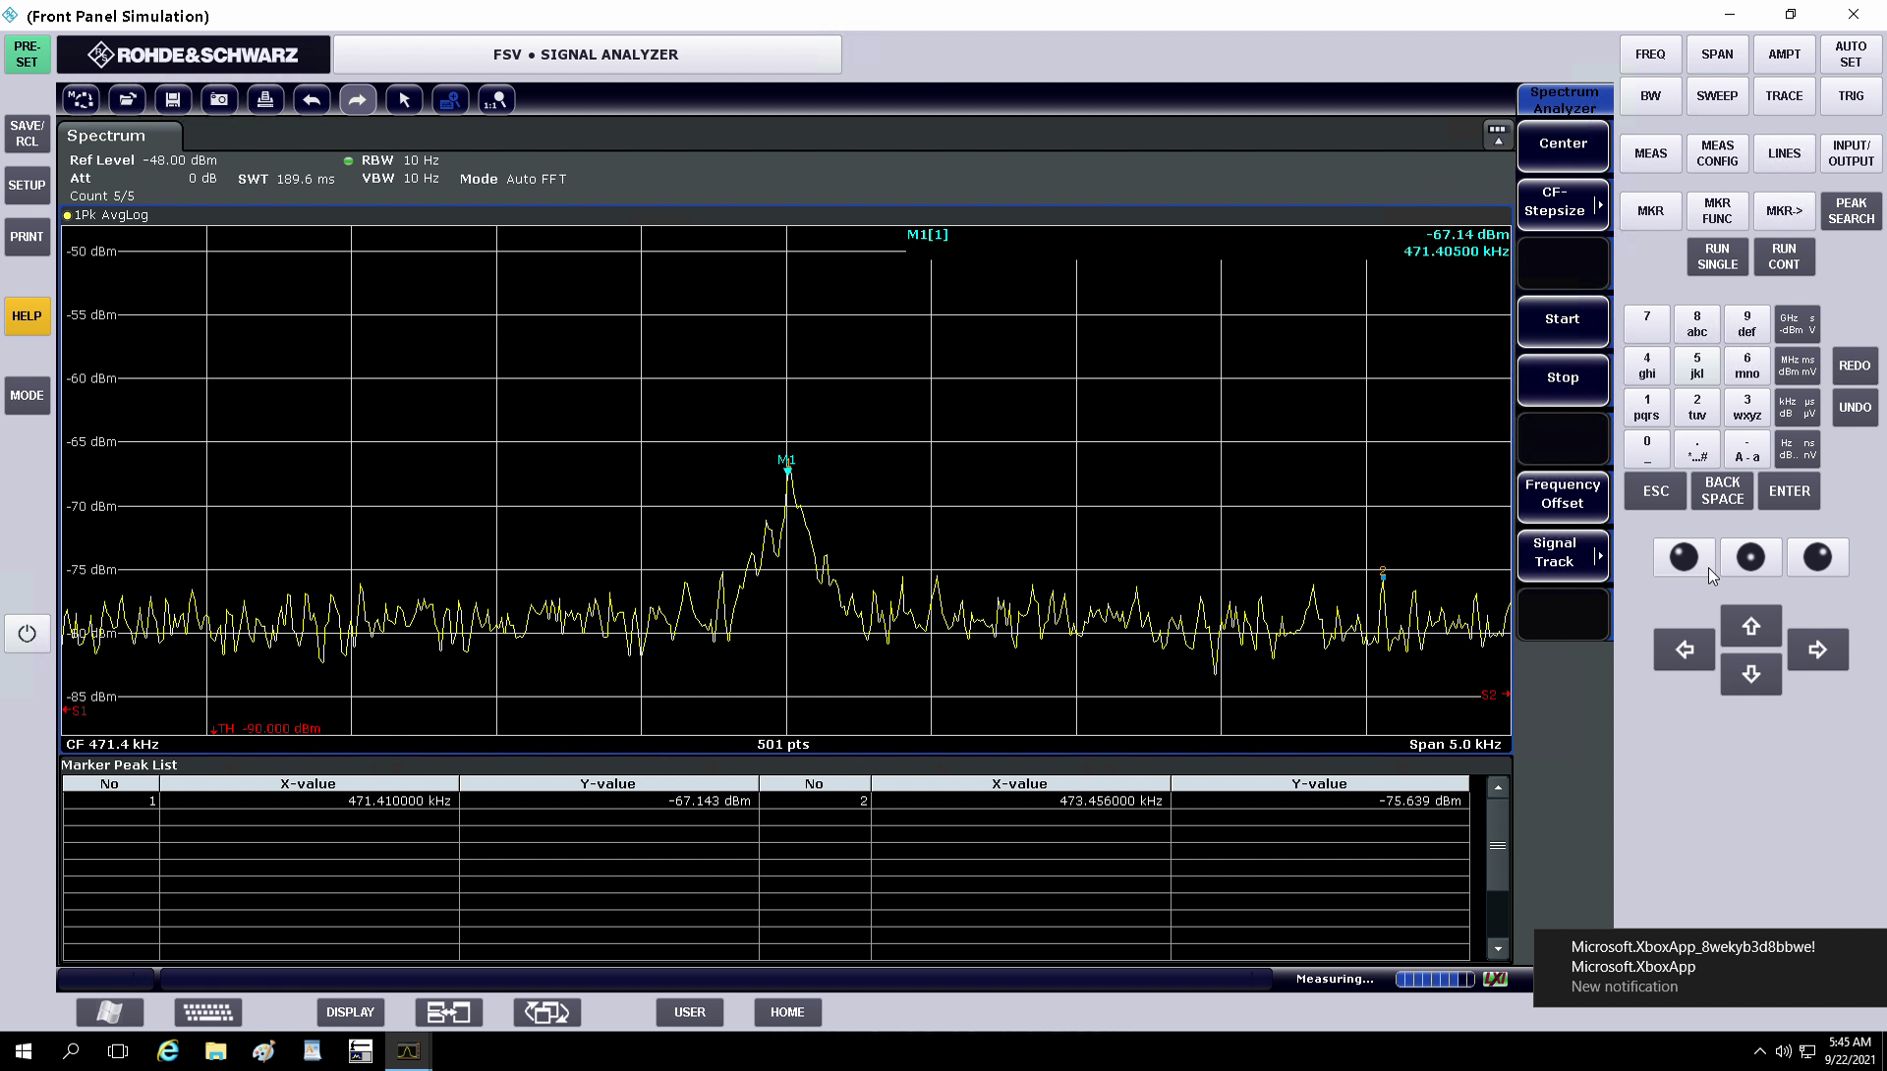
Electron cooling section
Electron cooling of Fe¹⁴⁺ at 3.2 MeV/u during 2 s
Schottky spectrum at 4-th harmonics

Slide 17
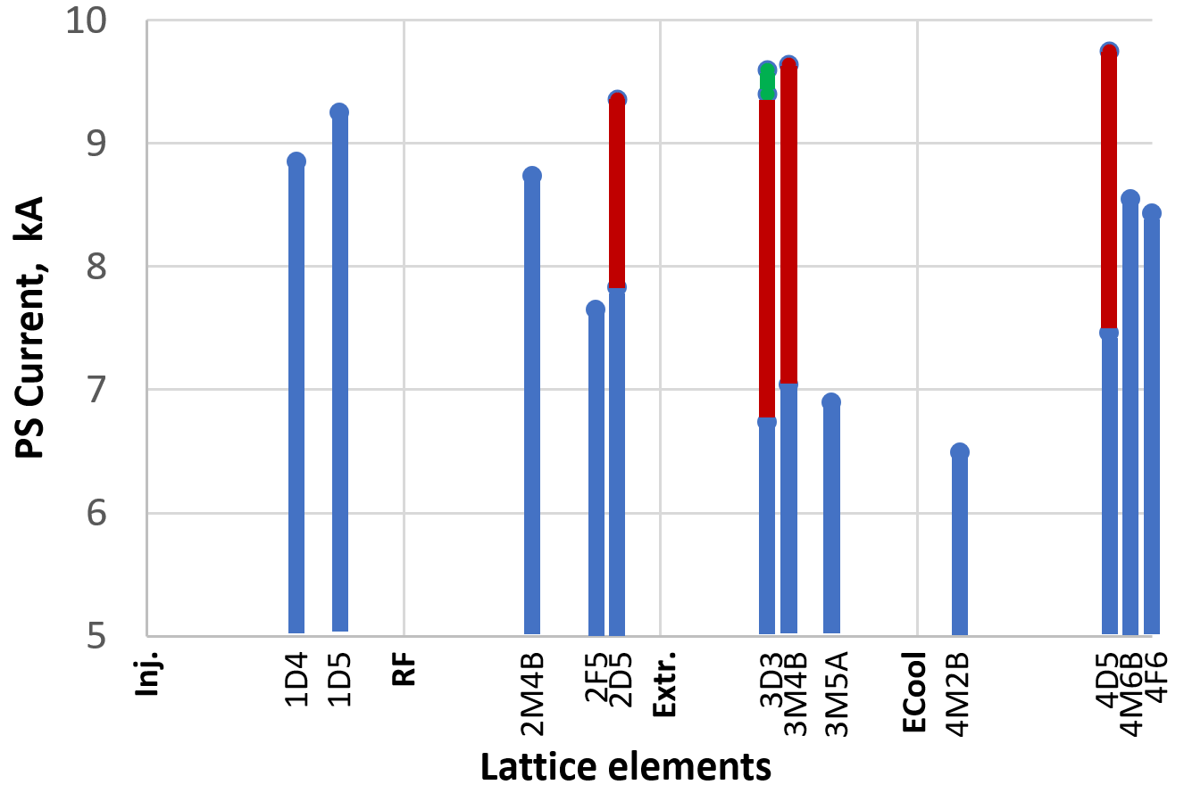
Magnetic system training and problems
The goal: B = 1.8T, dB/dt = 1.2T/s
30.12.20: design magnetic field cycle
increasing of main PS current up to 9.8 kA & quench detection.
It was take just 10 hours, and 17qunches of magnets was detected.
1st quadrant
2nd quadrant
3rd quadrant
4th quadrant

Slide 18
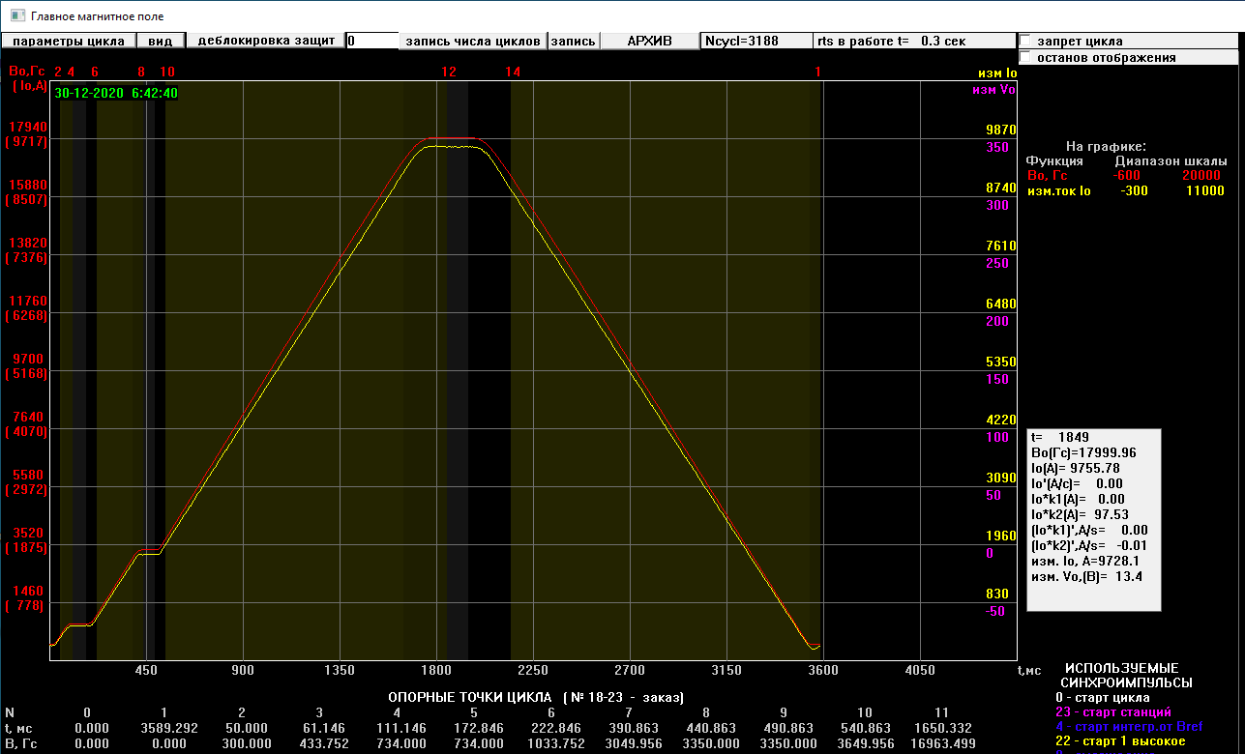
Design magnetic field amplitude & ramping rate
30.12.20: design magnetic field cycle
Project B=1.8 T
RUN - 1
dB/dt = 1.2 T/s
17999.96Gs
Electron cooling plateau
Injection plateau
3.6 s
CSRC, 16 of November 2021

Slide 19
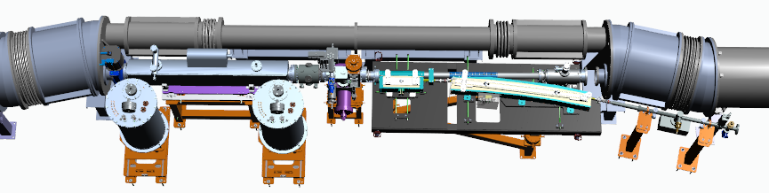
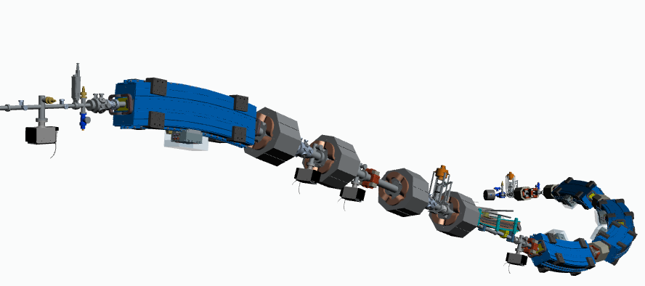
Beam extraction & transfer line
3-rd str. sect.
Contract with BINP
Beam fast extraction section
Circulating beam
To Nuclotron
3D model of the transfer line

Slide 20
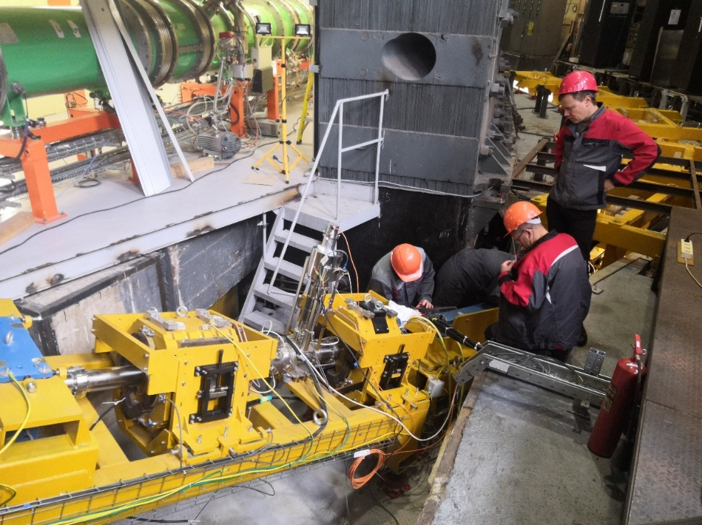
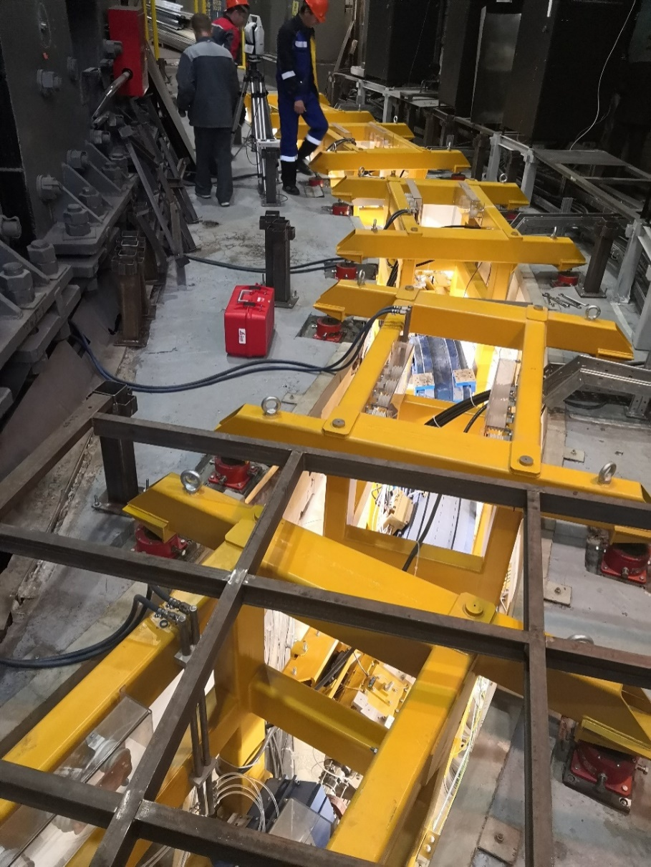
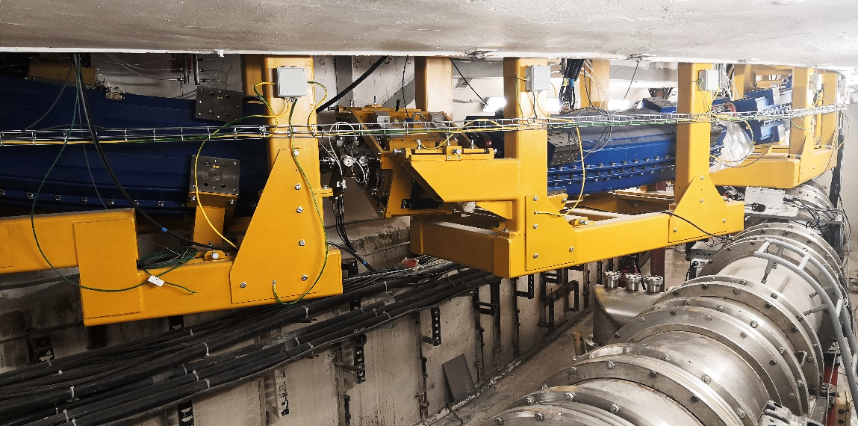
Beam extraction & transfer line
3-rd str. sect.
Contract with BINP

Slide 21
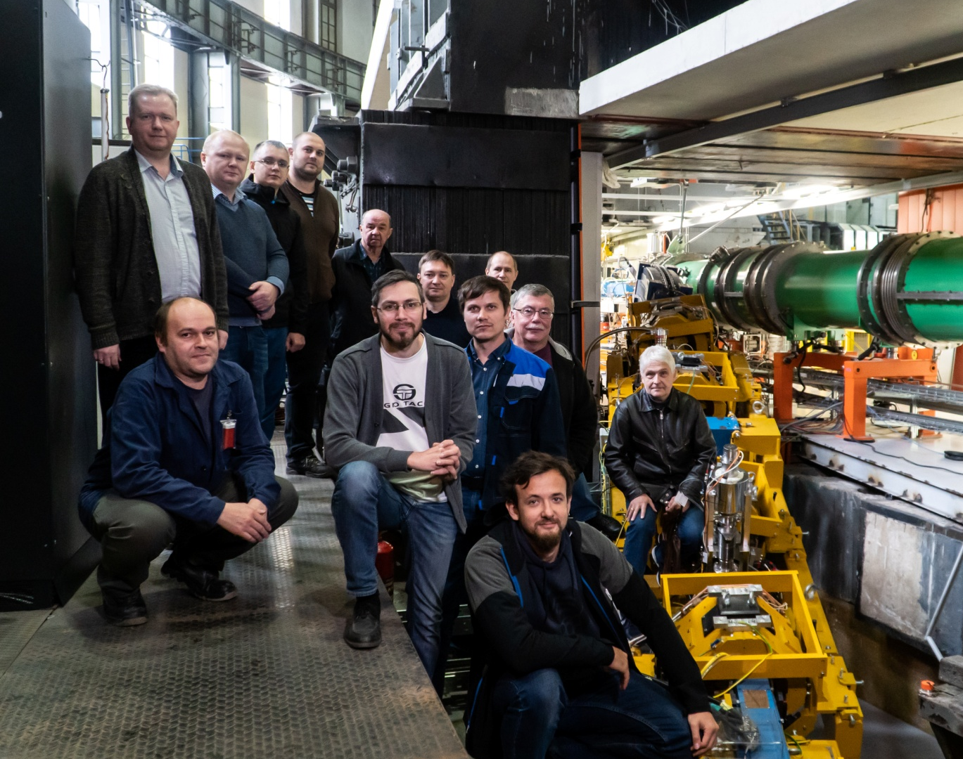
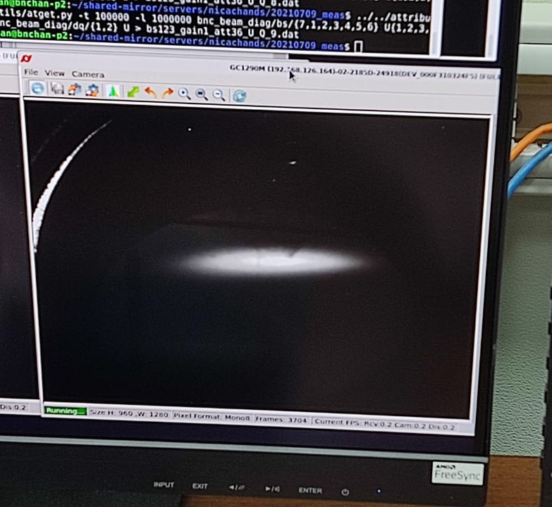
Beam extraction & transfer line
3-rd str. sect.
BINP team during beam line commissioning
⁵⁶Fe beam “portrait” at the exit of the transfer line Booster - Nuclotron
Commissioned! Autumn 2021
RUN-2
RuPAC 2021, Crimea, Alushta, 27 of September 2021

Slide 22
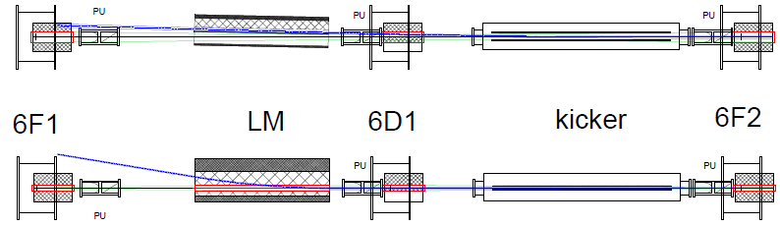
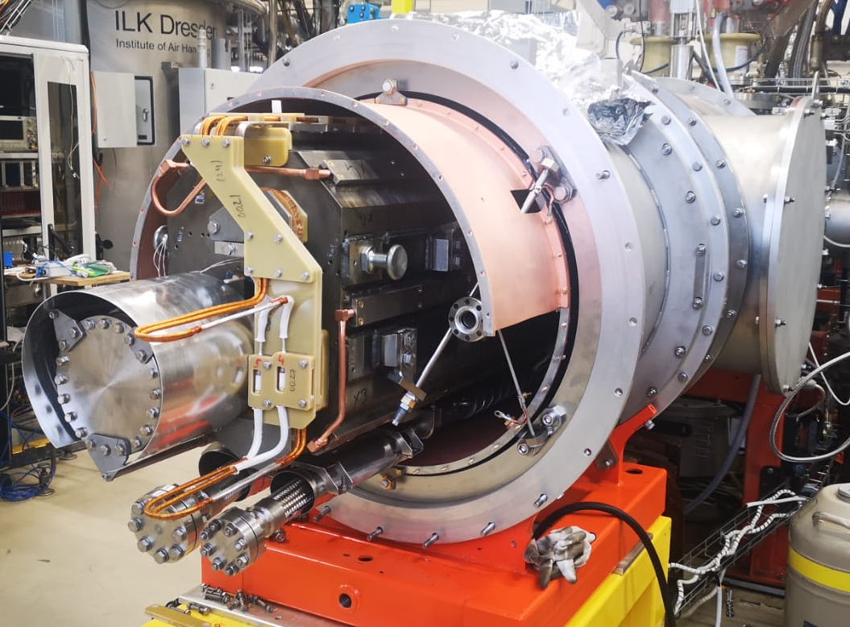
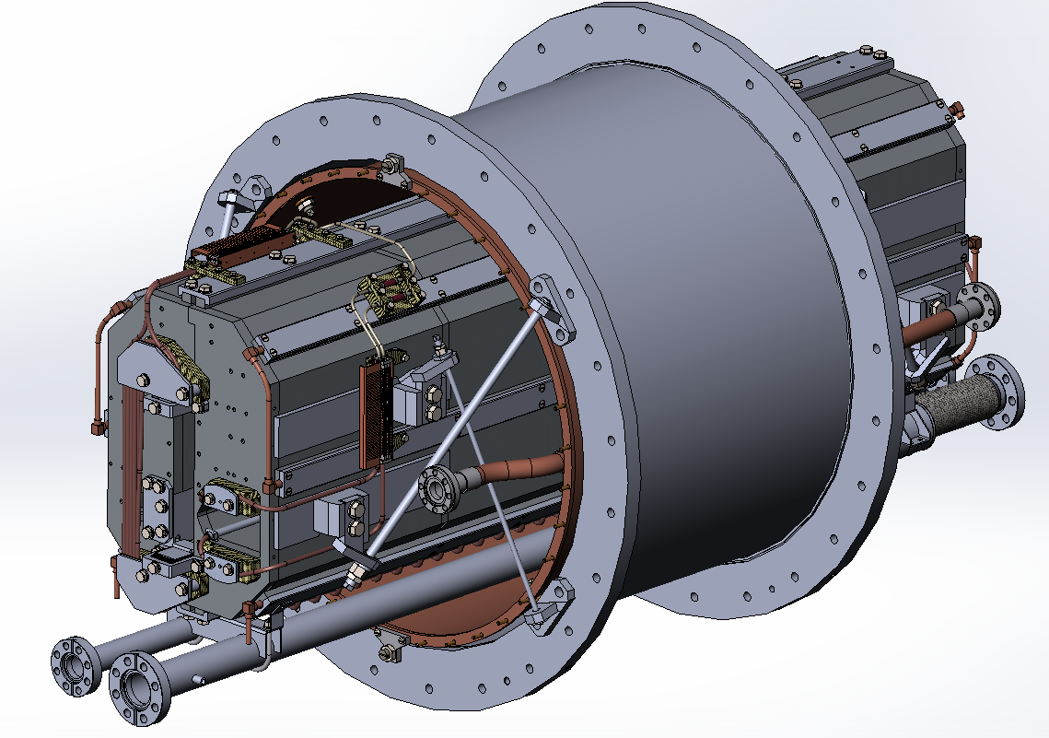
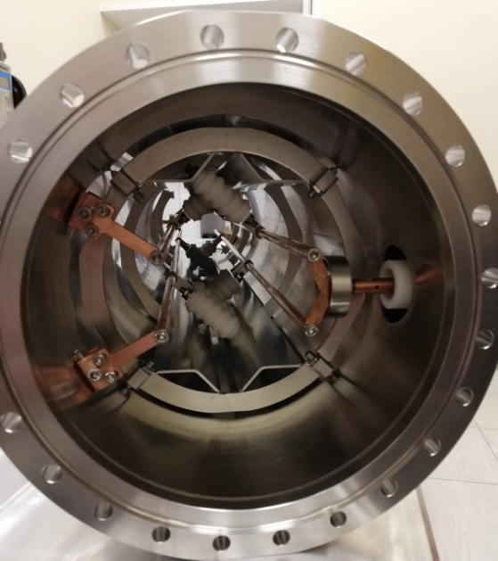
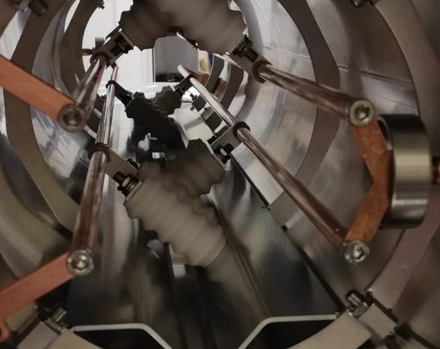
Beam injection system (into the Nuclotron)
Top view
Unique devices
Lambertson magnet
4-rod kicker
Tested & mounted
End of 2021
Side view
Commissioned in RUN -3
winter 2022
22

Slide 23
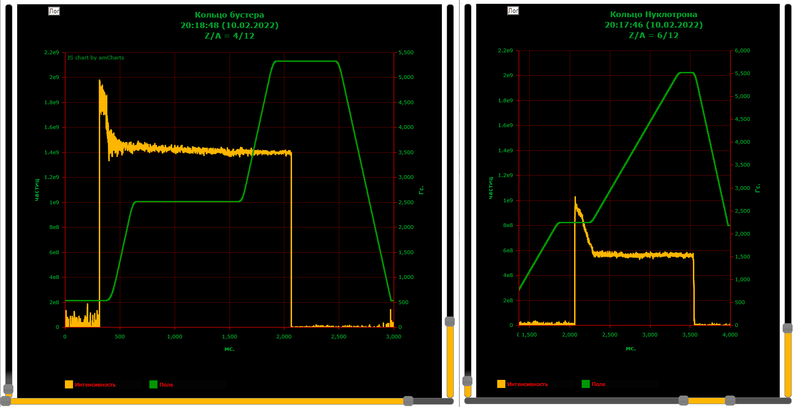
Main results of RUN-3 (Booster + Nuclotron)
Beam intensity in the Booster intensity in the Nuclotron
Intencity
Nucloton field
RF capture
Beam transfer with stripping С4+/С6+ transmission 75%
Acceleration
Booster field
Booster and Nuclotron beam DC current transformers signals

Slide 24
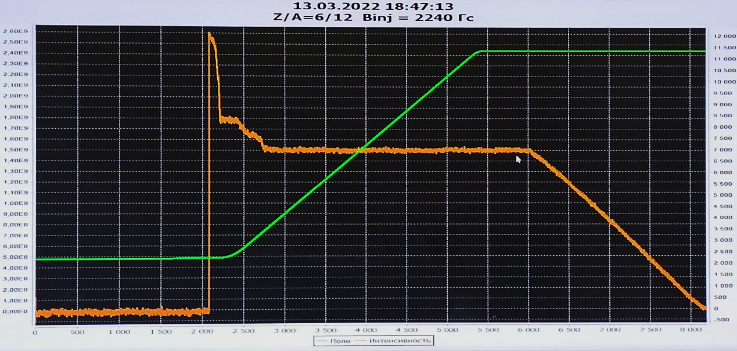

Main results of RUN-3 (Booster + Nuclotron)
Beam acceleration cycle in the Nuclotron
From the Booster ring
RF capture
Nuclotron field
Beam slow extr.
Acceleration
1-1.5*10⁹ of С ⁶⁺
Spill duration 5 c,
3 GeV/amu
Nuclotron beam DC current transformers signal

Slide 25
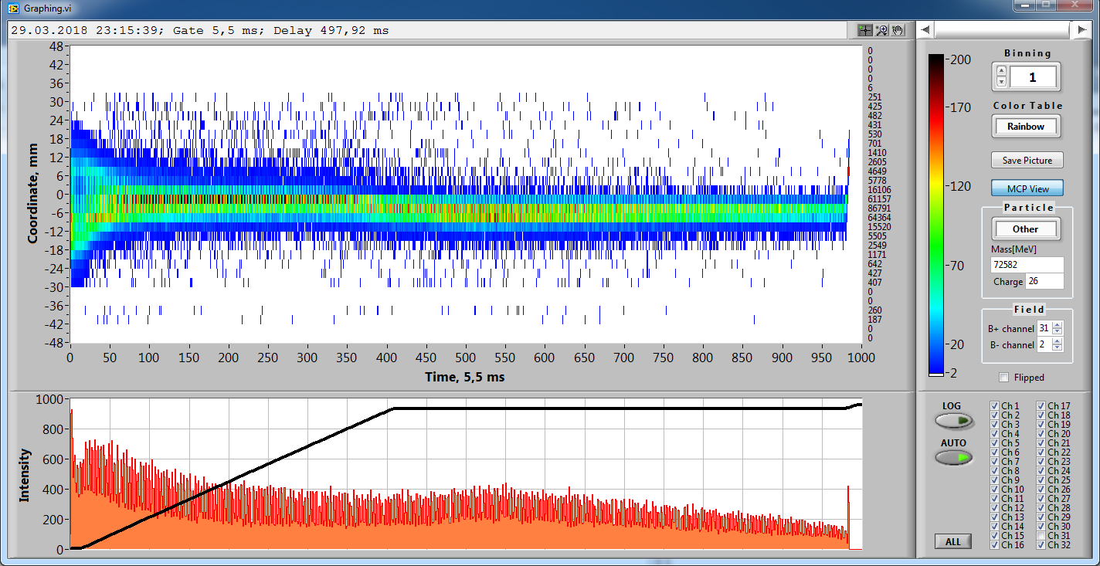
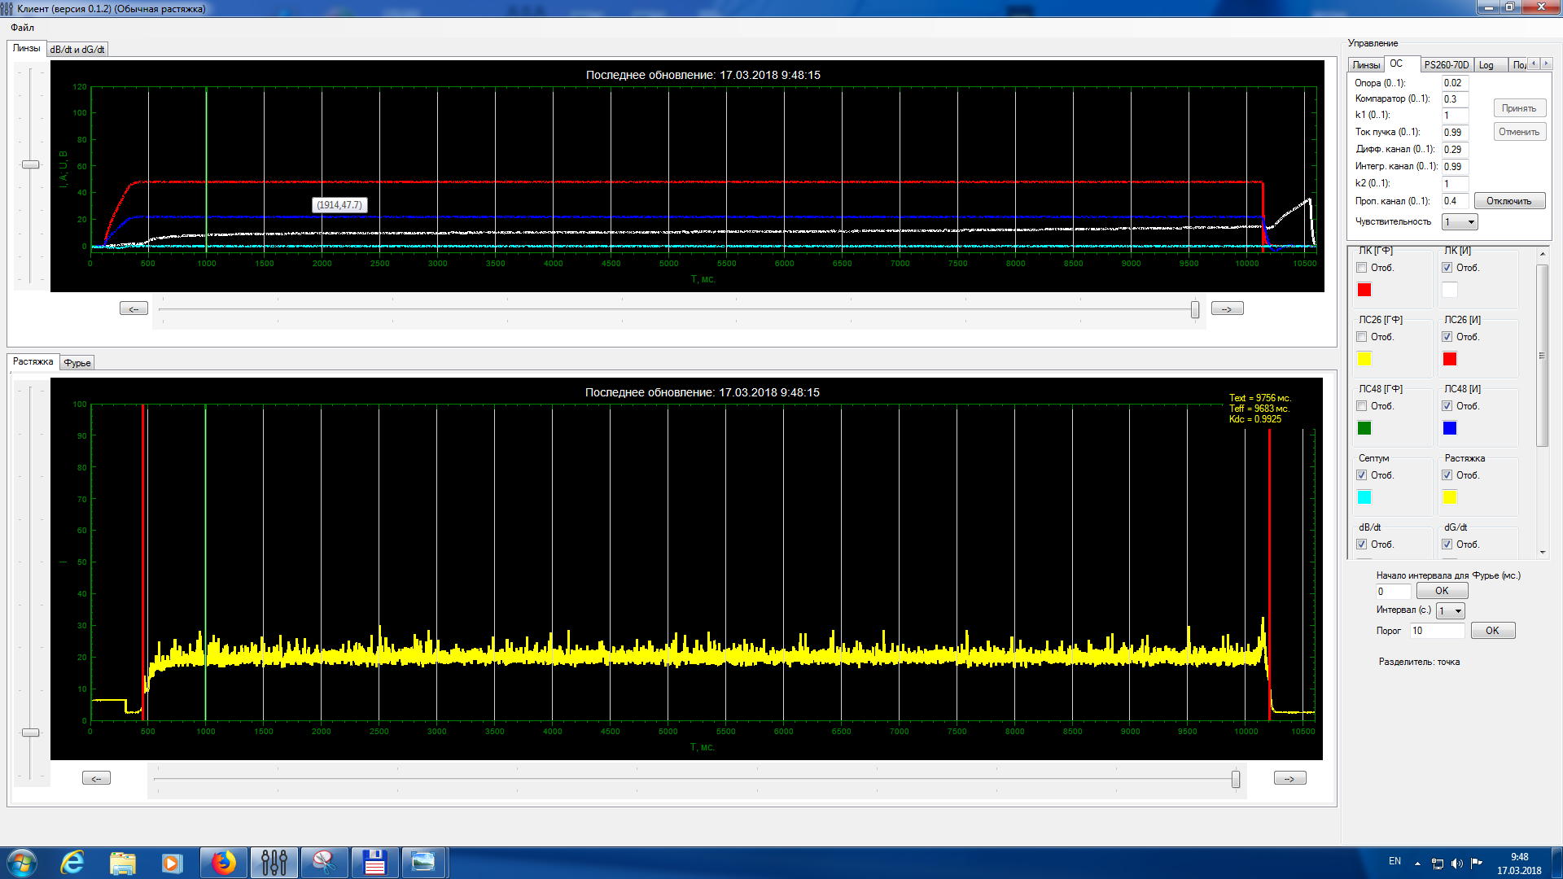
Heavy ion beams acceleration
2018
⁷⁸Kr⁺²⁶ beam extraction (2,8 Gev/u) RUN #55 at Nuclotron
⁷⁸Kr 2*10⁵ T_{spill} = 10s, k_{dc}= 99,3%

Slide 26
Nuclotron status table
Parameter | Project | Status (2021)
Max. magn. field, T | 2 | 2 (1.6 T routine)
B-field ramp, T/s | 1 | 0.8 (0.7 routine)
Accelerated particles | p–U, d↑ | p↑, d↑, p – Xe
Max. energy, GeV/u | 12 (p), 5.8 (d) 4.3( ¹⁹⁷Au⁷⁹⁺) | 5.6 (d, ¹²C), 3.6 (⁴⁰Ar¹⁶⁺)
Intensity, ions/cycle | 1E11(p,d), 2E9 (A > 100) | d 4*10¹⁰ (2*10¹⁰ routine), ⁷Li³⁺ 3*10⁹ ¹²C⁶⁺ 2*10⁹ ⁴⁰Ar¹⁶⁺ 1*10⁶ ⁷⁸Kr²⁶⁺ 2*10⁵ ¹²⁴Xe⁴²⁺ 1*10⁴
26

Slide 27
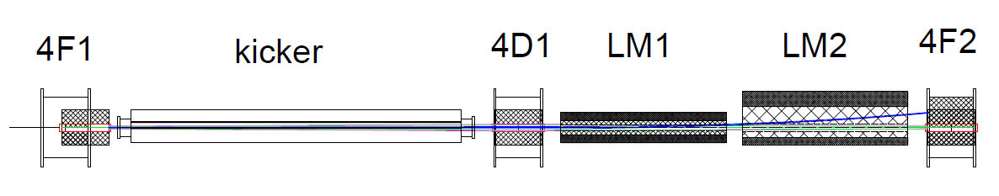
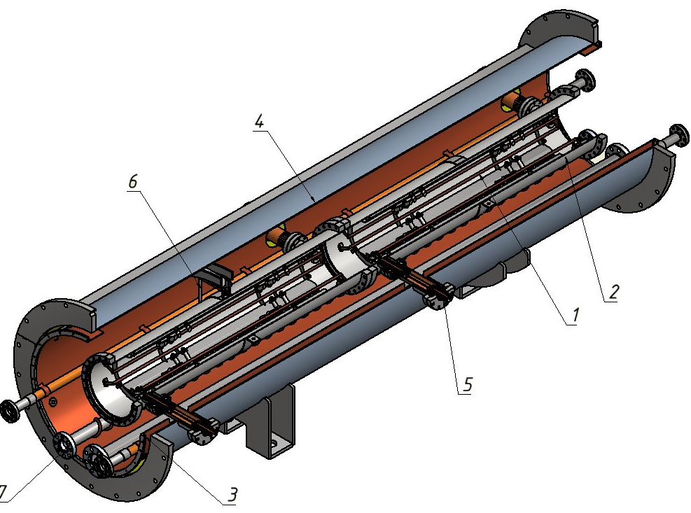
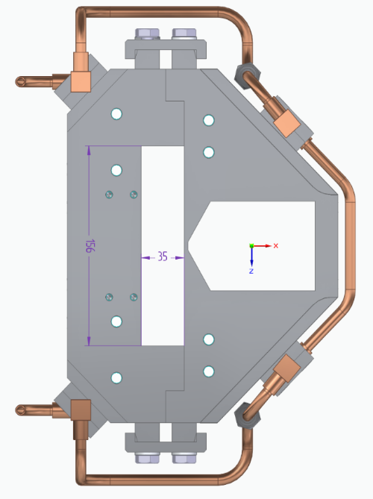
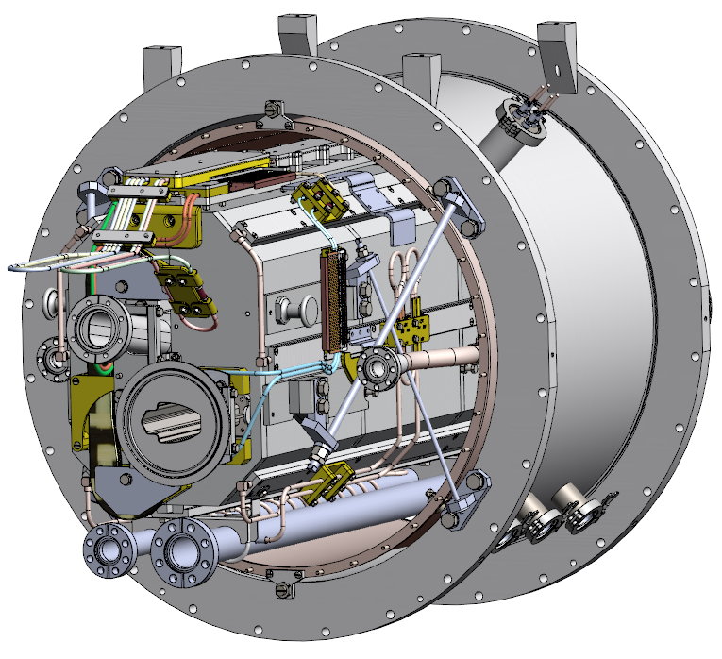
Fast extraction from the Nuclotron
Design development is in the progress
Delays:
Due to delays of LM for injection;
Due to delays of injection Kicker;
A lack of designers of SC magnets;
3 section kicker
Final stage of design
LM1
Not designed
LM2
Under redesign
Mitigation plan “plan B”:
Limitation of extracted beam energy by factor 1,6 (~2 GeV/u for Bi)
Doubling of injection LM with the same design and tooling for higher current;
Two sections of Kicker instead of 3 (not needed reconstruction lattice quads)

Slide 28
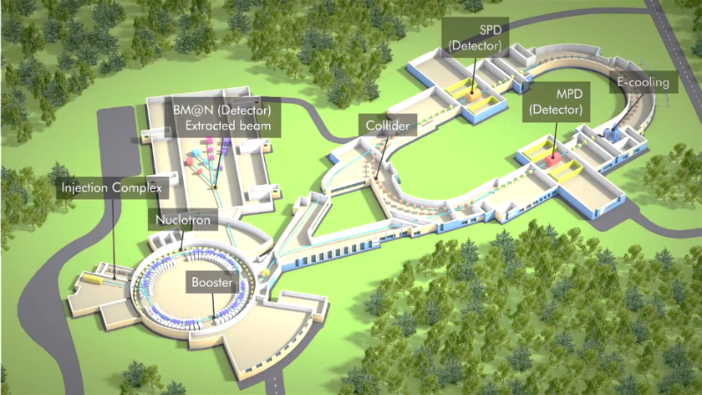
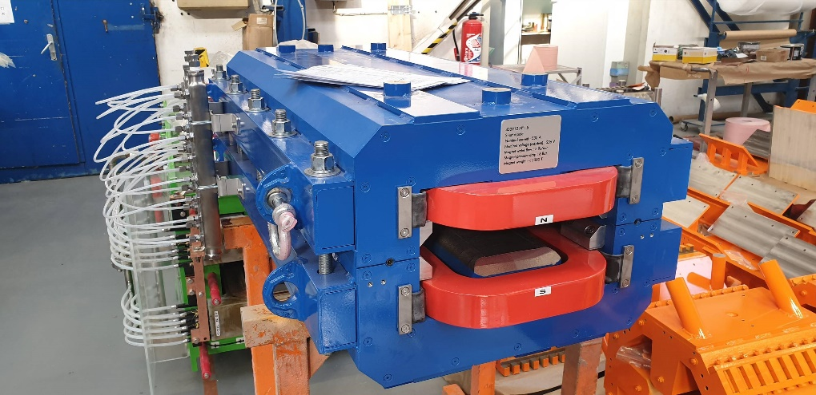
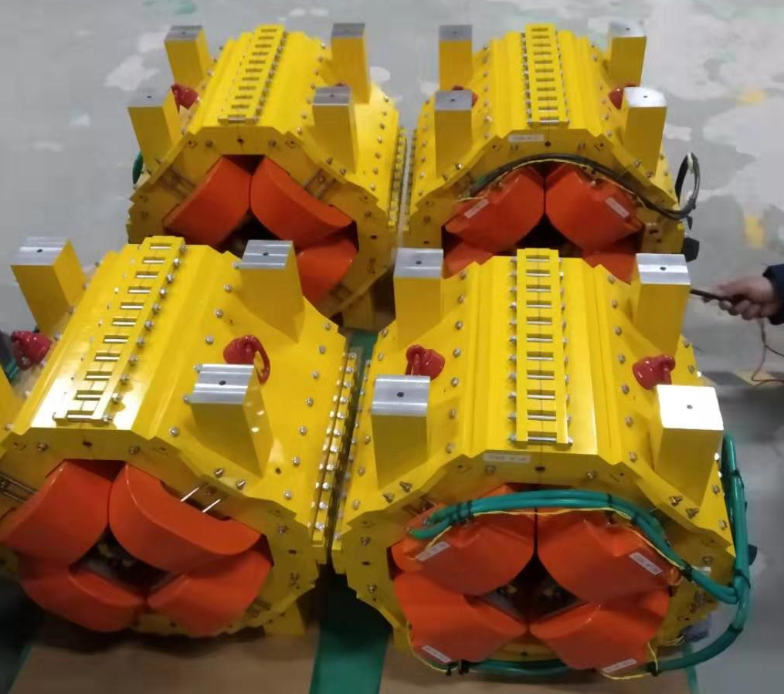
Nuclotron-Collider beam transport channel
Sigma Phi
Nuclotron-Collider transfer line is under delivery and construction by Sigma Phi
Magnetic element | Number | Effective length, m | Max. magnetic field (grad), T (T/m)
Long dipole | 21 | 2 | 1.5
Short dipole | 6 | 1.2 | 1.5
Quadrupole | 28 | 0.35/0,52 | 31
Steerer | 33 | 0.466 | 0.114
Magnets delivered in JINR in February 2021
November 2021 – delivery of first part of PS, beam diagnostics, support stands.
January 2022 – delivery of vacuum equipment.
July 2022 – second part of power supplies, profile monitors, control system.
September 2022 – start of commissioning of the channel equipment.
December 2022 – commissioning of the channel with a beam.

Slide 29
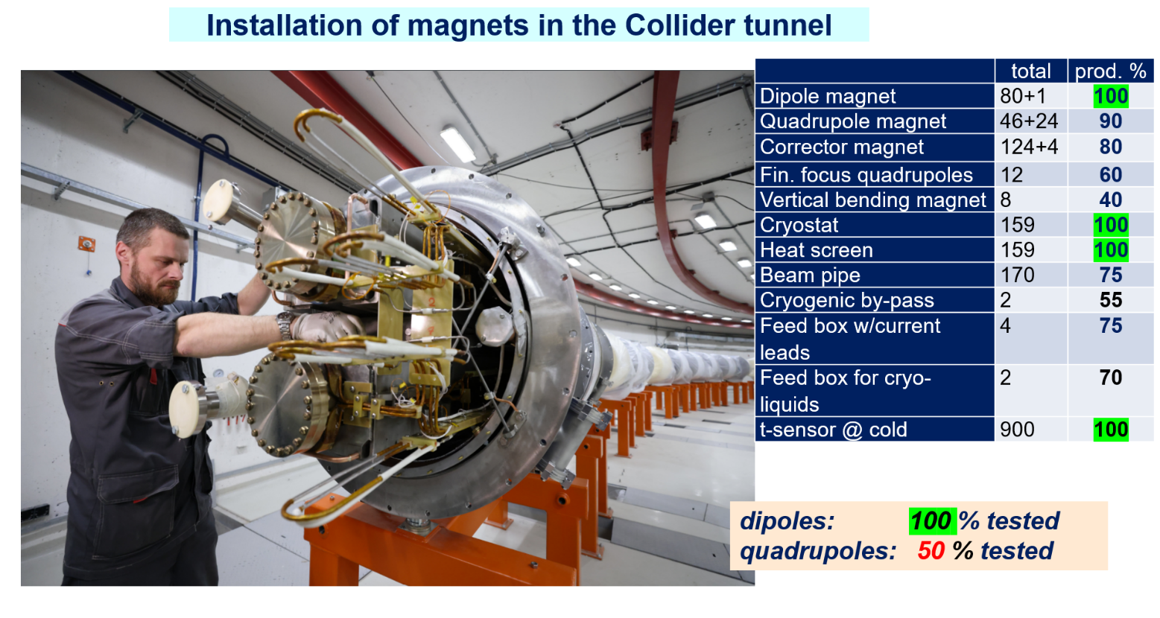
Collider SC magnetic system

Slide 30
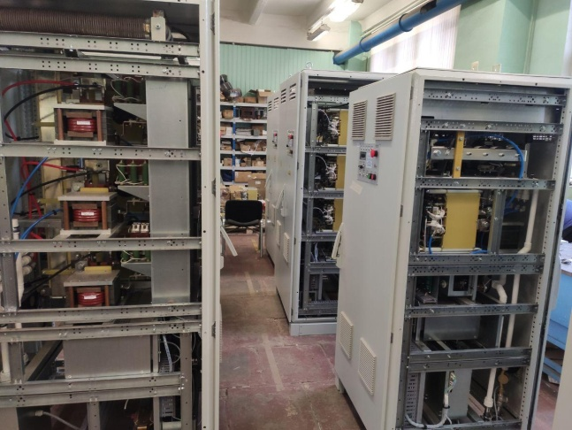
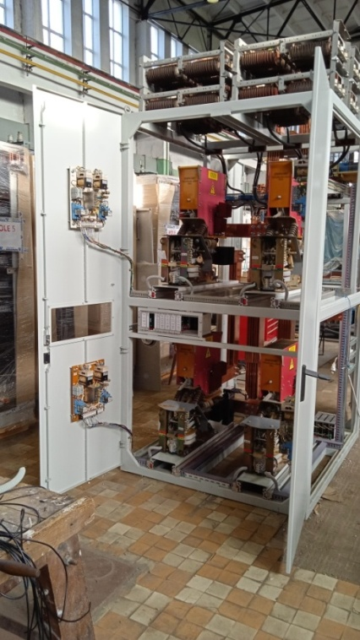




Collider power supply system
LM Invertor
(Moscow)
Three main power supplies
Energy evacuation keys
Prototype was constructed and tested
Additional power supplies (10В х 300А)
2 prototypes from 3 were constructed and tested
Constructed by LM Invertor (Moscow)
Delivered to JINR

Slide 31






Barrier bucket RF1 and harmonic RF2-RF3
BINP
RF1 cavity in BINP
Two RF1 cavities delivered to JINR in 2019
4 RF2 cavities for base configuration
mounted, 2 of then passes trough vacuum tests, installation in 4q of 2022
RF3 cavity and amplifier in BINP
16 RF3 cavities for extension configuration,
installation - end of 2022 – 2023,
beam tests – 2023/24
RF1 cavity in JINR
RF2 cavity in JINR

Slide 32



Electron Cooling System
Contract with BINP
HV Electron Cooler for NICA Collider
Design and construction at BINP
Installation at NICA in 2022
Parameter | Value
Electron energy, MeV Energy instability, ΔE/E | 0.2 – 2.5 ≤ 1⋅10⁻⁴
Electron beam current, A | 0.1 – 1.0
Cooling section length, m | 6.0
Solenoid magnetic field, T Field inhomogeneity, ΔB/B | 0.05 – 0.2 ≤ 1⋅10⁻⁵
Beginning of mounting – October of 2022
First beam tests – Sumer 2023
32

Slide 33

Synchronization and LLRF system
COZYLAB
Synchronization: 317+31+91 channels. LLRF: 30 channels
Stage 1 (T0 + 7 months) | Development of the NICA Injection complex (Booster+Nuclotron) Synchronization system, its testing on the Executive’s site, and its delivery to the Customer. Two LLRF Prototypes are provided up to this stage and testing is started during the Nuclotron-Booster run.
2.Stage 2/ (T0 + 13 months ) | Development of the first revision of NICA Injection complex LLRF system and on-site testing; Development of NICA Collider Synchronization System
3.Stage 3/ (T0 + 19 months ) | Development and testing of the final revision of synchronization and LLRF systems of the NICA complex.
4.Stage 4/ (T0 + 21 months ) | Services for mounting, final software installation and testing of the NICA Accelerator complex Synchronization and LLRF systems./
5.Stage 5 (T0 + 25 months ) | Services for SAT and commissioning of the NICA Accelerator complex Synchronization and LLRF systems.
Start of Contract with COSY Lab – November 2021
Synchronization and LLRF of Booster and Nuclotron – December 2022
Mounting and testing of NICA synchronization and LLRF – June 2023
33

Slide 34
Summary
During last beam runs of the injection complex was demonstrated:
Stable operation of the HILAC & Booster;
Low beam losses at all stages of acceleration;
Real possibility to acceleration of different ion species
High quality of the slowly extracted beam form the NUCLOTRON -
emittances, profiles, spill structure;
Stable operation of the new PS system of the beam transfer channels to BM@N (fix target exp.)
For operation of the NICA injection complex for collider,
♦ Increasing of operation stability of all main systems
♦ Minimization of beam losses on all stages
♦ Development of injection and other main systems
♦ Development of automatization and control
♦ new global synchronization

Slide 35


Thank you for attention

