Slide 1
MSC230 superconducting cyclotron
Presenter: Vladimir Malinin
21.09.022

Slide 2
Participants: Superconducting Cyclotron МSC230
Участники проекта:
ЛЯП
Научно-экспериментальный отдел новых ускорителей, Отдел Фазотрона
ЛФВЭ
Научно-экспериментальный отдел сверхпроводящих магнитов и технологий
Агапов А.В., Бреев В.М., Бунятов К.С., Герасимов В.А., Гоншиор А.Л., Гурский С.В., Доля С.Н., Иваненко И.А., Карамышев О.В., Карамышева Г.А., Киян И.Н., Лепкина О.Е., Ляпин И.Д., Малинин В.А., Мицын Г.В., Наумов Д.В., Новиков М.С., Никифоров Д.Н., Пивин Р.В., Попов Д.В., Романов В.М., Синица А.А., Трубников Г.В, Ширков Г.Д., Ширков С.Г., Федоренко С.Б., Ходжибагиян Г.Г., Шипулин К.Н., Яковенко С.Л.
НИИЭФА им. Ефремова, г. С.-Петербург

Slide 3
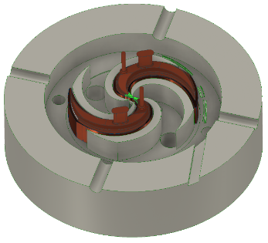
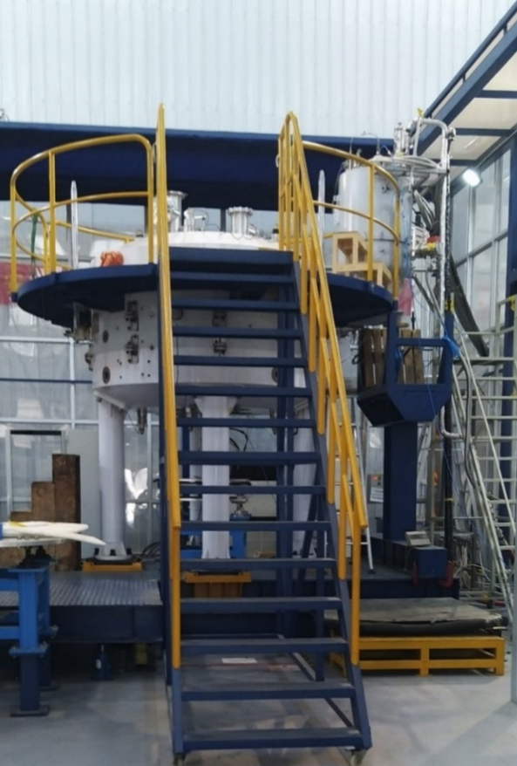
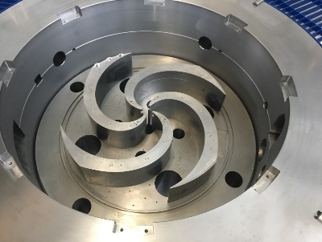
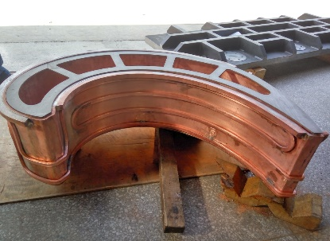
JINR’s medical cyclotrons designs
Collaboration with IBA (Belgium).
Project of carbon superconducting cyclotron C400.
Proton cyclotron C235-V3 for Dimitrovgrad.
Collaboration with ASIPP (Hefei, China)
Superconducting proton cyclotron SC200
From JINR project to successful start-up in Hefei!
IBA-JINR collaboration designed the C400 superconducting cyclotron for carbon therapy.
C235 V3 cyclotron (IBA, Belgium) for the hospital center of radiation medicine in Dimitrovgrad was assembled in Dubna.

Slide 4
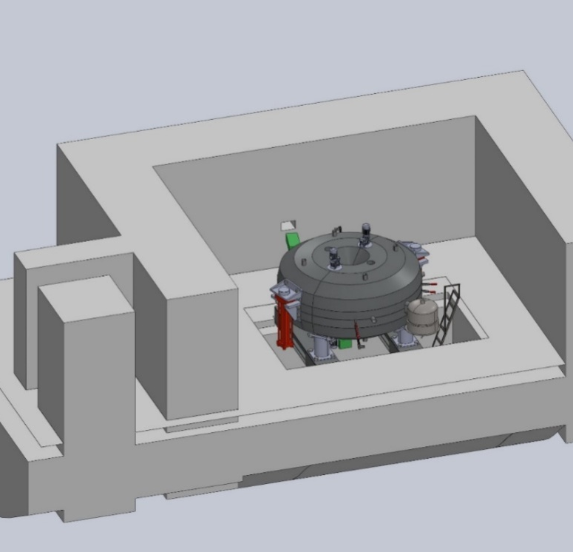
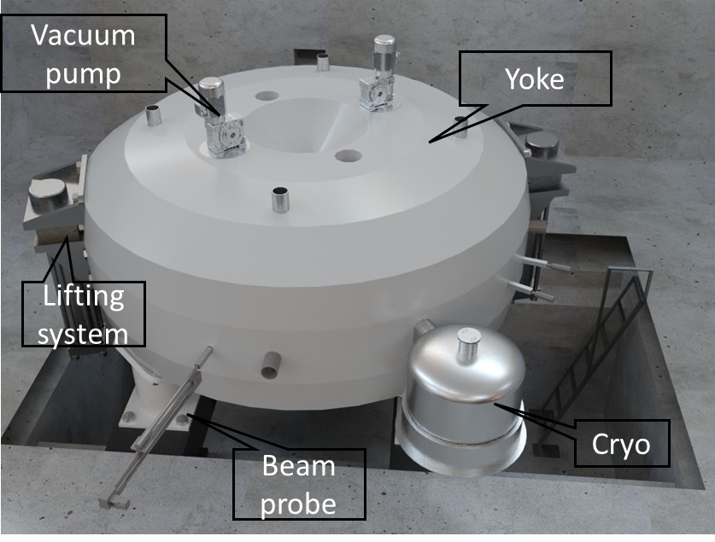
Superconducting Cyclotron МSC230 for the Medical Technical Complex in JINR
MSC230 stands for Medical Super Conducting cyclotron of 230 MeV energy
MSC230 is a source of a high‐intensity proton beam.
Possibilities for equipment modernization at the Medical Technical Complex of DLNP JINR
Delivering high dose rate irradiation for FLASH therapy studies
Model of МSC230 placed
in the bunker
Computer model of МSC230

Slide 5
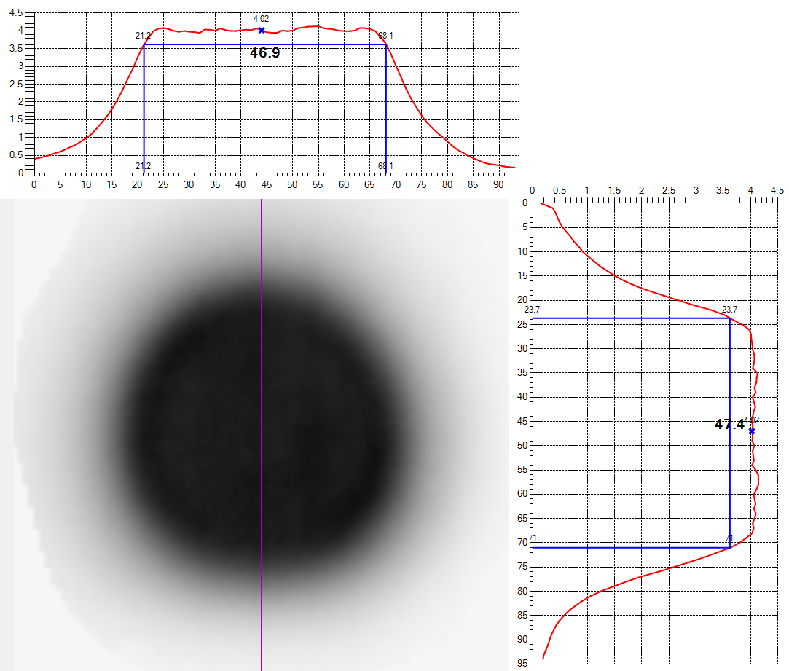
FLASH therapy studies
FLASH – new method of proton therapy consisting in irradiation with ultrashort (less than 0.5 s) pulses.
Compared to radiation therapy at a conventional dose rate (1–7 Gy/min), FLASH irradiation is performed at a dose rate ~ 100 Gy/s .
In order to deliver 100 Grey/second, extracted beam current should be at least 10 µA.
Healthy tissue is better able to withstand FLASH radiation, while the level of damage to the tumor is the same as with conventional treatment.
Allows for more effective treatment of radioresistant tumors, as well as recurrent diseases
Reduces the number of treatments
Proton beam profiles for studying the effect of FLASH therapy on biological objects. (formed at the MTC, based on the Phazotron accelerator)
Dose field width at 90% level is ~47 mm
Dose field uniformity is not worse than ±5%
Agapov A. Mitsyn G.V., Shipulin K.N

Slide 6
Comparison of parameters of cyclotrons for proton therapy
 | IBA C235 | Varian Proscan | MSC230
DYoke, m | 4.34 | 3.2 | 3.7
Height, m | 2.1 | 1.7 | 1.7
B_{0,} T | 1.7 | 2.4 | 1.7
Coil | Resistive | NbTi | NbTi or HTS
Weight, tonnes | 210 | 90 | 100
Extraction energy, MeV | 235 | 250 | 230
RF system | 2 x 4th Harmonic 106.5 MHz | 4x 2nd Harmonic 72 MHz | 4x 4th Harmonic 106.5 MHz
RF Power | 55 kW | 120 kW | 55 kW
Gap between poles | 95/9 mm elliptic | 50 mm | 50 mm
ESD voltage | 170-180 kV/cm | 80-100 kV/cm | 80-100 kV/cm

Slide 7
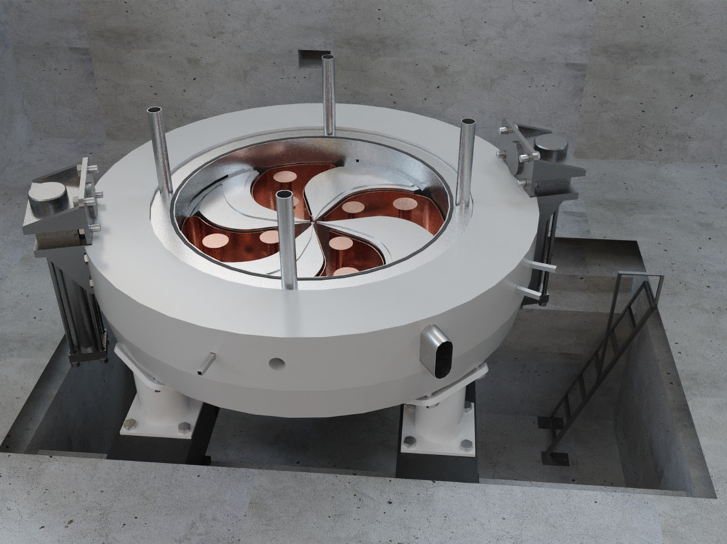
Main parameters of MSC 230
Magnet type | Compact, SC coil, warm yoke
Ion source | PIG
Final energy, MeV | 230
Pole radius, mm | 1070
Mean magn. field (center), T | 1.7
Dimensions (height×width), m | 1.7 × 3.7
Weight, tonnes | 100
Hill/Valley gap, mm | 50/700
A*Turn number | 270 000
RF frequency, MHz | 106.5
Harmonic number | 4
Number of RF cavities | 4
Voltage, center/extraction kV | 40/110
RF power, kW | 55
Number of turns | 500
Beam intensity, μA | 10
Extraction type | ESD
Low power consumption.
Reasonable size.
Minimum engineering efforts and challenges.
High quality of the beam.

Slide 8
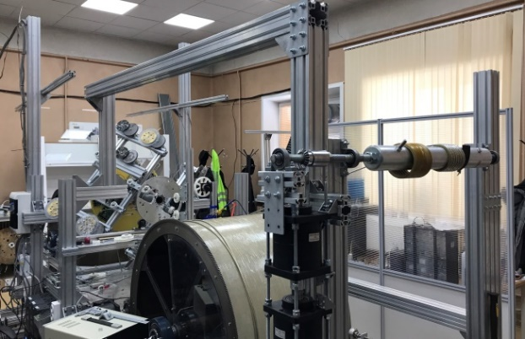
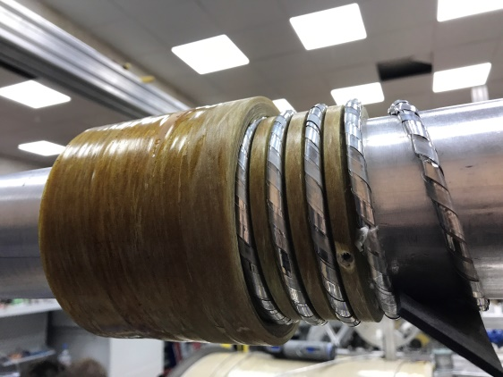
Superconducting coil for MSC230
Magnetic field in the center of the cyclotron is 1.7 T. The low magnetic field is advantageous not only for beam extraction and shimming, but also for the superconducting coil design, since the critical current is highly dependent on the magnetic field in the coil.
In the MSC230 cyclotron, NbTi can be used to produce coils; however, the design of the cyclotron allows the use of high-temperature superconducting (HTSC) materials, that have great potential. The technique developed for NICA at VBLHEP can be applied to the manufacture of MSC230 windings.
Unit for winding solenoids
Photo: Hodzhibagiyan G.G, Nikiforov D.N., Novikov M.S.
Six-turn sample

Slide 9
Current status
The development, modeling and optimization of the components of the cyclotron has been carried out. (simulations of the beam dynamics, magnet, accelerating system, etc.)
Terms of reference for the implementation of the project were formed
Agreement with NIIEFA signed
Ongoing: Coordination and preliminary design of the cryostat and the superconducting coils

Slide 10
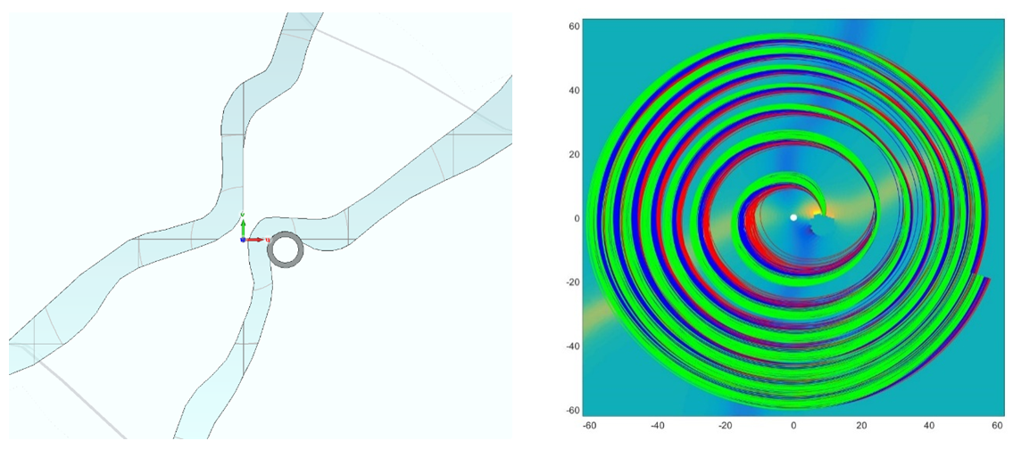
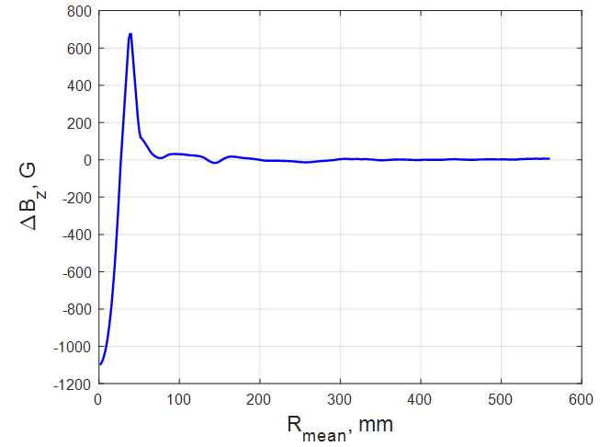
Central region of SC200
View of the dee tips and ion source position.
First turns in the cyclotron (40 RF deg).
JINR's design of the center: 350 nA internal beam achieved experimentally (400 predicted)
Challenges caused by high central magnetic field (3 T): construction of the bump makes the field in the very center lower than isochronous -> lagging particles at the beginning start to lag even more (the phase reached 60 deg)
Solved by varying the size of the gaps in the center to increase the efficiency of proton extraction from the source and at the same time avoid breakdowns

Slide 11
Central region of MSC230: tasks
Provide the possibility of forming a well-centered accelerated beam (less than 1 mm at a radius of 100 mm), consistent with the acceptance of the accelerator. Phase acceptance ± 20° RF
By selecting the position of the accelerating gaps, ensure sufficient vertical focusing by the electric field in the first and second turn
Minimize the probability of break-downs

Slide 12
Design of the structure of the central region
Two separate designs (working with the same RF system) to improve beam quality:
Axially-symmetric central region design
Optimized central region design

Slide 13
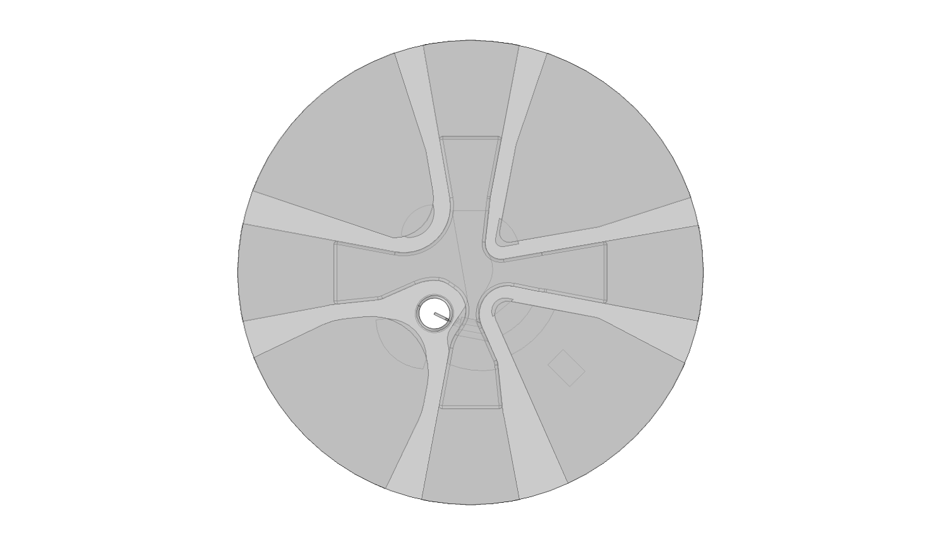
Structure of the central region: axially-symmetric
upper cross
dummy dee
dee
Ion source
diaphragm
puller

Slide 14
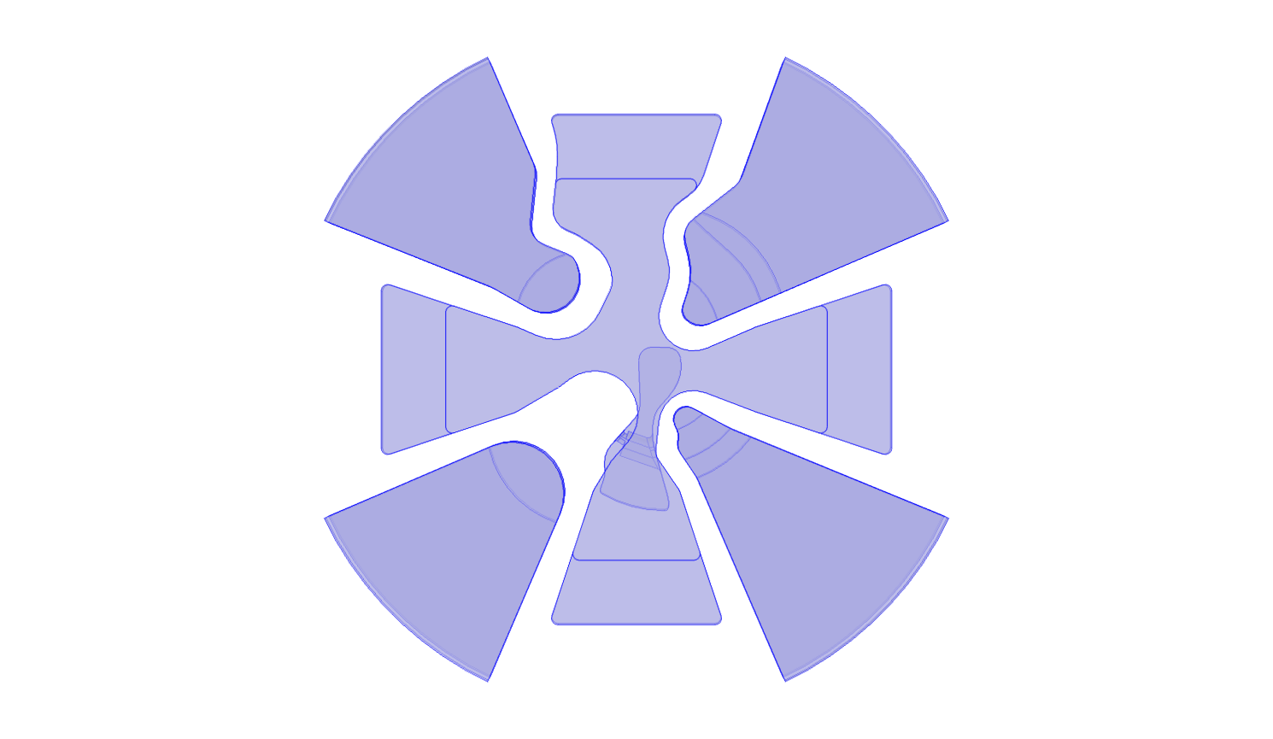
Structure of the central region: optimized

Slide 15
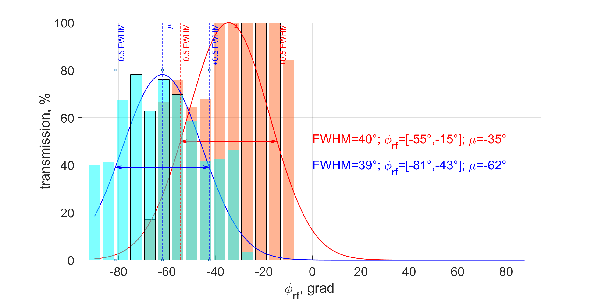

Phase acceptance – axially-symmetric/optimized center
optimized center
axially-symmetric center
Integral transmission: axially-symmetric - 19.8% /optimized - 27.7%

Slide 16
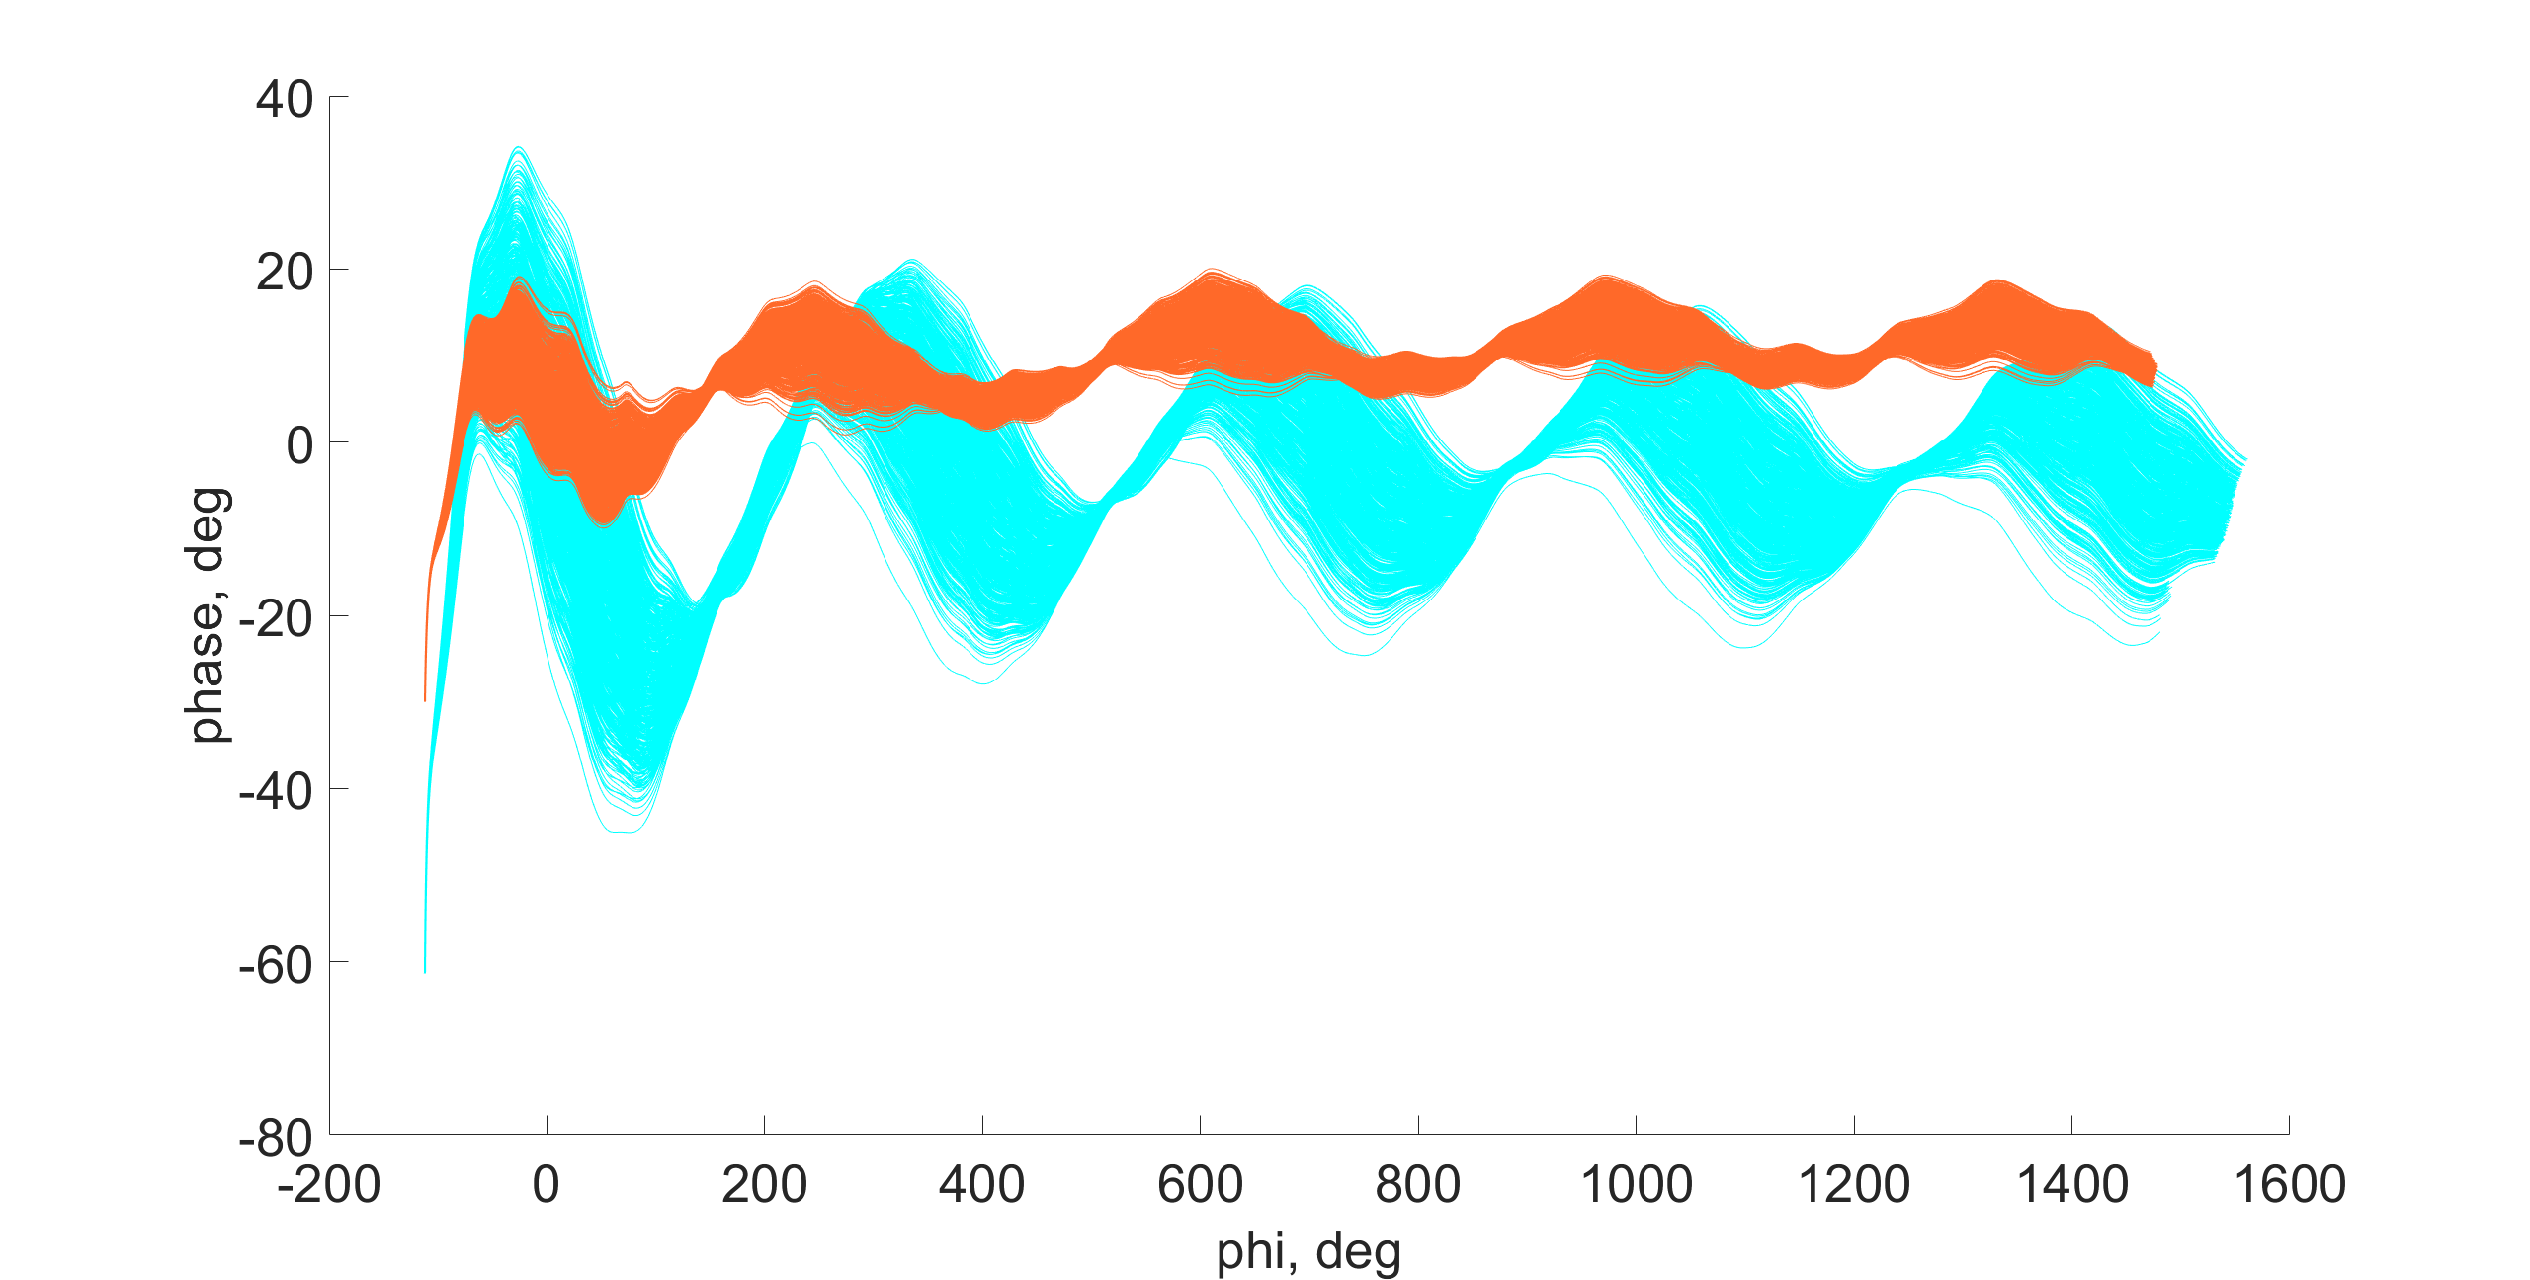
Phase shift – axially-symmetric/optimized center
optimized center
axially-symmetric center
Phase shift vs. angle. Positive phase corresponds to the lagging particle.

Slide 17
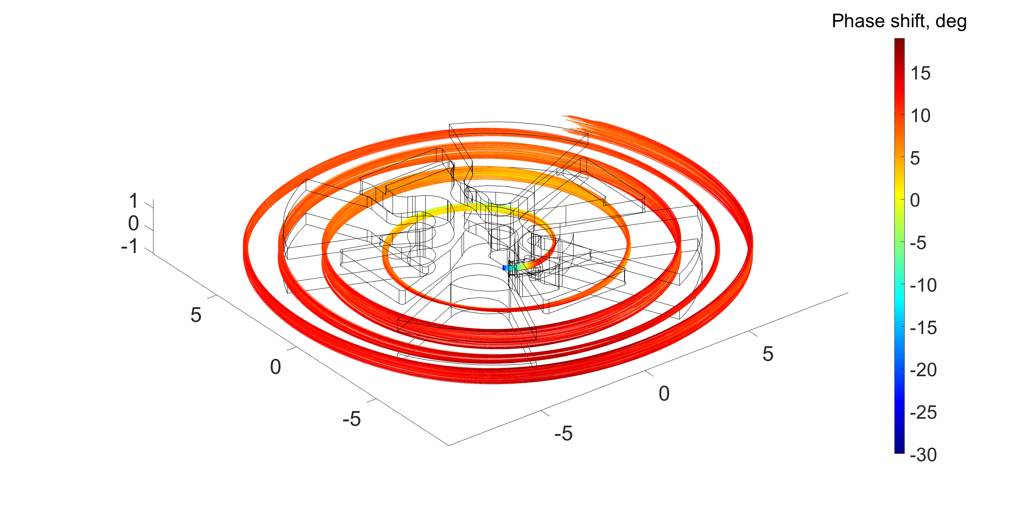
Phase shift (axially-symmetric, initial RF phase = -30 deg)

Slide 18
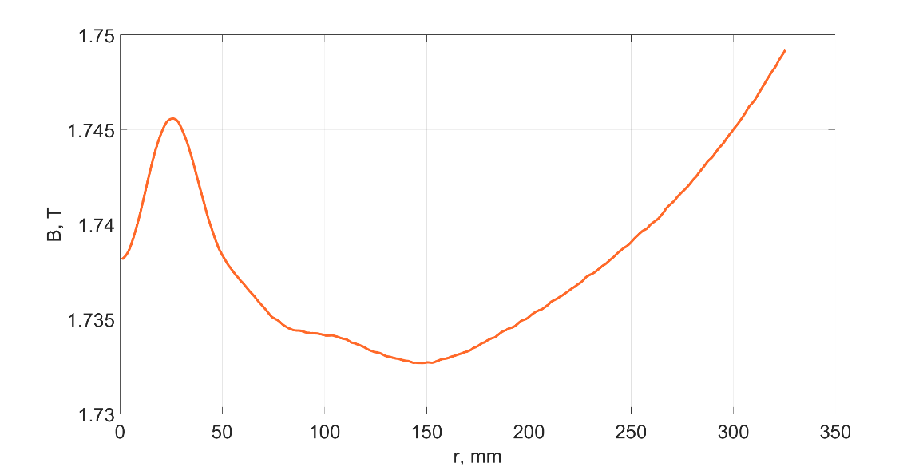
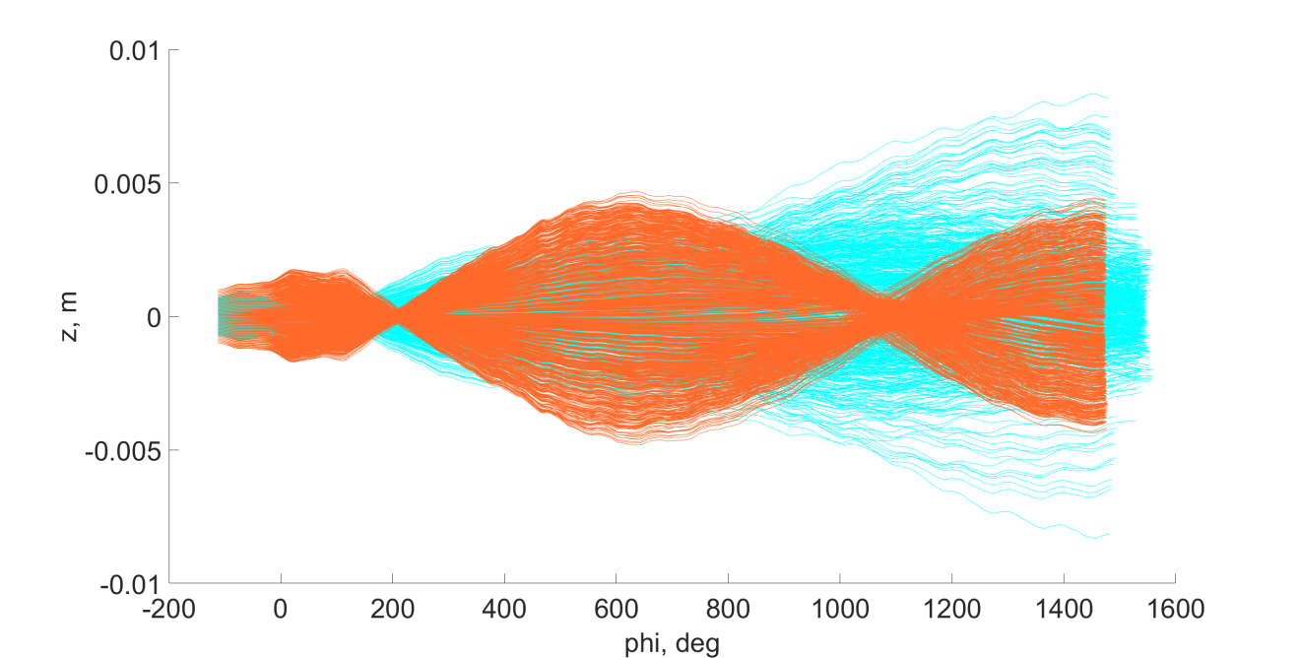
Vertical focusing
Average magnetic field along the radius
To provide vertical focusing, we create a bump (radial gradient) of the magnetic field (80-100 Gauss)
Magnetic focusing caused by the decreasing magnetic field begins after a radius R = 30 mm
For R< 30 mm: accelerating electric field provides vertical focusing of lagging particles

Slide 19
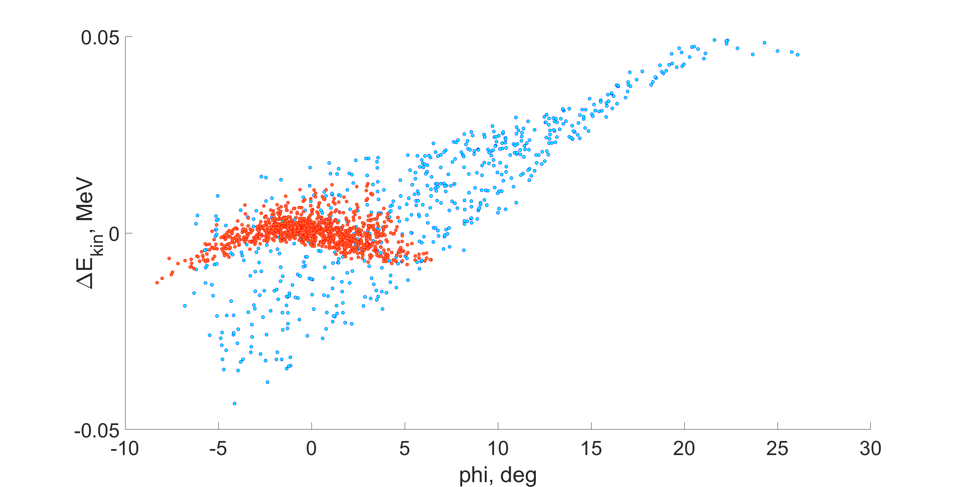
Variation in energy gain – optimized/axially-symmetric center
Variation in the kinetic energies of the particles at R=10 cm.

Slide 20
Conclusion
The goal of the project is to design and build an international biomedical innovation center at JINR, based on a superconducting proton accelerator developed at JINR, for the next purposes:
Carrying out fundamental and applied research in the field of radiation biology and medicine, first of all, the FLASH method based on the methods of conformal irradiation from the medical beam of the Medical Technical Complex (MTC DLNP).
Training and improving qualifications of specialists in the field of radiation biology and medicine.
Creating necessary conditions for the introduction of the latest technologies in the field of proton therapy of oncological diseases into clinical practice.

Slide 21
Thank you for your attention

Slide 22
Extra slides

Slide 23
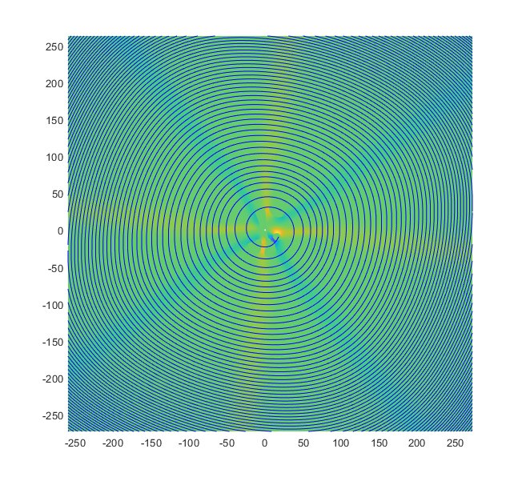
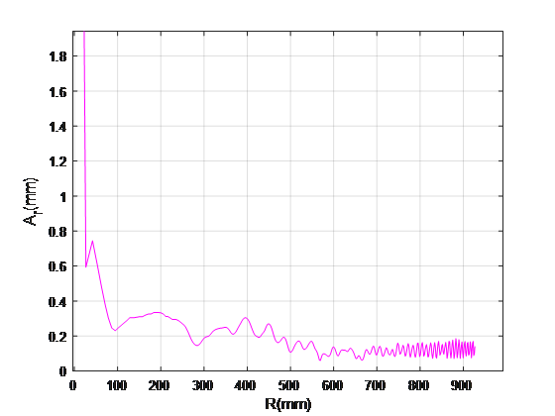
Centering
Backtracking (central particle) – optimization of the field map
Diaphragm is used to reduce the amplitude of radial radial oscillations of the beam of particles

Slide 24
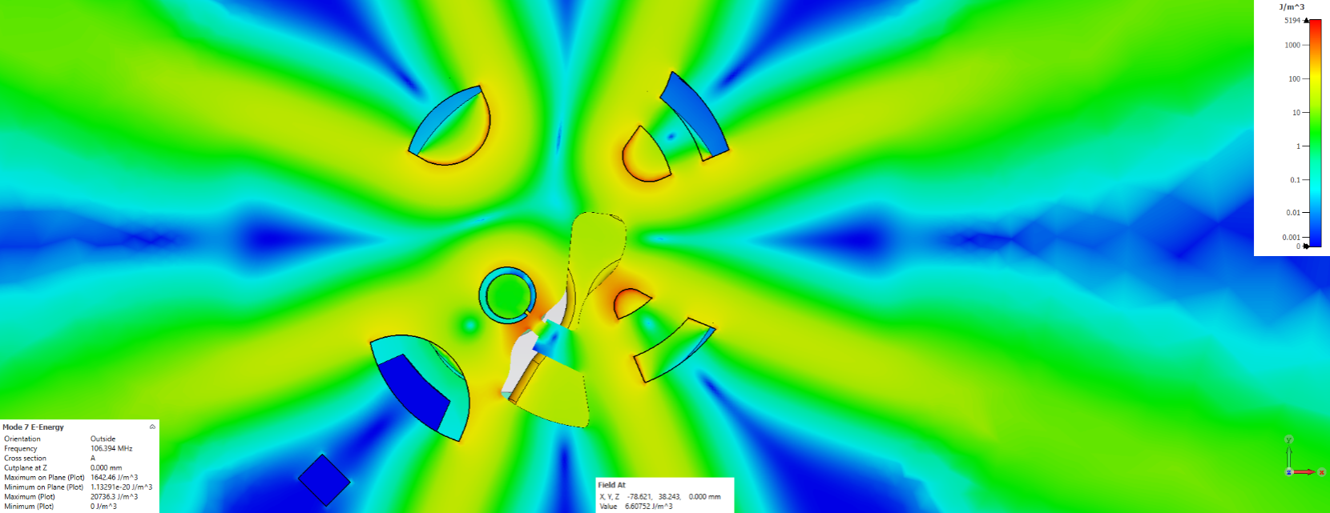
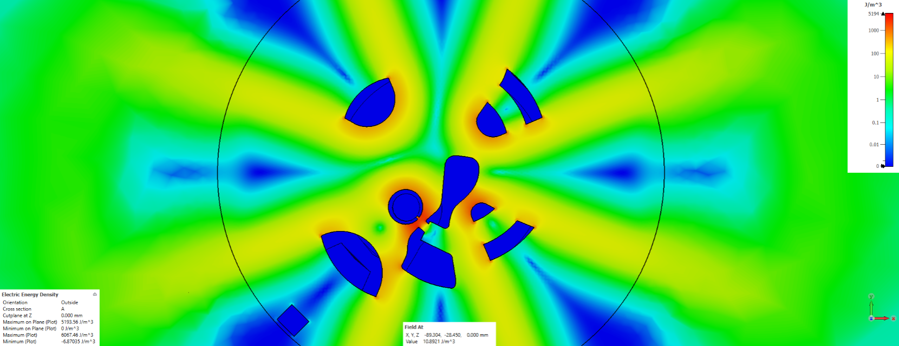
Electrostatic/RF simulation
RF simulation
The accelerating voltage across the gap of the RF cavity, calculated by integration of electric field along the particle trajectory:
electrostatic simulation
For the first gap:

Slide 25
Timetable
SCHEDULE
Month ordinal |  |  | 1 | 2 | 3 | 4 | 5 | 6 | 7 | 8 | 9 | 10 | 11 | 12 | 13 | 14 | 15 | 16 | 17 | 18 | 19 | 20 | 21 | 22 | 23 | 24 | 25 | 26 | 27 | 28 | 29 | 30 | 31 | 32 | 33 | 34 | 35 | 36
WBS No. | WBS | Months | 1st year |  |  |  |  |  |  |  |  | 2nd year |  |  |  |  |  |  |  |  |  |  |  | 3rd year
SC230 | SC230 cyclotron |  | 01 | 02 | 03 | 04 | 05 | 06 | 07 | 08 | 09 | 10 | 11 | 12 | 01 | 02 | 03 | 04 | 05 | 06 | 07 | 08 | 09 | 10 | 11 | 12 | 01 | 02 | 03 | 04 | 05 | 06 | 07 | 08 | 09 | 10 | 11 | 12
SC230.0 | Kick-off | 0
SC230.1 | Final physical design | 0
SC230.2 | Final engineering design | 6
SC230.3 | Magnet System | 23
SC230.3.1 | Cryostat/Coil | 17
SC230.3.2 | Steel/sectors | 18
SC230.3.3 | Lifting | 8
SC230.3.4 | Bz mapper | 8
SC230.3.5 | Shimming | 6
SC230.4 | Ion Source | 10
SC230.5 | RF system | 14
SC230.6 | Beam extraction system | 10
SC230.7 | Radial Probe | 10
SC230.8 | Control System | 12
SC230.9 | Auxiliary System | 10
SC230.10 | Integration Assembly | 4
SC230.11 | Beam Commissiong | 9
The very preliminary timetable

Slide 26
Reducing the probability of break-downs
Accelerating voltage is the central region – 30-40 kV;
RF system operates at 106.5 MHz;
Kilpatrick criterion: maximum value of the intensity Es = 120 kV/cm;
In the direction, perpendicular to the magnetic field lines, the magnetic field prevents electrical break-down -> the electric field strength can be 1.5 higher than the Kilpatrick limit;
Therefore, gap width is 2 mm (can be increased to 2.5 mm by moving the puller);
Corner rounding is necessary to reduce the values of local electric fields.

