Slide 1
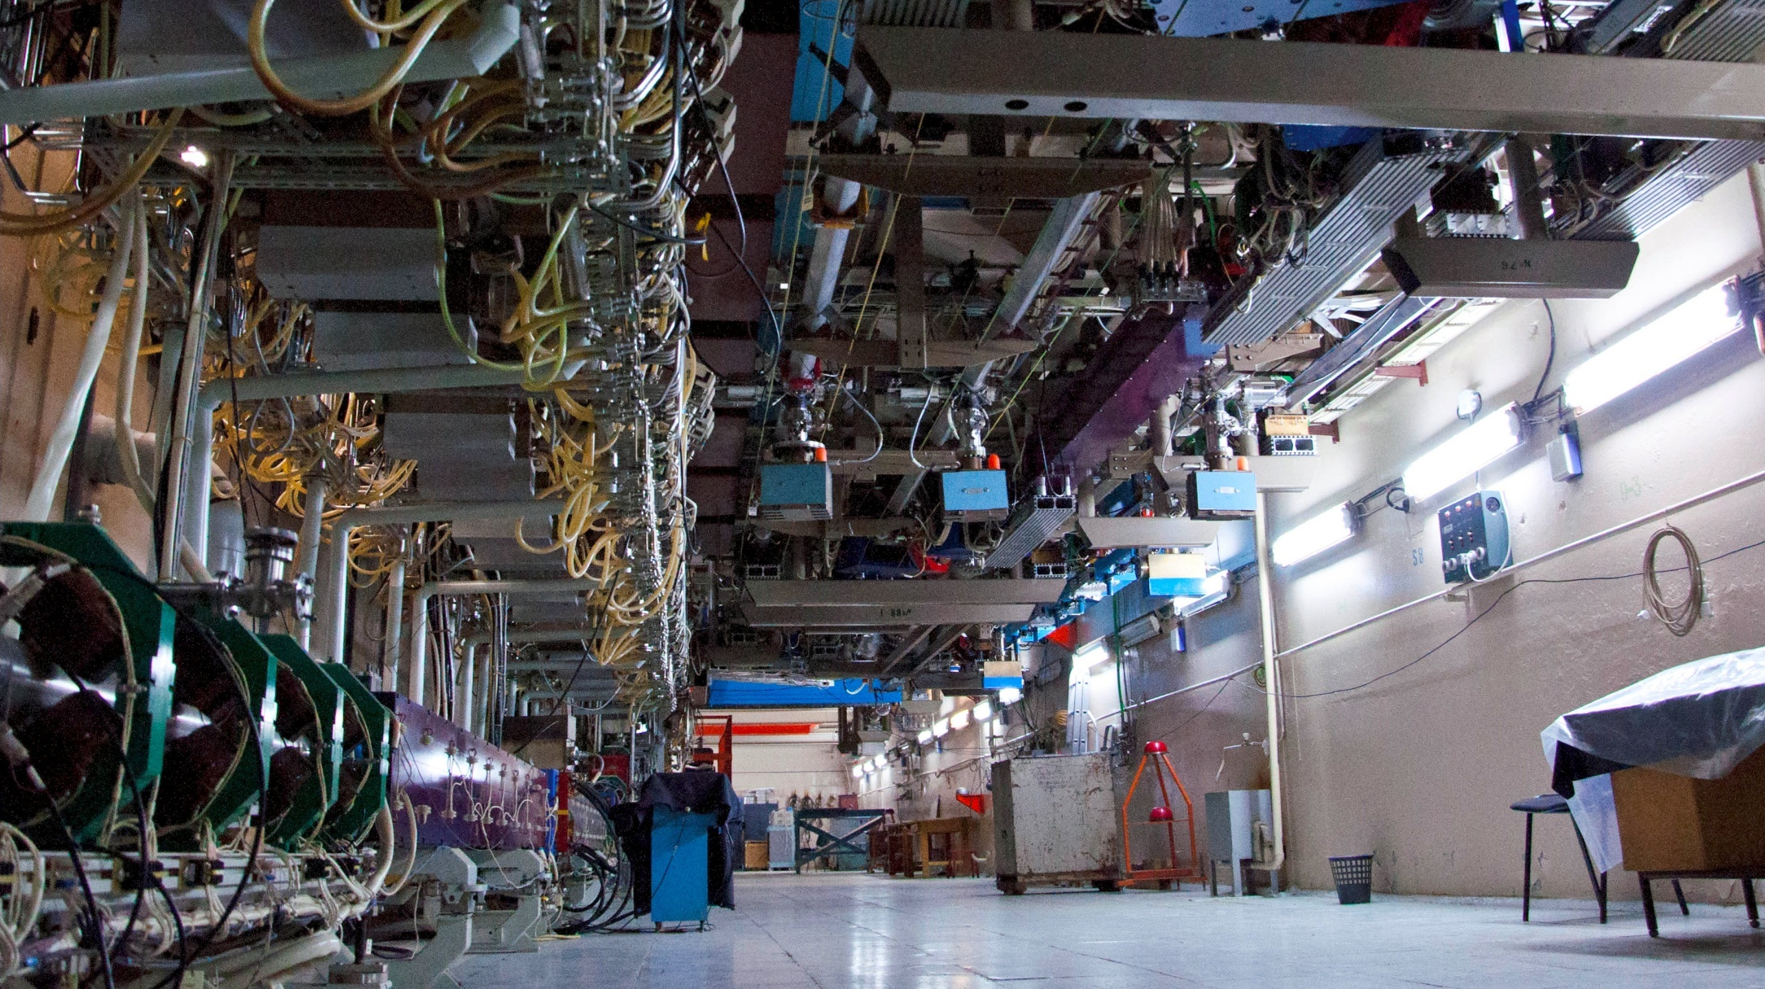
Experiments on the short x-ray pulse generation at the NovoFEL facility
presented by
Getmanov Yaroslav
& Borin V, Ma X, Maltseva Y,
Meshkov O, Shevchenko O, Vinokurov N
Budker INP
XIV МЕЖДУНАРОДНЫЙ СЕМИНАР
ПО ПРОБЛЕМАМ УСКОРИТЕЛЕЙ ЗАРЯЖЕННЫХ ЧАСТИЦ
∙ Крым, Россия, Sept 20-25 2022 ∙

Slide 2

Content
1. Introduction
2. Novosibirsk FEL facility
3. Energy Recovery Linacs
4. Layout of the experiment
4. Bremsstrahlung from a thin foil
5. Optimization of the used beam transport
6. The beam parameter measurements
7. Results
8. Conclusion
2
XIV Международный Семинар по Проблемам Ускорителей Заряженных Частиц, 20-25 Сент. 2022, Крым, Россия

Slide 3
What for?
An r. m. s. bunch duration at the fourth track of the ERL of the Novosibirsk FEL facility could be less than 10 picoseconds. Installing graphite foil, one can obtain the source of picosecond x-ray pulses with high (few MHz) repetition rate.
All other contemporary x-ray sources (storage rings, x-ray tubes, laser wake-field accelerators, x-ray FELs, etc.) have no such capability.
Sources of picosecond bremsstrahlung x-ray pulses could be an interesting application for low-energy (few tens of MeV) ERLs.
3
XIV Международный Семинар по Проблемам Ускорителей Заряженных Частиц, 20-25 Сент. 2022, Крым, Россия

Slide 4
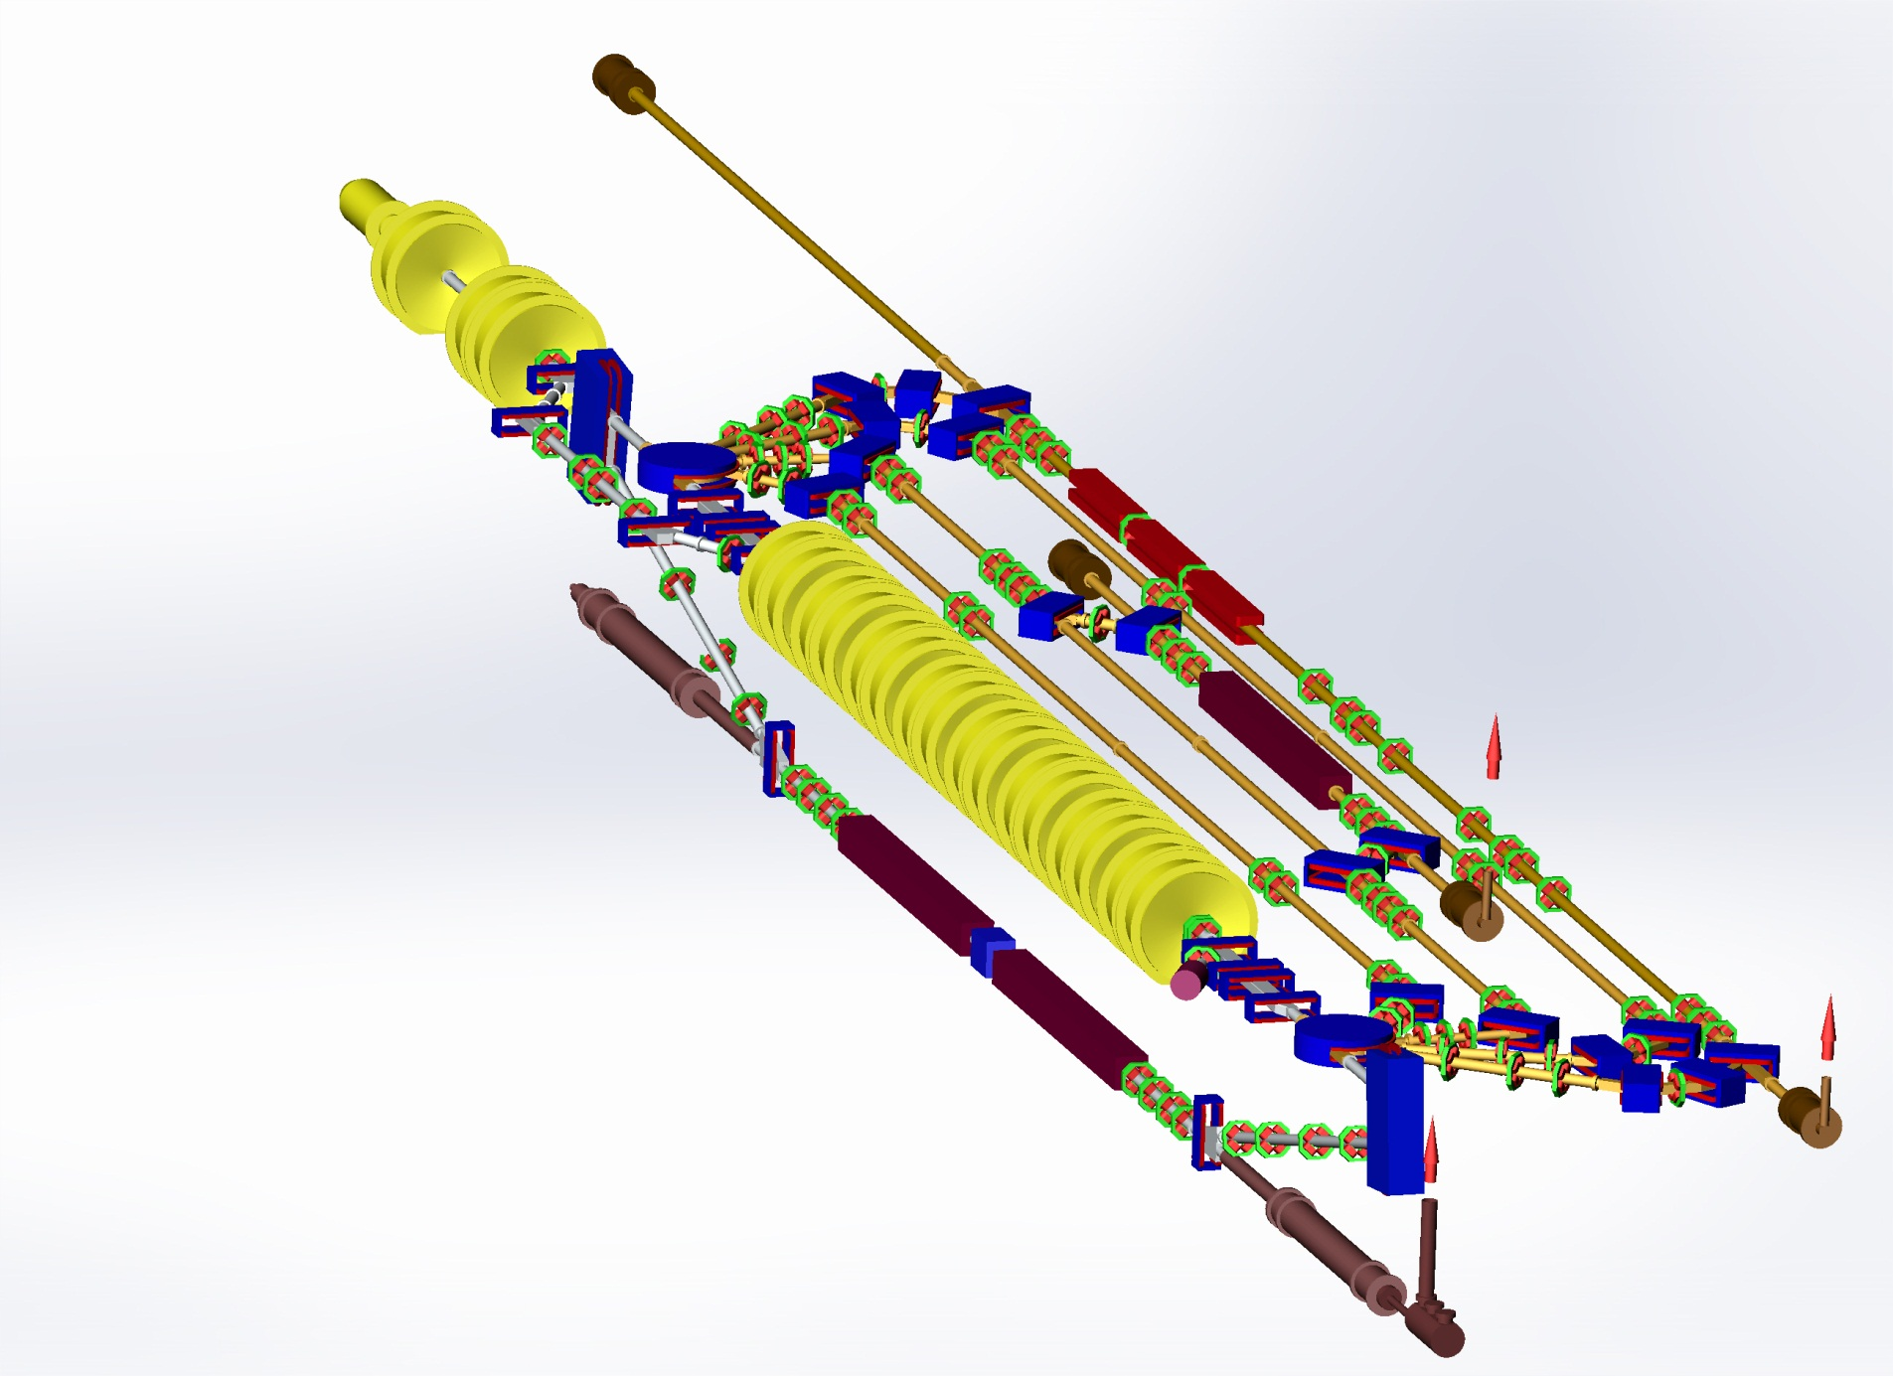
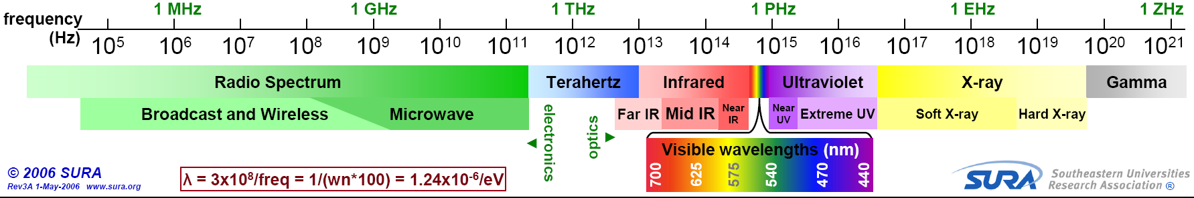
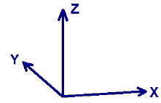
NovoFEL Accelerator Design
NovoFEL
Gun
The third IR FEL
undulator sections
The second FEL
undulator
Injector
The most attractive ranges for FELs are at very short and at very long wavelength, where there are no other lasers
Three FELs working in terahertz and far infrared regions
The most powerful source of coherent terahertz radiation
The first in the world multi-turn Energy Recovery Linac
The world record beam average current for ERLs
Main linac
The first THz FEL
undulator sections
Dump
4
XIV Международный Семинар по Проблемам Ускорителей Заряженных Частиц, 20-25 Сент. 2022, Крым, Россия

Slide 5
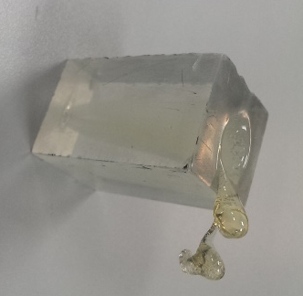
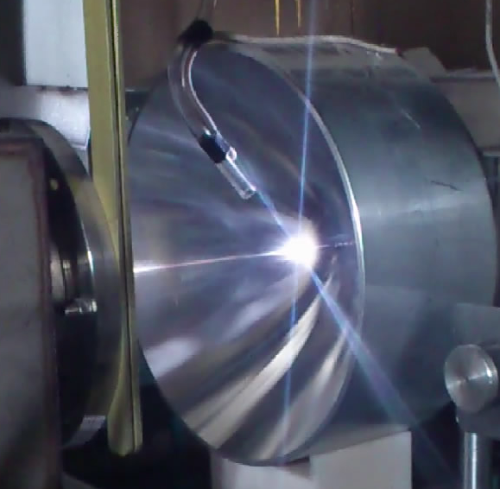
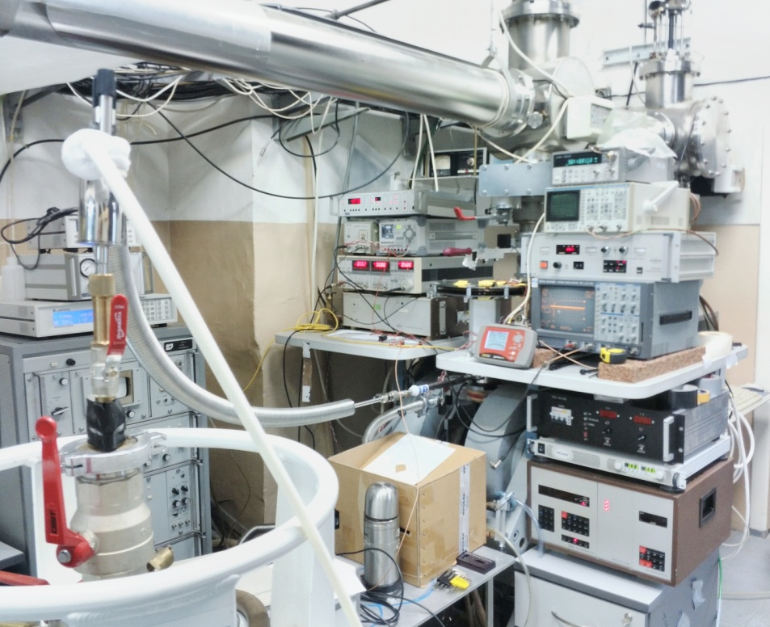
NovoFEL Parameters
FEL | 1 | 2 | 3
Energy, MeV | 12 | 22 | 42
Av. current, mA | 30 | 10 | 3
Wavelength, mkm | 90-240 | 37-80 | 8-11
Max. Av. Power, kW | 0.5 | 0.5 | 0.1
Electron efficiency кпд, % | 0.6 | 0.3 | 0.2
Bunch frequency, MHz | 5.64 | 7.52 | 3.76
Bunch duration, ps | 100 | 50 | 10
Accelerator tracks | 1 | 2 | 4
Launched | 2003 | 2009 | 2015
plexiglass
optical discharge
EPR station
5
XIV Международный Семинар по Проблемам Ускорителей Заряженных Частиц, 20-25 Сент. 2022, Крым, Россия

Slide 6
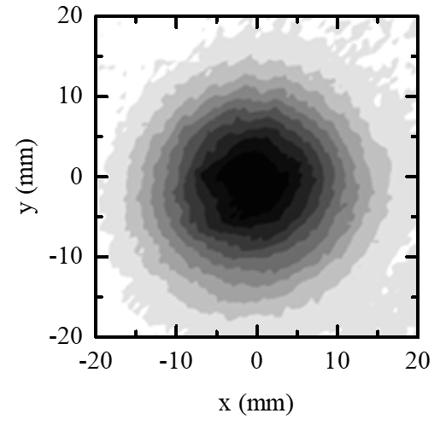
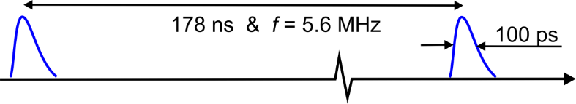
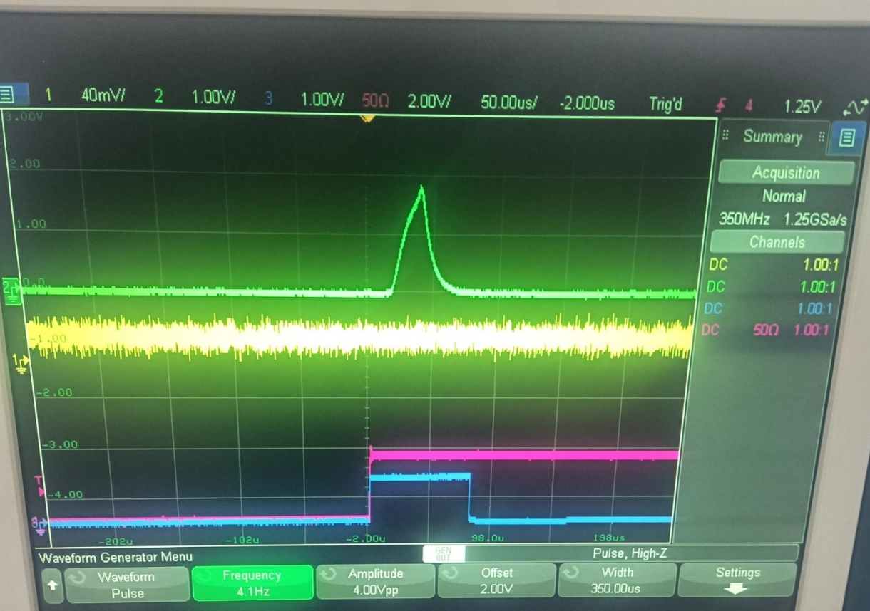
NovoFEL Radiation
radiation structure of the 1st FEL
beam image at station
Radiation with and without electron modulation
macropulse of radiation
6
XIV Международный Семинар по Проблемам Ускорителей Заряженных Частиц, 20-25 Сент. 2022, Крым, Россия

Slide 7
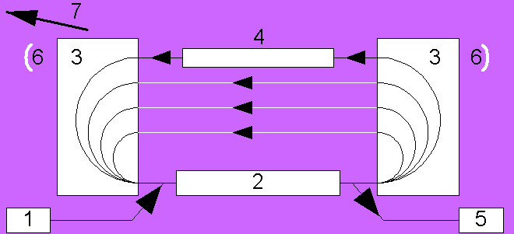
Energy Recovery Linear Accelerator
1 – injector, 2 – linac, 3 – bending magnets, 4 – undulator, 5 –dump
Accelerator is the most important part of
the high power radiation source
7
XIV Международный Семинар по Проблемам Ускорителей Заряженных Частиц, 20-25 Сент. 2022, Крым, Россия

Slide 8
Energy Recovery Linear Accelerator
1 – injector, 2 – linac, 3 – bending magnets, 4 – undulator, 5 –dump
Energy recovery
decreases radiation hazard and
makes possible operation at high average current.
8
XIV Международный Семинар по Проблемам Ускорителей Заряженных Частиц, 20-25 Сент. 2022, Крым, Россия

Slide 9
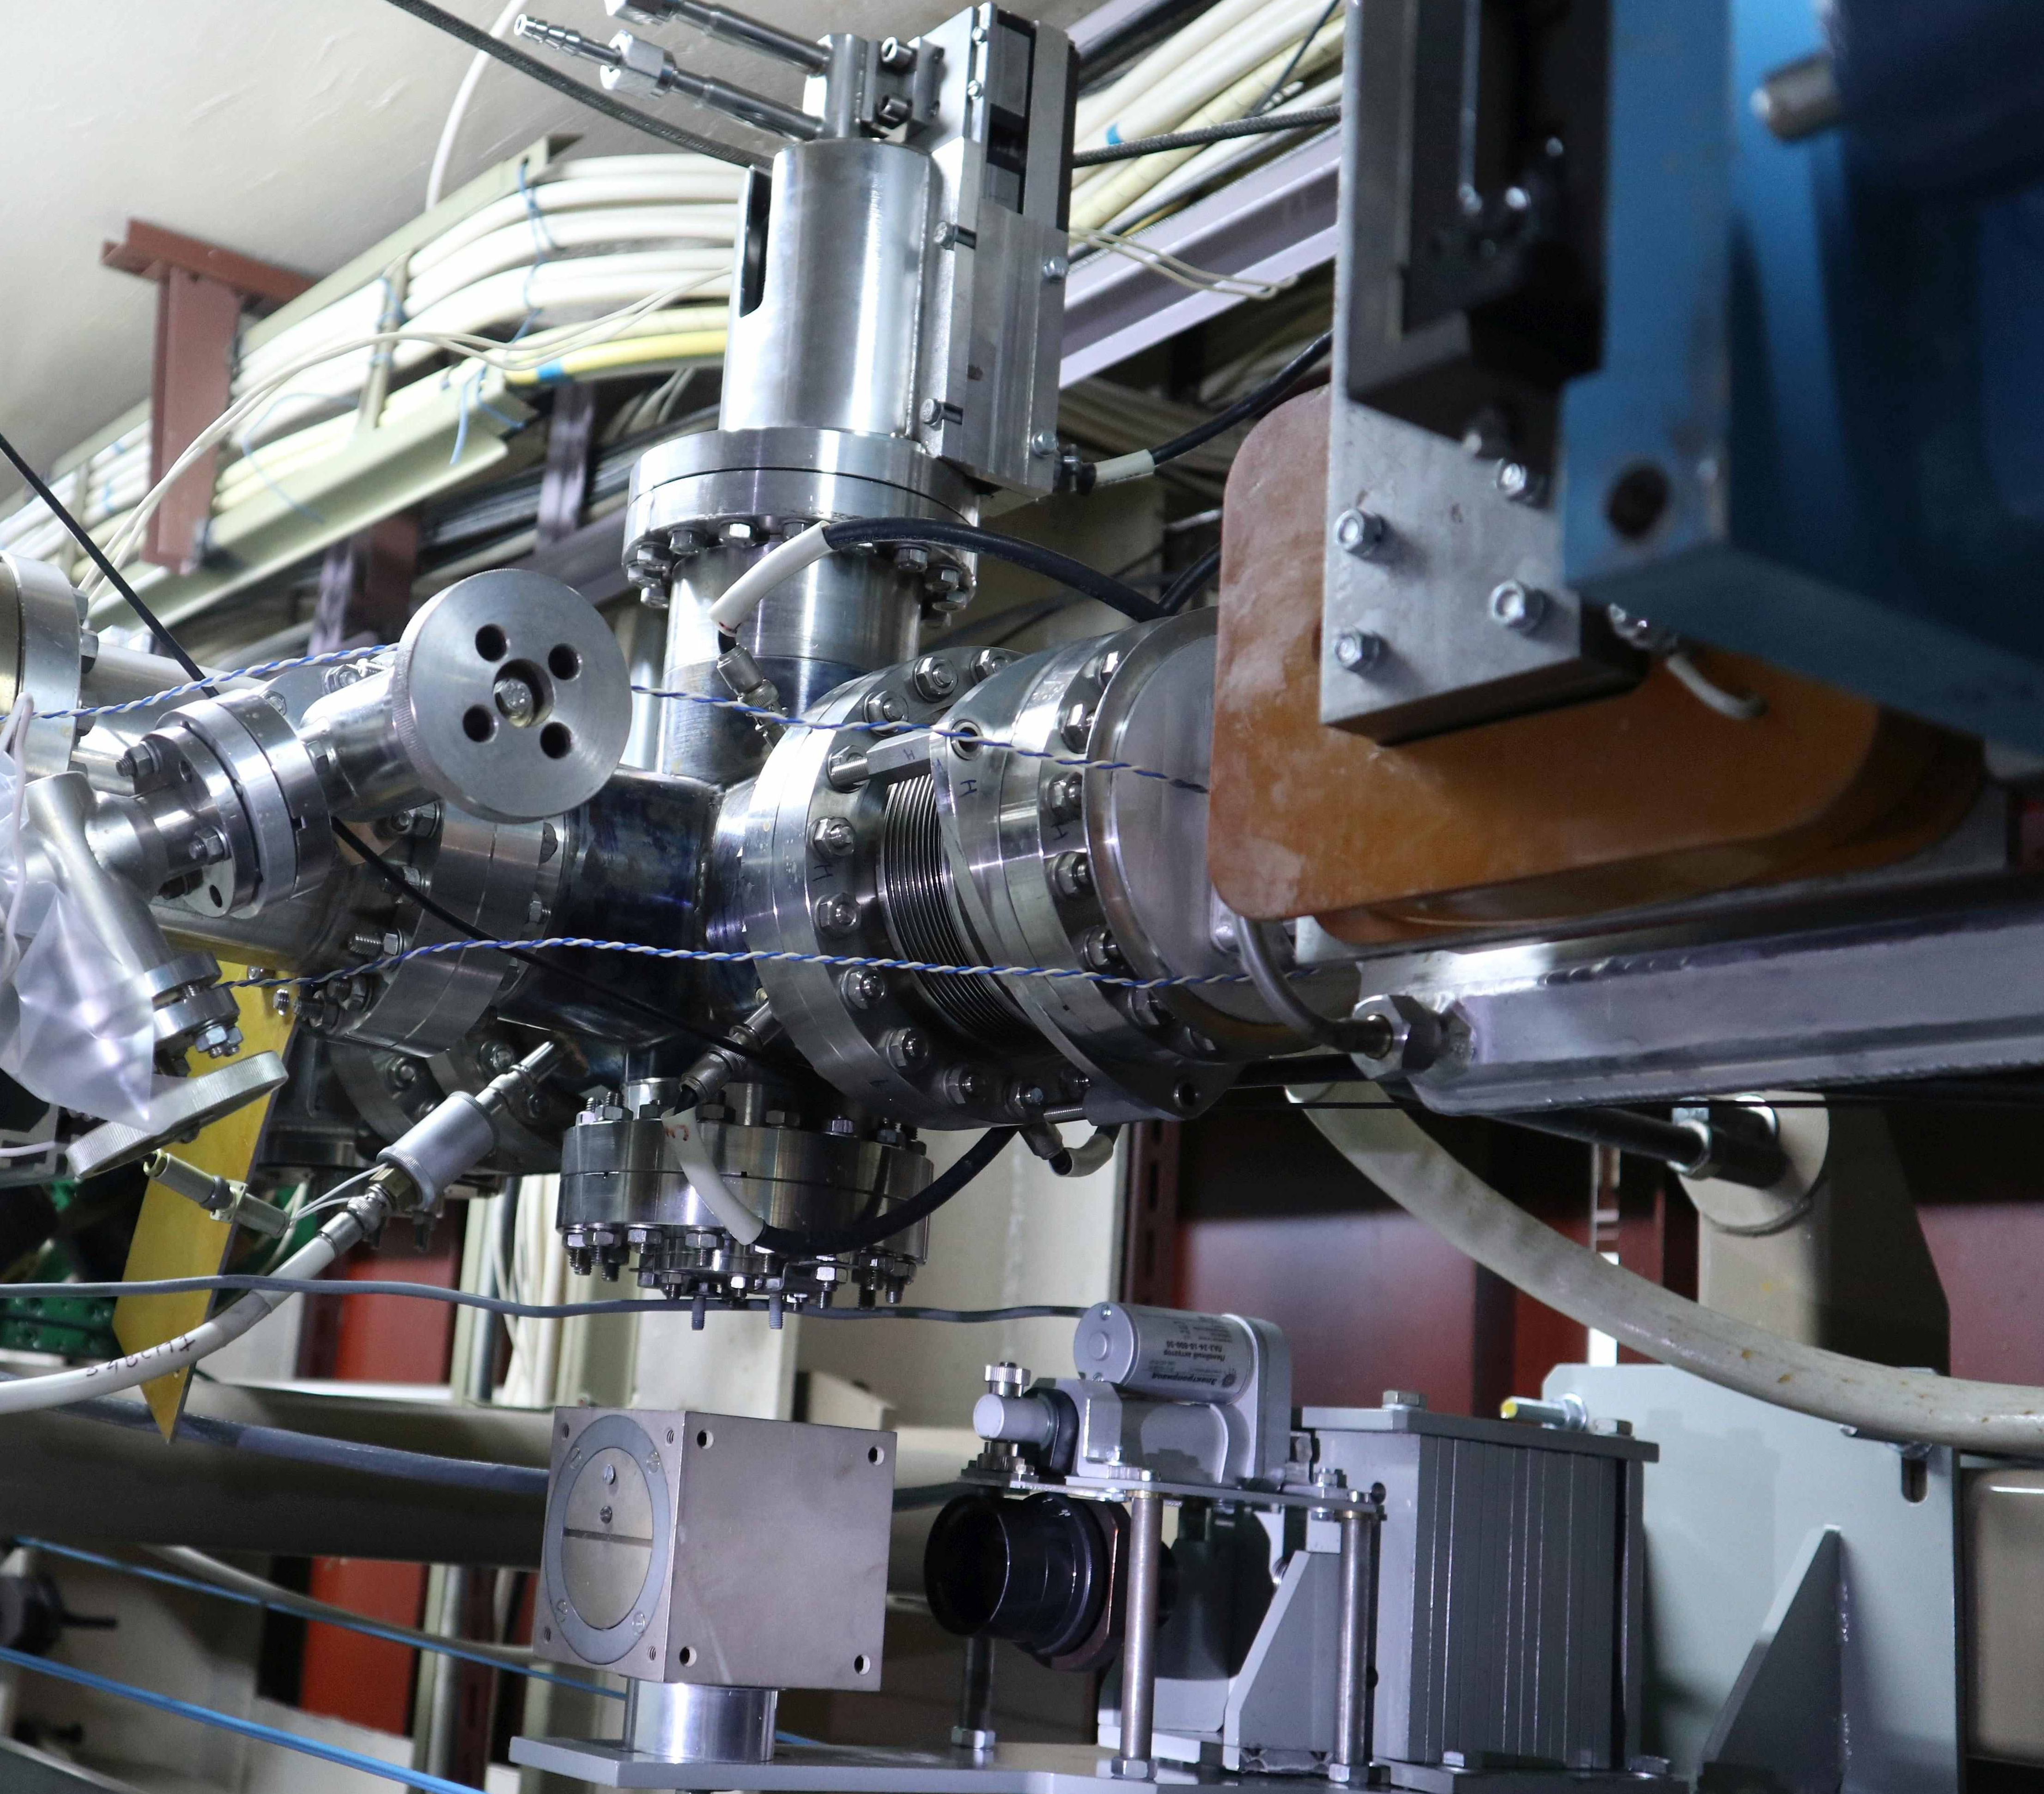
Four-Pass NovoFEL Energy Recovery Linear Accelerator
Parameters | 3rd
Energy, MeV | 38-42
Avg. current, mA | 3
Beam freq, MHz | 3.76
Bunch Charge, nC | 0.5-1
Bunch length, ps (estimation) | 10
Norm. Emittance Hor., mm*mrad (measured) | 80
Norm. Emittance Ver., mm*mrad (measured) | 30
PEA
area of generation
foil input
undulator
bremsstrahlung
electron bunch
ФЭУ
thin foil
diagnostic
9
XIV Международный Семинар по Проблемам Ускорителей Заряженных Частиц, 20-25 Сент. 2022, Крым, Россия

Slide 10
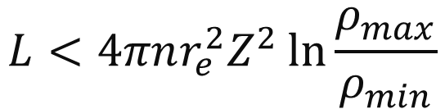
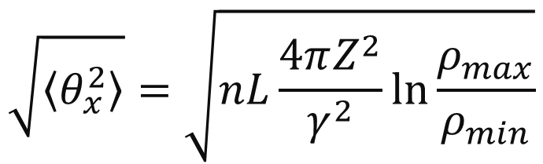
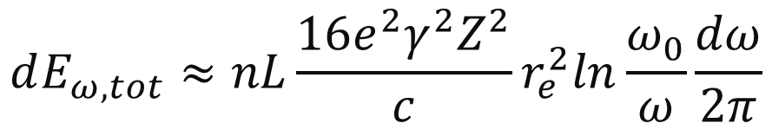
Low-frequency bremsstrahlung from a thin foil
The low-frequency ( ) intensity of radiation from the length L is
$$dE_{ω,tot}≈nL\frac{16e^{2}γ^{2}Z^{2}}{c}r_{e}^{2}ln\frac{ω_{0}}{ω}\frac{dω}{2π}$$
where n is the density of atoms, a is atomic radius, γ, e and r_{e} are Lorentz factor, electric charge and classical radius of electron, Z is atomic number.
This expression is valid if the corresponding r. m. s. multiple-scattering angle
$$\sqrt{\left\langle θ_{x}^{2}\right\rangle }=\sqrt{nL\frac{4πZ^{2}}{γ^{2}}\ln{\frac{ρ_{max}}{ρ_{min}}}}$$
does not exceed the angular divergence of radiation, which is about 1/ γ, or
$$L<4πnr_{e}^{2}Z^{2}\ln{\frac{ρ_{max}}{ρ_{min}}}$$
10
XIV Международный Семинар по Проблемам Ускорителей Заряженных Частиц, 20-25 Сент. 2022, Крым, Россия

Slide 11
The NovoFEL advantages and comparison with others sources
As already mentioned, the bremsstrahlung on the foil makes it possible to obtain 10 ps radiation pulses with a frequency of several MHz. The photon flux can be estimated as 10¹⁰/pulse. Moreover, the frequency can be smoothly adjusted (the maximum achieved FEL lasing bunch frequency is 22 MHz at the one-pass ERL).
For comparison:
at the SASE FEL (record peak brightness) pulse frequency is about 10Hz– 10kHz with pulse duration 0.1 ps, photon/pulse 10¹²;
at the storage rings frequency is about 100 MHz and pulse duration 40-100 ps;
with femtoslicing technique the pulse duration is about 0.1 ps with frequency 1-2 kHz and photon flux 10³/pulse.
In addition, those experiments do not require the installation of additional radiation output channels, since X-rays freely exit the vacuum chamber. And does not limit the other experiments at the facility, as the foil is easily removed from the orbit of the electron beam.
The main problem is a beam transport after scattering.
11
XIV Международный Семинар по Проблемам Ускорителей Заряженных Частиц, 20-25 Сент. 2022, Крым, Россия

Slide 12



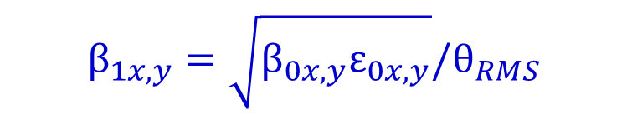

Beam parameters after the foil
target
E=38.8 MeV
The main problem of radiation sources based on ERL is a beam transport after generation
electron bunch
bremsstrahlung
20 m
3x1x1 mm
$$1/γ$$
ФЭУ
At the FEL lasing the main beam losses arise due to an increase in the energy spread by an order of magnitude due to microbunching.
3 MHz
thin foil
25μm
In the case of bremsstrahlung, the losses increase due to an angular spread and emittance grows of the beam after foil.
R. m. s. multiple-scattering angle
$$θ_{RMS}≈4∙{10}^{−3}$$
The beam transverse sizes does not change.
There are two options of foil input.
Emittance
$$ε_{1x,y}=σ_{x,y}θ_{RMS}$$
Twiss parameters after foil
$$β_{1x,y}=\sqrt{β_{0x,y}ε_{0x,y}}/θ_{RMS}$$
$$α_{1x,y}=0$$
The difference is in the geometry of the apertures and the distance to the lenses
12
XIV Международный Семинар по Проблемам Ускорителей Заряженных Частиц, 20-25 Сент. 2022, Крым, Россия

Slide 13
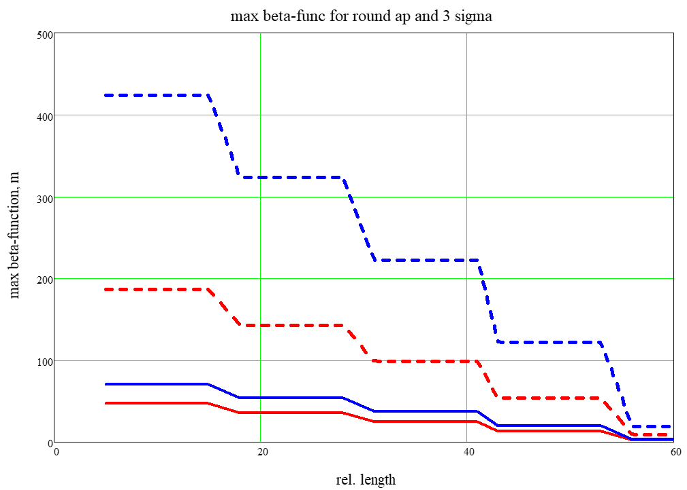

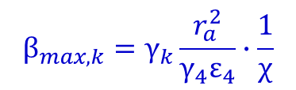
Electron beam propagation
The reason for the beam loss at bremsstrahlung differs from it of FEL lasing. Therefore, probably, the electron-optical structure should be reconfigured. To do this, it is useful to recalculate the regime and use it as initial conditions for tune.
To set the boundary conditions for the beta-functions, it is necessary to estimate the admissible beam losses.
At the FEL laing the maximum beam losses is 10–15%. Assuming the losses are uniform distributed over the tracks and equality of the loss powers at the tracks, the distribution of losses is 1.5, 2, 3, 5.5)% at the deceleration. It determines the fraction of the beam that must be passed through the system.
The beam emittance depends on how strongly the beam can be focused on the foil and on the angular divergence determined by the thickness and composition of the foil.
$$ε_{4x,y}=σ_{x,y}θ_{RMS}$$
$$β_{max,k}=γ_{k}\frac{r_{a}^{2}}{γ_{4}ε_{4}}∙\frac{1}{χ}$$
free
There are two options of foil input:
The first is in front of the undulators with rather narrow vertical aperture. But a camera is installed in this place and the beam size can be observed and adjusted.
The Second is after undulators, but without diagnostic and beam parameters can be only estimated.
vert
foil
hor
13
XIV Международный Семинар по Проблемам Ускорителей Заряженных Частиц, 20-25 Сент. 2022, Крым, Россия

Slide 14
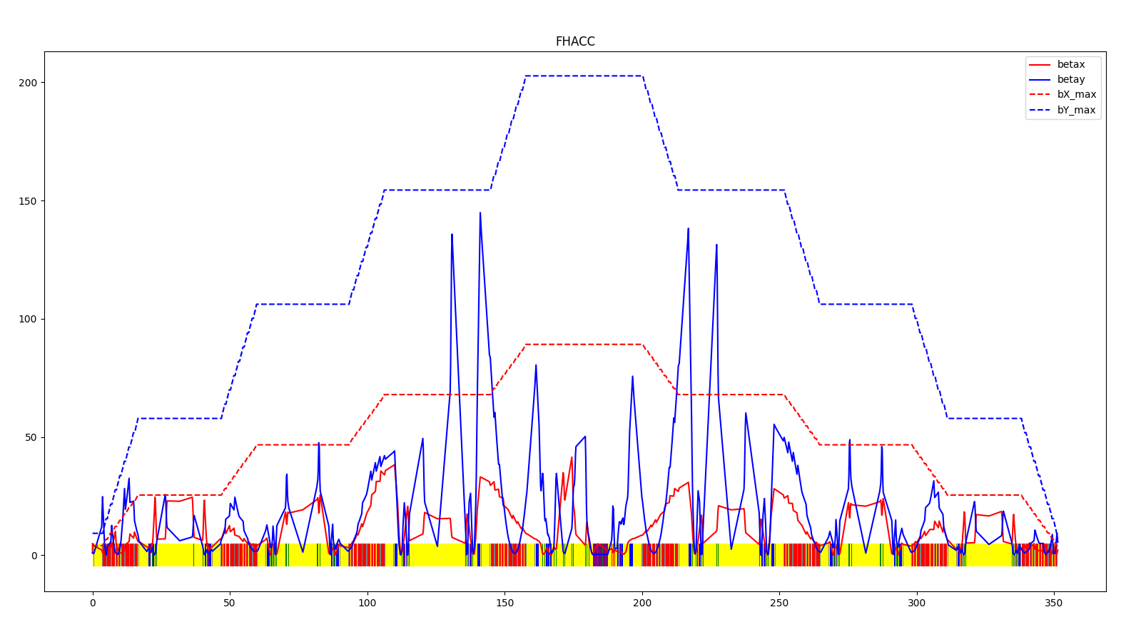
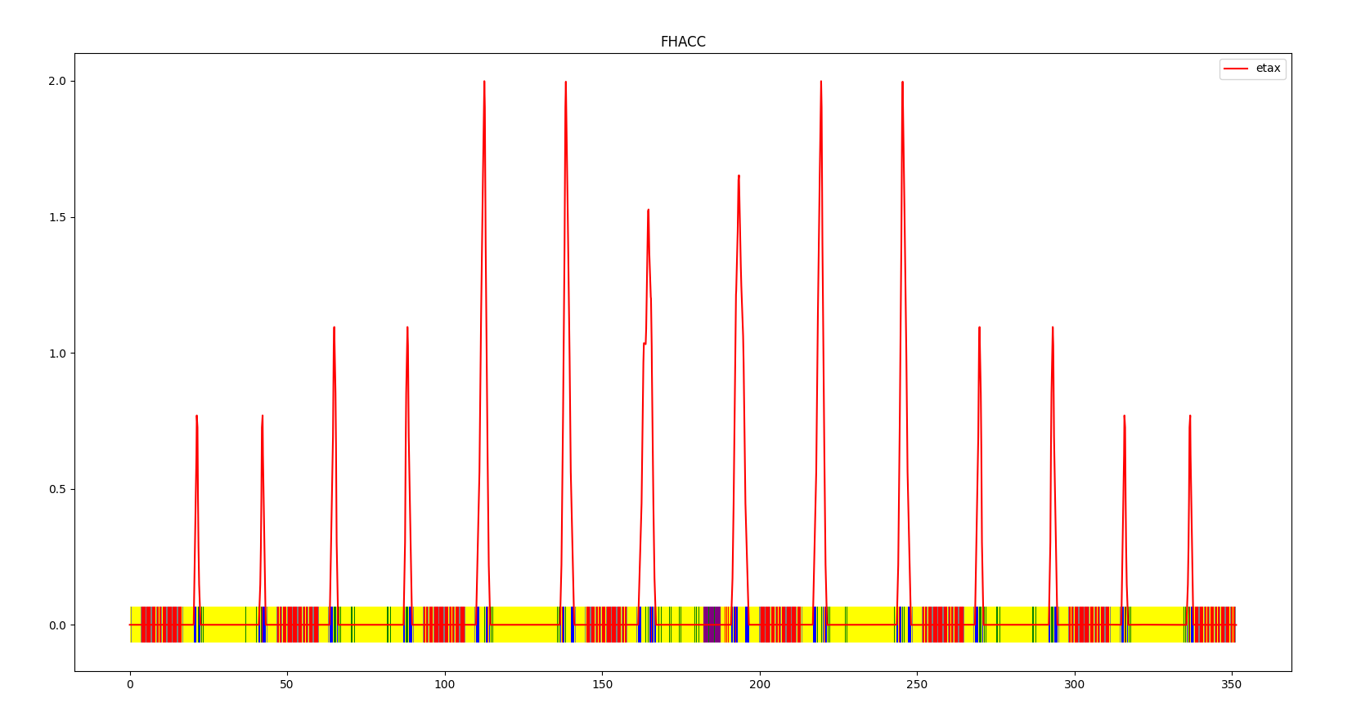
Electron optic optimization
example of the beam transport in ordinary mode
lattice parameters
conditions
Energy changes form 2 to 40 MeV
80 quadrupole lenses
8 bends with 16 dipoles
4 accelerating and decelerating RF sections
Total orbit length is about 350 m
Common optics at the intermediate tracks
Achromatic bends
Symmetric quad lenses
Symmetrical lattice functions at the input and output of the 4th track
Minimum emittance at the foil
14
XIV Международный Семинар по Проблемам Ускорителей Заряженных Частиц, 20-25 Сент. 2022, Крым, Россия

Slide 15
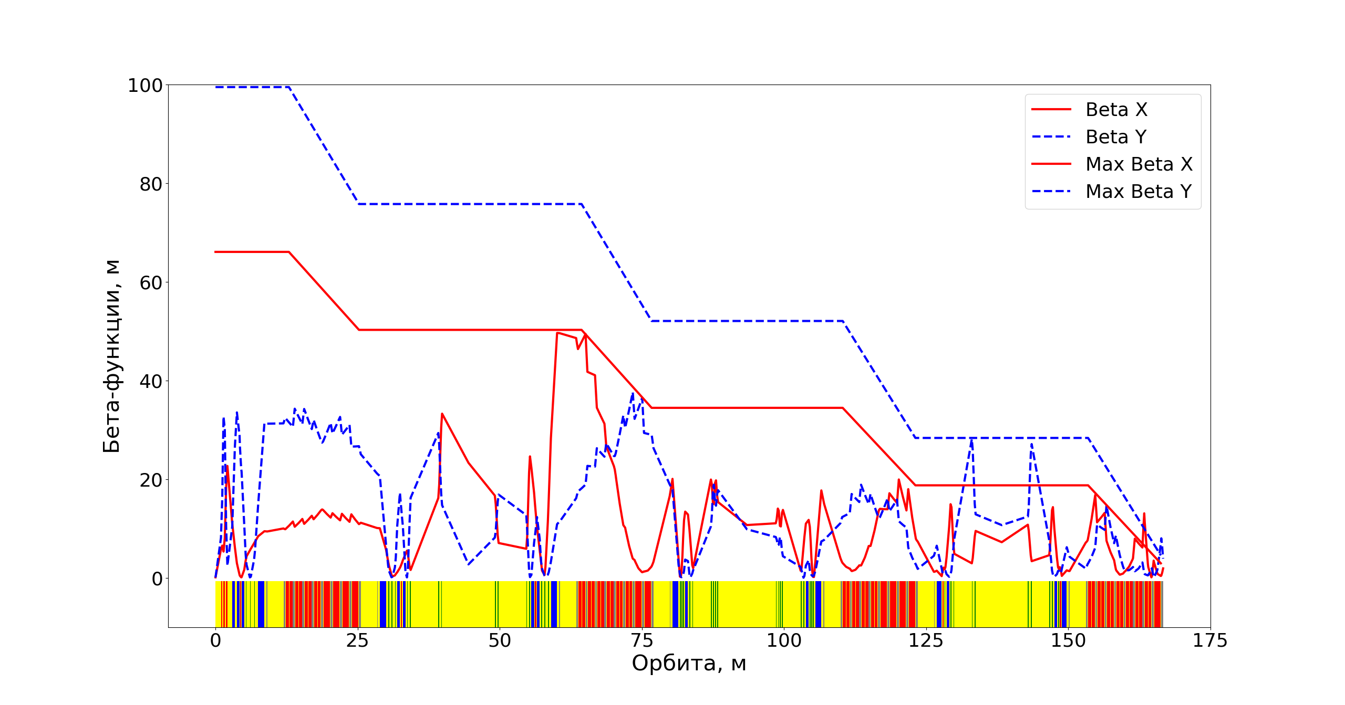

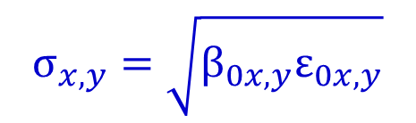
Foil Regimes
beam transport after the foil-5
the main problem – optic matching after bend
$$σ_{x,y}=\sqrt{β_{0x,y}ε_{0x,y}}$$
smaller beam size at the foil is required
$$ε_{1x,y}=σ_{x,y}θ_{RMS}$$
full deceleration
15
XIV Международный Семинар по Проблемам Ускорителей Заряженных Частиц, 20-25 Сент. 2022, Крым, Россия

Slide 16
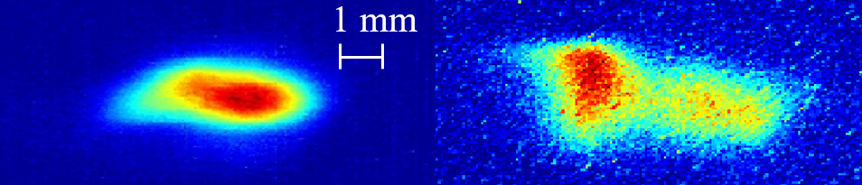
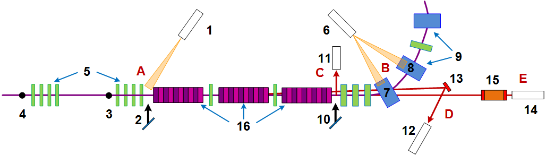
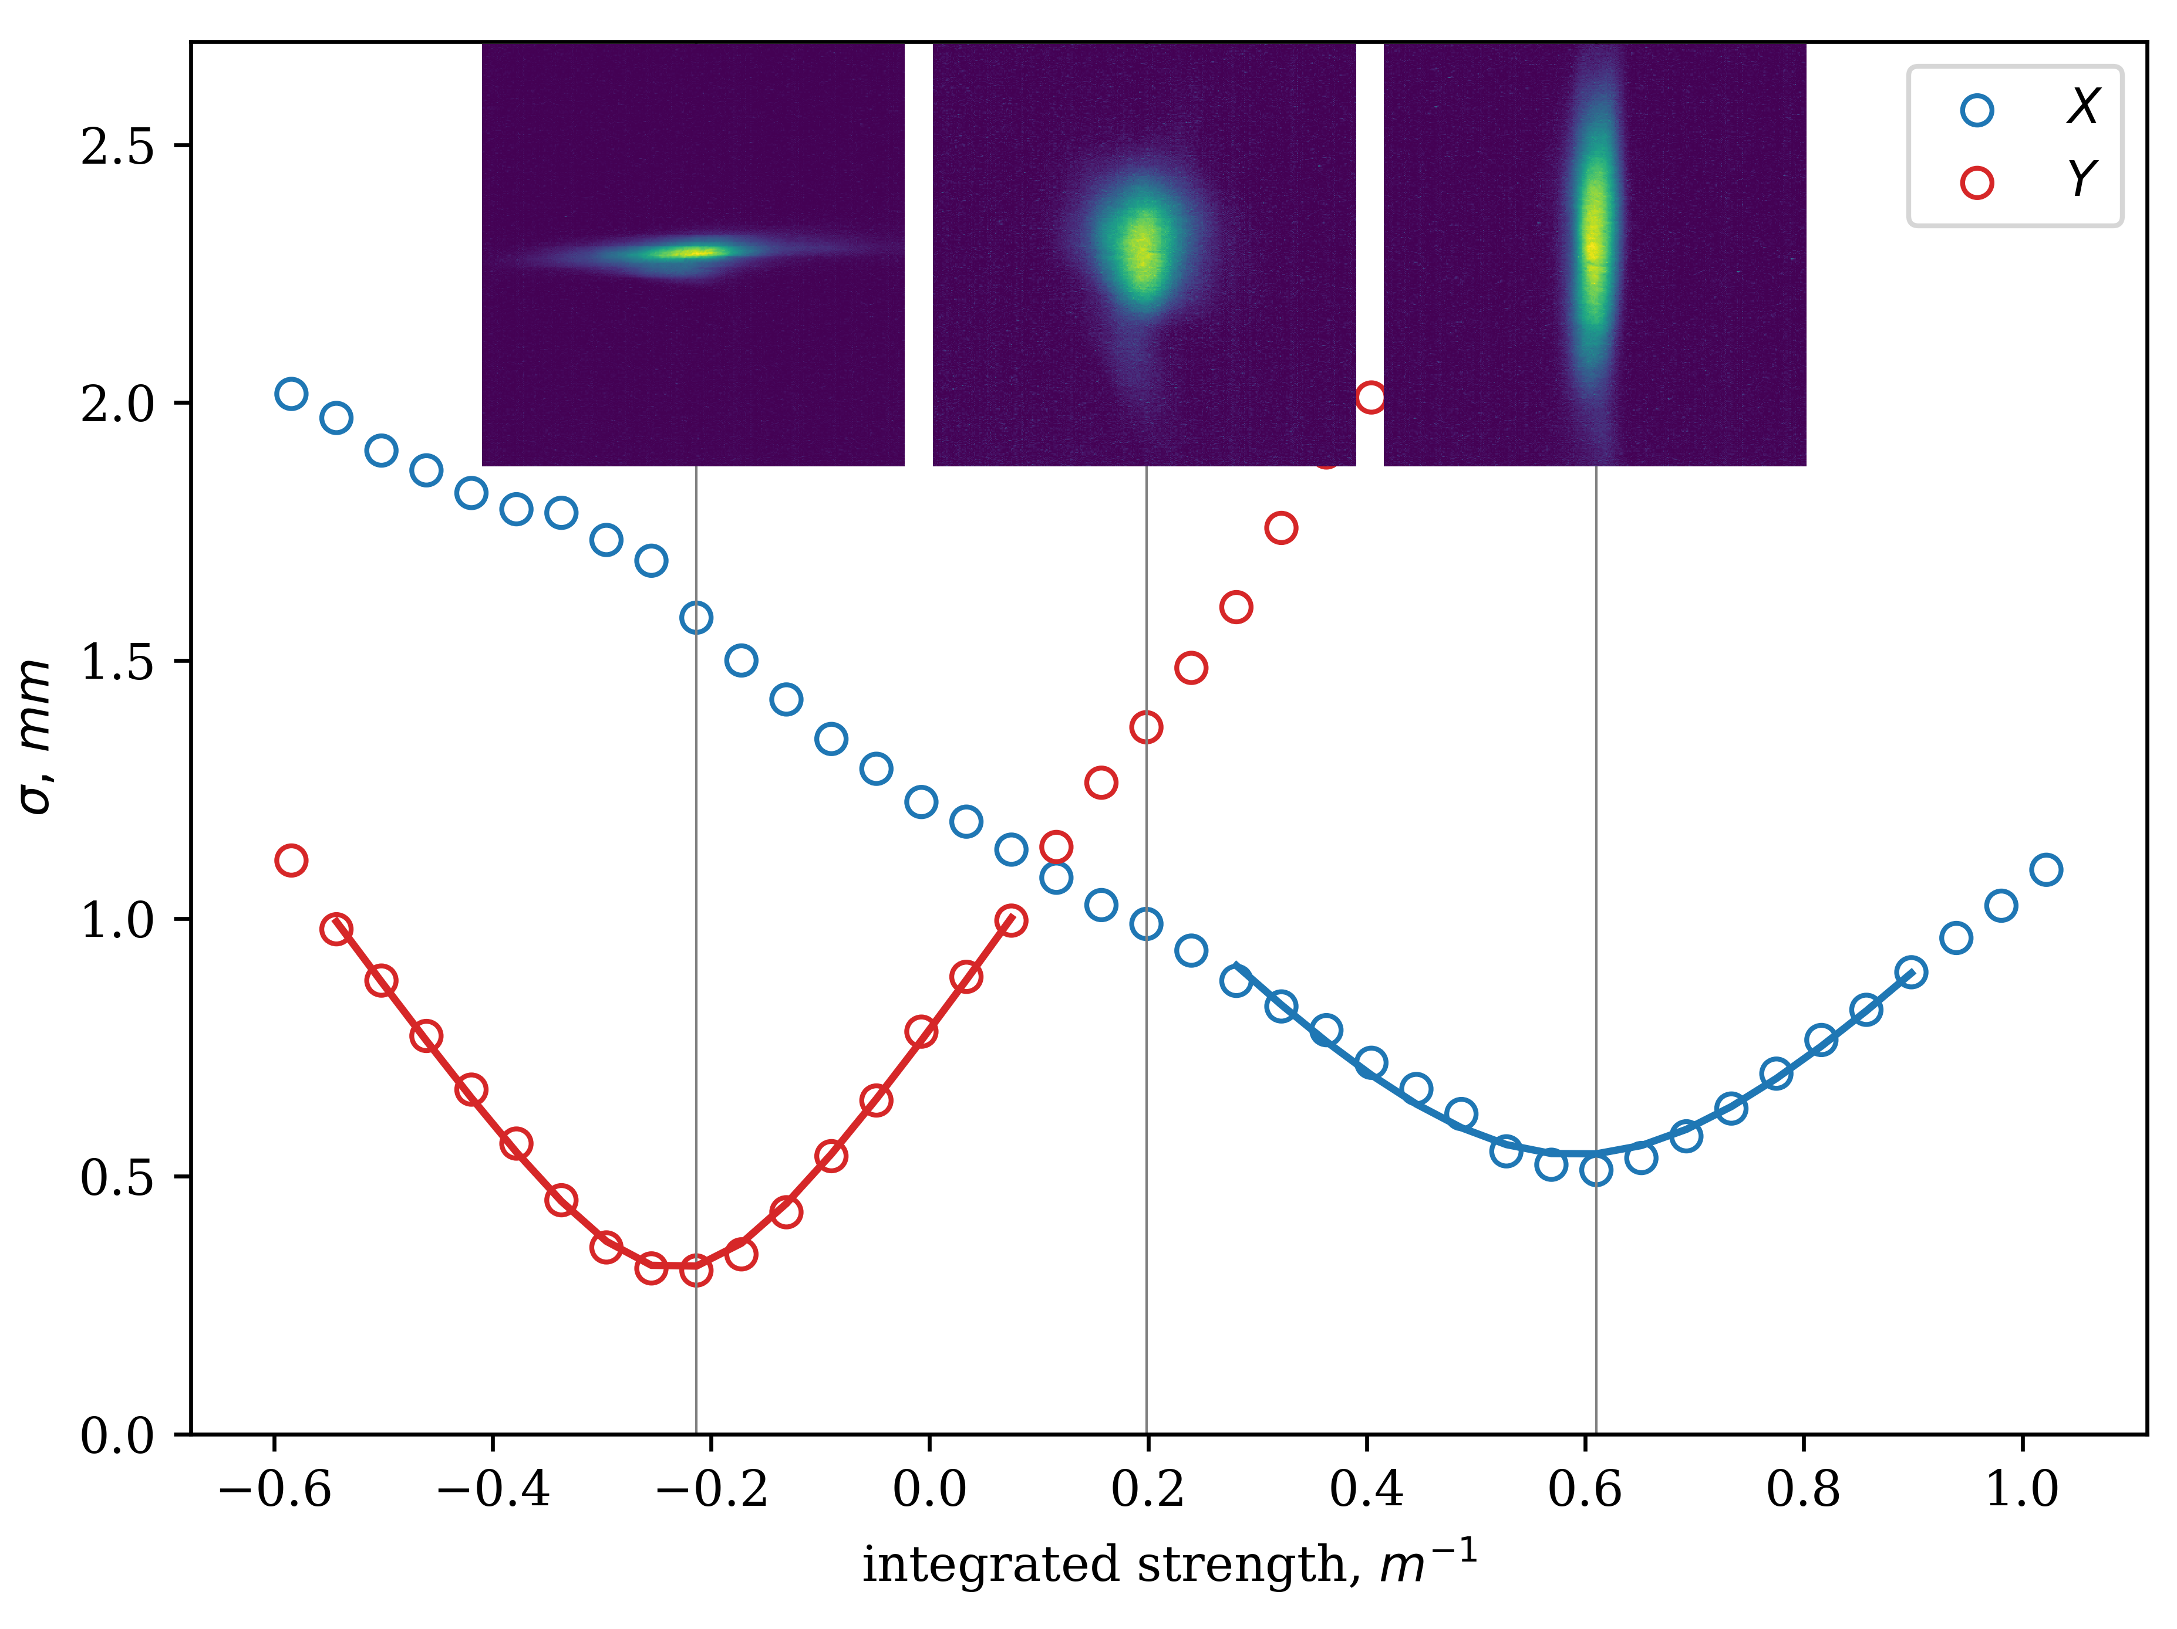
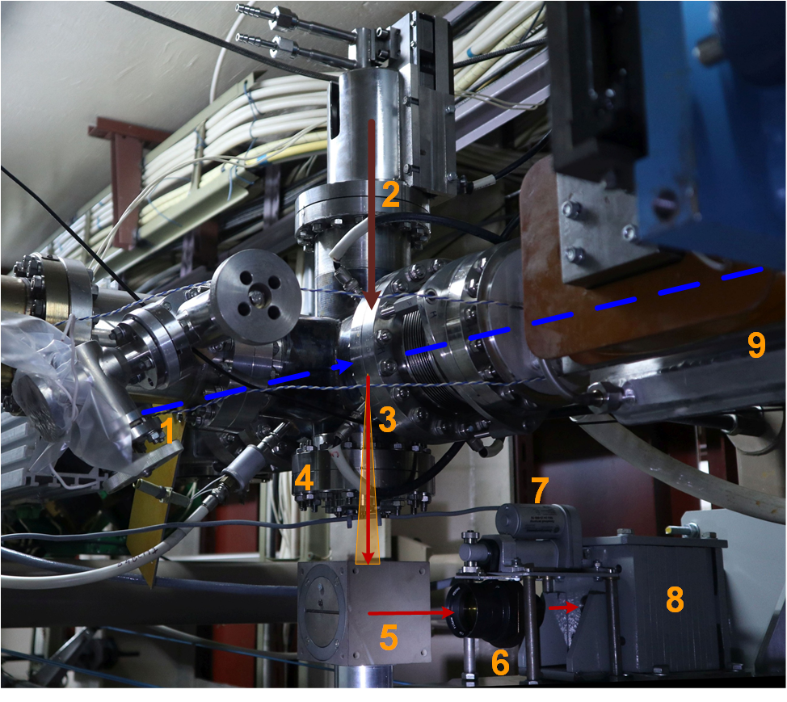
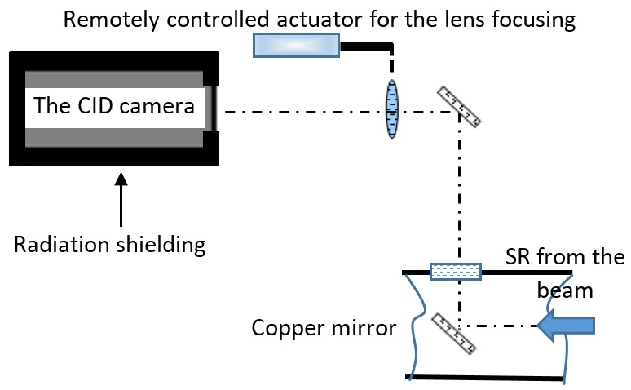
Beam parameters diagnostic system
bunch before FEL lasing
bunch after FEL lasing
emittance measurement
optical diagnostic of the bean sizes
scheme
16
XIV Международный Семинар по Проблемам Ускорителей Заряженных Частиц, 20-25 Сент. 2022, Крым, Россия

Slide 17
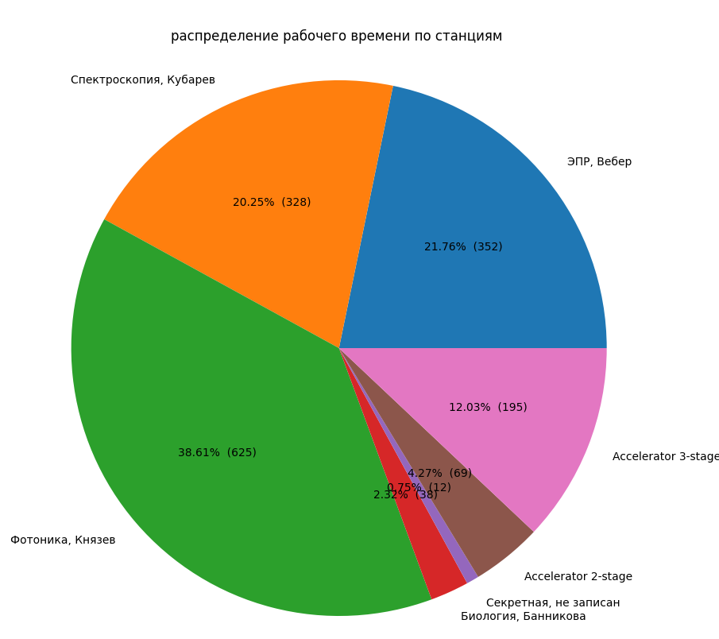
Experiments at the NovoFEL facility
Spectroscopy
(20.25%, 328 h)
Posters:
Commissioning Of The First Fel With Variable-period Undulator
Permanent Magnets For The Novofel Variable Period Undulator
Design And Simulation Results Of Helical Undulator With Variable Period
Development Of A 540-degree Magnetic Buncher Based On Permanent Magnets
Spontaneous Emission From Distributed Optical Klystron
EPR
(21.76%, 352 h)
3d Stage
(12.03%, 195 h)
Photonics
(38.61%, 625 h)
2d Stage (4.27%, 69 h)
Other (0.75%, 12 h)
Biology (2.32%, 38 h)
NovoFEL worktime at 2021-2022
17
XIV Международный Семинар по Проблемам Ускорителей Заряженных Частиц, 20-25 Сент. 2022, Крым, Россия

Slide 18
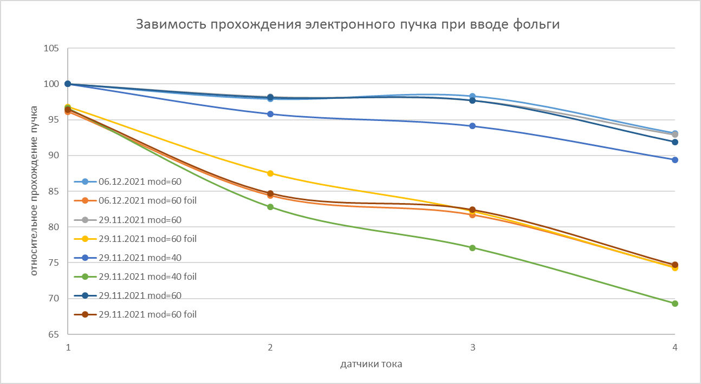
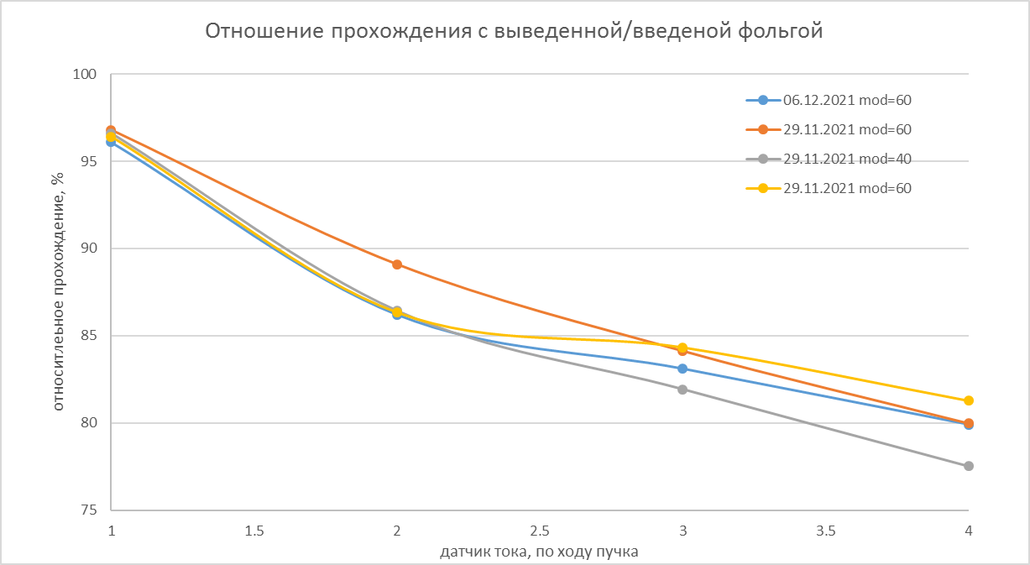
Experiments with graphite foil before undulators
rel. beam propagation
withot foil
Iin
Ifoil
with foil
rel. beam propagation
Ifoil / Iin
signal from PEA
18
XIV Международный Семинар по Проблемам Ускорителей Заряженных Частиц, 20-25 Сент. 2022, Крым, Россия

Slide 19
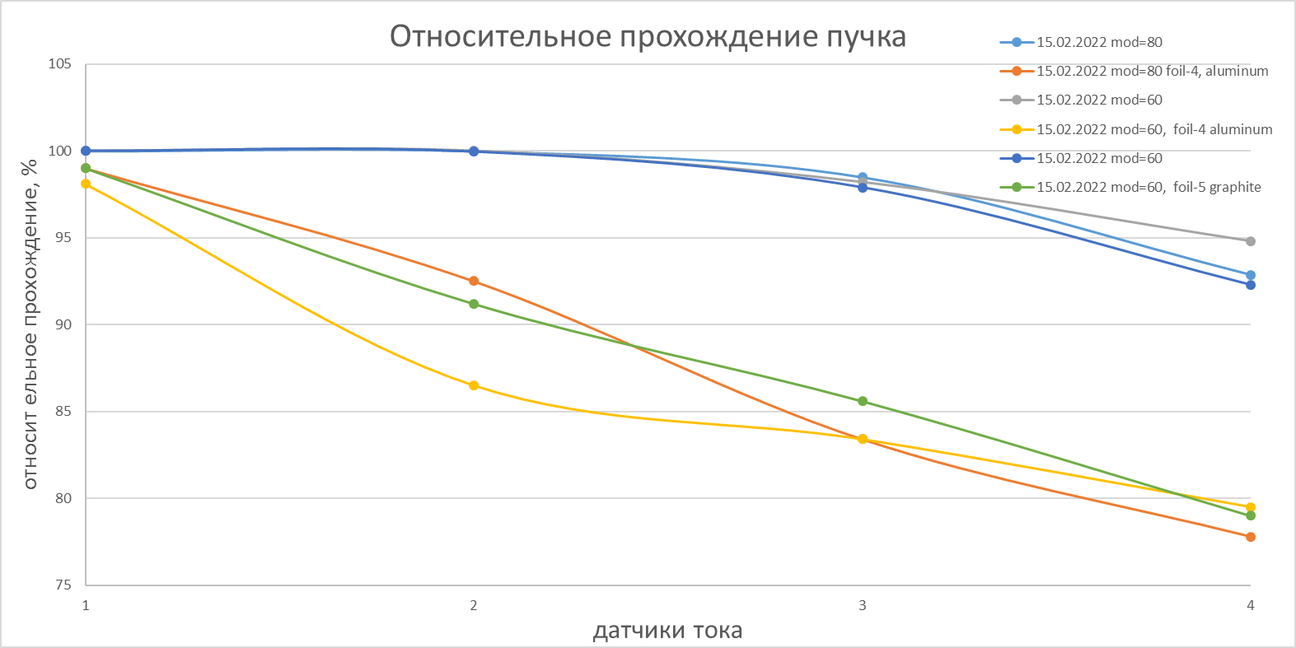
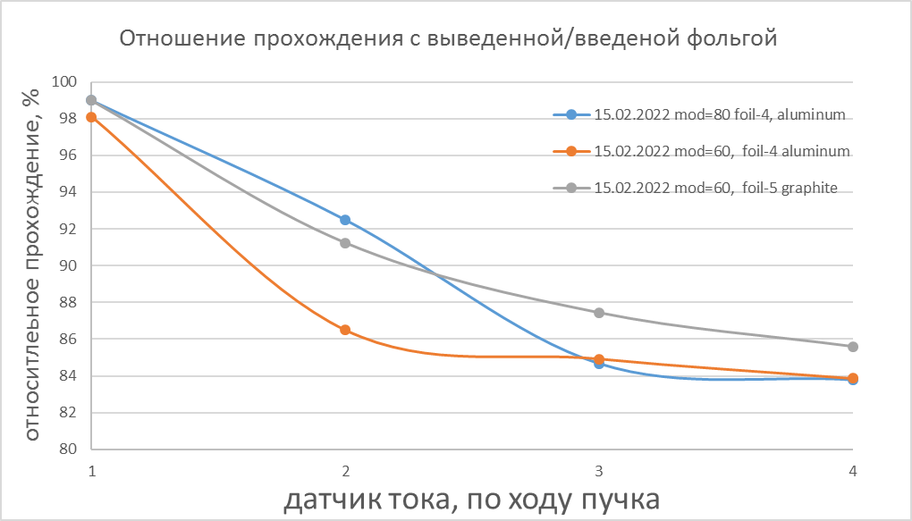
Aluminum foil before and graphite foil after undulators
I initial
без фольги
I foil-5-graphite
I foil-4-aluminum
с фольгой
rel. beam propagation
The bunch frequency 100 kHz is achieved with corresponds to 100 mkA beam current
I foil-graphite
19
XIV Международный Семинар по Проблемам Ускорителей Заряженных Частиц, 20-25 Сент. 2022, Крым, Россия

Slide 20
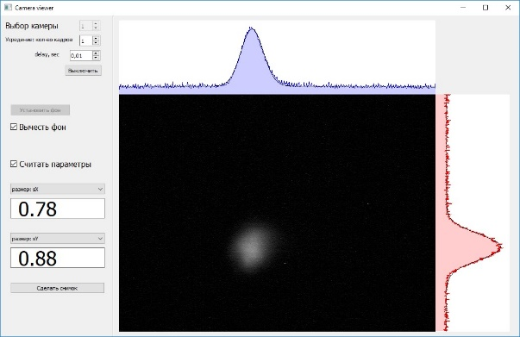
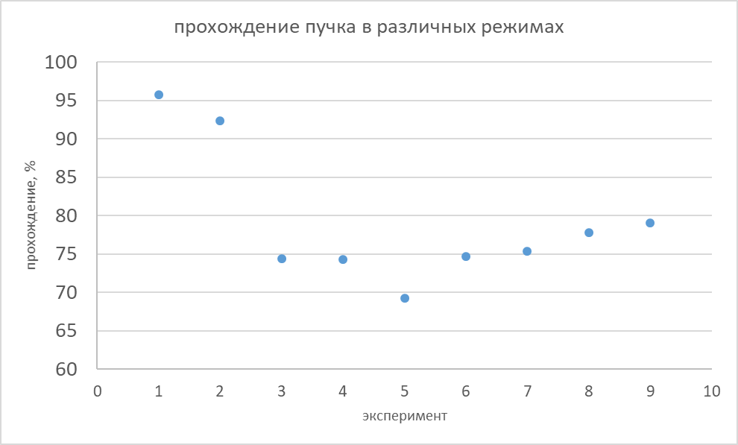
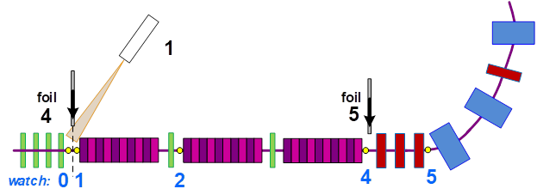
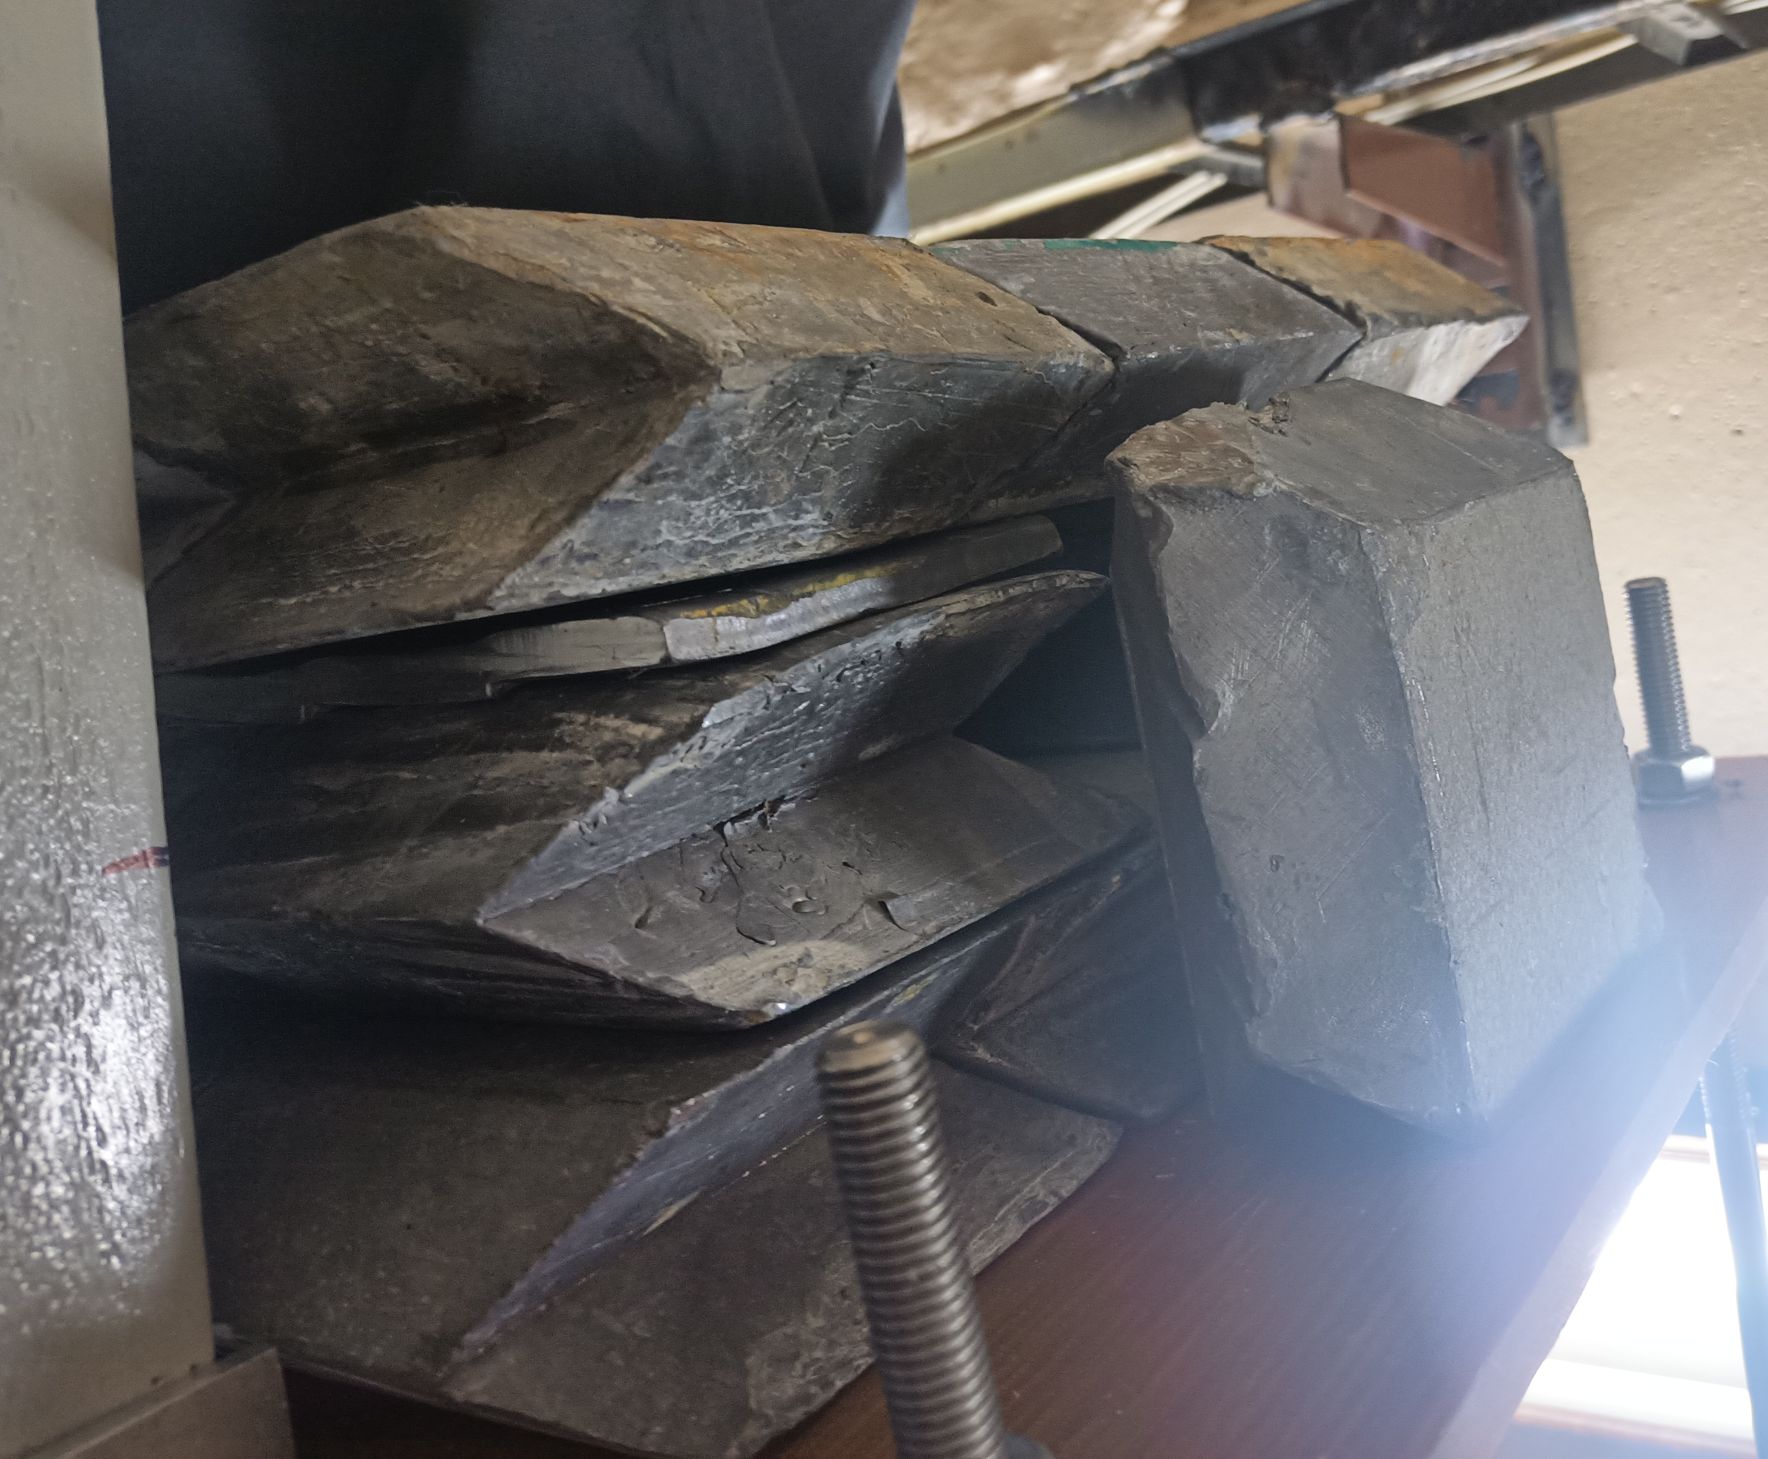
Short X-Ray Pulses Generation
beam propagation
1 – without lasing
2 – FEL lasing
3-5 – graphite foil-4
6-8 – aluminum foil-4
9 – graphite foil-5
beam image
with and without plumbum shield
PEA
signal from PEA
1 – foil input and camera
graphite and aluminum foils
graphite and aluminum foils
20
XIV Международный Семинар по Проблемам Ускорителей Заряженных Частиц, 20-25 Сент. 2022, Крым, Россия

Slide 21
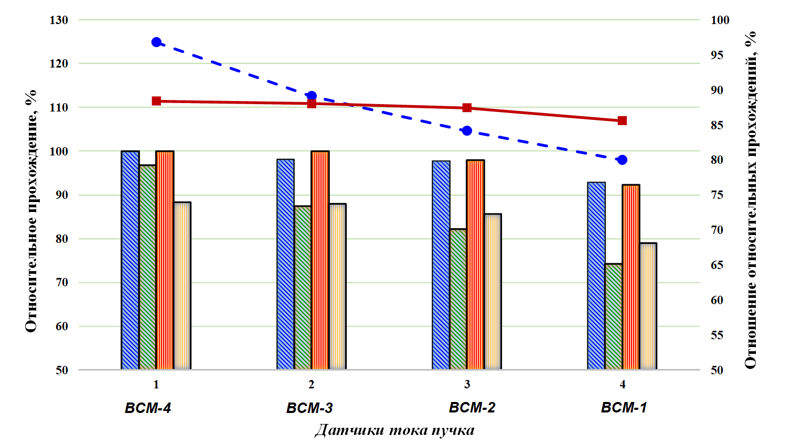
Experiment results
beam propagation
signal from PEA
21
XIV Международный Семинар по Проблемам Ускорителей Заряженных Частиц, 20-25 Сент. 2022, Крым, Россия

Slide 22
Conclusion
The possibility of generating short X-ray pulses has been experimentally shown
Registered radiation bunch duration is about 1 ns, which is determined by photo electronic amplifier resolution
Beam repetition rate reached 100 kHz and beam current reached 100 mkA.
The beam propagation rate was obtained at the level of 70-80% depending on the regime.
A further increase in frequency is associated with beam losses, which will be eliminated using
  experimental adjusting of the optic, based on the calculated regime
  decreasing the emittance on the foil using the optical diagnostic station
  additional installation of a quadrupole lens closer to the foil
  replacing the foil with a thinner one
The generation of short X-ray pulses at the NovoFEL looks promising
22
XIV Международный Семинар по Проблемам Ускорителей Заряженных Частиц, 20-25 Сент. 2022, Крым, Россия

Slide 23
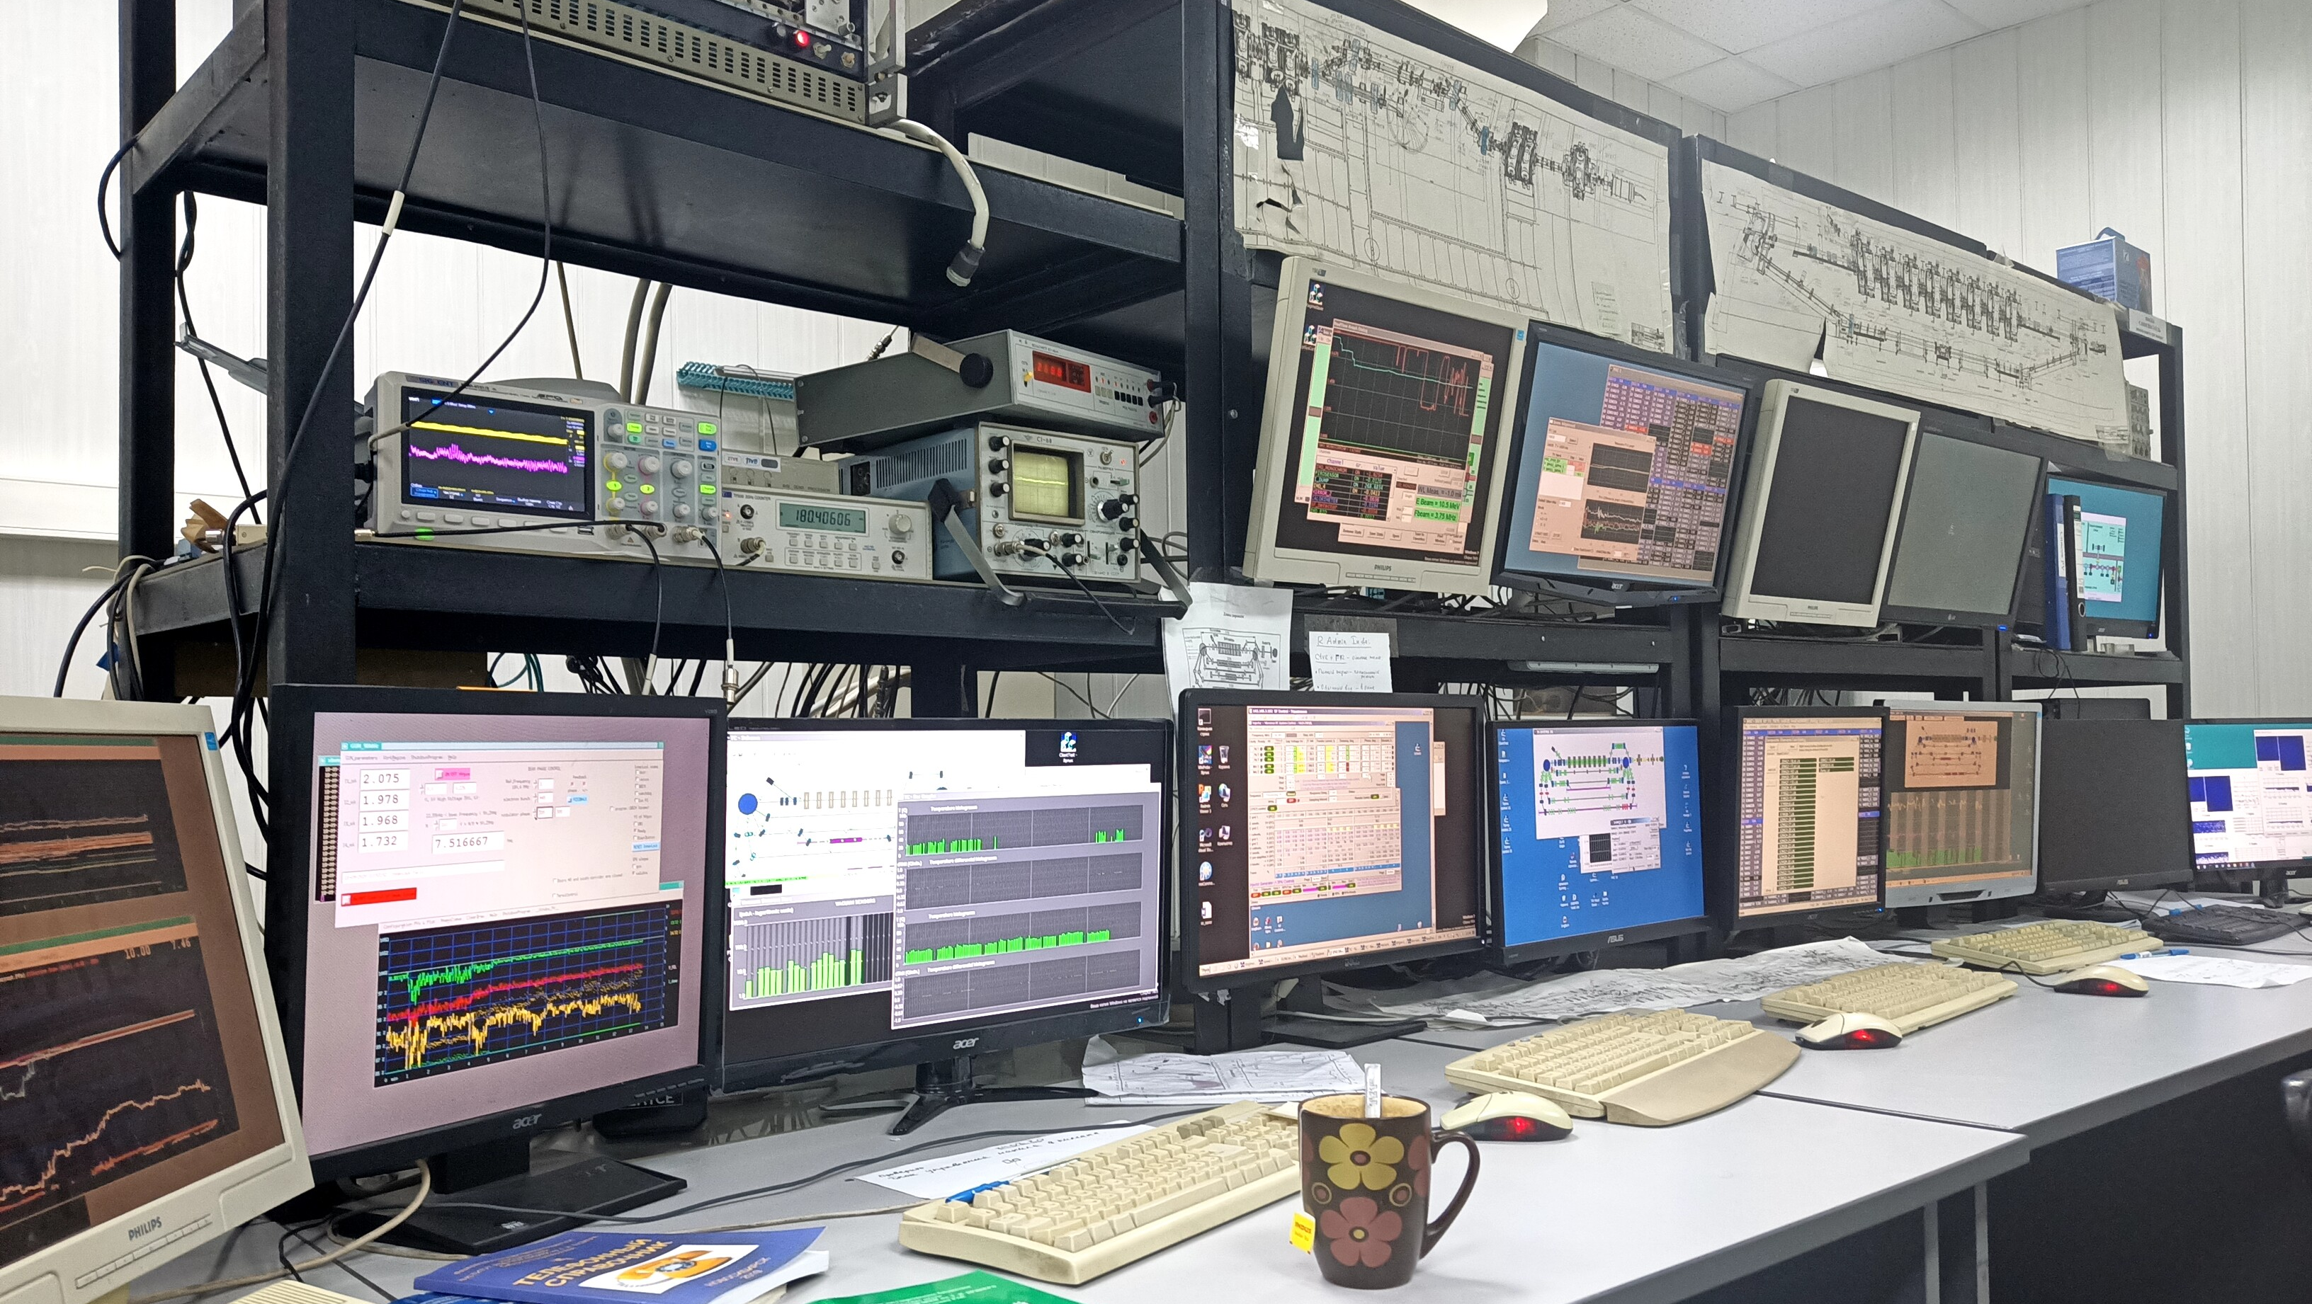
Спасибо за внимание!

