Slide 1
VEPP-5 injection complex
Fedor Emanov
On behalf of injection complex team

Slide 2
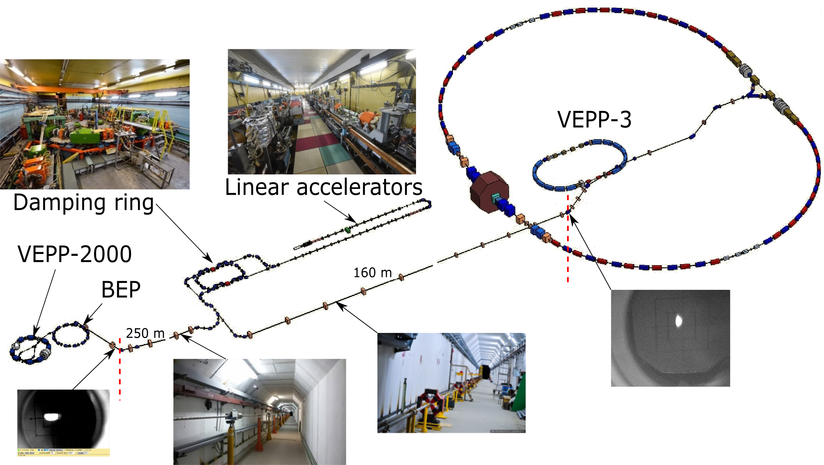
VEPP-5 injection complex layout

Slide 3
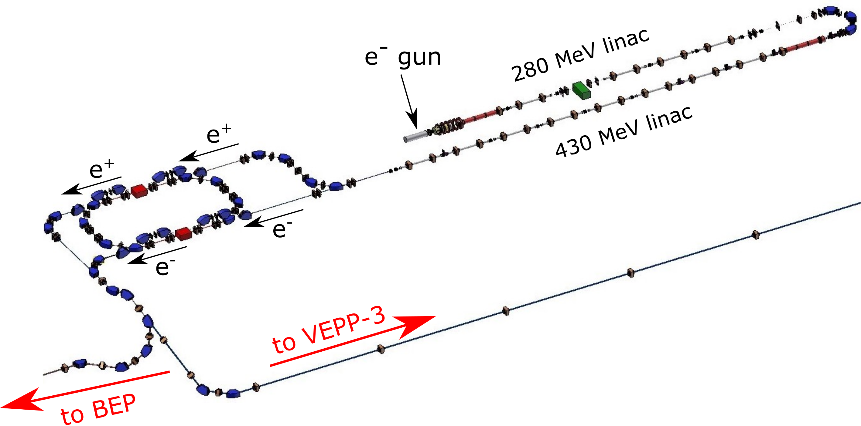
VEPP-5 injection complex layout
Damping Ring
Max. energy | 510 MeV
Circumference | 27.4 m
RF harmonic Number | 1 (64 before 2017)
Design beam current | 30 mA
Damping times | 11/18/12 ms
Hor./Vert emittance | 2.3/0.5∙10⁻⁶ cm∙rad
Linacs
Max. energy | 280/430 MeV
RF ferquency | 2855.5 MHz
Max. e⁻ number in beam | 10¹¹
Max. e⁺ number in beam | 6.3∙10⁹
Max. repetition rate | 12.5 Hz
Energy spread e⁺/e⁻ | 3%/1%

Slide 4
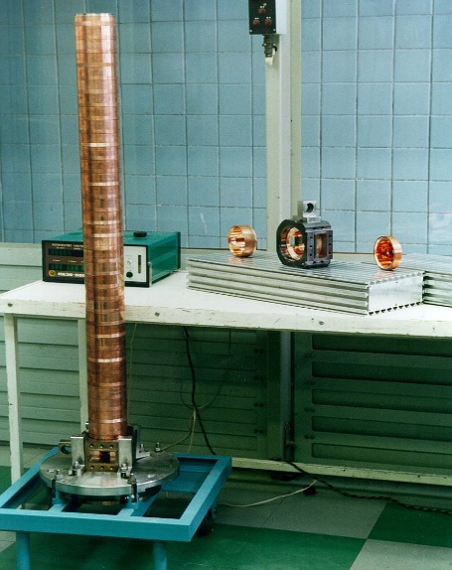
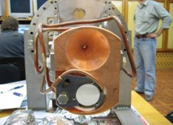
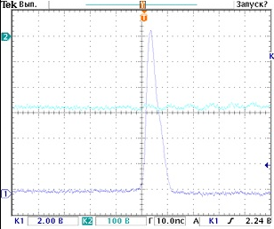
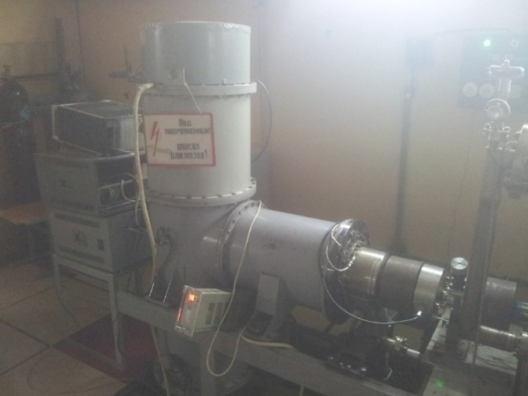
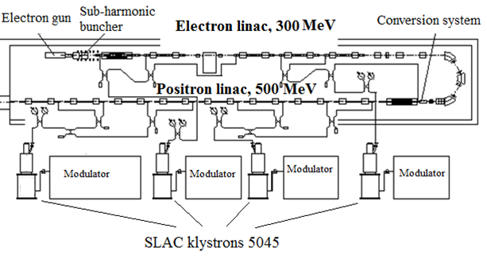
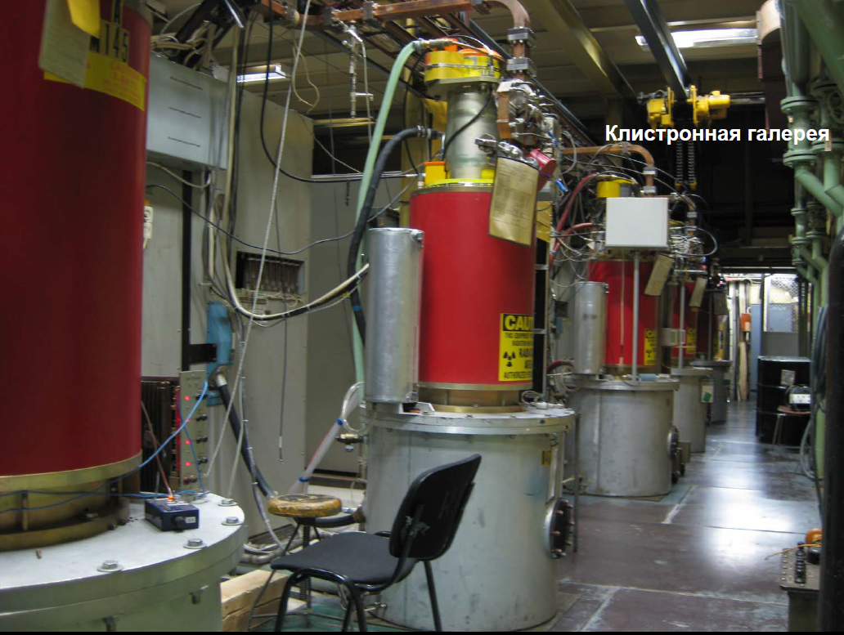
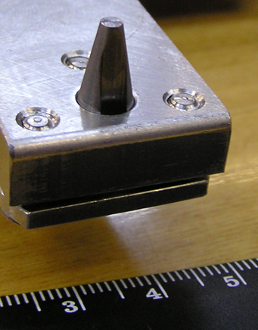
Linear accelerators
Flux concentrator
up to 10T peak field
Gun current sensor
5.3А, 1.77∙10¹¹ e⁻
Half-cavity at stand
Electron gun
Conversion target

Slide 5
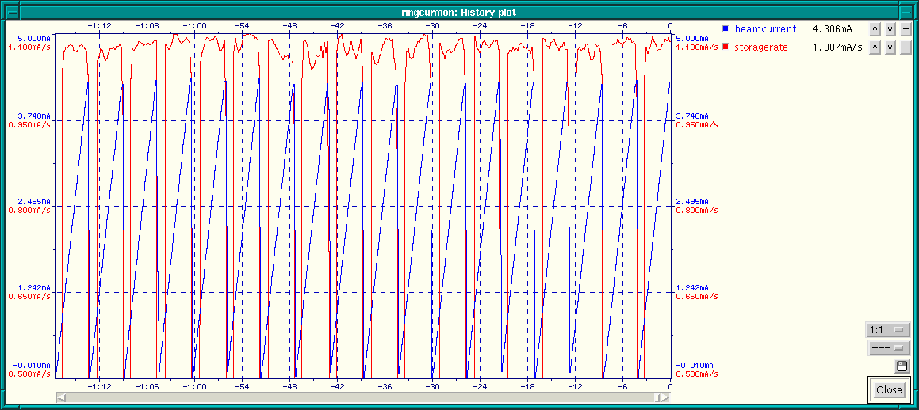
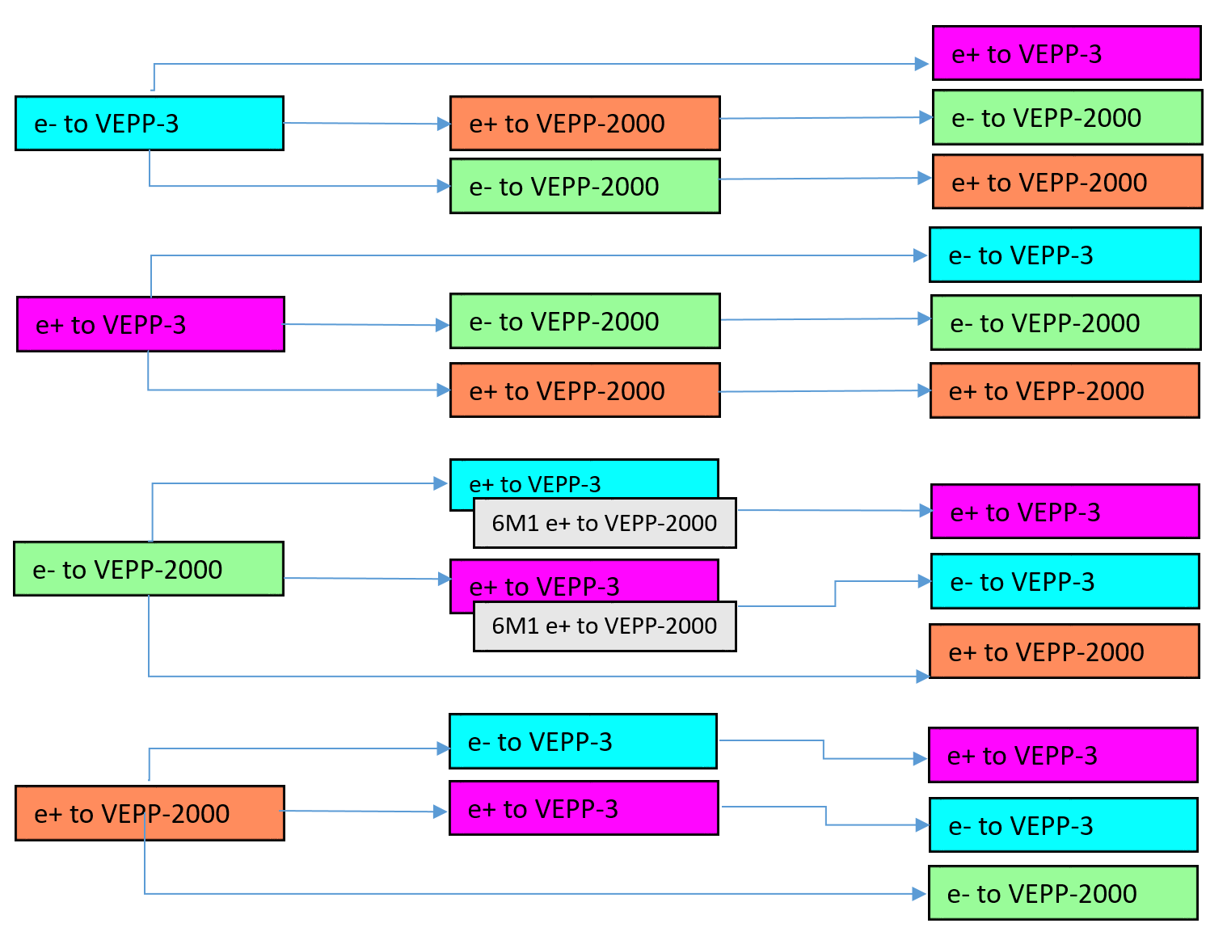
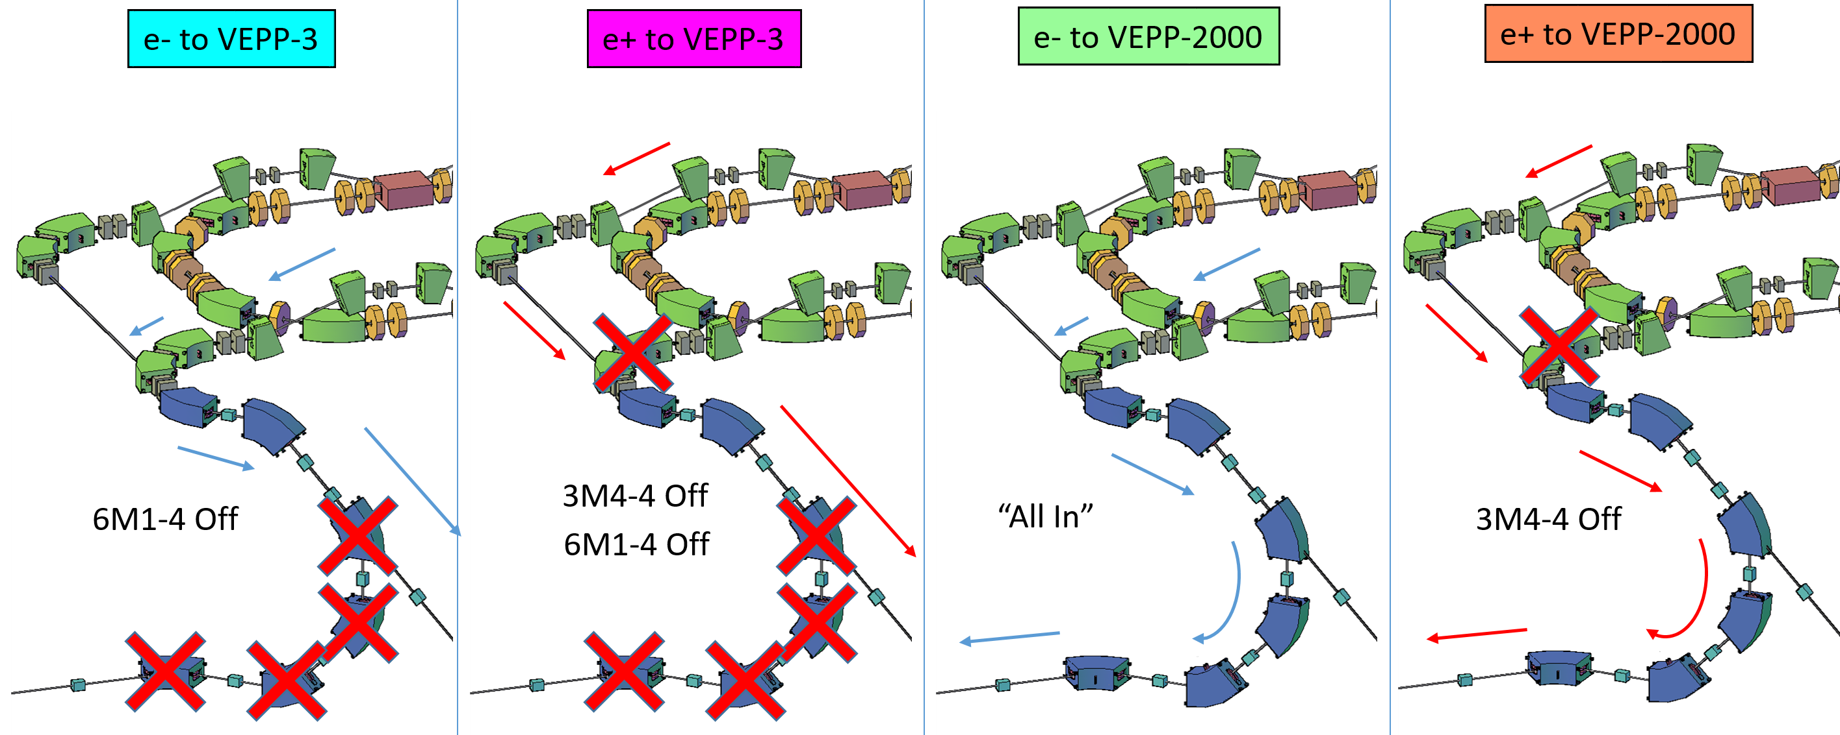
Operation with colliders
2 modes for damping ring and linacs (e-/e+)
We use the same energy for e-/e+ what makes possible the same damping ring mode
4 K-500 modes
12 transitions between user/particle type
Automatic mode switching for VEPP-2000
Vepp-3 modes are switched on the operator's request.
Positron injection-extraction cycle (6s)
Magnet transfers, 26s/step

Slide 6
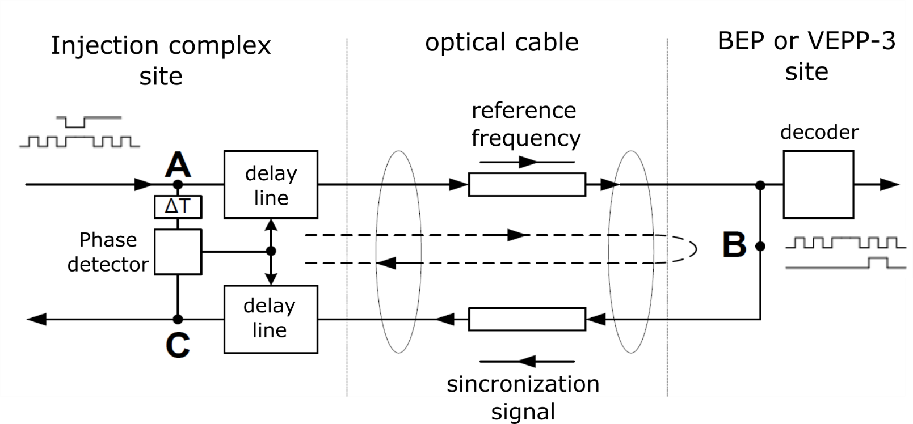
Operation with colliders: synchronization
F_{DR}/F_{BEP} F_{ref} | 287/352 38.109 kHz | F_{DR}/F_{BEP} F_{ref} | 1281/472 8.538 kHz
VEPP-3, BEP frequency shifted to meet required ratio for transfer synchronization.
Cable length thermal drift compensation was implemented.
Synchronization stability is 10 ps.

Slide 7


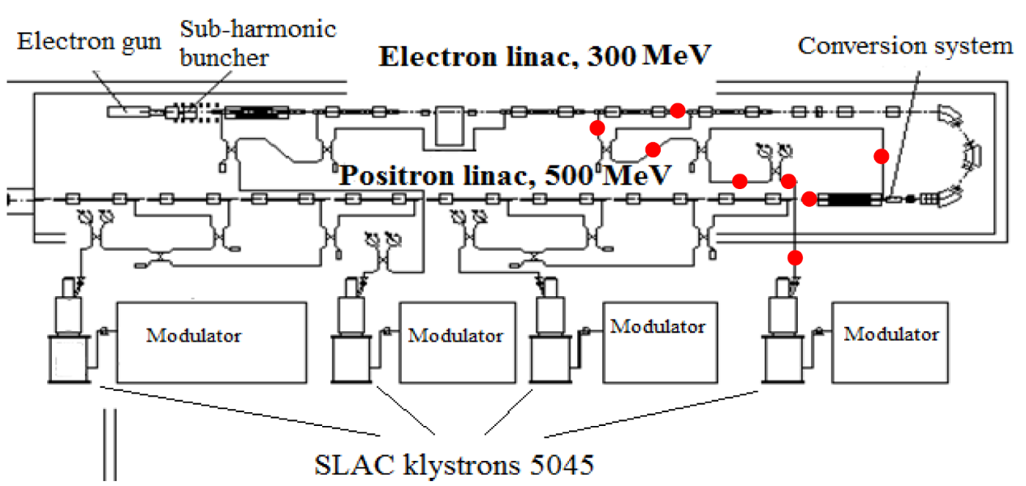
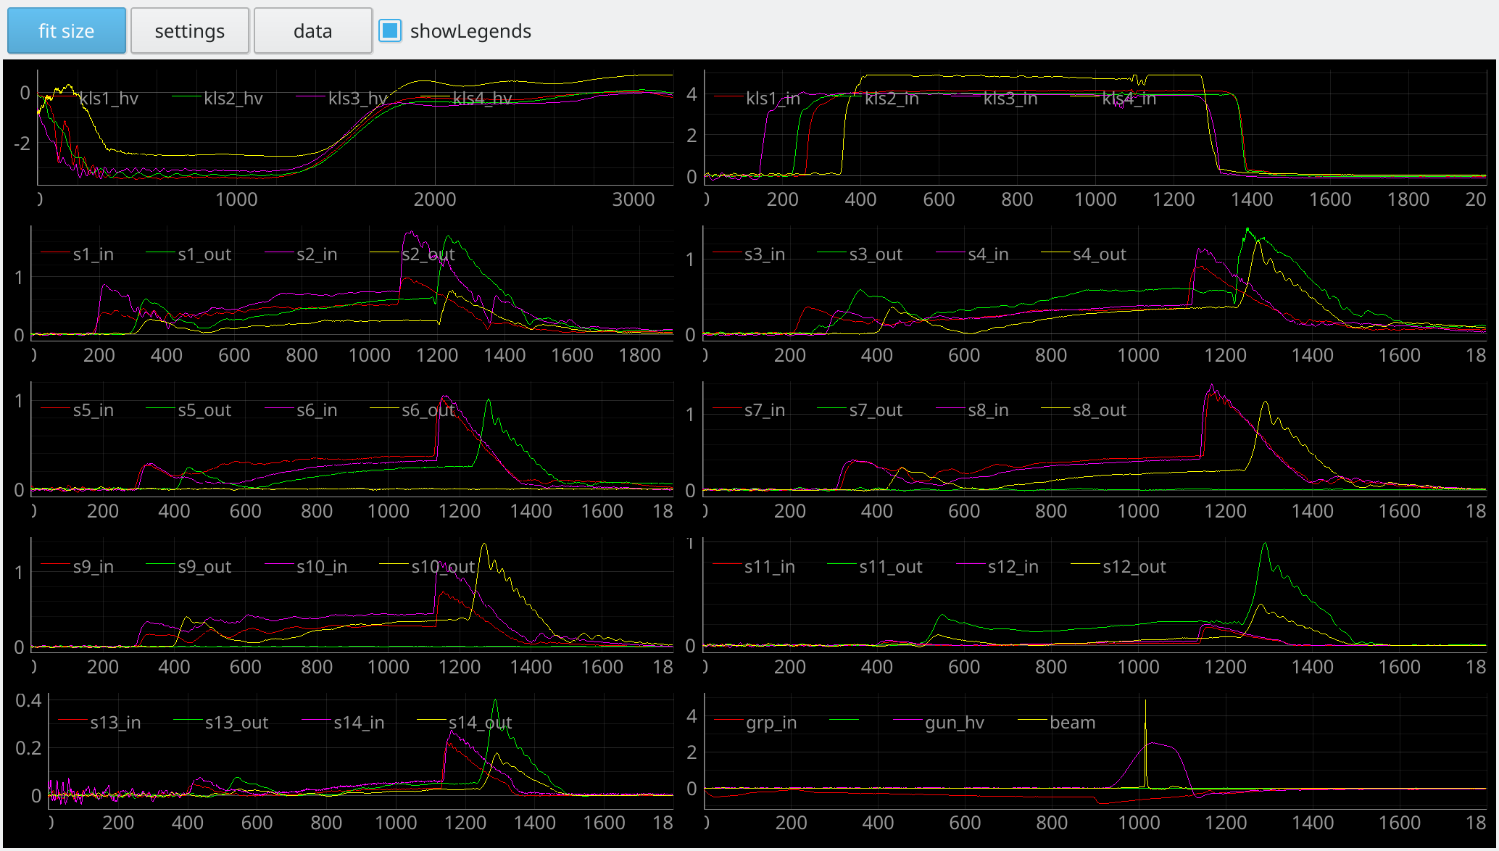
RF and gun signals ADCs deployed
BINP developed VME ADC250x4 and ADC1000 are deployed in order to measure all signals simultaneously.
Common ADC clock connected to injection complex master generator allows to measure time between any signals.
Integrated into injection complex software, automatic detection of usual signal changes under development.
10*4 channels
250 MHz ADC

Slide 8
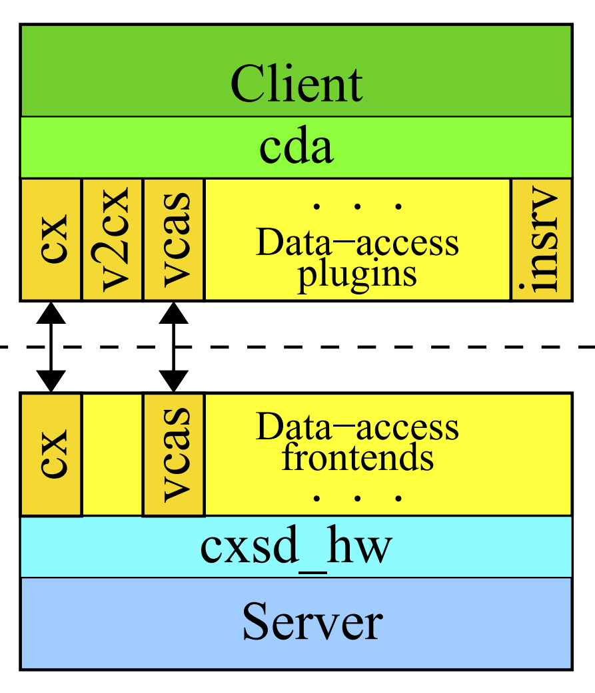
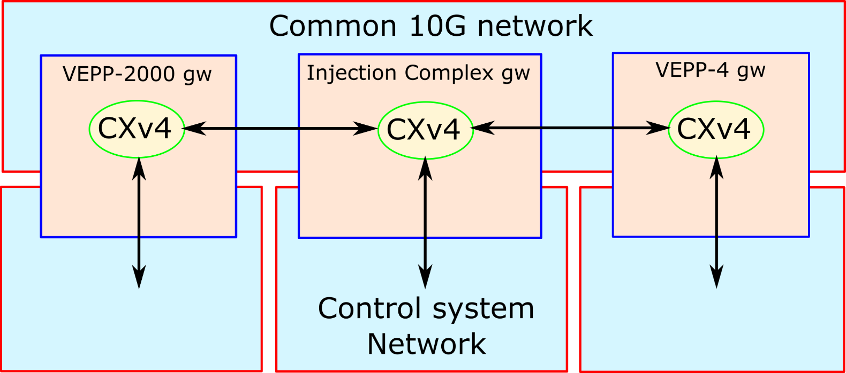
Control systems interaction
CXv4 module structure
by D.Bolkhovitianov
Injection complex control system software is based on CXv4 modular framework
PObox (noop) device driver created for communication between applications
VCAS, TANGO client modules have been created to interact with VEPP-2000
EPICS client module have been created to interact with VEPP-4
EPICS server module have been created in order to interface with Android application
EPICS
VCAS, TANGO

Slide 9
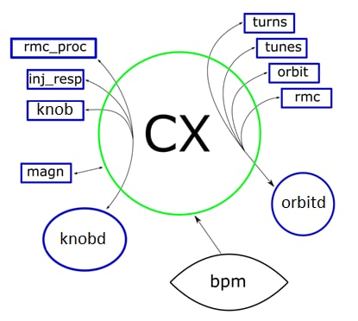
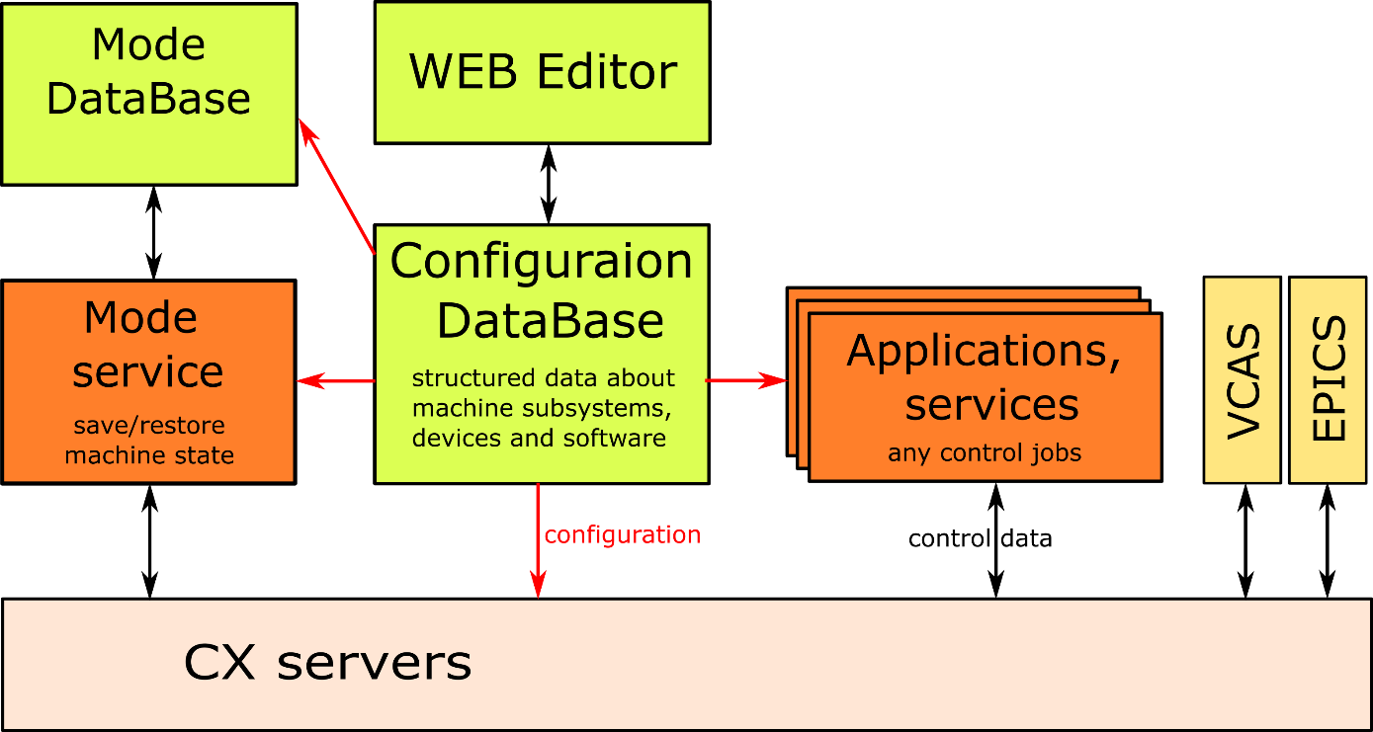
Control system software structure
Damping ring software
by V.Balakin
CX serves as distributed software bus for applications and hardware
General software structure
example

Slide 10
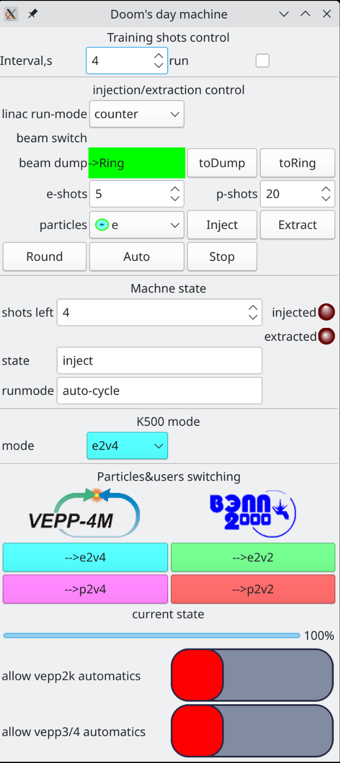
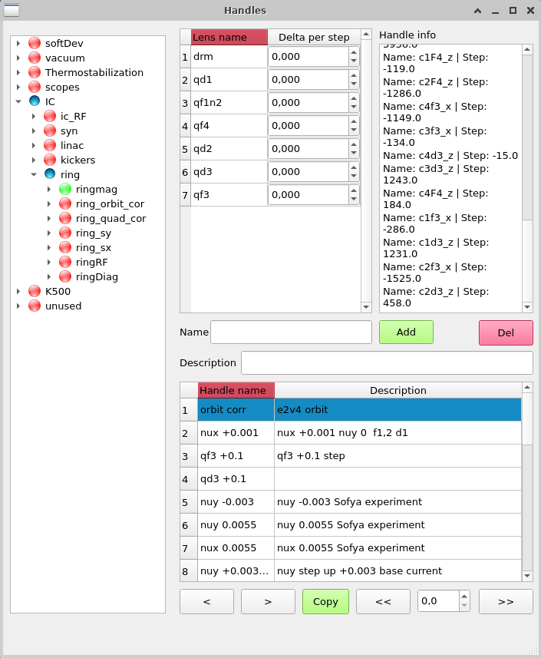
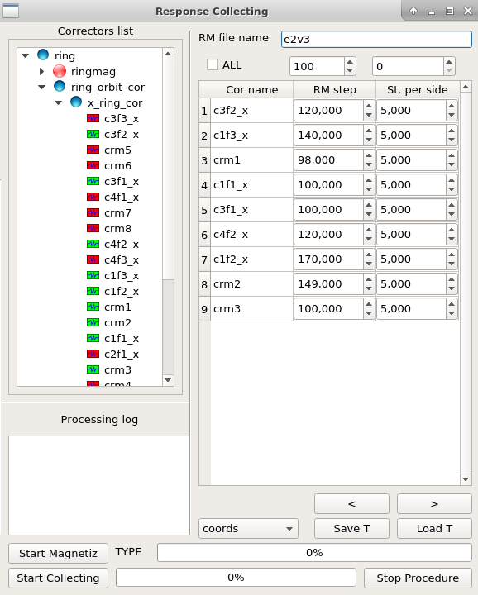
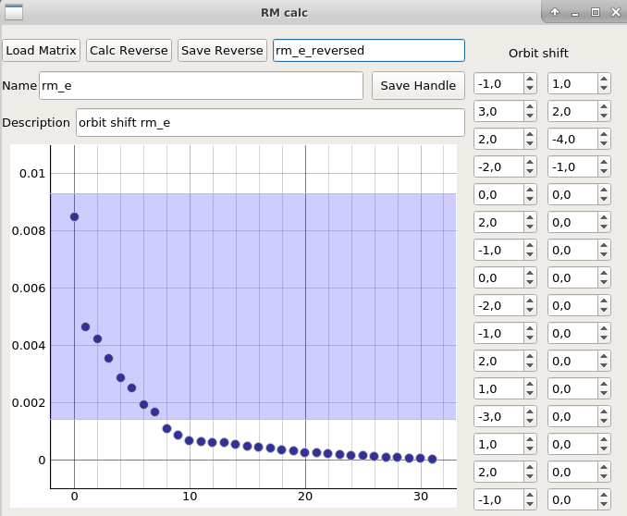
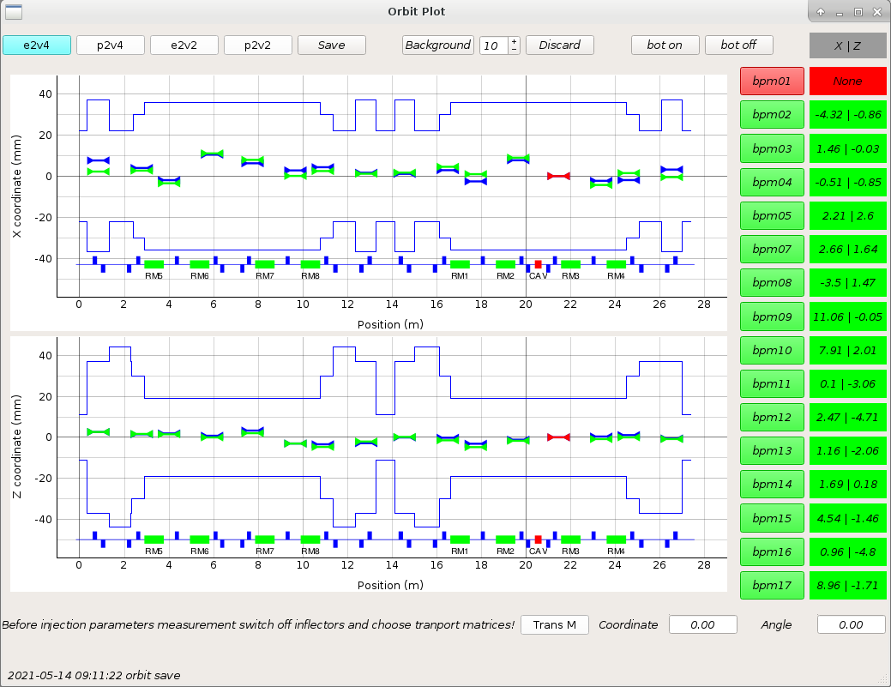
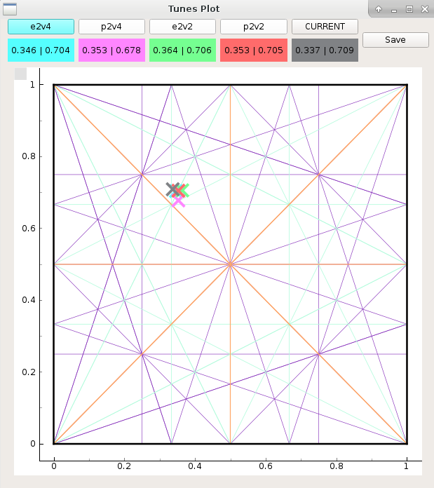
Control software
Frontend clients to interact with user only
Services to implement automatics, data processing, technological processes
CX-enabled Qt widgets and Designer plugins for fast software prototyping (Taurus do the same for tango)

Slide 11
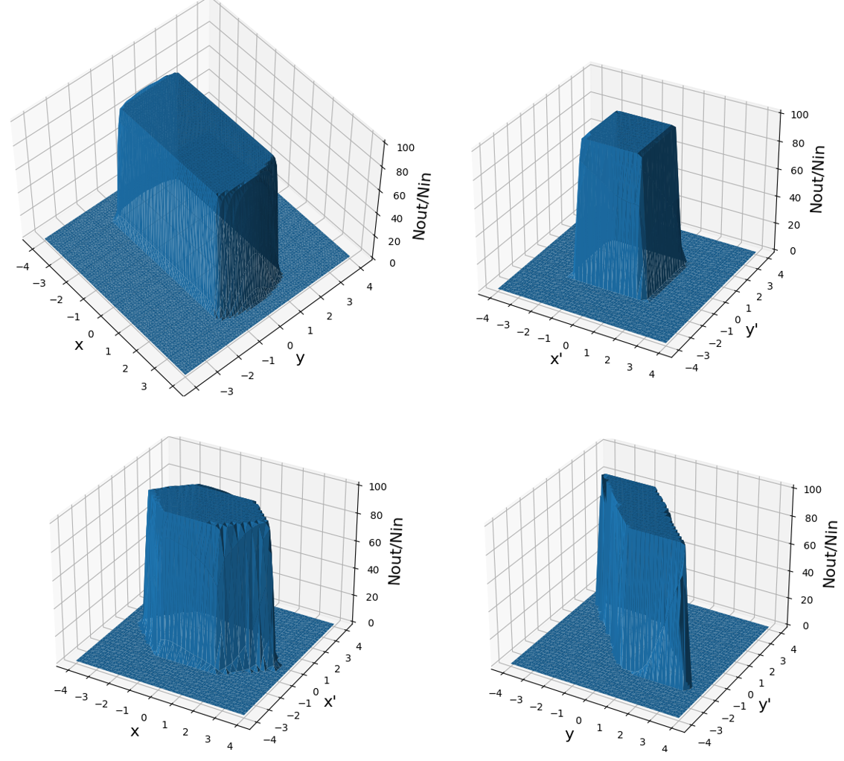
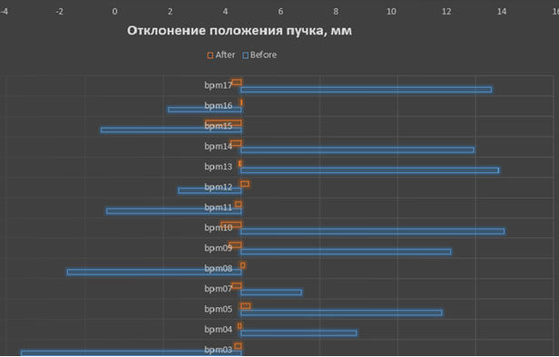
Control software: damping ring orbit correction
K-500 initial conditions tolerance estimated using transfer line model
Response 10% non-linearity range 5-7 mm near to BPM center and 1-2 mm near BPM edge
Due to this semi-automatic iterative response matrix based orbit correction was implemented
Beam position, mm
K-500 model transfer efficiency
over 𝑋𝑌 , 𝑋′𝑌 ′, 𝑋𝑋′ и 𝑌 𝑌 ′
(to VEPP-2000)

Slide 12
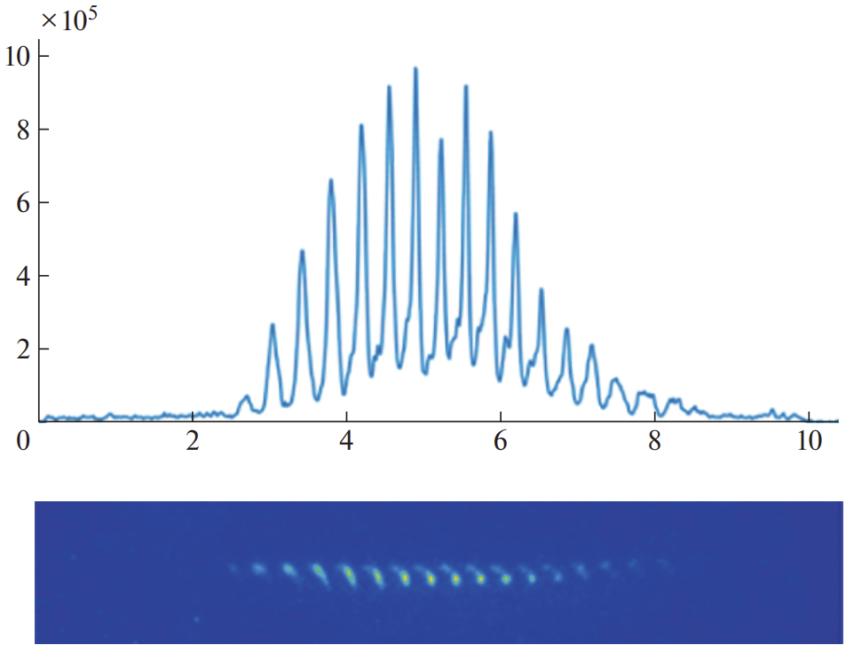
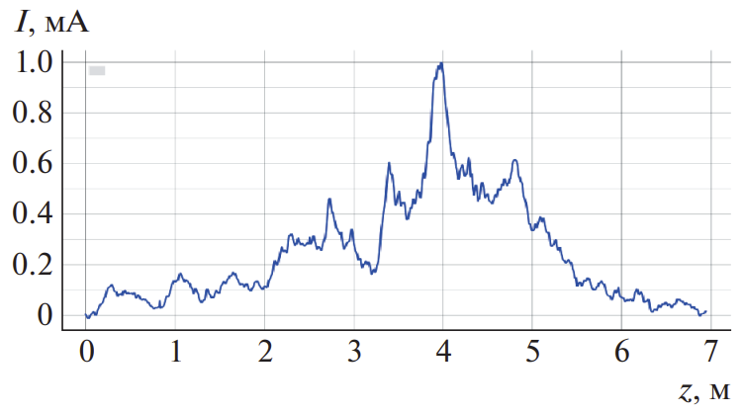
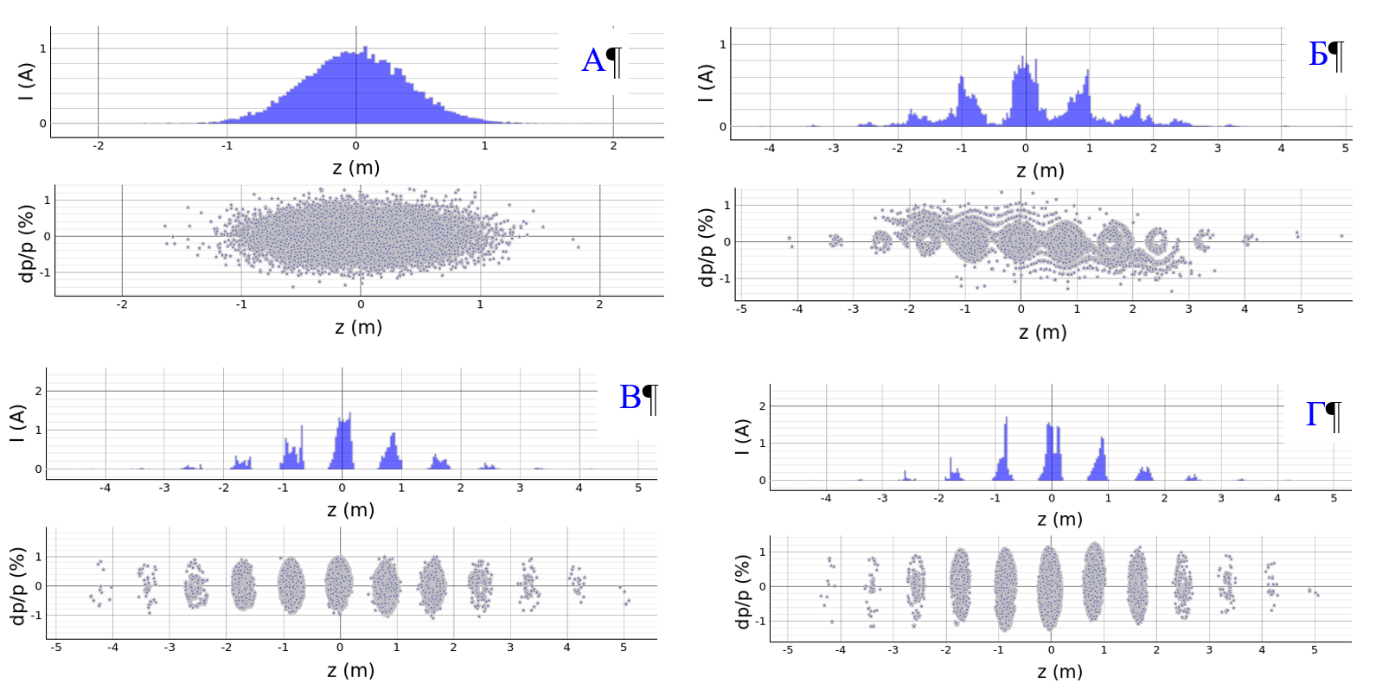
Activities: collective effects studies
Previously:
1st harmonic damping ring cavity installed in 2017 gives beam duration about 5 ns, which is good to measure with streak-camera and dissector.
Beam length over current was measured.
Beam longitudinal profile distortion measured.
Fast beam decoherence was observed.
Longitudinal motion model with impedances created
Update:
Added 350 MHz cavity to model in order to calculate beam regrouping for future applications.
Intensity, au
Time, ns
Linac beam just injected
2000
After 800 turns
13.5k
20k

Slide 13
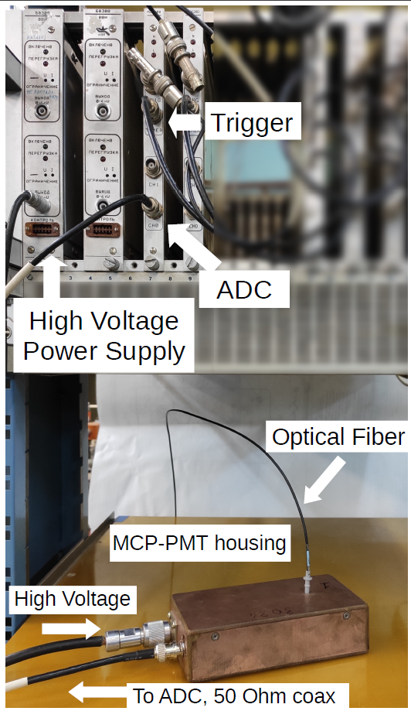
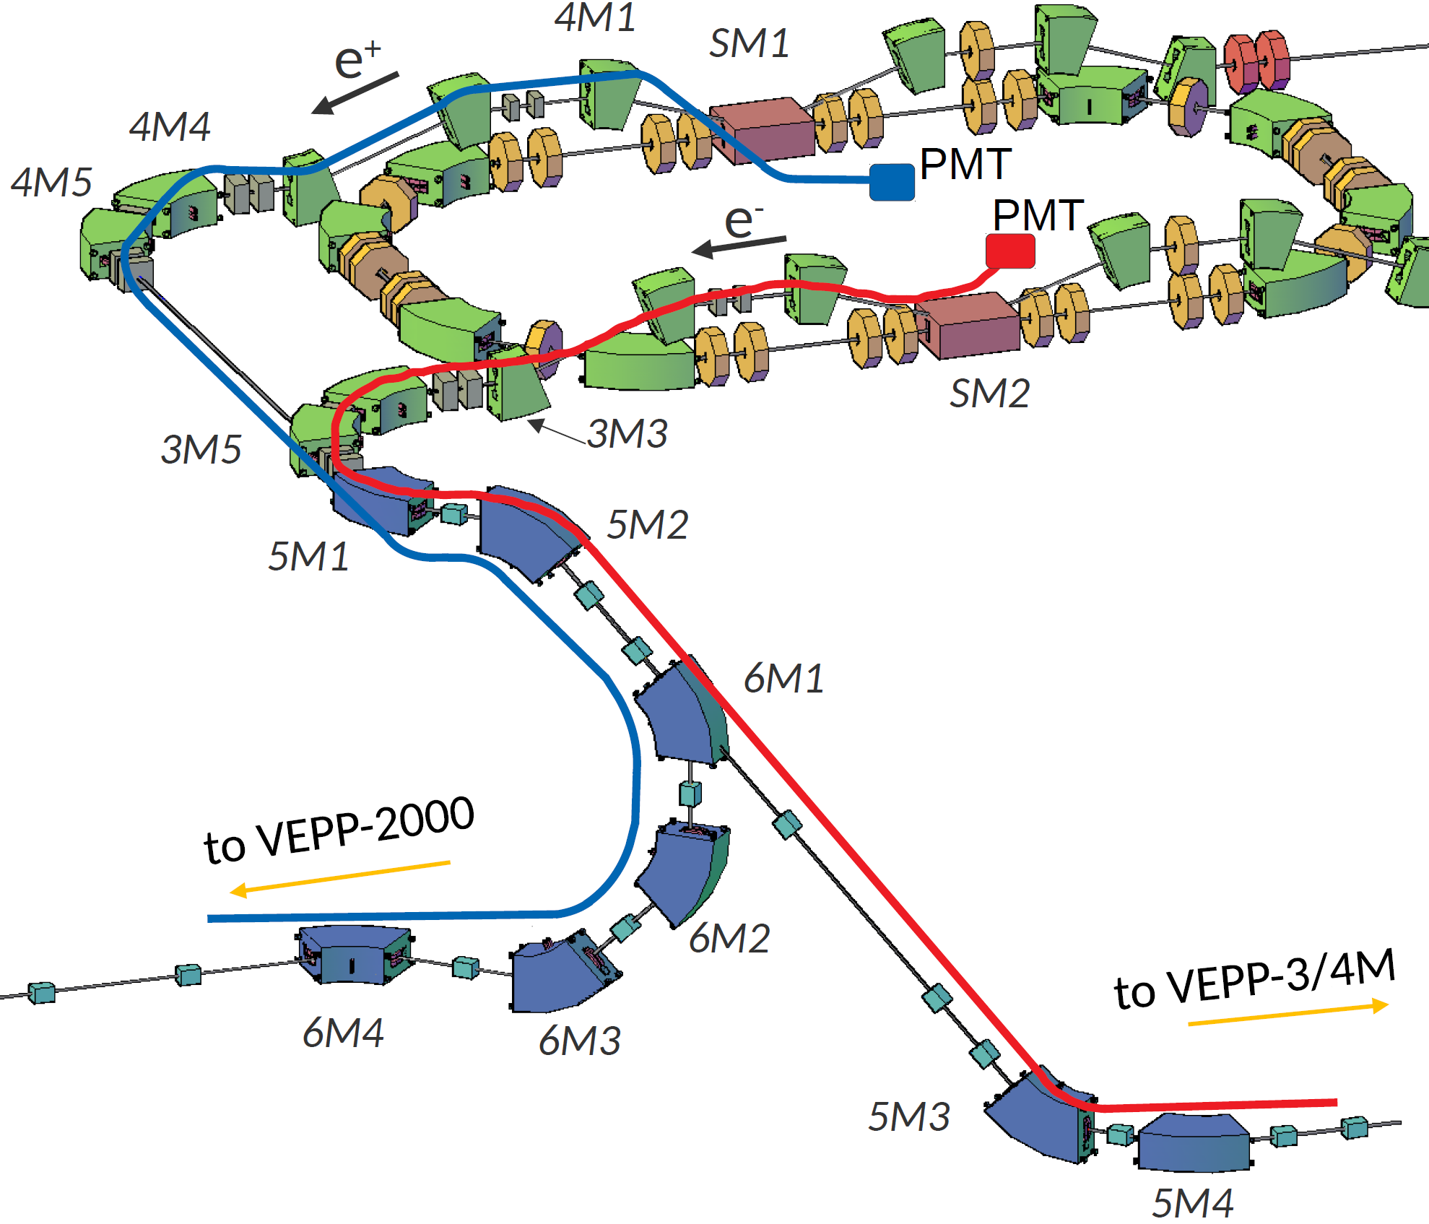
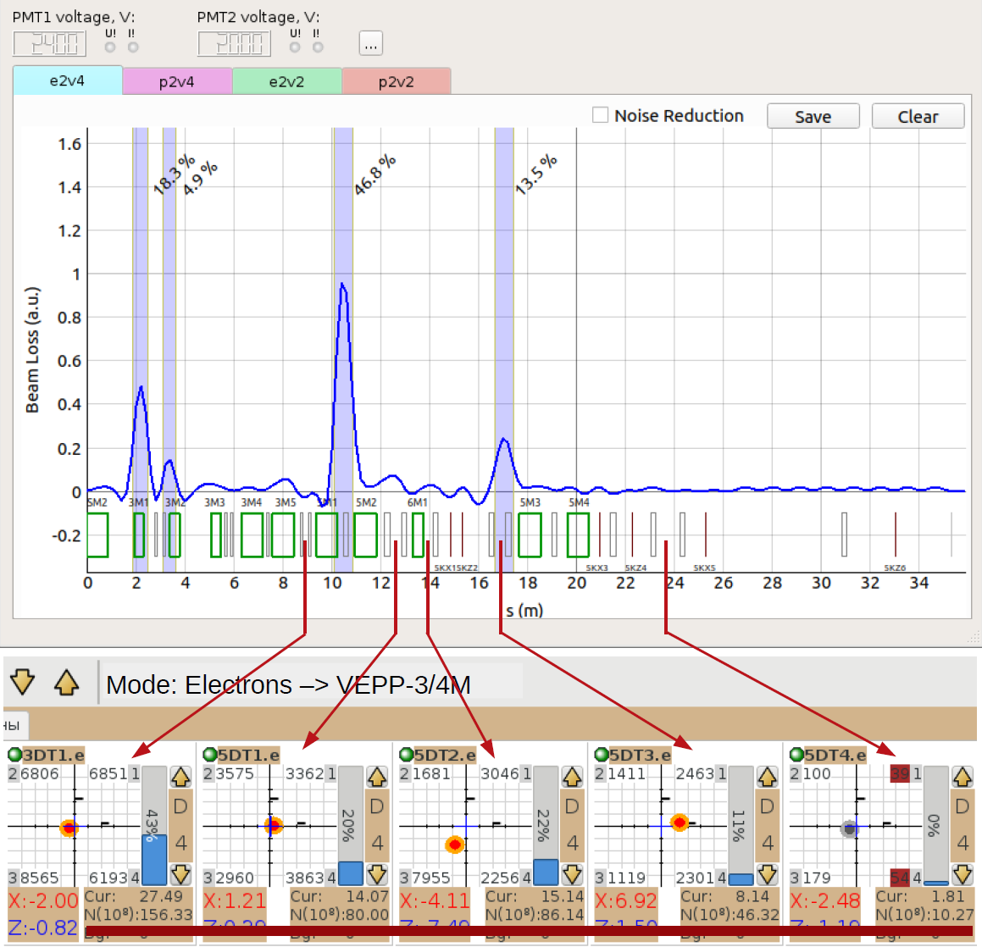
Activities: optic-fiber beam loss monitor
Optic-fiber beam loss monitor was developed and deployed to initial part of K-500.
Currently device integrated in injection complex control system and used in routine operation.

Slide 14
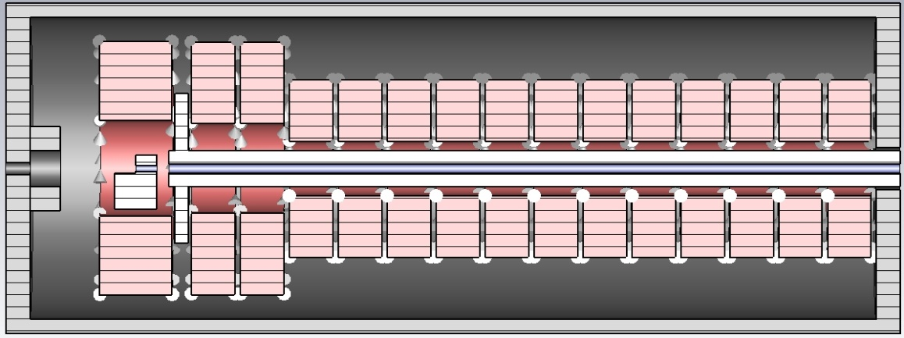
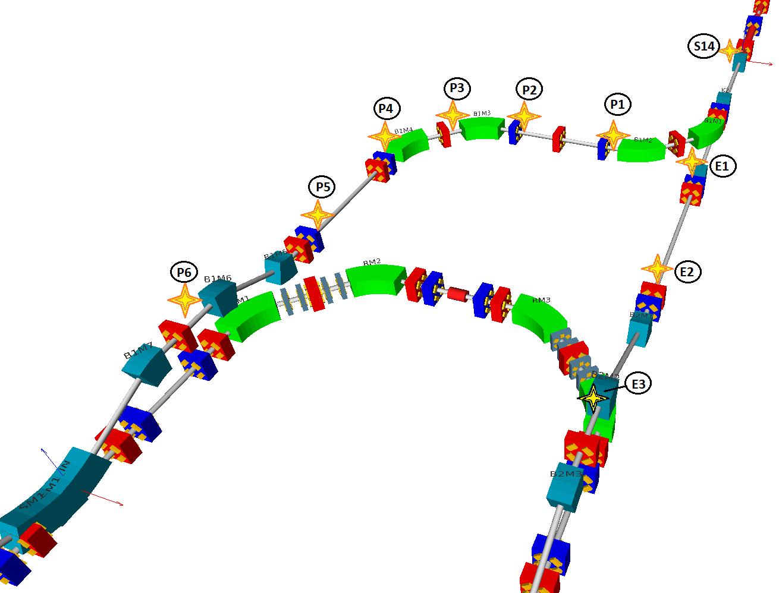
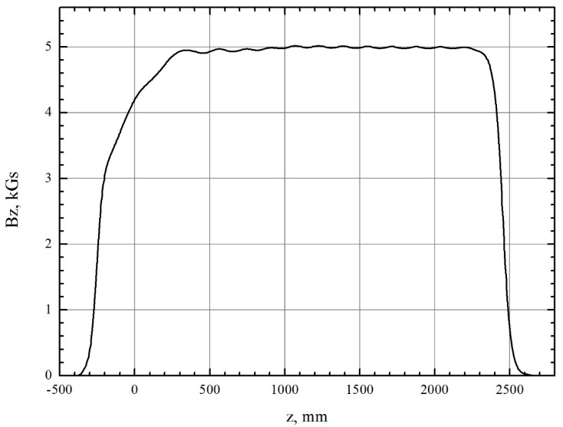
Activities: planned upgrades
Beam position monitors for damping ring injection channels
Beamlines from linac to damping ring don’t have any non-destructive diagnostic devices. We think a set of beam position monitors can allow us to tune injection lines more accurately and reduce operation efforts to keep stabilize injection from linac.
New positron solenoid
Since damage to positron solenoid resulted in significant positron production rate reduction and it is only possible to replace whole unit we decided to develop and produce new solenoid.

Slide 15
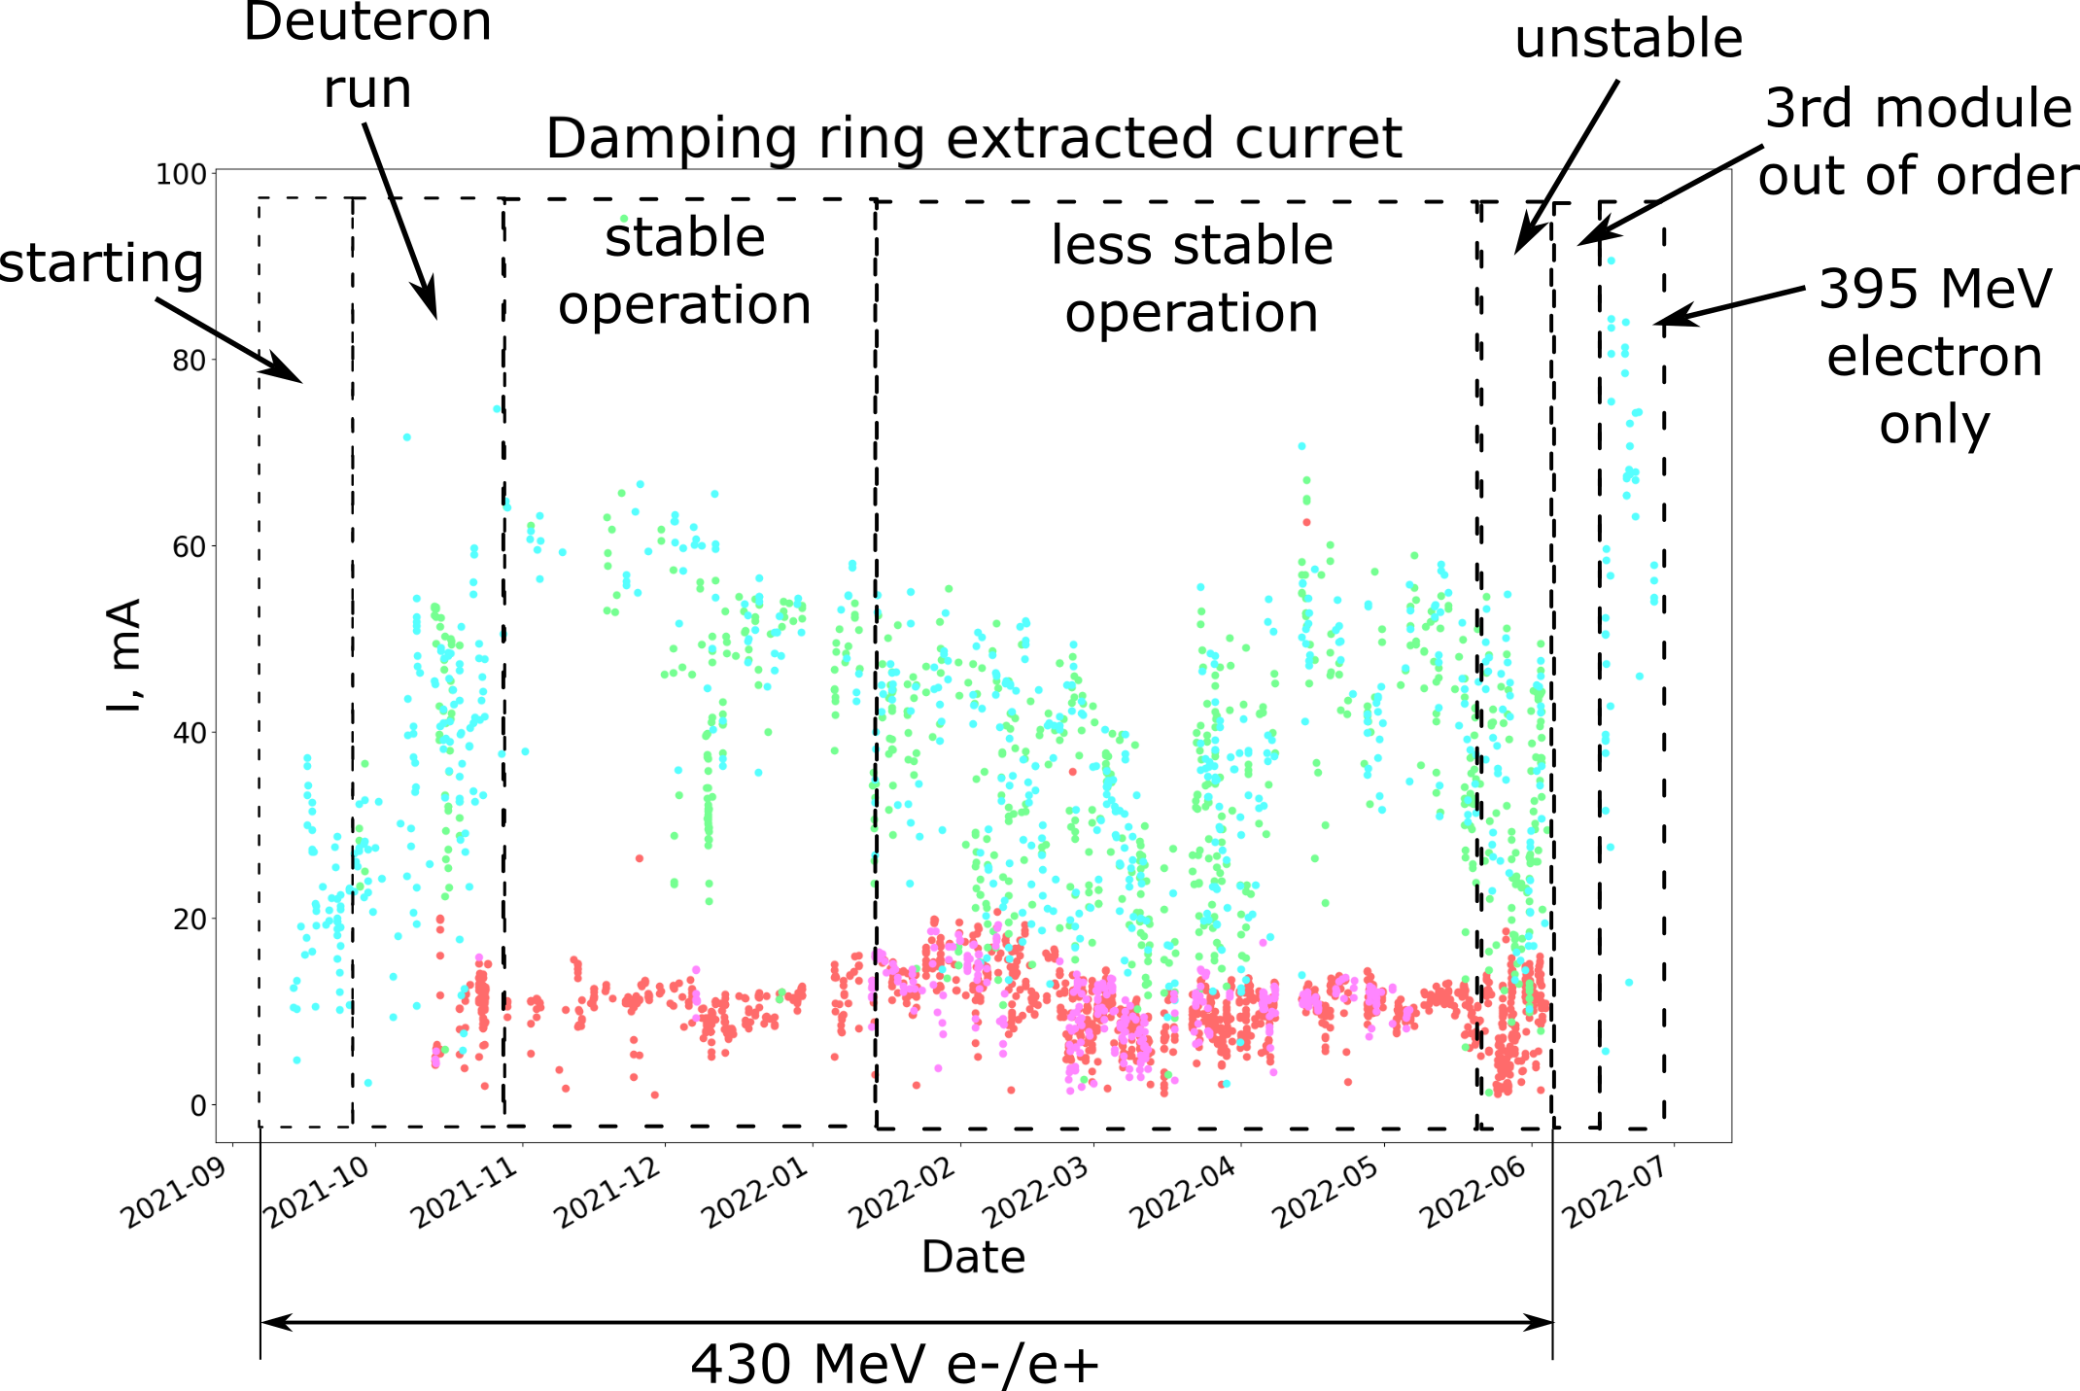
Season 21/22 operation: results

Slide 16
Season 21/22 operation: failures
Season 21/22
Season 20/21
reason | ~10 min | ~1 hr | ~6 hrs | ~12 hrs | ~24 hrs | sum
power outage | 29 | 17 | 0 | 0 | 0 | 0.91 | days
modulatos+klystrons | 260 | 68 | 18 | 7 | 6 | 18.6 | days
magnet power supply | 29 | 2 | 0 | 0 | 0 | 0.28 | days
control system | 5 | 5 | 0 | 0 | 0 | 0.24 | days
inflectors | 0 | 0 | 1 | 0 | 0 | 0.25 | days
thermostabilization | 1 | 3 | 0 | 0 | 0 | 0.13 | days
Damping Ring RF | 16 | 0 | 1 | 0 | 0 | 0.36 | days
Vacuum | 8 | 0 | 0 | 0 | 0 | 0.06 | days
other | 18 | 19 | 5 | 0 | 4 | 6.17 | days
Regular maintenance | 8 | 42 | 15 | 0 | 0 | 5.56 | days
 |  |  |  |  |  | 32.6 | days
subsystem | 0.1 hr | 1 hr | 6 hr | 12 hr | 24 hr | days
Power outage | 3 | 8 | 1 | 0 | 0 | 0,6
Linac Modulators | 235 | 30 | 5 | 2 | 1 | 5,0
Power sypplies | 29 | 9 | 0 | 0 | 0 | 0,4
Control system | 0 | 2 | 0 | 0 | 0 | 0,1
inflectors | 0 | 0 | 0 | 0 | 0 | 0,0
thermostabilization | 0 | 1 | 0 | 0 | 0 | 0,0
Damping ring RF | 6 | 1 | 0 | 0 | 2 | 2,1
Vacuum | 8 | 0 | 0 | 0 | 0 | 0,0
Other reasons | 0 | 4 | 1 | 0 | 2 | 2,4
Regular maintenance | 0 | 20 | 11 | 0 | 0 | 3,6
 |  |  |  |  |  | 14,2
Since 3rd linac modulator caused most downtime its power chain was finally upgraded.
1st klystron solenoid was replaced.

Slide 17
VEPP-5 injection complex team
Thank you
for your attention
Yu.I. Maltseva, A. Andrianov, K. Astrelina, V. Balakin, A. Barnyakov,
A.M. Batrakov, O.V. Belikov, D.E. Berkaev, D. Bolkhovityanov,
F.A. Emanov, A. Frolov, G. Karpov, A. Kasaev, A.A. Kondakov,
N. Kot, E.S. Kotov, G. Ya. Kurkin, R. Lapik, N. Lebedev,
A. Levichev, A. Yu. Martynovsky, P. Martyshkin, S. V. Motygin,
A. Murasev, V. Muslivets, D. Nikiforov, A. Pavlenko, A. Pilan,
Yu. Rogovsky, S. Samoylov, A.G. Tribendis, S. Vasiliev, V. Yudin

Slide 18
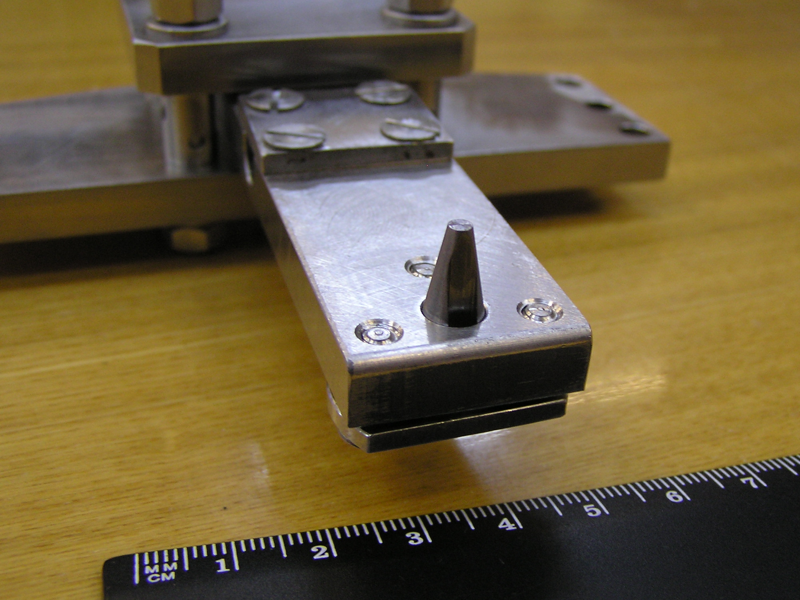
conversion target

Slide 19
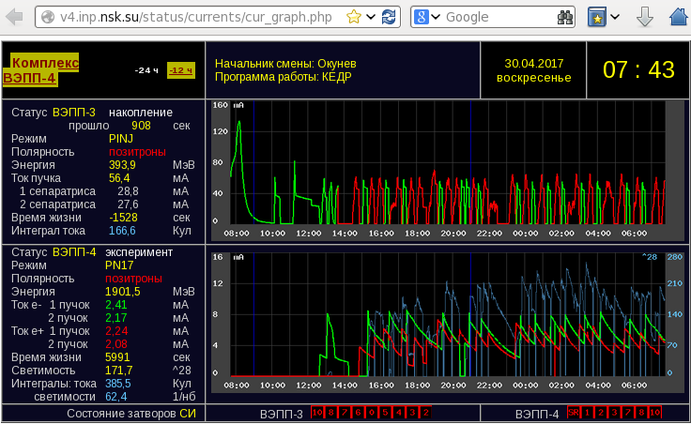
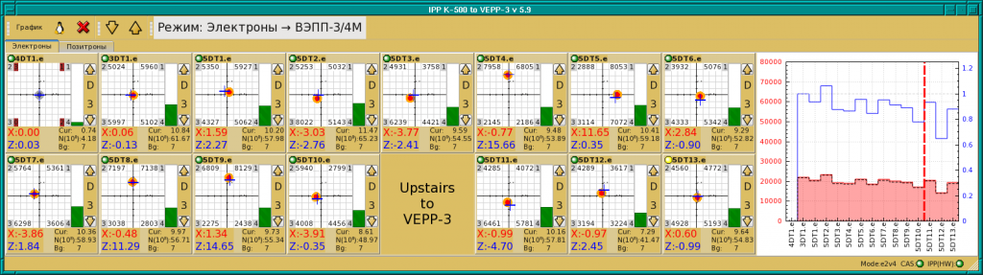
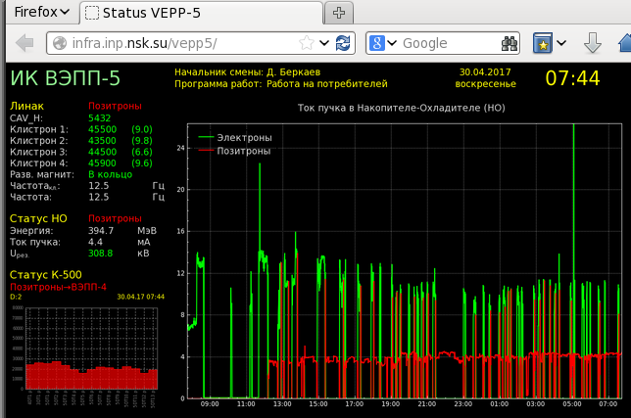
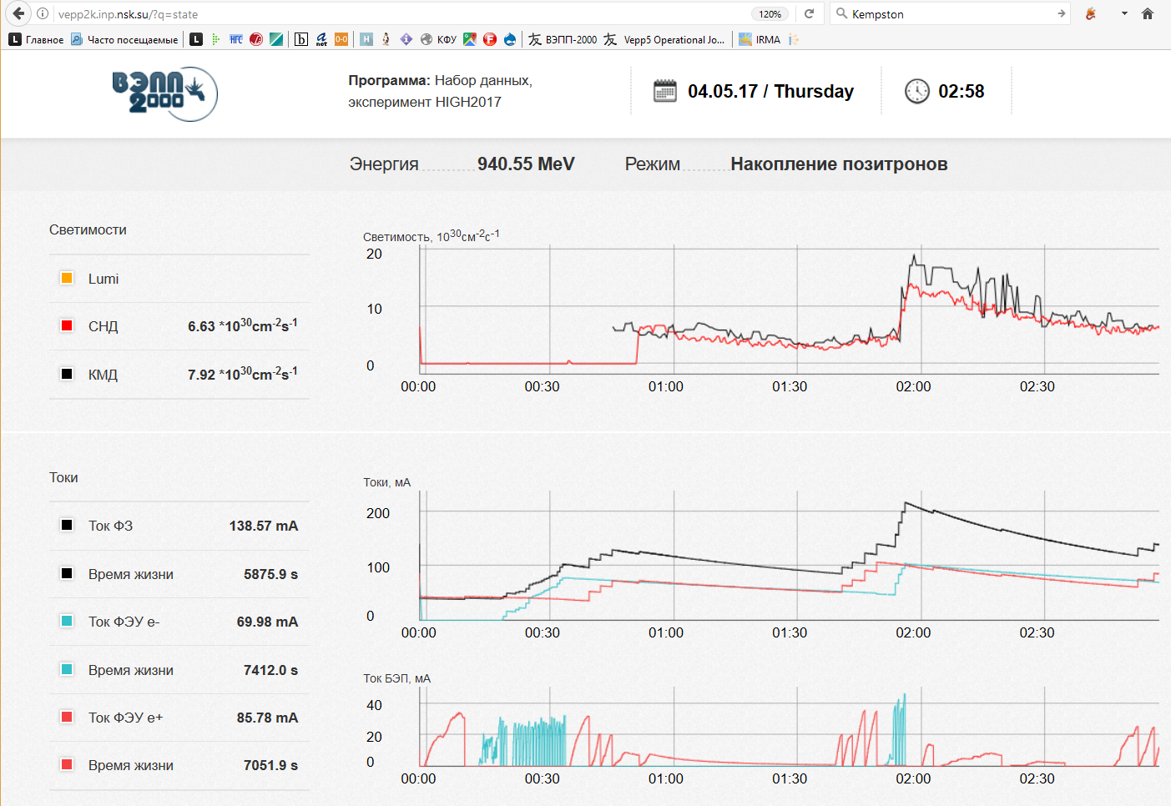
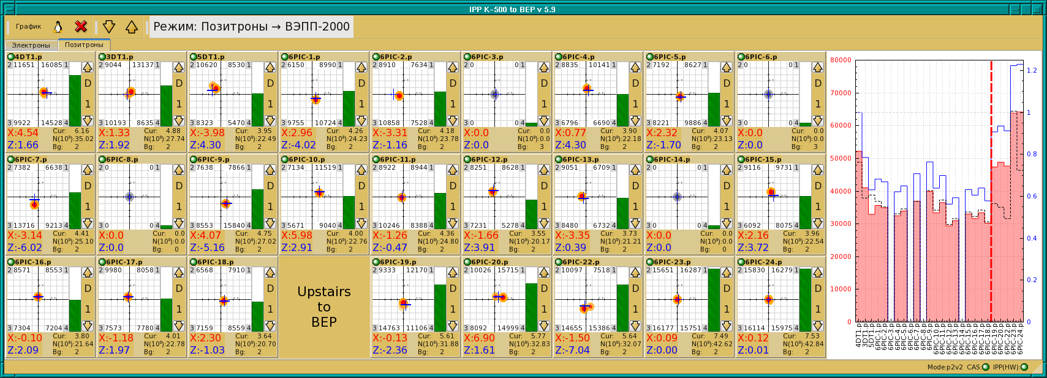
Operation with Two Colliders

Slide 20

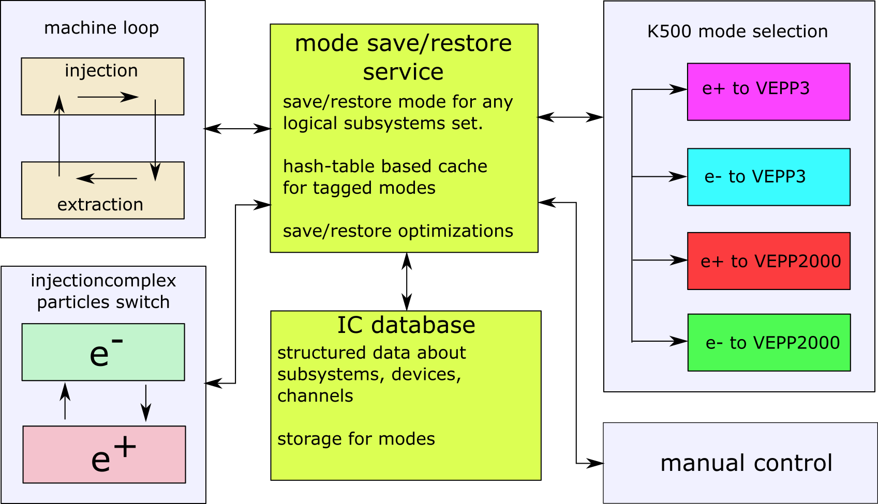
Injection complex operation techniques

