Slide 1
Investigation of the Magnetic Structure Characteristics of the NICA Booster in the Commissioning Runs with the Beam in 2020-2022
M. M. Shandov, E. V. Gorbachev, M. Yu. Korobitsina, S. A. Kostromin, V. A. Lebedev,
I. Yu. Nikolaichuk, G. S. Sedykh, V. L. Smirnov, A. V. Tuzikov, E. D. Tsyplakov
on behalf of the team
Veksler and Baldin Laboratory of High Energy Physics,
Joint Institute for Nuclear Research, Dubna, Russia

Slide 2
Introduction
Outlines
NICA Booster
Tune Measurements
Conclusion
Differential Orbit Measurements
Booster Beam Runs
Results

Slide 3
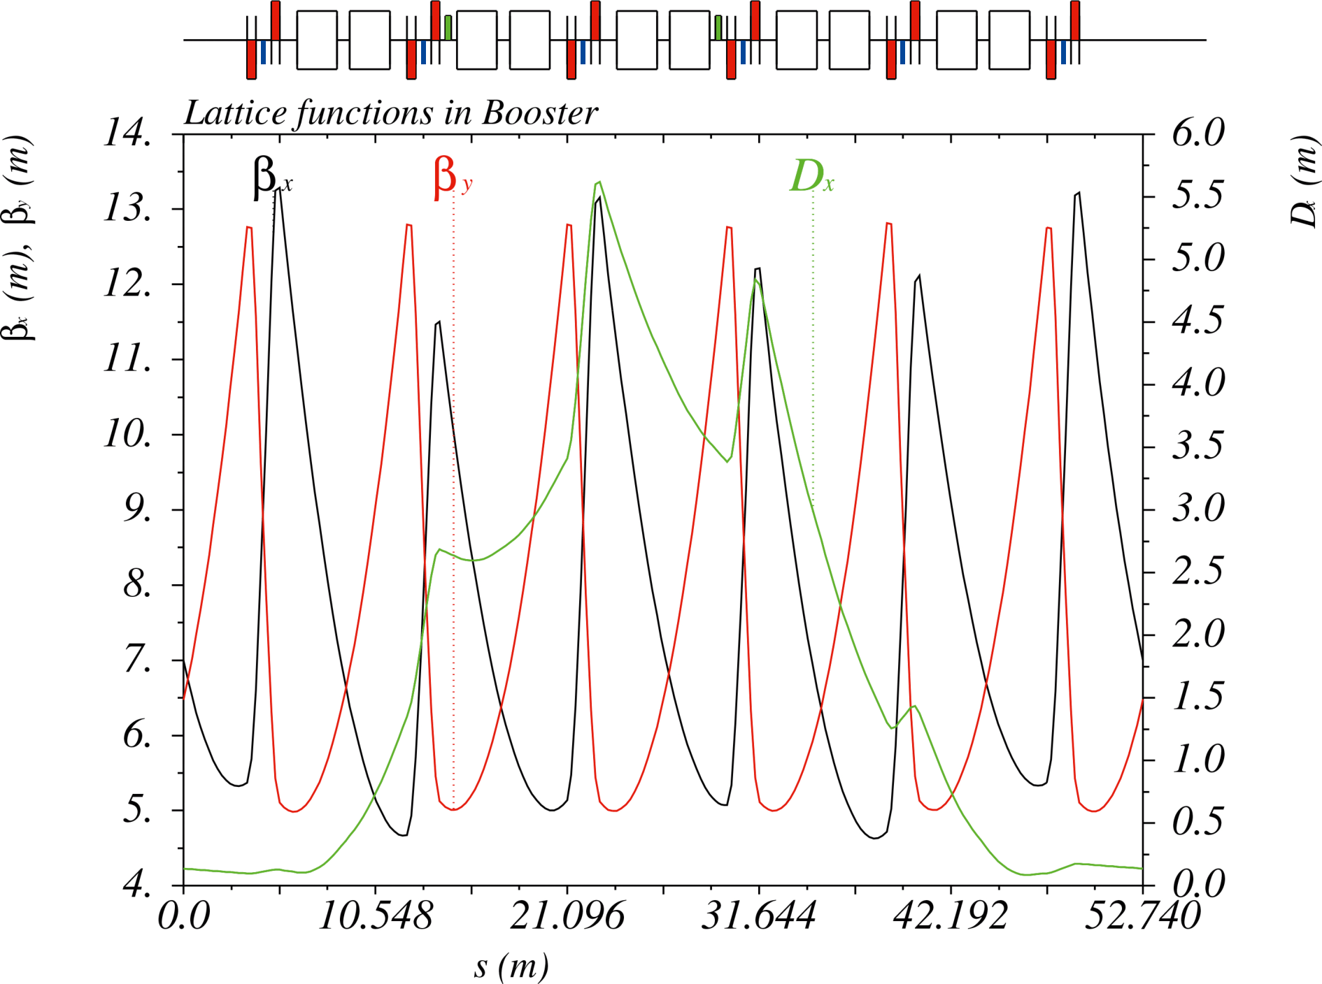
NICA Booster. Main Parameters
Ion | $${Au}^{31+}$$
Magnetic rigidity, $T⋅m$ at injection maximum | $$1.6$$ $$25.0$$
Circumference, $m$ | $$210.96$$
Number of super-periods | $$4$$
Number of DFO periods | $$24$$
Betatron tune ${ν_{x}}/{ν_{y}}$ | $${4.80}/{4.85}$$
Chromaticity ${ξ_{x}}/{ξ_{y}}$ | $${−5.10}/{−5.50}$$
Critical energy $γ_{tr}$, $GeV/u$ | $$3.25$$
Emittances hor/vert $6σ$, $π mm⋅mrad$ at injection after acceleration | $${15}/{15}$$ $${<11}/{<1.5}$$
RMS momentum spread, ${10}^{−3}$ at injection after acceleration | $$±1$$ $$±0.22$$
Revolution period, $μs$ at injection after acceleration | $$8.5$$ $$0.89$$
Technical specifications of the “Object "Booster" NICA”, 2019

Slide 4
Booster Beam Runs

Slide 5
At the Conference
A. Butenko “Status of the NICA Project”, 21.09
A. Tuzikov “Beam Transfer Systems in the NICA Accelerator Complex – Status and Plans”, 21.09
K. Levterov “Features of He1+, Fe14+ and C4+ Beams Injection into the Booster of the NICA Accelerator Complex”, 21.09
M. Yu. Korobitsina “Beam Injection Tuning at the Booster of the NICA Accelerator Complex”, 21.09
V. Zhabitsky “Control Methods of Longitudinal Momentum Spread of Ions in a Bunch at the Injection in Synchrotrons”, 22.09

Slide 6
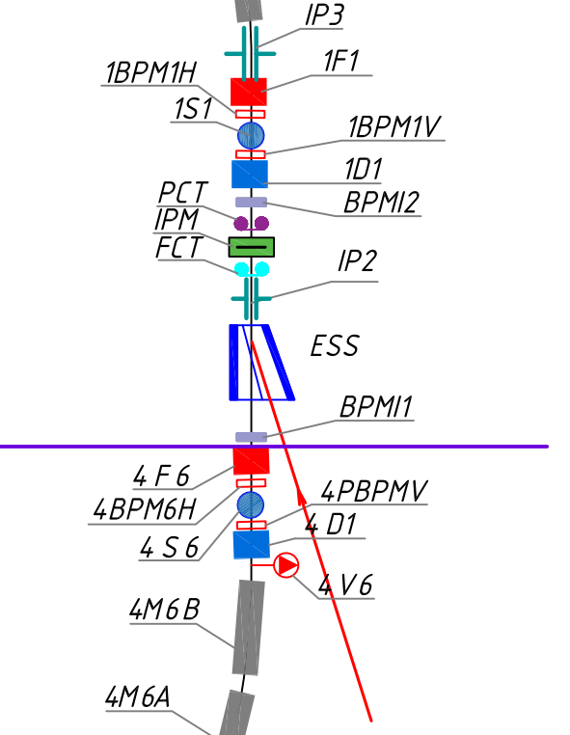
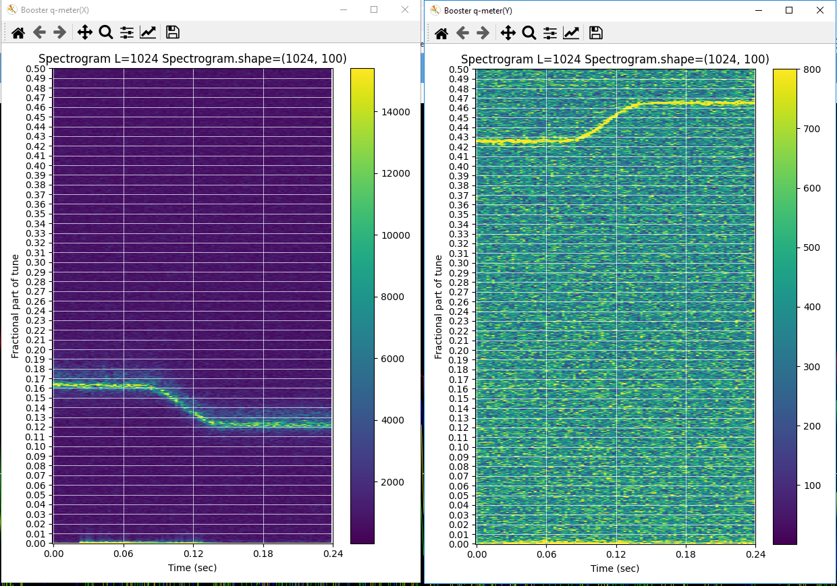
Tune Measurements
Run #2
He 1+
200 MeV
6078.4 Gs
k1=0.032, k2=0.060 to k1=0.025, k2=0.060

Slide 7
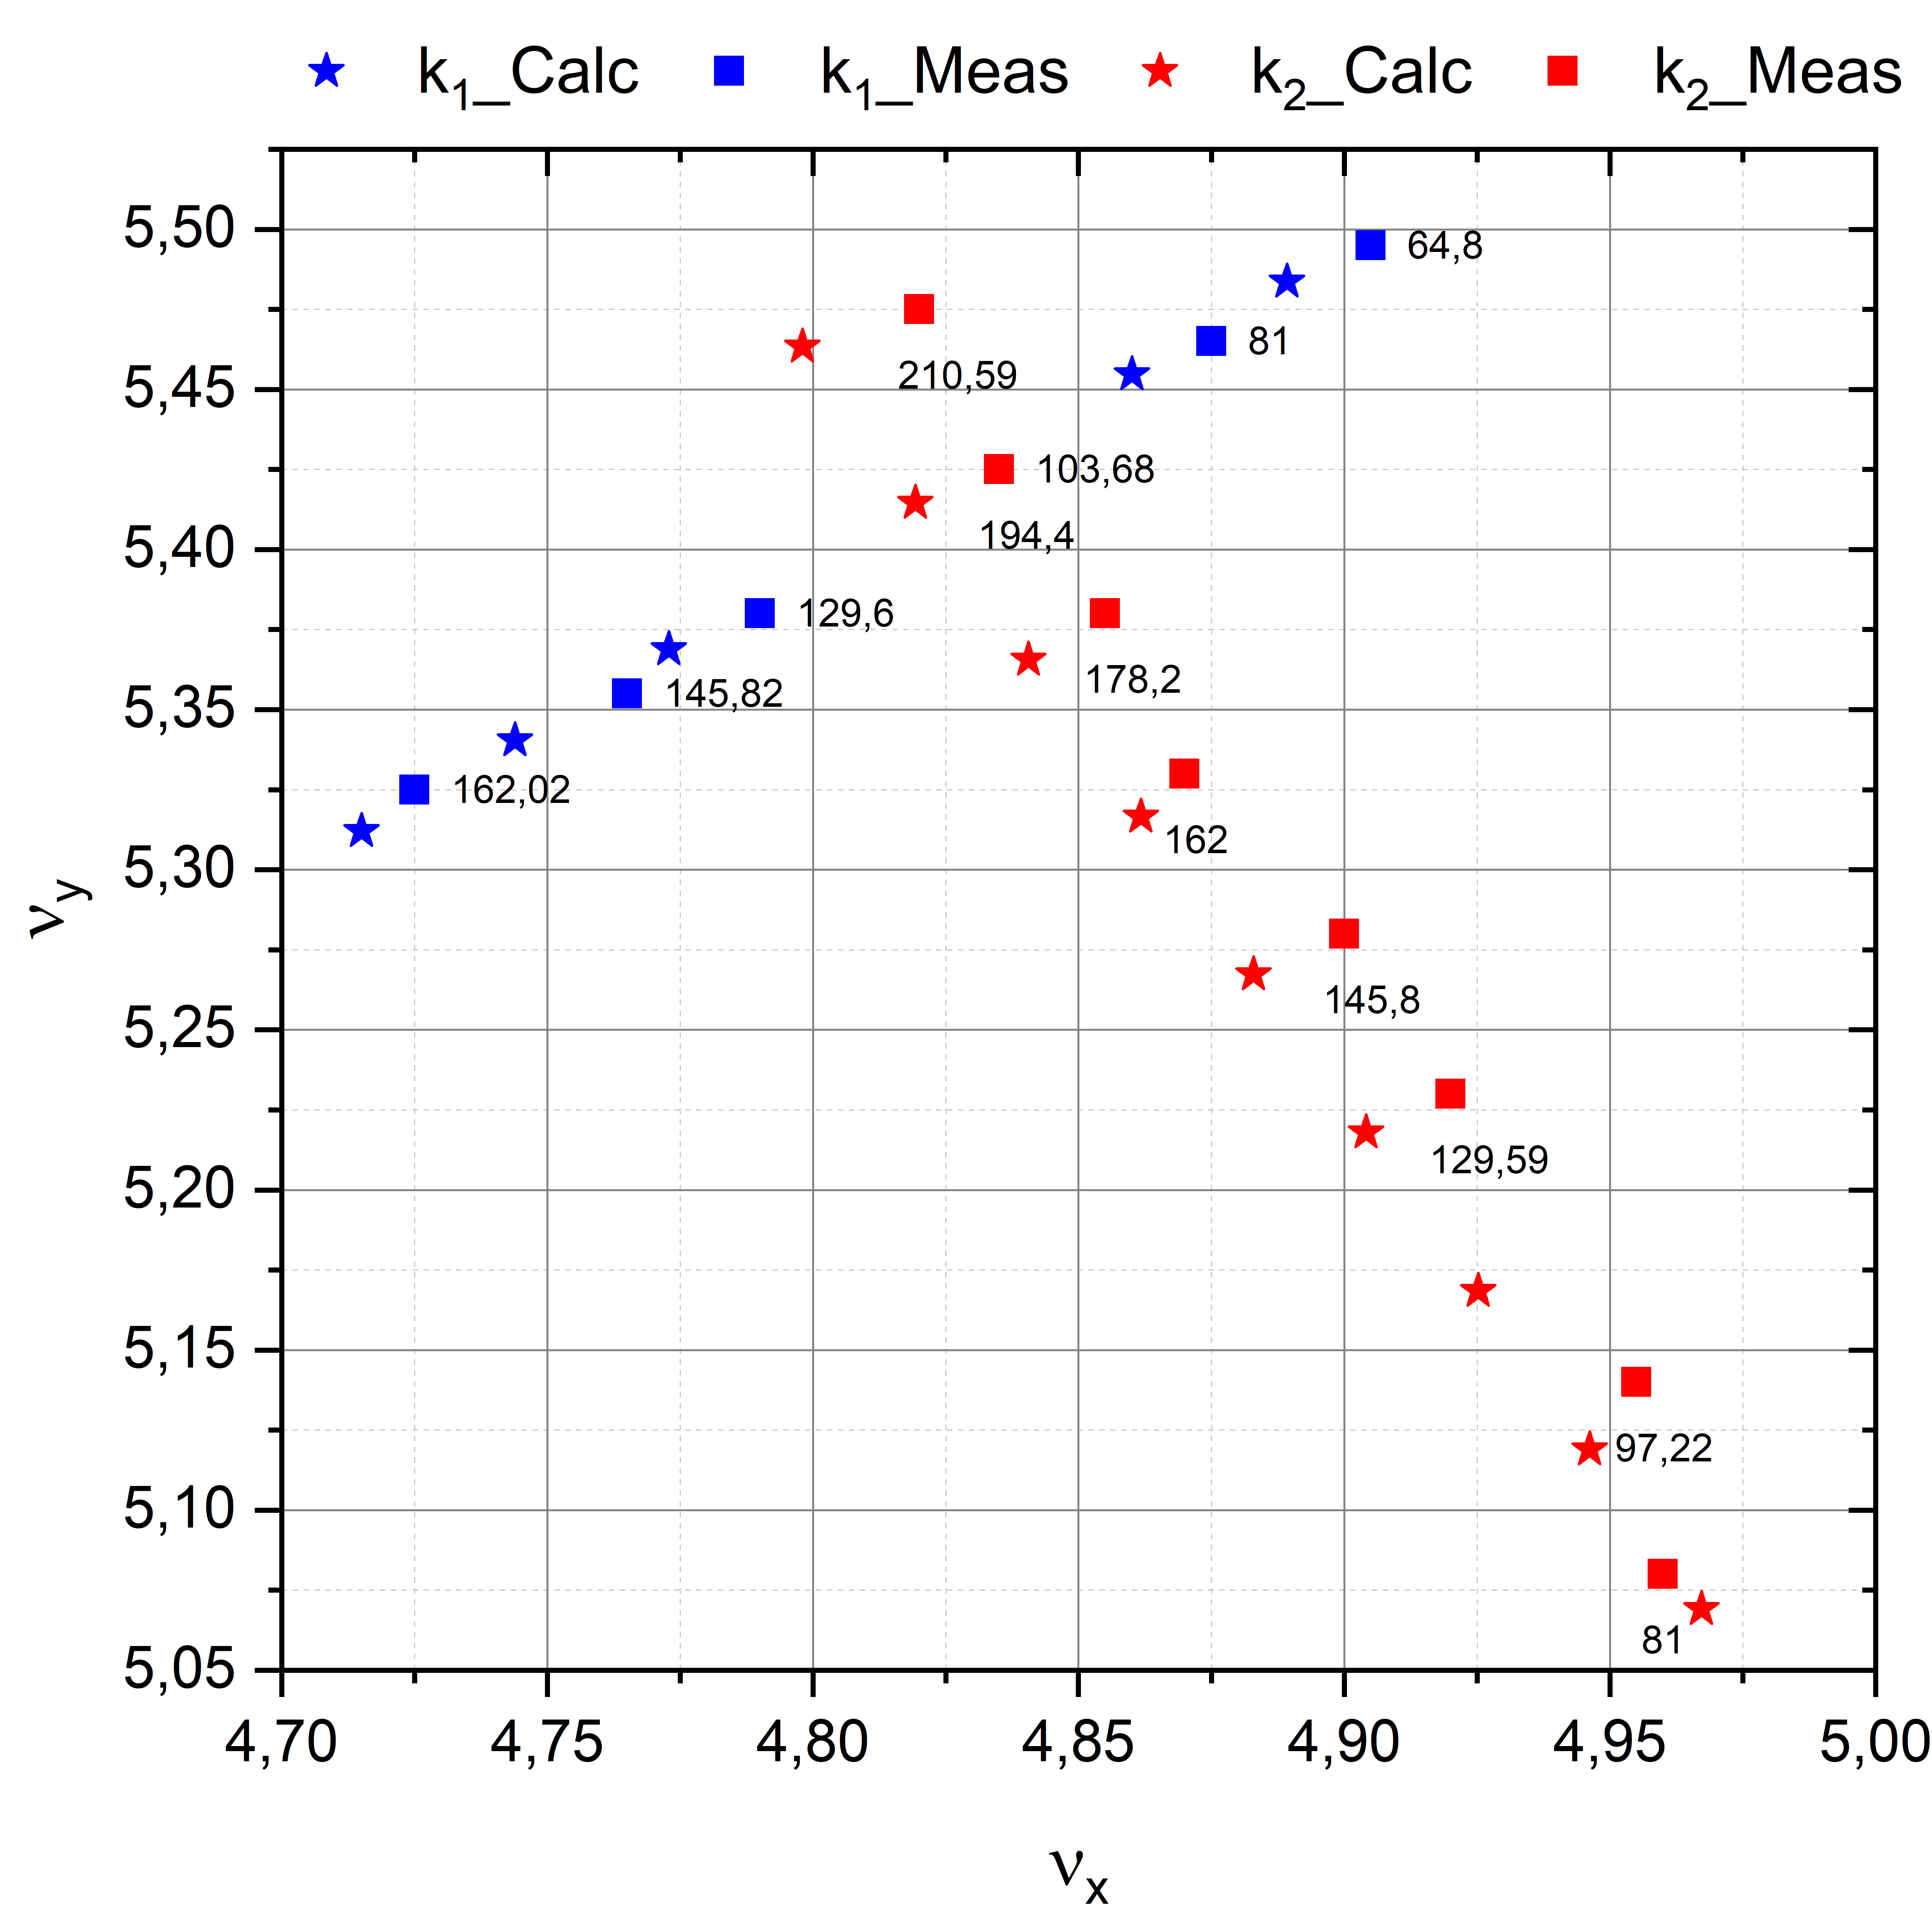
Tune Measurements
Scanned region: $\left\{\begin{aligned}ν_{x}=4.725÷4.960; \\ ν_{y}=5.080÷5.475 \end{aligned}\right.$
Operating Currents:
F lenses: $I_{F}=I_{dip}−k_{1}⋅I_{dip}$
D lenses: $I_{D}=I_{dip}−k_{1}⋅I_{dip}+k_{2}⋅I_{dip}$
$\left|ν_{calc}−ν_{meas}\right|≈1÷2\%$

Slide 8
Differential Orbits Measurements
Aim: to carry out preliminary measurements of the NICA Booster lattice functions in the Run #3
Tasks:
Develop a methodology for experiments
Develop a special software for experiments
Perform measurement of differential orbits in horizontal and vertical planes
Verify the optical model of the Booster
Correct the model parameters to ensure correlation between calculated and experimental results

Slide 9
Differential Orbits
$$X_{i}^{diff}=X_{i}^{pert}−X_{i}^{init}$$
Methodology:
Unperturbed orbit measurements $X_{1}^{init}$
Produce perturbation
Perturbed orbit measurements $X_{1}^{pert}$
Remove perturbation
Unperturbed orbit measurements $X_{2}^{init}$
Produce perturbation with “opposite sign”
Perturbed orbit measurements $X_{2}^{pert}$
Remove perturbation
Compare $X_{1}^{diff}=−X_{2}^{diff}$

Slide 10
Software Requirements
The Booster control system is based on the Tango-toolkit and includes 3 levels:
Equipment access level
Service level (data collection and primary processing)
Client level (control and diagnostic software)
Necessary software:
Beam position monitors (BPM) data
Corrector magnets control
RF-system control
Beam intensity control (FCT and PCT)
Software requirements:
Display current device status
Save data to file

Slide 11
Software Development and Debugging
Most of the equipment has only been tested before
Corrector power supplies debugging
Corrector power supplies software debugging
Tango-device for reading and storage data from 24 BPMs in each planes
Storage BPMs data each 100 ms
Tango-device for measuring differential orbits in automatic mode

Slide 12
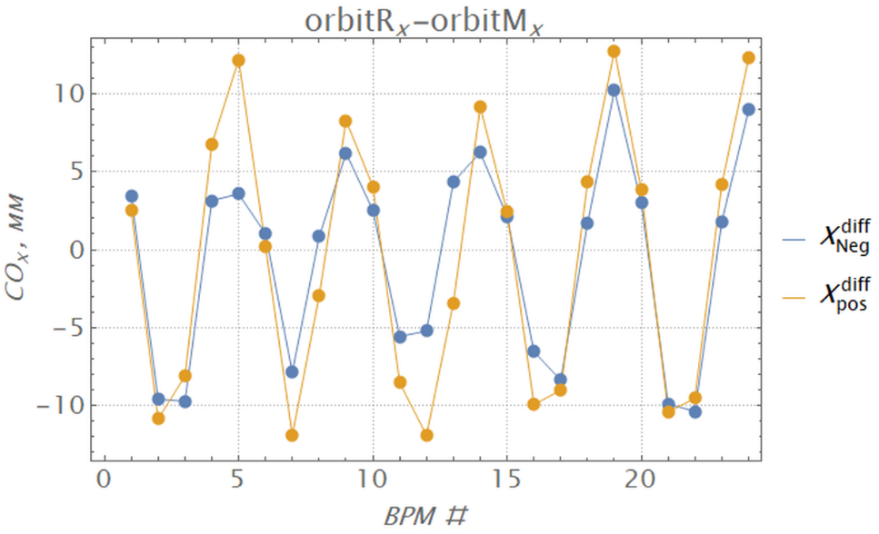
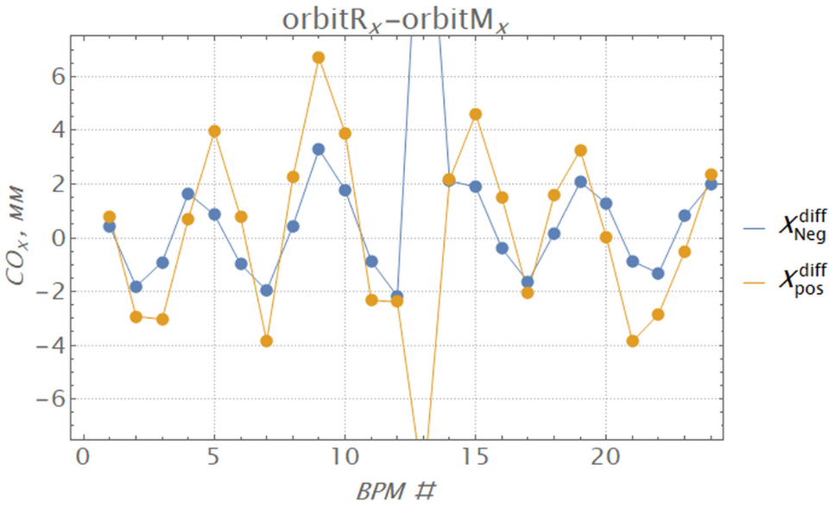
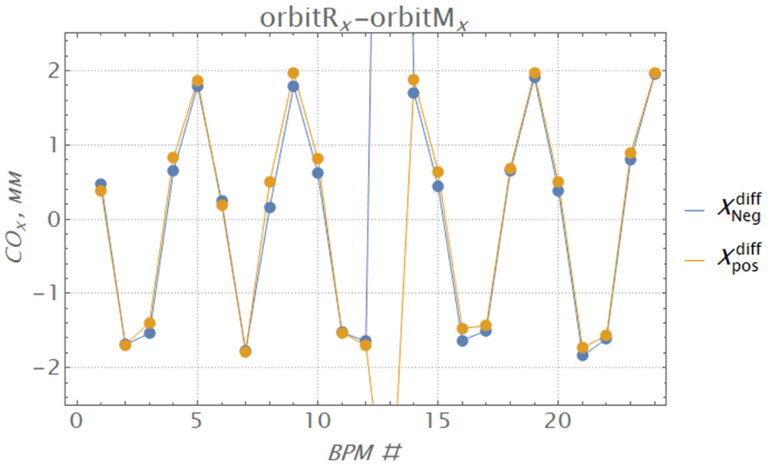
Differential Orbits Measurements
The aim of the first measurements was to test methodology, develop and debug software, equipment and diagnostic systems
Detailed studies of the Booster lattice dynamic properties and tuning the full range of design parameters were not provided
Perturbation: steerer operating currents $±0.7÷1.0 A$ or RF-system
Working point: ${ν_{x}}/{ν_{y}}={4.88}/{5.39}$
Steerer 2S1H
Step 1
Step 3
Step 5

Slide 13
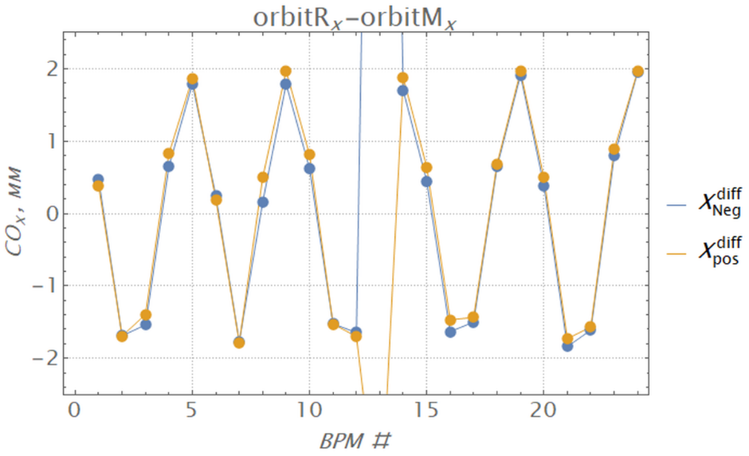
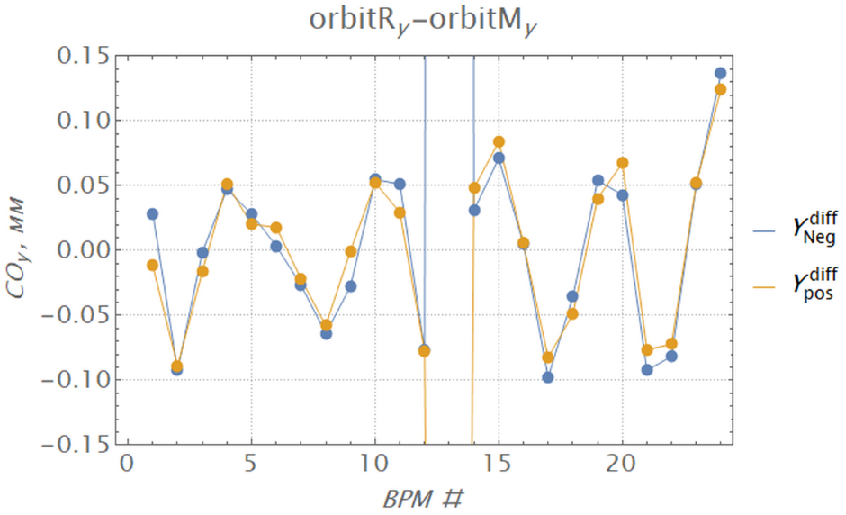
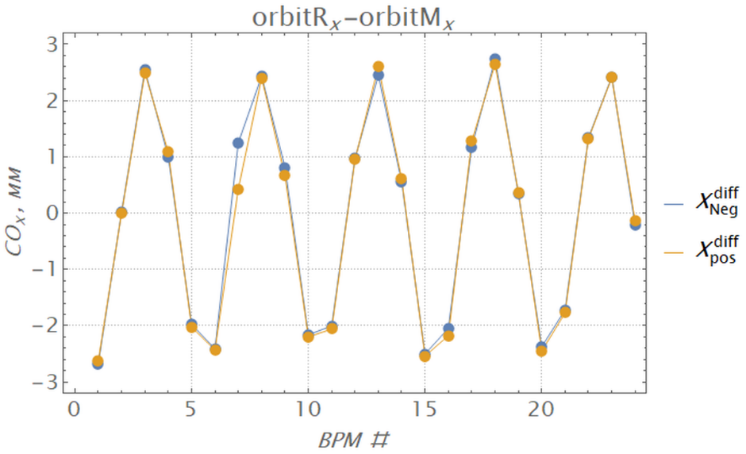
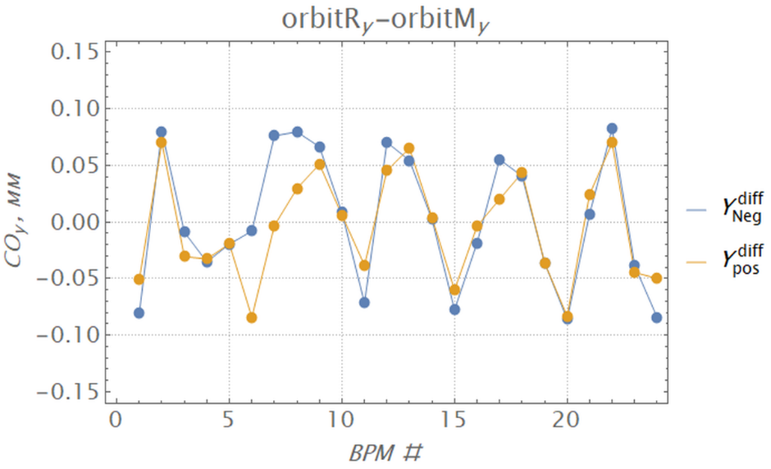
Differential Orbits Measurements
Steerer 2S1H, Step 5
Steerer 1S1V, Step 5

Slide 14
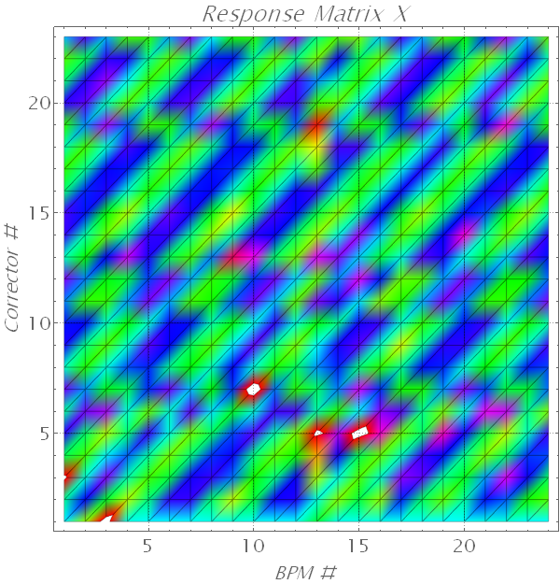
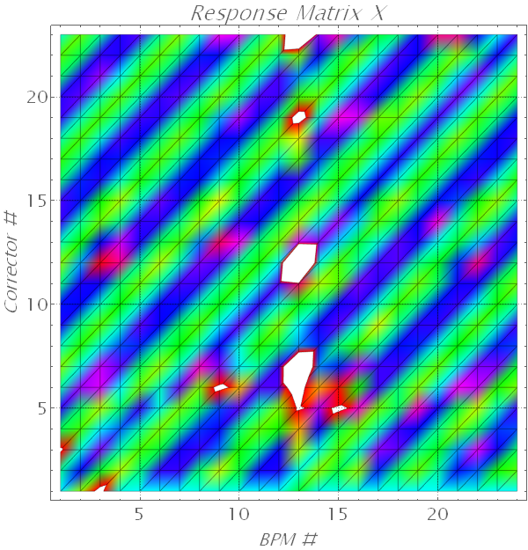
Steerers Polarities
2S2H
2S6H
3S1H
4S2H
4S6H
Before correction
Arter correction

Slide 15
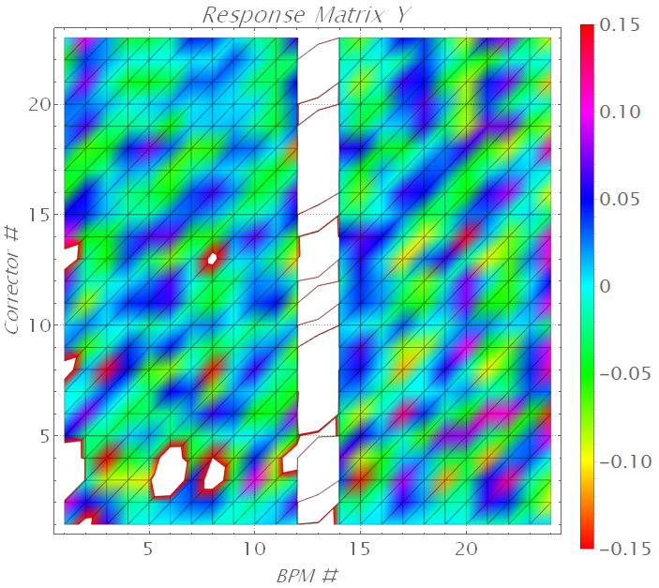
Steerers Polarities
Results:
the efficiency of the proposed method (data measurements and analysis could be performed by operators directly in the control room with the necessary software)
connection errors 5 correctors (2S2H, 2S6H, 3S1H, 4S2H, 4S6H)
problems with BPM #13 ($3BPM1H$)
synchronization of reading and writing data from BPM is required
further work with steerers in the vertical plane
the possibility and necessity of similar studies at the Nuclotron, beam transfer channels and the Collider

Slide 16
Orbit Response Matrix (ORM)
$$\left(\begin{matrix}R_{xx} & R_{xy} \\ R_{yx} & R_{yy}\end{matrix}\right)\left(\begin{matrix}θ_{x} \\ θ_{y}\end{matrix}\right)=\left(\begin{matrix}x \\ y\end{matrix}\right) or \vec{z}=R\vec{Θ},$$
$$R_{zz,ij}=\frac{z_{i}^{diff}}{θ_{z,j}},R_{xy,ij}=\frac{x_{i}^{diff}}{θ_{y,j}},R_{yx,ij}=\frac{y_{i}^{diff}}{θ_{x,j}}$$
Developed and tested software for the ORM measurements
The measurement time on the Booster was $≈30÷40 min$

Slide 17
Modelling
Accuracy of compatibility with the model $<1 \%$
$L_{eff}^{corr}=0.24 m$ correspond to 3D calculations

Slide 18
Dispersion
$$ΔX\left(s\right)=D_{x}\left(s\right)\frac{Δp}{p} <=>D_{x}\left(s\right)=−η\frac{Δx\left(s\right)}{Δf/f_{0}},$$
$$η=α−\frac{1}{γ^{2}}−slip factor;α−momentum compaction factor$$
$Δf=580.25±1.58 kHz, step=0.53 kHz$
$ΔE=3.144±0.018 MeV/u, step=0.006 MeV/u$

Slide 19
Modelling
Accuracy of compatibility with the model $<1 \%$ at $D_{x}>1 m$

Slide 20
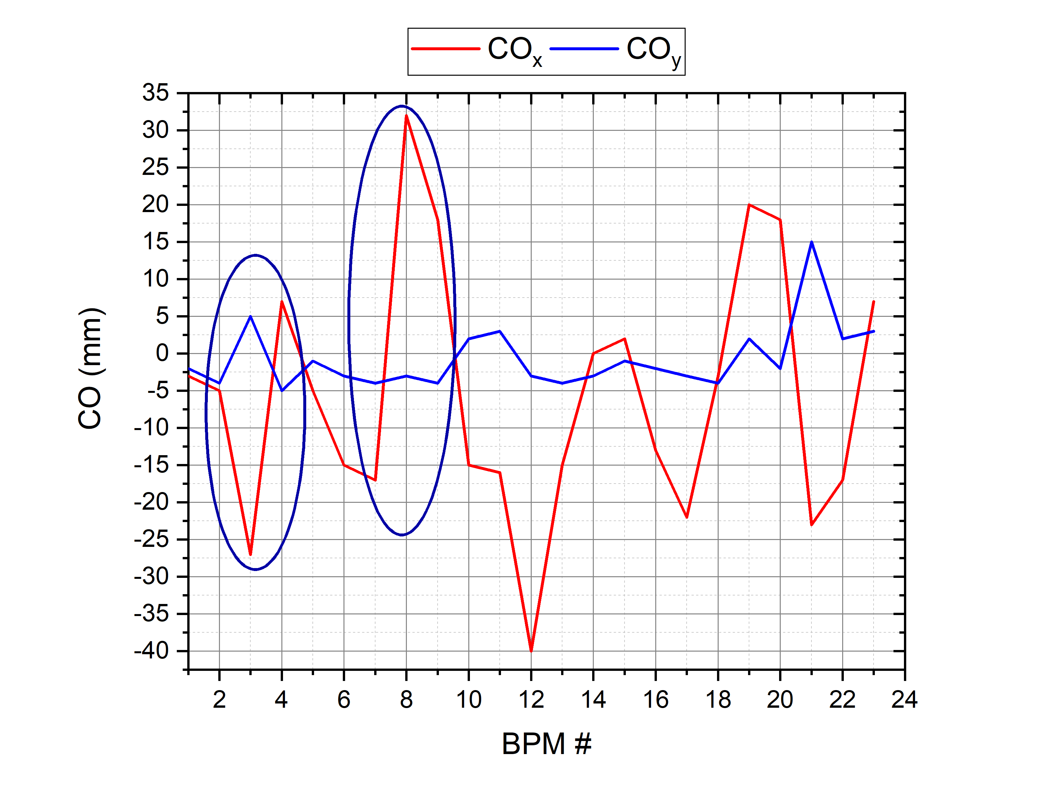
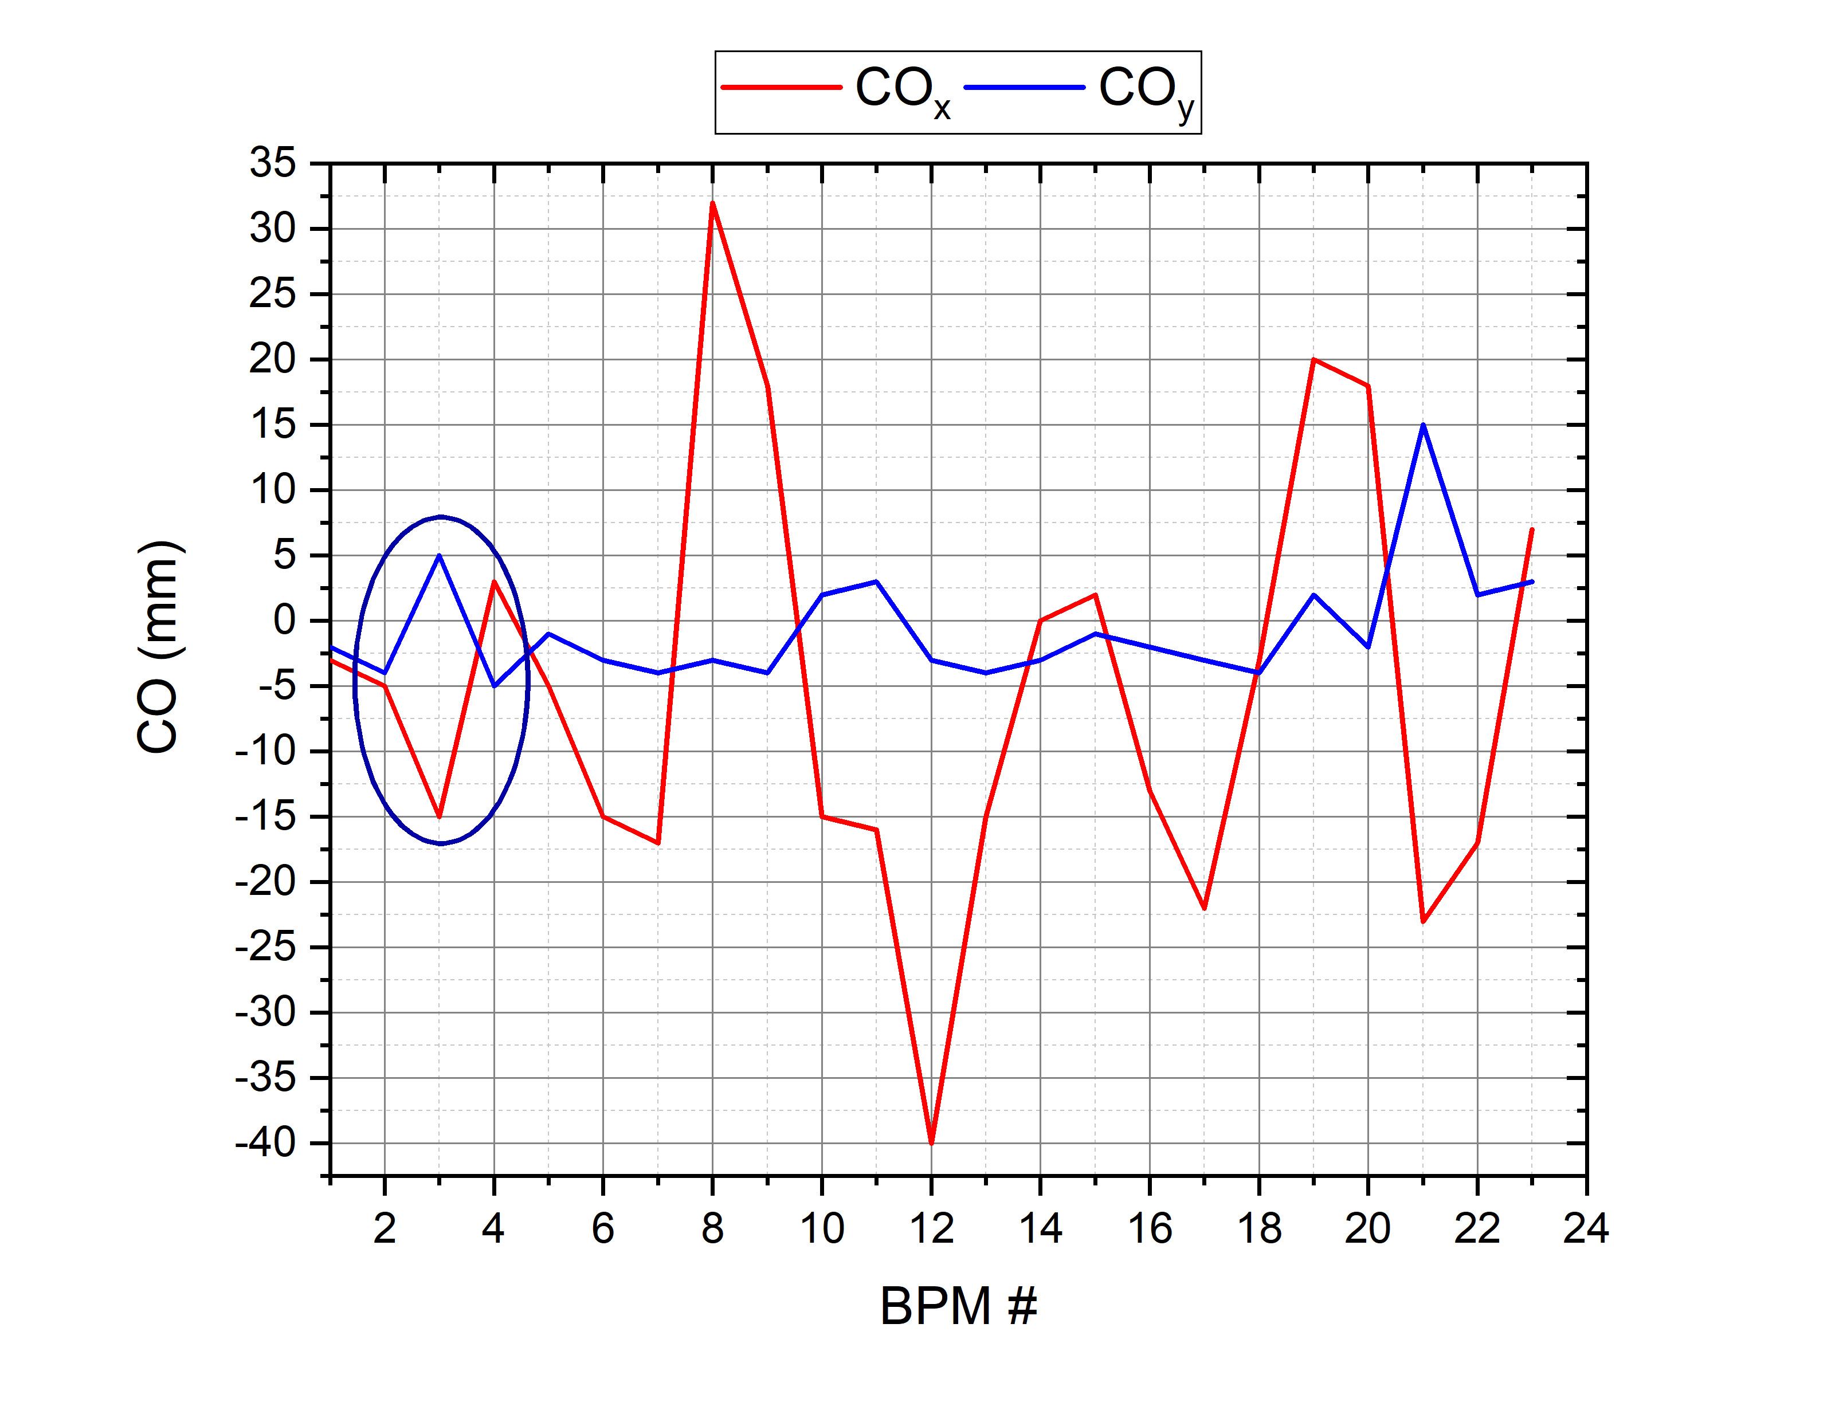
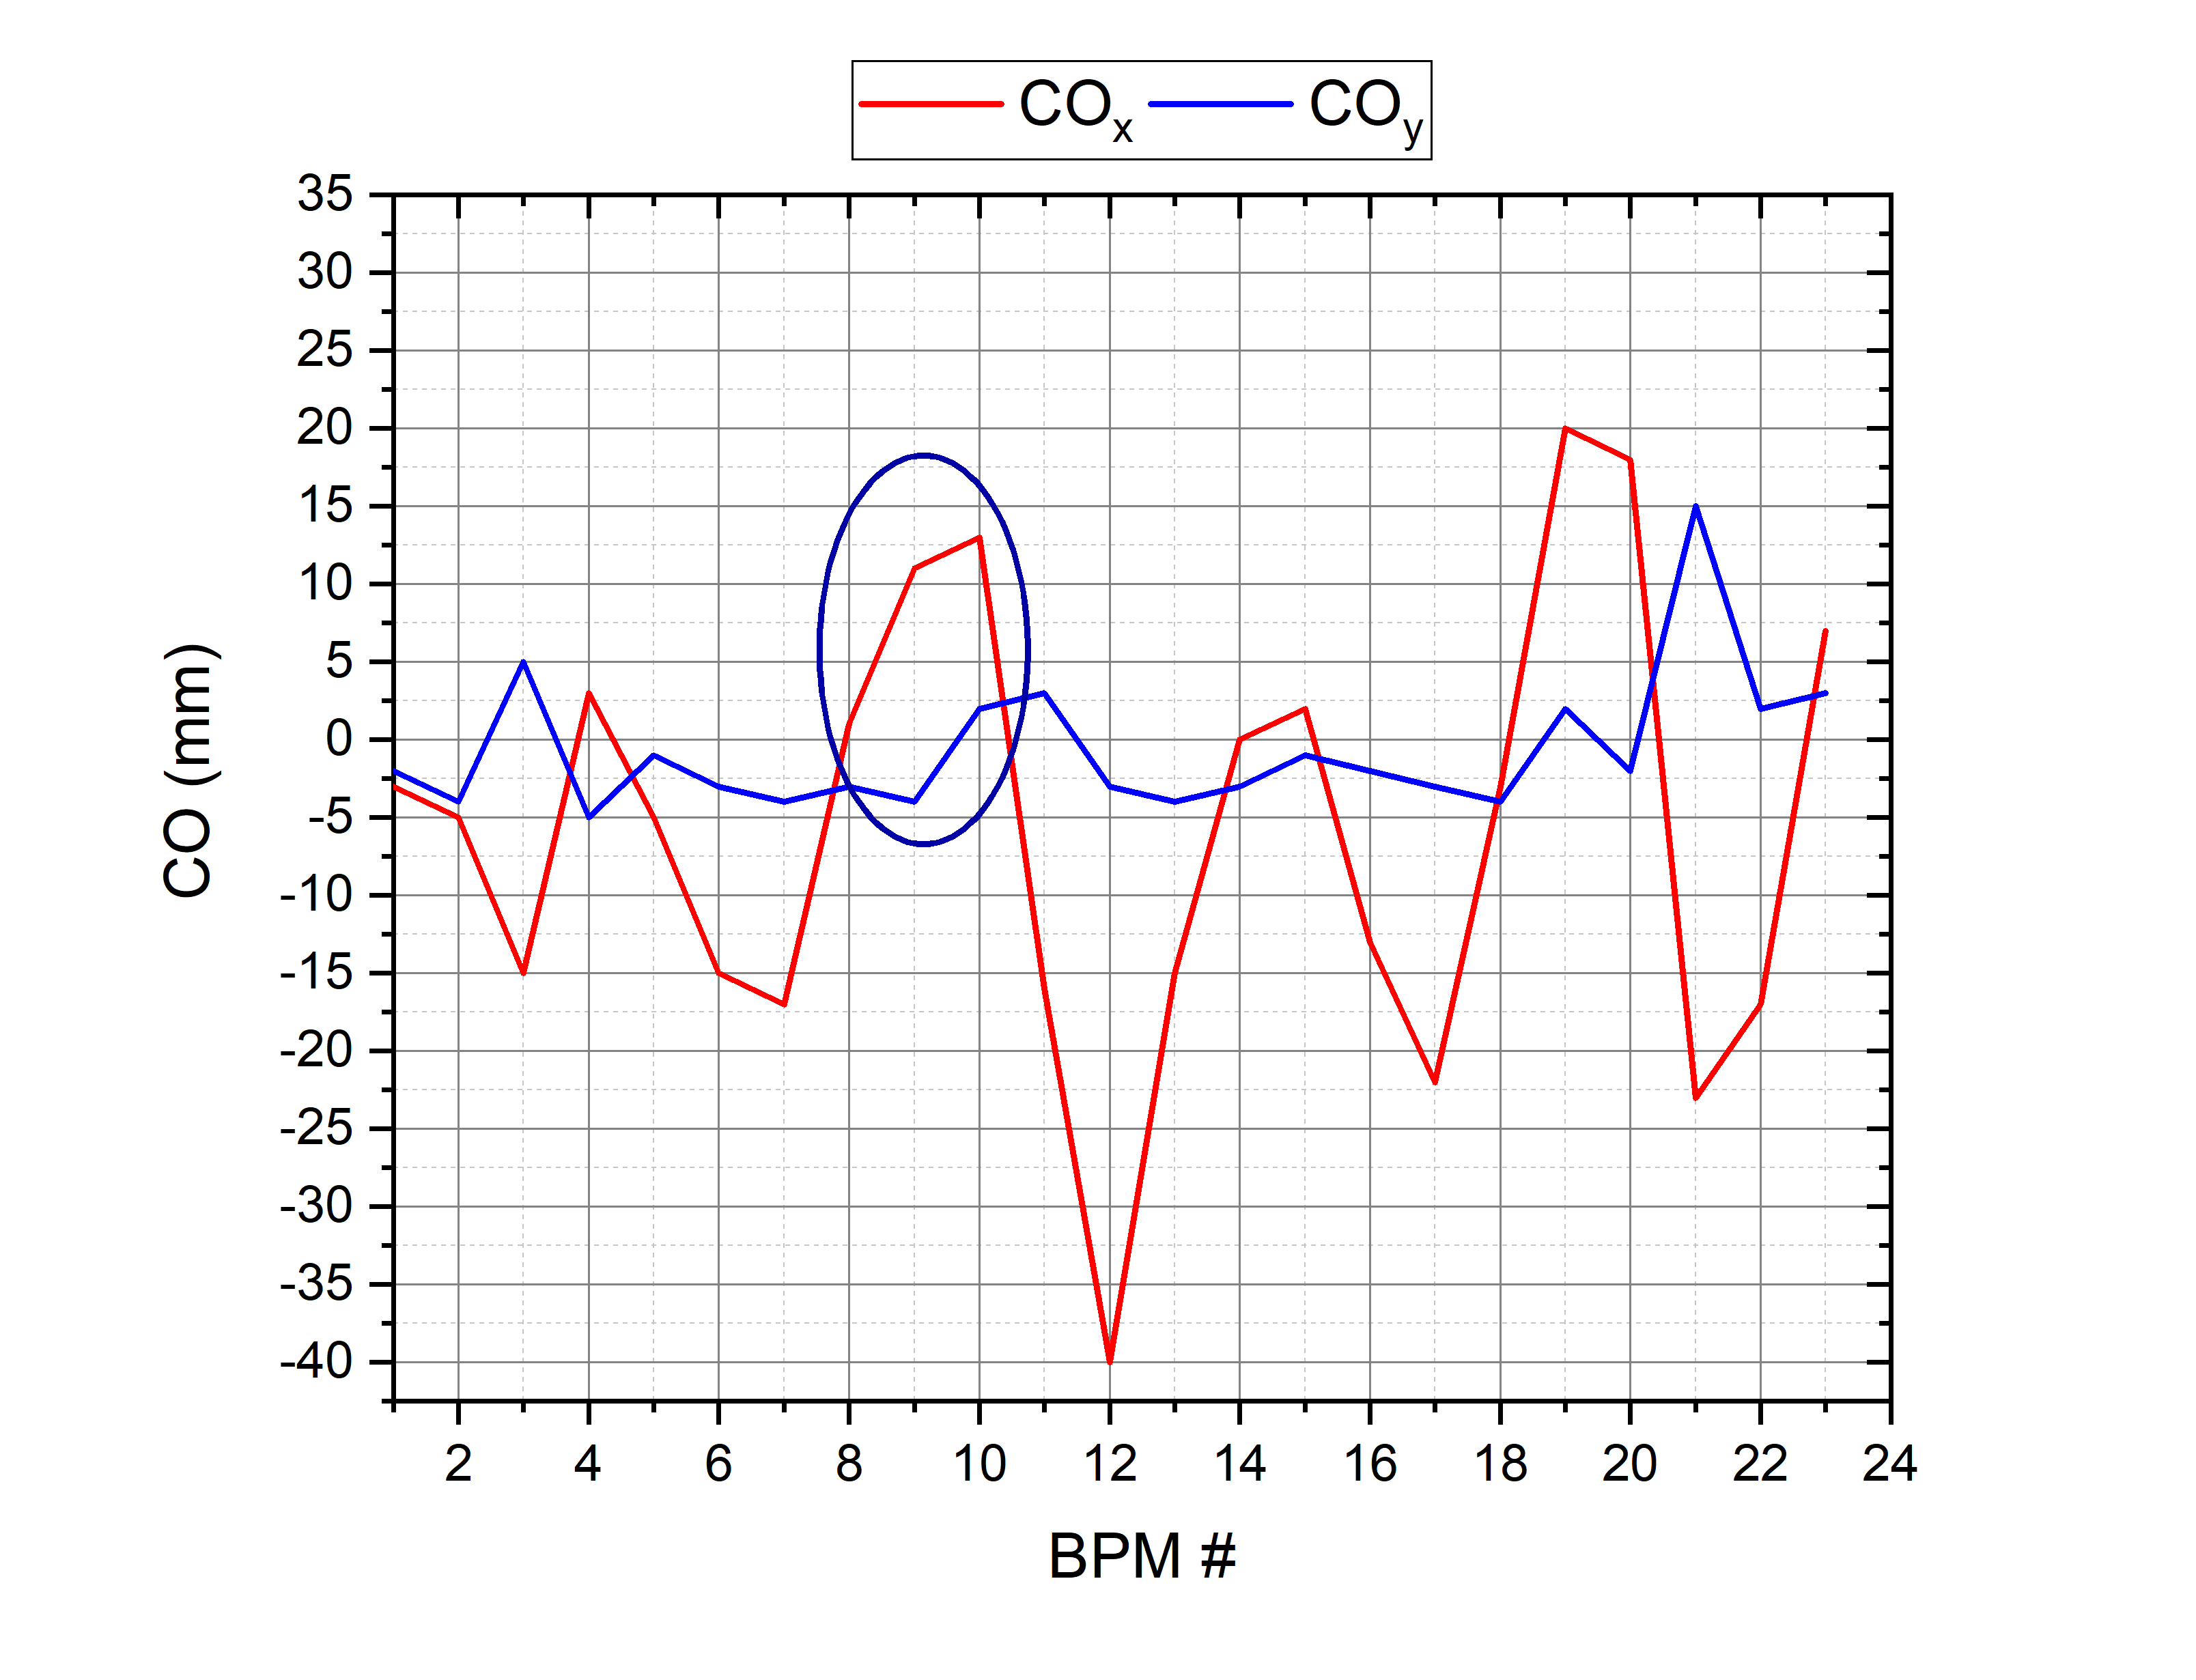
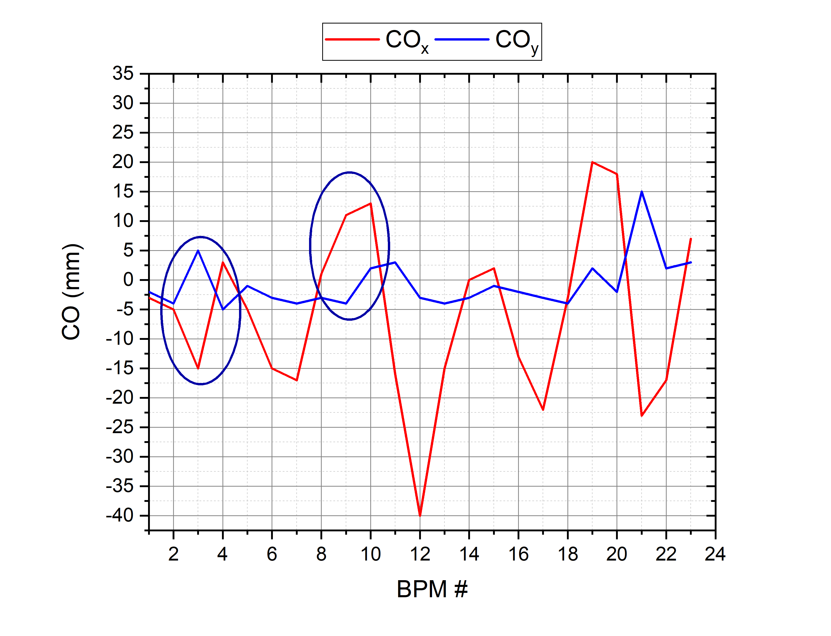
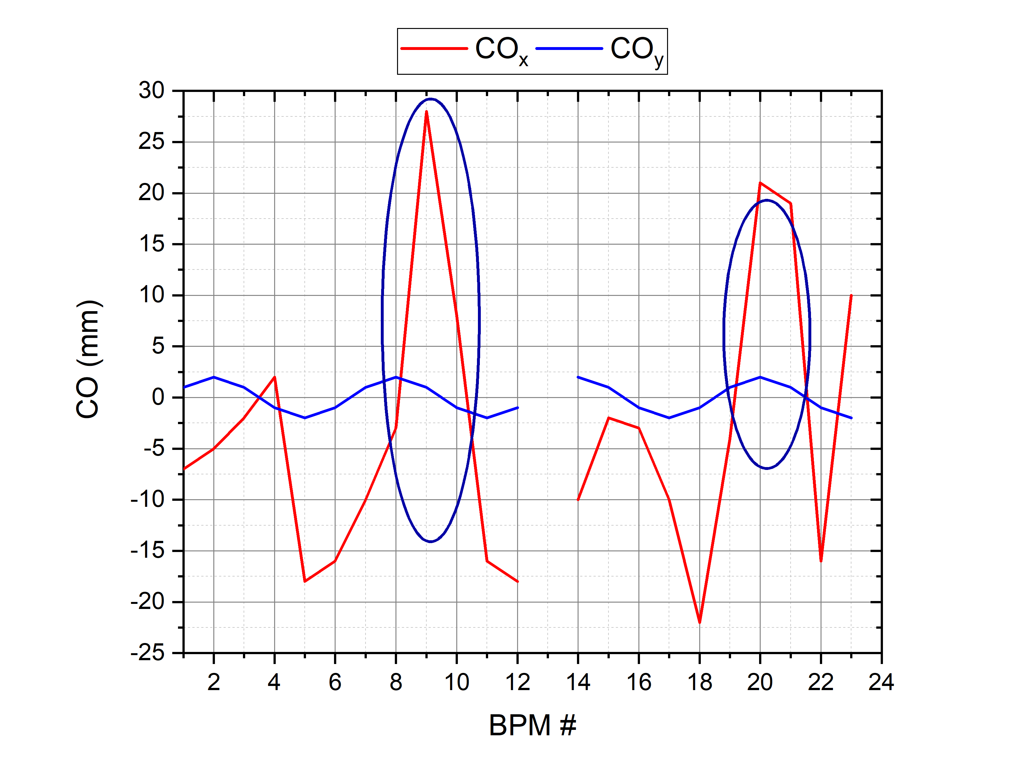
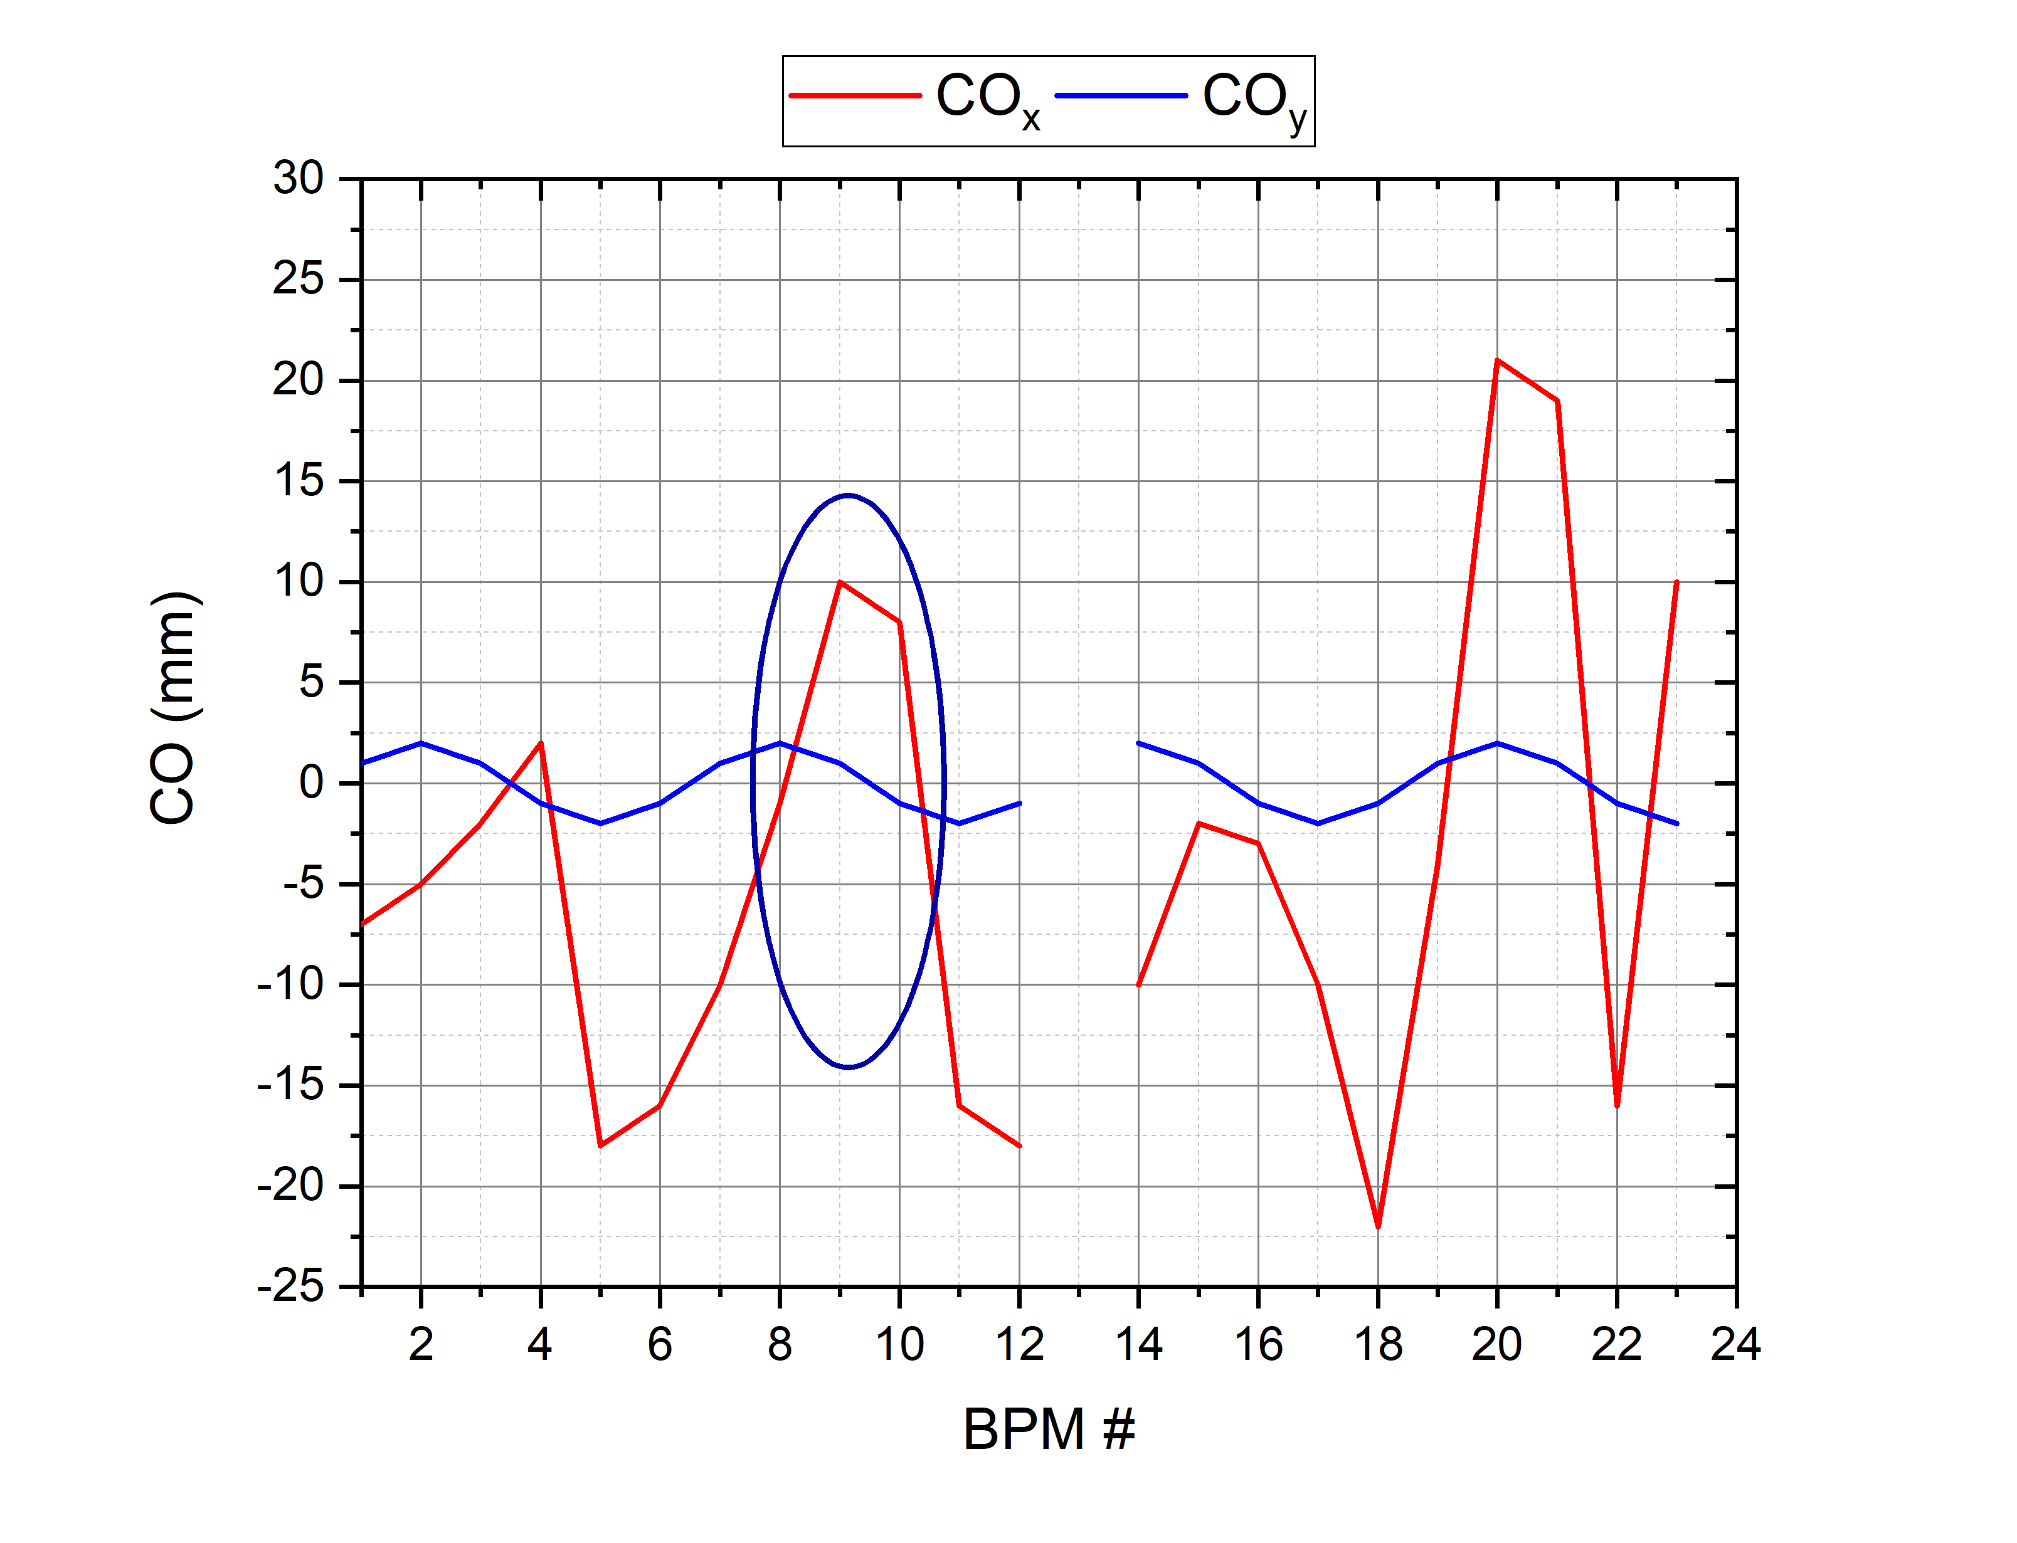
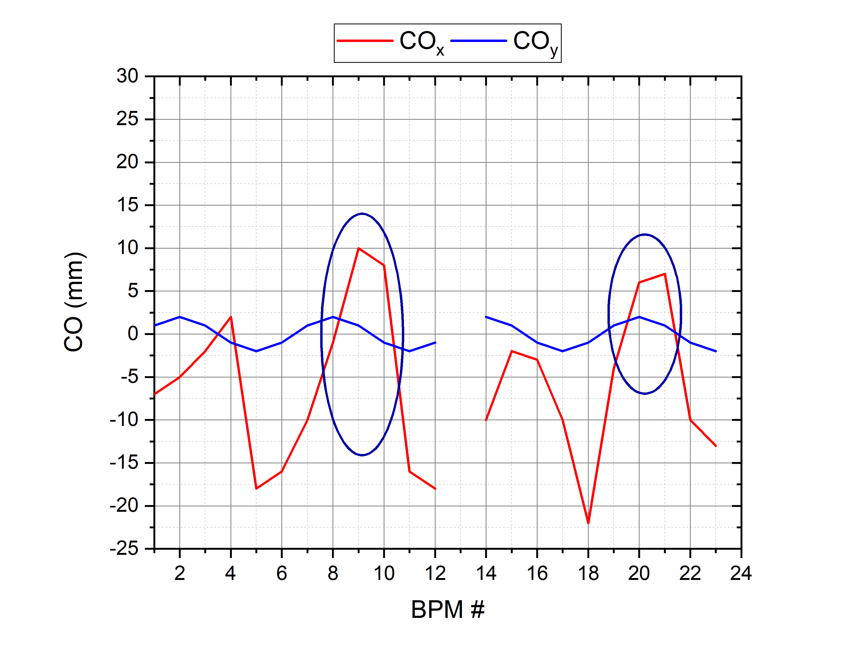
Bump Orbit
$${ν_{x}}/{ν_{y}}={4.88}/{5.39}$$
$${ν_{x}}/{ν_{y}}={4.80}/{4.85}$$

Slide 21
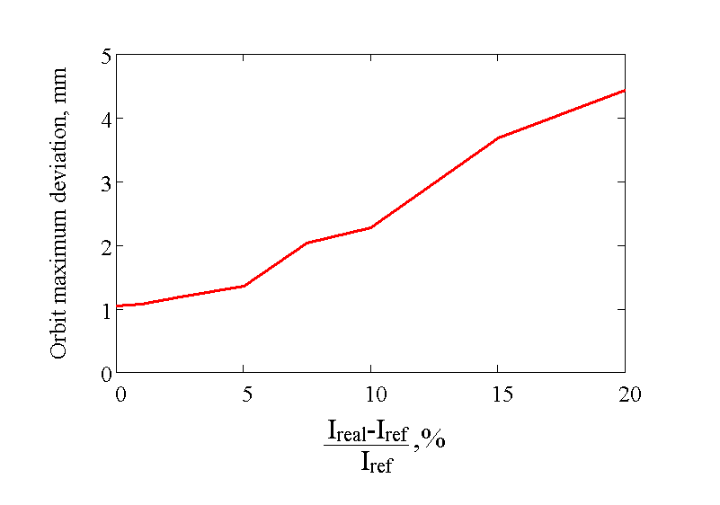
SVD
ORM used
Orbit $≤1,05$mm
Library developed
Necessity to study automatic mode

Slide 22
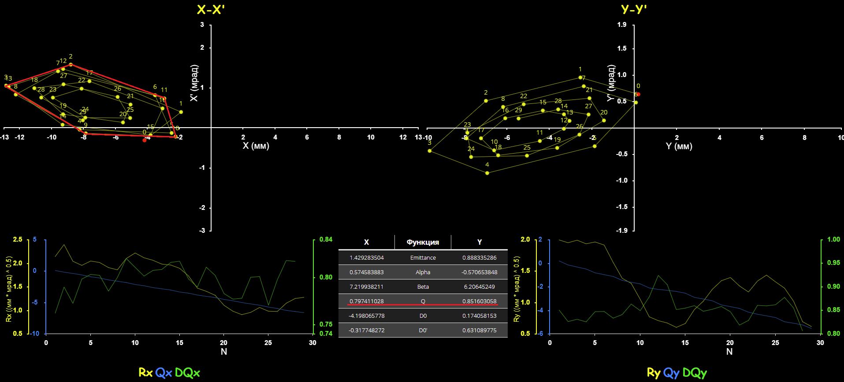
$${ν_{x}}/{ν_{y}}={4.80}/{4.85}$$
(x,x’)
(y,y’)

Slide 23
Conclusion
Tune scan
Developed and implemented software for measuring differential orbits and MOO.
The measurement time on the Booster was $≈30÷40 min$
Polarity check
ORM measured
Accuracy of compatibility with the model $<1 \%$ at $D_{x}>1 m$
$L_{eff}^{corr}=0.24 m$ correspond to 3D calculations
Local bump $<±3 A$ $CO≈10 mm$
SVD library
Optics measurements working group

Slide 24
Conclusion
The authors gratitude to the staff of the VBLHEP Accelerator Department, who supported and helped with the organization and conduct of the work
THANK YOU FOR ATTENTION !!!

Slide 25
Conclusion

