Slide 1
NICA BEAMLINES AND STATIONS FOR APPLIED RESEARCH
Presenter:
Georgii Filatov
on behalf of team
INTRODUCTION
General information about the NICA accelerator areas for applied research.
Stations requirements and equipment for applied research
Beam lines for stations based on ion Nuclotron beams
The first commissioning of the beam line and Station of CHip Irradiation (SOCHI).
Conclusion/plans
*SOCHI, SIMBO, ISCRA beam lines and station are discussed in this report

Slide 2
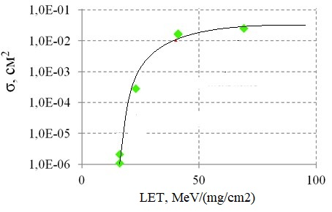
RADIATION DAMAGES IN MICROELECTRONIC
Galactic Cosmic Rays: protons and ions Z=2 to 92, E up to 10¹¹ GeV
Dependence of the latch-up effect cross section in microchip from ions LET range
For example: Single Event Lаtchup
NICA accelerator: HILAC (рус. ЛУТИ) CAN BE USED
not all modern microchips allow the process of decapsulation
GCR spectra for several ions [1]
[1] M.A. Xapsos, P.M. O'Neill, and T.P. O'Brien, “Near-Earth space radiation models,” , IEEE Trans. Nucl. Sci., vol. 60, no. 3, pp. 1681-1705, 2013
Dependence LET VS Ion energy

Slide 3
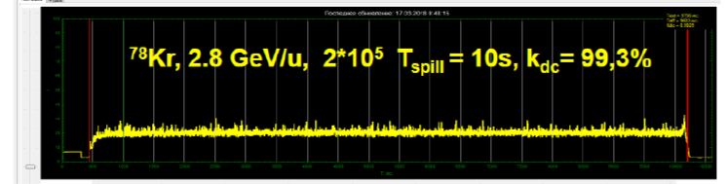
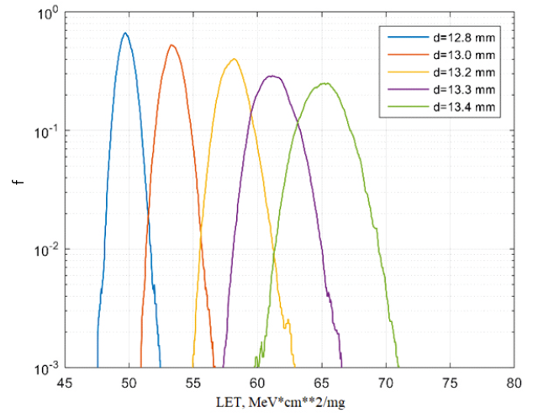
IRRADIATION BY HIGH ENERGY IONS
New Nuclotron beamlines applied for radiobiological researches and chip irradiations
Modern microchips irradiation without decapsulation
The ions like 131Xe54+ and 197Au79+ at energy of 150-200 MeV/n are decelerated in microchip package to energy of 5 -10 MeV/n corresponded to the Bragg peak.
Spectrum of LET in Si microchip for 197Au79+ ions at initial
energy 250 MeV/n after their deceleration in the
degrader system (set of polyethylene plates of different
thickness)
Spill of Kr ion beam extracted from Nuclotron
Peculiarities: long pulse duration and very good uniform extracted beam distribution in time
Radiobiological experiments
with dose 1-2 Gy
Intermediate energy of 0.5 – 1 GeV/n
Investigation:
  interactions of ions and bio objects
  genetic mutations
  morphological changes
The lower energy,
the greater energy and LET spread.

Slide 4
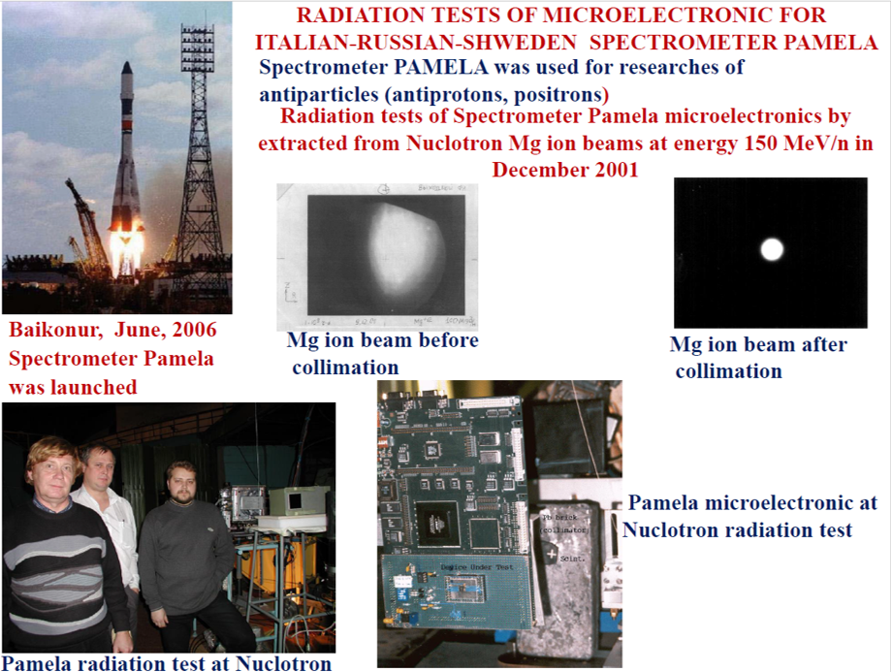

Slide 5
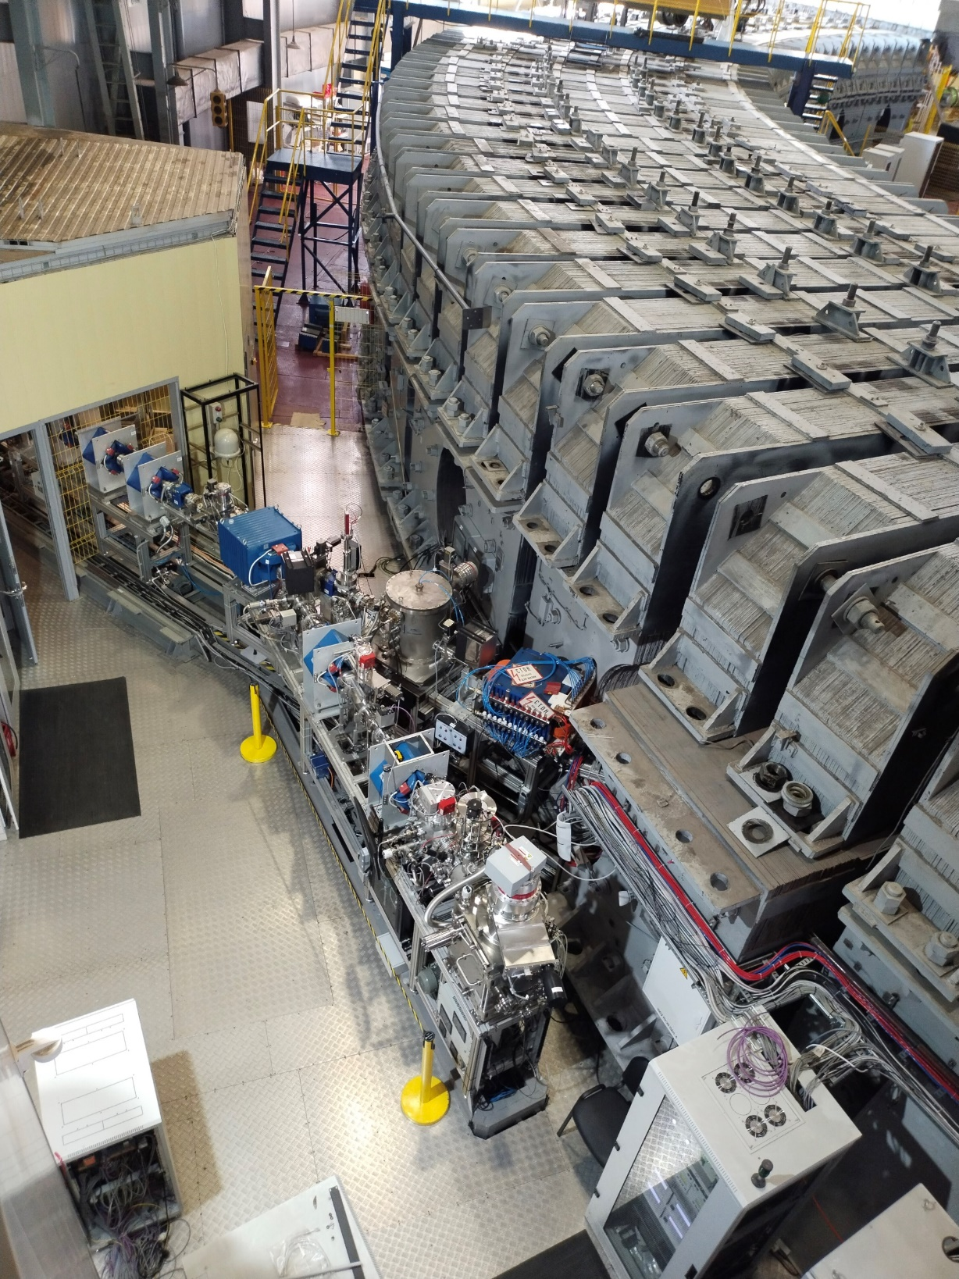
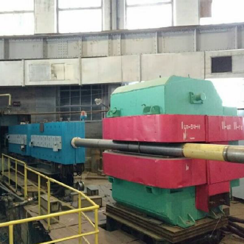
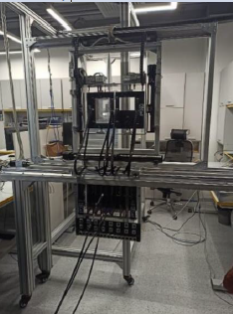
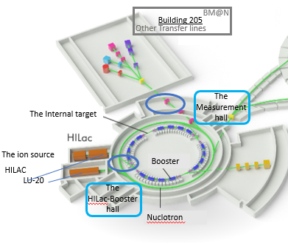
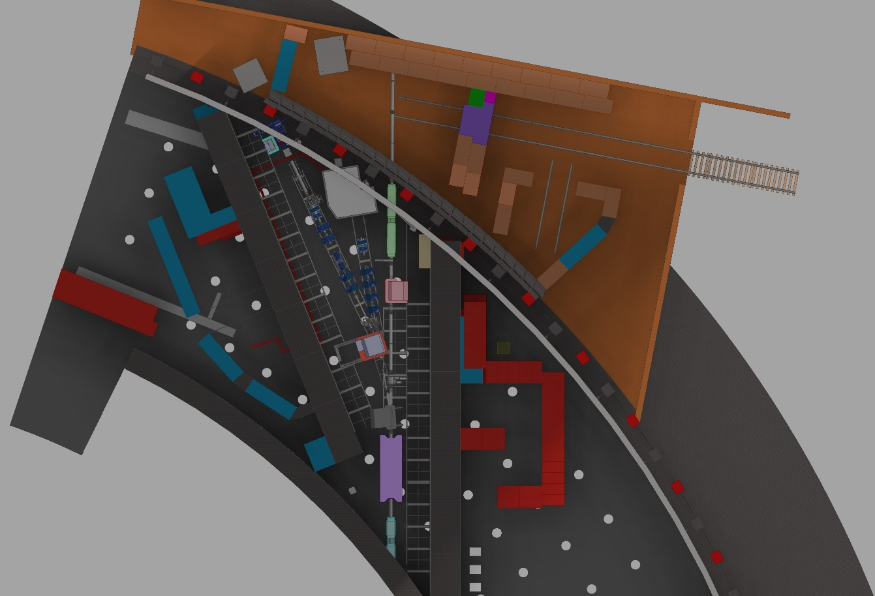
Special area-1 (SIMBO, ISCRA) | Special area-2 (SOCHI)
NuclotronIon Ion beams of intermediate energies | HILAC Ion beams of low energy
Radiation damages in microelectronic: Irdiation Station of Components of Radioelectronic Apparatuses (ISСRA) Radiobiological Researches: Station of Investigation of Medico-Biological Objects (SIMBO) | Radiation damages at microelectronic Station Of Chip Irradiation (SOCHI).
Shorted NICA’s scheme

Slide 6
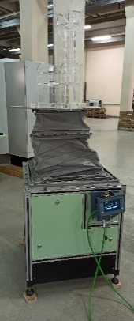
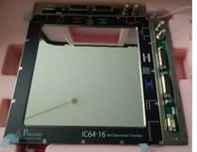
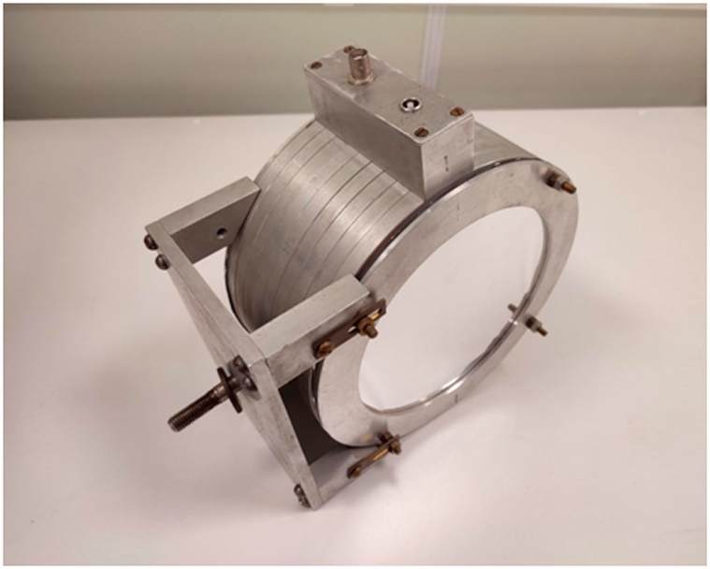
STATIONS
Parameter | SIMBO | ISCRA | SOCHI
Ion type | ⁴⁰Ar¹⁸⁺, ⁵⁶Fe²⁶⁺, ⁸⁴Kr³⁶⁺ |  | ¹²C⁴⁺, ⁴⁰Ar¹⁰⁺, ¹³¹Xe²²⁺, ⁸⁴Kr¹⁴⁺, ¹⁶⁹Tm²¹⁺, ¹⁹⁷Au³¹⁺, ²⁰⁹Bi³⁴⁺
 | ¹²C⁶⁺ | ¹³¹Xe⁵⁴⁺, ¹⁹⁷Au⁷⁹⁺
Ion energy, MeV/n | 400-1100 | 150-425 | 3,2
Beam intensity, particles per pulse | 10⁶-3×10⁹ | 3×10⁴-10⁸ | 10⁸-6×10⁹
Beam emittances (95%), ε_{x}/ε_{y} (π⋅mm⋅mrad) | 3-10/ 8-15 | 5-17/ 13-25 | 10/10
Mean particles flux density, particles/(cm².s) at the target | 10³-10⁵ | 10²-3×10⁵ | 10³-10⁵
Pulse time | 2-20 s |  | 0.5-8 μs
Positioning device for irradiated objects
precision linear movement
longitudinal axis ±100 mm,
transverse axis ±100 mm,
vertical axis +600 mm,
angular movement 10 degrees/sec.
The primate's fixation chair
JINR- Ostec-EC Enterprise collaborations
The equipment for the SIMBO station is being developed as part of the JINR-VST collaboration. Some detectors:
Ionization chamber № 2 based on the IC64-16 (Pyramid Technical Consultants, Inc) strip ionization chamber is a duplicating of detector № 1 is used to measure ion flux density and beam profiles in the non-scanning mode during beam adjustment before the experiment.
Ionization chamber № 3 a slanted multi-section dosimetric ionization chamber with column recombination suppression is used to determine the absorbed dose.

Slide 7
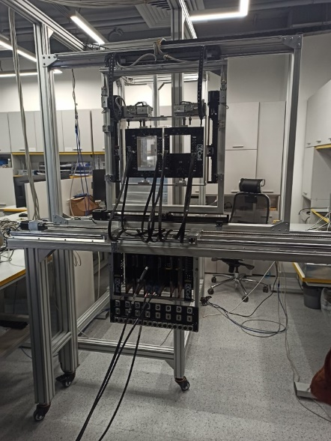
ISCRA station
The station includes the following components:
Energy degrader;
Test object positioning system;
Six-channel stepper motor controller;
System of ion beam profile projection and video control;
System of positive temperature setting for test objects (+25°C … +125°C, ±5°C, 10 min);
System of negative temperature setting of test objects (minus 60 ºС … 0 ºС, ±5ºС, 15 min);
Chamber with drained atmosphere for testing at negative temperatures;
Universal test board for device under test (DUT)
Scintillation-fiber detector;
Ionization chamber 1;
Proportional wire ionization chamber 2 (128-channel);
Miniature gas-filled ionization chamber 3;
Silicon detector;
A particle flux density meter;
Workplace in the Measurement Hall of Building 1
DUT: device under test
The equipment for the ISCRA station is being developed as part of the JINR-NRC Kurchatov Institute, ITEP-SPELS/MEPhI-GIRO-PROM collaboration.

Slide 8
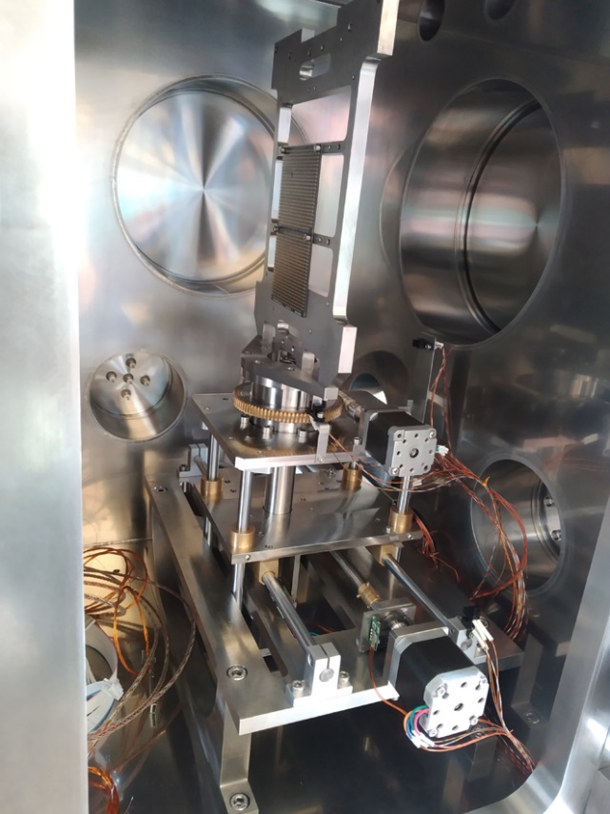
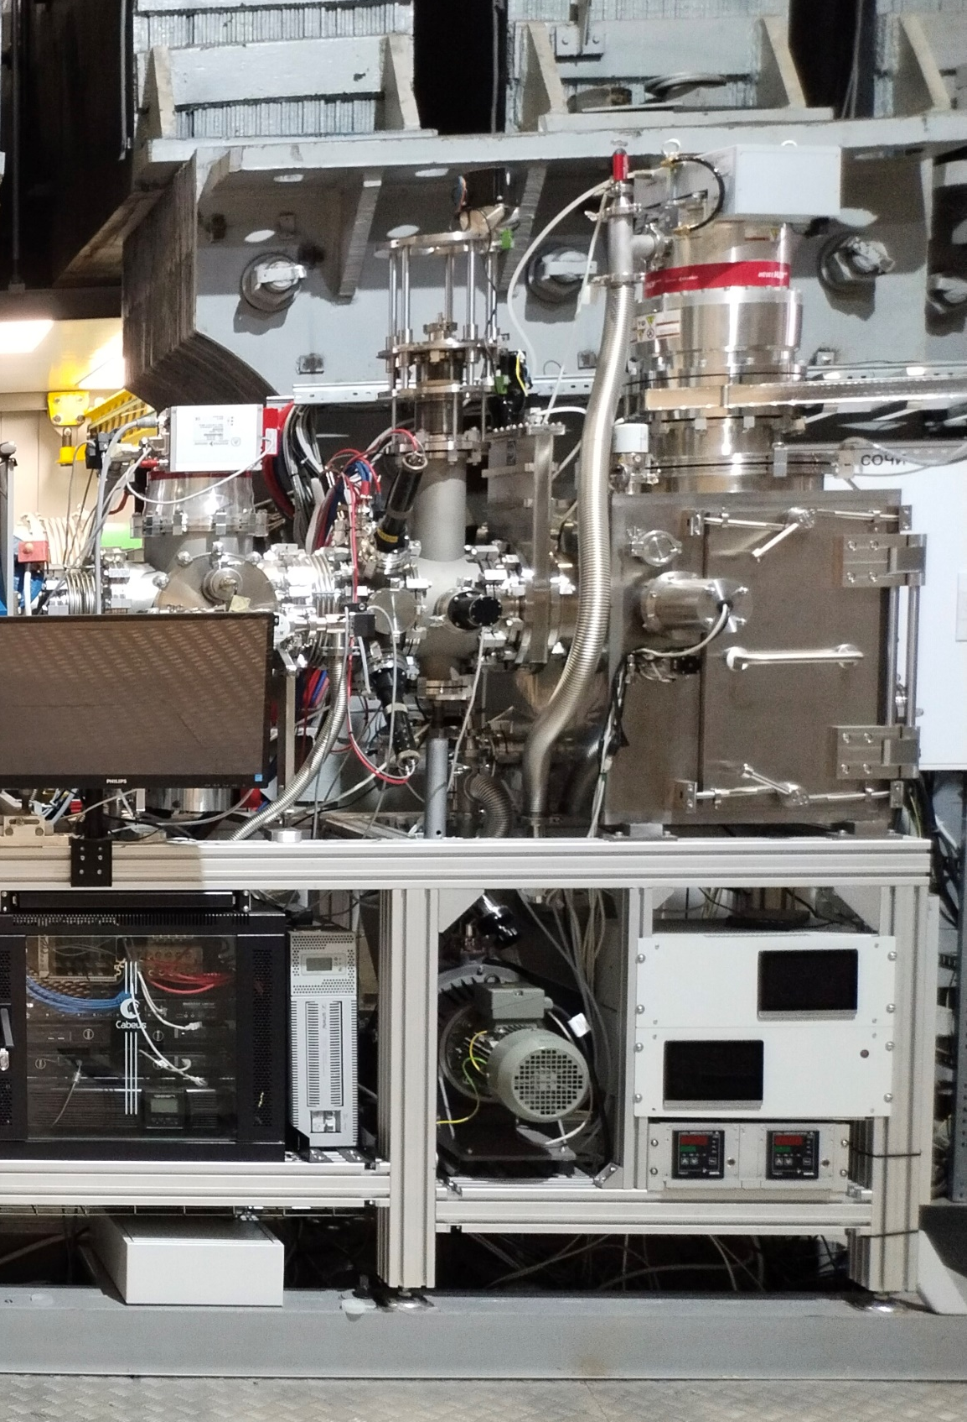
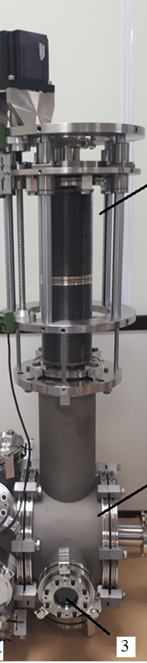
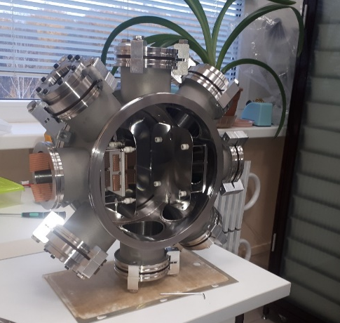
SOCHI STATION (AND DETECTORS)
developed as part of JINR-NRC KURCHATOV INSTITUTE collaboration with the participation of SPELS/MEPhI—GIRO-PROM—VST.
1/ online diagnostics and control of peripheral ion flux density and fluence
(system comprised of four scintillation-fiber detectors based on multichannel photomultipliers).
3/ A Faraday cup
to control the ion flux density during beam adjustment
main vacuum chamber
5/ fast phosphor detector
to measure beam profiles
positioning system for DUT,
universal test board for connecting test equipment with DUT,
DUT,
a heating module,
a phosphor detector of full absorption, a gas analyzer.
2/ MCP-based detector
used for nondestructive control of the intensity and spatial distribution of the ion beam in the horizontal plane during irradiation
4/ fast scintillation
detector
DUT: device under test

Slide 9
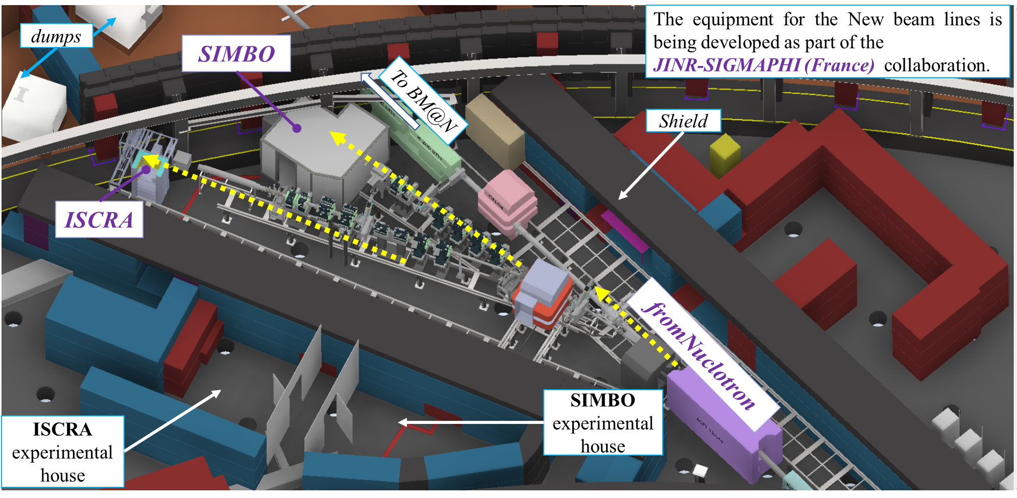
Measurement Pavilion Infrastructure
SIMBO ― Setup for Investigation of Medical Biological Objects, biological station is applied for irradiation by ions at energy of 400..1100 MeV/n
ISCRA ― Irradiation Setup for Components of Radioelectronic Apparature, technical station is applied for irradiation by ions at energy of 150..500 MeV/n

Slide 10
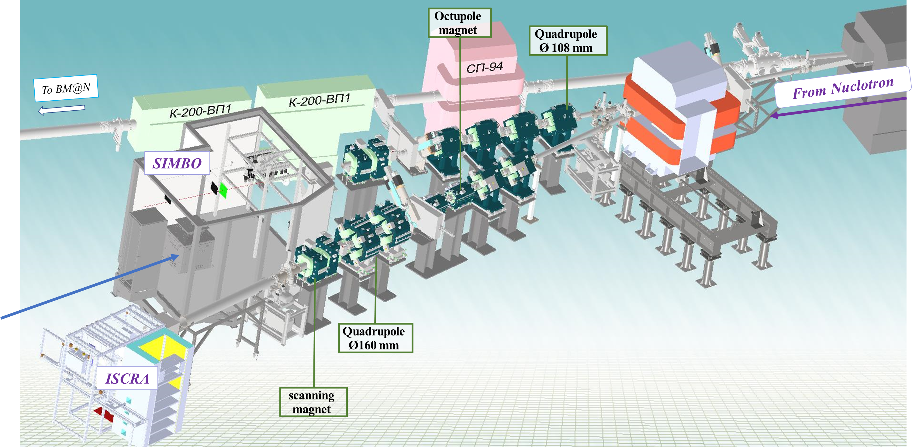
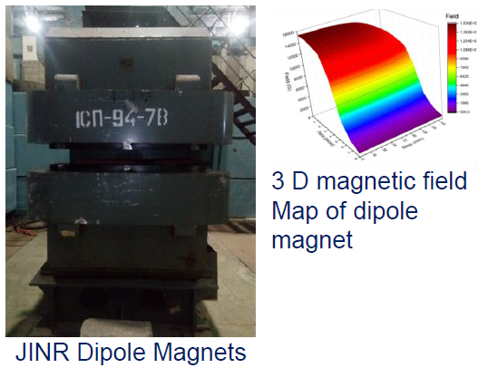
beam line equipment
 | Scanning | Quadrupole |  | 8-pole
Parameter | SMX/SMY | Type 1 | Type 2
# magnets | 2+2 | 6 | 2 | 2
Gap/bore Ø (mm) | 140 | 108 | 160 | 105
Field/Gradient (T, T/m, T/m³) | ± 0.8 | 0.6 - 5.4 | 0.2 - 1.4 | 1098
L_{eff} (mm) | 356 ± 4 | 492 ± 2 | 480 ± 2 | 505 ± 3
Good Field Region (mm) | H×V 60x60 | Ø 100 | Ø 128 | Ø 90
Rel. integrated field error x10⁻³ | < ±5 | < ±5 | < ±5 | < ±5
Operating mode | Scanning f=0.5-3Hz | DC | DC | DC
type 1,
bore 108
type 2,
bore 160
Mechanical layout of the quadrupoles

Slide 11
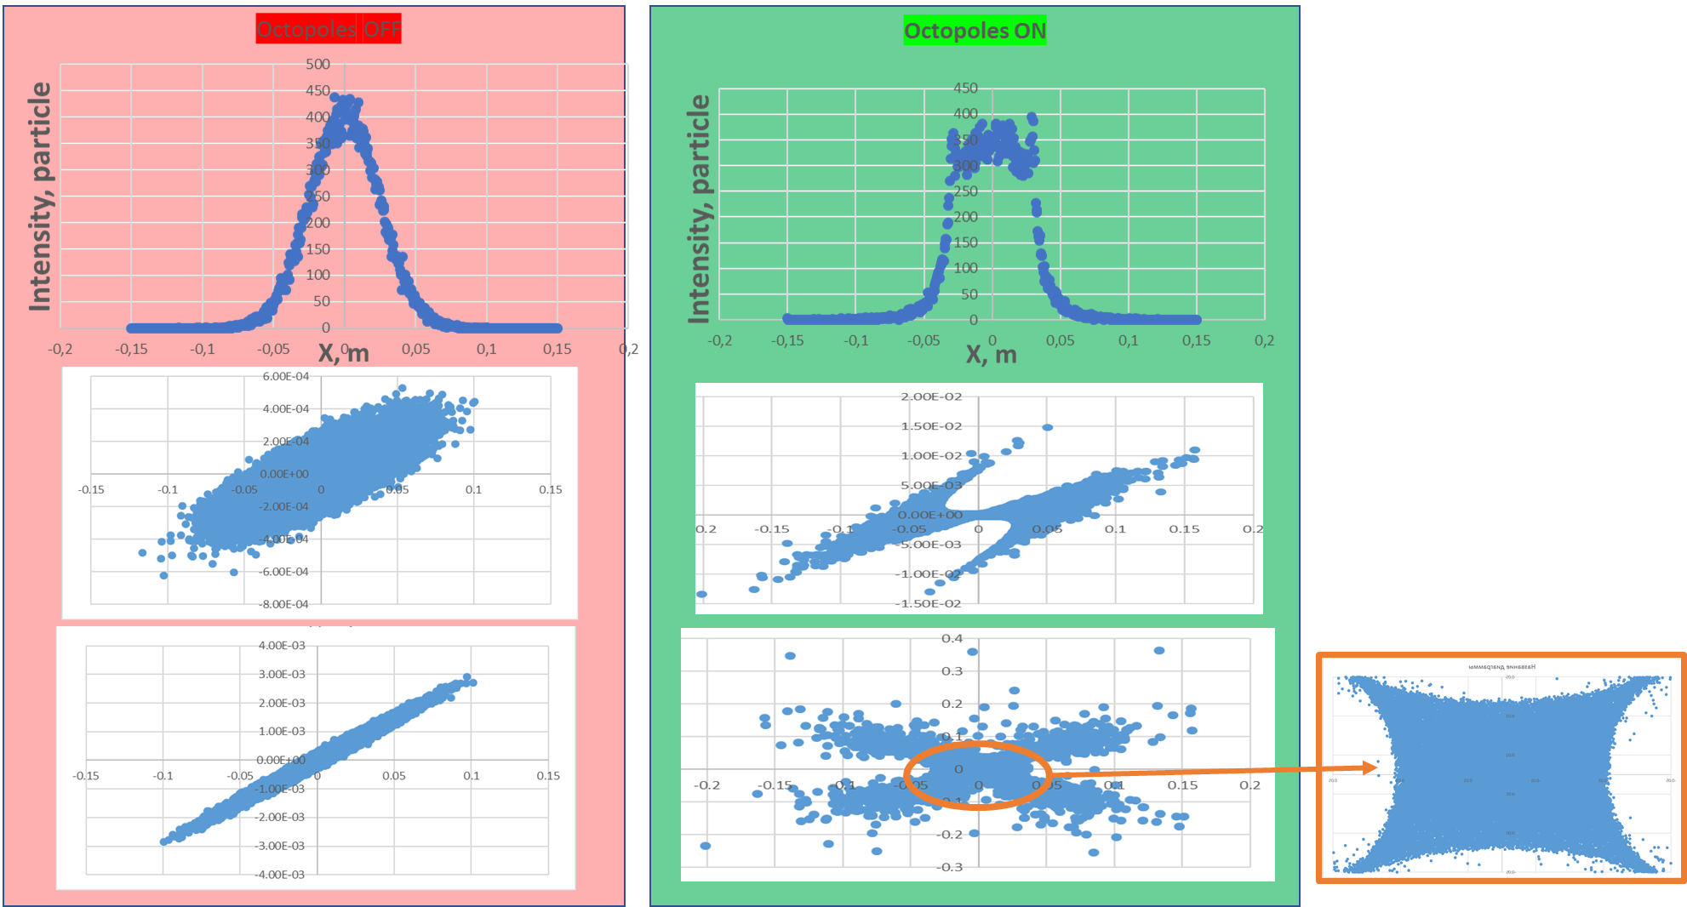
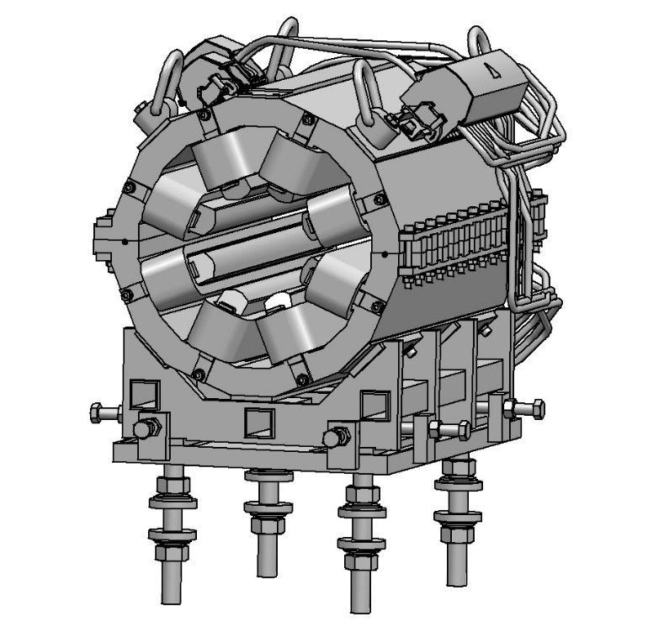
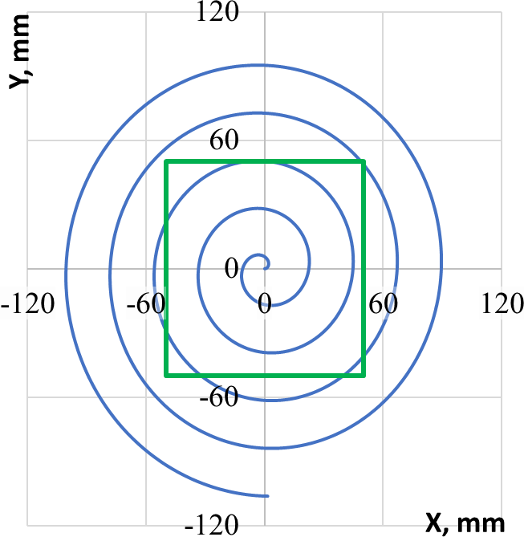
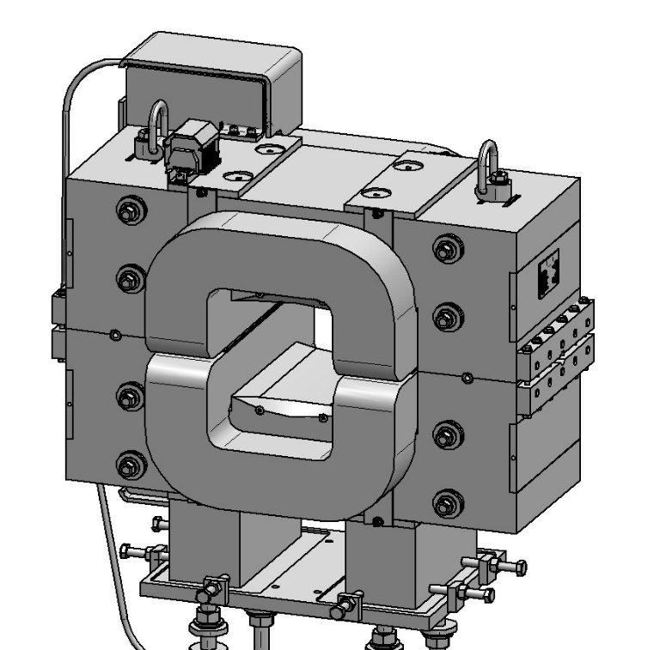
Octupole irradiation mode
To reach Beam homogeneity on the target better than 10%.
In ISCRA channel, two octupole magnets required
Mechanical layout of
the octupole magnet
50000 Particles
Scanning irradiation mode
Mechanical layout of the SMX scanning magnets
spiral mode at the target
large target area up to
  200×200 𝑚𝑚² (ISCRA)
  100×100 𝑚𝑚² (SIMBO)
For the 3-Hz repetition frequency homogeneity at the targets is better than 5%
Spiral and string scanning mode

Slide 12
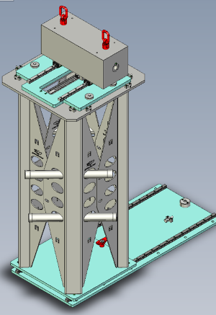
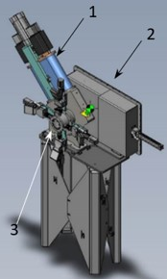
SIMBO Collimator
PS for magnets
For the magnets | octupoles | Type 1-2 (108, 160) | Sp94 | SM
PS type | SM 18-50 | SM 45-140 | ИП 635-230 | PA-400-350
Output voltage/Output current, (V/A) | 10/ 0.5 ÷ 20 | 50/3 ÷ 120 | 230/ 120÷635 | ±350 V/ ±400 A
Output signal relative uniformity | +/- 0.1% | +/- 0.1% | +/- 0.01% | N/A
Operating mode | DC |  |  | Scanning
Cooling | Air | Air | Water | Air
Manufacturer | DELTA ELEKTRONIKA |  | LM Inventor | IECO
A 500 mm length
beam limiting
movable collimator
with set of inserts
of various inner diameters
for formation of a sharp boundary irradiation field
Beam line detectors
The power supplies were delivered at JINR in the end of 2021, except for scanning magnets.
measurements irradiation parameters:
  the ion beam profiles,
  the primary ion fluence
  and the primary ion density flux.
The control of power supplies will be realized via Profibus and integrated into the NICA’s control system.
1 - Ionization chamber,
2 - Scintillating Fiber-based beam position Monitor,
3 - Online Detector (ion hallo)

Slide 13
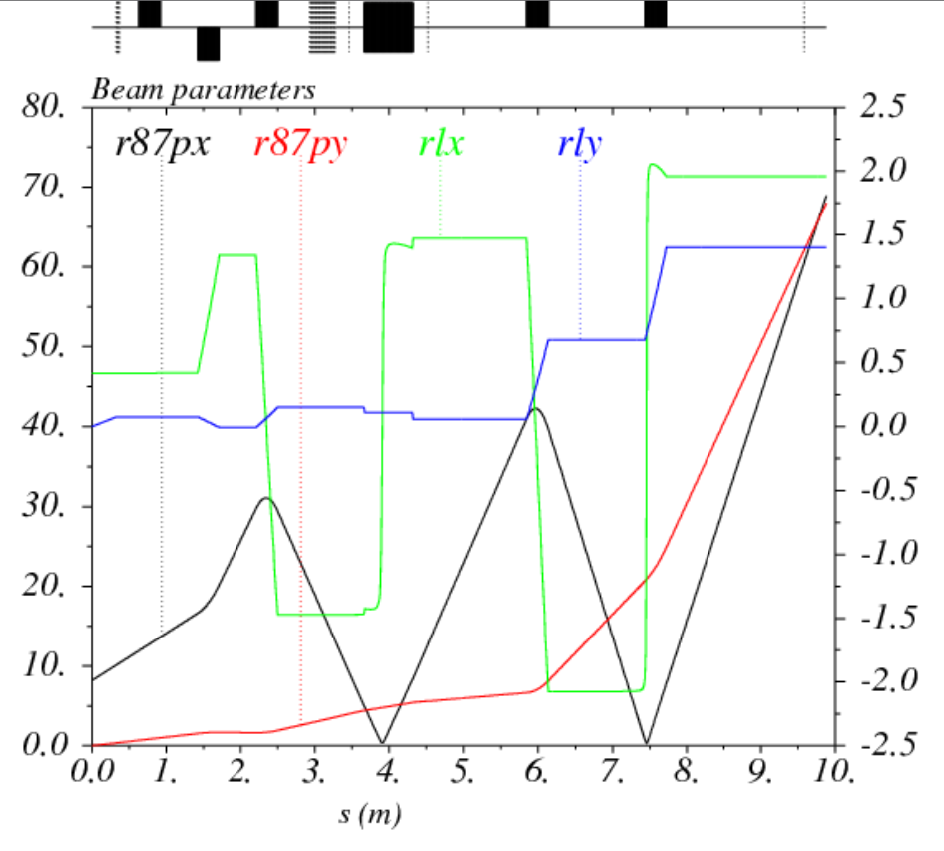
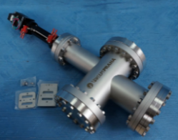
SOCHI BEAM DESIGN
HILAC (рус. ЛУТИ)
¹²C⁴⁺ to ¹⁹⁷Au³¹⁺ (3.2 MeV/n)
decapsulated chip irradiation
CAN BE USED
AT THE TARGET
beam currents of nA
the dose rate should not exceed 1 rad/µs to not distort test results
20 mm × 20 mm
homogeneity 10%
beam size is needed to be huge (more 70 mm In diam.)
high beam current of few mA coming from the HILAC-Booster channel
Leads to small beam size (30 µm)
Dispersion function to get beam in diameter at the station > 70 mm
by means of collimator
foil target:
20 holes
⌀ 30 μm
Step: 700 μm
50 μm stainless
collimator
movement system VAb Vacuum-Anlagenbau GmbH
the positioning accuracy is ±100 μm
controlled by a linear potentiometer
way of movement is 100 mm
13

Slide 14
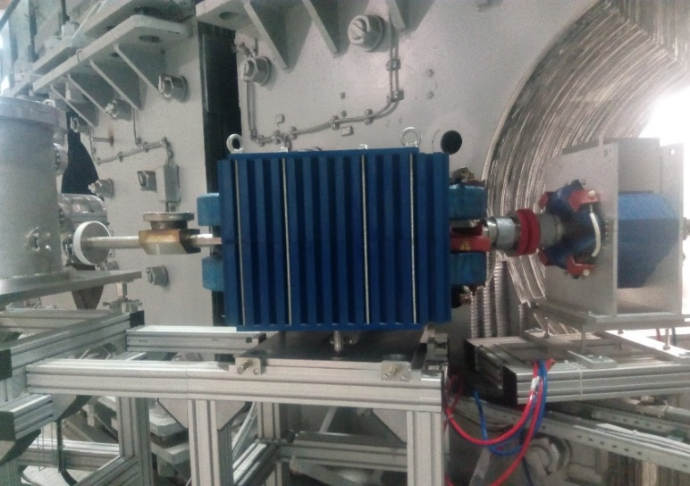
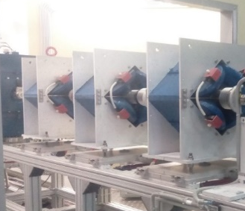
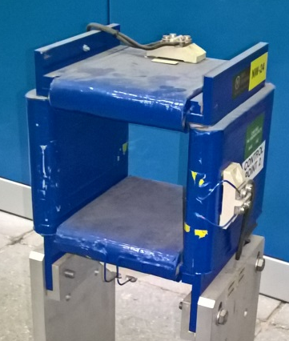
SOCHI MAGNETS AND PS
dipole
5 quadrupole magnets (3 HILAC-Booster +2 SOCHI )
the air-cooling of the magnet coils
the magnets operated in the pulsed mode (except steerer)
pair of two-coordinate steerers
(DS, 1 HILAC-Booster + 1 SOCHI )
magnet similar to those in the HILAC-Booster transfer line
Dipole magnet
Type of power source | Pulse
Effective length, m | 0.65
Max. magnetic field, T | 1
Gap, mm | 45
SOCHI PS
Quadrupole lenses
Type of power sources | Pulse
Effective length, m | 0.29
Max. gradient, T/m | 10
Gap (diameter), mm | 95
Parameter/magnet type | DS | QS | CS
PS/ Magnet quantity | 1/1 | 2/2 | 1/1
Beam line | SOCHI
PS type/ mode | Pulse (1 Hz) |  | DC
Max. voltage /current, V/A | 900/ 450 | 800/ 230 | 20/ 10
Stability × (±1·10-3) | 0.15 | 1 | 0.2
Half sin pulse length, ms | 90 | 30 | -
Manufacturer | JINR
Steerers
Type of power sources | DC
Effective length, m | 0.25
Max field, T | 0.05
Gap, mm | 125 × 110
14

Slide 15
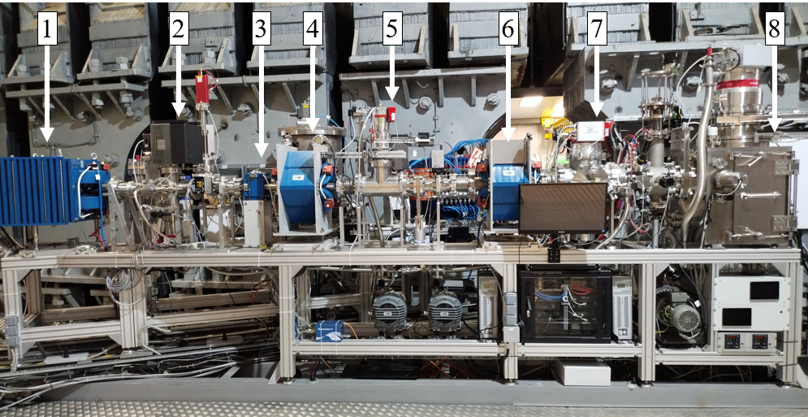
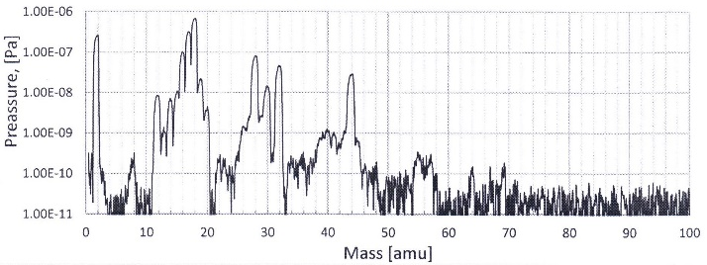
SOCHI VACUUM TESTS
The volume with microchips samples have a high level of gas flow and low vacuum level
Vacuum system in the SOCHI station and(or) beam lines
-cryogenic traps,
-a pulsed diaphragm (butterfly valves),
-pumps
will be prevent spoiling the vacuum condition in the HILAC-Booster beam line
1 - dipole magnet,
2 - third vacuum post,
3 - corrector,
4 - first quadrupole lens,
5 - second vacuum post,
6 - second quadrupole lens,
7 - first vacuum post,
8 - SOCHI station.
The mass spectrum of the residual gas
the residual gas pressure is lower than the pressure in the HILAc-Booster channel (10⁻⁶ Pa)

Slide 16
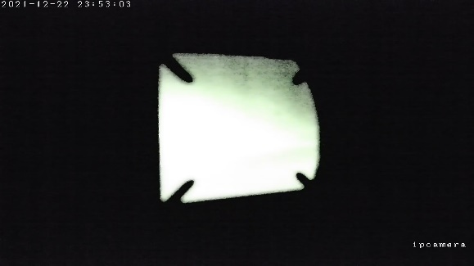
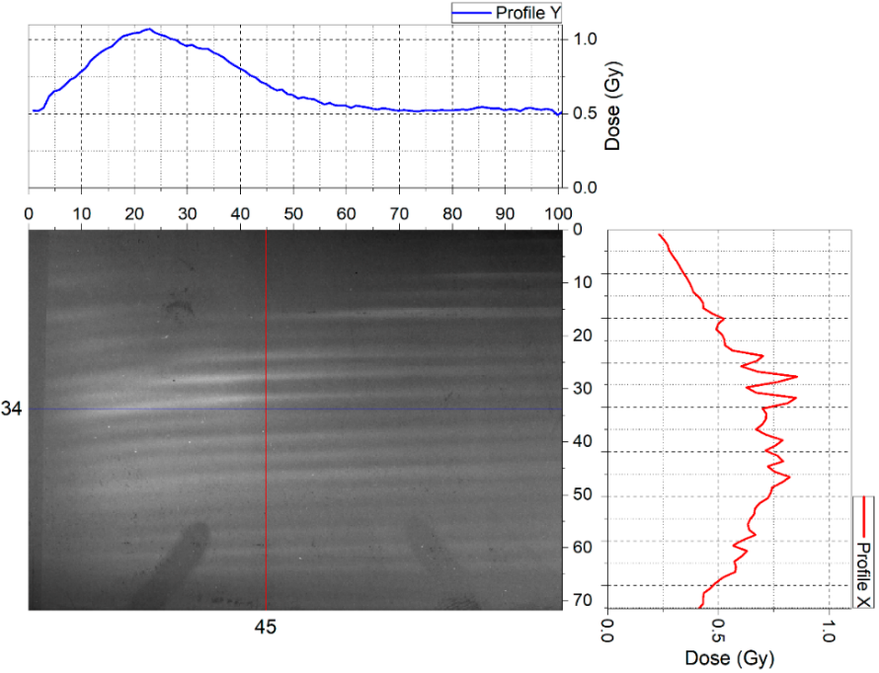
SOCHI PHYSICAL START-UP (December 2021)
Beam from HILAc:
Energy: 3.2 MeV/n
Ions: ¹²C⁴⁺
current 3.5 mA,
pulse duration 3 μs,
repetition frequency 4 s.
The photo shows the beam spot on a phosphor detector. Shadows from the system for online.
To provide good dose uniformity on the target when using a small ion beam, the collimator was modified
several slits
260 μm×35 mm,
30 μm×35 mm,
234 holes 30×15 μm with a step of 150 μm
An experiment on a target with a new collimator configuration will be carried out in further sessions on the SOCHI equipment.
The beam spot at the target
nonuniform structure of the striped character

Slide 17
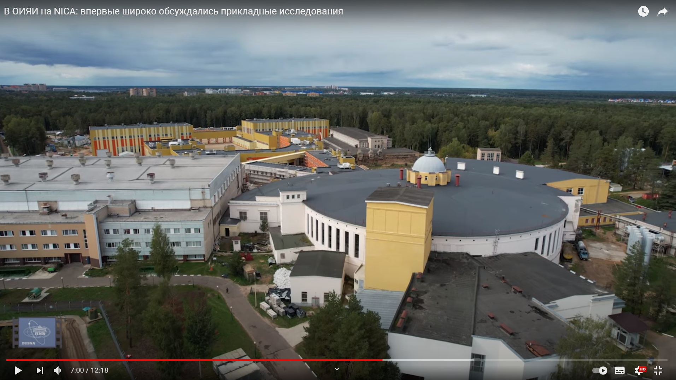

Conclusion
Collider NICA
The physical start-up of the SOCHI equipment was carried out in December 2021.
Further commissioning work will continue in 2022 on argon ion beams.
The works related to the installation of the SIMBO and ISCRA stations equipment are planned for late 2022/2023.
SIMBO, ISCRA
SOCHI
http://science-tv.jinr.ru/videonews/ https://www.youtube.com/watch?v=1sPX0y0I-T8

