Slide 1


Budker Institute of Nuclear Physics, Novosibirsk, Russia
B u d k e r I N P
Status and Development of
ELV accelerators
A.V. Semenov, D.S. Vorobev, E.V. Domarov, M.G. Golkovskii, Y.I. Golubenko, A.I. Korchagin, Kuksanov, A.V. Lavrukhin, R.A. Salimov, S.N. Fadeev.

Slide 2
The Budker Institute of Nuclear Physics of Russian Academy of Science are developing and manufacturing of electron accelerators of the ELV-type for their use in the industrial and research radiation-technological installations beginning 1970. The ELV-type accelerators were designed with use of the unified systems and units enabling thus to adapt them to the specific requirements of the customer by the main parameters such as the energy range, beam power, length of extraction window, etc.
Due to high power of electron beam in wide energy range, high efficiency of conversation of electricity power to electron beam power and simple procedure of accelerator control by operator ELV accelerators are the most popular Russian accelerator. They are well known in the world, especially in China and South Korea. By now, more than 200 accelerators have been delivered both within Russia and abroad.
http://www.inp.nsk.su/sites/promusk/eng

Slide 3
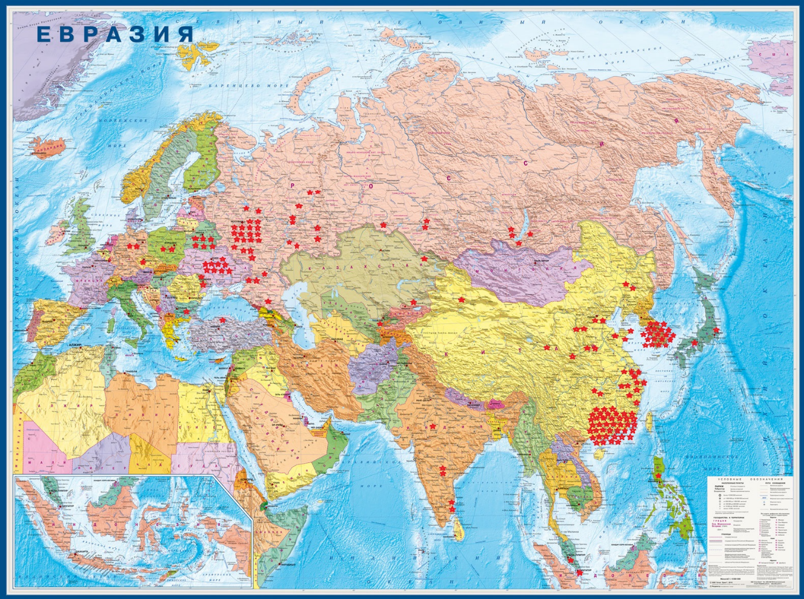
Placements of ELV Accelerators
• 50 accelerators were delivered inside of former USSR
• more then100 accelerators were delivered in China
• 19 accelerators were delivered in South Korea
• 2 accelerators were delivered in Japan
• 2 accelerators were delivered in Poland
• 7 Accelerators were delivered in Germany,
Chech Republic, Malaysia, Phillipines, Turkey
• 4 Accelerators were delivered to India.

Slide 4
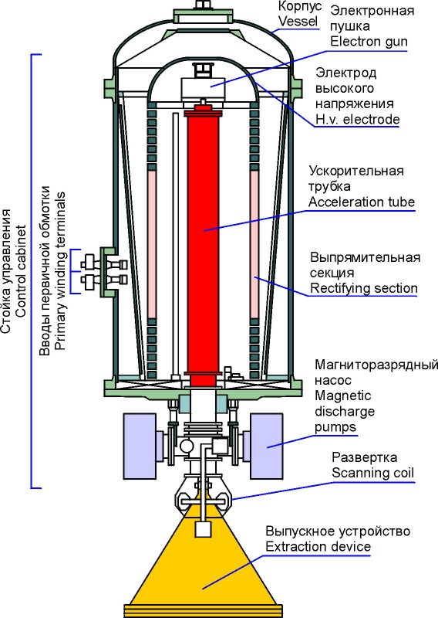
Accelerator design
The composition includes: Automated control system, Power supply, Gas system, Water cooling system

Slide 5
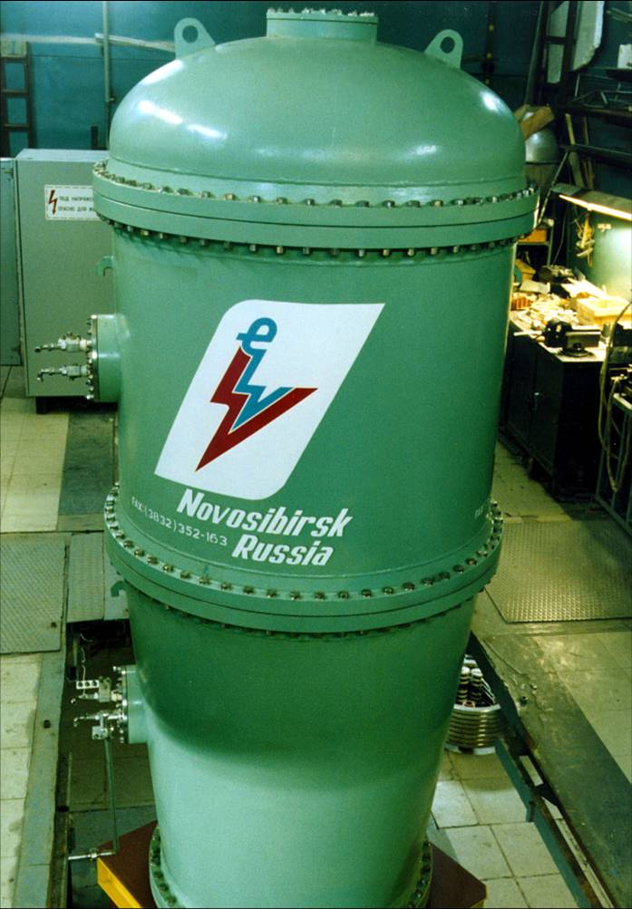
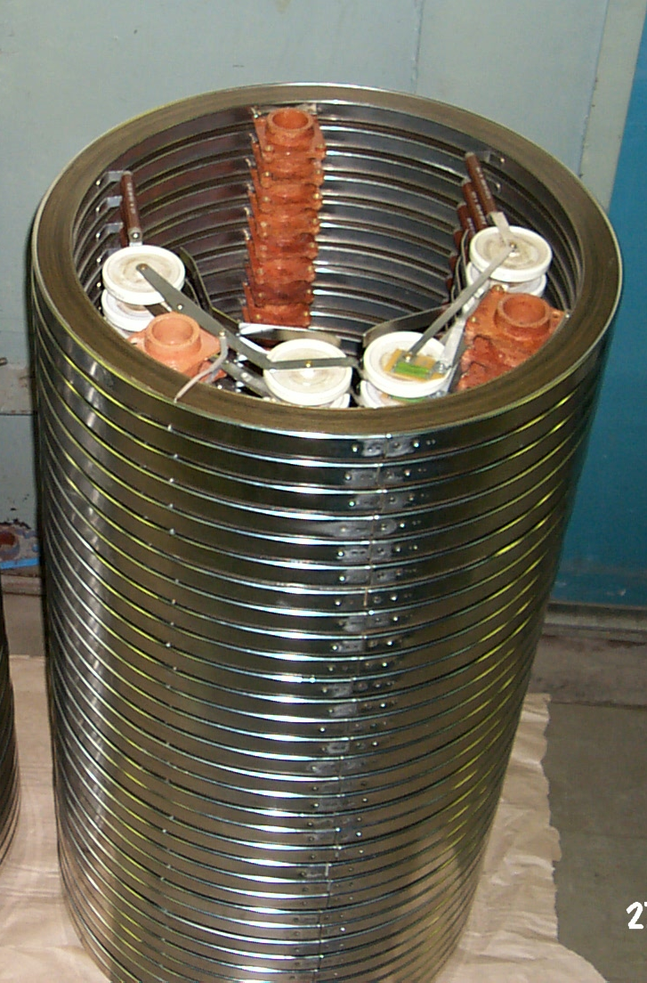
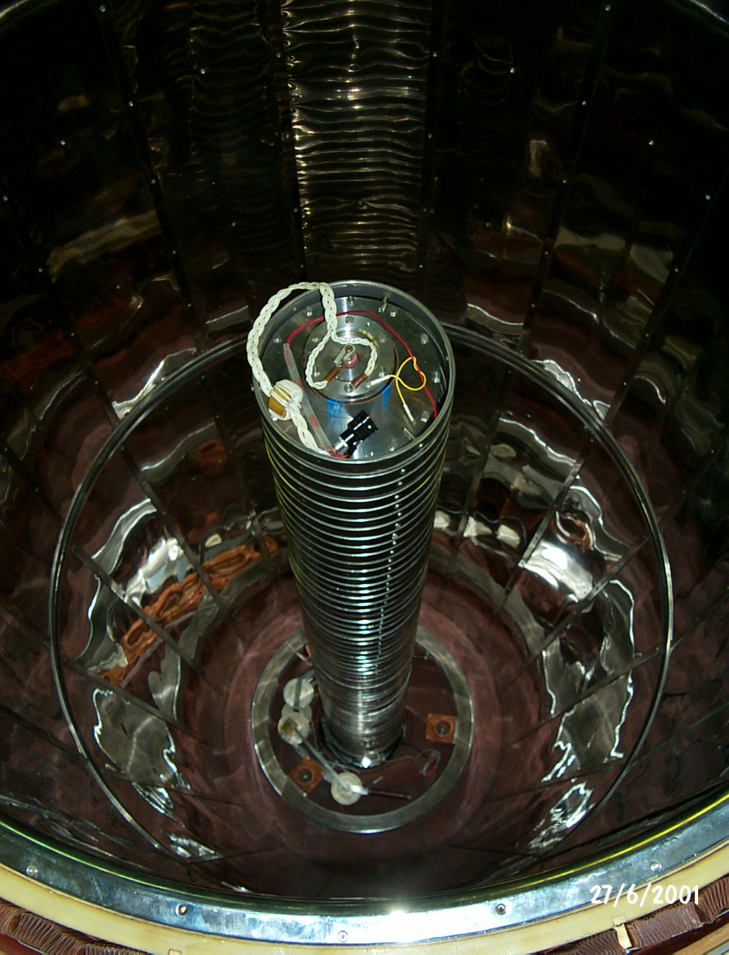
Accelerator design
H/V Generator: Rectifying Accelerating tube
Sections Column and Primary winding

Slide 6
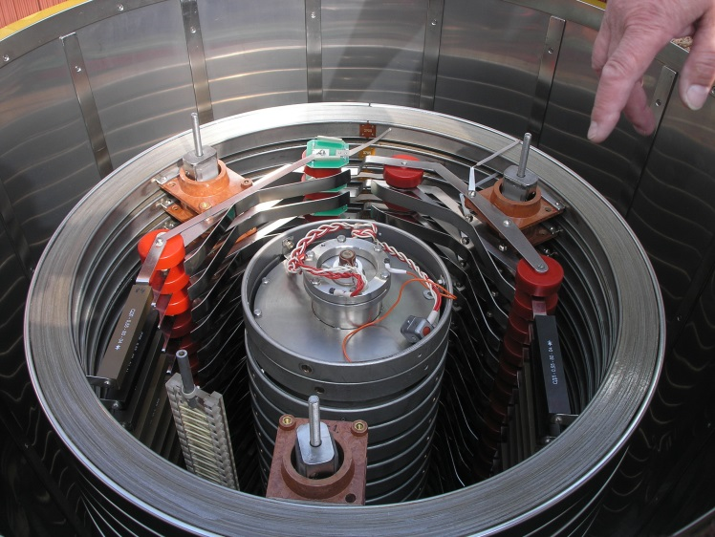
Accelerator tube inside of high voltage column

Slide 7
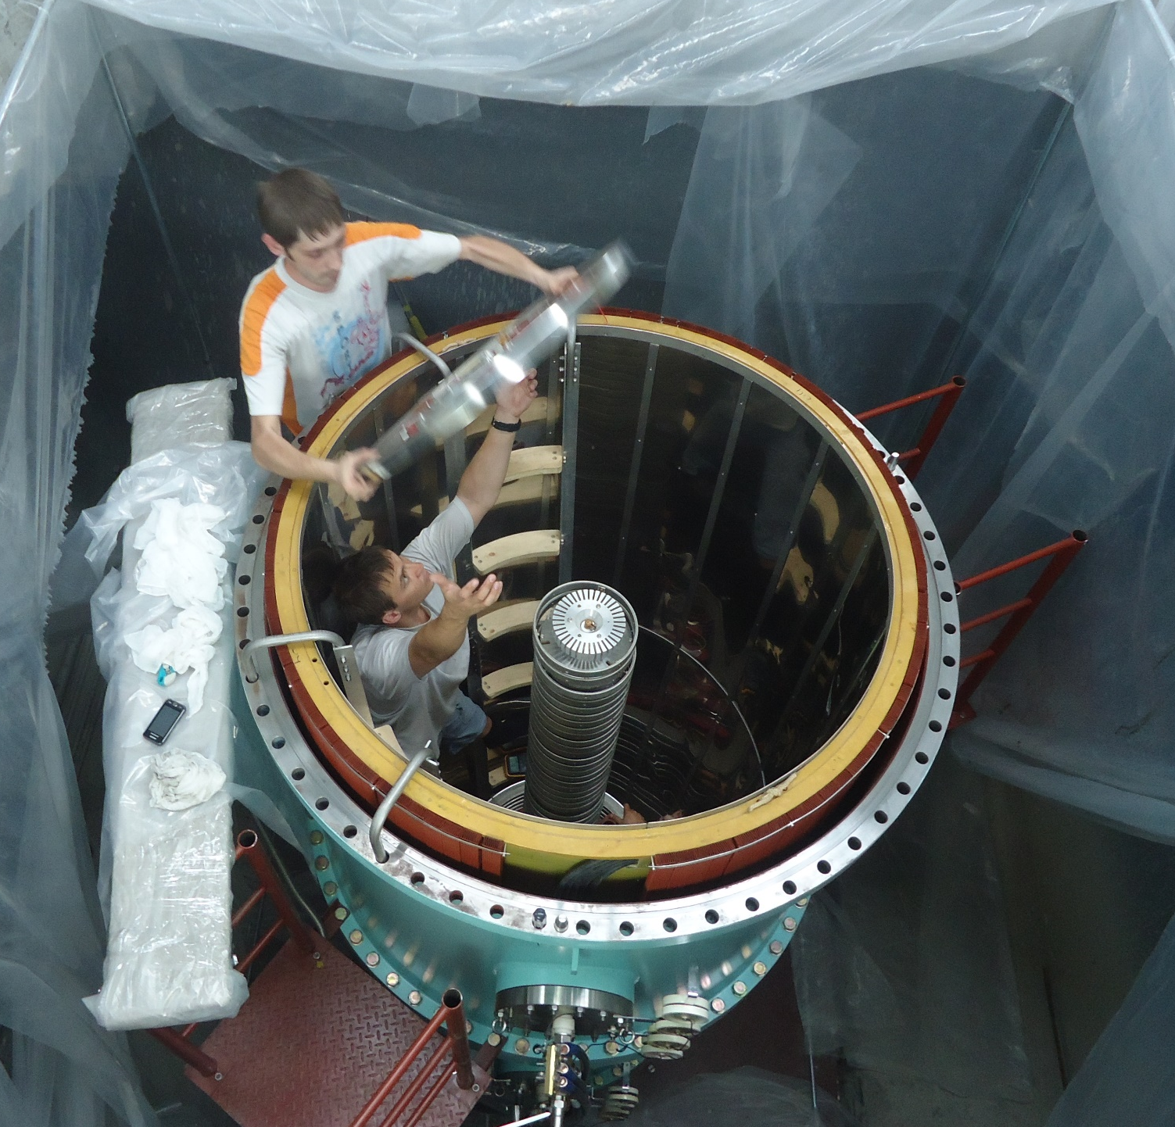
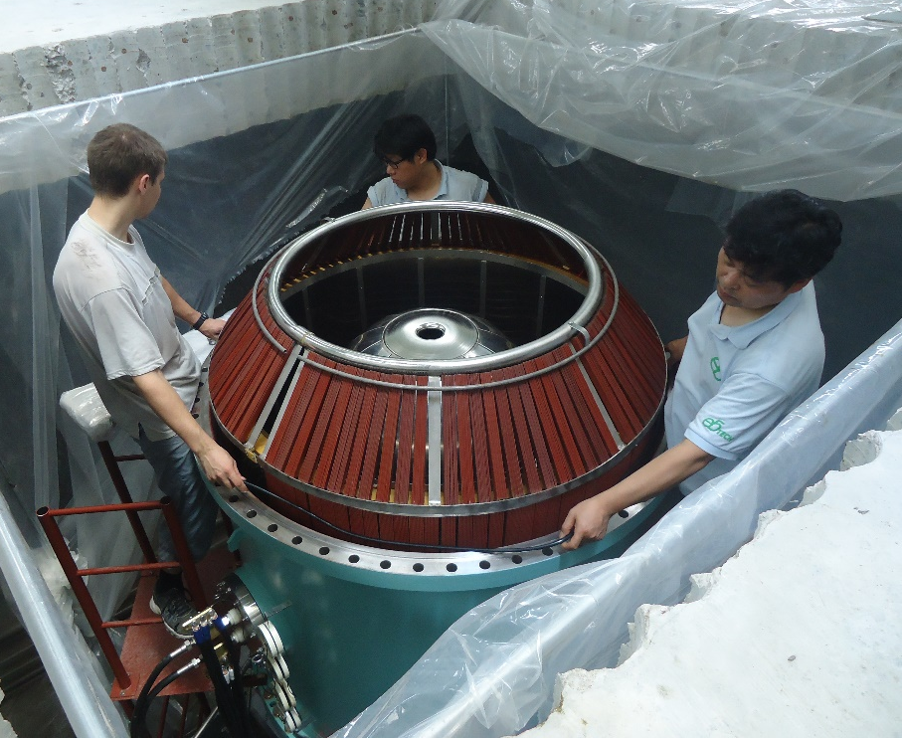
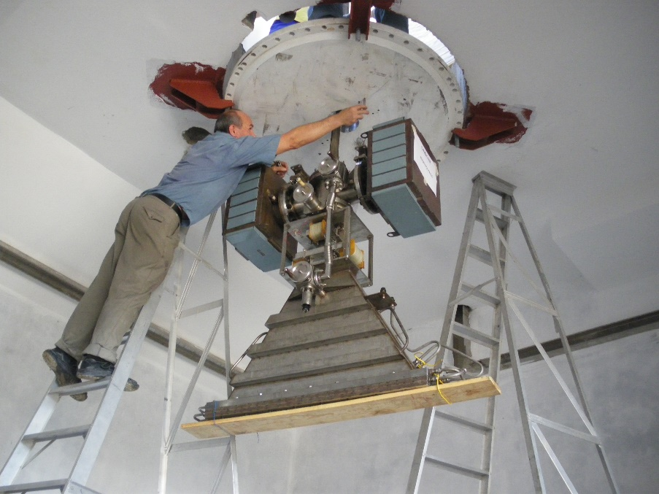
Accelerator assembling

Slide 8
Parameters of the ELV Accelerators
BINP proposes a number of electron accelerators of the ELV-type covering the energy range from 0.4 to 3 MeV with a beam of accelerated electrons of up to 130 mA and maximum power of up to 100 kW. Special case is 1 MeV 400 kW beam power electron accelerator ELV 12. High energy efficiency of accelerator is 60- 80%.
All models have similar concept but differ in overall dimensions, length of accelerator tube, and the number of high-voltage rectifying sections. This makes it easy to adapt accelerators to the requirements of technology. Accelerators are continuously modified while saving the modification. So the power of the ELV-4, ELV-6, ELV-8 accelerators was increased to 100 kV. The system of automated control of accelerators and communication with technological lines is constantly developing.
 | Energy range, MeV | Beam power, kW | Maximum beam current, mA
ELV-0.5 | 0.4-0.7 | 25-65 | 50-130
ELV-1 | 0.4-0.8 | 25 | 50
ELV-3 | 0.5-0.7 | 50 | 100
ELV-4-1,5 | 1.0-1.5 | 100 | 67
ELV-4-1 | 0,8-1 | 100 | 100
ELV-6 | 0.8-1.2 | 100 | 100
ELV-6M | 0.75-0.95 | 160 | 200
ELV-8 | 0,8-2.5 | 100 | 50
ELV-12 | 0.6-1.0 | 400 | 500
ELV-15 | 1,5-3,0 | 100 | 50
Notes:
Надо сказать, что мы можем создать ускоритель под любые требования заказчика. Далее рассмотрим наиболее интересные из последних разработок

Slide 9
ELV Accelerators overal dimensions

Slide 10
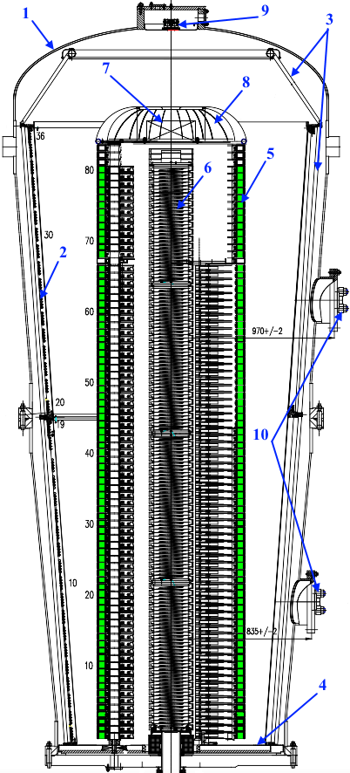
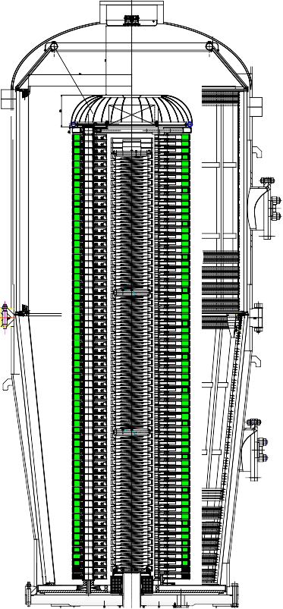
ELV-15 Accelerator
ELV-8 has an energy range from 0.8 MeV to 2.5 MeV, a beam current of 50 mA, and a power of 100 kW.
ELV-15 has an energy range from 1,5 MeV to 3 MeV, a beam current of 50 mA, and a power of 100 kW.
4500
3800
Rectifiers ELV-8 (left) and ELV-15 (right)
1 - vessel; 2 - primary winding; 3.4 - magnetic circuits; 5 - rectifier sections; 6 - accelerating tube; 7 - injector control unit; 8 - high voltage electrode; 9 - optical channels for injector control; 10 - primary winding terminals.
Notes:
ELV-15 is the newest model of ELV. It was developed due to many requests of accelerators users. 80 исправить на 81

Slide 11
ELV-12 Accelerator
The energy range from 0.6 to 1 MeV. Beam current 500 mA. Beam power 400 kW.
Notes:
ELV-12 was developed enough time ago. This a good machine that proved their possibilities for ecology. But up to now we nave no orders for these machines.

Slide 12
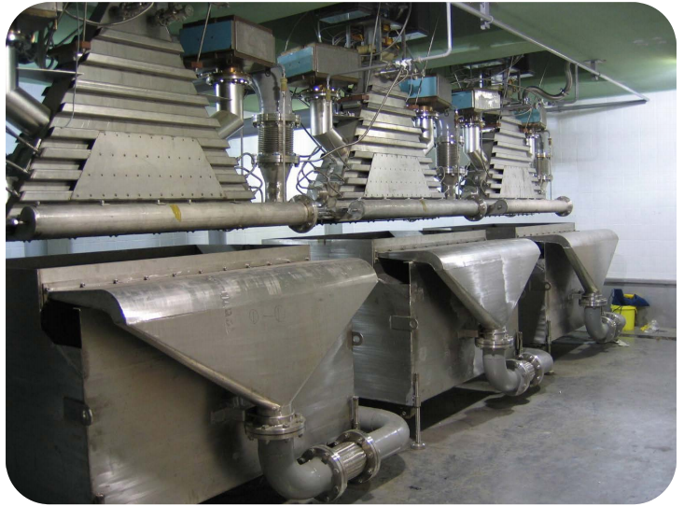
Reaction hall ELV-12 accelerator in Dyetec (Taegy)
http://www.inp.nsk.su/sites/promusk/eng

Slide 13
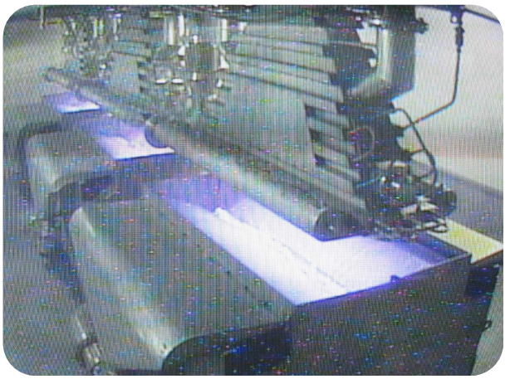
ELV-12 Accelerator
Irradiation treatment process. luminescence of water during irradiation.
http://www.inp.nsk.su/sites/promusk/eng

Slide 14
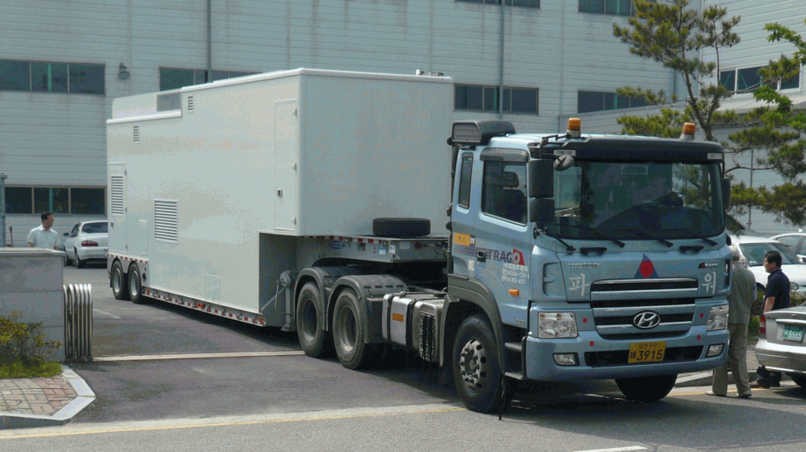
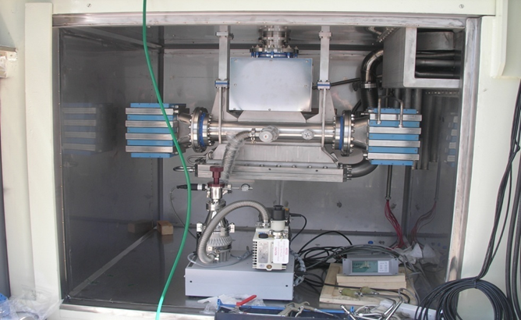
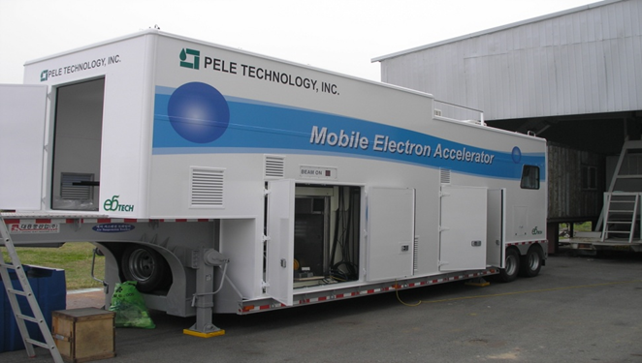
Mobile Accelerator (EB-Tech, South Korea)
• 20 kW mobile accelerator
• 30 mA beam current
• 0.7 MeV Energy
• All equipment in one or two trailers
• Waste water and gas treatment
Notes:
These accelerators have small amount of orders. Main purpose of them is demonstration af advantage of radiation texchnoligies.

Slide 15
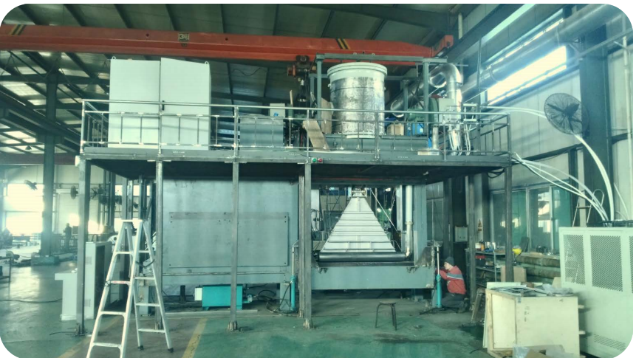
Local shield accelerator ELV-0.5
ELV-0.5 Accelerator, 0.5 MeV x 130 mA, Taiyuan, China.
The radiation shield is open and the extraction device is visible.
The window extraction device for ELV-0,5.
The accelerator in local radiation protection is also a new direction. They are especially attractive for the irradiation of films and tape materials, including industrial rubber goods.
Notes:
В подписи к рисунку добавить, что радиационная защита открыта и видно выпускное устройство

Slide 16
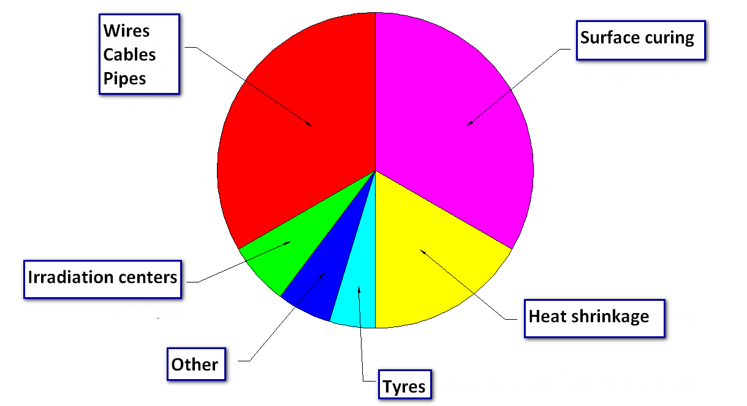
Aplication of industrial electron accelerators

Slide 17
Penetration depth of electron beam in material with density 1g/cm3

Slide 18
Inhomogeneity cable irradiation

Slide 19
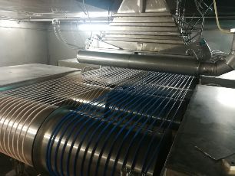
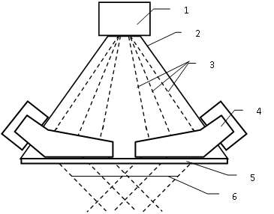
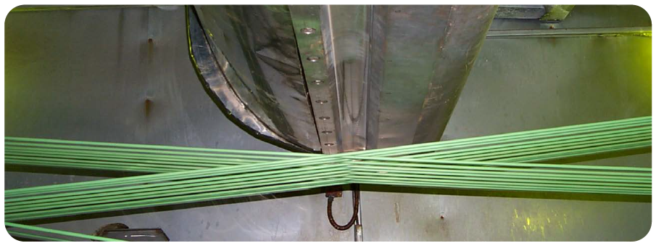
4-side irradiation system
Fig.1. Schematic diagram of the four-sided irradiation system: 1 - scanner system together with shift magnet; 2 - extraction chamber; 3 - electron trajectories; 4 - turned magnet; 5 - extraction window; 6 - irradiation area.
Fig.2. Principle of fore sides irradiation
The operation principle relies upon deviation of an electron beam by a magnetic field. The electron beam being accelerated pass thru scanning system results to forming rectangular raster. Further being effected by constant transversal field of turn magnets electron beam deviated on some angle (see Fig. 1 ). Shape of magnet's poles and a magnetic field force are selected so that the electrons deviated on an angle of 45° symmetrically of the extraction device axis, with irrespective of a place of an entrance. Being transported through an irradiation zone a cable orientation is changed for 180° on each pass, thus four-sided irradiation is occur (see Fig.2).

Slide 20
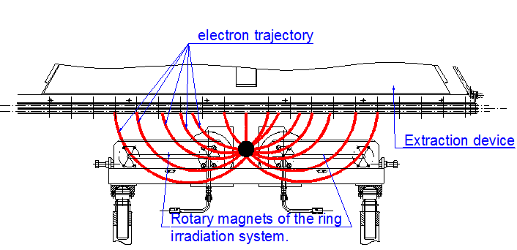
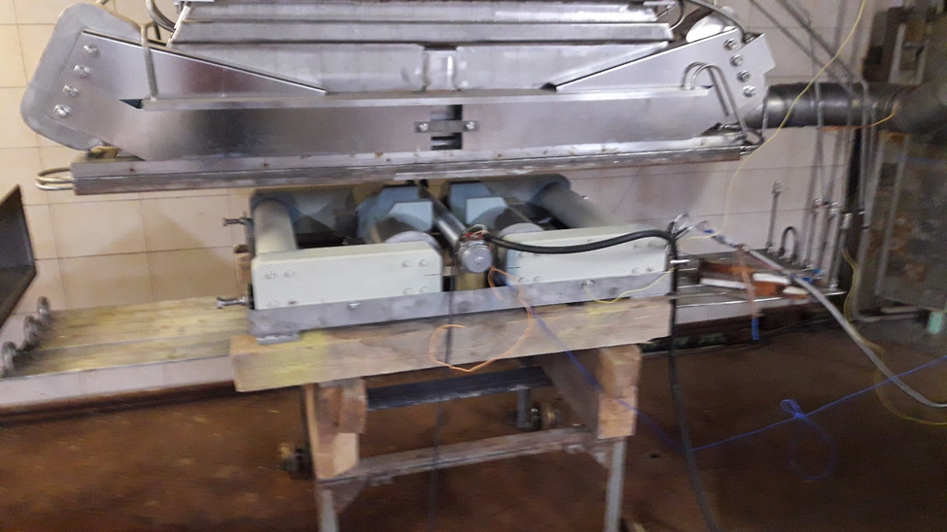
Ring irradiation system
Treatment of large cables (up to 60 mm in diameter) can be done by using the ring irradiation system. Cable is passing only 1 time through irradiation area
Notes:
Cable is passing only 1 time through irradiation area. Это устройство является дополнительным к стандартному ускориелю. Так на рисунке показано не только система кольцевогооблучения, но и магниты 4-х сторонней системы, котроая в данном случае не используется.

Slide 21
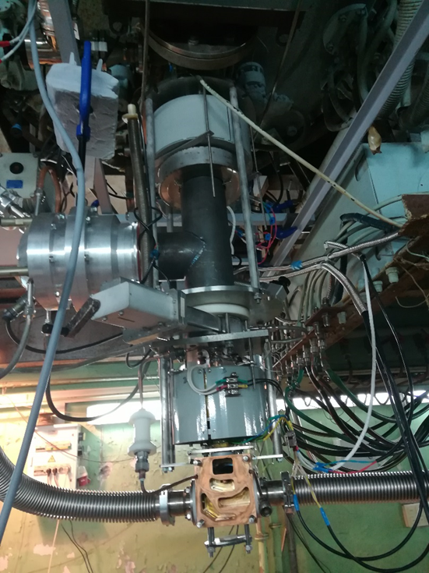
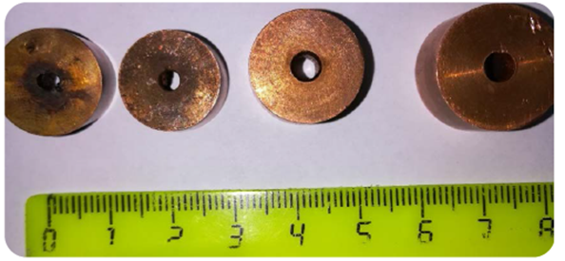
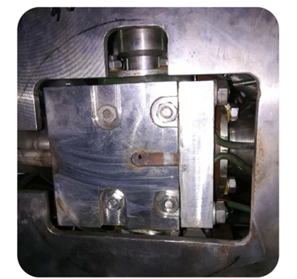
Concentrated beam extraction to atmosphere
Accelerator parameters: Energy 1.4 MeV, Beam current 50 mA, Beam power 70 kW. The beam diameter at the exit from the extraction device is 2,5 mm.
Notes:
There is special modified design of extraction device for focused beam/ Вообще говоря рисунки непонятны.

Slide 22
Producing of SiO2 nano-powder
Evaporation of quartz sand
Productivity – tens killograms per hour
Notes:
Результаты экспериментов по производству. Не натуральный, кварцевый

Slide 23
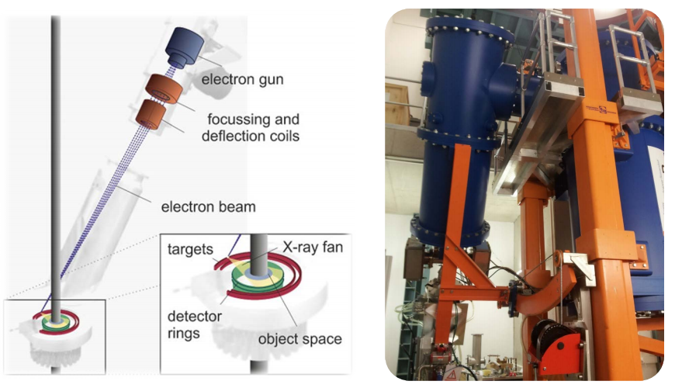
HECToR (Helmholtz-Zentrum Dresden, Germany)
ELV accelerators are widely used for scientific purposes. For example High Energy Computed Tomography Scanner In Helmholtz-Zentrum Dresden-Rossendorf (Germany, Dresden)
Notes:
Надо найти правильное название центра и статью. Где про это написано

Slide 24
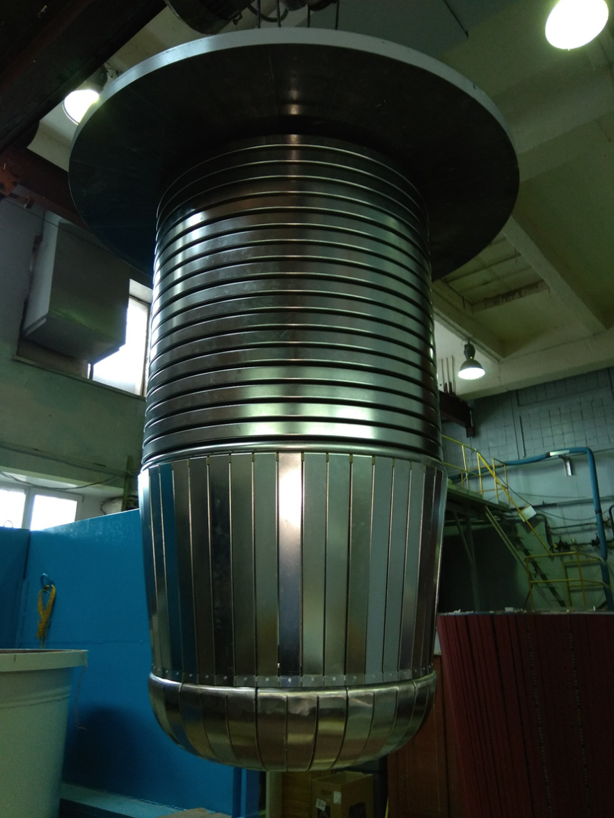
High voltage rectifier for Boron Neutron Capture Therapy. It has opposite orientation and is connected with tandem accelerator with special feeder inside H/V column.

Slide 25
Main application of ELV Accelerators
• Modification of polymer products
• Modification of the polyethylene insulation for the production of thermoresistant wires and cables 0.5-120 mm² with the capacity of up to 500 m/min
•The production of heat shrinkable pipes, films and bands with the capacity of up to 1000 kg/h
•The production of prepregand gel
•The production of artificial leather and rubber-technical products with the capacity of up to 1000 m/h
•Curing lacquer-paint coatings on different bases for the building industry of up to 500 m2/h
http://www.inp.nsk.su/sites/promusk/eng

Slide 26
We are ready for collaboration.
Thank you for attention!
http://www.inp.nsk.su/sites/promusk/eng

