Slide 1
DESIGN FEATURES OF THE CYCLOTRON C-250
K.E. Smirnov, A.A. Akimova, O.V. Ananeva, Yu.N. Gavrish, A.V. Galchuck, D.V. Kirtsev, V.G. Mudrolyubov, Yu.K. Osina, Yu.I. Stogov JSC «NIIEFA», 196641, St. Petersburg, Russia
XIV International Scientific Seminar in Memory of Professor V.P. Sarantsev
“Problems of Colliders and Particles Accelerators”
20 – 25 September 2022, Alushta, Crimea
Speaker – Smirnov Kirill

Slide 2
Basic requirements of the technical task
Parameter | Value
Type of accelerated parts | Protons
Beam energy, MeV | 30 – 250
Accelerated beam current, uA | Up to 5
Magnetic system | “Warm”
Number of beams of the transport system | 3
Pole diameter, mm | No more than 4 000
Electromagnet dimensions, mm | No more than 8 100x5 400x4 200
Weight of cyclotron, t | Not more than 850

Slide 3
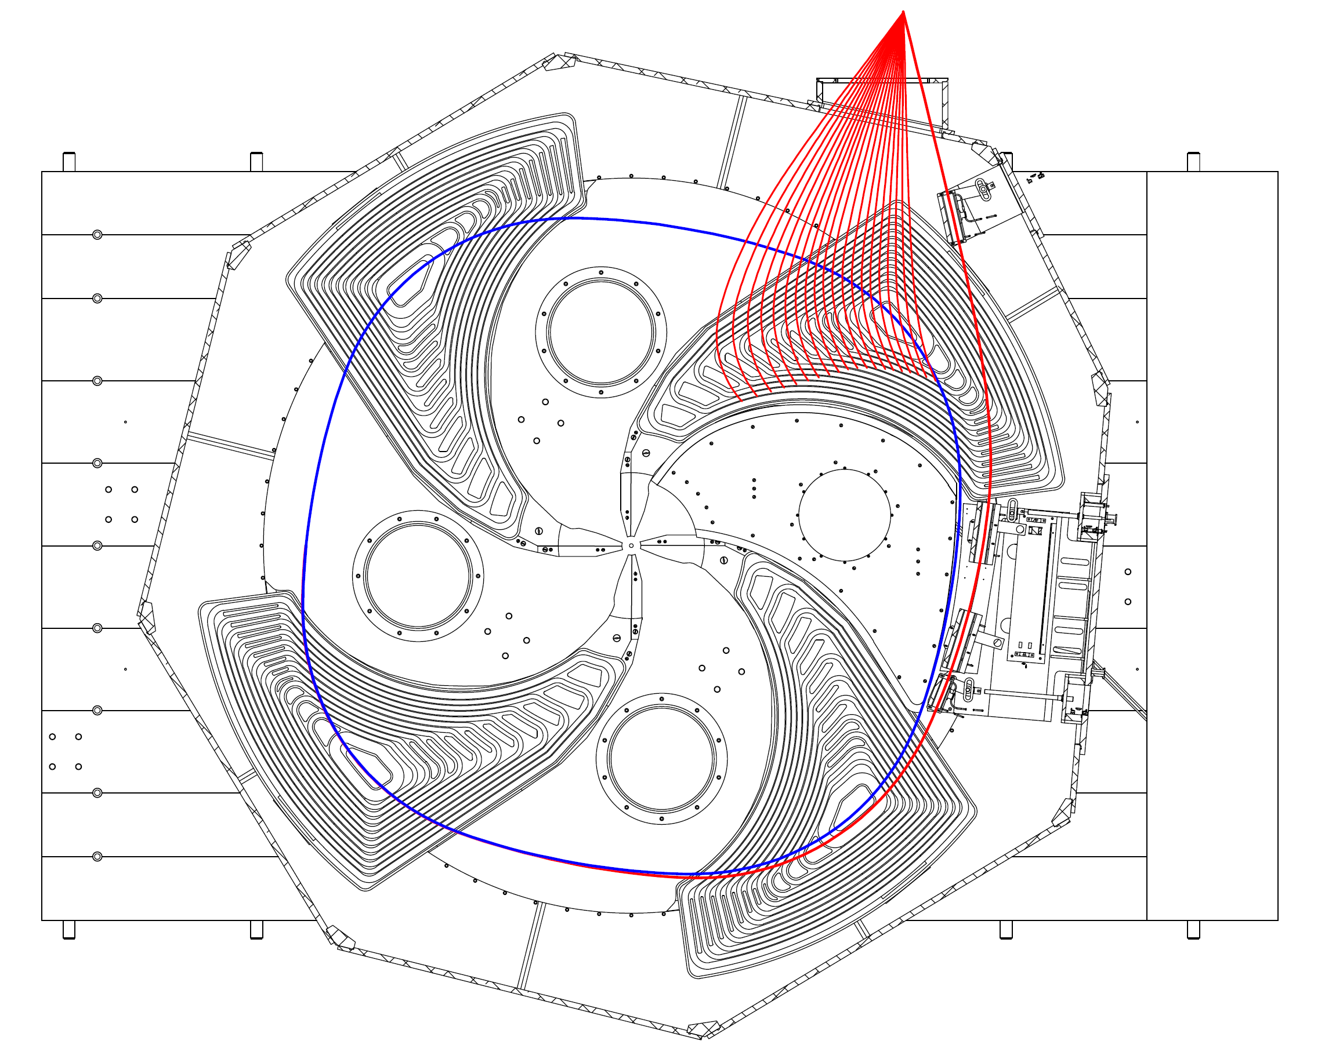
Separation of the energy range

Slide 4
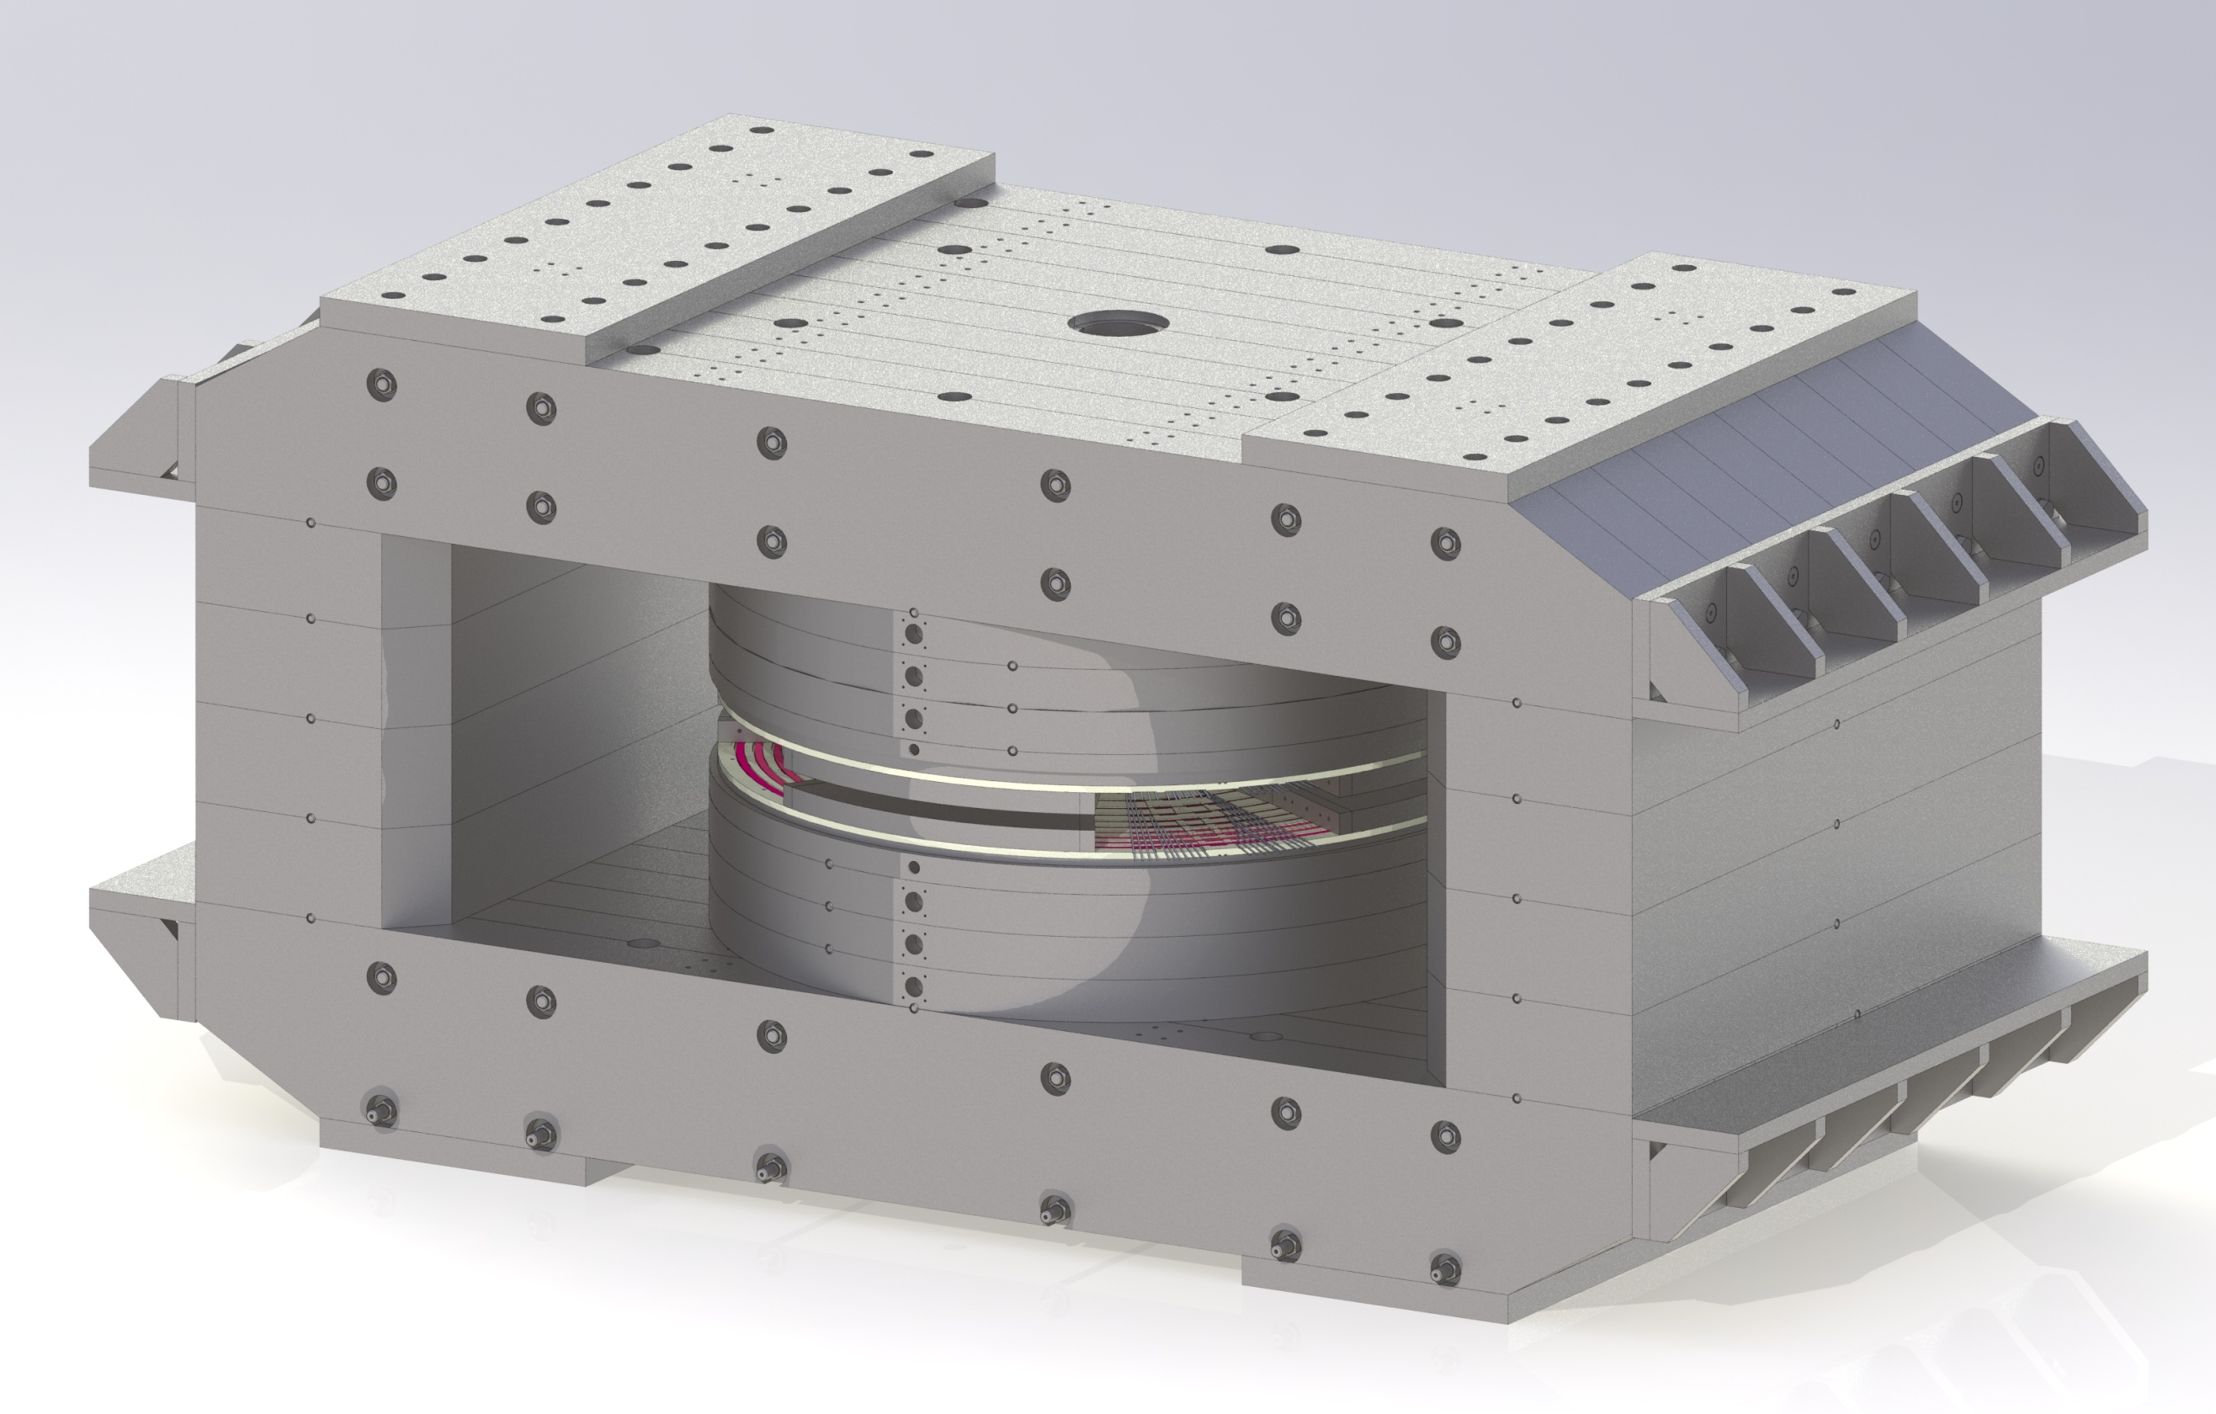
Main magnet of the cyclotron
Cyclotron MZI | Parameter | Cyclotron C – 250
8 100х4 000х4 300 | Magnet dimensions, mm | 8 100х4 000х3 600
860 | Weight of steel, t | 713
63 | Weight of copper, t | 35
4 000 | Pole diameter, mm | 4 000
80/300 | Air gaps, sector/valley, mm | 100/500
1 080 | Total number of parts | 1 400

Slide 5
Design features of main magnet
1. The presence of sectors with high helicity

Slide 6
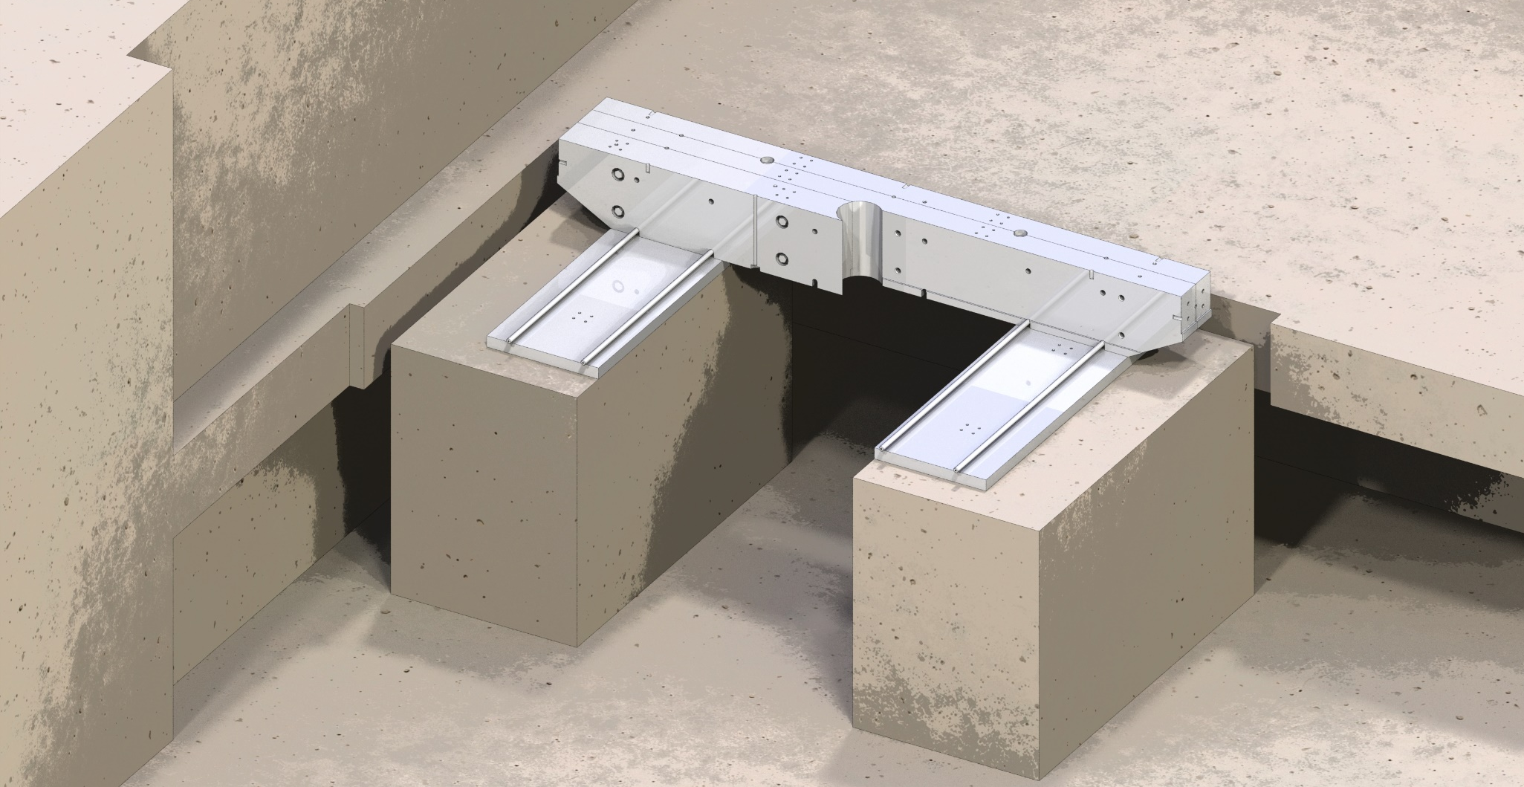
Design features of main magnet
2. The presence of through holes for placing the rods of the accelerating system

Slide 7
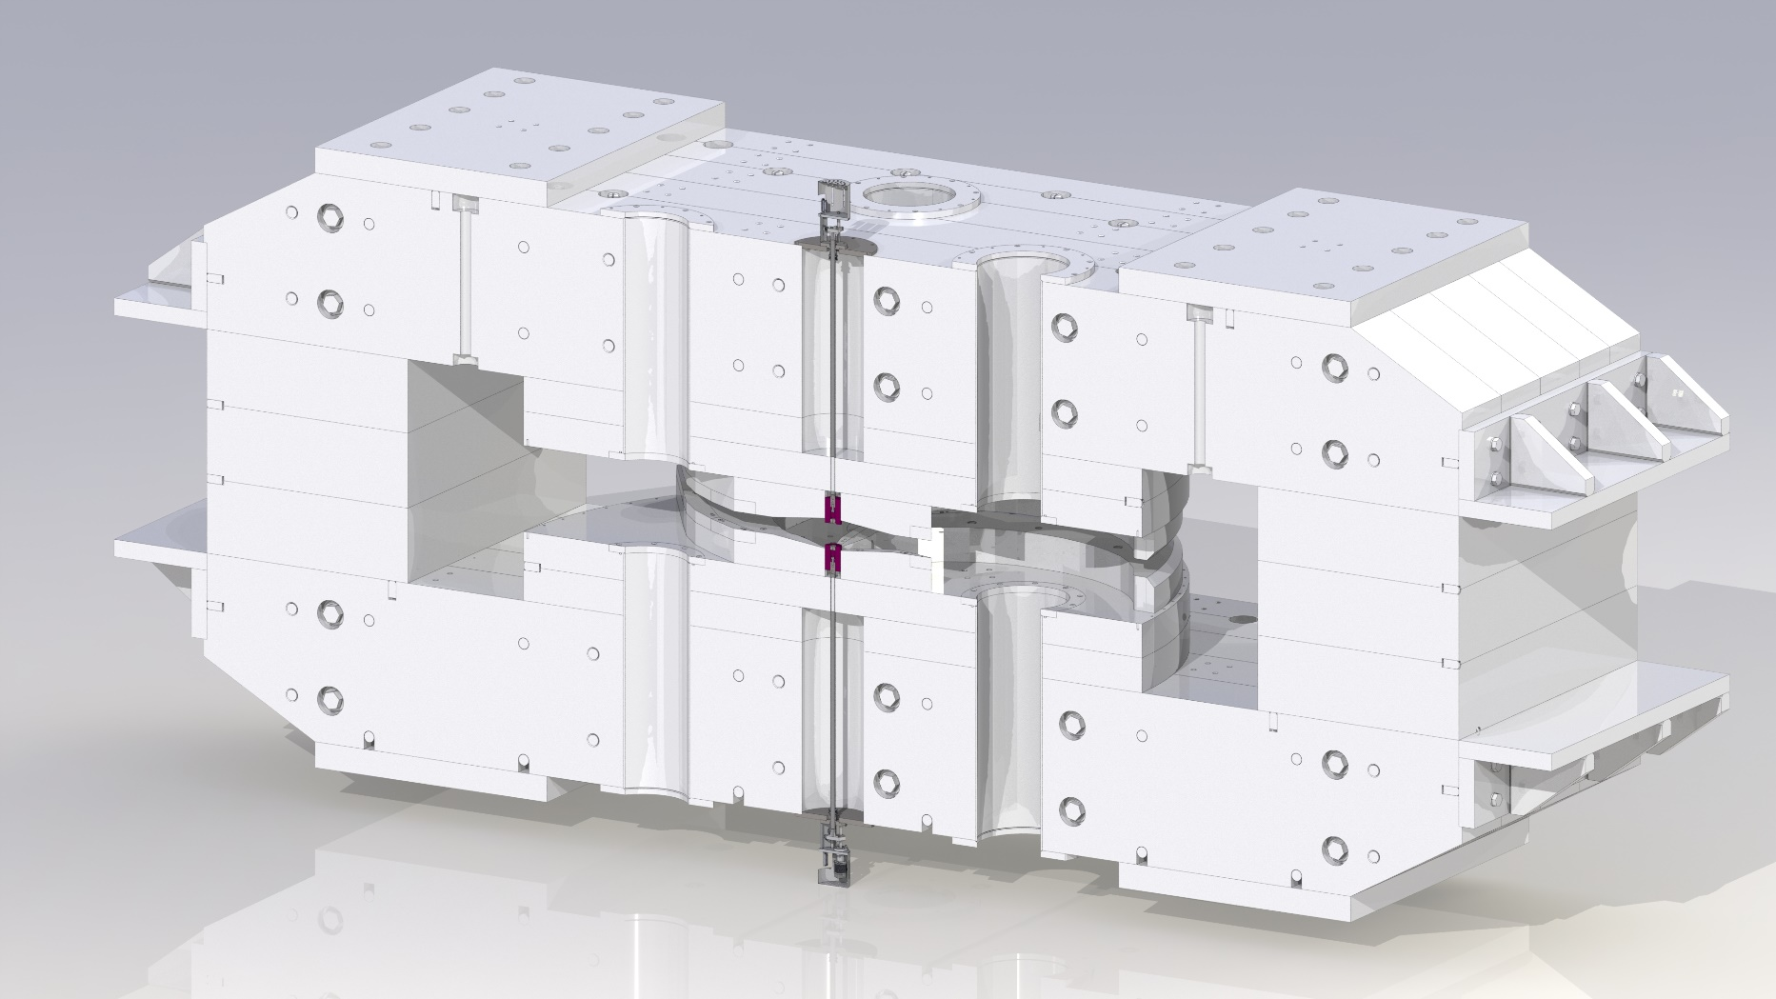
Design features of main magnet
3. Adjustment of the position of the magnetic plug

Slide 8
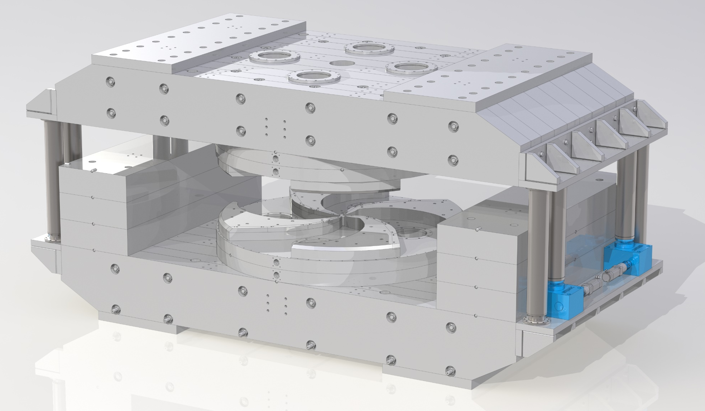
Design features of main magnet
4. Top half-yoke lifting system

Slide 9
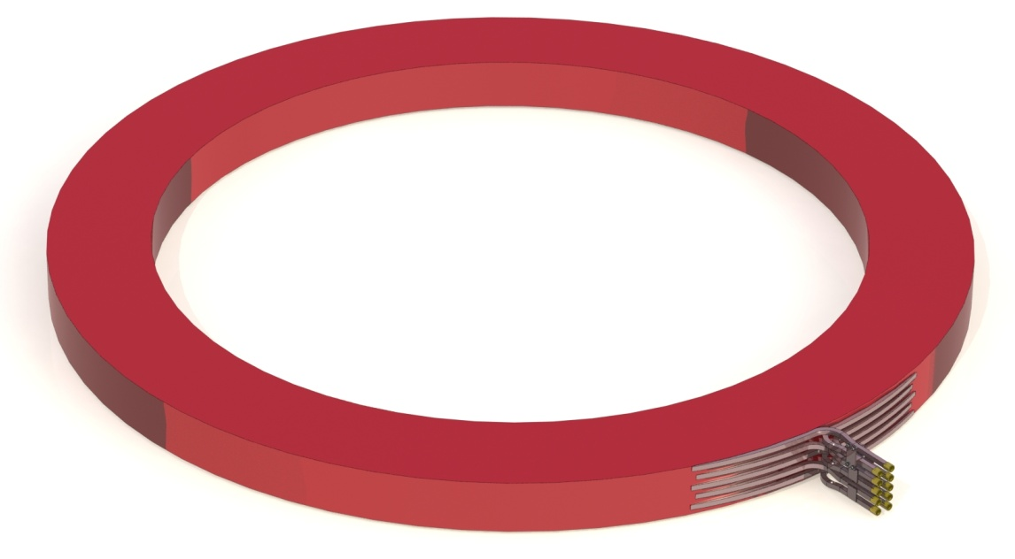
Main coils
Parameter | Value
Diameter, mm | 5 350
Weight, t | 17
Number of turns | 200
Conductor type | Copper hollow conductor, 29x29 mm
Operating current, A | 900
Power of the main coils power supply, kW | 110

Slide 10
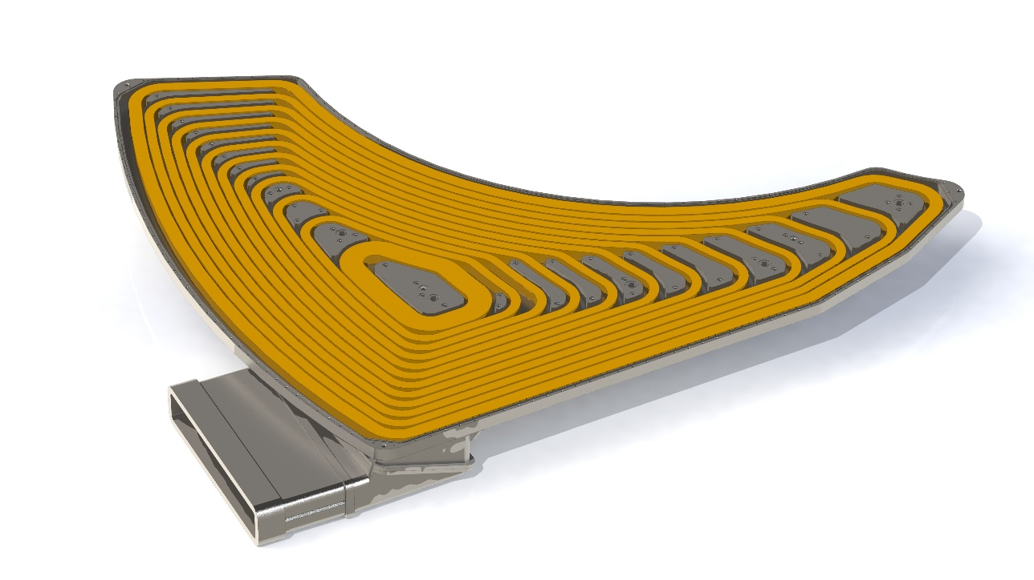
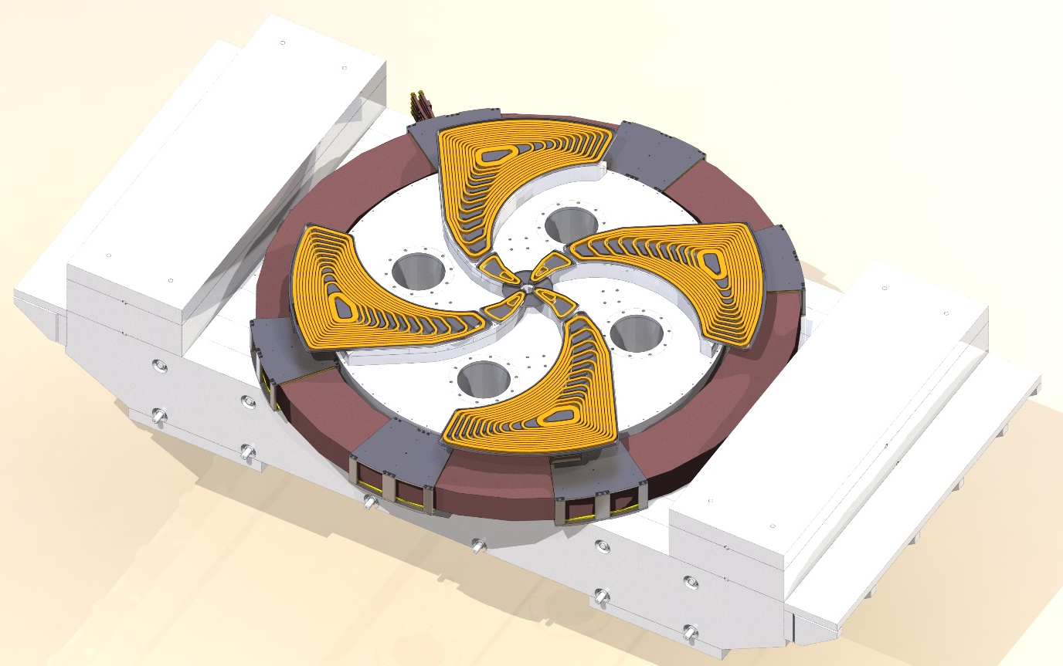
Correcting coils
Parameter | Value
Number of correcting coils | 114
Power of the correcting coils power supply, kW | 120
Conductor type | Copper hollow conductor, 7x7 mm

Slide 11
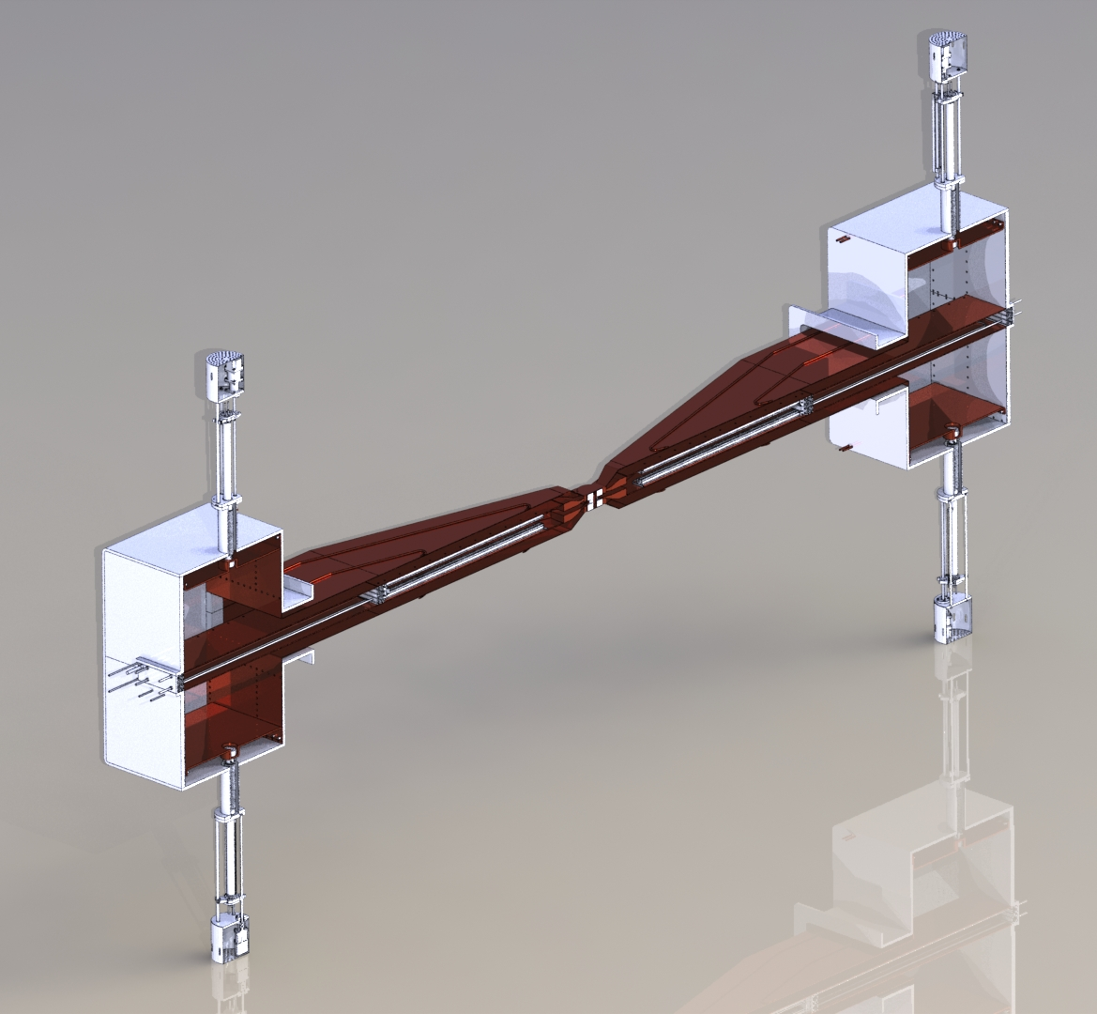
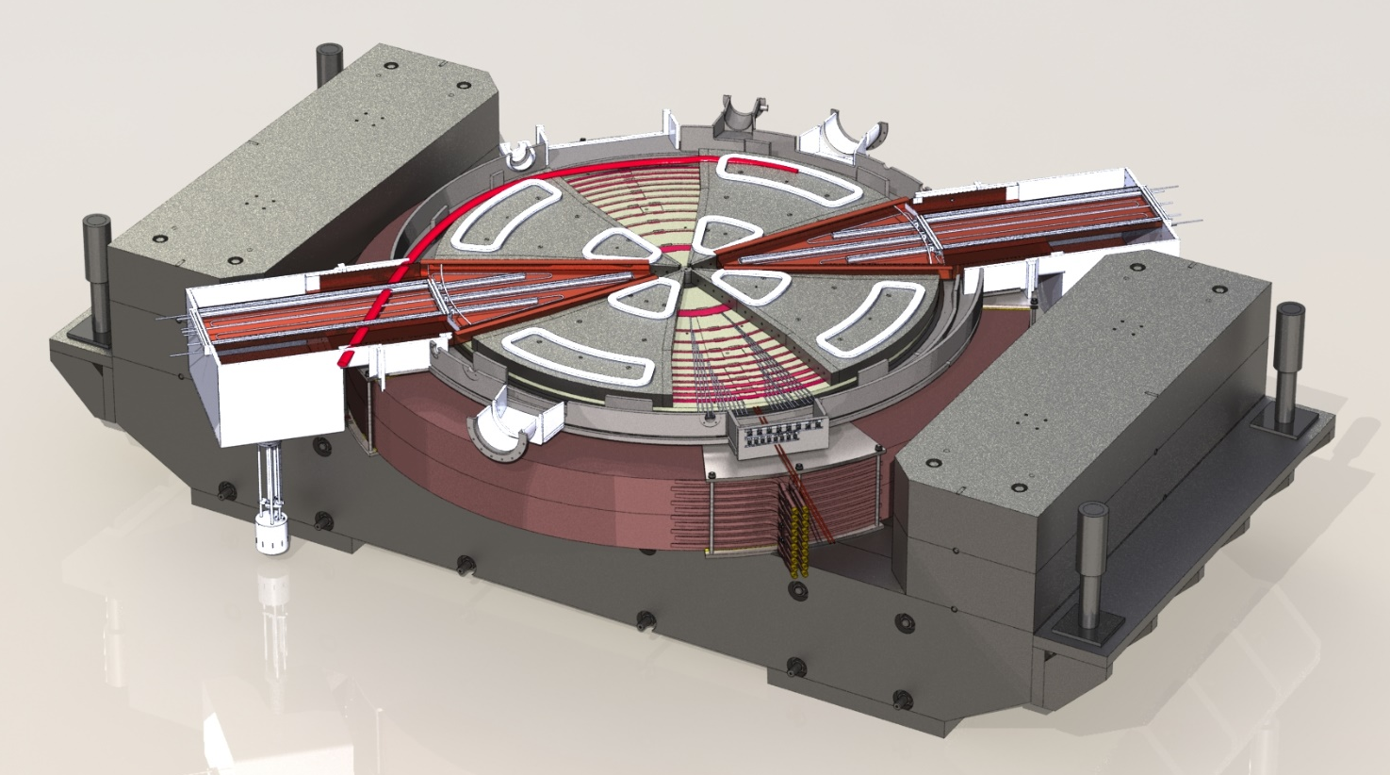
Accelerating system
Accelerating system of the MZI cyclotron

Slide 12
Accelerating system

Slide 13
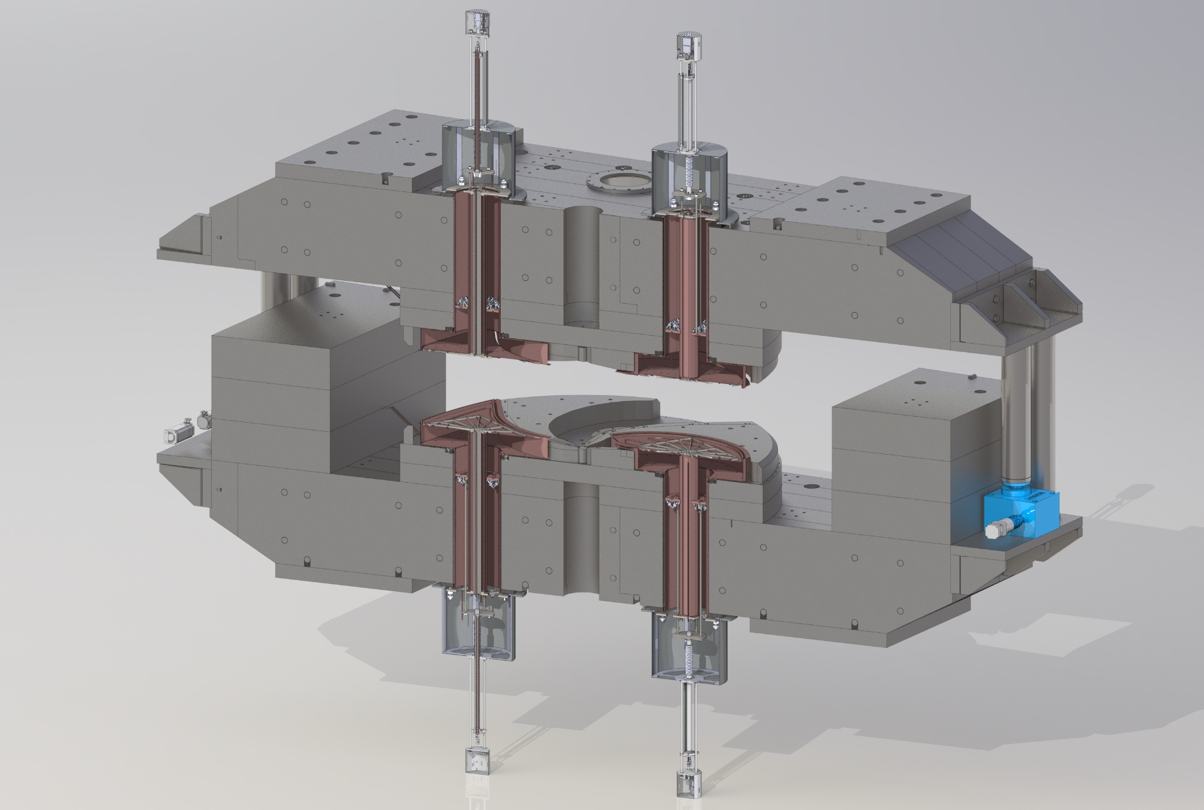
Accelerating system
Parameter | Value
Number of resonators | 2
Operating frequency range, MHz | 24 – 33,2
Active lose power, kW | 52 – 32
Accelerating voltage, kV | Up to 85

Slide 14
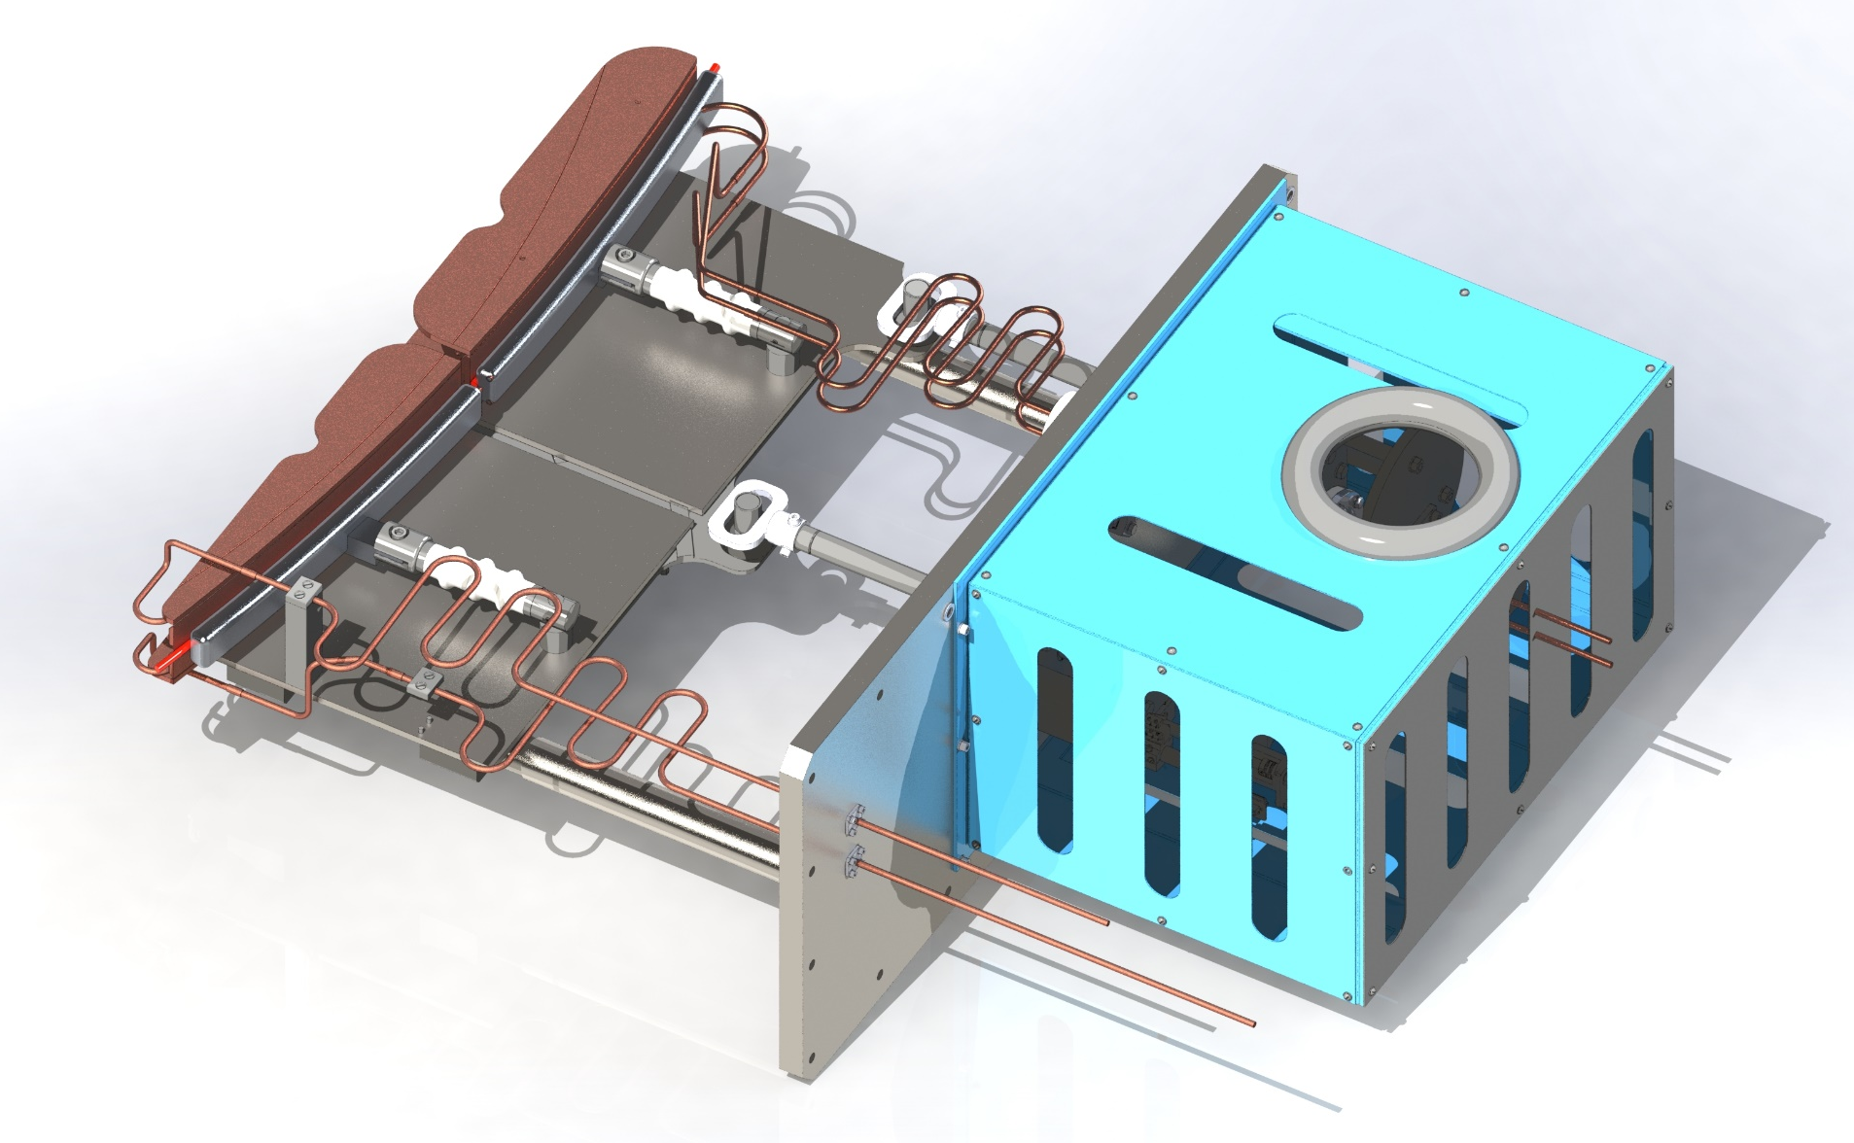
Electrostatic deflector

Slide 15
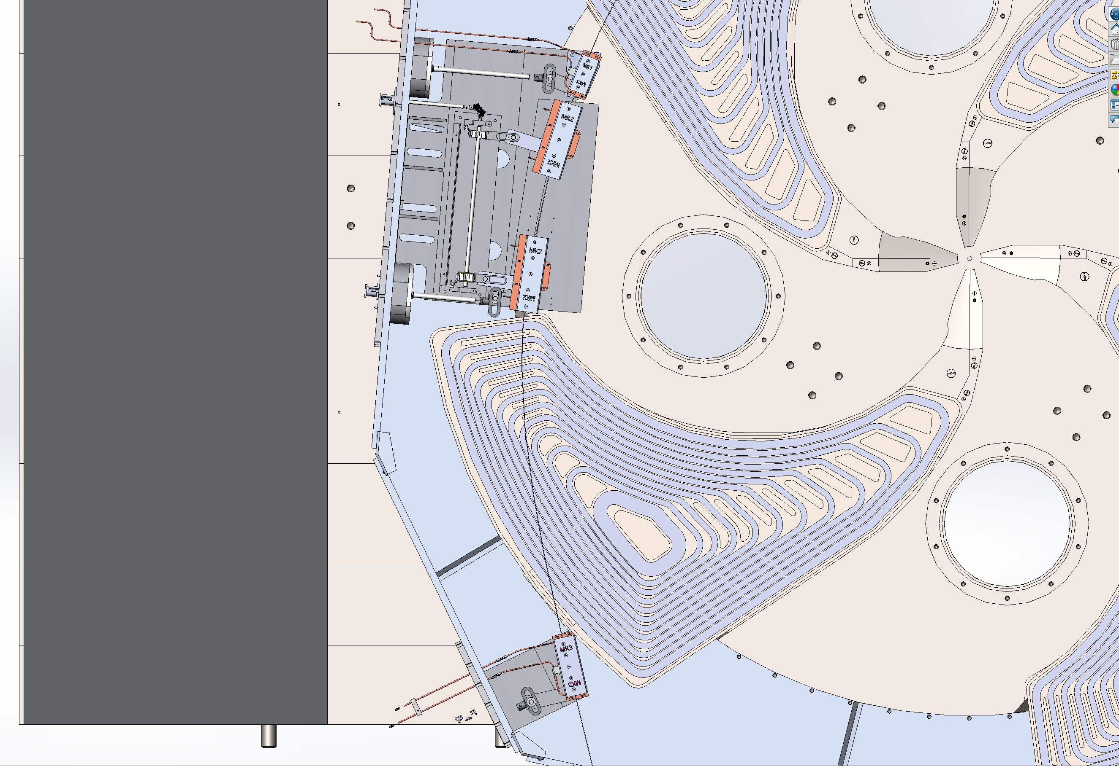
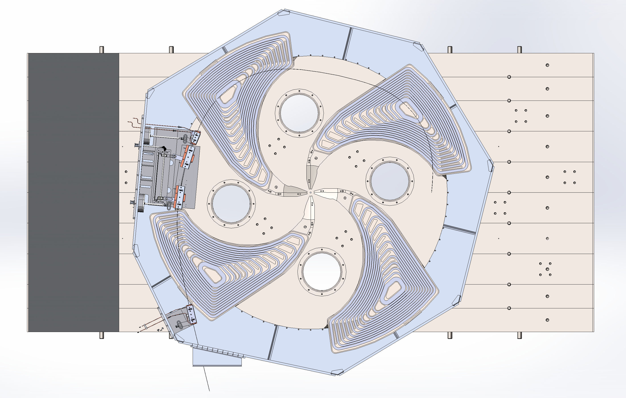
Magnetic channels

Slide 16
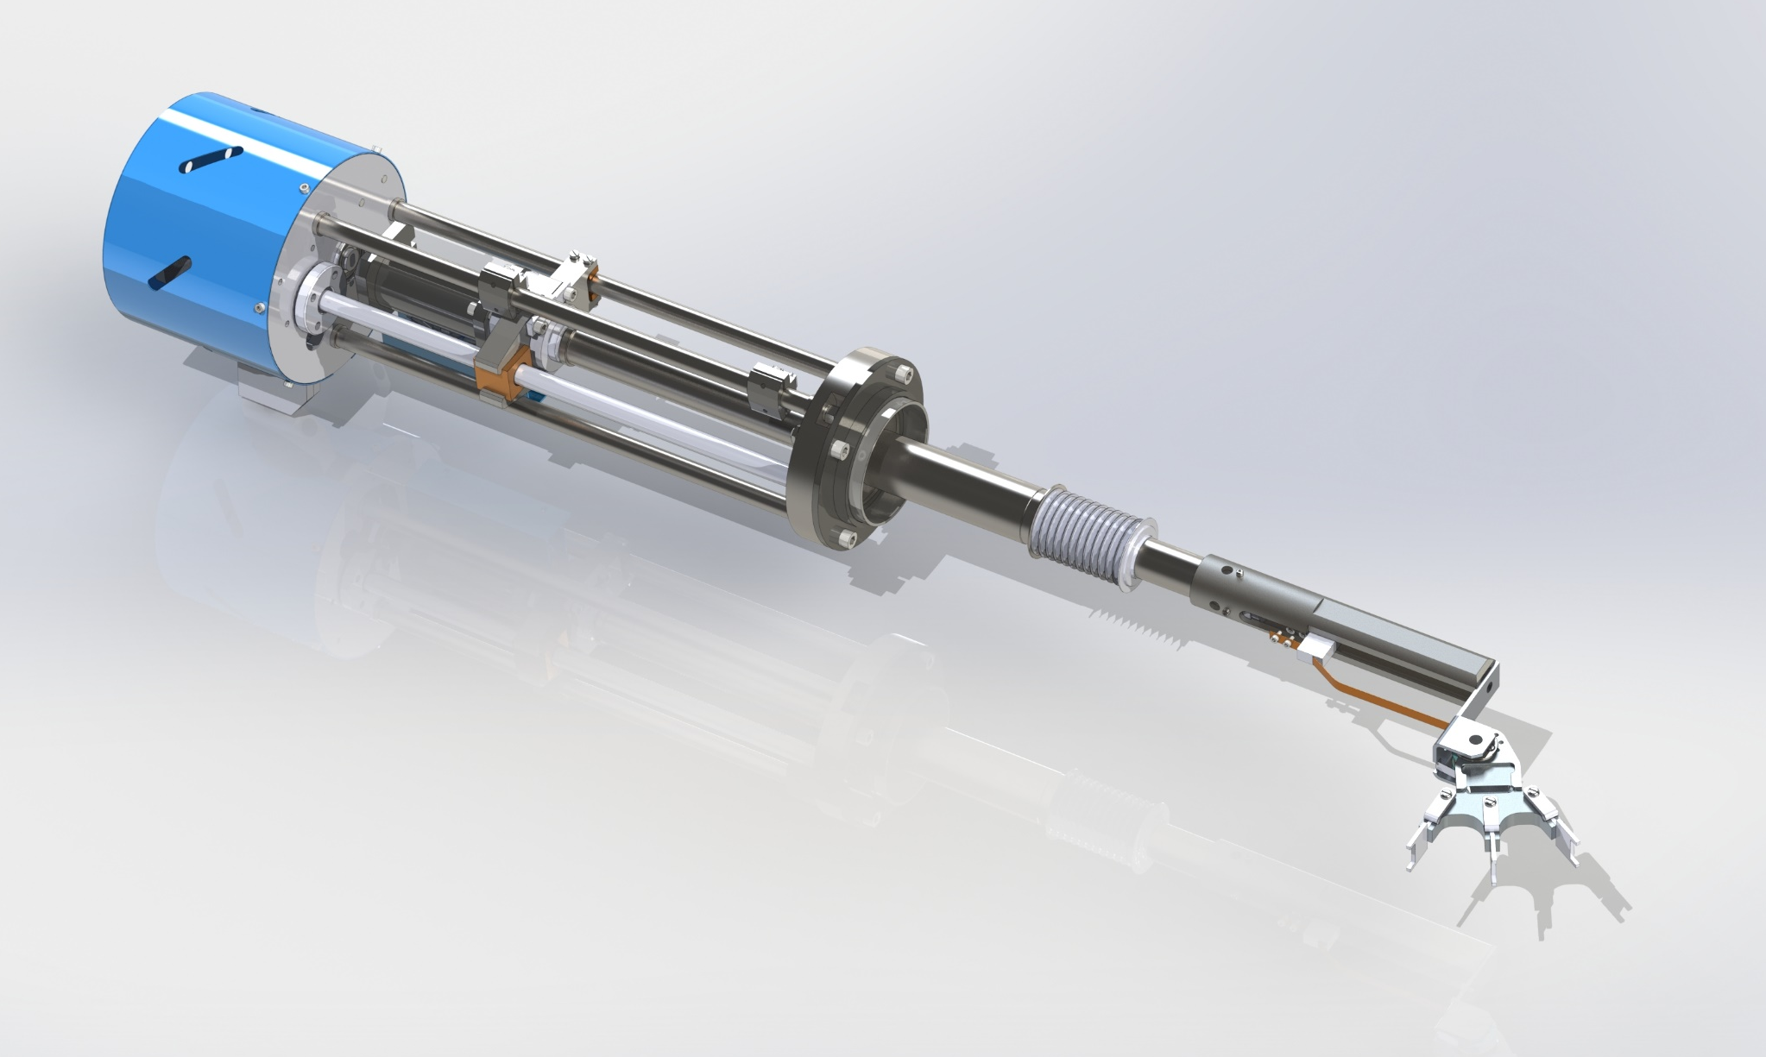
Stripper device

Slide 17
In conclusion
To date, the problems of placing equipment in the vacuum chamber of the cyclotron have been practically solved;
A computer model of an electromagnet, design documentation for a magnetic circuit, an accelerating system, main and corrective coils have been developed;
Production of the main components and systems of the cyclotron began;

Slide 18
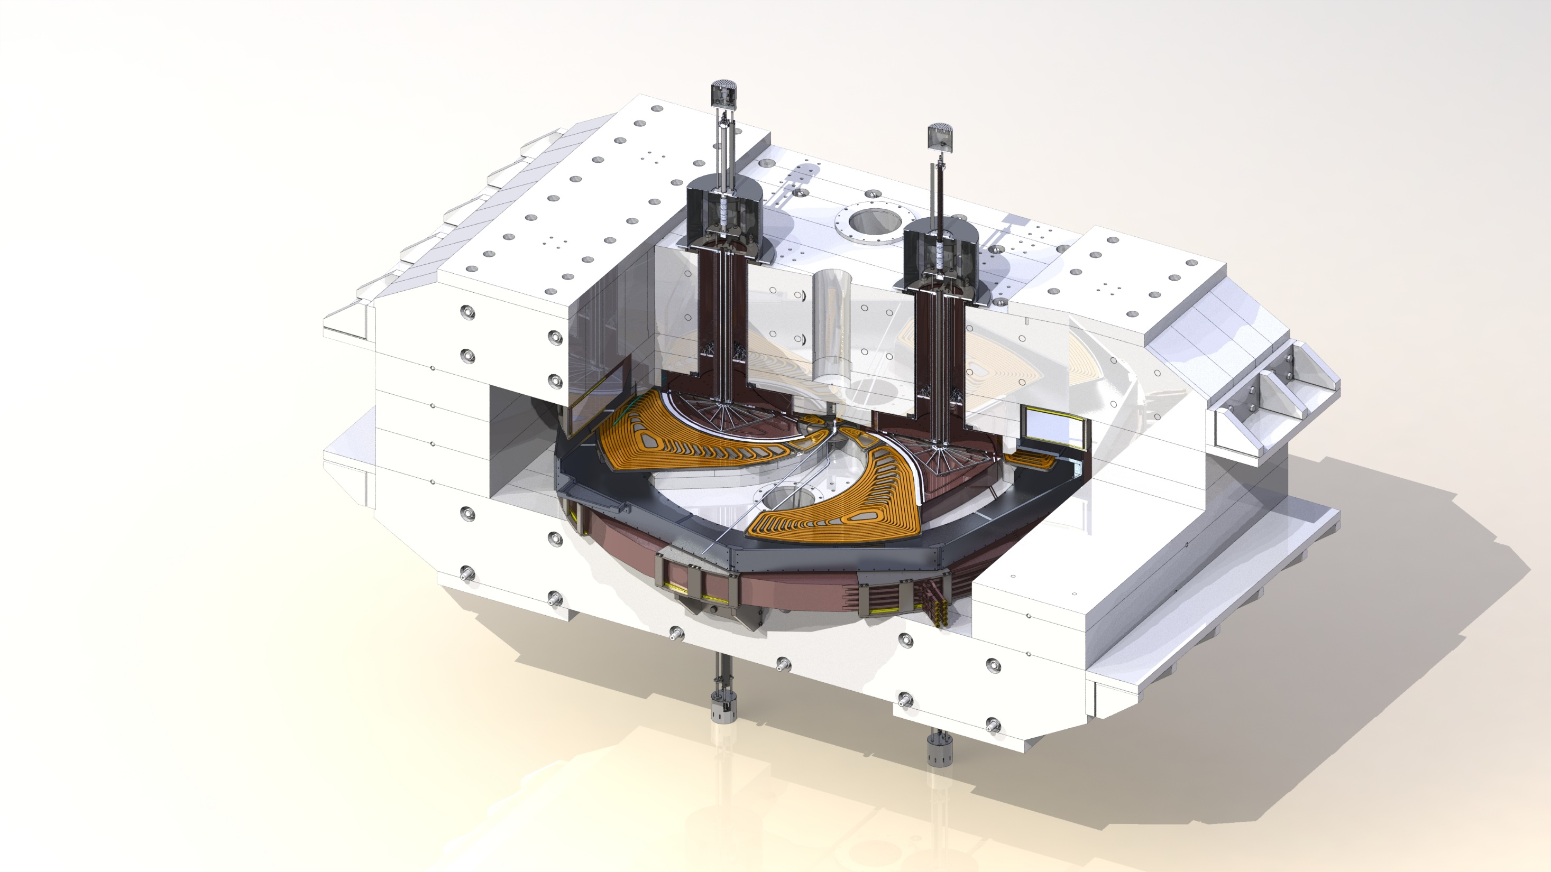
Thank you for your attention
Smirnov Kirill
Chief project engineer, JSC “NIIEFA”

