Slide 1
STATUS of PROJECT REALIZATION of the CYCLOTRON SYSTEM of MULTICHARGED IONS Usanova M.V, Akimova A.A., Gavrish Yu.N, Galchuk A.V., Grigorenko S.V. Grigoriev V.I., Klopenkov R.M., Kravchuk K.A., Kuzhlev A.N., Mudrolyubov V.G., Osina Yu.K., Smirnov K.E., Tsygankov S.S., Shmidberskаy А.A JSC «NIIEFA», 196641, St. Petersburg, Russia
XInternational Scientific Seminar in Memory of Professor V.P. Sarantsev
“Problems IV of Colliders and Particles Accelerators”
20 – 25 September 2022, Alushta, Crimea
Speaker – Usanova Marina

Slide 2
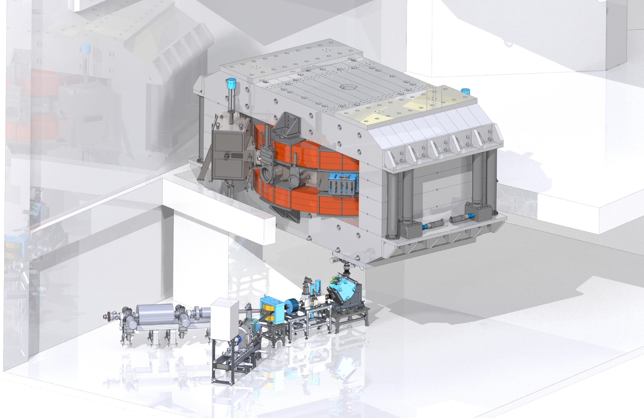

Slide 3
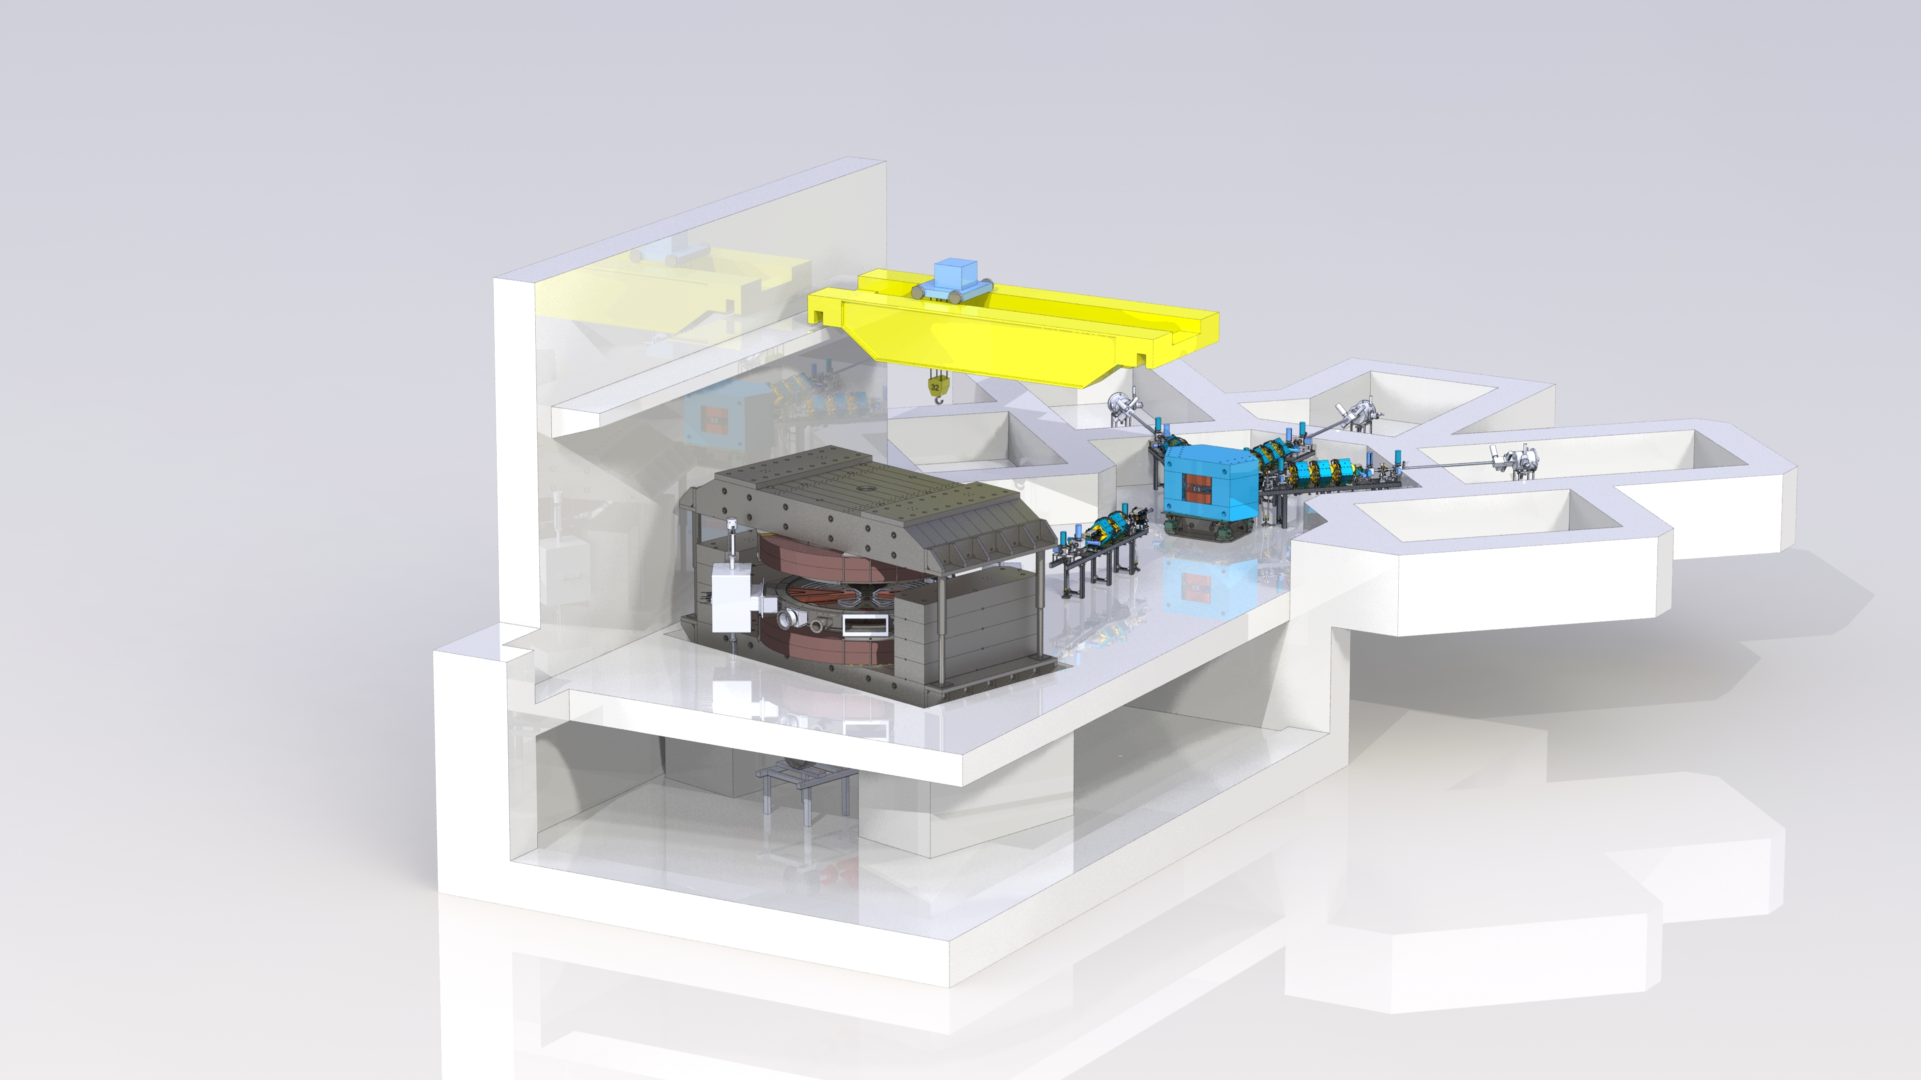

Slide 4
Main parameters of the cyclotron complex
Parameter | Value
Accelerated ions | С, О, Ne, Si, Ar, Fe, Kr, Ag, Xe, Bi
Accelerated ion energy, MeV/nucleon | 8 – 15
Mass number to charge ratio, A/z | 3 – 7
Electromagnet pole diameter, mm | 4 000
Magnet weight (Fe/Cu), t | 870/63
Induction in the centre, T | 1,29 – 1,6
Power supply of the main winding, kW | 320
Number of correction coils | 38
Injection system | External
Type of sources | ECR and electron-beam
Number of beams of the transport system | 3
Total energy consumption in operating mode, kW | 1 000
RF system operating frequency range, MHz | 13 – 20
RF system output power, kW | 60

Slide 5
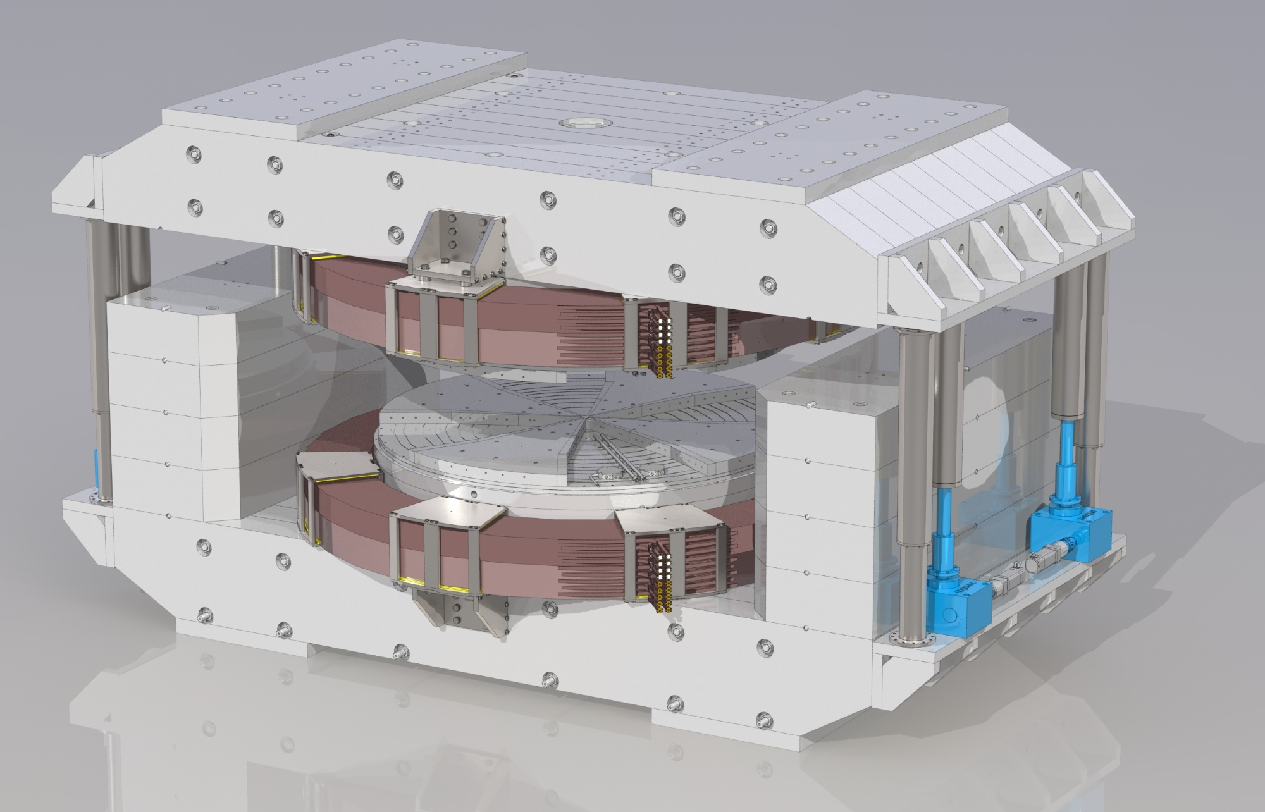
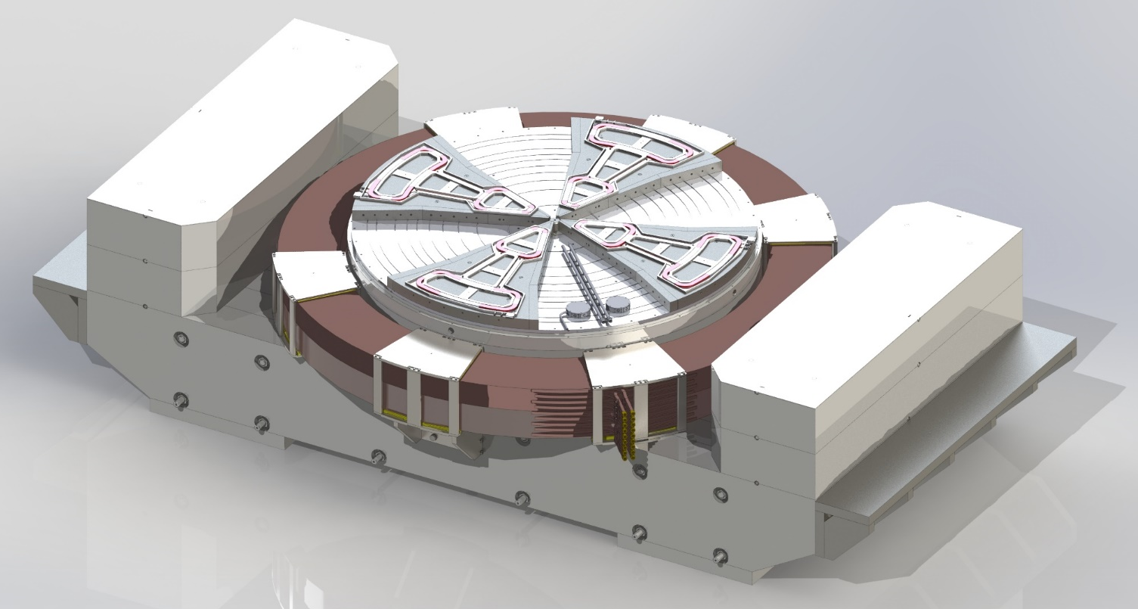
Electromagnet of the cyclotron
Parameter | Value
Pole diameter, mm | 4 000
Magnet weight (Fe/Cu), t | 870/63
Induction in the centre, T | 1,29 – 1,6
Power supply of the main winding, kW | 320
Number of correction coils | 38
Top half-yoke lifting system | Presence

Slide 6
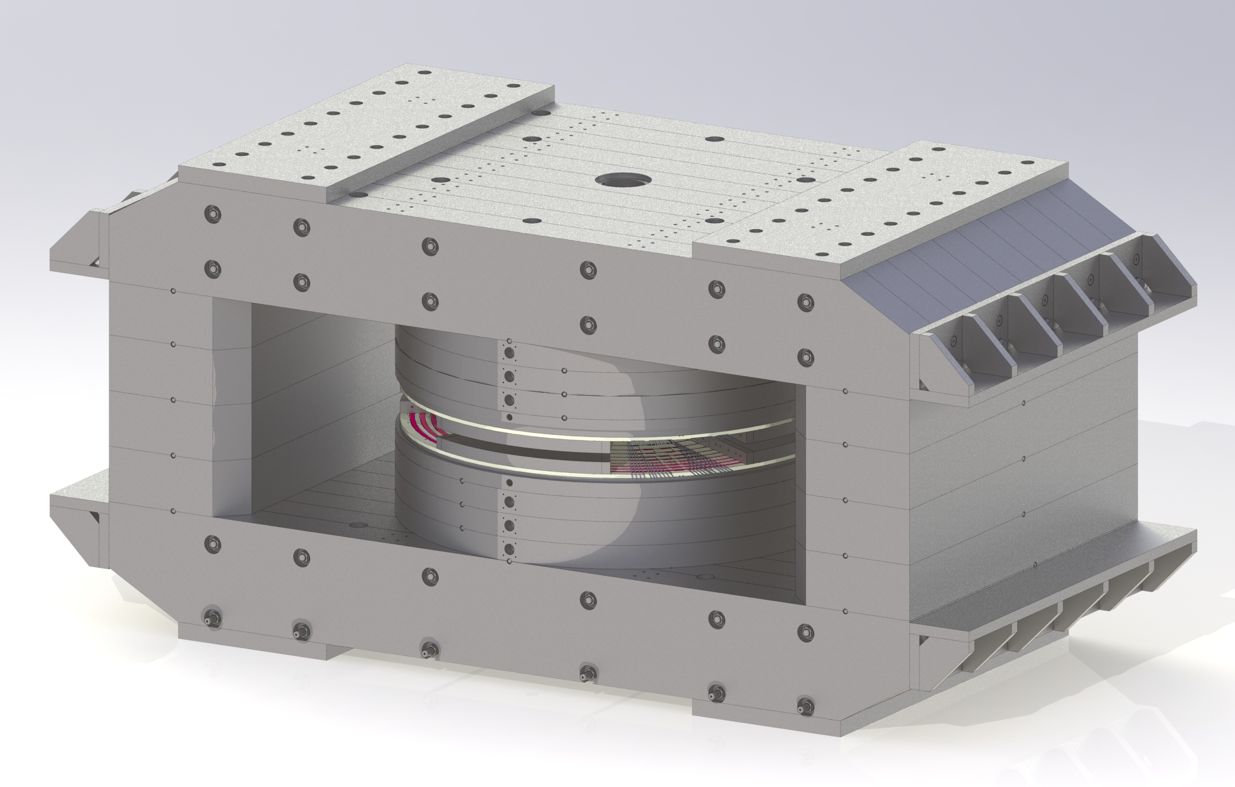
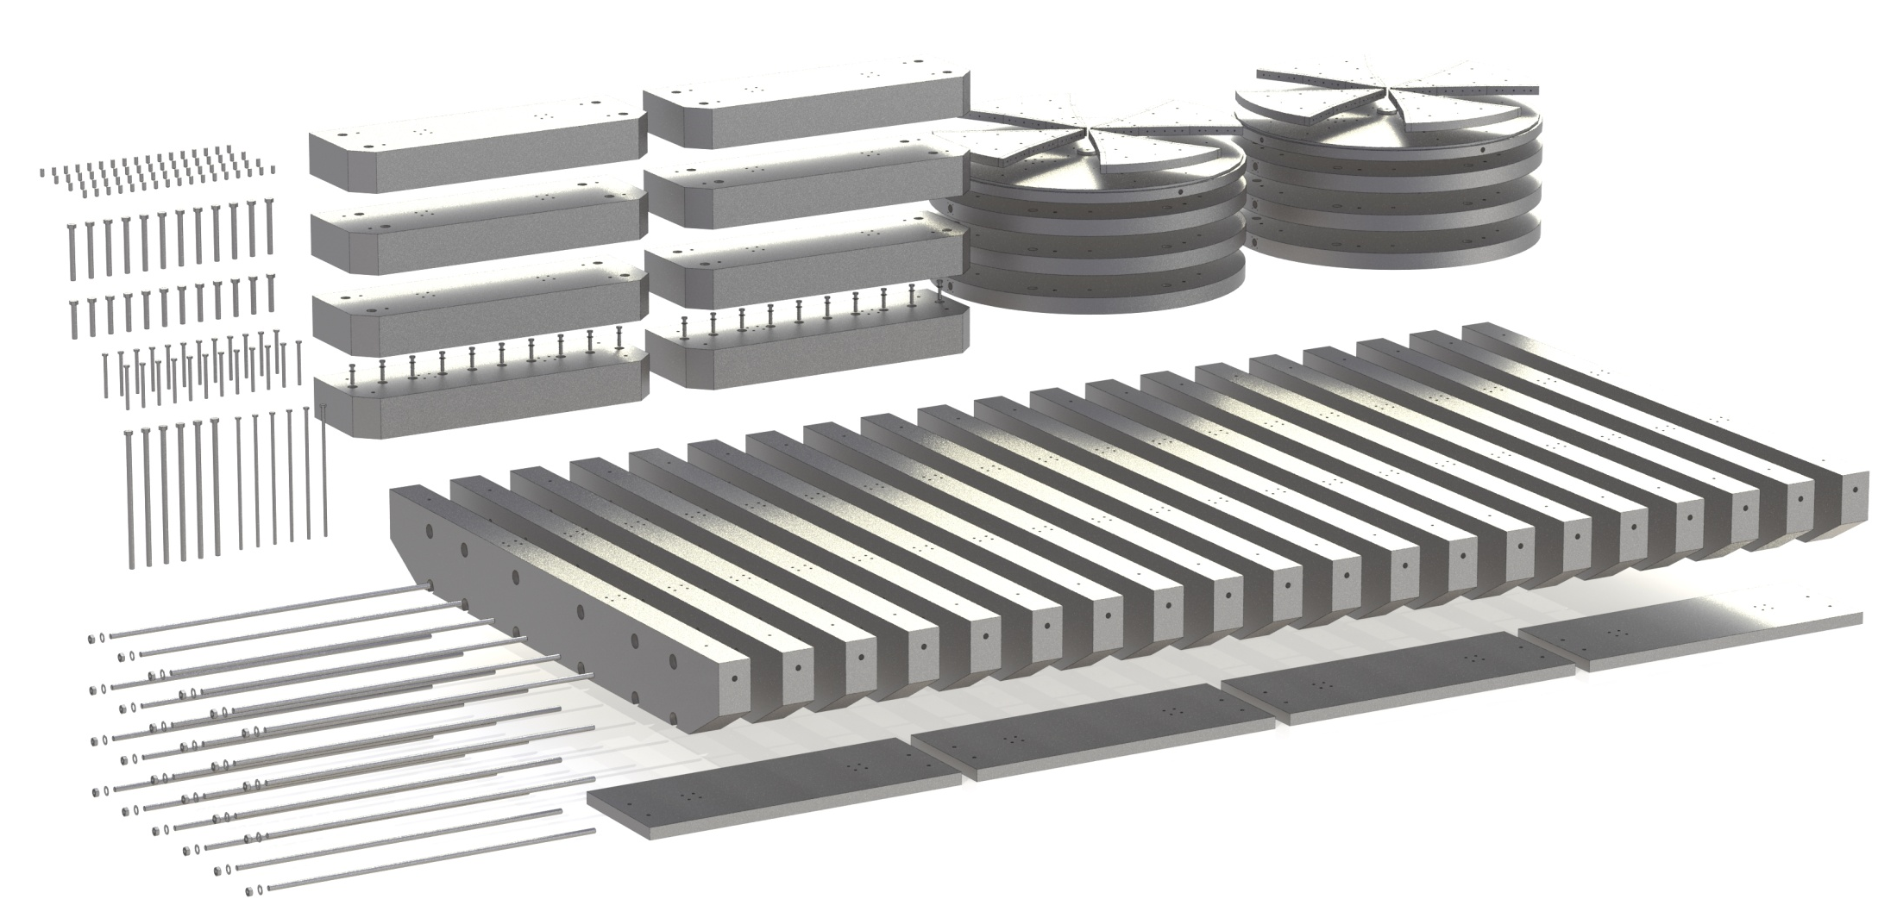
Main magnet of the cyclotron
Parameter | Value
Magnet dimensions, mm | 8 100х4 000х4 300
Weight of steel, t | 870
Pole diameter, mm | 4 000
Air gaps, sector/valley, mm | 300/80
Top half-yoke lifting system | Presence

Slide 7
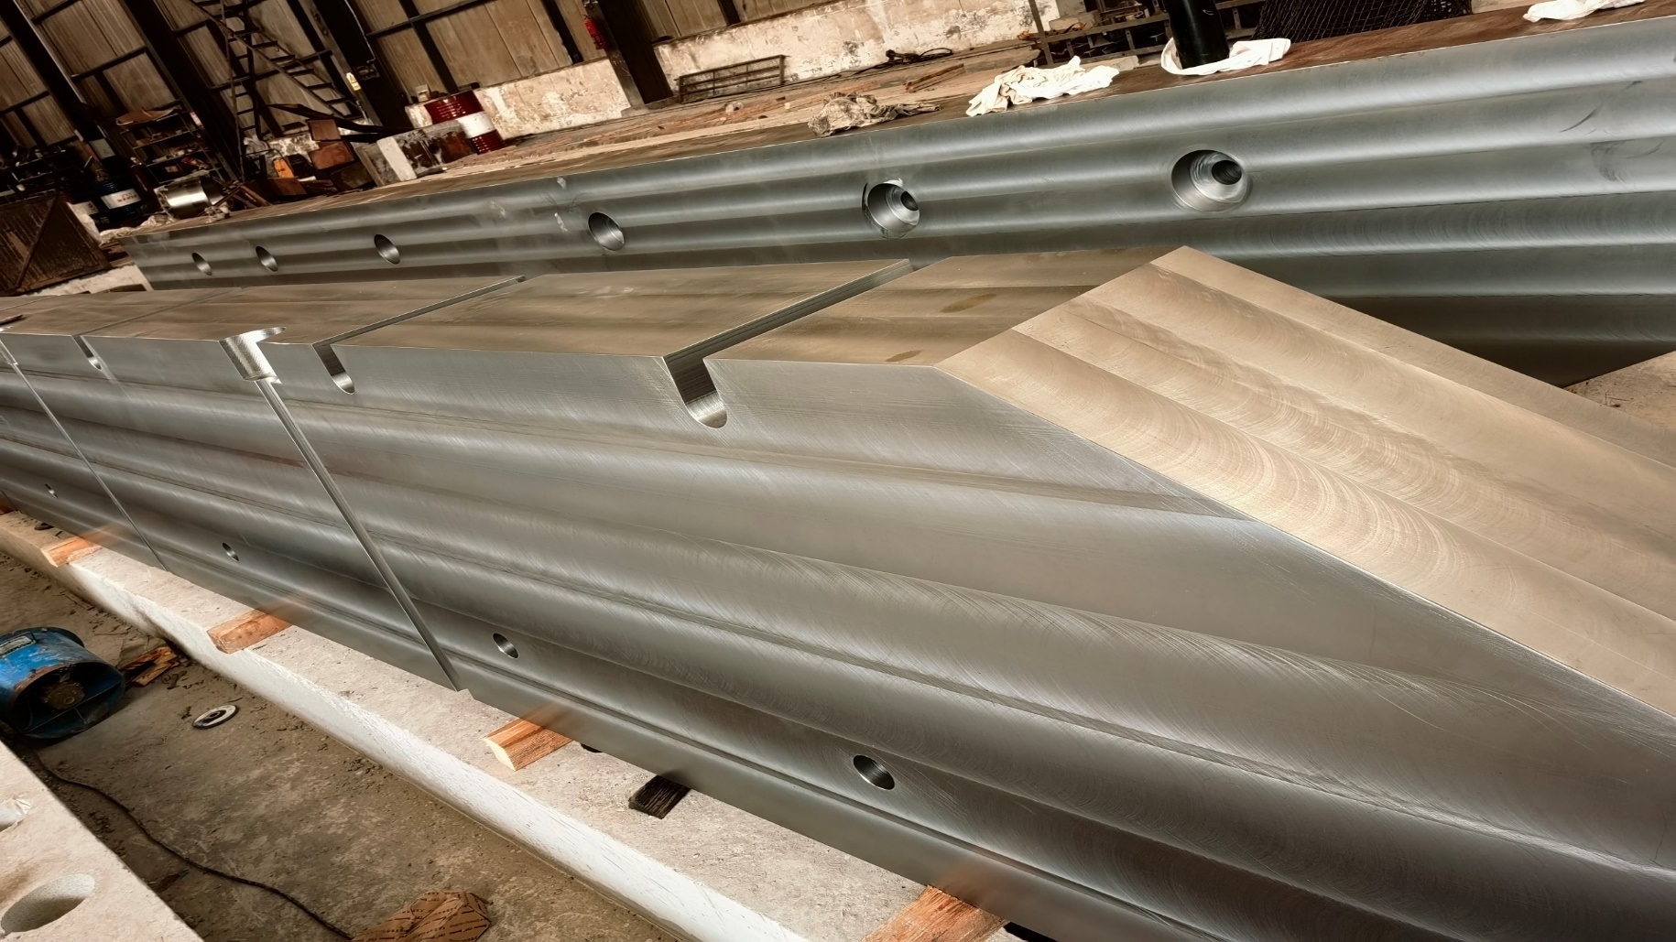
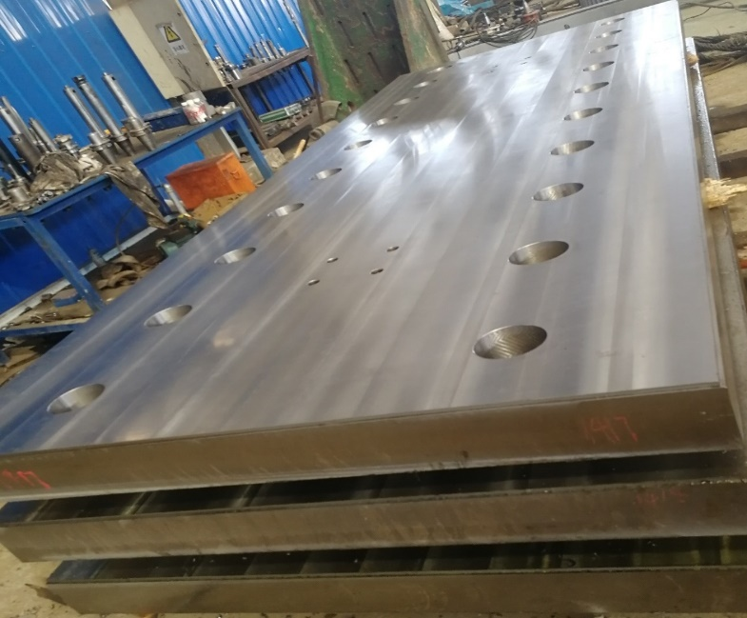
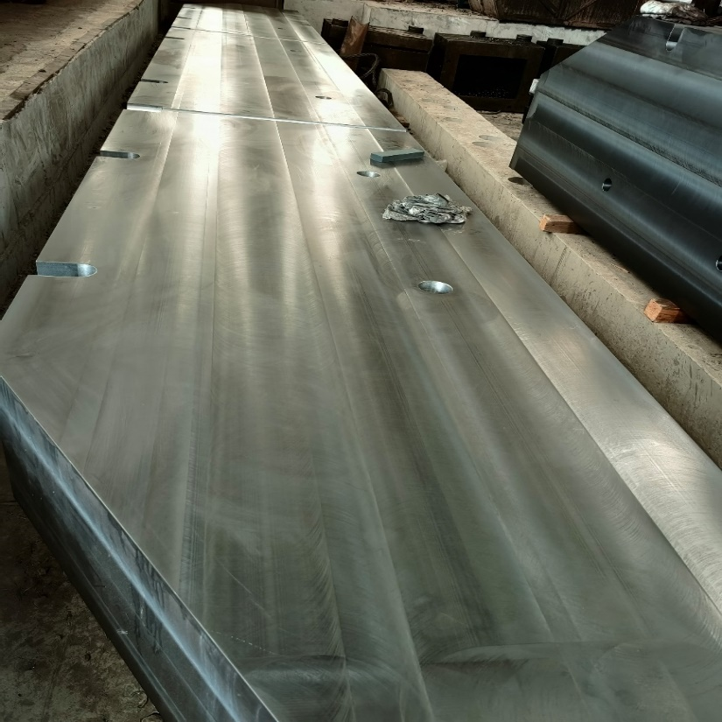
Main magnet details

Slide 8
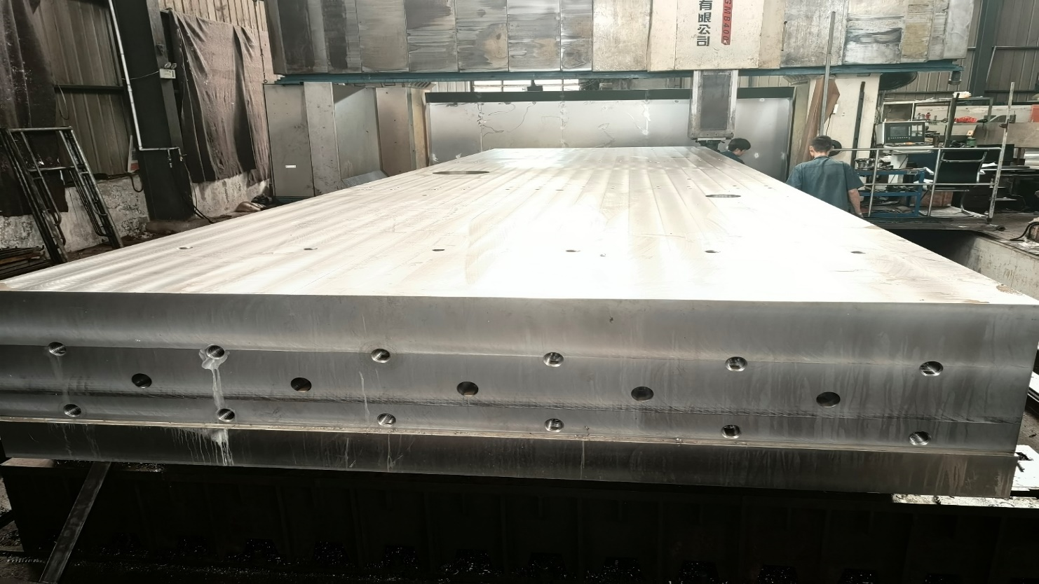
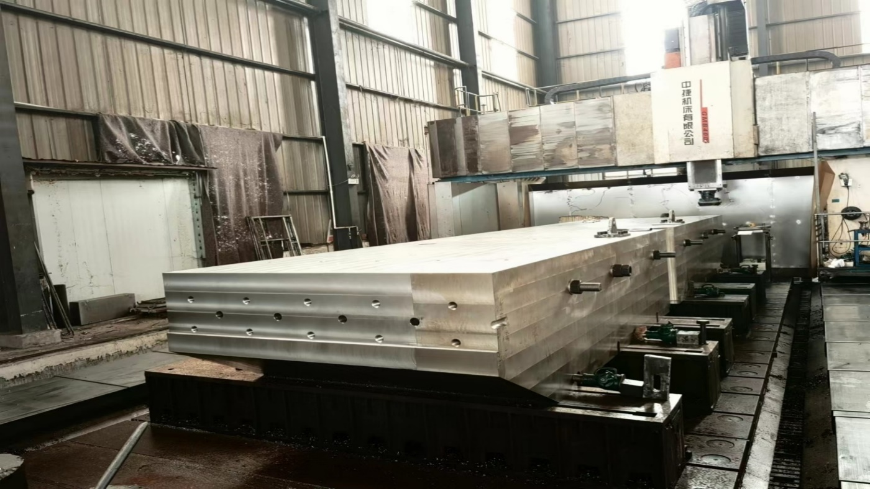
Main magnet details

Slide 9
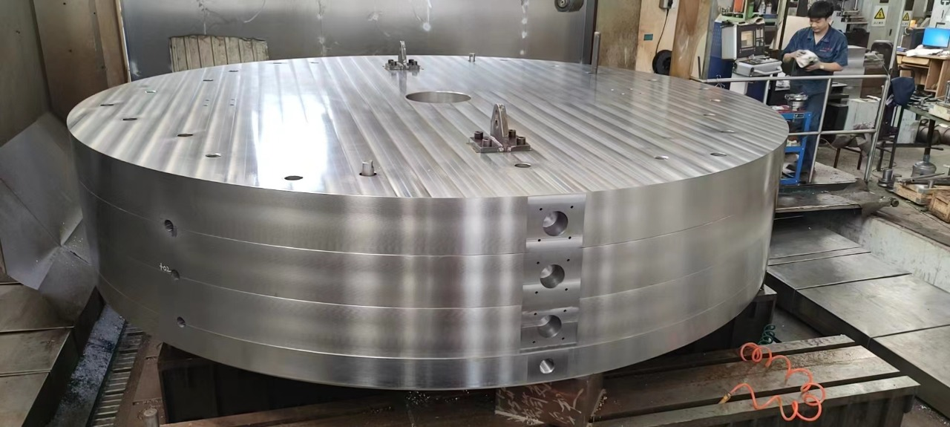
Main magnet details

Slide 10
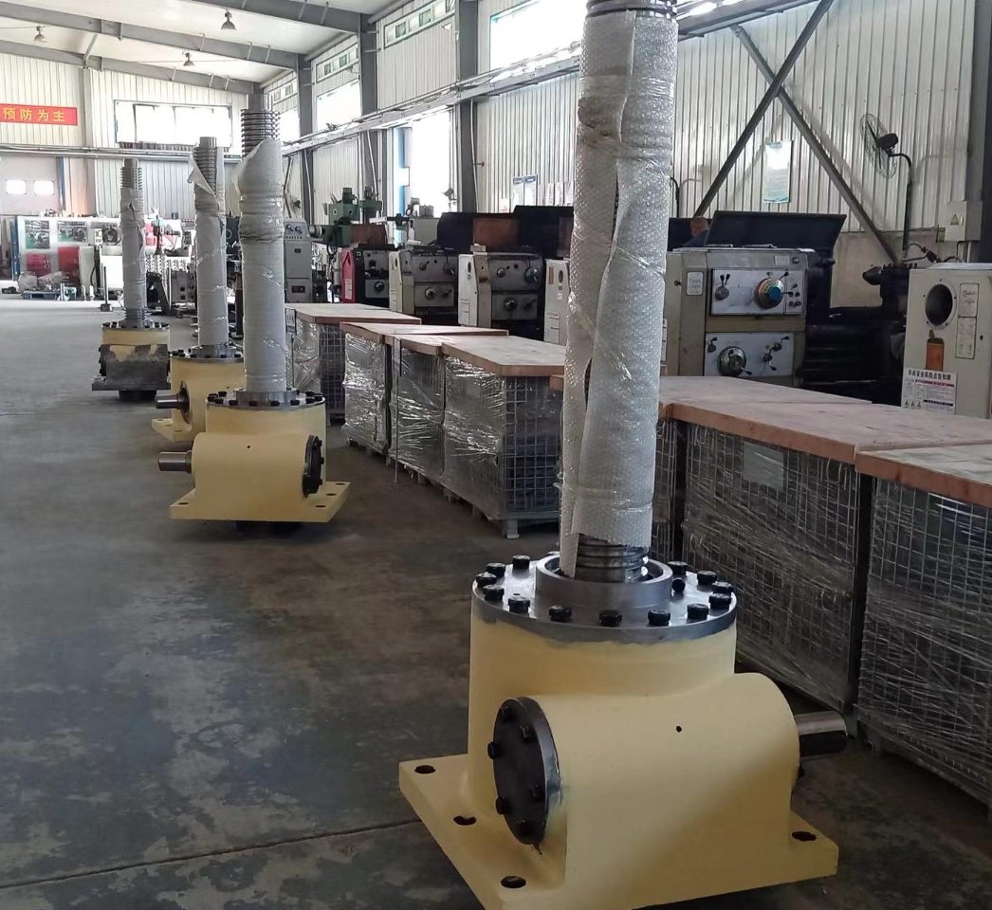
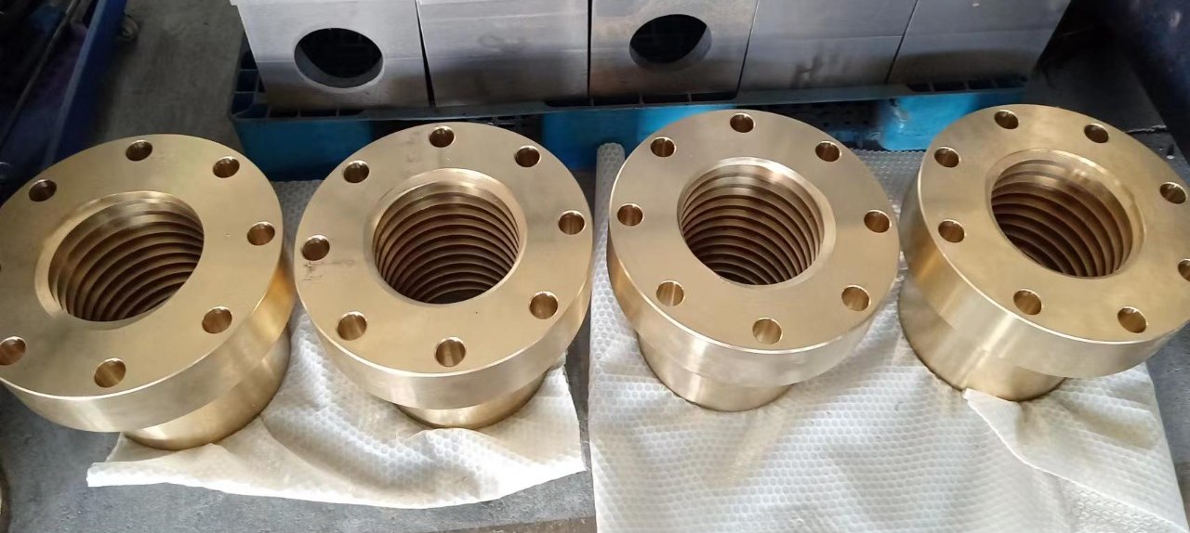
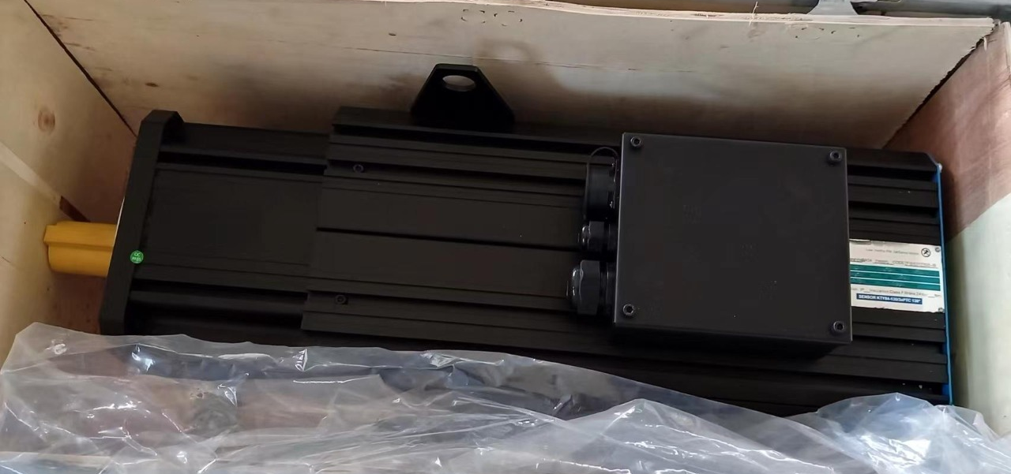
Top half-yoke lifting system

Slide 11
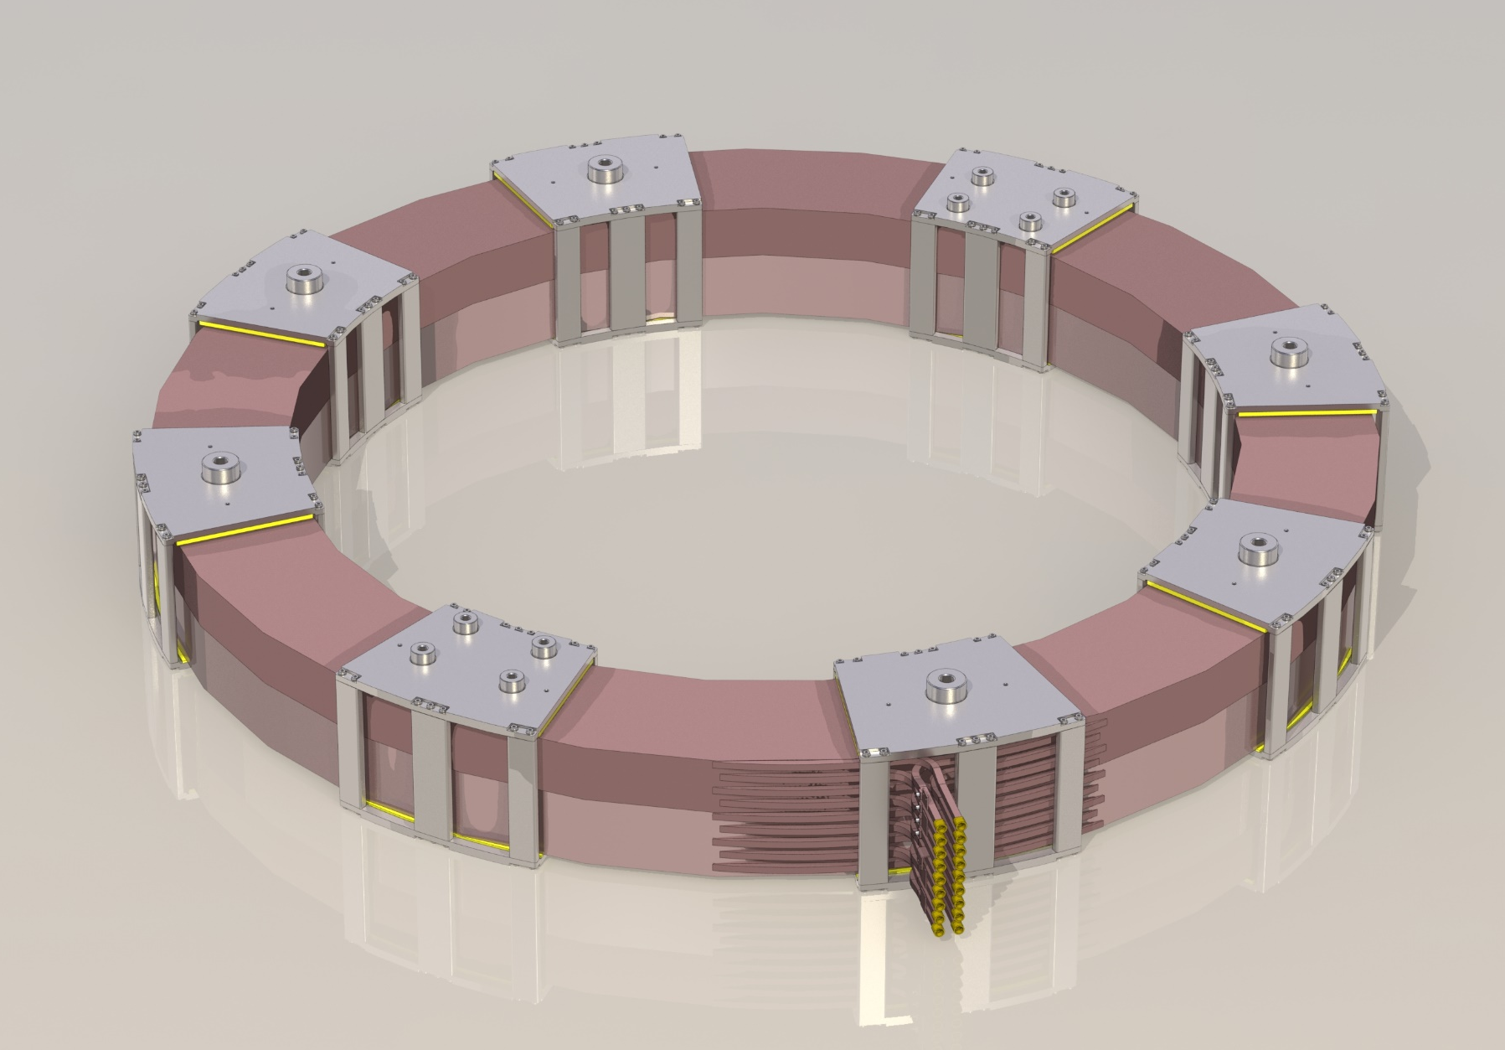
Main coils
Parameter | Value
Diameter, mm | 5 350
Weight of each coil, t | 32
Type of conductor | Hollow copper conductor 29x29 mm
Number of turns in each coil | 360
Power consumption of main coils, kW | 290

Slide 12
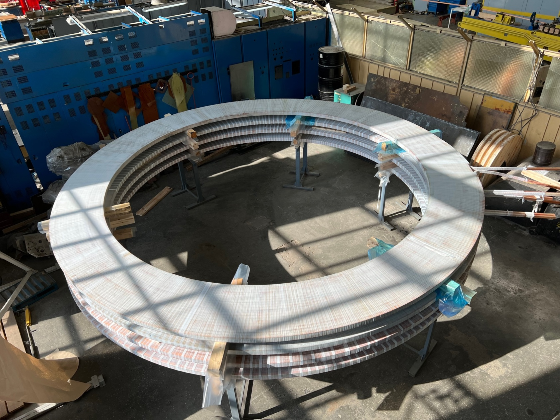
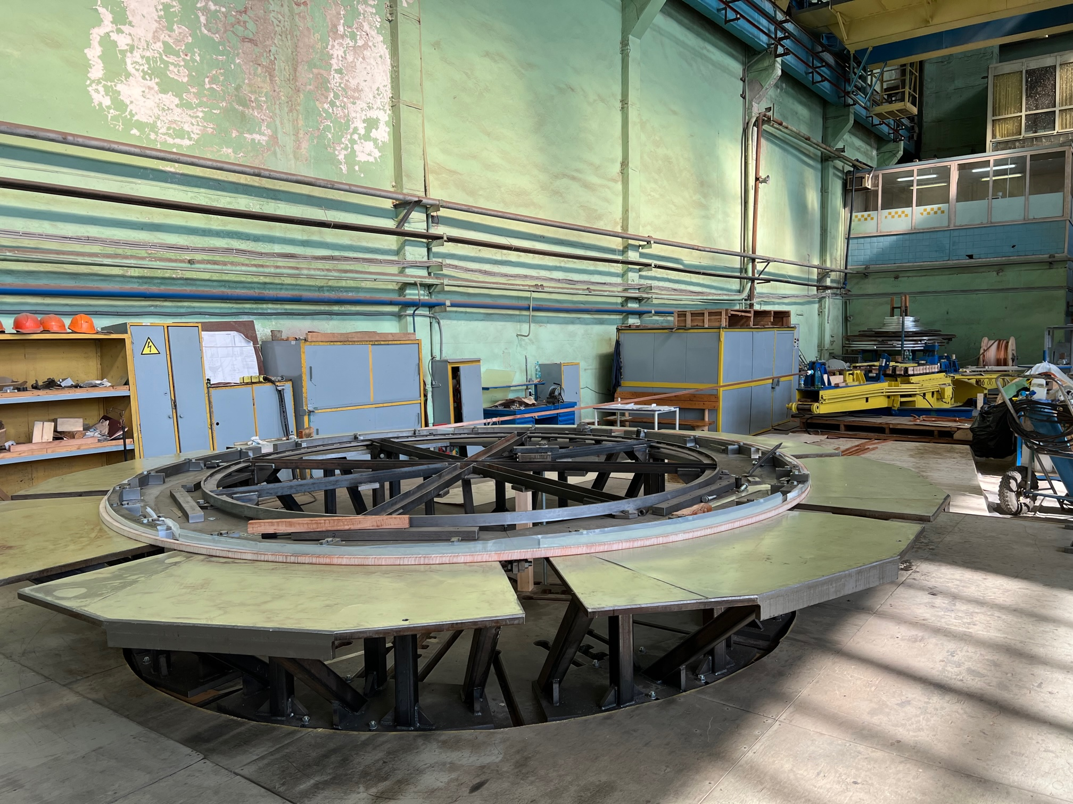
Main coils

Slide 13
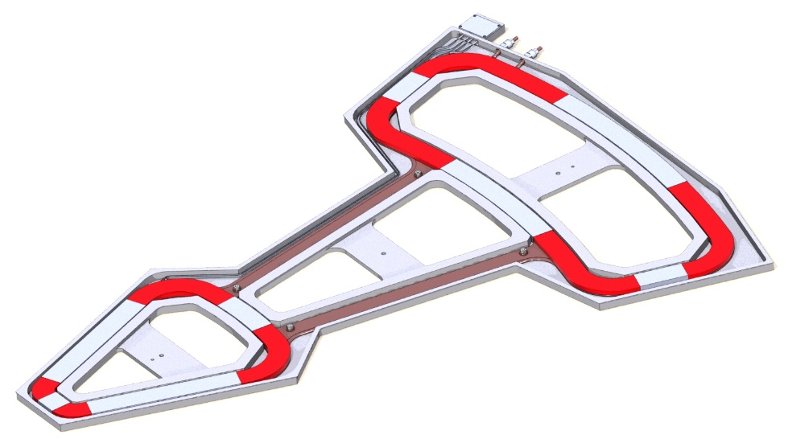
Correcting coils
Parameter | Value
Total number of coils | 38
Number of radial coils | 2 units of 11 coils
Total power consumption of radial coils, kW | 20
Number of azimuthal coils | 8 units of 2 coils
Total power consumption of azimuthal coils, kW | 2
Type of cooling | Water, indirectly

Slide 14
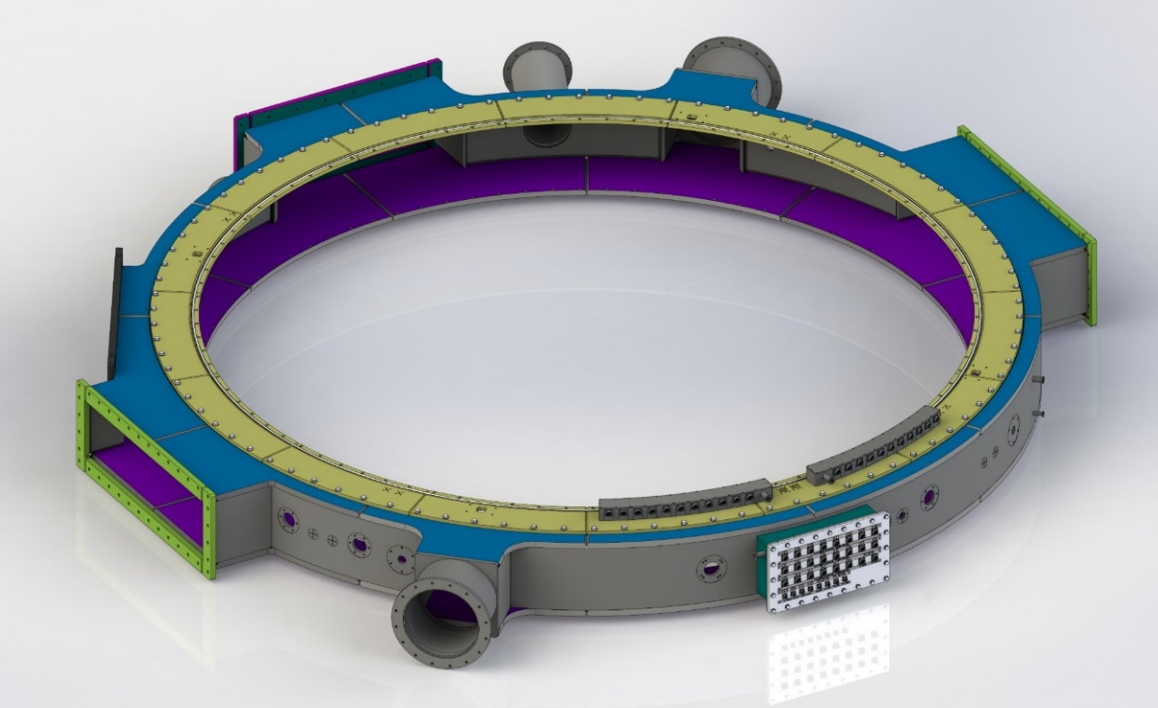
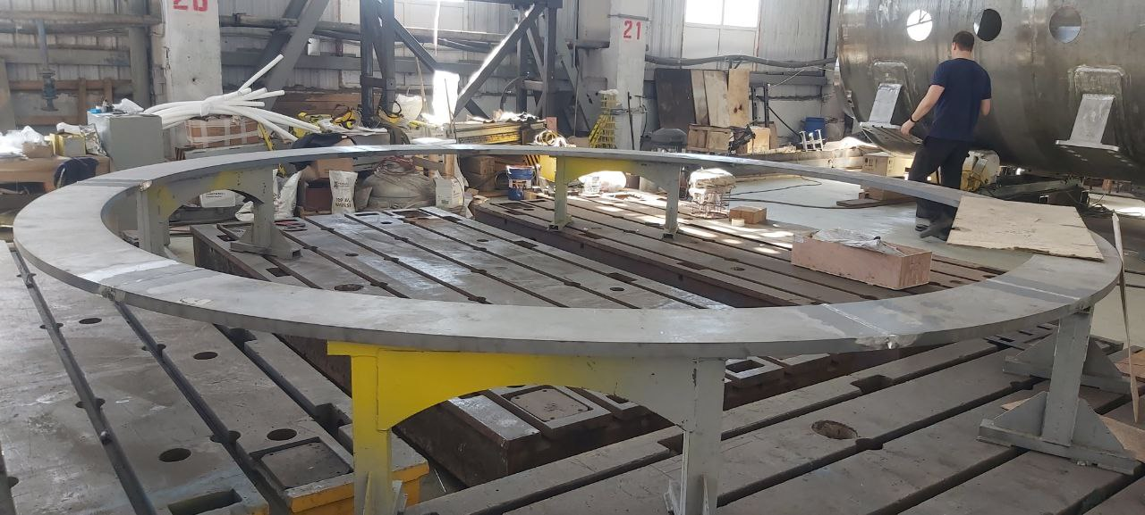
Vacuum chamber
Parameter | Value
Vacuum chamber design | Welded from titanium, with a separate top cover
Diameter, mm | 4 600
Number of flanges | 18
Weight , kg | 2415
Wall thickness, mm | 20 – 35

Slide 15
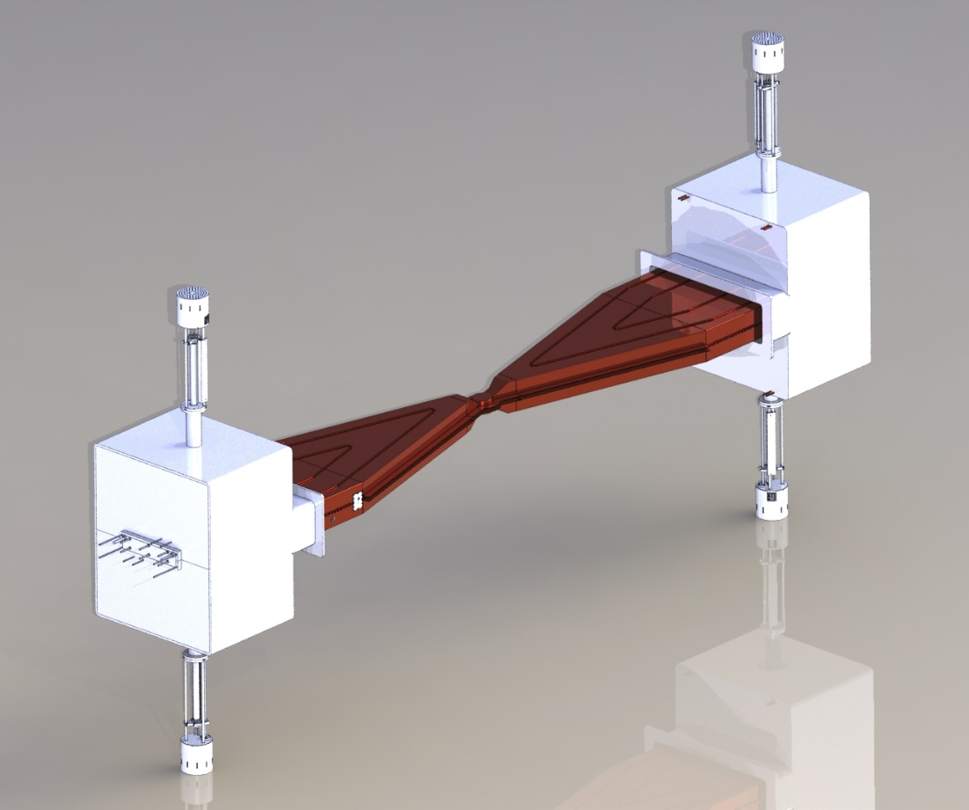
Resonance system
Parameter | Value
Number of resonators | 2
Operating frequency range, MHz | 13 – 20
Active lose power, kW | 40
Accelerating voltage, kV | Up to 70

Slide 16
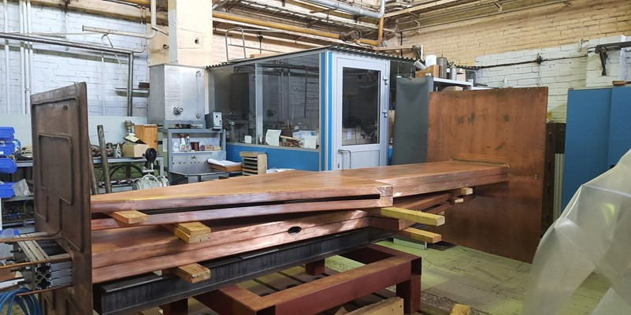
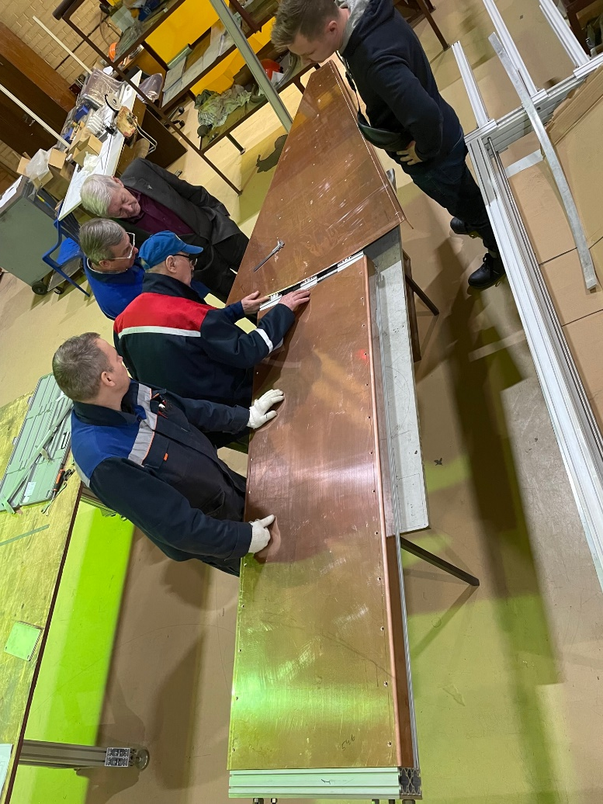
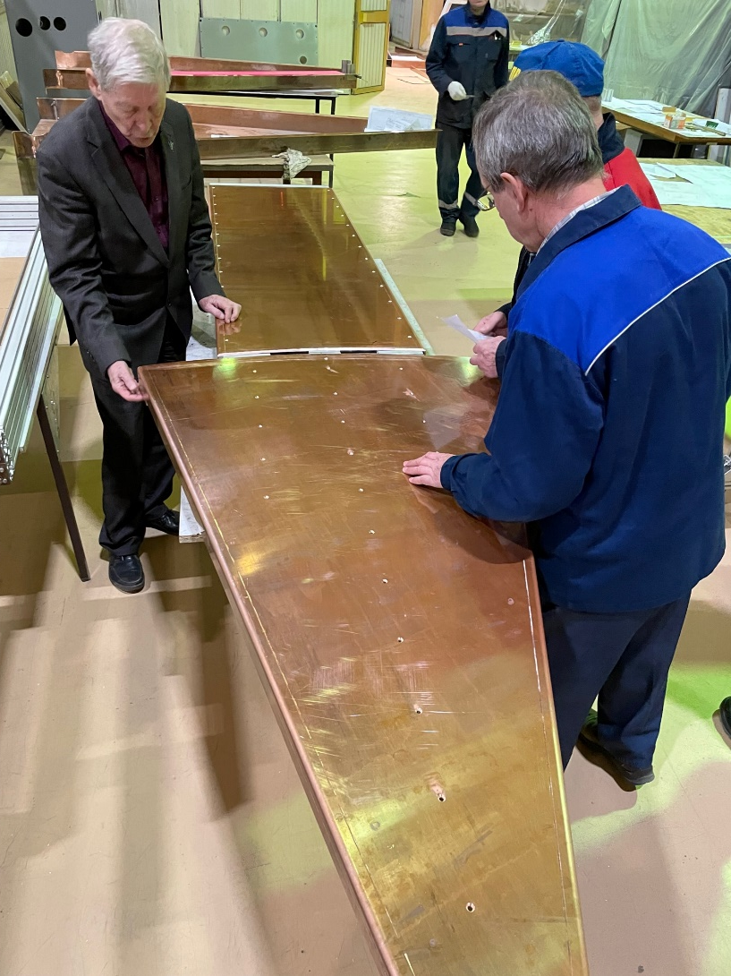
Resonance system

Slide 17
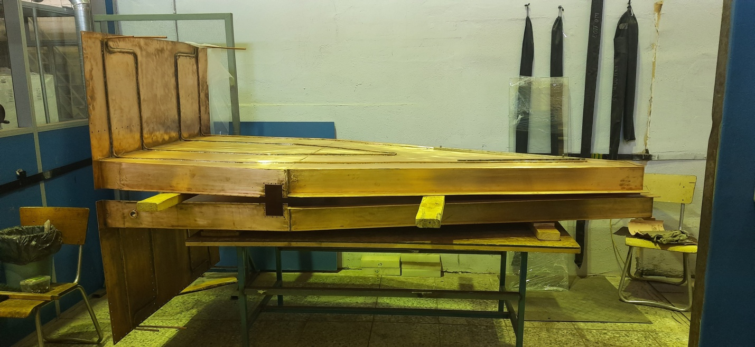
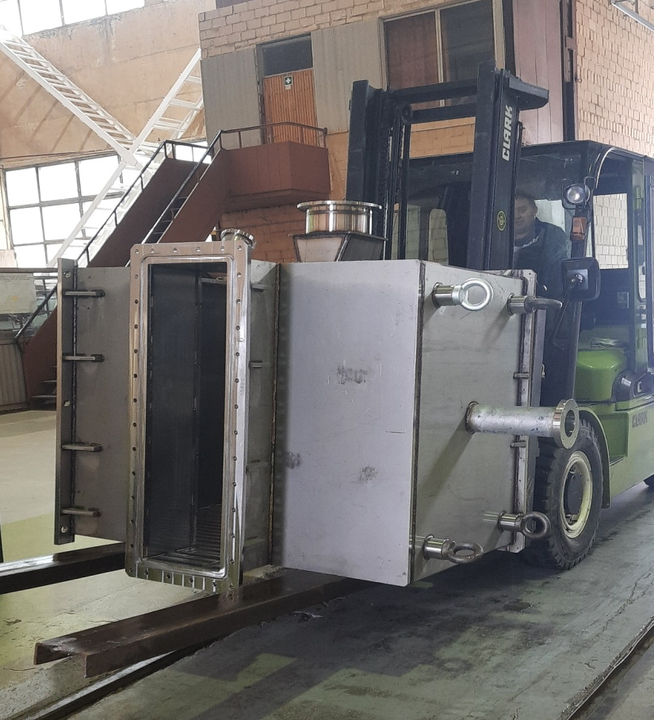
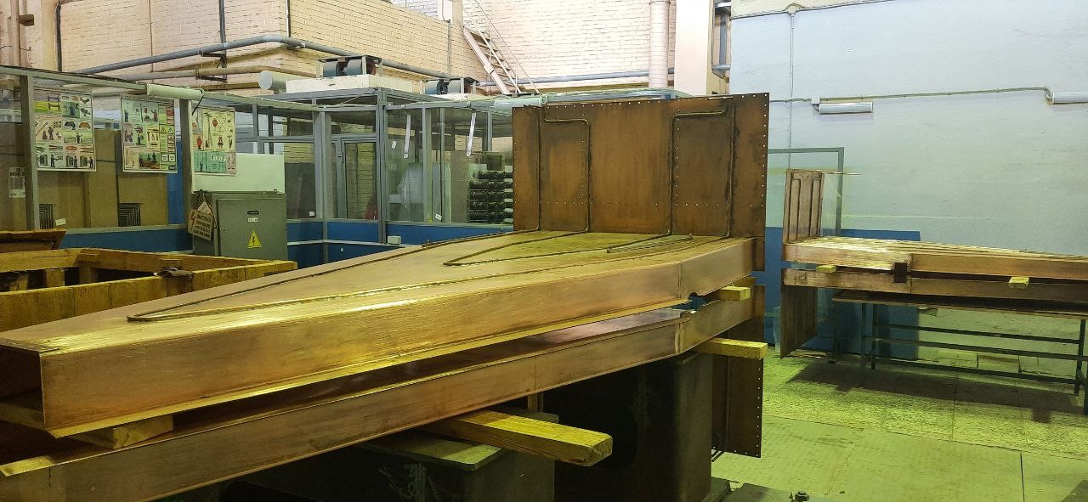
Resonance system

Slide 18
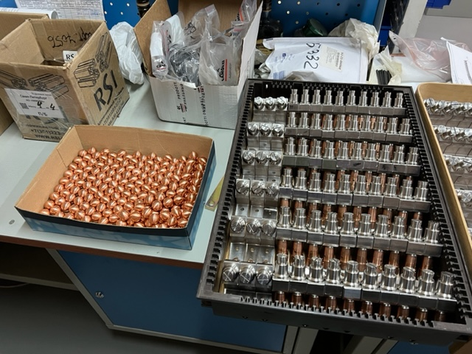
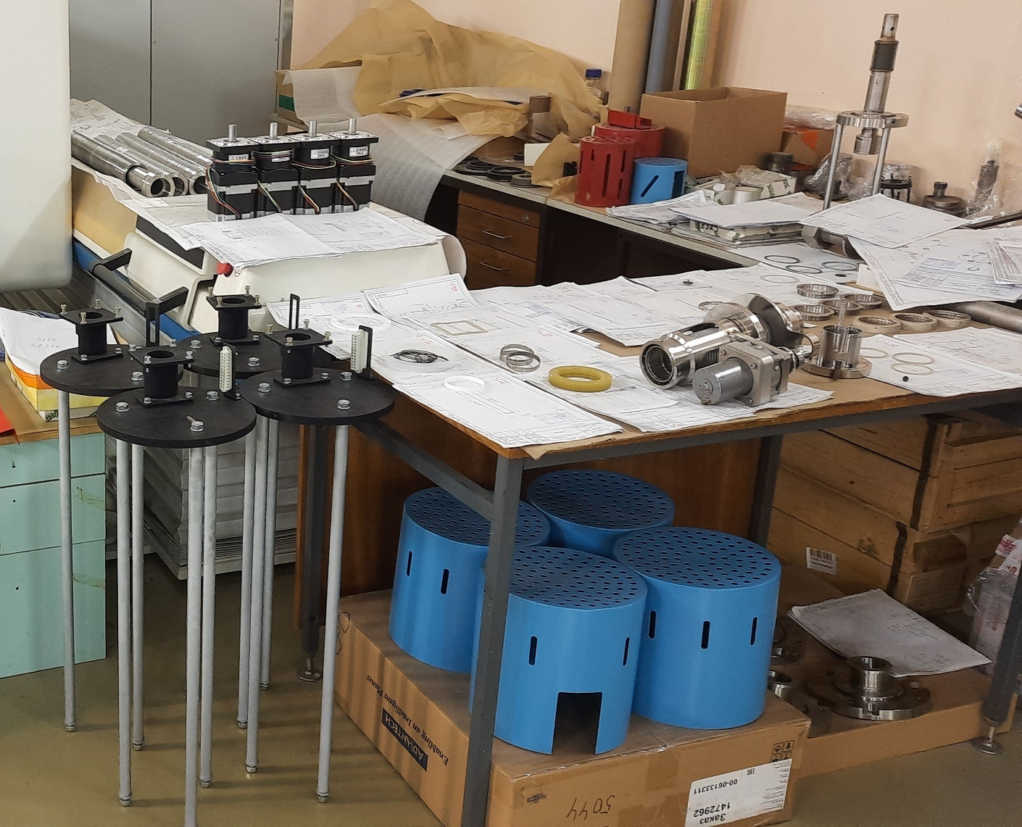
Resonance system

Slide 19
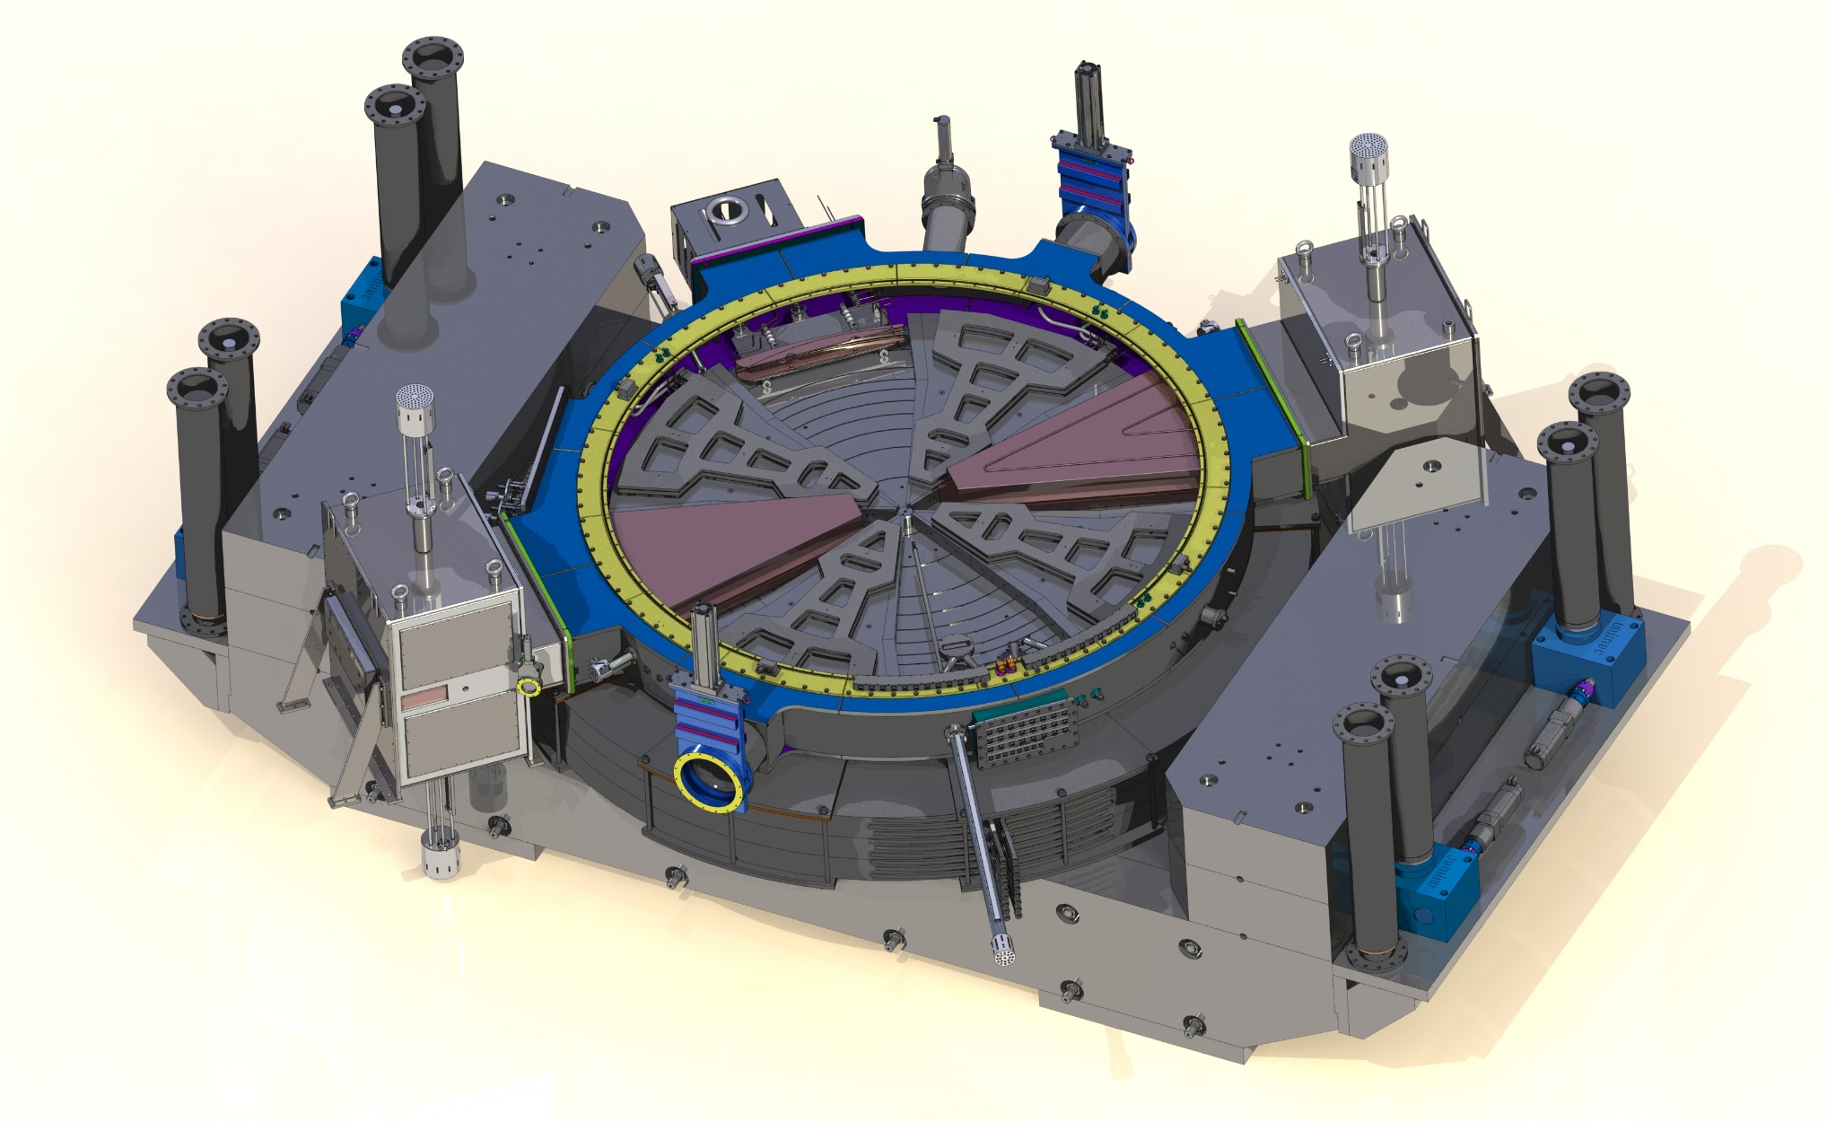
Vacuum chamber equipment
Parameter | Value
Working pressure, Тоrr | 1х10⁻⁷
Numbers of probes | 4
Number of high vacuum pumps | 5 (2 cryogenic ISO 400, 3 turbomolecular)

Slide 20
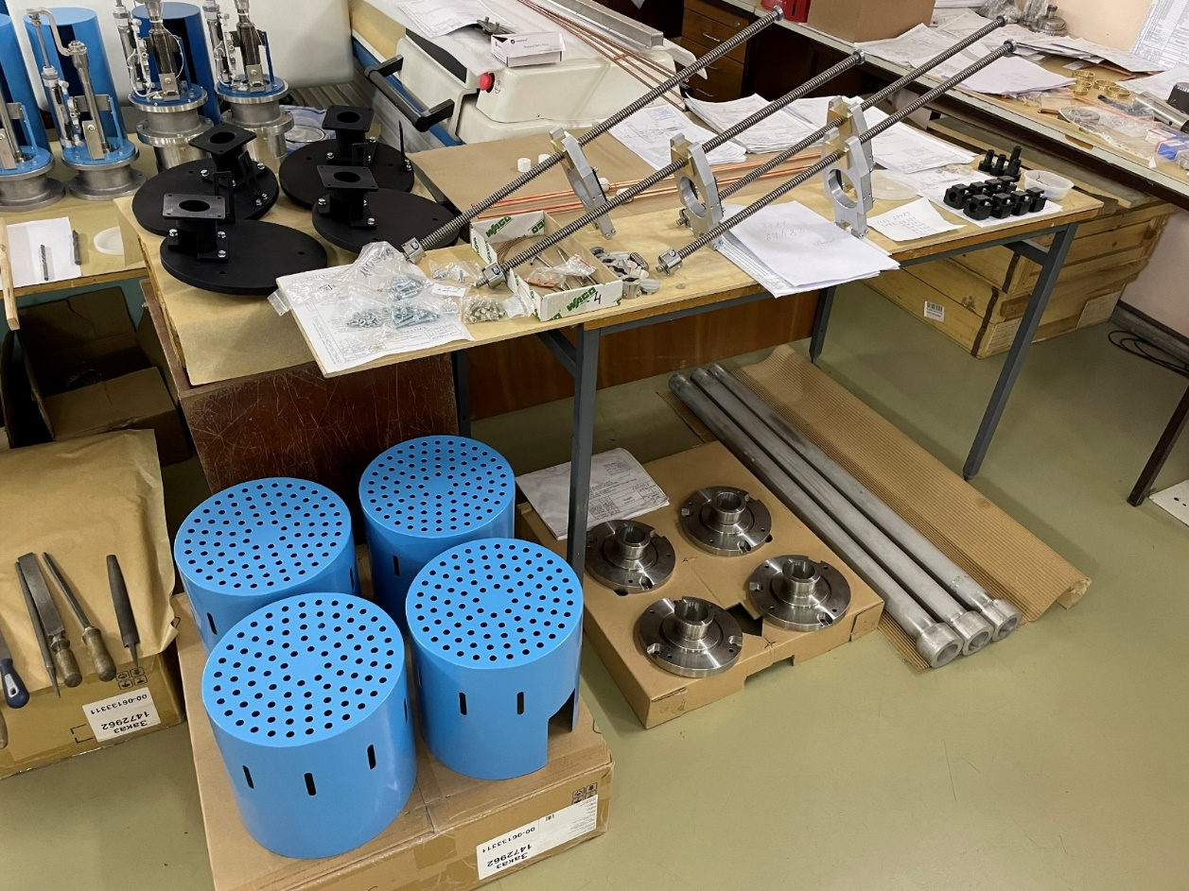
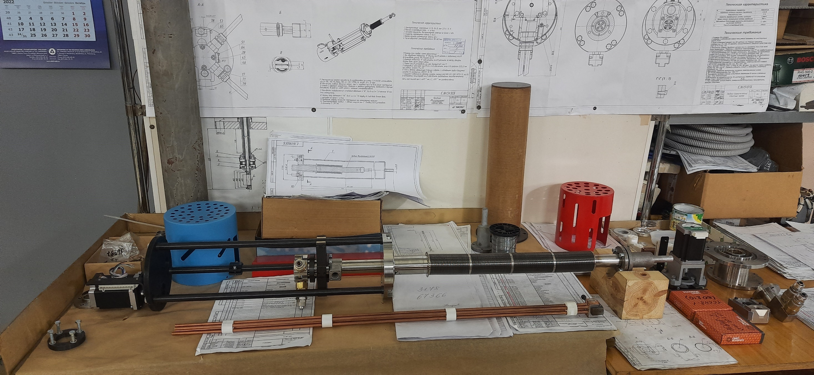
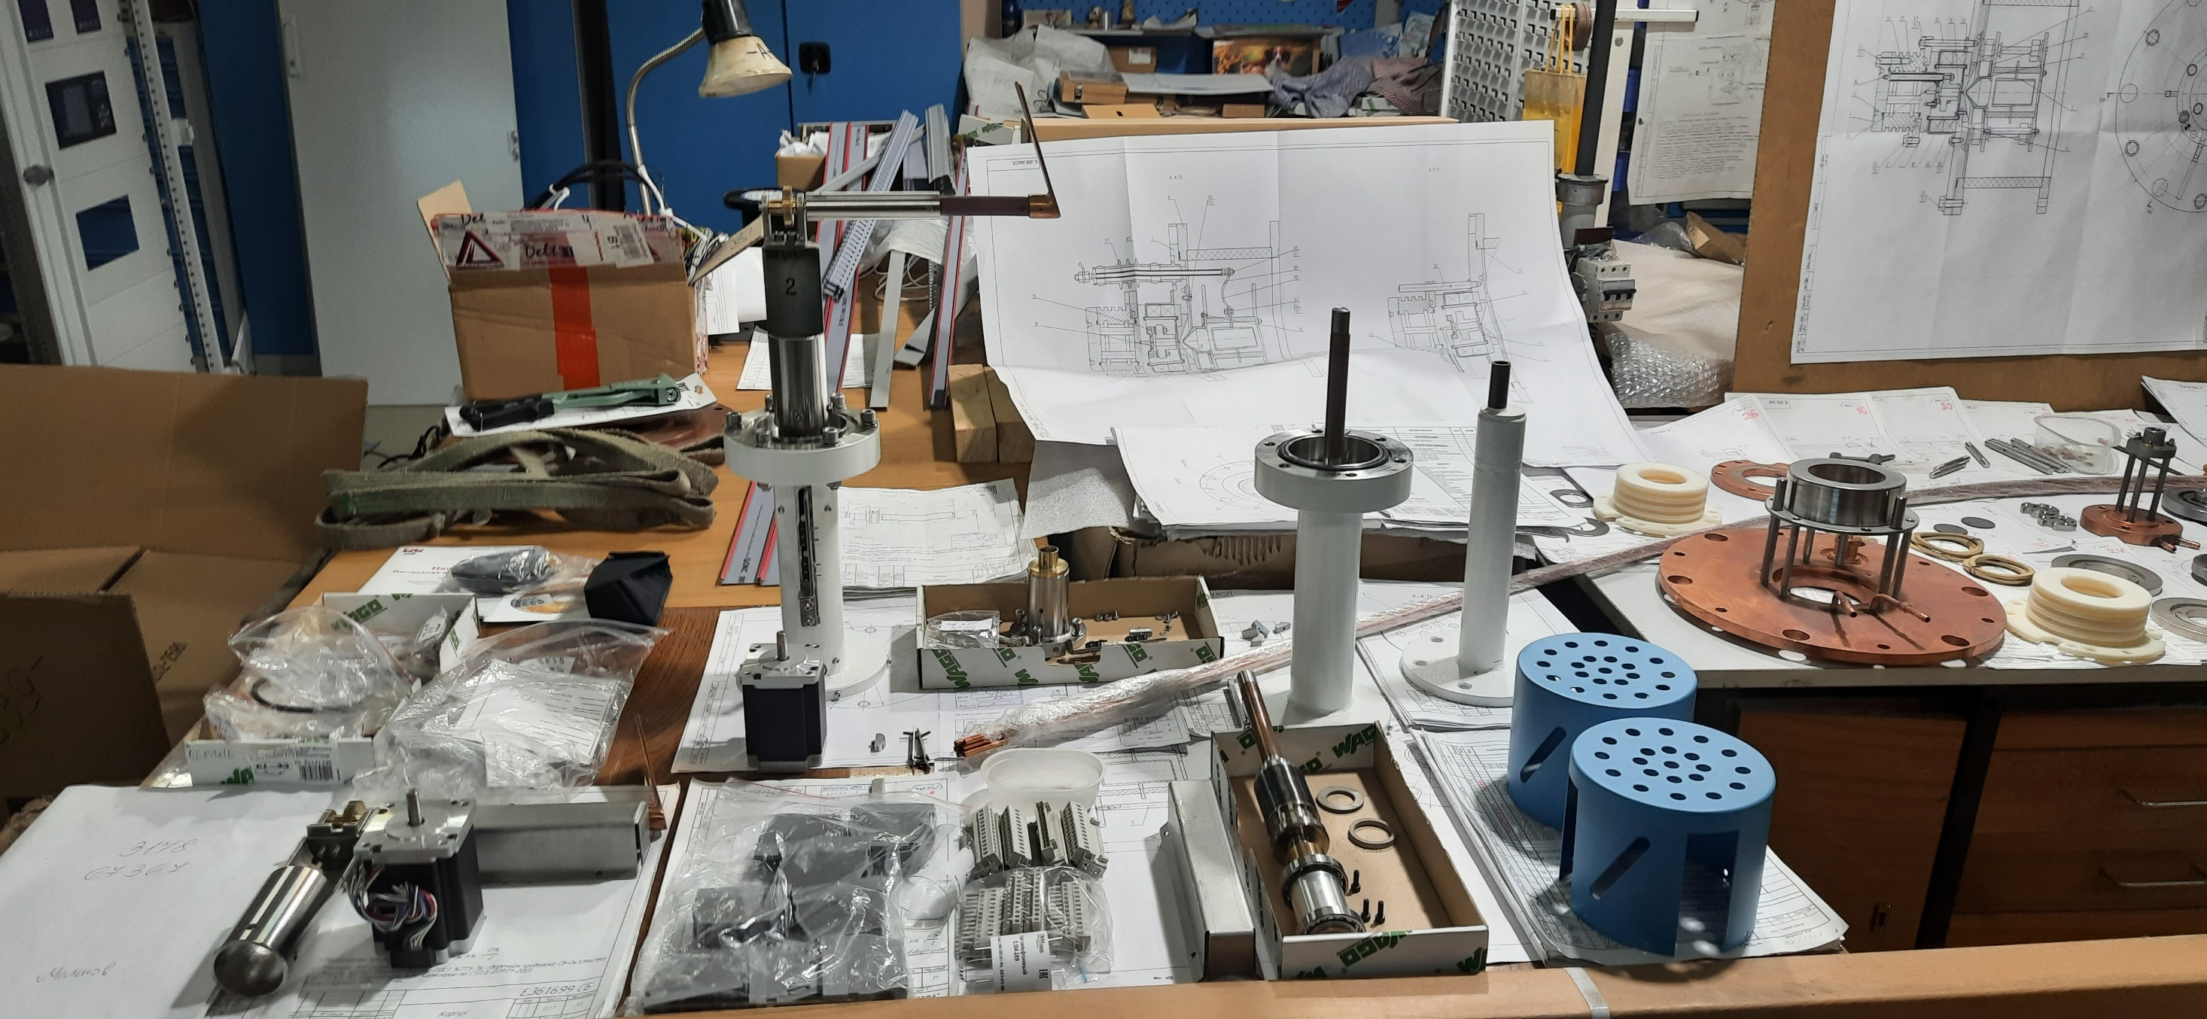
Vacuum chamber equipment

Slide 21
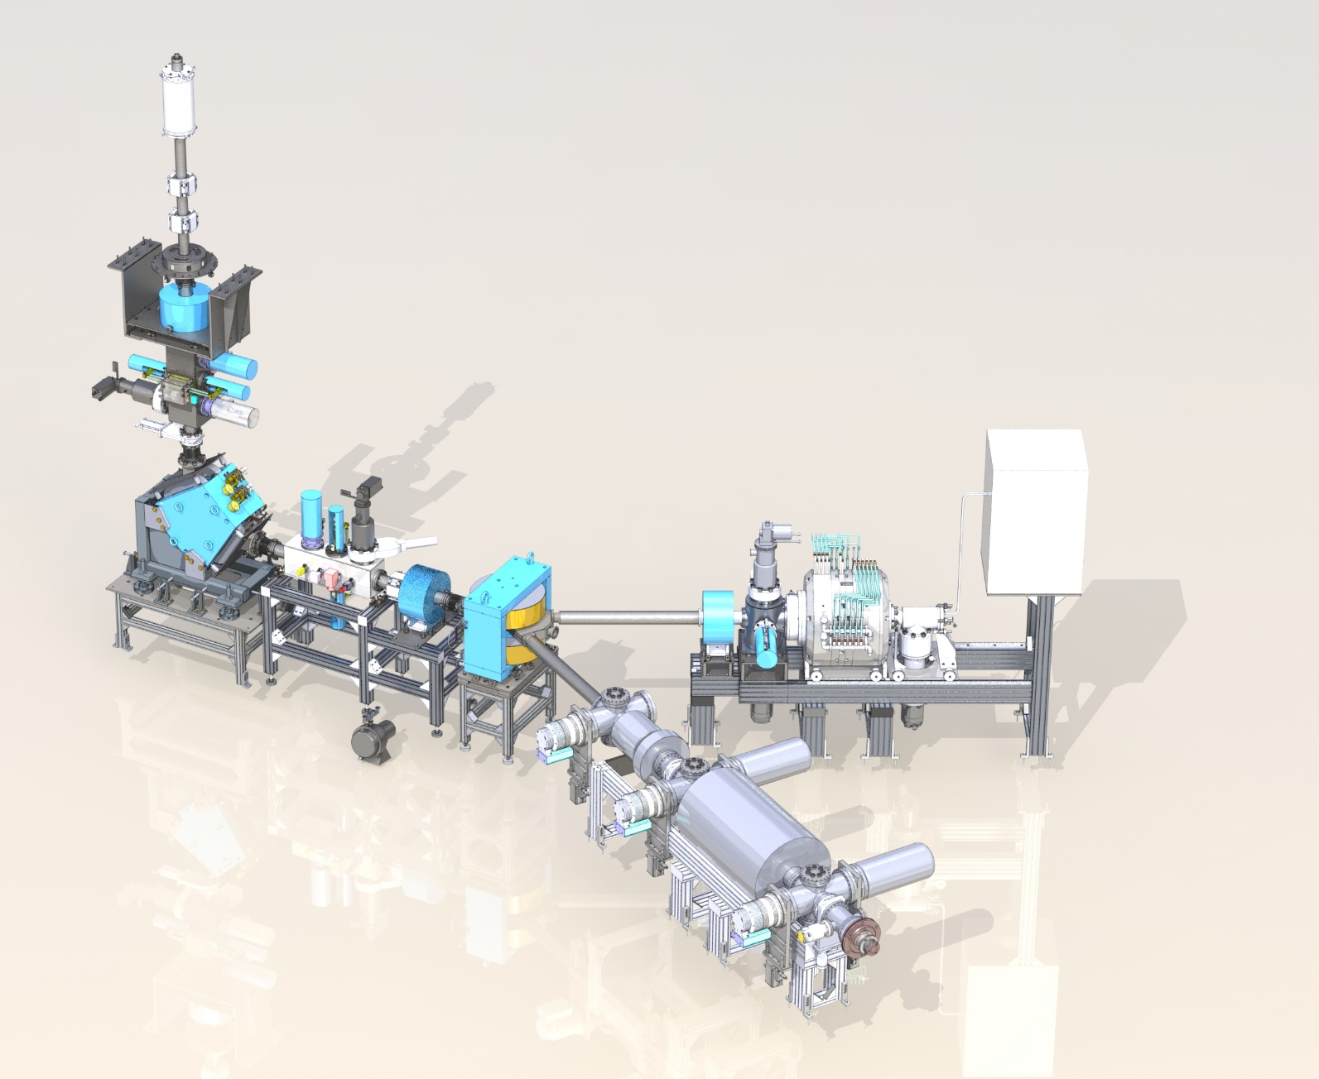
Injection system
Parameter | Value
Injection system | External
Number of sources | Up to 3
Type of sources | ECR and electron-beam

Slide 22
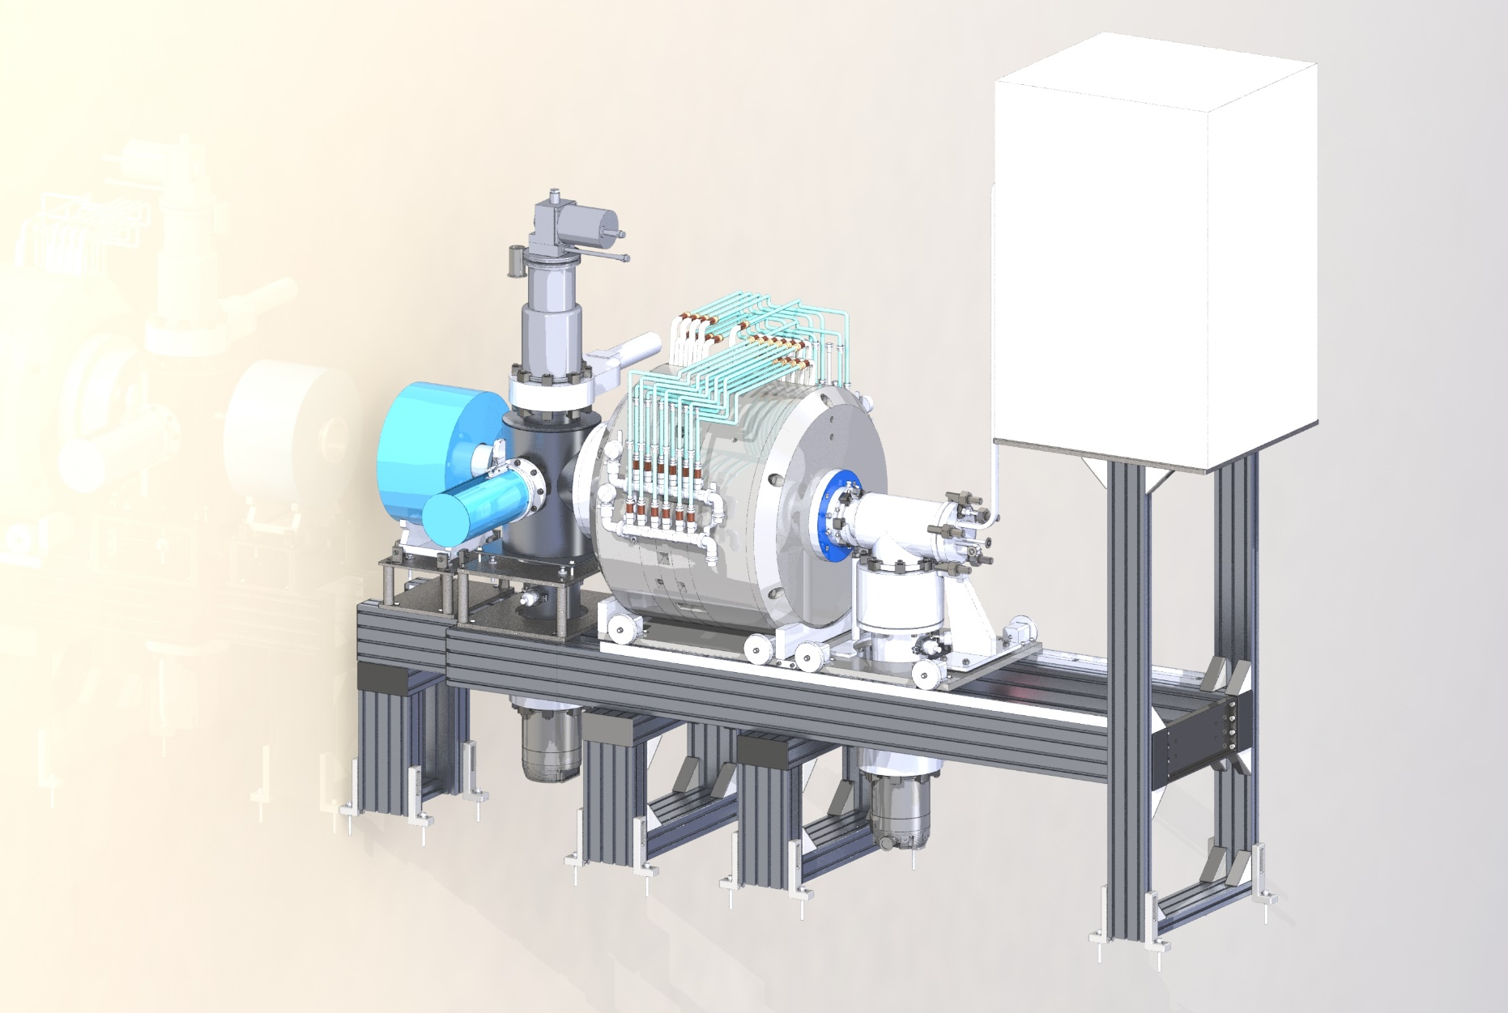
ECR ion source
Parameter | Value
SHF system operating frequency, ГГц | 14
Type of solenoid | «warm»
Power supply of solenoid, kW | 120
Solenoid induction, T | 2
Extraction energy, keV | 30
Ions | С, О, Ne, Si, Ar, Fe, Kr, Ag, Xe

Slide 23
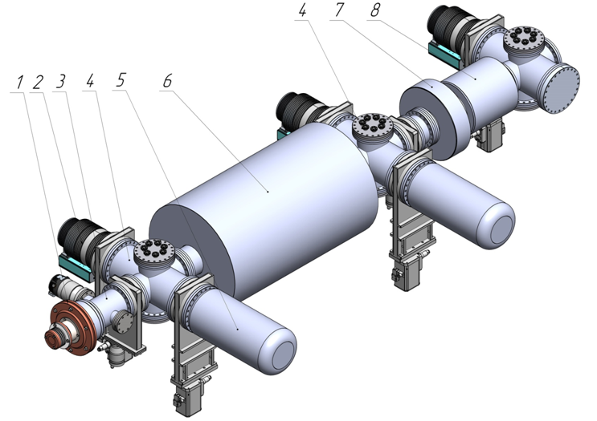
EBBIS ion source
Parameter | Value
Type of solenoid | superconducting
Power supply of solenoid, kW | 0,8
Solenoid induction, T | 5
Extraction energy, keV | 30
Ions | Bi⁺⁴³
1 — Ion source
2 — Turbopump
3 — Electron gun chamber
4 — Vacuum pumping chamber
5 — Cryopump
6 — Solenoid
7 — Magnet Lens
8 — Electron collector

Slide 24
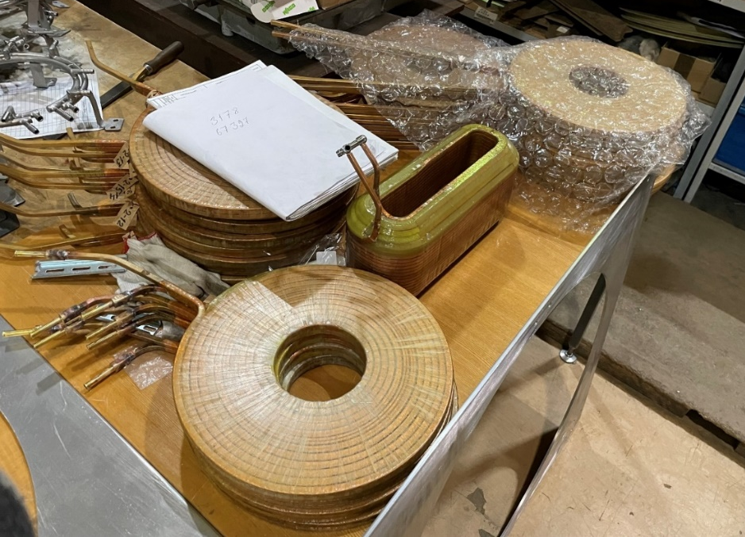
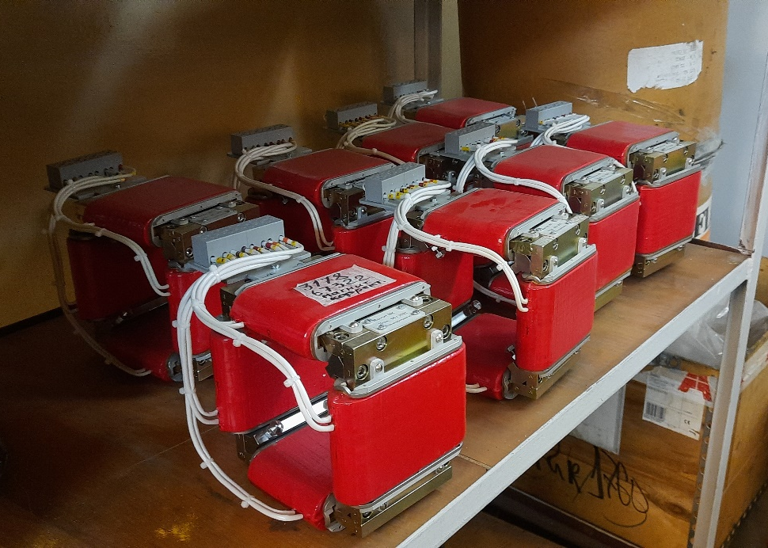
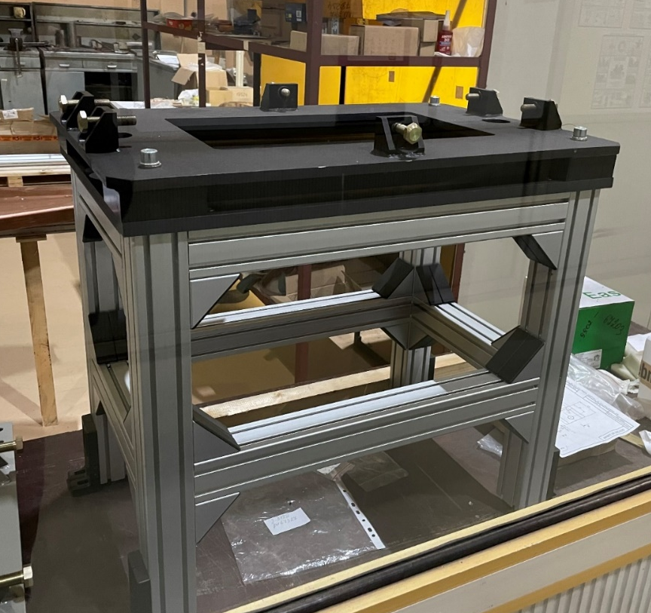
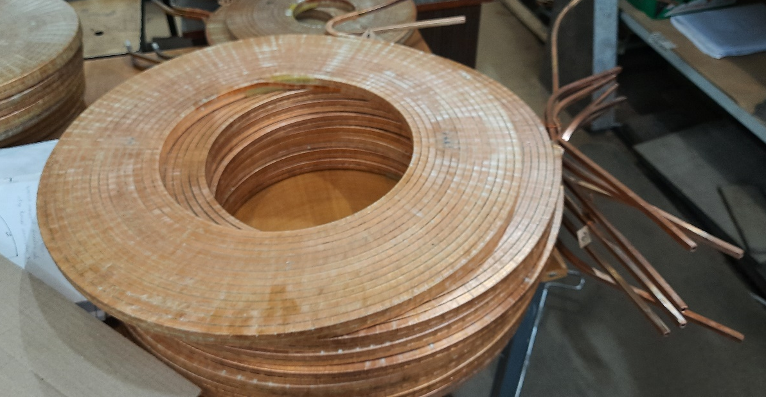
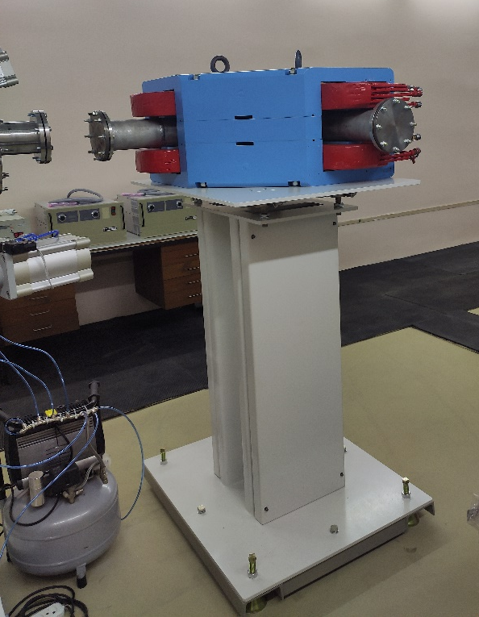
Injection system

Slide 25
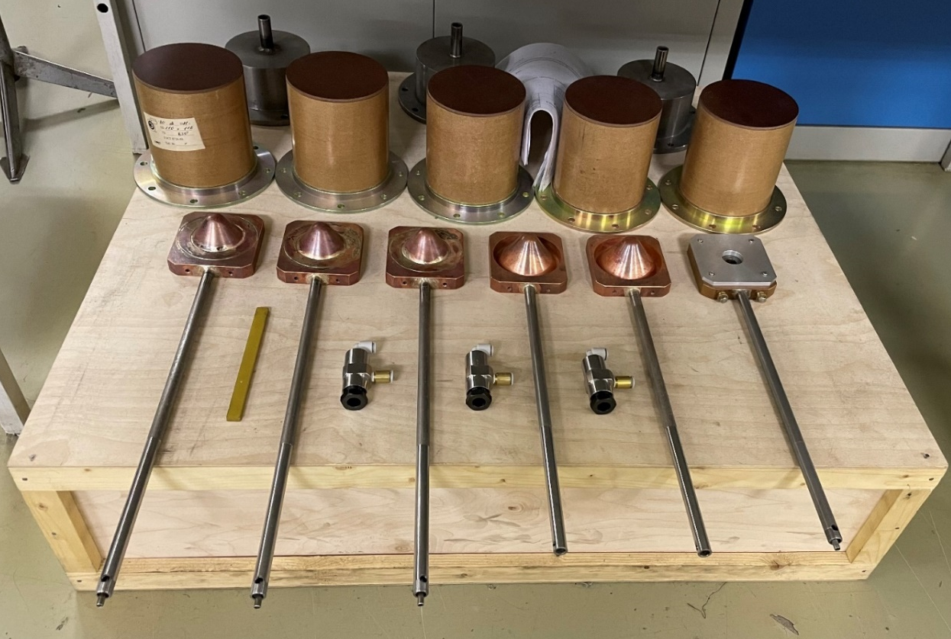
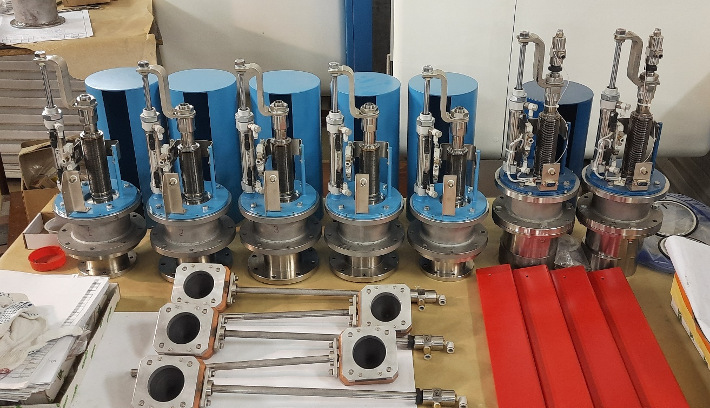
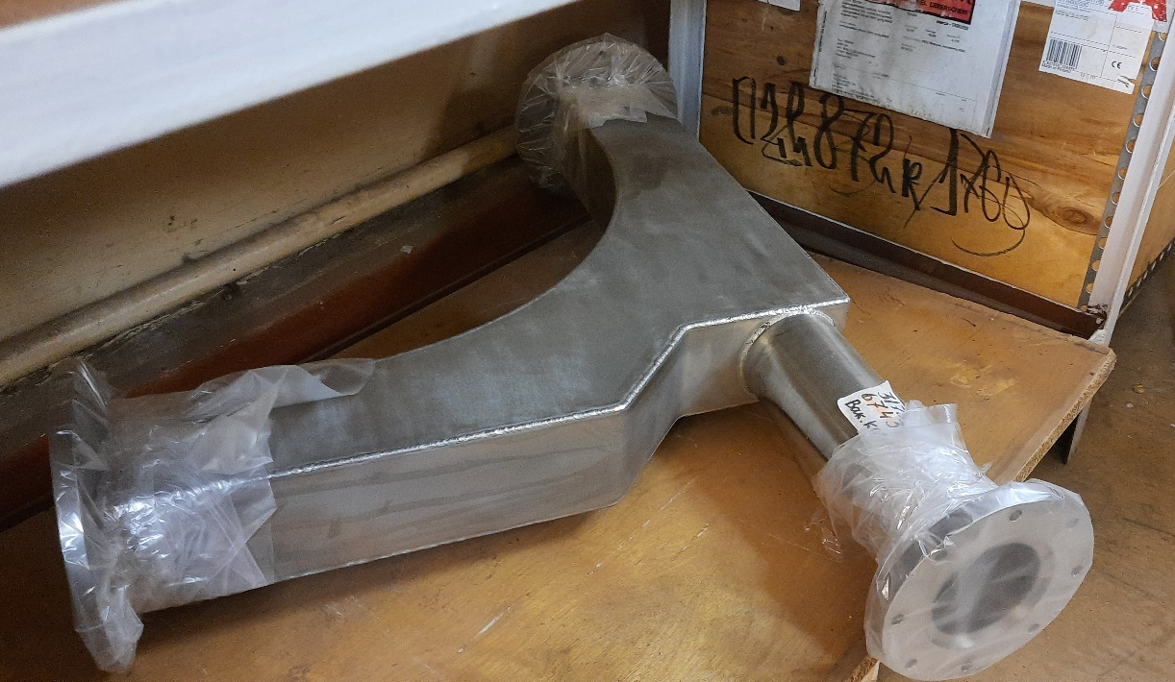
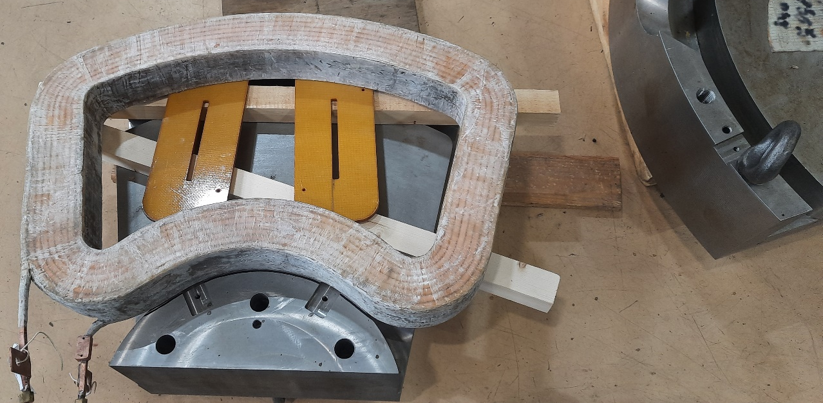
Injection system

Slide 26
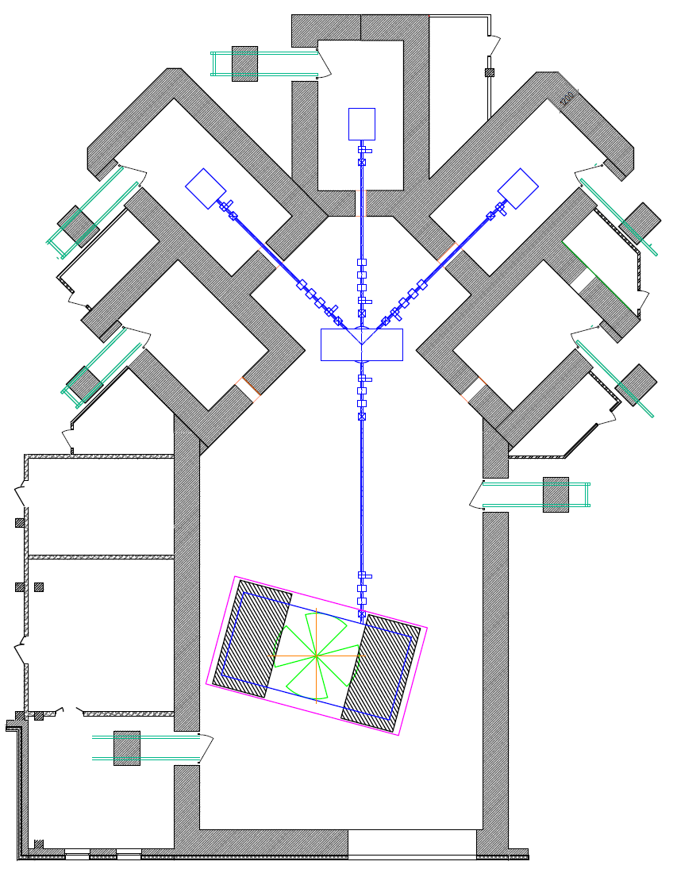
Beam transport system
Parameter | Value
Total length of beam transport system, m | 35
Number of switching magnets | 1 (2)
Number of lines beam transport system | 3 (5)
Number of quadrupole lenses | 13 (19)
Number of correcting magnets | 7 (11)
Number of beam diagnostic units | 5
Number of pumping stations | 5

Slide 27
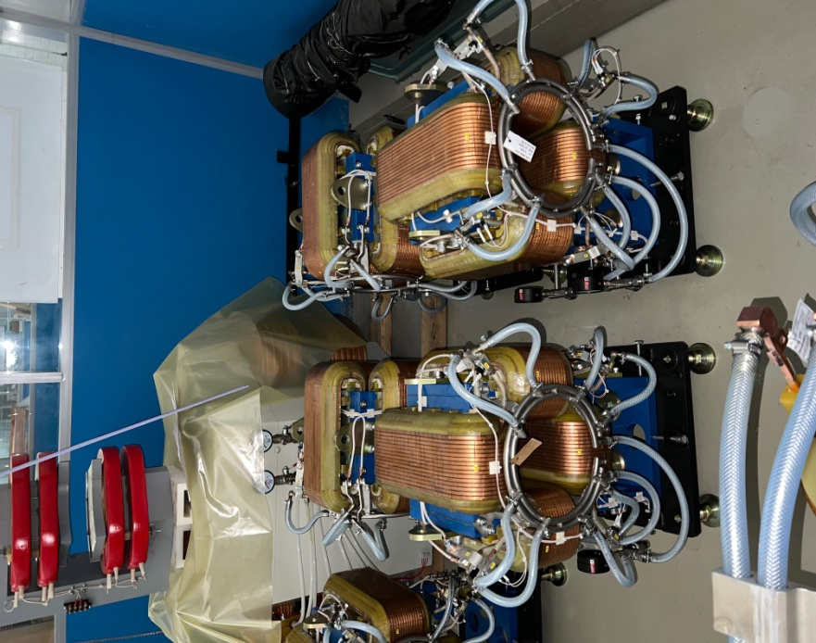
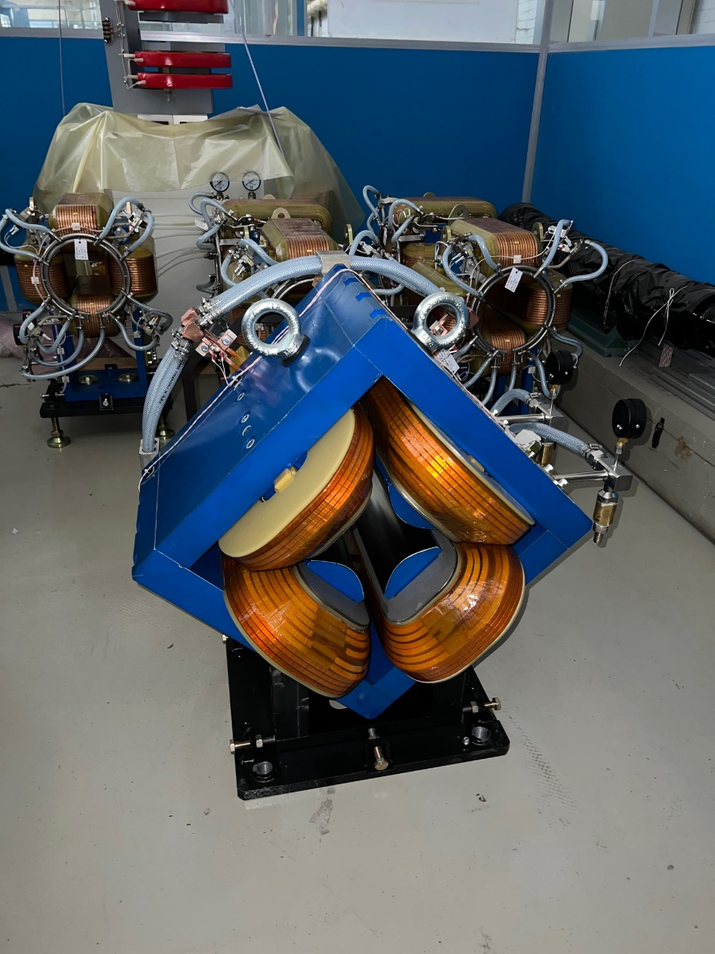
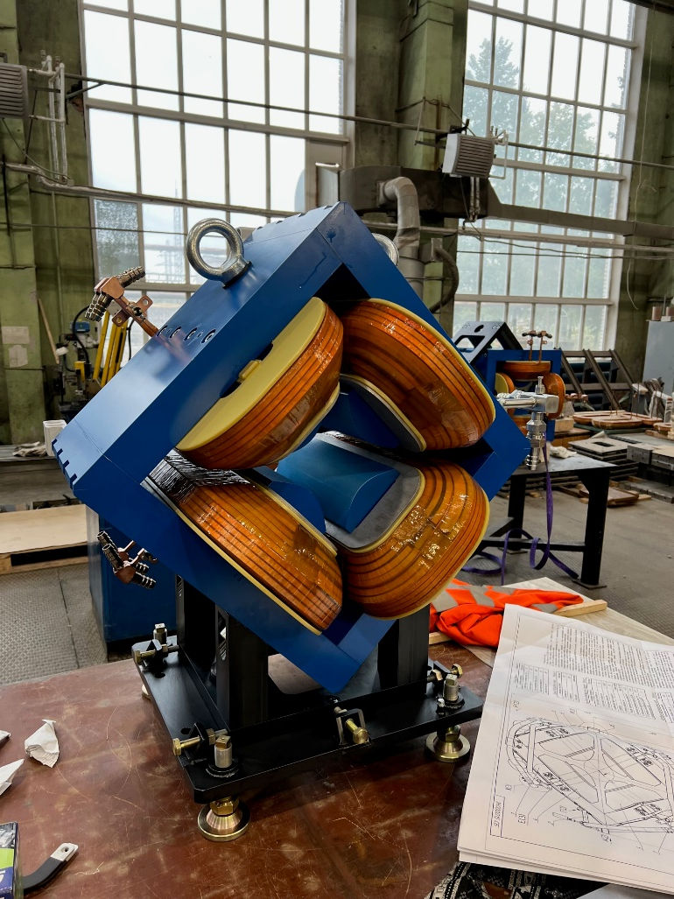
Beam transport system

Slide 28
Beam transport system

Slide 29
Partners in Russia

Slide 30
In conclusion
The planned date for manufacturing and autonomous factory testing of the equipment of the cyclotron complex is the end of 2023
Certain concerns are caused by problems with the supply of certain materials and components of imported production, this leads to the processing of design documentation, an increase in the time and cost of production

Slide 31
Thank you for your attention
Usanova Marina V.
Project manager, JSC «NIIEFA»,

